Slide 1



Precise Calculation of Collins-Soper Kernel from Lattice QCD
Jin-Xin Tan
Shanghai Jiao Tong University
Sep. 24 @SPIN 2025, Qingdao
In collaboration with:
Hang Liu, Zhi-Chao Gong, Qi-An Zhang, Wei Wang
Notes:
Hello everyone. I’m Jinxin Tan from Shanghai Jiao Tong University. It is my great pleasure to be here at SPIN 2025 and to share my work with you. The topic of my talk today is “Precise Calculation of Collins–Soper Kernel from Lattice QCD.” There are my collaborators.
1

Slide 2
Outline
2
Motivation
Lattice QCD calculation of CS Kernel
Theoretical Framework
Lattice Simulation and Results
Summary and Outlook
Notes:
In the following, I will present our work from three parts. First, I will explain why it is important to calculate the Collins–Soper kernel. Then, I will share some details about how we extract the CS kernel on the lattice and show our progress. Finally, I will conclude with a summary and some outlook for future work.
2

Slide 3
Outline
3
Motivation
Lattice QCD calculation of CS Kernel
Theoretical Framework
Lattice Simulation and Results
Summary and Outlook
Notes:
So, let me begin with the motivation for this study.
3

Slide 4
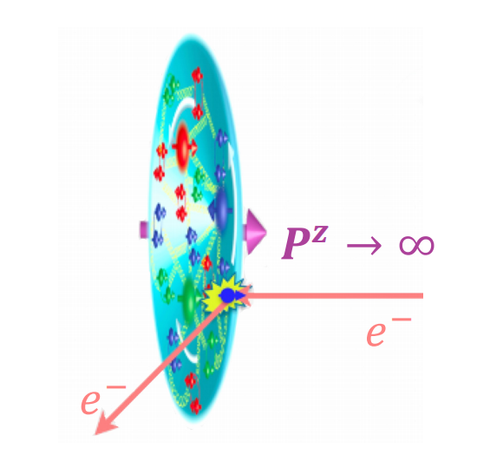
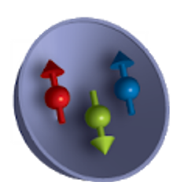

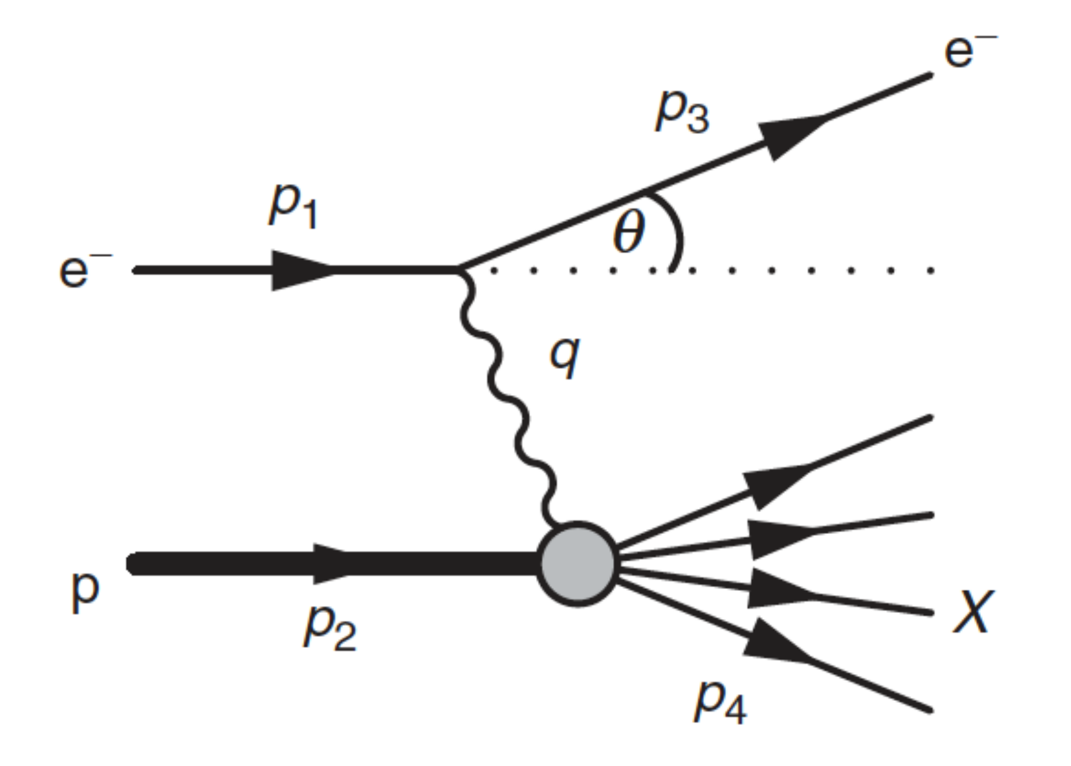
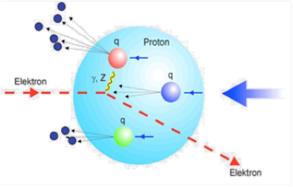



Exploration of Nucleon Structure
4
Feynman parton model
Gell-Mann
quark model
JLab
COMPASS
JAM
EIC
EIcC
......
0D: spin and mass
1D: PDF
3D: TMDs
Higgs
mechanism
Deep inelastic
scattering
Semi-Inclusive DIS
Notes:
Our understanding of nucleon structure has gradually improved, moving from low-dimension to higher-dimension information. At the zero-dimension, we focused on overall properties of the nucleon, like its mass and spin. With DIS experiments, the focus shifted to the one-dimension structure. From Feynman’s parton model ,we learned about the longitudinal momentum distributions of quarks, called PDFs. To get a fuller picture of the nucleon, we need to study its three-dimension structure. Today, many experiments, like SIDIS and Drell–Yan processes, study transverse-momentum-dependent distributions (TMDs), which are also a major focus of theoretical work.
4

Slide 5
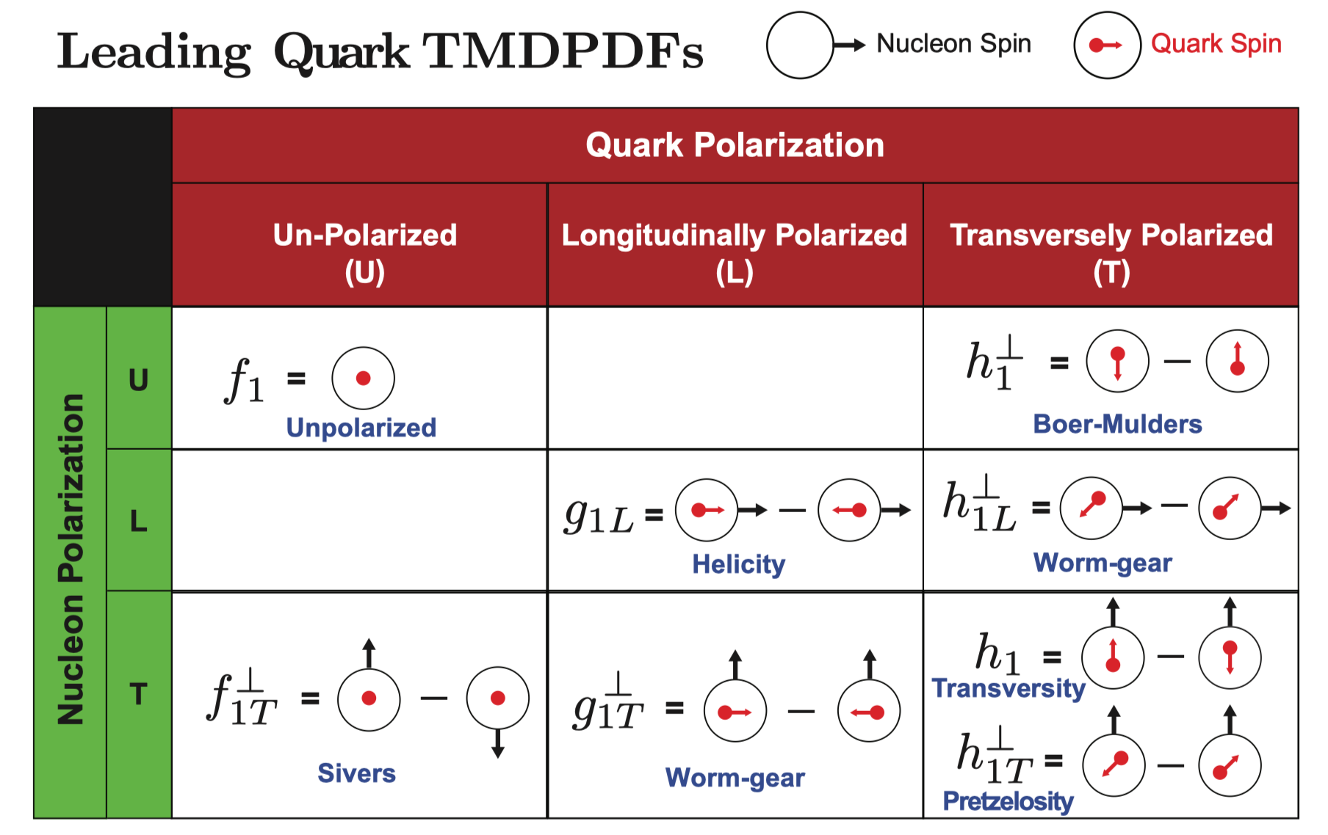
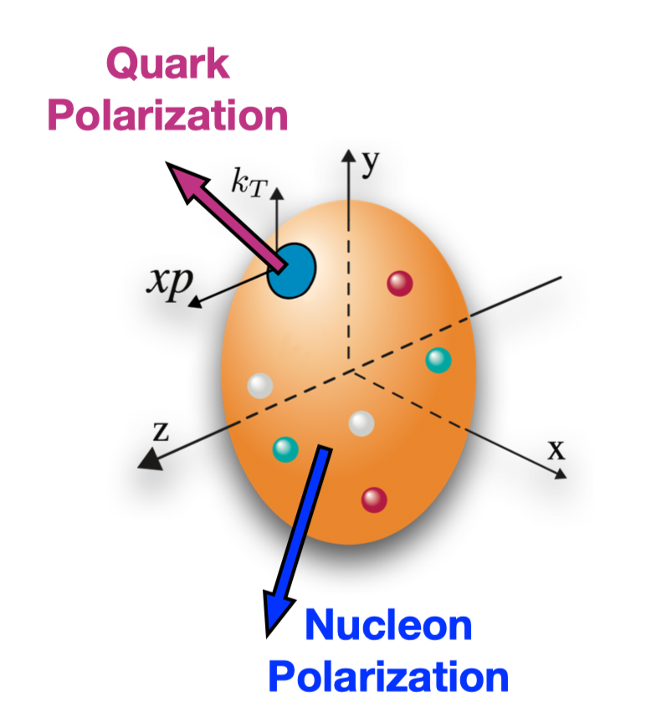
TMDPDFs: 3D tomography of the nucleon
5
Boussarie et al., TMD Handbook, 2304.03302
Notes:
The most important objects of study here maybe the TMDPDFs. It reflects the momentum distribution of quarks in the nucleon’s transverse plane and thus providing a more complete 3-dimensional picture. At leading twist, we can define eight independent TMDPDFs, each of which encodes the dynamics for different polarized states.
5

Slide 6
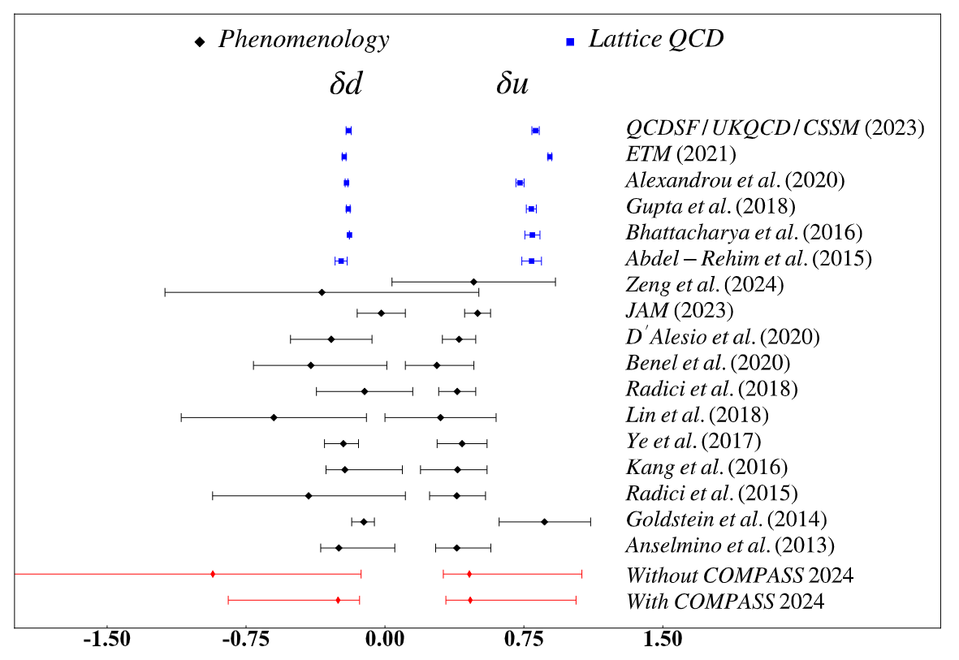
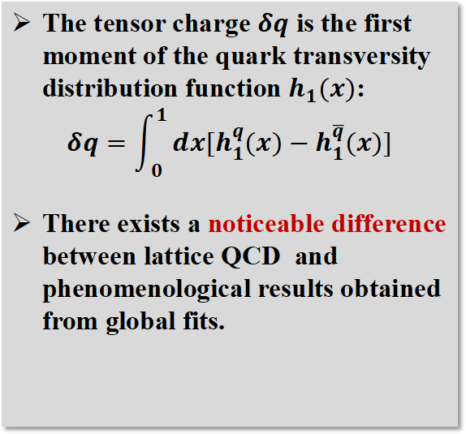
Phenomenological vs. Lattice at TMD Observables
6
Most recent global data fit-Tensor Charge
The tensor charge $δq$ is the first moment of the quark transversity distribution function $h_{1}(x)$:
$$δq=\int_{0}^{1}{dx[h_{1}^{q}(x)−h_{1}^{\overline{q}}(x)]}$$
There exists a noticeable difference between lattice QCD and phenomenological results obtained from global fits.
Zeng et al.,arXiv:2412.18324
High-precision calculations of TMDs on the lattice are urgently needed.
Notes:
In recent years, lattice QCD and phenomenology have shown some differences in certain TMD observables. For example, in the global fit of the tensor charge—which is the first moment of quark transversity—we can see from the figure on the right that the lattice and phenomenology results for $δu$ are different. In the lattice side, we need high-precision calculations for these TMD observables to make sure the differences aren’t caused by systematic uncertenty like Discrete error.
6

Slide 7
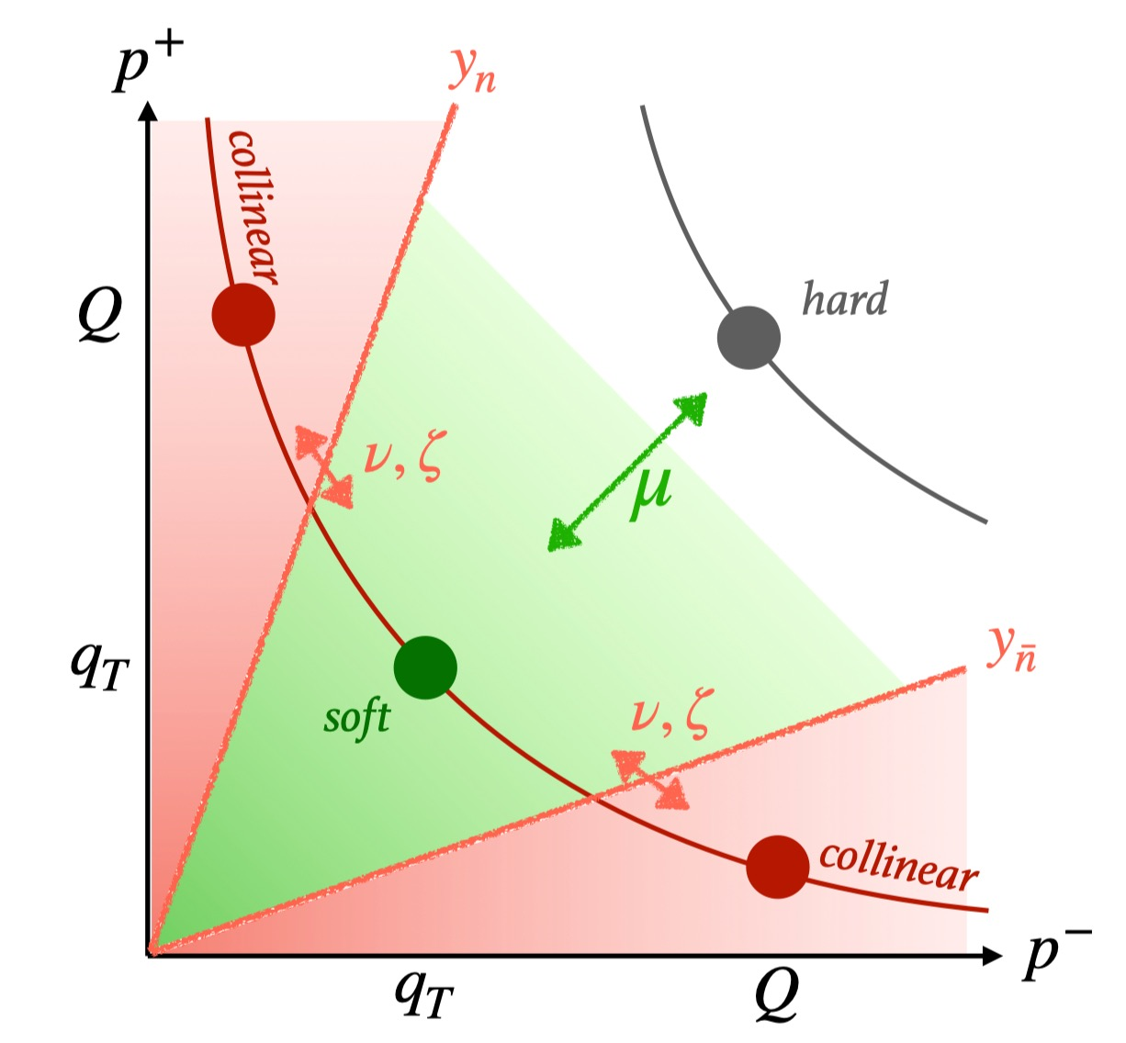
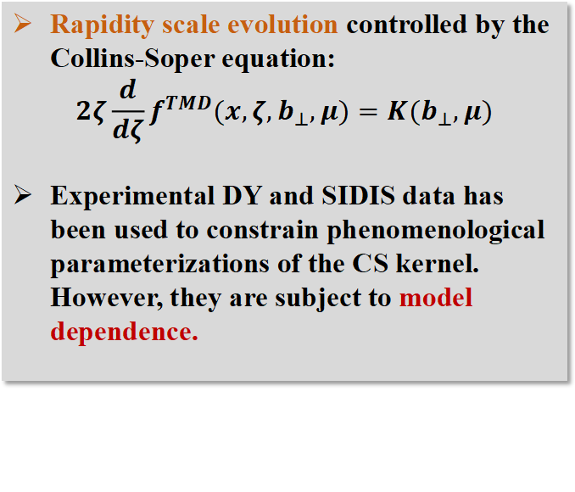
Collins-Soper Kernel
7
Rapidity scale evolution controlled by the Collins-Soper equation:
$$2ζ\frac{d}{dζ}f^{TMD}({x,ζ,b}_{⊥},μ)=K(b_{⊥},μ)$$
Experimental DY and SIDIS data has been used to constrain phenomenological parameterizations of the CS kernel. However, they are subject to model dependence.
First-principles calculations of the CS kernel directly describe the rapidity evolution of TMDs.
Notes:
As we know that , the CS kernel controls the rapidity evolution of the TMD distributions. Currently, phenomenology often use SIDIS and Drell–Yan experimental data to parametrize the CS kernel, but this approach clearly depends heavily on models. Therefore, we aim to extract the CS kernel from first-principles calculations, which allows us to describe the rapidity evolution of TMDs more accurately.
7

Slide 8
Outline
8
Motivation
Lattice QCD calculation of CS Kernel
Theoretical Framework
Lattice Simulation and Results
Summary and Outlook
Notes:
Next, I will introduce the theoretical framework for extracting the CS kernel on lattice.
8

Slide 9
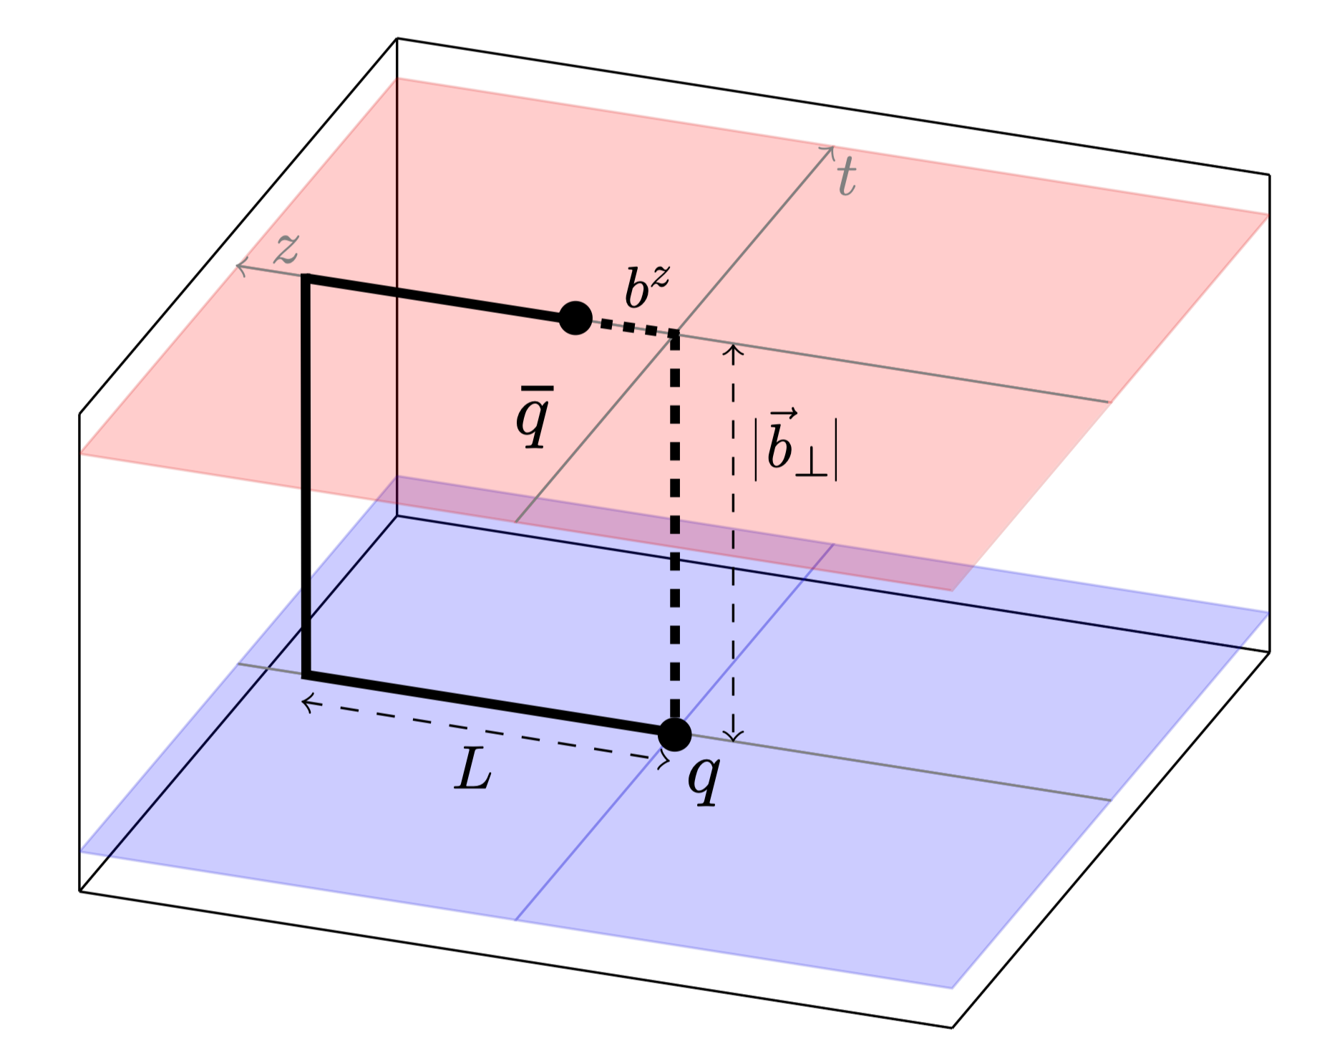
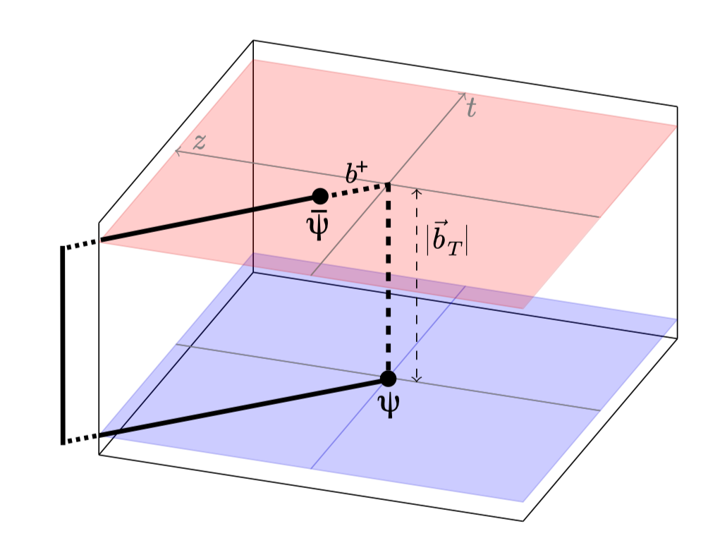

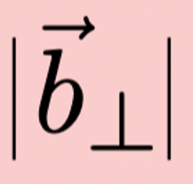
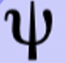

TMDs on Lattice QCD -- LaMET
9
External states
Lorentz boost
$$L→∞$$
$$P^{z}→∞$$
Equal-time correlators,
directly calculable on lattice
Space-like correlators,
NO effective method for directly calculation
Connected at large-momentum limit
Ji et al., PLB811(2020); Ebert et al., JHEP04(2022)
Matching kernel
$${\tilde{f}}_{Γ}(x,b_{⊥},μ,ζ^{z})S_{I}^{\frac{1}{2}}(b_{⊥},μ)=H_{Γ}(ζ^{z},μ)\exp\left[\frac{1}{2}K(b_{⊥},μ)\ln{\frac{ζ^{z}−iε}{ζ}}\right]f(x,b_{⊥},μ,ζ)+𝓞(\frac{Λ_{\text{QCD}}^{2}}{ζ^{z}},\frac{M^{2}}{(P^{z})^{2}},\frac{1}{b_{⊥}^{2}ζ^{z}})$$
Quasi TMDs
Intrinsic soft function
Collins-Soper kernel
Light-cone TMDs
Notes:
On the lattice, a very important method for calculating TMDPDFs is LaMET. We can calculate quasi-TMDs on the lattice by constructing equal-time correlation functions. When the momentum is large enough, we can use the factorization formula to match the lattice-calculable quasi- TMDs to the physical light-cone TMDs. And one key section in this matching is the CS kernel.
9

Slide 10

From quasi TMDs to Collins-Soper kernel
10
At leading power accuracy, CS kernel can be extracted from the $P^{z}$ dependence of TMDs:
$${\tilde{f}}_{Γ}(x,b_{⊥},μ,ζ^{z})S_{I}^{\frac{1}{2}}(b_{⊥},μ)=H_{Γ}(ζ^{z},μ)\exp\left[\frac{1}{2}K(b_{⊥},μ)\ln{\frac{ζ^{z}−iε}{ζ}}\right]f(x,b_{⊥},μ,ζ)+𝓞(\frac{Λ_{\text{QCD}}^{2}}{ζ^{z}},\frac{M^{2}}{(P^{z})^{2}},\frac{1}{b_{⊥}^{2}ζ^{z}})$$
Taking ratio, $S_{I}$ and $f$cancelled each other, then
$$K(b_{⊥},μ)=\frac{1}{\ln{(}P_{1}^{z}/P_{2}^{z})}\ln\left(\frac{H_{Γ}(ζ_{2}^{z},μ){\tilde{f}}_{Γ}(x,b_{⊥},ζ_{1}^{z},μ)}{H_{Γ}(ζ_{1}^{z},μ){\tilde{f}}_{Γ}(x,b_{⊥},ζ_{2}^{z},μ)}\right)$$
${\tilde{f}}_{Γ}$ could be either unsubtracted quasi TMD wave function or quasi TMDPDF.
Notes:
If we take ratios at different momenta cases, we can see that the intrinsic soft function and the light-cone TMD cancel out. This leaves only the CS kernel we want, the perturbative matching kernel, and the quasi-TMDs we can calculate on the lattice. Since this formula works for both hadron TMDPDFs and TMDWFs. And given that quasi-TMDWFs always have a better signal-to-noise ratio on the lattice, we choose to extract the CS kernel from the pion quasi-TMDWF.
10

Slide 11
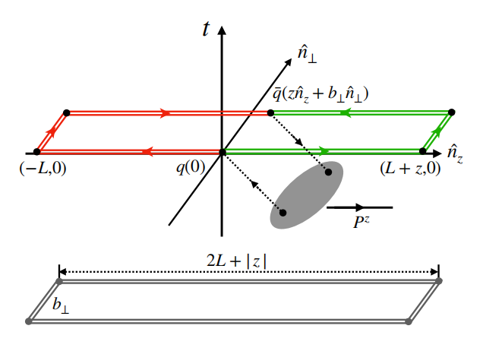
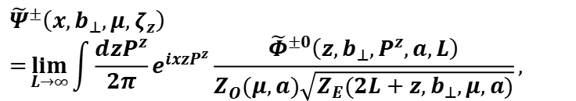
Quasi TMD Wave Function
11
The quasi-TMD wave functions can be defined as:
where the bare quasi-TMD wave function can be constructed as :
$${\tilde{Ψ}}^{±}\left(x,b_{⊥},μ,ζ_{z}\right)=\lim_{L→∞}{\int{\frac{dzP^{z}}{2π}}}e^{ixzP^{z}}\frac{{\tilde{Φ}}^{±0}\left(z,b_{⊥},P^{z},a,L\right)}{Z_{O}(μ,a)\sqrt{Z_{E}(2L+z,b_{⊥},μ,a)}},$$
$${\tilde{Φ}}^{±0}\left(z,b_{⊥},P^{z},a,L\right)=⟨0|\bar{q}(z{\hat{n}}_{z}+b_{⊥}{\hat{n}}_{⊥})ΓU_{⊐,±}(L,z,b_{⊥})q(0)|P^{z}⟩.$$
Chu et al., PRD109(2024); Chu et al., PRD 106(2022);
Zhang et al., PRL125(2020);
Notes:
The bare quasi-TMDWF is defined as a nonlocal matrix element, where the quark and antiquark are separated by a transverse distance $b$_perp and a longitudinal distance $z$. As shown in the figure on the right, they are connected by a Wilson line shaped like a staple.
To remove divergences, we first divide the bare matrix element by the square root of $Z_{E}$for a Wilson line with the same shape. It can cancel linear divergences from Wilson line self-energy. Then we divide by $Z_{O}$to match the $\overset{‾}{\text{MS}}$scheme result and remove logarithmic divergence from the cusp.
11

Slide 12
Outline
12
Motivation
Lattice QCD calculation of CS Kernel
Theoretical Framework
Lattice Simulation and Results
Summary and Outlook
Notes:
Then I will show some detail result of the lattice simulation
12

Slide 13
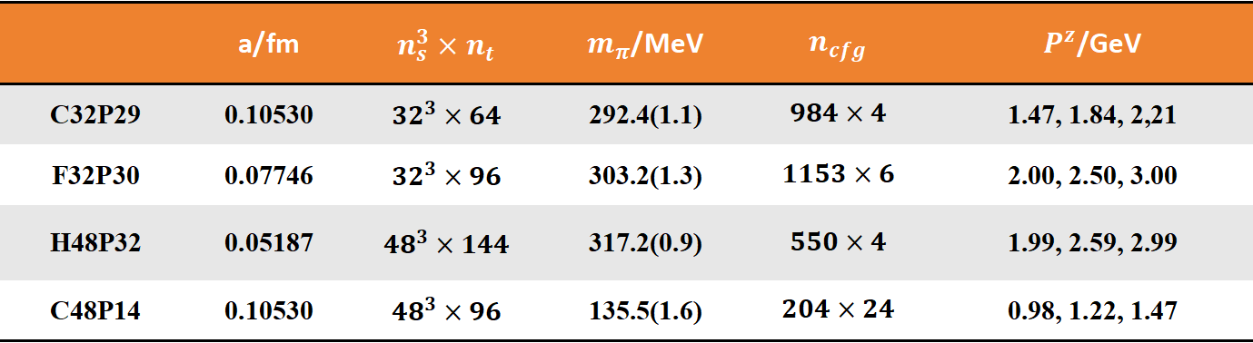
Lattice Setup
13
We choose the CLQCD lattice ensembles C32P29, F32P30, H48P32 and C48P14;
We use Coulomb gauge fixed wall source propagators;
We perform HYP smearing on the Staple-shaped gauge links when calculating quasi-TMDWFs and Wilson loop.
 | a/fm | $$n_{s}^{3}×n_{t}$$ | $m_{π}$/MeV | $$n_{cfg}$$ | $P^{z}$/GeV
C32P29 | 0.10530 | $${32}^{3}×64$$ | 292.4(1.1) | $$984×4$$ | 1.47, 1.84, 2,21
F32P30 | 0.07746 | $${32}^{3}×96$$ | 303.2(1.3) | $$1153×6$$ | 2.00, 2.50, 3.00
H48P32 | 0.05187 | $${48}^{3}×144$$ | 317.2(0.9) | $$550×4$$ | 1.99, 2.59, 2.99
C48P14 | 0.10530 | $${48}^{3}×96$$ | 135.5(1.6) | $$204×24$$ | 0.98, 1.22, 1.47
Notes:
We used four ensembles from CLQCD for our calculations. They include three different lattice spacings and four different pion masses. The largest momentum reaches 3 GeV. Other detail parameters are listed in the table.
For the propagators, we used a Coulomb gauge-fixed wall source. When calculating Wilson loops and quasi-TMDWFs, we applied HYP smearing to the gauge fields to improve the signal-to-noise ratio.
13

Slide 14
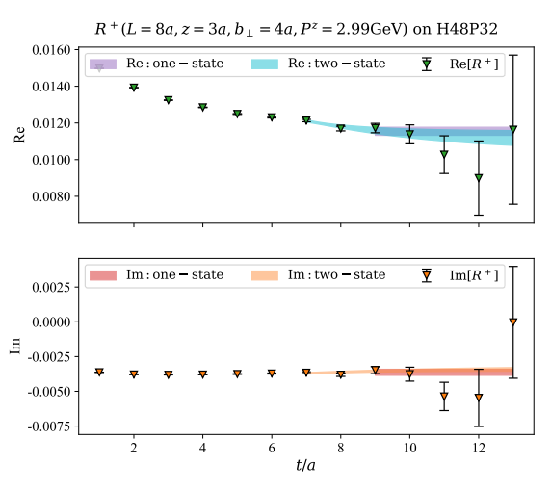



Bare Quasi-TMDWF Matrix Elements
14
To determine the bare quasi-TMDWF, we construct the non-local two point correlation function :
The bare matrix elements can be extracted by one-/two-state fit:
$$C_{2}^{±}(z,b_{⊥},P,p^{z},L,t,t^{′})=\frac{1}{n_{s}^{3}}\sum_{\vec{x}}{e^{i\vec{P}⋅\vec{x}}}\operatorname{Tr}{⟨}S_{w}(t^{′};\vec{x}+L{\hat{n}}_{z}+b{\hat{n}}_{x},t;−p^{z})$$
$$×U_{⊐,±}(L,z,b_{⊥})Γ_{1}S_{w}(\vec{x}+L{\hat{n}}_{z}+z{\hat{n}}_{z},t;t^{′};p^{z})Γ_{2}⟩$$
$$R^{±}(z,b_{⊥},P^{z},L,t)=\frac{C_{2}^{±}(z,b_{⊥},P^{z},L,t)}{C_{2}(0,0,P^{z},0,t)}={\tilde{Φ}}^{±0}(z,b_{⊥},P^{z},L)e^{−iz\frac{P^{z}}{2}}$$
$$×\left[1+c_{1}(z,b_{⊥},P^{z},L)e^{−ΔEt}\right]$$
Notes:
To calculate the bare quasi-TMDWF, we construct the nonlocal two-point correlation function. By taking the ratio with a local correlation function, we get the form shown below.
So the bare matrix elements can be extracted by one-state or two-state fits. The results are shown in the figure on the right. Both fits give consistent results within the errors.
14

Slide 15
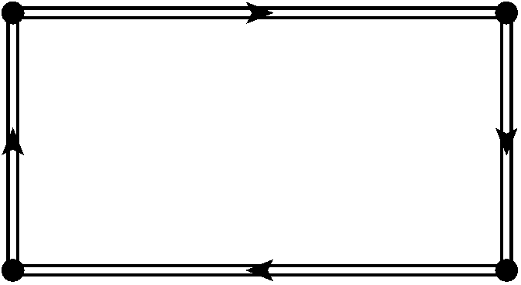
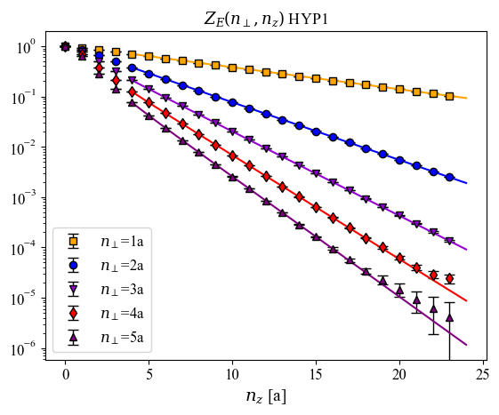

Wilson Loop Renormalization
15
Definition:
Parameterization:
$$Z_{E}=$$
Notes:
After extracting the bare matrix element, we need to do renormalization. So we calculated a Wilson loop which is formed by connecting two Wilson lines in different directions.
The figure below shows the lattice result of Wilson loop . Its long-distance decay gives the static potential. So we can fit and extrapolate the Wilson loop using this formula.
15

Slide 16
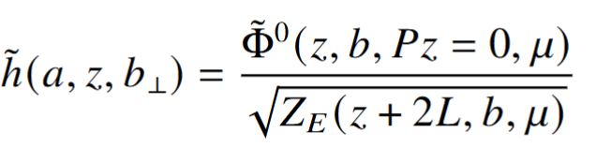
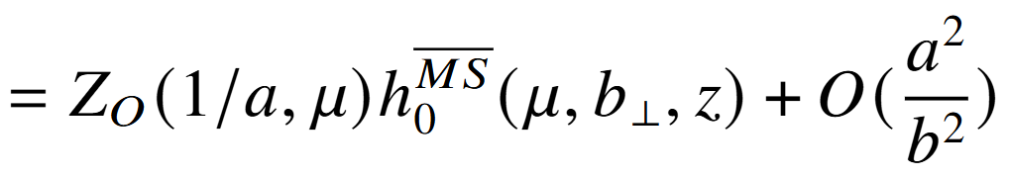
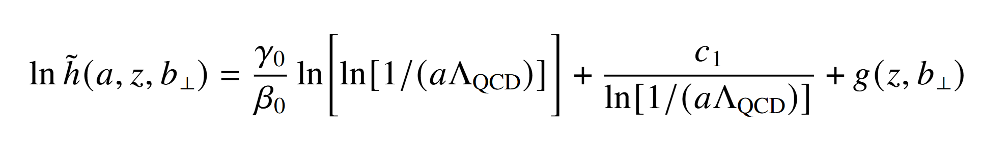
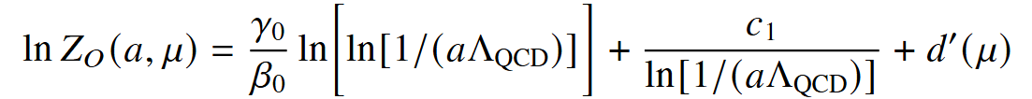
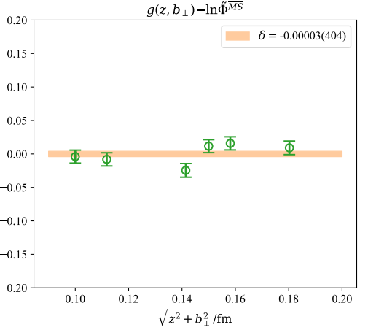
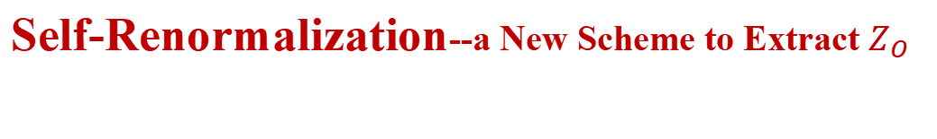
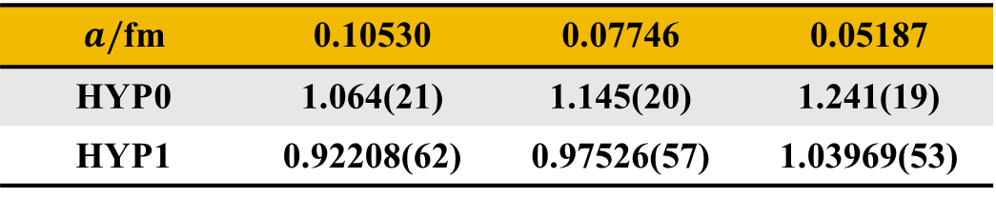

Self-Renormalization--a New Scheme to Extract $Z_{O}$
16
Subtracted matrix element
Renormalization condition:
Joint fit result：c₁=0.020
Parametrization:
✓
✓
$d’(μ)$= -0.448
$a/$fm | 0.10530 | 0.07746 | 0.05187
HYP0 | 1.064(21) | 1.145(20) | 1.241(19)
HYP1 | 0.92208(62) | 0.97526(57) | 1.03969(53)
Deng et al., JHEP 09 (2022); Huo et al. NPB 969(2021)
Notes:
In our work, for the first time in the case of quasi-TMDWFs, we introduce a New Scheme to Extract $Z_{O}$inspired by self-renormalization.
we determine the form of the logarithmic divergence and the scale dependence. The renormalization factor ZO for different lattice spacings and HYP smearing are obtained in this table.
16

Slide 17
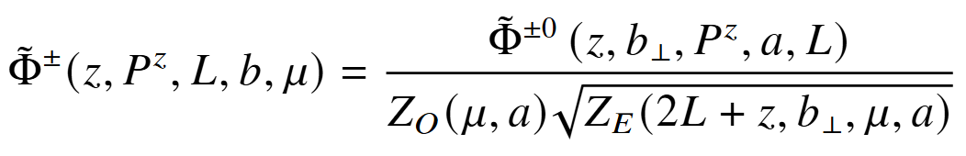
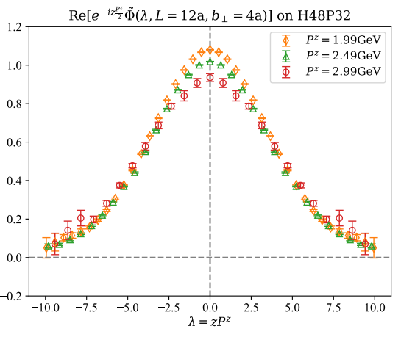
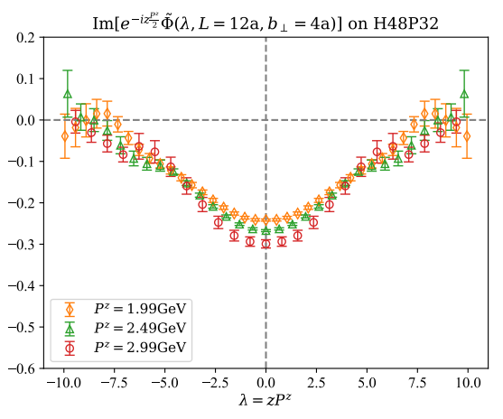
Quasi-TMDWFs in Coordinate Space
17
Notes:
So, when we have all three pieces of the quasi-TMDWF, we can plot its distribution in coordinate space. For each ensemble, we calculated results at three different momentums
17

Slide 18
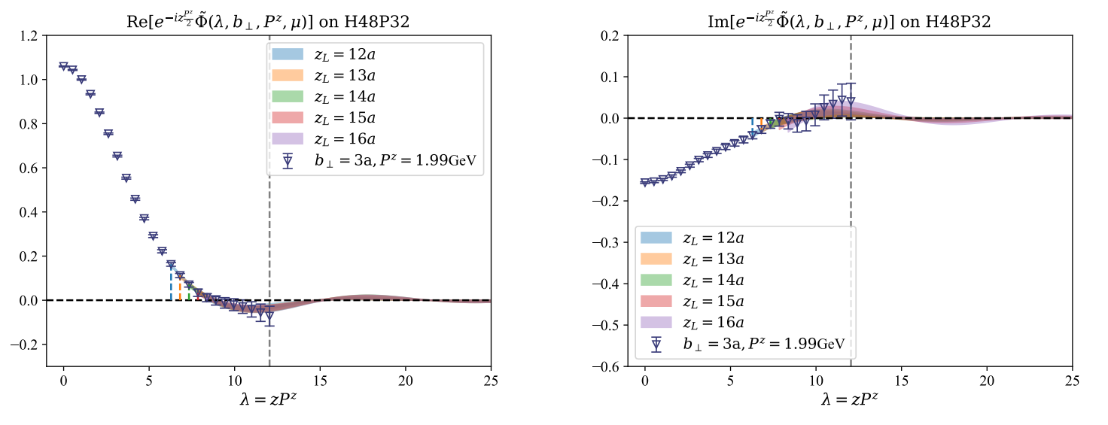

Extrapolation for Large $λ$
18
In large $λ$ area, a feasible form of asymptotic behavior can be written as:
Notes:
To remove unphysical oscillations, the extrapolation of the quasi-TMDWF in the large-$λ$ region is necessary. in this region the wave function behavior can be written as this formula. Since this extrapolation will introduce systematic errors, we compared results with different starting points ZL. As shown in the figure, they are consistent within errors. Of course, their differences are also included in the systematic uncertainty we will mention later.
18

Slide 19
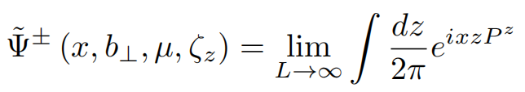
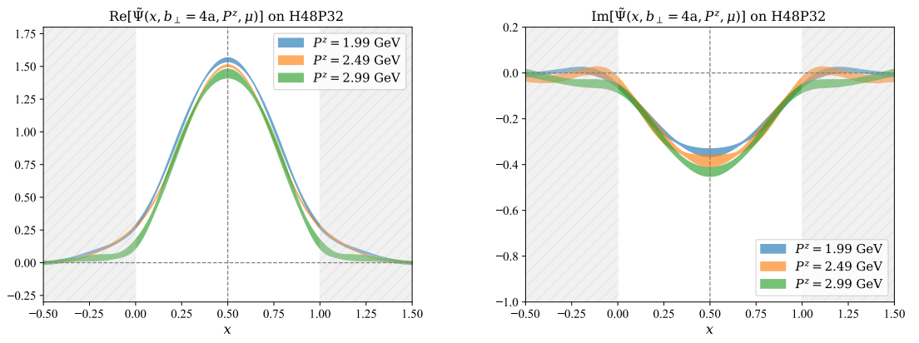
Quasi-TMDWFs in Momentum Space
19
Notes:
After the Fourier transformation, we obtain the quasi-TMDWF in momentum space.
19

Slide 20
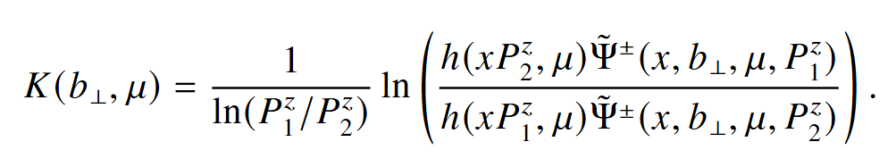
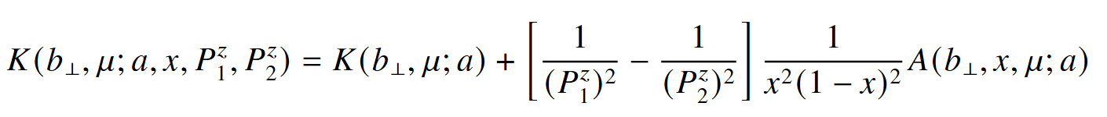
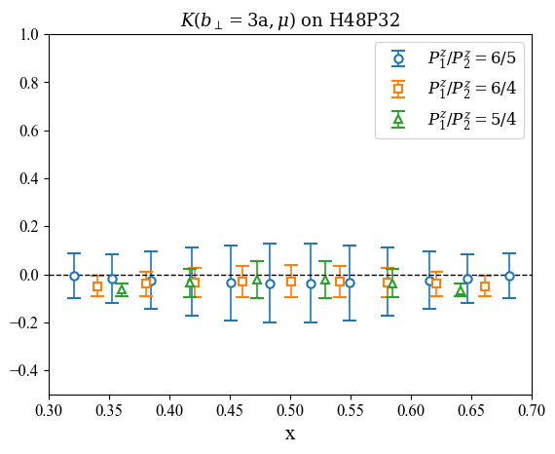
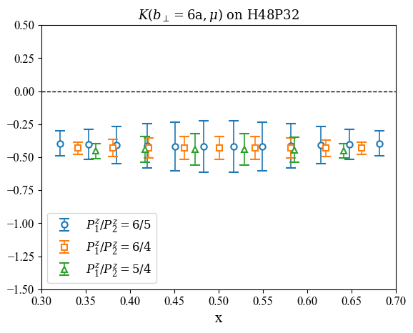
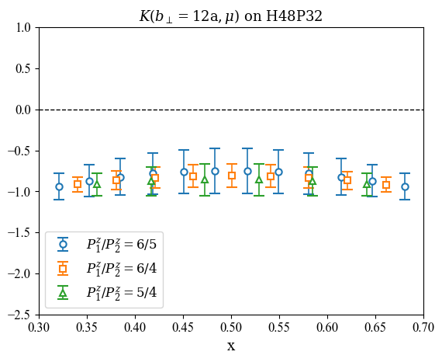
CS Kernel Extracted from Quasi-TMDWFs
20
quasi-TMDWFs
uNLO matching kernel
(For better visualization, we present a subset of points selected
from the 200 data points in each of the 3 cases.)
b-unexpanded matching kernel, PRD 108 (2023)
Notes:
So, we take the ratio at different momentum to calculate the CS kernel. In our work, we use the matching kernel from the paper below. The three figures shows the CS kernel with different b_perp. The three momentum combinations agree each other, but there is still some dependence on $x$ and $P_{z}$, which means the power correction is not cancel out. For better comparison, we present a subset from the 200 data points in each of the 3 cases.
20

Slide 21
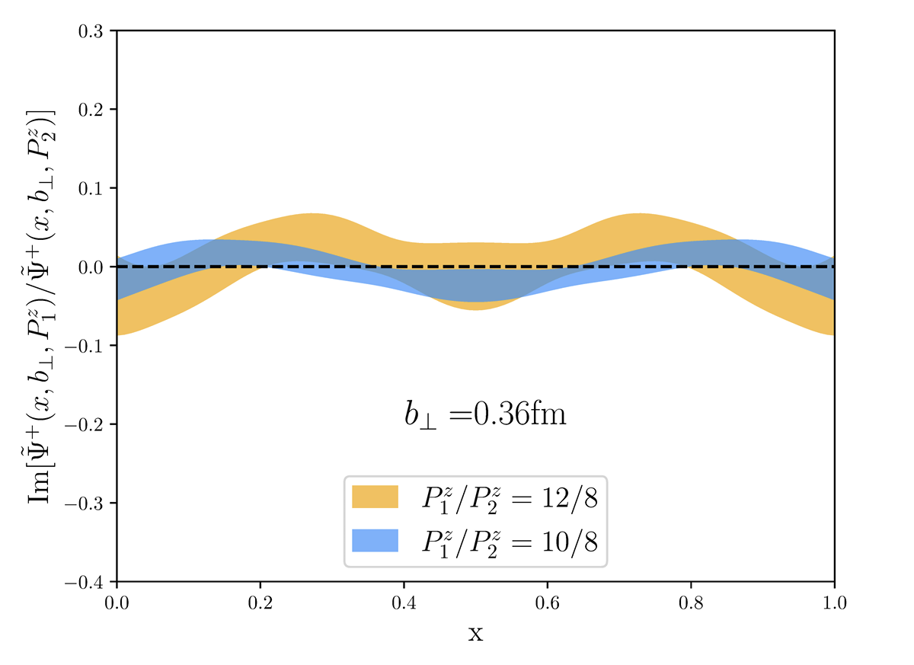
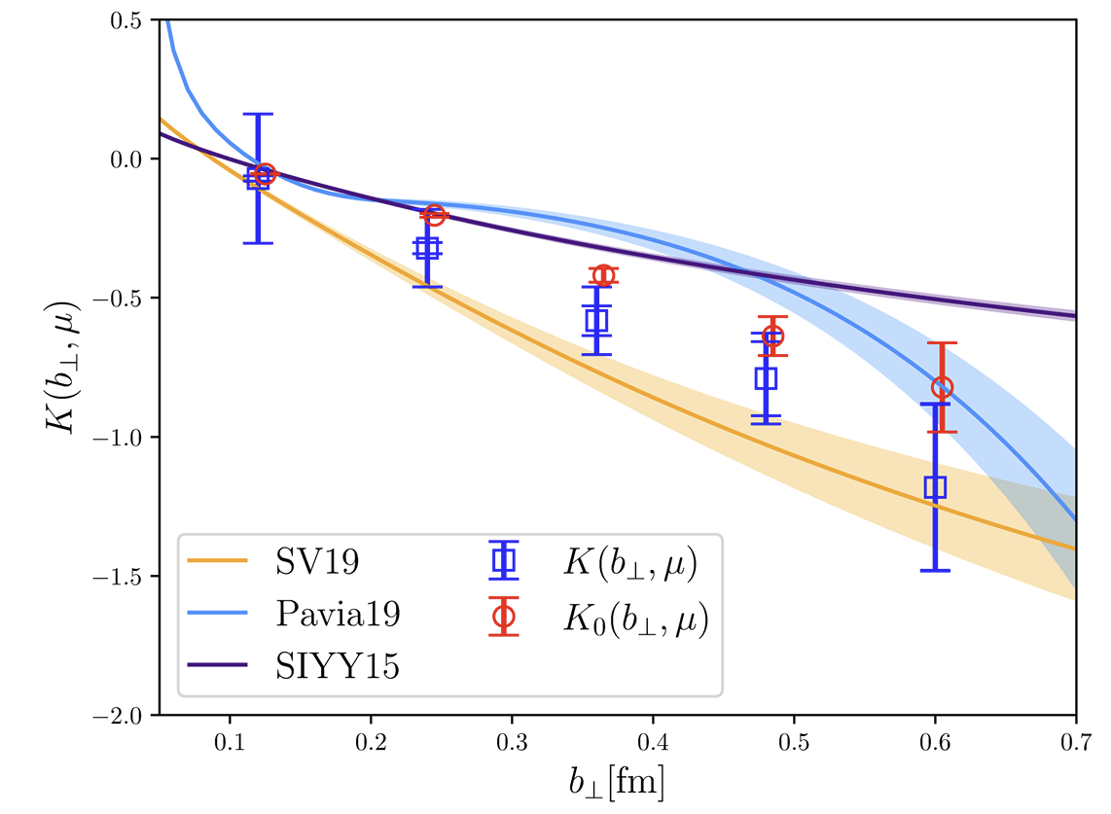
“Imaginary part” of the CS kernel
21
Systematic uncertainty from the imaginary part of the CS kernel:
Previous studies have shown that the imaginary part of the CS kernel primarily originates from the matching kernel.
$$σ_{\text{sys}}^{\text{Im}}=\sqrt{K(b_{⊥},μ)^{2}+\operatorname{Im}{[}K(b_{⊥},μ)^{2}]}−|K(b_{⊥},μ)|$$
LPC 22, PRD 106(2022)
Notes:
In previous work, the imaginary part of the CS kernel was regarded as a systematic error. The paper also points out that most of the imaginary part comes from the matching kernel. The quasi-TMDWF itself contribute a very small imaginary part. In the small-b region, this part of the systematic uncertainty is much larger than the statistical uncertainty.
21

Slide 22
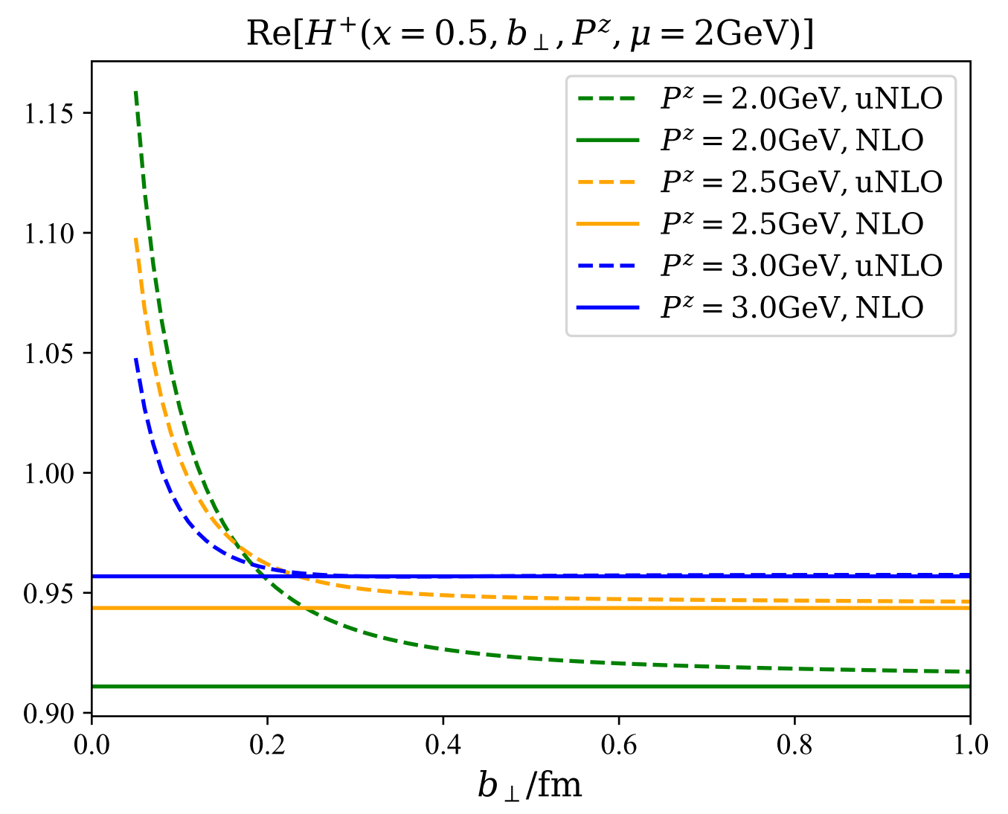
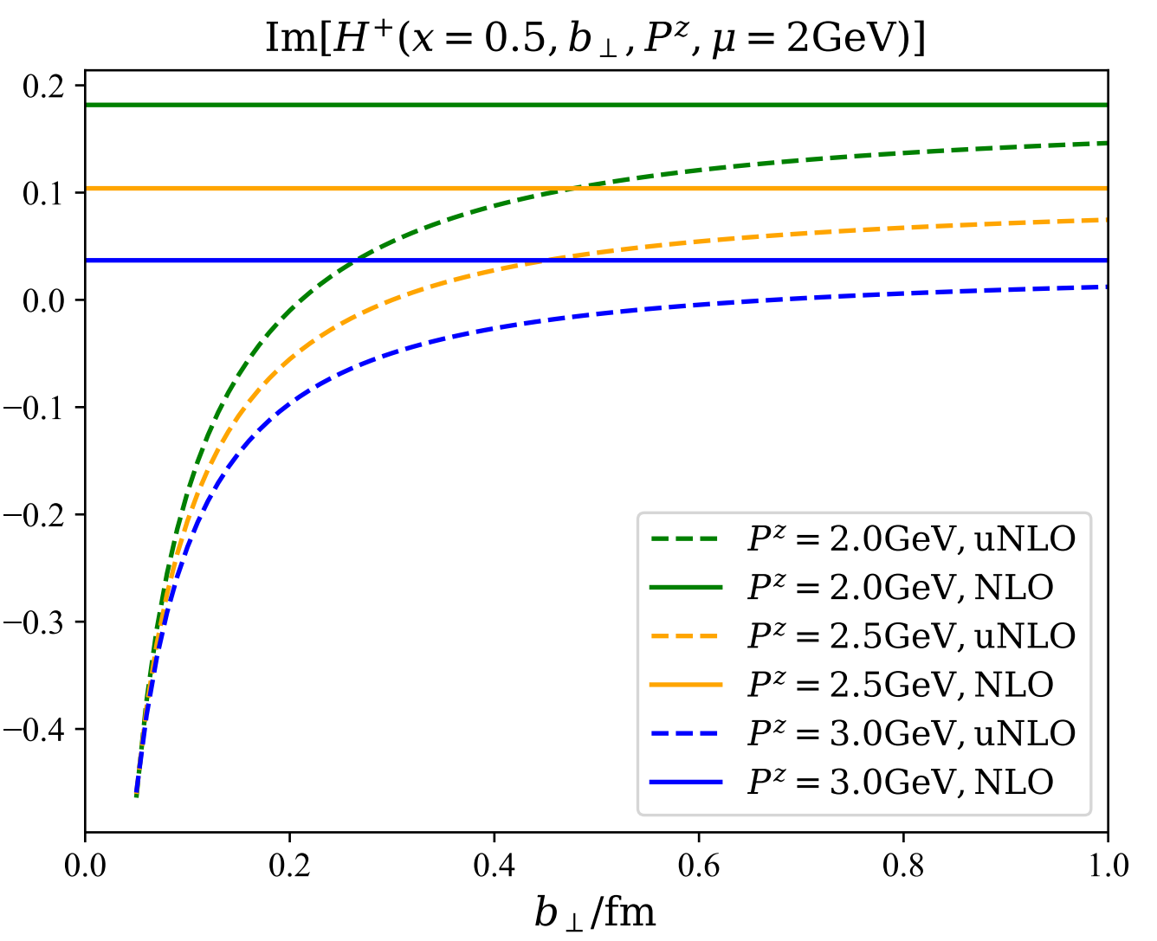
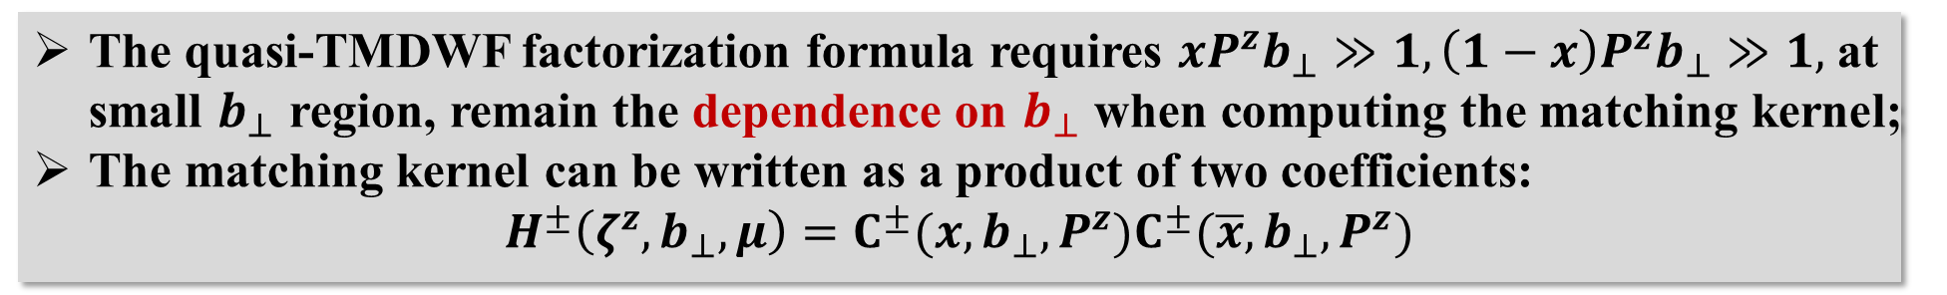
“Imaginary part” of the CS kernel
22
The quasi-TMDWF factorization formula requires $xP^{z}b_{⊥}≫1, \left(1−x\right)P^{z}b_{⊥}≫1,$ at small $b_{⊥}$region, remain the dependence on $b_{⊥}$when computing the matching kernel;
The matching kernel can be written as a product of two coefficients:
$$H^{±}\left(ζ^{z},b_{⊥},μ\right)=C^{±}(x,b_{⊥},P^{z})C^{±}(\overline{x},b_{⊥},P^{z})$$
b-unexpanded matching kernel, PRD 108 (2023)
Notes:
However, we know the quasi-TMDWF factorization formula requires $xP^{z}b_{⊥}$is large, this paper shows that at small $b_{⊥}$region, we can remain the b_perp dependence in matching kernel. These figue shows with the b increase ,b unexpanded matching kernel approaches its NLO result.
22

Slide 23
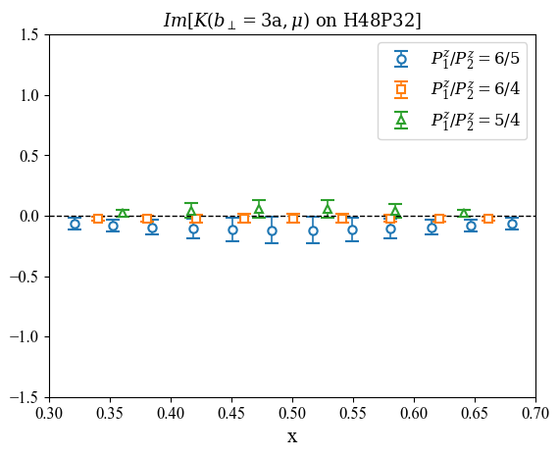
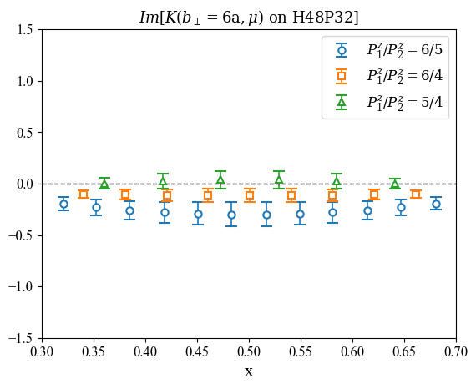
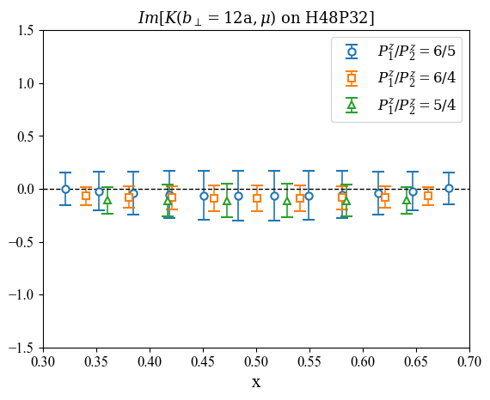
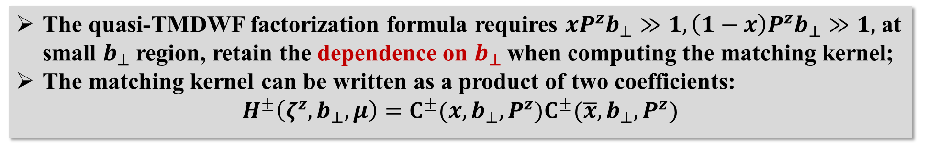
“Imaginary part” of the CS kernel
23
The quasi-TMDWF factorization formula requires $xP^{z}b_{⊥}≫1, \left(1−x\right)P^{z}b_{⊥}≫1,$ at small $b_{⊥}$region, retain the dependence on $b_{⊥}$when computing the matching kernel;
The matching kernel can be written as a product of two coefficients:
$$H^{±}\left(ζ^{z},b_{⊥},μ\right)=C^{±}(x,b_{⊥},P^{z})C^{±}(\overline{x},b_{⊥},P^{z})$$
(For better visualization, we present a subset of points selected
from the 200 data points in each of the 3 cases.)
b-unexpanded matching kernel, PRD 108 (2023)
Notes:
After applying this matching kernel, we plot the imaginary part of the CS kernel for different momentum combinations and find that they are all very close to zero. This will greatly reduce the systematic error from the unphysical imaginary part.
23

Slide 24
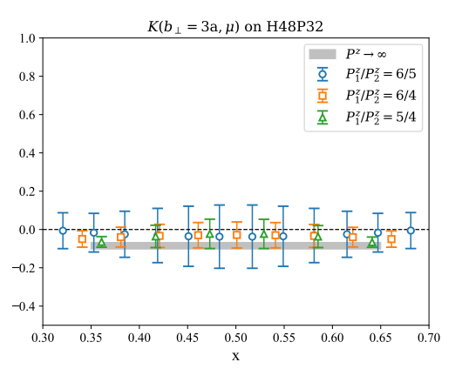
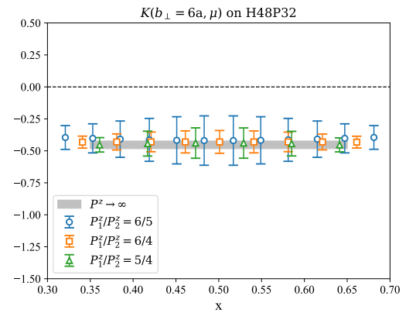
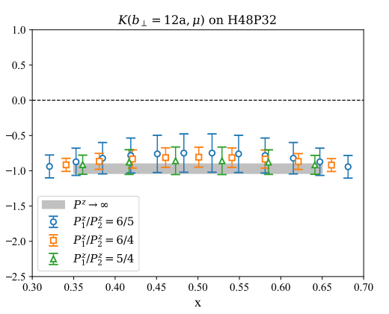
Large Momentum Limit Extrapolation
24
(For better visualization, we present a subset of points selected
from the 200 data points in each of the 3 cases.)
Notes:
Then ,considering that in power correction, the xPz-squared terms in the quasi-TMD factorization are suppressed. To include this effect, we perform the large-momentum limit extrapolation above to remove the $Pz$ and $x$ dependence.
24

Slide 25



Large Momentum Limit Extrapolation
25
... repeat for each $b_{⊥}$
and each a ...
Notes:
We can repeat this process for different $b_{⊥}$on each ensemble. This gives us the CS kernel at 4 lattice ensembles. The results show very beautiful consistency. At the same time, the figure on the right shows that the imaginary part stays around zero for each ensemble, which is very exciting for us.
25

Slide 26







Continuum Limit and Physical Mass Extrapolation
26
Notes:
Up here, we can perform the continuum and physical mass extrapolations as this form. The colored error bars show the results at different lattice spacings, while the black error bars show the results after the physical extrapolation.
Overall, the CS kernel shows little dependence on the pion mass. At small $b_{⊥}$ , the three colored error bars differ a lot, which means discrete error is large.
26

Slide 27


The Systematic Uncertainty
27
We have considered four sources of systematic uncertainties:
1.the unphysical imaginary part, 2.the large-$λ$ extrapolation,
3.the large-momentum extrapolation, 4.the continuum and physical mass extrapolations.
Notes:
We have considered four sources of systematic uncertainties: 1.the unphysical imaginary part,2.the large-$λ$ extrapolation, 3.the large-momentum extrapolation,4.the continuum and physical mass extrapolations. We consider the difference between the physical result and the data before extrapolation as a systematic error. The figure below shows the systematic error contributions from different sources. The gray band present the total systematic uncertainty. You can see that the blue one , the imaginary part has already been significantly suppressed.
27

Slide 28



Final Result
28
Continuum limit;
Physical mass;
$b_{⊥}=1$fm
Preliminary
Preliminary
Notes:
Finally we can get the result of the cs kernel from lattice. In the left figure, we compare our work with other theoretical calculation, In the small-b region, our results agree with the perturbative calculation at 3-loop level. More importantly, as the transverse separation enters the nonperturbative region, our lattice results remain reliable. Without model, our determination of the CS kernel up to b_\perp = 1 fm. We also compare our result with the phenomenology in the right figure. Our results show very good agreement with the global fit of SV19,which is the red band.
28

Slide 29
Outline
29
Motivation
Lattice QCD calculation of CS Kernel
Theoretical Framework
Lattice Simulation and Results
Summary and Outlook
Notes:
29

Slide 30

Summary and Outlook
30
We present the lattice QCD calculation of TMDs and CS kernel:
Logarithmic divergence of the quasi-TMDWFs is studied by self-renormalization;
Systematic uncertainty have been carefully addressed. The part from the imaginary part of the CS kernel is suppressed by the $b_{⊥}$-unexpanded matching kernel;
Physical extrapolation include large momentum, continuum limit and physical mass;
The CS kernel has been extracted in the long-distance region ($b_{⊥}=1$fm).
In the future, we will:
Better control of uncertainties;
Polarized TMDPDFs calculation;
......
Thank you for your attention!
Notes:
30

Slide 31
31
Backup
Notes:
31

Slide 32






TMDs on Lattice QCD
32
Large-momentum effective theory: connecting Euclidean lattice and physical observables
$$\frac{ξ^{−}}{\sqrt{2}}$$
Lorentz boost
EFT
$$−\frac{ξ^{−}}{\sqrt{2}}$$
Ji, PRL110(2013),
RMP93(2021), …
Achieved great success in the studies of TMDPDFs:
Proton transversity PDF, PRL131(2023)
Unpolarized nucleon TMDPDF, PRD109 (2024)
Boer-Mulders Function, arXiv:2502.11807
Notes:
32

Slide 33

Dispersion Relation
33
We use the following fitting formula to fit the dispersion relation of pion,
where the fit result is b1 = 1.0048 (90), b2 = -0.055 (16).
Notes:
33

Slide 34


L Dependence
34
The extraction of ${\tilde{Ψ}}^{±}(x,b_{⊥},μ,ζ_{z})$ requires L to be large enough. When L$≥$6a$≅$0.6fm, the matrix elements remain invariant.
Notes:
34

Slide 35


HYP smearing
35
N_conf = 500, fix timeslice = 4a, Pz=1.47GeV,
the noise-to-signal ratio of bare-TMDWF
N_conf = 500
HYP smearing significantly suppress the noise-to-signal ratio of bare-TMDWF
The noise-to-signal ratio of HYP smearing 1 times is lower than that of without HYP smearing.
Notes:
35

Slide 36

HYP smearing
36
Wilson Loop Renormalization
Notes:
36

Slide 37

HYP smearing
37
Quasi-TMDWFs
Notes:
37

Slide 38

HYP smearing
38
Quasi-TMDWFs
Notes:
38

Slide 39



Different Lorentz Structures
39
When $P^{z}$ = 1.47GeV
${{ Γ}_{src} = γ}^{t}γ_{5},{ γ}^{z}γ_{5},γ_{5}$ are consistent when the timeslice is large;
The signal-to-noise ratio of $γ^{t}γ_{5}, γ^{z}γ_{5}$ is greater than that of $γ_{5}$.
Notes:
39

Slide 40





Gauge Fixing Accuracy and Lorentz Structure
40
Left panel :
Right panel :We fix $Γ_{sink}=γ^{t}γ_{5} ,$
$the red: gauge fixing accuracy {10}^{−6}$
$the blue:$ $gauge fixing$ $accuracy$ ${10}^{−8}$
$the red:Γ_{src}=(γ^{t}γ_{5}+{i γ}^{z}γ_{5} )/2$
$the blue:Γ_{src}=γ_{5}$
Notes:
40

Slide 41

Self-Renormalization--a New Scheme to Extract $Z_{O}$
41
Subtracted matrix element
Renormalization condition:
Parametrization:
Deng et al., JHEP 09 (2022); Huo et al. NPB 969(2021)
Notes:
In our work, for the first time in the case of quasi-TMDWFs, we studied the logarithmic divergences in detail, inspired by self-renormalization.
After removing linear divergences, the zero-momentum matrix element can be factorized into a scale-dependent renormalization factor times the matrix element calculated in the $\overset{‾}{\text{MS}}$scheme.
This paper shows that the subtracted matrix element can be parameterized as shown below. The first two terms describe the logarithmic divergences. The g term describes the remaining part. The later terms are for matching to $\overset{‾}{\text{MS}}$, and $d^{′}$in $Z_{O}$ absorbs the scale dependence.
We first use all the zero-momentum lattice data to do the joint fit of $c_{1}$.
41

Slide 42



Self-Renormalization--a New Scheme to Extract $Z_{O}$
42
Subtracted matrix element
Renormalization condition:
Joint fit result：c₁=0.020
Parametrization:
Deng et al., JHEP 09 (2022); Huo et al. NPB 969(2021)
Notes:
We obtained the result for $c_{1}$and the fit shown below. Then we can fix the form of the logarithmic divergences. We also marked the data around the pion mass of 135 on the figure by blue errbars and found that the zero-momentum matrix element shows independence on the pion mass.
42

Slide 43
Self-Renormalization--a New Scheme to Extract $Z_{O}$
43
Subtracted matrix element
Renormalization condition:
Joint fit result：c₁=0.020
Parametrization:
✓
✓
$d’(μ)$= -0.448
$a/$fm | 0.10530 | 0.07746 | 0.05187
HYP0 | 1.064(21) | 1.145(20) | 1.241(19)
HYP1 | 0.92208(62) | 0.97526(57) | 1.03969(53)
Deng et al., JHEP 09 (2022); Huo et al. NPB 969(2021)
Notes:
We then adjusted $d^{′}$to match $g$ term with the $\overset{‾}{\text{MS}}$ result in the perturbative region. This lets us remove the $\overset{‾}{\text{MS}}$ part of $g$, fix the logarithmic divergence $c_{1}$, and define the scale dependence.
Finally, we obtained the renormalization factor $Z_{O}$for the three lattice spacings.
43

Slide 44


Quasi-TMDWFs in Coordinate Space
44
Notes:
So, when we have all three pieces of the quasi-TMDWF, we can plot its distribution in coordinate space. For each ensemble, we calculated results at three different momentums
44

Slide 45

Quasi-TMDWFs in Momentum Space
45
Notes:
After the Fourier transformation, we obtain the quasi-TMDWF in momentum space.
45

