Slide 1






Global analysis of TMD PDFs
and EicC Projection
The 26th international symposium on spin physics (SPIN2025)
Reporter：Hongxin Dong
Collaborators：Tianbo Liu, Peng Sun, Ke Yang, Chunhua Zeng,
Yuxiang Zhao. (Transverse Nucleon Tomography Collaboration)
Report date ：2025.09.23

Slide 2
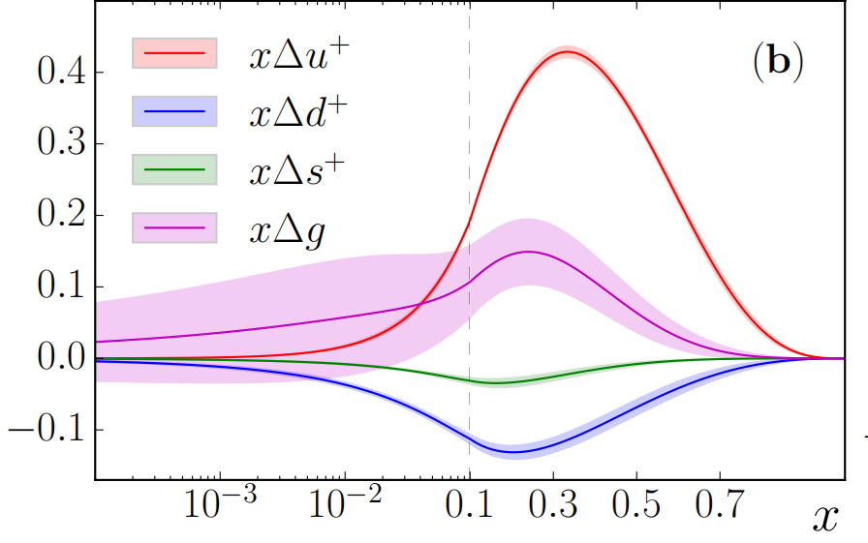
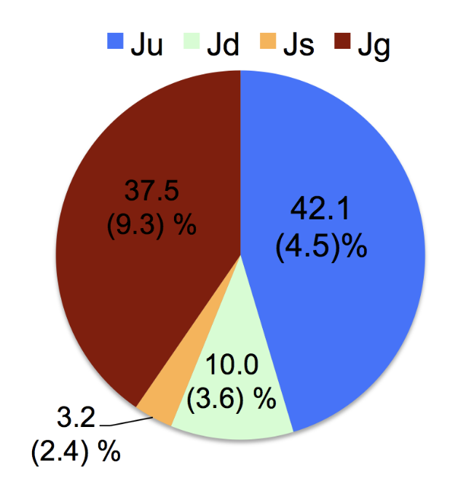


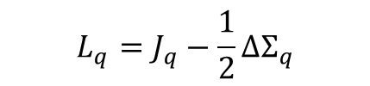

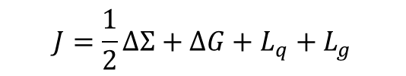
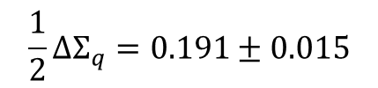


Introduction
Theoretical formalism
Numerical Result
Summary
Spin decomposition
$$J=\frac{1}{2}ΔΣ+ΔG+L_{q}+L_{g}$$
Proton spin puzzle: $ΔΣ=Δu+Δd+Δs\sim 0.3$
JAM, PRD 93 (2016) 7, 074005
ETMC, PRD 101 (2020) 9, 094513
国内研究
$$Δu^{+}= 0.83±0.01 \\ Δd^{+}=−0.44±0.01 \\ Δs^{+}=−0.10±0.01 \\ ΔΣ = 0.28±0.04 \\ ΔG = 1±15$$
$$L_{q}=J_{q}−\frac{1}{2}ΔΣ_{q}$$
$$J_{q}+J_{g}=0.473±0.071$$
$$L_{q}=0.094±0.051$$
$$\frac{1}{2}ΔΣ_{q}=0.191±0.015$$
JAM, PRL. 119 (2017) 13, 132001
$$ΔΣ = 0.36±0.09$$

Slide 3
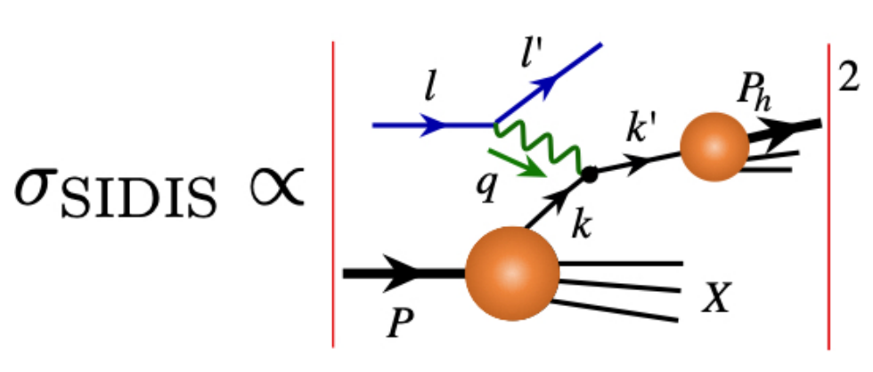
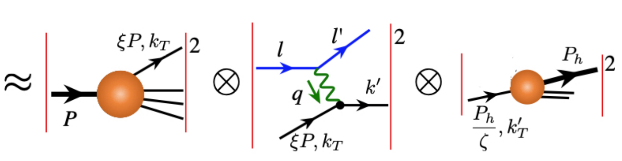


Introduction
Theoretical formalism
Numerical Result
Summary
Semi-inclusive Deep Inelastic Scattering
$$e\left(l\right)+N\left(P\right)→e\left(l^{′}\right)+h\left(P_{h}\right)+X$$
$$A final state hadron (P_{h}) is identified$$
[Figure from TMD Handbook]
Enables an exploration of the mechanism by which color neutral hadrons emerge from colored partons.
Investigate the flavor dependence by analyzing various hadron species, for example, pions and kaons.
Probe the multidimensional imaging of the nucleon

Slide 4





















Introduction
Theoretical formalism
Numerical Result
Summary
TMDs
TMD PDFs |  | Quark polarization
 |  | Unpolarized （U） | Longitudinally polarized(L) | Transversely polarized(T)
Nucleon polarization | U
 | L
 | T
Momentum fraction $x=\frac{k^{+}}{P^{+}}$
$f_{q}(x)$ : collinear PDF
$$f_{1}$$
$$h_{1}^{⊥}$$
$f_{q}(x,k_{⊥})$ : TMD PDF
Boer-Mulders
Unpolarized
$$g_{1L}$$
$$h_{1L}^{⊥}$$
Nucleon spin
8 leading twist TMD PDFs
Helicity
Longi-transversity
$$f_{1T}^{⊥}$$
$$g_{1T}$$
$$h_{1}^{ }$$
Parton spin
Transversity
Sivers
Worm-gear
$$h_{1T}^{⊥}$$
Pretzelosity
TMD FFs |  | Quark polarization
 |  | Unpolarized （U） | Transversely polarized(T)
Hadron polarization | U
TMD FFs
$$D_{1}$$
$$H_{1}$$
Collins

Slide 5
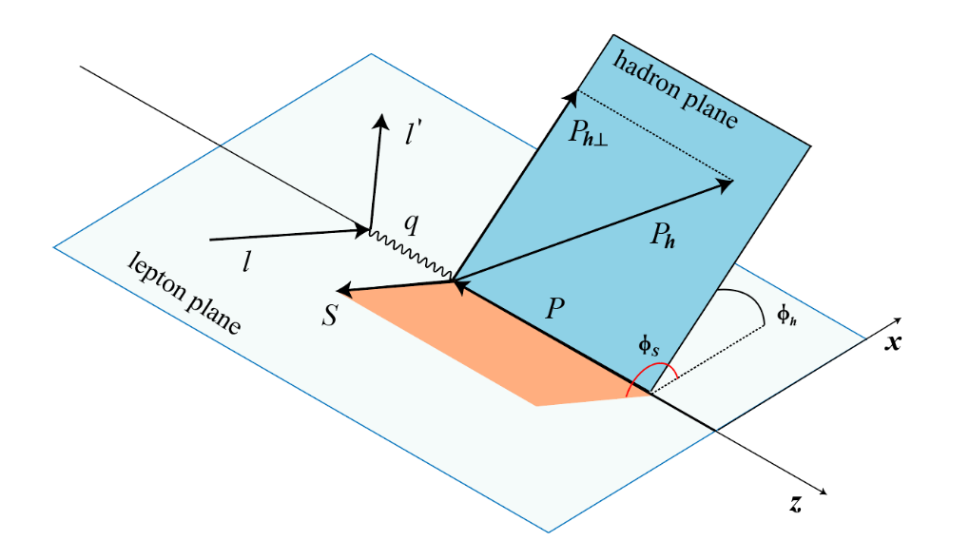
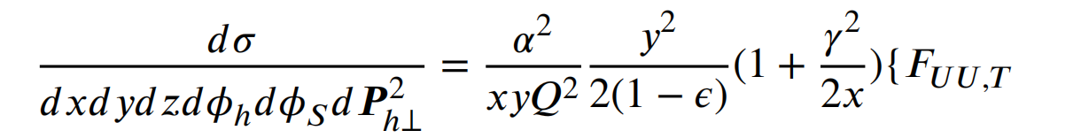
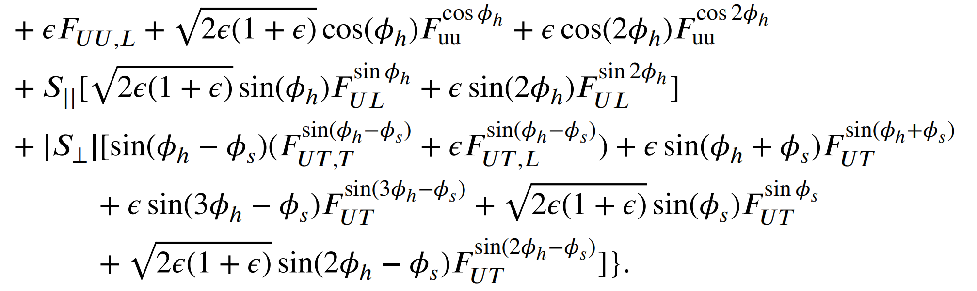

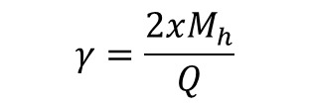
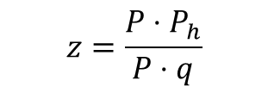
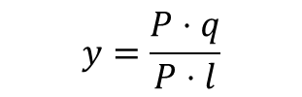
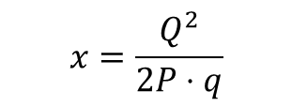
Introduction
Theoretical formalism
Numerical Result
Summary
Structure Functions of SIDIS
18 structure functions $F_{AB,C}\left(x,z,P_{h}^{2},Q^{2}\right)$
$$A:lepton polarization$$
$$B:nucleon polarization$$
$$C:virtual photon polarization$$
$$x=\frac{Q^{2}}{2P⋅q}$$
$$y=\frac{P⋅q}{P⋅l}$$
$$z=\frac{P⋅P_{h}}{P⋅q}$$
$$γ=\frac{2xM_{h}}{Q}$$

Slide 6
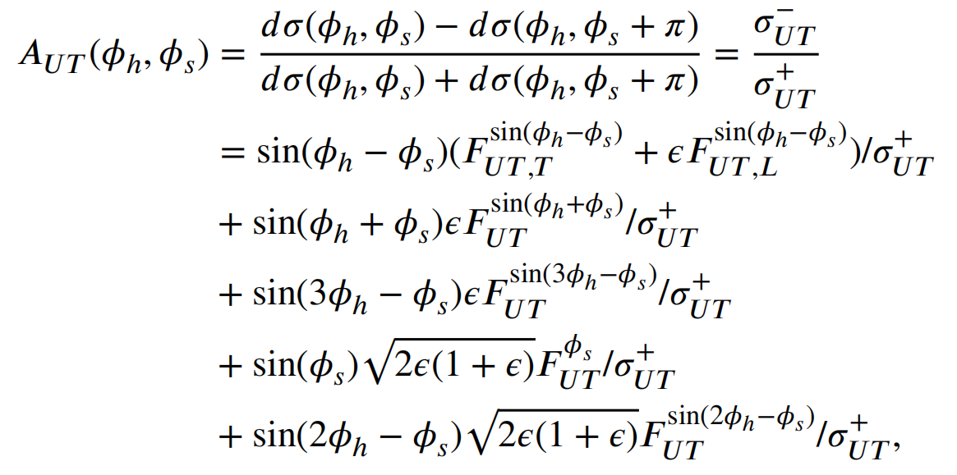
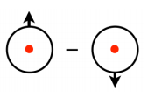
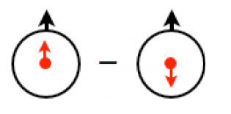

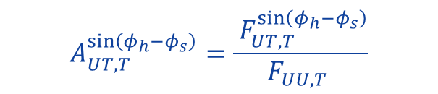
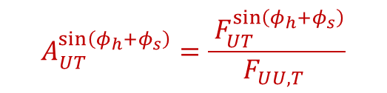

Introduction
Theoretical formalism
Numerical Result
Summary
Signle Spin Asymmetries of SIDIS
Sivers asymmetry
Collins asymmetry
Sivers PDF
Transversity PDF
In TMD region
$$A_{UT,T}^{\sin\left(φ_{h}−φ_{s}\right)}=\frac{{ F}_{UT,T}^{\sin\left(φ_{h}−φ_{s}\right)}}{F_{UU,T} }$$
$$f_{1T}^{⊥}⊗D_{1}^{ }$$
Sivers PDF and Unpolarized FF
$$A_{UT}^{\sin\left(φ_{h}+φ_{s}\right)}=\frac{{ F}_{UT}^{\sin\left(φ_{h}+φ_{s}\right)}}{F_{UU,T} }$$
$$h_{1}^{ }⊗H_{1}^{⊥}$$
Transversity PDF and Collins FF

Slide 7
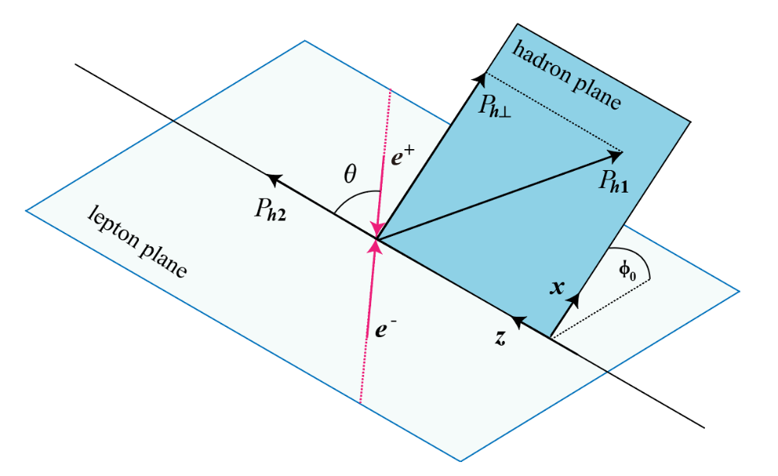
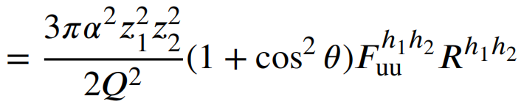
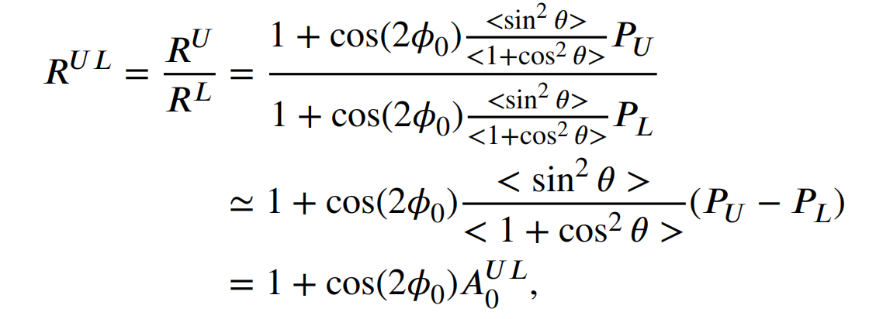
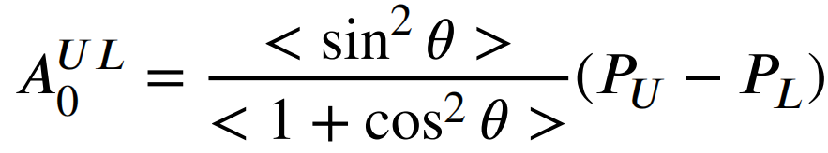


Introduction
Theoretical formalism
Numerical Result
Summary
Signle Spin Asymmetries of SIDIS
$$e^{+}+e^{−}→h_{1}+h_{2}+X$$
$$H_{1}^{⊥}⊗H_{1}^{⊥}$$
Collins function

Slide 8
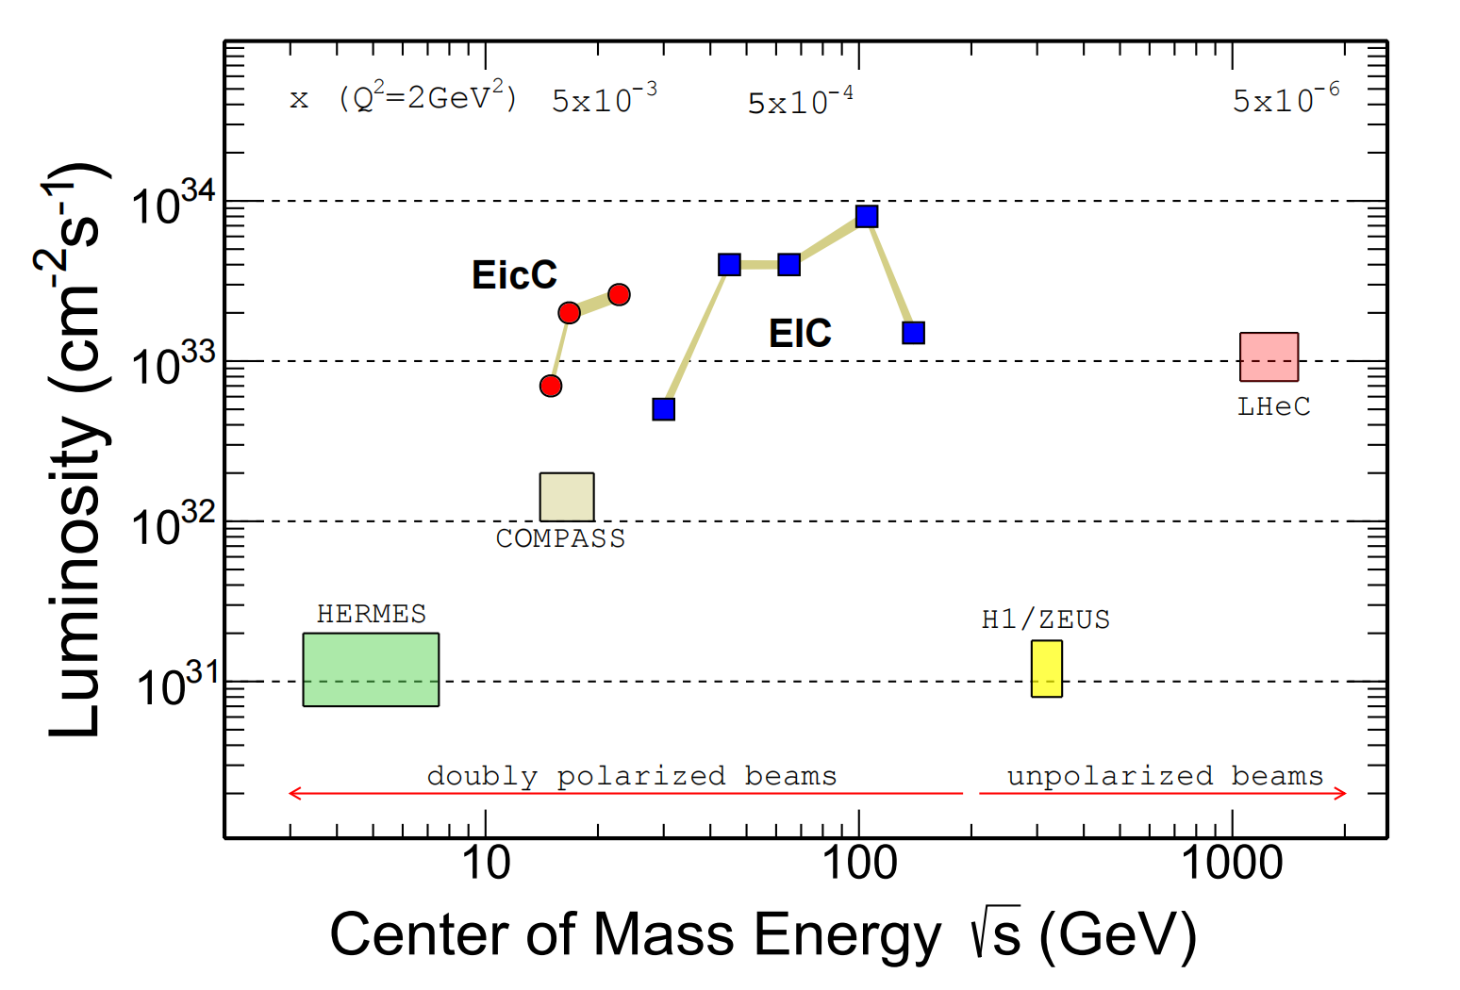
Introduction
Theoretical formalism
Numerical Result
Summary
Kinematic distribution of SIDIS Datasets
[Figure from EicC White Paper]

Slide 9
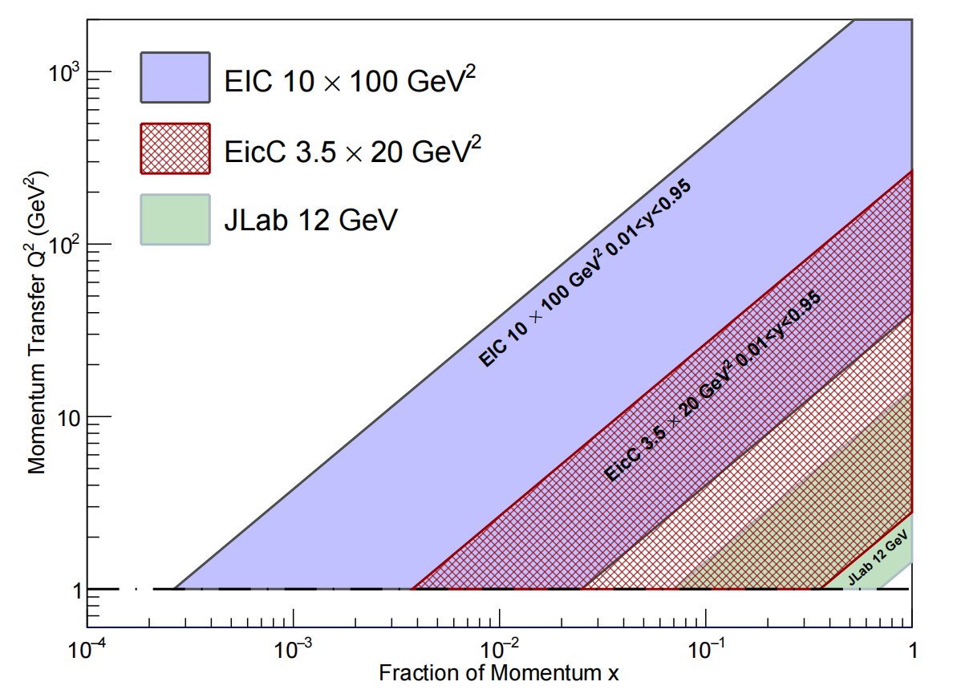
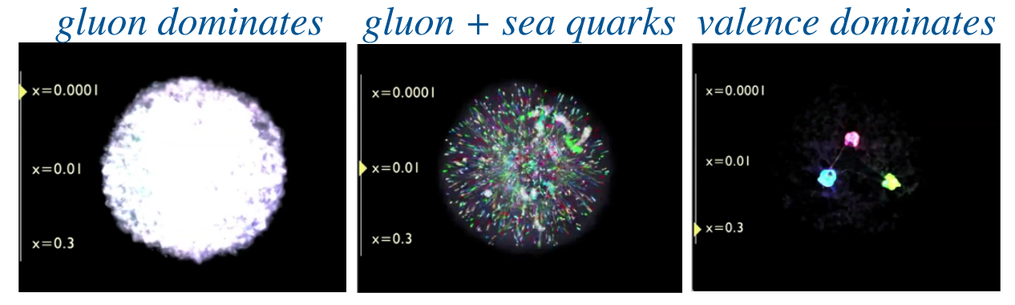
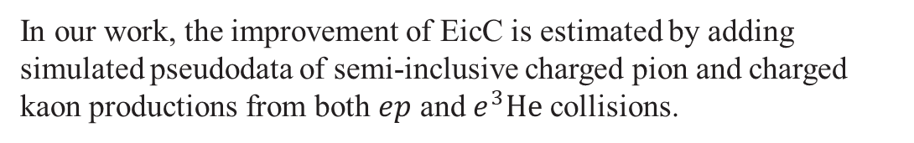
Introduction
Theoretical formalism
Numerical Result
Summary
EicC projection
EicC is optimized to systematically explore the gluon and sea quarks in moderate x regime at a crucial place between JLab and EIC-US.
In our work, the improvement of EicC is estimated by adding simulated pseudodata of semi-inclusive charged pion and charged kaon productions from both $ep$ and $e^{3}He$ collisions.
[Figure from EicC CDR]

Slide 10
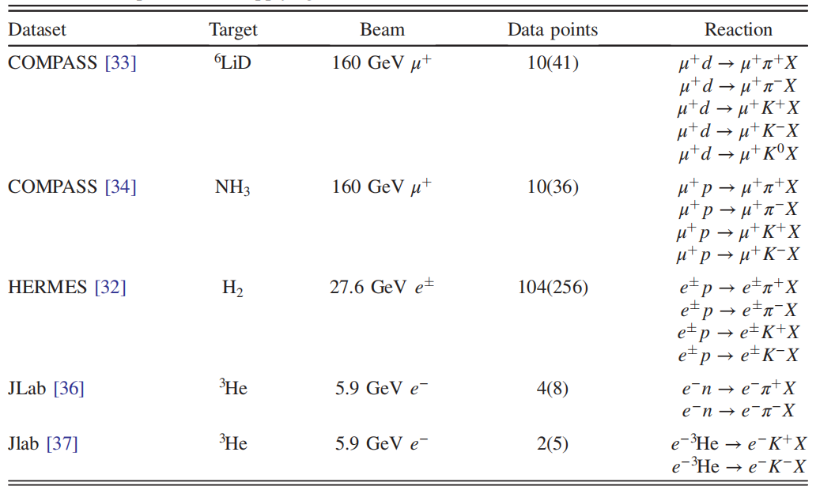

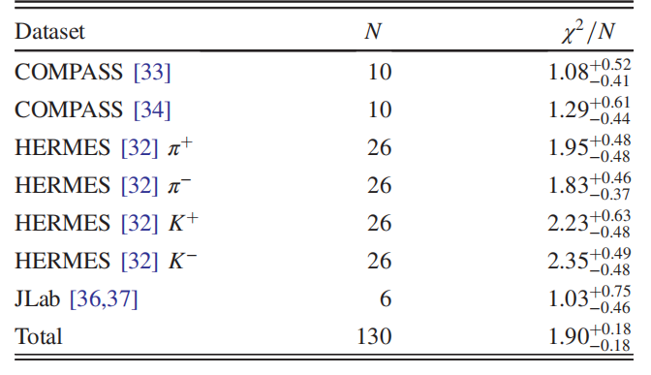
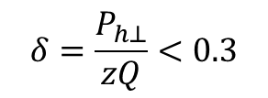
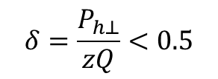
Introduction
Theoretical formalism
Numerical Result
Summary
Datasets for Sivers
$$δ=\frac{P_{h⊥}}{zQ}<0.5$$
Phys. Lett. B 673, 127 (2009).
world data
data uncertainty
SIDIS data:130
Phys. Lett. B 744, 250 (2015).
1000 replica
fit independently
J. High Energy Phys. 12 (2020) 010.
1000 results
$$δ=\frac{P_{h⊥}}{zQ}<0.3$$
average and
standard deviation
Phys. Rev. Lett. 107, 072003 (2011).
EicC pseudodata:4983
Phys. Rev. C 90, 055201 (2014).
TMDs
Sivers function

Slide 11
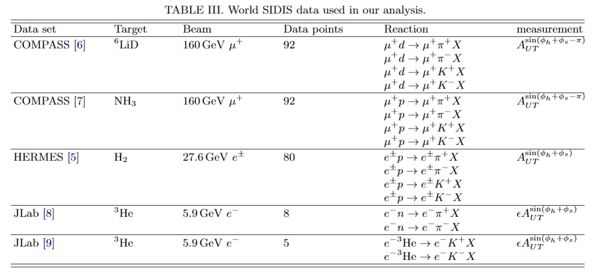
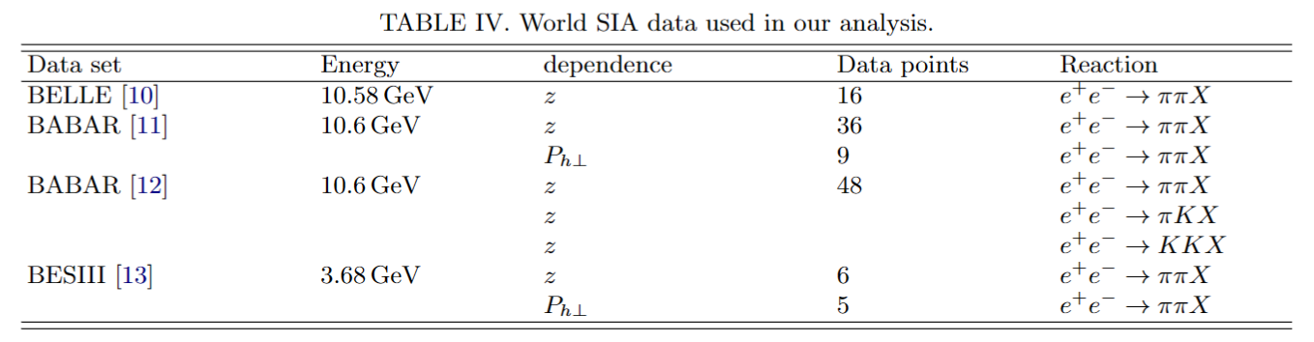
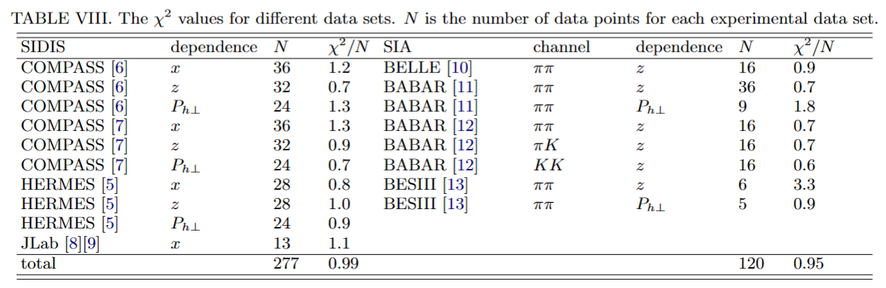
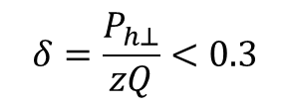
Introduction
Theoretical formalism
Numerical Result
Summary
Datasets for
transversity
Phys. Lett. B 673, 127 (2009).
world data
Phys. Lett. B 744, 250 (2015).
data uncertainty
SIDIS data:277
J. High Energy Phys. 12 (2020) 010.
1000 replica
fit independently
Phys. Rev. Lett. 107, 072003 (2011).
Phys. Rev. C 90, 055201 (2014).
1000 results
average and
standard deviation
SIA data:120
TMDs
Total world data:397
Collins function &
transversity function
SIA datasets
EicC pseudodata:1347
Phys. Rev.D 78, 032011 (2008); 86, 039905(E) (2012).
$$δ=\frac{P_{h⊥}}{zQ}<0.3$$
Phys. Rev. D 90, 052003 (2014).
Phys. Rev. D 92, 111101 (2015).
Phys. Rev. Lett. 116, 042001 (2016).

Slide 12
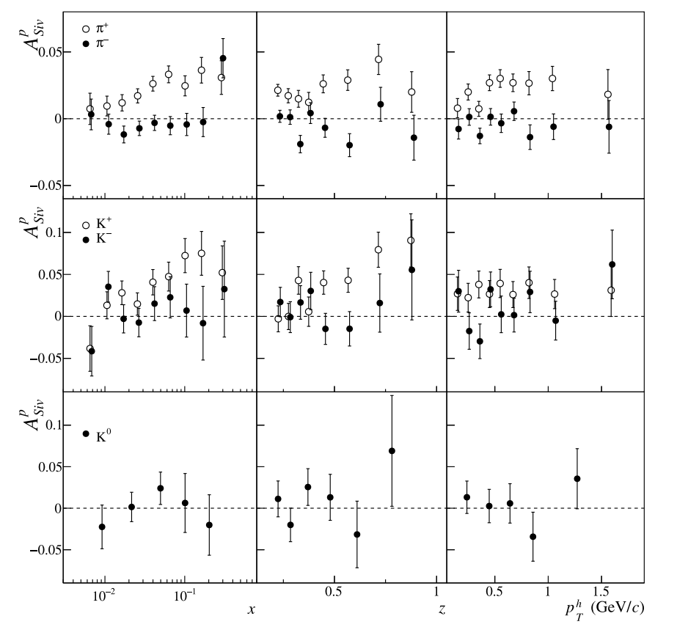
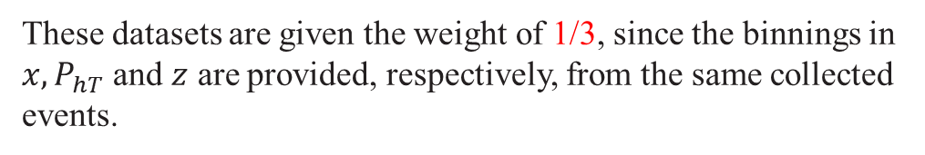
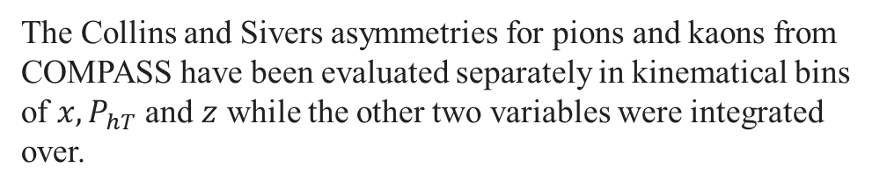
Introduction
Theoretical formalism
Numerical Result
Summary
Datasets for Sivers asymmetry
The Collins and Sivers asymmetries for pions and kaons from COMPASS have been evaluated separately in kinematical bins of $x, P_{hT}$ and $z$ while the other two variables were integrated over.
These datasets are given the weight of 1/3, since the binnings in $x, P_{hT}$ and $z$ are provided, respectively, from the same collected events.
COMPASS, PLB 744 (2015) 250-259

Slide 13
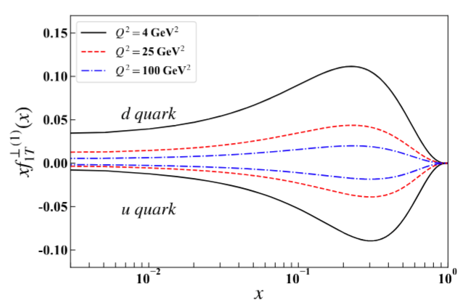
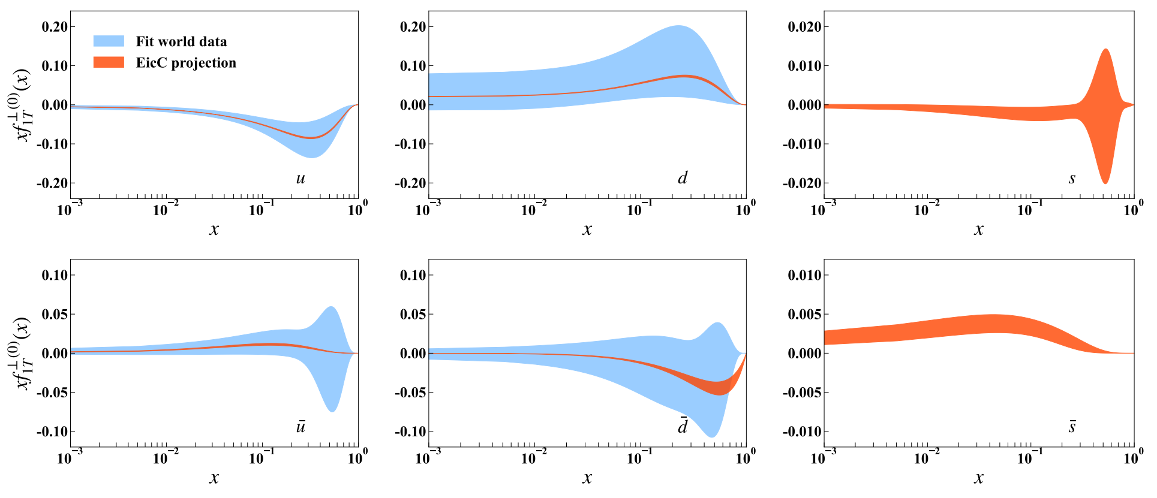
Introduction
Theoretical formalism
Numerical Result
Summary
Global fit & EicC pseudo data – Sivers function
C. Zeng, T. Liu, P. Sun, Y. Zhao, Phys. Rev. D 106 (2022) 094039.

Slide 14
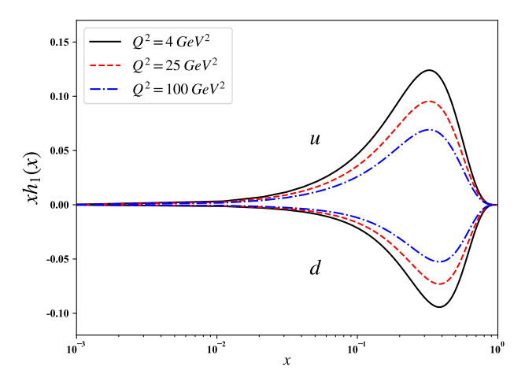
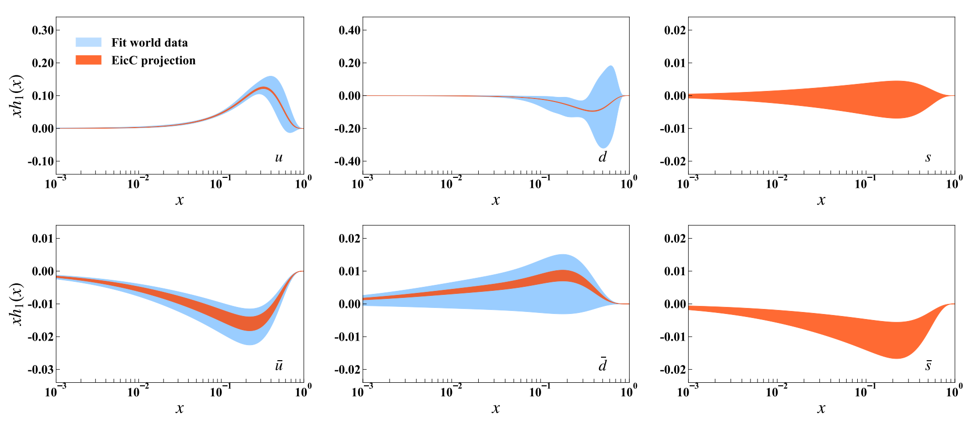
Introduction
Theoretical formalism
Numerical Result
Summary
Global fit & EicC pseudo data – transversity function
C. Zeng, H. Dong, TL, P. Sun, Y. Zhao, PRD 109 (2024) 056002.

Slide 15
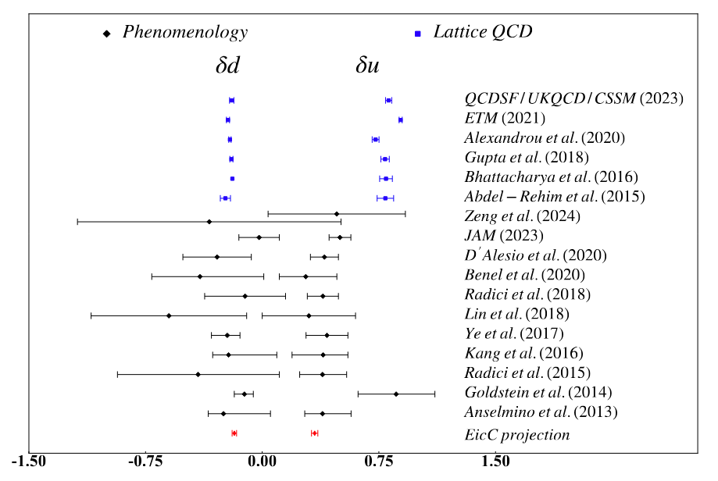
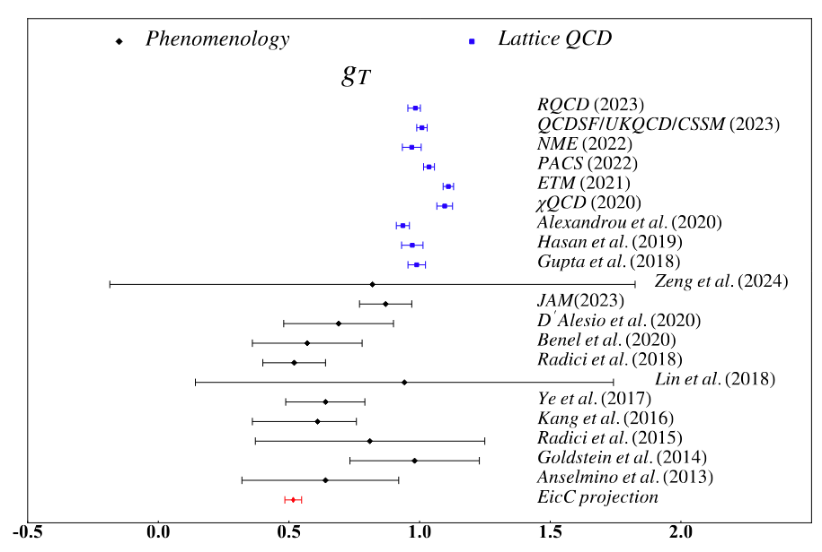
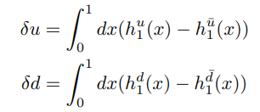

Introduction
Theoretical formalism
Numerical Result
Summary
Tensor charge
C. Zeng, H. Dong, TL, P. Sun, Y. Zhao, PRD 109 (2024) 056002.

Slide 16
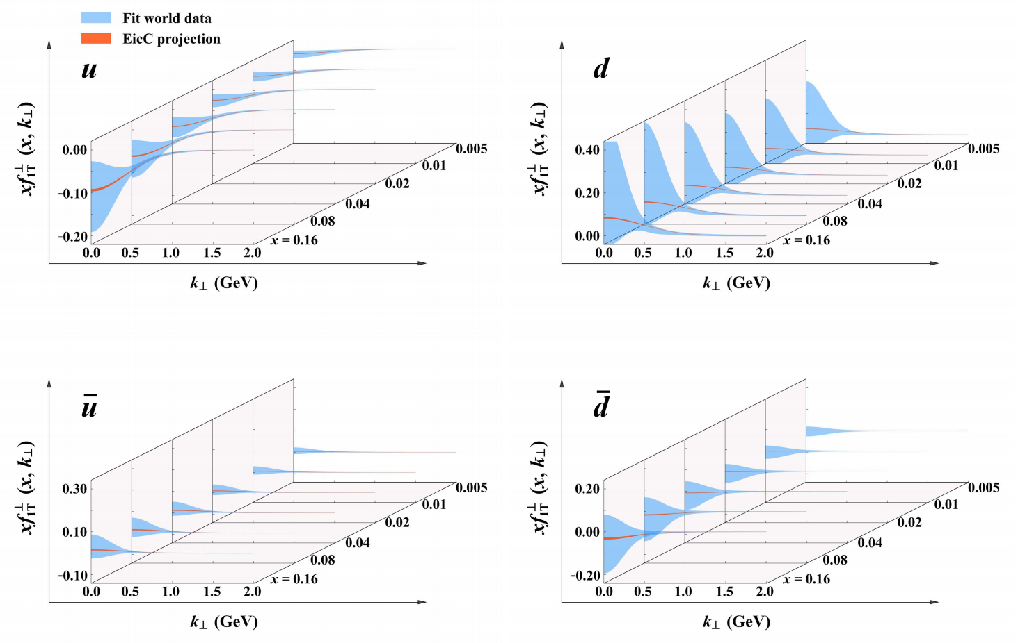
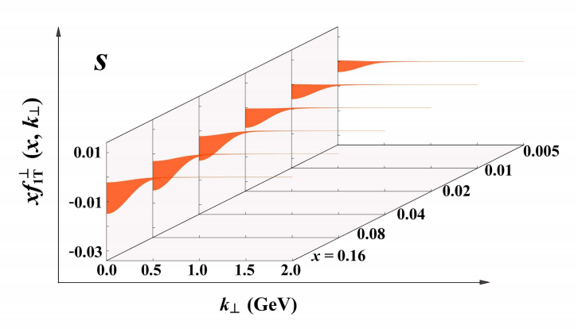
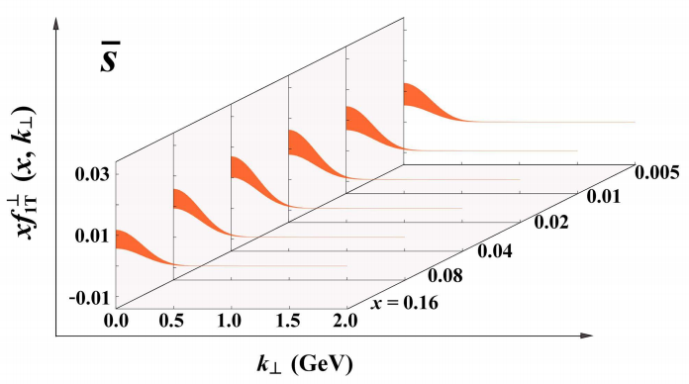
Introduction
Theoretical formalism
Numerical Result
Summary
Three-dimensional nucleon structures – Sivers function
C. Zeng, T. Liu, P. Sun, Y. Zhao, Phys. Rev. D 106 (2022) 094039.

Slide 17
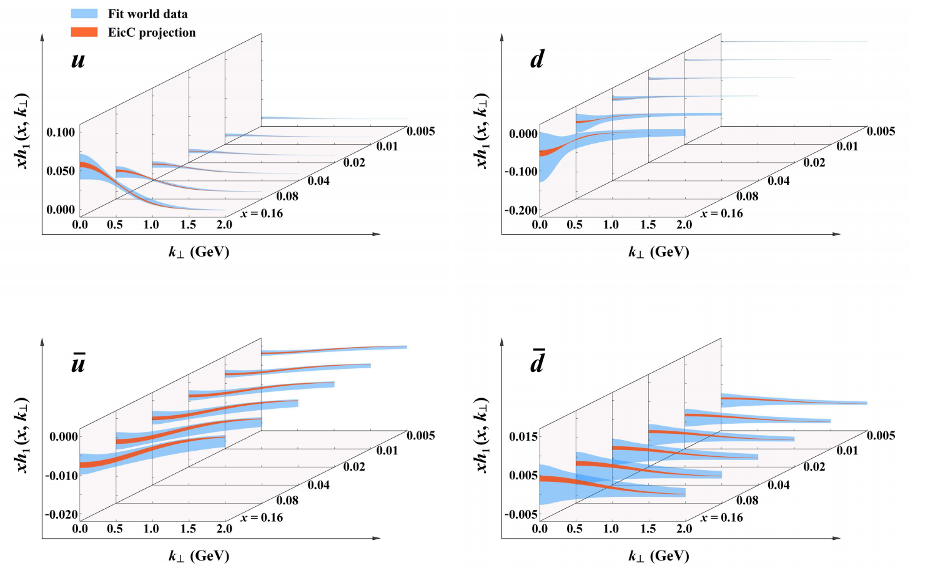


Introduction
Theoretical formalism
Numerical Result
Summary
Three-dimensional nucleon structures – transversity function
C. Zeng, H. Dong, TL, P. Sun, Y. Zhao, PRD 109 (2024) 056002.

Slide 18

Introduction
Theoretical formalism
Numerical Result
Summary
New COMPASS Data
SIDIS on transversely polarized deuteron target.
COMPASS Collaboration, Phys. Rev. Lett. 133 (2024) 101903.

Slide 19


Introduction
Theoretical formalism
Numerical Result
Summary
New COMPASS Data
Sivers function
transversity function
C. Zeng, H. Dong, T. Liu, P. Sun, Y. Zhao, arXiv:2412.18324

Slide 20



Introduction
Theoretical formalism
Numerical Result
Summary
Comparison with the world data (Sivers asymmetry)
COMPASS data
HERMES data
JLab data

Slide 21


Introduction
Theoretical formalism
Numerical Result
Summary
Comparison with the world data (Collins asymmetry)
COMPASS data

Slide 22



Introduction
Theoretical formalism
Numerical Result
Summary
Comparison with the world data (Collins asymmetry)
HERMES data
JLab data

Slide 23



Introduction
Theoretical formalism
Numerical Result
Summary
Comparison with the world data (Collins asymmetry)
BELLE data
BESIII data
BABAR data

Slide 24


Introduction
Theoretical formalism
Numerical Result
Summary
Comparison with the world data (Collins asymmetry)
BABAR data

Slide 25


Introduction
Theoretical formalism
Numerical Result
Summary
Comparison with the world data
COMPASS SIDIS data (2024)
Sivers asymmetry
Collins asymmetry

Slide 26






Introduction
Theoretical formalism
Numerical Result
Summary
Double Spin Asymmetries of SIDIS
worm-gear
worm-gear asymmetry
worm-gear asymmetry datasets
In TMD region
$$A_{LT}^{\cos\left(φ_{h}−φ_{s}\right)}=\frac{{ F}_{LT}^{\cos\left(φ_{h}−φ_{s}\right)}}{F_{UU} }$$
J. High Energy Phys. 12 (2020) 010.
$${g_{1T}^{⊥}}_{ }^{ }⊗D_{1}^{ }$$
Phys. Lett. B 770, 138 (2017).
worm-gear and unpolarized
Phys. Rev. Lett. 108, 052001 (2012).

Slide 27

Introduction
Theoretical formalism
Numerical Result
Summary
Global fit & EicC pseudo data – worm-gear
K. Yang, T. Liu, P. Sun, Y. Zhao, B.-Q. Ma, Phys. Rev. D 110 (2024) 034036.

Slide 28






Introduction
Theoretical formalism
Numerical Result
Summary
Three-dimensional nucleon structures – worm-gear function
$$⊥$$
$$⊥$$
$$⊥$$
$$⊥$$
$$⊥$$
$$⊥$$
K. Yang, T. Liu, P. Sun, Y. Zhao, B.-Q. Ma, Phys. Rev. D 110 (2024) 034036.

Slide 29



Introduction
Theoretical formalism
Numerical Result
Summary
Comparison with the world data (worm-gear asymmetry)
COMPASS data
HERMES data
JLab data

Slide 30

Introduction
Theoretical formalism
Numerical Result
Summary
Conclusions
1. We used the QCD factorization to investigate the Sivers, transversity, worm-gear and
Collins distribution with the TMD evolution effect considered.
2. We find that the result of fitting world data for Sivers, transversity and worm-gear sea quarks distribution hints a significant uncertainty. We need EicC to improve this situation.
3. Integrating the new COMPASS data with a high statistic precision into our fitting, the accuracy of the $d$, $\overline{d}$ quark extraction for both transversity and Sivers distribution is notably improved, as well as the tensor charge.

Slide 31
THANKS FOR LISTENING
Reporter：Hongxin Dong
Collaborators：Tianbo Liu, Peng Sun, Ke Yang, Chunhua Zeng,
Yuxiang Zhao. (Transverse Nucleon Tomography Collaboration)
Report date ：2025.09.23

Slide 32






Introduction
Theoretical formalism
Numerical Result
Summary
Global fit & EicC pseudo data – Collins function
$$H_{1πfav}^{⊥(1)}(z,b)=\frac{1}{z^{2}}N_{f}^{π}{\left(1−z\right)}^{α_{f}^{π}}z^{β_{f}^{π}}D_{NP}(z,b)$$
$$D_{NP}(z,b)=exp[−\frac{η_{1f}^{π}z+η_{2f}^{π}\left(1−z\right)}{\sqrt{1+η_{3f}^{π}{\left(b/z\right)}^{2}}}\frac{b^{2}}{z^{2}}](1+η_{4f}^{π}\frac{b^{2}}{z^{2}})$$

Slide 33




Introduction
Theoretical formalism
Numerical Result
Summary
Three-dimensional nucleon structures – Collins function
$$f_{1T;q←p}^{⊥}\left(x,b\right)=\frac{N_{q}{\left(1−x\right)}^{α_{q}}x^{β_{q}}（1+ε_{q}x）\exp\left(−{r_{q}}_{ }b^{2}\right)}{n}$$

Slide 34

Introduction
Theoretical formalism
Numerical Result
Summary
Evolution equations

Slide 35






Introduction
Theoretical formalism
Numerical Result
Summary
Parameter
$$f_{1T;q←p}^{⊥}\left(x,b\right)=\frac{N_{q}{\left(1−x\right)}^{α_{q}}x^{β_{q}}（1+ε_{q}x）\exp\left(−{r_{q}}_{ }b^{2}\right)}{n}$$
$$h_{1}^{u}\left(x,b\right)=\frac{N_{u}{\left(1−x\right)}^{α_{u}}x^{β_{u}}（1+ε_{u}x）\exp\left(−{r_{u}}_{ }b^{2}\right)}{n} f_{1}^{u}(x,Q_{0})$$
$$h_{1}^{\overline{u}}\left(x,b\right)=\frac{N_{\overline{u}}\exp\left(−{r_{ }}_{\overline{u}}{ b}^{2}\right)}{n} [f_{1}^{u}\left(x,Q_{0}\right)−f_{1}^{\overline{u}}\left(x,Q_{0}\right)]$$

