Slide 1


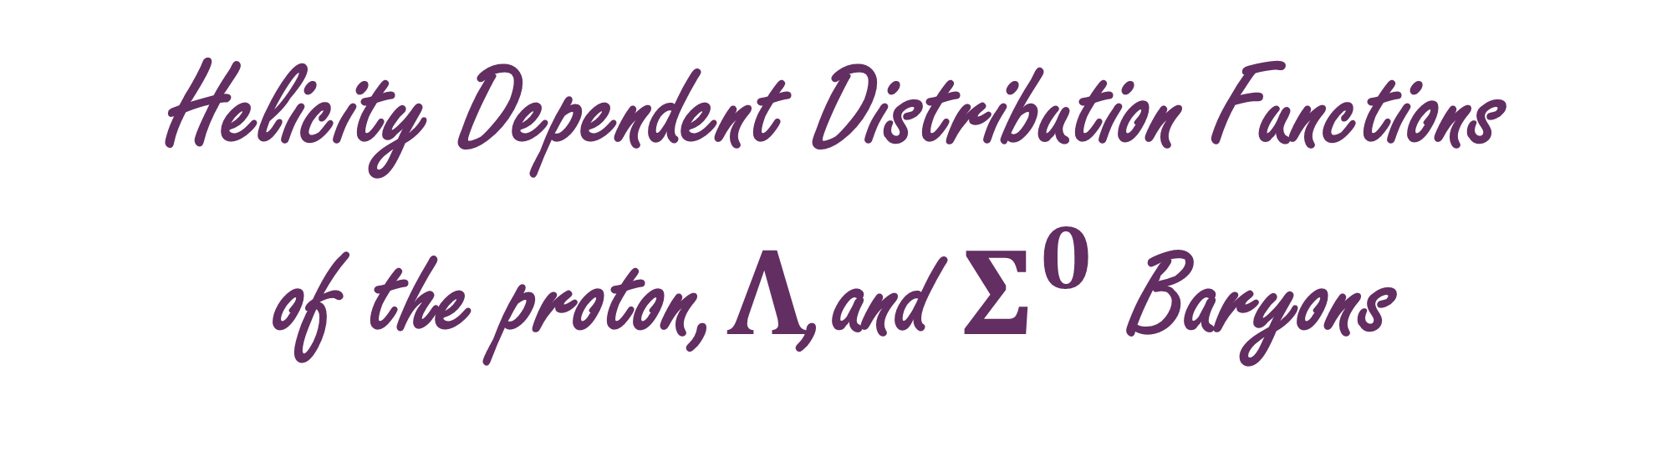
Grant no. 12135007
Craig Roberts … http://inp.nju.edu.cn/
Helicity Dependent Distribution Functions
of the proton,$Λ$,and $Σ^{0}$ Baryons
Notes:
25+5

Slide 2




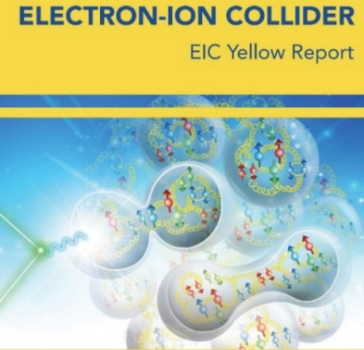



Basic Questions for 21st Century Science
How Does the Mass of the Nucleon Arise?
How Does the Spin of the Nucleon Arise?
What Are the Emergent Properties of Dense Systems of Gluons?
Response … International community is operating, building, and planning facilities with the potential for delivering answers
Notes:
20+5

Slide 3
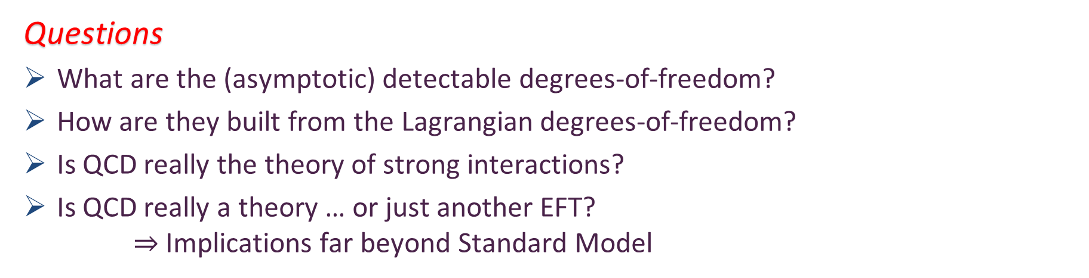
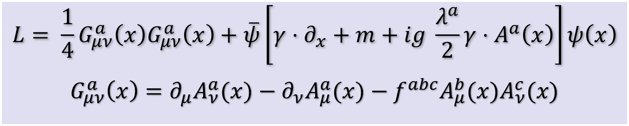
Quantum Chromodynamics
$$L= \frac{1}{4}G_{μν}^{a}\left(x\right)G_{μν}^{a}\left(x\right)+\overline{ψ}\left[γ⋅∂_{x}+m+ig \frac{λ^{a}}{2}γ⋅A^{a}\left(x\right)\right]ψ\left(x\right)$$
$$G_{μν}^{a}\left(x\right)=∂_{μ}A_{ν}^{a}(x)−∂_{ν}A_{μ}^{a}(x)−f^{abc}A_{μ}^{b}{(x)A}_{ν}^{c}(x)$$
Gluon and Quark Confinement
One-line Lagrangian – expressed in terms of gluon and quark partons
Which are NOT the degrees-of-freedom measured in detectors
Questions
What are the (asymptotic) detectable degrees-of-freedom?
How are they built from the Lagrangian degrees-of-freedom?
Is QCD really the theory of strong interactions?
Is QCD really a theory … or just another EFT?
$⇒$ Implications far beyond Standard Model

Slide 4
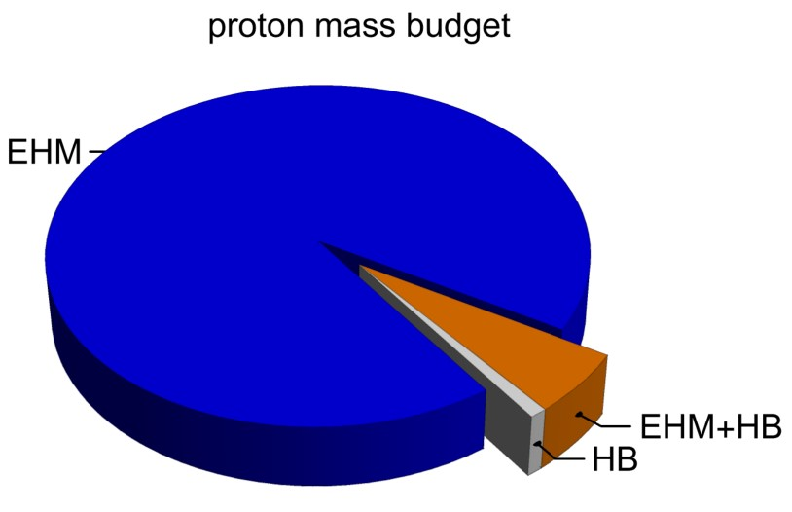
Emergence of Hadron Mass
Standard Model of Particle Physics has one obvious mass-generating mechanism
= Higgs Boson … impacts are critical to evolution of Universe as we know it
However, Higgs boson alone is responsible for just ∼ 1% of the visible mass in the Universe
Proton mass budget … only 9 MeV/939 MeV is directly from Higgs
Decomposition is
gauge invariant
Poincaré invariant
scale invariant
Evidently, Nature has another very effective mechanism for producing mass:
Emergent Hadron Mass (EHM)
Alone, it produces 94% of the proton’s mass
Remaining 5% is generated by constructive interference between EHM and Higgs-boson
What is the origin of EHM?

Slide 5
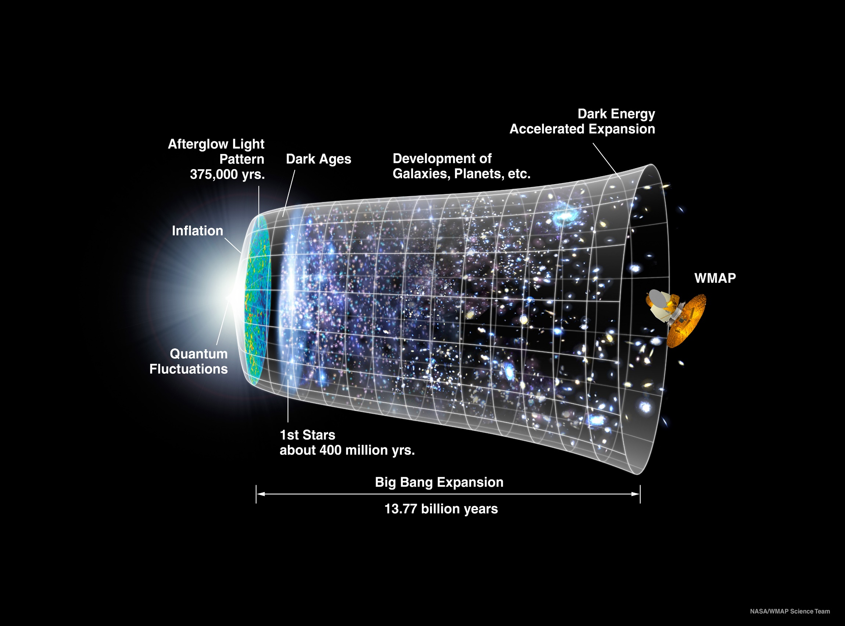
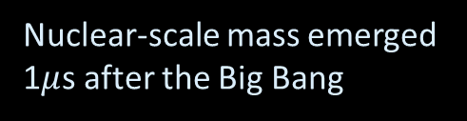
Our Universe
Nuclear-scale mass emerged 1$μ$s after the Big Bang
Its appearance was crucial to the formation of the Universe as we know it

Slide 6


In the Beginning…

Slide 7
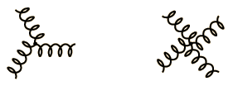
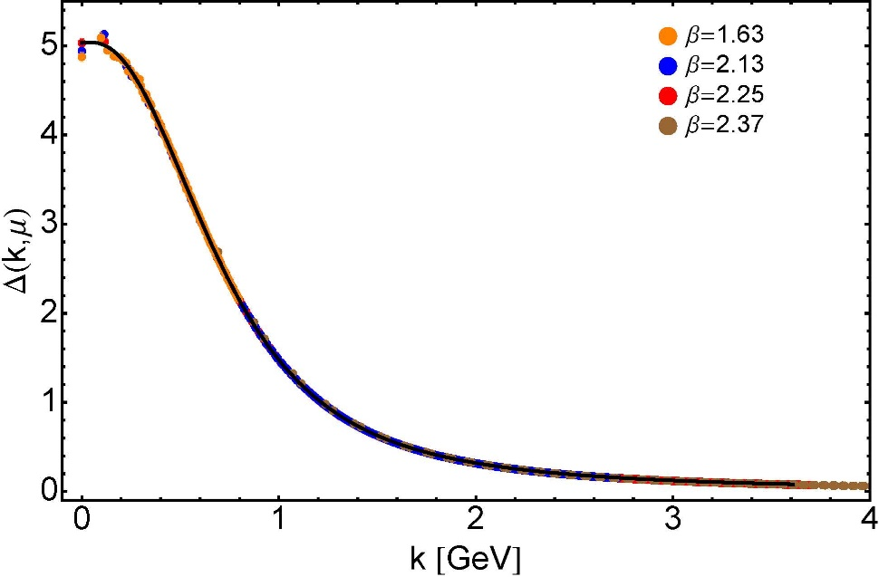

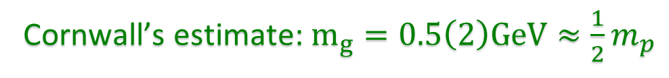

Ancient History
Cornwall’s estimate: $m_{g}=0.5\left(2\right)GeV≈\frac{1}{2}m_{p}$
$≈$ 45 years ago
Dynamical mass generation in continuum quantum chromodynamics,
J.M. Cornwall, Phys. Rev. D 26 (1981) 1453 … $>1100$ citations
Owing to strong self-interactions, gluon partons $⇒$ gluon quasiparticles,
described by a mass function that is large at infrared momenta
3-gluon vertex
4-gluon vertex
$$\frac{1}{m_{g}^{2}}$$
Truly mass from nothing
An interacting theory, written in terms of massless gluon fields, produces dressed gluon fields that are characterised by a mass function that is large at infrared momenta
Gluon propagator … continuum and lattice QCD agree
QCD fact
Continuum theory and lattice simulations agree
Empirical verification?

Slide 8

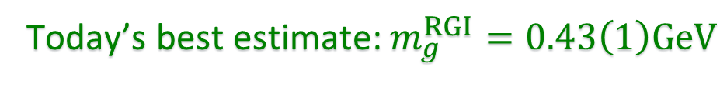

Ancient History
D. Binosi, Emergent Hadron Mass in Strong Dynamics, Few Body Syst. 63 (2022) 42.
M. N. Ferreira, J. Papavassiliou, Gauge Sector Dynamics in QCD, Particles 6 (1) (2023) 312–363.
Today’s best estimate: $m_{g}^{RGI}=0.43\left(1\right)GeV$
Gauge Invariance and Mass,
J. S. Schwinger
Phys. Rev. 125 (1962) 397-398
It is argued that the gauge invariance of a vector field does not necessarily imply zero mass for an associated particle if the current vector coupling is sufficiently strong.
EHM means
Gluons are massive via Schwinger Mechanism
More than 40 years ago
Dynamical mass generation in continuum quantum chromodynamics,
J.M. Cornwall, Phys. Rev. D 26 (1981) 1453 … $∼1050$ citations
Owing to strong self-interactions, gluon partons $⇒$ gluon quasiparticles,
described by a mass function that is large at infrared momenta
3-gluon vertex
4-gluon vertex
$$\frac{1}{m_{g}^{2}}$$
Truly mass from nothing
An interacting theory, written in terms of massless gluon fields, produces dressed gluon fields that are characterised by a mass function that is large at infrared momenta
Gluon propagator … continuum and lattice QCD agree
QCD fact
Continuum theory and lattice simulations agree
Empirical verification?

Slide 9
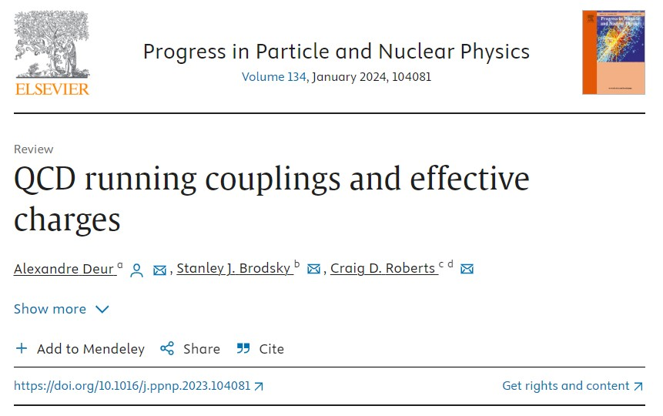
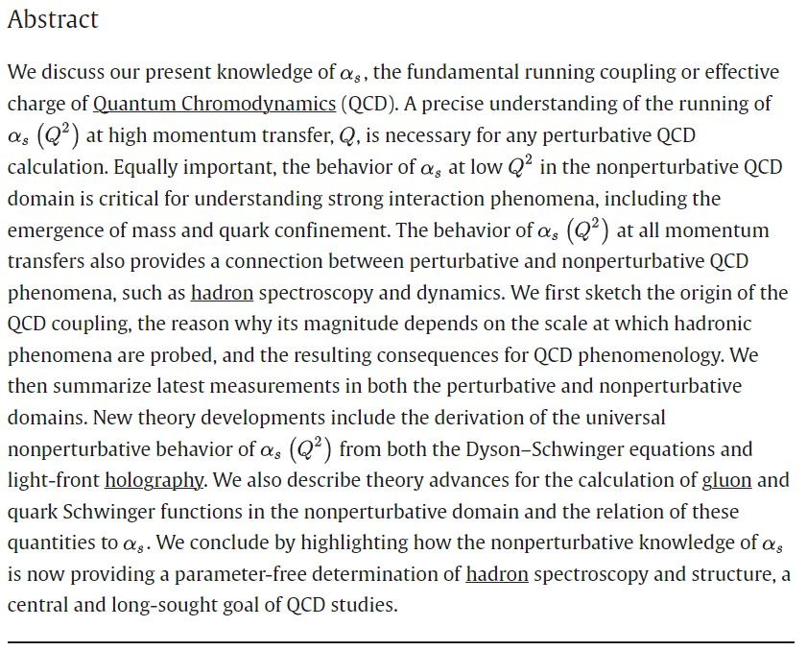

Slide 10

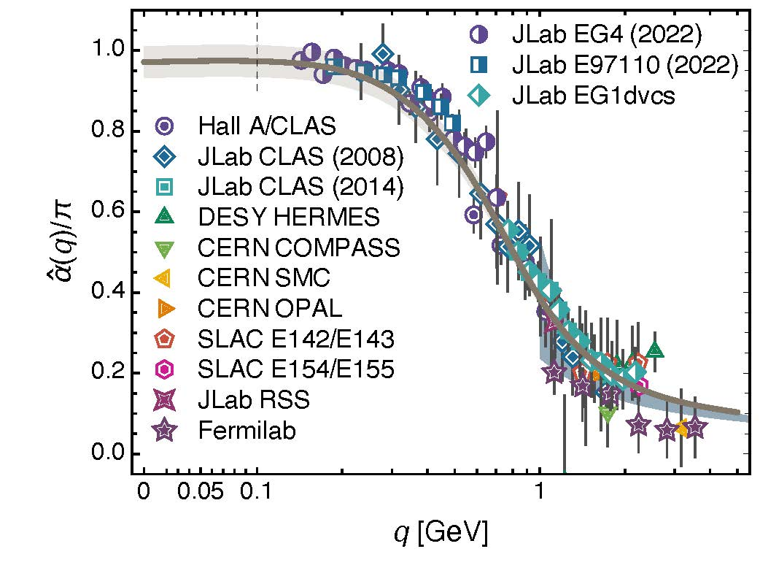
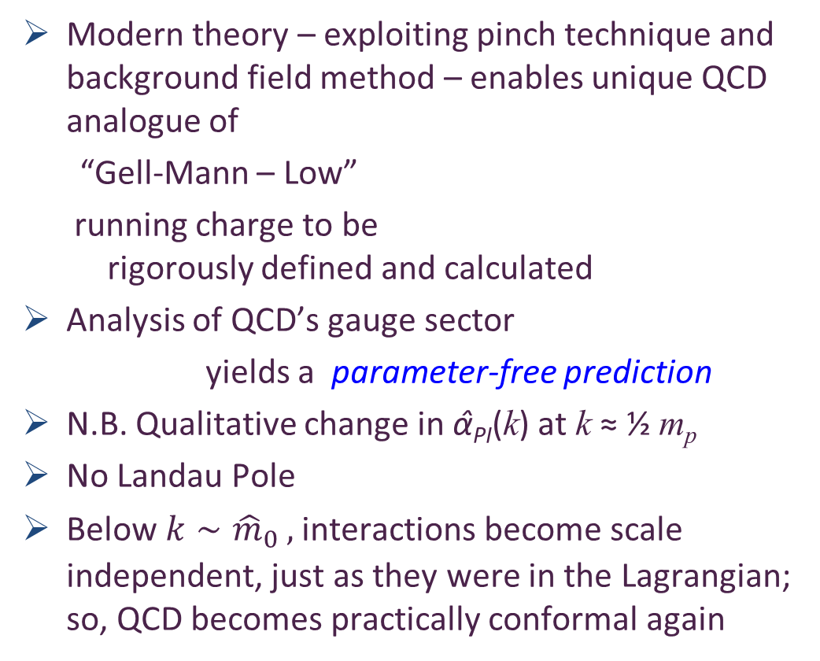

Process independent effective charge = running coupling
W orkshop on Dyson-Schwinger Equations in Modern Mathematics
and Physics (DSEMP2014) Trento, Italy, September 22-26, 2014
Effective charge from lattice QCD, Zhu-Fang Cui, Jin-Li Zhang et al.,
NJU-INP 014/19, arXiv:1912.08232 [hep-ph], Chin. Phys. C 44 (2020) 083102/1-10
$3289$ total downloads
Modern theory – exploiting pinch technique and background field method – enables unique QCD analogue of
“Gell-Mann – Low”
running charge to be
rigorously defined and calculated
Analysis of QCD’s gauge sector
yields a parameter-free prediction
N.B. Qualitative change in α̂_{PI}(k) at k ≈ ½ m_{p}
No Landau Pole
Below $k∼{{\hat{m}}_{0}}_{ },$interactions become scale independent, just as they were in the Lagrangian; so, QCD becomes practically conformal again
Process independent strong running coupling
Daniele Binosi et al., arXiv:1612.04835 [nucl-th], Phys. Rev. D 96 (2017) 054026/1-7
Experimental determination of the QCD effective charge α_{g1}(Q).
A. Deur; V. Burkert; J.-P. Chen; W. Korsch, Particles 5 (2022) 171
QCD Running Couplings and Effective Charges, Alexandre Deur, Stanley J. Brodsky and Craig Roberts, e-Print: 2303.00723 [hep-ph], Prog. Part. Nucl. Phys. 134 (2024) 104081

Slide 11
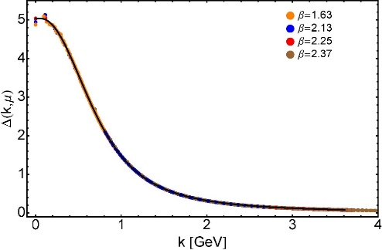
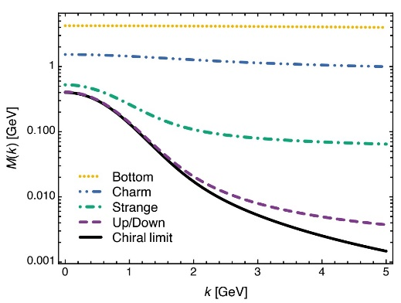

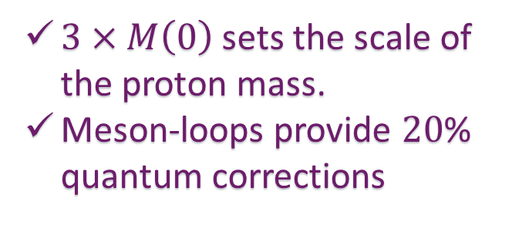
EHM Basics
Absent Higgs boson couplings,
QCD Lagrangian is scale invariant … yet …
Massless gluons become massive
A momentum-dependent, IR saturating charge is produced
Massless quarks become massive
Three pillars of EHM
$3×M\left(0\right)$ sets the scale of the proton mass.
Meson-loops provide $20$% quantum corrections

Slide 12
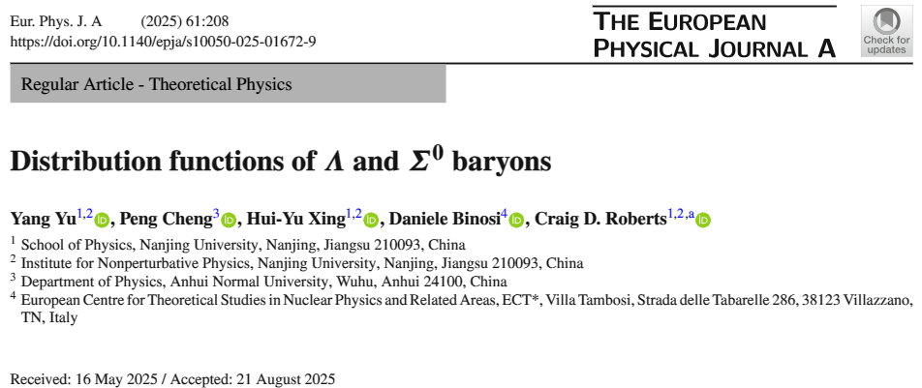
Also
Polarised parton distribution functions and proton spin, Peng Cheng et al. e-print: 2304.12469 [hep-ph], Phys. Lett. B 844 (2023) 138074/1-7
Contact interaction study of proton parton distributions, Yang Yu et al., e-Print: 2402.06095 [hep-ph], Eur. Phys. J. C 84 (2024) 7, 739/1-23

Slide 13

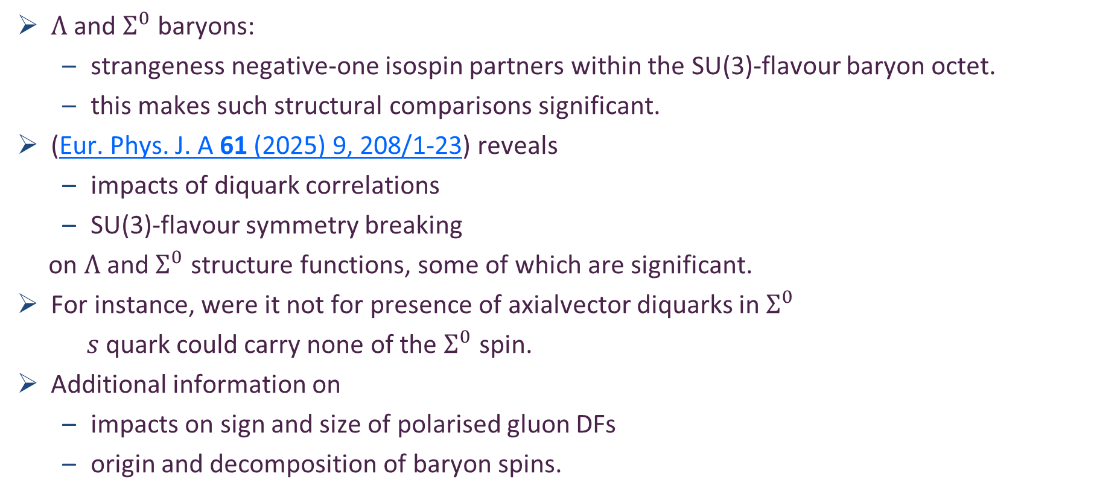
Why $Λ$ and $Σ^{0}$?
$Λ$ and $Σ^{0}$ baryons:
strangeness negative-one isospin partners within the SU(3)-flavour baryon octet.
this makes such structural comparisons significant.
(Eur. Phys. J. A 61 (2025) 9, 208/1-23) reveals
impacts of diquark correlations
SU(3)-flavour symmetry breaking
on $Λ$ and $Σ^{0}$ structure functions, some of which are significant.
For instance, were it not for presence of axialvector diquarks in $Σ^{0}$
$s$ quark could carry none of the $Σ^{0}$ spin.
Additional information on
impacts on sign and size of polarised gluon DFs
origin and decomposition of baryon spins.

Slide 14
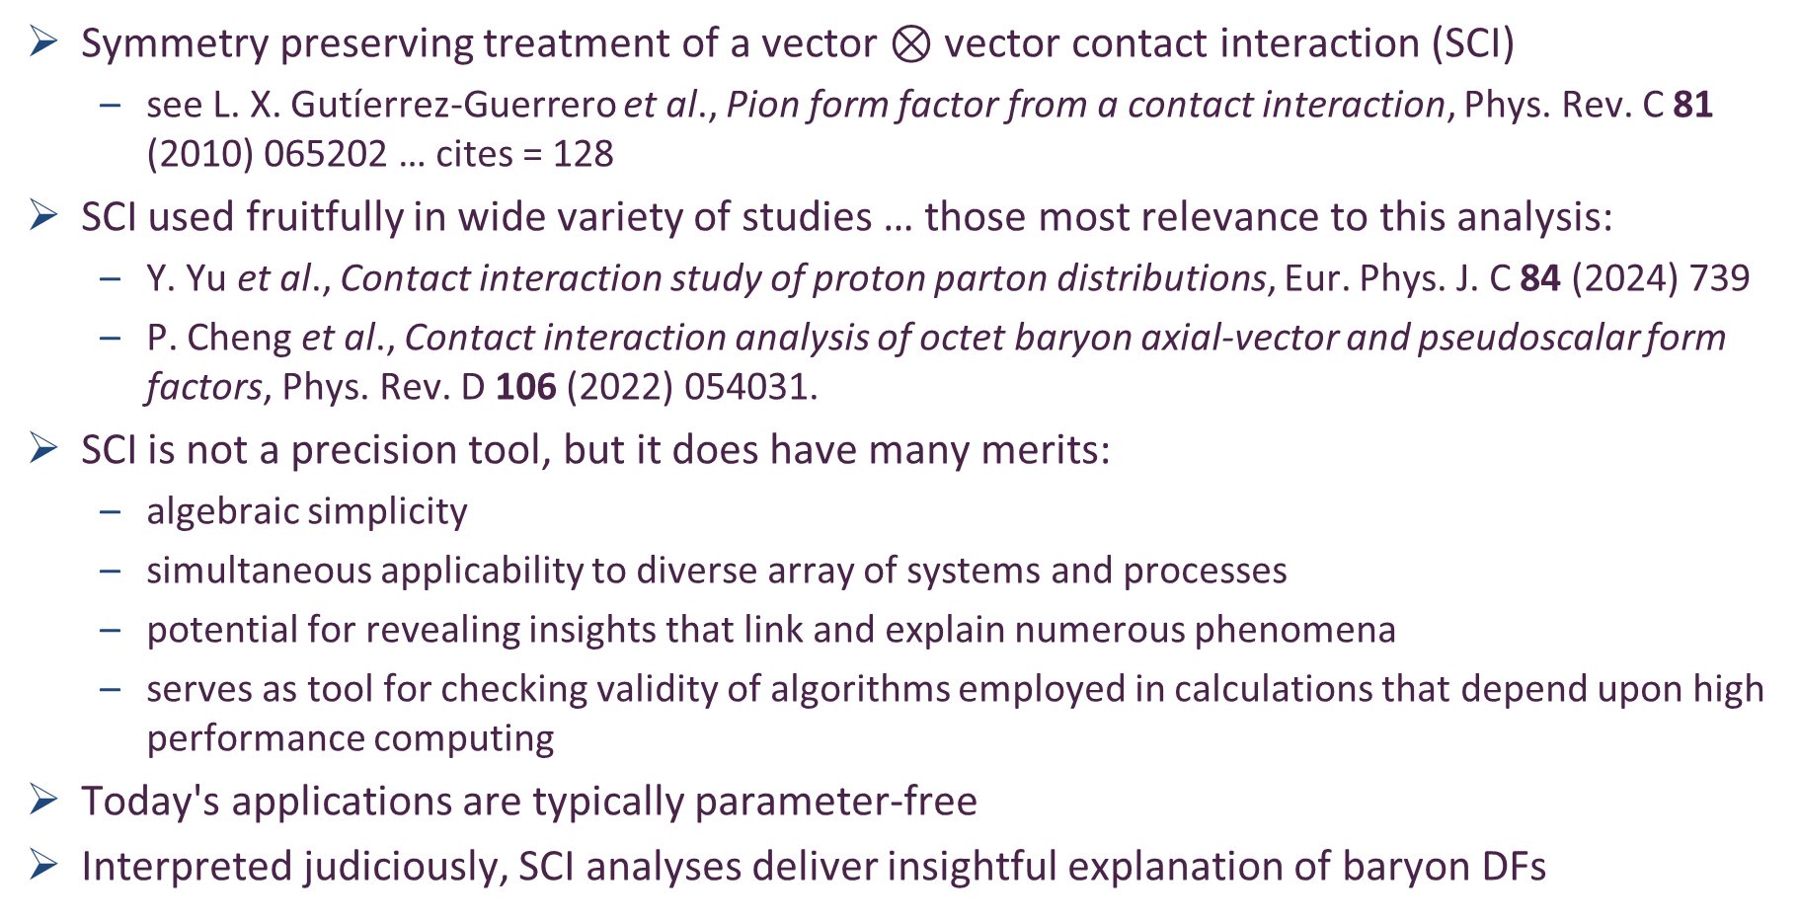
Analysis Tool - SCI
Symmetry preserving treatment of a vector $⊗$ vector contact interaction (SCI)
see L. X. Gutíerrez-Guerrero et al., Pion form factor from a contact interaction, Phys. Rev. C 81 (2010) 065202 … cites = 128
SCI used fruitfully in wide variety of studies … those most relevance to this analysis:
Y. Yu et al., Contact interaction study of proton parton distributions, Eur. Phys. J. C 84 (2024) 739
P. Cheng et al., Contact interaction analysis of octet baryon axial-vector and pseudoscalar form factors, Phys. Rev. D 106 (2022) 054031.
SCI is not a precision tool, but it does have many merits:
algebraic simplicity
simultaneous applicability to diverse array of systems and processes
potential for revealing insights that link and explain numerous phenomena
serves as tool for checking validity of algorithms employed in calculations that depend upon high performance computing
Today's applications are typically parameter-free
Interpreted judiciously, SCI analyses deliver insightful explanation of baryon DFs

Slide 15
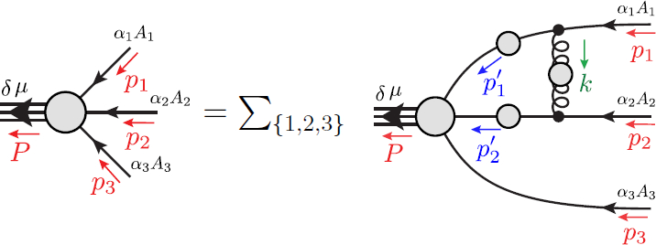
Faddeev Equation for Baryons
Nucleon mass from a covariant three-quark Faddeev equation, G. Eichmann et al., Phys. Rev. Lett. 104 (2010) 201601
Nucleon charge and magnetisation distributions […], Z-Q. Yao, et al. e-Print: 2403.08088 [hep-ph], Fund. Res. (2025) in press
Nucleon Gravitational Form Factors, Z.-Q. Yao et al., e-Print: 2409.15547 [hep-ph], Eur. Phys. J. A 61 (2025) 92/1-13

Slide 16
Structure of Baryons
Poincaré covariant Faddeev equation sums all possible exchanges and interactions that can take place between three dressed-quarks
Evidently, direct solution of Faddeev equation using rainbow-ladder truncation is now possible … remains a challenging numerical problem

Slide 17
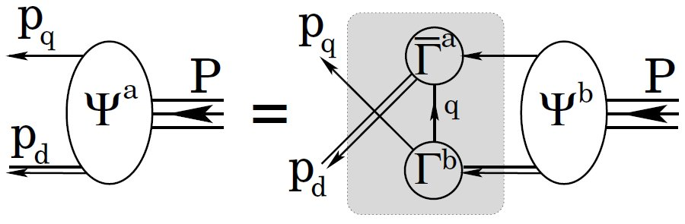
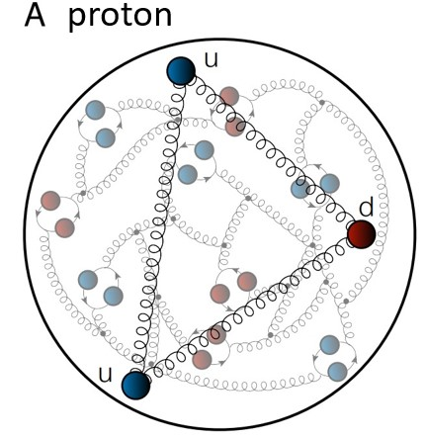
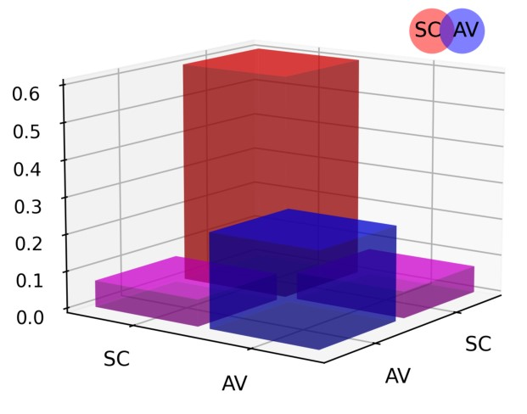
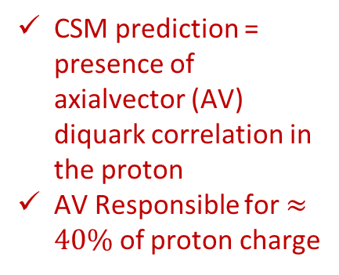
Structure of Baryons
Solution delivers
Poincaré-covariant
proton wave function
Poincaré covariant Faddeev equation sums all possible exchanges and interactions that can take place between three dressed-quarks
Evidently, direct solution of Faddeev equation using rainbow-ladder truncation is now possible … remains a challenging numerical problem
For many applications, diquark approximation to quark + quark scattering kernel is used
Prediction: owing to EHM phenomena, strong diquark correlations exist within baryons
proton and neutron … both scalar and axial-vector diquarks are present
CSM prediction = presence of axialvector (AV) diquark correlation in the proton
AV Responsible for $≈40\%$ of proton charge

Slide 18
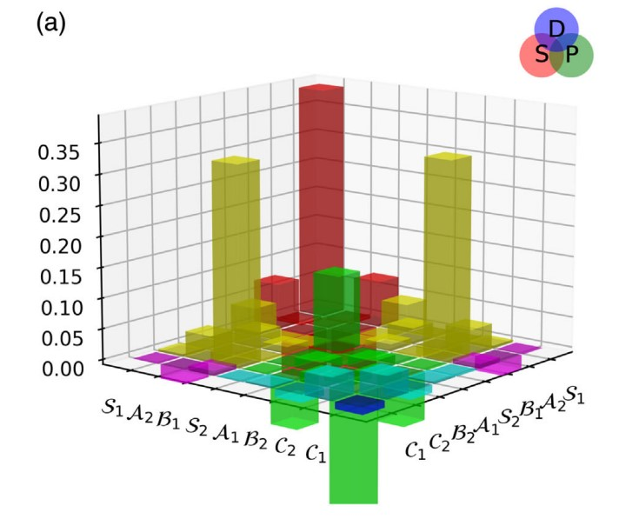

Structure of Baryons
Solution delivers
Poincaré-covariant
proton wave function
Poincaré covariant Faddeev equation sums all possible exchanges and interactions that can take place between three dressed-quarks
Direct solution of Faddeev equation using rainbow-ladder truncation is now possible, but numerical challenges remain
For many applications, diquark approximation to quark+quark scattering kernel is used
Prediction: owing to EHM:
octet baryon wave functions not just S-wave, but contain strong P-wave contributions
baryon wave functions
necessarily contain
orbital angular momentum
CSM prediction = canonical normalization dominated by $S⊗S$, but receives large $S⊗P$ and $P⊗P$
contributions
Non-$S⊗S$make-up 6$0\%$ of proton charge

Slide 19
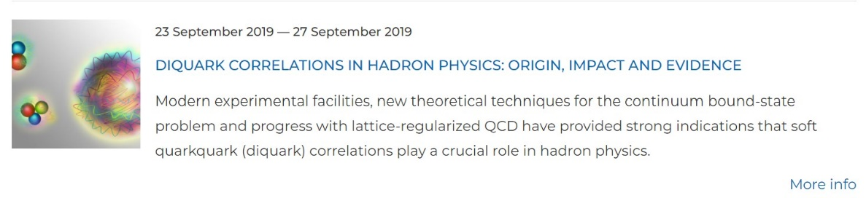
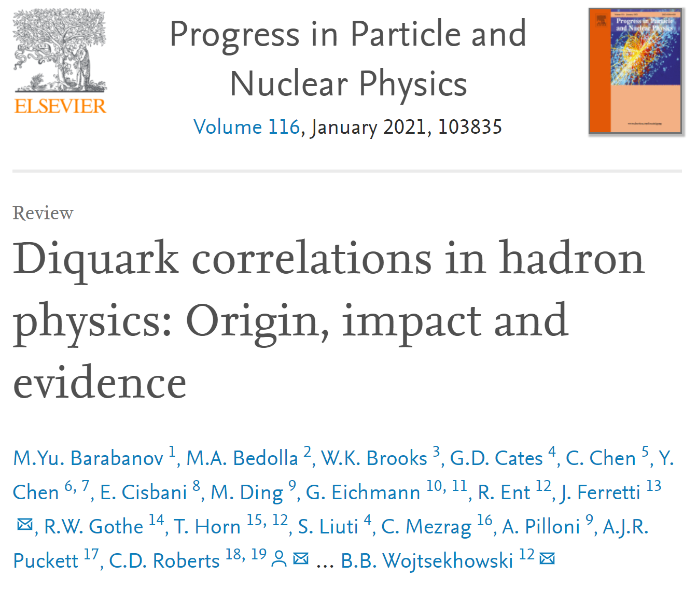
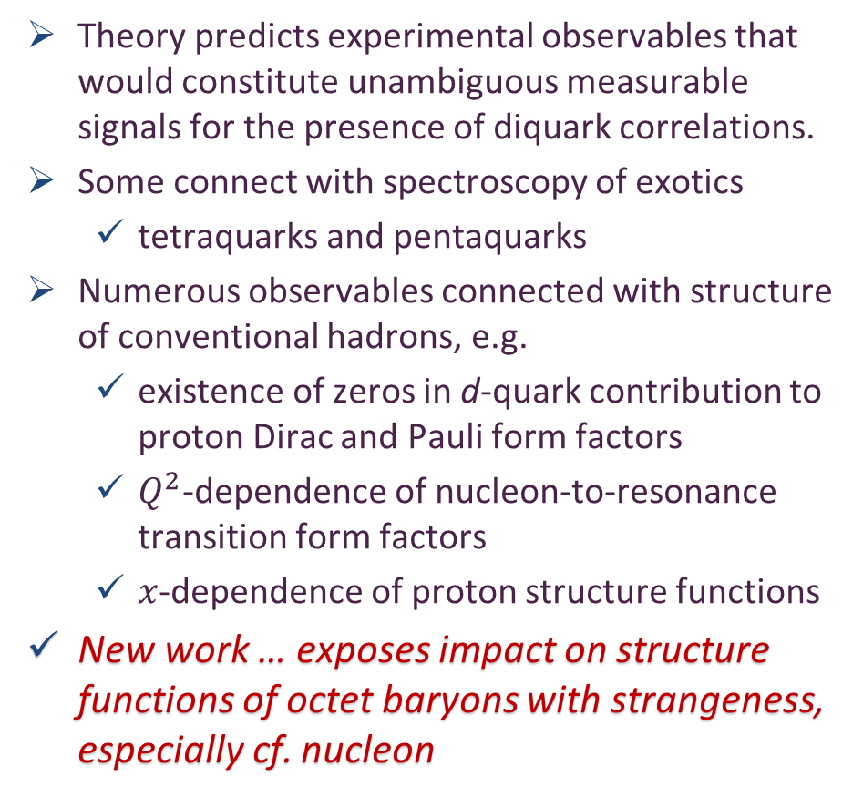
Diquarks - Facts
Theory predicts experimental observables that would constitute unambiguous measurable signals for the presence of diquark correlations.
Some connect with spectroscopy of exotics
tetraquarks and pentaquarks
Numerous observables connected with structure of conventional hadrons, e.g.
existence of zeros in d-quark contribution to proton Dirac and Pauli form factors
$Q^{2}$-dependence of nucleon-to-resonance transition form factors
$x$-dependence of proton structure functions
New work … exposes impact on structure functions of octet baryons with strangeness, especially cf. nucleon

Slide 20
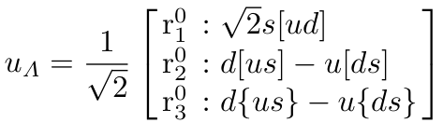
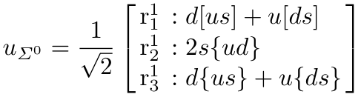
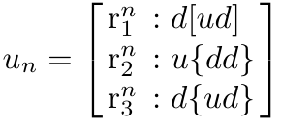
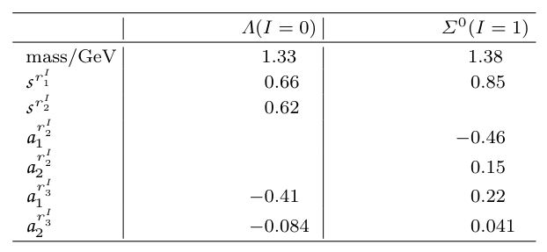

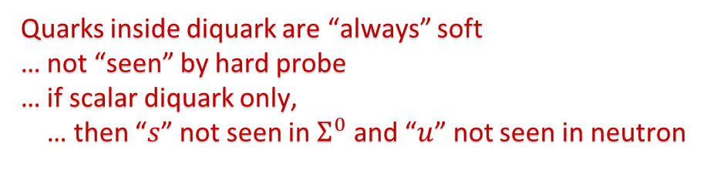

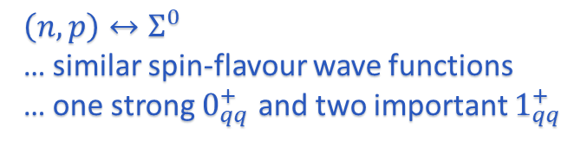
Spin-Flavour Wave Functions (same for any interacting diquark approach)
Quarks inside diquark are “always” soft
… not “seen” by hard probe
… if scalar diquark only,
… then “$s$” not seen in $Σ^{0}$ and “$u$” not seen in neutron
Scalar diquark correlations (2)
… almost equally important
$Λ$ …
$Σ^{0}$ …
$n$ …
Axialvector diquarks (1)
Scalar diquark correlations (1)
… dominant
Axialvector diquarks (2)
Scalar diquark correlations (1)
Axialvector diquarks (2)
$\left(n,p\right)↔Σ^{0}$
… similar spin-flavour wave functions
… one strong $0_{qq}^{+}$ and two important $1_{qq}^{+}$

Slide 21
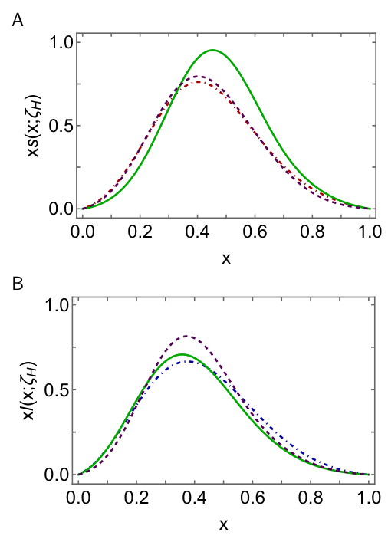
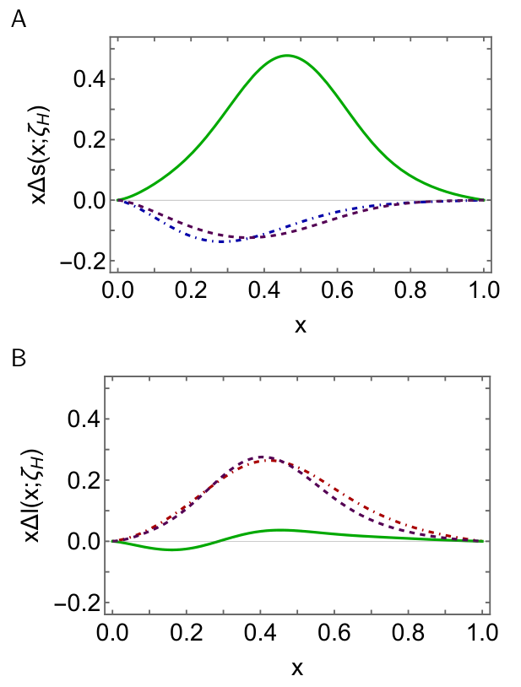
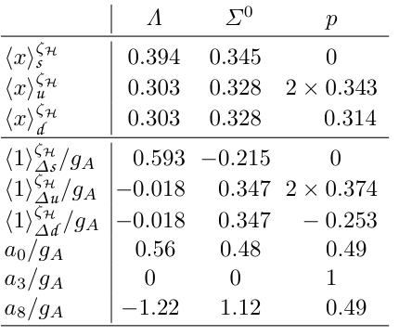













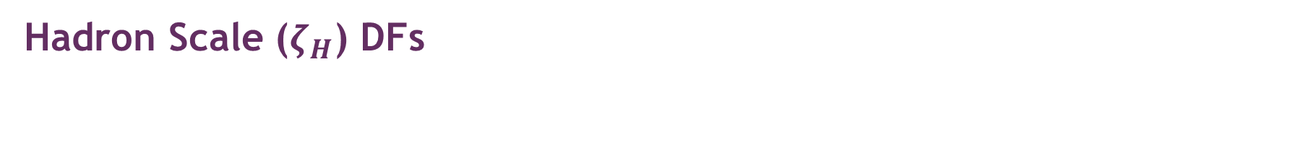

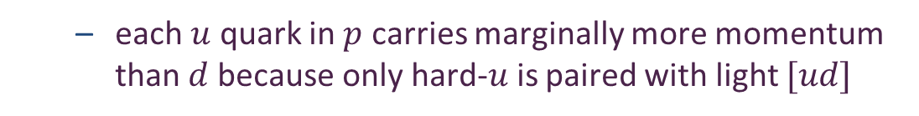
Hadron Scale ($ζ_{H}$) DFs
Unpolarised
Polarised
$$s_{Λ}$$
$${Δs}_{Λ}$$
General Remarks
$s$ quark carries largest part of $Λ$momentum because it has pairing with lightest diquark $[ud]$
$s↔l$ disparity much smaller in $Σ^{0}$ because $s$ paired with $\{ud\}$ and $m_{\{ud\}}>m_{[ud]}$
$$s_{Σ^{0}}$$
$${0.5 d}_{n}$$
$${Δu}_{n}$$
$${Δs}_{Σ^{0}}$$
$$l_{Σ^{0}}$$
$${Δl}_{Σ^{0}}$$
$${0.5 Δd}_{n}$$
$$l_{Λ}$$
$$u_{n}$$
$${Δl}_{Λ}$$
$$u_{n}$$
each $u$ quark in $p$ carries marginally more momentum than $d$because only hard-$u$is paired with light $[ud]$

Slide 22
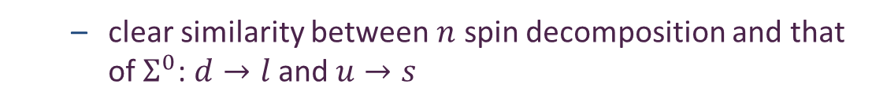
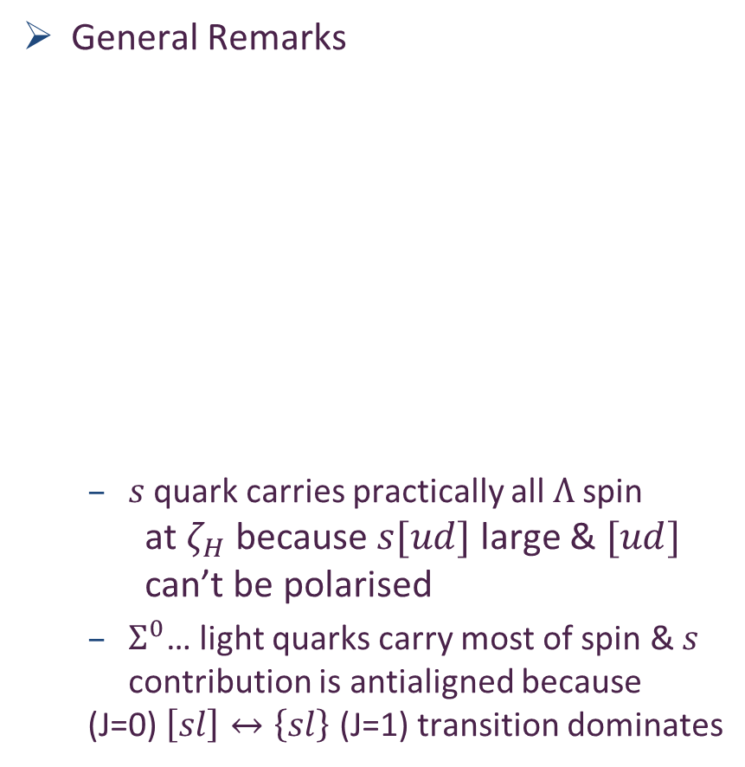
Hadron Scale ($ζ_{H}$) DFs
Unpolarised
Polarised
$$s_{Λ}$$
$${Δs}_{Λ}$$
General Remarks
$s$ quark carries practically all $Λ$spin
at $ζ_{H}$ because $s[ud]$ large & $[ud]$ can’t be polarised
$Σ^{0}$… light quarks carry most of spin & $s$ contribution is antialigned because
(J=0) $\left[sl\right]↔\left\{sl\right\}$ (J=1) transition dominates
$$s_{Σ^{0}}$$
$${0.5 d}_{n}$$
$${Δu}_{n}$$
$${Δs}_{Σ^{0}}$$
$$l_{Σ^{0}}$$
$${Δl}_{Σ^{0}}$$
$${0.5 Δd}_{n}$$
$$l_{Λ}$$
$$u_{n}$$
$${Δl}_{Λ}$$
$$u_{n}$$
Subtle cancellations between diquark components
clear similarity between $n$ spin decomposition and that of $Σ^{0}$: $d→l$ and $u→s$

Slide 23

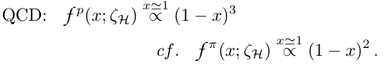




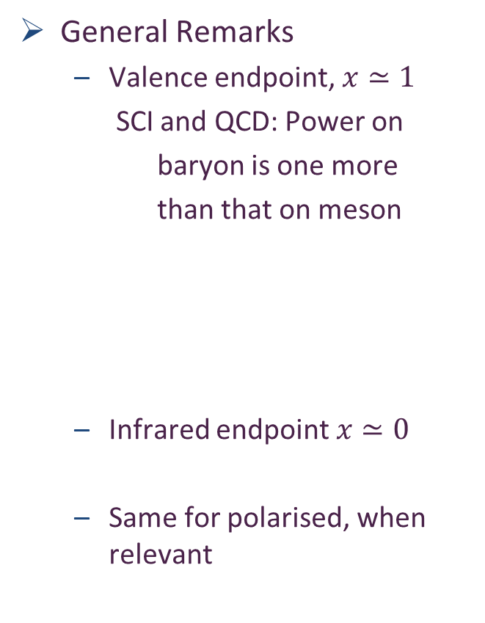


Hadron Scale ($ζ_{H}$) DFs
Unpolarised
Polarised
$$s_{Λ}$$
$${Δs}_{Λ}$$
General Remarks
Valence endpoint, $x≃1$
SCI and QCD: Power on
baryon is one more
than that on meson
Infrared endpoint $x≃0$
Same for polarised, when relevant
$$s_{Σ^{0}}$$
$${0.5 d}_{n}$$
$${Δu}_{n}$$
$${Δs}_{Σ^{0}}$$
$$l_{Σ^{0}}$$
$${Δl}_{Σ^{0}}$$
$${0.5 Δd}_{n}$$
$$l_{Λ}$$
$$u_{n}$$
$${Δl}_{Λ}$$
$$u_{n}$$
Follows that, contrary to phenomenology-based prejudice,
$Δq(x)/q\left(x\right){\left.​\right|}_{x≃0}$ $≠0$
Important result … must be checked with QCD interaction

Slide 24









Hadron Scale ($ζ_{H}$) DFs
Unpolarised
Polarised
$$s_{Λ}$$
$${Δs}_{Λ}$$
General Remarks
These ratios are independent of resolving scale, $ζ$
True pointwise
namely, under evolution
$$s_{Σ^{0}}$$
$${0.5 d}_{n}$$
$${Δu}_{n}$$
$${Δs}_{Σ^{0}}$$
$$l_{Σ^{0}}$$
$${Δl}_{Σ^{0}}$$
$${0.5 Δd}_{n}$$
$$l_{Λ}$$
$$u_{n}$$
$${Δl}_{Λ}$$
$$u_{n}$$

Slide 25




Hadron Scale ($ζ_{H}$) DFs
Unpolarised
Polarised
$$s_{Λ}$$
$${Δs}_{Λ}$$
General Remarks
These ratios are independent of resolving scale, $ζ$
$Σ^{0}$ … $Δs→0$ … in absence of axialvector diquark … so this ratio diverges
$$s_{Σ^{0}}$$
$${0.5 d}_{n}$$
$${Δu}_{n}$$
$${Δs}_{Σ^{0}}$$
$Σ^{0}↔N$ spin-flavour similarity again evident
$$l_{Σ^{0}}$$
$${Δl}_{Σ^{0}}$$
$${0.5 Δd}_{n}$$
$$l_{Λ}$$
$$u_{n}$$
$${Δl}_{Λ}$$
MARATHON $d/u{\left.​\right|}_{x≃1}=0.23±0.10$
Valence quark ratio in the proton, Zhu-Fang Cui et al. e-print: 2108.11493 [hep-ph], Chin. Phys. Lett. Express 39 (04) (2022) 041401/1-5.

Slide 26
















HI Evolved to $ζ=ζ_{2}=2$GeV … Valence
$$s_{Λ}$$
P.-L. Yin et al., All-Orders Evolution of Parton Distributions: Principle, Practice, and Predictions, Chin. Phys. Lett. Express 40 (9) (2023) 091201.
$$s_{Σ^{0}}$$
$$s_{Λ}$$
$$s_{Σ^{0}}$$
Evolution $ζ_{H}→ζ_{2}$relocates support in valence quark DFs to lower $x$;
hence, whilst it preserves patterns of difference and similarity described previously, they steadily become less perceptible with increasing scale.
Large-$x$ power law:
Evolution changes “${1_{ζ}}_{H}$” $→$ “${2_{ζ}}_{2}$”
In QCD, it changes “${3_{ζ}}_{H}$” $→$ “${4_{ζ}}_{2}$”
Regarding figures, very precise data & reliable phenomenology would be necessary before predicted differences between $Λ$, $Σ^{0}$, $p$ DFs could be confirmed empirically
$${0.5 d}_{n}$$
$${0.5 d}_{n}$$
$$l_{Σ^{0}}$$
$$l_{Σ^{0}}$$
$$l_{Λ}$$
$$u_{n}$$
$$l_{Λ}$$
$$u_{n}$$

Slide 27









HI Evolved to $ζ=ζ_{2}=2$GeV … Glue
P.-L. Yin et al., All-Orders Evolution of Parton Distributions: Principle, Practice, and Predictions, Chin. Phys. Lett. Express 40 (9) (2023) 091201.
$$g_{Λ}$$
Evolution from $ζ_{H}→ζ_{2}$ “liberates” glue and sea parton contributions from the dressed quarks that constitute the $ζ_{H}$ baryon.
hence, sea and glue DFs emerge entirely from evolution
Figure B …
proton glue has additional support on valence quark domain $x ≳ 0.2$
Large-$x$ power law:
As in QCD $≈1+β_{Valence}^{SCI}$
$$g_{Σ^{0}}$$
$$g_{n}$$
$$\frac{g_{Λ}}{g_{p}}$$
$$\frac{g_{Σ^{0}}}{g_{p}}$$

Slide 28



HI Evolved to $ζ=ζ_{2}=2$GeV … Momentum Fractions
Glue and sea momentum fractions are same in all octet baryons
$p$ … diquark correlations in Faddeev wave function entail that light-front fraction of proton’s momentum carried by each $u_{V}$ is 9.2% more than that carried by the $d_{V}$
$Σ^{0}$ … diquark structure is similar to that of the nucleon.
$s$ quark carries 5.2% more momentum than each of the light quarks.
$M_{s}≈1.2 M_{l}$ … EHM modulation of Higgs boson contribution ${\hat{m}}_{s}≈25 {\hat{m}}_{l}$
$Λ$ … Higgs boson effects somewhat amplified by the dominance of lighter scalar diquark correlations in the wave function.
$s$ quark carries 30% more momentum than each of the light quarks.

Slide 29










HD Evolved to $ζ=ζ_{2}=2$GeV … Valence
$${Δs}_{Λ}$$
Evolution $ζ_{H}→ζ_{2}$relocates support in valence quark HD DFs to lower $x$;
hence, again, preserves patterns described previously
Large-$x$ power law:
Same as HI:
As in QCD
Regarding figures
$Σ^{0}↔p$ differences impossible to resolve experimentally
$Λ↔p$ differences are very significant
Measurable, e.g., DIS spin transfer to $Λ$
$${Δu}_{n}$$
$${Δs}_{Σ^{0}}$$
$${Δl}_{Σ^{0}}$$
$${0.5 Δd}_{n}$$
$${Δl}_{Λ}$$

Slide 30










HD Evolved to $ζ=ζ_{2}=2$GeV … Glue
$$Δg_{Λ}$$
$${Δg}_{n}$$
Evolution from $ζ_{H}→ζ_{2}$ “liberates” glue and sea parton contributions from dressed quarks that constitute $ζ_{H}$ baryon
All HD glue DFs are nonnegative
Compared with HI glue DFs, peak heights of $x$-weighted $Δ$DFs are roughly order of magnitude smaller
$Λ$ baryon contains more polarised glue than proton
$Σ^{0}$ contains less polarised gluon than proton
$ΔG^{B}\left(ζ\right)=\int_{0}^{1}{dx ΔG^{B}(x;ζ)}$
Large-$x$ power law:
Again, as in QCD $≈1+β_{Valence}^{SCI}$
$${Δg}_{Σ^{0}}$$
$$\frac{{Δg}_{Λ}}{g_{Λ}}$$
$$\frac{{Δg}_{p}}{g_{p}}$$

Slide 31

HD Evolved to $ζ=ζ_{2}=2$GeV … Glue
$$Δg_{Λ}$$
$${Δg}_{n}$$
Figure B
proton data [84, COMPASS] … uncertainty too large for any real empirical distinction to be drawn between different baryons.
highlighted by fact that mean empirical proton value on domain covered by measurements is
0.113 ± 0.038 ± 0.036.
On same domain, SCI predictions for this mean are:
$Λ$ … 0.159;
$Σ^{0}$ … 0.118;
$p$ … 0.131.
$${Δg}_{Σ^{0}}$$
$$\frac{{Δg}_{Λ}}{g_{Λ}}$$
$$\frac{{Δg}_{p}}{g_{p}}$$

Slide 32






Baryon Spin at $ζ_{H}$
Having calculated $Λ$, $Σ^{0}$, $p$ helicity-dependent DFs, can address the issue of baryon spin species decomposition.
$ζ_{H}$ … essentially Poincar$é$ covariant framework $⇒$ unambiguous determination of OAM dressed-quark + diquark system
Contributions from individual flavours can be computed using WW approximation, which is exact at $ζ_{H}$ (no explicit glue)
$Λ$: light-quarks carry bulk of quark + diquark OAM
$Σ^{0}$ & $p:OAM$largely invested in singly-represented valence quark. (This means $s$ in $Σ^{0}$because $l = u = d$.)
Outcomes are consequences of diquark correlations in respective Faddeev wave functions
e.g. in $Λ$, $s$ quark helicity is dominant because leading wave function piece is $s[ud]$ so OAM stored in the parts that have $l$-quarks as bystanders to correlations.

Slide 33






Baryon Spin at $ζ_{2}$ … after evolution
Any measurement of a baryon spin works with a conserved current, viz. a quantity proportional to the zeroth moment of the polarised structure function.
Our notation, the relevant observable is:
SCI predictions (QCD-kindred similar):
Regarding proton, at scale $ζ = 1.73$ GeV, the value 0.32(7) is reported [COMPASS].
Apparently, contemporary CSM analyses deliver a viable explanation baryon spin
Gluon contribution
Flavour singlet axial charge
Invariant under evolution
$$⇒$$

Slide 34





Baryon Spin Decomposition
One common scheme
$\sum_{q∈B}{ℓ_{q}^{B}}$ is exact, but WW approximation
used for flavour separation
… accurate to 10%
Overall decomposition
Net glue contribution to each baryon’s spin is the same because, overall, it is determined by the quark momentum fraction, which is the same in each hadron; see Table p. 31
Remainder lodged with quark helicity and OAM
$ζ_{2}$: quark OAM in $Λ$ is only $≈ 55$% of that in $Σ^{0}, p$
Notably, SCI proton OAM contributions semiquantitatively
aligned with the lQCD values reported in
[C. Alexandrou et al., Complete flavor decomposition of spin & momentum fraction of proton using lQCD simulations at physical pion mass, Phys. Rev. D 101 (9) (2020) 094513].

Slide 35

Baryon DF Summary
Far-valence domain, only presence of axialvector diquarks in $Σ^{0}$ that enables nonzero finite values for $l(x)/s(x)|x≃1$, $∆l(x)/∆s(x)|x≃1$
Even with axialvector diquarks, dominance of scalar diquarks in $Σ^{0}$leads to values of these ratios that are large compared with $Λ, p$
Absent axialvector diquarks, $s$ valence quark would carry NONE of $Σ^{0}$ spin.
Higgs couplings into QCD generate a large disparity between $l$- and $s$-quark current masses. However, in baryons, as in mesons, the Higgs-driven imbalance is largely masked by the size of EHM effects.
Whilst peak locations in $x$-weighted $Λ$, $Σ^{0}$ valence quark DFs are shifted with respect to those in the nucleon, the relocations are modest
Reflect impacts of both diquark structure and dressed-quark mass differences
Notably, CSM analyses predict nonzero $c+\overline{c}$ DF in each hadron
sea quark profiles & fairly commensurate magnitudes
skip

Slide 36

Baryon DF Summary
Helicity-dependent glue DF is nonnegative in each hadron considered
Compared with kindred unpolarised glue DFs, peak magnitudes of $x$-weighted polarised DFs are an order of magnitude smaller.
$Λ$ baryon contains more polarised glue than the proton, whereas there is less in $Σ^{0}$
However, differences are small
$Λ$, $Σ^{0}$, $p$ spin decompositions
Hadron scale (no unsublimated glue or sea )
$Λ$… light-quarks carry most of the quark + diquark OAM
$Σ^{0}$, $p$… OAM is largely invested in singly-represented valence quark.

Slide 37

Baryon DF Summary
Spin and OAM contributions evolve with scale.
Accounting for non-Abelian anomaly contribution to flavour-singlet current:
CSMs delivers a viable explanation of proton spin measurements
predicted values for each hadron lying within contemporary empirical bounds.
In detail, at $ζ_{2}$, compared with proton value:
quarks carry 12% more of $Λ$ spin
3% less of that of the $Σ^{0}$
The net glue contribution to each baryon’s spin is the same, viz. ≈ 40%
Regarding quark OAM, that in $Λ$-baryon is only $≈ 55$% of that in $Σ^{0}, p$

Slide 38
Emergent Hadron Mass
Grant no. 12135007
QCD is unique amongst known fundamental theories of natural phenomena
The degrees-of-freedom used to express the scale-free Lagrangian are not directly observable
Massless gauge bosons become massive, with no “human” interference
Gluon mass ensures a stable, infrared completion of the theory through the appearance of a running coupling that saturates at infrared momenta, being everywhere finite
Massless fermions become massive, producing
Massive baryons and simultaneously Massless mesons
These emergent features of QCD are expressed in every strong interaction observable
They can also be revealed via
EHM interference with Nature’s other known source of mass = Higgs
We are capable of building facilities that can validate these concepts, proving QCD to be
the 1st well-defined four-dimensional quantum field theory ever contemplated
This may open doors that lead far beyond the Standard Model

Slide 39


Can’t build a Theory of Everything
before status of QCD is decided
$${\text{L}}_{Nature}= ?$$
There are theories of many things,
But is there a theory of everything?
Thankyou

Slide 40


Slide 41

Quantum Chromodynamics
$$L= \frac{1}{4}G_{μν}^{a}\left(x\right)G_{μν}^{a}\left(x\right)+\overline{ψ}\left[γ⋅∂_{x}+m+ig \frac{λ^{a}}{2}γ⋅A^{a}\left(x\right)\right]ψ\left(x\right)$$
$$G_{μν}^{a}\left(x\right)=∂_{μ}A_{ν}^{a}(x)−∂_{ν}A_{μ}^{a}(x)−f^{abc}A_{μ}^{b}{(x)A}_{ν}^{c}(x)$$
One-line Lagrangian – expressed in terms of
massless gluon ($A_{μ}^{a}$) and Higgs-mass quark ($ψ$) partons
Which are NOT the degrees-of-freedom measured in detectors
Gluon and Quark Confinement
Advantages of the Color Octet Gluon Picture,
H. Fritzsch, Murray Gell-Mann, H. Leutwyler, Phys. Lett. B 47 (1973) 365-368
“The quarks come in three "colors," but all physical states and interactions are supposed to be singlets with respect to the SU(3) of color. Thus, we do not accept theories in which quarks are real, observable particles; nor do we allow any scheme in which the color non-singlet degrees of freedom can be excited.”

Slide 42

Proton Mass Budget
Decomposition is
gauge invariant
Poincaré invariant
scale invariant
Higgs boson couplings into QCD produce current quark masses. Nothing else.
${\hat{m}}_{u}=3.11$MeV & ${\hat{m}}_{d}=6.78$ MeV
This adds up to just 1.4% of the proton mass
Nucleon $σ$-term is product of these current masses with in-hadron condensates
$$\left\langle N\left|\overline{u}u\right|N\right\rangle ≈\left\langle N\left|\overline{d}d\right|N\right\rangle$$
Such condensates are order parameters for EHM
$σ$-term minus Higgs-only term $≈47$ MeV $≈5$% of the nucleon mass
This leaves 94% of the nucleon mass owing to EHM

Slide 43



Emergence of Hadron Mass - Basic Questions
Decompositions are
gauge invariant
Poincaré invariant
scale invariant
What is the origin of EHM?
Does it lie within QCD?
What are EHM’s connections with …
Gluon and quark confinement?
Dynamical chiral symmetry breaking (DCSB) – quarks massive, yet pion massless?
Nambu-Goldstone modes = π & K?
What is the role of Higgs in modulating EHM expressions in observable properties of hadrons?
Without Higgs mechanism of mass generation, π and K would be indistinguishable
What and wherefrom is mass?
Proton and $ρ$-meson mass budgets are practically identical
$$↑↓ →↑↑$$
$π$- and $K$-meson mass budgets
are completely different from those of proton and $ρ$

Slide 44













HI Evolved to $ζ=ζ_{2}=2$GeV … Sea
P.-L. Yin et al., All-Orders Evolution of Parton Distributions: Principle, Practice, and Predictions, Chin. Phys. Lett. Express 40 (9) (2023) 091201.
$${2\overline{d}}_{p}$$
$${2\overline{l}}_{Λ}$$
$${2\overline{u}}_{p}$$
Evolution from $ζ_{H}→ζ_{2}$ “liberates” glue and sea parton contributions from the dressed quarks that constitute the $ζ_{H}$ baryon.
hence, sea and glue DFs emerge entirely from evolution
Figure B …
proton sea has additional support on valence quark domain $x ≳ 0.2$
$Λ$ sea has more support than $Σ^{0}$ sea
Large-$x$ power law:
As in QCD $≈2+β_{Valence}^{SCI}$
All baryons have measurable $c+\overline{c}$ component
… with sea-like profile, not intrinsic with valence profile
$${s_{p}+\overline{s}}_{p}$$
$${2\overline{s}}_{Λ}$$
$${c_{p}+\overline{c}}_{p}$$
$${c_{Λ}+\overline{c}}_{Λ}$$
$$\frac{S_{Λ}^{s,c}}{S_{p}}$$
$$\frac{S_{Σ^{0}}^{s,c}}{S_{p}}$$

Slide 45
Gauge Invariance
The issue of gauge invariance is sometimes raised in connection with the CSM analyses
Any related concerns are baseless.
Continuum calculations are typically performed in Landau gauge for three practical reasons
Landau gauge is a fixed point of the QCD renormalisation group; so, the gauge parameter does not run and, once fixed, Landau gauge remains Landau gauge
In delivering manifestly Poincaré covariant n-point functions, Landau gauge ensures Poincaré invariant results for all calculated observables
Landau gauge can readily be fixed in studies employing lattice-regularised QCD (lQCD); so, valid comparisons can straightforwardly be made between results obtained using these two complementary nonperturbative approaches. Few other gauges are accessible using lQCD.
Point (iii) is significant because lQCD is a manifestly gauge invariant approach. Thus, agreement between the Landau gauge continuum prediction for a given n-point function and the Landau gauge projection of lQCD simulations that yield the same Schwinger function is practical confirmation of the gauge covariance of the continuum result.

Slide 46
Gauge Invariance
It is worth adding that solutions of QCD's quantum equations of motions, e.g., Dyson-Schwinger equations, are gauge covariant.
Gauge transforms are nugatory, in the sense that they introduce non-dynamical transformations of gauge covariant objects.
Consequently, such quantities, properly combined into a gauge invariant matrix element, will deliver gauge invariant results.
These remarks are confirmed, in practice, by comparisons between continuum predictions and experimental observables because the measured quantities are plainly gauge invariant and an approach that directly connects elementary n-point Schwinger functions with measured quantities must be preserving gauge invariance if it is delivering agreement with the bulk of those observables.
These last remarks entail that all features of the Landau-gauge elementary n-point functions are expressed in calculated observables. Thus, for instance, whilst the nonperturbative running of the dressed quark mass may not itself be directly observable, its impacts on observables are.

Slide 48





Process-independent Effective Charge
https://1drv.ms/b/s%21Apbnb6VLY1RplPRdL0J4Wm-tlzQd-Q?e=hdZxHH
May 2024
Most-read article in the May issue of SciAm
Translated into Chinese, French, German, Italian
Cover story on Chinese and German editions
SciAm is one of the Top-5 popular science magazines in the world.
International circulation that exceeds 10,000,000 readers per month in subscriptions and millions more via social media etc.

Slide 49




All-orders evolution
All-Orders Evolution of Parton Distributions: Principle, Practice, and Predictions
Pei-Lin Yin (尹佩林), NJU-INP 075/23, e-Print: 2306.03274 [hep-ph]
P1 – In the context of Refs. [73, 74], there exists at least one effective charge, $α_{1ℓ}(k^{2})$, which, when used to integrate the leading-order perturbative DGLAP equations, defines an evolution scheme for parton DFs that is all-orders exact.
CSM Process-Independent charge serves this purpose
Hadron scale, $ζ_{H}$
Scale at which all properties of a given hadron are carried by valence degrees-of-freedom

Slide 50

AO Evolution
Principle
Hadron scale, $ζ_{H}$, is rigorously defined in connection with a Grunberg charge, in terms of which leading-order DGLAP evolution is promoted to the status of an all-orders exact procedure.
The AO scheme is not a model, and neither is $ζ_{H}$.
Instead, the AO approach, involving and defining $ζ_{H}$, is complete by definition.
As explained by Grunberg, there is always an effective (process-dependent) effective charge for which the AO propositions are true.
Consequently, there is no room for doubt about the existence of $ζ_{H}$.
Crucially, such a Grunberg effective charge is
consistent with the renormalization group;
renormalization scheme independent;
everywhere analytic and finite;
and supplies an infrared completion of any standard running coupling.

Slide 51

AO Evolution
Crucially, such a Grunberg effective charge is
consistent with the renormalization group;
renormalization scheme independent;
everywhere analytic and finite;
and supplies an infrared completion of any standard running coupling.
These features entail that all calculations of a DF at a scale within a domain of pQCD applicability are compatible with this effective charge.
Moreover, and especially important, is the fact that one does not need to know the pointwise form of the effective charge
Its existence alone is sufficient to deliver
the definition of $ζ_{H}$ and all attendant consequences
N.B. glue and sea DFs are identically zero at $ζ_{H}$

Slide 52
AO Evolution
The potential issue with a Grunberg effective charge is
that reference to a specific process may make it globally useless
We know that is not the case
The class of process-dependent (Grunberg) charges,
defined in connection with the AO scheme,
may be characterized by our unique, predicted process-independent effective charge
Thus far, the AO class of charges – in particular, our PI charge – has served in the same form for all known parton DFs
Namely, for a large array of structure functions and fragmentation processes.
This is a very broad domain of applicability for one single Grunberg charge.

Slide 53




Gravitational Form Factors Mass, Spin, Pressure Distributions
Prediction built from
Zhao-Qian’s results
Lattice results in left panel from [Hackett:2023rif]
Authors acknowledge these are first results.
Statistical errors are very large.
Results on only one lattice spacing & one lattice volume are available.
Only one unphysical pion mass is used.
Renormalisation scheme is not gauge invariant and renormalisataion constants were calculated on a different lattice from the one used to compute the GFFs.
No other computed observable is available on the lattice setup the authors used.
Follows, inter alia, that the systematic errors on [Hackett:2023rif] are completely unknown and therefore uncontrolled.
Hence, no one can know whether it is better to agree or disagree with the lQCD results – Nevertheless, authors claimed “benchmark for future”
CSM prediction (parameter-free) in precise agreement with inference from $ππ, K\overline{K}$ scattering data [Cao:2024zlf]

Slide 54
Gravitational Form Factors Mass, Spin, Pressure Distributions
Prediction built from
Zhao-Qian’s results
CSM prediction (parameter-free) in precise agreement with inference from $ππ, K\overline{K}$ scattering data [Cao:2024zlf]
CSM results
Systematic errors considered and controlled
Statistical errors associated with numerical algorithms small
Parameter-free unification of nucleon gravitational form factors with data-consistent predictions for pion, kaon, and nucleon electromagnetic form factors [Yao:2024drm, Yao:2024uej]
CSM predictions are fully benchmarked

Slide 55
Gravitational Form Factors Mass, Spin, Pressure Distributions
Prediction built from
Zhao-Qian’s results
CSM prediction (parameter-free) in precise agreement with inference from $ππ, K\overline{K}$ scattering data [Cao:2024zlf]
My position
Breadths of application & success of the parameter-free framework employed suggest that predictions delivered should serve as benchmarks for future phenomenology and theory.
No improvement on CSM study can be anticipated before lattice-QCD analyses have simultaneously delivered infinite-volume, continuum-limit, carefully renormalised, physical pion mass studies of all physical properties discussed, viz. pion, kaon, nucleon electromagnetic and gravitational FFs.
CSM predictions are truly setting the standard against which future calculations/inferences should be judged

Slide 56

Photoproduction of heavy vector mesons

Slide 57

EHM Measurements How does the mass of the nucleon arise?
Once considered viable …
Electromagnetic process ($V=J/ψ, Υ$) … $e+p→e^{′}+V+p$
to access purely hadronic process … $V+p→V+p$
But …
Deciphering the mechanism of near-threshold J/ψ photoproduction, M.-L. Du, V. Baru, F.-K. Guo et al., Eur. Phys. J. C 80, 1053 (2020)
Vector-meson production and vector meson dominance, Yin-Zhen Xu, Si-Yang Chen, Zhao-Qian Yao et al., Eur. Phys. J. C 81 (2021) 895/1-11
Near threshold heavy quarkonium photoproduction at large momentum transfer, P. Sun, X.-B. Tong, F. Yuan, Phys. Rev. D 105 (2022) 5, 054032
There is no objective, model-independent means by which to connect $e+p→e^{′}+V+p$ with $V+p→V+p$
Hence, vector meson photoproduction
does not provide a path to the QCD trace anomaly
(or anything else)

Slide 58




$J/ψ$ photoproduction: from threshold to very high energies
J/ψ photoproduction: threshold to very high energy, Lin Tang (唐淋), Yi-Xuan Yang (杨逸轩), Zhu-Fang Cui (崔著钫) and Craig D. Roberts, NJU-INP 089/24, e-Print: 2405.17675 [hep-ph], Phys. Lett. B 856 (2024) 138904/1-7
If GPD scheme valid at all, then only very near threshold.
All $W$ unification impossible
Some modern proposals for reaction model:
GPD treatment – gain access to in-proton gluon gravitational form factors
Coupled channels treatment – $P+ J/ψ p rescattering$
S. Sakinah, T. S. H. Lee, H.-M. Choi, Dynamical Model of J/Ψ photoproduction on the nucleon – arXiv:2403.01958 [nucl-th] Phys. Rev. C 109 (2024) 6, 065204
Suggestion = Final state interactions dominate cross-section near-threshold, so obscuring any connection with in-proton gluon distributions and/or gluon gravitational form factors.
$γ+p→c+\overline{c}+P+p→J/ψ+p$
Lin Tang (唐淋) et al. NJU-INP 089/24
Exposes $c+\overline{c}$ content of the dressed photon
Couples the intermediate $c+\overline{c}$system to
proton’s valence quarks via Pomeron exchange

Slide 59



$J/ψ$ photoproduction: threshold differential cross-section
GPD model (dotted blue)
overfitting issue
concave differential cross-section with max. at low $\left|t\right|$
trying to reconcile GlueX and $J/ψ$-007 data (some tension)
all other reaction models produce convex $\frac{dσ}{dt}$
$P+J/ψp$ rescattering
dashed green – $χ_{dof}^{2}=8$
$P+quark loop$
solid purple – $χ_{dof}^{2}=7$

Slide 60




$J/ψ$ photoproduction: total cross-section, threshold to high-$W$
Reported ZEUS uncertainty in W is large, but uncertainty in $σ$ is small
Distorts $χ^{2}$
GPD model (dotted blue)
Inapplicable on $W>5$ GeV
$χ_{dof}^{2}$ undefined
$P+J/ψp$ rescattering
dashed green
ZEUS+H1 $χ_{dof}^{2}=2.1$
H1 $χ_{dof}^{2}=1.6$
$P+quark loop$
solid purple
ZEUS +H1 $χ_{dof}^{2}=3.5$
H1 $χ_{dof}^{2}=1.0$

Slide 61

$J/ψ$ photoproduction: from threshold to very high energies
Two reaction models provide viable unification
differential and total cross-section data
GPD model does NOT
Premature to connect γ + p → J/ψ + p photoproduction data with anything derived from/connected with GPDs
Theory predicts that proton mass radius < proton charge radius – see Empirical Determination of the Pion Mass Distribution, Y-Z. Xu (徐胤禛) et al., NJU-INP 070/23, e-Print: 2302.07361 [hep-ph], Chin. Phys. Lett. Express 40 (2023) 041201/1-7.
Best description of data is provided by CSM reaction model
$(W,t)$ dependence of quark loop is important to differential cross-section near threshold
Photoproduction probes quark structure of $γ→J/ψ$ not glue in proton

