Slide 1
Perspective on proton polarised parton distribution functions
Peng Cheng
Anhui Normal University
Based on Phys.Lett.B 844 (2023) 138074
SPIN2025
Qingdao，2025.9.22-26

Slide 2
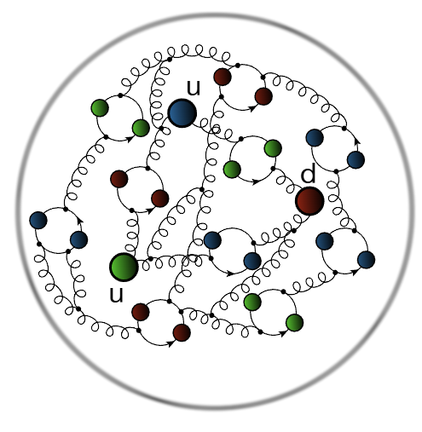
Proton
Nature’s most fundamental bound-state;
Proton(p): u+u+d
Infinitely many gluon and sea-quark:
Continuum Schwinger function methods (CSMs)
provide a widely used approach to nucleon
structure.
How the spin of the proton originates from its quark and gluon constituent?
The polarized parton distribution functions (PDFs).
Z. - Q. Yao, D. Binosi, Z.-F. Cui, C. D. Roberts, 2403.08088
Notes:
However, as highlighted by the Fig, valence quark partons are only part of the explanation for proton structure. ever since the formulation of QCD, physics has sought to measure and understand the distributions of these partons.

Slide 3
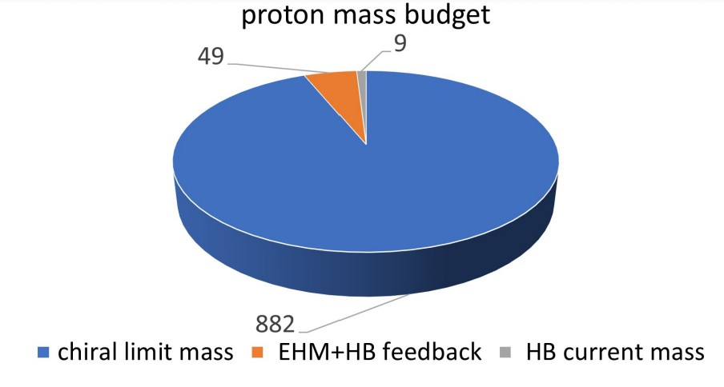
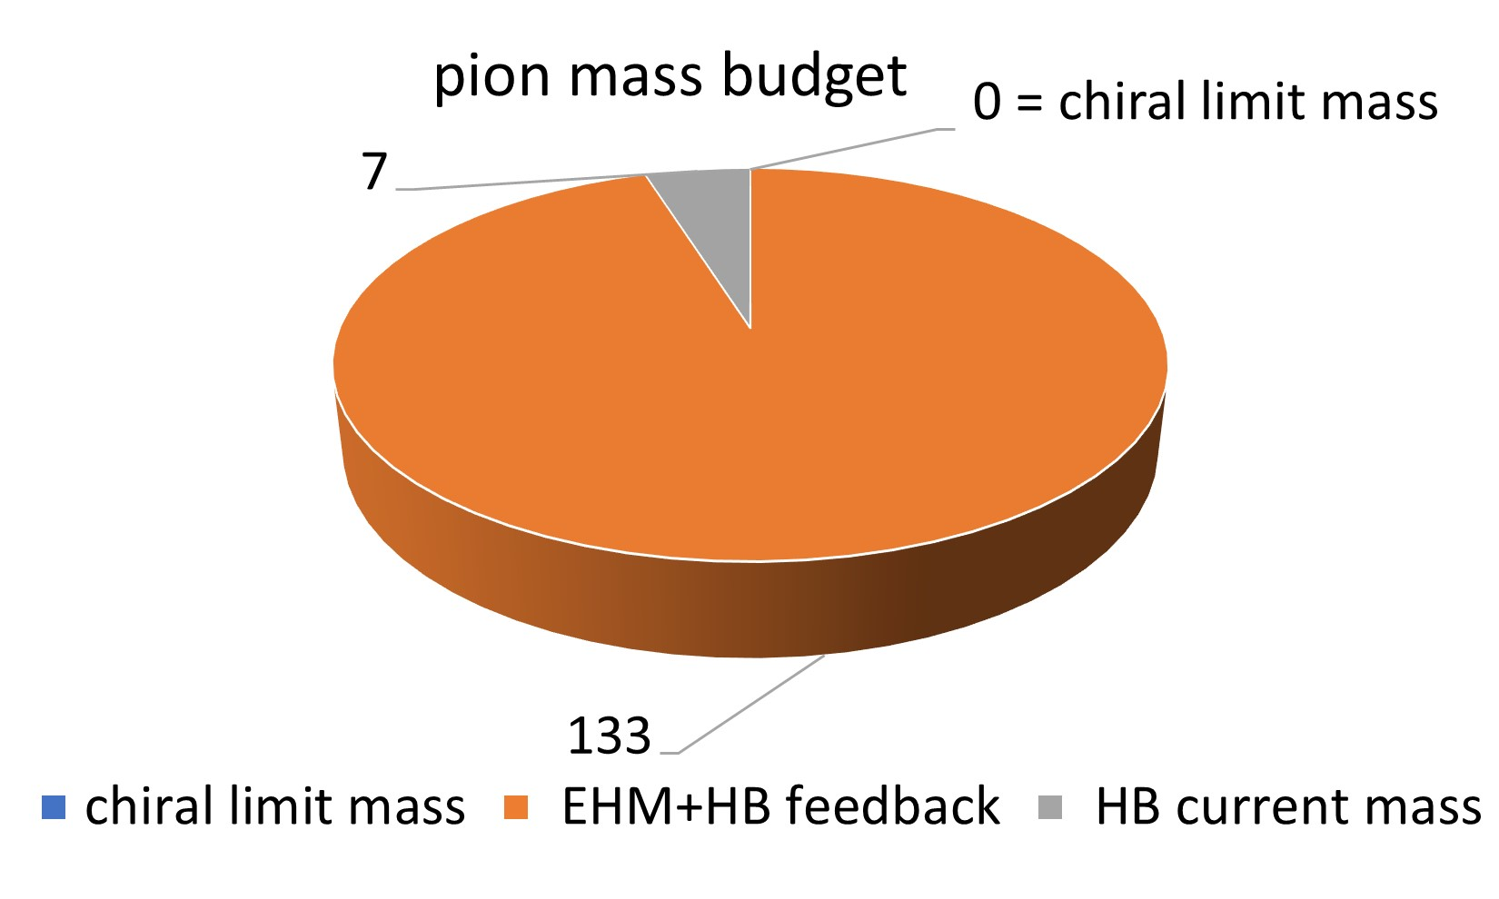
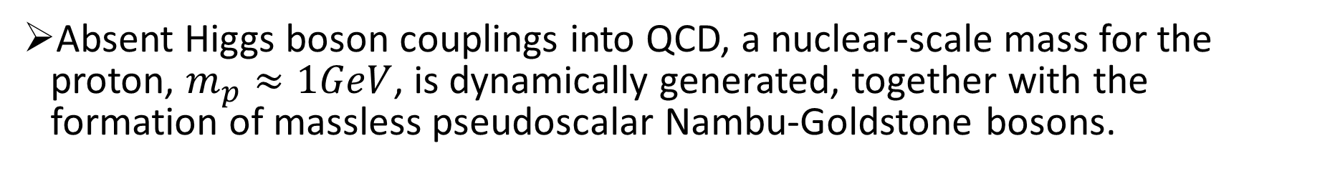
Emergent Hadron Mass
Absent Higgs boson couplings into QCD, a nuclear-scale mass for the proton, $m_{p}≈1GeV$, is dynamically generated, together with the formation of massless pseudoscalar Nambu-Goldstone bosons.
Any quark+antiquark interaction that delivers a good description of meson properties also generates nonpointlike quark+quark (diquark) correlations in multiquark systems.
Diquark correlations in hadron physics: Origin, impact and evidence
M.Yu.Barabanov et al. Prog.Part.Nucl.Phys. 116 (2021) 103835.
Notes:
diquark has a wide range of applications；

Slide 4
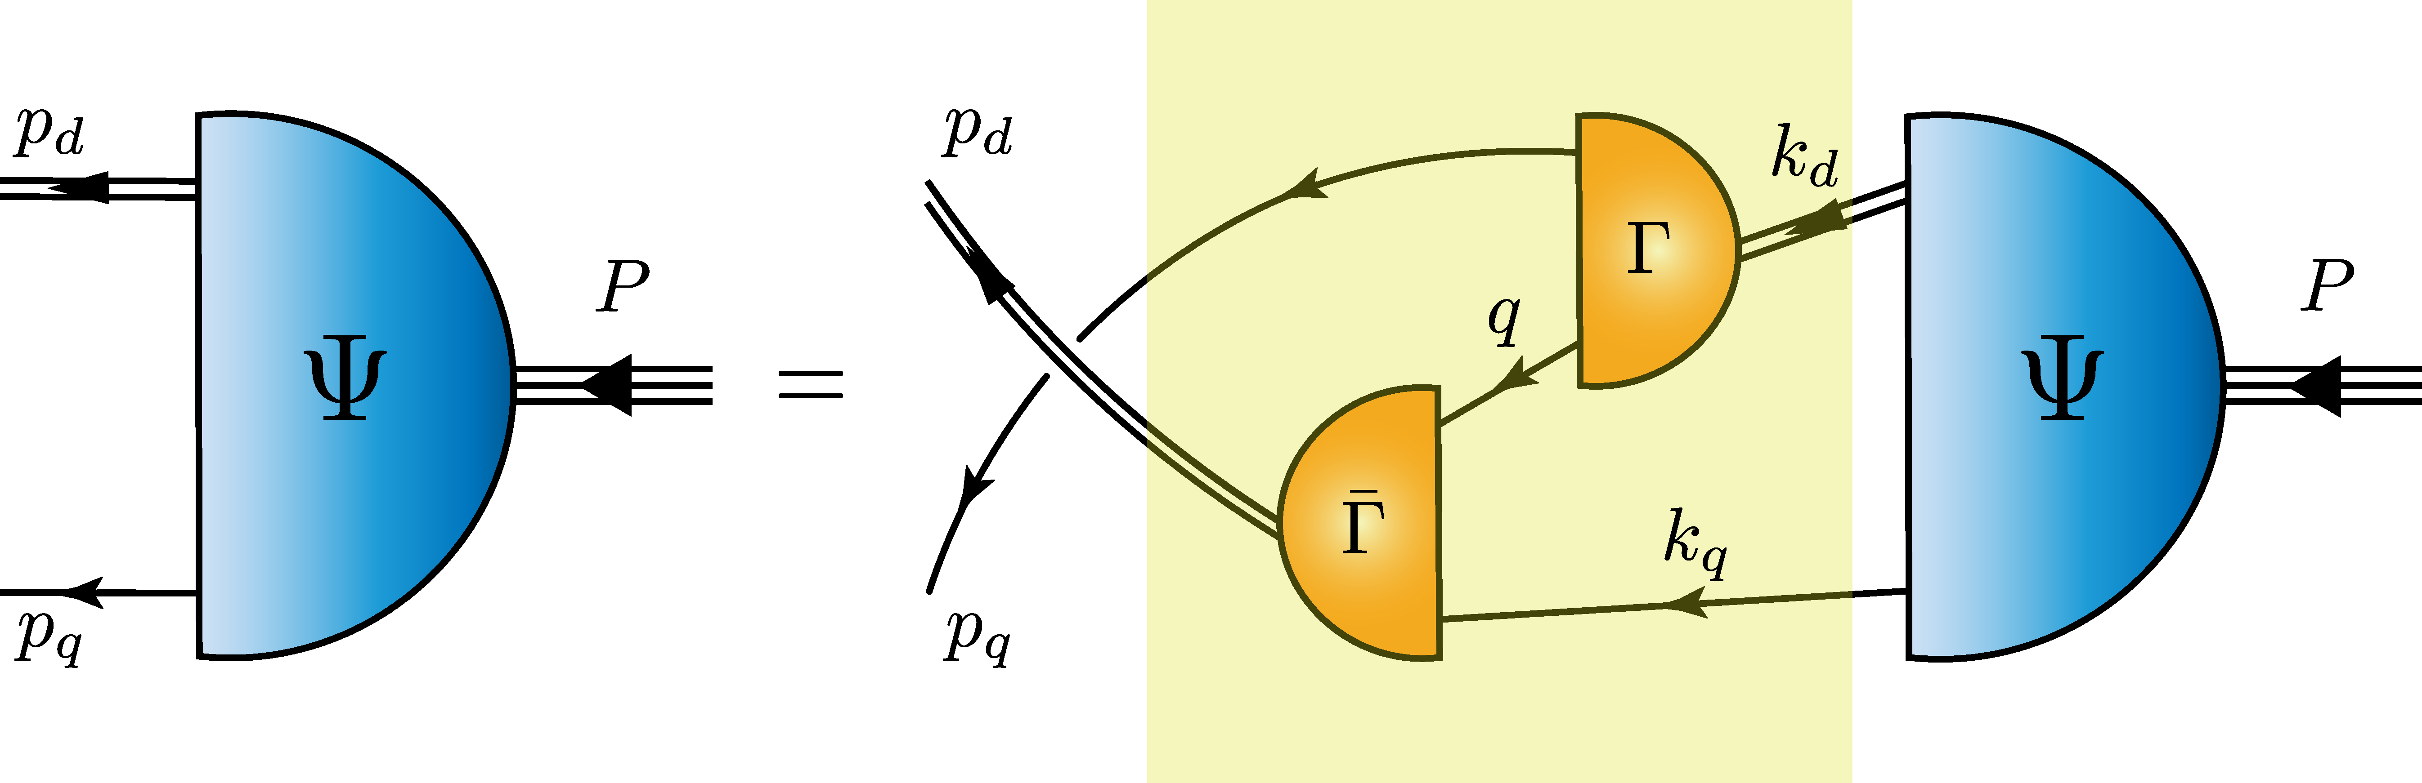
Faddeev Equation(Quark+Diuark Framework)
Quark+diquark framework
Having proven effective in describing proton properties.
Diquark correlation
(I=0,J^P=0^+):isoscalar-scalar diquark
(I=1,J^P=1^+):isovector-axialvector diquark
(I=0,J^P=0^-):isoscalar-pesudoscalar diquark
(I=0,J^P=1^-):isoscalar-vector diquark
(I=1,J^P=1^-):isovector-vector diquark
G. Eichmann, H. Sanchis-Alepuz, R. Williams, R. Alkofer, C. S. Fischer, Prog. Part. Nucl. Phys. 91 (2016) 1- 100.
C. Chen, B. El-Bennich, C. D. Roberts, S. M. Schmidt, J. Segovia, S-L. Wan, Phys. Rev. D 97 (2018) 3, 034016.
Notes:
Profiting from the emergence of diquarks, we can use a fully-interacting dressed-quark+nonpointlike-diquark approximation to the proton bound-state equation.
Accounting for Fermi-Dirac statistics, five types of correlation are possible in a J=1/2 baryon bound state；
For the ground state, we only need to include the two positive-parity diquark correlations

Slide 5


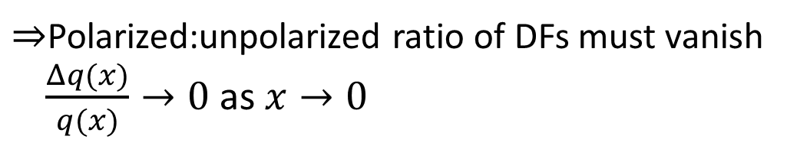
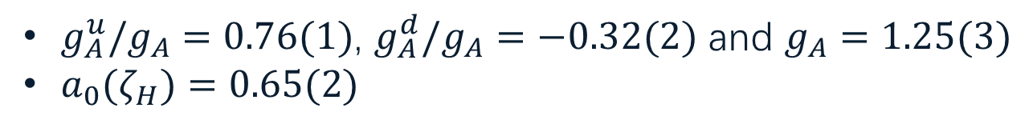
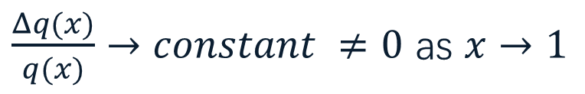
Polarised quark distribution functions：Basis
The hadron-scale quark+diquark Faddeev equation predictions
True in general: at hadron scale, , , what is $f(x)$?
Constraints from pQCD
At low-x: there is no correlation between helicity of struck quark and that of parent proton;
At high-x, polarized and unpolarized valence quark distributions possess the same power-law behaviour, viz.
$g_{A}^{u}/g_{A}=0.76(1)$, $g_{A}^{d}/g_{A}=−0.32(2)$ and $g_{A}=1.25(3)$
$a_{0}(ζ_{H})=0.65(2)$
C. Chen and C. D. Roberts, Eur. Phys. J. A 58 (2022) 10, 206.
$⇒$Polarized:unpolarized ratio of DFs must vanish
$\frac{Δq(x)}{q(x)}→0$ as $x→0$
Regge phenomenology: $Δq\left(x\right)∝x^{1/2}q(x)$
M. M. Brisudova et al. Phys. Rev. D 61 (2000) 054013.
$\frac{Δq(x)}{q(x)}→constant ≠0$ as $x→1$
Notes:
We need to admit that It need additional time for a Faddeev equation based prediction for the polarised valence quark DFs at the hadron scale.
Here, I employ a phenomenological approach to address the issue;
In proceeding to a discussion of proton helicity DFs, the following hadron-scale quark+diquark Faddeev equation predictions at the hadron scale are important.
Hadron scale: the scale at which all properties of a hadron are carried by its valence quark.
a0 measures the contribution of the valence-quark’s spin to the proton’s spin. The remainder of the proton spin is stored in quark+diquark orbital angular momentum.
We can set such an ansatz:
We can use constraints suggested by perturbative QCD analyses to formulate f(x).
x: momentum fraction; The ratio tends to be a constant that is not zero

Slide 6
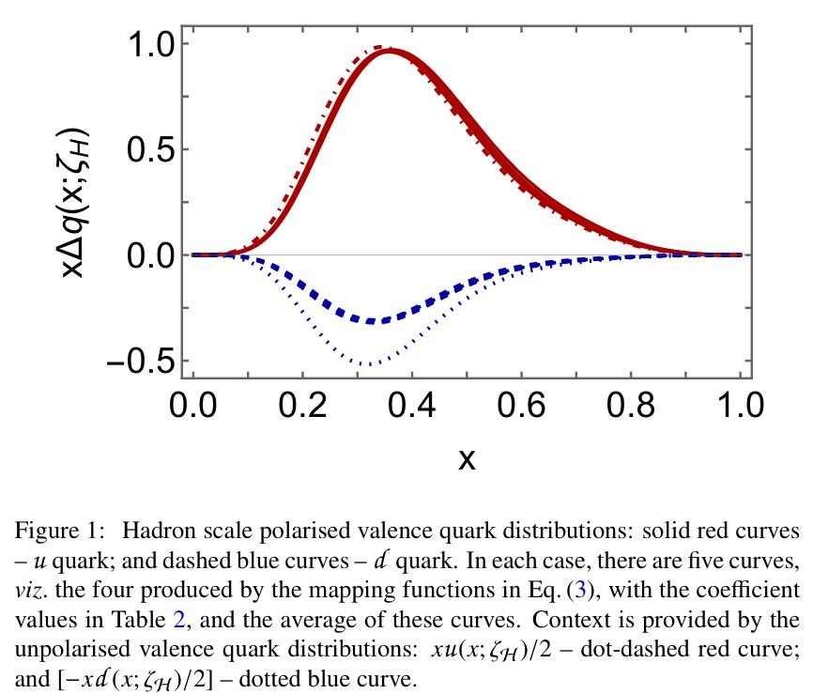

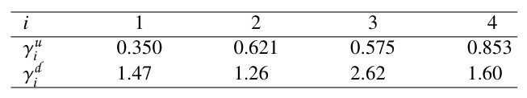


Polarised quark distribution functions at $ζ_{H}$
Implement constraints($s_{u}=1=−s_{d}$)
In each case, $γ$ is fixed by ensuring:
Notes:
To test the sensitivity of results to Ansatz, four distinct mappings are given here;
The resulting Ansätze for the hadron-scale polarised valence quark DFs are illustrated in Fig, wherein they are compared with the corresponding unpolarised DFs.
The results of different ansatz almost overlap. The results are insensitive to ...

Slide 7
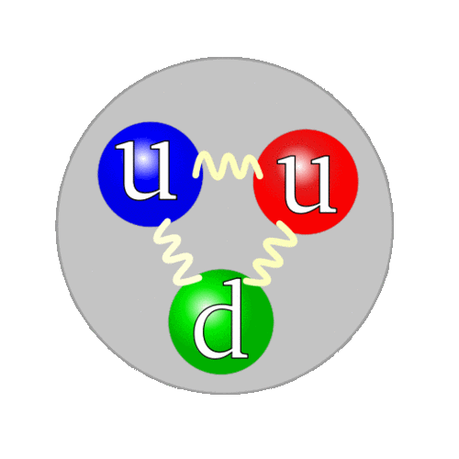
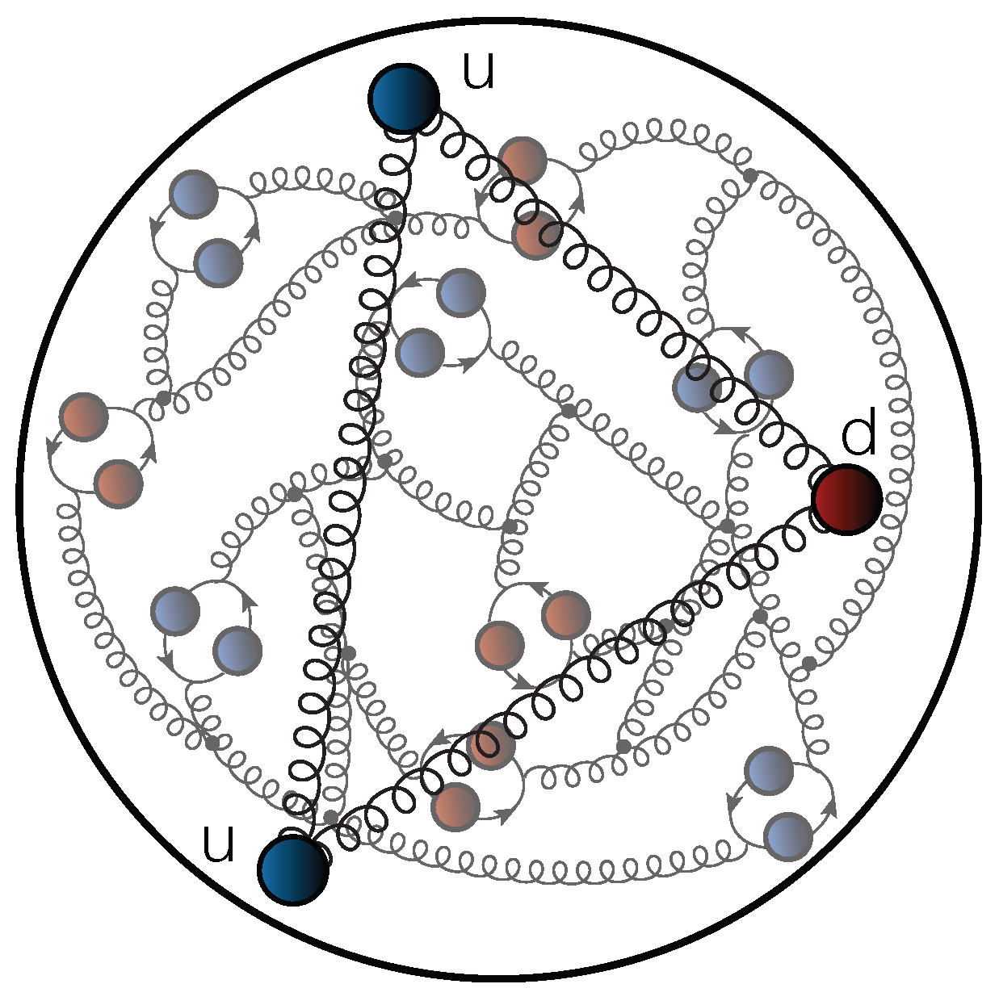
Parton distributions:energy scales
Evolution
Fully-dressed valence quarks
(quasiparticles)
Unveiling of glue and sea of d.o.f.
(partons)
Notes:
At Zeta_H (hadron scale), all properties of the proton are carried by its dressed valence quark dof.
We need to evolve it to a higher energy scale

Slide 8
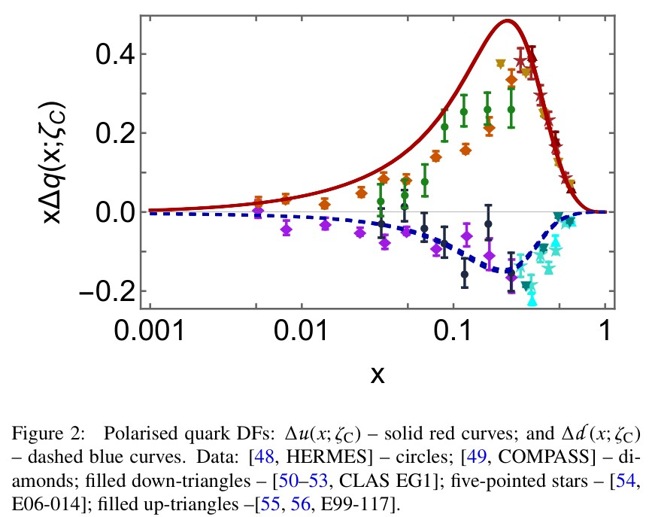
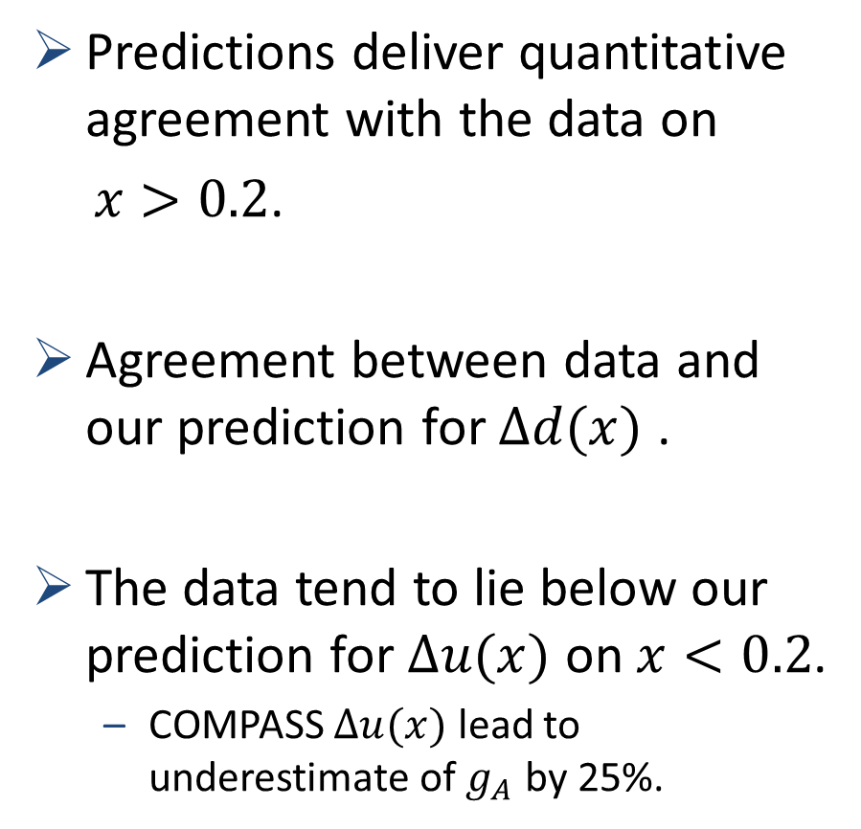
Polarised quark distribution functions at $ζ_{C}=\sqrt{3}GeV$
Predictions deliver quantitative agreement with the data on
$x>0.2$.
Agreement between data and our prediction for $Δd(x)$ .
The data tend to lie below our prediction for $Δu(x)$ on $x<0.2$.
COMPASS $Δu(x)$ lead to underestimate of $g_{A}$ by 25%.
Notes:
one obtains the 𝜁C = √3 GeV polarised quark DFs drawn in Fig, wherein they are compared with data inferred from experiments: Predictions deliver quantitative agreement with data on $x>0.2$.
our results of d quark agree with the all available world data.
Referring to the COMPASS results, the data of u quark tend to fall below our prediction, This aligns with the observations that the COMPASS results yield underestimate of$g_{A}$ by 25%.

Slide 9
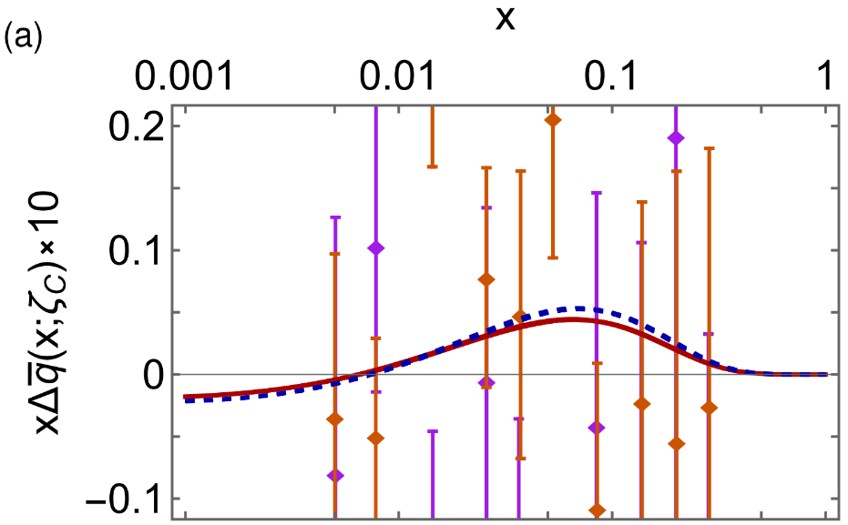
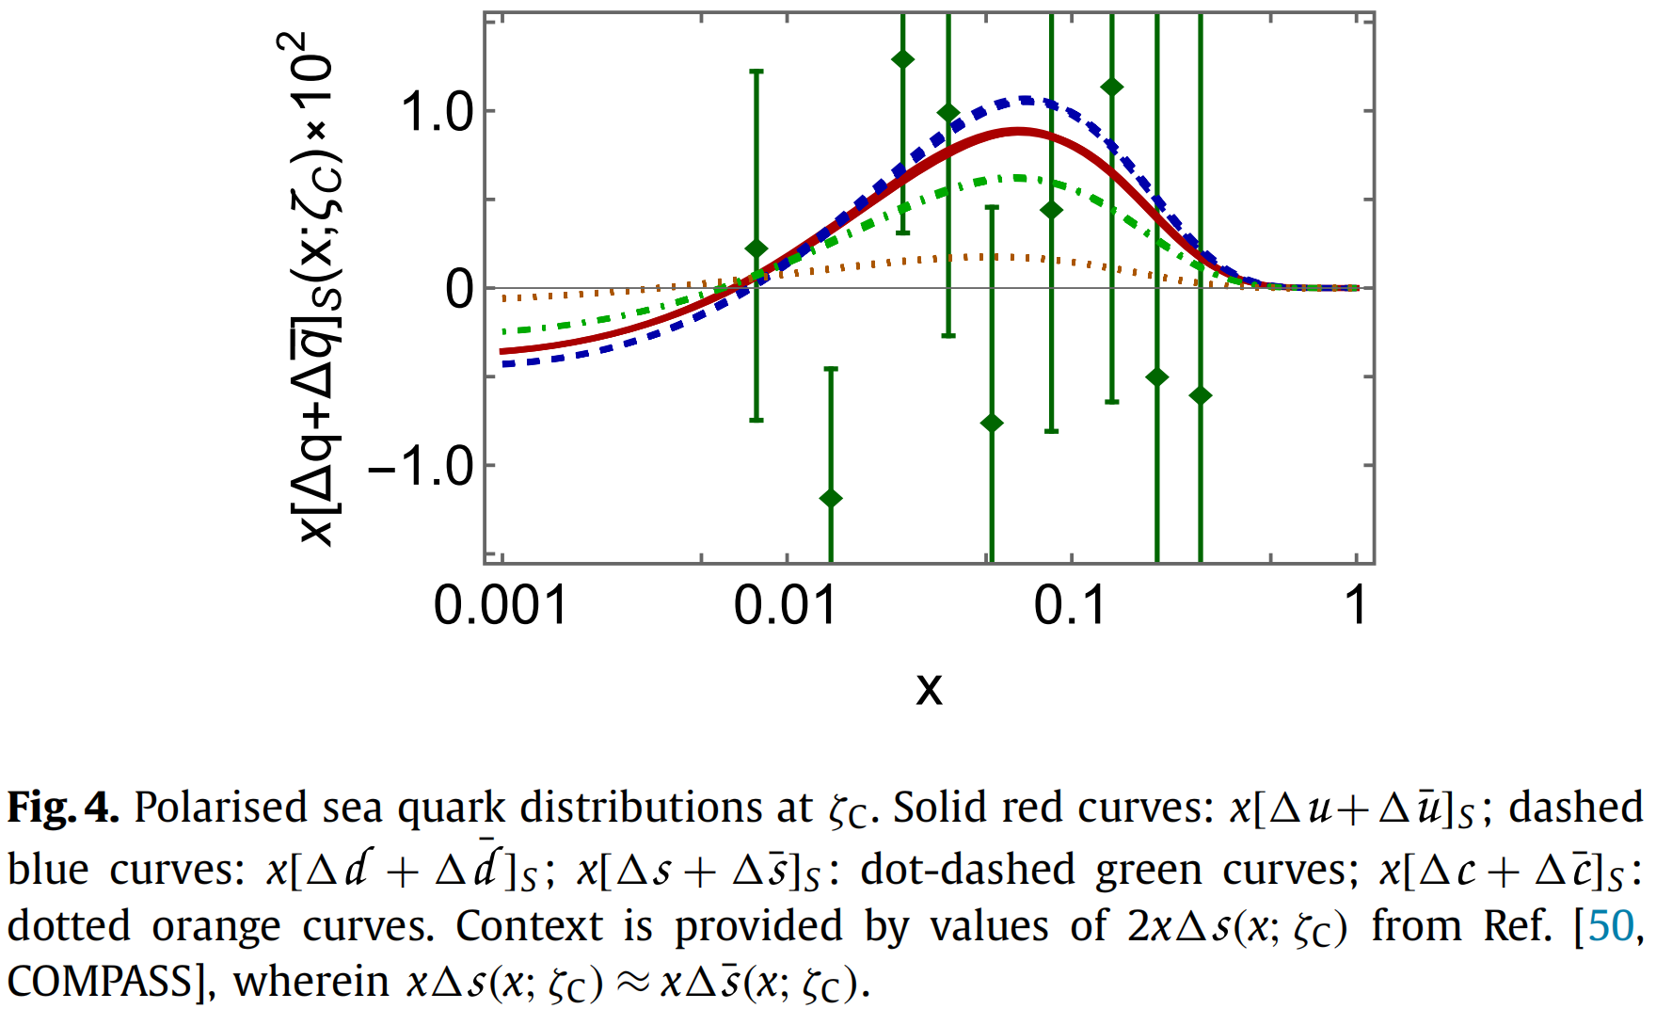
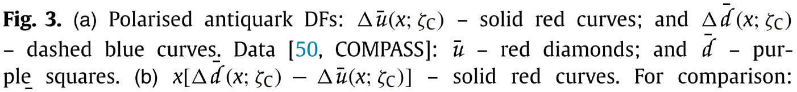
Polarised quark distribution functions at $ζ_{C}=\sqrt{3}GeV$
The magnitude matches our prediction.
Notes:
These are our polarized antiquark distributions’s results, along with datas from COMPASS. On the scale of this image, the data have large uncertainties. So, can only be used to set plausible bounds on the size of these distributions.
Our predictions for all polarized sea quark DFs are shown in this image. The image includes datas on s quark from COMPASS. The data uncertainties are also large.
Broadly speaking, the magnitude matches our prediction for these DFs.

Slide 10
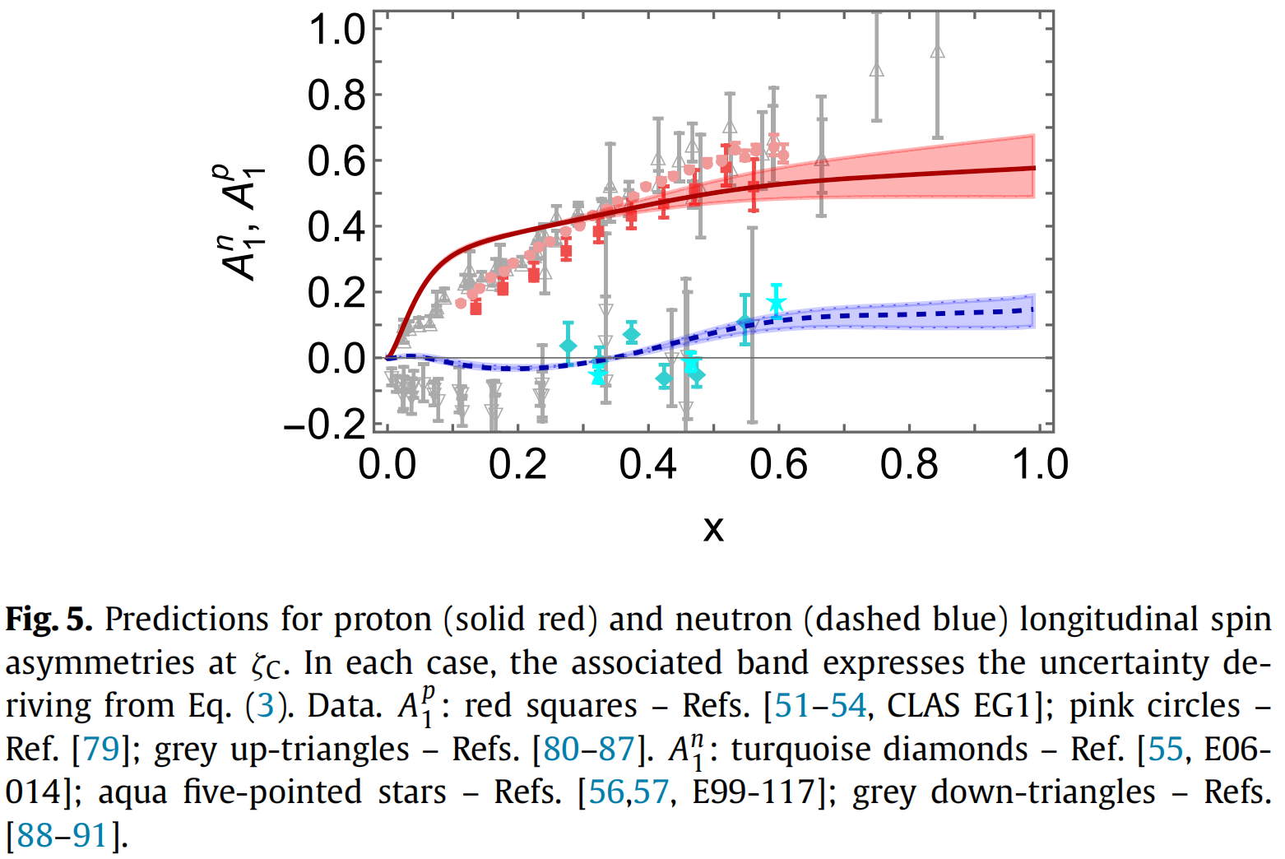
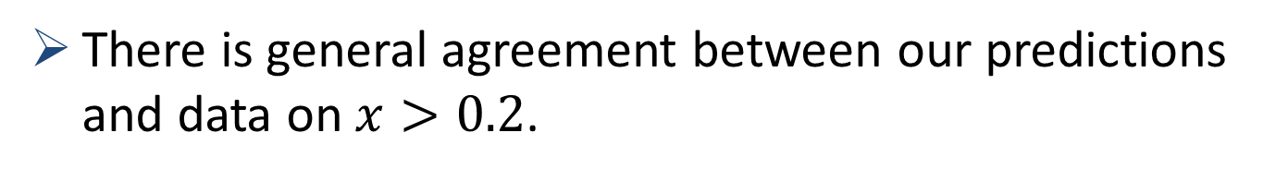
Polarised quark distribution functions at $ζ_{C}=\sqrt{3}GeV$
There is general agreement between our predictions and data on $x>0.2$.
Notes:
We also deliver predictions for the nucleon longitudinal spin asymmetries. For comparison, we also show results inferred from data. At low x, our results do not match the experimental results well. But there is general agreement between our predictions and data on $x>0.2$. The experimental results on $x>0.6$ is desirable.

Slide 11
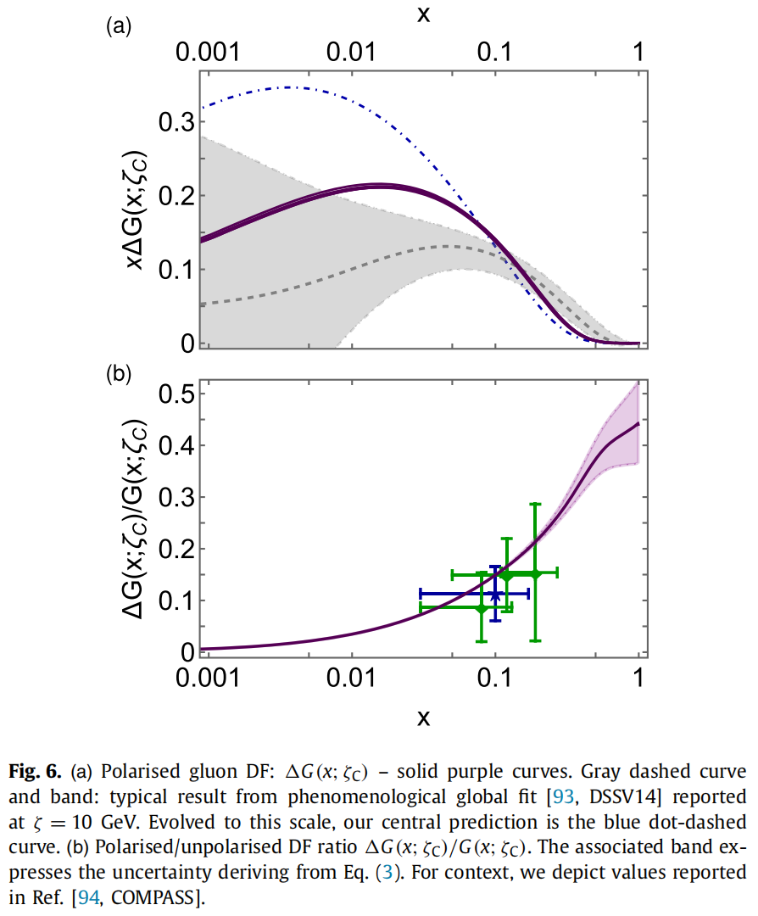
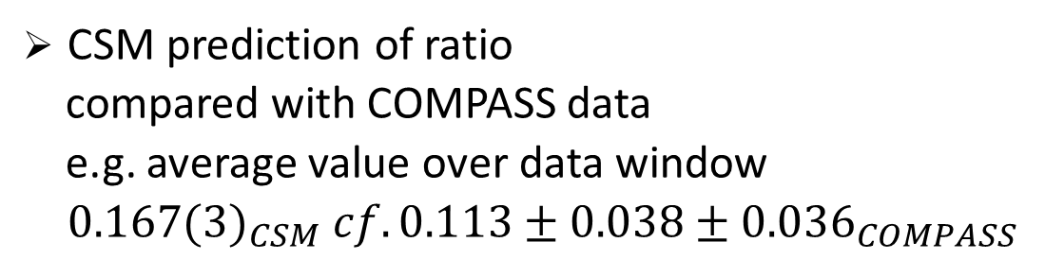
Polarised gluon distribution functions at $ζ_{C}=\sqrt{3}GeV$
On the complementary domain,
Cf.DSSV14:0.19(6)
Daniel de Florian, et al., Phys. Rev. Lett. 113 (2014) 1, 012001.
CSM prediction of ratio
compared with COMPASS data
e.g. average value over data window
${0.167(3)}_{CSM} cf. {0.113±0.038±0.036}_{COMPASS}$
C. Adolph et al., Eur. Phys. J. C 77 (4) (2017) 209.
Notes:
Here, I show our results of gluon:
The solid purple curve is our prediction at Sqrt[3] GeV.
The gray dashed curve and band represent results from phenomenological global fit at 10GeV. Evolved to this scale, our central prediction is the blue dot-dashed curve. On x<0.05, our predictions for glue DFs are larger in magnitude than those from the phenomenological fits. Notwithstanding this, on the complementary domain, we find:
Our prediction for the ratio unpolarized:polarized is shown in Fig.b.
It exhibits excellent agreement with COMPASS data.This is highlighted by comparing the mean value of my result on the domain covered by measurements, which is 0.167(3) within the experimental error bar.

Slide 12
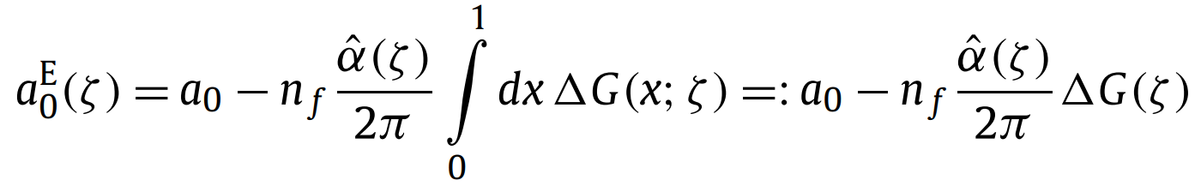
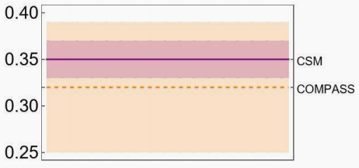

Proton Spin
Recall page 5, which records
Under evolution, this value is independent of scale.
However, measurements of the proton spin are sensitive to non-Abelian anomaly corrected combination ($n_{f}=4$)
CSM prediction:
COMPASS:
$a_{0}≈65\%$ of proton spin
Carried by valence quark quasiparticle degrees of freedom at the hadron scale.
Notes:
records that ≈ 65% of the proton spin is attributed to valence quark quasiparticle degrees of freedom at the hadron scale. Nf=4 is the number of active quark flavours.
Using our result for polarized gluon distributions, we predict measurements of the proton spin =0.35.
compares favourably with that reported in COMPASS.

Slide 13
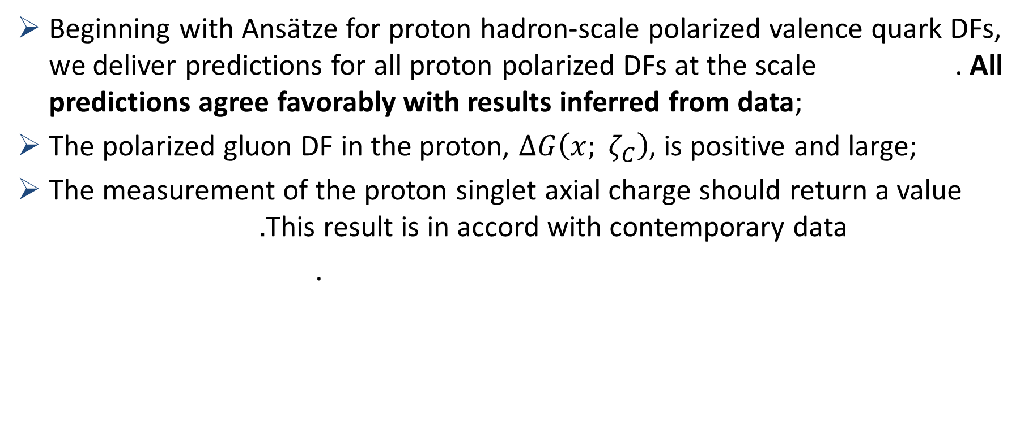
Summary
Beginning with Ansätze for proton hadron-scale polarized valence quark DFs, we deliver predictions for all proton polarized DFs at the scale . All predictions agree favorably with results inferred from data;
The polarized gluon DF in the proton, $∆G\left(x; ζ_{C}\right)$, is positive and large;
The measurement of the proton singlet axial charge should return a value $.$This result is in accord with contemporary data
.
Thankyou
Notes:
developed using insights from perturbative QCD and constrained by solutions of a quark+diquark Faddeev equation, and supposing the existence of an effective charge which defines an evolution scheme for parton DFs -–both unpolarised and polarised –- that is all-orders exact, ...
Meanwhile, I was able to predict that measurements of the proton singlet axial charge should return a value 𝑎E0 (𝜁C) = 0.35(2).
This result is in accord with contemporary data.

