Slide 1




Observation of a family of all-charm tetraquarks with spin-2 and positive parity at CMS
Xining Wang
Tsinghua University / Nanjing Normal University
26th International Symposium on Spin Physics
Sep 24, 2025

Slide 2
Outline
Motivation
𝐽/𝜓𝐽/𝜓 updated result
𝐽/𝜓𝜓(2S) result
Spin-parity measurement
Summary
2

Slide 3
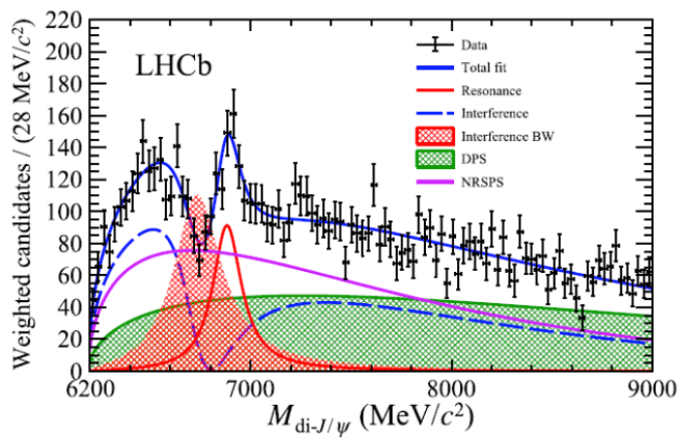
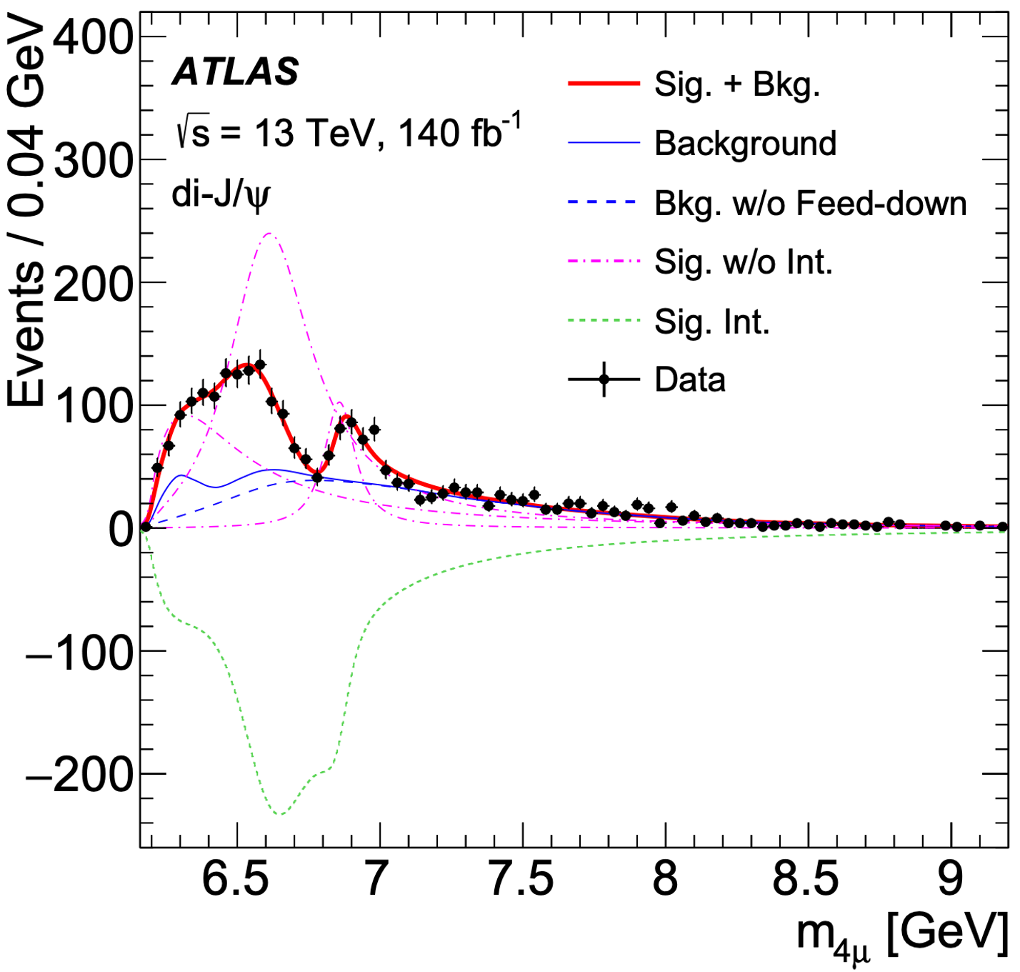
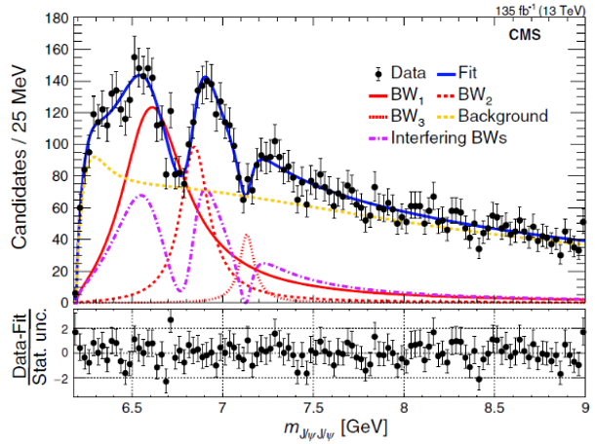
Status
All-charm Tetraquark on LHC in J/ψJ/ψ channel
Phys.Rev.Lett. 131 (2023) 15, 151902
Sci.Bull. 65 (2020) 23, 1983
Phys. Rev. Lett. 132 (2024) 111901
ALL exp observe X(6900)
+ additional structure
Only CMS claimed X(6600) & X(7100)
  Hump @ 6.6 GeV: Different modeling
  Hint @ 7.2 GeV: LHCb not consider; ATLAS 3σ hint in $J/ψψ(2S)$
All exp use interference, but in diff ways
  LHCb: extra BW interfere with SPS, X(6900) NOT interfering!
  ATLAS and CMS: different multi-resonance interference
A number of unresolved questions !
All exp see a threshold excess, NOT explained! Classified as background
3

Slide 4
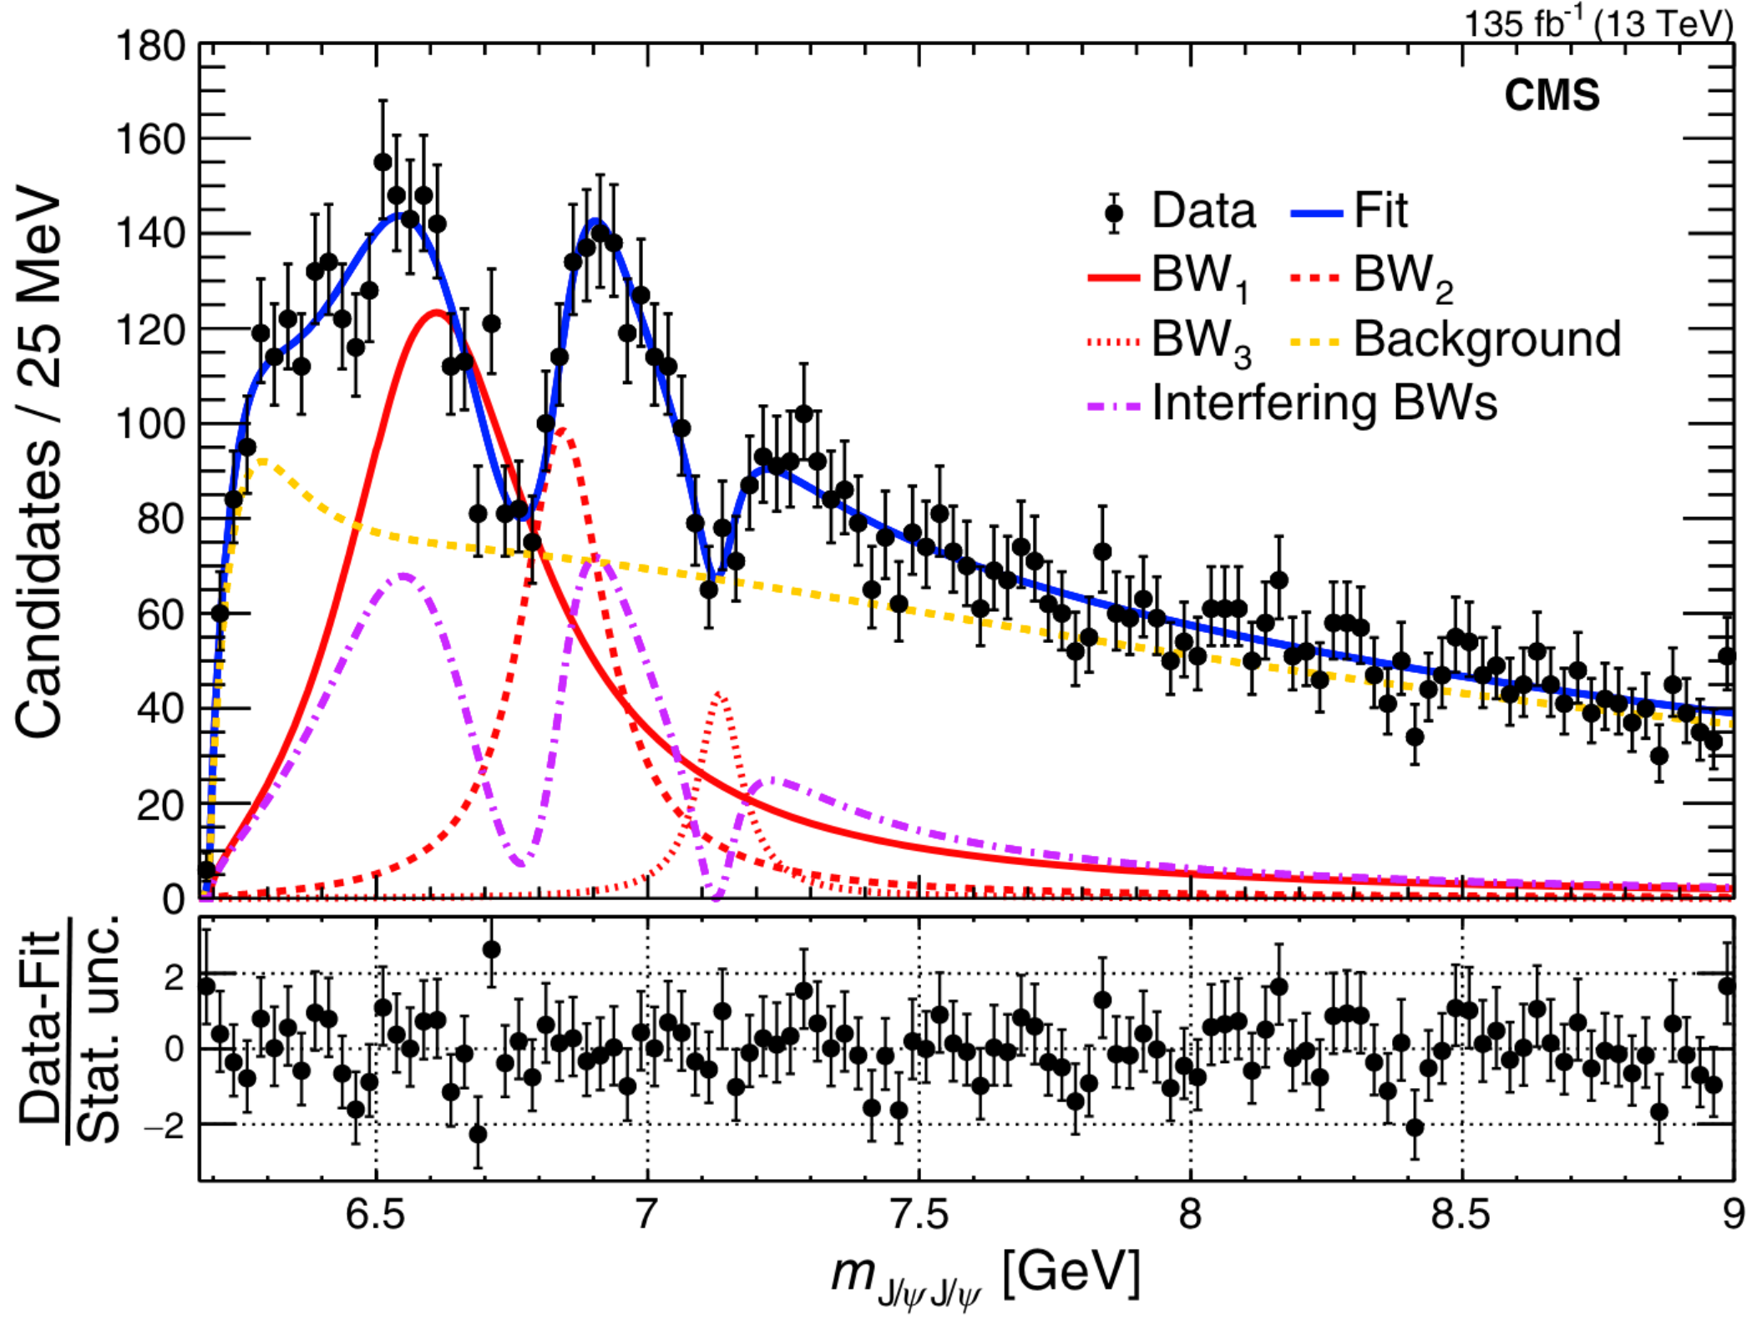
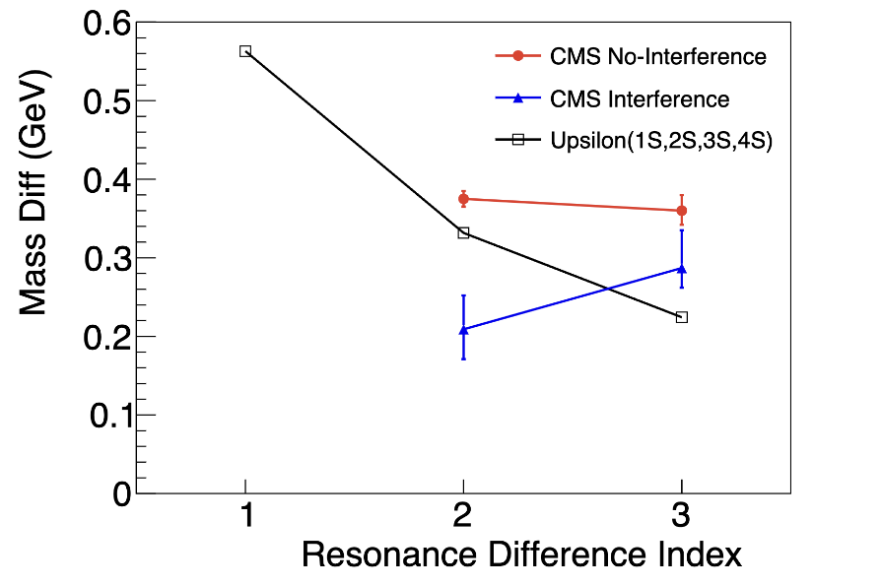
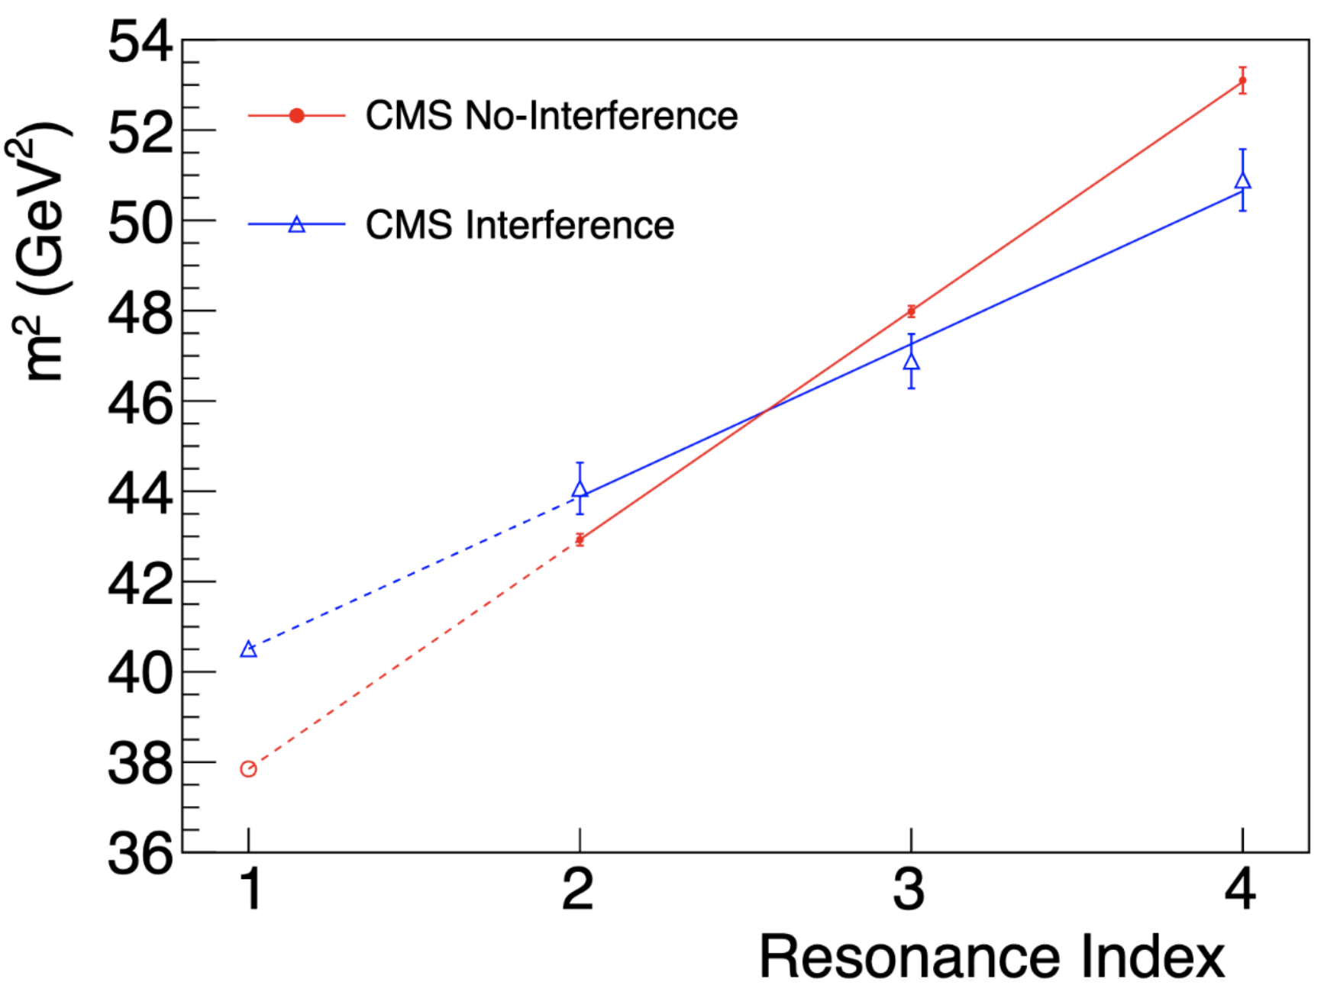

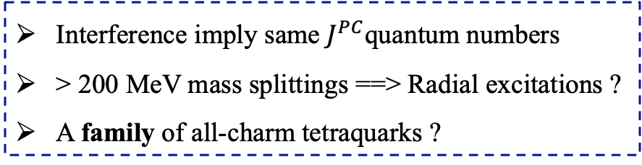
Status
Phys. Rev. Lett. 132 (2024) 111901
Chinese Phys. Lett. 41 111201
Run II
Run II
Run II
$Υ$ Family
Res. Diff Indices:
1: Y(2S)-Y(1S)
2: Y(3S)-Y(2S), X(6900)-X(6600)
3: Y(4S)-Y(3S), X(7100)-X(6900)
Run 2 result:
X(7100): 4.7σ
Interference < 4σ
Interference imply same $J^{PC}$quantum numbers
> 200 MeV mass splittings ==> Radial excitations ?
A family of all-charm tetraquarks ?
With 3.6X statistics:
Significance of ALL states over 5σ ?
Significance of interference over 5σ ?
A FAMILY of all-charm tetraquark states with same $J^{PC} ?$
4

Slide 5
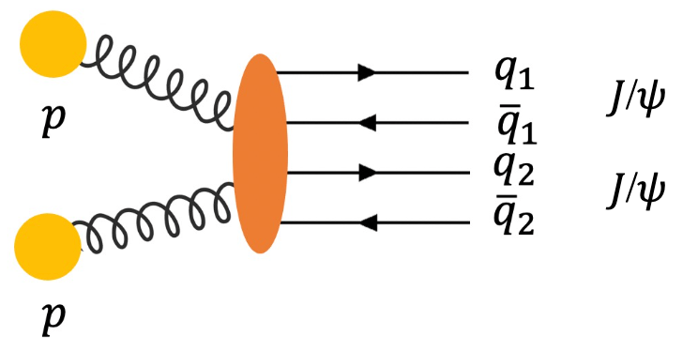
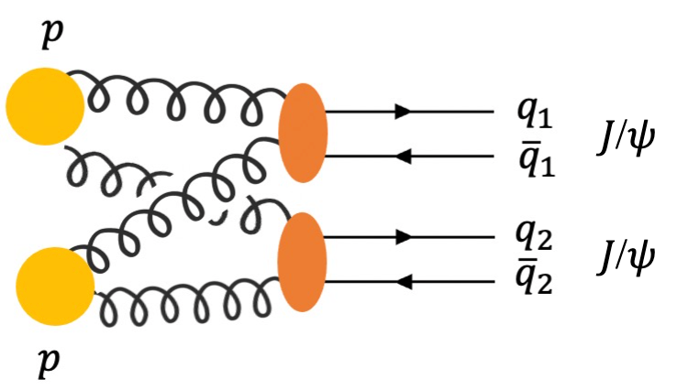
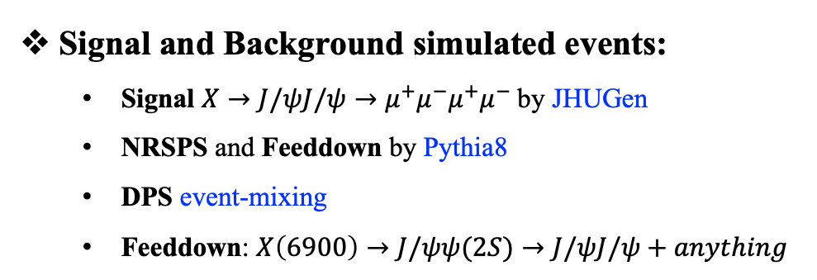
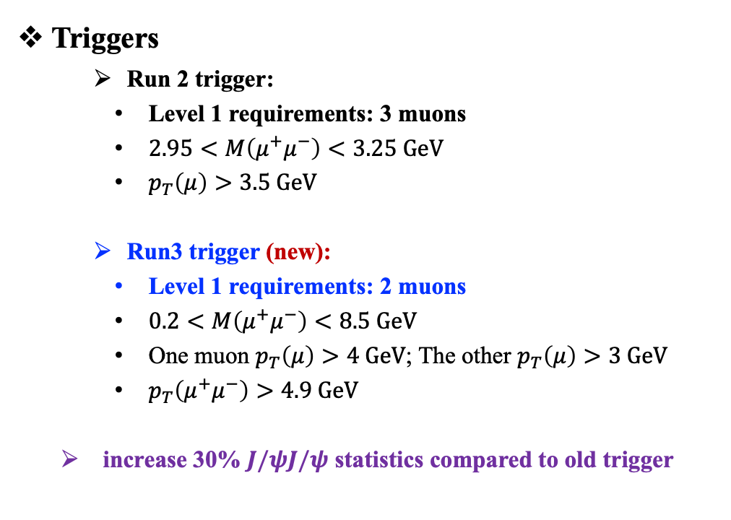
Datasets, MC, trigger, and event selection
Data samples (315 fb⁻¹)
  Run 2: 135 fb⁻¹ data taken in 2016, 2017 and 2018
  Run 3: 180 fb⁻¹ data taken in 2022, 2023 and 2024
Triggers
    Run 2 trigger:
    Level 1 requirements: 3 muons
    $2.95<M\left(μ^{+}μ^{−}\right)<3.25 GeV$
    $p_{T}\left(μ\right)>3.5 GeV$
    Run3 trigger (new):
    Level 1 requirements: 2 muons
    $0.2<M\left(μ^{+}μ^{−}\right)<8.5 GeV$
    One muon $p_{T}\left(μ\right)>4 GeV$; The other $p_{T}\left(μ\right)>3 GeV$
    $p_{T}\left(μ^{+}μ^{−}\right)>4.9 GeV$
  increase 30% $J/ψJ/ψ$ statistics compared to old trigger
Signal and Background simulated events:
  Signal $X→J/ψJ/ψ→μ^{+}μ^{−}μ^{+}μ^{−}$by JHUGen
  NRSPS and Feeddown by Pythia8
  DPS event-mixing
  Feeddown: $X\left(6900\right)→J/ψψ(2S)→J/ψJ/ψ+anything$
Event selection
  Follow Run 2 cuts + new trigger for Run 3
SPS
DPS
5

Slide 6
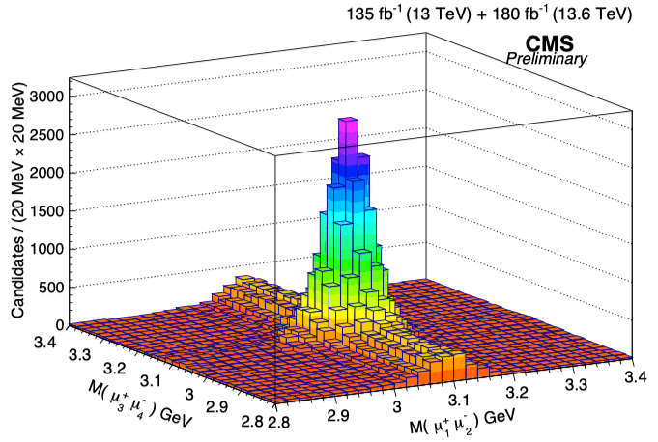

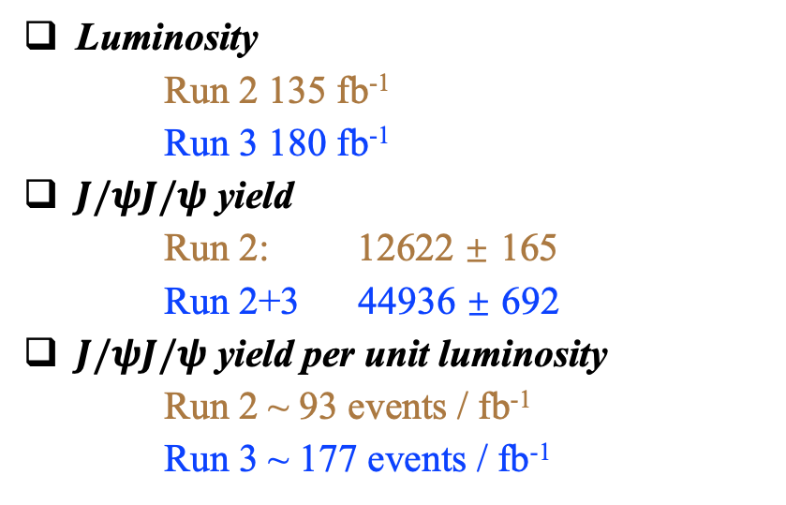
𝐽/𝜓𝐽/𝜓 yield: two-dimensional fit
Luminosity
Run 2 135 fb⁻¹
Run 3 180 fb⁻¹
$J/ψJ/ψ$ yield
Run 2: 12622 ± 165
Run 2+3 44936 ± 692
$J/ψJ/ψ$ yield per unit luminosity
    Run 2 ~ 93 events / fb⁻¹
    Run 3 ~ 177 events / fb⁻¹
  Run 2+3 $J/ψJ/ψ$ yield is 3.6X of Run 2
  Run 2+3 luminosity is 2.3X of Run 2
6

Slide 7
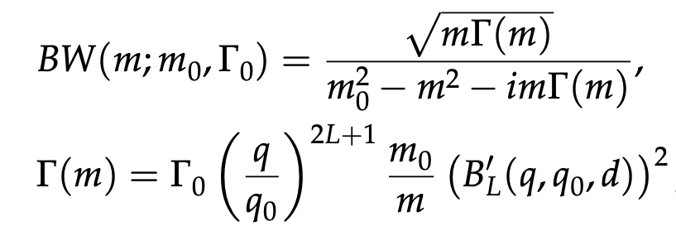
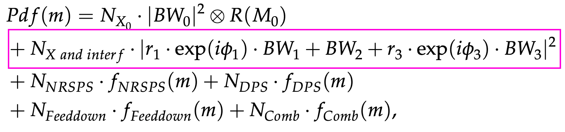
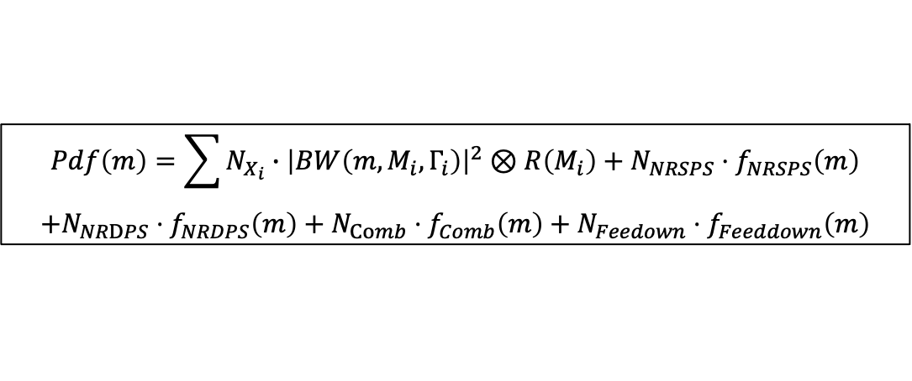
Signal and background models
Signal shape: Relativistic Breit-Wigner
Background component: NRSPS + NRDPS + Feeddown + Comb + BW0
Non-interference model:
  Signal-hypothesis: NRSPS + NRDPS + Comb + Feeddown + BW0 + BW1 + BW2 + BW3
$$Pdf\left(m\right)=\sum{N_{X_{i}}∙{\left|BW\left(m,M_{i},Γ_{i}\right)\right|}^{2}⊗R\left(M_{i}\right)}+N_{NRSPS}⋅f_{NRSPS}\left(m\right)$$
$$+N_{NRDPS}⋅f_{NRDPS}\left(m\right)+N_{Comb}⋅f_{Comb}\left(m\right)+N_{Feedown}⋅f_{Feeddown}\left(m\right)$$
Interference model:
  Signal-hypothesis: NRSPS + NRDPS + Comb + Feeddown + BW0 + BW123 Interf. Term
7

Slide 8
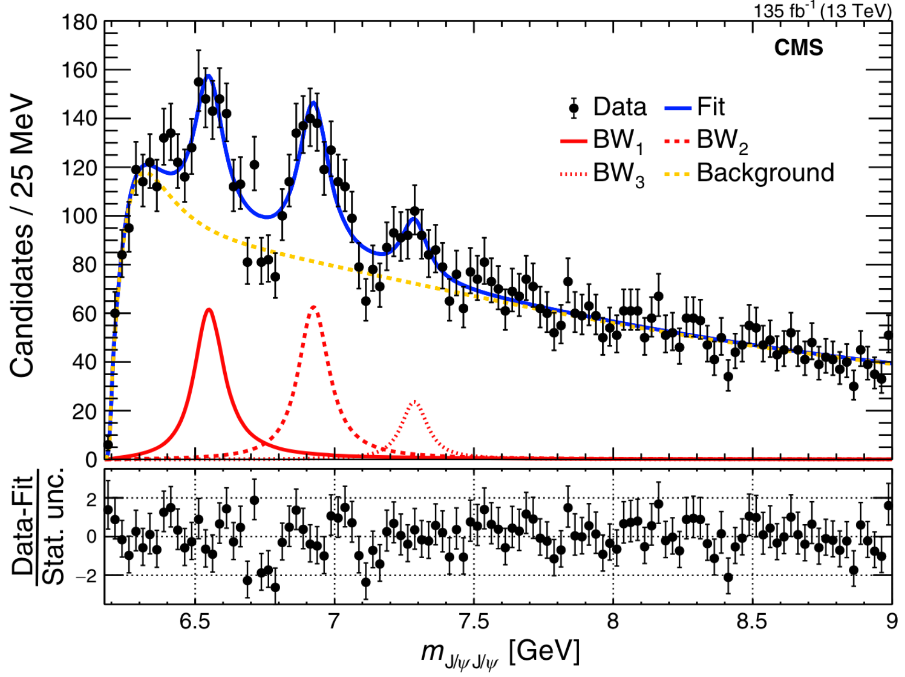
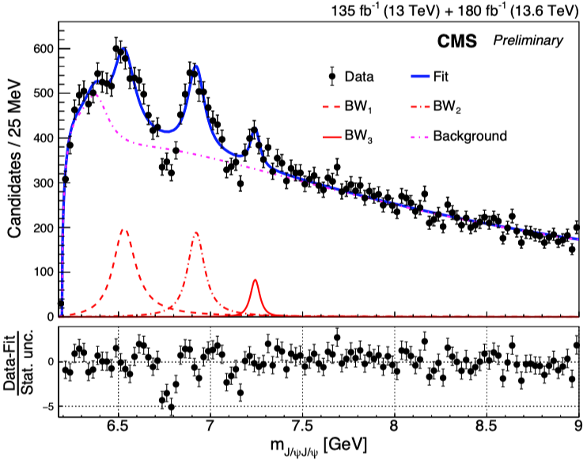
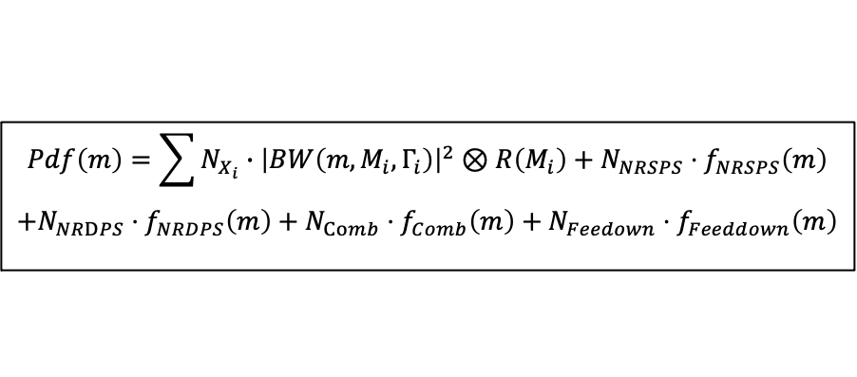
Run 2 & 3 no-interference fit result
No-interference model:
  Signal-hypothesis: NRSPS + NRDPS + Comb + Feeddown + BW0 + BW1 + BW2 + BW3
$$Pdf\left(m\right)=\sum{N_{X_{i}}∙{\left|BW\left(m,M_{i},Γ_{i}\right)\right|}^{2}⊗R\left(M_{i}\right)}+N_{NRSPS}⋅f_{NRSPS}\left(m\right)$$
$$+N_{NRDPS}⋅f_{NRDPS}\left(m\right)+N_{Comb}⋅f_{Comb}\left(m\right)+N_{Feedown}⋅f_{Feeddown}\left(m\right)$$
Run 2 No-Interf
Run 2+3 No-Interf
Dips poorly described — no-Interf. model no longer sufficient !
8

Slide 9
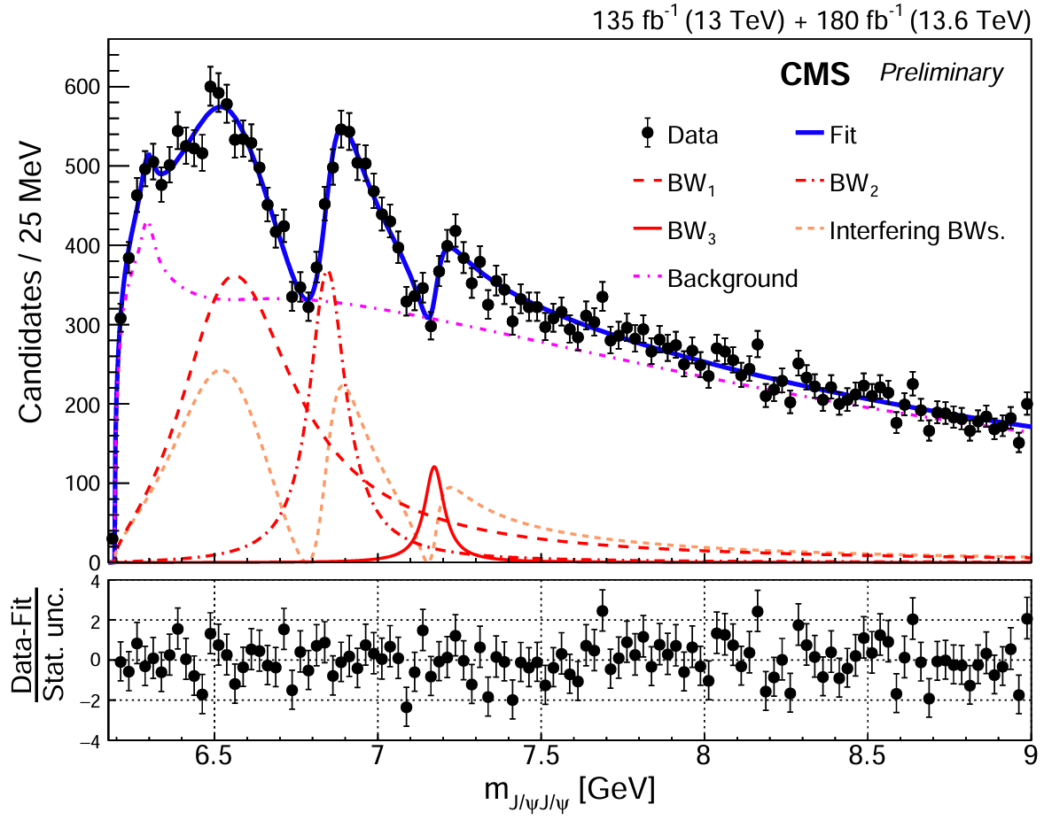
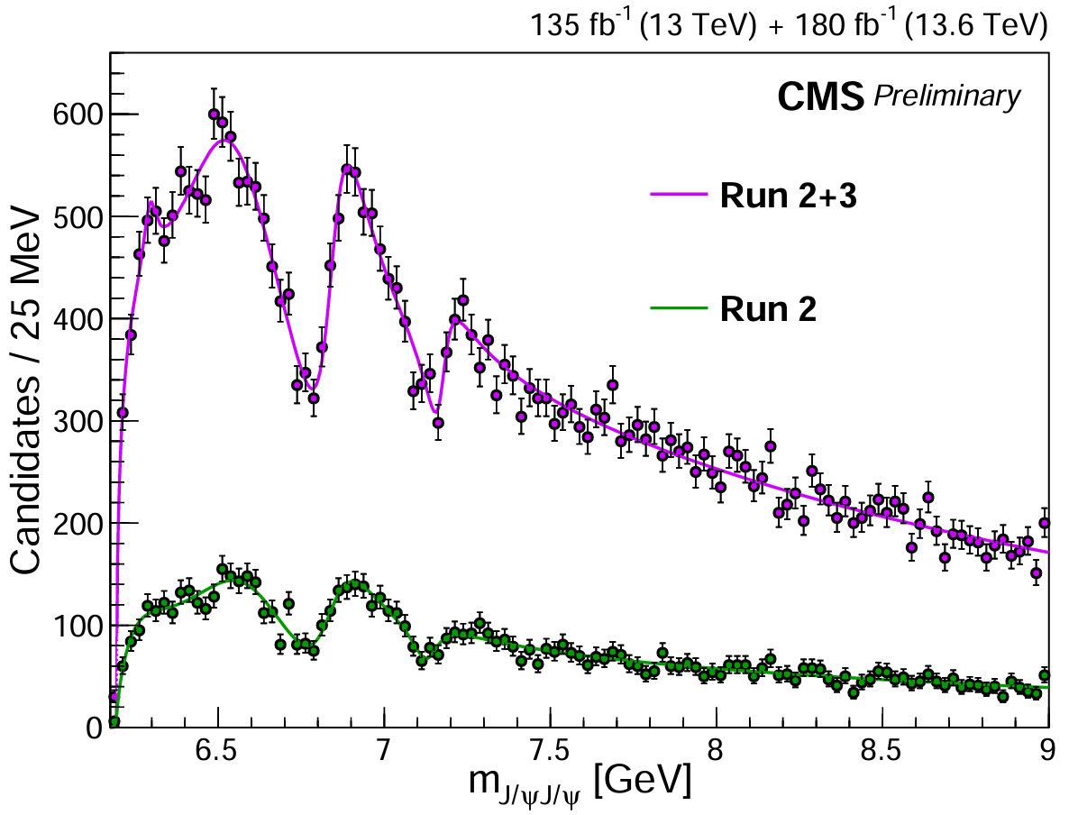

Run 2 & 3 interference fit result
Interference model with Run 2 + 3:
15σ
17σ
8σ
Dip1: 10σ
Dip2: 7σ
All states and dips well above 5σ !
Quantum interference among structures validated!
Strongly imply that they have same $J^{PC}$
9

Slide 10
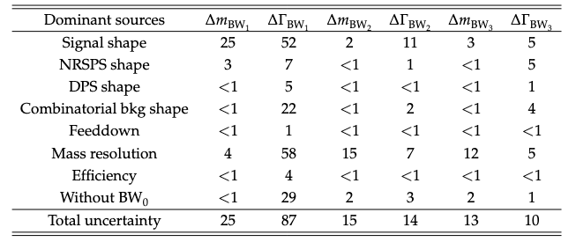
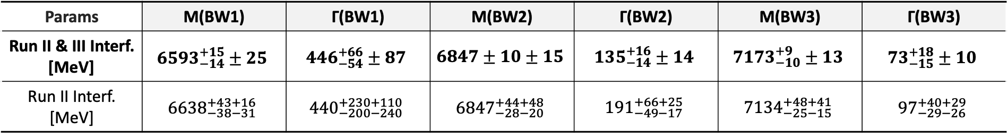
Run 2 & 3 interference fit result
Params | M(BW1) | Γ(BW1) | M(BW2) | Γ(BW2) | M(BW3) | Γ(BW3)
Run II & III Interf. [MeV] | $${6593}_{−14}^{+15}±25$$ | $${446}_{−54}^{+66}±87$$ | $$6847±10±15$$ | $${135}_{−14}^{+16}±14$$ | $${7173}_{−10}^{+9}±13$$ | $${73}_{−15}^{+18}±10$$
Run II Interf. [MeV] | $${6638}_{−38−31}^{+43+16}$$ | $${440}_{−200−240}^{+230+110}$$ | $${6847}_{−28−20}^{+44+48}$$ | $${191}_{−49−17}^{+66+25}$$ | $${7134}_{−25−15}^{+48+41}$$ | $${97}_{−29−26}^{+40+29}$$
VS. Run 2 result
  Statistical uncertainty reduced by a factor of 3
  Systematic uncertainty reduced by about a factor of 2
  Large mass splittings (> 200 MeV) still exist, with improved precision
10

Slide 11
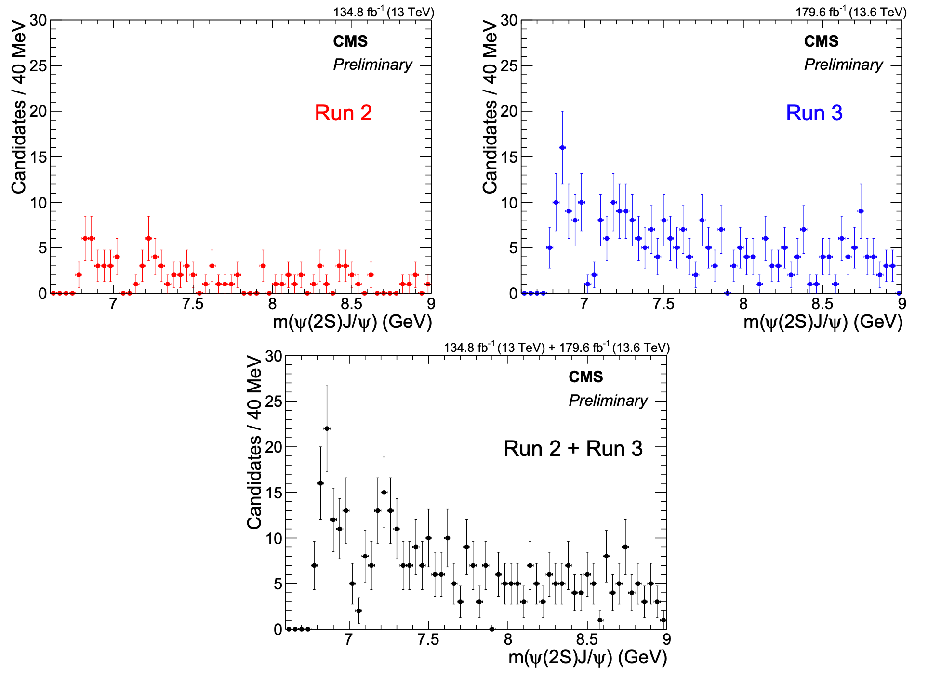
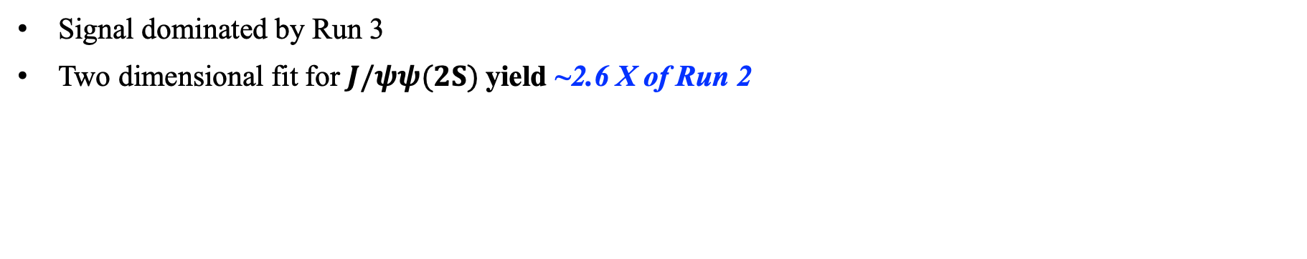
Explore 𝐽/𝜓𝜓(𝟐𝐒) channel with Run 2 & 3 data
X(6900) near threshold obvious
X(7100) is visible
According to $J/ψJ/ψ$ channel, should be an X(6900) and an X(7100)
Signal dominated by Run 3
Two dimensional fit for $J/ψψ(2S)$yield ~2.6 X of Run 2
Run 2 ~109 ± 14
Run 3 ~281 ± 22
Run 2+3 ~386 ± 26
11

Slide 12
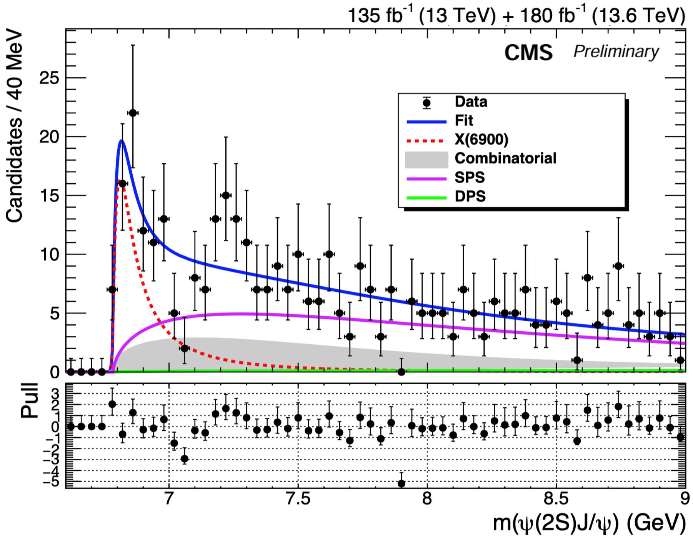
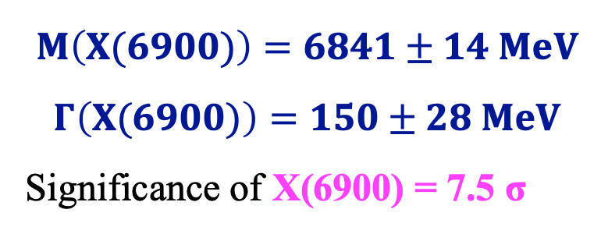
Explore 𝐽/𝜓𝜓(𝟐𝐒) channel with Run 2 & 3 data
Only consider X6900 in 𝐽/𝜓𝜓(𝟐𝐒) channel
$$M\left(X(6900)\right)=6841±14 MeV$$
$$Γ\left(X(6900)\right)=150±28 MeV$$
Significance of X(6900) = 7.5 σ
12

Slide 13
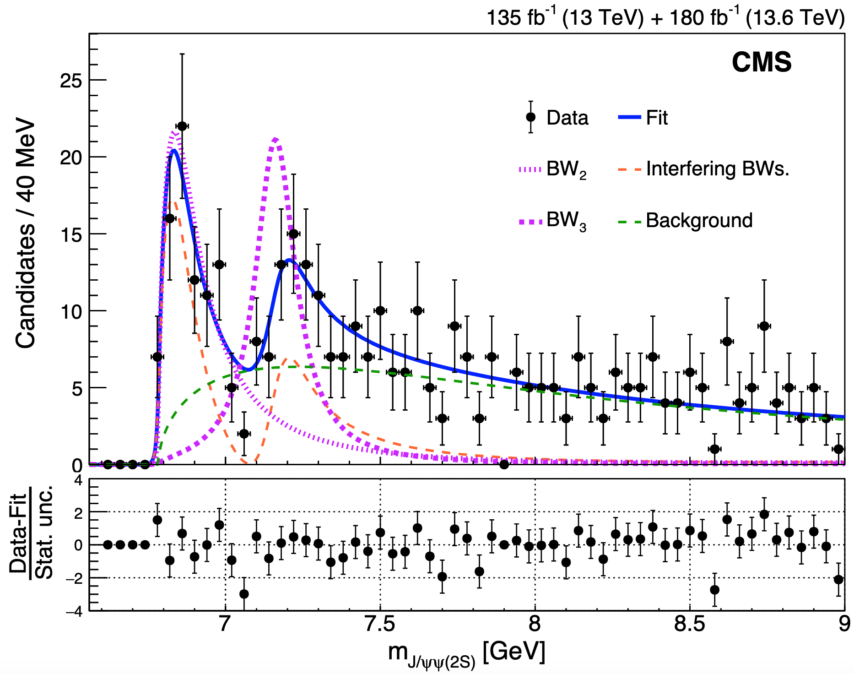

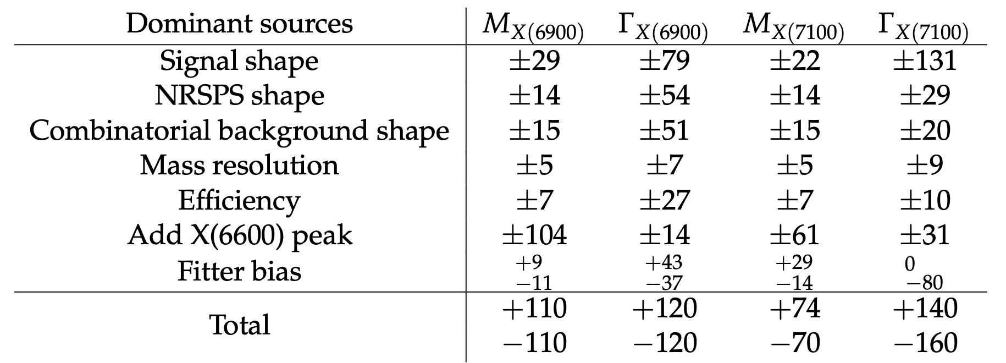
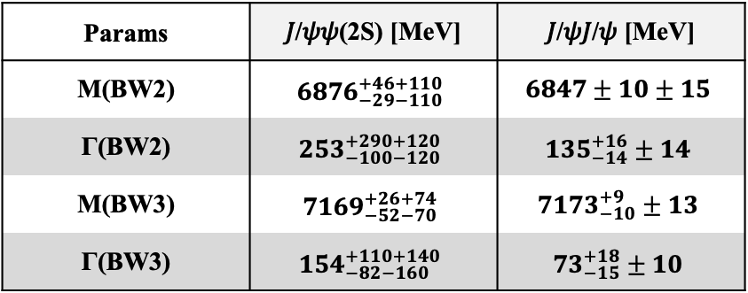
Explore 𝐽/𝜓𝜓(𝟐𝐒) channel with Run 2 & 3 data
Params | 𝐽/𝜓𝜓(2S) [MeV] | 𝐽/𝜓𝐽/𝜓 [MeV]
M(BW2) | $${6876}_{−29−110}^{+46+110}$$ | $$6847±10±15$$
Γ(BW2) | $${253}_{−100−120}^{+290+120}$$ | $${135}_{−14}^{+16}±14$$
M(BW3) | $${7169}_{−52−70}^{+26+74}$$ | $${7173}_{−10}^{+9}±13$$
Γ(BW3) | $${154}_{−82−160}^{+110+140}$$ | $${73}_{−15}^{+18}±10$$
Significance of X(6900) = 7.9σ
Significance of X(7100) = 4.0σ
Consistent with 𝐽/𝜓𝐽/𝜓 result!
Confirmed in a different channel!
ATLAS only claim X(6900) 4.7σ in 𝐽/𝜓𝜓(𝟐𝐒) channel
13

Slide 14
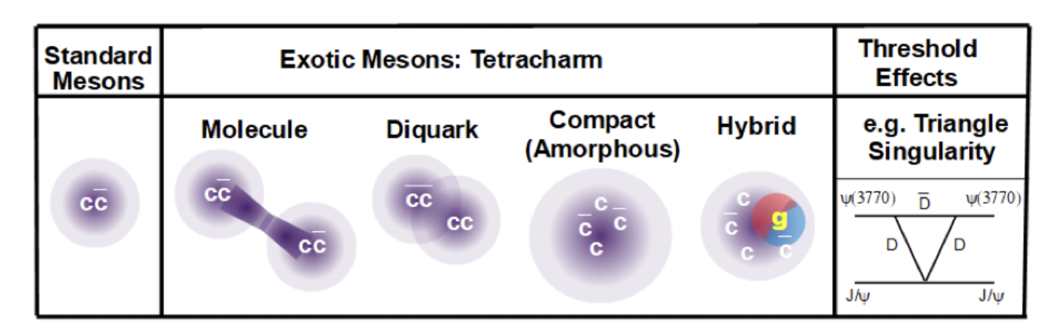
Theoretical models
Models of potential quark conﬁgurations for J/ψJ/ψ mesons.
  Meson-meson “molecule” ($c\overline{c}$- $c\overline{c}$)
  Pair of diquarks ($cc$-$\overline{c}\overline{c}$)
  Hybrid with a valence gluon
  Peaks as artifact of dicharmonia production thresholds
  ……
What are their internal structures?
Spin-parity measurement provide critical insights
14

Slide 15
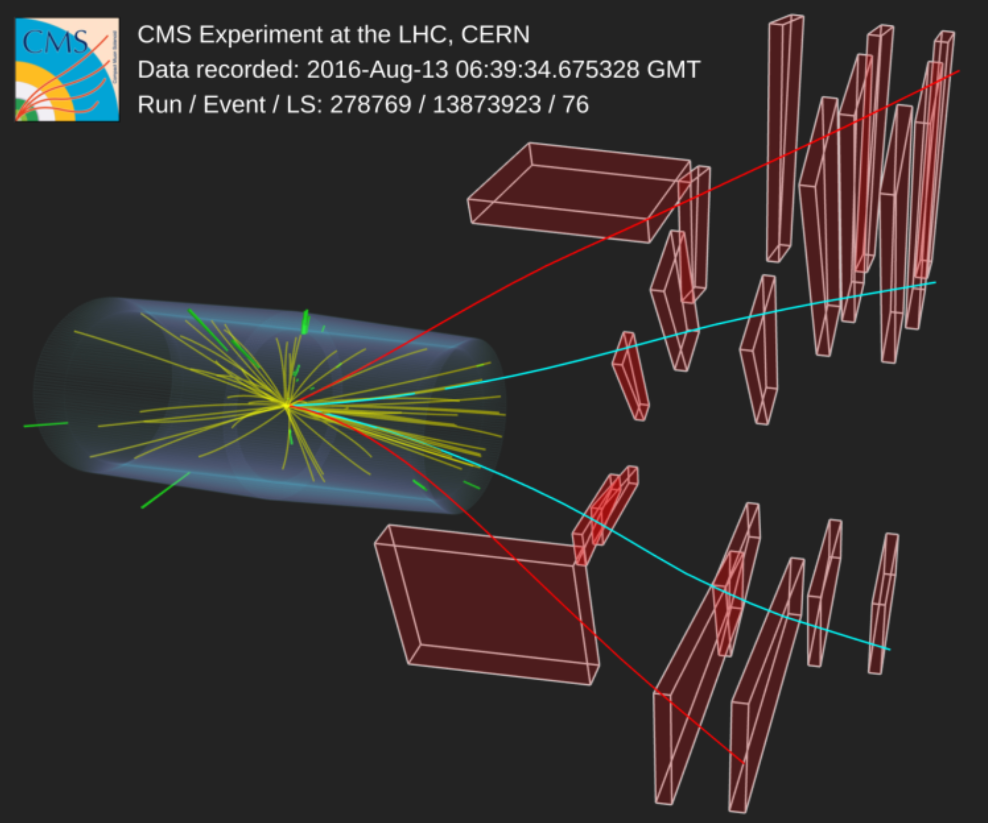
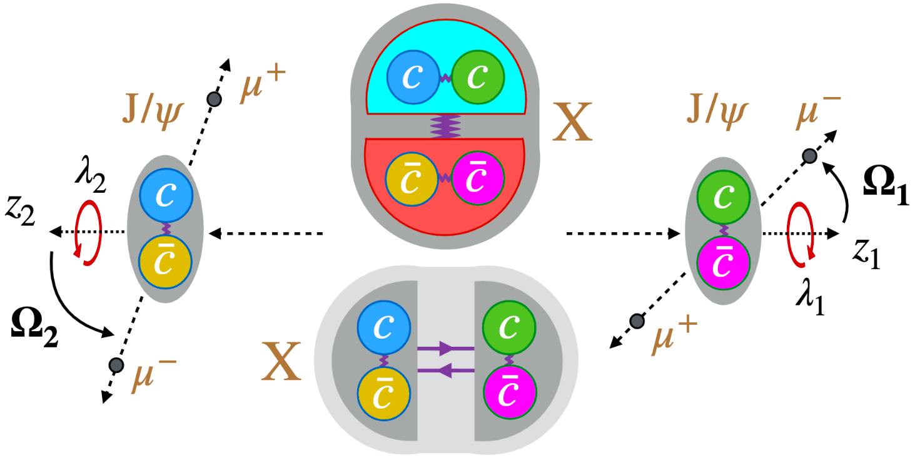

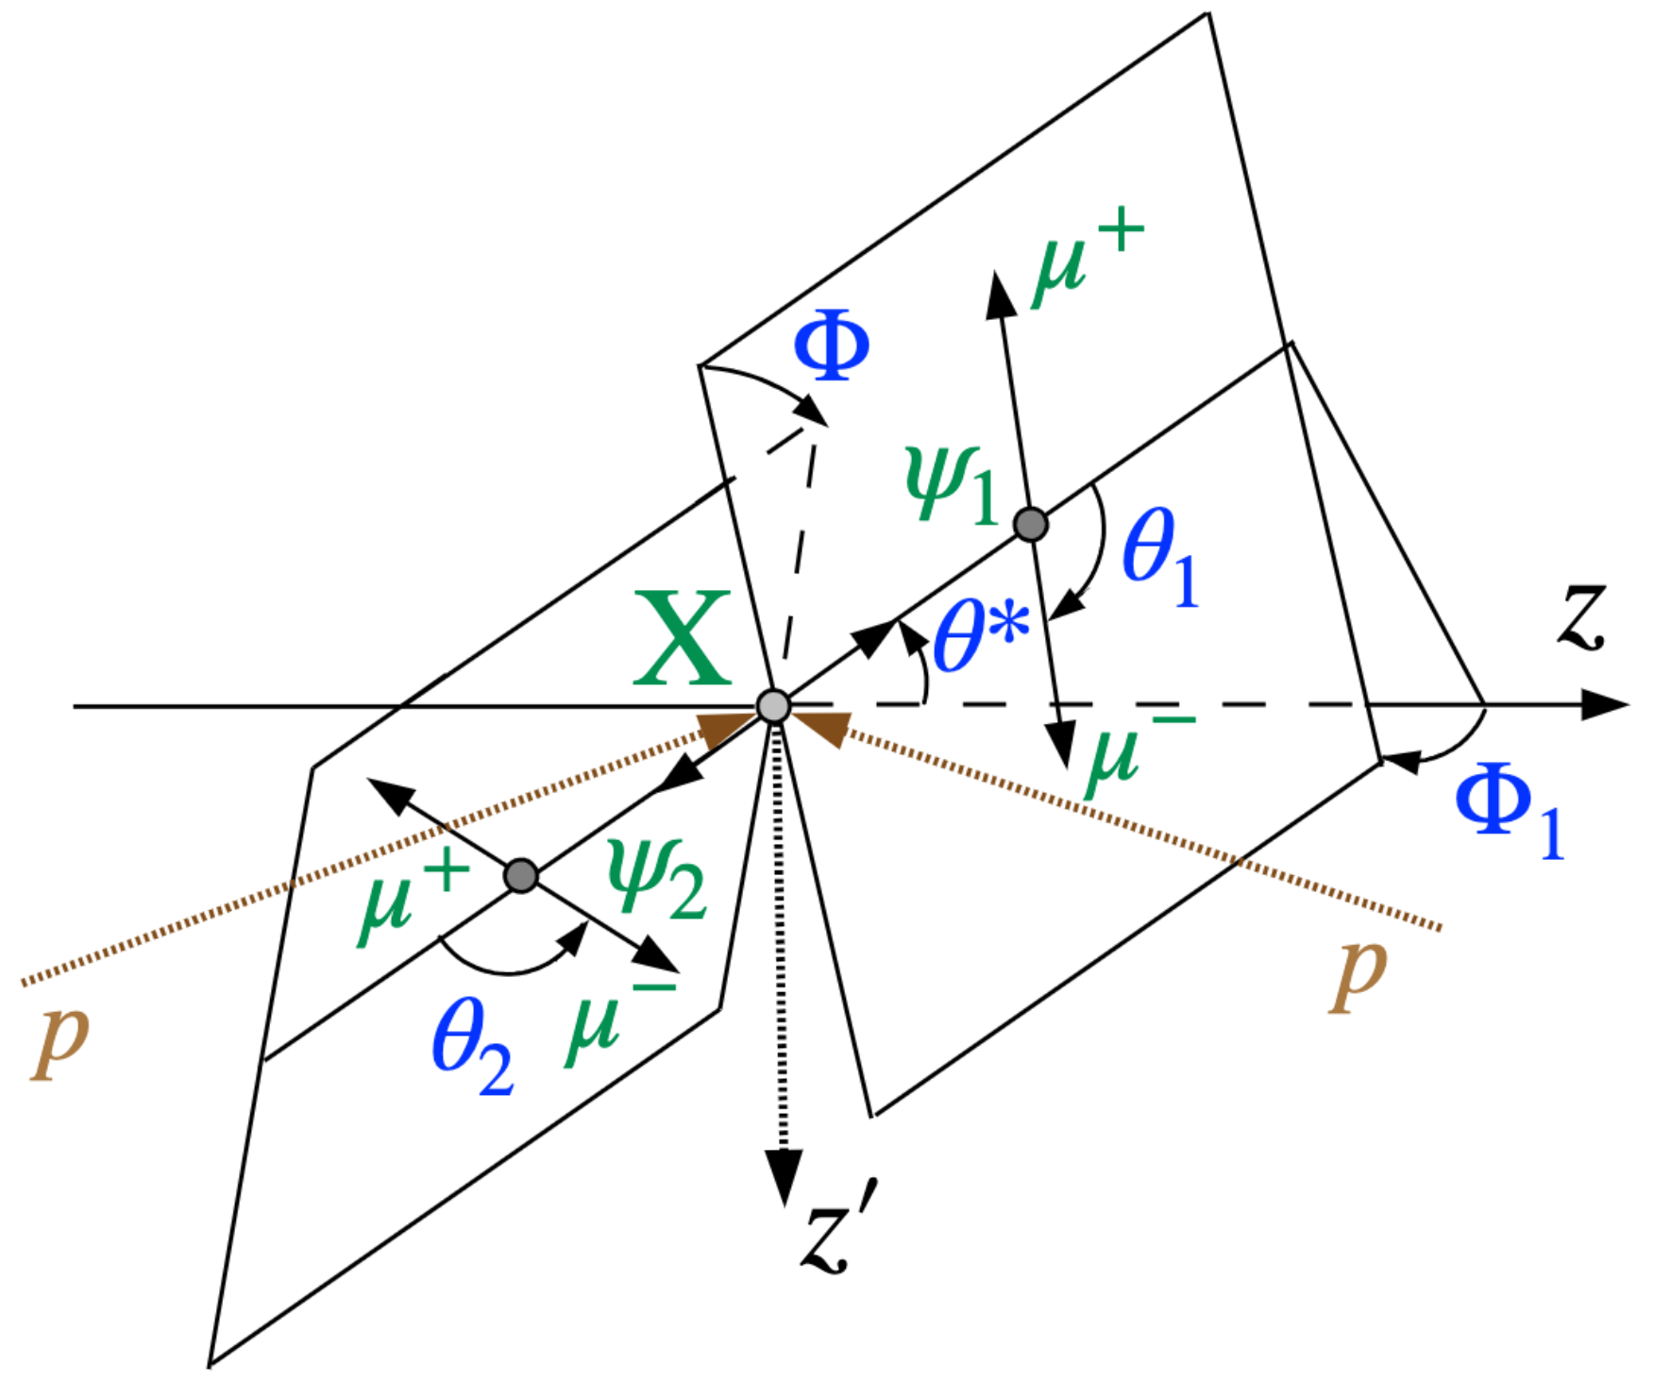



Spin parity analysis
15

Slide 16
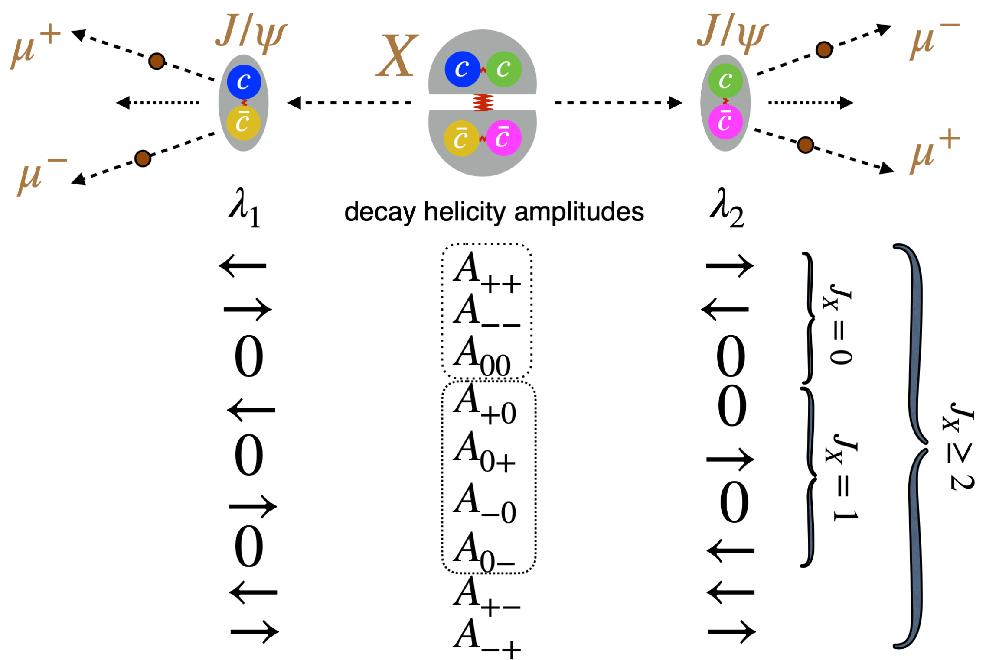

$J/ψ$ polarizations
16

Slide 17
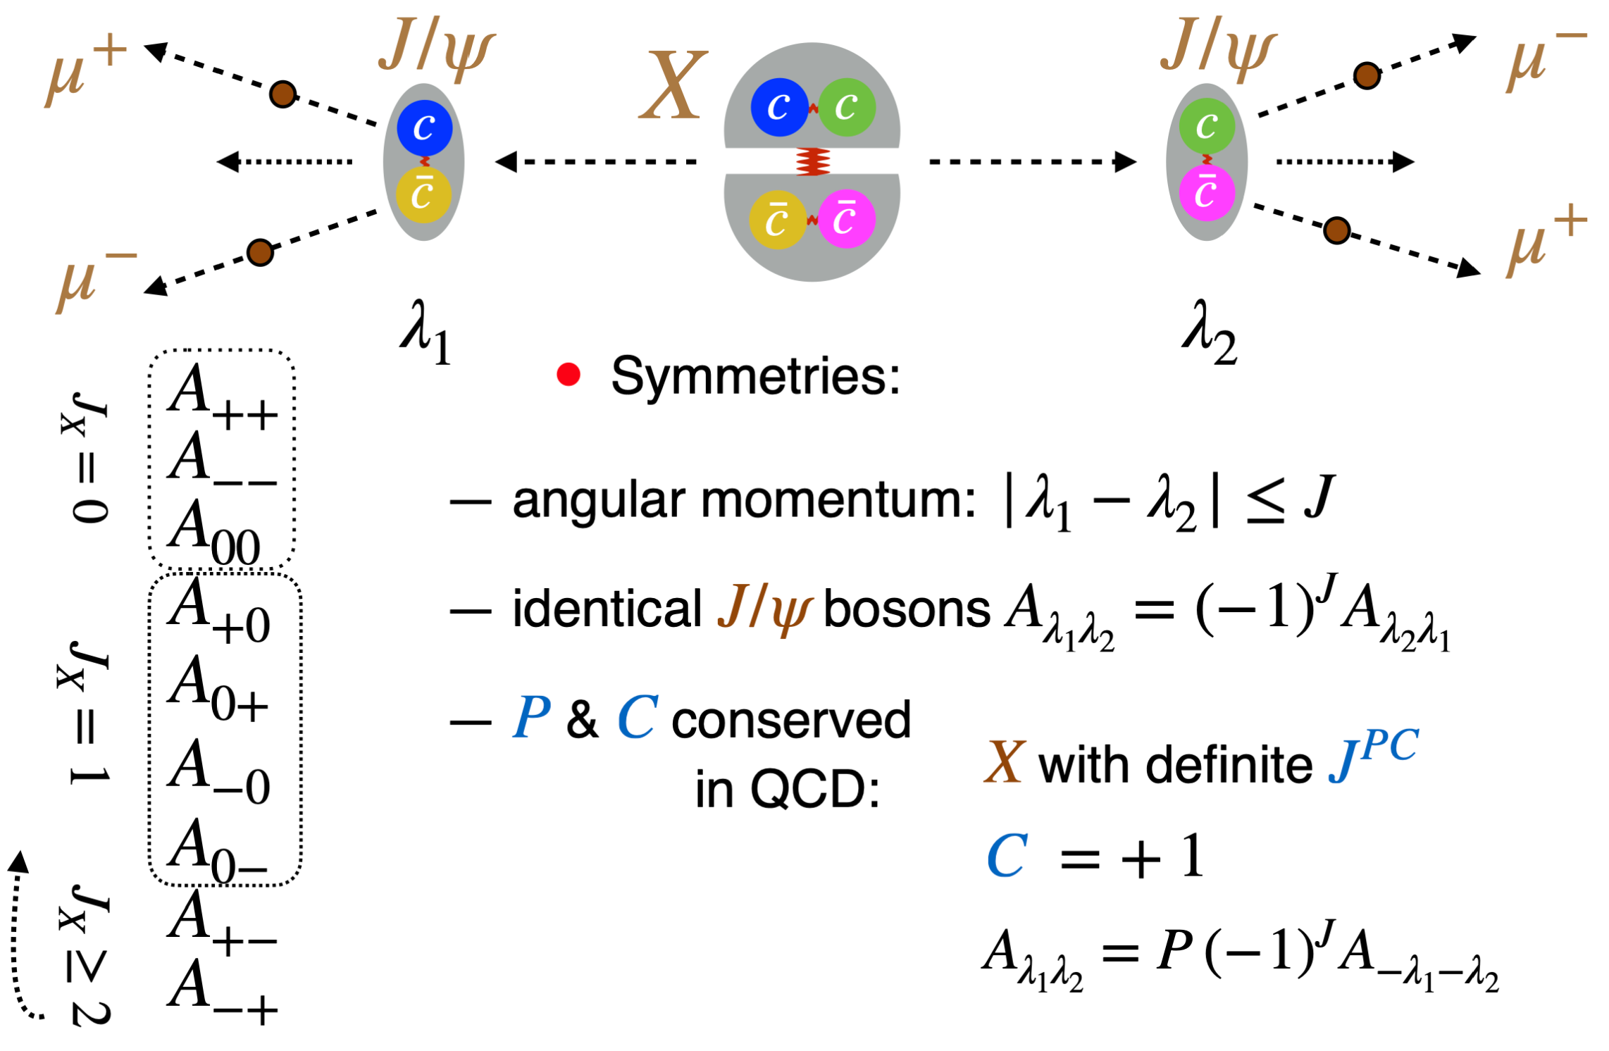
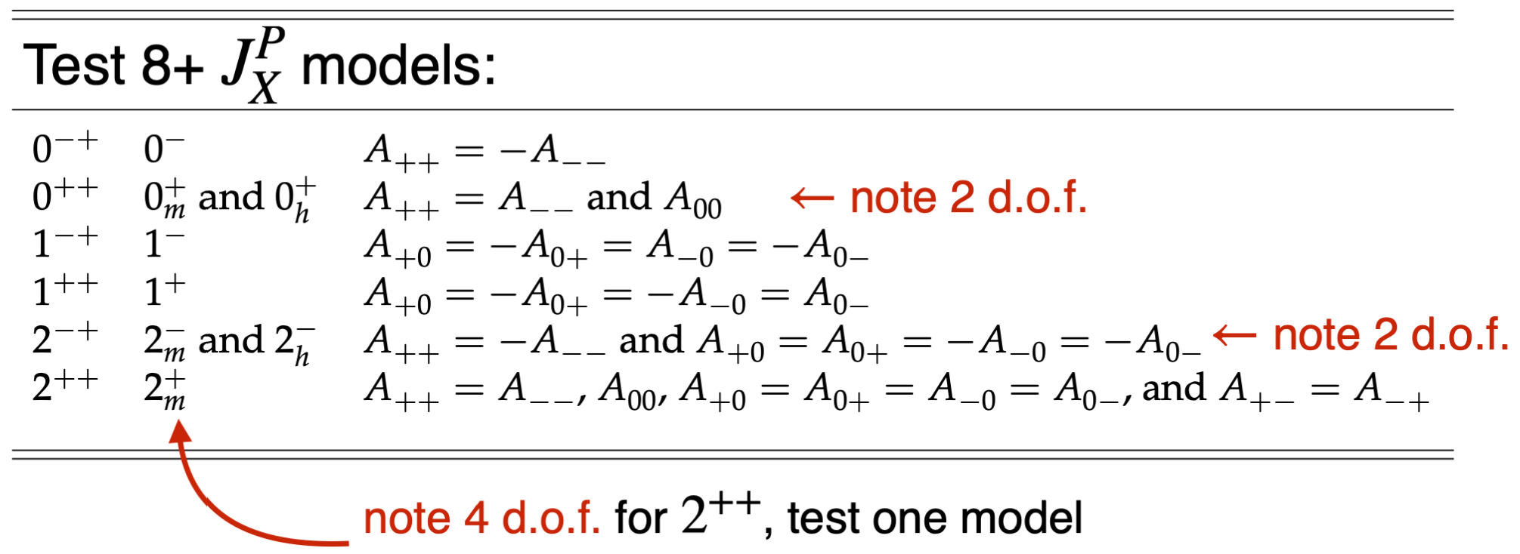
$J/ψ$ polarizations
17

Slide 18
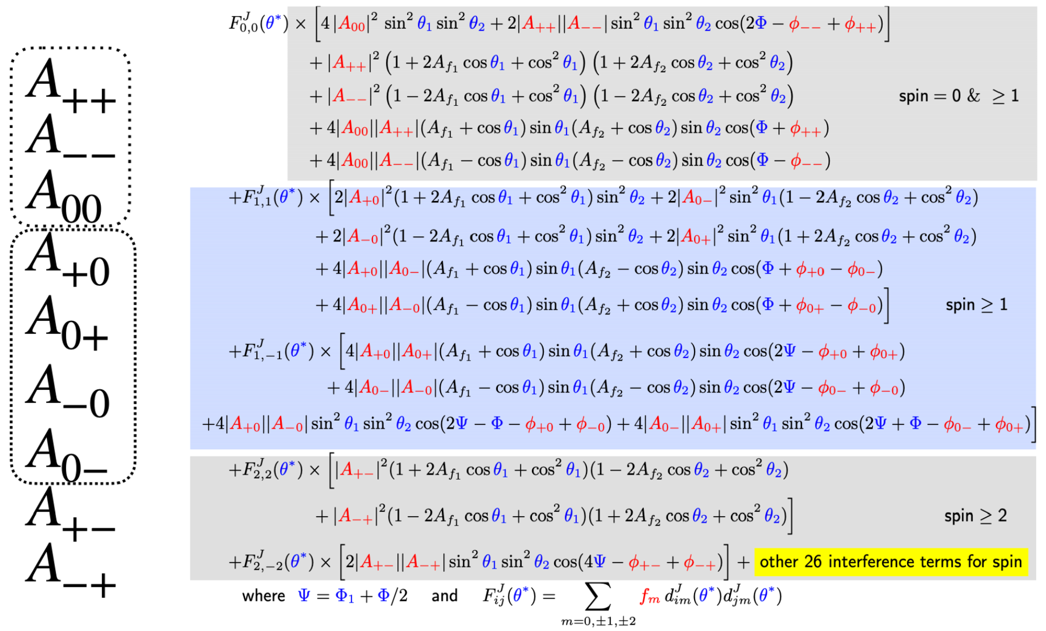
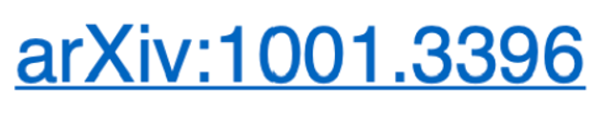
Angular Analysis
Valid
for any J
18

Slide 19
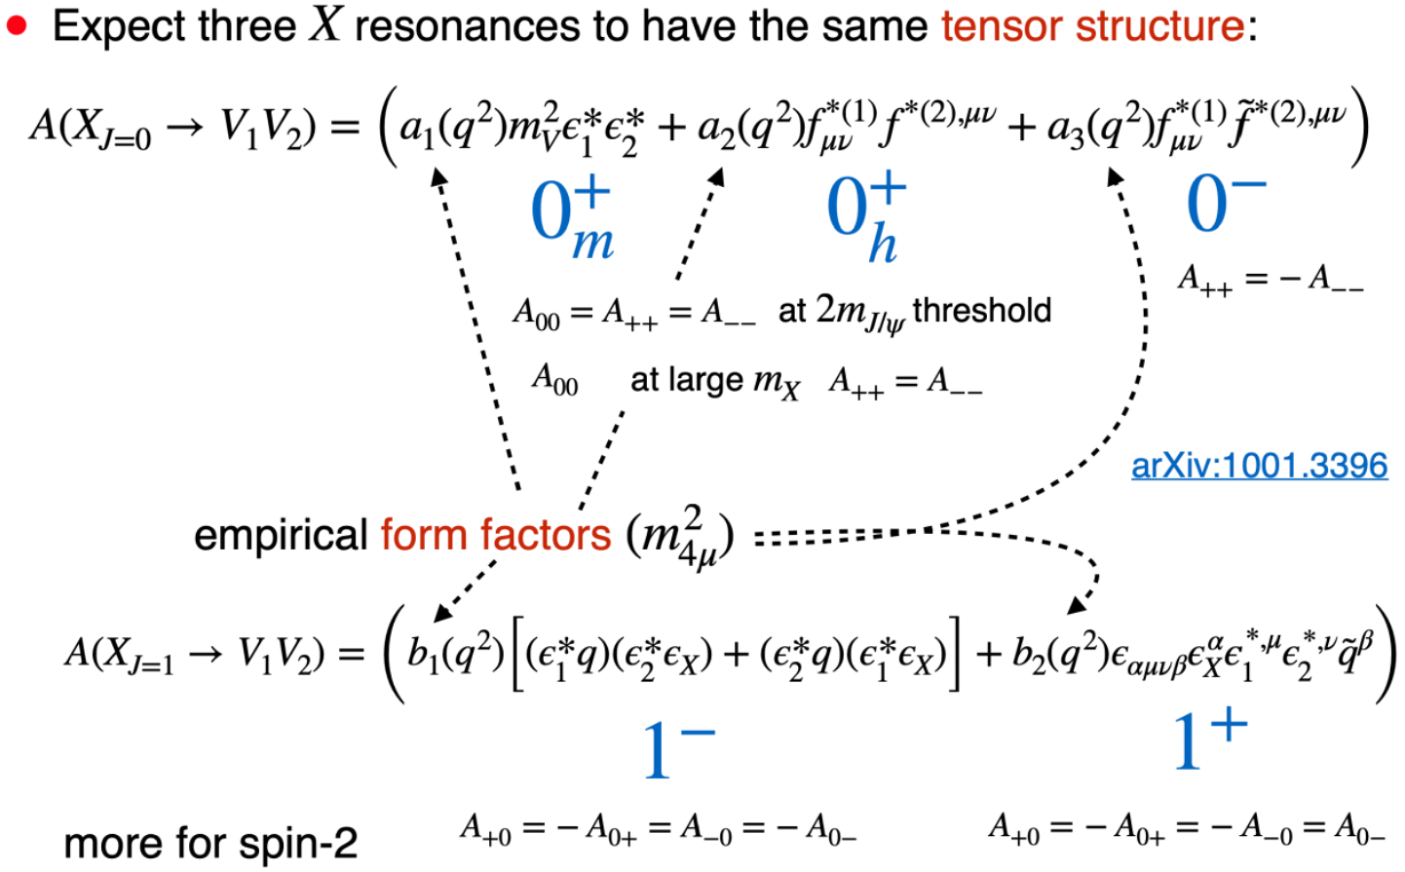
Lorentz-Invariant Amplitude
19

Slide 20
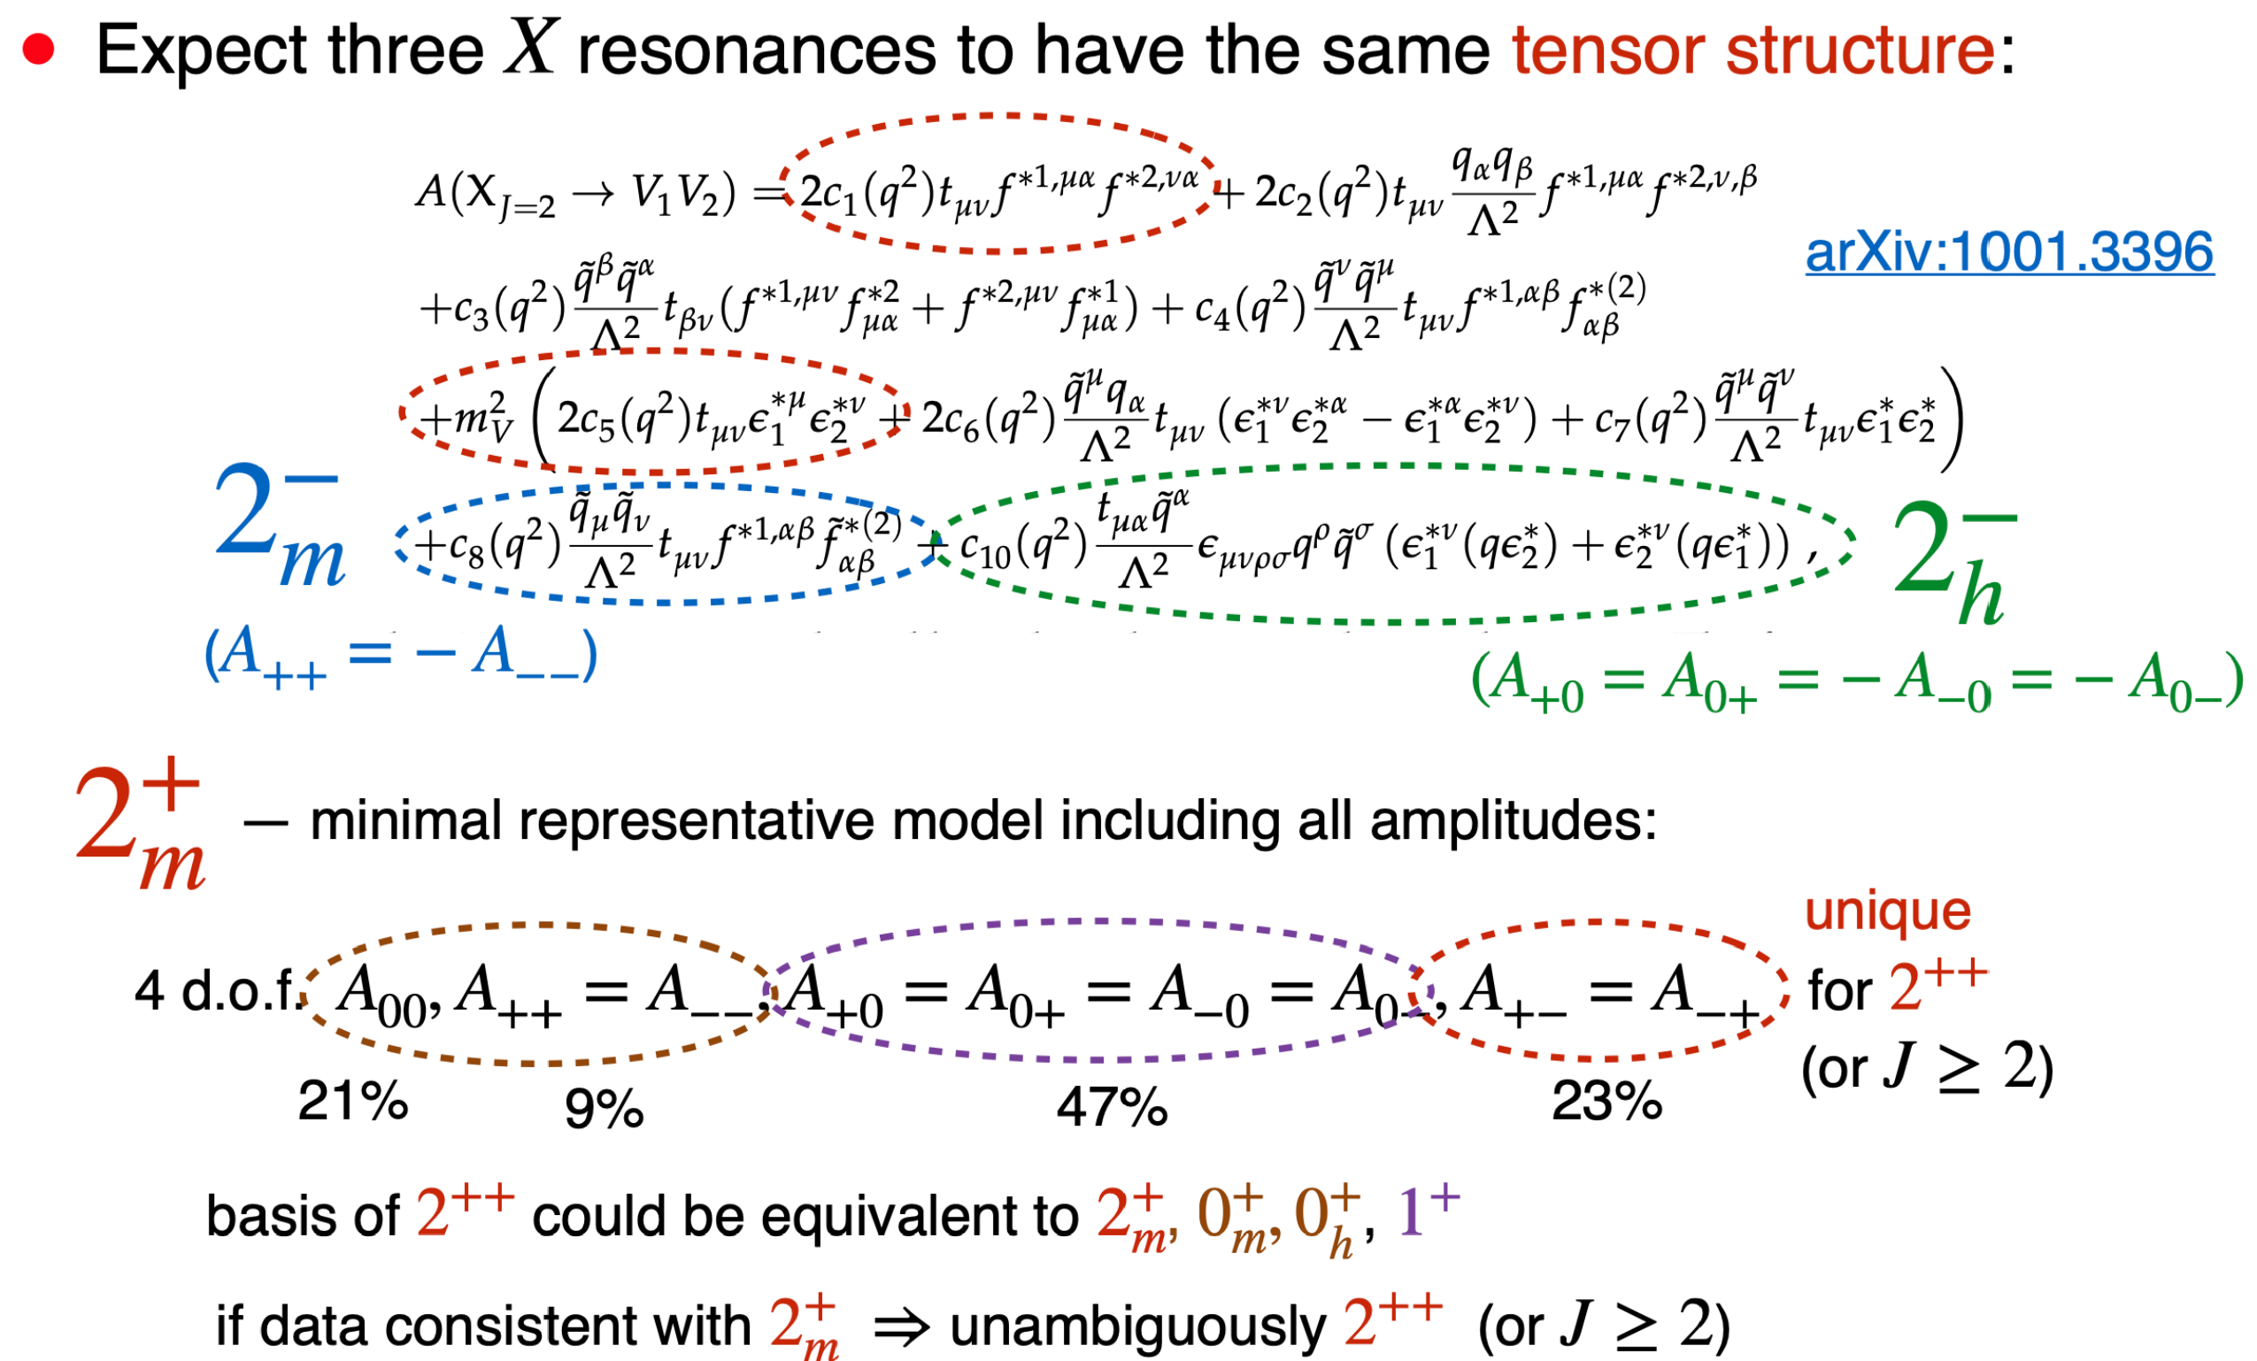
Lorentz-Invariant Amplitude
20

Slide 21
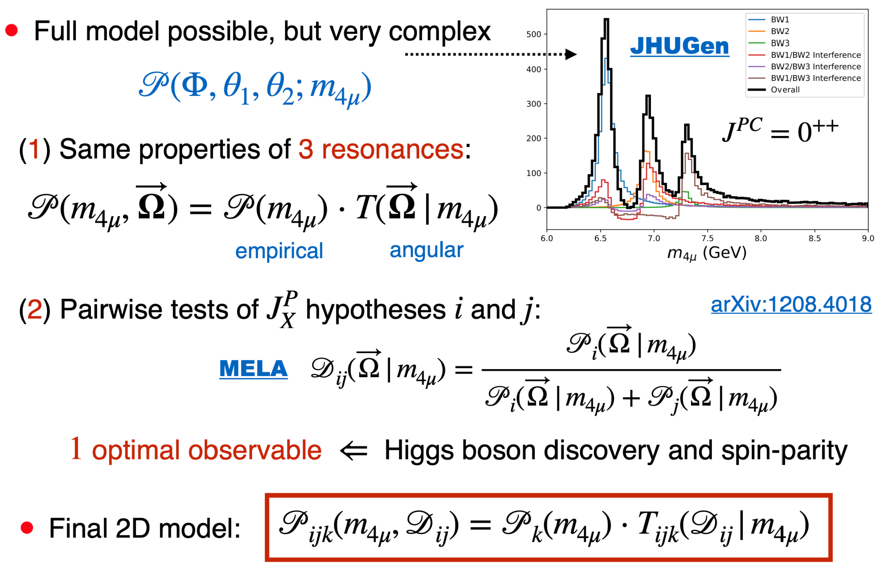

Simplification in Angular Analysis
21

Slide 22
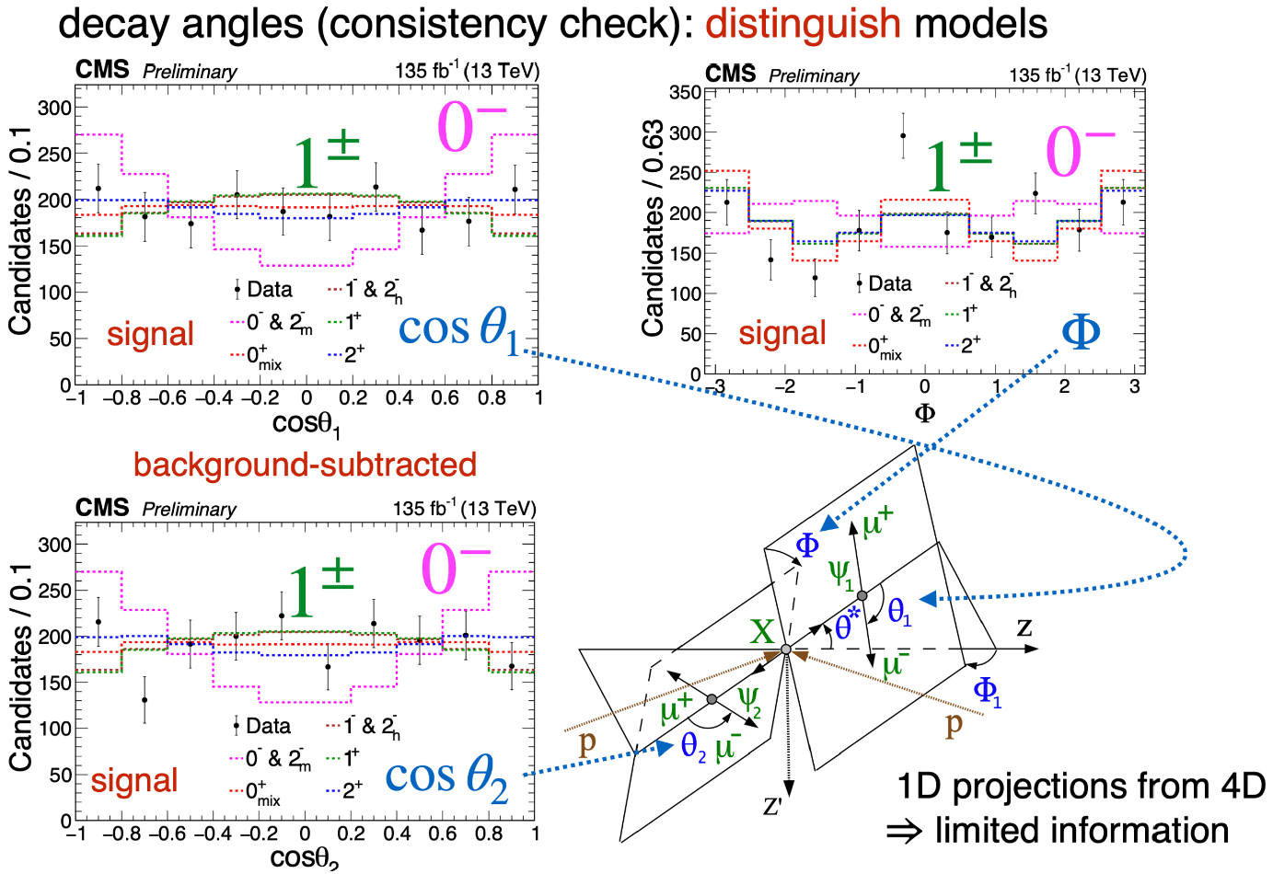


Decay Angles
Production angles not use
Consistent with unpolarized (backup)
22

Slide 23
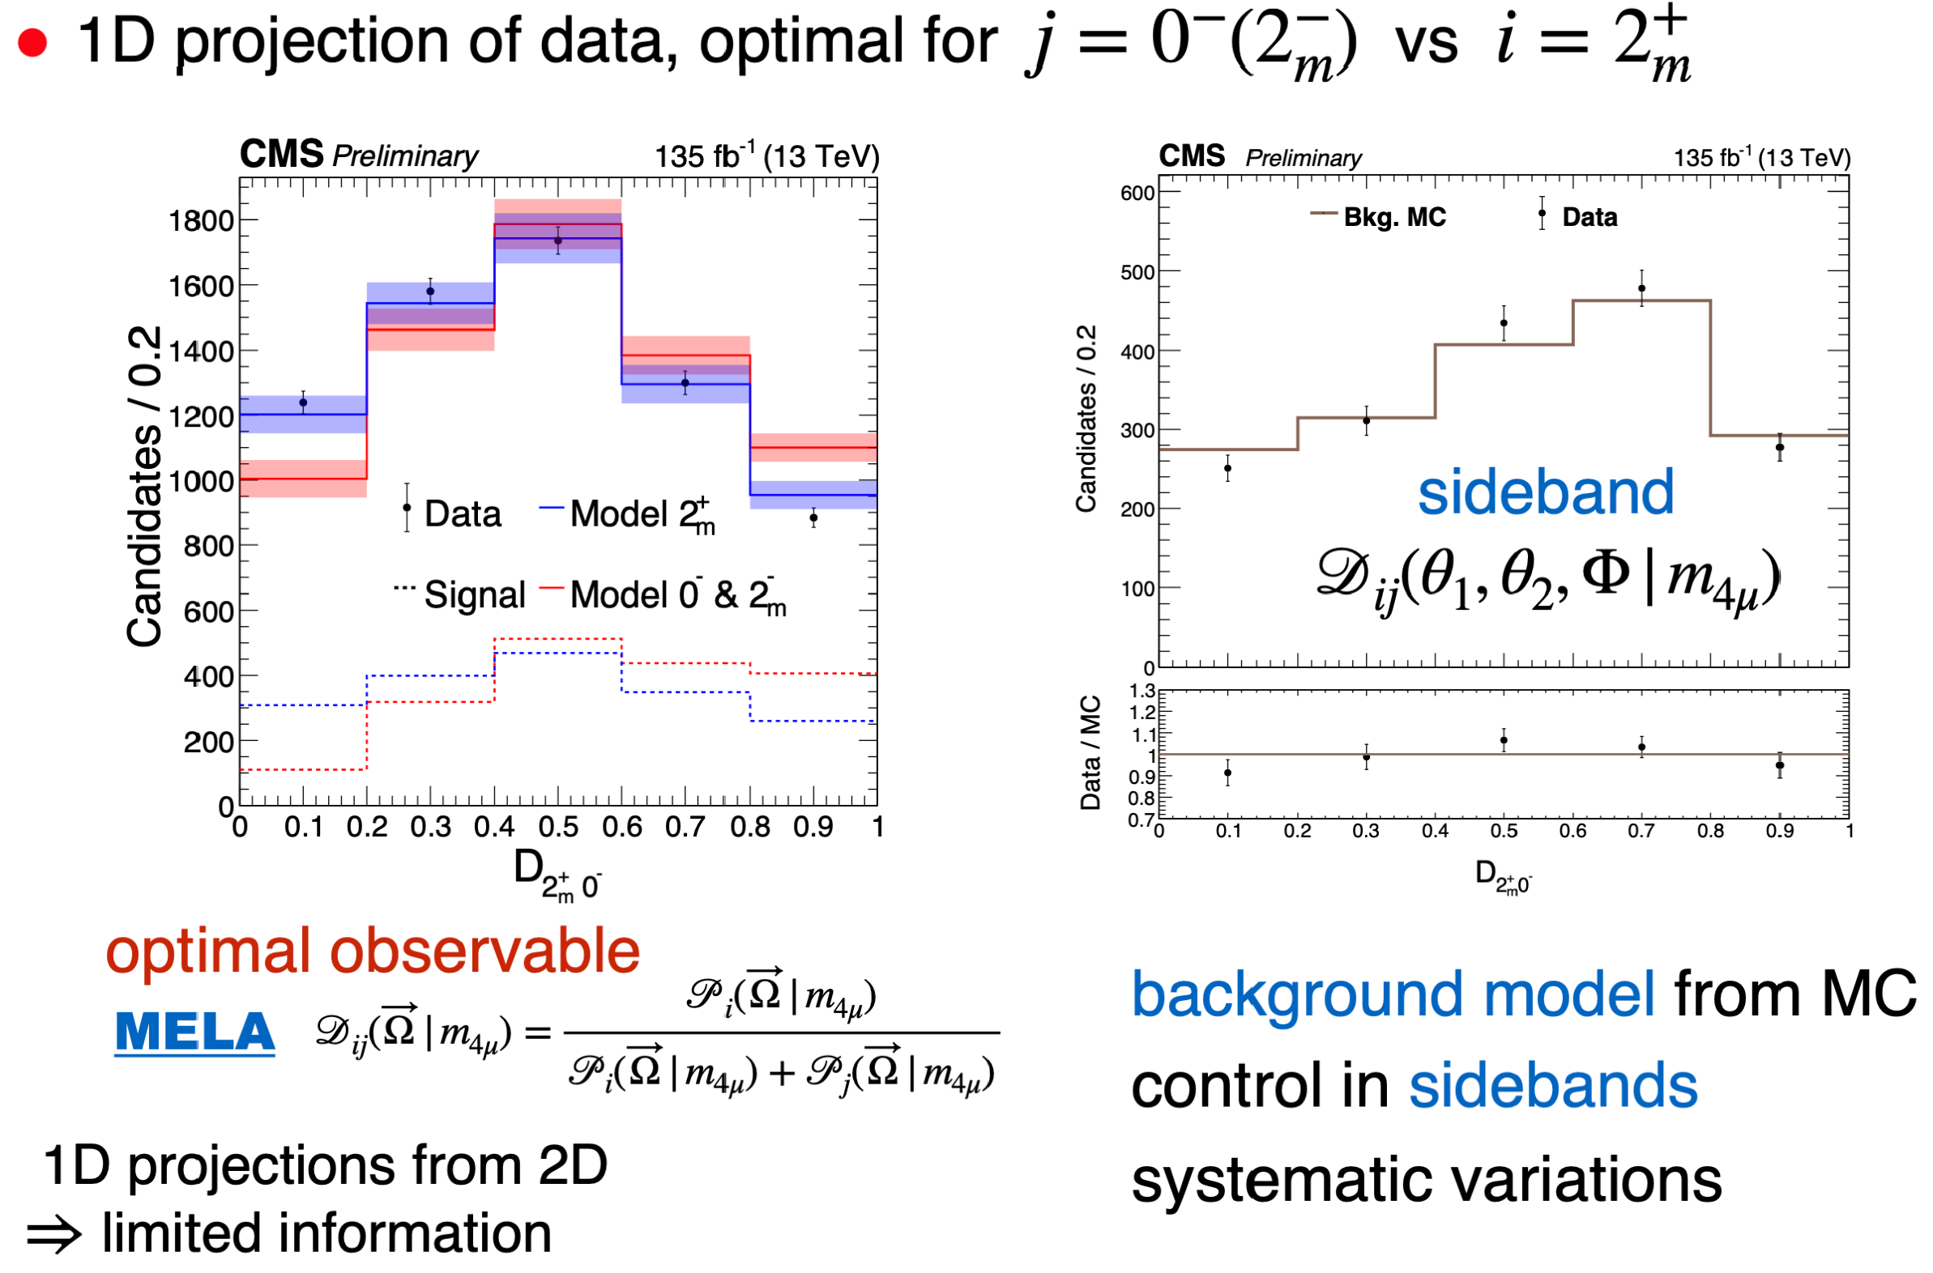

Optimal Observable
23

Slide 24
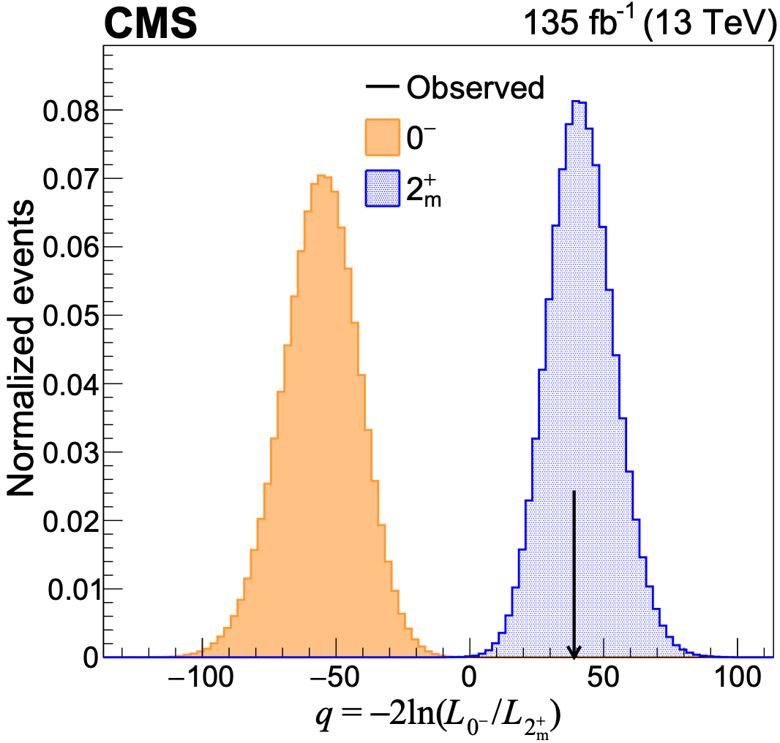
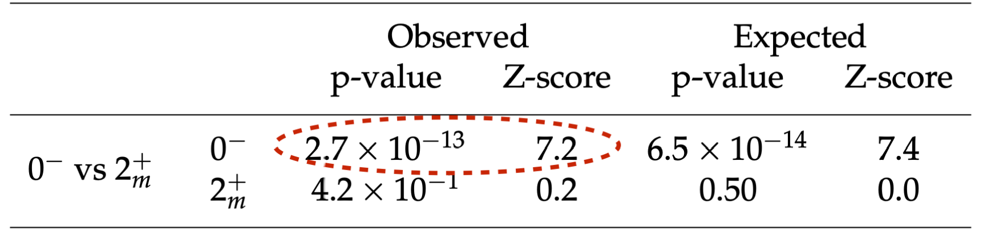
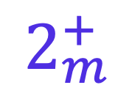

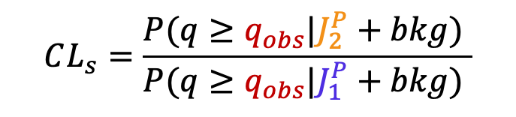
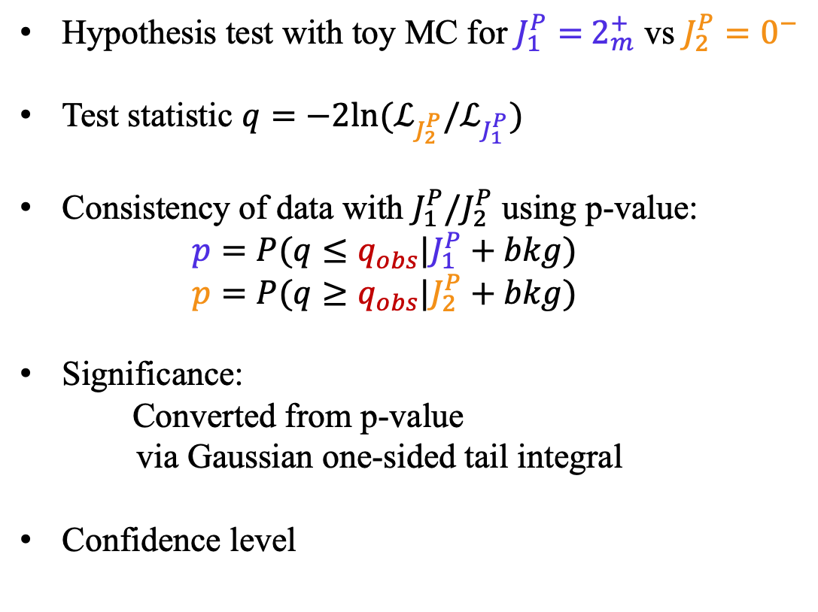

Statistical Analysis
Hypothesis test with toy MC for $J_{1}^{P}=$ $2_{m}^{+}$ vs $J_{2}^{P}=0^{−}$
Test statistic $q=−2ln⁡(ℒ_{J_{2}^{P}}/ℒ_{J_{1}^{P}})$
Consistency of data with $J_{1}^{P}/J_{2}^{P}$ using p-value:
  $$p=P(q≤q_{obs}|J_{1}^{P}+bkg)$$
  $$p=P(q≥q_{obs}|J_{2}^{P}+bkg)$$
Significance:
  Converted from p-value
  via Gaussian one-sided tail integral
Confidence level
$$0^{−}$$
$$2_{m}^{+}$$
observed $q_{obs}$
$$CL_{s}=\frac{P(q≥q_{obs}|J_{2}^{P}+bkg) }{P(q≥q_{obs}|J_{1}^{P}+bkg) }$$
24

Slide 25
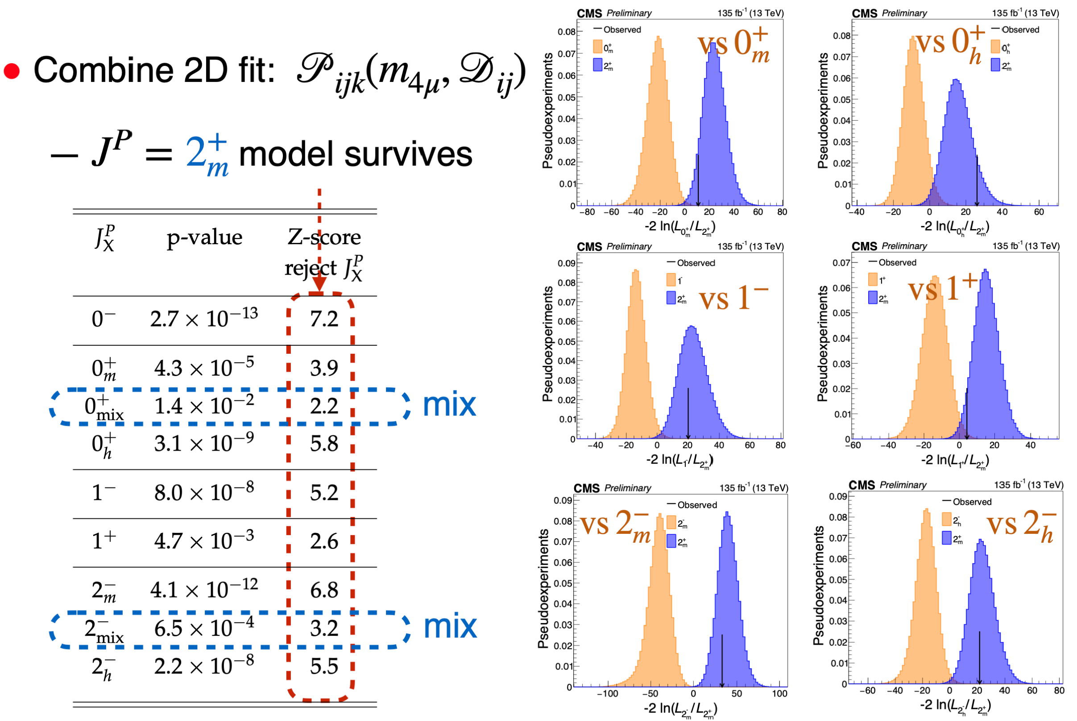

Hypothesis test
$PC=++$ very certain
$J≠1$ at > 99% CL
$J≠0$ at > 95% CL
$J>2$ less likely
$J=2$ consistent, rare
25

Slide 26

Summary
A family of all-charm tetraquarks with $J^{PC}=2^{++}$
  Three structures X(6600), X(6900), X(7100) established with significances > 5σ
    The first two analyses including 2024 data among LHC 3 exps
    Precision improved by factor of 3
    Multiple states makes comparisons possible
  Quantum interference among structures validated with significances > 5σ
  ==> States have common J^{PC}, measured as $2^{++}$
  Large mass splittings, Regge trajectory
  ==> radial family of states
CMS is painting a coherent picture of $J/ψJ/ψ$ structures
THANKS!
26

Slide 27

27

Slide 28





Internal structure
Compact tetraquark
(diquark-antidiquark)
Molecule
(meson-meson)
Bound state of two mesons
Sexaquark “molecule”
connected by residual strong (nuclear) force, like proton and neutron in a nucleus
Connects two colored objects through direct strong interactions, like quarks in a proton or neutron
28

Slide 29




Internal structure
Fundamental study of matter at quark level
  Unique all-heavy tetraquark states
Quantum numbers $J^{PC}=?$ directly related to structure
Compact tetraquark (diquark-antiquark)
  ($cc$) or ($\overline{c}\overline{c}$) identical
  antisymmetric total wave function (Pauli exclusion principle)
  color anti-triplet (attraction)
  $L=0$, axial vector $S_{1,2}=1$
Molecular: less restrictions (meson $S_{1,2}=0,1$)
$J^{PC}=2^{++}$: consistent with diquark-antidiquark model with spin-1 diquarks and $L=0$
29

Slide 30

Discussion
Phys. Rev. Lett., 132(11):111901, 2024
Chinese Phys. Lett. 41 111201
$Υ$ Family
Run 2+3
Res. Diff Indices:
1: Y(2S)-Y(1S)
2: Y(3S)-Y(2S), X(6900)-X(6600)
3: Y(4S)-Y(3S), X(7100)-X(6900)
Run 2
Run 2
Interference imply same $J^{PC}$quantum numbers
> 200 MeV mass splittings among triplet similar to $Υ$ family
Squared masses of triplet align Regge trajectory ==> Radial excitations
Regge plot favors spin-1 diquark model
Width trend similar to $Υ$ family
30

Slide 31



Family of all-charm tetraquarks with $J^{PC}=2^{++}$
offers new perspectives on interpretation for exotics
S(diquark)=1
S(antidiquark)=1
J=2
L=0
31

Slide 32
New conventional hadrons at LHC
32

Slide 33
New exotic hadrons at LHC
33

Slide 34


𝐽/𝜓𝐽/𝜓: 6-15 GeV fits
34

Slide 35




Concept of Analysis: Production
match $p_{z}^{X}$
match $p_{T}^{X}$
35

Slide 36


Fit model
Final 2D fit model ($0^{+} vs. 0^{−}$):
${P(m_{X},D}_{0^{−}})=$……
$+N_{\left(interf−BW1BW2BW3\right)}∗\left[f_{0_{m}^{+}}∗P_{0_{m}^{+}\left(interf−BW1BW2BW3\right)}{(m_{X},D}_{0^{−}}\right)$
$+\left(1−f_{0_{m}^{+}}\right)∗P_{0^{−}\left(interf−BW1BW2BW3\right)}{(m_{X},D}_{0^{−}})]$
$f_{0_{m}^{+}}$: fraction of $0_{m}^{+}$ signal component
36

Slide 37

Concept of Analysis: Production
37

Slide 38

Angular Analysis
38

Slide 39

Polarization in Production
39

Slide 40

Production Angles
40

Slide 41

Production Angles
41

Slide 42

Discriminant Distributions
42

Slide 43

Hypothesis test
43

Slide 44


Summary of Results
44

Slide 45

Fit results
45

