Slide 1

Exploring Exotic Spin-Dependent Interactions Beyond the Standard Model
Haiyang Yan(闫海洋)/Liangyong Wu(吴良勇)
Ningbo University
2025/9/24
SPIN 2025 Qingdao
Notes:
Good morning everyone. I’m Liangyong Wu.
My talk today is about: Exploring Exotic Spin-Dependent Interactions Beyond the Standard Model.

Slide 2
Outline
Motivation and Theoretical Background
Experimental Investigations
Summary
Notes:
Here is the outline of my talk:
I’ll start with the motivation and give some theoretical background.
Then I’ll go through experimental investigations at different scales.
And finally, I’ll wrap up with a summary.

Slide 3

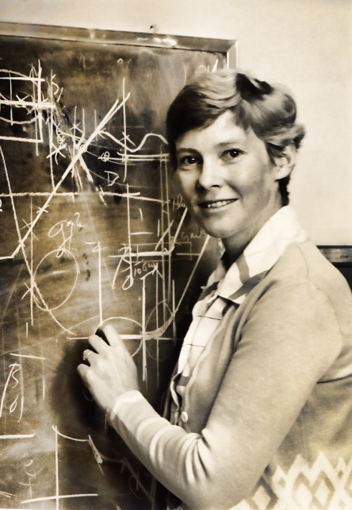
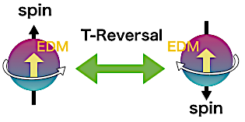
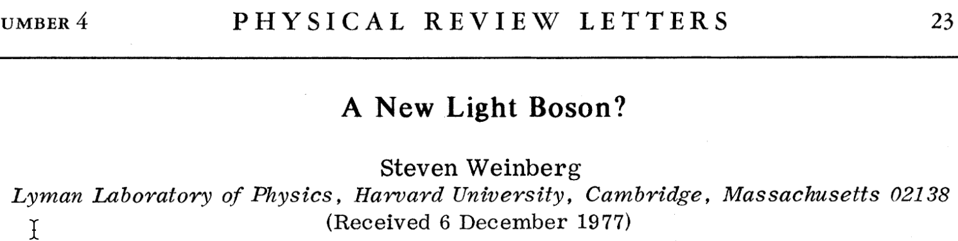


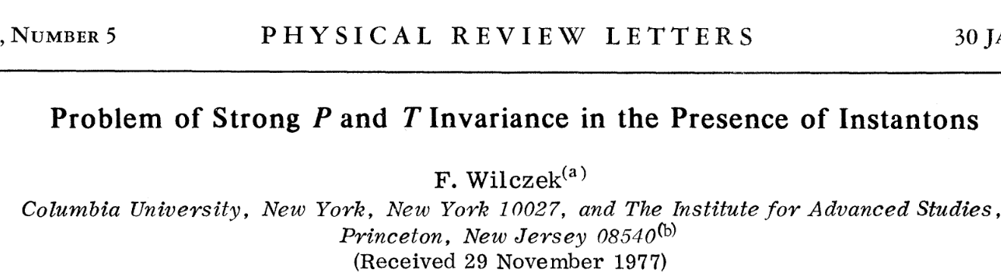
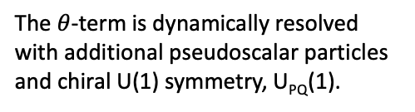
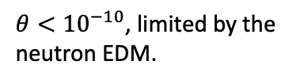
Spin-dependent interactions mediated by axions
CP-violation in Strong Interaction
Peccei-Quinn (PQ) Symmetry
The $θ$-term is dynamically resolved with additional pseudoscalar particles and chiral U(1) symmetry, U_{PQ}(1).
R. Peccei and H. Quinn, Phys. Rev. Lett. 38, 1440 (1977);
R. Peccei and H. Quinn, Phys. Rev. D 16, 1791 (1977).
$θ<{10}^{−10}$, limited by the neutron EDM.
Wilczek and Weinberg identify axions, very light, neutral pseudoscalar particles, arising from this mechanism.
F. Wilczek, Phys. Rev. Lett. 40, 279 (1978);
S. Weinberg, Phys. Rev. Lett. 40, 223 (1978).
Notes:
The axion originate from a solution to a problem of the Standard Model, called Strong CP Problem.
The QCD Lagrangian permits a CP-violating term, which would induce a nonzero neutron electric dipole moment.
However, experiments show the neutron EDM is incredibly small, which is unnatural in the theory, as we expect that the level of CP violation should be around 1.
In 1977, Peccei and Quinn proposed an elegant solution that introduces a new pseudoscalar field and new chiral U(1) symmetry.
Through absorbing the theta-term into the new field, they dynamicly eliminate the CP-violation in the strong interaction.
Later then, Wilczek and Weinberg found that this mechanism could produce new particle, which is very light and weak coupling to particle.
Wilczek named this particle, axion.

Slide 4
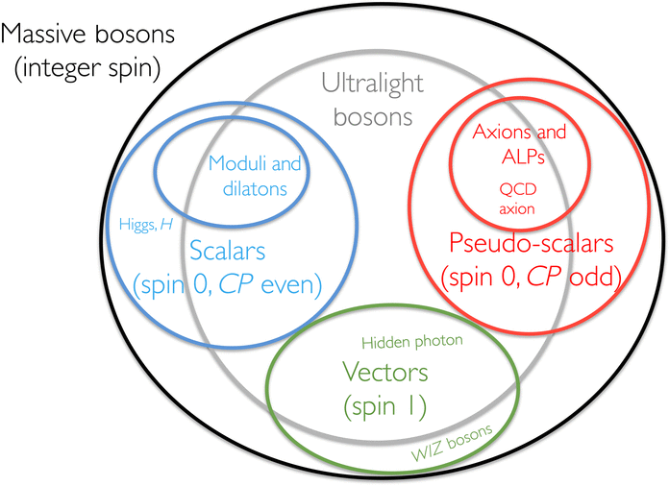
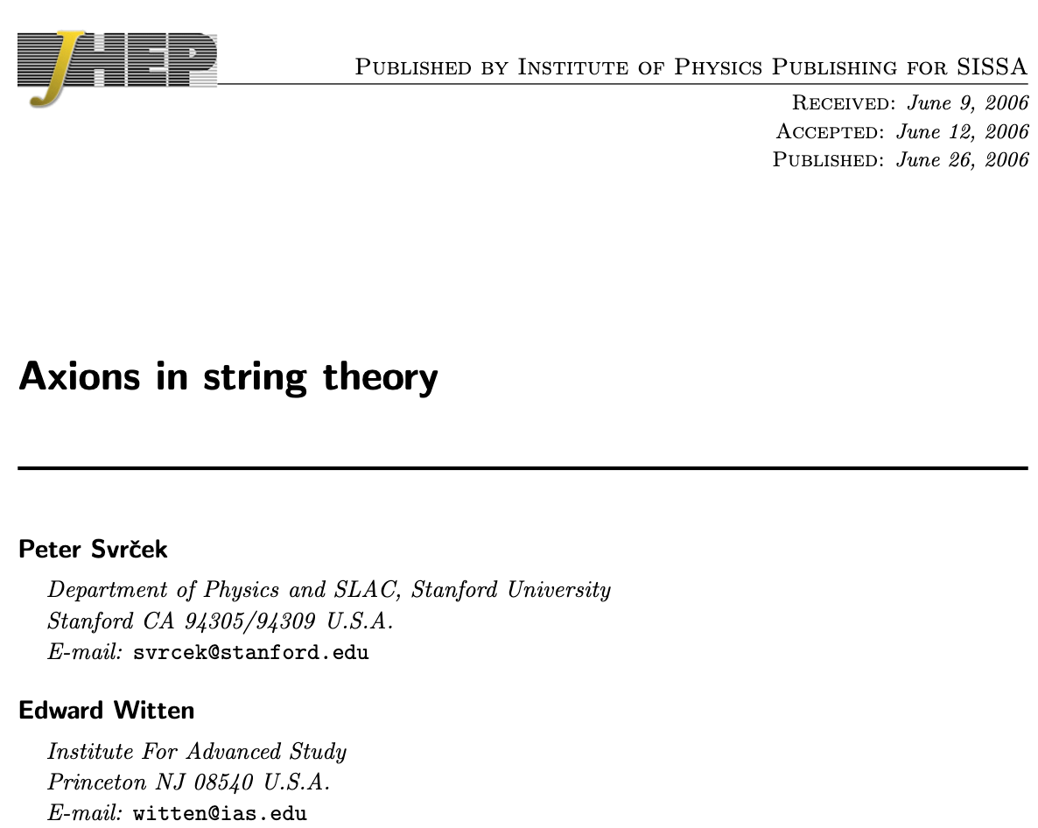
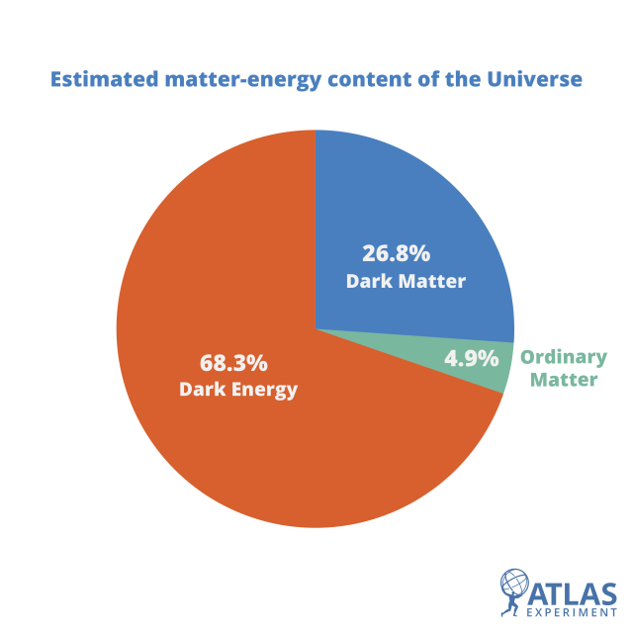
Axions: Bridging Modern Physics and Astronomy
Axions and axion-like particles (ALPs) also appear in many theories.
Plausible Dark Matter Candidate
F. Chadha-Day, J. Ellis and D. Marsh, Sci. Adv. 8, eabj3618 (2022).
Notes:
Nowadays, the idea of axion generation has been extended into many Standard Model Extension theories.
Specially, the axions and their generalizations, Axion-Like Particles or ALPs, appear naturally in string theory.
Due to their weak interacting property with ordinary matter. they are also plausible candidate for the dark matter.
These highlight the importance of detecting these particles in experiments.

Slide 5
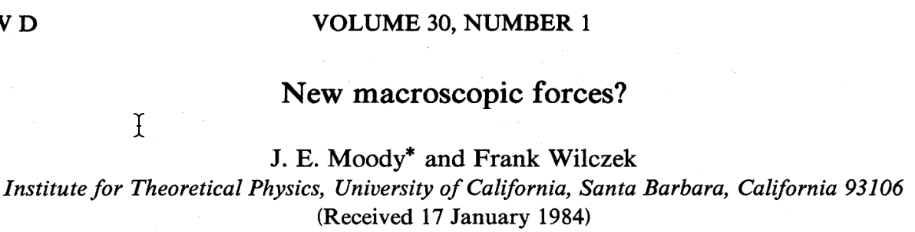
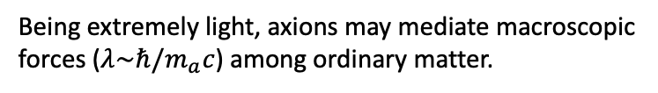
Spin-dependent interactions mediated by axions
Being extremely light, axions may mediate macroscopic forces ($λ\sim ℏ/m_{a}c$) among ordinary matter.
Interaction Lagrangian
Monopole-dipole type
Two fermions interacting via exchanging axion.
Interacting range:
Phys. Rev. D 30, 130 (1984).
Notes:
One way of detecting these particles is through searching for the interactions they mediated.
As the mass of the axions can be extremely light, we could detect them through the long range forces the mediated.
For the axion or axion-like particles, they could couple to the fermions through scalar and pseudoscalar vertex.
And in the non-relativistic limit, two types of exotic spin-dependent interactions are generated.
For the dipole-dipole one, it is similar to the magnetic dipole interaction, except that their spatial dependence is Yukawa-like potential.
The typ

Slide 6
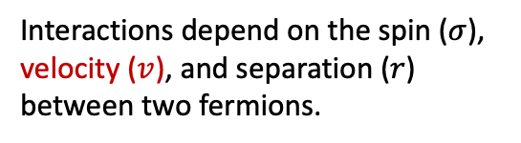
Spin-dependent interactions are ubiquitous
Light Z’ boson exchange
Monopole-dipole type
P. Fayet, Phys. Lett., 95B(2), 285, (1980).
Interactions depend on the spin ($σ$), velocity ($v$), and separation ($r$) between two fermions.
Notes:
Except axions， new vector particles from standard model extension—such as massive Z' bosons or paraphotons—can mediate spin-dependent interactions as well.
These interactions can depend not only on spin (σ) and separation (r), but also on the relative velocity (v) between particles.

Slide 7
Other types of spin-dependent interactions
Axion-wind
Lorentz and CPT-violating field
Peter W. Graham and Surjeet Rajendran, Phys. Rev. D 88, 035023 (2013).
V. Kostelecky and Charles D. Lane, Phys. Rev. D 60, 116010 (1999).
As a dark-matter candidate, the light axion behaves as an oscillating field that couples to spin.
The spin-dependent interactions arise from the Lorentz-violating extension of the standard model.
magnetic-dipole coupling
electric-dipole coupling
Notes:
Besides the Yukawa type exotic interactions, these interactions featuring the coupling between a field and spin
are also widely searched.
Besides these, we also outline the other type of spin-dependent interactions which as widely searched in the experiments.

Slide 8
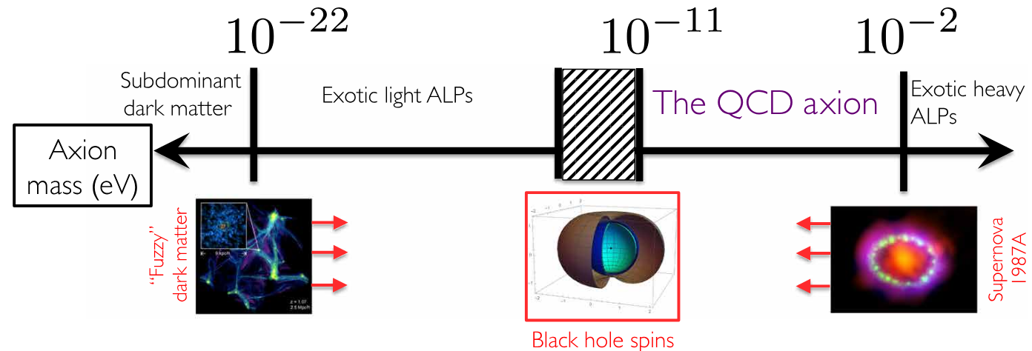
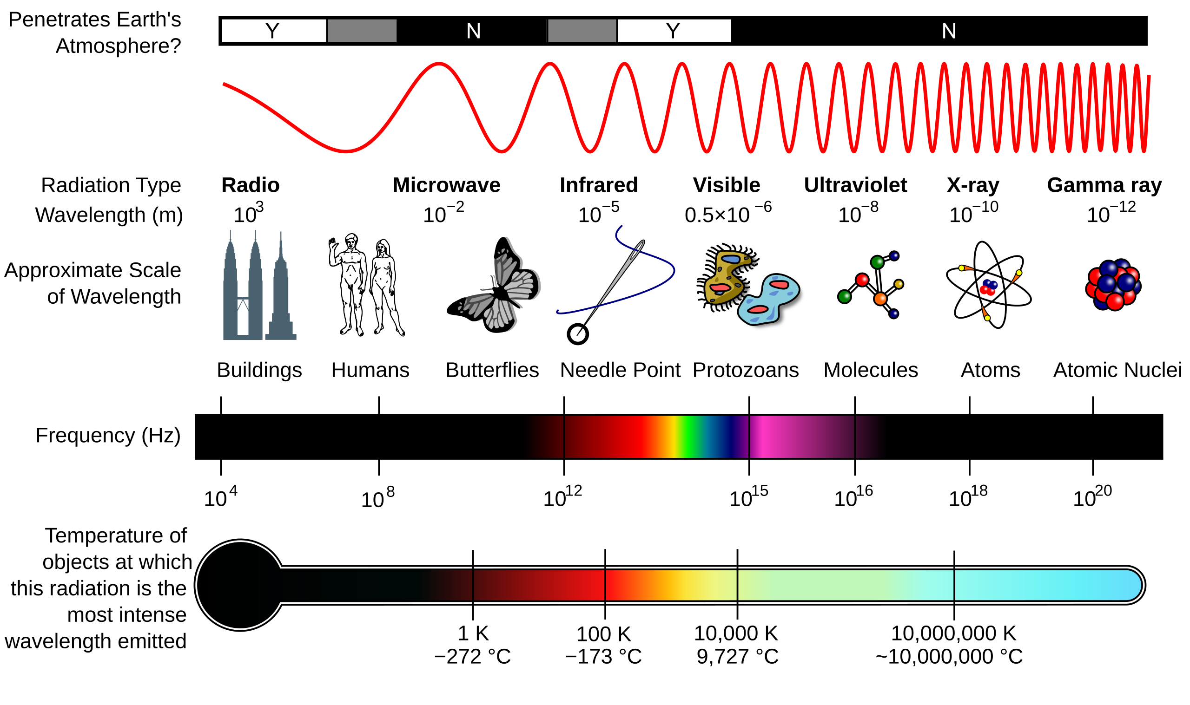


The Possible Axion Mass Range
Compton wavelength
$${10}^{16} m$$
$${10}^{−4} m$$
F. Chadha-Day, J. Ellis and D. Marsh, Sci. Adv. 8, eabj3618 (2022).
A variety of experiments are needed to explore the entire parameter space.
Notes:
One challenge of searching for the axions is that we have on prior information about the mass of it.
The possible mass of the axion, and hence the range of the force it mediates, is vast.
Even limited by the astrophysical consideration, its mass still across 24-orders of magnitude.
Therefore, we claim that to cover this immense parameter space, it requires a diversity of techniques,
each probing a specific range of masses and coupling strengths, from laboratory scales to astrophysical observations.

Slide 9
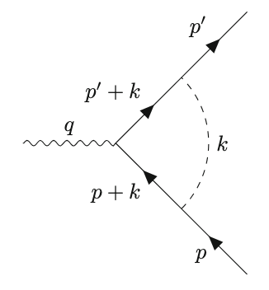
Detection at atomic scales: Muon g-2
The electromagnetic vertex correction contributed by new interactions.
Constraints on the coupling strengths of scalar and vector particles to muon.
EDM:
H. Yan, Eur. Phys. J. C (2019) 79:971.
Muon g-2:
Latest result on muon g-2:
R. Aliberti, arXiv.2505.21476.
L. Y. Wu and H. Yan, arXiv:2508.00504.
Notes:
At the atomic scale, we could constrain the exotic interaction with the EDM or the anomalous magnetic moment of the muon.
The idea is that, if the new particle interacts with the muon,
they should contribute to the electromagnetic vertex correction.
We could calculate the theoretical contribution of interaction to the EDM and g-2.
So, base on the discrepancy between the measured and theoretical value of the EDM and g-2 in the framework of standard model. Recently, the latest g-2 experiment reveal a consistent between the theory.
So based on the result, we could place constraints on new particles coupling to the muons.
As the muon experiment is ongoing worldwide, such as the muEDM experiment at PSI, we expect better constraints could be derived with the EDM data.

Slide 10
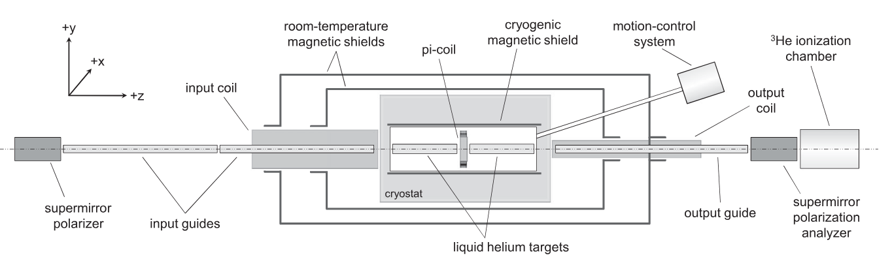
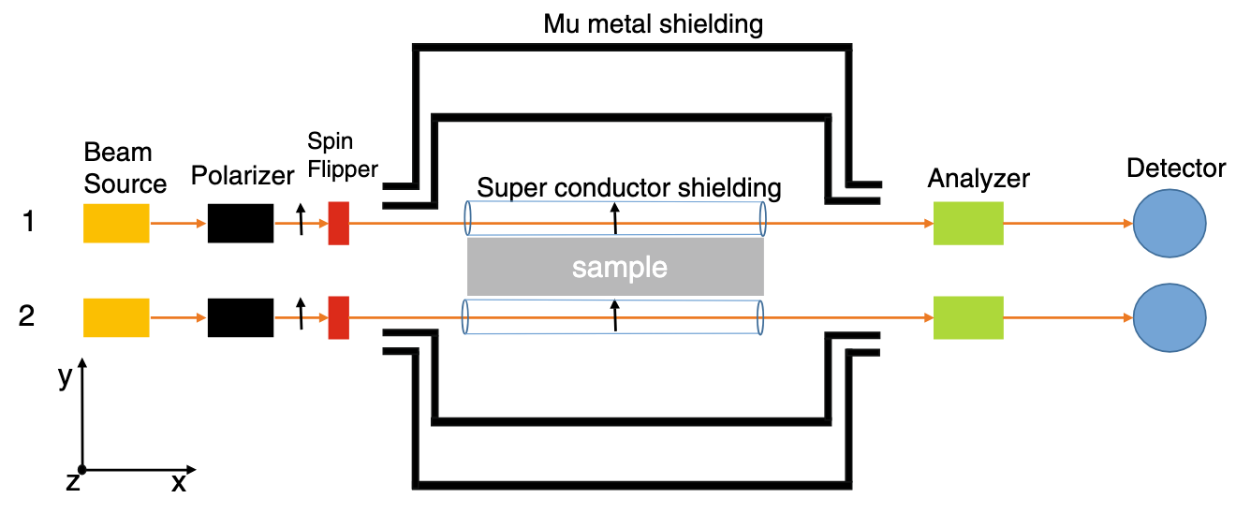

Detection at mesoscopic scales (mm-um): spin rotation
³He beam with high beam intensity ($\sim {10}^{14} atoms/s$)
H. Yan and W. M. Snow, Phys. Rev. Lett. 110, 082003 (2013).
Parity-odd:
³He spin rotation
H. Yan and et al., Eur. Phys. J. C (2014) 74:3088.
m (eV)
The most stringent constraint to date at${10}^{−6}<λ<{10}^{−2} m$.
Muon spin rotation based on $μ$SR technique
Notes:
Moving to millimeter scales, The neutron spin rotation technique is advantages in exploring the exotic interactions.
The basic idea is that pseudo-magnetic field generated by the exotic interaction will rotate the
Spin direction of the neutron.
As the neutron could pass through a medium almost without absorption,
The exotic interaction between the neutron and the unpolarized nucleon in the medium
could be measured at almost no-separation distance.
As shown in the plot, the strength of the VA coupling derived from this method remain the most strict in the micrometer range.
Similarly, a polarized 3He beam was proposed to to search for the exotic interactions. Based on the well-developed muon spin rotation technique, we could also explore the exotic interaction between muons at this range.

Slide 11
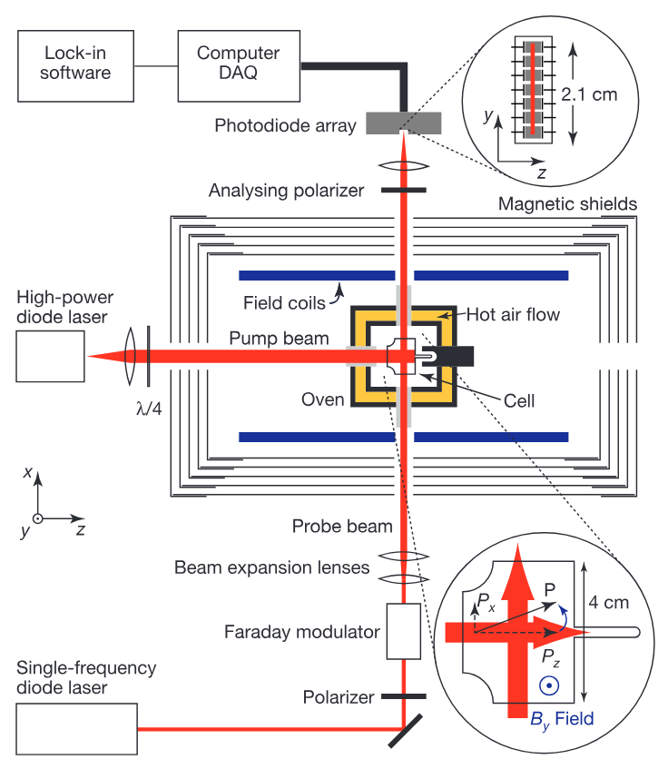
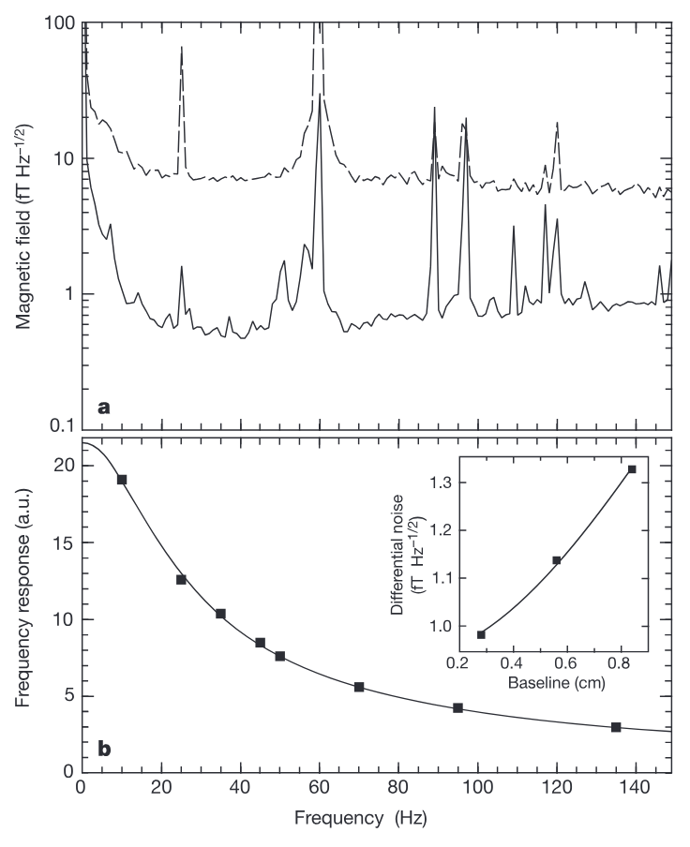

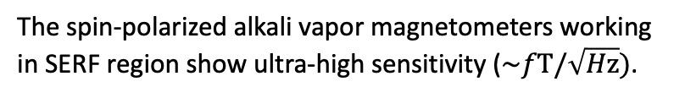
Detection at laboratory scales: atomic magnetometers
The spin-polarized alkali vapor magnetometers working in SERF region show ultra-high sensitivity ($\sim fT/\sqrt{Hz})$.
Commercial available alkali
magnetometer by QuSpin Inc.
I. Kominis, T. Kornack, J. Allred and M. Romalis, Nature 422, 596 (2003).
Notes:
In the laboratory scale, most experiment uses atomic magnetometers.
Especially after the development of ultra-sensitive alkali vapor magnetometer in 2003 which push the
sensitivity to below femtotesla per suare Hz.
The magnetometers based on the same principle are commercial available.
Although the sensitivity is inferior, its compactness is easy for deployment in array.

Slide 12
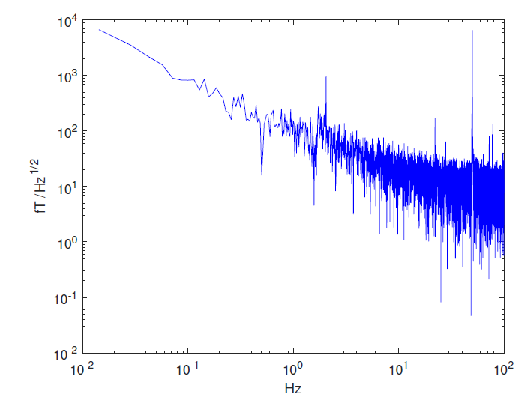
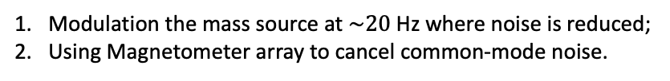
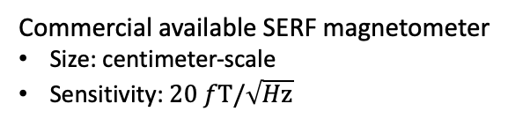
Detection at laboratory scales: atomic magnetometers
Effective magnetic field:
Commercial available SERF magnetometer
Size: centimeter-scale
Sensitivity: $20 fT/\sqrt{Hz}$
Exotic field direction
Rotation frequency
Signal frequency
Noise is suppressed by 50 percent
K. Y. Wu and et al., Phys. Rev. Lett. 129, 051802 (2022).
Modulation the mass source at $\sim 20$Hz where noise is reduced;
Using Magnetometer array to cancel common-mode noise.
The typical noise power density of the magnetometer.
Notes:
To search for the VA interaction, we use an array of four commercial magnetometers
placed symmetrically around the rotating mass sources.
The exotic field generated by the rotating BGO crystal is sensed by the magnetometers.
As the direction of the exotic field sensed by the magnetometers are indicated, we could
combine the signal from the four magnetometers to suppress the noise.
The key to our sensitivity is a two-fold strategy:
First, we modulate the source at a frequency where the magnetometer's noise is minimal.
Second, we use the array to perform a common-mode rejection:
thanks to the different directions of the exotic field sensed by the magnetometers,
we cancel out ambient noise while preserving the signature of the exotic field.

Slide 13
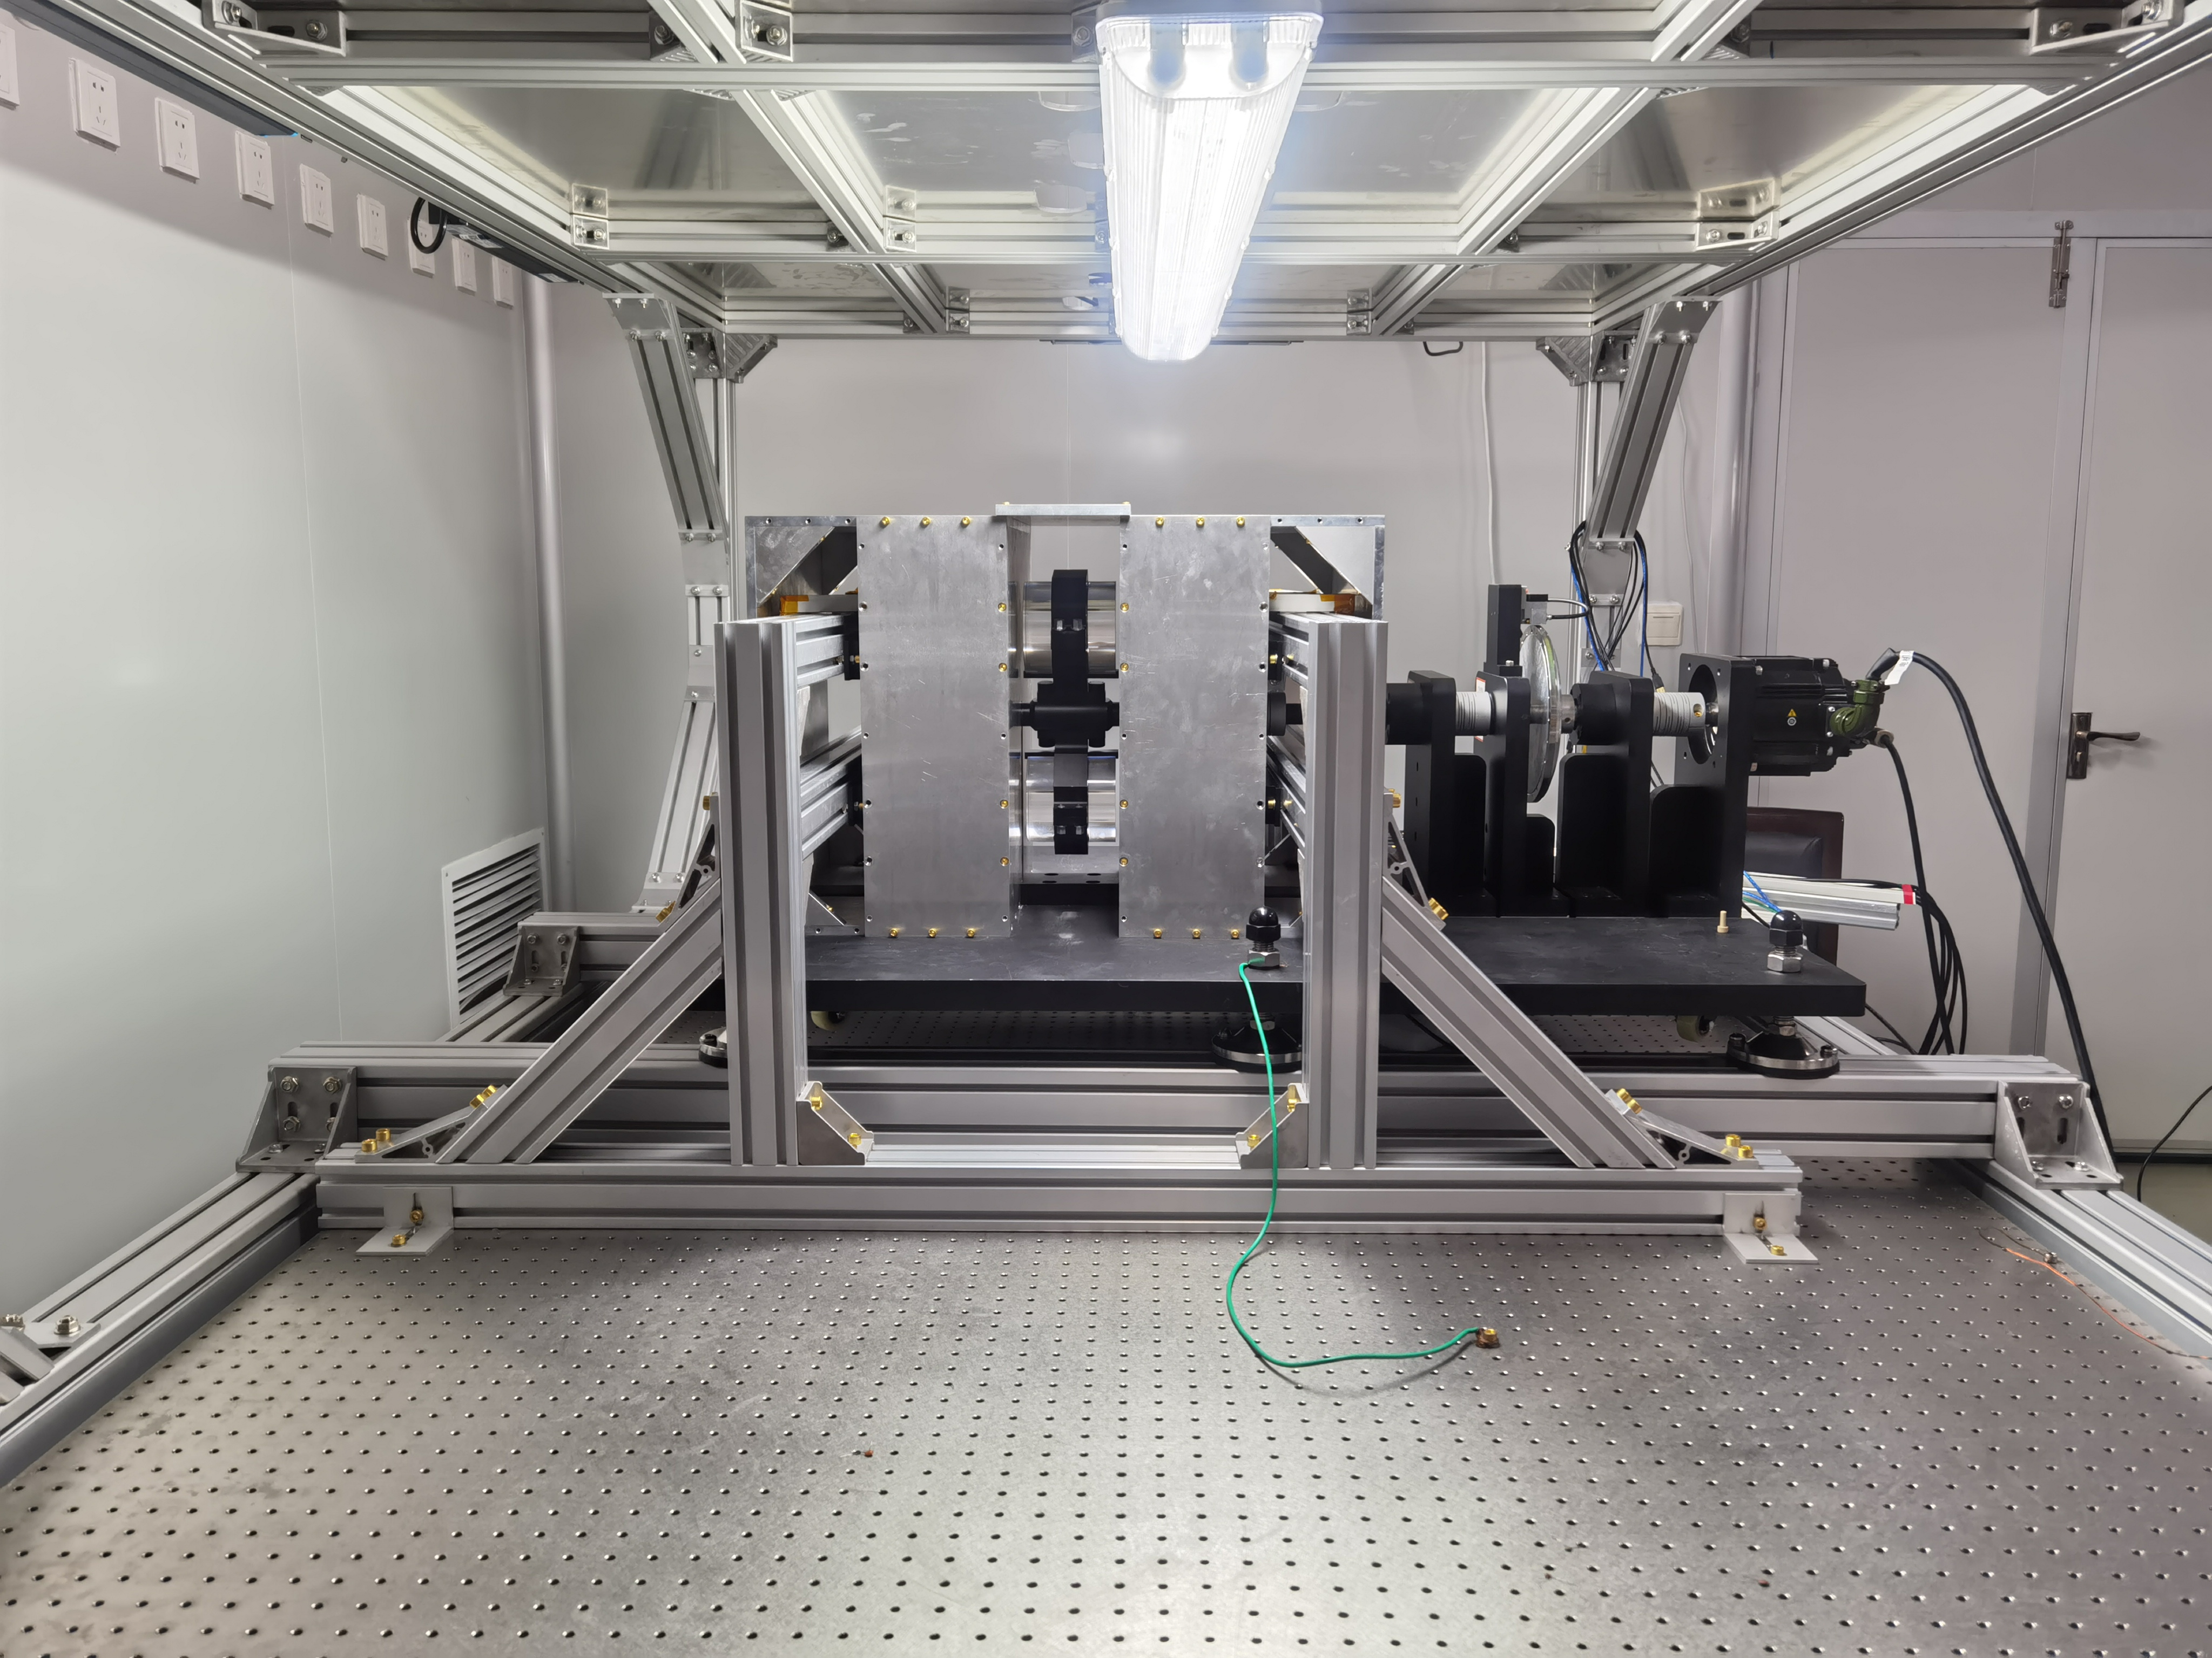
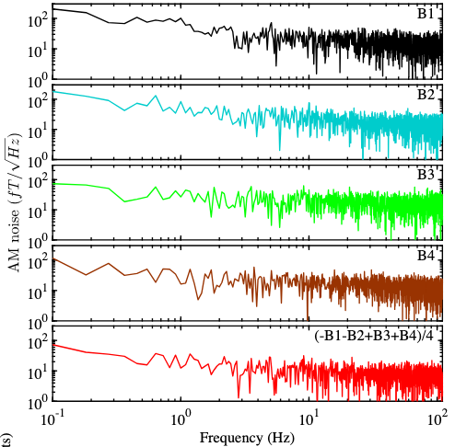
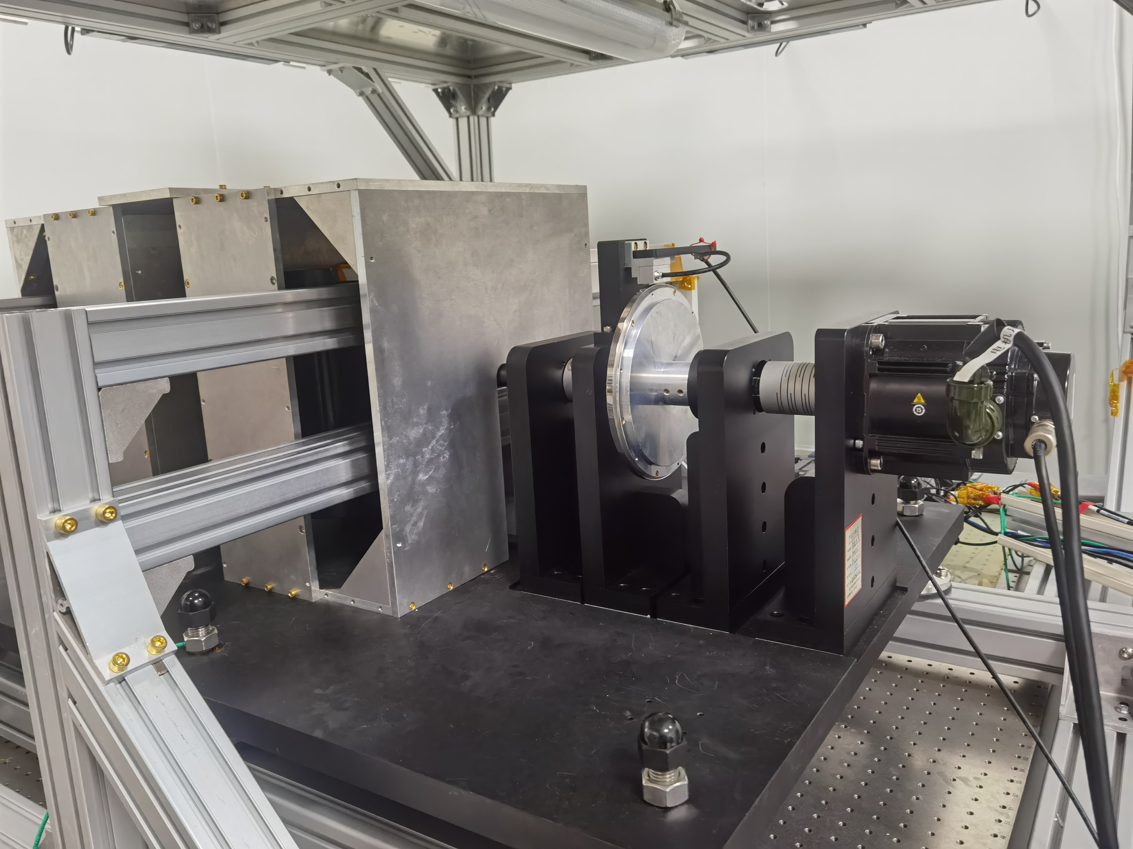
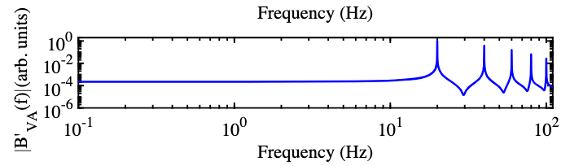

Detection at laboratory scales: atomic magnetometers
Common noise is suppressed with commercial SERF magnetometers in array.
encoder
BGO
Servo motor
Pneumatic vibration isolated optical table
m (eV)
Noise PSD
Monte Carlo Simulation
$$λ (m)$$
The constraint on VA coupling
after 130 h data integration.
KY Wu, SY Chen, GA Sun, SM Peng, M Peng, H Yan
Physical Review Letters 129 (5), 051802
Experimental Setup
Notes:
This is the experimental setup where the magnetometers are isolated from the rotation mechanism by
Setting them at an air-floating optical table.
From the noise power spectrum, it is evident that the noise is suppressed in the combined signal.
After 130 hours of integration, we placed new constraints on the coupling strength of these VA-type interactions, significantly improving previous limits.

Slide 14

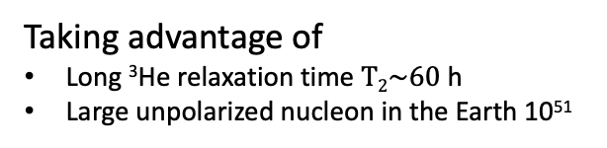
Detection at Earth Range: ³He Relaxation
Relaxation of ³He caused by fluctuated exotic field:
Taking advantage of
Long ³He relaxation time $T2\sim 60$ h
Large unpolarized nucleon in the Earth 10⁵¹
³He
m (eV)
H Yan, GA Sun, SM Peng, Y Zhang, C Fu, H Guo, BQ Liu, Phys. Rev. Lett., 115, 182001 (2015).
Notes:
Now let’s look at a larger scale. The Earth itself can actually act as an ideal mass source. It’s made up of a huge number of unpolarized nucleons, so we can treat it as a source of an exotic field.
If we consider spin-velocity-dependent interactions, a helium atom will feel a random fluctuating field because of its thermal motion. Even though this fluctuating field doesn’t produce a net effect—like shifting the Larmor frequency of helium—it still causes extra relaxation of the helium spins.
And because helium has a very long relaxation time, we can use this to set very stringent limits on these exotic interactions.

Slide 15
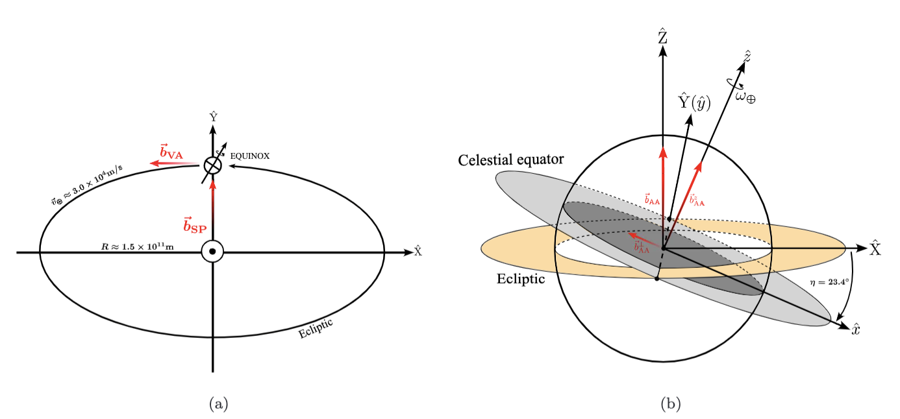
Detection at astronomical distances
The unpolarized nucleon in the Sun as source
The Earth’s rotation as a modulation to the exotic signal
The spin-dependent interactions in Sun-centered and Earth-based frames.
Notes:
For ultralight particle which the Compton wavelength is comparable to the distance between the Sun and Earth,
We could search for the exotic interaction with the Sun as an mass source.
We analyze effective magnetic field generated by the SP, VA, and AA types interactions on the spin over the Earth.
Due to the Earth rotation, the effective field sensed by the spin is modulated to the Earth’s rotation frequency.
So through searching for the modulation in the resonance frequency of the spin, we may constrain such interactions.

Slide 16
Detection at astronomical distances
m (eV)
Search for sidereal modulation on the spin precession in ³He-¹²⁹Xe comagnetometer caused by the exotic interaction.
Based on the Lorentz-violation test experiment using ³He-¹²⁹Xe comagnetometer.
m (eV)
F. Allmendinger and et al., Phys. Rev. Lett. 112(11):110801, (2014).
Upper limit on the exotic magnetic field sourced by the Sun:
L. Y. Wu, KY Zhang, M Peng, J Gong, H Yan., Phys. Rev. Lett. 131, 091002 (2023).
Notes:
We re-analyzed data from a precision 3He-129Xe comagnetometer experiment designed to test Lorentz symmetry,
which behave like a similar modulated by the Earth’s rotation.
By looking for this sidereal modulation in the spin precession difference between the two species,
we were able to place a constraint on SP and VA coupling at astronomical distances.

Slide 17
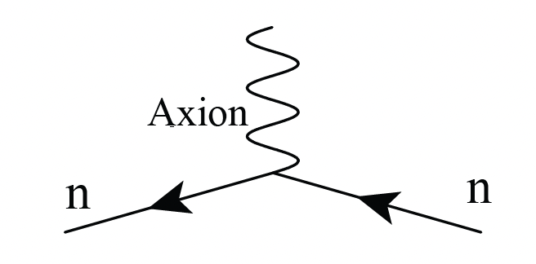
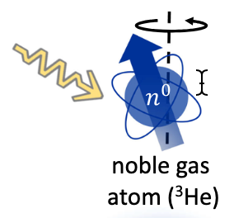
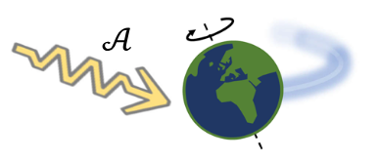


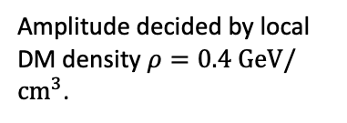

Constraining the axion wind
axion-fermion coupling
The axion with large occupation acting like a “classical field” around the Earth.
Wave vector $k=m_{a}v$
Random phase
Compton frequency $ω=m_{a}c^{2}/ℏ$
Amplitude decided by local DM density $ρ=0.4 GeV/{cm}^{3}$.
I. Bloch and et al., Nature Communications | (2023)14:5784
Modulation on Larmor frequency:
$$v\left(t\right)=v_{0}+δv cos\left(ω_{a}t+φ\right)$$
Notes:
The above methods we introduced are indirect detection methods, where the axion play role in the interaction as a virtual particle.
However as we mentioned above, if axions are dark matter, it acts like a oscillating classical field, with frequency decided by the axion mass.
For the large mass axion-or the high frequency-the detection using a microwave cavity where the axion is converted to the electromagnetic wave in a high magnetic field.
For lower frequency, the oscillating classical field is detected through its coupling to the spin. For example by measuring the modulation of the Larmor frequency caused by the field.

Slide 18
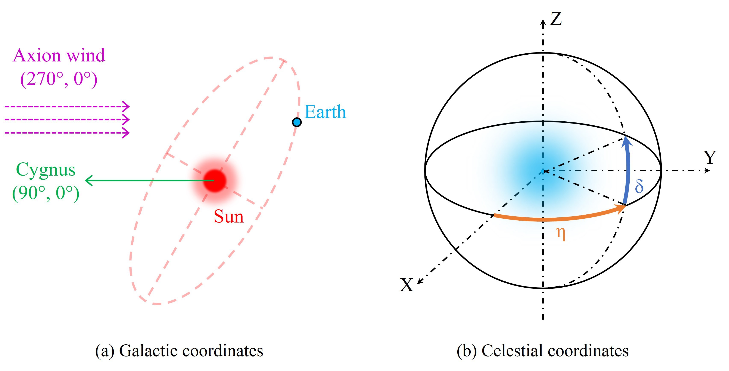
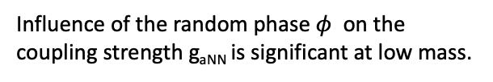
Constraining the axion wind
The Lorentz-violation test experiment with ³He-¹²⁹Xe comagnetometer is always sensitive to axion wind coupling.
For ultralow frequencies axion field:
F. Allmendinger and et al., Phys. Rev. Lett. 112(11):110801, (2014).
Effective magnetic field with random amplitude
Axion wind in the galactic and and celestial coordinates.
Influence of the random phase $φ$ on the coupling strength g_{aNN} is significant at low mass.
K. Y. Zhang, L. Y. Wu and H. Yan. Phys. Rev. Lett. (Accepted 29 August, 2025)
Notes:
For ultralight axion, the oscillating field could be viewed as a constant field with random amplitude.
Due to the Earth’s rotation, we will see an sidereal modulated field.
Different from the exotic field we talk about before, here the amplitude of the signal is random.
A effect of the phase on the coupling should be considered.
As shown in the plot, constraints over the coupling is less stringent when the phase is close to 0, pi, or 2pi.

Slide 19
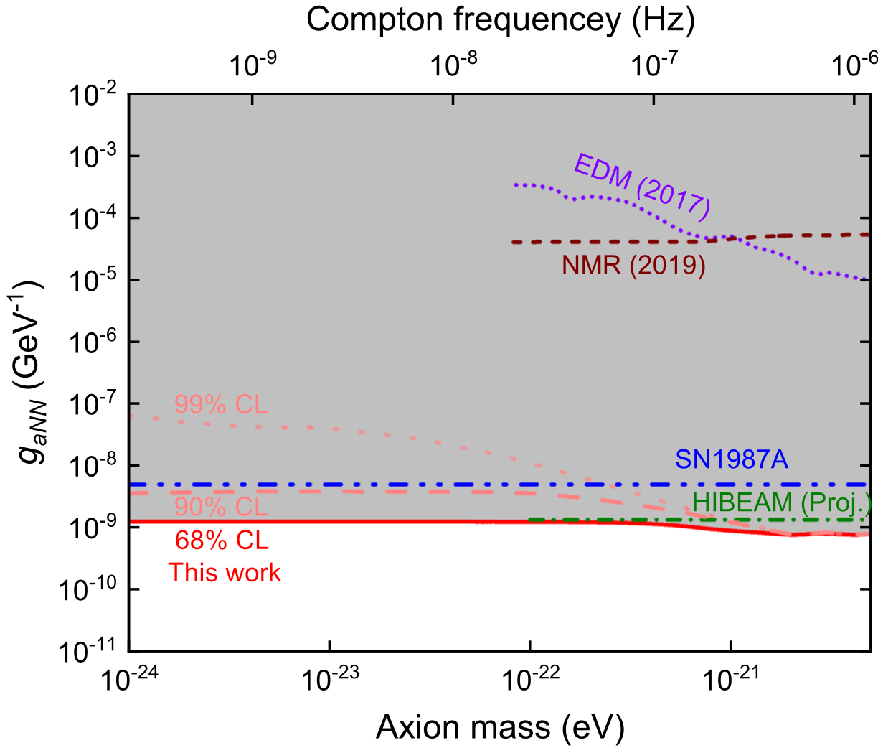
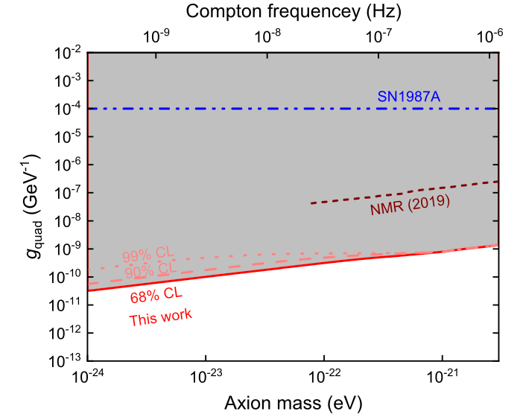

Constraining the axion wind
New limits on $gaNN$ over the axion mass region
${10}^{−24}<m_{a}<5× {10}^{−21}$ eV.
Notes:
Take the random phase into consideration, we derive new constraints on g_{aNN} for axion mass less than 10-22 eV.
However, the effect of random has significant effect for different confidence level.

Slide 20
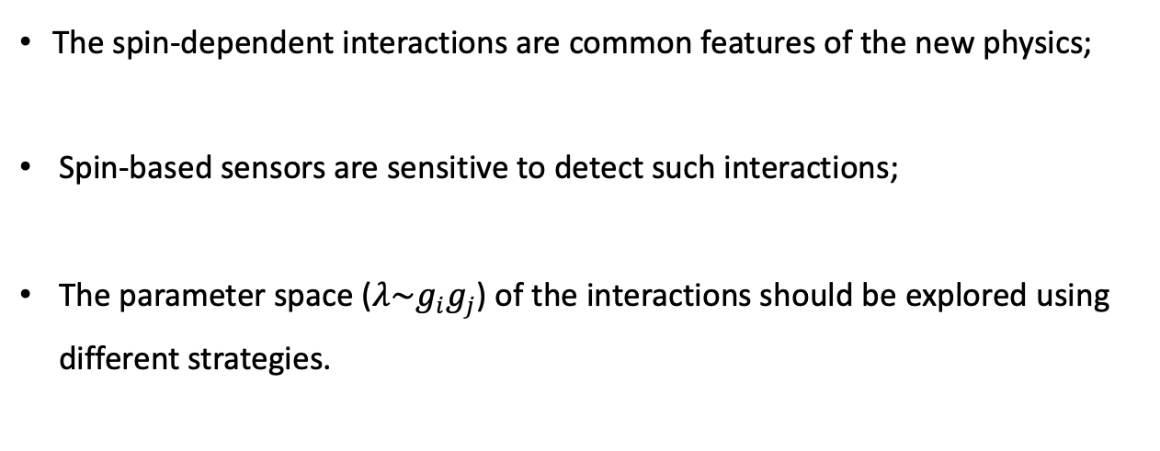
Summary
The spin-dependent interactions are common features of the new physics;
Spin-based sensors are sensitive to detect such interactions;
The parameter space ($λ\sim g_{i}g_{j}$) of the interactions should be explored using different strategies.
Notes:
"In conclusion, spin-dependent interactions are a generic and powerful signature of physics beyond the Standard Model.
The theoretical motivation is strong, spanning from the Strong CP Problem to dark matter. "To search for them, we employ a multi-scale strategy, using spins as precision sensors from the atomic scale all the way to the astronomical scale.
While no definitive signal has been found yet, our continuously improving experiments are carving away at the possible parameter space, guiding us toward a deeper understanding of the universe."

Slide 21
Thank you for your attention.
Notes:
So this all my talk today, thank you.

