Slide 1



Polarized Fusion
25th September 2025
Ralf Engels (IKP-2@FZJ/GSI)
Notes:
25 minutes + 5 minutes discussion

Slide 2
Advantages of Polarized Fuel for Nuclear Fusion Energy Production
25th September 2025
Ralf Engels (IKP-2@FZJ/GSI)
Notes:
25 minutes + 5 minutes discussion

Slide 3
No civilization without energy
Level of Civilization ≈ Energy Consumption
Fossil Fuels → Climate Change, Limited Resources, Unequal Distribution
Nuclear Fuels → Radioactive Risks, Limited Resources, Unequal Distribution
Green Energies → Can‘t be switched on and off / Missing Storage Capacities
Possible Solution: Nuclear Fusion

Slide 4
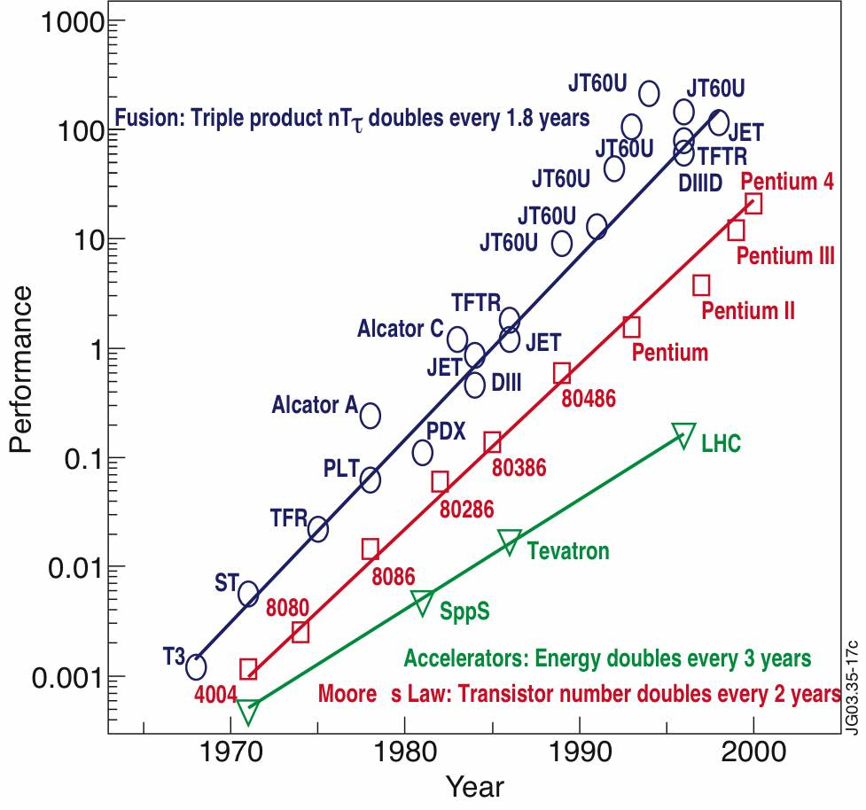
Development of Nuclear Fusion

Slide 5
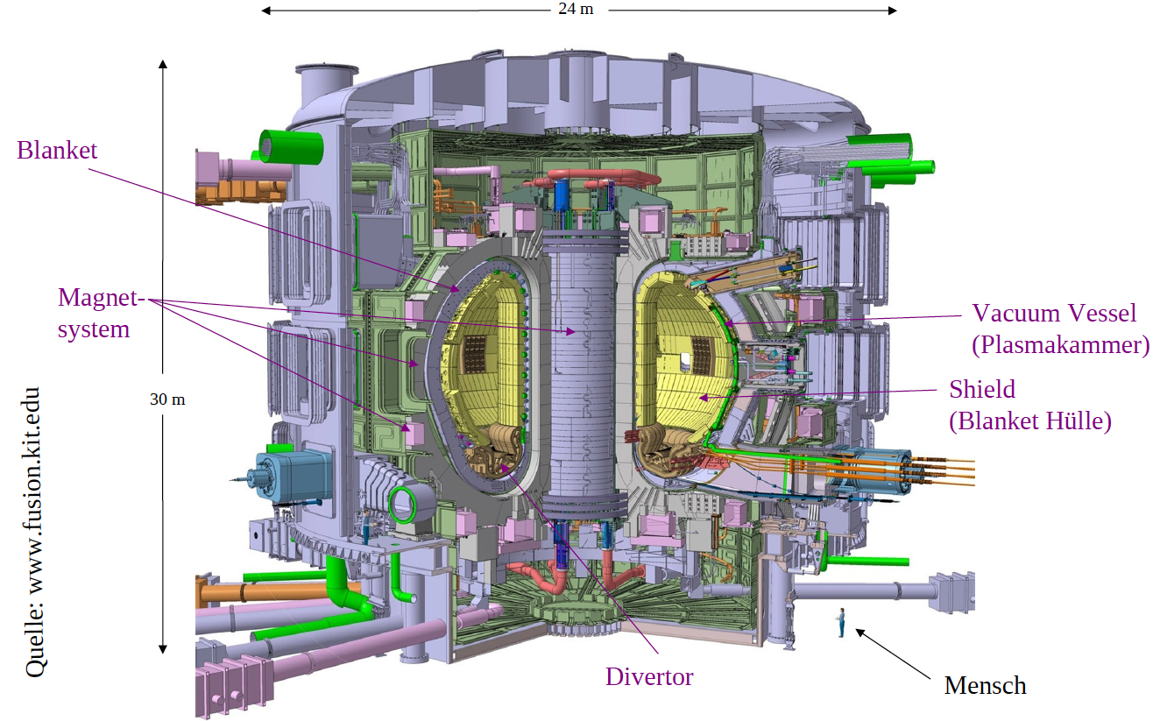
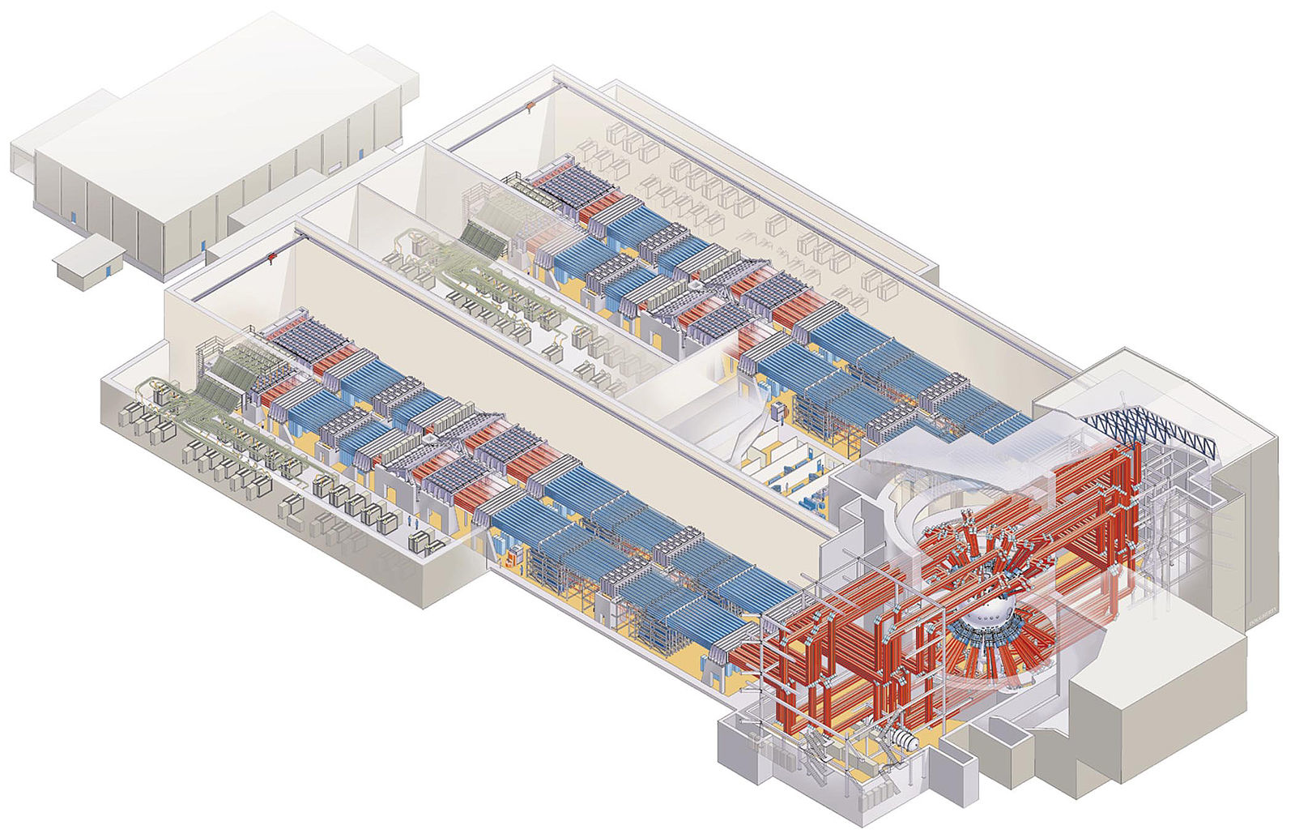
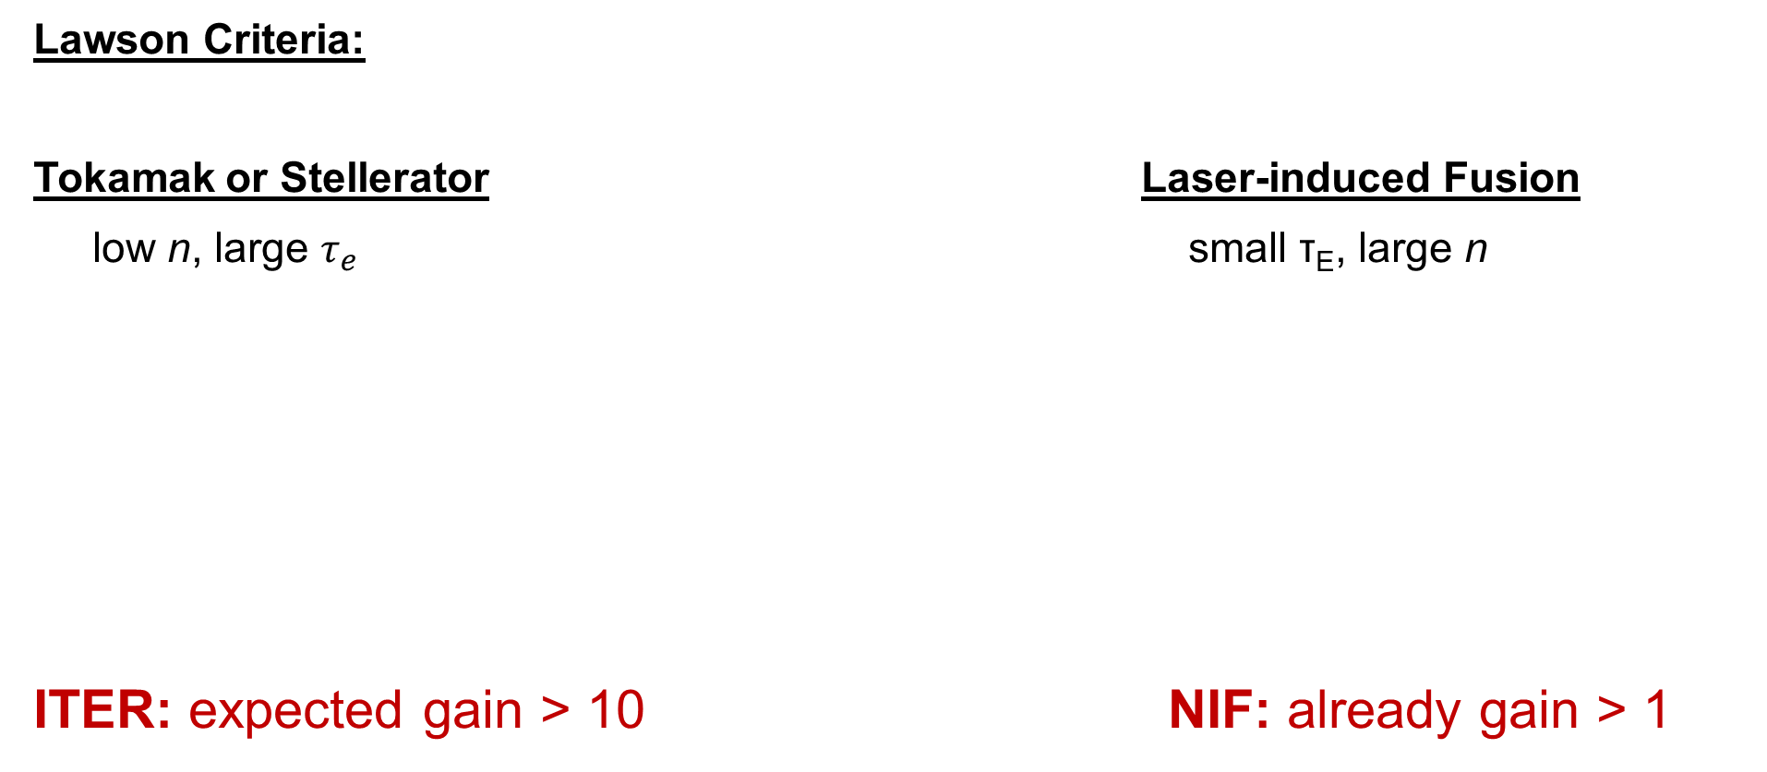
Magnetic Confinement ↔ Inertial Fusion
For T+D fusion at T≈ 25 keV:
Lawson Criteria:
Tokamak or Stellerator Laser-induced Fusion
low n, large $τ_{e}$ small τ_{E}, large n
ITER: expected gain > 10 NIF: already gain > 1
→ n · τ_{E} ≥ 1.5 · 10²⁰ m⁻³ s
Can the cross sections be improved?

Slide 6
Magnetic Confinement ↔ Inertial Fusion
Lawson Criterium:
Tokamak or Stellerator Laser-induced Fusion
low n, large τ_{E} small τ_{E}, large n
ITER: Q > 10 NIF: already Q > 1
→ n_{e} τ_{E} ≥ 1.5 · 10²⁰ m⁻³ s (T ≈ 25 keV)
Can the cross sections be improved?

Slide 7
Polarized Fusion
Nuclear Forces are Spin dependent !!!
Polarized Beam on Target → Modification of the Differential Cross Section (A_{i(j)})
Polarized Beam and Target → Modification of the Differential
and the Total Cross Section (C_{i(i),j(j)})

Slide 8
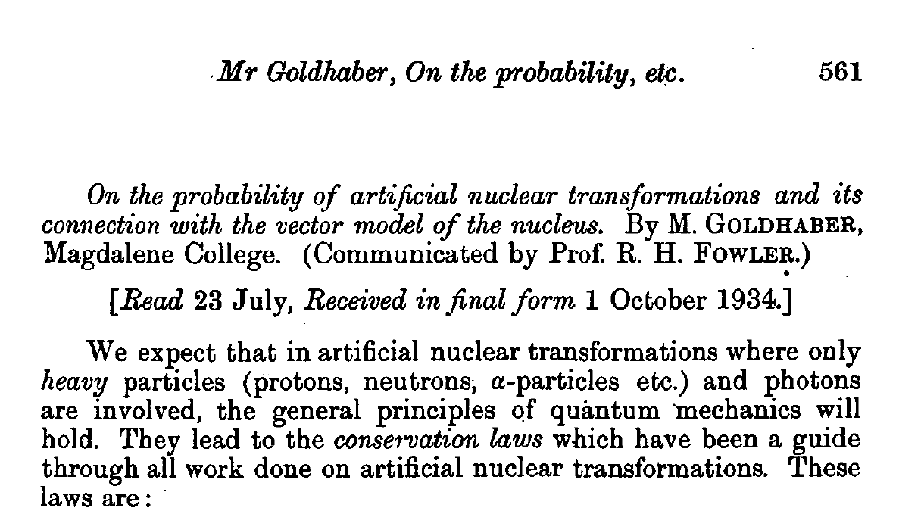
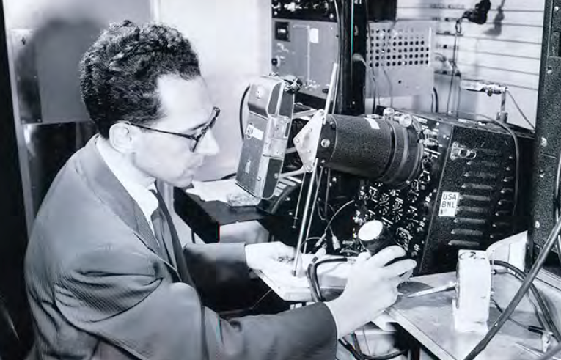
Polarized Fusion: The Beginnings
First ideas date back to the 1930s
Maurice Goldhaber, 1911 – 2011
Mathematical Proceedings of the Cambridge Philosophical Society, 30, 561 (1934). doi:10.1017/S0305004100012810

Slide 9
Polarized fusion: A Simple Model
t + d ⁵He ⁴He + n Factor: ~1.5 at 107 keV
S: ½ + 1 3/2
J = 3/2 ⁺ / s-wave dominated (> 96%)
³He + d ⁵Li ⁴He + p Factor: ~1.5 at 430 keV
Experimental Proof: Ch. Leemann et al., Helv. Phys. Acta 44, 141 (1971)

Slide 10
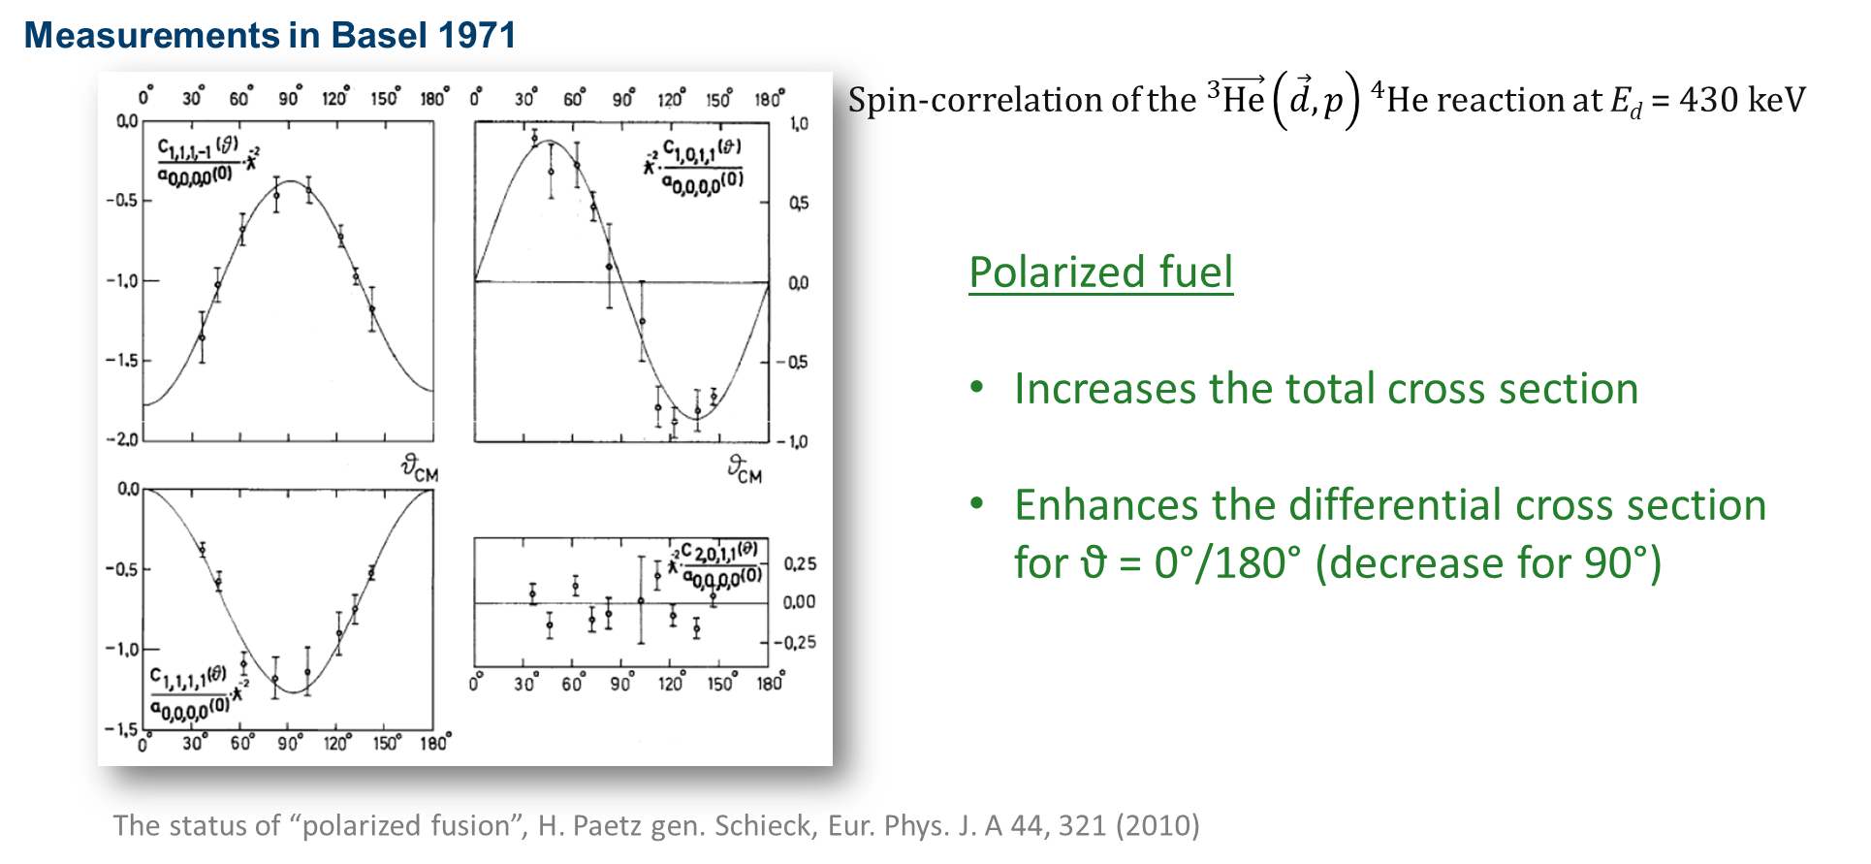

Polarized Fusion: First Proof
Polarized fuel:
Increase the total cross section
Manipulate the differential cross section,
(e.g. enhance the neutron flux for
$θ=0°/180°$ and decrease for 90°)

Slide 11
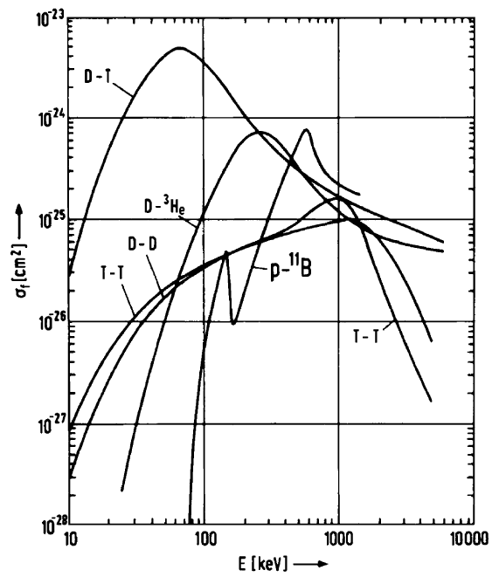
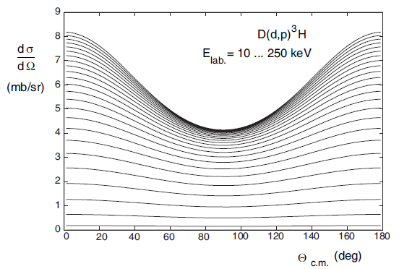
Polarized Fusion: unpol. Cross Section
Total cross section
Differential cross section

Slide 12
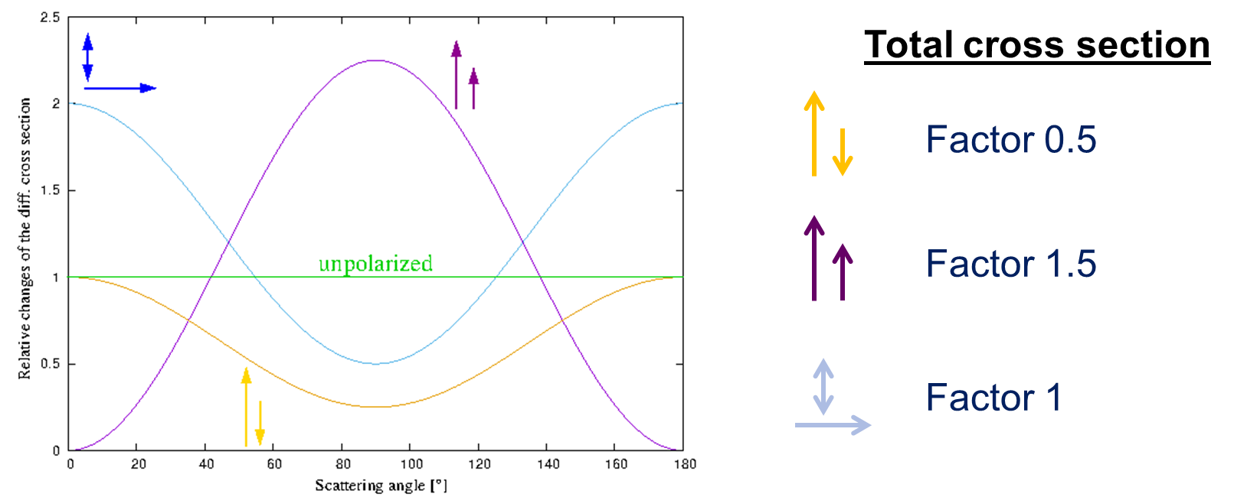
Polarized Fusion: Differential Cross Section

Slide 13
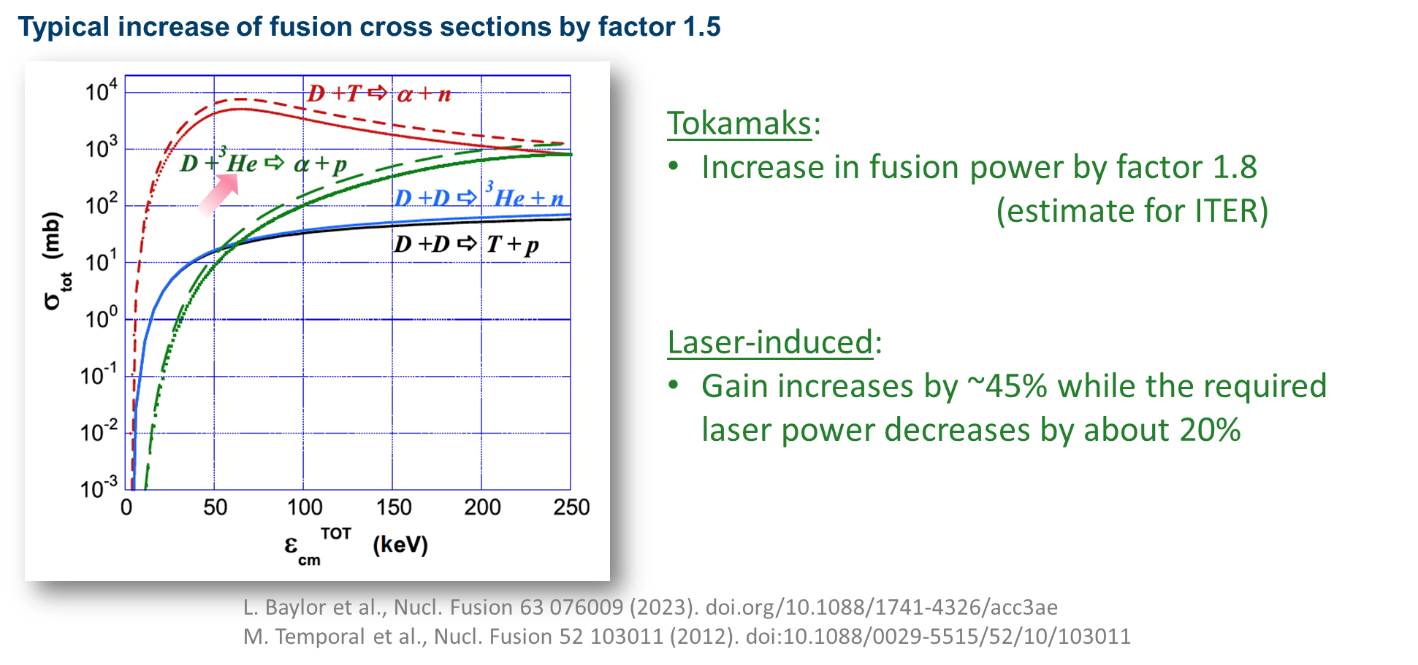
Polarized Fusion: Total Cross section

Slide 14
Polarized Fusion: Actual Papers
„Simultaneous Enhancement of Tritium Burn Efficiency and Fusion Power with Low-Tritium Spin-Polarized Fuel“, J.F. Parisi et al., Nucl. Fusion 64 126019 (2024), DOI: 10.1088/1741-4326/ad7da3
→ Less Tritium needed
J.F. Parisi and A. Diallo; „Electric Power Enhancement using Spin-Polarized Fuel in Fusion Power Plants“, arXiv:2502.1594v1 (2025)
→ Disproportional Electric Power Increase
J. F. Parisi, A. Diallo, and S. Meschini; „Revisiting Fusion in D-³He Plasmas With Spin-Polarized Fuel“, arXiv:2504.09869v2 (2025).
→ Even stronger increase for D-³He Plasmas
“Neutronics analysis of spin-polarized fuel in spherical tokamaks”, J. Bae et al., Nucl. Fusion 65 086051 (2025), DOI: 10.1088/1741-4326/adf3c6
→ Advantages of manipulated diff. cross section
“Ab initio predictions for polarized deuterium-tritium thermonuclear fusion”, G. Hupin et al., Nat Com. 10 351 (2019).

Slide 15
Polarized Fusion: Neutron Foccusing
Deuterium: P_{zz} = -2
Focussing of the Neutrons !
1.) Helps for breeding of the
tritium! (⁶Li + n -> ⁴He + t)
2.) Helps to save money:
blanket exchange, magnet lifetime
3.) Less neutrons on the inner wall
-> less cooling needed
-> coils can come closer to the plasma
ITER: E ~ B^{7.81}

Slide 16
What are the problems ?
1.) Will polarization survive in a fusion plasma?
2.) How to produce enough polarized fuel, i.e. D, T and ³He ?
3.) What about the D + D reactions?
d + d → t + p or d + d → ³He + n

Slide 17

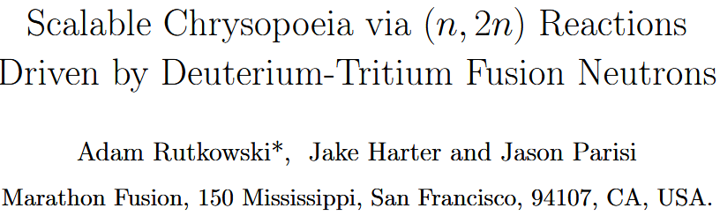

Active collaborations
PREFER (“Polarization Research for Fusion Experiments and Reactors”):
IKP-2 and PGI-6 of FZ Jülich / Uni. Düsseldorf, Uni. Ferrara, Uni. Heraklion/FORTH,
(PNPI St. Petersburg, BINP Novosibirsk)
(see talk by G. Ciullo on Tuesday)
Jefferson Lab, Uni. Virgina, Oak Ridge Lab., Uni. California and the DIII-Tokamak
Uni. Princeton / Marathon Fusion (https://www.marathonfusion.com)
polarized p-B Fusion in China
(see talks by Wei Yang and Zhi Li on Tuesday)
arXiv:2507.13461

Slide 18
Will polarization survive in a fusion plasma?
1.) Kulsrud, Goldhaber, et al.; Phys. Rev. Lett. 49, 1248 (1982).
(-> Polarization should survive long enough in a Tokamak!)
2.) Greenside, et al.; J. Vac. Sci. Technol. A 2(2), 619 (1984).
(-> Polarization losses during wall interaction -> Patent on surface coating !!!!)
3.) Coppi et al.; Phys. Fluids 29, 4060 (1986).
(Possible resonances with some plasma modes will destroy
the nuclear polarization -> Polarization lifetime as analyser
for these plasma modes !!!)

Slide 19
Will polarization survive in a fusion plasma?
Depolarization mechanism Rate (s ⁻¹)
Ion + electron recombination ( ~ B⁻² ) 10 ⁻⁶
Binary collisions: spin-orbit coupling for T: 8 ∙ 10 ⁻⁶
for D: 3 ∙ 10 ⁻⁷
Wall recycling: expected for non–metallic materials ≤1
Field inhomogeneity's (n_{D}=10¹⁴ cm³): for D: 4.7 ∙ 10⁻⁵
Resonant plasma waves: spin-flip matrix element
for δB = 1 G, B₀ = 13 T for T: 0.027
Estimated depolarization rates for the IGNITOR project:

Slide 20
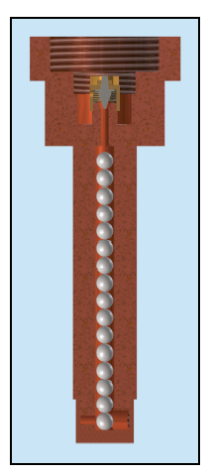
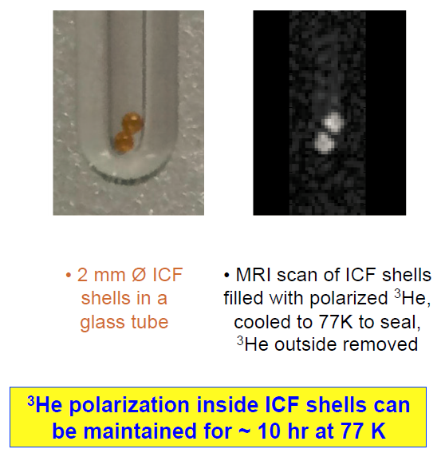
Will polarization survive in a fusion plasma?
Actual Projects (Magnetic confinement):
Collaboration between Jlab, Uni. of Virgina, Oak Ridge Lab., Uni. of California and the DIII-Tokamak/San Diego
Idea: Fill the DIII tokamak with polarized ³He and LiD ice and measure the lifetime of the polarization in situ.
A.Sandorfi et al.; Springer Proceedings in Physics 187 (2016).
W. Heidbrink et al.; Frontiers in Physics 12, 1355212 (2024).
DOI: 10.3389/fphy.2024.1355212
            A. Garcia et al.; „The use of D–D reactions to diagnose the lifetime of spin polarized fuel”,
            Nucl. Fusion 65, 046005 (2025).
            DOI 10.1088/1741-4326/adb59b

Slide 21
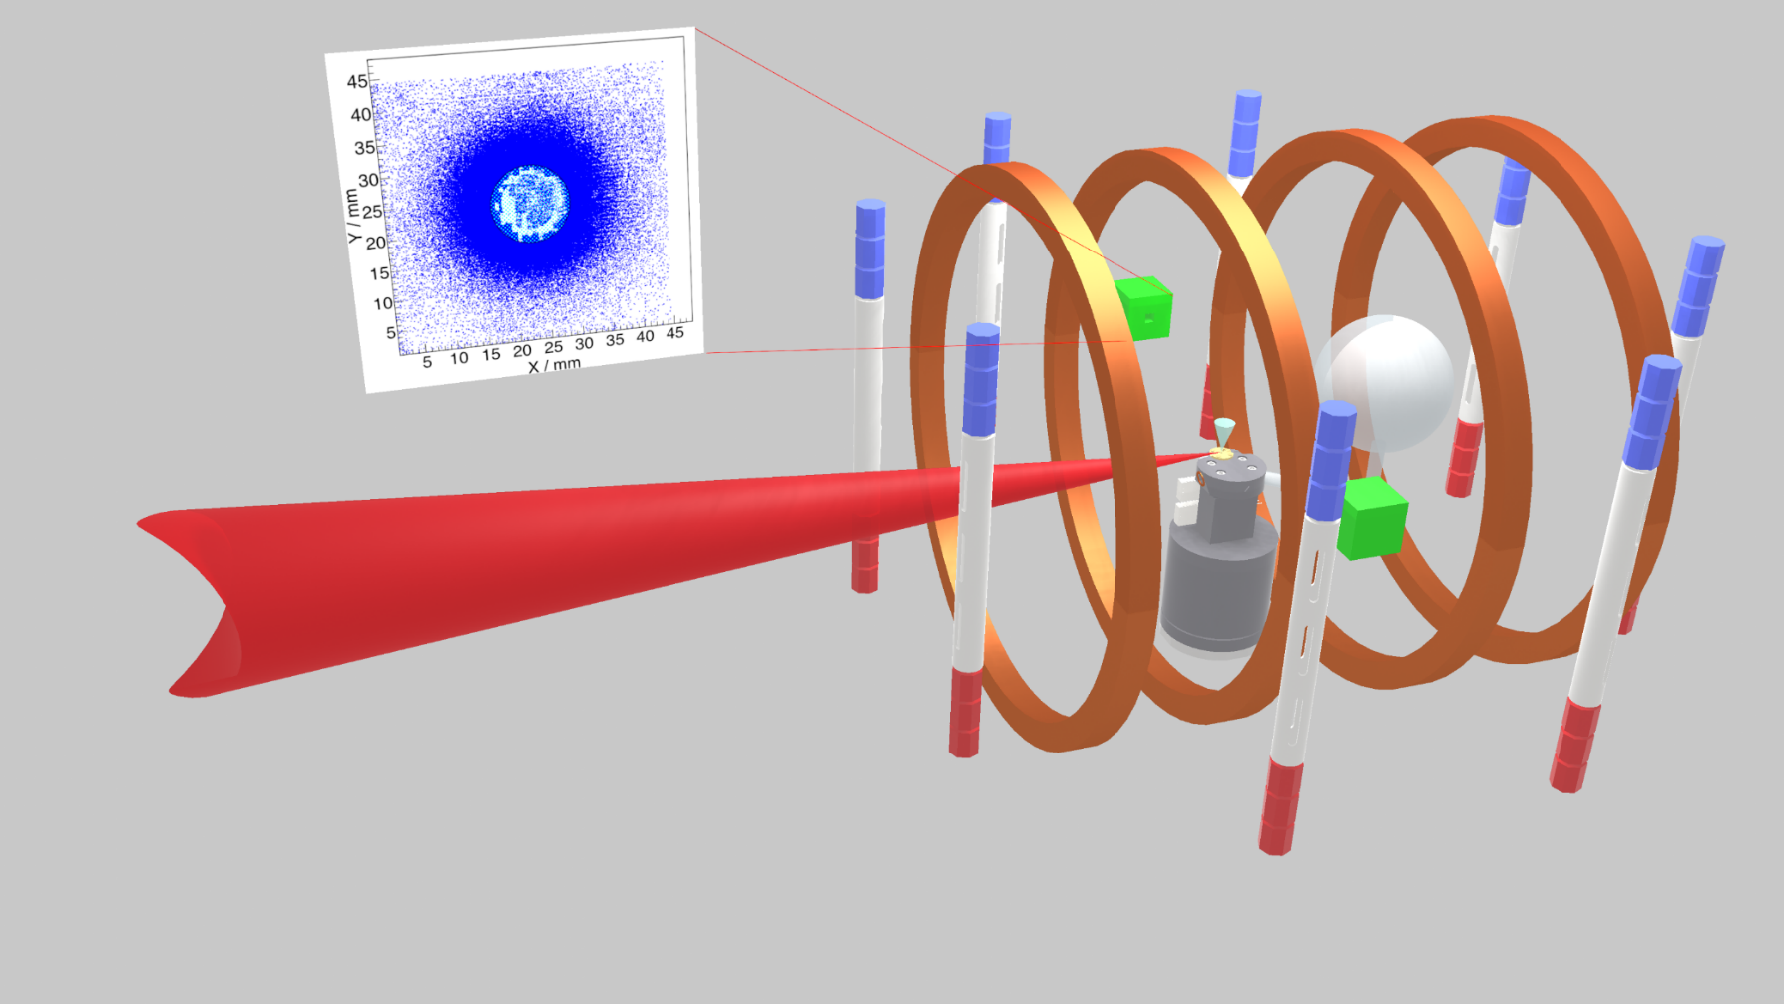
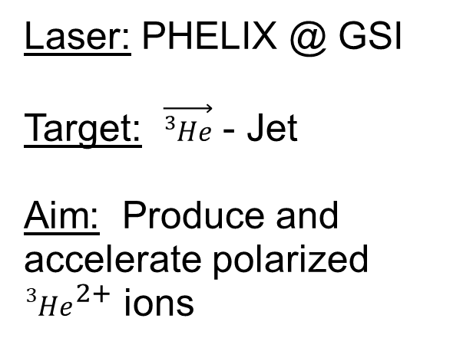
Will polarization survive in a fusion plasma?
Laser: PHELIX @ GSI
Target: $\vec{{}_{ }^{3}{He}}$ - Jet
Aim: Produce and accelerate polarized ${{}_{ }^{3}{He}}^{2+}$ ions

Slide 22
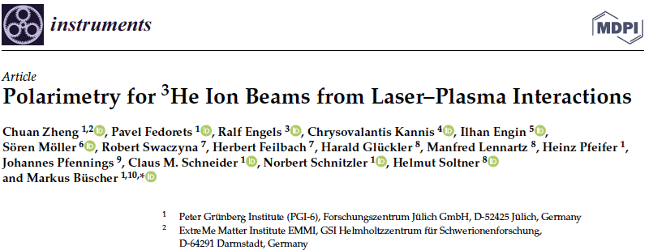
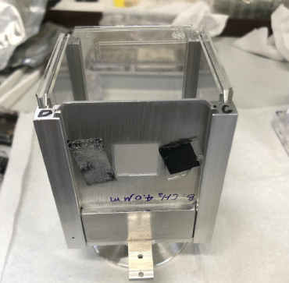
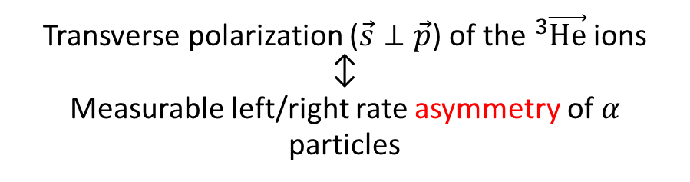
Will polarization survive in a fusion plasma?
Employ analyzing power of the $D\left({}_{ }^{3}{\vec{He}},α\right)p$ reaction
on
CD₂ foil
off
Helmholtz coils
− on
Transverse polarization ($\vec{s}⊥\vec{p}$) of the ${}_{ }^{3}{\vec{He}}$ ions
↕︎
Measurable left/right rate asymmetry of 𝛼 particles

Slide 23
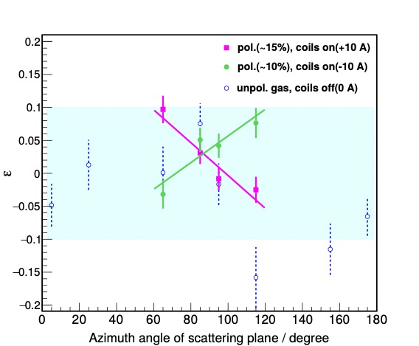
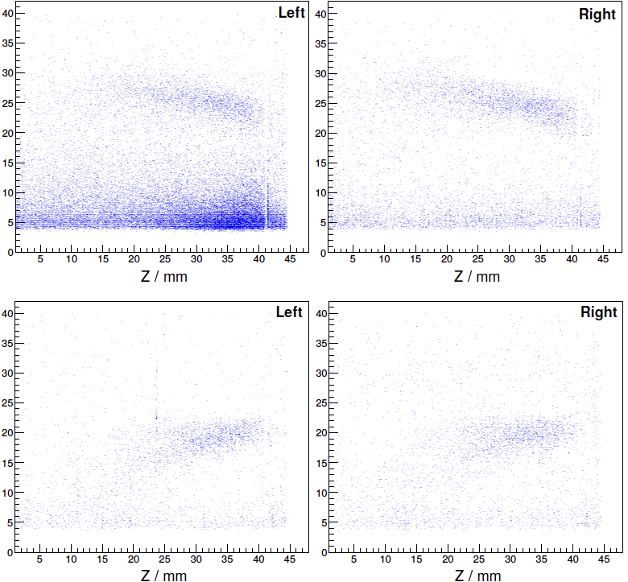

Will polarization survive in a fusion plasma?
Unpolarized ³He gas
$D\left({}_{ }^{3}{\vec{He}},α\right)p$
Long. polarized ³He gas
Ch. Zheng et al.; “Preservation of 3He ion polarization after laser-plasma acceleration”, arxiv:2310.04184v2 (2024)

Slide 24
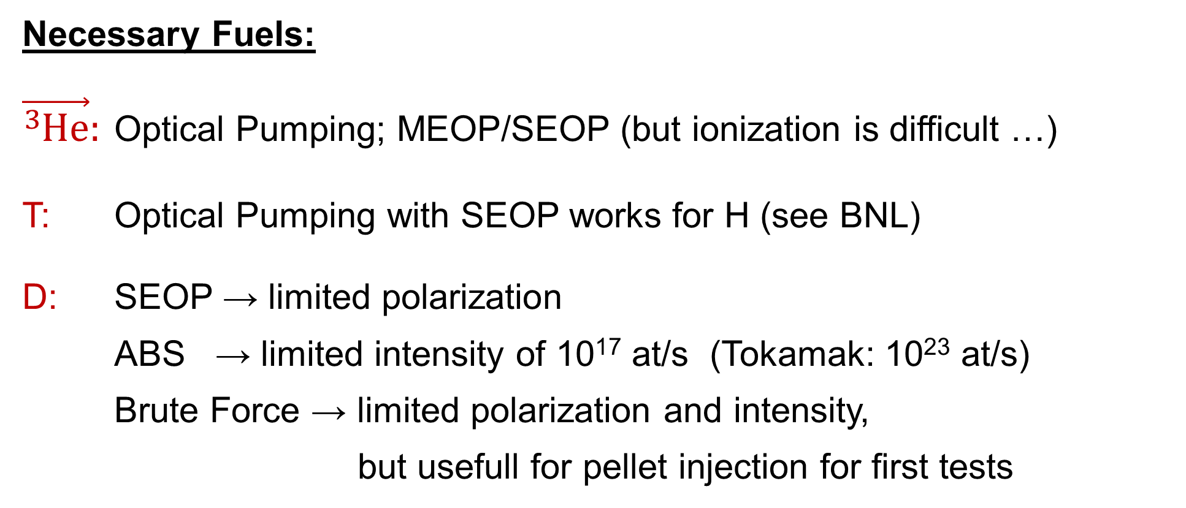
How to produce enough polarized fuel, i.e. D, T and ³He?
Necessary Fuels:
$\vec{{}_{ }^{3}{He}}:$ Optical Pumping; MEOP/SEOP (but ionization is difficult …)
T: Optical Pumping with SEOP works for H (see BNL)
D: SEOP → limited polarization
ABS → limited intensity of 10¹⁷ at/s (Tokamak: 10²³ at/s)
Brute Force → limited polarization and intensity,
but usefull for pellet injection for first tests

Slide 25
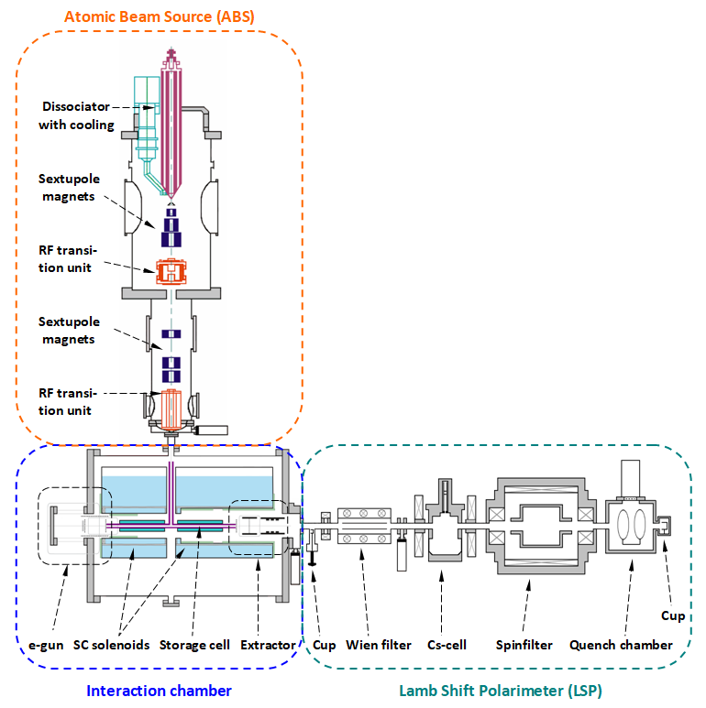
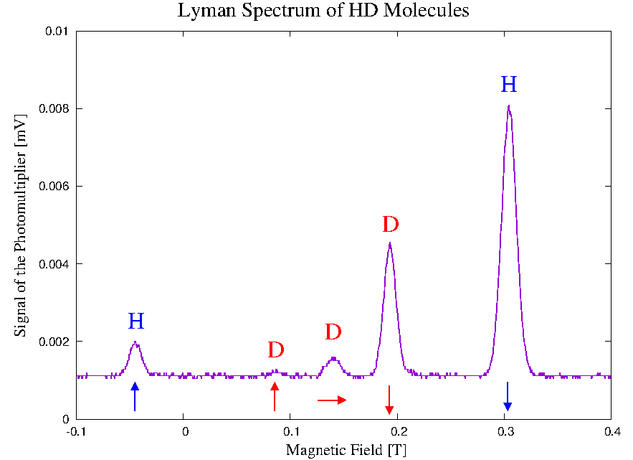
How to produce enough polarized fuel, i.e. D, T and ³He?
2nd / parallel life of the ANKE ABS:
Investigation of the nuclear polarization during:
Recombination processes
Wall interaction
---
→ see my talk on Tuesday
Idea:
Collect HD (TD) molecules as ice with large polarization on a cold surface.
→ see talk of G. Ciullo
on Tuesday
R. Engels et al., Phys. Rev. Lett. 124 113003 (2020)
R. Engels et al., Phys. Rev. Lett. 115 113007 (2015)
Surface: Fomblin on Fused Quarz
T = 80 K / B = 0.528 T / E = 0.3 keV
P_{z} (H) = - 0.77
P_{z} (D) = - 0.79
P_{zz} (D) = + 0.69
22

Slide 26
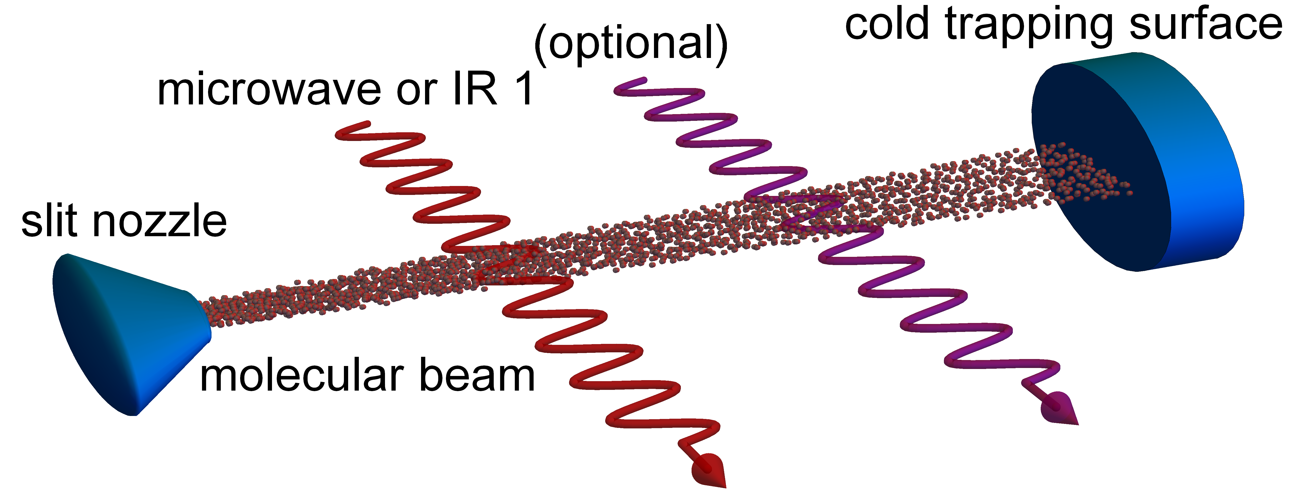
How to produce enough polarized fuel, i.e. D, T and ³He?
New Idea from P. Rakitzis: (Patent)
Collecting pol. molecules on a cold surface as ice inside a strong magnetic field
Intense cold D₂ or HD beam:
10²² mol./s, sharp velocity
Transfer of rotational polarization into nuclear polarization with „motion-induced“ transitions or via coherent hyperfine beat
→ see talk of Ch. Kannis on Tuesday
Optical pumping of the rot. magnetic moment J into m_{J} = +1/-1 with
IR laser or microwaves

Slide 27
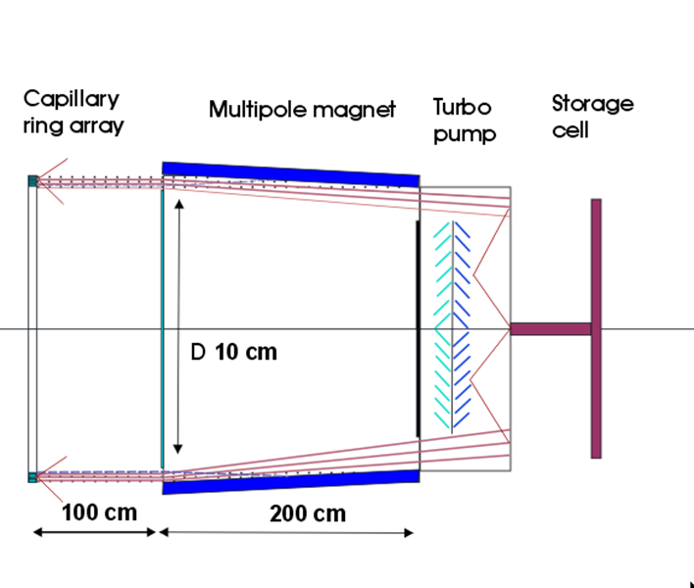
How to produce enough polarized fuel, i.e. D, T and ³He?
Other ideas:
BINP: Molecular Atomic beam source
for D₂ and HD (DT)
Collaboration of BINP, Uni. Düsseldorf,
IKP-2/PGI-6@FZ Jülich and Uni. Ferrara
- ????
Lambshift-
Polarimeter
or
Cold surface
D. Toporkov et al.; JETP Letters 105(5):289 (2017)

Slide 28
What about the D+D reactions?
Can cross sections be increased ?
t + p
Can the trajectories of the neutrons
be controlled ?
Can neutrons be suppressed ?
→ „Quintet suppression factor“
d + d
³He + n
Spin 1 on Spin 1:
In general:
8 Analyzing Powers A_{i(i)} and 32 Spin-Correlation Coeffizients C_{i(i),i(i)}
beam and target same particles:
4 Analyzing Powers A_{i(i)} and 16 Spin-Correlation Coeffizients C_{i(i),i(i)}
Both spins are aligned:
A_{zz}(ϑ), C_{z,z}(ϑ) , C_{zz,zz}(ϑ) are necessary
A_{zz}(ϑ) already known:
Takishi et al.; Phys. Rev. C 46 R1155 (1992)
B. Becker et al.; Few-Body Syst. 13, 19–39 (1992)

Slide 29
What about the D+D reactions?
Deltuva and Fonseca, Phys. Rev. C 81 (2010)

Slide 30
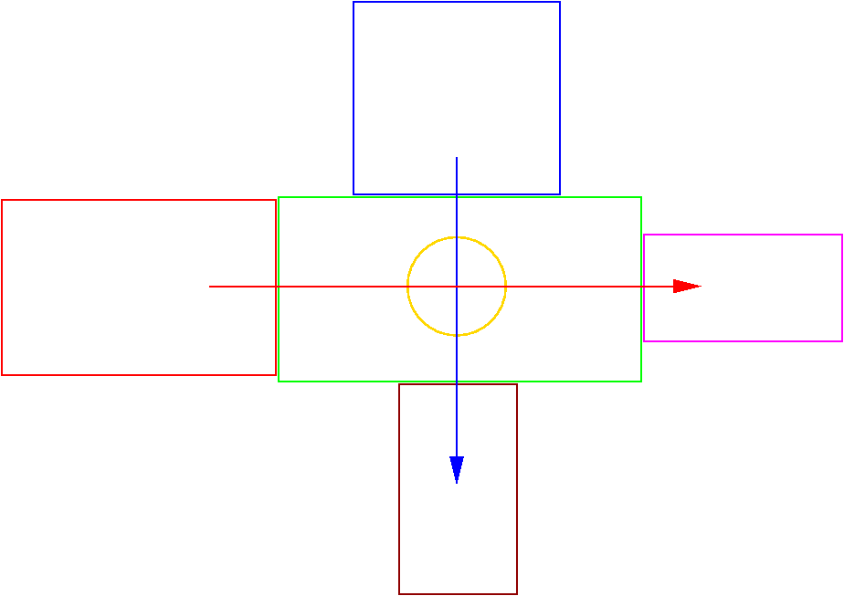
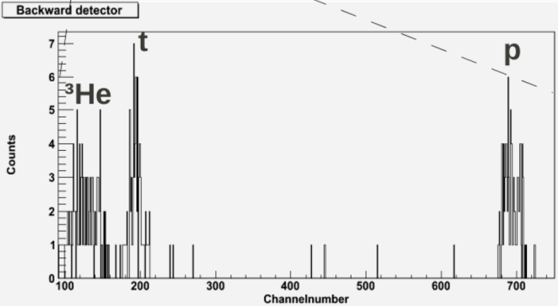
What about the D+D reactions?
Petersburg Nuclear Physics
Institute (PNPI) of the
Kurchatov Center in Gatchina
(A. Vasiliev et al.)
ABS from Ferrara:
~ 6 ∙ 10¹⁶ at/s
→ ~ 3 ∙ 10¹¹ at/cm²
Detector Setup:
4π covered by
large pos. sens. Detectors
(~400 single PIN diodes ?)
POLIS (KVI, Groningen)
dd-fusion polarimeter (FZJ)
Ion beam: I ≤ 20 μA
→ 1.5 ∙ 10¹⁴ d/s
( E_{beam} ≤ 32 keV )
A. Yu. Rozhdestvenskij et al.;
Physics of Atomic Nuclei 87(3) 224 (2024)
LSP from POLIS
Luminosity: 4.5 ∙ 10²⁵ /cm² s
→ count rate: ~ 60 /h
→ 1 month of beam time
LSP from FZJ

Slide 31
Conclusion
Polarized Fuel is an interesting option for all fusion reactors !!!
Higher energy output
Optimized breeding of new tritium
Reduced costs for commercial reactor
…..
Some work needs to be done and is in progress
Polarized Fuel
Polarization Lifetime
D + D Cross Sections
……

