Slide 1
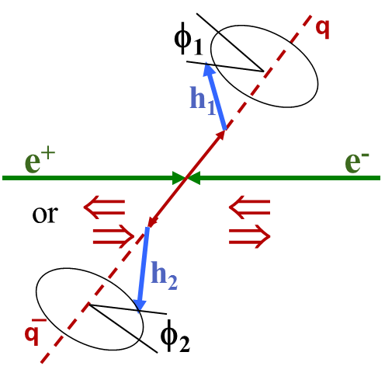
Spin physics at BESIII
Hai-Bo Li
(on behalf of the BESIII Collaboration)
Institute of High Energy Physics, CAS, Beijing
The 26th international symposium on spin physics (SPIN2025)
Qingdao, Aug. 22-26,2025

Slide 2
Outline
Introduction
Hyperon physics @BESIII
  Observation of transverse polarizations of entangled hyperon pairs
  CP violations in hyperon decays with polarization + quantum entanglement
Quark fragmentations : Collins FF and unpolarized FF
Summary
See talks by Hongfei Shen : Hyperon physics @BESIII
Yuxiang Zhao: Fragmentation function @ BESIII

Slide 3
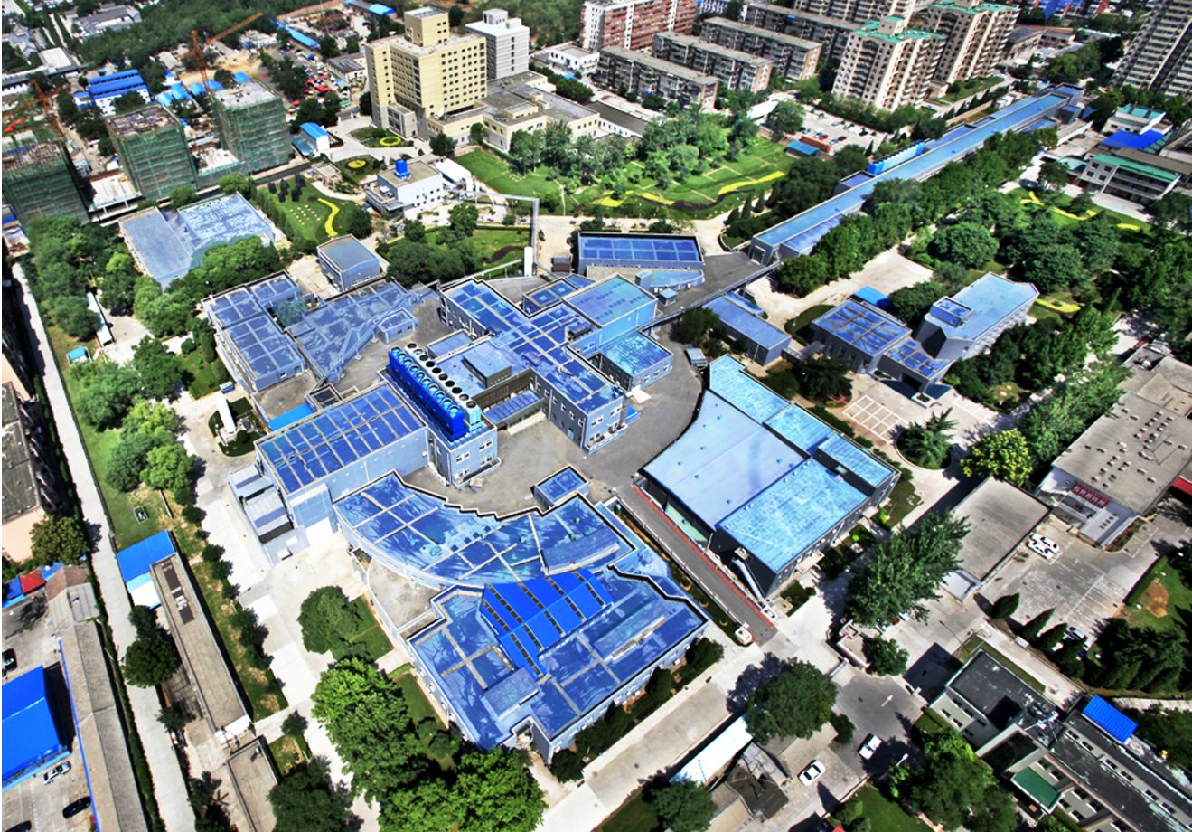
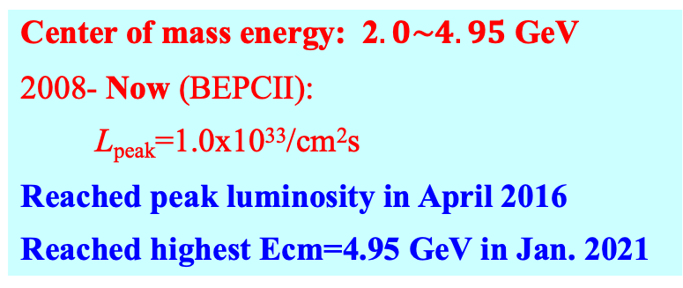
Beijing Electron-Positron Collider II (BEPCII)
Center of mass energy: 2$.0\sim 4.95$ GeV
2008- Now (BEPCII):
L_{peak}=1.0x10³³/cm²s
Reached peak luminosity in April 2016
Reached highest Ecm=4.95 GeV in Jan. 2021
Linear part
BEPCII
(Circular part)
BESIII detector
Notes:
Circumference : 240 meters, Linac part: 200 meters

Slide 4
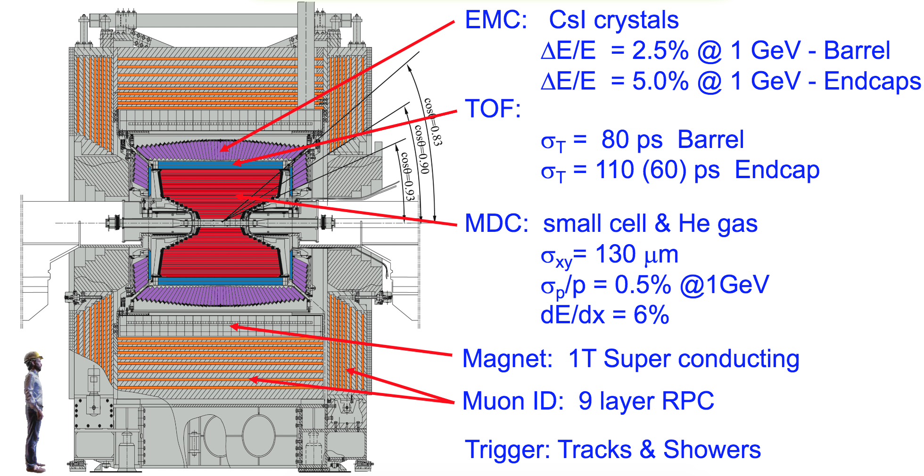
BESIII detector
The detector is designed for neutral and charged particle with excellent resolution, PID, and large coverage.
Total weight 730 ton, ~40,000 readout channels, Data rate: 5kHz, 50Mb/s
Has been in full operation since 2008, all subdetectors are in very good status!
Notes:
Cos theta = 0.93 → 21.56 度， cos theta = 0.9 → 26.5 度
北京谱仪III（BESIII）的最外层缪子探测器（Muon Identifier, MUID） 主要用于鉴别和重建高能缪子（μ±），其设计基于多层阻性板室（RPC）和铁磁屏蔽层的组合，通过探测穿透能力强的高能缪子与其他粒子的差异来实现鉴别。以下是其工作原理的详细解析：
📌 MUID的结构设计
探测层布局
RPC探测器：共 9层，每层由**阻性板室（RPC）**构成，分为桶部（Barrel）和端盖（Endcap）两部分，覆盖极角范围 |cosθ| < 0.92。
铁磁吸收体：每两层RPC之间夹有 10 cm厚铁板（总厚度约1 m），用于吸收强子（如π、K、p）和电磁簇射（如e±、γ），仅高能缪子可穿透。
RPC工作单元
气体混合物：Ar/C₂H₂F₄/iC₄H₁₀（比例约45/50/5），提供高雪崩增益和快响应。
电极结构：双层玻璃纤维环氧树脂板（电阻率~10¹¹ Ω·cm），表面涂覆石墨层作为电极，工作电压~9 kV。
读出系统
条状读出电极：每层RPC的读出条宽度为 3–5 cm，正交排列（X/Y向）实现三维径迹重建。
电子学：快放大器（~10 ns上升时间）和时间数字转换器（TDC），时间分辨率~2 ns。
🔍 工作原理分步解析
粒子穿透与筛选
带电粒子从内探测器（如MDC、TOF）进入MUID时：
缪子（μ±）：因相互作用弱，几乎无能量损失，可穿透全部铁层和RPC。
强子（π±/K±/p）：在铁中发生强相互作用或核反应，被吸收或产生次级粒子。
电子/光子：引发电磁簇射，能量沉积在铁层中。
RPC信号产生
穿透的缪子在RPC气体中电离产生电子-离子对，电子在强电场（~50 kV/cm）下雪崩放大，形成可测信号。
多级触发：要求粒子至少穿透 6层RPC 才被认定为缪子候选者，降低本底噪声。
径迹重建
通过多层RPC的击中点拟合缪子径迹，结合内探测器动量信息，排除散射本底。
动量阈值：>0.5 GeV/c的缪子可穿透全部铁层（1 m铁对应~500 MeV/c的动量截止）。
本底抑制
时间符合：RPC信号需与对撞时间同步（窗口~20 ns）。
几何关联：与外径迹匹配（如与MDC径迹外推点偏差<5 cm）。
⚙️ 关键性能参数
参数MUID性能探测效率>95%（对 pμ>1 GeV/cpμ​>1 GeV/c）空间分辨率~1 cm（单层RPC）时间分辨率~2 ns（单次测量）强子抑制比>10³（对π±）覆盖动量范围>0.5 GeV/c
🌟 物理应用与优势
粲物理与τ物理
鉴别 J/ψ→μ+μ−J/ψ→μ+μ− 和 D0→K−μ+νμD0→K−μ+νμ​ 等含缪子的衰变道。
新物理寻找
探测长寿命粒子（如暗光子）衰变的缪子信号。
与内探测器互补
联合TOF和dE/dx数据，提高低动量缪子（pμ<1 GeV/cpμ​<1 GeV/c）的鉴别效率。
⚠️ 技术挑战与解决方案
铁磁材料饱和：强磁场（1.0 T）下铁板磁导率下降，通过优化铁层厚度和间隙设计减少磁场畸变。
RPC老化：高辐照导致气体增益下降，定期更换气体混合物并监测计数率变化。
噪声抑制：采用差分读出和阈值甄别剔除宇宙线本底。
📊 与其他实验对比
实验缪子探测器类型动量截止（GeV/c）效率（1 GeV/c）BESIIIRPC+铁层（1 m）0.5>95%CMS闪烁体砖+径迹室0.7>99%LHCb多丝正比室+铁层0.6~90%
BESIII的MUID通过铁层筛选+RPC探测的组合，在有限空间内实现了高效的缪子鉴别，为粲偶素和QCD研究提供了关键数据支持。如需具体效率曲线或触发逻辑细节，可参考BESIII合作组的《NIM A》技术文档。

Slide 5



Europe (19)
Germany(6): Bochum University,
GSI Darmstadt, Helmholtz Institute Mainz, Johannes Gutenberg University of Mainz, Universitaet Giessen, University of Münster
Italy(3): Ferrara University, INFN, University of Turin,
Netherlands(1 ):KVI/University of Groningen
Russia(3): Budker Institute of Nuclear Physics, Dubna JINR，Lebedev Physical Institute
Sweden(1):Uppsala University
Turkey (1):Turkish Accelerator Center Particle Factory Group
UK(3): University of Manchester, University of Oxford, University of Bristol
Poland(1): National Centre for Nuclear Research
~ 700 members
From 93 institutions
in 16 countries
USA(3)
Carnegie Mellon University
Indiana University
University of Hawaii
Mongolia(1)
Institute of Physics and Technology
Pakistan(2)
Institute of Business Administration (IBA), Karachi
University of the Punjab
Korea(1)
Chung-Ang University
Thailand(1)
Suranaree University of Technology
India(1)
Indian Institute of Technology madras
China (63)
Beihang University, Central China Normal University, Central South University, Chengdu University of Technology ，China Center of Advanced Science and Technology, China University of Geosciences, Fudan University, Guangxi Normal University, Guangxi University, Guangxi University of Science and Technology, Hangzhou Normal University, Hebei University, Henan University, Henan Normal University, Henan University of Science and Technology, Henan University of Technology, , Hengyang Normal University, Huangshan College, Hunan University, Hunan Normal University, Inner Mongolia University, Institute of High Energy Physics, Institute of Modern Physics, Jiangsu Ocean University，Jilin University, Lanzhou University, Liaoning Normal University, Liaoning University, Longyan University, Nanjing Normal University, Nanjing University, Nankai University, North China Electric Power University,Peking University, Qufu Normal University, Renmin University of China，Shaanxi Normal University，Shanxi University, Shanxi Normal University, Sichuan University, Shandong Management University ，Shandong Normal University, Shandong University, Shandong University of Technology, Shanghai Jiao Tong University, Soochow University,South China Normal University, Southeast University, Southwest University of Science and Technology， Sun Yat-sen University, Tsinghua University, University of Chinese Academy of Sciences, University of Jinan, University of Science and Technology of China, University of Science and Technology Liaoning, University of South China, Wuhan University, Xi’an Jiaotong University, Xinyang Normal University, Yantai University , Yunnan University , Zhejiang University, Zhengzhou University
Chile(2)
University of Tarapaca
University of La Serena

Slide 6

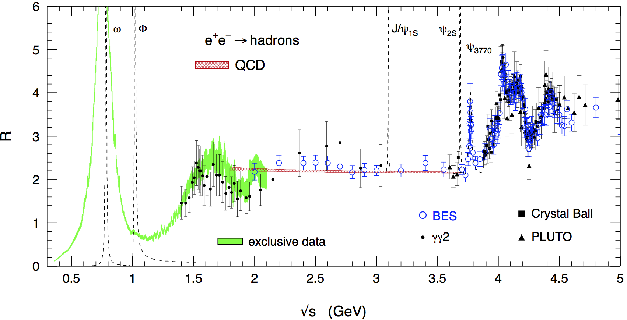
Why still Charm? Rich Physics
Hadron form factor
R value and QCD
Hadronization
Fragmentation functions
Nucleon structure
Light hadron spectroscopy
Gluonic and exotic states
Physics with t lepton
XYZ particles
Charm mesons
Charm baryons

Slide 7
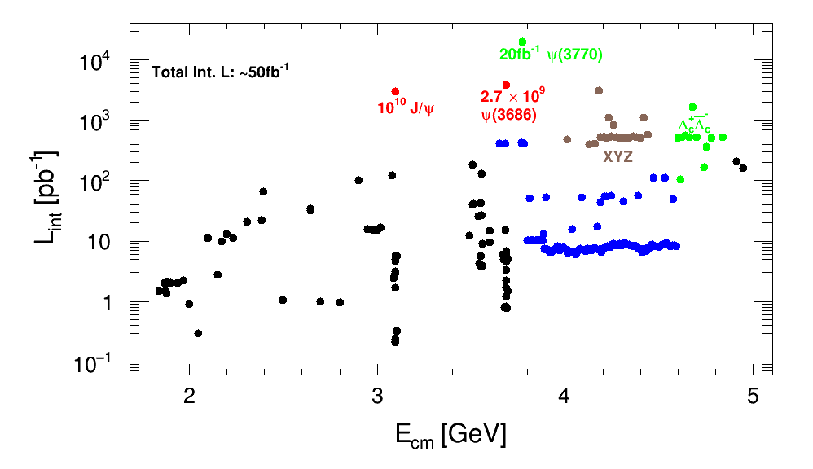
BESIII data samples: integrated luminosity

Slide 8
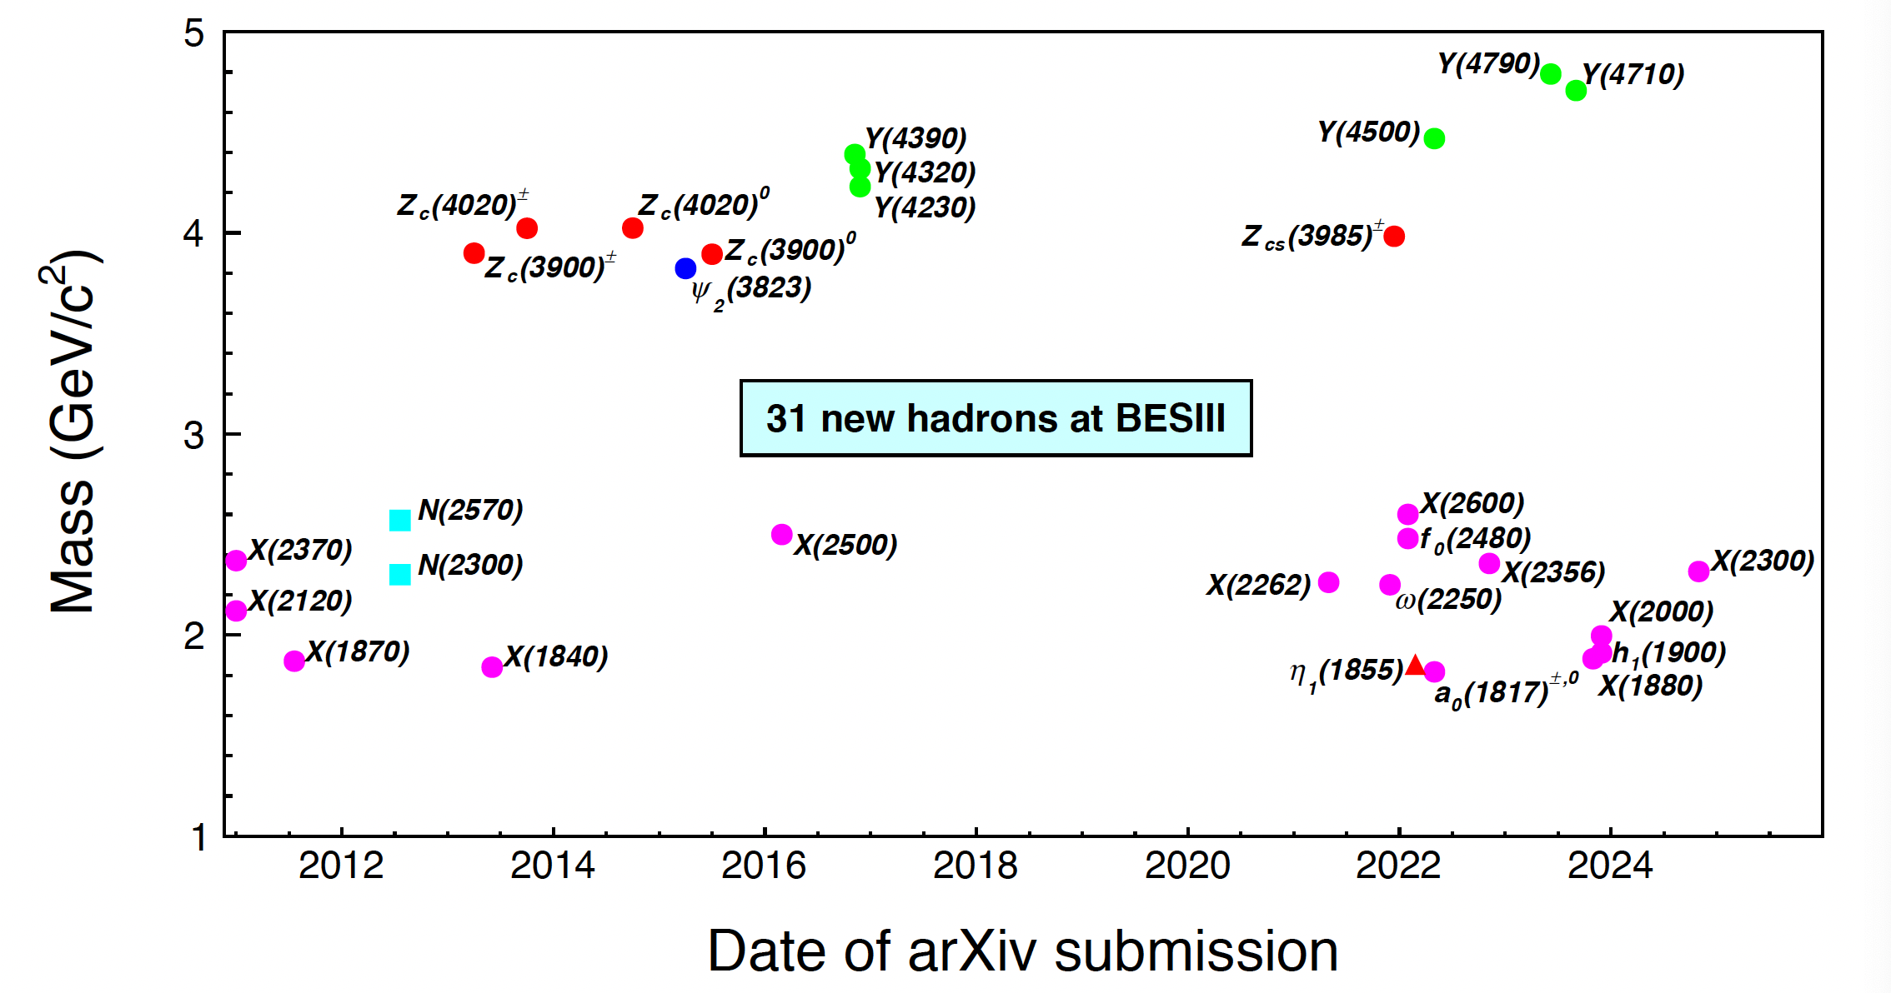
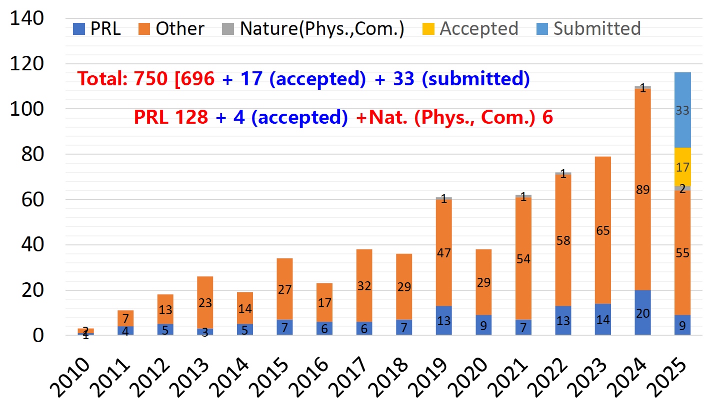
BESIII achievements
Totally 750 papers published by BESIII until Sep. 17, 2025
See talks by Hongfei Shen : Hyperon physics and Yuxiang Zhao: Fragmentation function @ BESIII

Slide 9
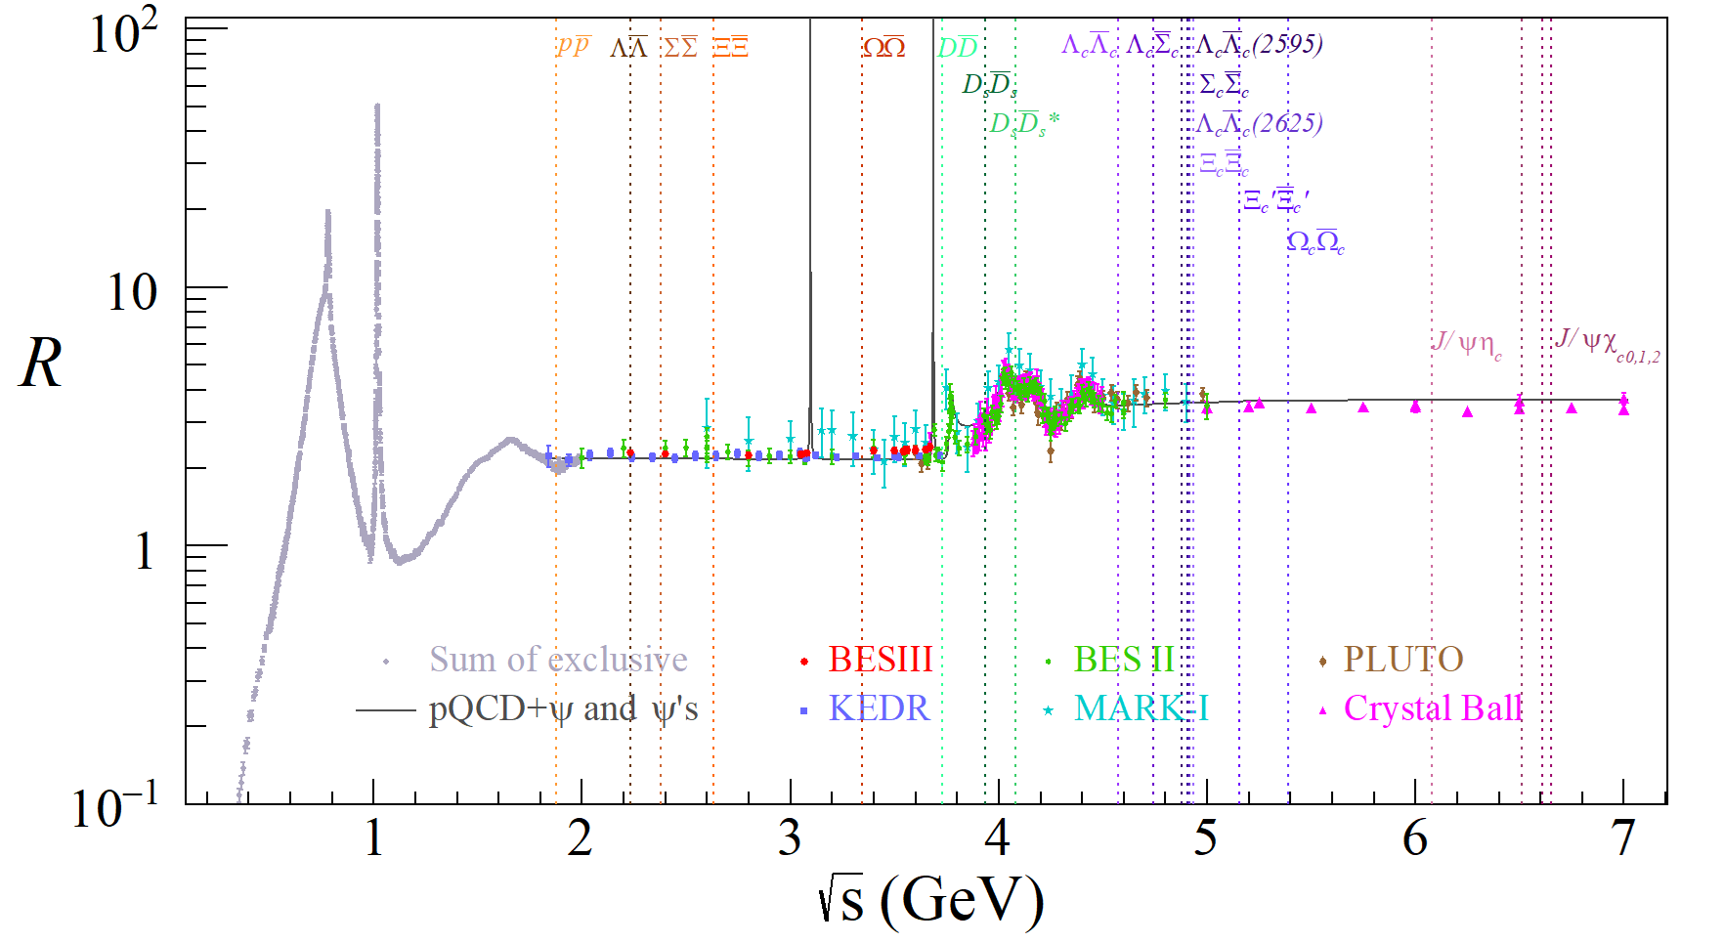
Advantage: quantum-entangled hadron pairs near to the thresholds
Meson and baryon pairs productions near
thresholds allow us to probe:
form-factors, relative phases,
spin polarization, CP violation.

Slide 10
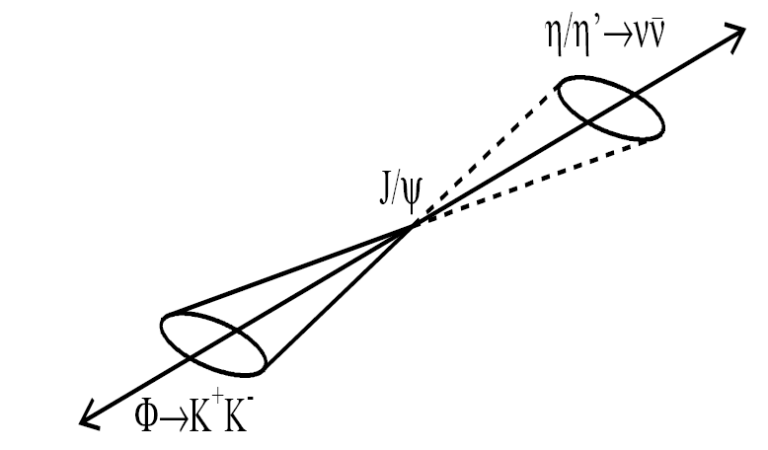
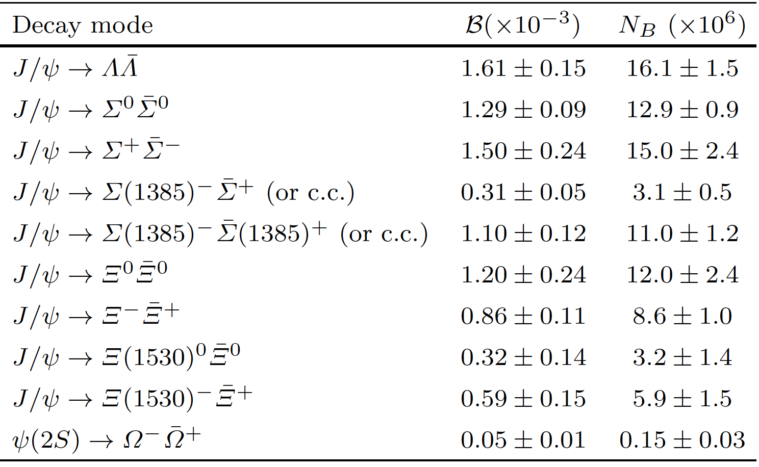
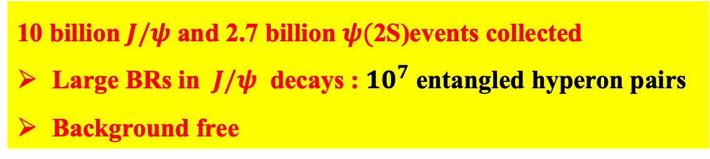

BESIII: a hyperon factory
Hai-Bo Li, arXiv:1612.01775
10 billion $J/ψ$ and 2.7 billion $ψ($2S)events collected
Large BRs in $J/ψ$ decays : ${10}^{7}$ entangled hyperon pairs
Background free
e+
e-
Single tag
$$Σ^{+}→pπ^{0}$$

Slide 11
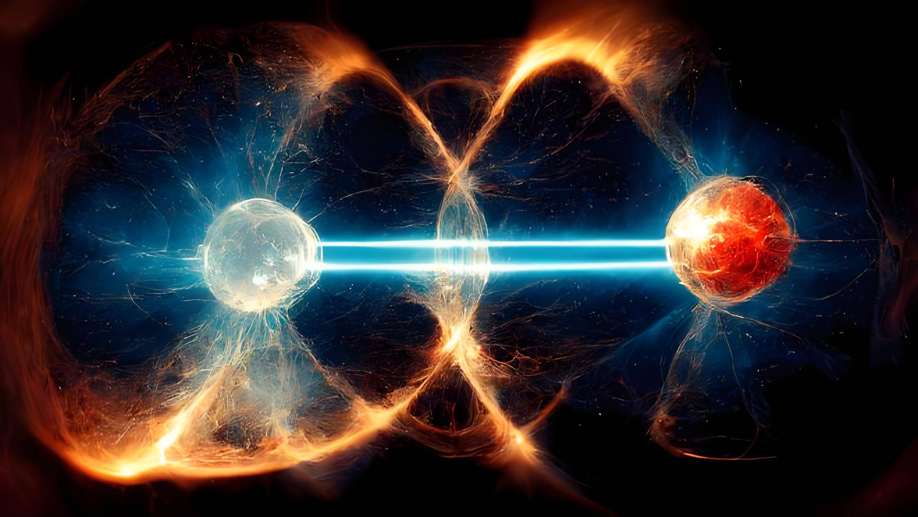

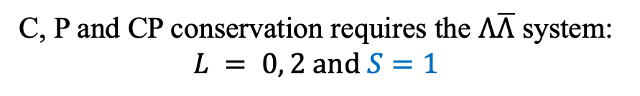




Spin entanglement of the hyperon anti-hyperon at BESIII
Spin correlation!
$J^{PC}=1^{−−}$
$$e^{+}e^{−}→γ^{∗}→J/ψ→Λ\overline{Λ}$$
$$Λ$$
$$\overline{Λ}$$
C, P and CP conservation requires the $Λ\overline{Λ}$ system:
$$L = 0, 2 and S=1$$
$Λ\overline{Λ}$ in the spin triplet state
Spins of $Λ$ and $\overline{Λ}$ must be parallel
Kang, Li, Lu, Phys.Rev. D81 (2010) 051901

Slide 12
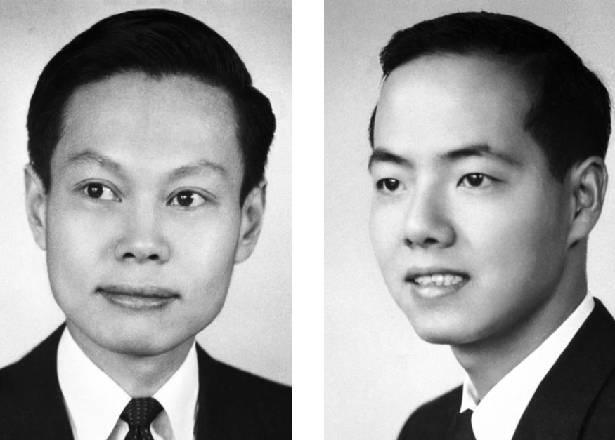
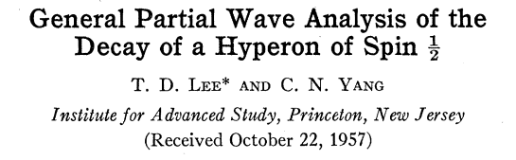
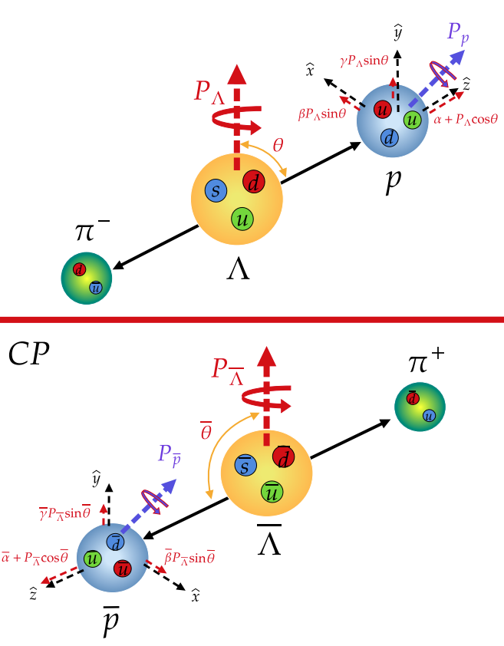
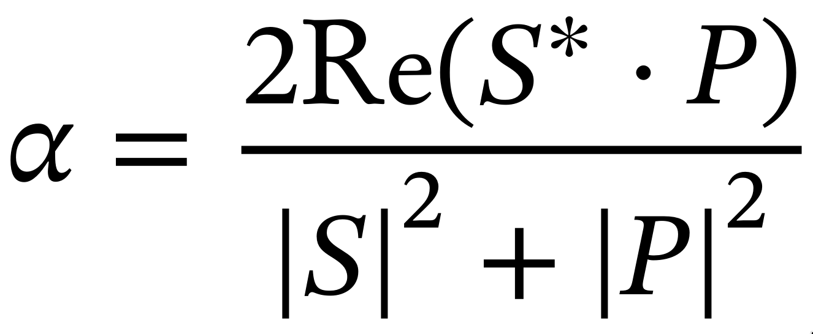
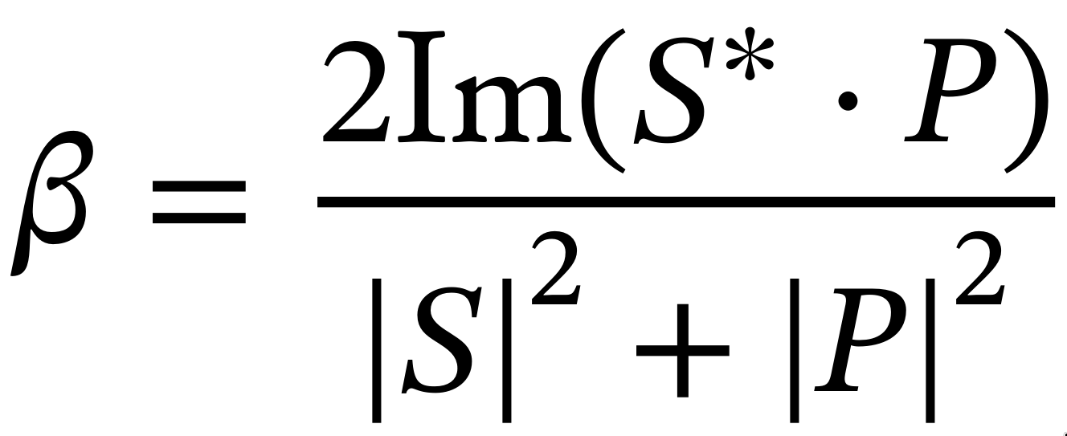
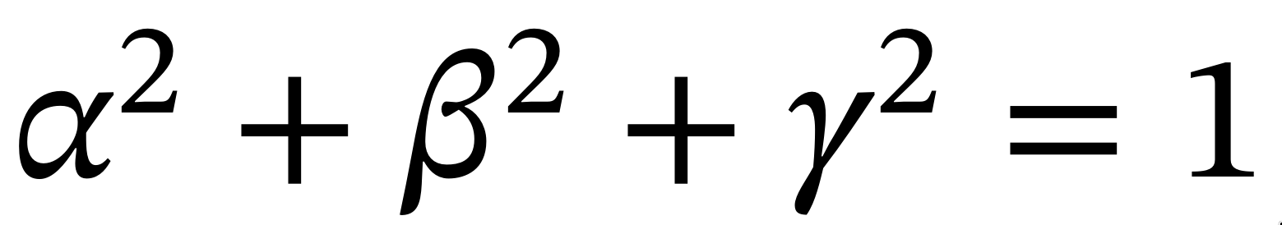

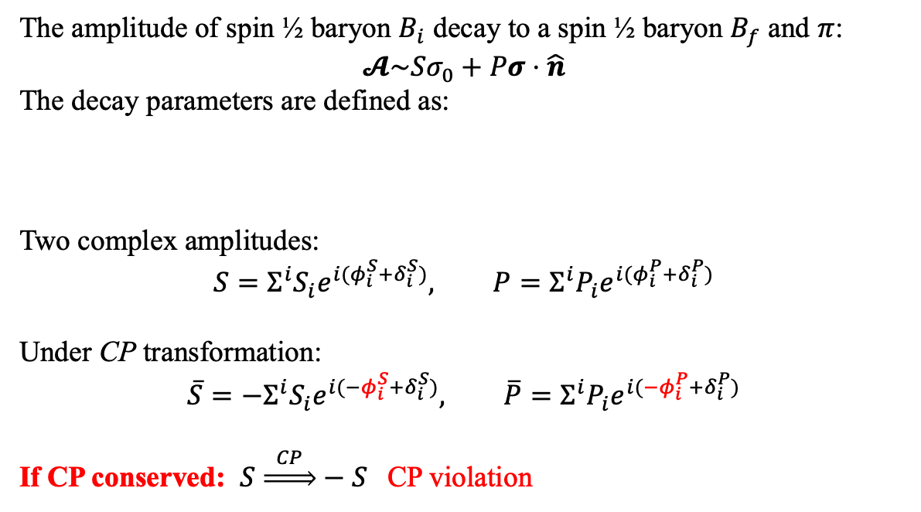

CPV in hyperon decay
Parameterization of the hyperon decays
Parity violation in up and down asymmetry
Phys. Rev. 108, 1645 (1957)
The amplitude of spin ½ baryon $B_{i}$ decay to a spin ½ baryon $B_{f}$ and $π$:
$$𝓐\sim Sσ_{0}+Pσ⋅\hat{n}$$
The decay parameters are defined as:
Two complex amplitudes:
$$S=Σ^{i}S_{i}e^{i(φ_{i}^{S}+δ_{i}^{S})}, P=Σ^{i}P_{i}e^{i(φ_{i}^{P}+δ_{i}^{P})}$$
Under CP transformation:
$$\overline{S}={−Σ}^{i}S_{i}e^{i(−φ_{i}^{S}+δ_{i}^{S})}, \overline{P}=Σ^{i}P_{i}e^{i({−φ}_{i}^{P}+δ_{i}^{P})}$$
If CP conserved: $S \underset{⇒}{ CP }−S$ CP violation
$φ$ weak phase, $δ$ strong phase
CP violation is in the difference of up-down asymmetries
of hyperon and anti-hyperon decays ?
+ entangled hyperon-anti-hyperon productions.
$P \underset{⇒}{ CP } P$
Notes:
These decays are described by the usual decay parameters given by Lee
and Yang' with the convention used here of
The experimental observables are the total rate \Gamma, and
the decay parameters \alpha, beta, and gamma which govern the
decay-angular distribution and the polarization of the final
baryon. Among alpha, beta, and gamma, only two are independent
as they are related through
the identity
The angular distribution of the pion from a completely polarized hyperon at rest.
The three parameters are related through this relation ?

Slide 13
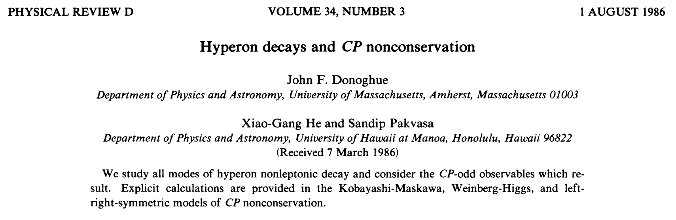

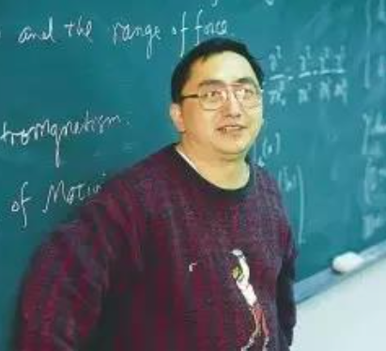

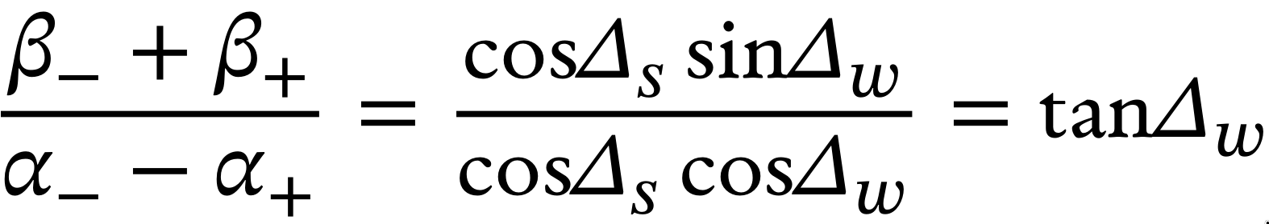








CP observables in hyperon decays
PRD 34,833 1986
hep-ph/991023
hep-ph/0002210
PRD 34,833 1986
John F. Donoghue
Xiao-Gang He
Sandip Pakvasa
SM Prediction:
$Δ=\frac{Γ−\overline{Γ}}{Γ+\overline{Γ}}≈\sqrt{2}\frac{T_{\frac{3}{2}}}{T_{\frac{1}{2}}}\sin{Δ_{s}\sin{φ_{CP}}}$
$$−5.4×{10}^{−7}$$
Not sensitive to $CPV$
Decay width difference
$$A=\frac{Γα+\overline{Γ}\overline{α}}{Γα−\overline{Γ}\overline{α}}≈\tan{Δ_{s}}\tan{φ_{CP}}$$
Easiest to measure
Decay parameter difference
$$−0.5×{10}^{−4}$$
Polarization of decayed baryon needs to be measured
$$B=\frac{Γβ+\overline{Γ}\overline{β}}{Γα−\overline{Γ}\overline{α}}≈\tan{φ_{CP}}$$
Decay parameter difference
$$3.0×{10}^{−3}$$
$Ξ^{−}, Ξ^{0}, Ω^{−}$ cascade decay
Notes:
Sandip from Hawai, who was one of early researchers of CPV in hyperons.

Slide 14
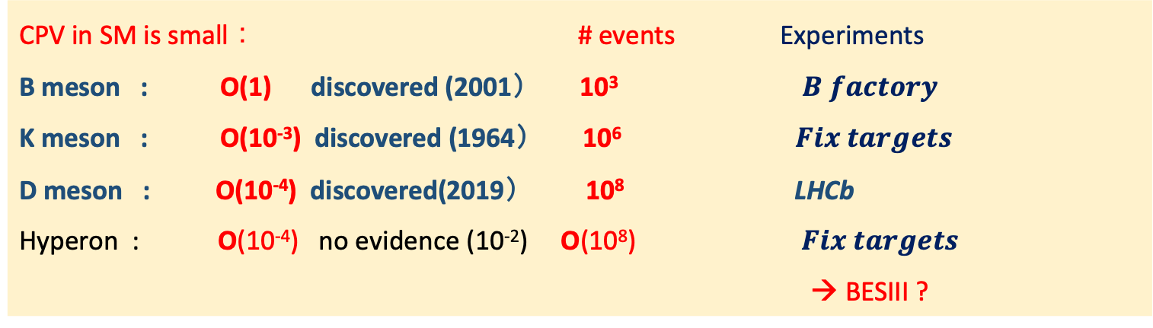
CPV in hyperon decays, # events we need?
CPV in SM is small ： # events Experiments
B meson : O(1) discovered (2001） 10³$B factory$
K meson : O(10⁻³) discovered (1964） 10⁶ $Fix targets$
D meson : O(10⁻⁴) discovered(2019） 10⁸ LHCb
Hyperon : O(10⁻⁴) no evidence (10⁻²) O(10⁸) $Fix targets$
→ BESIII ?
Flavor-SU(3) Octet of spin ½
Flavor-SU(3) Decuplet of spin 3/2
Ω⁻ was predicted by quark model
Discovered in 1964 at BNL.

Slide 15
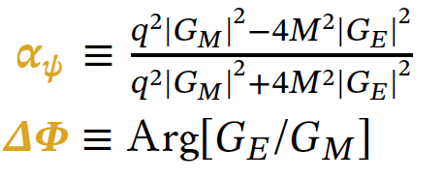
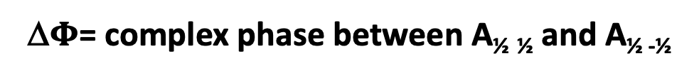
Entangled and Polarized hyperon pairs @ $e^{+}e^{−}$ collisions
m=±1
m=±1
A_{½ -½}
θ,φ
A_{½ ½}
θ,φ
J/ψ
J/ψ
A_{-½ ½}
m=±1
A_{-½ -½}
m=±1
θ,φ
θ,φ
J/ψ
J/ψ
From Steve Olsen
Parity conservation : A_{½ ½} =A_{-½ -½}
parity conservation : A_{½} _{-½} =A_{-½ ½}
Δ$Φ$= complex phase between A_{½} _{½} and A_{½ -½}
Notes:
According to parity conservation,

Slide 16
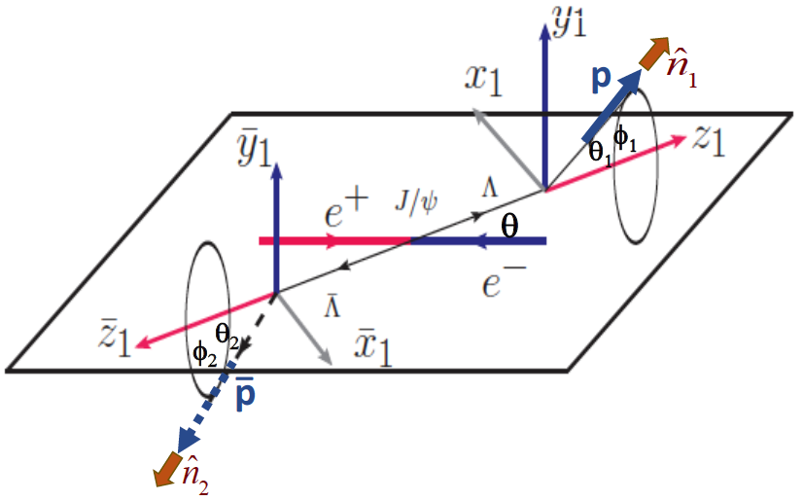

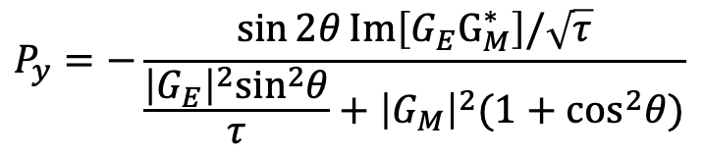
Correlated 5-dim. angular distribution
If Δ$Φ$ ≠ 0, Λ and Λ are transversely polarized
Unpolarized part
Entangled part
Polarized part
Polarization-term can be used to determine $α_{−}$ and $α_{+}$ simultaneously
Λ
$$P_{y}=−\frac{\sin{2θ}Im\left[G_{E}G_{M}^{∗}\right]/\sqrt{τ}}{\frac{{\left|G_{E}\right|}^{2}\sin^{2}θ}{τ}+{\left|G_{M}\right|}^{2}(1+\cos^{2}θ)}$$
Notes:
the joint angular distribution is [

Slide 17
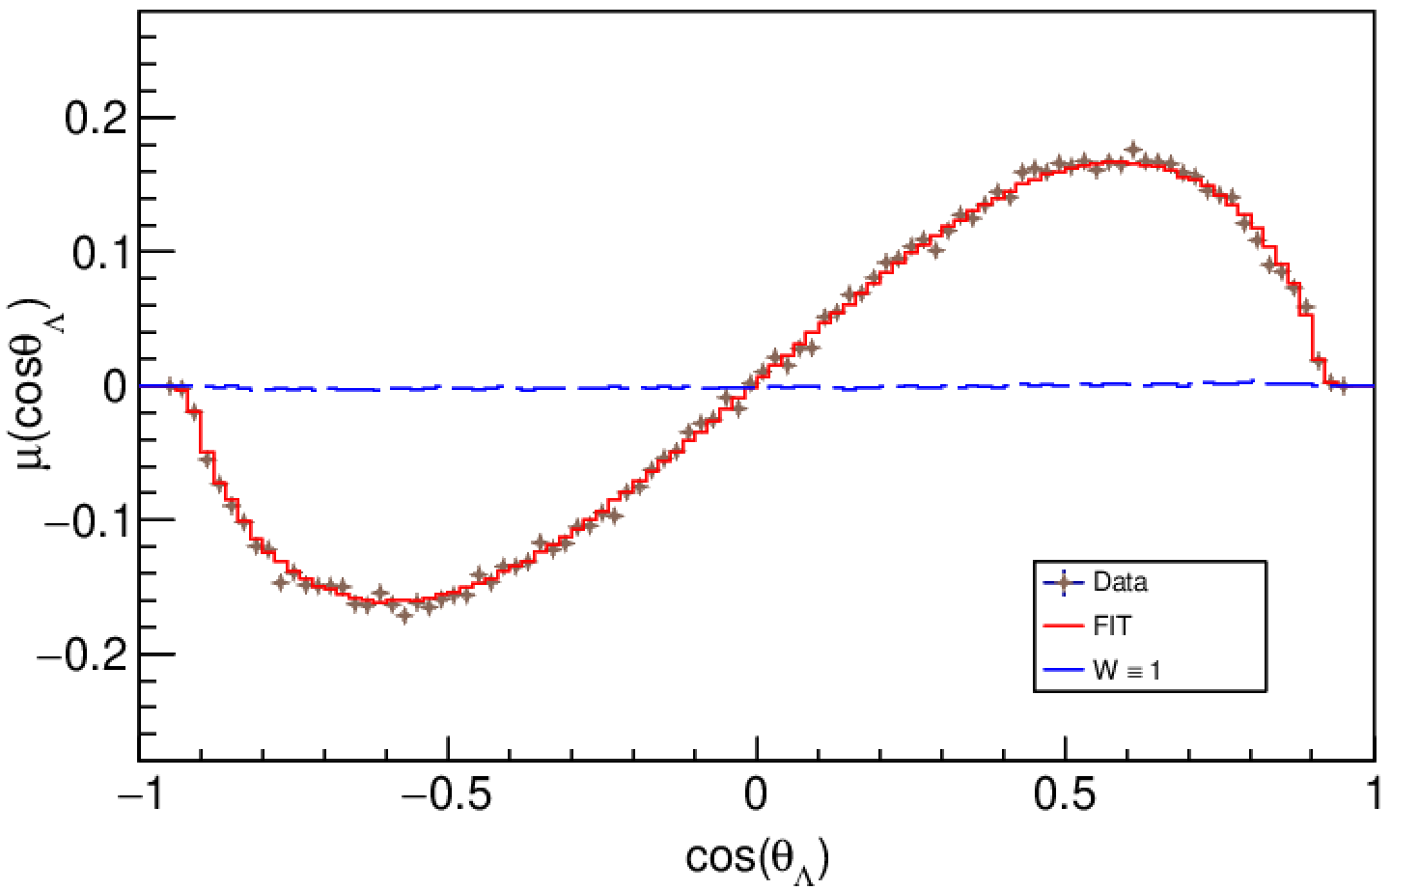
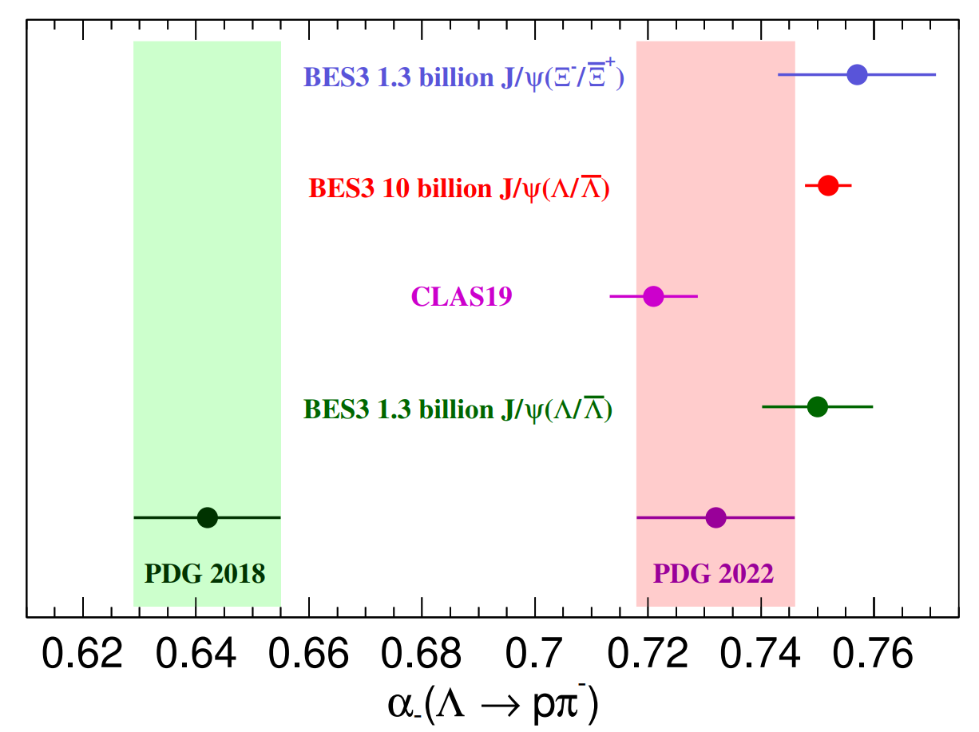
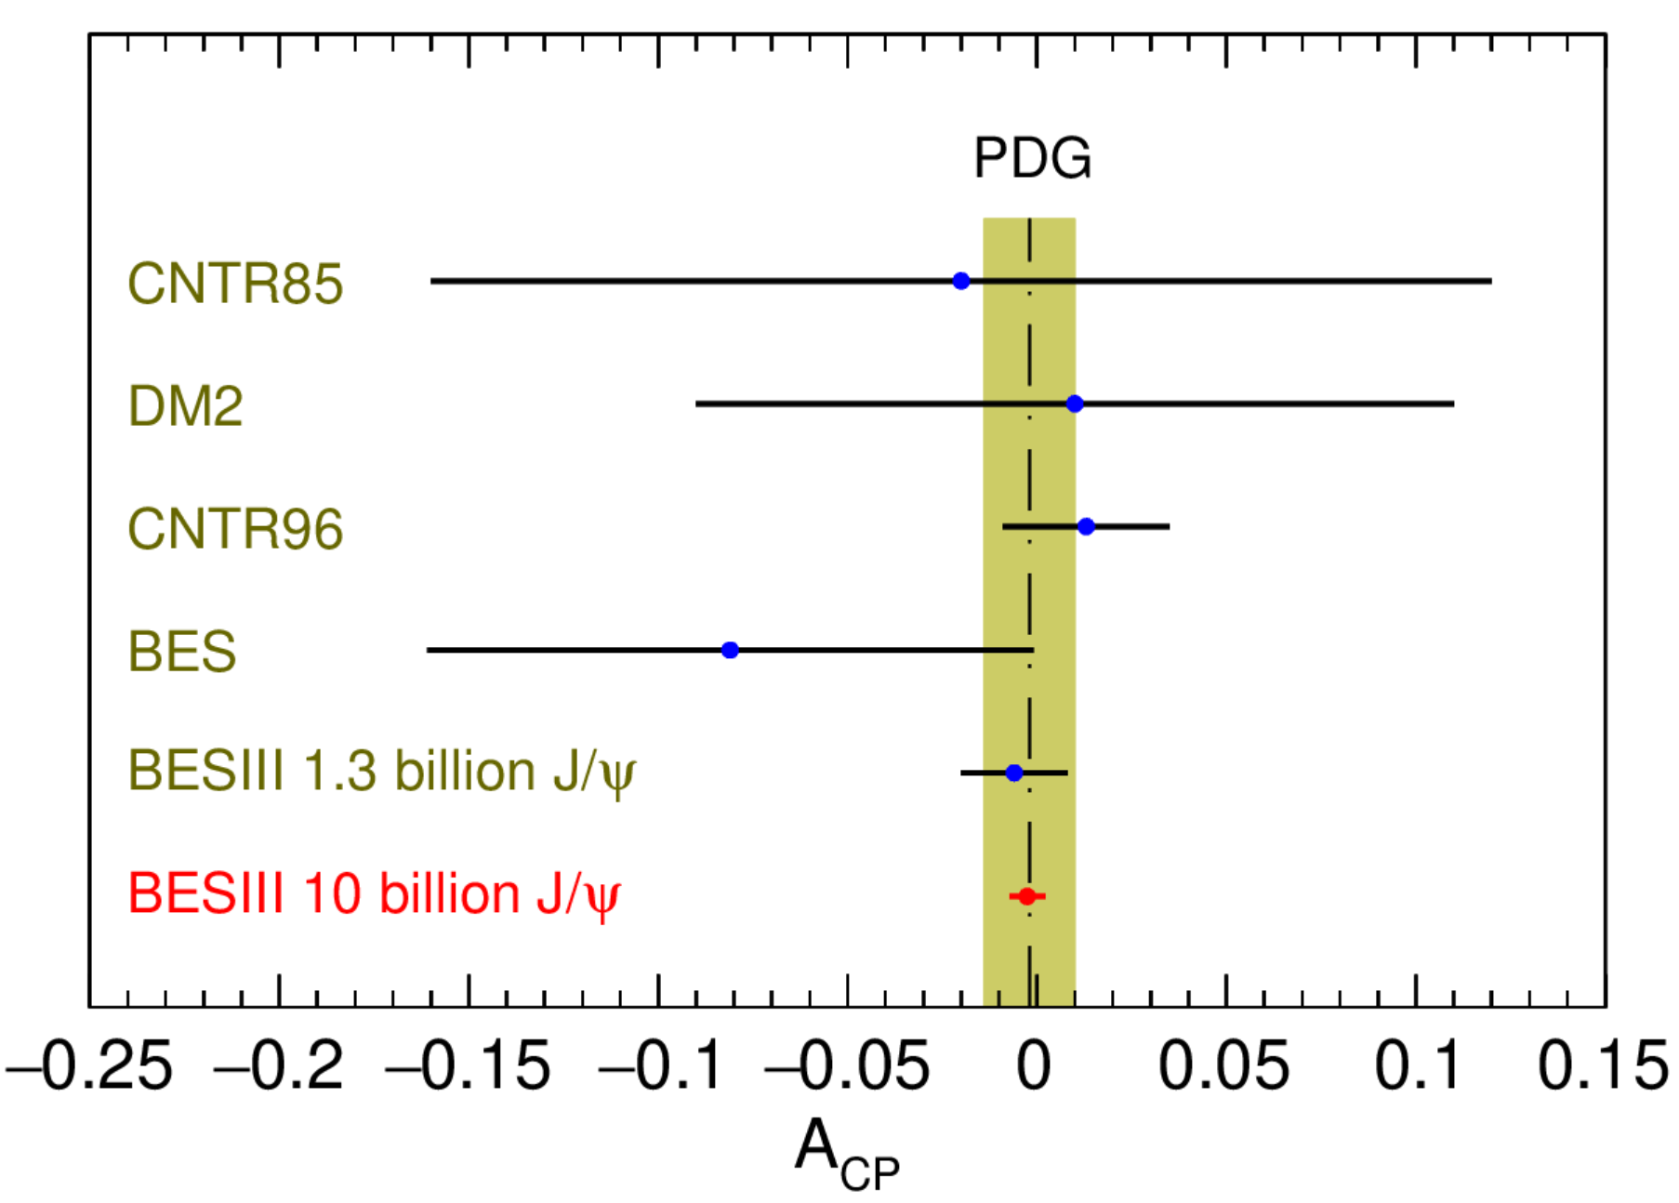
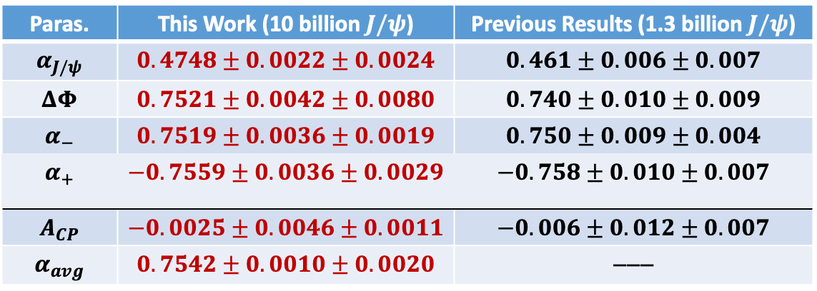

Transverse polarization and $CP test in \text{J}\text{/}ψ →Λ$ $\overline{Λ}$
10 billion J/$ψ$ (Phys. Rev. Lett. 129, 131801 (2022)
Nat. Phys. 15, 631 (2019)
10 billion $J/ψ$
Paras. | This Work (10 billion $J/ψ$) | Previous Results (1.3 billion $J/ψ$)
$$α_{J/ψ}$$ | $$0.4748±0.0022±0.0024$$ | $$0.461±0.006±0.007$$
$$ΔΦ$$ | $$0.7521±0.0042±0.0080$$ | $$0.740±0.010±0.009$$
$$α_{−}$$ | $$0.7519±0.0036±0.0019$$ | $$0.750±0.009±0.004$$
$$α_{+}$$ | $$−0.7559±0.0036±0.0029$$ | $$−0.758±0.010±0.007$$
$$A_{CP}$$ | $$−0.0025±0.0046±0.0011$$ | $$−0.006±0.012±0.007$$
$$α_{avg}$$ | $$0.7542±0.0010±0.0020$$ | −−−
Polarization: max 25%
More than 10
standard deviation
shift from all
previous
measurements
Sensitivity of A_{CP} ：
below 0.5%
unprecedented
precision
Standard model prediction : A_{CP}~ 10⁻⁴ (PRD 34, 833 (1986))

Slide 18
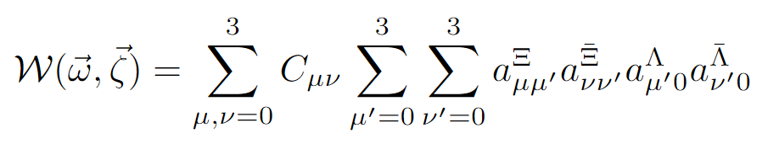
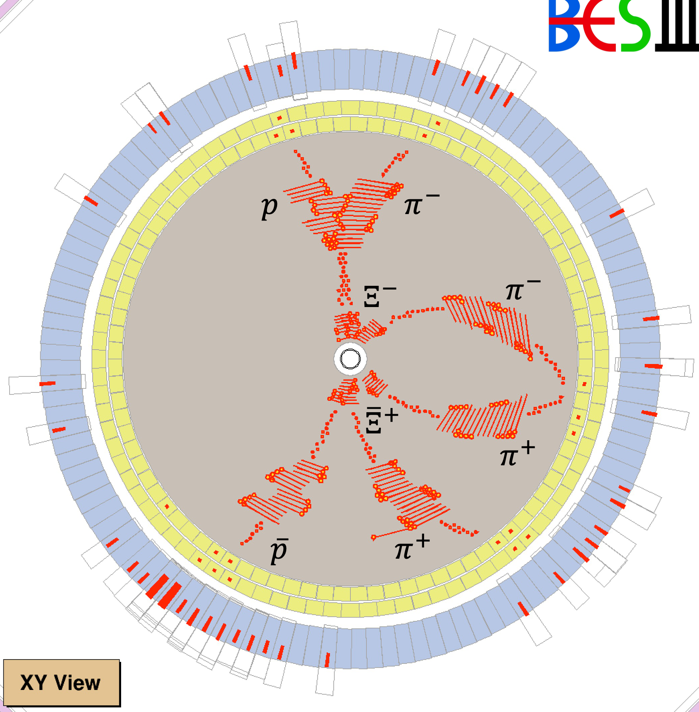
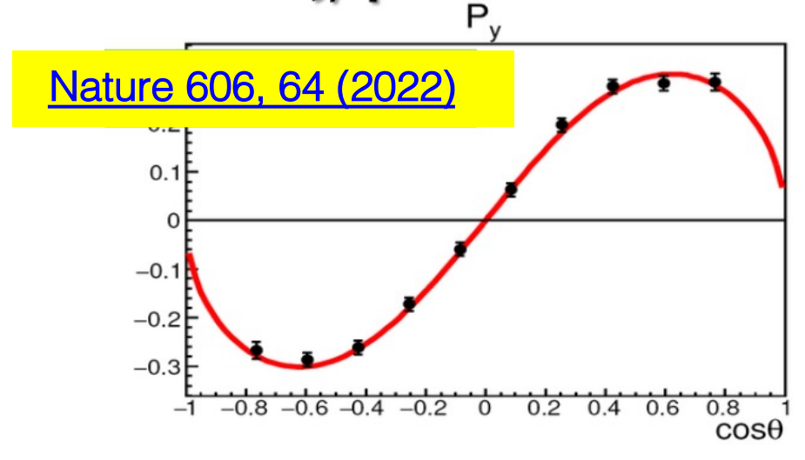








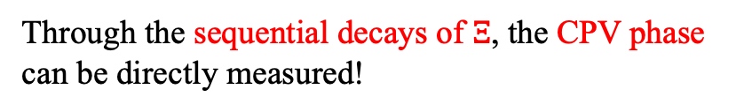


Observation of $Ξ^{−} {\overline{Ξ}}^{+}$polarization in spin correlated state
1.3 billion J/$ψ$
$Ξ^{−} {\overline{Ξ}}^{+}$polarization
$$pπ^{−}$$
↱
spin-aligned
quantum entangled
$$Λ$$
$$Λπ$$
↱
$$e^{+}e^{−}→J/ψ→Ξ\overline{Ξ}$$
↳
$$\overline{Λ}π$$
↳
$$\overline{p}π^{+}$$
$$\overline{Λ}$$
Through the sequential decays of $Ξ$, the CPV phase can be directly measured!
The perfect reaction for hyperon $CPV$ searches!
Phys. Rev. D 99, 056008 (2019)
Phys. Lett. B 772, 16 (2017)
Notes:
Next is the Search for CPV in Xi decays. The whole process is e+e→jpsi->Xi Xibar, Xi->Lambda pi, Lambda ->ppi. This figure shows how a XiXibar event looks like in the BESIII detector. The joint angular distribution of this process can be described by this formula. This process has a relatively high branching fraction and comparable S/P waves, plus the sequential Xi decay, it’s the perfect reaction for hyperon CPV searches.

Slide 19
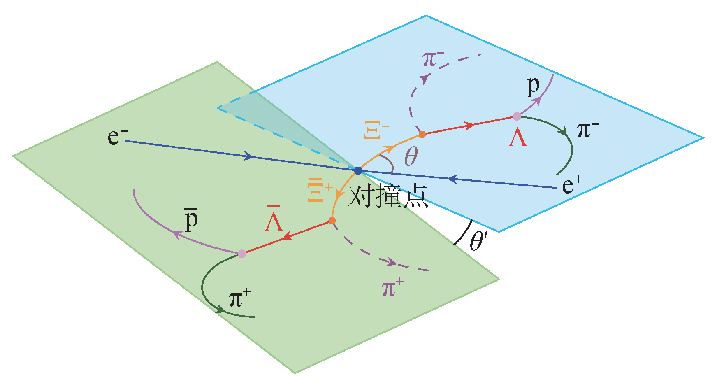
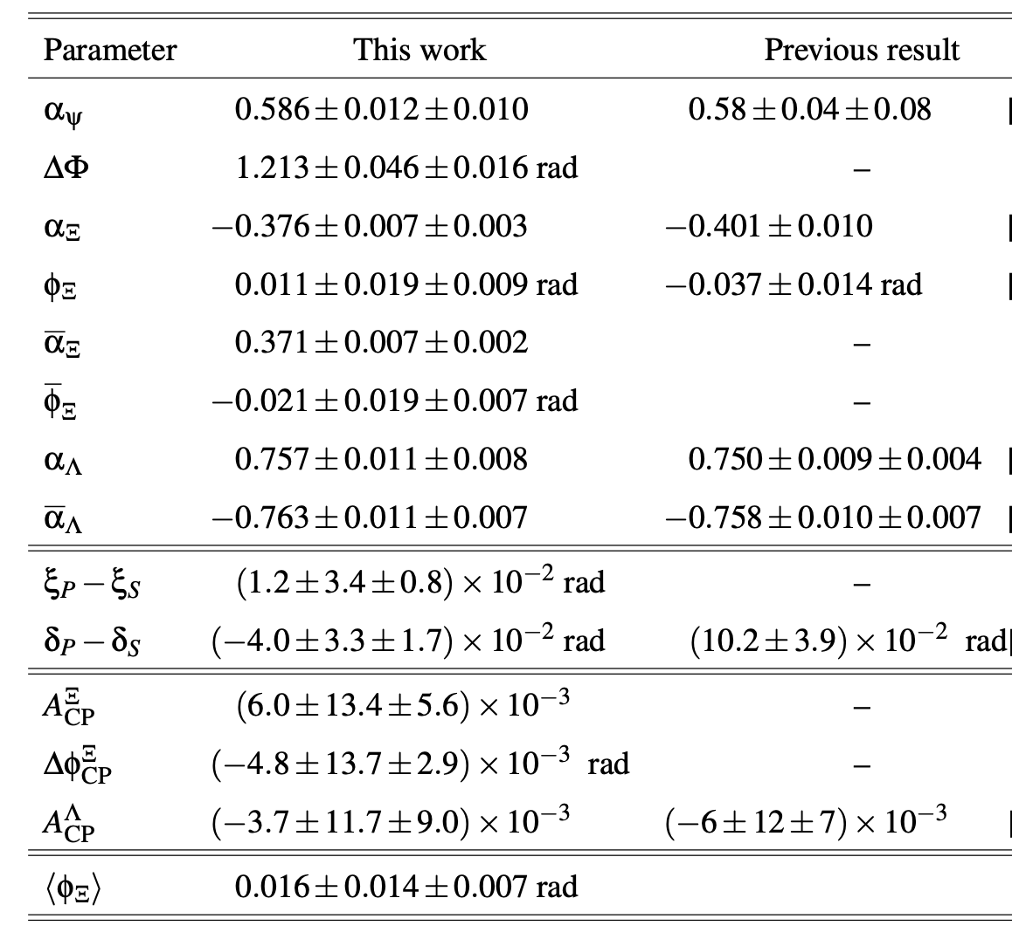
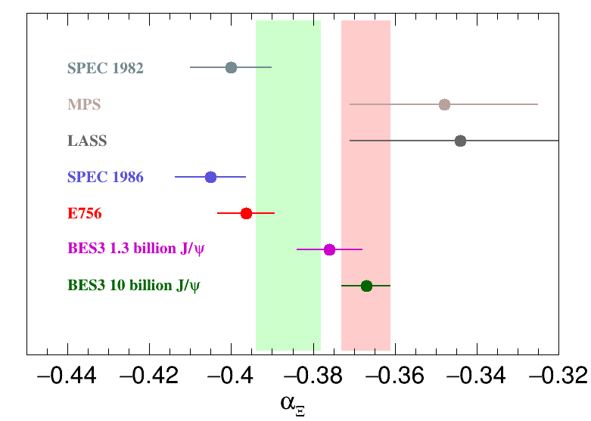
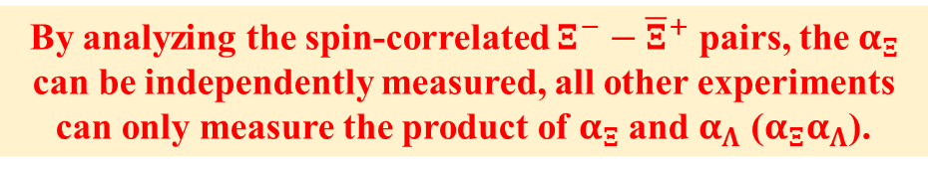

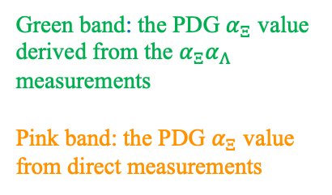

Search for CP violation in spin-correlated $Ξ^{−}−{\overline{Ξ}}^{+}$ pairs
BESIII Nature 606 (2022) 64-69
1.3 billion J/$ψ$
Ξ⁻ →Λπ
73 K $Ξ^{−}−{\overline{Ξ}}^{+}$ pairs with 99% purity
Green band: the PDG $α_{Ξ}$ value derived from the $α_{Ξ}α_{Λ}$ measurements
Pink band: the PDG $α_{Ξ}$ value from direct measurements
By analyzing the spin-correlated $Ξ^{−}−{\overline{Ξ}}^{+}$ pairs, the $α_{Ξ}$ can be independently measured, all other experiments can only measure the product of $α_{Ξ}$ and $α_{Λ}$ ($α_{Ξ}α_{Λ}$).

Slide 20
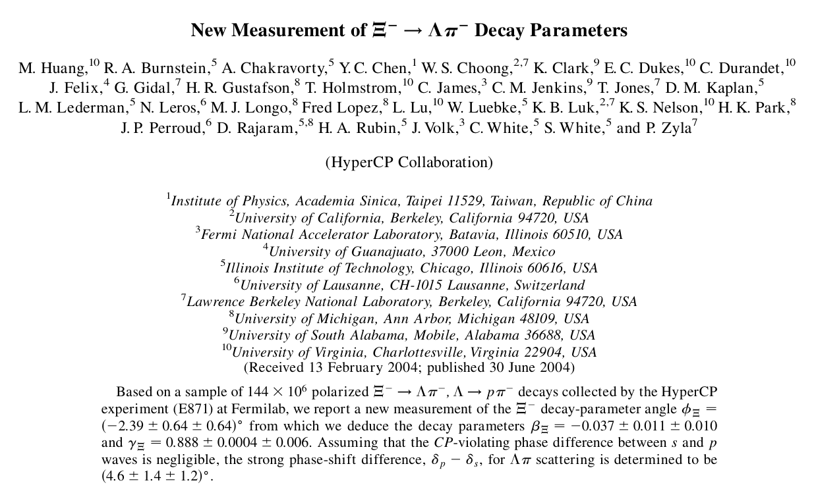

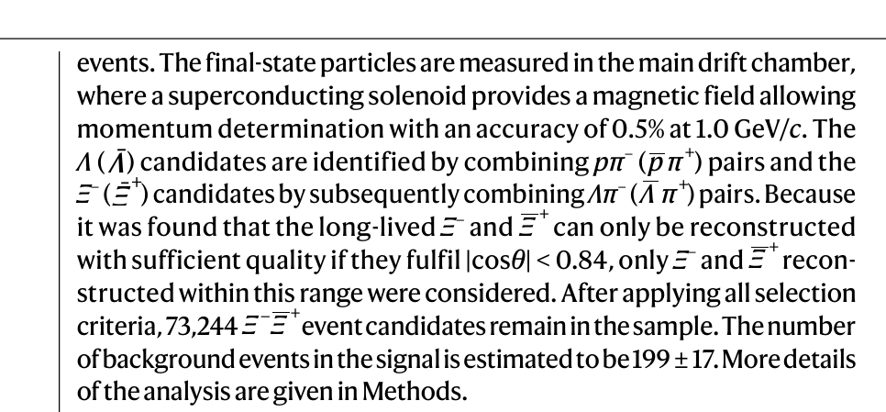
Search for CP violation in spin-correlated $Ξ^{−}{\overline{Ξ}}^{+}$ pairs
HyperCP: Phys. Rev. Lett. 93 (2004) 011802
BESIII: Nature 606 (2022) 64-69
144 M $Ξ^{−}$: $φ_{Ξ}=−0.032±0.011±0.011$ rad
73K $Ξ^{−}{\overline{Ξ}}^{+}$ pairs : ${⟨φ}_{Ξ}⟩=0.016±0.014±0.007$ rad
With 73 K reconstructed $Ξ^{−}{\overline{Ξ}}^{+}$ pairs from 1.3 billion J/ψ events at BESIII, we achieved a precision for $φ$ parameter comparable to that in the HyperCP experiment in which 144 million $Ξ^{−}$ are reconstructed.
The spin correlation between the $Ξ^{−}$ and ${\overline{Ξ}}^{+}$ significantly improved the precision of the decay parameter measurements; the single-event sensitivity of BESIII is 1000 times that of HyperCP

Slide 21
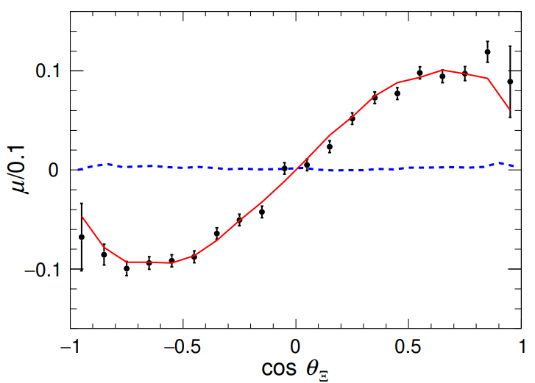
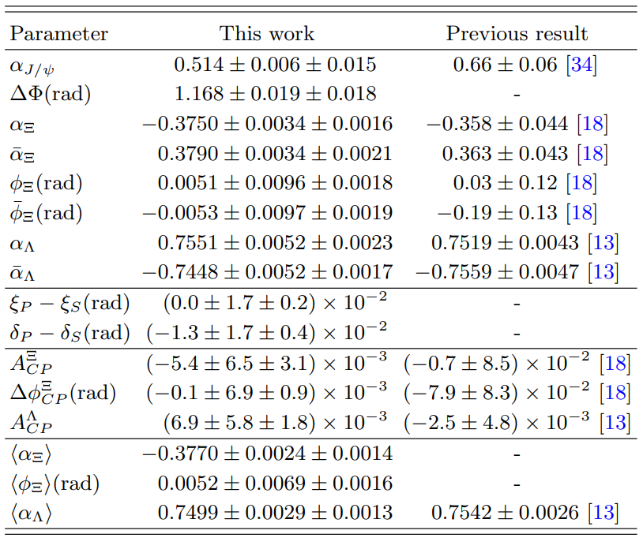
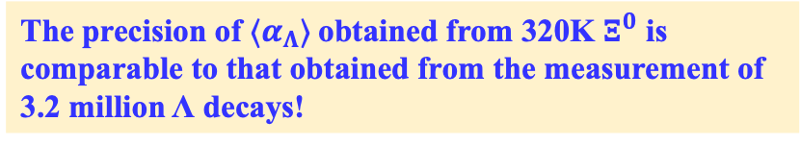


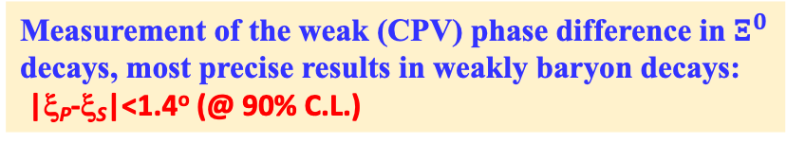
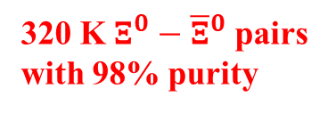


Search for CP violation in quantum-entangled $Ξ^{0}−{\overline{Ξ}}^{0}$ pairs
10 billion J/$ψ$
$$e^{+}e^{−}→J/ψ→Ξ^{0}{\overline{Ξ}}^{0}$$
$$Ξ^{0}→Λπ^{0}$$
320 K $Ξ^{0}−{\overline{Ξ}}^{0}$ pairs with 98% purity
$Ξ^{0}$ Polarization
The precision of the asymmetry parameter: $10^{−3}$
Measurement of the weak (CPV) phase difference in $Ξ^{0}$ decays, most precise results in weakly baryon decays:
|ξ_{P}-ξ_{S}|<1.4º (@ 90% C.L.)
Three CP tests
The precision of $⟨α_{Λ}⟩$obtained from 320K $Ξ^{0}$ is comparable to that obtained from the measurement of 3.2 million Λ decays!
Phys. Rev. D 108, L031106 (2023) Editors’ suggestion

Slide 22


J/ψ→ ΞΞ is perfect for hyperon-decay CPV searches
_
quantum-correlated spin-aligned initial state
supports measurements ←no strong-phase suppression
P_{Ξ} is exactly equal to P_{Ξ} at production
⟨P ⟩_{eff} = 1
_
almost background free
  production and most decays occur in a vacuum
  effects of detector materials monitored by measurements
  systematic errors are ~1/10th the statistical ones and scale as 1/√N_{evt} (at least so far)
_
_
partially reconstructed Ξ⁻Ξ⁺ & Ξ⁰Ξ⁰ events can also be used
|ξ_{P}-ξ_{S}| sensitivity will be below 0.1º with 10¹²J / ψ events!

Slide 23
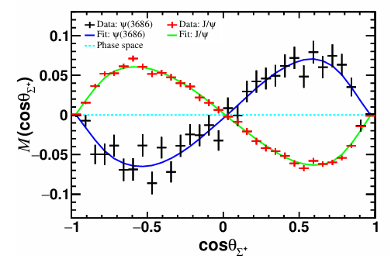






Polarization and CP test in J/$ψ and ψ\left(2S\right)→Σ^{+}{\overline{Σ}}^{−}$
$e^{+}e^{−}→J/ψ,ψ(3686)→Σ^{+}{\overline{Σ}}^{−}$, $Σ^{+}→pπ^{0}, \overline{Λ}→\overline{p}π^{0}$
arXiv:2503.17165, submitted to PRL
Puzzle of $Σ^{+} p$olarizations
10B $J/ψ$ and 2.7B $ψ(3686)$
1.12 M $Σ^{+}{\overline{Σ}}^{−}$ pairs reconstructed
Phys. Rev. Lett. 131, 191802 (2023)
Opposite directions of the $Σ^{+}$ polarization in $J/ψ$ and $ψ\left(3686\right)$ decays
Most precise measurements of the $Σ^{+}$ decay parameters
Most precise CP test in the decays of $Σ^{+}$
Polarization ratio of $Σ^{+}$ between $J/ψ$ and $ψ(3686)$ decays

Slide 24








Search for Strong CPV in $Σ^{0}(→Λγ)$ decay
Phys. Rev. Lett. 133 (2024) 10, 101902
  Probe strong CP, $θ$-term (Not yet observed)
Puzzle of $Σ^{0}$Polarizations
10 B $J/ψ$ and 2.7 B $ψ(3686)$
$$e^{+}e^{−}→J/ψ,ψ(3686)→Σ^{0}\left(→Λγ\right){\overline{Σ}}^{0}\left(→\overline{Λ}γ\right), Λ→pπ^{−}, \overline{Λ}→\overline{p}π^{+}$$
Similar behavior is observed in $Σ^{+}$, but not in $Λ or Ξ$!
Opposite directions of the $Σ^{0}$ polarization
The first attempt to measure the P-violating decay parameter of $Σ→Λγ$.
The first strong-CP test in hyperon decays: 3 per mill.
Notes:
The $θ$-term is

Slide 25






More and more $J/ψ$ needed
BESIII collected
10 billion $J/ψ$
(4 million hyperons)
Current technology “Topup” $×2$ +
improved technology “monochromatic collision” $×10$ +
Someday with new facility ($J/ψ$ factory) $×10$0
X.G. He et al. Sci.Bull. 67 (2022) 1840-1843:
${10}^{13}J/ψ$ per year
10 Billions of hyperon pairs produced
Billion of hyperon pairs reconstructed
CPV： ${10}^{−4} −{10}^{−5}$
Challenge the Standard Model

Slide 26



Λ EDM via Quantum entanglement
BESIII: arXiv:2506.19180
Challenges in Hyperon EDM Measurement:
  Short lifetimes make traditional spin-precession measurements impractical
  Prior direct Λ EDM limit (Fermilab, 1981): $\left|d_{Λ}\right|< 1.5 × {10}^{−16}e·cm.$
Novel Approach @ BESIII:
  Utilize entangled $Λ–\overline{Λ}$ pairs produced via $e^{+}e^{−}→J/ψ→Λ\overline{Λ}$
  Extract EDM from CP-odd angular correlations in decay distributions
  Angular variables sensitive to EDM via interference with CP-violating form factor $H_{T}$
Phys. Rev. D 23, 814–816 (1981)
Spin precession method
Extract EDM through CP-violating FF

Slide 27






Search for hyperon EDM at BESIII
X.G.He, J.P. Ma, Phys.Lett.B 839(2023)137834
Detailed dynamics in $J/ψ$ decay to hyperon pair, have been studied:
$$𝒜=ε_{μ}\left(λ\right)\overline{u}\left(λ_{1}\right)\left(F_{V}γ^{μ}+\frac{i}{2M_{Λ}}σ^{μν}q_{ν}H_{σ}+γ^{μ}γ^{5}F_{A}+σ^{μν}γ^{5}q_{ν}H_{T}\right)ν(λ_{2})$$
Dominant contribution
Psionic form factor
$F_{V}$ and $H_{σ}$
can also be represented as $G_{1}$ and $G_{2}$
$P$violation term
Complex form factor, $F_{A}≠0$ indicate $P$ violation
$H_{T}$ is included in this term
$$H_{T}(q^{2})=\frac{2e}{3m_{Jψ}^{2}}g_{V}d_{B}(q^{2})$$
Assuming $d_{B}(q^{2})≡d_{B}(0)$
$d_{B}(q^{2})$: electric dipole form factor
$d_{B}\left(0\right)$: electric dipole moment
Physics Letters B 551 (2003) 16–26
arXiv:hep-ph/0412158

Slide 28

Sensitivities of hyperon EDM at BESIII
Jinlin Fu, Hai-Bo Li, Jianpeng Wang, Fusheng Yu, and Jianyu Zhang, arxiv: 2307.04364

Slide 29



Most precise Λ EDM measurement
BESIII: arXiv:2506.19180
EDM extracted via full angular analysis of entangled decays:
$$Re\left(d_{Λ}\right)=\left(−3.1±3.2±0.5\right)×{10}^{−19} e⋅cm$$
$$Im(d_{Λ})=(2.9±2.6±0.6)×{10}^{−19} e⋅cm$$
which corresponds to an upper bound of:
$$\left|d_{Λ}\right|<7.0×{10}^{−19} e⋅cm (95\% CL)$$
Improves sensitivity by 3 orders of magnitude over previous best.
First EDM constraint from strange quark system using quantum entanglement.
Triple-product asymmetry projection: EDM = 0 vs non-zero EDM hypothesis:
Kinematic variable $O≡\left({\hat{l}}_{p}×{\hat{l}}_{\overline{p}}\right)⋅\hat{k}$
Triple-product asymmetry observable:
  $$A(O) =\frac{N_{event}(O>0)−N_{event}(O<0)}{N_{event}(O>0)+N_{event}(O<0)}$$
${\hat{l}}_{p}$(${\hat{l}}_{\overline{p}}$): unit momentum of $p(\overline{p})$ in $Λ(\overline{Λ})$ rest frame
$\hat{k}:$unit momentum of $Λ$ in $J/ψ$ rest frame

Slide 30




Energy-dependent polarization in $e^{+}e^{−}→Λ_{c}^{+}{\overline{Λ}}_{c}^{−}$
BESIII: arXiv:2508.11400
What’s the production dynamics of charmed baryon?

Slide 31



Energy-dependent polarization in$e^{+}e^{−}→Λ$ $\overline{Λ}$
BESIII: arXiv:2506.08072, accepted by PRL
The modulus of the ratio between the electric and magnetic form factor,
remains fairly constant across the considered energy range, the relative
phase changes by more than 90º between 2.396 and 2.6544 GeV.
Notes:
Spinning hyperons reveals their inner secrets - new measurement by the
BESIII collaboration
Exploring the interior of a particle that only lives a fraction of a
nanosecond may seem like an impossible task, but a new experimental
study from the BESIII collaboration shows the way. The aim is to
understand the heavy and short-lived siblings of protons and neutrons,
namely the hyperons. In electron-positron collisions at high energies,
pairs of a Lambda hyperon and its antimatter equivalent, the
anti-Lambda, can form. This is a complicated process involving strongly
interacting quarks, antiquarks and gluons, all carrying so-called colour
charge. The result is a blue-green-red quark-triplet forming a
colour-neutral Lambda, and a yellow-magenta-cyan triplet forming an
anti-Lambda. BESIII has extracted a sequence of ¡°snapshots¡± of the
time evolution of this process. These ¡°snapshots¡± are encoded as form
factors, describing the location and motion of quarks inside the
hyperons. The BESIII measurements exploit a unique feature of hyperons:
when they decay, they reveal the direction of their inner magnet - the
spin - through the emission angles of their daughter particles. This is
particularly interesting since it can be utilised in calculations of the
hyperon charge radius. The BESIII results indicate that negatively
charged quarks reside close to the centre of the hyperon, shedding new
light on how quarks form the matter we are made of.

Slide 32

Spin correlated quark-anti-quark in $e^{+}e^{−}$ Annihilation
In $e^{+}e^{−}$ annihilation, $e^{+}e^{−}→$γ* (spin-1) → spin-1/2 q and q̅
  In a given event, the spin directions are unknown, but they must be parallel
  Exploit this correlation by using hadrons in opposite jets
Using 62 pb⁻¹ @ 3.65 GeV continuum region below open-charm threshold

Slide 33









Collins Fragmentation Function (FF)
The measurement of the Collins FF provides an important test in understanding strong interaction dynamics and thus is of fundamental interest in understanding QCD
SIDIS
J. C. Collins, Nucl.Phys. B396, 161 (1993)
$e^{+}e^{−}$ collision
D₁: the unpolarized FF
H₁: Collins FF
→ describes the fragmentation of a transversely polarized quark into a spinless hadron h.
→ depends on
→leads to an azimuthal modulation of hadrons around the quark momentum.
$$z=2E_{h}/\sqrt{s}$$
Notes:
The number density for finding a hadron h produced from a transversely polarized quark q is defined.
Semi-Inclusive Deep Inelastic Scatttering
The transverse quark spin distributions (the so-called transversity)
The measurement of the Collins FF provides an important
test in understanding strong interaction dynamics and
thus is of fundamental interest in understanding QCD, the
underlying theory of the strong interaction. Because of its
chiral-odd nature, it needs to couple to another chiral-odd
function, for instance, the transversity distribution [2–4] in
semi-inclusive deep inelastic scattering (SIDIS) or another
Collins FF in e.e− annihilations, to form accessible
observables. The transversity distribution, which contributes
to the nucleon transverse spin, corresponds to the
tensor charge of the nucleon and is the least known leadingtwist
quark distribution function.

Slide 34

Importance : Q² evolution for all these experiments
From Feng Yuan 2013 @IHEP, Beijing
PRD 88. 034016; arXiv:1505.05589
Reliable determination of the Collins functions, and extraction of the nucleon tensor charge
Study the QCD evolution effects with global analysis
  SIDIS + $e^{+}e^{−}$: to extract the nucleon transverse spin distribution
BESIII
COMPASS
BARBAR
HERMES
BELLE
JLab
Q²(GeV²)
3-10GeV²
25GeV²
100GeV²
Notes:
Combine with SIDIS to extract the nucleon transverse spin distribution, Transversity. BESIII and SIDIS share a similar energy region, avoiding the as-yet unclear Q2Q2 evolution.
Compare with Belle/BaBar to understand Q2Q2 evolution effects and test QCD. Existing theoretical predictions:
the energy evolution of the
Collins FF at different Q2 is a key factor to evaluate the
transversity [17]. Recently, the treatment of the evolution is
developed in Refs. [18–22], which predict about a factor of
2 change in the observed asymmetries between BESIII
energy and Belle and BABAR energy but is not directly
validated by experimental data.

Slide 35



Reference frame @ BESIII
PRD 78, 032011
The Thrust frame: Method12
The second hadron frame: Method0
Thrust axis
jet1
√
jet2
At low energy:
no jet like
BESIII
Belle BABAR
The thrust frame
The second hadron frame
Only the second method could be performed at BESIII

Slide 36



Product of Two Collins FFs
  Favored fragmentation process describes the fragmentation of a quark of flavor q into a hadron with a valence quark of the same flavor: i.e.: u→π+, d→π-
  Disfavored for d→π⁺, u→π⁻
Unlike-sign pairs= U:
π∓π±: (fav x fav)+(dis x dis)
Like-sign pairs = L:
π±π±: (fav x dis)+(dis x fav)
All charged pairs= C (U+L):
ππ: (fav + dis)x(fav + dis)
π=π±
Notes:
Different combination of charged pions ⇒ sensitivity to favored or unfavored FFs

Slide 37


2Φ₀ Distribution：Double Ratio
Normalized ratio
of raw asymmetries:
    For Charged, Unlike-sign and Like-sign pairs, we have R^{U}, R^{C} , R^{L}
Unlike (U: π±π∓), Like (L: π±π±), Charged (C: π±π∓ + π±π±)
Different combinations of favored and disfavored FFs
Double Ratio: R^{U}/R^{L} and R^{U}/R^{C}
  The differences between U, L, and/or C distributions in the data sample are due to the Collins effect
  MC asymmetry consistent with zero
We fit the double ratio with a cosine function in order to extract the Collins asymmetry:
Depends on the pion pair fractional energy (z₁, z₂)

Slide 38



Results of Collins asymmetry
z bins
BESIII : PRL 116, 042001 (2016)
Pt bins
Clear nonzero Collins asymmetries, increase with higher fraction energy, pt
The expected behavior of the Collins asymmetries as a function of sin²θ2/(1+cos²θ2) is linear and vanish at θ2=0
comparable with predictions from authors of PRD 93, 014009, who provided the predictions using BESIII kinematics (z,pt)
linear fit:
solid lines (constant term is free)
dashed lines (constant term=0)

Slide 39







Collins asymmetry in different Q²
PRD 90, 052003 (2014)
BESIII results
the measured Collins asymmetry is larger than those measured at higher Q² experiments
this behavior is qualitatively in agreement with prediction reported in the PRD 88, 034016 (2013) , PRD 93, 014009
PRD 86, 039905(2012)
PRL 116, 042001 (2016)
PRD 90, 052003 (2014)
PRD 86, 039905(2012)
PRL 116, 042001 (2016)

Slide 40



Accessing FFs in 𝒆⁺𝒆⁻ annihilation
Experimental observable in 𝑒⁺𝑒⁻ annihilation: normalized differential cross-section of the inclusive production of final state hadron “ℎ”
Single Inclusive hadron production at in 𝑒⁺𝑒⁻ annihilation (SIA)
Notes:
Single inclusive hadron production in electron-
positron annihilation (SIA) provides direct insights into
the hadronization process in a controlled and clean
environment. It enhances our understanding of how
quarks and gluons fragment into hadrons, which is crucial
for advancing our knowledge of Quantum Chromody-
namics (QCD) and for accurately modeling hadron
production in various high-energy processes. The typical
experimental observable in SIA is

Slide 41



Inclusive $π^{0}$ and $K_{S}$ productions @ BESIII
PRL 130 (2023) 231901
$$z=2E_{h}/\sqrt{s}$$
Broad relative hadron energy range z_{h} from 0.1 to 0.9 with precision of around 3% at z_{h} ∼ 0.4.
Results significantly deviate from several theoretical calculations based on the existing FFs
Provide brand new inputs in low-energy region to global fits of fragmentation function
Notes:
Based on the electron-positron collision data collected by BESIII at the center-of-mass energies from 2.2324 to 3.6710 GeV, the differential cross sections of inclusive $π^{0}$ and $K_{S}^{0}$ production as a function of hadron momentum and normalized by the total cross section of the inclusive hadronic process are measured. Our results significantly deviate from several theoretical calculations based on the existing FFs, as shown in following figure. These results provide new ingredients for the global data fits of the FFs, in which almost no single inclusive annihilation data measured in this special energy region has been included.

Slide 42


Inclusive production of 𝝅±/𝑲±@ BESIII
Normalized differential cross section of the inclusive process at 8 c.m.energies from 2.00 to 3.67 GeV
Note that the observable has been scaled by an artificial factor in the plots and the line through the bin center is
to group the points according to their center-of-mass energy.
BESIII: arXiv:2502.16084 accepted by PRL
Z coverage from 0.13-0.95
Opportunity to test QCD factorization at low energy scale.
$$z=2E_{h}/\sqrt{s}$$

Slide 43

Inclusive production of 𝝅±/𝑲±@ BESIII
BESIII: arXiv:2502.16084 accepted by PRL
Normalized differential cross sections: the green and red bands denote the “NPC” NNLO calculations with 1σ limits,
based on new global analyses by including SIA world data and our new results.
The blue band is the “NPC” NNLO calculation for K_{S} by using K± fragmentation functions via isospin symmetry.
Only the measurements on the right of the dotted lines are employed in the fit.
Notes:
NPC : nonperturbative QCD calculations

Slide 44


Inclusive $η$production @ BESIII
PRL 133, 021901 (2024)
BESIII fit: NNLO + hadron mass correction + high-twist

Slide 45
BESIII white paper: Future Physics Programme
arXiv:1912.05983 : Chin.Phys. C44 (2020) no.4, 040001
Another 6 years running to collect >60 fb⁻¹ data at different energies .

Slide 46



BEPCII upgrades in 2024
BEPCII upgrade (installation: 2024. 7- 2024. 12)
Highest beam energy: 2.8 GeV
Luminosity: 1.2$×{10}^{33}$ cm⁻²s⁻¹ （ 4.0 ~ 5.0 GeV）
(0.4-0.7) $×{10}^{33}$ cm⁻²s⁻¹ （ 5.0 ~ 5.6 GeV）
BESIII will collect about 60 fb⁻¹ between 4.0 – 5.6 GeV, and to study potential physics:
Cover energy up to 5.6 GeV
Deeper studies of the XYZ states
Study the ground-state charmed baryons
Provide information on charm-quark fragmentation function
Notes:
The fragmentation functions of the light quarks have been measured with a reasonable precision, while the information on the c-quark fragmentation function (CFF) is scarce. There is virtually no experimental data on CFF below the energy of the B-factories. Such information is vital. It is proposed to perform a first measurement of the inclusive D-meson production in e⁺e⁻ collisions in the energy domain between charmonium and bottomonium using a unique data sample of about 5 fb⁻¹ integrated luminosity at energies from 4.60 to 4.95 GeV.

Slide 47


Summary
BESIII is running smoothly and is now highly productive.
Advantages of BEPCII/BESIII: threshold-scan data, and quantum-entangled meson and baryon pairs.
The BEPCII upgrades were completed in 2024, enabling more data collection above 4.0 GeV (up to 5.6 GeV) to study: excited charmonium, charmonium-like states, XYZ particles, charmed baryons, etc.
BESIII plays a leading role in charmed hadron physics.
Charm is still needed for precise test of the SM!
2021
2035
Strong phase in
neutral D decay

Slide 48
Thank you for your attentions!

Slide 49







From Hai-Kai Sun
Sandip PAKVASA
X.G. He
John Donoghue

