Slide 1





Hadronization and SIDIS
Anselm Vossen
Research Supported by

Slide 2
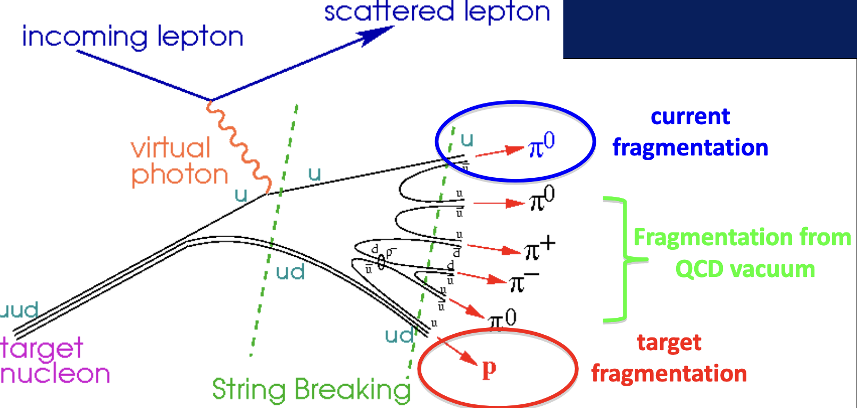
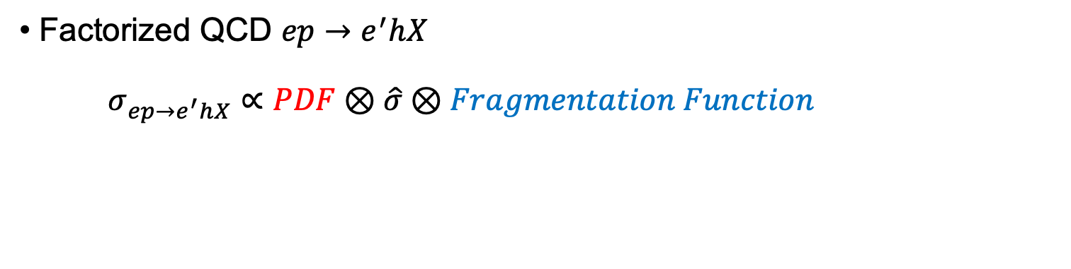
Deep Inelastic Scattering and Hadronization
“forward”
“backward”
Factorized QCD $ep→e^{′}hX$
$σ_{ep→e^{′}hX}∝PDF⊗\hat{σ}⊗Fragmentation Function$

Slide 3
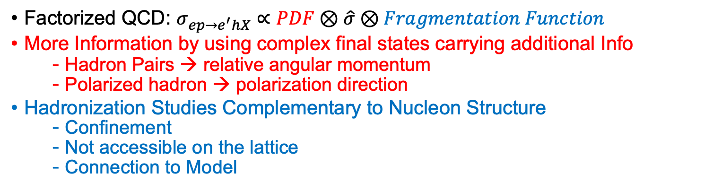
Deep Inelastic Scattering and Hadronization
“forward”
“backward”
Factorized QCD: $σ_{ep→e^{′}hX}∝PDF⊗\hat{σ}⊗Fragmentation Function$
More Information by using complex final states carrying additional Info
  Hadron Pairs → relative angular momentum
  Polarized hadron → polarization direction
Hadronization Studies Complementary to Nucleon Structure
  Confinement
  Not accessible on the lattice
  Connection to Model

Slide 4
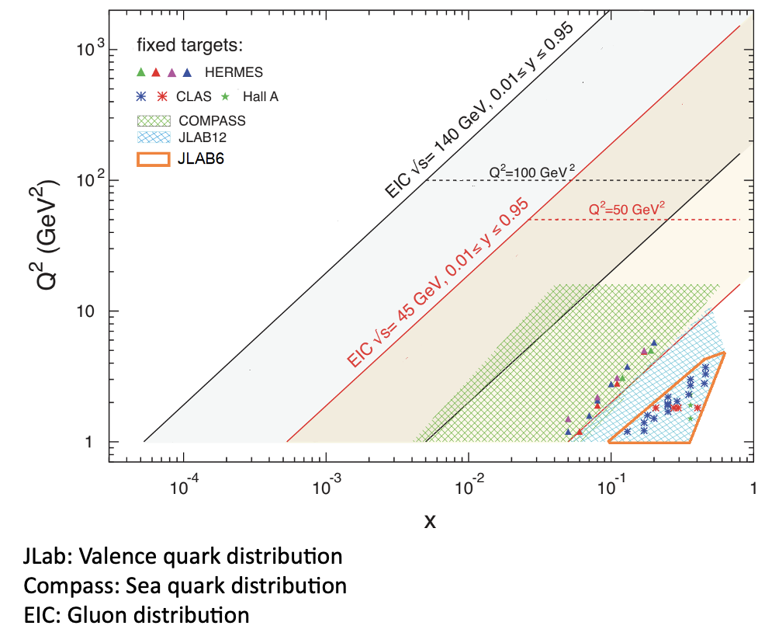
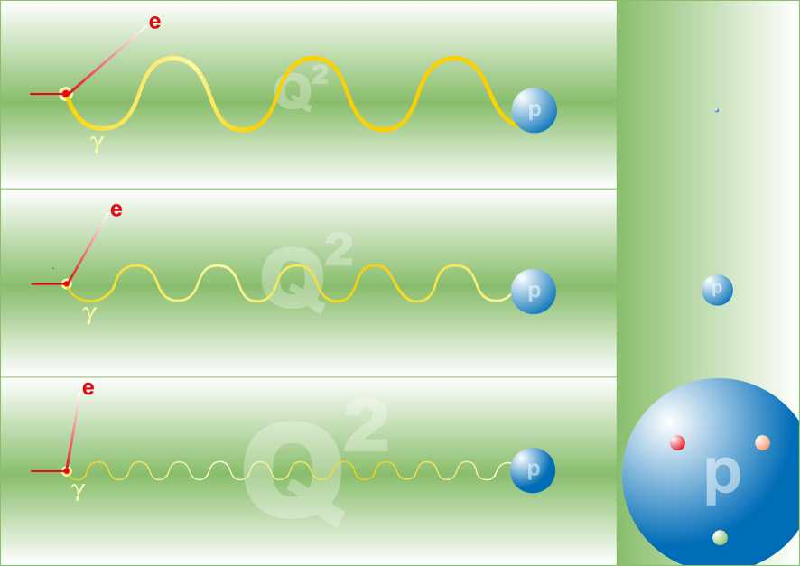
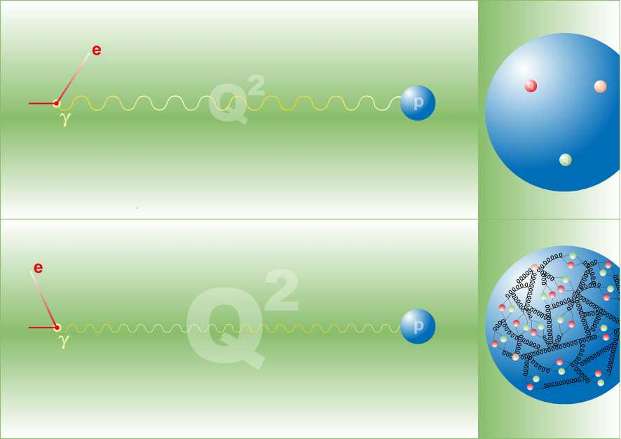
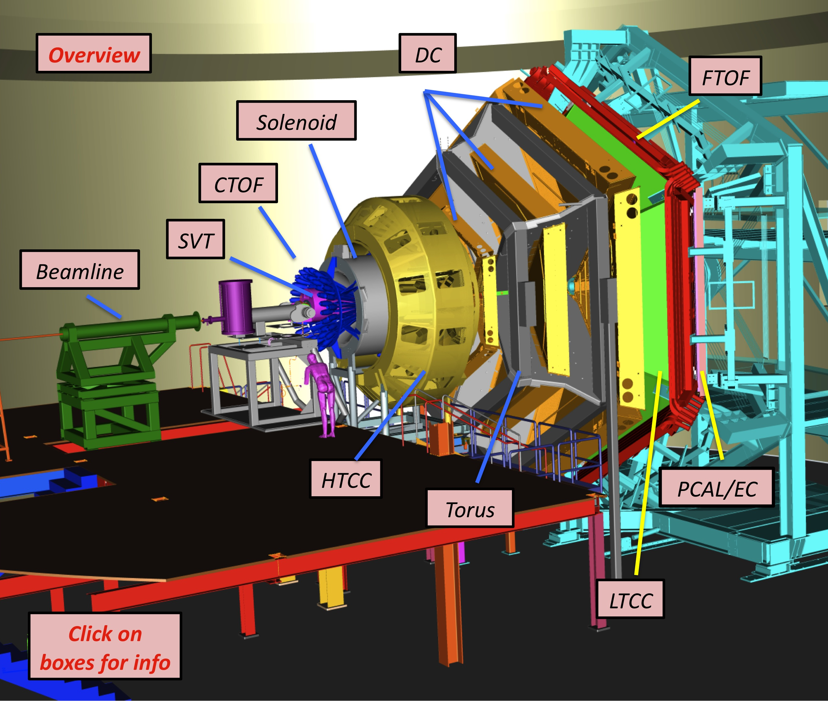
Present and Future: Jlab and EIC
Exposure
EIC
  Concentrate on CLAS12 @Jlab
  →Full acceptance
  EIC: See B. Surrow’s talk on Friday
https://www.jlab.org/Hall-B/clas12-web/

Slide 5

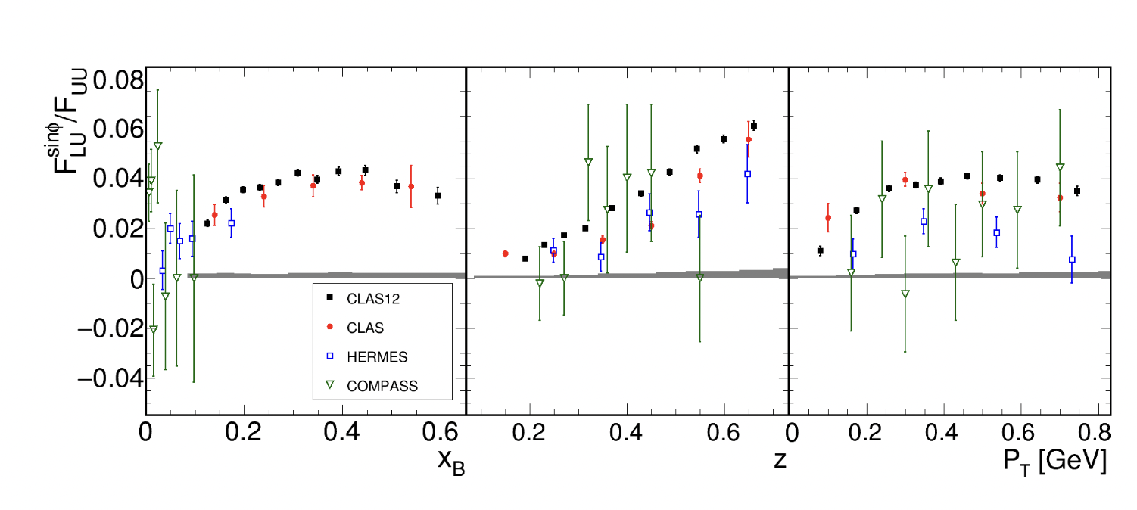
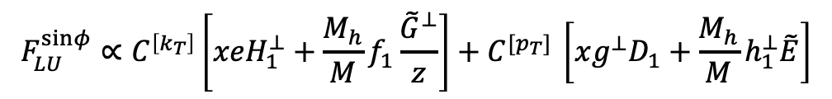
Case in point:
Pion Beam Spin Asymmetries
Phys.Rev.Lett. 128 (2022) 6, 062005
twist-3 chiral odd pdf
unpolarized PDF
Boer-Mulders
twist-3 t-odd PDF
$$F_{LU}^{sinφ}∝C^{\left[k_{T}\right]}\left[xeH_{1}^{⊥}+\frac{M_{h}}{M}f_{1}\frac{{\tilde{G}}^{⊥}}{z}\right]+C^{{[p}_{T}] }\left[xg^{⊥}D_{1}+\frac{M_{h}}{M}h_{1}^{⊥}\tilde{E}\right]$$
Collins FF
twist-3 FF
unpolarized FF

Slide 6
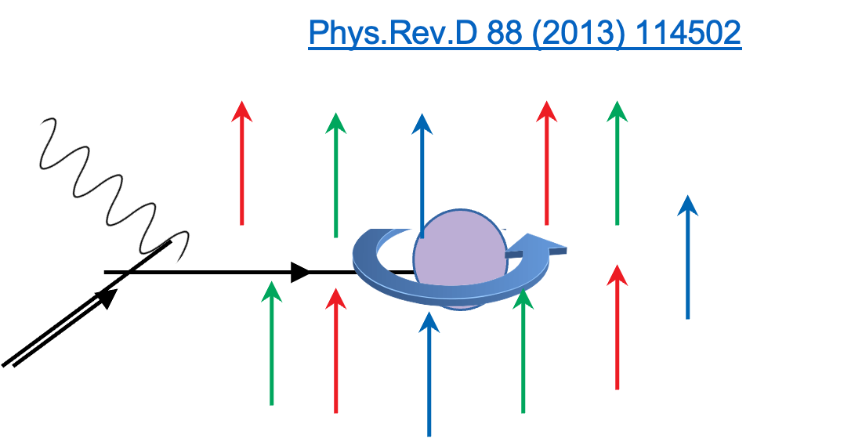

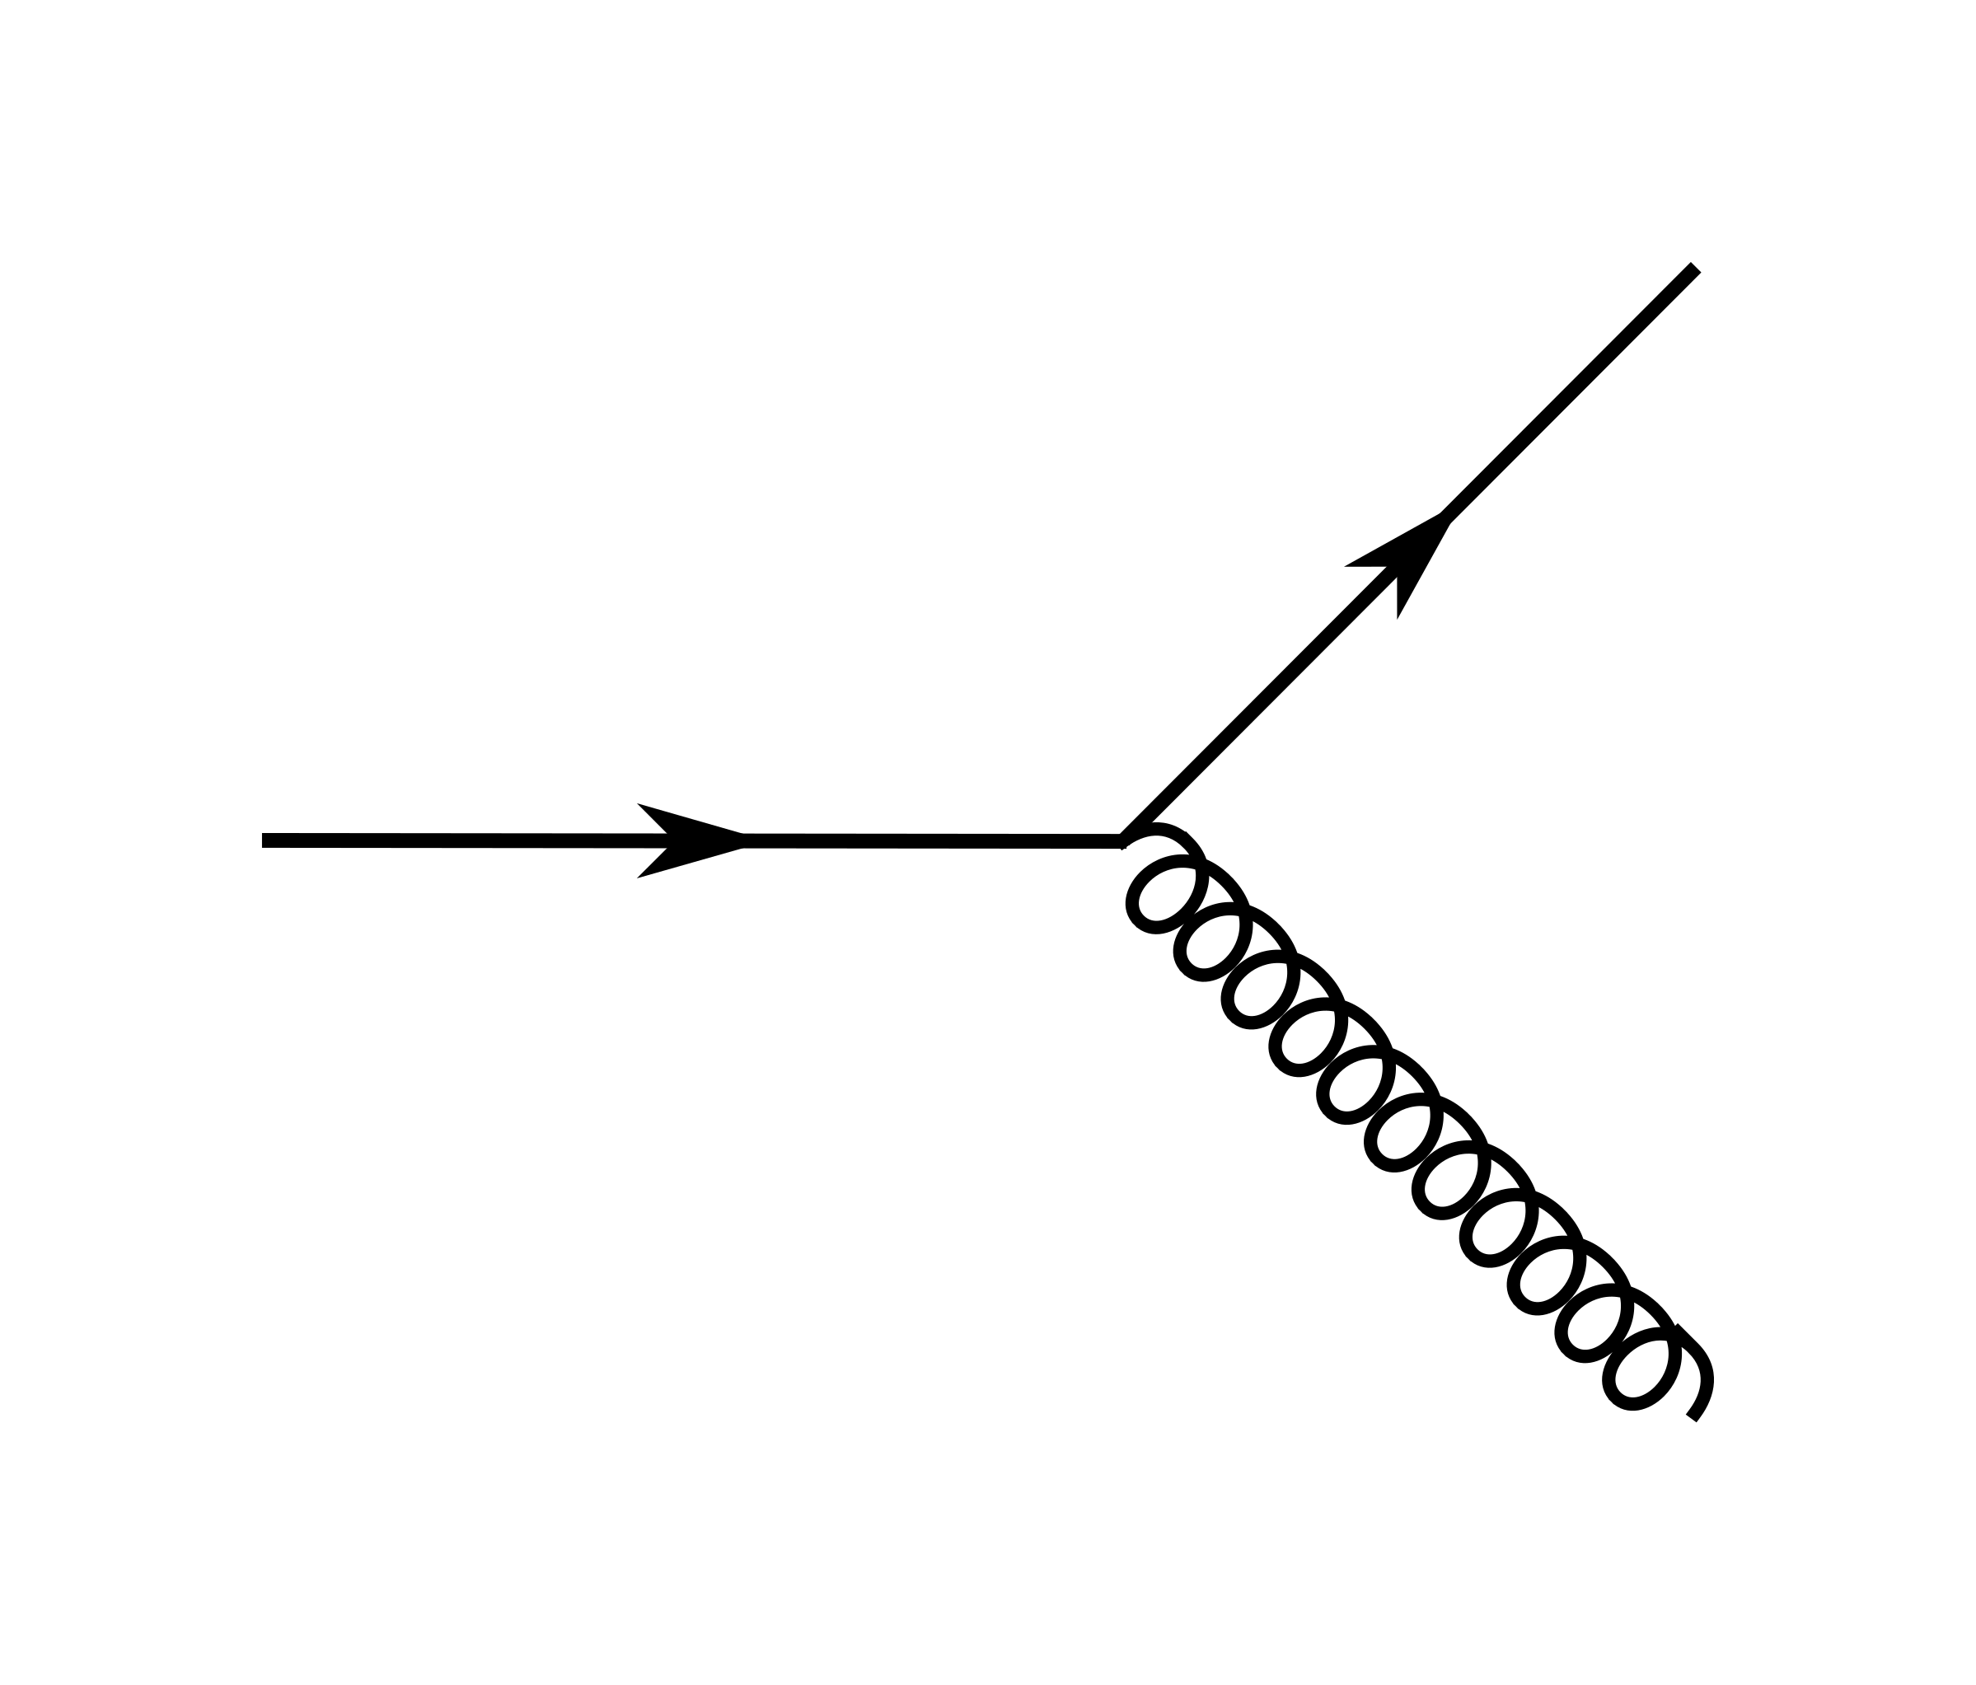
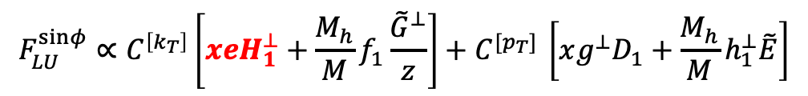
Case in point:
Single Pion Beam Spin Asymmetries
Phys.Rev.Lett. 128 (2022) 6, 062005
twist-3 chiral odd pdf
unpolarized PDF
twist-3 t-odd PDF
Boer-Mulders
$$F_{LU}^{sinφ}∝C^{\left[k_{T}\right]}\left[xeH_{1}^{⊥}+\frac{M_{h}}{M}f_{1}\frac{{\tilde{G}}^{⊥}}{z}\right]+C^{{[p}_{T}] }\left[xg^{⊥}D_{1}+\frac{M_{h}}{M}h_{1}^{⊥}\tilde{E}\right]$$
Collins FF
twist-3 FF
unpolarized FF
“pure” Twist3 PDF e(x) : Interference of quark-gluon amplitudes
  Go beyond the parton picture!
-
+
+
  First moment: “Boer-Mulders Force”: Transverse force exerted by color field on q↑ after scattering, in an unpolarized nucleon

Slide 7
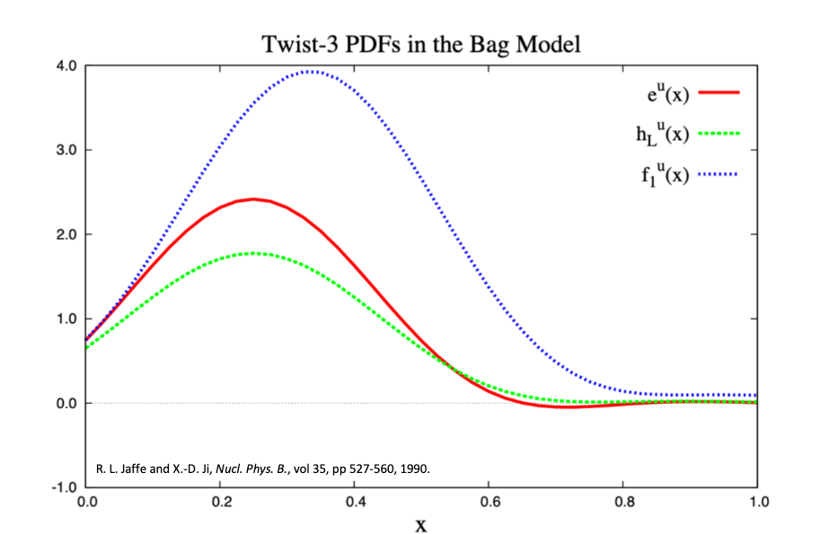
Case in point:
Single Pion Beam Spin Asymmetries
Phys.Rev.Lett. 128 (2022) 6, 062005
twist-3 chiral odd pdf
unpolarized PDF
twist-3 t-odd PDF
Boer-Mulders
$$F_{LU}^{sinφ}∝C^{\left[k_{T}\right]}\left[xeH_{1}^{⊥}+\frac{M_{h}}{M}f_{1}\frac{{\tilde{G}}^{⊥}}{z}\right]+C^{{[p}_{T}] }\left[xg^{⊥}D_{1}+\frac{M_{h}}{M}h_{1}^{⊥}\tilde{E}\right]$$
Collins FF
twist-3 FF
unpolarized FF
“pure” Twist3 PDF e(x) : Interference of quark-gluon amplitudes
  Go beyond the parton picture!
-
+
+
Jaffe, Ji, Nucl. Phys.B 35,557,1990

Slide 8

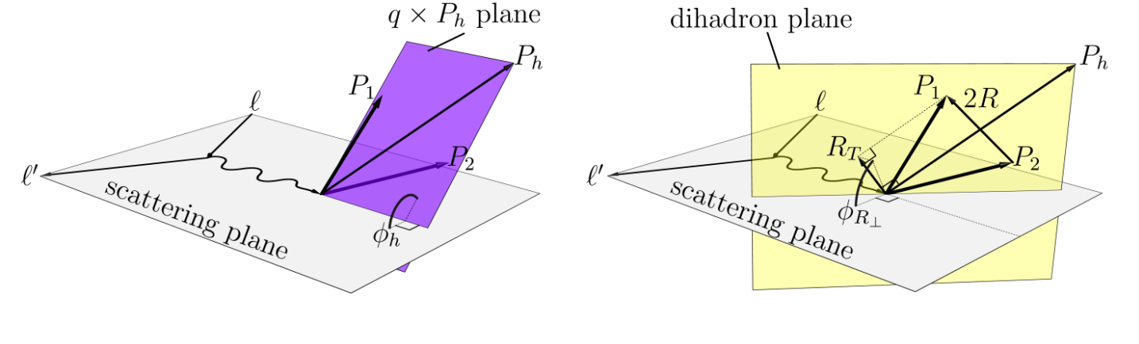
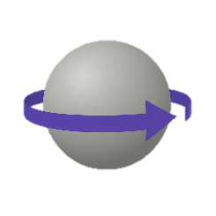



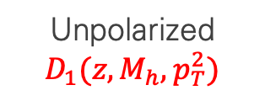

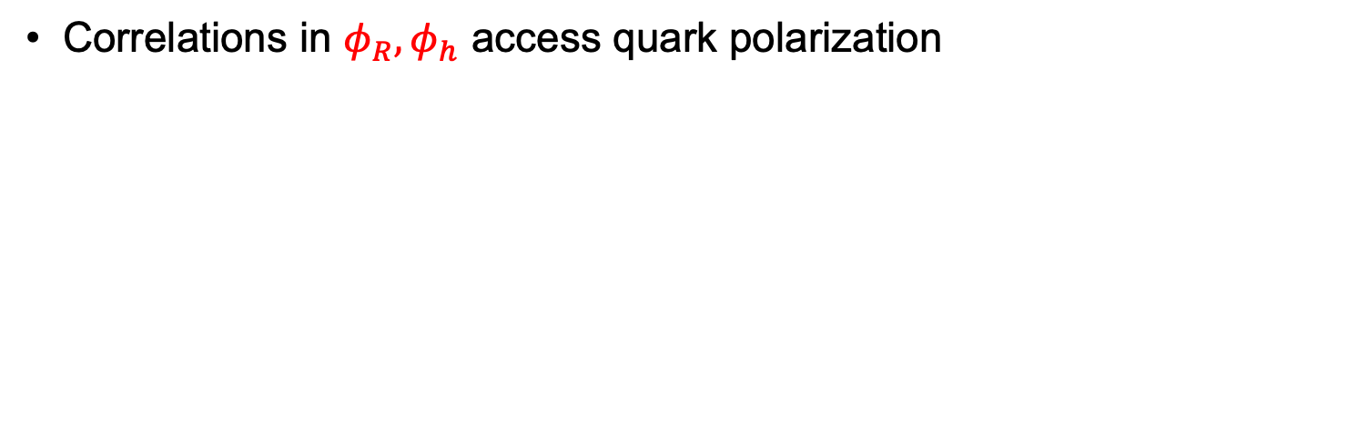

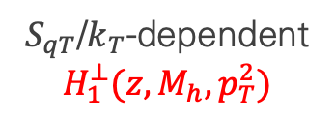


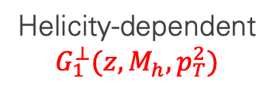


Better:
Dihadron Fragmentation Functions
Correlations in $φ_{R},φ_{h}$ access quark polarization
Unpolarized
$$D_{1}(z,M_{h},p_{T}^{2})$$
$$h_{1}$$
$$h_{2}$$
Helicity-dependent
$$G_{1}^{⊥}(z,M_{h},p_{T}^{2})$$
$$h_{1}$$
$$h_{1}$$
$$−$$
$$h_{2}$$
$$h_{2}$$
$S_{qT}$/$k_{T}$-dependent
$$H_{1}^{⊥}(z,M_{h},p_{T}^{2})$$
$$h_{1}$$
$$h_{1}$$
$$−$$
$$h_{2}$$
$$h_{2}$$

Slide 9
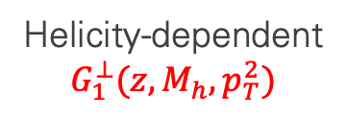

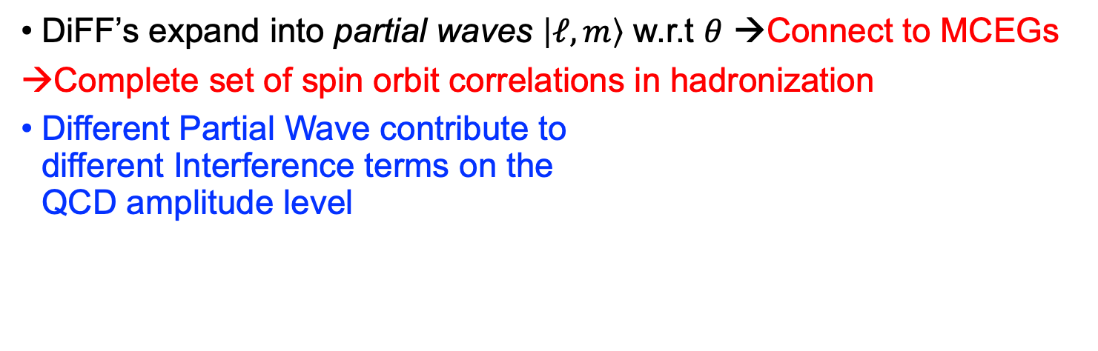
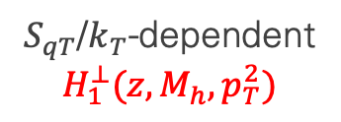
Better:
Dihadron Fragmentation Functions
DiFF’s expand into partial waves $\left|ℓ,m\right\rangle$ w.r.t $θ$ →Connect to MCEGs
→Complete set of spin orbit correlations in hadronization
Different Partial Wave contribute to
different Interference terms on the
QCD amplitude level
Unpolarized
$$D_{1}(z,M_{h},p_{T}^{2})$$
$$h_{1}$$
$$h_{2}$$
Helicity-dependent
$$G_{1}^{⊥}(z,M_{h},p_{T}^{2})$$
$$h_{1}$$
$$h_{1}$$
$$−$$
$$h_{2}$$
$$h_{2}$$
2-Point Correlations
In phase space
→insight into hadronization
→connection to models
$S_{qT}$/$k_{T}$-dependent
$$H_{1}^{⊥}(z,M_{h},p_{T}^{2})$$
$$h_{1}$$
$$h_{1}$$
$$−$$
$$h_{2}$$
$$h_{2}$$

Slide 10
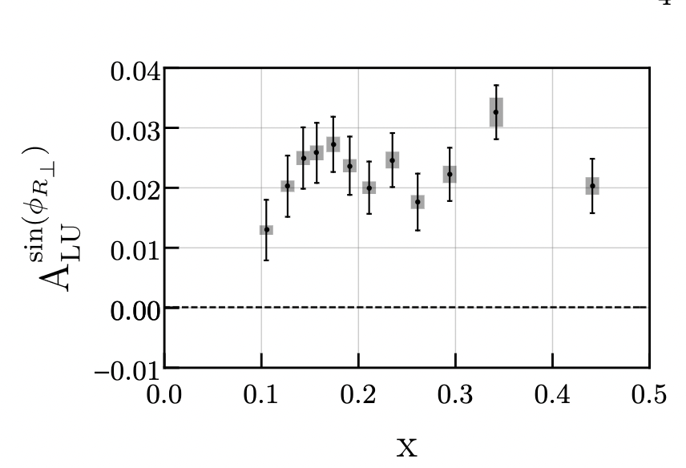
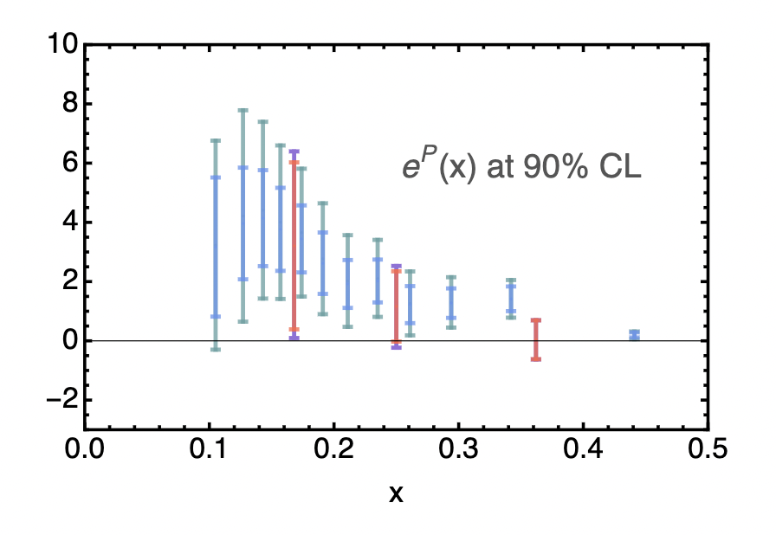


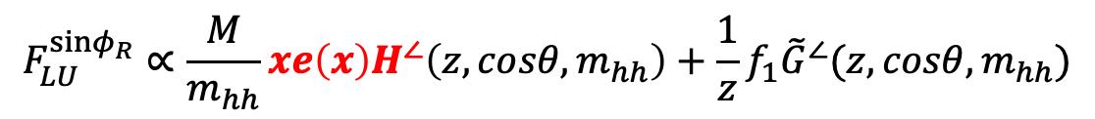
Better: di-hadrons
π⁺
π–
First extraction of chiral odd $e(x)$ →point-by-point!
$$∝e⋅H_{1}^{∠}$$
Phys.Rev.Lett. 126 (2021) 152501
Phys.Rev.D 106 (2022) 1, 014027
$$F_{LU}^{sinφ_{R}}∝\frac{M}{m_{hh}}xe\left(x\right)H^{∠}\left(z,cosθ,m_{hh}\right)+\frac{1}{z}f_{1}{\tilde{G}}^{∠}(z,cosθ,m_{hh})$$
-
+
+

Slide 11
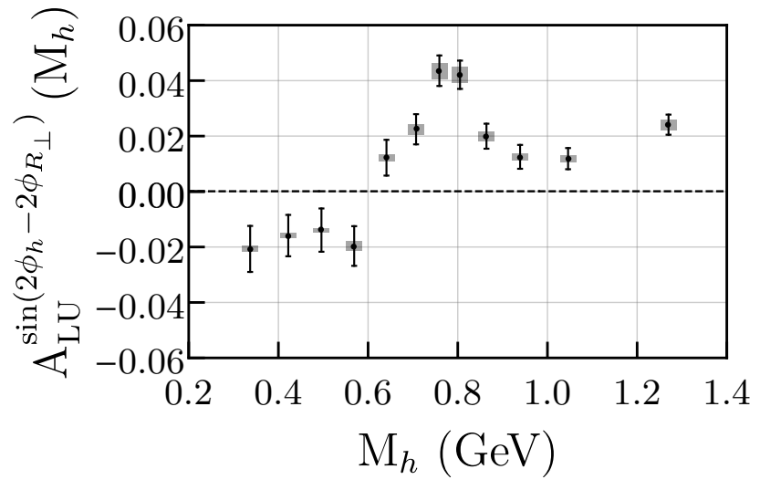
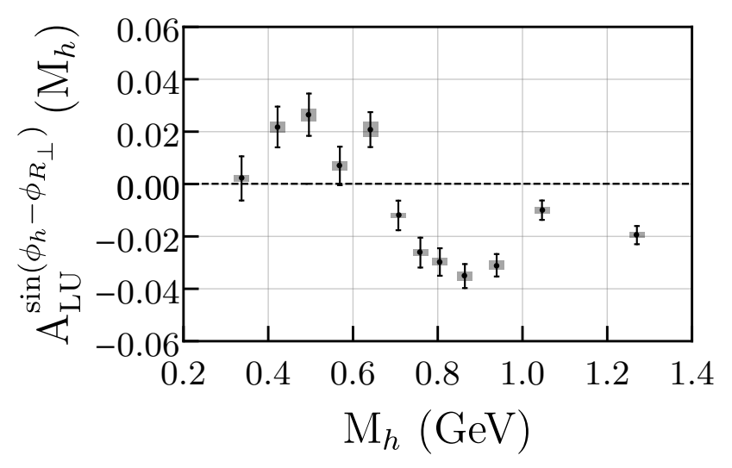
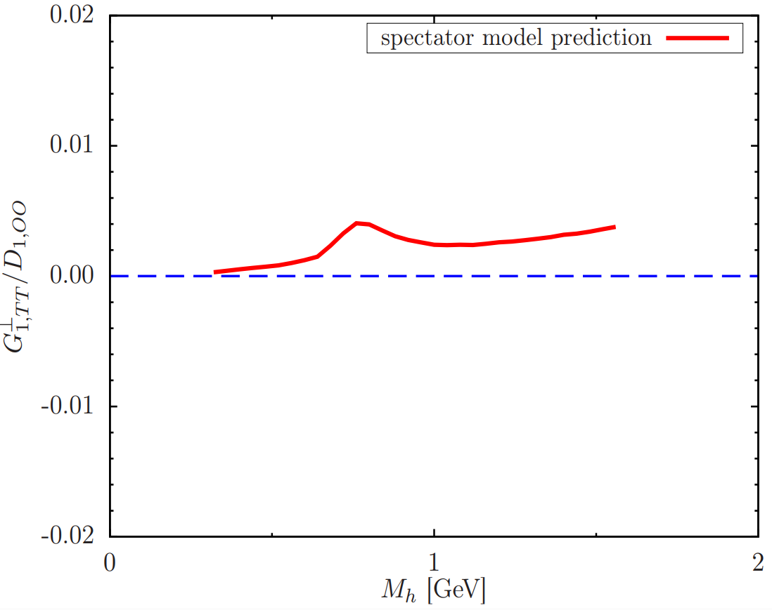
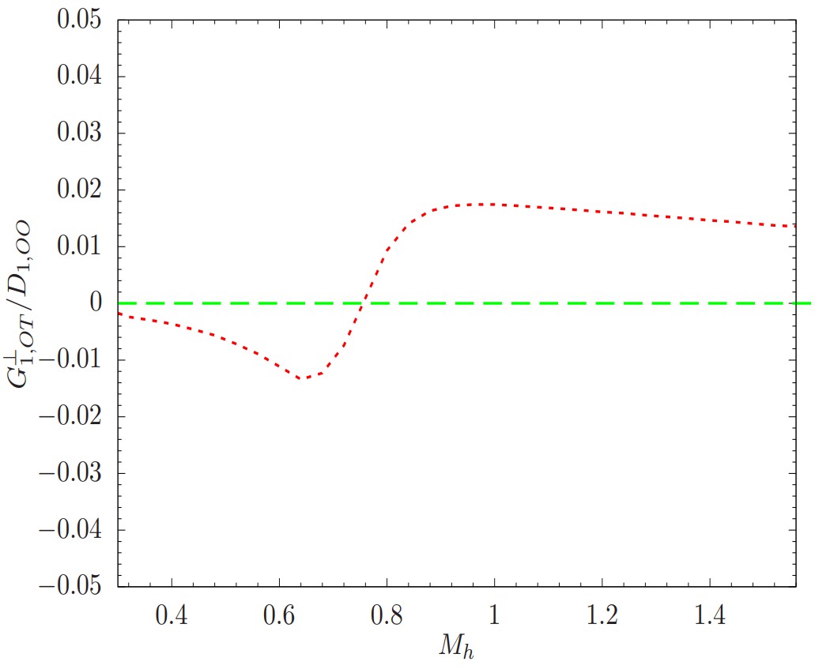





First Measurement of $G_{1}^{⊥}$ →no 1h equivalent
$dσ_{LU}∝f_{1}⊗G_{1}^{⊥}$
Fragmentation sensitive to quark helicity
$$dσ_{LU}$$
PRL 126, 152501 (2021)
$$G_{1,OT+LT}^{⊥}$$
$$G_{1,TT}^{⊥}$$
PRD 102, 014044
Firt nonzero $G_{1}^{⊥}$ signal
Resonance structure predicted by spectator models and verified at CLAS12
T. Hayward (MIT)
PRD 101, 054020

Slide 12
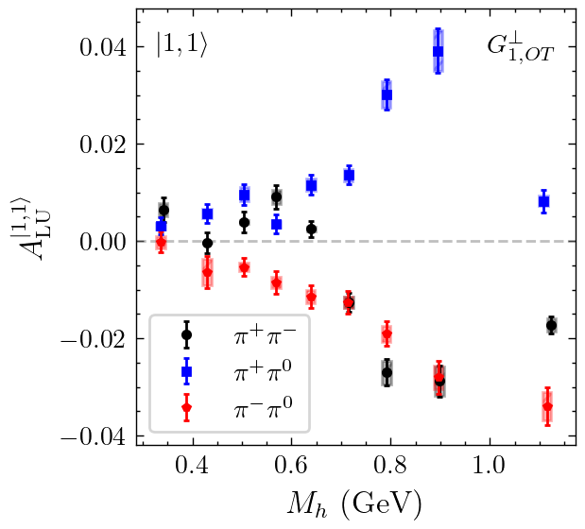
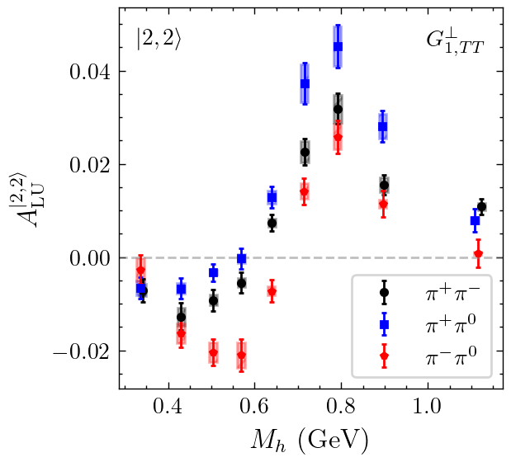


Flavor dependence of Different Partial Waves
Preliminary
Preliminary
$$A_{LU}^{|1,1⟩}∝f_{1}\left(x\right)⊗G_{1,OT}^{⊥}$$
$$A_{LU}^{|2,2⟩}∝f_{1}\left(x\right)⊗G_{1,TT}^{⊥}$$
Partial Waves are Flavor dependent
  Different Decay Channels contribute to different PWs

Slide 13
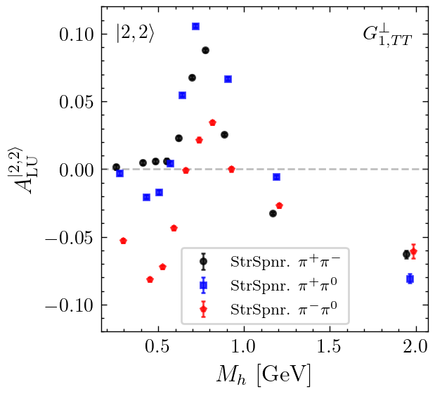




Reproduction in Event Generator Models
StringSpinner introduces spin-dependent fragmentation into PYTHIA8 based on the string+${}_{ }^{3}{P_{0}}$ model of hadronization ($q\overline{q}$ produced in $L=S=1, J=0$ quantum state)
Pythia allows to extrapolate beyond validity of factorized QCD framework
With parameter tuning, StringSpinner can replicate several of our dihadron beam-spin asymmetries across multiple $ππ$ channels $→$ huge step for phenomenology!
Preliminary
Preliminary
StringSpinner Modeling
Possible dip from $ω→ππX$
G. Matousek (Duke)

Slide 14
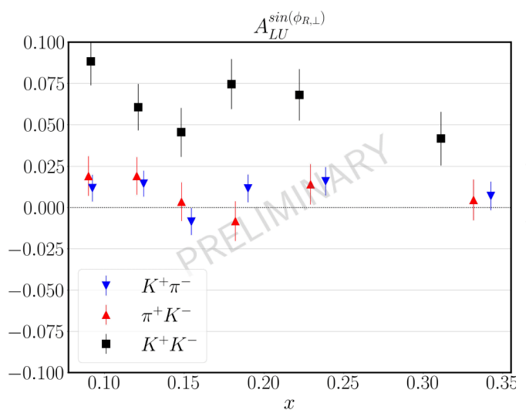
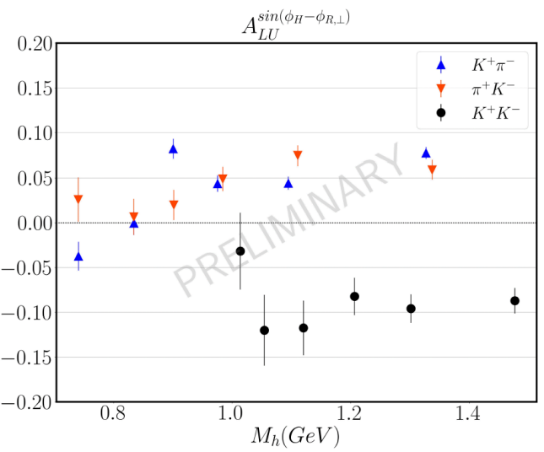




Large Kaon Asymmetries Currently not understood
Large asymmetries observed in $K^{+}K^{−}$ dihadrons $→$ larger than $π^{+}π^{−}$ dihadrons! (compare to large $A_{C}$ at BaBar)
Correlations of $πK$ appear absent in $H_{1}^{⊥}$ DiFF (left plot) yet large in $G_{1}^{⊥}$ (right plot)
Access to $K^{∗}$ and $φ$ vector meson contributions to single hadron SIDIS
$$f_{1}\left(x\right)G_{1}^{⊥}(z,M_{h})$$
$$e\left(x\right)H_{1}^{⊥}(z,M_{h})$$
C. Pecar (Duke)
$$dσ_{LU}$$

Slide 15
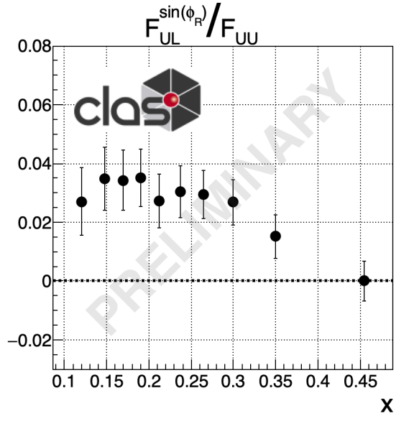
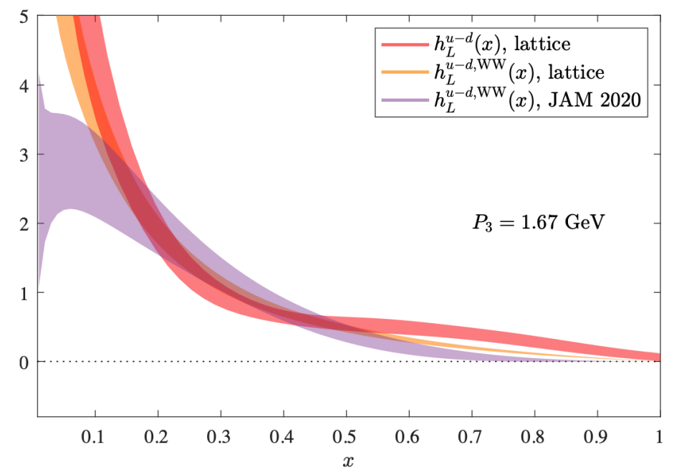
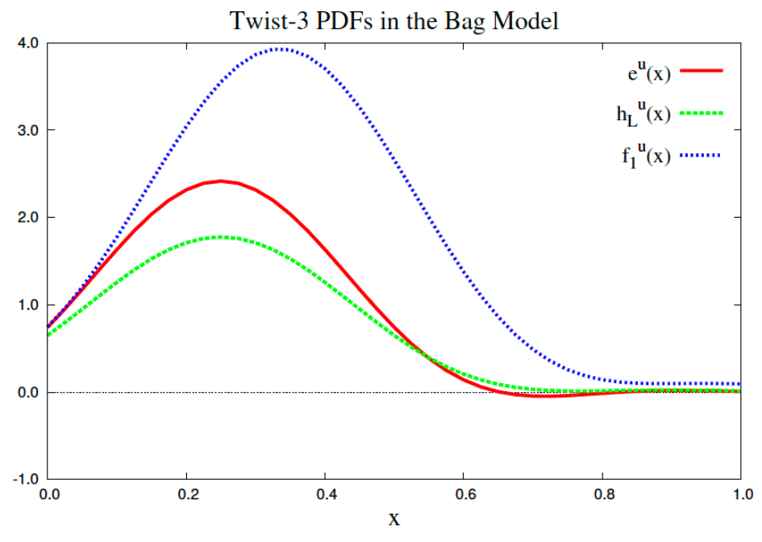

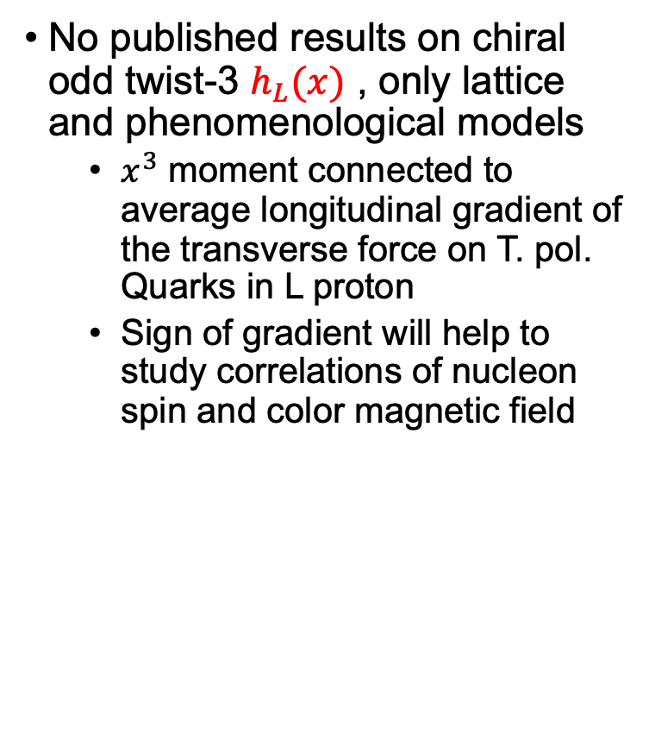

New: Longitudinal Target SSAs
$$dσ_{UL}$$
No published results on chiral odd twist-3 $h_{L}(x)$ , only lattice and phenomenological models
  $x^{3}$ moment connected to average longitudinal gradient of the transverse force on T. pol. Quarks in L proton
  Sign of gradient will help to study correlations of nucleon spin and color magnetic field
Nucl. Phys. B375, 527 (1992)
$$F_{UL}^{\sin{φ_{R}}}∝h_{L}\left(x\right)H_{1}^{⊥}(z,M_{h})$$
arXiv:2111.01056

Slide 16
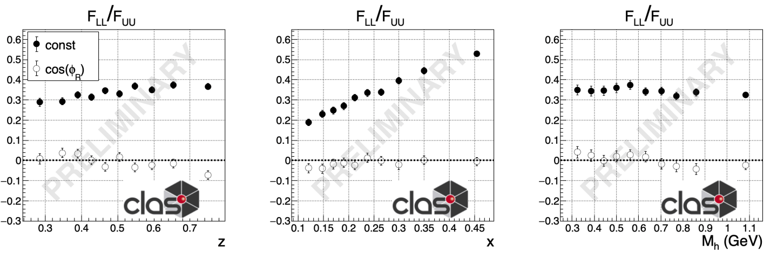





Access to Twist3 FFs in
Longitudinal Double Spin Asymmetries
$$dσ_{UL}$$
$$π^{+}π^{−}$$
$$X$$
$$F_{LL}/F_{UU}$$
$F_{LL}^{const}/F_{LL}^{\cos{φ_{R}}}$ sensitive to $g_{1L}D_{1}/g_{1L}\tilde{D}$
→probe of twist-3 DiFF $\tilde{D}$ size
Preliminary results indicate $\tilde{D}$ is
roughly one order of magnitude smaller than $D_{1}$
  Different than PDFs!

Slide 17
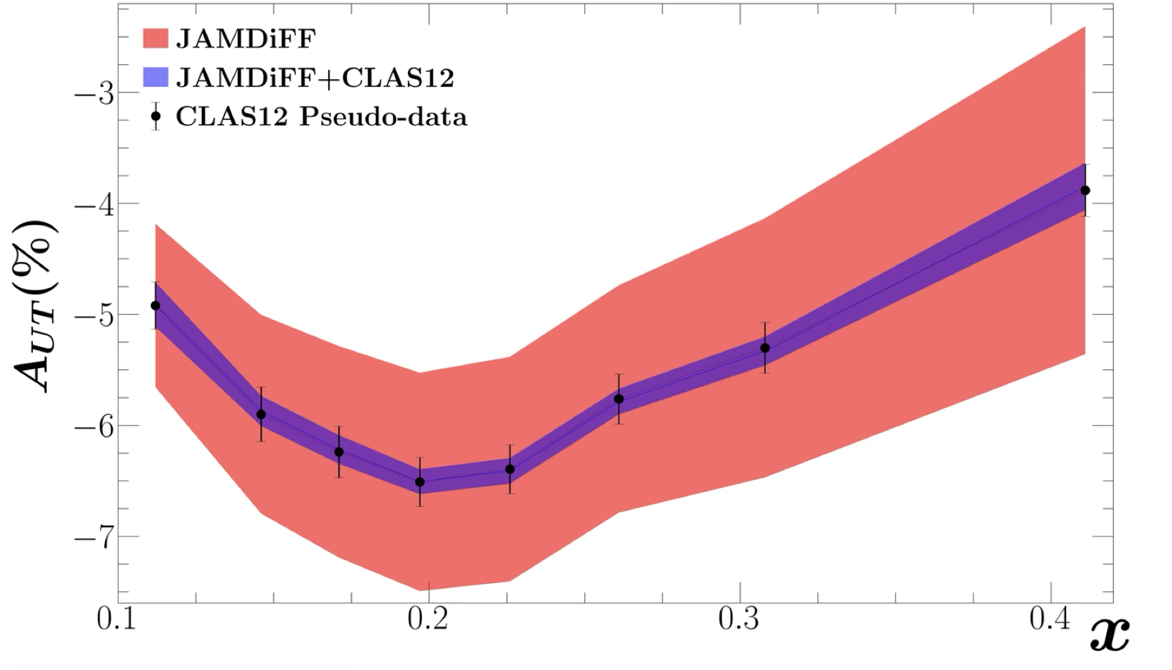
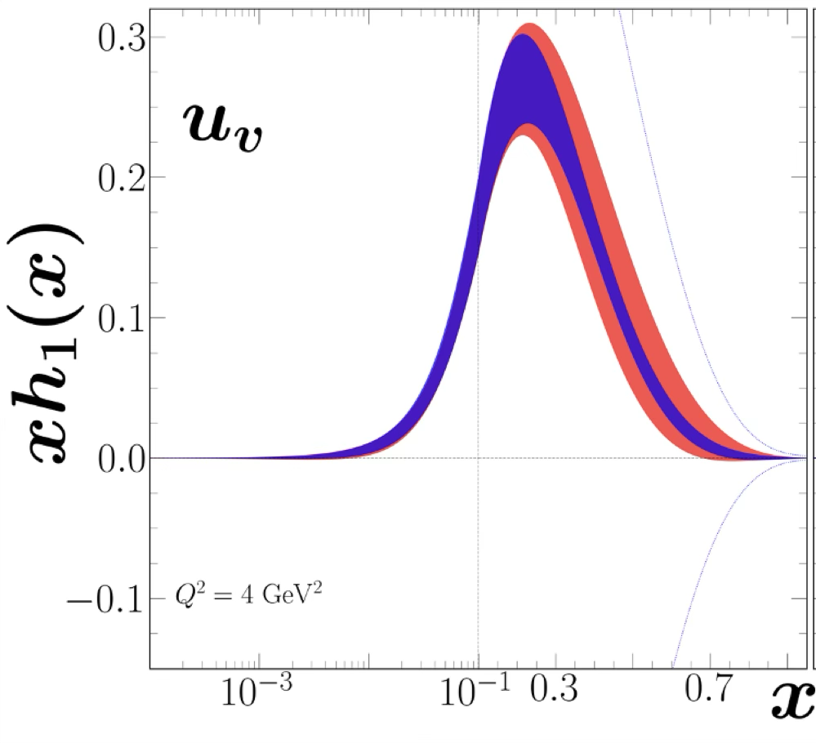
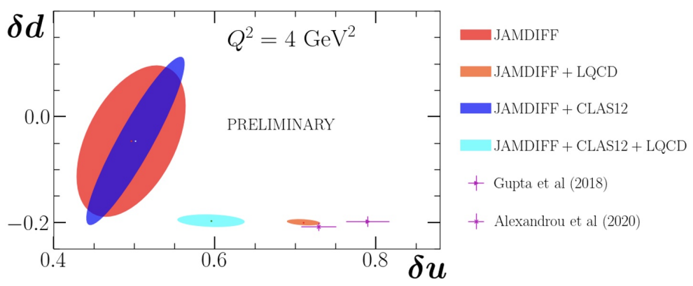


Tranversely Polarized Target $≈2029$
$$dσ_{UT}$$
Run Group H: 1st transversely polarized target experiment at CLAS12
Significant impact in valence region
Projected to be able to test Phenomenology – Lattice Tension
M. McEneaney (Duke)
See M. Contalbrigo’s talk
Thursday morning

Slide 18
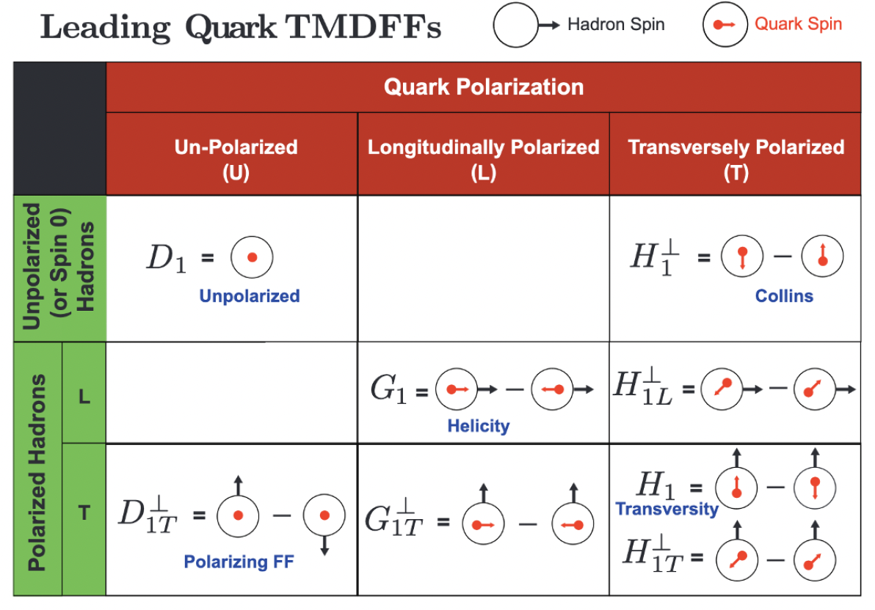



Polarized $Λ$’s as a tool to Learn about Spin Structure
Theory: X. Zhao et al., cf., Zhao et al., PRL 134, 231901 (2025)
CFR predictions come from pQCD fits to $e^{+}e^{−}$ data
TFR predictions come from a spectator quark-diquark model calculation
Image from arXiv:2304.03302v1
First measurement of $A_{LUT}$
Future:
  Precision $Λ$ program at CLAS12
  Comparison with MC models

Slide 19




Studying Hadronization in $e^{+}e^{−}$
Dominated by B factories Belle, BaBar
  →For BES III see Hai-Bo Li ‘s talk
Belle II aims to have significantly higher luminosity, current record: 4.7x10³⁴cm⁻²s⁻¹.
Whitepaper on QCD physics: 2204.02280 [hep-ex]
  E.g. Use high statistics for complex final states
  EE correlators
  g-2
  $α_{S}$
  …
Belle

Slide 20




Polarized FFs from Belle
ϕ_{R2}−π
Cross-section $e^{+}e^{−}→\left(h_{1}h_{2}\right)\left(\overline{h_{1}} \overline{h_{2}} \right)+X$
$$∝D_{1}^{⊥} \overline{D_{1}^{⊥}}+ H_{1}^{⊥} \overline{H_{1}^{⊥}}cos\left(φ_{R1}+φ_{R2}\right)$$
π−ϕ_{R1}
PRL 107, 072004(2011)
Single Hadrons
Cross section: Phys. Rev. D 96, 032005
PRL 96 (2006) 232002
PRD 78 (2008) 032011
PRD100 (2019) 9, 092008 ($p_{T}, π^{0},η)$
Statistics Hungry, only possible at B-factories

Slide 21















Examples: Single/Di-hadron Multiplicities, Polarization and back-to-back Correlations to access Fragmentation Studies
Cross-sections
of VMs and unstable particles
$$ρ^{0},ω,K^{∗0},φ,η, K_{S}^{0},f_{0}\left(980\right),D$$
$$ρ^{0}$$
$$ω$$
$$K^{∗0}$$
$$x_{p}$$
$p_{T}$ dependence of
single hadron
fragmentation
$$p_{T}[GeV]$$
Phys.Rev.D 99 (2019) 11, 112006
Belle: Phys.Rev.D 111 (2025) 5, 052003
0.85 < T < 0.9
Phys. Rev. Lett. 122, 042001 (2019)
$$e^{+}e^{−}→Λ^{↑}X$$
First measurement of spontaneous
$Λ$ polarization, first prompt $Λ$

Slide 22




Current Program at Belle II $−$ $Λ$
Spin Entanglement in $Λ^{↑}−Λ^{↑}$ correlations
  Compare with calculations in Schwinger model and Quantum Computer
    Also di-hadrons
  Long/Trans spin transfer to $Λ$ in $Λ−Λ$ and $Λ−h_{1}h_{2}$ correlations
From Phys. Rev. D 109, 116003,Phys. Rev. Lett. 131, 021902 (di-hadrons)
See also Lin, Liu, Shao, Wei arXiv:2507.15387
Belle II off-resonance simulation for $Λ−Λ$ polarization correlations
$$e^{+}e^{−}→q\overline{q}, q∈u, d, s, c$$
$P_{Λ\overline{Λ}}=$ 0.0006 $± 0.0005$ (fit)

Slide 23




Brand New Opportunities at Belle II: Precision Jet Physics in $e^{+}e^{−}$
Jet physics (will) play an important role at the EIC and LHC
Precision measurements in $e^{+}e^{−}$ annihilation will test current theoretical understanding ($N^{3}LL$)
Lower energies like Belle in particular sensitive to hadronization effects
Example: Transverse Momentum Imbalance ← → TMD framework
New suggestion: Measure Colllins-like back-to-back azimuthal correlations for jets
Di-hadron FFs of pions and kaons around jets
➔Sensitive to transversity
JHEP. 2019, 31 (2019).
Gutierrez-Reyes, D., Scimemi, I., Waalewijn, W.J. et al. Transverse momentum dependent distributions in e⁺e⁻ and semi-inclusive deep-inelastic scattering using jets. J. High Energ. Phys. 2019, 31 (2019).
PRD102.7 (2020): 074015.
Belle II
projections
(stat only)
compared to theory
Fund.Res. 3 (2023) 346-350,
e-Print: 2104.03328 [hep-ph]

Slide 24



SIDIS at the EIC

Slide 25

SIDIS physics at an EIC: Coverage
Common theme on EIC impact
  Extended kinematic coverage and precision, along with polarization
  and possible beam charge degrees of freedom allow multi-pronged approach →needed to extract multidimensional objects
  TMD factorization is valid
Large $Q^{2}$ lever arm: probe evolution, disentangle contributions to $σ$
Coverage to low $x:$ access sea and gluon distributions

Slide 26

Depolarization Factors
Twist 2
Suppressed at EIC
Twist 3
Slide from C. Dilks

Slide 27





Longitudinal double spin asymmetries
$A_{LL}=\frac{σ^{↑⇑}−σ^{↑⇓}}{σ^{↑⇑}+σ^{↑⇓}}∝g_{1}$
Projections for Athena (2022 JINST 17 P10019)
3$\%$ point-to-point, $2\%$scale uncertainties (from Hera experience)
$z>0.2$
$15.5 fb^{−1}$ at $18x275,$other datasets scaled accordingly
➔See also double tagged $A_{1}$

Slide 28




Example: Transversity Extraction from Di-hadrons
Only proton data
Test small$−x$ constraint
See also Phys.Lett.B 816 (2021) 136255 for single hadrons
Projected to be able to distinguish between lattice and phenomenology
(Similar to CLAS)
5×41: 2.857 fb⁻¹
10×100: 51.298 fb⁻¹
18×275: 10 fb⁻¹

Slide 29


Precision $Λ$ physics at the EIC
Phys.Rev.D 105 (2022) 9, 094033
Also $→↑$ spin transfer, in-jet fragmentation
$40 fb^{−1}$ at each energy
Significant impact of low $√s$ data

Slide 30


Early Running Constraints
Year | Species | Energy | Luminosity ($fb^{−1})$ | p/A polarization
Year 1 | $$e+Ru/Cu$$ | $$10×115$$ | 1 | N/A
Year 2 | $$e+d$$ | $$10×130$$ | 10 | N/A
Year 2 | $$e+p$$ | $$10×130$$ | 1 | trans
Year 3 | $$e+p$$ | $$10×130$$ | 5 | trans&long
Year 4 | $$e+Au$$ | $$10×100$$ | 0.5 | N/A
Year 4 | $$e+p$$ | $$10×250$$ | 4 | trans&long
Year 5 | $$e+Au$$ | $$10×100$$ | 0.5 | N/A
Year 5 | $$e+^{3}He$$ | $$10×166$$ | 4 | trans& long
$O(10\% )$ of YR projection data
Early HI data
top energy in Year 4
Cross-section measurements ((n)PDF, (n)FFs, are not luminosity hungry but need good understanding of detector
BSAs a good start but kinematically suppressed
Also consider asymmetries in species, final state, charge..

Slide 31



Transverse Single Spin Asymmetries at $10 fb^{−1}$
Uncertainties $≪$then expected asymmetries
Insights into TMD framework
Ecce projections for Sivers asymmetries
(NIMA 1049 (2023) 168017)

Slide 32

(n)FFs
DSS14
nFF24
Plots by P. Zurita with $10/ 1 fb^{−1}$ for $p/A$
Larger impact on nFFs, remaining questions with interpolation to intermediate A
Beyond impact on individual FF set, need to probe consistency and compatibility with other datasets

Slide 33





Unpolarized (n)(TMD) PDFs
$$x=0.1$$
Impact of $1fb^{−1}$ DIS on
nTuJu21 nPDFs
(P. Zurita)
SIDIS Impact?
MAP analysis (Bacchetta at ePIC collaboration meeting),
Simulated data by G. Matousek (Duke)
Significant impact, even with limited data
Absolute cross-sections will be challenging in the beginning
Nuclear PDFs/FF can also be measured as ratios to p/d

Slide 34

Summary & Conclusion
Final states beyond single hadron fragmentation essential for precision studies in SIDIS
  Di-hadrons
  $Λ$ Hyperons
Study of Hadronization allows complementary insights into QCD
  Fragmentation mechanisms
  Spin-orbit correlations in fragmentation
  (Target Fragmentation)
CLAS12 is on the way to a precision program in SIDIS
  Unpolarized, longitudinally, transversely polarized targets
  Proton, Deuterium, He3 targets
  Multidimensional studies
Belle/Belle II essential for precision studies of hadronization
EIC will open new opportunities to study SIDIS over a wide range of $Q^{2}$

Slide 36

Transverse Single Spin Asymmetries at $10 fb^{−1}$
Previous $Λ$ projections assume $40 fb^{\begin{aligned}−1 \\ \end{aligned}}$
TSSAs: Uncertainties $≪$then expected asymmetries
Insights into TMD framework
Ecce projections for Sivers asymmetries
(NIMA 1049 (2023) 168017)

Slide 37


Background from Exclusive Vector Meson Production
$ρ$ contribution has complex kinematical dependence
SDMEs depend on $θ$ ➔complex interplay with acceptance
Different for $ρ^{0}$and $ρ^{+}$ in part due to different polarization states

Slide 38





Background from Exclusive Vector Meson Production
$$ρ_{L}?$$
$$ρ_{L}?$$
$$ρ_{T}?$$
$ρ$ contribution depends on SDMEs
Highly dependent on experimental acceptance
Comparison to ρ⁰ indicates where the “diffractive” events are appearing. There are separate dynamical contributions with wildly different azimuthal moments that complicate the picture. Which kinematic regions are contributing to the measurements in single pion observables?

Slide 39





Theoretical Analysis Inconclusive: Too many unknown ingredients
S. Diehl et. al (CLAS collab.), Phys. Rev. Lett. 128, 062005 (2022)
model 1 (Mao et al., EPJ C 73)
model 2 (Mao et al., EPJ C 74)
eH₁┴ g┴D₁
model 3 eH₁┴ (Schweitzer et al.)
Proton = active quark
plus spectator scalar
and axial-vector diquarks
in total: 344 bins x 12 bins in ϕ
~ 4130 BSA bins
e(x) based on the chiral
quark soliton model

Slide 40






Fracture Functions to describe Target Region
probability for the target ($p/n$) remnant to form a hadron given ejected quark $q_{f}$
  No hard/soft energy scale separation
Direct relationship to traditional PDFs by integrating
over fractional longitudinal nucleon momentum $ζ$
  $\sum_{h}{\int_{0}^{1−x}{dζ ζ {\hat{u}}_{1}\left(x,ζ\right) =\left(1−x\right)f_{1}\left(x\right)}}$
  $\sum_{h}{\int_{0}^{1−x}{dζ ζ {\hat{l}}_{1L}\left(x,ζ\right) =\left(1−x\right)g_{1L}\left(x\right)}}$
M. Anselmino et al., Phys. Lett. B. 699 (2011), 108, [hep-ph] 1102.4214

Slide 41










Precision x-sections available from Belle for $π, K, p$ and more
Single hadron cross sections:
$$e^{+}e^{−}→hX$$
Transverse momentum dependent asymmetries
$e^{+}e^{−}→(h)(h)X$,
PRL111 (2013) 062002
PRD101(2020) 092004
Unpol SIDIS, pp: $\frac{dσ}{dz}$
$$e^{+}e^{−}→(h)(h)X$$
and scale dependence
PRD 99 (2019) 112006
Polarizing Λ fragmentation
$$D_{1T}^{⊥}(z,k_{t},Q^{2})$$
PRL 122 (2019), 042001
PRD92 (2015) 092007
PRD101(2020) 092004
PRD96 (2017) 032005
Transverse momentum dependence underway

Slide 42




First observation of correlations between Current and target region
“back-to-back” configuration $h_{1}$ in the CFR $h_{2}$in TFR →convolution of a fracture function and a fragmentation function.
Unique access to longitudinally polarized quarks in unpolarized nucleons… no corresponding PDF!
Make use of different asymmetries in CFR and TFR to distinguish regions

Slide 43




Fracture Functions
First observation of correlations between Current and target region
Visible separation between TFR ($x_{F}<0$) and CFR ($x_{F}>0$)
No Collins mechanism in TFR → $F_{UL}^{\sin{2φ}}≈0$
e
p
When two hadrons are produced “back-to-back”^{1,2} with one in the CFR and one in the TFR the structure function contains a convolution of a fracture function and a fragmentation function.
Leading twist beam(target)-spin asymmetry.
Leading twist beam(target)-spin asymmetry.
Unique access to longitudinally polarized quarks in unpolarized nucleons… no corresponding PDF! Reverse situation in target-spin asymmetry (which uniquely has no depolarization, similar to Sivers)
First measurement sensitive to TMD Fracture Functions

Slide 44





Preliminary Analysis: Fracture Functions
First observation of correlations between Current and target region
Visible separation between TFR ($x_{F}<0$) and CFR ($x_{F}>0$)
No Collins mechanism in TFR → $F_{UL}^{\sin{2φ}}≈0$
e
p
e
p
TFR Access to helicity distribution $g_{1L}$
Integral relation holds!

Slide 45

Azimuthal Asymmetries in back-to-back jets
New suggestion: Measure Colllins-like back-to-back azimuthal correlations for jets
➔Sensitive to transversity
Current Belle II projections for acceptance effects encouraging
Charm contributions will be important
Analysis about to enter Collaboration Review
The time-reversal odd side of a jet
Fund.Res. 3 (2023) 346-350, e-Print: 2104.03328 [hep-ph]
S. Schneider

Slide 46



Next Generation B factory SuperKEKB
Close to Belle lumi before long shutdown
Beam currents only a
factor of two higher
than KEKB (~PEPII)
“nano-beams” are the key; vertical beam size is 50nm at the IP
Belle II already delivered world record luminosity
Belle II aims to have significantly higher luminosity, current record: 4.7x10³⁴cm⁻²s⁻¹.
Physics see:
“Opportunities for precision QCD physics in hadronization at Belle II -- a snowmass whitepaper”
  Hadronization studies
    FFs of complex states, Model indendent measurements
    g-2
    $α_{S}$
    Energy-Energy-Correlation
    More
    Chiral Belle
Future P5 recommendation: FCC-ee or muon collider up to 10 TeV
  $\frac{1}{s}$ $σ$- dependence, dataset of 10s of $ab^{−1}$
  $⇒$ no precision measurement outside the $Z$ resonance

Slide 47




High x at Jlab 22
P.Schweitzer et al. arXiv:1210.1267
e-Print: 2306.09360 [nucl-ex]
$≈$doubling beam energy significantly increases phase space
Pin down valence structure of the proton
Integration in global analyses (e.g. strange distributions, CS Kernel)

Slide 48



Slide 49


Slide 50




Target Fragmentation → Fracture Functions
Sum rule with $g_{1}$
Correlations between CFR-TFR allows to extract fracture functions coupled to FFs

Slide 51








$$e^{−}p→e^{−}KπX \\ e^{−}p→e^{−}K^{+}K^{−}X$$
$$dσ_{LU}$$
Large asymmetries observed in $K^{+}K^{−}$ dihadrons $→$ larger than $π^{+}π^{−}$ dihadrons!
Correlations of $πK$ appear absent in $H_{1}^{⊥}$ DiFF (left plot) yet large in $G_{1}^{⊥}$ (right plot)
Access to new flavor dependence of $G_{1}^{⊥}$
Access to $K^{∗}$ and $φ$ vector meson contributions to single hadron SIDIS
$$K^{+}π^{−}$$
$$π^{+}K^{−}$$
$$f_{1}\left(x\right)G_{1}^{⊥}(z,M_{h})$$
$$e\left(x\right)H_{1}^{⊥}(z,M_{h})$$
Invariant Masses
$$K^{+}K^{−}$$
C. Pecar (Duke)

Slide 52


$$e^{−}p→e^{−}π^{+}π^{−}X$$
$$dσ_{LL}$$
$F_{LL}^{const}/F_{LL}^{\cos{φ_{R}}}$ sensitive to $g_{1L}D_{1}/g_{1L}\tilde{D}→$ probe of twist-3 DiFF $\tilde{D}$ size
Preliminary results indicate $\tilde{D}$ is roughly one order of magnitude smaller than $D_{1}$
N. Wickramaarachchi (Duke)

Slide 53



$$e^{−}p→e^{−}π^{+}π^{−}X$$
$$dσ_{UT}$$
Run Group H: 1st transversely polarized target experiment at CLAS12
Recently approved with rating A by the Program Advisory Committee (PAC) – awaiting beam-time
Recent projections from the JAM group show RG-H will be competitive with lattice efforts to constrain the tensor charge [8]
M. McEneaney (Duke)

Slide 54

Comparison with Theory
Predictions by X. Zhao et al., cf., Zhao et al., PRL 134, 231901 (2025)
CFR predictions come from pQCD fits to $e^{+}e^{−}$ data
TFR predictions come from a spectator quark-diquark model calculation
Lambda also Spin transfer to Lambda
Also additional vector in final state
→azimuthal asymmetires
Future: More lambda program at CLAS…
Also Stringspinner

Slide 55


Short and long term goals

Slide 56
Single Hadron FFs from Belle
Single hadron cross sections:
$$e^{+}e^{−}→hX$$
Transverse momentum dependent asymmetries
$e^{+}e^{−}→(h)(h)X$,
PRL111 (2013) 062002
PRD101(2020) 092004
Unpol SIDIS, pp: $\frac{dσ}{dz}$
$$e^{+}e^{−}→(h)(h)X$$
and scale dependence
PRD 99 (2019) 112006
Polarizing Λ fragmentation
$$D_{1T}^{⊥}(z,k_{t},Q^{2})$$
PRL 122 (2019), 042001
PRD92 (2015) 092007
PRD101(2020) 092004
PRD96 (2017) 032005
Transverse momentum dependence underway

Slide 57




Polarized FFs from Belle
Azimuthal asymmetries:
$e^{+}e^{−}→(h)(h)X$,
${σ∝D}_{1}\overline{D_{1}}+H_{1}\overline{H_{1}}\cos\left(φ_{1}+φ_{2}\right)$
PRL 96 (2006) 232002
PRD 78 (2008) 032011
PRD100 (2019) 9, 092008 ($p_{T}, π^{0},η)$
Statistics Hungry, only possible at B-factories

Slide 58



Measurement of $Λ$ polarization
$z_{h}=2E_{h}/\sqrt{s }$
Phys. Rev. Lett. 122, 042001 (2019)
Observed non-zero polarization in
$e^{+}e^{−}→ΛX$ at Belle
$$→\text{hadronization} \text{effect}$$
Nonzero transverse polarization observed for $Λ$ and $\overline{Λ}$ as function of $z_{h}$and $p_{T}$
Investigate feed-down contributions from $Σ^{0}$ and charm decays
$$\hat{n}=\hat{T}×{\hat{p}}_{Λ}$$

Slide 59



Measurement of $Λ$ polarization
$z_{h}=2E_{h}/\sqrt{s }$
Phys. Rev. Lett. 122, 042001 (2019)
Observed non-zero polarization in
$e^{+}e^{−}→ΛX$ at Belle
$$→\text{hadronization} \text{effect}$$
Nonzero transverse polarization observed for $Λ$ and $\overline{Λ}$ as function of $z_{h}$and $p_{T}$
Investigate feed-down contributions from $Σ^{0}$ and charm decays
Polarization measurement also with respect to hadron in opposite hemisphere
$$\hat{n}=\hat{T}×{\hat{p}}_{Λ}$$

Slide 60


Entanglement via $ΛΛ$ spin correlations
  Phys. Rev. D 106, L031501 (2022)
  Phys. Rev. D 109, 116003 (2024)
Entanglement as a probe to hadronization
  Experimentally track entangled $s\overline{s}$ quark into hadrons
  Theoretical framework:
    Quantum simulations to validate entanglement observable
    Real time dynamics modeled via 1+1D four-flavor Schwinger model with string-breaking dynamics
  Experimental:
    Spin correlation extracted from the correlation of relative spin projections
    $$N∝1+α^{2}P_{Λ,Λ}\cos{(nθ_{ab})}$$

Slide 61



Entanglement via $ΛΛ$ spin correlations
Preliminary results from Quark Matter 2025, Jan Vanek
Past particle correlation measurements have been carried out at a wide variety of collisions
Limited by low statistics for spin analyses
Recently, $Λ$ hyperon pair spin-spin correlation in pp collisions measurement at STAR
Λ particle correlation measurement examples:
DELPHI Collaboration, Phys. Lett. B 318 249-262 (1993)
OPAL Collaboration, Phys. Lett. B 384 377-387 (1996)
ALEPH Collaboration, Phys. Lett. B. 475 395-406 (1999)
NA49 Collaboration, Nucl. Phys. A 715 55-64 (2002)
SELEX Experiment, J. Phys.: Conf. Ser. 295 012089 (2011)
STAR Collaboration, Phys. Rev. Lett. 114 022301 (2015)
BESIII Collaboration. Nat Commun 16, 4948 (2025)
. . .

Slide 62




Longitudinal spin transfer via dihadron polarization
Helicity correlation of two produced partons
Alternative approach to traditional methods using polarized beams and targets
Image by S.Y. Wei, DIS24
Phys.Lett.B 839, 137821 (2023)
Image from arXiv:2304.03302v1

Slide 63

Longitudinal spin transfer via dihadron polarization
Experimental considerations:
  Contributions from longitudinal polarization not exactly zero (but expected to be small)
Other possible future measurement
  Transverse spin correlation of two $Λ$ hyperons sensitive to $H_{1T}$
  Measurement of transverse spin correlation of two $Λ$ hyperons normal to the hadron production plane (defined by thrust axis)
2410.20917
Image from arXiv:2304.03302v1

Slide 64




Transverse $Λ$ polarization
Measurement sensitive to polarizing transverse-momentum dependent (TMD) fragmentation functions (FF) $D_{1T}^{⊥Λ/q} \left(z,k_{⊥}^{2}\right)$
Belle measurement data accurate enough for phenomenological studies to extract FF
  Phys. Rev. D 102, 054001 (2020)
  Phys. Rev. D 102, 096007 (2020)
  Phys. Lett. B 809, 135756 (2020) + . . .
Used for $Λ$ polarization predictions in $ep→ΛX:$
Phys. Rev. D 105, 094033 (2022)
Image from arXiv:2304.03302v1

Slide 65



Polarized Hyperon Production
Large $Λ$ transverse polarization in unpolarized pp collision
Caused by polarizing FF $D_{1T}^{⊥}\left(z,p_{⊥}^{2}\right)?$
Polarizing FF is chiral-even, has been proposed
as a test of universality.
FF counterpart of the Sivers function.
OPAL experiment at LEP has studied transverse $Λ$
polarization, no significant signal was observed.
First Observation at Belle !
➔Extraction of PFF (Cagliari, UCLA)
PRL36, 1113 (1976); PRL41, 607 (1978)
PRL105,202001（2010）
PRD 91, 032004 (2015)
Eur. Phys. J. C2, 49 (1998)
PRD 105 (2022) 9, 094033

Slide 66




Belle II Makes Precision $Λ$ program possible!
Example,
$Λ$ feeddown at the EIC
EIC
PRL122 (2019) 4, 042001
Opportunities at Belle II:
  Feed down correction for $p_{T}$ dependence and associated production
    (currently only for z dependence, introduces large uncertainties)
    $Λ^{↑}−Λ^{↑}$ correlations →Entanglement studies
    Extension to tensor polarized FFs: e-Print: 2206.11742 [hep-ph]
    ….
  Explore low $p_{T}$ region (not shown here) with higher statistics and better tracking resolution
Complementary Statistics to $Λ$ program at the EIC
  Universality test
  $Λ$ FFs to extract polarized PDFs
  Flavor separation
  …

Slide 67



CLAS12 pion BSAs
Phys.Rev.Lett. 128 (2022) 6, 062005
Also MultiD binning, $π^{0},π^{+},π^{−}$
Certain regions of multidimensional analysis agree well with predictions while others clearly diverge (typically low P_{T} and high z).
K⁺
π⁺
model 1 (Mao et al., EPJ C 73)
model 2 (Mao et al., EPJ C 74)
Issues in the interpretation
  Four different terms contributing (all poorly known)
  Background processes from exclusive VMs and target FF
Use final state with more degrees of freedom → more targeted

Slide 68

EIC kinematic leverarm provides Insight into Evolution
CS kernel sensitive to vacuum structure [Vladimirov 2020]
Significant uncertainties on extractions
Disagreement in different extractions and with lattice
From Bermudez-Martinez, Vladimirov , arxiv:2206.01105

Slide 69



EIC kinematic leverarm provides Insight into Evolution
EIC Yellow Report
Ecce projections for Collins asymmetries for $10 fb^{−1}$ at each energy
(NIMA 1049 (2023) 168017)

Slide 70



Di-hadrons to access saturation
Signals in di-hadron correlation and broadening large
→First hint with limited datasets? (projections here for $10 fb^{−1})$

Slide 71



Impact Twist-3 PDF $g_{T}$
$A_{LT}$ (here projection with $100 fb^{−1}$)

Slide 72







PDF in SIDIS $⇔FF$in $e^{+}e^{−}$
E.g. Sivers $⇔Λ^{↑}$ production
  GPDs $⇔$ GDAs
X
X
Spacelike SIDIS
Timelike SIA
72

Slide 73

Tentative Timelines relevant for TMD program shown here
CLAS12 in Hall B
2018-2020: unpolarized proton/deuterium target – long. polarized beam
2022/23 longitudinally polarized proton/deuterium long target → $≈5 \%$produced
Future Polarized He3 (long/trans)
Hall A
2028 SoLID with He3/proton target (long/transverse)
See talk by Chao Peng

Slide 74





Compare Partial Wave Decomposition in MC and Data
Comparing to Polarized Lund model here (StringSpinner, A. Kerbizi et al, Comput.Phys.Commun. 272 (2022))
New version of string+${3P}_{0}$ model shown at SPIN (Kerbizi) with improved VM treatment

Slide 75


Slide 76


Longitudinal target results
Results represent 5% proton target
Harut Avakian at
$$F_{LL}∝g_{1}\left(x,k_{T}\right)⊗D_{1}\left(z,p_{T}\right)$$
Convolution over transverse momentum space
Rich program underway

Slide 77

Notional CEBAF & upgrade schedule (FY24 – FY42)
Accelerator and engineering team have worked up an early schedule and cost estimate
  Schedule assumptions based on a notional timing of when funds might be available (near EIC ramp down based on EIC V3 profile)
  For completeness, Moller and SoLID (part of 12 GeV program) are shown; positron source development also shown
Tia Keppel at
77

Slide 78


What about quark-gluon interactions?
Consider coherent quark gluon pair
Cross-section suppressed with $1/Q^{2}$ →very hard to measure due to uncertainty of overall cross-section
But: (→QED) What about polarized interference pattern?
Proton

Slide 79

Di-hadrons
More targeted
More complete picture of what happens
  Connection to MC

Slide 80
Regions & complications? Role of MC in hadronization
Maybe more complicated, in particular at low energy
Hadronization studies necessary to separate effects, correct for acceptance
(i.e. first show raw process then with acceptance), ISR?
Role of MC
Jlab (now) (compass →See Fulvio’s talk) EIC
(e.g. show transversity impact as interplay between EIC and Jlab)
Timeline from now to EIC…

Slide 81

SIDIS is a premier tool to probe the quark and gluon degrees of freedom
h
q
FF_{q}
σ
PDF
X’
3D Spin-Momentum Structure
Sea Quark Polarization
Saturation Effects
Fragmentation Functions
Passage of color through nuclear matter (nFFs)

Slide 82





SIDIS cross-section
Disentangling the different contributions is not trivial
Ratio of T to L flux
  At fixed x e.g. change $Q$

Slide 83


SIDIS X-section in the Parton Model
Massive simplification, Nontrivial assumptions for validity
  Power corrections, decays, targetFF, …
  Open questions
    transverse momentum spectrum
    TMD evolution
    …
Boer-Mulders
Unpolarized
Worm Gear
Transversity
Polarized target
Sivers
Pretzelosity
Polarzied beam and target
Worm Gear
S_{L} and S_{T}: Target Polarizations; λe: Beam Polarization
x: momentum fraction carried by struck quark, z: fractional energy of hadron
83

Slide 84


Validations of Theory Framework
TMD extraction is non-trivial
Higher Twist Contributions
Overlap of regions that are not captured by factorized TMD picture
VM Meson decays
Radiative corrections
Evolution (CS Kernel)
➔EIC will be critical test of our understanding (high lumi, leverarm in kinematics to disentangle various contributions)
MAP extraction of FFs
Expect corrections in powers ofδ ∼ PhT /z/Q
Plots from A. Bacchetta’s talk at ePIC Collaboration meeting

Slide 85



Statistical uncertainty scaling factor for $18x275$
C/A
WG (LT)
$G_{1}^{⊥}$
W/A
$e,$
$g_{T}$
Slide from C. Dilks

Slide 86





$He^{3}$Double Tagging at the EIC allows clean neutron measurement
Neutron is to $87\%$ polarized
Double tagged events thus
provide access to polarized
neutron beam
Reconstruction of initial neutron
momentum from tagged protons allows reduction of uncertainties
from nuclear corrections
Friščić, I, Nguyen, D, Pybus, JR, Jentsch et al

Slide 87


Example: transversity extraction from Jlab and the EIC
But careful with parametrization bias…
Phys.Lett.B 816 (2021) 136255

Slide 88




Kinematic comparisons
COMPASS
HERMES/JLab24
JLab12
Plot by H. Avakian
JLab7/9/11
NB: Kinematic slice heavily biased towards Jlab

Slide 89


Order of magnitude in luminosity depending on $\sqrt{s}$ (beware of projections with fixed $∫L$)

Slide 90


Wide Coverage

