Slide 1


From HIAF to EicC
a facility under construction and its future
Jiancheng Yang and Lijun Mao
on behalf of HIAF design group at IMP CAS
2025/09/26, Qingdao

Slide 2
Outline
Scientific motivation
Introduction of HIAF
Challenges and key technologies of HIAF accelerators
From HIAF to EicC: collision, polarization and cooling
Conclusion

Slide 3
Outline
Scientific motivation
Introduction of HIAF
Challenges and key technologies of HIAF accelerators
From HIAF to EicC: collision, polarization and cooling
Conclusion

Slide 4
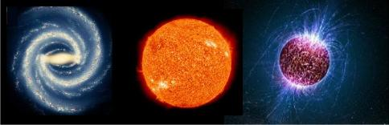
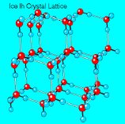
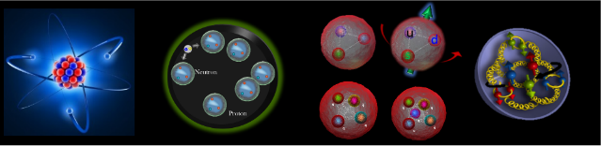
Scientific Motivation
Particle accelerators are devices that speed up the particles that make up all matter in the universe and collide them together or into a target. This allows scientists to study those particles and the forces that shape them.
——DOE explains
Gravitational force
Electromagnetic force
Strong force
Galaxy ~10²¹m | Solar ~10⁹m | Neutron star ~10⁴m | Crystal ~10⁻⁸m | Atom 10⁻¹⁰m | Atomic nucleus 10⁻¹⁵ ⁻ ¹⁴ m | nucleon（10⁻¹⁵m）
 |  |  |  |  |  | Quark | Gluon
High intensity HI beams
RIBs ~1.5-2 GeV/u
Relative. HI beams ~100 GeV/u
High Intensity
High Energy

Slide 5
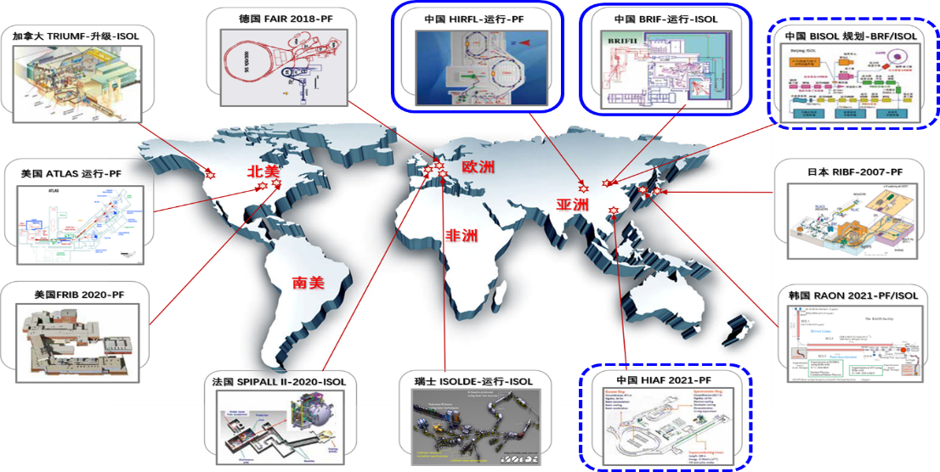
Scientific Motivation
More than 30 facilities are in operation in the world, with the energy range from MeV/u to TeV/u

Slide 6
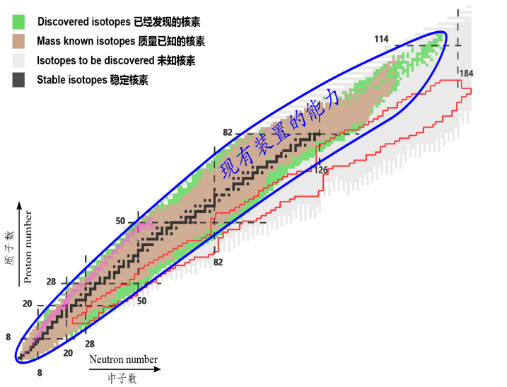
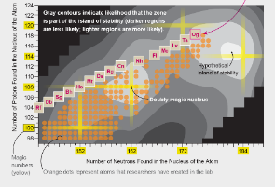

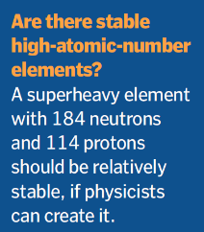
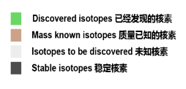
Scientific Motivation
How to explore the limit of nuclear existence?
Hypothetical island of stability
Energy frontier or Intensity frontier, that is the question
Science,
125 Top Questions

Slide 7
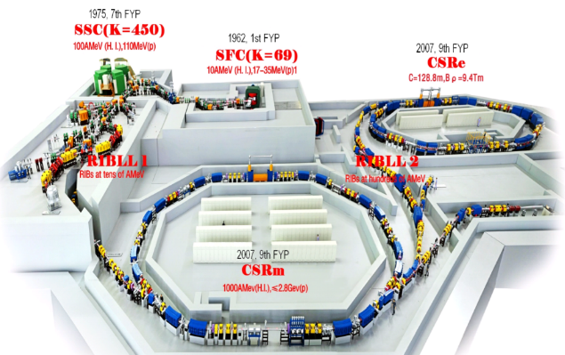
Scientific Motivation
Heavy ion research facility at Lanzhou (HIRFL)
Phys. Rev. C 100, 051203(R) (2019)
First measured in CSR
Accuracy improved in CSR
Stable nuclei
Phys. Rev. C 96, 031303 (R) (2017)
^{94m}Ru
Phys. Lett. B 781, 358 (2018)
Phys. Rev. Lett. 106, 112501 (2011)
Phys. Rev. C 99, 064303 (2019)
Chin. Phys. C 39, 104001 (2015)
Ions | Energy (MeV/u) | Current (ppp)
²³⁸U⁷⁴⁺ | 500 | ~10⁸
⁷⁸Kr²⁶⁺ | 500 | ~10⁹
¹²C⁶⁺ | 1000 | ~10¹⁰
Phys. Rev. Lett. 109, 102501 (2012)
Astrophys. J. Lett., 766, L8 (2013)
Phys. Lett. B, 735, 327 (2014)
Phys. Rev. Lett. 117, 182503 (2016)
Phys. Lett. B, 767, 20 (2017)
Phys. Rev. C 98, 014319 (2018)
Phys. Rev. C, 102, 054311 (2020)
Phys. Rev. C 98, 014315 (2018)

Slide 8
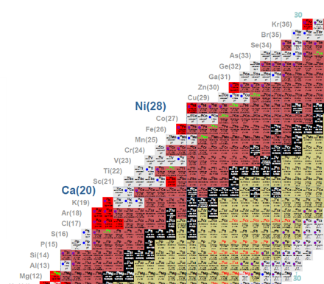

Scientific Motivation
Precise mass measurement spectrometry of short-lived nuclides
Too many isotopes can not be produced, mainly because of very small cross-section
A high intensity heavy ion beam accelerator facility is needed
^{94m}Ru
HIAF (High Intensity heavy-ion Accelerator Facility)
---proposed in 2011
---approved in 2015
---construction from 2018
---beam commissioning in 2025

Slide 9
Outline
Scientific motivation
Introduction of HIAF
Challenges and key technologies of HIAF accelerators
From HIAF to EicC: collision, polarization and cooling
Conclusion

Slide 10
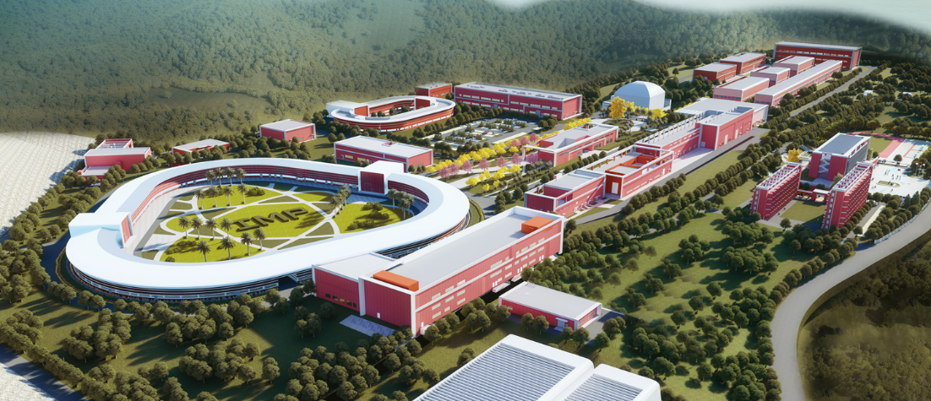
HIAF introduction
Budget ~3 billion CNY (including civil construction), start from Dec. 2018, installation finished in Sept. 2025, located in Huizhou.

Slide 11

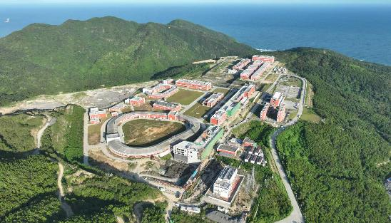
HIAF introduction
Budget ~3 billion CNY (including civil construction), start from Dec. 2018, installation finished in Sept. 2025, located in Huizhou.
December. 2018
September. 2025

Slide 12
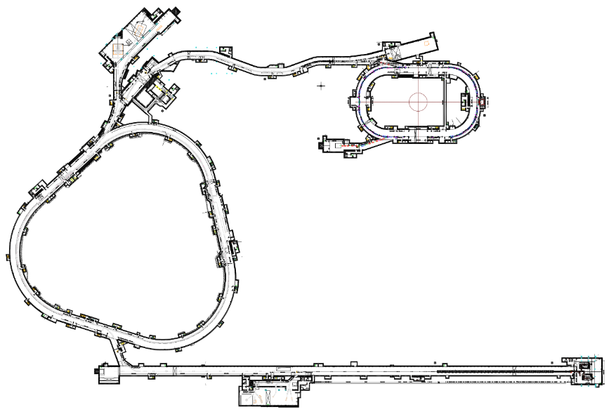
HIAF introduction
HIAF = 4th SECR + superconducting Linac + Fast ramping rate synchrotron+ Terminals
HFRS: Radioactive beam line
6
2
Low energy nuclear structure terminal
High energy experimental terminal
High energy fragment separator HFRS
High precision spectrometer ring SRing
Electron ion recombination terminal
Radioactive ion beam physics terminal
3
L: 180m, Bρ: 25 Tm
4
5
SRing:
Spectrometer ring
Circumference: 273m
Rigidity: 13-15 Tm
Electron/Stochastic cooling
Two TOF detectors
Four operation modes
BRing
Fast cycle ring
Circumference: 570 m
Rigidity: 34 Tm
Large acceptance (250/120)
Two planes painting injection
Fast ramping rate（3-10Hz）
iLinac:
Superconducting linac
Length:100 m
Energy: 17-22 MeV/u(U³⁵⁺⁻⁴⁵⁺)
SECR:
Superconducting
ECR source
1

Slide 13
HIAF introduction
HIAF beam parameters: the highest heavy ion bunches in the world
 | SECR | iLinac | BRing | HFRS | SRing | FAIR
Length / circumference (m) | --- | 114 | 569 | 192 | 277 | 1080
Final energy of U (MeV/u) | 0.014 (U³⁵⁺) | 17 (U³⁵⁺) | 835 (U³⁵⁺) | 800 (U⁹²⁺) | 800 (U⁹²⁺) | 2700 (U²⁸⁺)
Max. magnetic rigidity (Tm) | --- | --- | 34 | 25 | 15 | 100
Max. beam intensity of U | 50 pμA (U³⁵⁺) | 28 pμA (U³⁵⁺) | 1×10¹¹ppp (U³⁵⁺) | ------- | (2~4)×10¹¹ppp (U⁹²⁺) | 4×10¹¹ppp (U²⁸⁺)
Operation mode | DC | CW or pulse | fast ramping (12T/s, 3Hz) | Momentum-resolution 1100 | DC, deceleration | 0.5

Slide 14
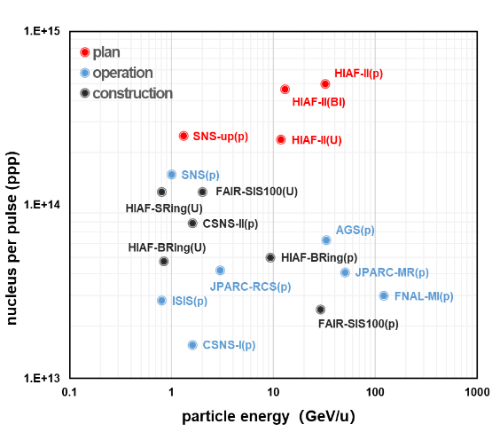
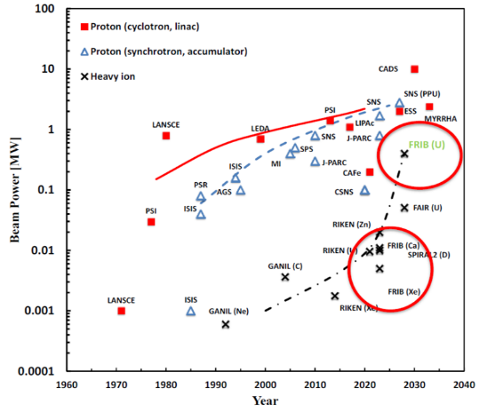
HIAF introduction
the average beam power is not competitive, the stopping power in materials is enough for high energy intensity physics.
0.1 MJ
1 MJ
Total energy per pulse
HIAF

Slide 15
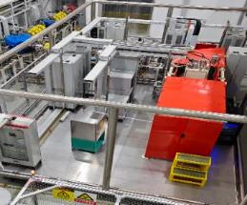
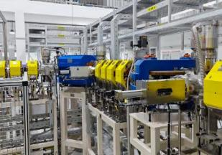
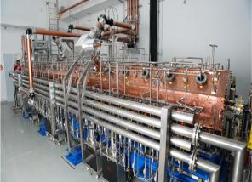
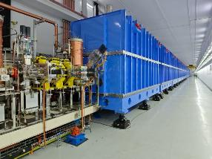
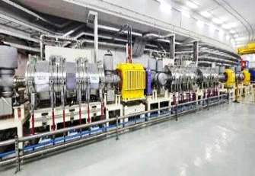
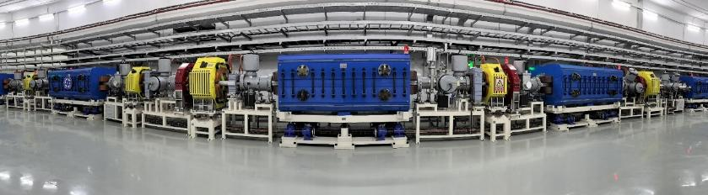
HIAF introduction

Slide 16
Outline
Scientific motivation
Introduction of HIAF
Challenges and key technologies of HIAF accelerators
From HIAF to EicC: collision, polarization and cooling
Conclusion

Slide 17
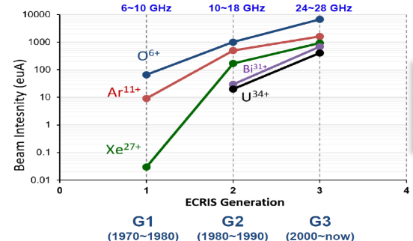
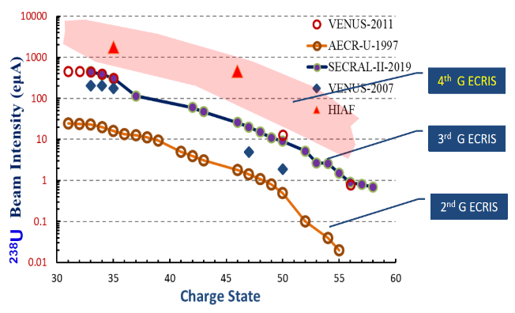
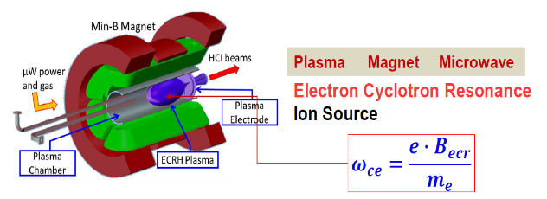
Challenges and key technologies
4th SECR: state of the art ECRIS
The goal of the stored particle number in HIAF needs a powerful ion source
1 emA U³⁵⁺ is required
45GHz
---L. Sun, ICIS’23

Slide 18
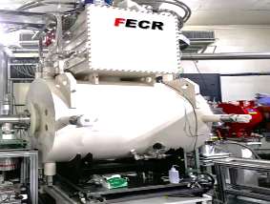
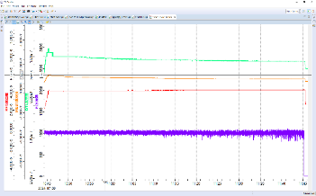
Challenges and key technologies
4th SECR: state of the art ECRIS
The goal of the stored particle number in HIAF needs a powerful ion source
1 emA U³⁵⁺ is required
45GHz
1.016emA O⁶⁺
---L. Sun, ICIS’23

Slide 19
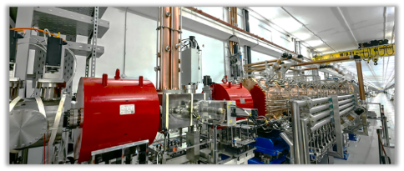
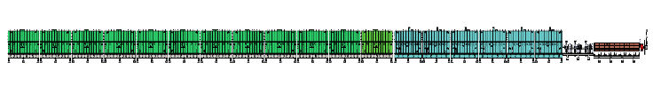
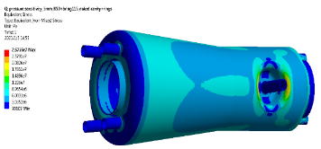
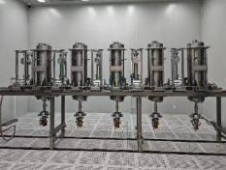
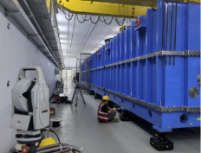
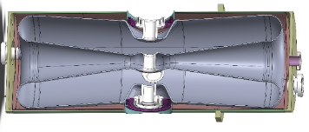
Challenges and key technologies
Superconducting linac: CW and pulsed modes
To BRing with 3 Hz pulsed beam
To low energy terminal with CW beam
3HB+RFQ
MEBT
QWR007
HWR015
HWR 015
RFQ in tunnel
QWR 007
Cavities and Cryomodule

Slide 20
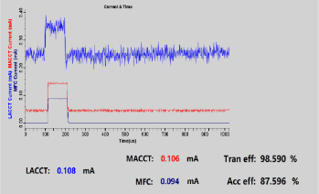
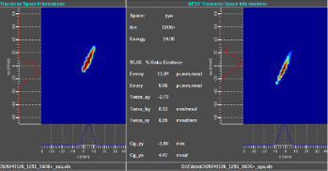

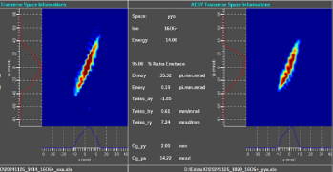
Challenges and key technologies
Primary commissioning of ESR and RFQ
1 emA ¹⁶O⁶⁺ beam has been obtained from RFQ, Kr and Bi have been accelerated successfully
Efficiency as well as stabilities have to study in detail
Commissioning results
Ion | Current | Pulse width | Energy | Trans. effy | Accel. effy
¹⁶O⁶⁺ | 1 emA | 1ms@1Hz | 12.86 MeV | 70.9% | 60.6%
⁸⁴Kr¹⁹⁺ | 115 eμA | 1ms@1Hz | - | 94.6% | 86.4%
²⁰⁹Bi³¹⁺ | 52 eμA | 1ms@1Hz | 169.4 MeV | 93.0% | -
RFQ entrance：0.07 π.mm.mrad
RFQ entrance：0.23 π.mm.mrad

Slide 21
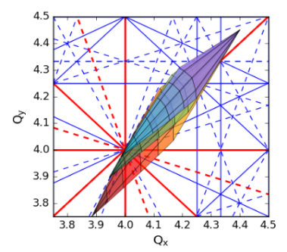
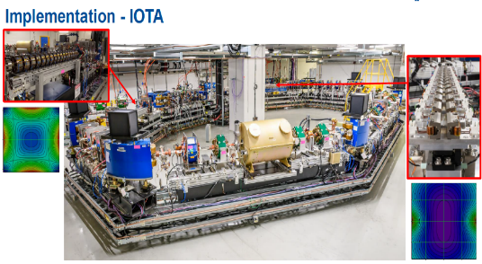
Challenges and key technologies
Booster Ring (BRing): Fast ramping rate synchrotron
Working point (oscillation frequency) for each particle is different
Beam loss due to resonance or dynamic vacuum effect
Fast ramping acceleration is a possible way to avoid the beam loss
Very high current ramping rate up to 38 kA/s for dipole PS
High acceleration voltage up to 240kV/turn
Thin wall vacuum chamber to avoid distortion with eddy current
0.6T/s @ HIRFL
10T/s @ SIS 18
12T/s @ BRing

Slide 22
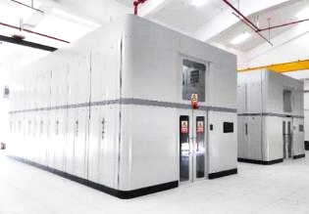
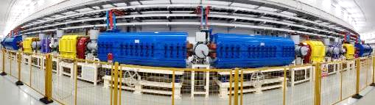
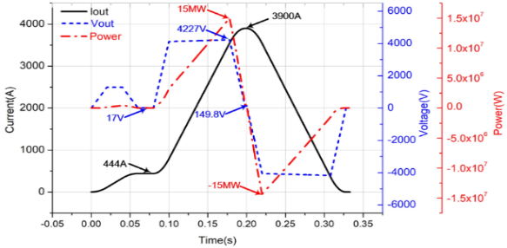
Challenges and key technologies
Fast ramping rate full energy storage power supply for dipoles and quadrupoles
Requirement of magnet power converters featured by fast ramping rate：12T/s, ±38000A/s,
the peak power reaches 230MW totally at full load
Power (MVA) | Conventional | Energy storage
BRing bendng magnet | 180 | 15
BRing quadruple magnet | 50 | 6
Total of BRing | 250 | 41
Total of HIAF | 297 | 88
Energy capacitor is used to store energy during the falling, and provide the energy for next fast ramping

Slide 23
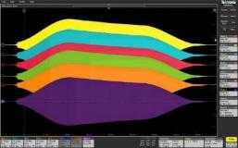

Challenges and key technologies
Magnetic ally core loaded RF system
To satisfy fast acceleration, the voltage for total RF system should be 240 kV
acceleration
Amp. Error < ±1%
Cavities in tunnel
Facilities | Voltage (kV) | Length (m) | Gradient (kV/m)
JPARC-RCS | 41 | 1.78 | 23
JPARC-MR | 46.7 | 1.78 | 26.2
SIS18 | 50 | 2 | 25
HIAF-BRing | 70 | 2 | 35
Gradient of traditional ferrite is only ~10kV/m, long dispersion-free space is needed, challenges for beam optical design

Slide 24
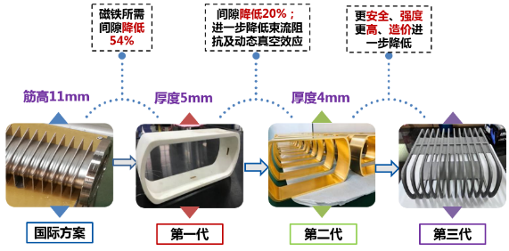
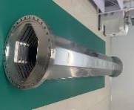
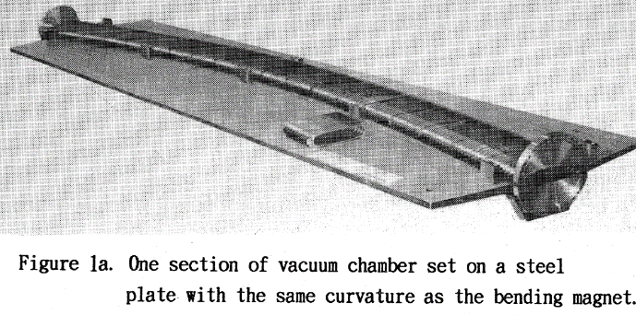
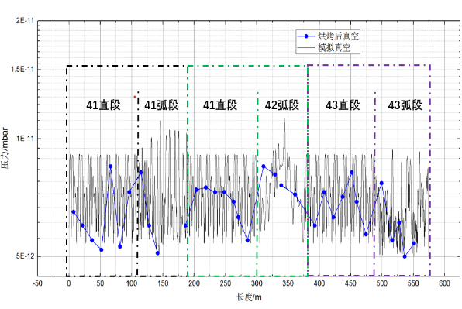
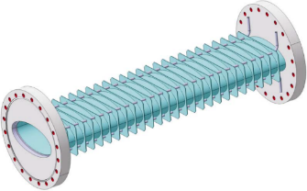
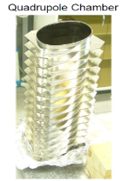
Challenges and key technologies
Titanium alloy-lined thin-walled vacuum chamber
Problem: fast ramping of the magnets induces eddy currents:
The chamber walls are heated
Generation of additional harmonics in field
Vacuum system for HIMAC in 1993
Rings inside @ IMP
Vacuum better than 7×10⁻¹²mbar
Solution from GSI
Stainless steel-0.3mm
Rib-15mm,one side

Slide 25
Outline
Scientific motivation
Introduction of HIAF
Challenges and key technologies of HIAF accelerators
From HIAF to EicC: collision, polarization and cooling
Conclusion

Slide 26
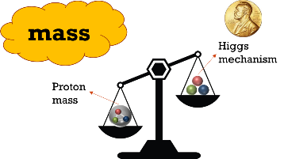
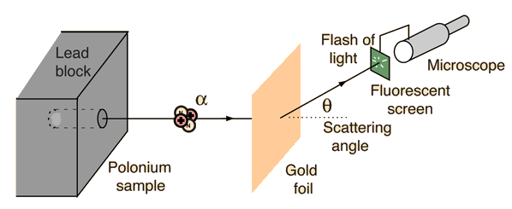

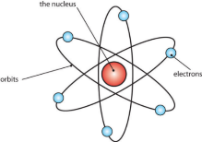



EicC motivation
Rutherford experiment
5.3 MeV
Proton, neutron not discovered yet
Experimentally… we need to determine each of the above contributions

Slide 27










EicC motivation
From fixed target to collider
Improve the energy, luminosity and polarization
Resolution=energy
Luminosity=current
$$E^{∗}=1.37\sqrt{E_{inc}}\sqrt{GeV}$$
Spin
unpolarized
polarized
$$E^{∗}=2\sqrt{E_{1}}\sqrt{E_{2}}$$
---Y.Zhang, Jlab, EIC leture

Slide 28


EicC motivation
Electron cooler and electron target
EicC covers the kinematic region between JLab experiments and EIC@BNL
EicC focuses on moderate x and sea-quark region
EicC
HIAF-U
Collider ring ~1149.07 m
Electron ring ~287.80 m
2.8 GeV ~ 5 GeV
eLinac
HIAF
BRing_N ~569.10 m
BRing_S ~ 574.54 m
Proton energy up to 24.85 GeV
电子对撞环eRing ~ 1151.20 m
---Max Klein, University of Liverpool，2014

Slide 29

EicC motivation
Electron cooler and electron target
Phase 1: HIAF for nuclear physics
Phase 2: HIAF upgrade for applied science
Phase 3: EiccC
EicC
HIAF-U
Parameter | electron | proton
Circumference (m) | 1151.20 | 1149.81
Kinetic energy (GeV) | 3.5 | 19.08
CM energy (GeV) | 16.76
f_{collision} (MHz) | 100
Polarization | 80% | 70%
Bunch intensity (x10¹¹) | 0.44 | 0.27
$ε_{x},ε_{y}$ (nm·rad, rms) | 12.5/3.75 | 25/12.5
$β_{x}^{∗}/β_{y}^{∗}$ (cm) | 10/4 | 5/1.2
RMS divergence (mrad) | - | 0.7/1.0
Bunch length (cm, rms) | 0.75 | 8
Crossing angle (mrad) | 50
Hourglass | 0.52
Luminosity (cm⁻²s⁻¹) | 1.13 × 10³³
Collider ring ~1149.07 m
Electron ring ~287.80 m
2.8 GeV ~ 5 GeV
eLinac
HIAF
HIAF
BRing_N ~569.10 m
BRing_S ~ 574.54 m
Proton energy up to 24.85 GeV
电子对撞环eRing ~ 1151.20 m

Slide 30



Collision
High luminosity and quasi-full-acceptance
50 mrad
X’
High luminosity mode: large particle number, small betatron function, peak luminosity up to $4.25×10^{33} cm^{−2}s^{−1}$
X
Quasi-full-acceptance mode: large particle number, small betatron function, peak luminosity up to$1.13×10^{33} cm^{−2}s^{−1}$

Slide 31


Collision
Rapid cycling operation mode
Replace all in minutes or seconds
Rapid-cycling booster
9 s or 12 min (multi-EC)
Higher integral luminosity
Injection line
Beam dump line
DUMP
the collision bunches are replaced online and quickly enough, much higher peak and integral luminosity is feasible
Kicker
Collision ring
Swap-out injection scheme

Slide 32



Polarization
Constant-field solenoid Siberian snake
A constant field solenoid Siberian snake has been designed in the BRing-N
Mingxiang Li, et al., PRAB, 28, 094002 (2025)
The required magnetic field ramp rate for a conventional constant-strength solenoid Siberian snake is 29 T/s, to control the depolarization loss below 10%;
The spin tune gap generated by a constant-field solenoid Siberian snake is sufficient to avoid the vertical tune (red line), which will significantly reduce hardware challenges;

Slide 33



Beam cooling
Beam cooling can be used for accumulation, improving beam quality and compensating the emittance growth.
CW
1 bunch
3 injections
2.03×10¹³ ppp
RMS $ε_{x}/ε_{y}$ ~ 200/100 π nm·rad
192 bunches
2 injections, 384 bunches
1.05×10¹¹ ppb
4.05×10¹³ ppp
RMS $ε_{x}/ε_{y}$ ~ 100/50 π nm·rad
6.8×10¹² ppp
RMS $ε_{x}/ε_{y}$ ~
12/6 π mm·mrad
Proton beams as an example!
2 GeV
9.3 GeV
Acc. ~ 0.1 s
E.C. ~ 120 s
To replace all collision bunches ~ 12 mins
Acc. ~ 4 s

Slide 34





Beam cooling
Magnetized DC electron cooling can be used in BRing-N for beam accumulation.
 | E-cooling
energy（keV） | 450
current（A） | 2.0
$$τ∝\frac{A}{Z^{2}}\frac{1}{n_{e}}βγ^{2}ε^{1.5}$$
lower energies, better cooling

Slide 35



Beam cooling
Relativistic electron cooling will be used in collider ring for compensation
Items | Value
energy | >11 MeV/u
charge/bunch | >1 nC
bunch length | ~ 4 cm
average current | >100 mA
ion
electron
E-gun
ERL
Dump

Slide 36
Outline
Scientific motivation
Introduction of HIAF
Challenges and key technologies of HIAF accelerators
From HIAF to EicC: luminosity, polarization and cooling
Conclusion

Slide 37
Conclusion
As an injector of EicC, the HIAF accelerator complex (phase 1) has been installed completely
The upgrade project of HIAF will focus on the improvement of energies and intensities, in order to satisfy the requirement of EicC
The beam dynamics and technical challenges related to collision, polarization and beam cooling should be studied and solved in coming years

Slide 38

Thanks for your attention!

