Slide 1



Baryon CP violation
Measurements at LHCb
Yanxi Zhang
on behalf of the LHCb collaboration
26th International Symposium on Spin Physics
21 – 26/Sep./2025

Slide 2

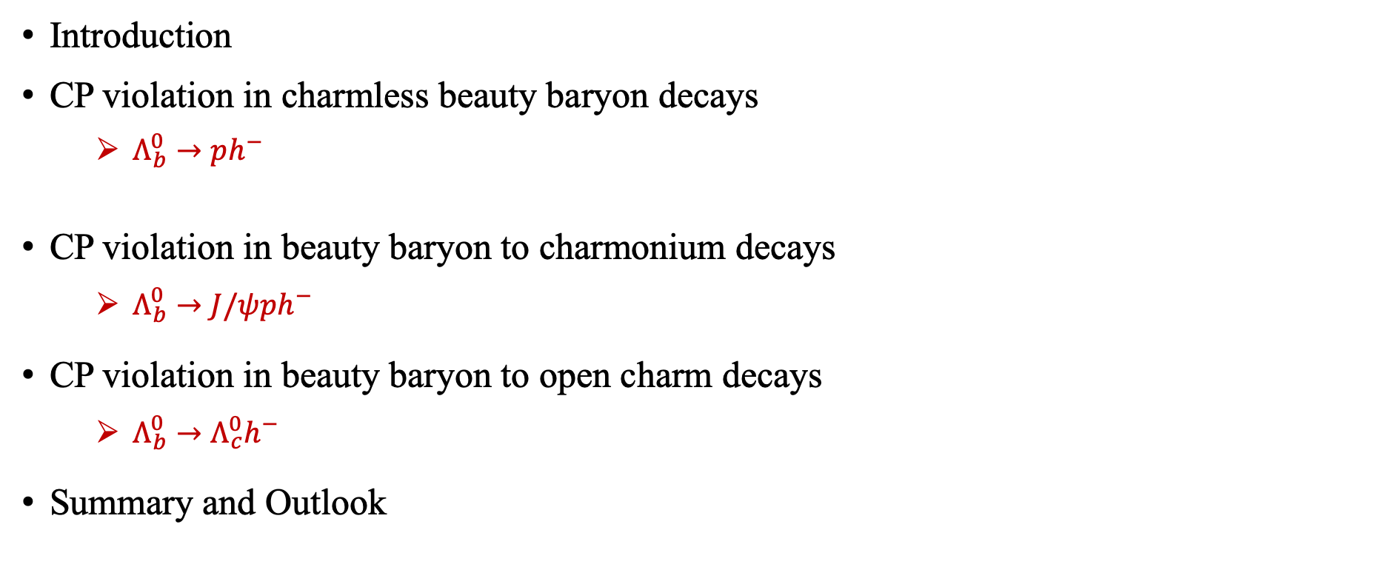



Outline
Introduction
CP violation in charmless beauty baryon decays
  $Λ_{b}^{0}→ph^{−}$
CP violation in beauty baryon to charmonium decays
  $Λ_{b}^{0}→J/ψph^{−}$
CP violation in beauty baryon to open charm decays
  $Λ_{b}^{0}→Λ_{c}^{0}h^{−}$
Summary and Outlook
$Λ_{b}^{0}/Ξ_{b}^{0}→Λh_{1}^{+}h_{2}^{−}$
$Λ_{b}^{0}/Ξ_{b}^{0}→{pK}_{s}^{0}h^{−}$
$Λ_{b}^{0}→pK^{−}π^{+}π^{−}$
[PRD 111 (2025), 092004]
[PRL 134 (2025) 101802]
[arXiv:2508.17836]
Nature 643 (2025) 1223
[arXiv:2509.16103]
[PRL 133 (2024) 261804]
* $h=K$ or $π$

Slide 3


Introduction
Violation of CP symmetry (CPV) is essential to explain the observed matter-antimatter asymmetry in the Universe
CP violation
Matter
Sakharov
conditions
Antimatter
CPV in Standard Model (CKM mechanism) insufficient to account for observed asymmetry
Understanding CP violation within the SM and searching for CP violation beyond are important frontiers in particle physics

Slide 4
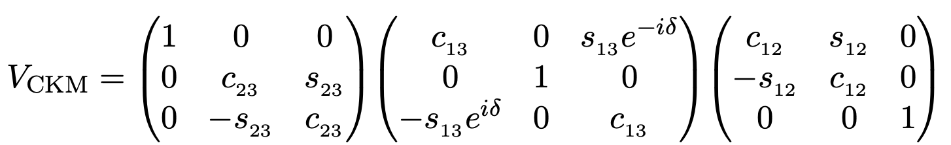
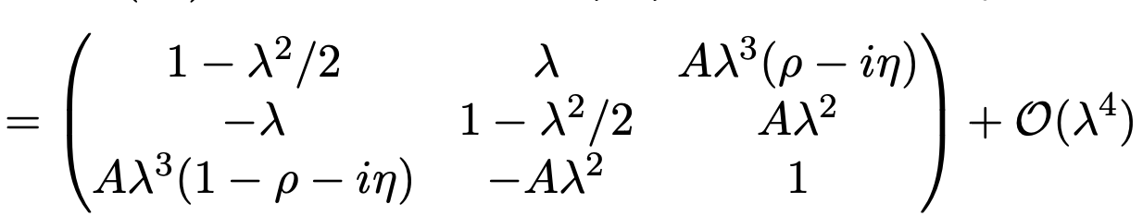
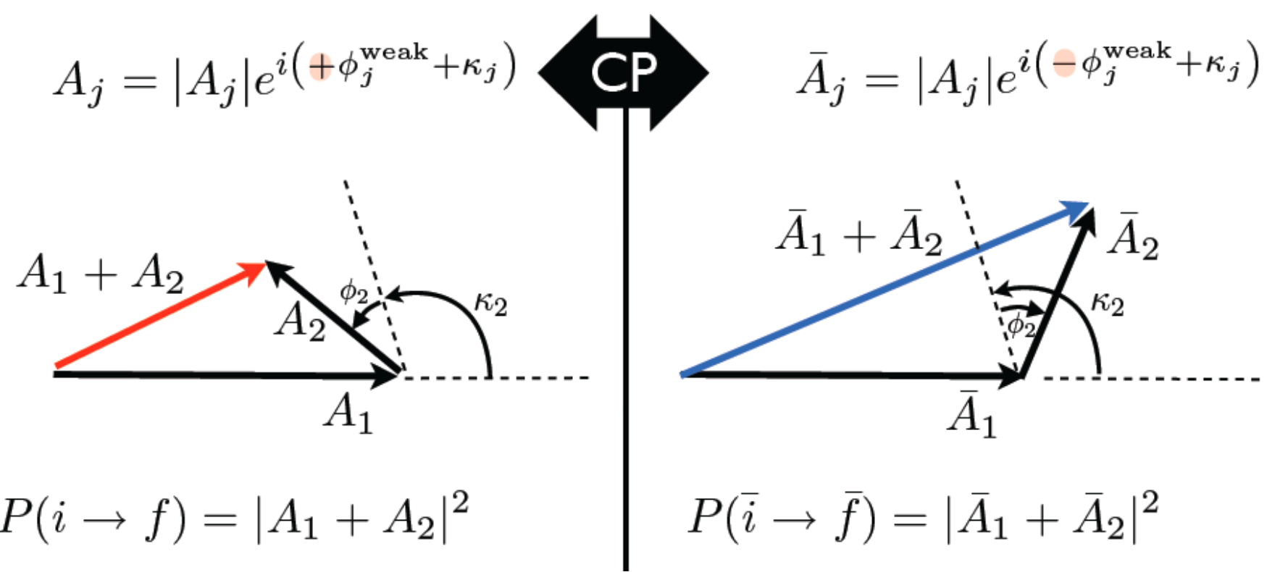
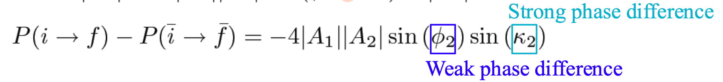
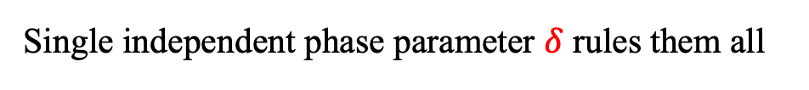
CP violation in the SM
CP violating weak phases in quark mixing (CKM) matrix
Single independent phase parameter $δ$ rules them all
Interference of (at least) two amplitudes generates CP violation
Two amplitudes have both weak and strong phase differences

Slide 5
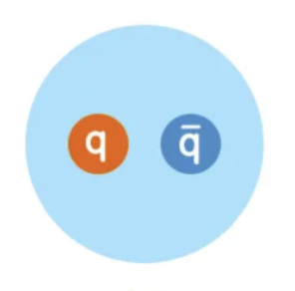
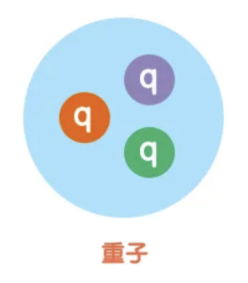
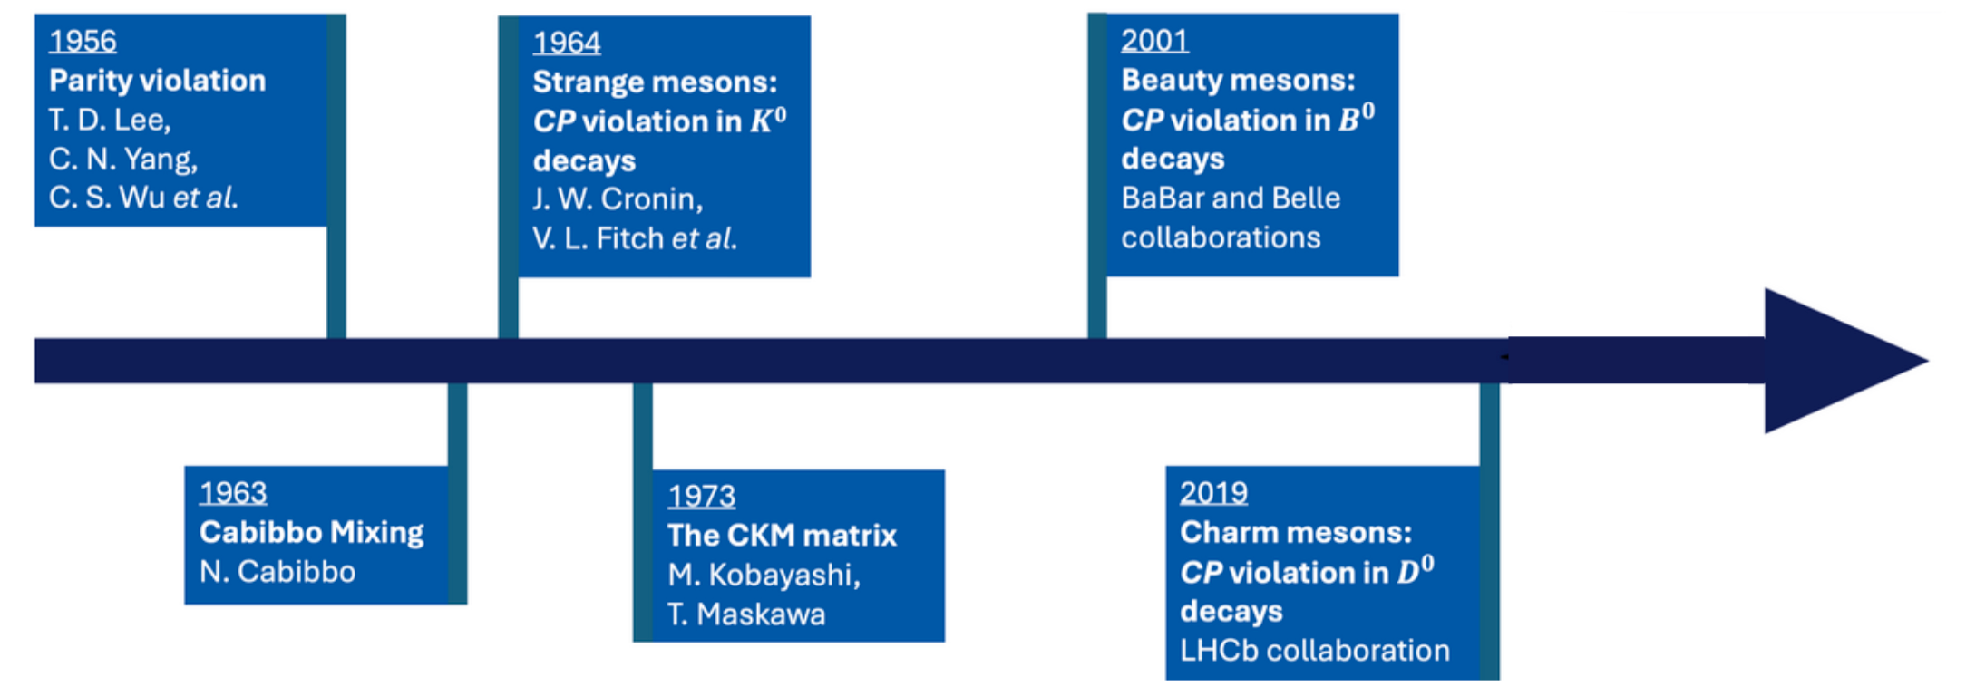
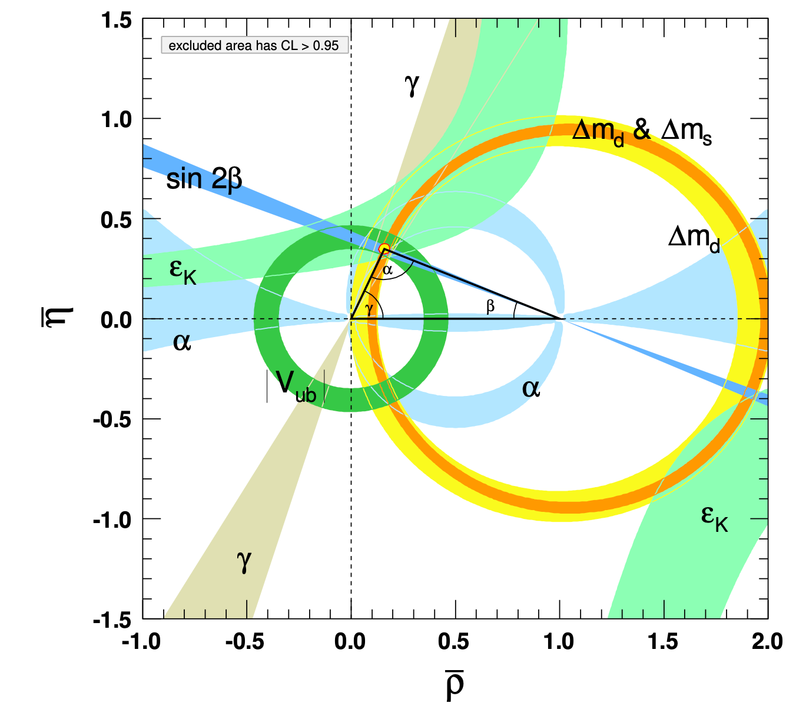
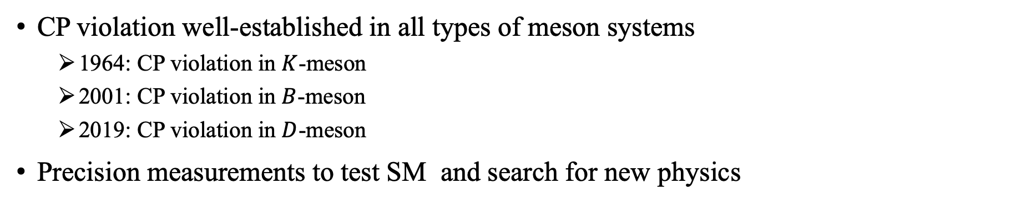
CP violation in mesons
CP violation well-established in all types of meson systems
  1964: CP violation in $K$-meson
  2001: CP violation in $B$-meson
  2019: CP violation in $D$-meson
Precision measurements to test SM and search for new physics
Meson
Baryon

Slide 6
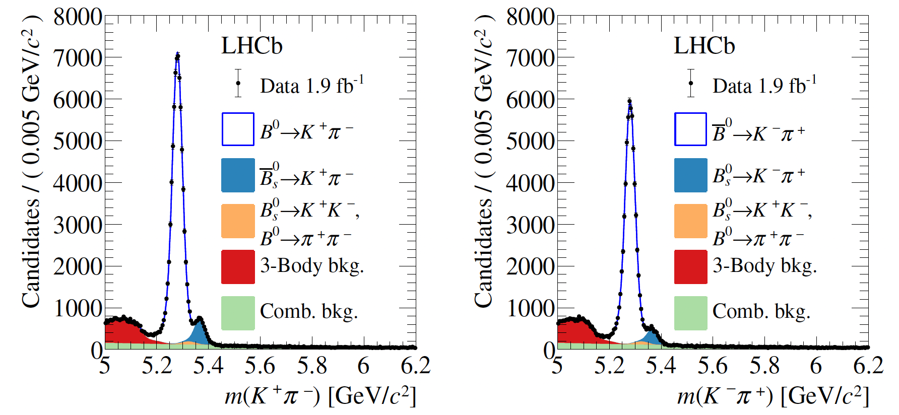
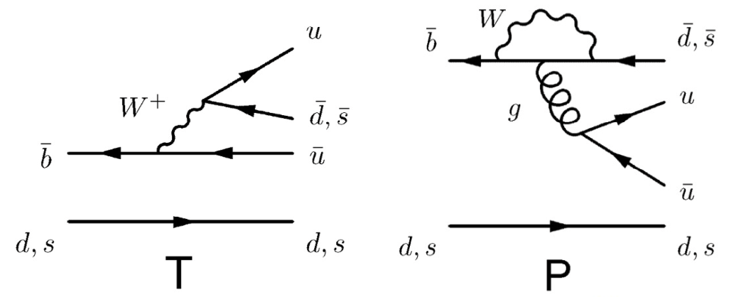





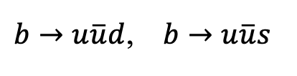
$B$-meson CP violation
Large CP violation expected in charmless decays due to tree & loop interference
PRD98 (2018) 032004
$$B→K^{+}π^{−}$$
$$B→K^{−}π^{+}$$
$b→u\overline{u}d$, $b→u\overline{u}s$
$$V_{tq}$$
$$A_{CP}^{{\overline{B}}^{0}→K^{−}π^{+}}=−0.083±0.005$$
$$A_{CP}^{{\overline{B}}_{s}^{0}→K^{+}π^{−}}=0.236±0.017$$

Slide 7
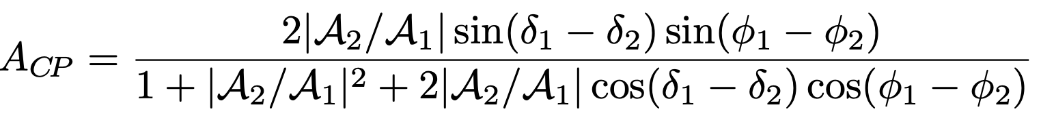
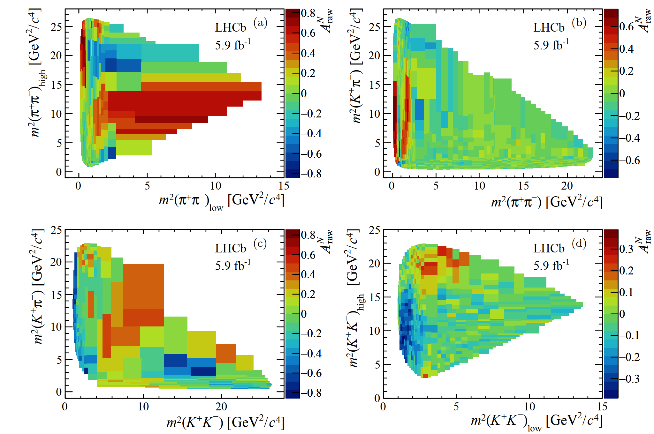


Multibody decays
Varying strong phases and resonance compositions across phase space
$$B^{±}→K^{±}π^{+}π^{−}$$
$$B^{±}→π^{±}π^{+}π^{−}$$
PRD108(2023)012008

Slide 8


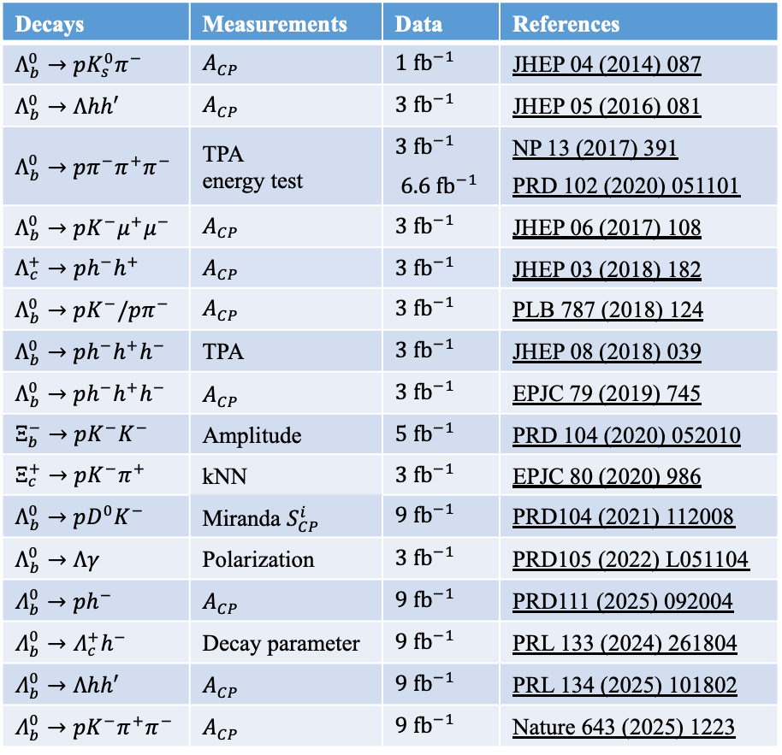

Baryon CP violation
Complementary to meson studies, comprehensive test of SM
Predicted in SM but only observed recently
Decays | Measurements | Data | References
$Λ_{b}^{0}→pK_{s}^{0}π^{−}$ | $A_{CP}$ | $1{ fb}^{−1}$ | JHEP 04 (2014) 087
$Λ_{b}^{0}→Λhh′$ | $A_{CP}$ | $3 {fb}^{−1}$ | JHEP 05 (2016) 081
$Λ_{b}^{0}→pπ^{−}π^{+}π^{−}$ | TPA energy test | $3{ fb}^{−1}$ $6.6 {fb}^{−1}$ | NP 13 (2017) 391 PRD 102 (2020) 051101
$Λ_{b}^{0}→pK^{−}μ^{+}μ^{−}$ | $A_{CP}$ | $3 {fb}^{−1}$ | JHEP 06 (2017) 108
$Λ_{c}^{+}→ph^{−}h^{+}$ | $A_{CP}$ | $3 {fb}^{−1}$ | JHEP 03 (2018) 182
$Λ_{b}^{0}→pK^{−}/pπ^{−}$ | $A_{CP}$ | $3{ fb}^{−1}$ | PLB 787 (2018) 124
$Λ_{b}^{0}→ph^{−}h^{+}h^{−}$ | TPA | $3{ fb}^{−1}$ | JHEP 08 (2018) 039
$Λ_{b}^{0}→ph^{−}h^{+}h^{−}$ | $A_{CP}$ | $3{ fb}^{−1}$ | EPJC 79 (2019) 745
$Ξ_{b}^{−}→pK^{−}K^{−}$ | Amplitude | $5{ fb}^{−1}$ | PRD 104 (2020) 052010
$Ξ_{c}^{+}→pK^{−}π^{+}$ | kNN | $3{ fb}^{−1}$ | EPJC 80 (2020) 986
$Λ_{b}^{0}→pD^{0}K^{−}$ | Miranda $S_{CP}^{i}$ | $9{ fb}^{−1}$ | PRD104 (2021) 112008
$Λ_{b}^{0}→Λγ$ | Polarization | $3{ fb}^{−1}$ | PRD105 (2022) L051104
$Λ_{b}^{0}→ph^{−}$ | $A_{CP}$ | $9{ fb}^{−1}$ | PRD111 (2025) 092004
$Λ_{b}^{0}→Λ_{c}^{+}h^{−}$ | Decay parameter | $9{ fb}^{−1}$ | PRL 133 (2024) 261804
$Λ_{b}^{0}→Λhh′$ | $A_{CP}$ | $9{ fb}^{−1}$ | PRL 134 (2025) 101802
$Λ_{b}^{0}→pK^{−}π^{+}π^{−}$ | $A_{CP}$ | $9{ fb}^{−1}$ | Nature 643 (2025) 1223
Rough estimate of baryon CPV magnitudes:
Strange
Charm
Beauty
$$\sim 10\%$$
$$\sim 0.1\%$$
$$\sim 0.01\%$$

Slide 9
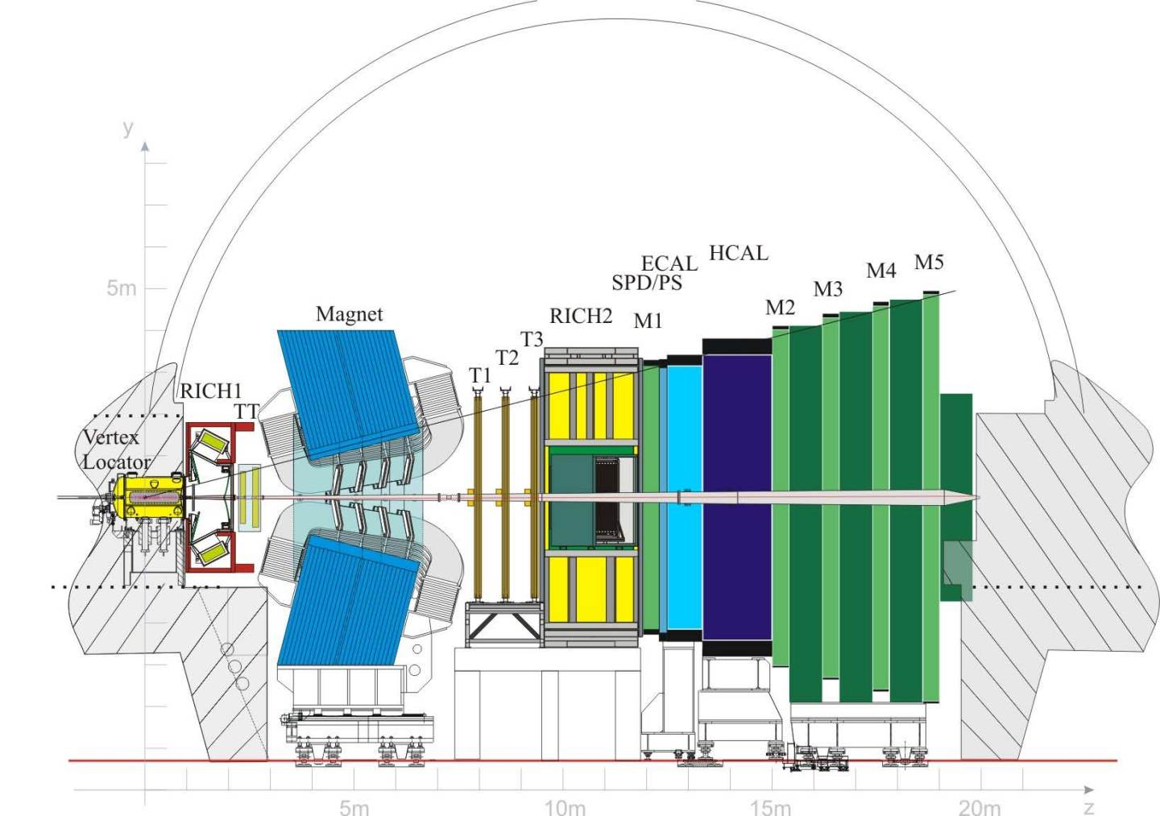

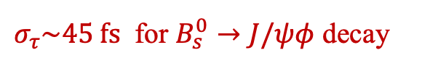
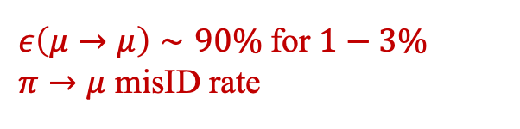

LHCb detector
JINST 3 (2008) S08005
IJMPA 30 (2015) 1530022
Particle ID
Tracking
Excellent vertexing
$σ_{τ}\sim 45 fs$ for $B_{s}^{0}→J/ψφ$ decay
Precise momentum measurement
$$Δp/p=0.5−1\% \left(5∼200 GeV/c\right)$$
Hadron PID
$$ε\left(K→K\right),ε\left(p→p\right)>90\%$$
Muon PID
$ε\left(μ→μ\right)∼90\%$ for $1−3\%$ $π→μ$ misID rate
Run 1-2 detector

Slide 10
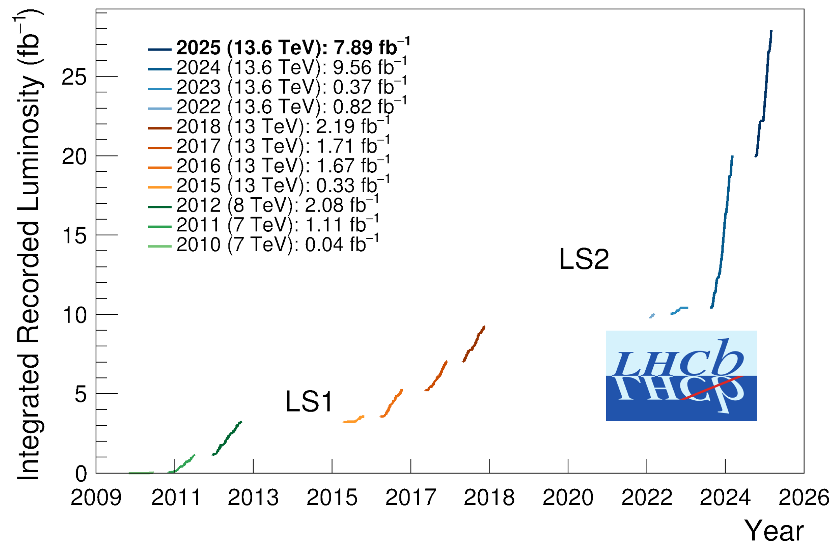
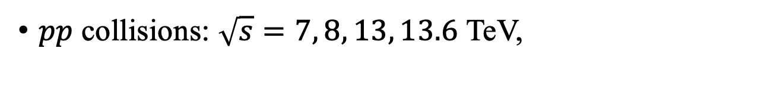
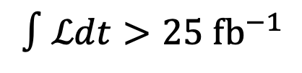
LHCb data
$$∫ℒdt>25 {fb}^{−1}$$
$pp$ collisions: $\sqrt{s}=7, 8, 13, 13.6$ TeV,
$σ\left(b\overline{b}, 13 TeV\right)≈0.5 mb$, $σ\left(c\overline{c}\right)≈20×σ\left(b\overline{b}\right)$
Run 3
Results here with only Run 1 and Run 2 data
Run 2
Run 1
Notes:
Copiously produced

Slide 11
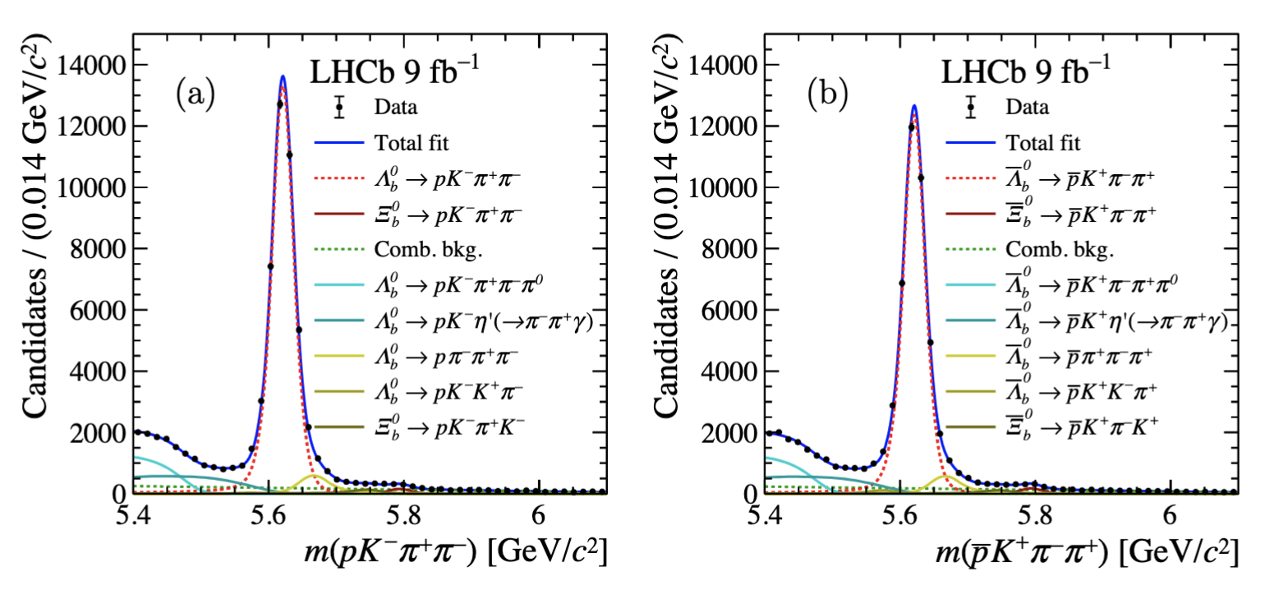
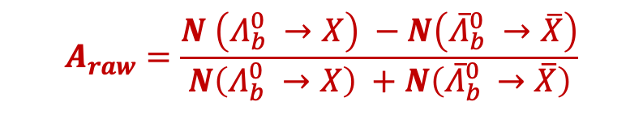

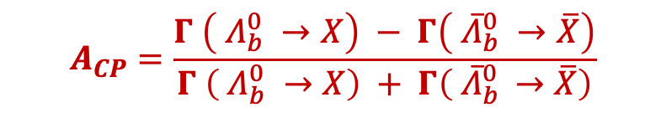

CP violation measurement
CPV manifested as difference between particle antiparticle decay rates
$$A_{CP}=\frac{Γ \left( Λ_{b}^{0} →X\right) − Γ\left( {\overline{Λ}}_{b}^{0} →\overline{X}\right)}{Γ \left( Λ_{b}^{0} →X\right) + Γ\left( {\overline{Λ}}_{b }^{0}→\overline{X}\right)}$$
$$Λ_{b}^{0}→pK^{−}π^{+}π^{−} {\overline{Λ}}_{b}^{0}→\overline{p}K^{+}π^{−}π^{+}$$
Counting yields of particle and antiparticle decays
$$A_{raw}=\frac{N \left(Λ_{b}^{0} →X\right) −N\left({\overline{Λ}}_{b}^{0} →\overline{X}\right)}{N\left(Λ_{b}^{0} →X\right) +N\left({\overline{Λ}}_{b }^{0}→\overline{X}\right)}$$
Experimental and production asymmetries need to be subtracted
Nature 643 (2025) 1223
$$A_{CP}=A_{raw} −A_{exp}−A_{P}$$
Control channel is included in some results, and the difference of CPV is measured
$${ΔA}_{CP}=A_{CP}(sig) −A_{CP}(control)$$

Slide 12
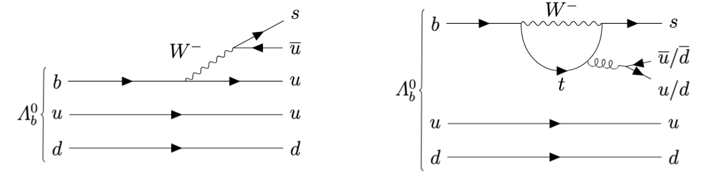
CP violation in charmless beauty baryon decays

Slide 13
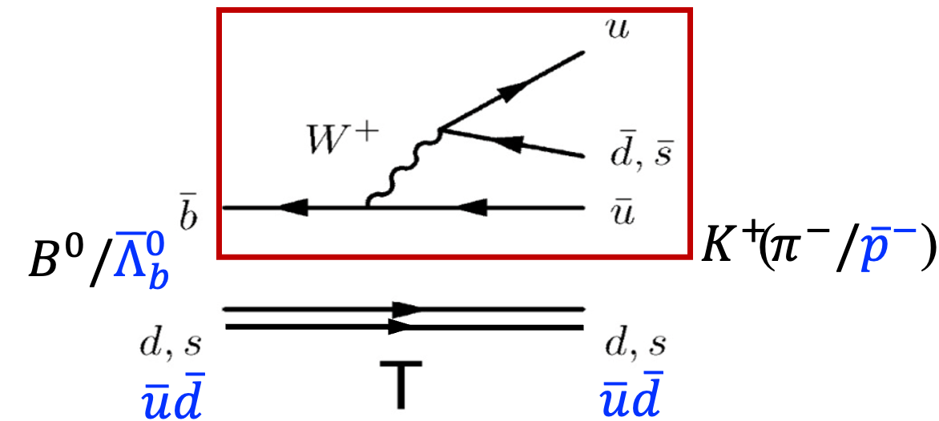
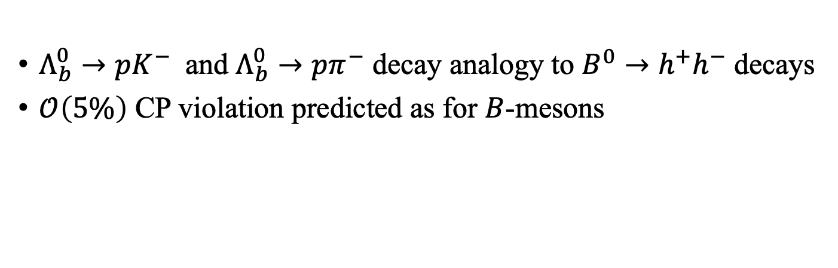
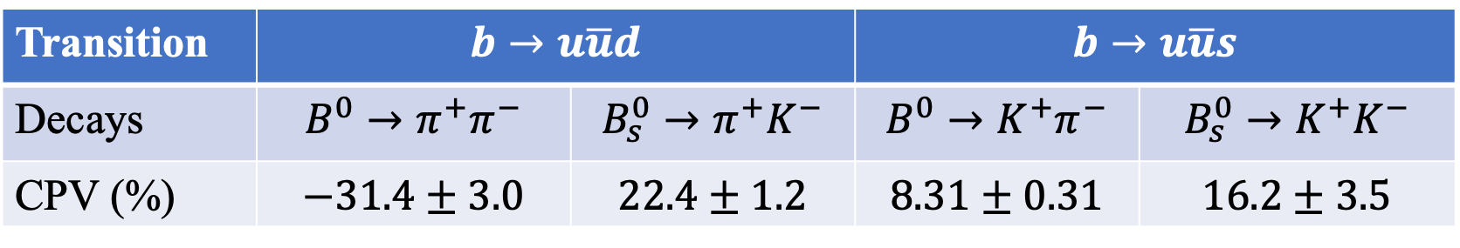
Charmless $Λ_{b}^{0}→ph^{−}$ decays
$Λ_{b}^{0}→pK^{−}$ and $Λ_{b}^{0}→pπ^{−}$ decay analogy to $B^{0}→h^{+}h^{−}$ decays
$𝒪\left(5\%\right)$ CP violation predicted as for $B$-mesons
PRD 102 (2012) 034033
PRD 95 (2017) 093001
Transition | $$b→u\overline{u}d$$ |  | $$b→u\overline{u}s$$
Decays | $$B^{0}→π^{+}π^{−}$$ | $$B_{s}^{0}→π^{+}K^{−}$$ | $$B^{0}→K^{+}π^{−}$$ | $$B_{s}^{0}→K^{+}K^{−}$$
CPV (%) | $$−31.4±3.0$$ | $$22.4±1.2$$ | $$8.31±0.31$$ | $$16.2±3.5$$

Slide 14
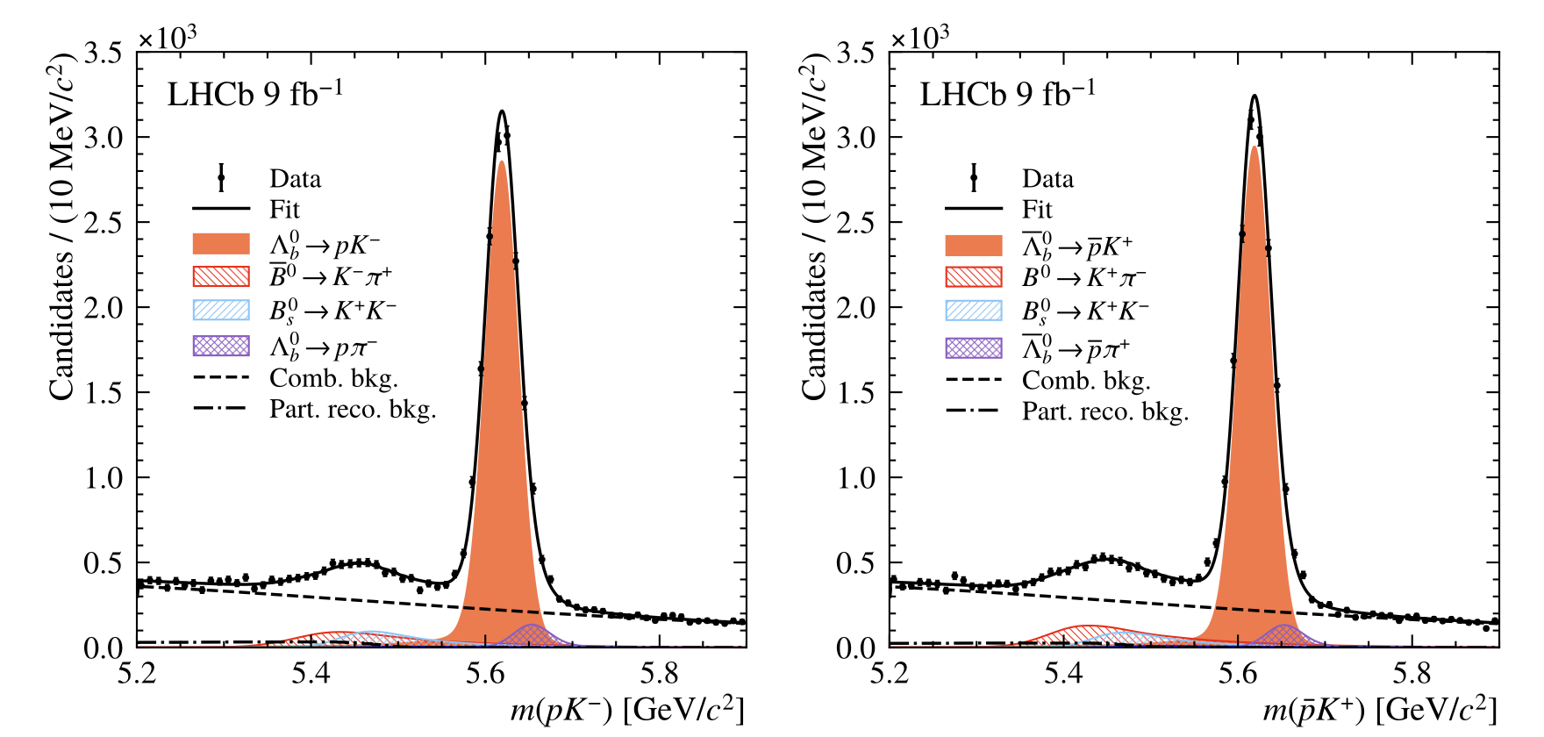
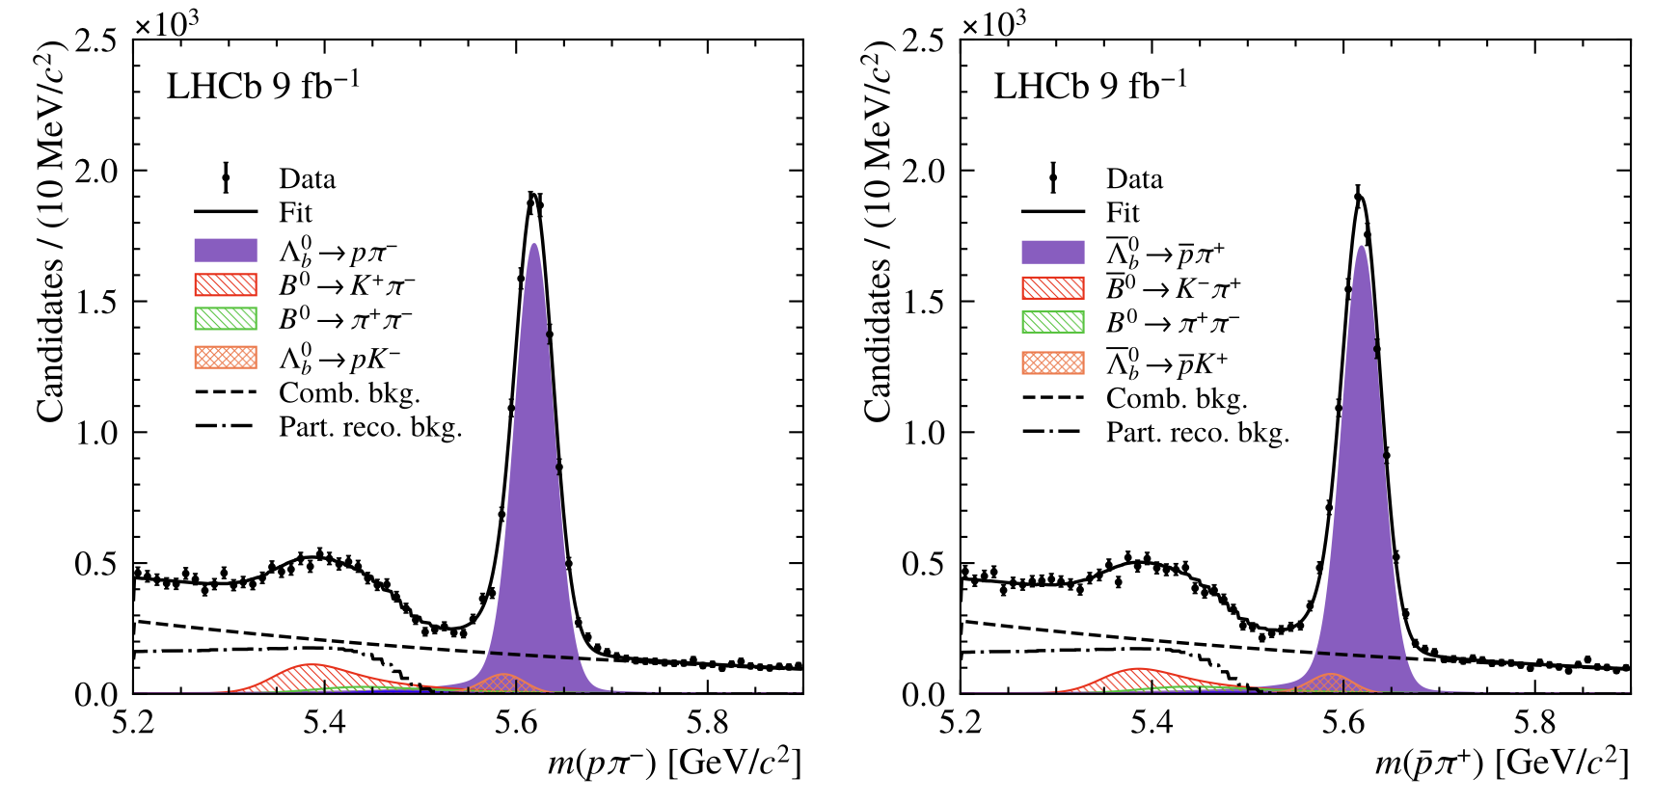


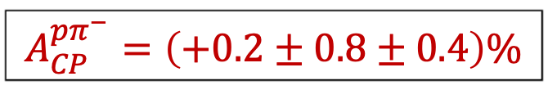

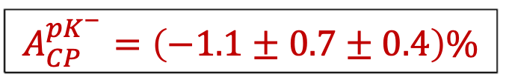

CP violation for $Λ_{b}^{0}→ph^{−}$ decays
[PRD 111 (2025), 092004]
Sizable CP violation not established
$$A_{CP}^{pK^{−}}=\left(−1.1±0.7±0.4\right)\%$$
$$A_{CP}^{pπ^{−}}=\left(+0.2±0.8±0.4\right)\%$$
$pK^{−}$
$\overline{p}K^{+}$
$pπ^{−}$
$\overline{p}π^{+}$
Most precise result in this mode
  Precision improved by a factor of 3 compared to known value
  Statistical uncertainties dominated

Slide 15
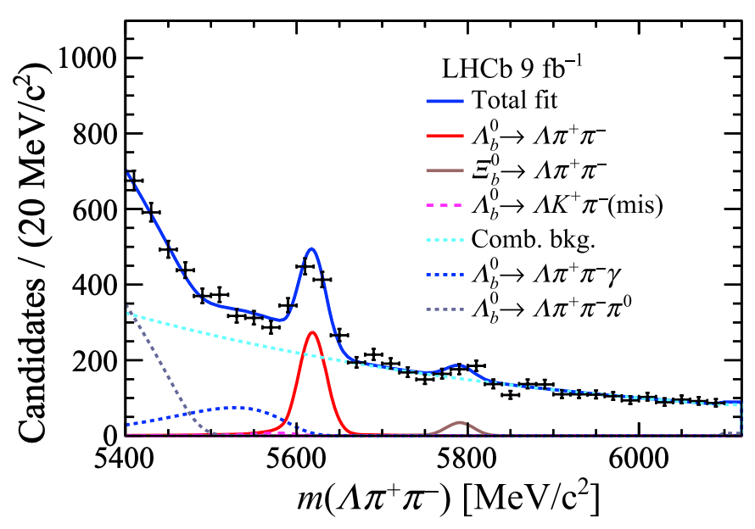
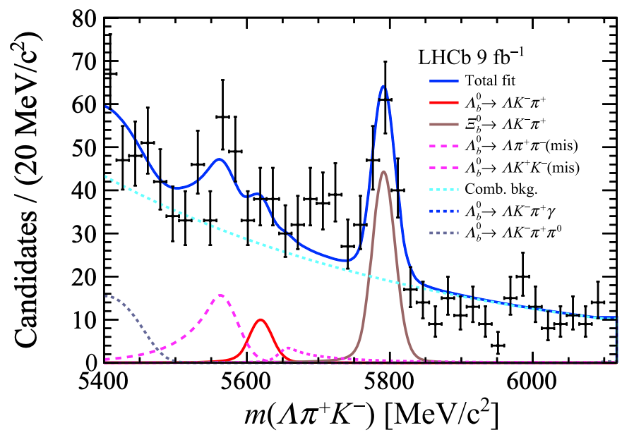
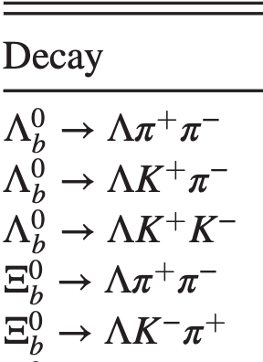
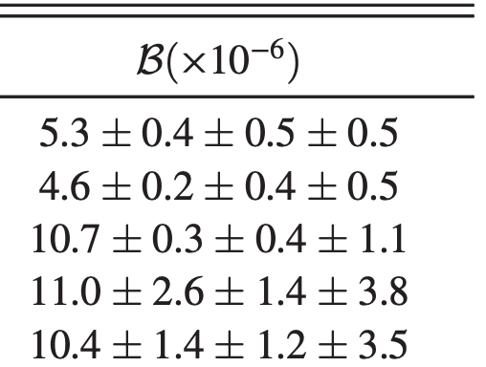
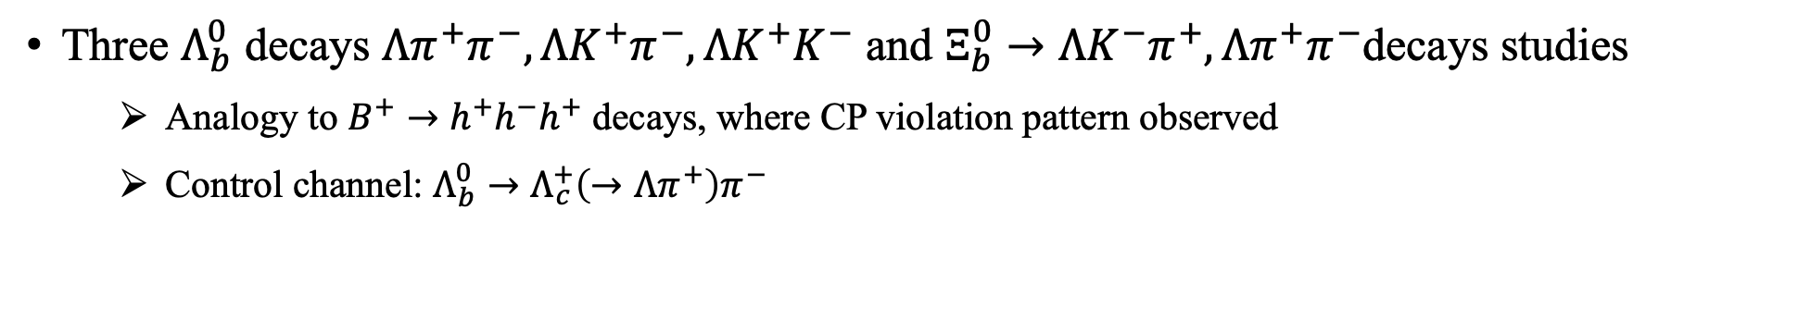
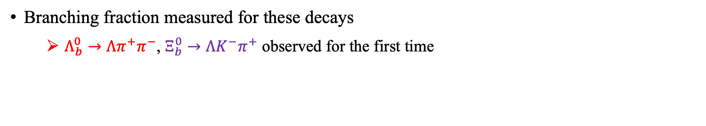
Charmless $Λ_{b}^{0}/Ξ_{b}^{0}→Λh_{1}^{+}h_{2}^{−}$ decays
[PRL 134 (2025) 101802]
Three $Λ_{b}^{0}$ decays $Λπ^{+}π^{−}, ΛK^{+}π^{−}, ΛK^{+}K^{−}$ and $Ξ_{b}^{0}→ΛK^{−}π^{+},Λπ^{+}π^{−}$decays studies
  Analogy to $B^{+}→h^{+}h^{−}h^{+}$ decays, where CP violation pattern observed
  Control channel: $Λ_{b}^{0}→Λ_{c}^{+}\left(→Λπ^{+}\right)π^{−}$
Branching fraction measured for these decays
  $Λ_{b}^{0}→Λπ^{+}π^{−}$, $Ξ_{b}^{0}→ΛK^{−}π^{+}$ observed for the first time

Slide 16
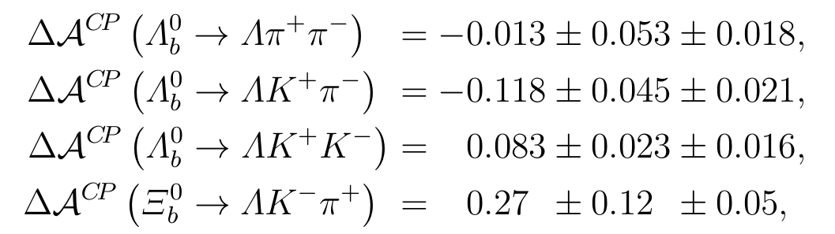
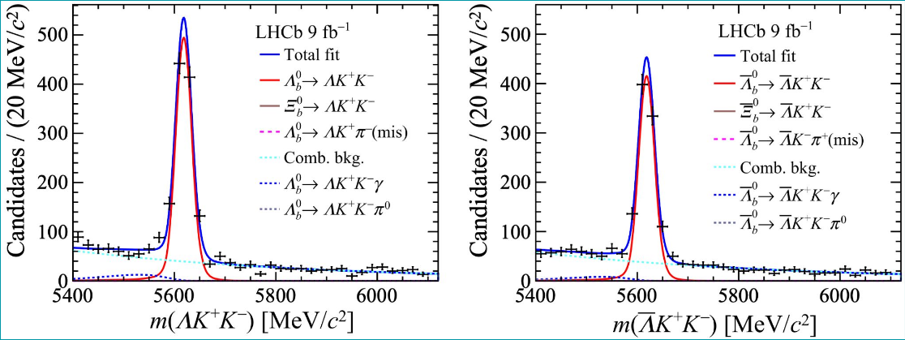
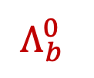
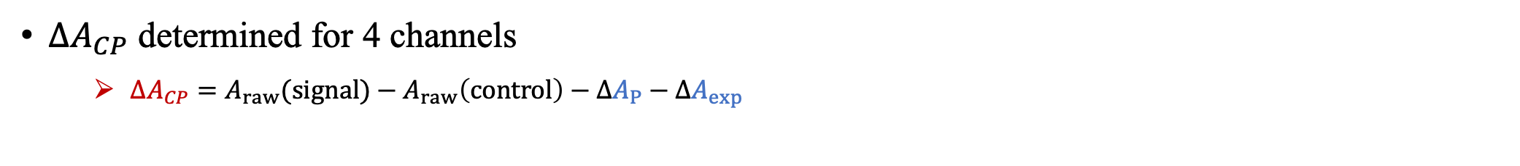
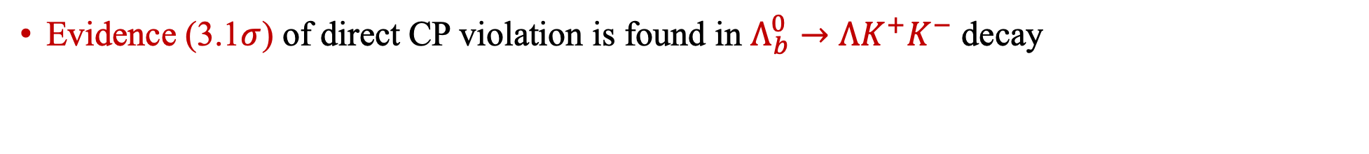
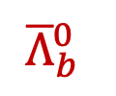
$A_{CP}$ measurement in $Λ_{b}^{0}/Ξ_{b}^{0}→Λh_{1}^{+}h_{2}^{−}$ decays
[PRL 134 (2025) 101802]
${ΔA}_{CP}$ determined for 4 channels
  ${ΔA}_{CP}=A_{raw}(signal)−{A_{raw}\left(control\right)−ΔA}_{P}−{ΔA}_{exp}$
Evidence (3.1$σ$) of direct CP violation is found in $Λ_{b}^{0}→ΛK^{+}K^{−}$ decay
$$Λ_{b}^{0}$$
$${\overline{Λ}}_{b}^{0}$$

Slide 17
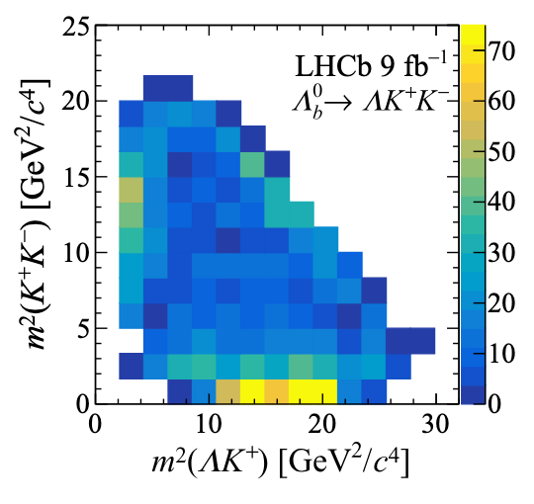
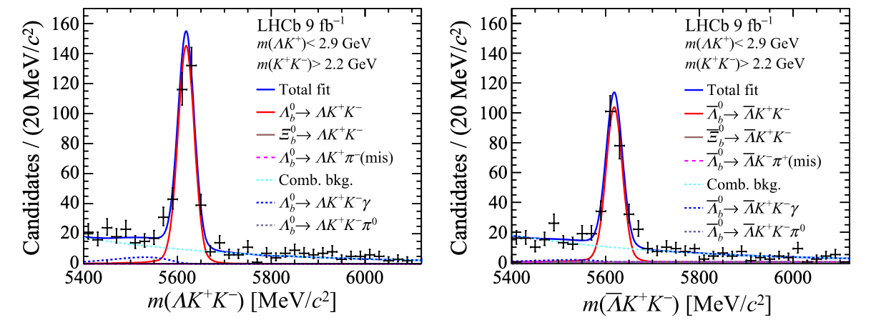
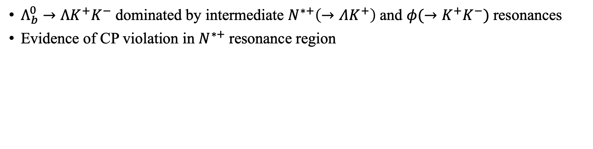

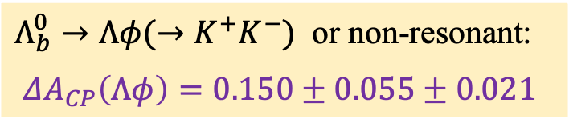




Local CP asymmetry for $Λ_{b}^{0}→ΛK^{+}K^{−}$
[PRL 134 (2025) 101802]
$Λ_{b}^{0}→ΛK^{+}K^{−}$ dominated by intermediate $N^{∗+}\left(→ΛK^{+}\right)$and $φ(→K^{+}K^{−})$resonances
Evidence of CP violation in $N^{∗+}$resonance region
$m_{ΛK^{+}}<2.9$ GeV
${Λ_{b}^{0}→N}^{∗+}\left(→ΛK^{+}\right)K^{−}$: possibly via $b→u\overline{u}s$
$ΔA_{CP}\left(N^{∗+}K^{−}\right)=0.165±0.048±0.017$
$$Λ_{b}^{0}→N^{∗+}K^{−}$$
$${\overline{Λ}}_{b}^{0}→N^{∗−}K^{+}$$
$m_{K^{+}K^{−}}<1.1$ GeV
(consistent with zero)
$Λ_{b}^{0}→Λφ(→K^{+}K^{−})$ or non-resonant:
$ΔA_{CP}\left(Λφ\right)=0.150±0.055±0.021$

Slide 18






Local CP asymmetries
PRL 134 (2025) 101802
$m_{ΛK^{+}}<2.3$ GeV
$m_{π^{+}π^{−}}<1.7$ GeV
$Λ_{b}^{0}→N^{∗+}\left(→ΛK^{+}\right)π^{−}$
$ΔA_{CP}\left(N^{∗+}π^{−}\right)=−0.078±0.051±0.027$
$Λ_{b}^{0}→Λf(π^{+}π^{−})$
$ΔA_{CP}\left(Λf\right)=0.088±0.069±0.021$

Slide 19





Charmless $Λ_{b}^{0}/Ξ_{b}^{0}→{pK}_{s}^{0}h^{−}$ decays
[arXiv:2508.17836 ]
$Λ_{b}^{0}/Ξ_{b}^{0}→{pK}_{s}^{0}h^{−}$ decays similar to $Λh_{1}^{+}h_{2}^{−}$, just different hadronization processes
  Control channel: $Λ_{b}^{0}→Λ_{c}^{+}\left(→pK_{s}^{0}\right)π^{−}$
Branching fraction measured for $Λ_{b}^{0}→{pK}_{s}^{0}π^{−}$, $Λ_{b}^{0}/Ξ_{b}^{0}→{pK}_{s}^{0}K^{−}$ decays
  First observation of $Λ_{b}^{0}/Ξ_{b}^{0}→{pK}_{s}^{0}K^{−}$ decays
  $Λ_{b}^{0} →{pK}_{s}^{0}π^{−}$ branching fraction improved by a factor of 9
preliminary
stat.
syst.
control
mode
$b$-quark
fragmentation
fractions
Improved precision
First observation!

Slide 20





CP violation
[arXiv:2508.17836]
Measurements for $Λ_{b}^{0}/Ξ_{b}^{0}→{pK}_{s}^{0}K^{−}$ and $Λ_{b}^{0}→{pK}_{s}^{0}π^{−}$ decays
  ${ΔA}_{CP}={ΔA}_{raw}−ΔA_{P}−ΔA_{exp}$
No significant CP violation found
$Λ_{b}^{0}→$ ${pK}_{s}^{0}π^{−} {\overline{Λ}}_{b}^{0}→$ ${\overline{p}K}_{s}^{0}π^{+}$
$Λ_{b}^{0}→$ ${pK}_{s}^{0}K^{−} {\overline{Λ}}_{b}^{0}→$ ${\overline{p}K}_{s}^{0}K^{+}$

Slide 21






Local CP violation
[arXiv:2508.17836]
Local CP violation for $Λ_{b}^{0}→{pK}_{s}^{0}π^{−}$ investigated
  Binning according to identified $N^{∗∗0}, K^{∗−}$ resonances
No significant localized CP violation found
Local $A_{CP}$ in 4 regions of $Λ_{b}^{0}→{pK}_{s}^{0}π^{−}$ decay
$$K^{∗}{\left(892\right)}^{+}$$
$$K_{J}^{∗}{\left(1400\right)}^{+}$$
$$N^{∗∗0}$$

Slide 22











The $Λ_{b}^{0}→pK^{−}π^{+}π^{−}$ decay
Nature 643 (2025) 1223
Contributed by tree and loop diagrams
Rich resonances
$Λ_{b}^{0}→N^{∗∗+}\left({pπ}^{+}π^{−}\right)K^{−}$,
$$pK^{∗∗}(K^{−}π^{+}π^{−})$$
$Λ_{b}^{0}→Λ^{∗∗}\left(pK^{−}\right)f(π^{+}π^{−})$,
$$N^{∗∗0}\left(pπ^{−}\right)K^{∗∗0}(π^{+}K^{−})$$
Large yield and high signal purity
Golden mode available to reduce nuisance asymmetries for CPV
$Λ_{b}^{0}→Λ_{c}^{+}(pK^{−}π^{+})π^{−}$ control mode: same initial and final state as signal decay, allows to cancel production and detection asymmetries
$$Λ_{b}^{0}→Λ_{c}^{+}π^{−}$$
$${\overline{Λ}}_{b}^{0}→{\overline{Λ}}_{c}^{−}π^{+}$$
$A_{yield}=A_{CP}+A_{P}+ΔA_{exp }$
$$A_{yield}\left(Λ_{b}^{0}→Λ_{c}^{+}π^{−}\right)=\left(1.25±0.23\right)\%$$

Slide 23






Raw yield asymmetry of $Λ_{b}^{0}→pK^{−}π^{+}π^{−}$
Nature 643 (2025) 1223
Maximum-likelihood fits to mass spectra to extract signal yield
$Λ_{b}^{0}$
${\overline{Λ}}_{b}^{0}$
$A_{yield }=\left(3.71±0.39\right)\%$
$$N_{yield}^{} \text{=}$$
$$\left(4.184 ± 0.025\right)×{10}^{4}$$
$${\overline{N}}_{yield}^{} \text{=}$$
$$\left(3.885 ± 0.023\right)×{10}^{4}$$

Slide 24









Corrections for experimental bias
Nature 643 (2025) 1223
$A_{CP}=ΔA_{yield}−ΔA_{P}−ΔA_{exp }$
Production asymmetry: cancelled by matching $Λ_{b}^{0}$ kinematics of control to signal mode
Detection asymmetry: candidate by candidate correction depending on final state kinematics
$ΔA_{prod}=0$
$ΔA_{exp}=0.01\%$

Slide 25



Systematic uncertainties
Nature 643 (2025) 1223
From nuisance asymmetries
From signal extraction
Total: $0.10\%$

Slide 26



First observation of CP violation
Nature 643 (2025) 1223
$A_{CP}=(2.45±0.46±0.10)\%$
Rule out CP symmetry ($5.2σ$) and large CP violation

Slide 27












Local $A_{CP}$ in $Λ_{b}^{0}→pK^{−}π^{+}π^{−}$ decays
Nature 643 (2025) 1223
Four dominating phase space structures
Local $A_{CP}$ reaching 6$σ$
  Interference between resonance states induces phase-space-dependent CPV
  Most significant local CPV found in $N^{∗∗+}$ resonances regions
4$σ$
6$σ$
  $Λ$resonances
  $f_{0}$ resonances
$$Λ_{b}^{0}$$
$${\overline{Λ}}_{b}^{0}$$
  $N^{∗∗+}$ resonances
Tianze Rong

Slide 28

CP violation in beauty baryon to charmonium decays

Slide 29






S$tudy of Λ_{b}^{0}→J/ψph^{−}$decays
$b→c\overline{c}q$ process, sensitive to charm loop (pollution to $B$-mixing phase measurement)
$$λ\sim 0.22$$
Loop contribution relatively enhanced
Recent evidence of CP violation in analogy $B^{+}→J/ψπ^{+}$ decays
$$\left(3.2σ\right)$$

Slide 30










CP violation$of Λ_{b}^{0}→J/ψph^{−}$decays
[arXiv:2509.16103]
Relative CP asymmetry between $Λ_{b}^{0}→J/ψpK^{−}$ and $Λ_{b}^{0}→J/ψpπ^{−}$ decays
  $ΔA_{CP} = (4.31±1.06±0.28)\%$
  First evidence of CP violation in beauty baryon to charmonium decays
    $3.9σ$
$$Λ_{b}^{0}→J/ψpπ^{−}$$
$$Λ_{b}^{0}→J/ψpK^{−}$$
$$Λ_{b}^{0}$$
$${\overline{Λ}}_{b}^{0}$$
$$Λ_{b}^{0}$$
$${\overline{Λ}}_{b}^{0}$$

Slide 31






Local CP violation for $Λ_{b}^{0}→J/ψpπ^{−}$ decay
[arXiv:2509.16103]
Decay dominated by various $N^{∗∗0}\left(→pπ^{−}\right)$ resonances and possibly exotics
Various binning schemes for phase space, no strong dependence observed
  Evenly in Dalitz-plot in 4 bins
  According to $N^{∗∗0}$ resonances with or without helicity angle binning
$N^{∗∗0}$ contributions
4-Dalitz bins
$N^{∗∗0}$ bins
PRL 117 (2016) 082003

Slide 32

CP violation in beauty baryon to open charm decays

Slide 33






Baryon decay parameters
Proposed by Lee & Yang to study P violation in hyperon decay $Λ→pπ^{+}$
  Initial and final spins permits two partially waves, S and P, defining decay parameters
$$\frac{1}{2}→\frac{1}{2}+0$$
S and P waves
$$\frac{dΓ}{\operatorname{dcos}{θ}}=\frac{1}{2}Γ\left(1+αP_{Λ}\cos{θ}\right)$$
$$P_{p}=\frac{\left(α+P_{Λ}\cos{θ}\right)z^{′}+βP_{Λ}x’+γP_{Λ}y′}{1+αP_{Λ}\cos{θ}}$$
Parity violating observables: $α\left(Λ,\overline{Λ}\right)$, $β\left(Λ,\overline{Λ}\right)$, $γ\left(Λ,\overline{Λ}\right)$
CP violating observables: $A_{CP}^{α}≡\frac{α\left(Λ\right)+α\left(\overline{Λ}\right)}{α\left(Λ\right)−α\left(\overline{Λ}\right)}$ …
Addition to decay rate asymmetry

Slide 34




Beauty and charm baryon decay parameters
PRL 133 (2024) 261804
Simultaneous angular analysis of 6 decays
  $Λ_{b}^{0}→Λ_{c}^{+}h^{−} \left(h=π, K\right)$
  with $Λ_{c}^{+}→Λ h^{+}$, $Λ→p π^{−}$
  or $Λ_{c}^{+}→pK_{s}^{0}$

Slide 35






P and CP violation
PRL 133 (2024) 261804
P violating $α$ parameters
CP violating $A_{CP}^{α}$ parameters
First time for $Λ_{b}^{0}→Λ_{c}^{+}h^{−}$ decays
Most precise for $Λ_{c}^{+}$ decays
Confirmation of BESIII for $α(Λ→pπ^{−})$
Consistent with CP symmetry
Consistent with Belle and BESIII
$A_{CP}^{α}=\frac{α\left(Λ\right)+α\left(\overline{Λ}\right)}{α\left(Λ\right)−α\left(\overline{Λ}\right)}$

Slide 36









More for $Λ_{c}^{+}→Λh^{+}$ decays
PRL 133 (2024) 261804
No CP violation in $β$, $γ$ or phases
Weak phases consistent with zero, non-zero strong phases
$Δφ$ (weak phase)
$$0.01±0.02$$
$$−0.03±0.14$$
$Δδ$ (strong phase)
$$2.693±0.017$$
$$2.57±0.19$$
$Δ_{Λ_{c}^{+}}$: phase difference between two helicity amplitudes
Inputs for global fit PRD111 (2025) 034011

Slide 37



Spin makes a difference
Why CP violation in baryons generally smaller?
  One diagram (tree) overwhelming ?
  Small strong phase difference ?
$A_{CP}∝\left|\frac{P}{T}\right|\sin\left(δ_{T}−δ_{P}\right)\sin\left(φ_{T}−φ_{P}\right)$
T
Dynamics more complex than mesons
  Three body system; multiple amplitudes
P
Possible cancellation of S and P amplitudes for CP violation
PRL134 (2025) 22, 221801

Slide 38



Summary and outlook
Baryon CP violation: complementary to mesons as test of SM and search for new physics
LHCb experiment: intensive studies of baryon CP violation
  First observation in $Λ_{b}^{0}→pK^{−}π^{+}π^{−}$
  Evidence in $Λ_{b}^{0}→ΛK^{+}K^{−}$ and $Λ_{b}^{0}→J/ψph^{−}$
  Precise measurements using decay parameters
Patterns and puzzles: generally small, explained by SM?
More opportunities at future LHCb
  Increased data and advanced techniques
LHCb schedule
Many thanks !

Slide 39
Backup

Slide 40

Constrain penguin pollution

Slide 41


Extracting weak and strong phases
CPV observables can also be defined using the decay parameters of CP-conjugated processes
  $\overline{α}$, $\overline{β}$, $\overline{γ}$are the decay parameters of anti-baryon decays
  Δ𝛿 (Δ𝜙) is the strong (weak) phase difference between S- and P-waves
Clean observables, less polluted by experimental effects
Complementary to decay rate asymmetry
[PRL 129 (2022)131801]
[Sci.Bull. 68 (2023) 583-592]
[PRL 133 (2024) 261804]

