Slide 1
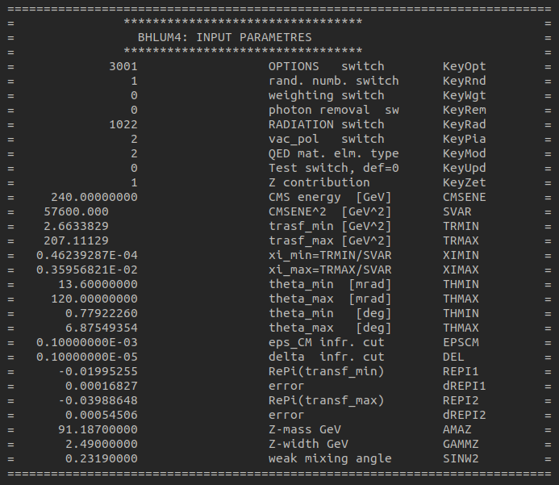
Bhlumi Output $NEvent={10}^{6}$
$$H 101.21317±0.03902768$$
$$W 226.21403±0.08669156$$
$$Z 694.01025±0.26357947$$

Slide 2
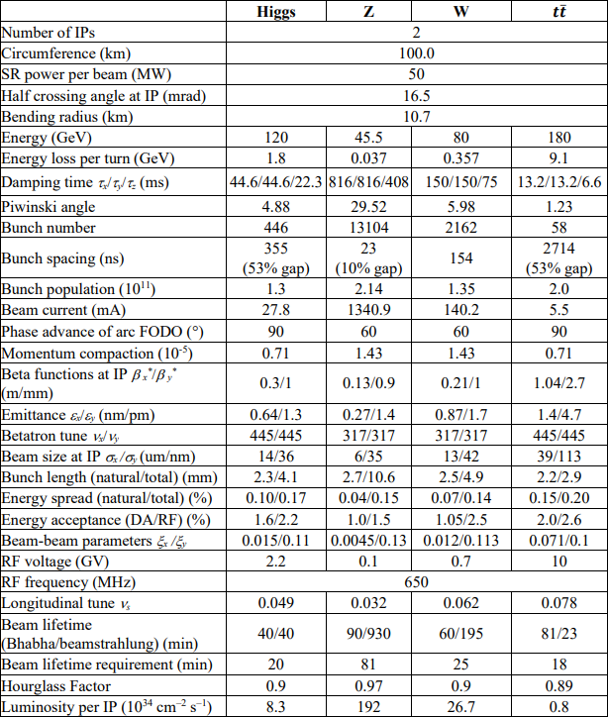
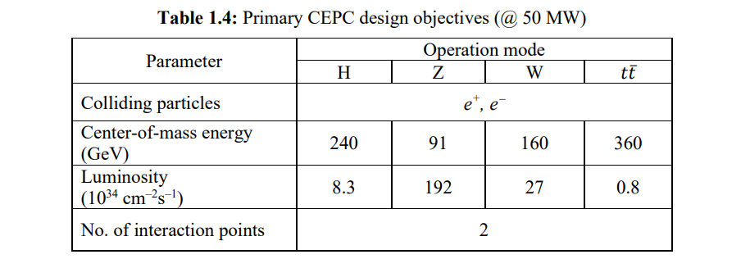
Page 31
Page 49

Slide 3
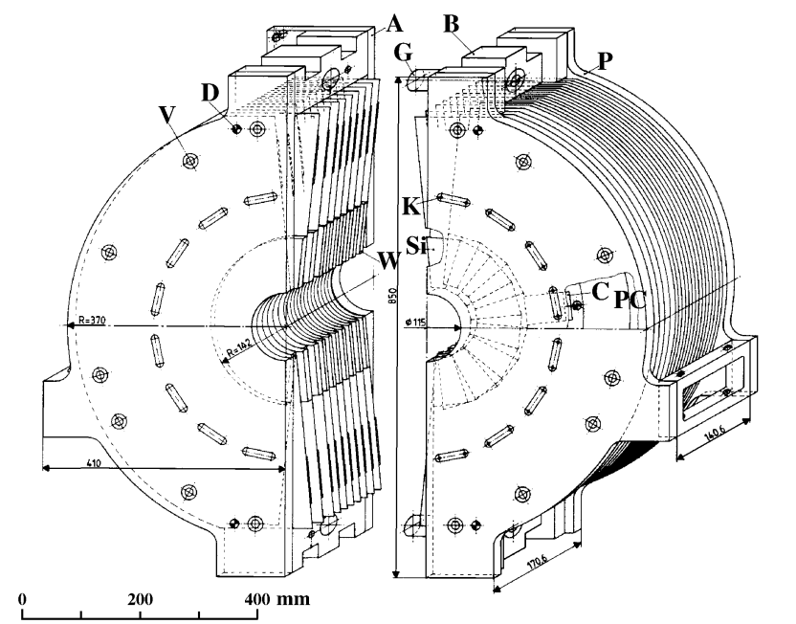
OPAL
±2.5m from IP
62 and 142 mm from the beam axis
19 layers of silicon 18 tungsten plates
$22X_{0}$ tungsten
$14×1X_{0}+4×2X_{0}$
3mm diameter water cooling pipes at R=220 mm

Slide 4
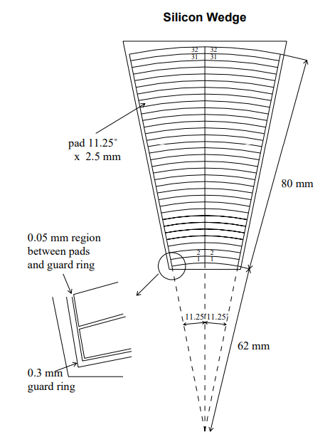
Ceramic hybrid
64-pad silicon wafer diode + 4 AMPLEX chip + 130 other
$19\left(layer\right)×32\left(wedge\right)=608(total)$
Every second layer is rotated by 11.25 degrees, to
reduce any systematic effects
input capacitance difference: Trimming capacitors

Slide 5
Front End Electronics
AMPLEX chip 16 channels
charge amplifier + shaping amplifier + track and hold
4 chips per ceramic signals from the 64 pads =>common output
gain of the amplifier matches signals expected from 45 GeV EM showers
At shower maximum ∼ 1.0 to 1.3 pC per layer
signal equivalent to 300 to 400 minimum ionizing particles (mips)
AMPLEX & ADC limit ~1000 mips
equivalent noise 1500 to 2000 electrons for a typical detector capacitance of 20 pF
Better than 10:1 signal to noise for mips
AMPLEX Selected + trimming resistor
channel-to-channel uniformity of approximately 1%

Slide 6
Front End Electronics
AMPLEX gain & Cross talk among channels depend on
input capacitance & hold signal timing
Capacitance: Outer edge ≈ 2 Inner edge => Trimming capacitors
AMPLEX channel ordering inverted between the two radial pad columns of each ceramic
To minimize the effects of residual gain and cross talk variations
3 of 608 not functional
none of them within three radiation lengths of the shower maximum at layer 7X0
missing energy interpolated from the depositions observed in adjacent layers

Slide 7
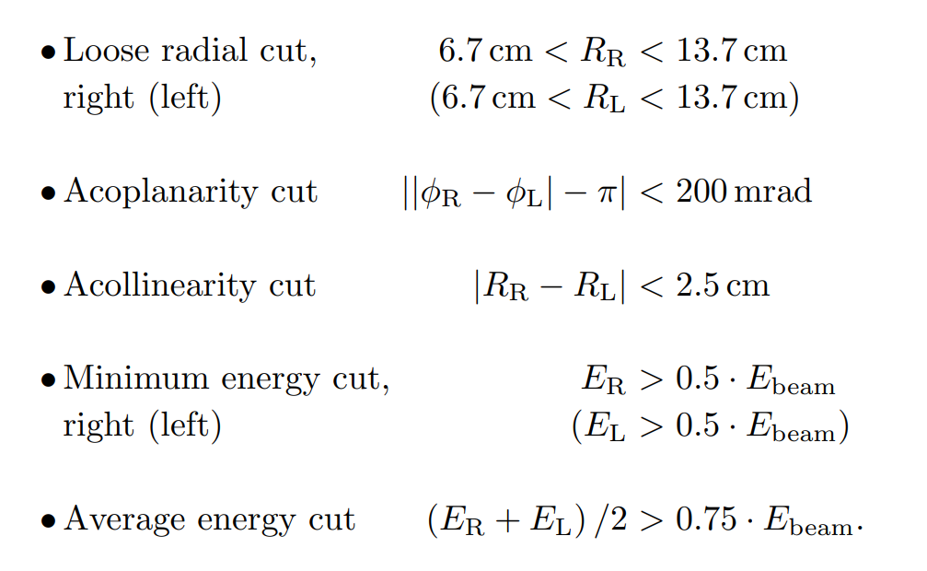
Bhabha Event Selection
Isolation Cuts
Definition Cuts

Slide 8
Trigger
AMPLEX includes a trigger output
When in trigger mode,
16 channels averaged as a single output
4 AMPLEX summed provide a single signal (for each silicon wafer)
Combined by the trigger hardware provide whole calorimeter and wafer-tower sums
even if not triggered,
all of the signals used by the trigger are digitized and stored
trigger information is used to determine independently the energy and azimuth of showers

Slide 9
Trigger
“wagon tagger”
based on fast analog sums of the signals induced by EM showers on the back-plane of the wafers
locally discriminated and processed to provide a bunchlet synchronization signal
operated in “AND” mode
required coincident tags in the left and right calorimeters

Slide 11
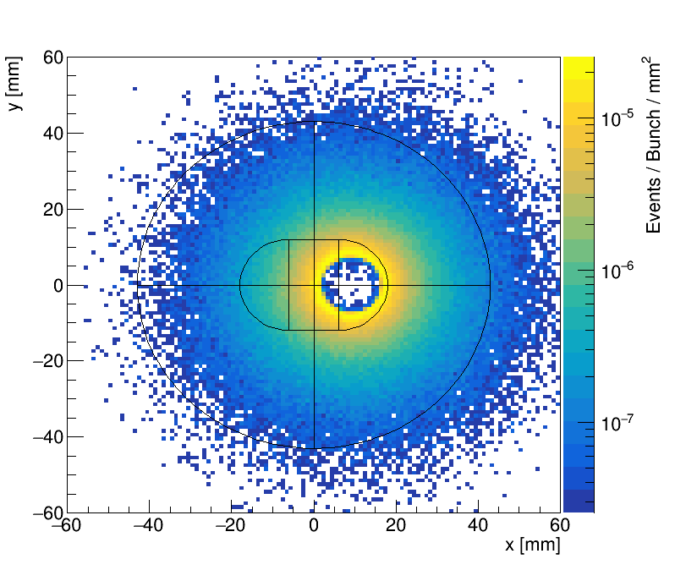
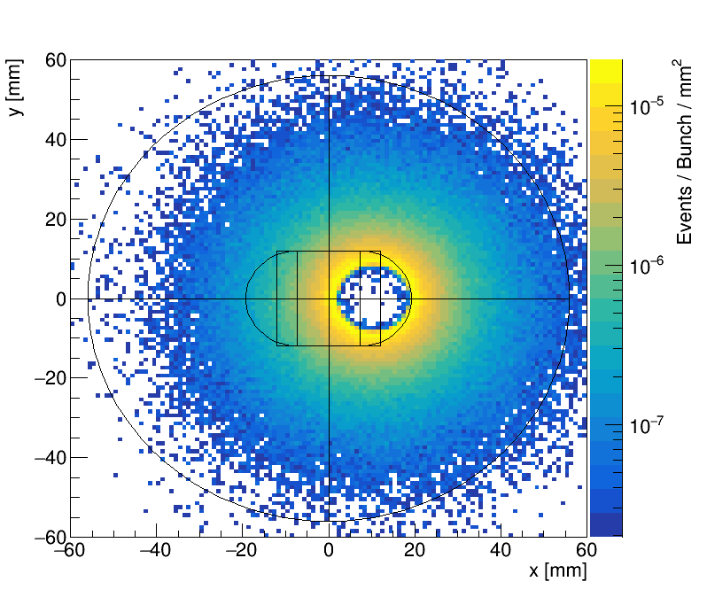
Higgs (@50MW)
硅片1 $(z=560mm)$
硅片2 $(z=640mm)$

Slide 12
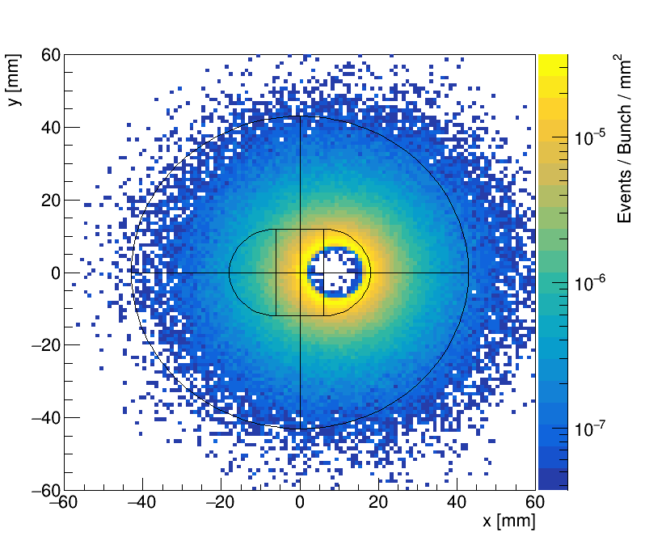
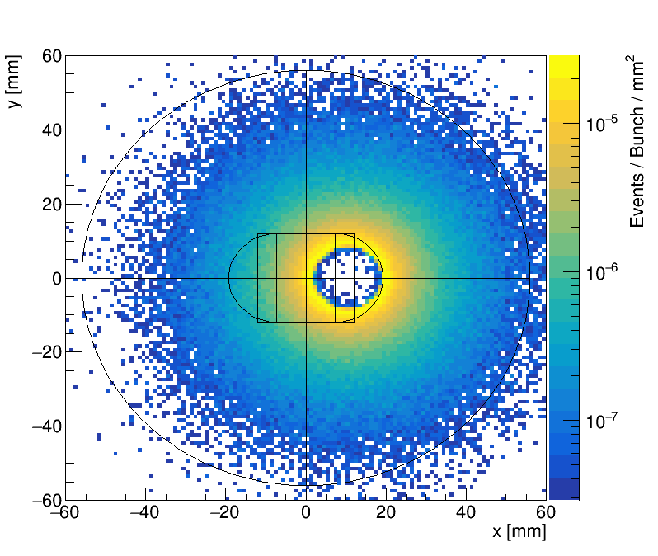
W (@50MW)
硅片1 $(z=560mm)$
硅片2 $(z=640mm)$

Slide 13
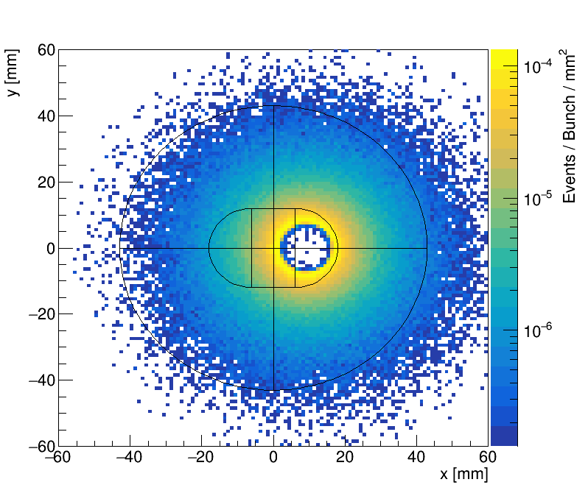
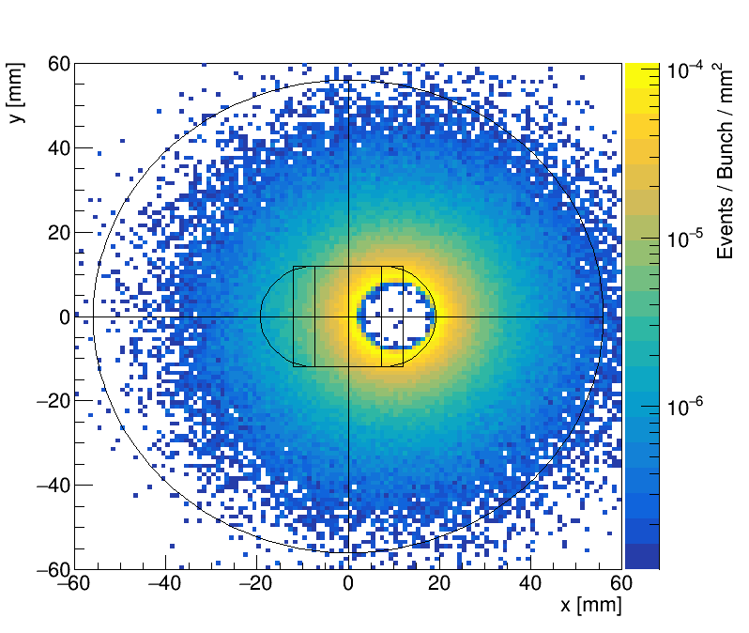
Z (@50MW)
硅片1 $(z=560mm)$
硅片2 $(z=640mm)$

Slide 14
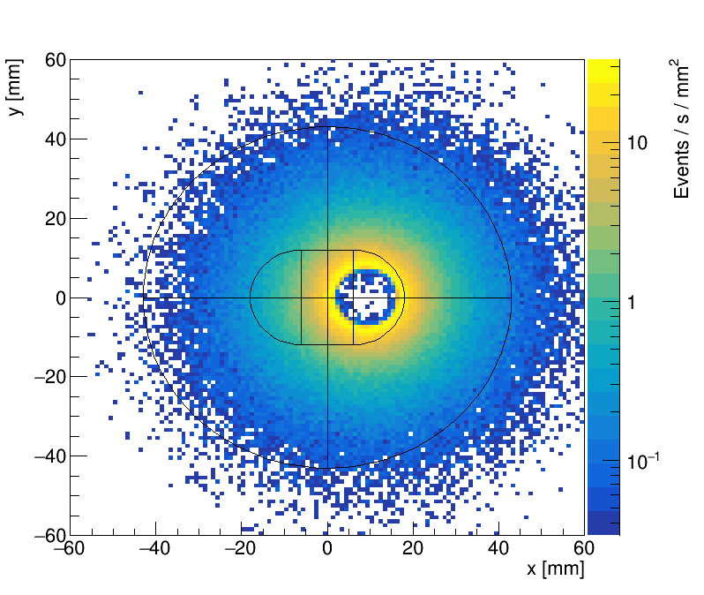
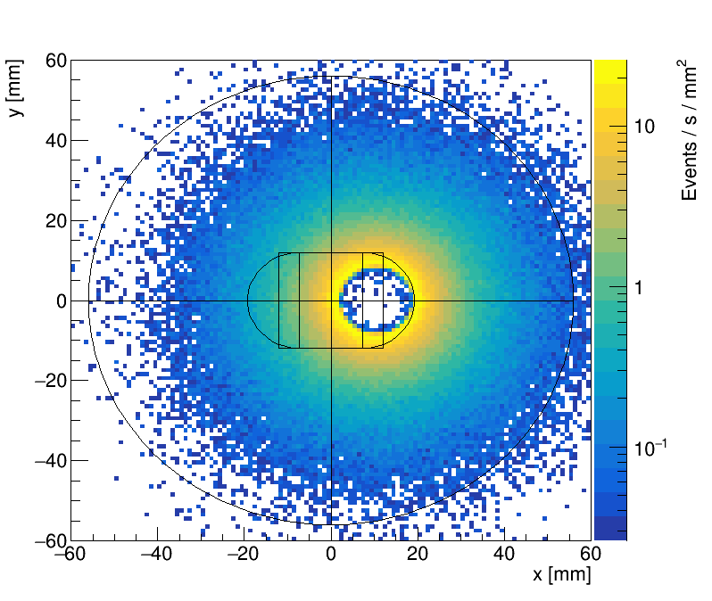
Higgs (@50MW)
硅片1 $(z=560mm)$
硅片2 $(z=640mm)$

Slide 15
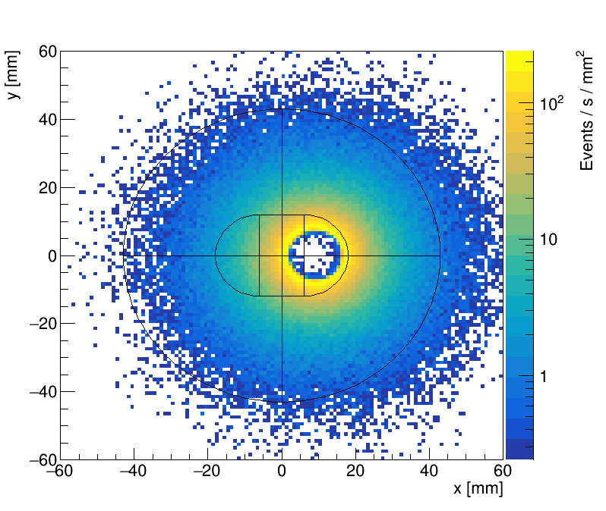
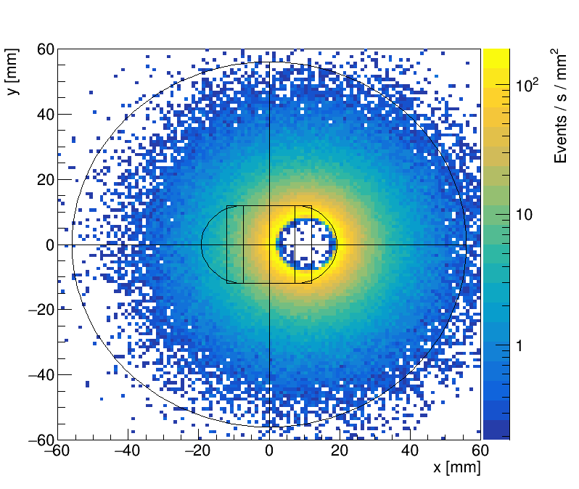
W (@50MW)
硅片1 $(z=560mm)$
硅片2 $(z=640mm)$

Slide 16
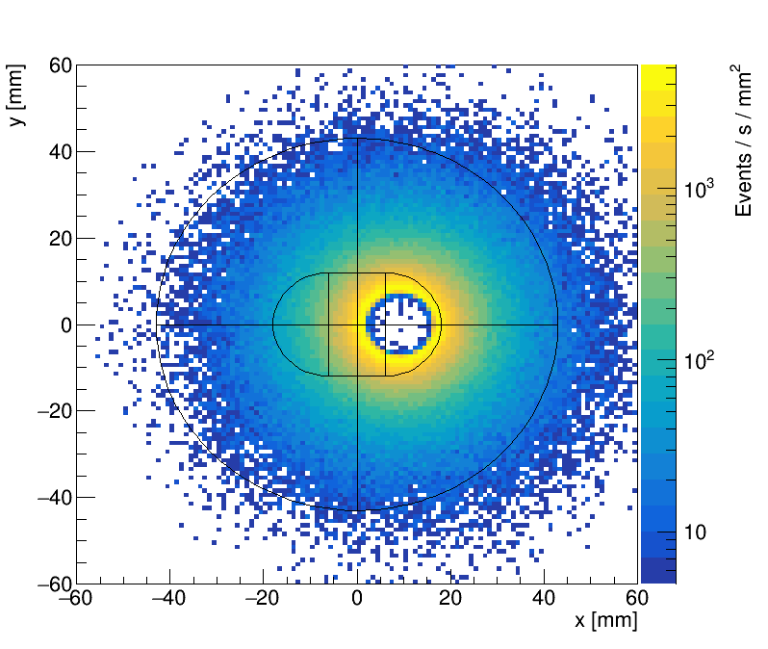
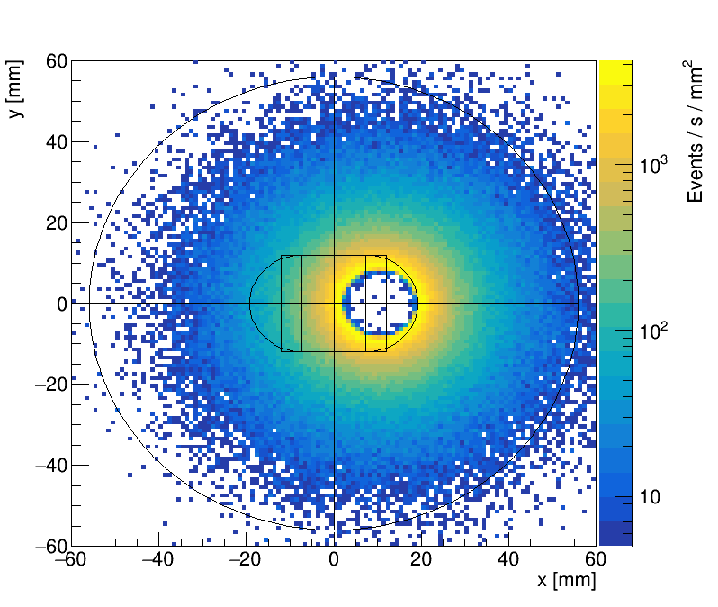
Z (@50MW)
硅片1 $(z=560mm)$
硅片2 $(z=640mm)$

Slide 17
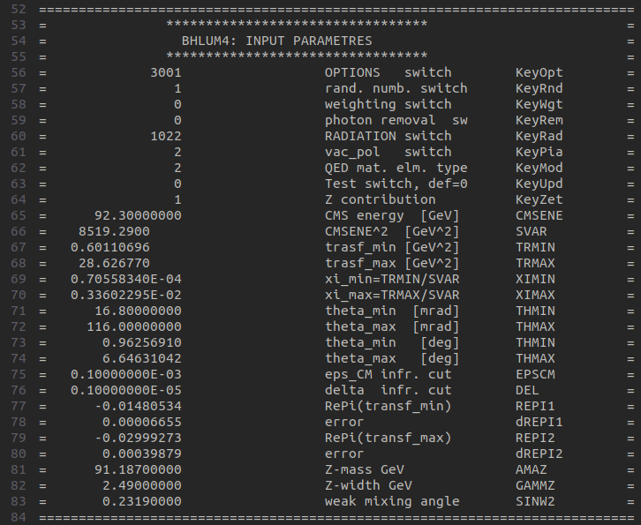
demo
prod2

