Slide 1

CEPC Global Control and Services
环形正负电子对撞机
Circular Electron Positron Collider
23 April, 2024
Dapeng Jin
Institute of High Energy Physics, CAS, Beijing

Slide 2


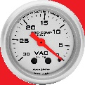
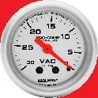
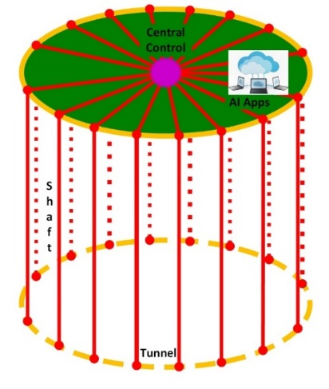

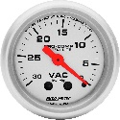
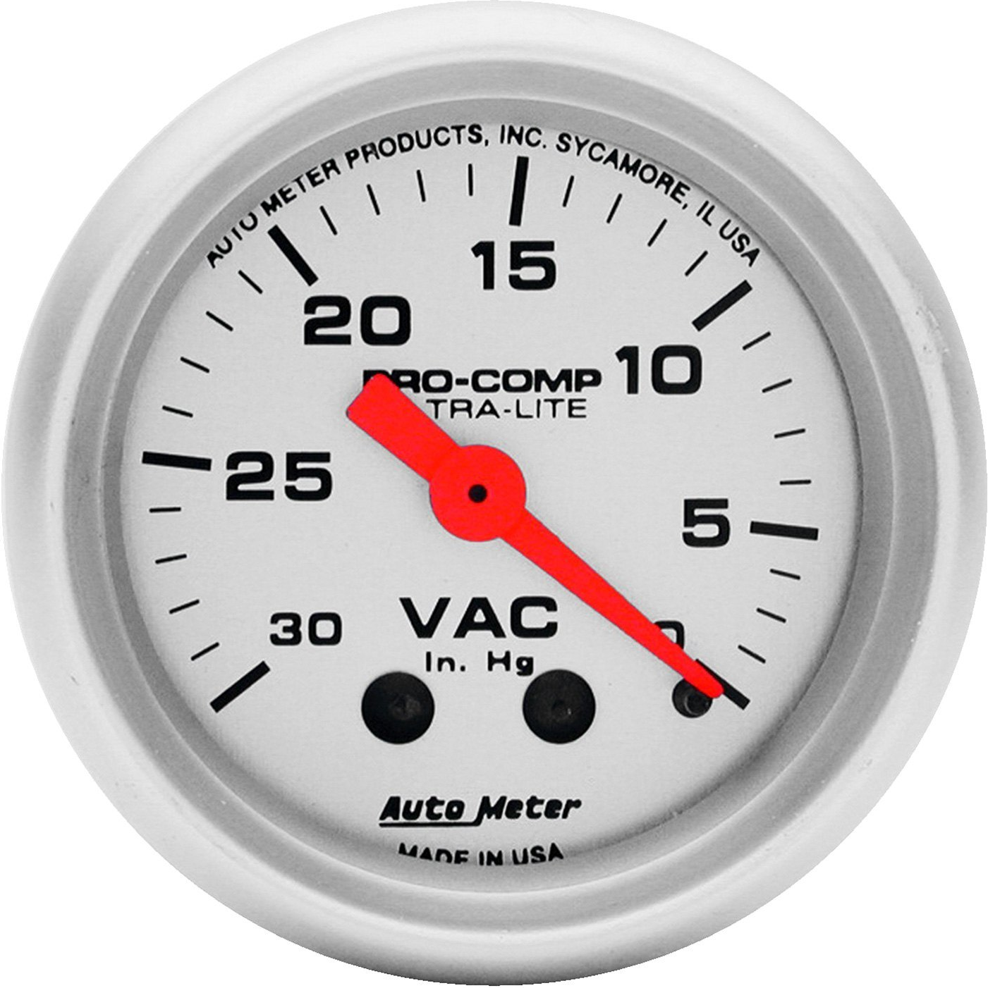
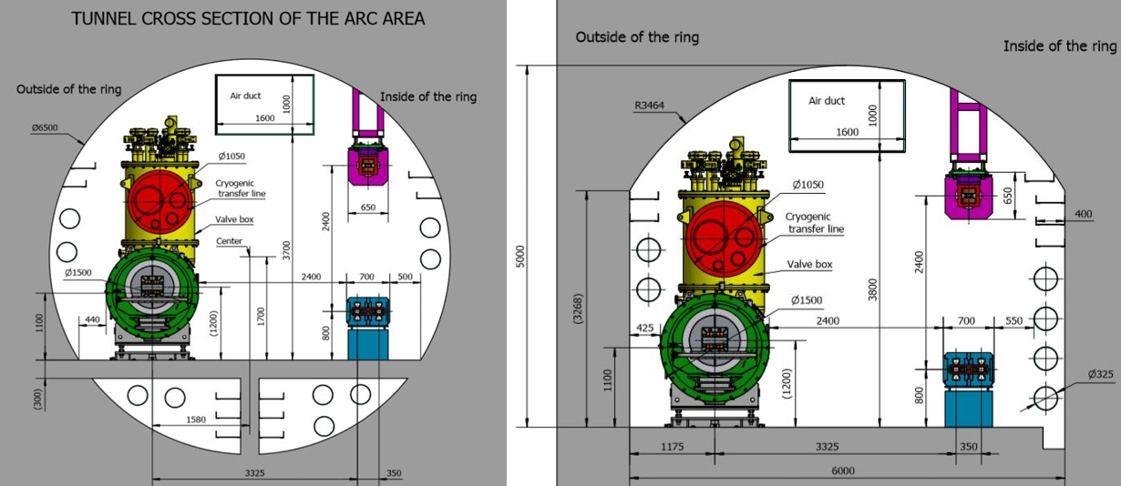
Brief of CEPC & key issues of control system
Control network with DAQ
Timing system
Clock(Reference line)
MPS
Orbit feedback…
Three nets : Control & DAQ, Clock, Timing
Signal transmission in tunnel
Global software services
BI
Mag. & PS
VAC
Ctrl./DAQ/
Timing/Clock
Part of control along the beam

Slide 3
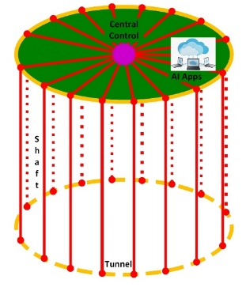
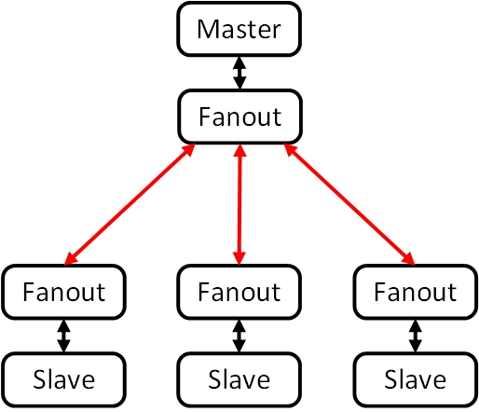
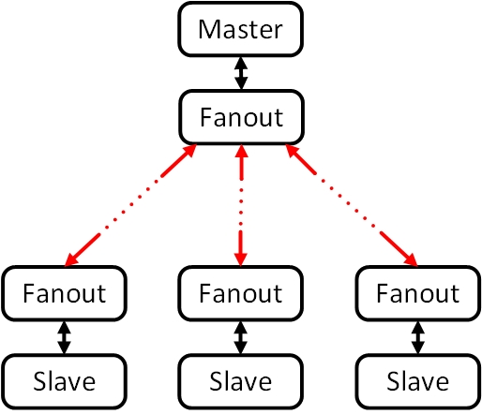
Key issues of control system
Problem : Delay variation over several clock cycles due
to the long optical fibers and temperature change.
Possible solutions:
Global measurement and compensation : multi-clock
Ground routing self-measurement and compensation

Slide 4
Key issues of control system
Problem : Signal transmission in tunnel
Possible solutions : Radiation protection for optical fibers & wireless transmission

Slide 5
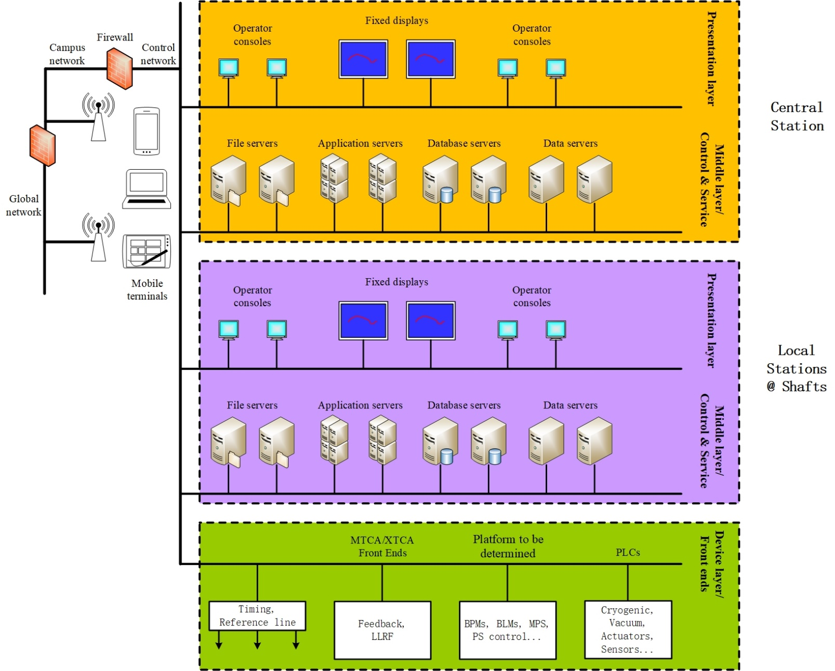
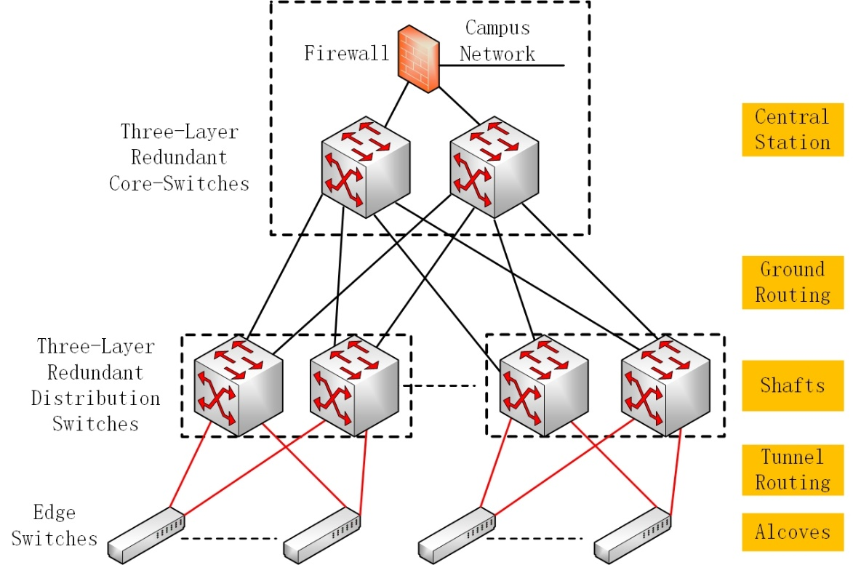
Key issues of control system
Automation of development and maintenance.
Backup strategy & remote recovery.
AI application.

Slide 6
Key issues of control system
Performance improvement based on precise(1ns – 10us) correlated data from the front end. Distributed logic analyzer.
Fault prediction for planned maintenance to improve availability.
Several-hundred GB data for each DAQ.

Slide 7
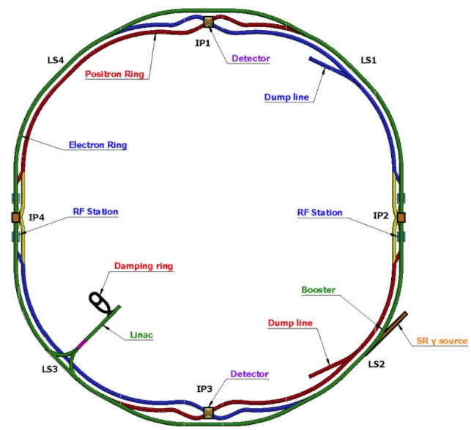
Key issues of control system
Source & acceleration & confinement.
Key components: source, acc. structure, mag. & PS, BI(monitoring and feedback)
Precise clock : (from reference line or timing)
Source, acc. structure, beam feedback, tune measurement… : both phase & jitter (5ps to 100fs), reference line, few stations
BI(BPM, BCM…) : jitter (5ps to <1ps), timing possible, BPM distributed around
Timing : (mostly delay adjustable)
BI : < 50ps
PS : ~5ns

Slide 8
Thanks for your attention!

