Slide 1


CEPC vacuum chamber automatic fabrication line design consideration
Yongsheng Ma
Vacuum group, IHEP,CAS
Apr 23th 2024

Slide 2
Content
Production line development
NEG coating
Spray for heating film
Key components development
Spray for heating film R&D
Production line cooperation company
Summary

Slide 3
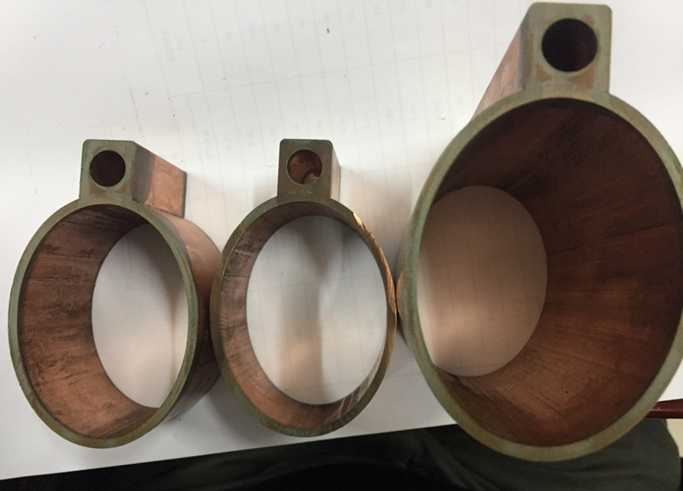
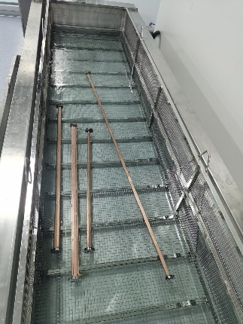
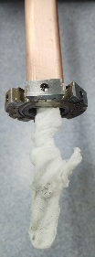
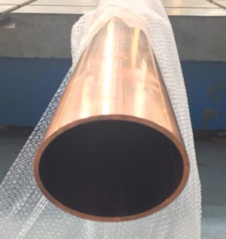
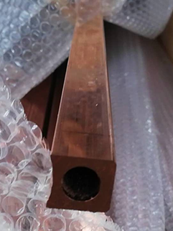
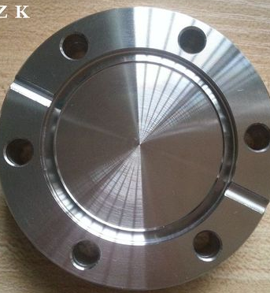
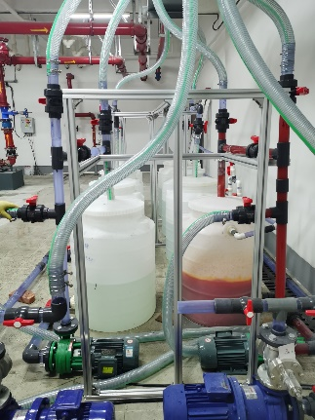
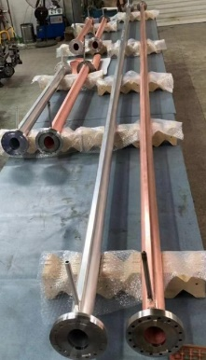
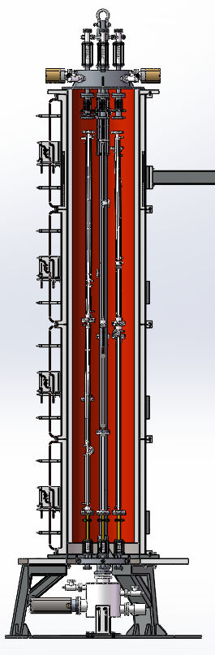
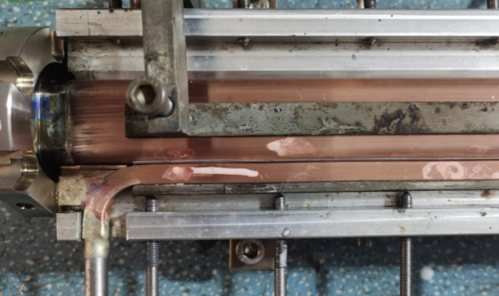
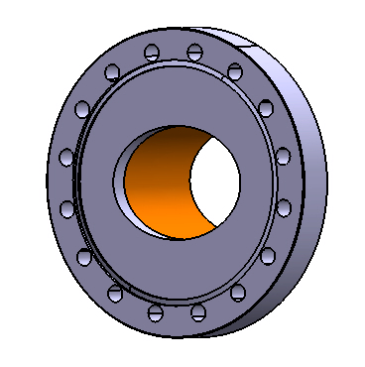
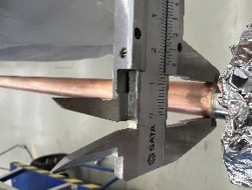
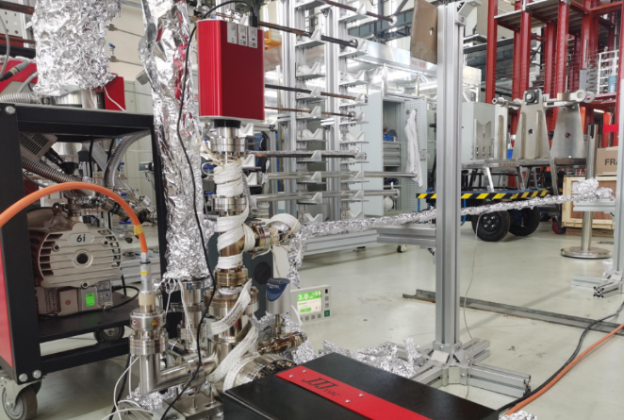
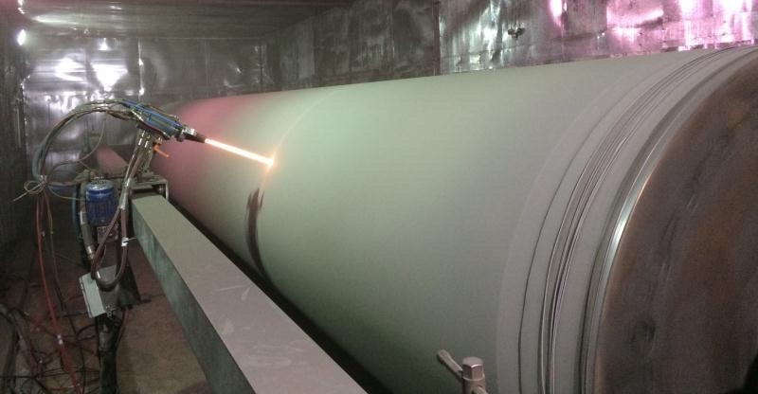
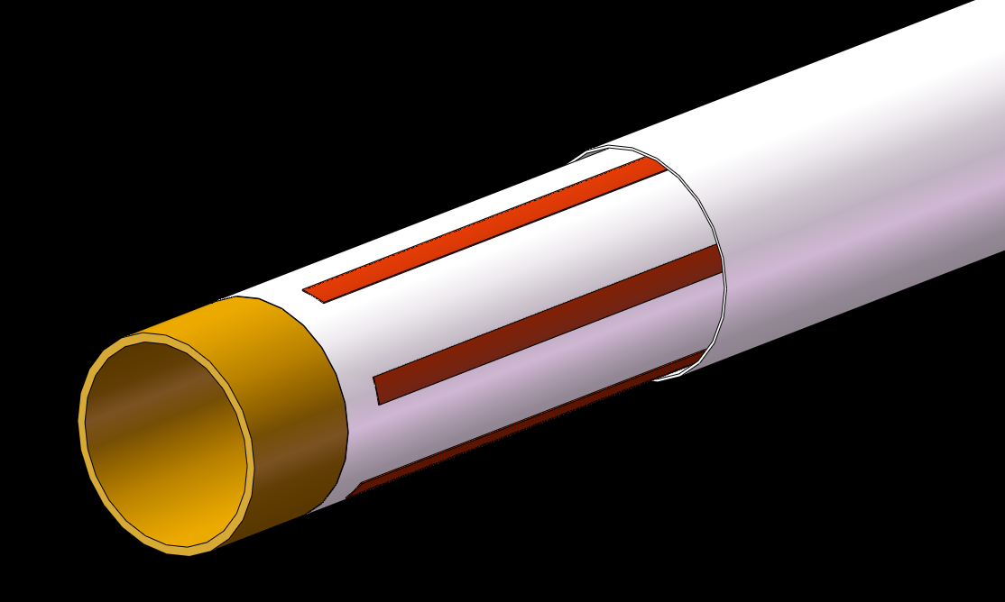
Production line of vacuum chambers and NEG coating, spraying
Production line with spraying and NEG coating is designed and will be built for vacuum chambers massive production.
Vacuum chamber 11.4m
3
NEG coating
Vacuum chamber
Beam pipe +
Cooling channel
Conflat Flange
1
Cleaning: etching, passivation, resining
Welding/Brazing
Electron beam welding（in vacuum ）
Testing: dimension, leakage
2
The flanges and beam pipe are welded by EBW, and low temperature brazing solder are used between the beam pipe and water cooling channel.
Multilayer of ceramic and conductivity layers
DCMS
In vacuum

Slide 4
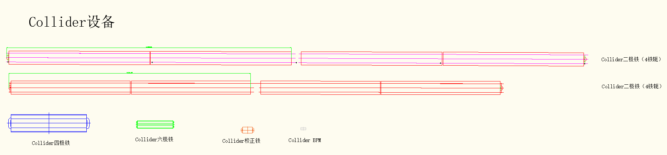
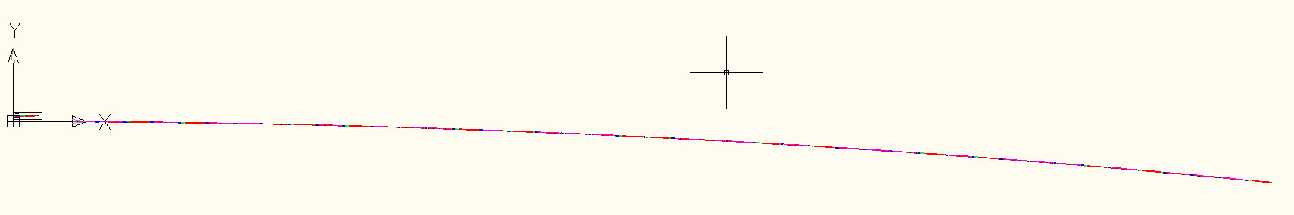
Configuration of Vacuum chamber in collider
Wang YW
LI MX
collider 真空盒的数量与长度统计：根据磁铁长度与布局得到
 | 根据磁铁分类 | 组合数量 | 真空盒长度 |  | 标准单元数量 | 真空盒总数量 | 合计长度 | 备注
标准单元 | 二级铁组合A | 30 | 11.5 | 米 | 64 | 3840 | 44160 | 磁铁组合放2根真空盒
 | 二级铁组合B | 16 | 9.8 | 米 | 64 | 2048 | 20070.4 | 磁铁组合放2根真空盒
 | 四六级铁组合 | 16 | 6.5 | 米 | 64 | 1024 | 6656 | 磁铁组合放1根真空盒
 | 四级，校正铁组合 | 31 | 3.8 | 米 | 64 | 1984 | 7539.2 | 磁铁组合放1根真空盒
弧区汇总 |  |  |  |  |  | 8896 | 78425.6
直线节 |  |  | 11 |  |  | 364 | 4000
高频代用 |  |  | 11 |  |  | 513 | 5648
对撞区 |  |  | 5.5 |  |  | 513 | 7000
直线节汇总 |  |  |  |  |  | 1391 | 16648
合计 |  |  |  |  |  | 10287 | 95074

Slide 5

Capacity and R&D plan of production line
Capacity: 11.4m, 6400 units annually for welding, 500 units for NEG coating and spaying.
The construction of the total vacuum chambers for the collider rings will be completed in 3.5 years using 4 production lines, which includes 4 welding oven and 12 NEG coating and spraying setups.
生产速度
 | 每批次数量 | 每批次时间/h (估算) | 每天工作时长/h | 每天完成数量 | 每年工作天数 | 每年共完成数量 | 设备数量（实际） | 真空盒总数量 | 完成时间/年
真空盒焊接 | 4 | 2.5 | 16 | 26 | 250 | 6400 | 1（4） | 21000 | 3.3
清洗 | 6 | 4 | 16 | 24 | 250 | 6000 | 1（4） | 21000 | 3.5
镀膜前组装 | 6 | 4 | 16 | 24 | 250 | 6000 | 1（4） | 21000 | 3.5
NEG coating | 6 | 72 | 24 | 2 | 250 | 500 | 1（3*4） | 21000 | 3.5
Spray | 1 | 8 | 16 | 2 | 250 | 500 | 1（3*4） | 21000 | 3.5
batch production
The key processing components development, Vacuum sealing/ leakage detecting;
Cathode R&D;
Spraying R&D;
NEG coating facility design, spraying facility design;
R&D plan
2024.5~9:
2024.9~12:
The production line design and optimization, design review;
2025.1~6:
Biding and fabricating;
2025.7~10:
Installation and debugging
2025.11~12:
Acceptance testing

Slide 6
Production line composition
Classification | Sub-devices | Parameters | Note
Electron-beam welder | Electron-beam gun Power supply Vacuum chamber | Meets the Length of 11.4m vacuum chamber 6 working position | Design and manufacturing
Brazing | Mechanical holder Power supply | 350℃ 11.4m long | Low temperature brazing in air by conductivity heating, expecting stead by double hole copper tube
Heating film facility | Electron-beam gun Power supply Controller Mechanical Structure | Meets the Length of 11.4m vacuum chamber Multilayer Spray Ceramic and conductivity layer | R&D
NEG coating tower | Pumping system Vacuum measurement Power supply Vacuum chambers Discharge Gas Cathode、controller | Meets the Length of 11.4m vacuum chamber 6 working position Background vacuum <5e-7Pa Baking temperature 200℃ | Developing to be more fitted the production line
Measurement and testing | Dimension measurement Leakage testing | Dimension measurement 11.5m/0.1mm Leakage testing 1e-10 mbar·L/s | Design and manufacturing
Cleaning | Etching Passivation rinsing | 10~50um deionized water rinsing | Design and manufacturing
Production line auxiliary equipment | Moving band robot arm system controller | Meets the Length of 11.4m vacuum chamber | Design and manufacturing

Slide 7
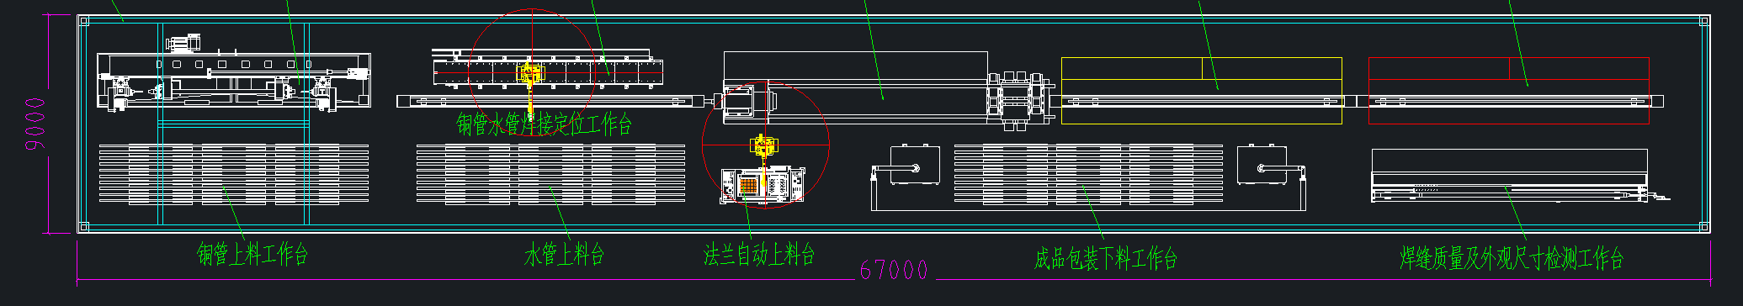
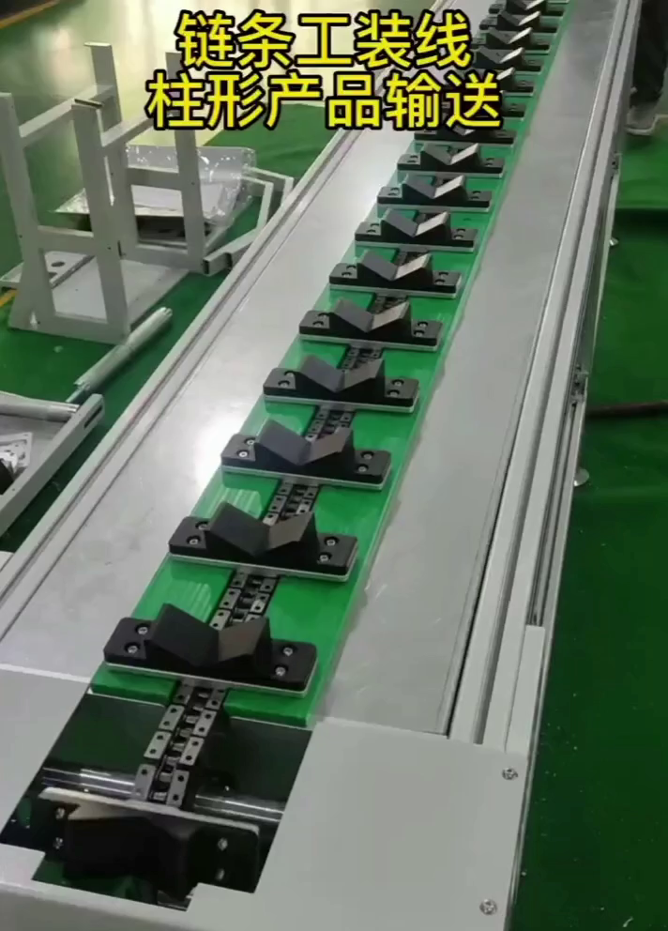
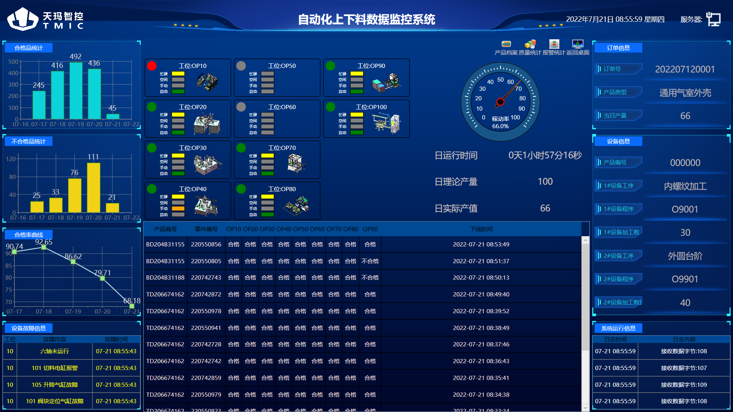
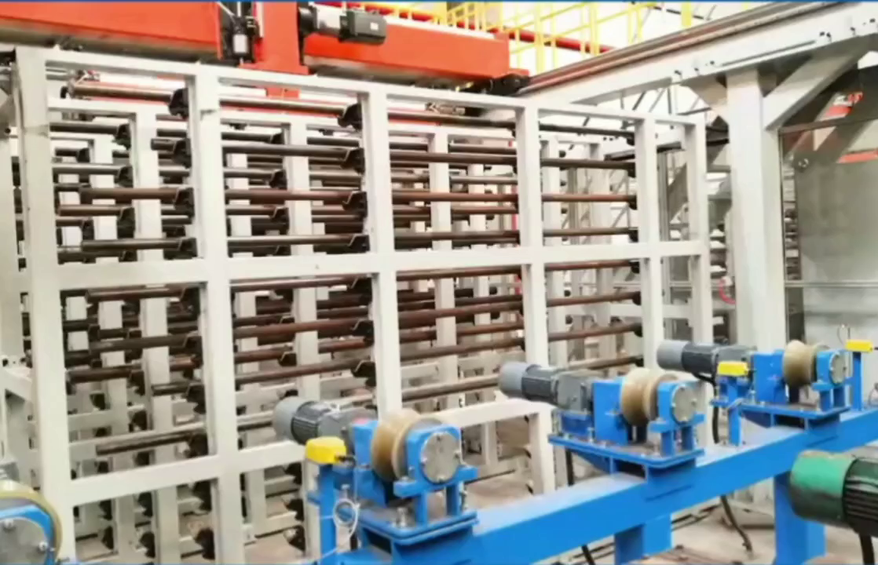
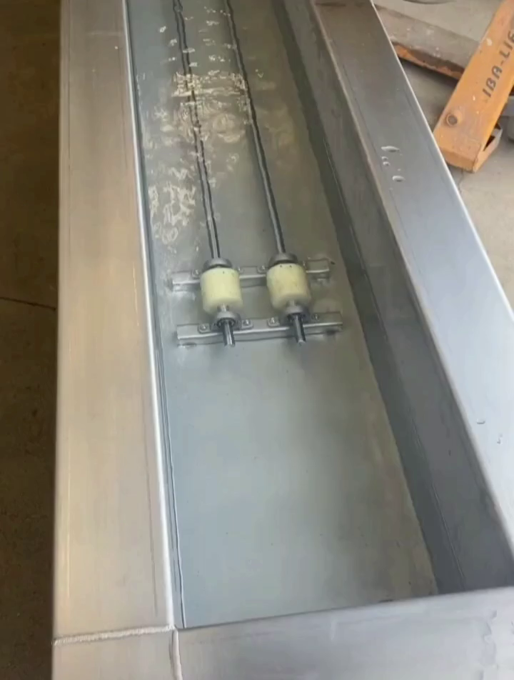
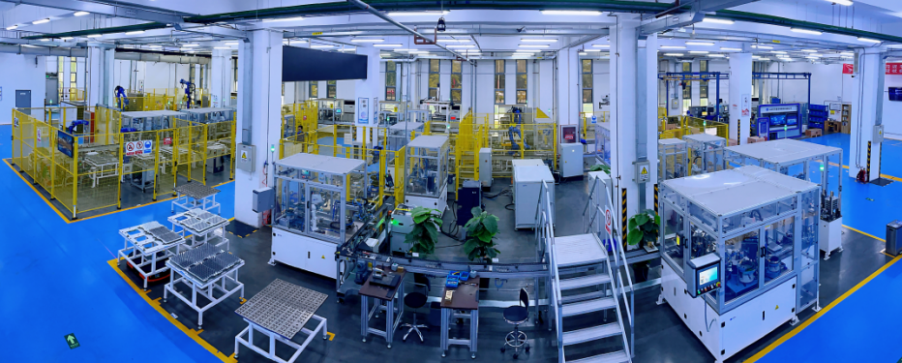
Production line layout
Cleaning
Spraying heating film
Assembling for NEG coating
NEG coating
Bench
Automatic loading and unloading
Testing
Conveyor
Automatic inspection of production data
robot arm

Slide 8
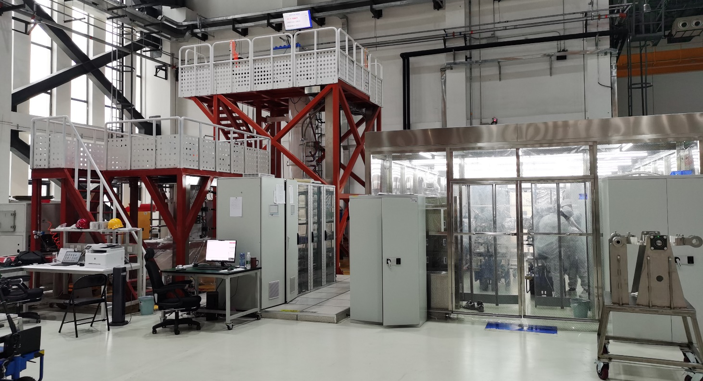
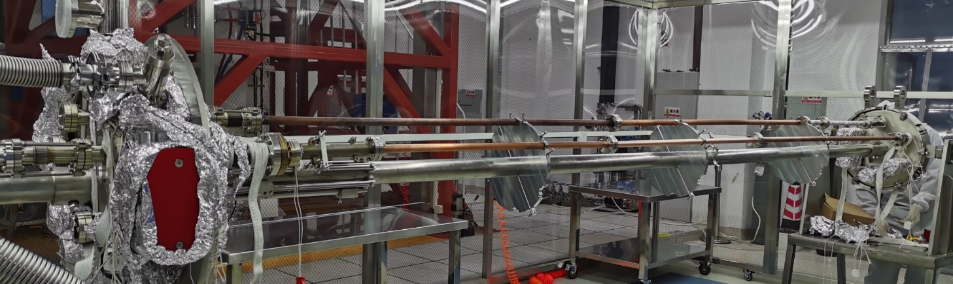
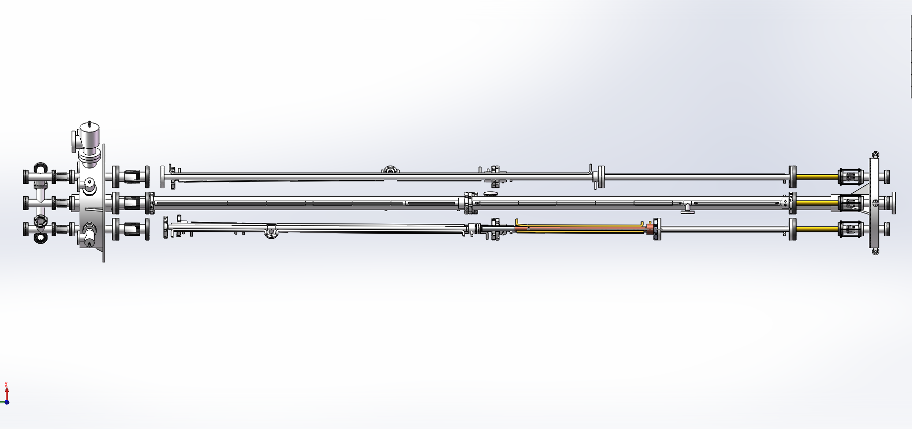
Massive production of NEG coating manually for HEPS
The coating device A: Vacuum chambers are connected in parallel to 6 groups, each group of vacuum chambers length should be lower than 3.5m, outer diameter is about 0.47m;
The coating device B: Antechamber are connected in parallel to 4 groups, each group of vacuum chambers length should be lower than 1.5m, due to its discharge difficulty.
Two setups of NEG coating have been built for vacuum pipes of HEPS at IHEP Lab. And a lot of test vacuum pipes have been coated, which shows that NEG film has good adhesion and thickness distribution.
A：Circle, racetrack
B：Antechamber
Dust-free room
8

Slide 9
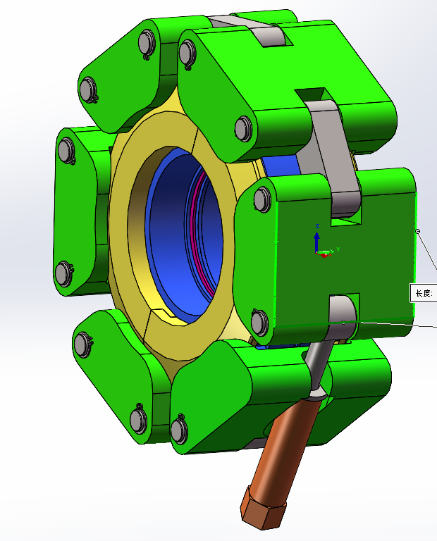
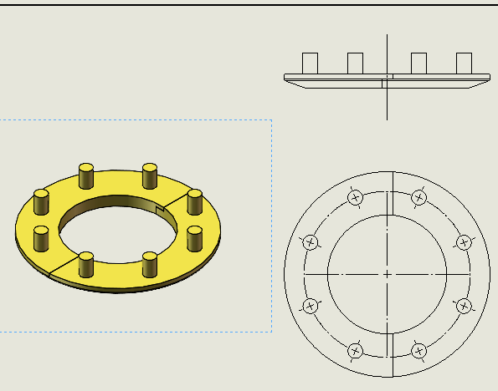
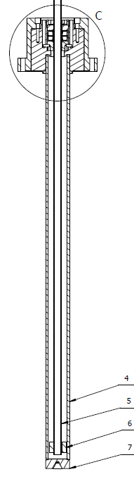
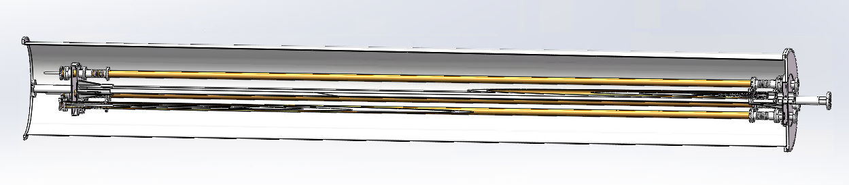
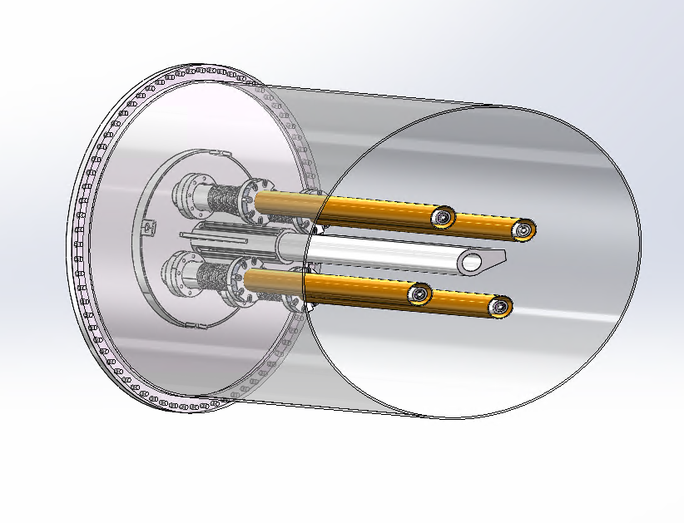
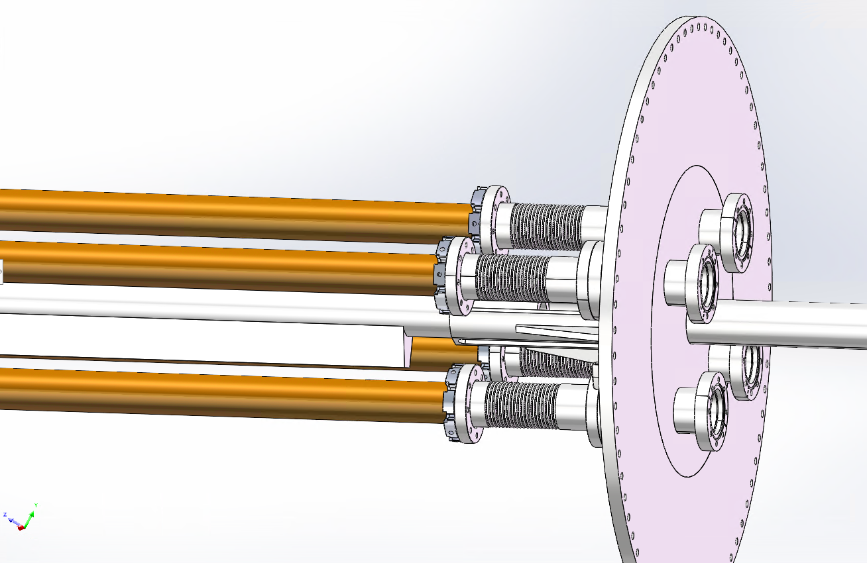
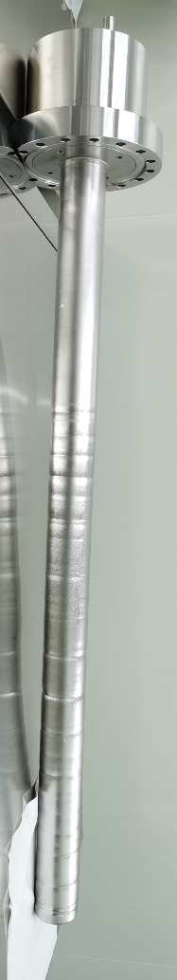
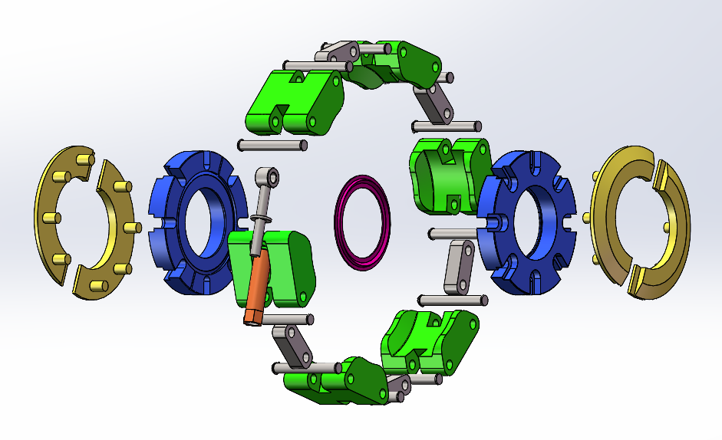
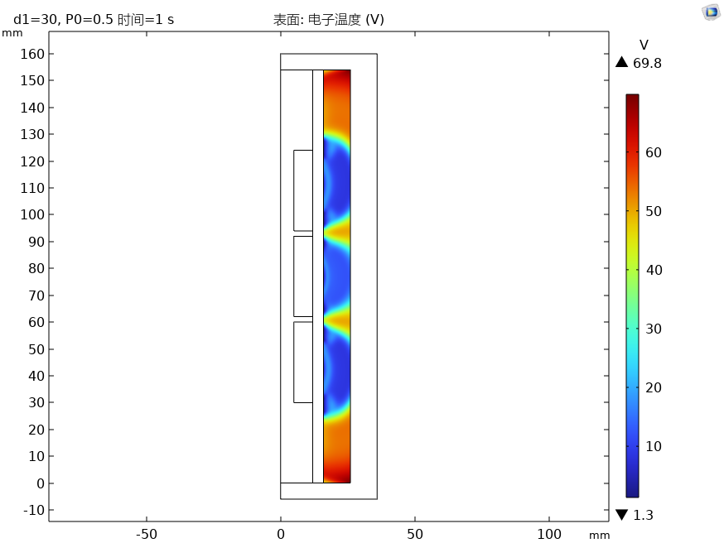
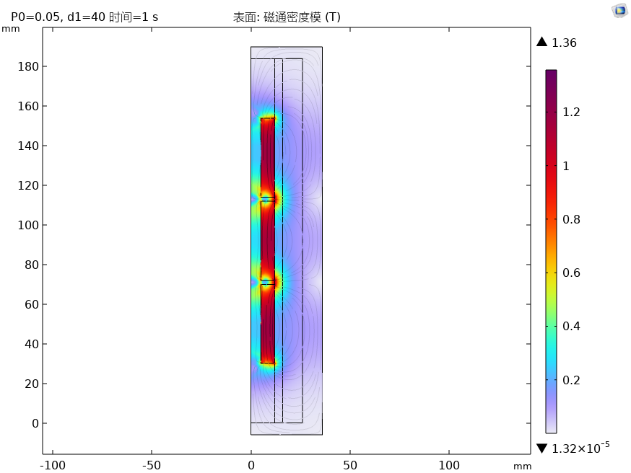
Massive production of NEG coating for CEPC——Upgrade plan
Due to the diameter of CEPC is D56, the cathode wire is planed to be replaced with a magnetron sputtering cathode
Permanent magnet instead of the solenoid which supplies magnetic field for DCMS;
By combining the low vacuum chamber outside of the vacuum chambers to be coated with NEG, the high vacuum process is simplified;
Components are designed to be more compatible for automatic production

Slide 10
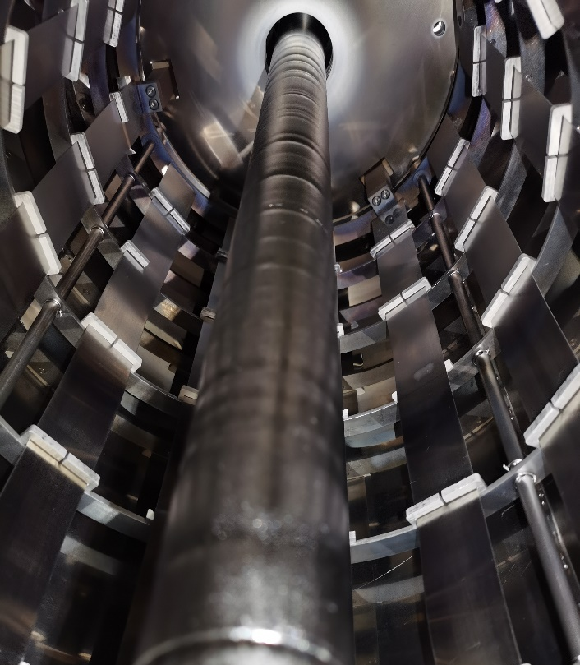
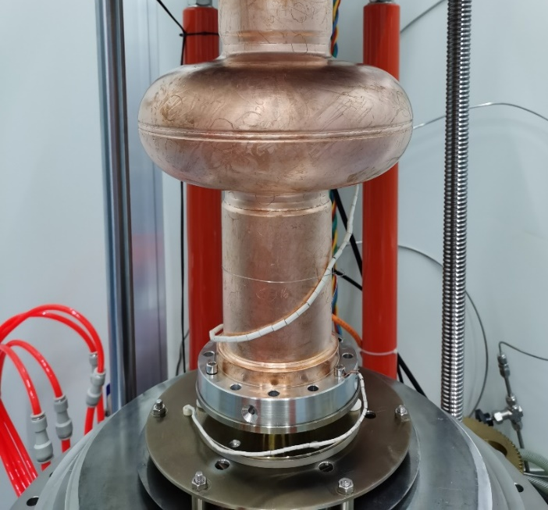
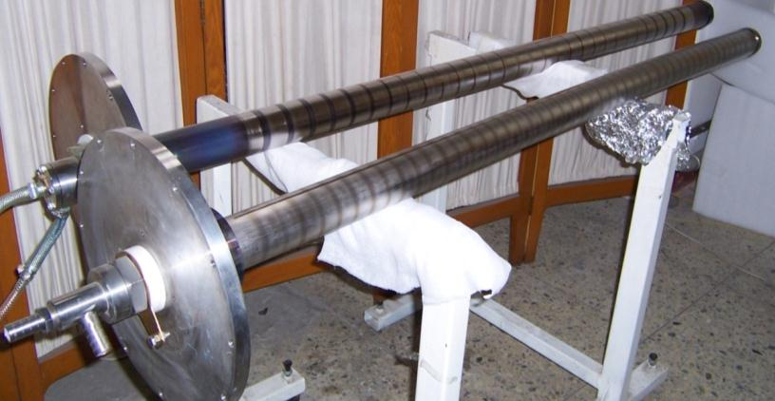
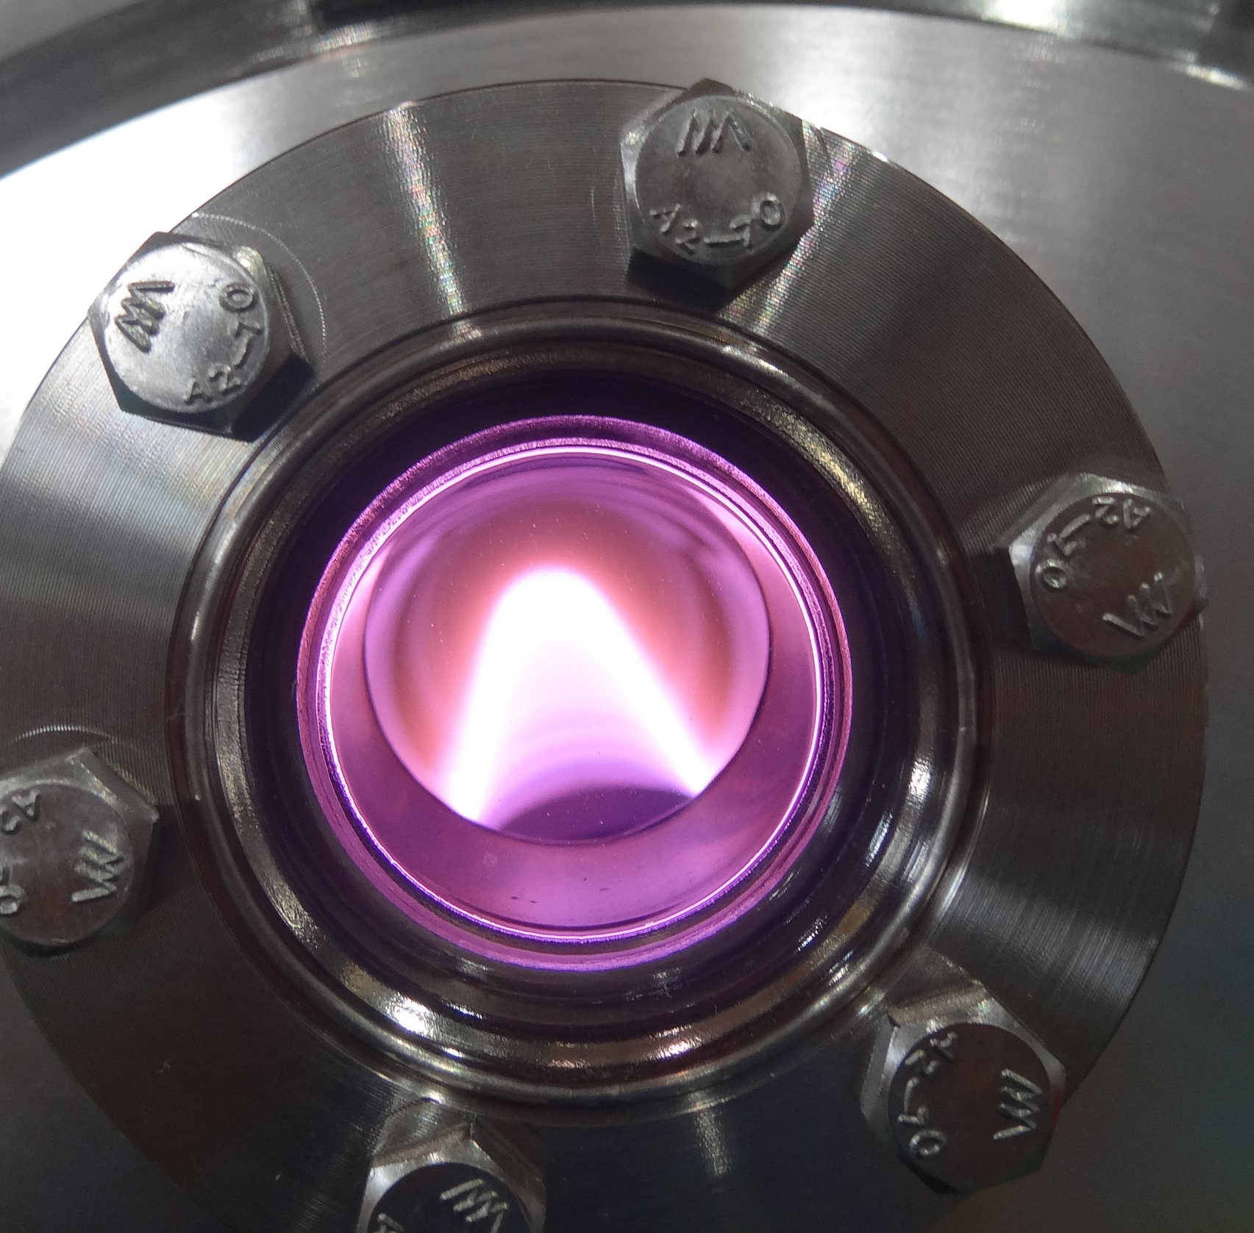
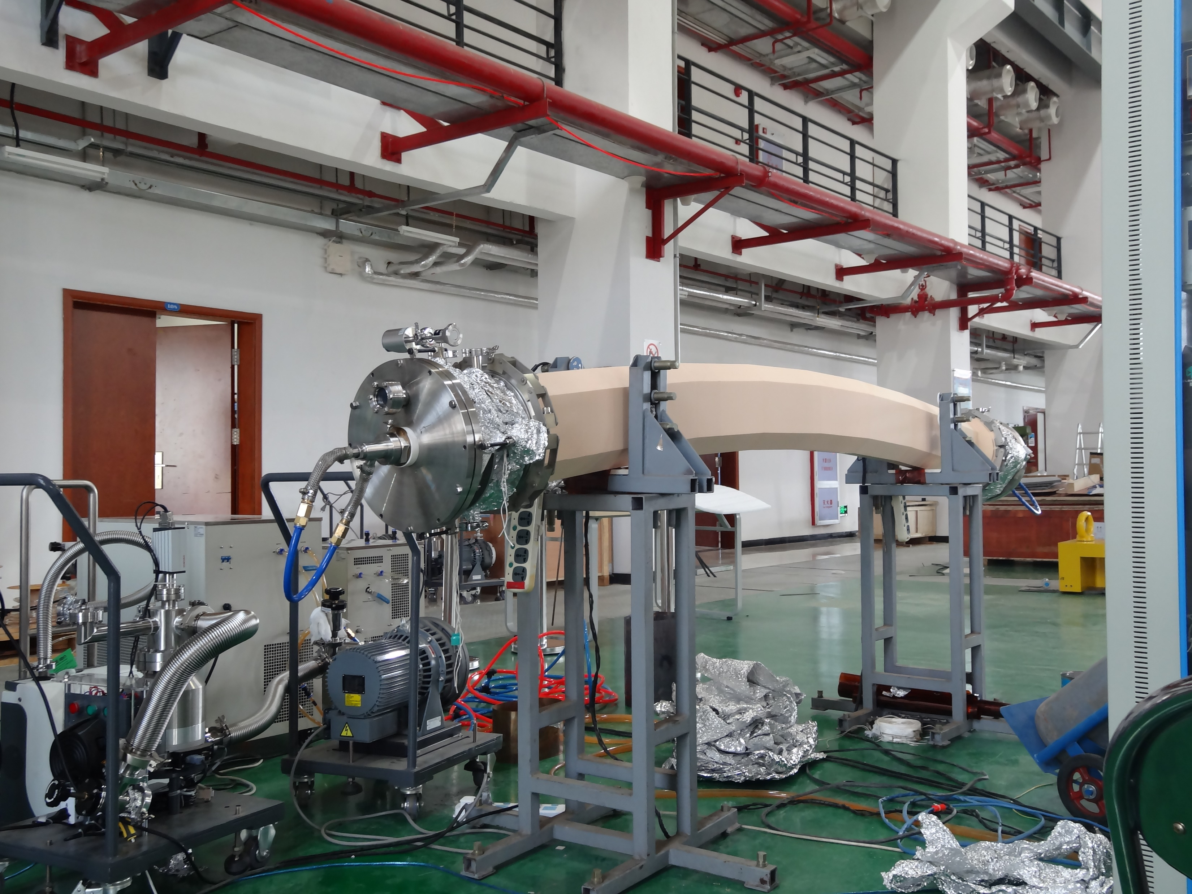
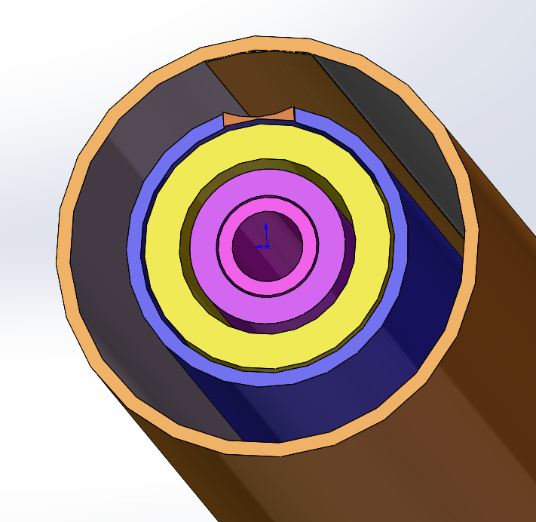
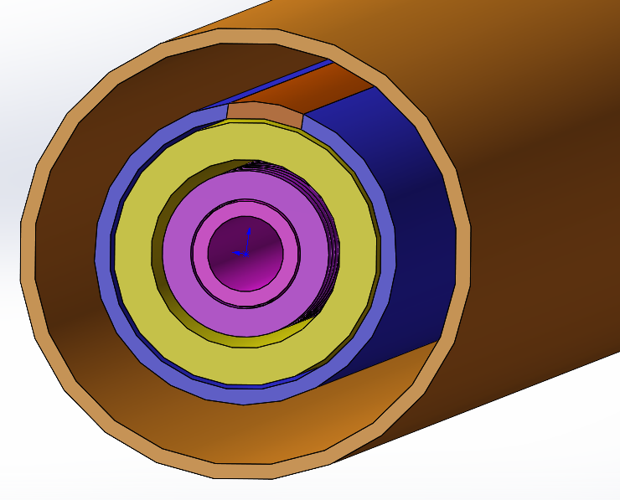
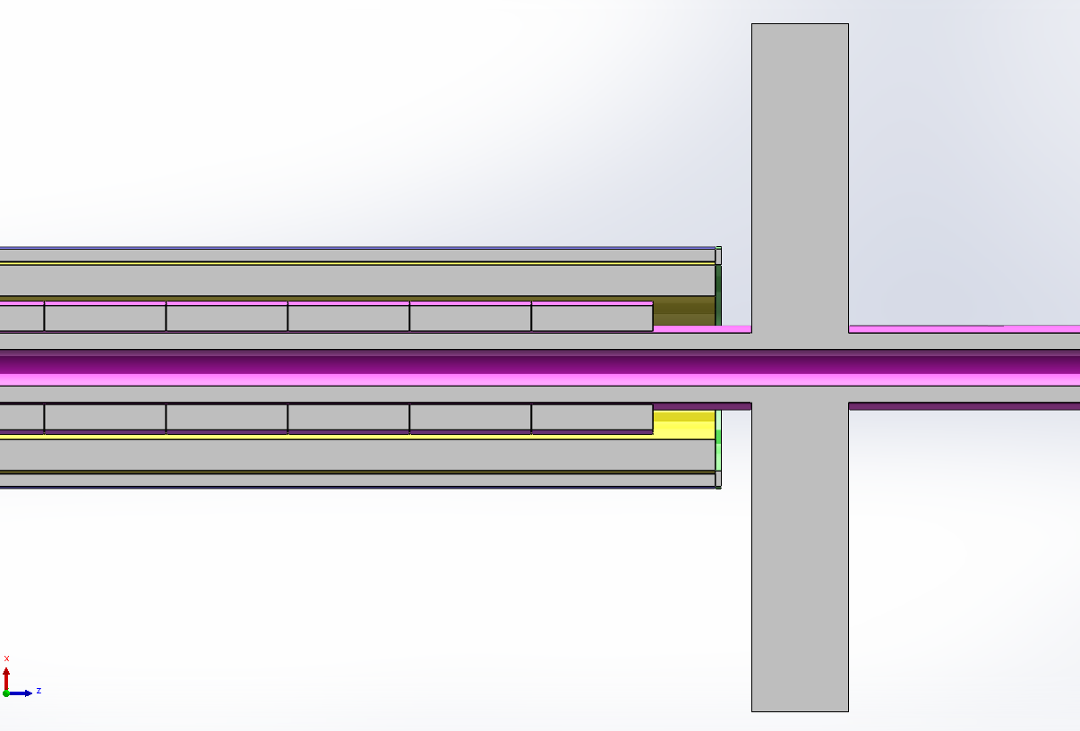
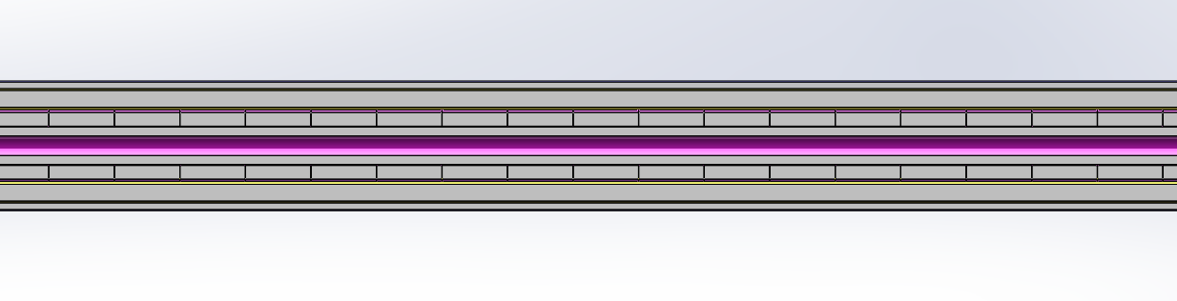
Work foundation magnetron-sputtering-cathode
Niobium coating by DCMS for 1.3GHz RF Copper substrate
TiN coating by DCMS for Ceramic vacuum chambers of CSNS
The challenging of magnetron-sputtering-cathode for CEPC
A prototype of the magnetron sputtering cathode needs to be developed before massive application in the NEG coating system. The prototype needs to address the support, sealing, plasma discharge, and cooling of the cathode.
Length 11.6m

Slide 11
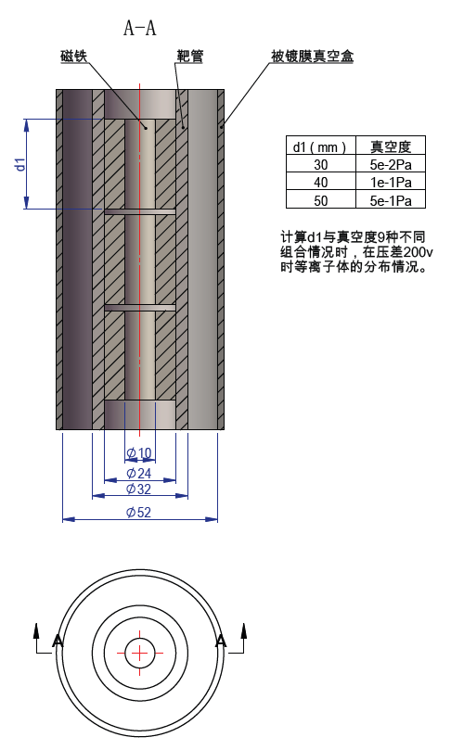
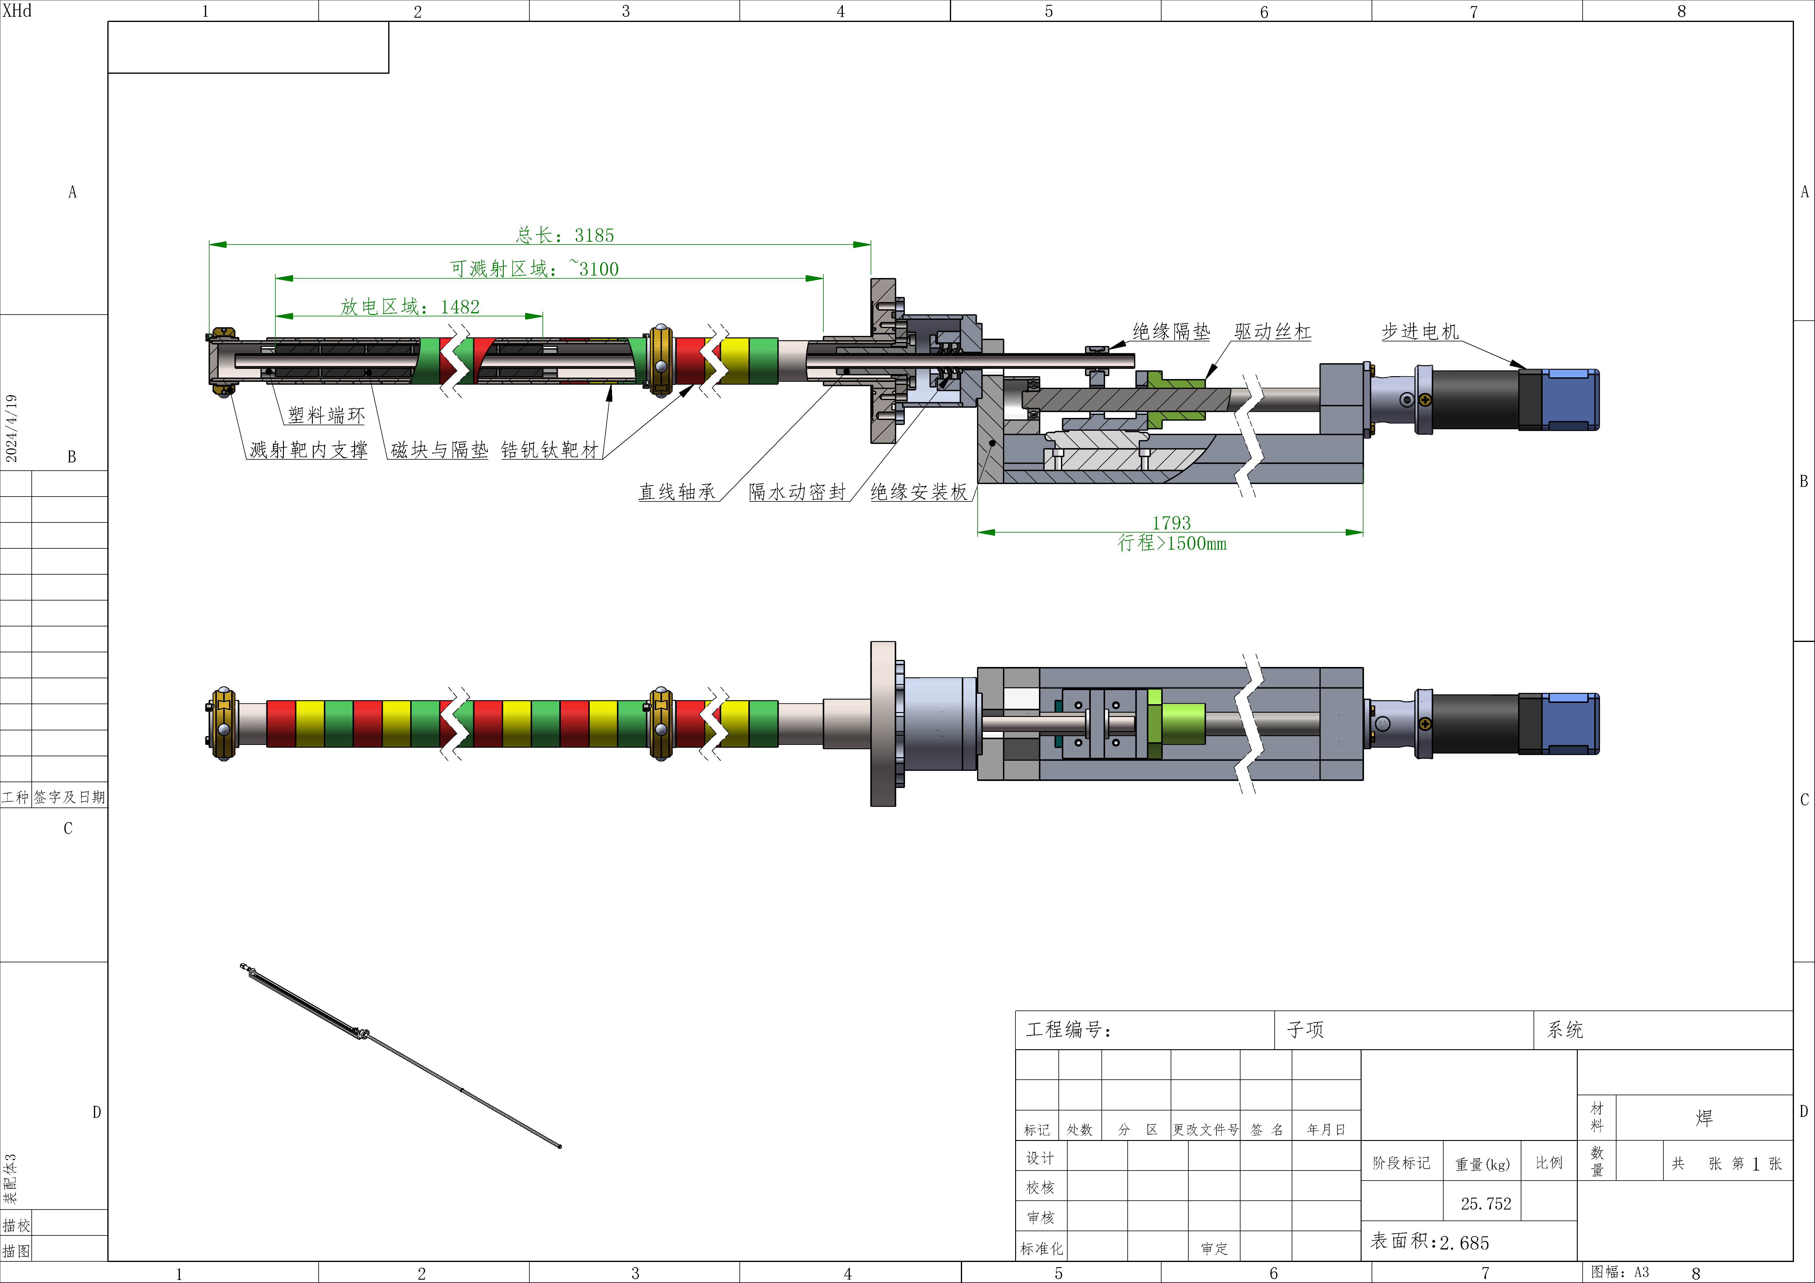
Prototype of cathode under development
Relationship between discharge area and discharge current of cathode
放电面积与放电电流的关系
靶体外径 | 放电长度 | 面积 | 电流密度 | 总电流 | 电压 | 功率
mm | mm | cm2 | mA/cm2 | A | V | kW
35 | 6000 | 6594 | 10 | 65.94 | 1000 | 65.9
45 | 6000 | 8478 | 20 | 169.56 | 1000 | 169.6
The discharge power of cathode and cooling water flow rate
发热功率 | 进出水∆T | ρ水 | 管径d | 水比热容 | 流量 | 流量 |  | 流速v
kW | ℃ | kg/m3 | mm | J/（kg•℃） | m3/s | m3/h | L/min | m/s
65.9 | 60 | 1000 | 10 | 4.20E+03 | 2.62E-04 | 9.42E-01 | 15.70 | 3.33
169.6 | 60 | 1000 | 10 | 4.20E+03 | 6.73E-04 | 2.42E+00 | 40.37 | 8.57
25 | 60 | 1000 | 10 | 4.20E+03 | 9.92E-05 | 3.57E-01 | 5.95 | 1.26
30 | 60 | 1000 | 10 | 4.20E+03 | 1.19E-04 | 4.29E-01 | 7.14 | 1.52
60 | 60 | 1000 | 10 | 4.20E+03 | 2.38E-04 | 8.57E-01 | 14.29 | 3.03
A length of 3m cathode prototype will be designed and developed.

Slide 12
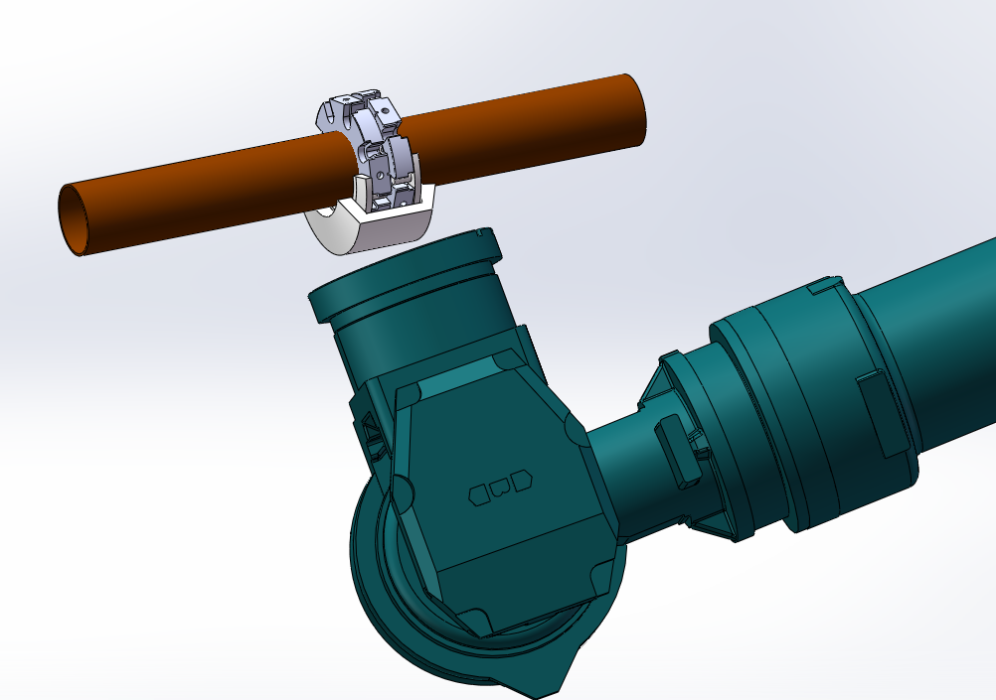
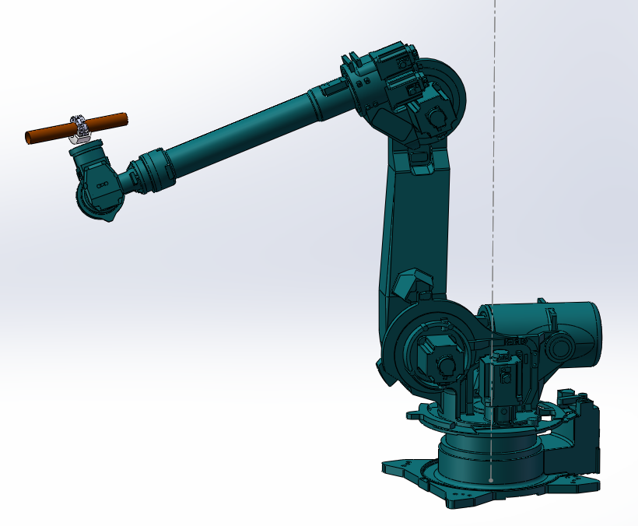
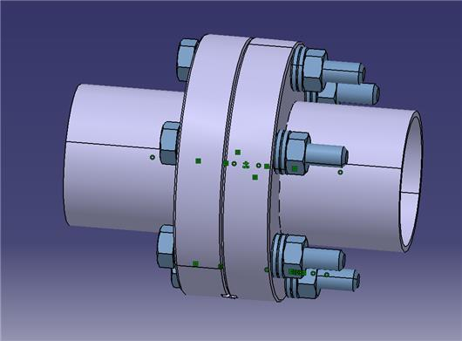


The key processing components development
Vacuum sealing/ leakage detecting

Slide 13



Why spraying heating film
The baking is the most crucial procedure in achieving ultra-high vacuum
Necessity:
In order to meet the ultra-high vacuum requirement of achieving a dynamic vacuum level of 3.0E-10 mbar.
NEG coating reactivation
Too thick
Lifetime is very short under SR of CEPC
N₂
N₂
H₂
H₂
O₂
MO
O₂
Heat
O
High
vacuum
or
inert gas
H₂O
C
MC
CO
H₂O
CO₂
CO₂

Slide 14
Spraying for heating film
Solution：multilayer heating film will be coated outside of the vacuum chamber which composited by ceramic and conductivity layer
solution
Ceramic layer
Convection
Radiation
currentI
Conductivity layer
  The structure of spraying heating circuit
Conduction
Ceramic layer
Heating layer
Thickness： 0.5mm
Cu/ceramic transition layer
Vacuum chamber
  The Process of spraying heating circuit

Slide 15




Spraying heating film R&D
Atmospheric plasma spraying:
Can be carried out directly in the atmosphere, with low environmental requirements and strong adaptability. the spraying process can be fully automated for production.
“heating circuit”
Cu/Ag NW
Processing of spray
Plasma spraying

Slide 16









Spraying marketing research and plan
Related products
Processing and facilities composition of spraying
Electric heating circuit
De-icing for airplane
R&D with merchant
Cold spraying of Cu, Al
Collaborating with merchant to R&D the spraying process;
Biding and constructing the spraying facilities;
Function layer | Processing | Note
Substrate preprocessing | Sand blasting 喷砂处理 | 降噪（115 to 85分贝） 除尘 冷却
Transition layer | Plasma Spraying 等离子喷涂
Ceramic layer | Plasma Spraying
Metal layer (Cu) | Cold Spraying 冷喷涂
Ceramic layer | Plasma Spraying

Slide 17





Production line cooperation company
北京天玛智控科技股份有限公司(简称天玛智控)成立于2001年7月，由中国煤炭科工集团所属天地科技股份有限公司控股，注册于北京市顺义区林河南大街27号(科技创新功能区)，并于2023年6月在上交所科创板挂牌上市(股票代码: 688570)。

Slide 18








Production line cooperation company
北京轩宇智能科技有限公司
从东方红一号开始，我国研制并发射的六大系列200余颗星（船）中502所参与了90%以上的星（船）任务，负责航天器控制与推进分系统的抓总及产品研制工作。
如今502所已发展成为集研究、开发、设计、制造、试验于一体的综合性研究所， 在国内空间飞行器控制领域处于主导地位。
2015年，中国航天五院502所组建全资子公司——北京轩宇智能科技有限公司。致力于在智能装备、智能检测、智能控制和信息技术等领域的创新和市场拓展
定制化核工业智能装备
核工业系列机器人
手套箱自动生产线
中关村：总部基地
总装集成基地（杭州）
单棒生产线是一条全自动化的生产线，壳管支点成型、上下端塞压塞和环缝既包括包焊接、芯块称重、排长和装管、绕丝焊接等工艺设备，还包括超声检测、X光检查和高温氦检漏等理化设备

Slide 19
Summary
Production line of vacuum chambers NEG coating will be R&D in 2 years;
NEG coating by magnetron sputtering cathode method R&D will be carried out to adapt the production line;
The key processing components development, Spraying heating film will be carried out ;
Thanks for your attention

Slide 20
Backslides

Slide 21
Electron beam welding of vacuum chamber（in vacuum ）
序号 | 品目 | 规格型号 | 数量
1 | 电子束焊枪 | 70kV,100mA，7kW | 2
2 | 高频开关高压电源 | 70kV,100mA，7kW | 2
3 | 动枪机构 | X方向800mm行程 | 2
4 | 侧移式焊接室 | 内部尺寸：13.0m*2.0m*1.0m，约26.0m³ | 1
 |  | 合金钢材质
5 | 焊接室真空泵组系统 | 配置2套萊宝DIP20000扩散泵+2台SV630B机械泵+2台WH4400罗茨泵+2台D30C维持泵 | 1
6 | 电子枪真空泵组系统 | 中科科仪F100/150+RV2 | 2
7 | X/Y工作台 | 工作台平面尺寸：12000mm×900m | 1
 |  | X轴行程：800mm；Y轴行程：900mm；
 |  | 负载1300kg
8 | 6工位C轴转台 | 数控伺服驱动，0.1～30 转/分之间连续可调。定位精度±0.1°；负载1000kg | 1
9 | 引出台 | 非标 | 1
10 | CNC数控系统 | FANUC Series 0i-MF PLUS | 1
11 | 电子束控制系统 | BP-EBW-C控制系统 | 1
12 | 高清摄像观察系统 | 10倍放大 | 1
13 | 冷水机组 | KCA-06 | 2
6 vacuum chambers welding per batch in 3h
Vacuum chamber
Conflat Flange
8000 vacuum chambers could be welded per year under 16h/d duty, and the all vacuum chambers of collider will be welded in 2.5~3 years under the length distribution of TDR.
Electron beam welder
Inner dimension：13.0m*2.0m*1.0m

Slide 22
NEG coating tower
Classification | Sub-devices | Parameters
Pumping system | SIP | 100L/s
 | Molecular pump | 400L/s
 | Helium leak detector | He
Vacuum measurement | Film gauge | 0~133Pa
 | Vacuum gauge | 1E-10Pa
 | RGA | Aum 1~100
Cathode | / | 11.6m length/D35
Power supply | DC Power supply of discharge | 0~1kv/0~100A
 | Baking and Power controller | 0~400℃
Vacuum chambers | UHV Vacuum chamber | 304/316L
 | LV Vacuum chamber &furnace
 | bellows
Discharge Gas | Kr/N2 | 100.00%
Accessory | operating platform | 12.5m
 | TiZrV | >99.5%/1mm
 | valve
 | cermic, support
 | controller system/ | the all devices remote control

Slide 23


Processing data management
A full period database, digital management platform, of components suggested to be built. Take vacuum chambers of collider for example:
The hardware design, processing, post-processing, debugging, installation, and operation of accelerators
Material
Structure
Welding
NEG coating/spraying
Activation cycles
Installation
Running

Slide 24

Vacuum requirements and configuration
 | Energy | Material | Cross Section/mm | Length/m | Dynamic pressure /Torr
LINAC | 30 GeV | Stainless steel, copper | Φ20~30 | 1,601+ 335 (BTL) | Acc <2×10⁻⁷ E-gun<2×10⁻⁸
Damping ring | 1.1 GeV | Extruded aluminum 6061 | Φ30/Al 6061 | 147 | <2×10⁻⁸
Booster | 30 to 180 GeV | Extruded aluminum 6061 | Φ56/thickness of 2mm | 100,000 | <3×10⁻⁸ tt<4×10⁻⁸
Collider | 45.5~180 GeV | Extruded copper, NEG film SEY<1.2 | Φ56/thickness of 2mm | 100,000×2 | Z<8×10⁻¹⁰ tt<1×10⁻⁸
MDI | 45.5~180 GeV | Copper/tungsten alloy, NEG film | Φ20 | 12 | <3×10⁻⁹
LTB | 30 GeV | Stainless steel | Φ56 | 3,000 | <1×10⁻⁷
BTC(CTB) | 6 GeV | Stainless steel | Φ56 | 240×6 | <1×10⁻⁷
DL | 1.1 GeV | Stainless steel | Φ30 | 240 | <1×10⁻⁷

Slide 25
Layout & configuration of Collider
collider | Classification | length/m
 | Arc beam pipe | 78752
 | Straight section beam pipe | 8456
 | RF Substitute pipe | 1192
 | RF system | 352
 | Insertion and extraction | 286
 | Manifold for SIP | 1333
 | Bellows | 2082
 | BPM | 300
 | Manifold for Gauge & RGA | 247
 | Detector 1 | 12
 | Detector 2 | 12
 | Collider section | 7000
 | Total length | 100000
Parameter | e⁺ & e–
Energy [GeV] | 45.5~180
Beam current [A] | 0.0033~1.39
Circumference [m] | 100,000 ×2
Bending radius [m] | 10,700
Beam pipe material | Extruded copper (water-cooled) NEG coating
Beam pipe shape (mm) | Φ56/thickness of 2mm
Pump type in arcs | SIP
Modes | E (Gev) | Beam gas scattering lifetime (h) | Vacuum requirement (Torr)
Higgs | 120 | 10 | 2 × 10⁻⁹
W | 80 | 5 | 1.5 × 10⁻⁹
Z | 45.5 | 3 | 8 × 10⁻¹⁰
tt | 180 | 15 | 1 × 10⁻⁸

Slide 26
Layout & configuration of Booster
 | Classification | length/m
booster | arc beam pipe | 78428
 | Straight section beam pipe | 17010
 | RF Substitute pipe | 384
 | RF system | 96
 | insertion and extraction | 198
 | Manifold for SIP | 1250
 | Bellows | 850
 | BPM | 240
 | Manifold for Gauge & RGA | 1544
 | total length | 100000
Parameter | e⁺ & e–
Energy [GeV] | 30~180
Beam current [A] | 0.11~14.4×10⁻³
Circumference [m] | 100,000
Bending radius [m] | 11,380.8
Beam pipe material | Extruded Al
Beam pipe shape (mm) | Φ56/thickness of 2mm
Pump type in arcs | SIP
Dynamic pressure /Torr | <3×10⁻⁸ tt<4×10⁻⁸

Slide 27
Booster vacuum system
Booster will work in four modes of higgs, W, Z, tt under 30MW and 50MW alternatively. 50MW is given to calculate the vacuum parameters as it has the highest energy and gas load.
The gas load under different beam energy and beam density
Mode | E | I | PSD | PL | Q_{gas} | Q_{LSR} | P_{ave}
 | Gev | A | Molecules/photon | W/m | Torr·L/s | Torr·L/s·m | Torr
Higgs | 120 | 1.03E-03 | 2.00E-05 | 23.31 | 6.00E-05 | 8.40E-10 | 2.15E-08
W | 80 | 5.17E-03 | 1.00E-05 | 23.03 | 1.00E-04 | 1.40E-09 | 2.21E-08
Z | 45.5 | 2.67E-02 | 2.00E-06 | 12.44 | 5.87E-04 | 8.22E-09 | 2.14E-08
tt | 180 | 2.00E-04 | 1.35E-03 | 22.84 | 1.18E-03 | 1.65E-08 | 3.96E-08
The finite element analysis conducted on the vacuum chamber indicates that the highest temperature reached is 28.9°C when the ambient temperature is 25°C and a convective heat transfer coefficient of 2×10^{–5} W/mm²⋅℃ is assumed.
The main pumping process will then be followed by ion pumps distributed around the circumference at intervals of about 12 m.

Slide 28
Linac vacuum system
The Linac vacuum system with a length of 1936m is divided into 59 sections. it consists of electron gun, bunching system, accelerating structures .
Sputter ion pumps: 3431; Vacuum gauges: 1352; Gate valves: 60
Section | Static pressure /Torr | Dynamic pressure /Torr
E-gun | <1×10⁻⁹ | <2×10⁻⁸
Buncher | <5×10⁻⁸ | <2×10⁻⁷
Accelerating structure | <5×10⁻⁸ | <2×10⁻⁷
Waveguide | <5×10⁻⁸ | <5×10⁻⁷
Most of the components are made of oxygen-free copper . The thermal outgassing rate is 1×10⁻¹¹ Torr·l/s·cm².
The static pressure distribution of a accelerator structure
Vacuum diagram of klystron and accelerator structures
Notes:
conventional technology

Slide 29


Layout of Damping ring, Transport line
DR | Classification | length/m
 | arc beam pipe | 119.0
 | Straight section beam pipe | 14.0
 | RF Substitute pipe | 0.0
 | RF system | 3.0
 | insertion and extraction | 2.8
 | Manifold for SIP | 1.5
 | Bellows | 1.5
 | BPM | 4.0
 | Manifold for Gauge & RGA | 1.5
 | total length | 147.3
Parameter | e⁺ & e–
Energy [GeV] | 1.1
Beam current [A] | 0.012~0.024
Circumference [m] | 147
Bending radius [m] | 2.87
Beam pipe material | Extruded Al
Beam pipe shape (mm) | Φ30/thickness of 1
Pump type in arcs | SIP
Dynamic pressure /Torr | 2×10⁻⁸
transport line | Classification | length/m | Note
transport line | linac to booster | 3000 | e- & e+ 1500 m
 | booster to colider | 960 | On axis：e- & e+ 240 m Off axis: e- & e+ 240 m
 | colider to booster | 480 | e- & e+ 240 m
 | damping ring | 240 | In & ex 120 m
 | total length | 4680
Parameter | e⁺ & e–
Linac to Damping Ring | e+/e-
Energy (GeV) | 1.1 GeV
Linac to Booster
Energy (GeV) | 30 GeV
Booster to Collider
Energy (GeV) | 45 GeV~180 GeV
Dynamic Pressure (Torr) | 2e-8

Slide 30
Damping ring vacuum system
For the DR, with values of E = 1.1 GeV, I = 0.012~0.024 A, and ρ = 2.87 m, these equations give a total synchrotron radiation power of P_{SR} = 1.08 kW and a linear power density of P_{L} = 60.1 W/m.
The gas load under different beam energy and beam density
Mode | E | I | PSD | P_{L} | Q_{gas} | Q_{LSR} | P_{ave}
 | Gev | A | Molecules/photon | W/m | Torr·L/s | Torr·L/s·m | Torr
 | 1.1 | 0.024 | 2.00E-06 | 60.1 | 1.28E-06 | 7.09E-8 | 1.78E-08
With an effective pumping speed of 15 L/s and a distribution of 2 meters sputtering ion pumps, the vacuum value of 1.78×10^{–8} Torr will be reached.
Due to the beam current of damping ring is low enough, SEY of aluminium vacuum chamber which do not need NEG coating or TiN coating could meet the requirement of physics.
RF shielding Bellows with spring and contact fingers made of stainless steel will be employed to absorb the extension and the misalignment of vacuum chambers and other vacuum devices during installation.

Slide 31

MDI Vacuum & vacuum chamber R&D in EDR
Vacuum chamber of Tungsten alloy will be developed in EDR;
NEG coating is suggested to the fork vacuum chambers;
Water cooling pipe is designed due to the high thermal load of impedance at high light Z model;
SR absorber will be used on the upstream of MDI to decrease the gas load of Synchrotron radiation.

Slide 32



Protypes of Dump chamber and membrane window
The elliptical Ti thin membrane window of 170×10 mm with a thickness of 0.1 mm was welded on the s. s. plate with a diameter of 183 mm and a thickness of 5mm.
membrane windows
Inner cross section of ellipse in 60 × 30 mm
Outer cross section of rectangle in 62 × 32 mm
Membrane windows
The thickness of Ti window is 0.1mm
Deformation test under vacuum: elliptical window is 0.4mm, circle window is 2.3mm;
ultimate vacuum<5 ×10⁻¹⁰ Torr。
Notes:
材料的选择→加工工艺→样件试制→检漏→变形测量→极限真空测试
对0.1mm厚的钛膜进行电子束焊和钎焊试验；
钛窗真空下变形实验，椭圆窗0.4mm，圆窗2.3mm，打压1MPa未发现有漏；
极限真空小于5 ×10⁻⁸Pa。

