Slide 1

Status of the Muon Detector for Ref-TDR
Xiaolong Wang
For muon Det R&D group
Fudan University
04/23/2024

Slide 2
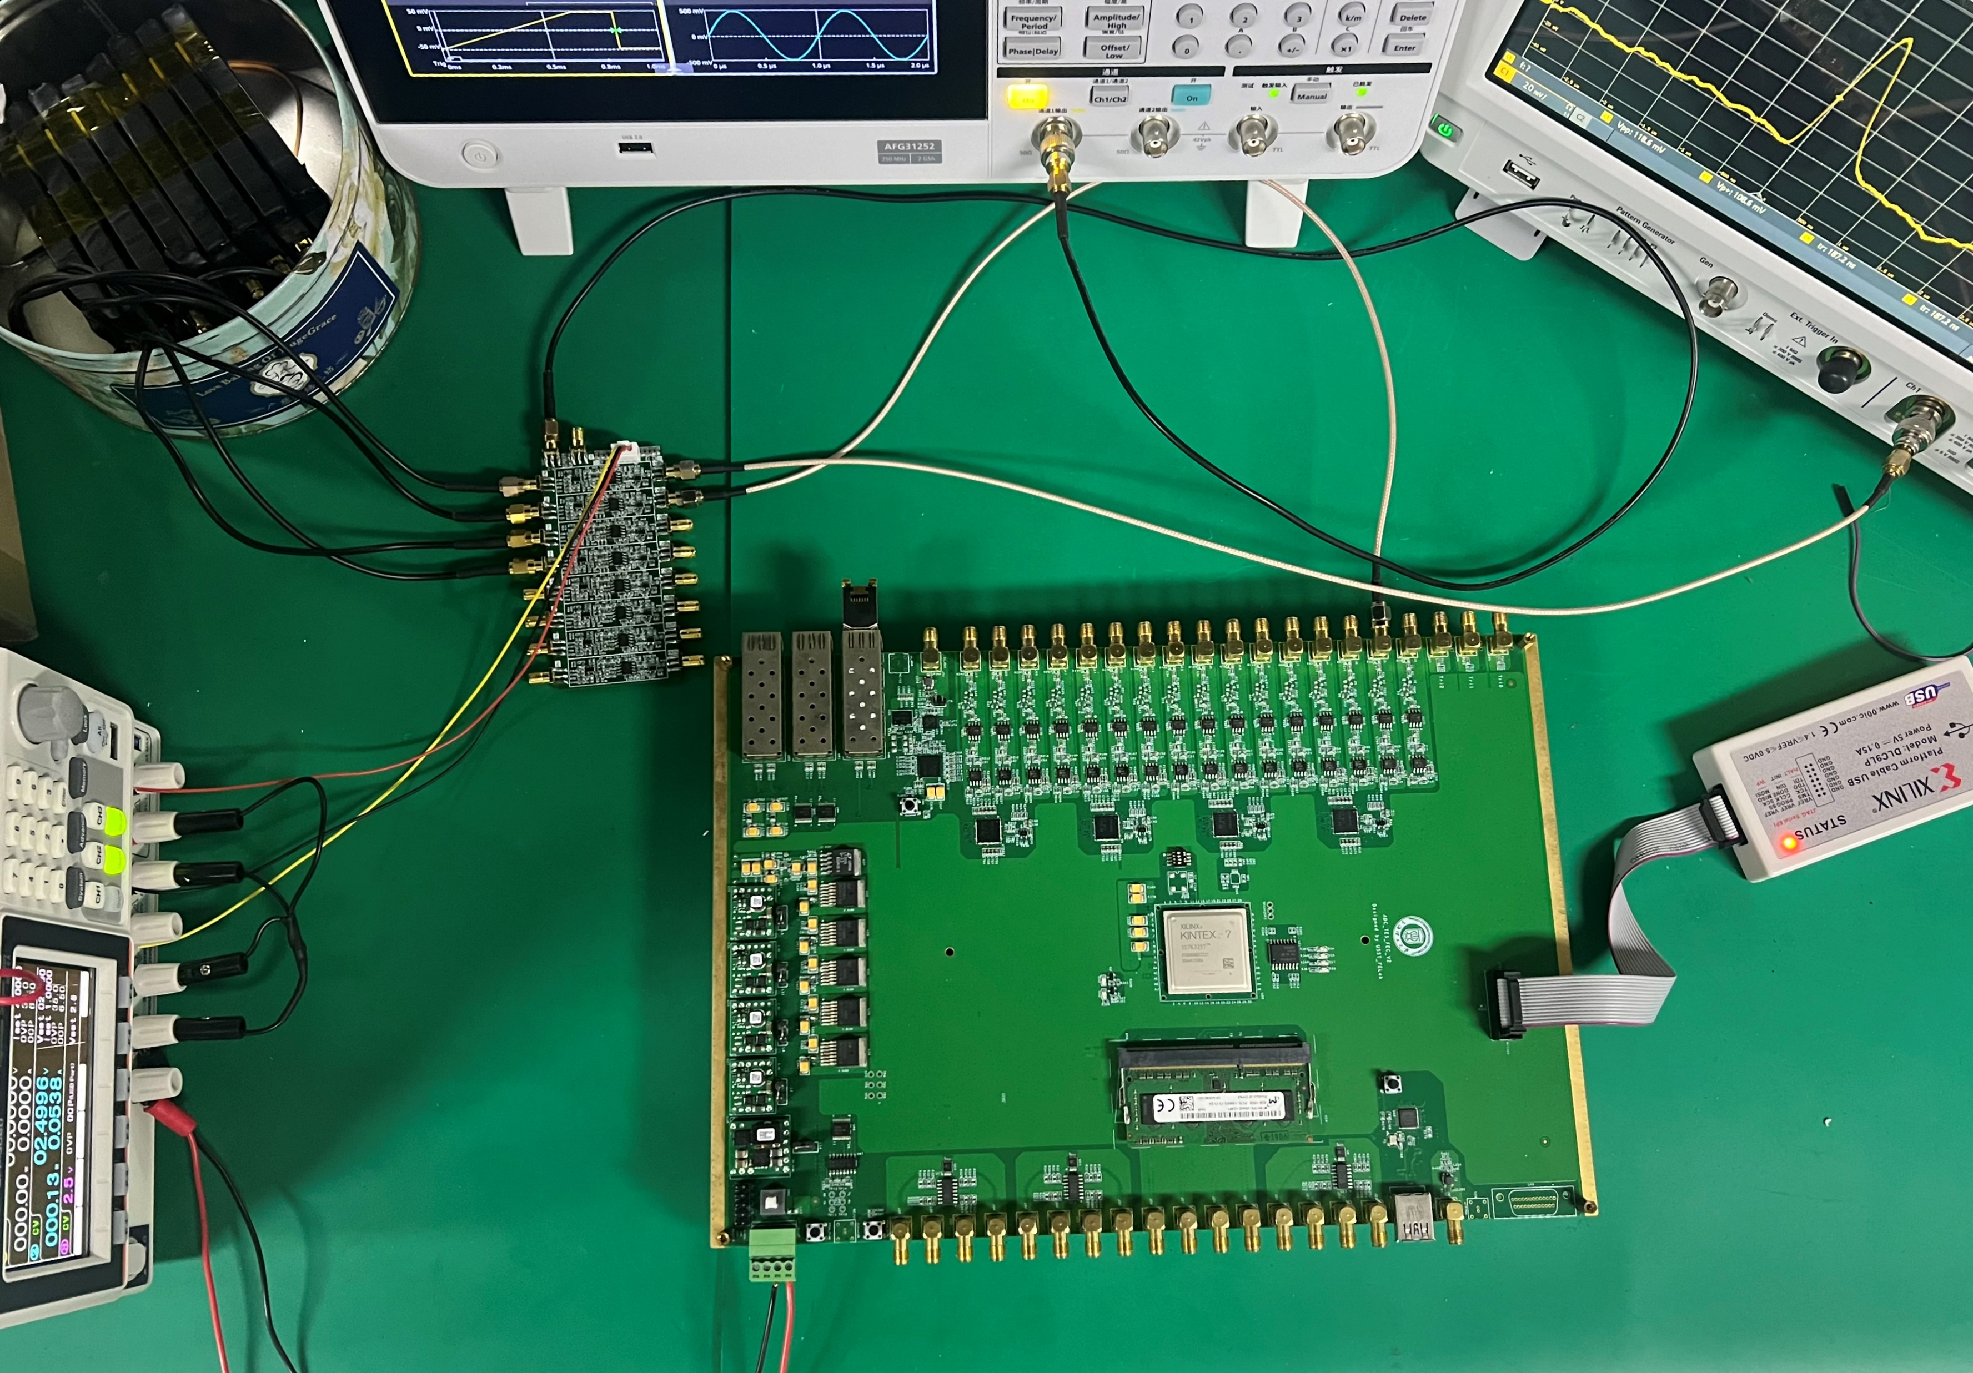

The status of PS scheme
1. Scintillator production: GNKD starts to build mold for scintillator strips.
2. Backend electronics: USST gets the FW read after the simulation, and testing with generated pulses shows a time resolution of ~0.1ns, without sincillator+SiPM. Going to start the design of the new board.
3. Simulation and SW: Nankai and SCNU start to work on the simulation under the CEPCSW frame.

Slide 3
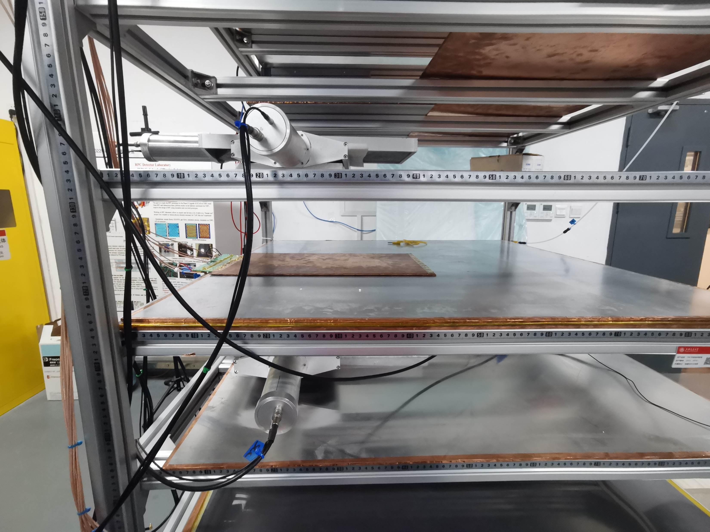

The status of RPC scheme
1. SJTU resumed the RPC ($1×1{ m}^{2}$) with 8 ch readout, got good results: eff > 90%. Going to study time resolution.
2. A student of Fudan is working on fixing Belle II RPC problem (eff drop due to vapor) at KEK. Could be a reference.
RPC@SJTU
RPC@KEK

Slide 4
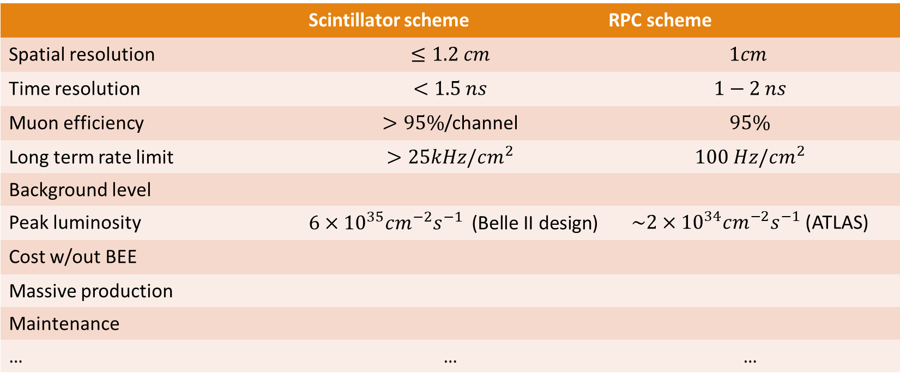
Compare the PS and RPC schemes
 | Scintillator scheme | RPC scheme
Spatial resolution | $$≤1.2 cm$$ | $$1cm$$
Time resolution | $$<1.5 ns$$ | $$1−2 ns$$
Muon efficiency | $>95\%$/channel | $$95\%$$
Long term rate limit | $$>25kHz/cm^{2}$$ | $$100 Hz/cm^{2}$$
Background level
Peak luminosity | $6×{10}^{35}cm^{−2}s^{−1}$ (Belle II design) | $\sim 2×{10}^{34}cm^{−2}s^{−1}$ (ATLAS)
Cost w/out BEE
Massive production
Maintenance
… | … | …

Slide 5
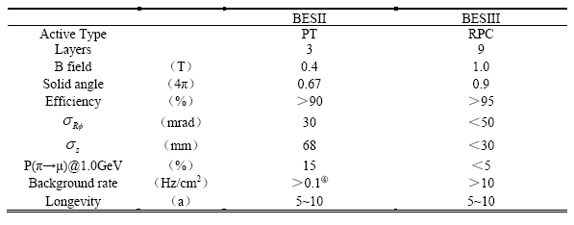
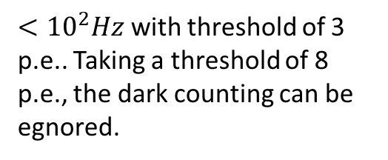
Background level
SiPM
$<{10}^{2}Hz$ with threshold of 3 p.e.. Taking a threshold of 8 p.e., the dark counting can be egnored.

Slide 6
Background event display
Belle II expected a neutron-induced RPC Rate of > 10 Hz/cm2.

Slide 7
Muon identification efficiency in Belle II

Slide 8
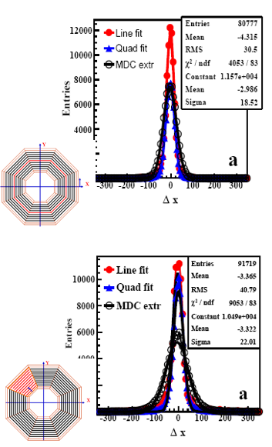
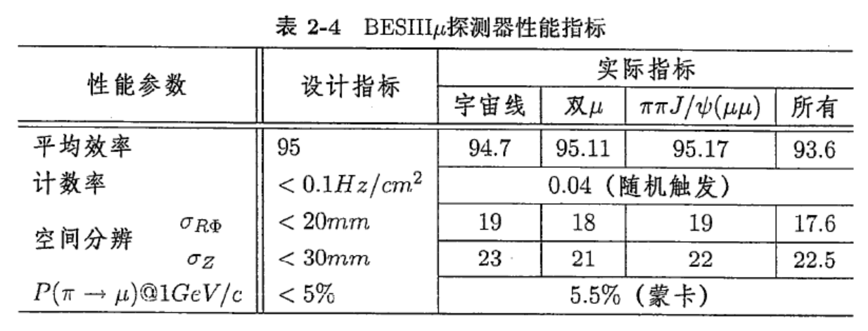
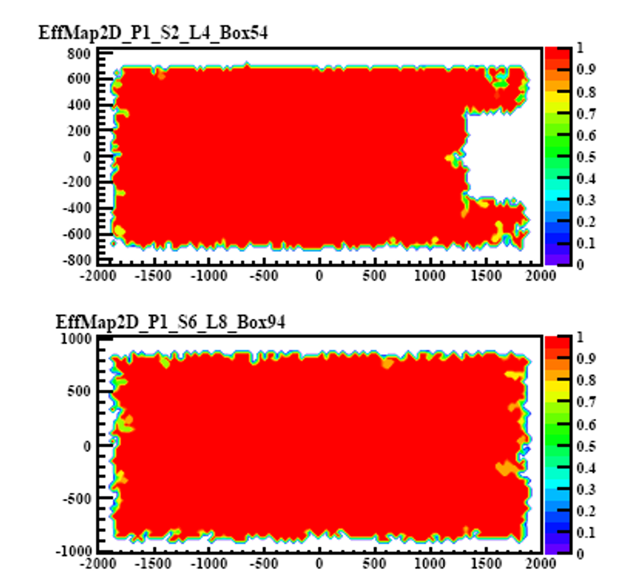
From Yuguang
Reached performance of BESIII MUC
Lessons
Module box should be compressed;
Add sunlight plate in the yoke gaps.
Sparking protection needed in FEE. Major maintenance is to replace FEE boxes for MUC

Slide 9
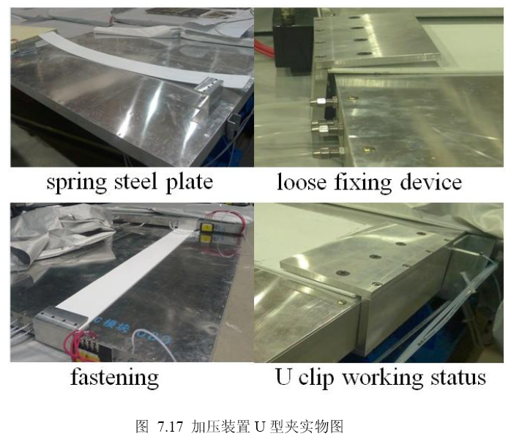
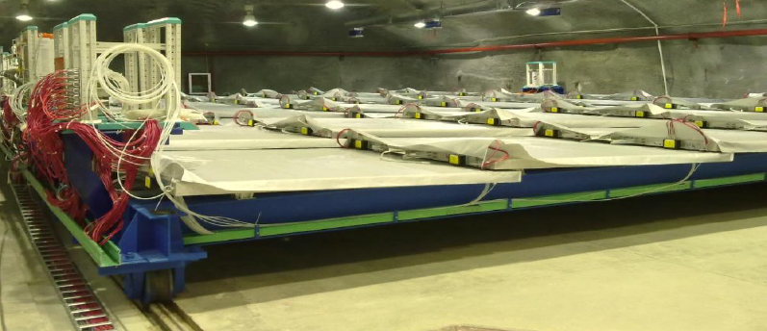
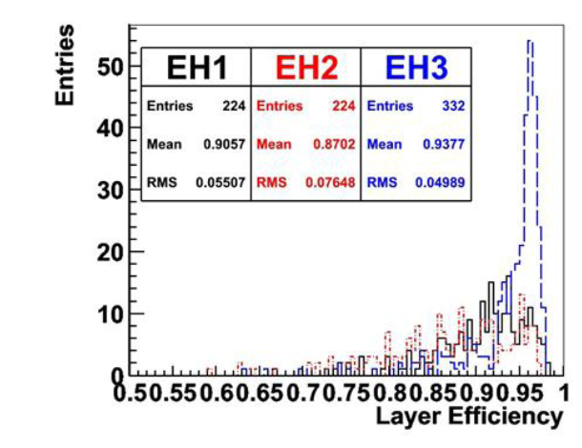
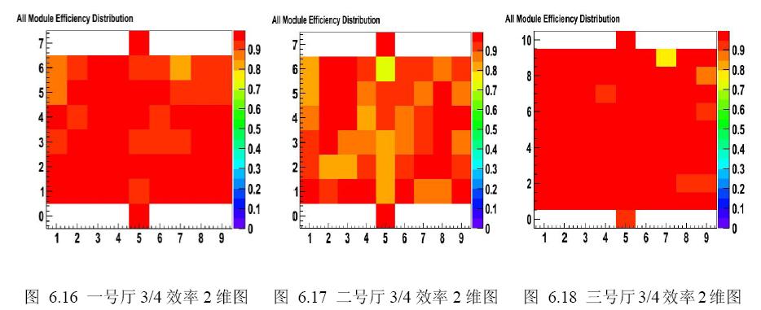
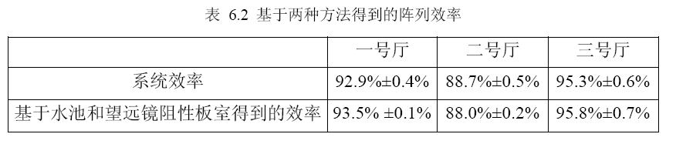
From Yuguang
Performance and lessons
Eff @ Hall #3 > 95%; 92.9% @Hall #1; 88.7%@Hall #2;
Bare chamber bulging or cracking due to gas pressure and not enough compression by module(box), no yoke helps;
Dry air flushing inside modules.
Waterproof cloth covered on modules.
Pressure and flow control needed for gas system

Slide 10
Conclusion on muID performance
Both scintillator and RPC can provide excellent muID with low background level.

Slide 11
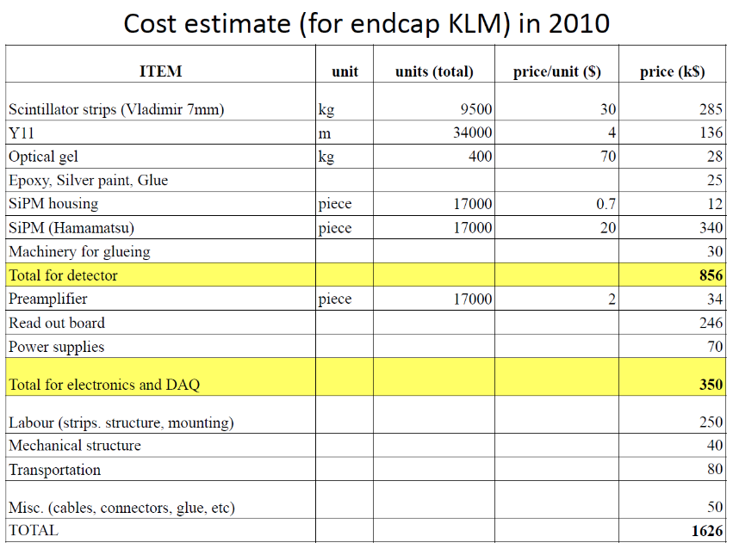
Cost of Belle II KLM
Inflation of RMB：
2008：8.1%
2009：19.0%
2010：8.3%
2011：7.7%
2012：6.4%
2013：5.8%
2014：3.8%
2015：6.4%
2016：4.6%
2017：2.1%
2018：1.5%
2019：2.6%
2020：7.8%
2021：0.9%
Average inflation recently：4.19%
The inflation from 2008 to 2021 is 2.257.

Slide 12
Cost Estimation
Recent estimation (5 layers) according to Geant4 simulation:
Estimation of 4-layer scheme (years ago): SiPM and electronics：
  KLM造价，电子学部分平均价格为$20，SiPM约为$20。我们估计的SiPM造价可以在$10水平。即每一道的总价格约为￥210。因此，电子学和SiPM总造价约为(14208+6290)*210=4.3M￥。
WLS fiber：
  桶部：一个超层，垂直方向3.2m*8m/4cm=640m，沿束流方向8m*3.2m/4cm=640m，共1280m。桶部一共需要光纤长度为1280m*4*8=40960m。
  端盖：34000m(eKLM)*0.37=12580m。
  因此，总共53540m。单价估计$4/m，光纤所需造价为1.5M￥。
  (最近的小批量采购价大约1000日元/米，即50元。)
Scintillator：
  探测总面积约1600m^2，因此，总体积为1600m^2*1cm（厚）=16000L。塑闪造价估计200￥/L，总造价为3.2M￥。
Totally：4.3+1.5+3.2=9.0M。
Barrel: (300*5+93+95+97+99+102)*8=15,888 ch
Endcap： 996*5*2=9,960 ch
Totally： 25,848 ch, corresponding to ~11.25M￥
Comparing that of ~20,000 ch from estimation on 4 layers
We just realized from the Geant4 simulation that the detector channel of scintillator could be as long as 6m in endcaps. Need to tune the strip lengths and the number of readout channels.

Slide 13
From Yuguang
BESIII MUC cost
Bare RPCs | 1272 m^2 |  | 1.2k/m^2 | 1.526 M | From GNKD
Box | 136 |  | 2000/module | 0.272 M | From GNKD
Readout strip & insulation materials | 636 m^2 |  | 3145/m^2 | 2.0 M | From GNKD
Electronics | 9152ch |  | 200/ch | 1.83 M | From USTC
Sub total | Consistent with Jiawen Zhang: ~560W(all) |  |  | 5.628M
HV system |  |  |  | 0. 4M | Estimated
Gas system |  |  |  | 0. 3M | Estimated
Total |  |  |  | 6.328 M

Slide 14
From Yuguang
DYB RPC veto cost
Bare RPCs | 3200 m^2 | 1600/m^2 | 5.14 M | From GNKD
Box | 195 | ~2500/module | ~0.4875 M | Estimated
Readout strip & insulation materials | 3200 m^2 | ~740/m^2 | 2.37 M | Estimated
Subtotal |  | From Changgeng Yang | 8.0M
Electronics | 6000ch | 200/ch | 1.2 M | From USTC
HV system |  |  | ~1.0M | Estimated
Gas system |  |  | ~0.8M | Estimated
Total |  |  | ~11.0M
But, what I got: Gas system costs $450k! HV costs $273k?

Slide 15
CEPC RPC Muon cost
From Yuguang
Bare RPCs (Bakelite) | 5080 m^2 | 2200/m^2 | 11.18 +0.6 = 11.78M | From GNKD
Bare RPCs(glass) | 5080 m^2 | 1000/m^2 | 5.08+0.6=5.68M | Estimated
Box | 280 | 3500/module | 0.98 M | Estimated
Readout strip & insulation materials | 5080 m^2 | 1000/m^2 | 5.08 M | Ref to DYB
Subtotal |  |  | 17.84(Bakelite)/11.74(glass)
Electronics (discrete) | 31100 ch | ~200/ch | 6.22 M | From USTC
Electronics (ASIC) | 31100 ch | ~146.5/ch | 4.55M | From USTC
HV system |  |  | 1.5M | Estimated
Gas system |  |  | 1.0M | Estimated
Total | Bakelite RPC: 26.56M(discrete)/2.489(ASIC); Glass RPC: 20.46M(discrete)/18.79(ASIC)
RPC mass production condition
Vendor: GaoNengKeDi co.ltd only, currently; glass RPC no problem. New clean room needed. Raw materials are not issue. (Bakelite, graphite, glass, glue, strips insulation film, etc. )

Slide 16
Comparison on cost in construction
Number of channels: 25,848 vs 31,100
Effective area of superlayers: 1600m^2 vs 2540m^2 (5080/2)
Cost until here: 11.25M vs 17.84M(Bakelite)/11.74M(glass)
Additional cost of RPC:
6.22 M for Electronics (discrete)
4.55M for Electronics (ASIC) (ignored in comparison)
1.5M for HV
1.0M for gas system
Two more comparisons:
Construction and maintenance will be more complicated in RPC scheme.
PS scheme can take some technologies from HCAL R&D, possible to reduce the cost.
  ---Scintillator, SiPM, ASIC, etc.

Slide 17
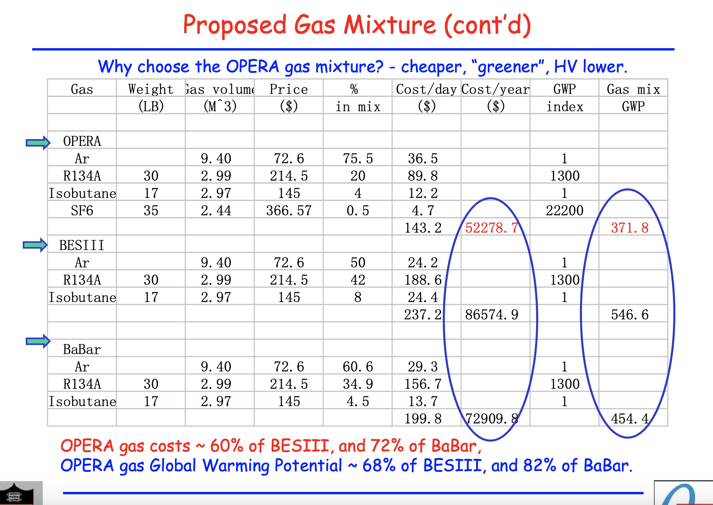
Gas cost
Dayabay Per year:
$73k -> ~0.5M￥
Belle II RPC per year:
~0.5M￥ (similar) for half of the KLM volume.
So, how much will be the gas cost for CEPC per year?

Slide 18
Conclusion on cost
There is no conclusion that RPC has an obvious advantage in cost for construction.
RPC has gas cost, and it may be > 1M per year.
Scintillator has advantages in construction and maintain, and therefore save labor cost.

Slide 19
Backup

Slide 20
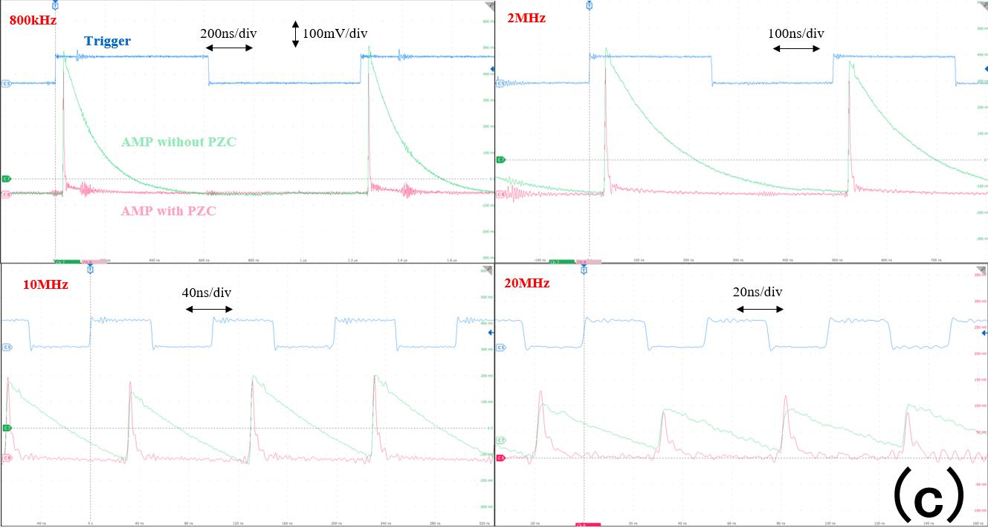
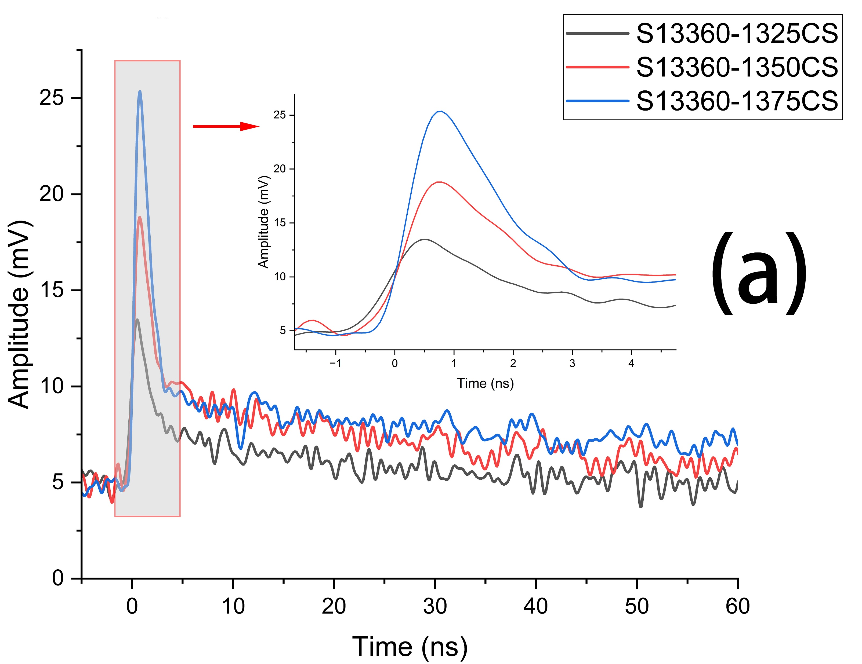
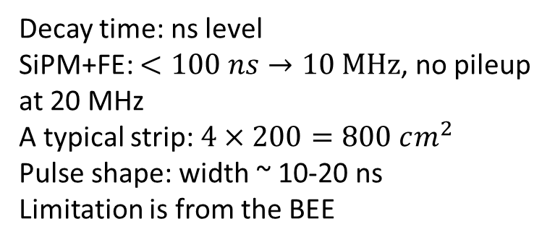
Rate limitation of scintillator
Decay time: ns level
SiPM+FE: $<100 ns→10 MHz$, no pileup at 20 MHz
A typical strip: $4×200=800 cm^{2}$
Pulse shape: width ~ 10-20 ns
Limitation is from the BEE
SPE from MPPC
SPE from NDL EQR15
X.Y. Wang et al., NST34,169(2023)

Slide 21
Neutron and gamma backgrounds

Slide 22
DYB

