Slide 1
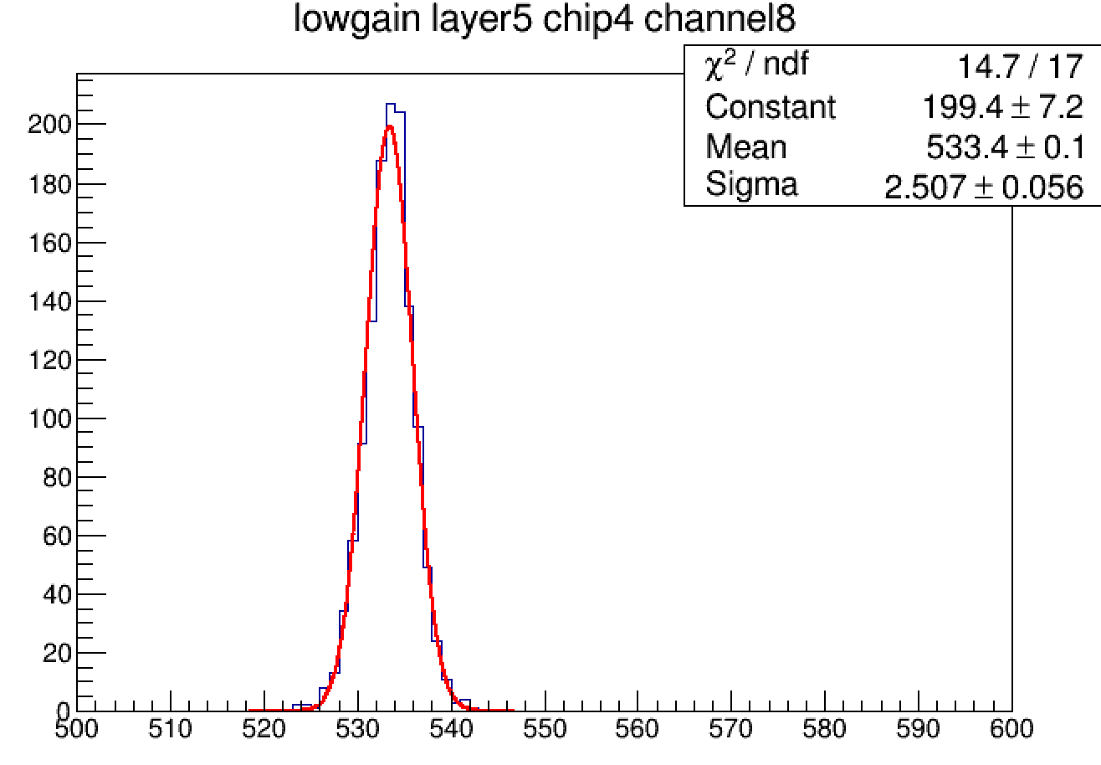
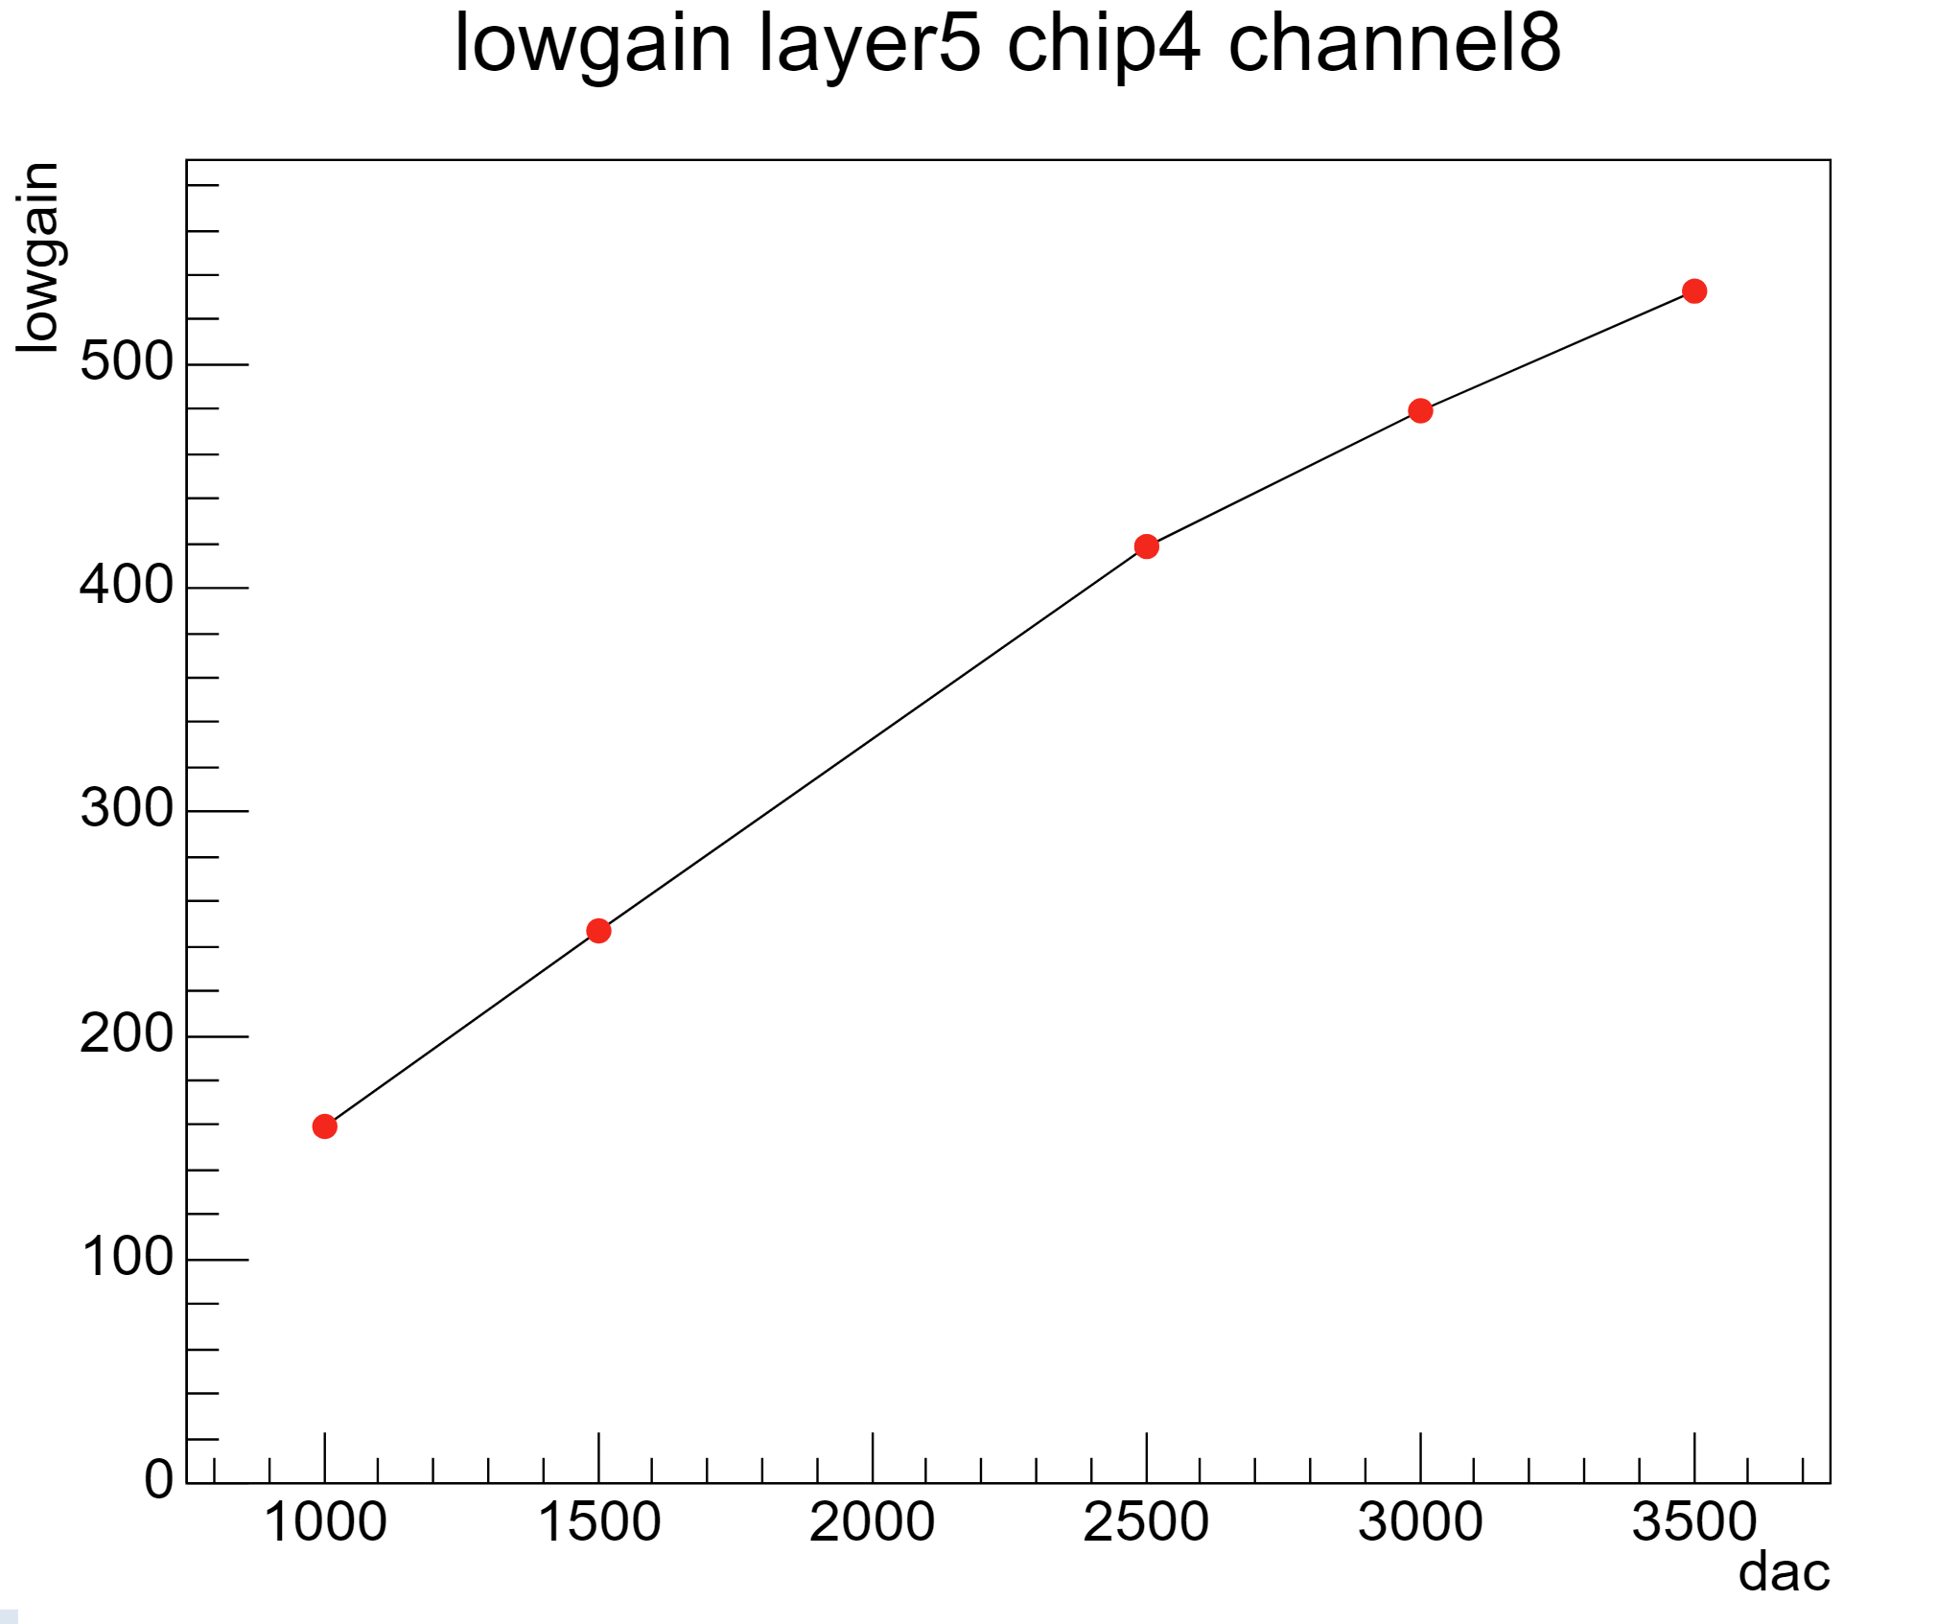
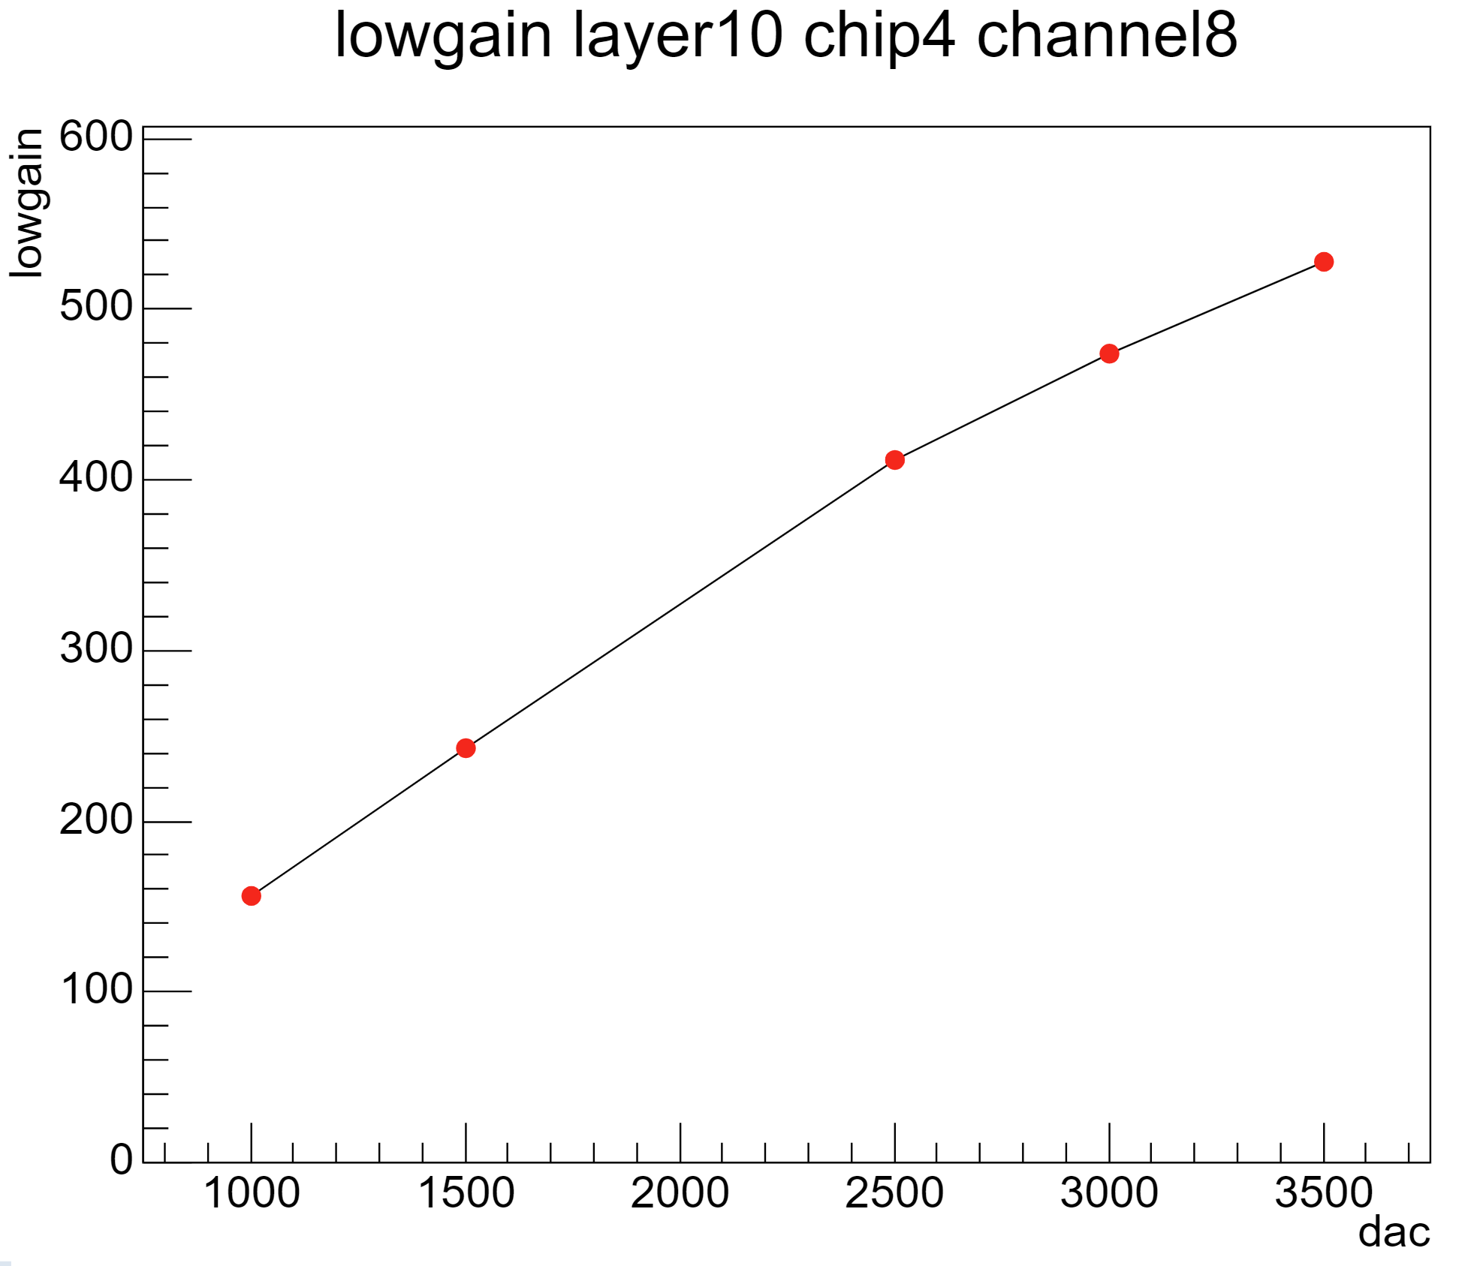
electronic calibration
already minus pedestal
dac stands for the amount of charge injected obvious non-linearity of lowgain

