Slide 1
第四届LHCb物理前沿研讨会
CP violating observables in $B→VV→P_{1}P_{2}P_{3}P_{4}$ decays
汇报人：李亚 （南京农业大学）
合作者：李湘楠，肖振军，周锐，严大程

Slide 2
Motivation
01
Outline
Framework
02
Recent progress
03
Summary
04

Slide 3
Motivation
01

Slide 4
CP violation (CPV) is a key requirement for generating the matter-antimatter asymmetry in the universe.
CPVs in K-, B-, D-meson have been confirmed by experiments.
First evidence (3.3σ ) for CPV in ${ Λ}_{b}→pπ^{+}π^{−}π^{−}$ decays.
In SM, CPV is attributed to an irreducible phase in the CKM quark-mixing matrix.
Notes:
CP violation (CPV) is a key requirement for generating the matter-antimatter asymmetry in the universe. [Rev. Mod. Phys.76 (2003) 1]
CPVs in K-, B-, D-meson have been confirmed by experiments.
Phys. Rev. Lett. 13(1964) ; Belle, Phys. Rev. Lett.(2001 ) LHCb; Phys. Rev. Lett.(2019)

Slide 5
Triple-product asymmetries (TPAs) may reveal potential signals of CPV
TP take the form which arises from
contractions. It is odd under time reversal. (arXiv:2211.07332)
The construction of a scalar triple product requires a final state with at least four particles, e.g. four-body decays.
Notes:
Triple-product asymmetries (TPAs) may reveal potential signals of CPV. [Valencia, 1989; Datta, London, 2003]

Slide 6
Four-body B meson decays are rich in CPV phenomena in the quark sector.
Rich resonance structures.
Interference between different resonances might induce lager CPV.
Angular analysis could provide a lot of meaningful CP asymmetries.
Several Collaborations have observed B meson decays into various four-body charmless hadronic final states in certain two body invariant mass regions.
$$B_{s}^{0}→(K^{+}K^{−})({K^{−}π}^{+})$$ | JHEP11(2013)092
$$B_{s}^{0}→(K^{+}π^{−})({K^{−}π}^{+})$$ | JHEP03(2018)140
$$B^{0}→(π^{+}π^{−})(K^{+}π^{−})$$ | JHEP05(2019)026
$$B_{(s)}^{0}→(K^{+}π^{−})({K^{−}π}^{+})$$ | JHEP07(2019)032
$$B_{s}^{0}→(K^{+}K^{−})(K^{+}K^{−})$$ | JHEP12(2019)155

Slide 7
Opportunities for CPV searches but also modelling challenges
More complicated strong dynamics than two-body ones.
Receive both resonant and nonresonant contributions.
Suffer substantial final-state interactions.
A factorization formalism in full phase space is not yet available.
In the multi-body sector
The leading-power regions of a Dalitz plot.
[C.-H. Chen and H.-N. Li, PLB 561 (2003) 258]
Quasi-two-body mechanism. The validity of factorization.
[NPB 899 (2015) 247,NPB 555 (1999) 231]
Two-meson distribution amplitudes (TMDAs).
[Sov. J. Nucl. Phys. 38 (1983) 289, PRD 91 (2015) 094024,PLB 763 (2016) 29…]
The scenario has been successful applied to three-body decay, encourages
us to extended it to the four-body ones.

Slide 8
Framework
02

Slide 9
In the standard model, low-energy effective Hamiltonian is given:
Fermi coupling constant
Local four-quark operators
CKM matrix elements
Wilson coefficient
For two-body nonleptonic B meson decays, the key step is to calculate the hadronic matrix elements

Slide 10
Theoretical approach
Factorization Approach
H.Y. Cheng, C.K. Chua, Y. Li,…
QCD Factorization
A. Furman, B.El Bennich, R. Kaminski, T. Mannel,
X.H. Guo, Y.D. Yang, Z.H. Zhang,…
PQCD
H.n. Li, C.D. L$\ddot{u}$, Z.J. Xiao, W. Wang, W.F. Wang,
R. Zhou, …
Symmetry
X.G. He, G.N. Li, D. Xu, J.L. Rosner, M. Gronau,…
Sum rules
Ulf-G. Meißner, Y.M. Wang, Y.L. Sheng, S. Cheng
A. Khodjamirian (QCD)

Slide 11
PQCD approach

Slide 12
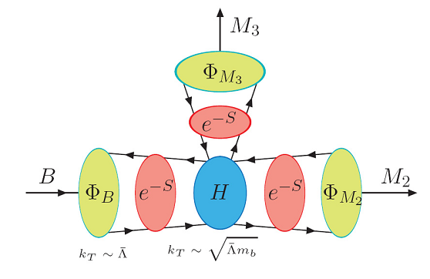
k_{T} factorization: The full amplitudes of two-body decay $B→M_{1}M_{2}$ can be factorized as
References:
PPNP51-85(2003);
arXiv:0707.1294;
0907.4940;
1406.7689
Hard
Kernel
Wave
Function
Sudakov
Factor
Jet
Function
Wilson
Coefficients
$k_{T}$ resummation
Threshold resummation

Slide 13
PQCD approach
Transition form factor is dominated from the perturbative region;
Nonfactorizable and annihilation diagrams can be calculated in PQCD.
Large strong phase from annihilation diagrams which plays an important role in the CP asymmetry.
Direct CPV(%) | FA | BBNS | PQCD | exp.
$$B→π^{+}π^{−}$$ | $$−5±3$$ | $$−6±12$$ | $$+30±20$$ | $$+32±4$$
$$B→K^{+}π^{−}$$ | $$+10±3$$ | $$+5±9$$ | $$−17±5$$ | $$−8.3±0.4$$
References:
Phys. Rev. D 63, 054008 (2001)
Phys. Rev. D 63, 074009 (2001)
Phys. Lett. B 504, 6 (2001)
Semileptonic B meson decays
Two-body B meson decays (pure annihilation decays)
Three-body and four-body hadronic B meson decays
b-baryon decays
PQCD

Slide 14
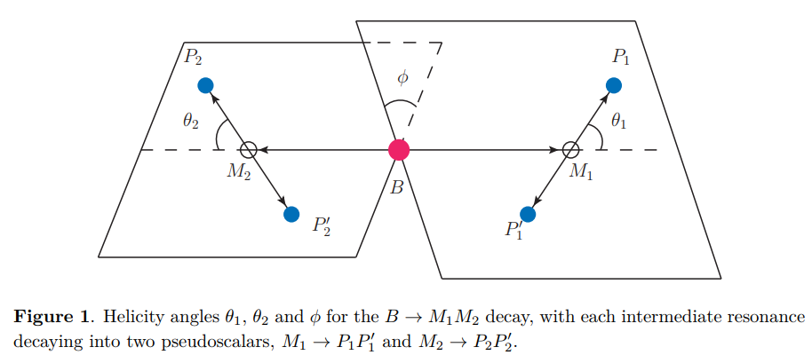
$B→VV→P_{1}P_{2}P_{3}P_{4}$ decays
Based on the quasi-two-body mechanism, four-body processes are assumed to proceed dominantly with two intermediate resonances
two-meson DAs (TMDAs)
A decay amplitude is written as
TMDAs

Slide 15
$B→VV→P_{1}P_{2}P_{3}P_{4}$ decays
Analyze angular distribution in four-body decays

Slide 16
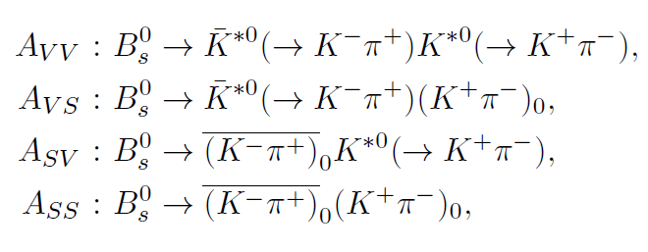
$B→VV→P_{1}P_{2}P_{3}P_{4}$ decays
$A_{0},A_{∥}, A_{⊥}$
CP-even: $A_{0},A_{∥},$ $A_{S^{−}},$ $A_{SS}$ CP-odd: $A_{⊥}$, $A_{S^{+}}$

Slide 17
In addition to direct CPV, one can predict triple product asymmetries (TPAs)
$${\hat{n}}_{V2}$$
$${\hat{n}}_{V1}$$
$$φ$$
$${\hat{p}}_{V1}$$
TP$≡$

Slide 18
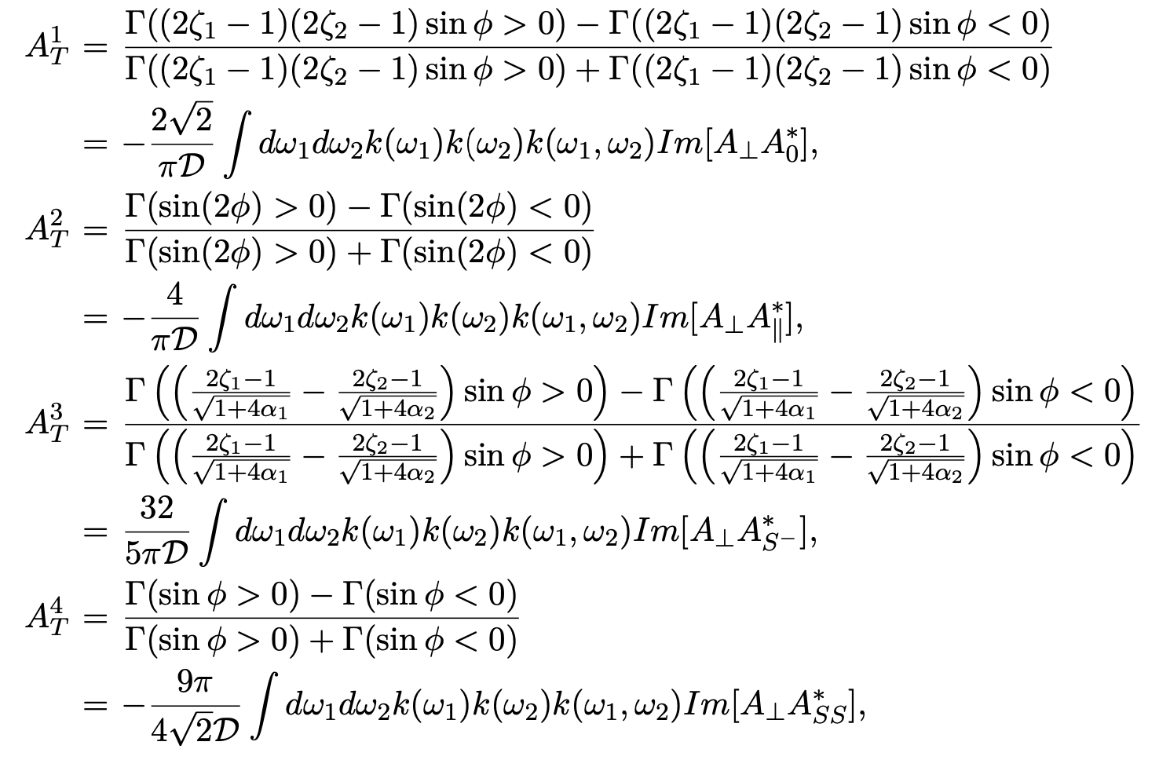
Triple product asymmetries(TPAs)
JHEP 05 (2021) 082, JHEP 07 (2015) 166
Strong phases$Δδ$ can produce a nonzero value

Slide 19
Note that a strong phase difference yields a TPA even in the absence of weak phases, so a nonzero TPA does not necessarily signal CP violation.
Strong phases$Δδ$ can produce a nonzero value
To identify a true CP violation signal, one has to compare the TPAs in B and $\overline{B}$ meson decays.
$$∝\sin{φ\cos{δ}}$$
$$∝\cos{φ\sin{δ}}$$
Notes:
Note that AiT (true), nonvanishing only in the presence of the weak phase difference, provides an alternative measure of CP violation. Furthermore, compared with direct CP asymmetries, AiT (true) does not suffer the suppression from the strong phase difference, and reaches a maximum
when the strong phase difference vanishes. On the contrary, AiT (f ake) can be nonzero even as the weak phase difference vanishes. Such a quantity is sometimes referred to as a fake asymmetry, which reflects the effect of strong phases.

Slide 20
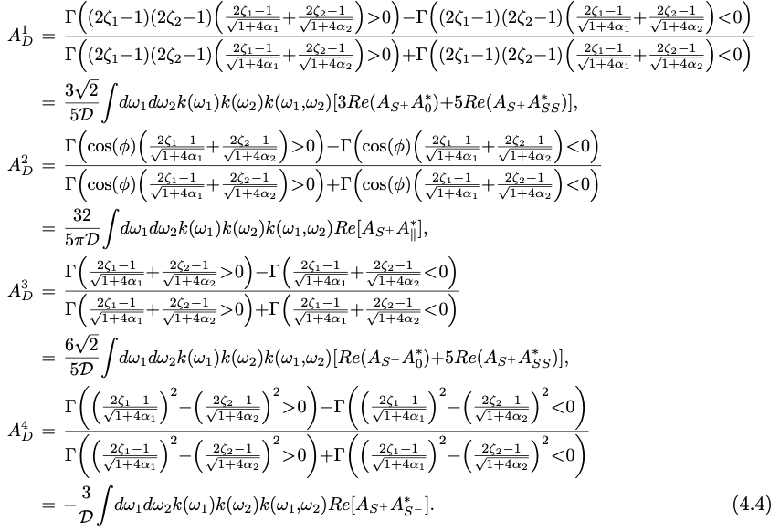
S-wave-induced direct CP asymmetries

Slide 21
S-wave-induced direct CP asymmetries
Combining the quantities for the corresponding CP-conjugate process, we define the S-wave-induced direct CP asymmetries
It can be measured using untagged samples, in which CP-conjugate processes need not be distinguished.
$$∝Sinφ Sinδ$$
Notes:
Note that the above quantities, as the sum of the asymmetries in the B and B ̄ meson decays, can be measured using untagged samples, in which CP-conjugate processes need not be distinguished.

Slide 22
Recent progress
03
JHEP 05 (2021) 082; Eur. Phys. J. C 81 (2021) 9, 806; Phys. Rev. D 105 (2022) 5, 053002;
Phys. Rev. D 105 (2022) 9, 093001; Eur. Phys. J. C 83 (2023) 10, 974; arXiv:2404,19198

Slide 23
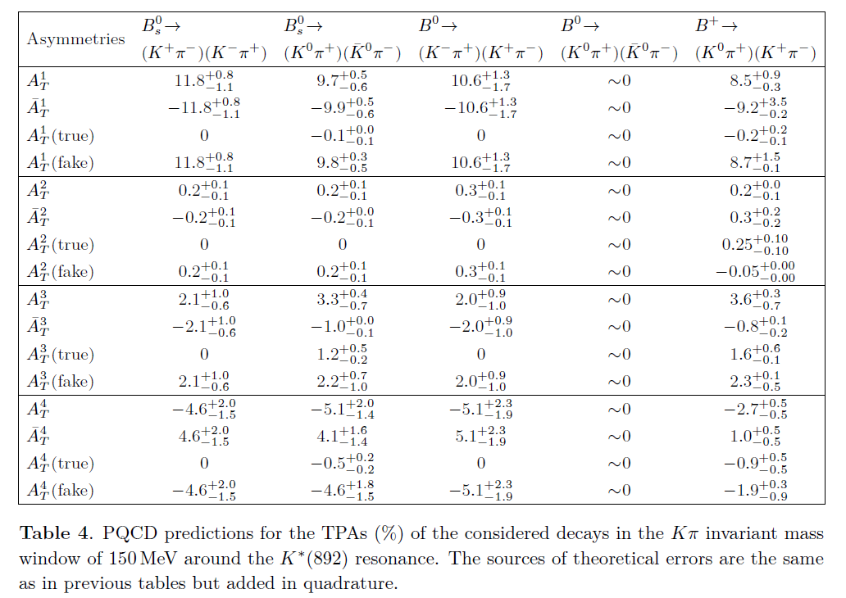
PQCD predictions for TPAs (%) of the four-body B(s) → (Kπ)(Kπ) decays
LHCb[JHEP07(2015)166]
Asymmetry | Data
$A_{T}^{1}$(true) | $$0.003±0.041±0.009$$
$A_{T}^{2}$(true) | $$0.009±0.041±0.009$$
$A_{T}^{3}$(true) | $$0.019±0.041±0.008$$
$A_{T}^{4}$(true) | $$−0.040±0.041±0.008$$
The LHCb measurements show no manifest deviation from zero.
Notes:
In the modes with the neutral intermediate states K0¯K 0, each helicity amplitude involves the same single weak phase in the SM, such that true TPAs vanish without the weak phase difference.
Because the decay B0 → (K0π+)(K ̄0π−) receives a contribution solely from the weak annihilation, its tiny transverse polarization component (see table 1) leads to the negligible TPAs as exhibited in table 4.
The searches for the true TPAs in the Bs0 → (K+π−)(K−π+) decay [27] in the untagged data sample indeed show no manifest deviation from zero.
The diminishing A2T (true) for the Bs0 → (K0π+)(K ̄ 0π−) mode can be also understood through the similarity between the perpendicular and parallel polarization amplitudes.
In the modes with the neutral intermediate states, the true TPAs vanish without the weak phase difference.
The tiny transverse polarization component in the pure annihilation mode leads to the vanishing TPAs.
The smallness of $A_{T}^{2}$ is attributed to the suppression from the strong phase
difference between the perpendicular and parallel polarization amplitudes.
The predicted nonvanishing fake TPAs can be tested if flavor tagged measurements are available in the future.

Slide 24
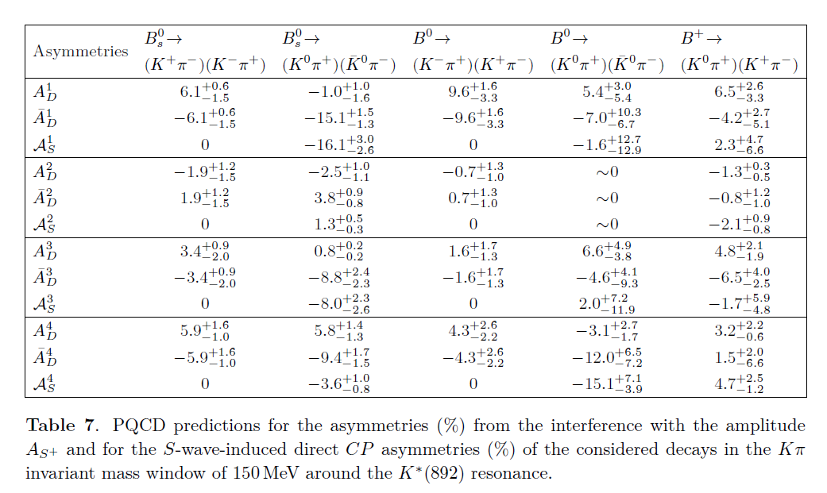
S-wave-induced direct CP asymmetries ${(10}^{−2})$
LHCb[JHEP07(2015)166]
Asymmetry | Data
$$A_{S}^{1}$$ | $$−0.061±0.041±0.012$$
$$A_{S}^{2}$$ | $$0.081±0.041±0.008$$
$$A_{S}^{3}$$ | $$−0.079±0.041±0.023$$
$$A_{S}^{4}$$ | $$−0.081±0.041±0.010$$
The LHCb measurements show no manifest deviation from zero.
The fractions $f_{S^{+}}$ are less than 10%, most values of $A_{D}$ are only a few percent.
The observed two largest S-wave-induced direct CP asymmetries are over 15% in magnitude, which could be searched in the future.

Slide 25
A new observable $L_{K^{∗}{\overline{K}}^{∗}}$ defined as the ratio of the longitudinal branching ratios of ${\overline{B}}_{s}→K^{∗0}{\overline{K}}^{∗0}$versus ${\overline{B}}_{d}→K^{∗0}{\overline{K}}^{∗0}$
phase-space factor
longitudinal polarisation fractions
Notes:
As shown in ref. [19] this observable can be defined as a ratio of longitudinal amplitudes of two U-spin related decays.
Even though the deviation in LK∗K ̄∗ is not yet at the level of a troublesome discrepancy with the SM, its potential connection with other B-flavour anomalies makes it interesting to investigate it further in terms of possible SU(3)-breaking NP contributions. We may explore in a model-independent way how to explain this anomaly via contributions only
to the Wilson coefficients of the b → s transition, while keeping the corresponding b → d SM-like (or with opposite NP contributions).

Slide 26
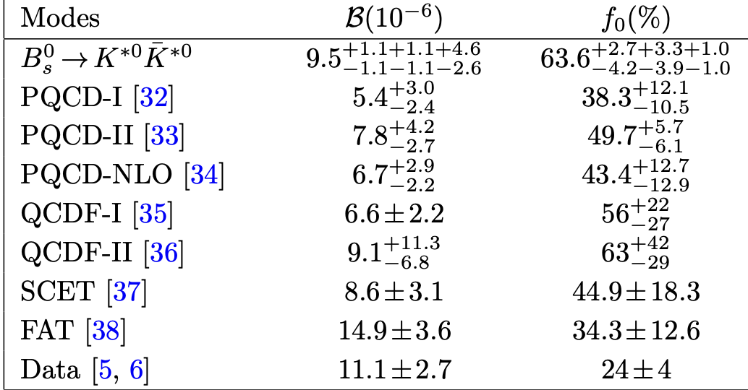
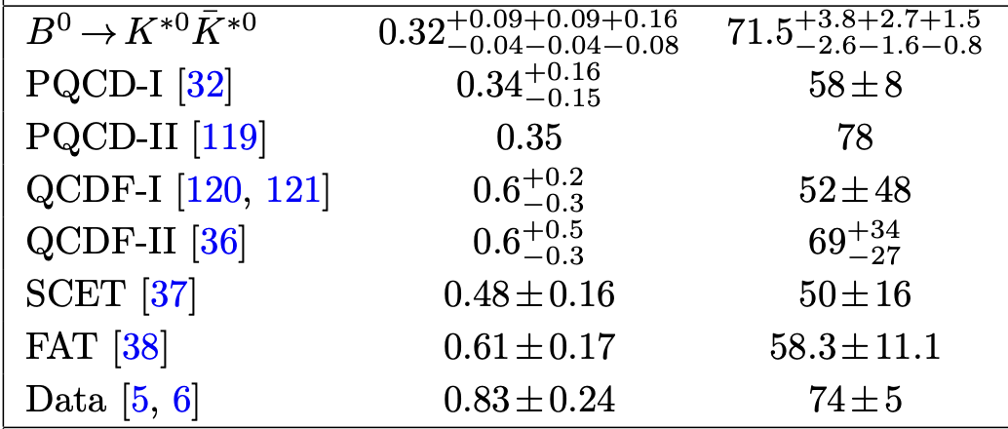
$$L_{K^{∗}{\overline{K}}^{∗}}$$ | exp | PQCD(LO) | PQCD(NLO) | QCDF (2301.10542)
 | $$4.43±0.92$$ | $${14.83}_{−8.23}^{+12.50}$$ | $${14.20}_{−5.58}^{+7.50}$$ | $${19.53}_{−6.64}^{+9.14}$$

Slide 27
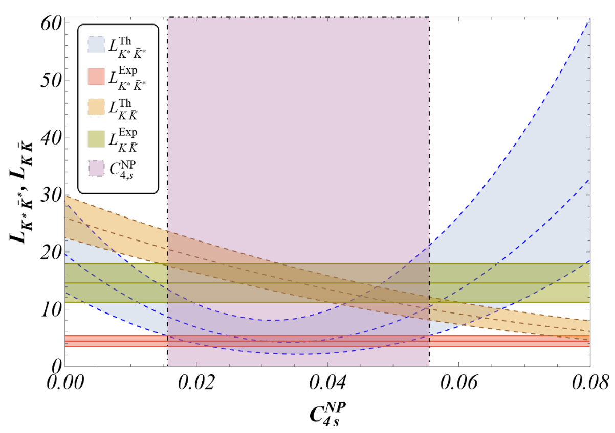
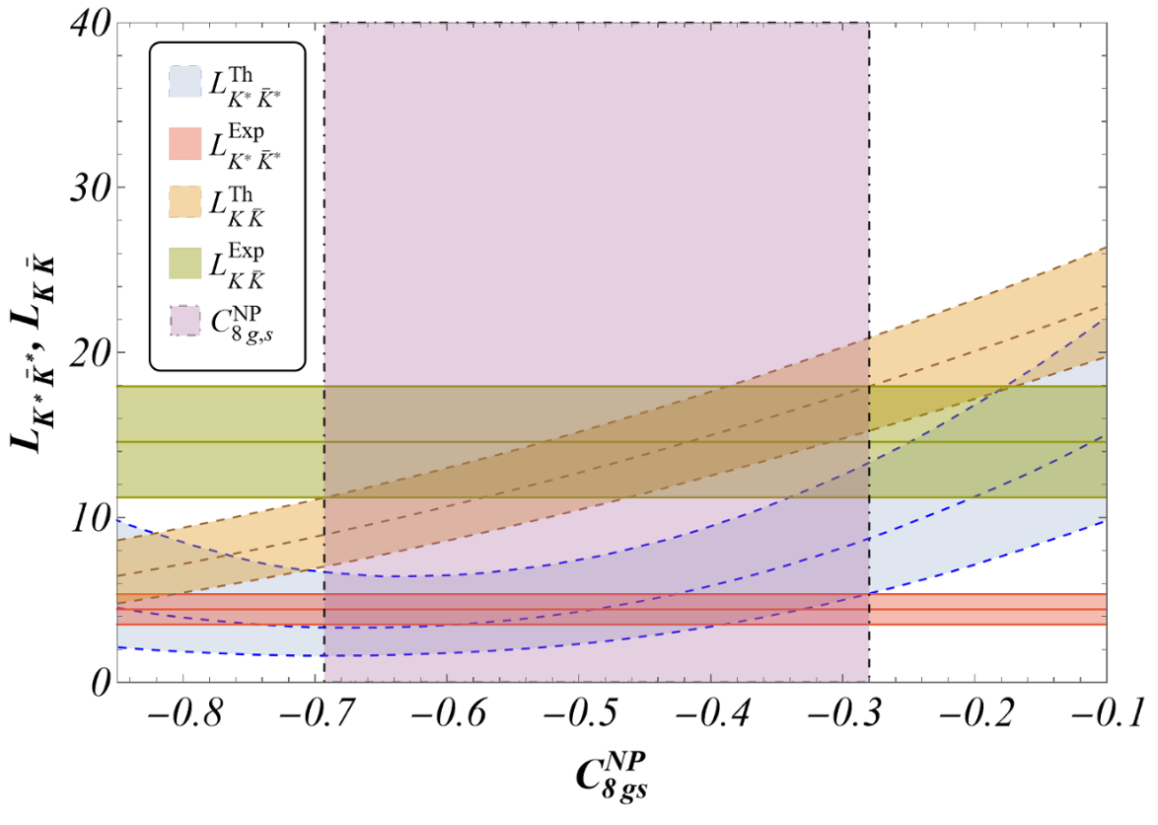
arXiv: 2301.10542 [A. Biswas et al. ]
Notes:
L ∗ ̄∗ is dominated by C4NP and C8NP and it is rather insensitive to C6NP

Slide 28
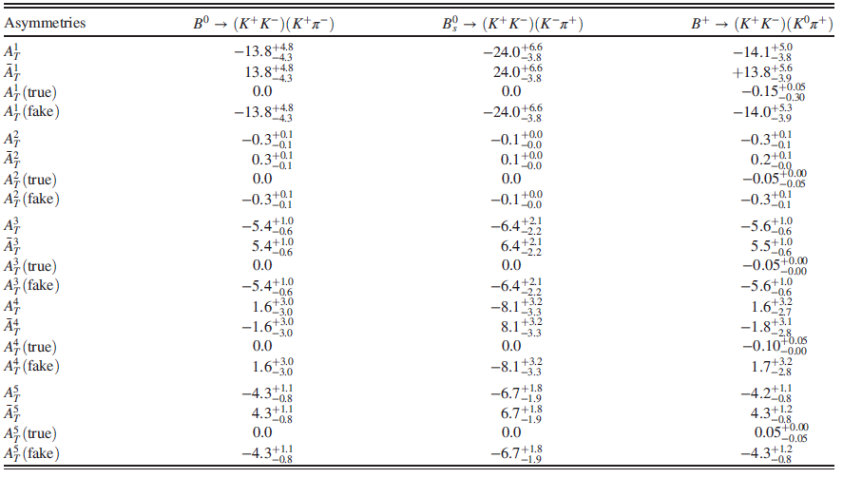
PQCD predictions for TPAs (%) of the four-body B(s) → (KK)(Kπ) decays

Slide 29
PQCD predictions for TPAs of the $B^{0}→(K^{+}K^{−})(K^{+}π^{−})$ decay together with data from LHCb, BABAR and Belle
 | PQCD | LHCb | BABAR | Belle
$A_{T}^{1}$(true) | $0.0$ | $$−0.007±0.012±0.002$$ | $$−0.046±0.031±0.017$$ | $$−0.029±0.025±0.005$$
$A_{T}^{2}$(true) | 0.0 | $$+0.004±0.014±0.002$$ | $$−0.003±0.056±0.036$$ | $$0.021±0.040±0.006$$
$A_{T}^{3}$(true) | 0.0 | $$+0.004±0.006±0.001$$ | $$…$$ | $$…$$
$A_{T}^{4}$(true) | 0.0 | $$+0.002±0.006±0.001$$ | … | $$…$$
$A_{T}^{1}$(fake) | $${−0.138}_{−0.043}^{+0.048}$$ | $$−0.105±0.012±0.006$$ | $$−0.203±0.031±0.019$$ | $$−0.211±0.025±0.010$$
$A_{T}^{2}$(fake) | $$−0.003±0.001$$ | $$−0.017±0.014±0.003$$ | $$0.016±0.058±0.038$$ | $$−0.041±0.040±0.013$$
$A_{T}^{3}$(fake) | $${−0.054}_{−0.006}^{+0.010}$$ | $$−0.063±0.006±0.005$$ | … | …
$A_{T}^{4}$(fake) | $$−0.016±0.030$$ | $$−0.019±0.006±0.007$$ | … | …
The true TPAs of the${ B}^{0}$mode is measured to be consistent with zero, showing no evidence for CPV.
A significant fake asymmetry $A_{T}^{1}(fake)$ is observed in all three measurements.
The only available measurements for the S-wave induced TPAs are from LHCb.
Notes:
$B^{0}→(K^{+}K^{−})(K^{+}π^{−})$ 味道改变中性流过程FCNC

Slide 30
True TPAs are zero for pure penguin decays, which is consistent with those from LHCb.
The tiny transverse polarization component in the pure annihilation mode leads to the negligible TPAs.
The large fake $A_{T}^{1}$simply reflects the importance of the strong final state phases.
The smallness of $A_{T}^{2}$ is attributed to the suppression from the strong phase difference between the perpendicular and parallel polarization amplitudes .
Notes:
B0 → φφThe tiny transverse polarization component in the pure annihilation mode leads to the negligible TPAs.

Slide 31
04
Summary

Slide 32
The PQCD factorization formalism based on the quasi-two-body decay mechanism for four-body B meson decays has been well established and have many potential applications.
Various CP asymmetries are presented. In particular, by including the S-wave components, we have estimated the S-wave induced TPAs and direct CPV for the first time.
The true TPAs in most of the considered channels are tiny, of order ${10}^{−2}$or even lower. The fake ones could be larger, but they do not reflect CPV.
The angular analysis may be improved by expanding the mass region, which provide more meaningful asymmetries in the future.

Slide 33
Thank you

