Slide 1
Theoretical progress of $B→Kπ$ puzzle
第四届LHCb前沿物理研讨会
Xin Liu (刘新)
Jiangsu Normal University
Thank Profs. H.-n. Li and Z.J. Xiao for collaborations and discussions
30th July, 2024

Slide 2
OUTLINE
1. B-meson Physics & Kπ puzzle
2. Experimental Data
3. Theoretical Explorations
4. Summary and Outlook
Sorry for those missed works!

Slide 3
B-meson Physics & Kπ puzzle

Slide 4
B-meson Physics
Three main physical objectives:
Testing the standard model physics related to flavor;
Exploring the CPV in the B-meson system;
Probing the possible new physics beyond the standard model.
Dedicated B-physics experiments:
Two B factories——BABAR@SLAC and Belle@KEK with many key measurements
Bevan et al., The Physics of the B Factories, arXiv:1406.6311
LHCb(ATLAS and CMS)@LHC and Belle-II@SuperKEKB with many exciting results
Bediaga et al., Physics case for an LHCb Upgrade II – Opportunities in flavor physics, and beyond, in the HL-LHC era, arXiv:1808.08865
Also see, e.g., Chengping’s and Shanzhen’s talks in this workshop
Kou et al., The Belle II Physics Book, arXiv:1808.10567

Slide 5
Theoretical efforts in nonleptonic B-meson decays:
From Beneke’s talk @ “Status and Prospects of Nonleptonic B Decays” on 31st May, 2022
Developing many dynamical frameworks such as QCDF, SCET, PQCD …
factorization theorem to separate the perturbative from nonperturbative strong interaction effects
QCD dynamics to calculate hadronic matrix elements with precision
nonperturbative inputs from experiments and QCDSR/LQCD
Improving theoretical predictions to match the more and more precise data
General agreement between theory and experiment but several puzzles
Focusing on long-standing $B→Kπ$ puzzle

Slide 6
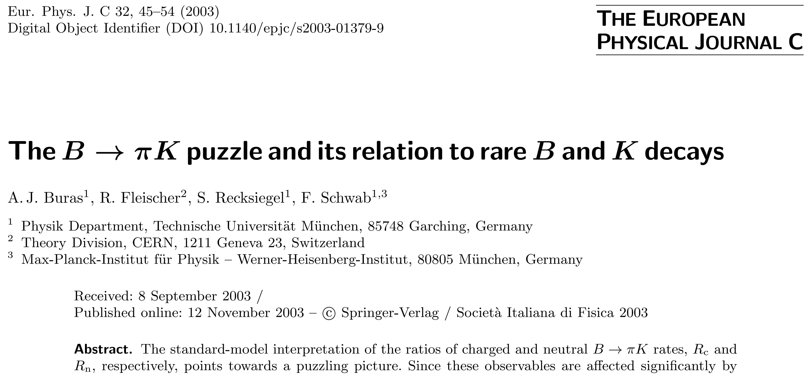
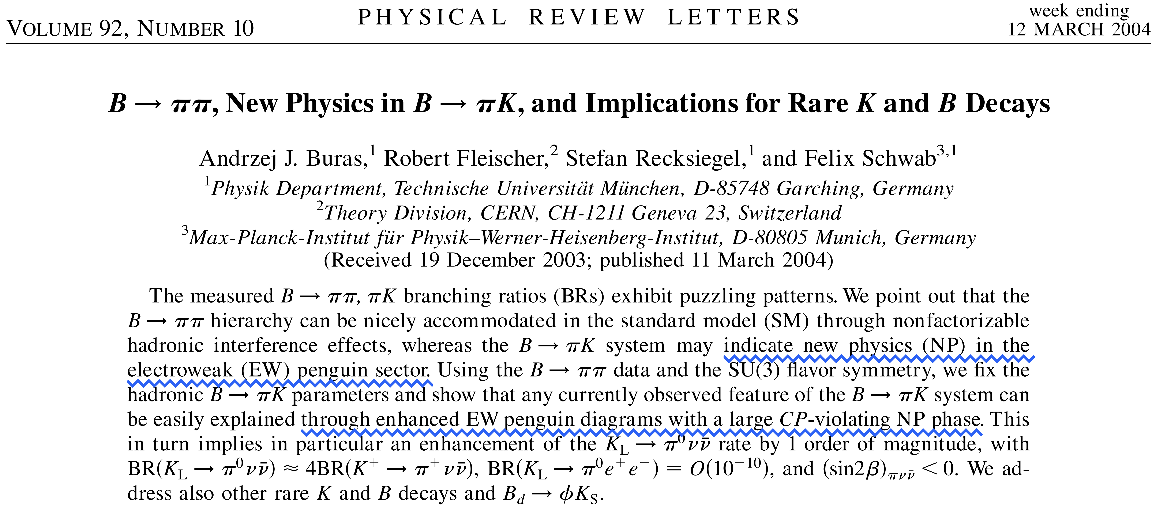
$B→Kπ$ puzzle
Two sources ( 20 years ago )
Ratios of branching ratios seem to violate isospin
$$\text{R}\text{c}≡2\text{×}\frac{BR(B^{±}→K^{±}π0) }{BR(B^{±}→π^{±}K0)}$$
theoretically expected R_{c}$−$R_{n} ≈ 0
$$\text{R}\text{n}≡\frac{1}{2}\text{×}\frac{BR(B0→K^{±}π^{∓}) }{BR(B0→π0K0)}$$
$$\text{R}≡\left[\frac{BR(B0→K^{±}π^{∓}) }{BR(B^{±}→π^{±}K0)}\right]\frac{τ_{B^{+}}}{τ_{B^{0}}}$$
HFAG2003: R_{c}>1 while R_{n}<1
Puzzling!

Slide 7
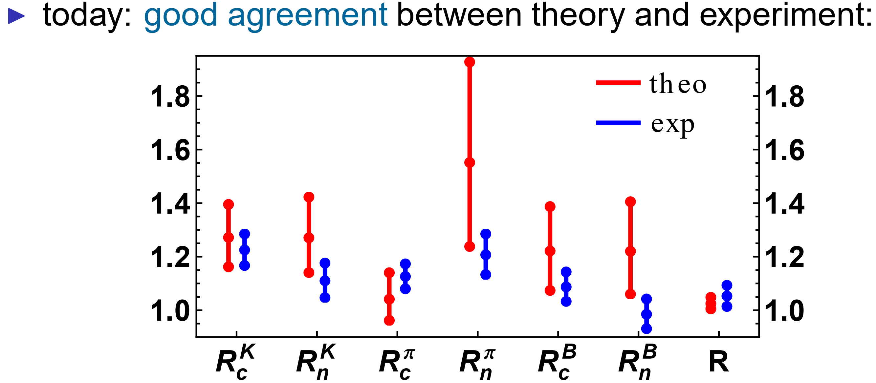
From Hofer’s talk @ Valencia in February, 2013
The $B→Kπ$ decays obey isospin relations!
Also Kπ isospin-based sum rule:
Grammatico@EPS-HEP 2021 in July, 2021
Gronau, The precise sum rule among four B-> Kπ CP asymmetries, hep-ph/ 0508047
Isospin violation parameter
In agreement with standard model expectation of zero!

Slide 8
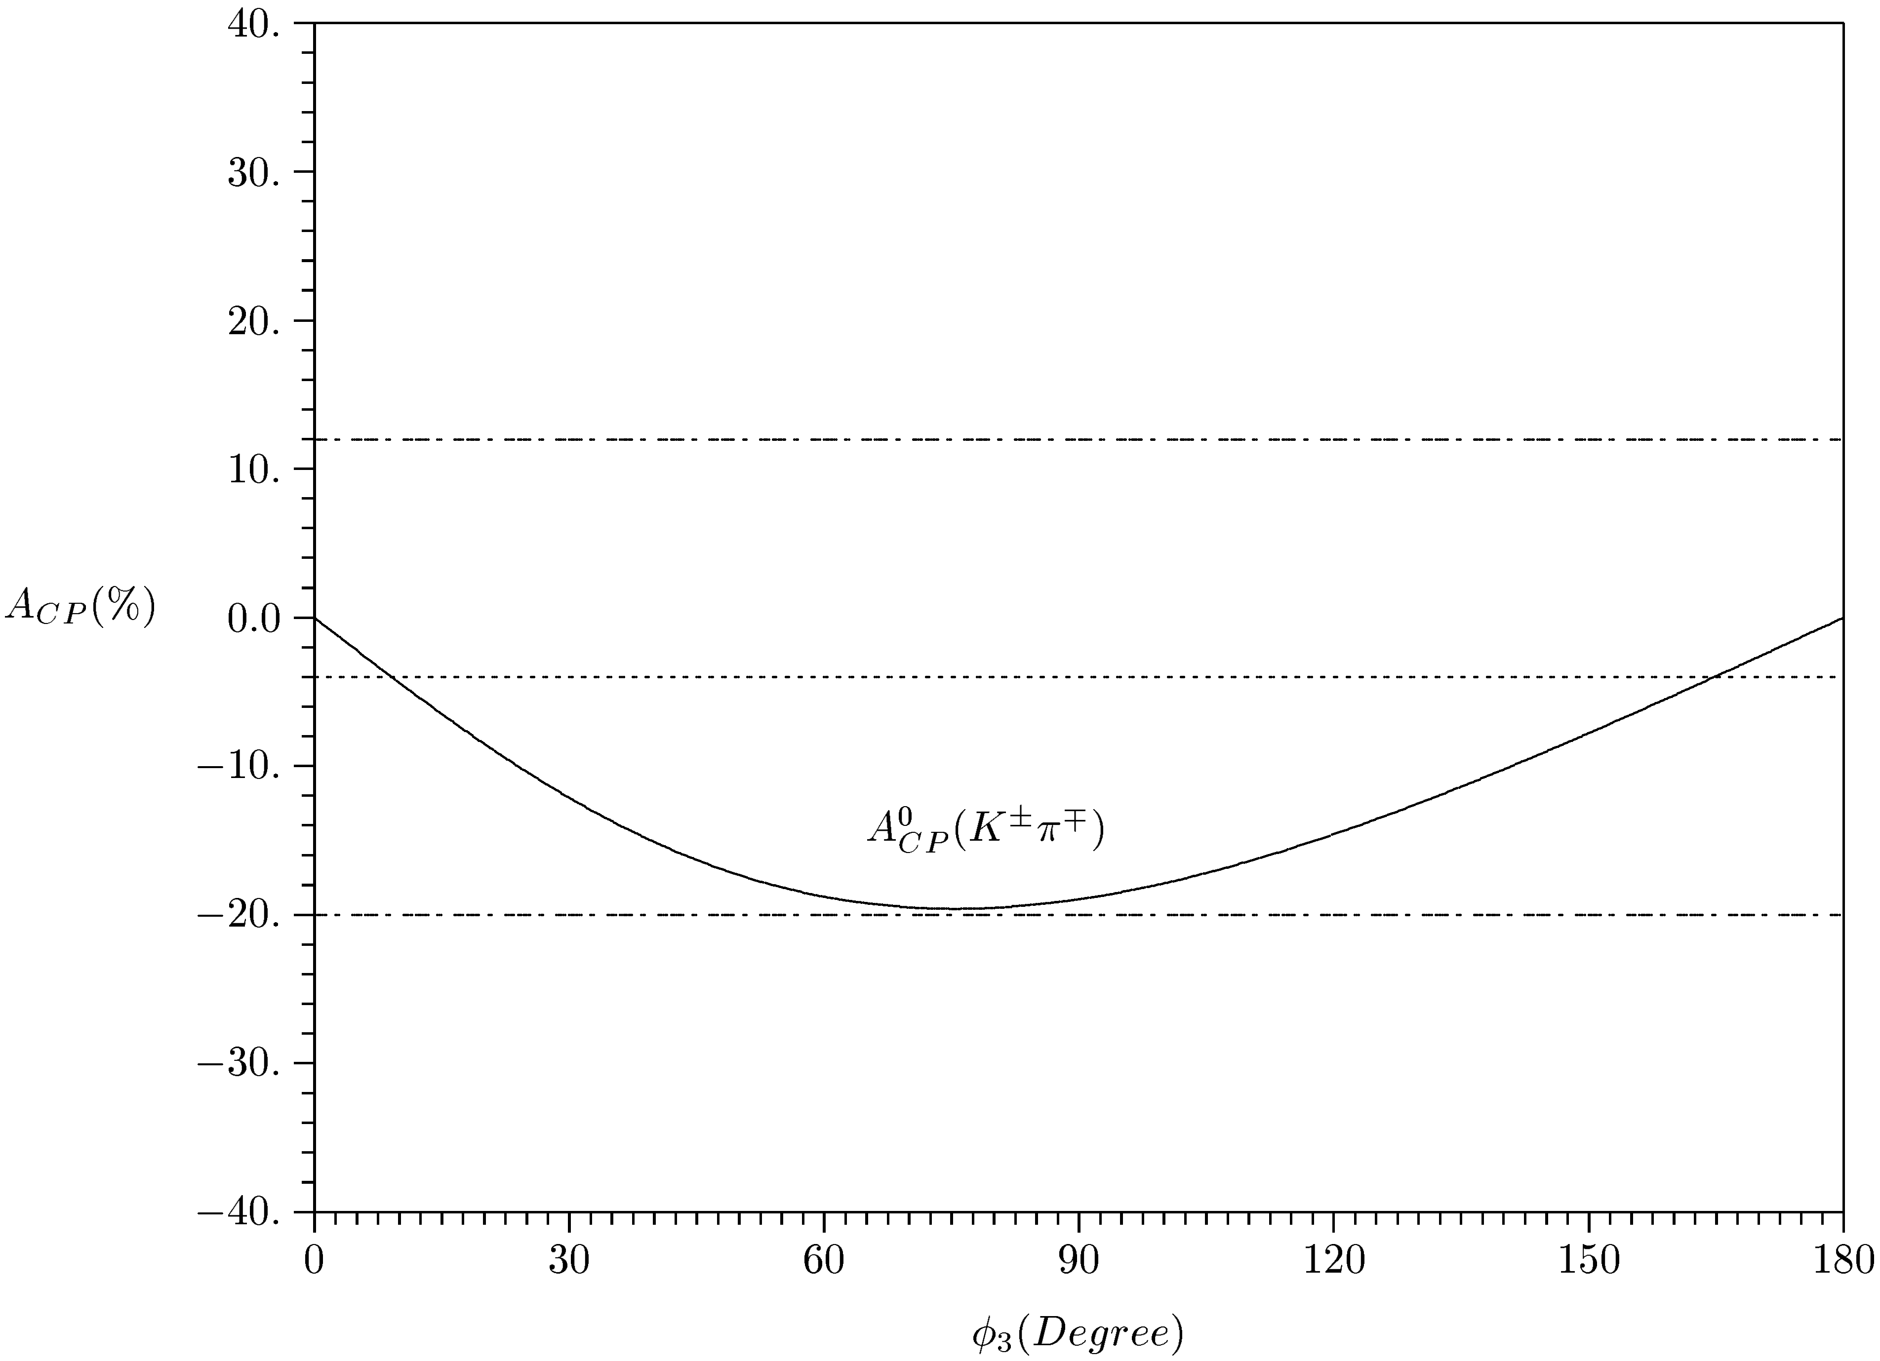
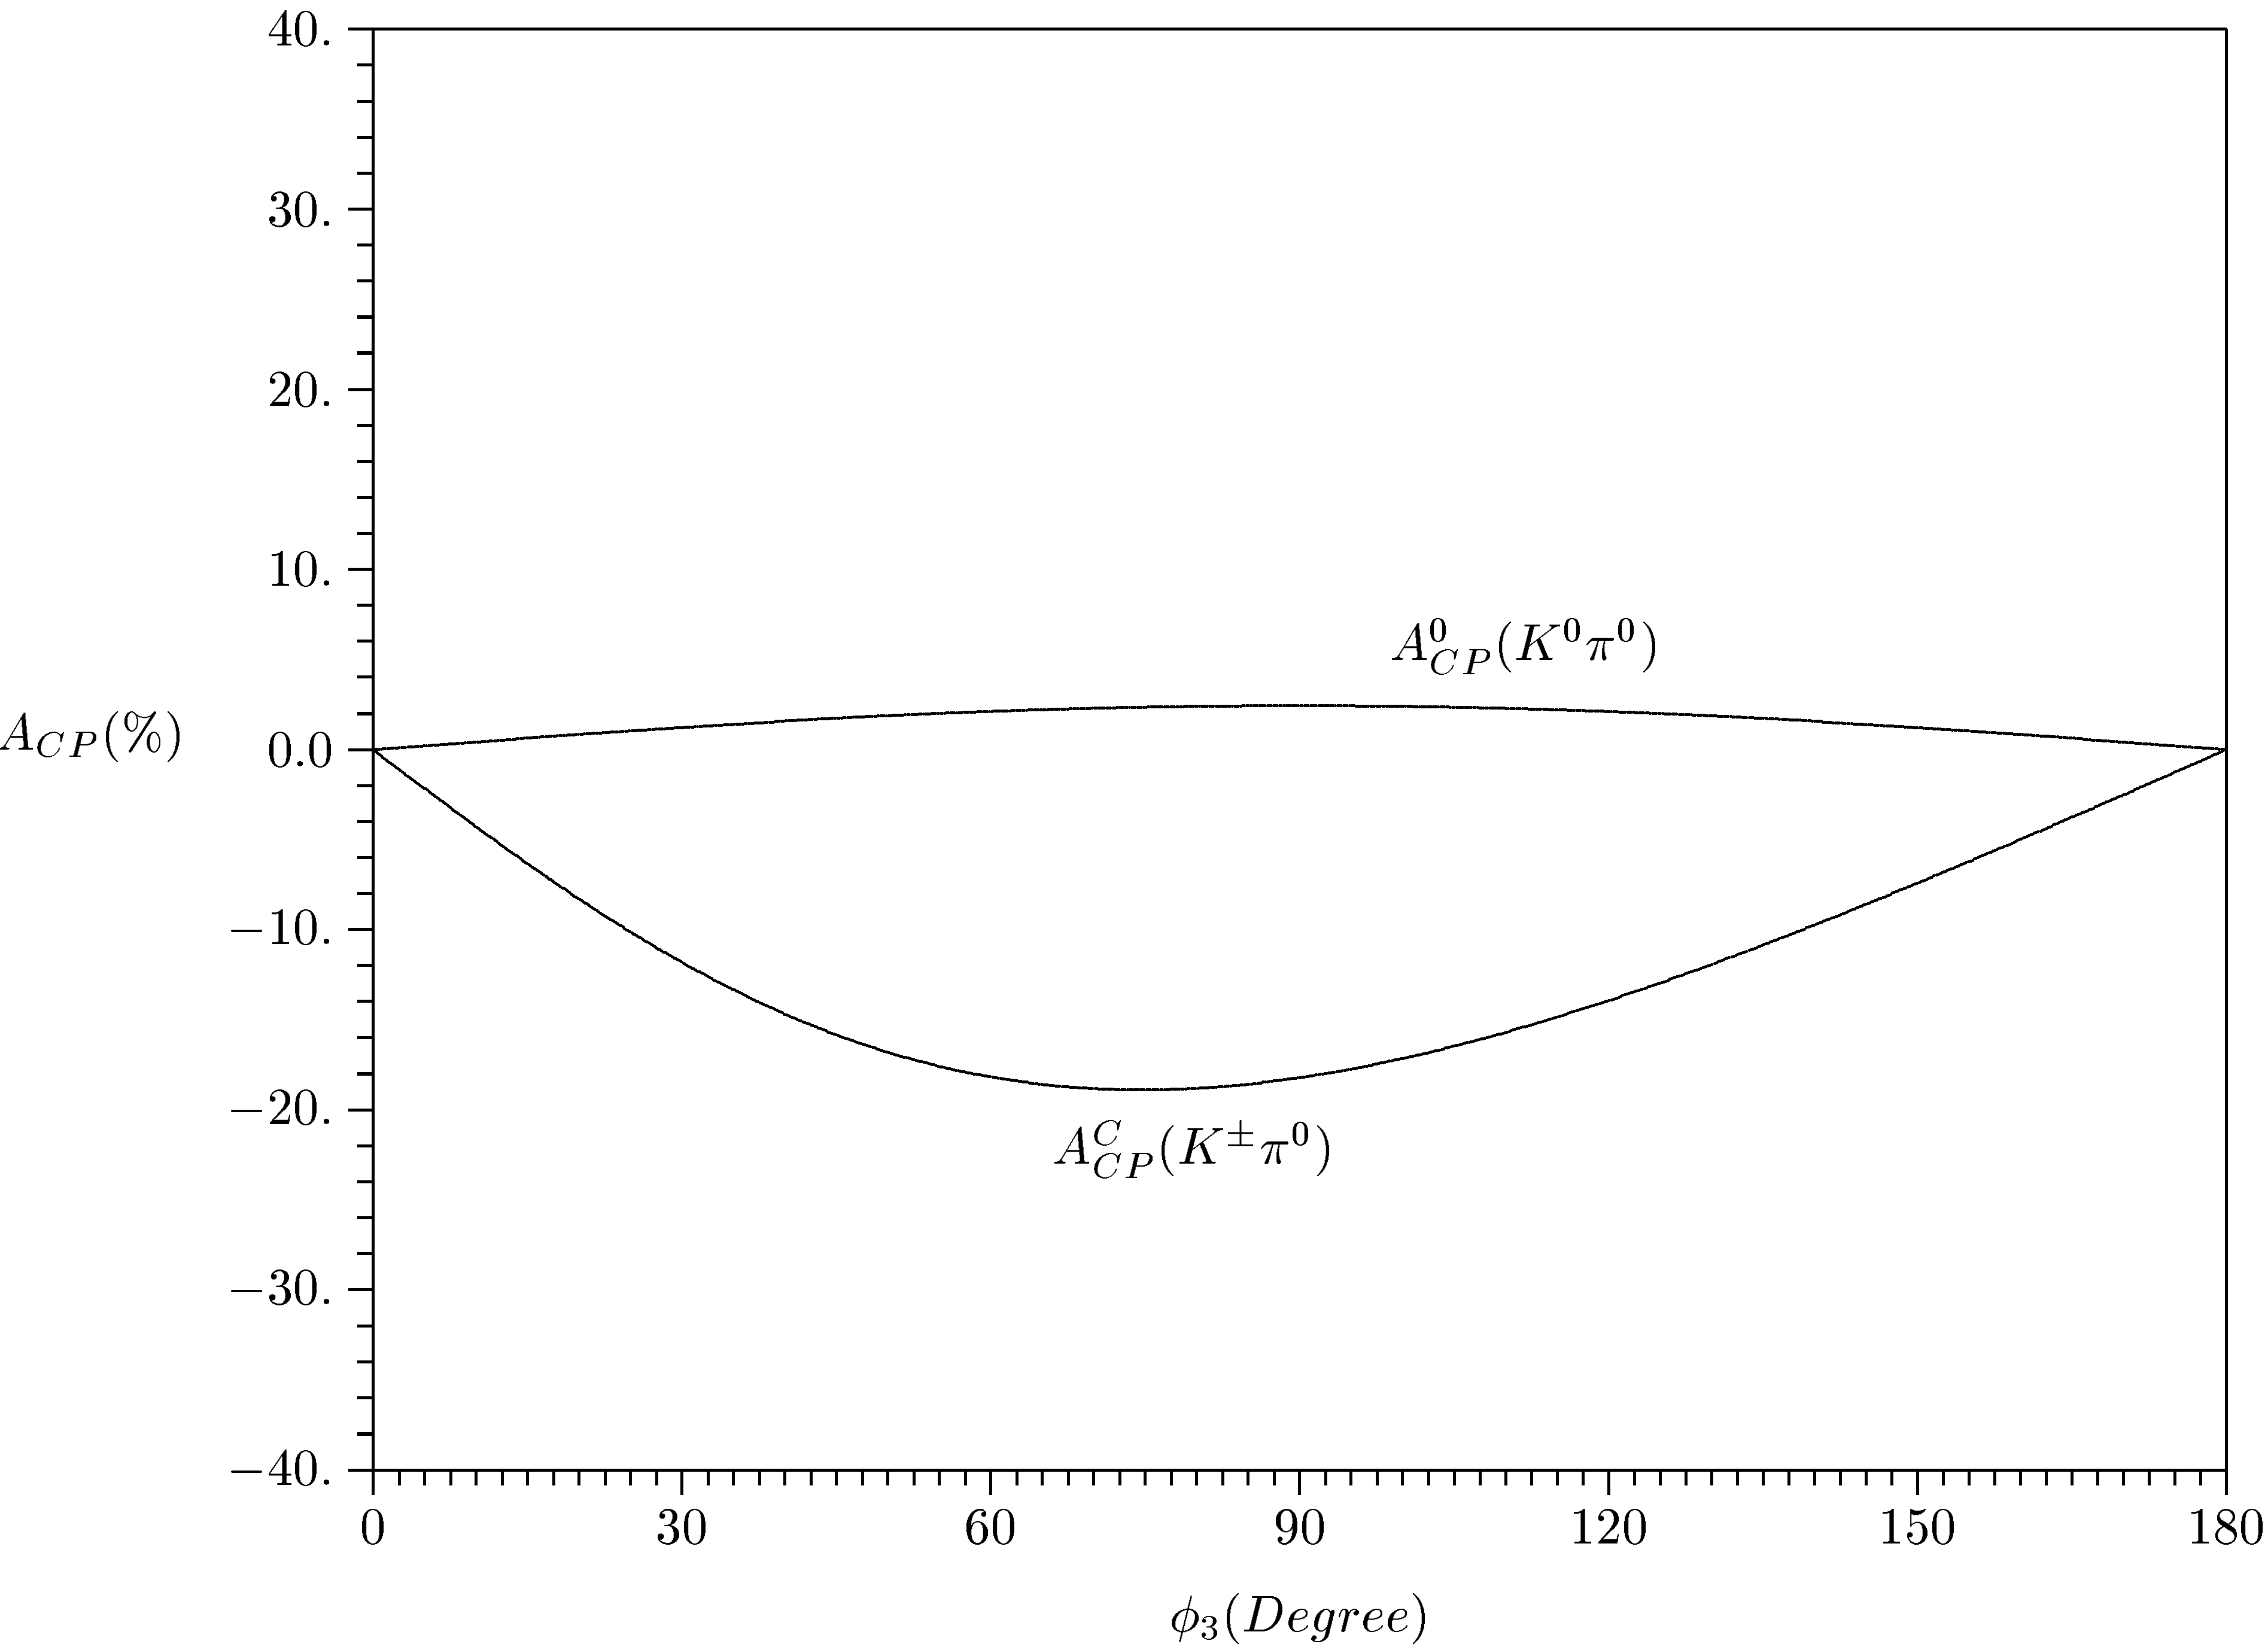
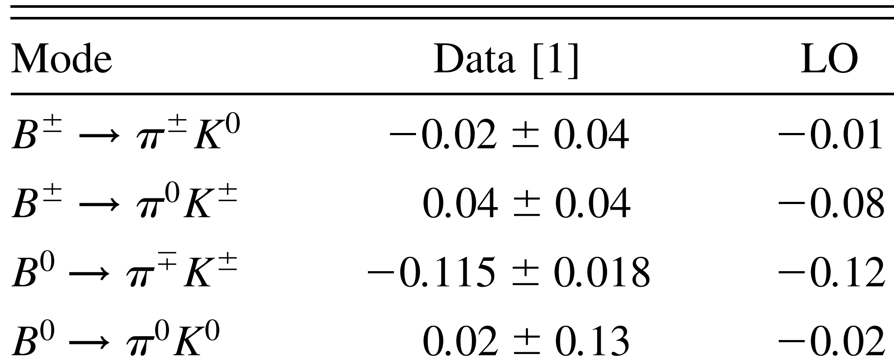
Direct CP asymmetry
PQCD-LO
Definition
$$A_{CP}=\frac{{|\text{A}(\overline{B}→\overline{f})|}^{2}−{|\text{A}(B→f)|}^{2}}{{|\text{A}(\overline{B}→\overline{f})|}^{2}+{|\text{A}(B→f)|}^{2}}$$
HnLi, Keum and Sanda, Penguin enhancement and B-> Kπ decays in Perturbative QCD, hep-ph/0004173
Naïve Expectation from isospin:
$$A_{CP}\left({K^{±}π}^{0}\right)≈A_{CP}(K^{±}π^{∓})$$
Same sign
$$∆A_{Kπ}≡A_{CP}\left({K^{±}π}^{0}\right)−A_{CP}\left({K^{±}π}^{∓}\right)\sim 0$$
HnLi, Mishima and Sanda, Resolution to the B-> Kπ puzzle, hep-ph/0508041

Slide 9
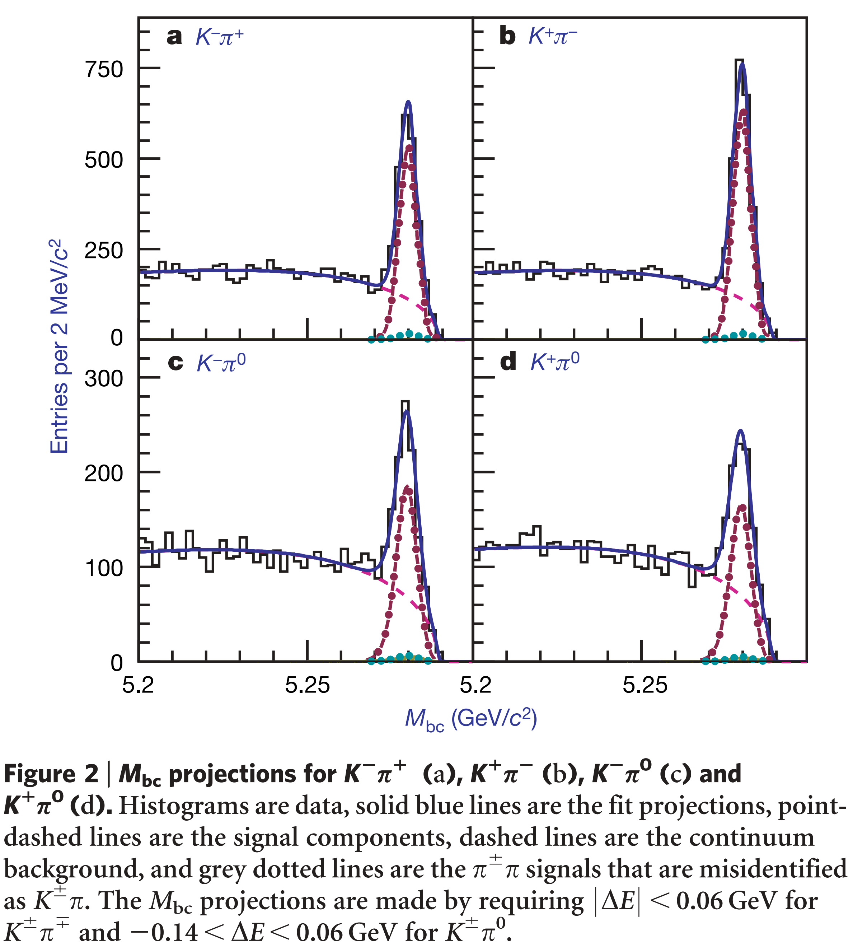
The observed anomalous difference
$$ΔA_{Kπ}≠0$$
the well-known Kπ puzzle!
established at the 4.4σ level from Belle 2007
$$ΔA_{Kπ}≡A_{CP}\left({K^{±}π}^{0}\right)−A_{CP}\left({K^{±}π}^{∓}\right)= +0.147±0.028$$
nonzero at > 5σ level from HFAG 2008

Slide 10
From Yanxi’s talk “Recent CPV results at LHCb” @ HFCPV2021
the long-standing Kπ puzzle!

Slide 11
Experimental Data

Slide 12
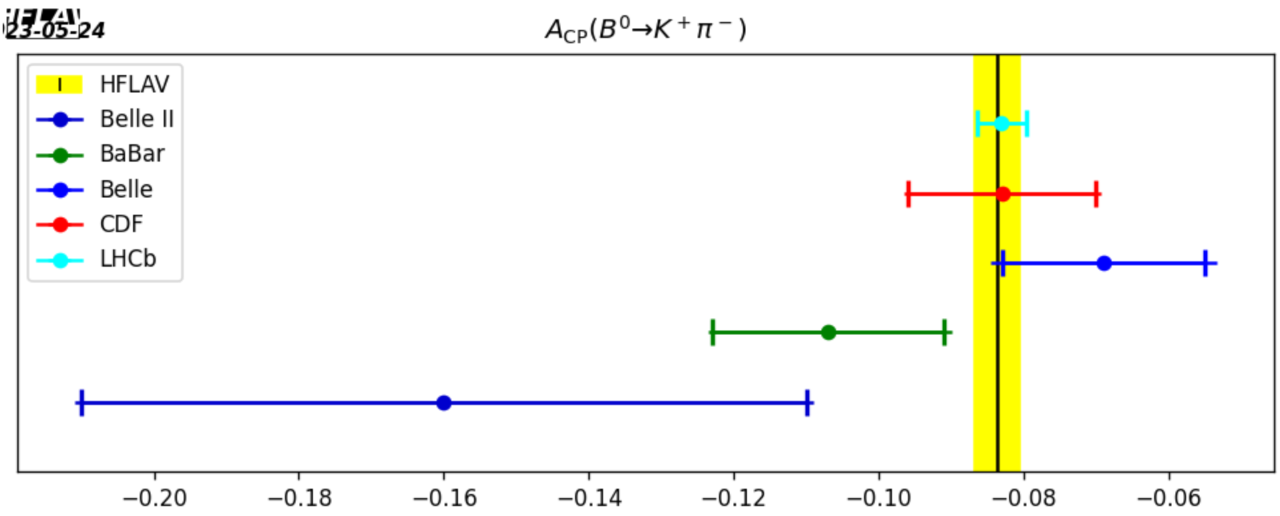
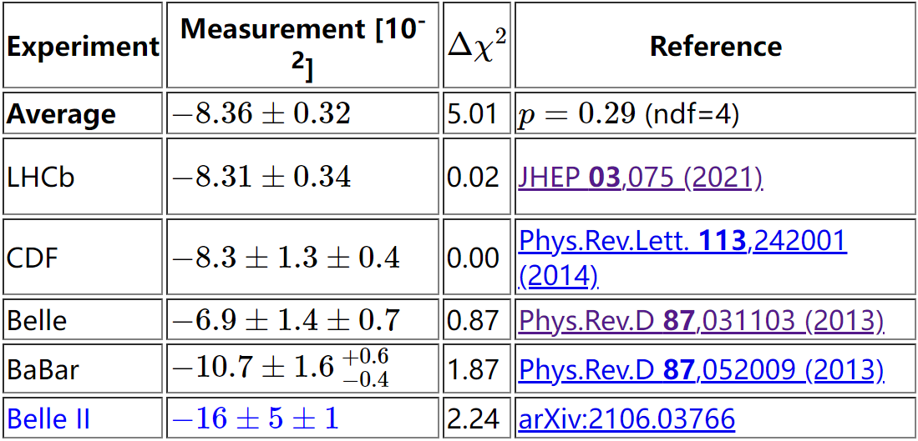
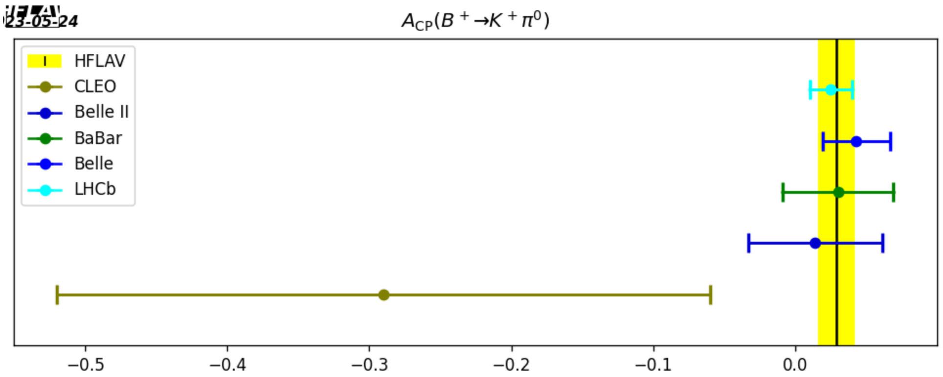
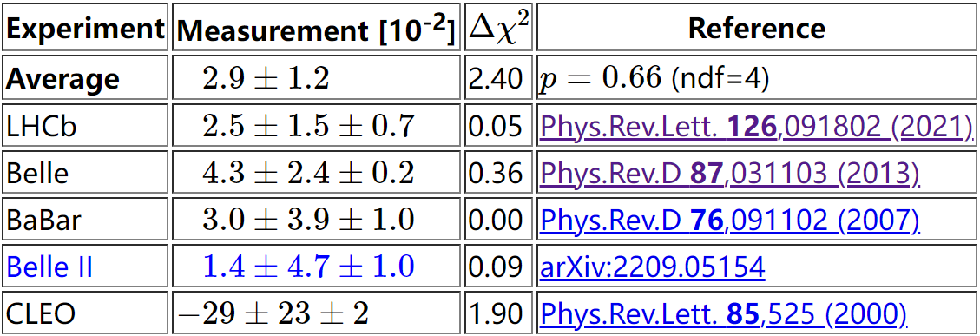
$∆A_{Kπ}=0.113±0.012$ (HFLAV2023)
Rare B decays | Heavy Flavor Averaging Group https://hflav.web.cern.ch/content/rare-b-decays#averages

Slide 13
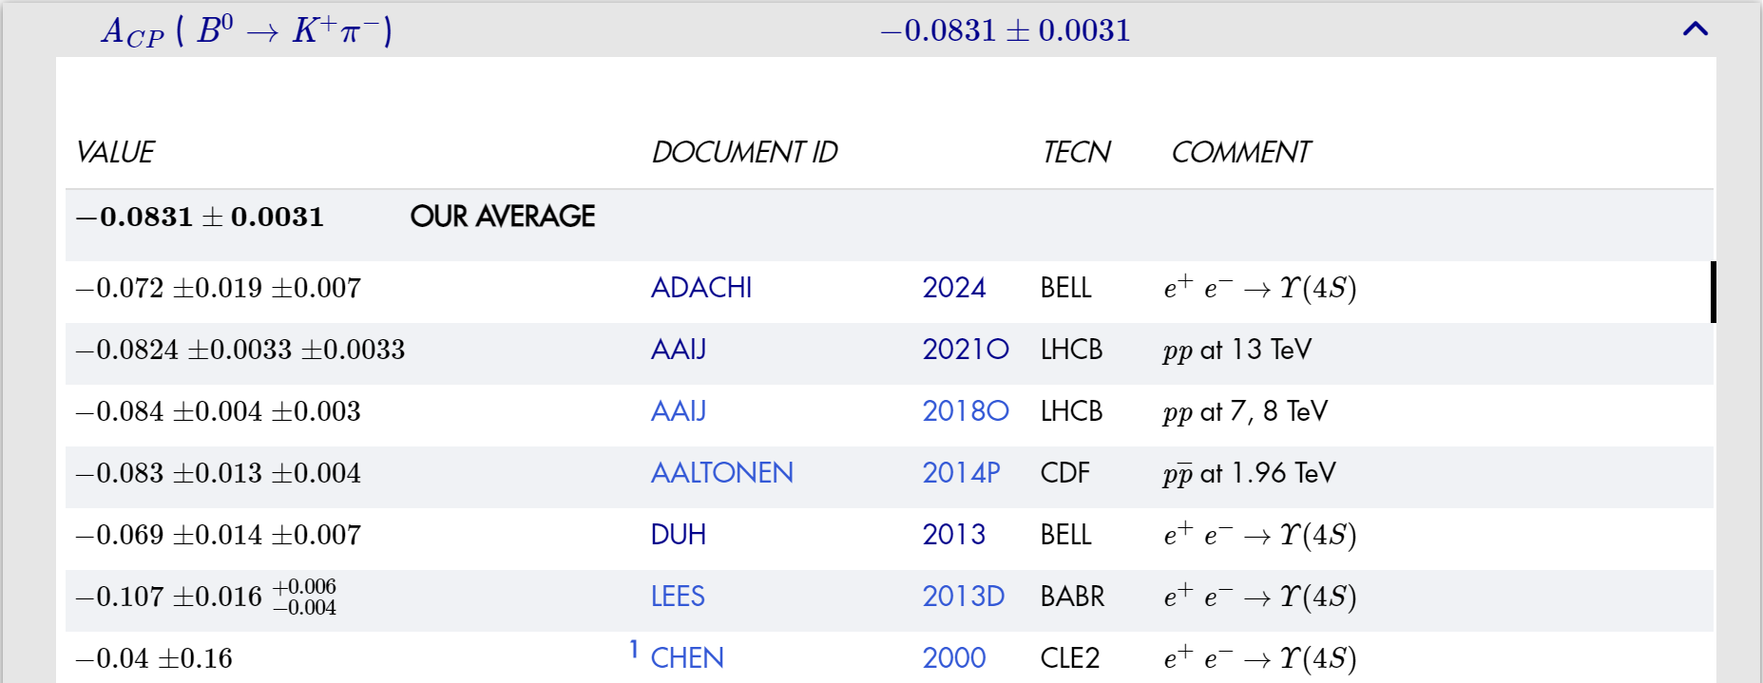
Navas et al. (Particle Data Group), the review of particle physics, to be published in Phys. Rev. D 110, 030001 (2024)
$∆A_{Kπ}=0.110±0.012$ (PDG2024)
pdgLive https://pdglive.lbl.gov/ParticleGroup.action?init=0&node=MXXX045

Slide 14
Theoretical Explorations

Slide 15
Penguin-dominated $B→Kπ$ decays in diagrammatic approach
topological-amplitude parametrization:
$$A\left(B^{+}→K^{0}π^{+}\right)=P,$$
$\sqrt{2 }A\left(B^{+}→K^{+}π^{0}\right)=−P\left[1+\frac{P_{ew} }{P}+\left(\frac{T}{P}+\frac{C}{P}\right)e^{iγ}\right]$,
P: QCD penguin amplitude
P_{ew}: electro-weak penguin amplitude
$A\left(B^{0}→K^{+}π^{−}\right)=−P\left(1+\frac{T}{P}e^{iγ}\right)$,
T: color-allowed tree amplitude
$\sqrt{2 }A\left(B^{0}→K^{0}π^{0}\right)=P\left(1−\frac{P_{ew}}{P}−\frac{C}{P}e^{iγ}\right)$,
C: color-suppressed tree amplitude
Counting rules in terms of powers of λ( = |V_{us}|):
T/P ~ λ
P_{ew} /P ~ λ
C/P ~ λ²
YYCharng and HnLi, Determining weak phases from the B-> ππ, Kπ decays, hep-ph/0410005

Slide 16
Direct CP asymmetry due to different strong and weak phases
Two directions towards resolving $B→Kπ$ puzzle
Large complex $P_{ew}$
After Buras et al’s pioneering work, lots of papers appeared to interpret the correlations of new physics with this puzzle. For example,
Buras, Fleischer, et al:
Arnowitt, Oh, et al:
Khalil, Masiero, Murayama:
NPB 697,133(04); EPJC 45,701(06)
PLB 633,748(06)
PLB 682, 74(09)
Barger, CWChiang, et al:
YDYang, GRLu, RMWang:
Hofer et al:
PLB 598,218(04)
PRD 73,015003(06)
JHEP 02,080(11)
Mishima and Yoshikawa:
WSHOU, HnLi, Mishima et al:
Chang, Kim, Song:
PRD 70, 094024(04)
PRL 98,131801(07)
PLB 696,367(11)
YLWu and YFZhou:
Bhattacharyya, Chatterjee, Nandi:
Fleischer, Jaarsma, Keri Vos, et al:
PRD 71, 021701(R)(05); 72, 034037(05); 74, 094007(06)
PRD 78,095005(08)
PLB 785,525(18), EPJC 78, 943(18)
Khalil and Kou:
Fleischer, Jager, Pirjol, Zupan:
PRD 71, 114016(05)
…...
Kim, Oh, et al:
PRD 78,111501(R)(08)
QChang, XQLi, YDYang:
The general consensus for a large complex $P_{ew}$ is that one needs new physics beyond SM.
PRD 72, 074005(05); PLB 665, 231(08)
JHEP 09,038(08); 05,056(09)
Baek, CWChiang, London, et al:
PRD 71,057502(05); PLB 653,249(07); 663,410(08); 675,59(09)…

Slide 17
Interesting observations from different groups:
Large $P_{ew}$ and C were fitted for $B→Kπ$ from the data within a framework of flavor SU(3).
CWChiang et al, Charmless B-> PP decays using flavor SU(3) symmetry, hep-ph/0404073
New data imply only a large $C$ constructive to T; and a small $P_{ew}$; and no strong signal of new physics；Only $C/T$, larger than the PQCD calculations, demands more study.
YYCharng and HnLi, Determining weak phases from the B-> ππ, Kπ decays, hep-ph/0410005
The established difference between the direct CP asymmetries of ${B^{±}→π}^{0}K^{±}$ and $B^{0}→π^{∓}K^{±}$ appears to be generated by hadronic and not by new physics.
Fleischer, Recksiegel and Schwab, On puzzles and non-puzzles in B-> ππ, Kπ decays, hep-ph/0702275
The present $B→Kπ$ data are compatible with the SM … and argue that anomalously large subleading terms are not needed.
Ciuchini et al, Determining weak phases from the B-> ππ, Kπ decays, arXiv:0811.0341[hep-ph]
The best-fit region overlaps largely with the parameter space favored in the SM: there is not yet enough motivation to go beyond the SM.
Kundu, Patra and Roy, Complete analysis of all B-> Kπ decays, arXiv:2106.15633[hep-ph]

Slide 18
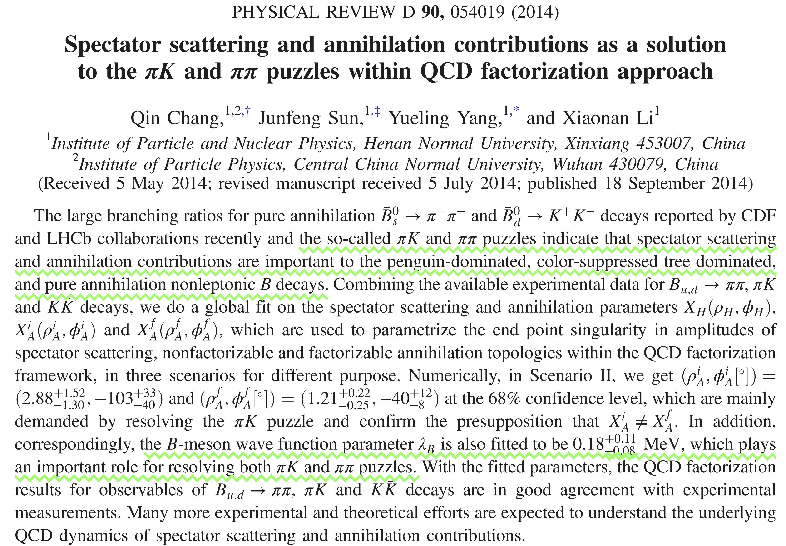
Large complex $C$
QCDF framework
QChang et al:

Slide 19
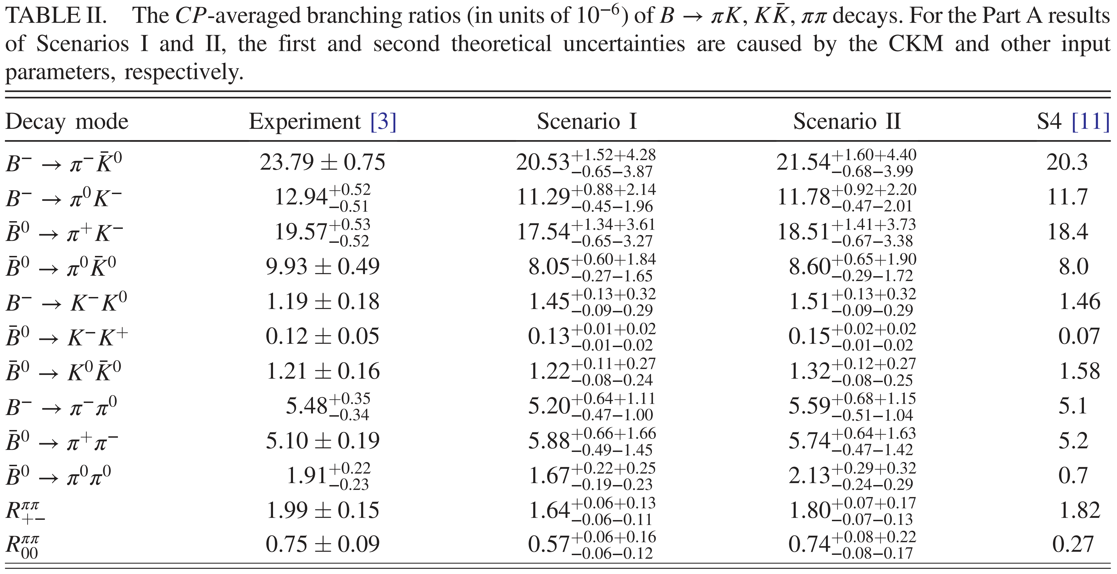
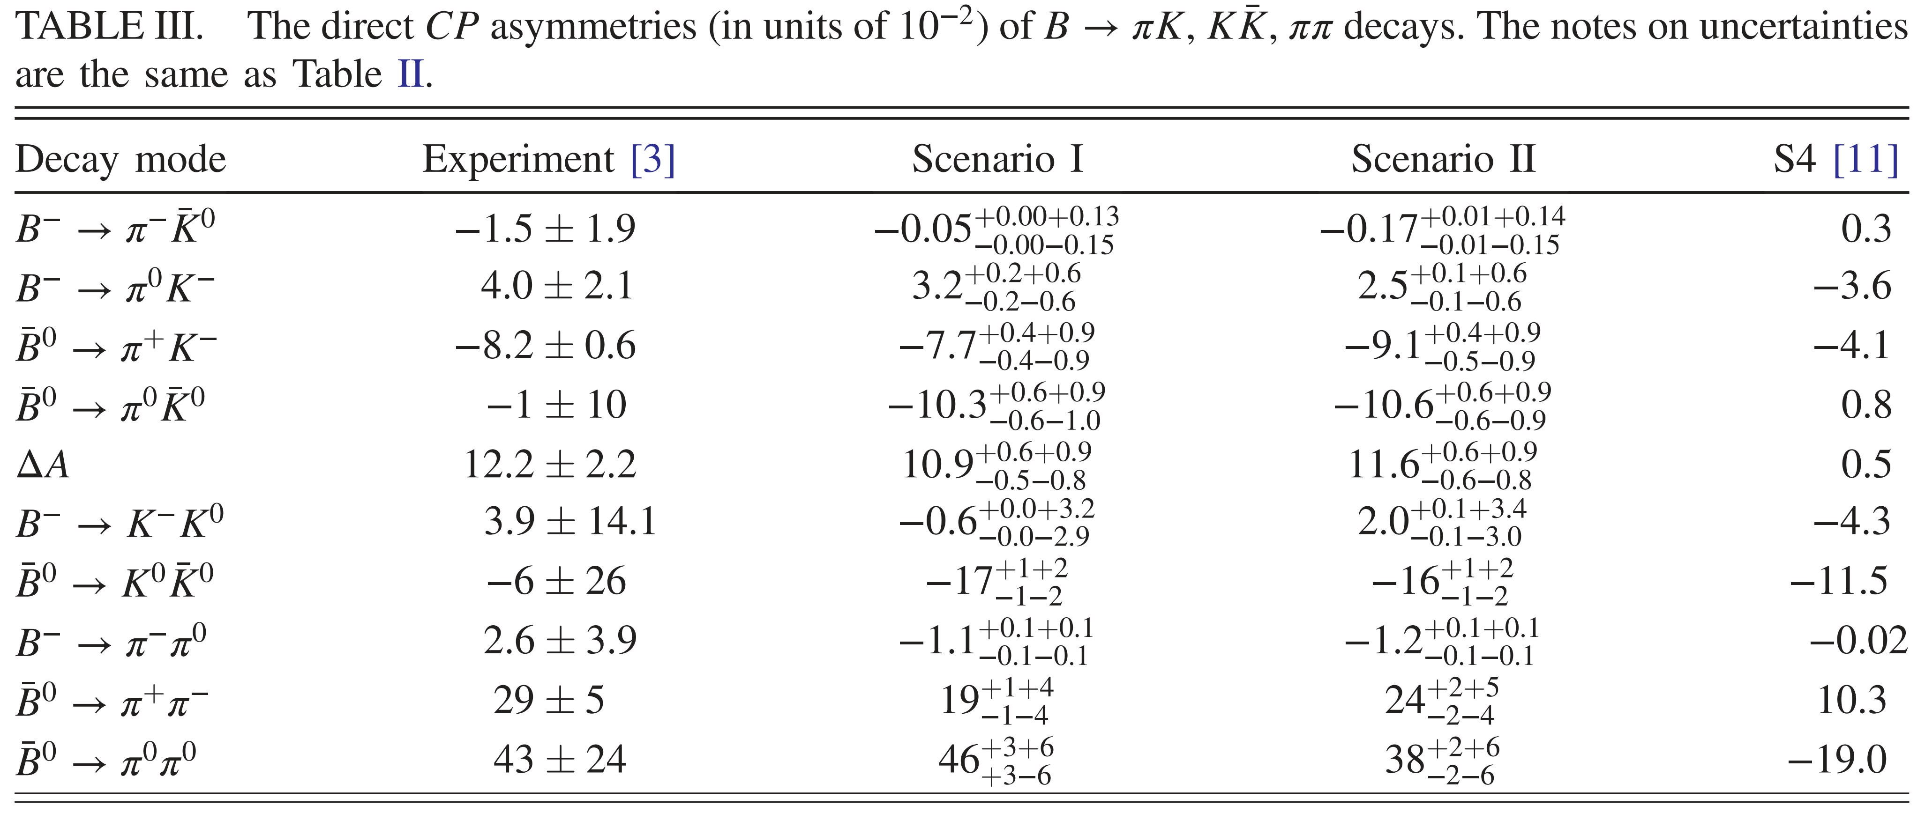

Slide 20
HYCheng and CKChua:
HYCheng and CKChua, Resolving B-CP puzzles in QCD factorization, arXiv: 0908.3506[hep-ph]
HYCheng and CKChua, Revisiting charmless hadronic ${\text{B}}_{u,d}$ decays in QCD factorization , arXiv: 0909.5229[hep-ph]
The $P_{ew}$ solution to $B→Kπ$ CP puzzle via new physics is irrelevant for solving the CP and rate puzzles related to tree-dominated decays, e.g. $B^{0}→π^{0}π^{0}$.
Therefore, it is most likely that the $C$with large magnitude and sizable strong phase is preferred to resolve the $B→Kπ$ CP puzzle without invoking new physics.
Power corrections to a large complex $a_{2}$, the parameter for describing the $C$, due to hard spectator scattering and/or final-state interactions can resolve the observed anomalous simultaneously.
Not changing the B-meson wave function parameter λ_{B}
Large effects of soft power corrections on $a_{2}$ for $B→PP$ modes have to do with the special nature of pion as a $q\overline{q}$ bound state and a nearly massless NG boson.
Duraisamy and Kagan, Power corrections to $e^{+}e^{−}→π^{+}π^{−},K^{+}K^{−}$ and $B→Kπ$,$ππ$, arXiv:0812.3162[hep-ph]

Slide 21
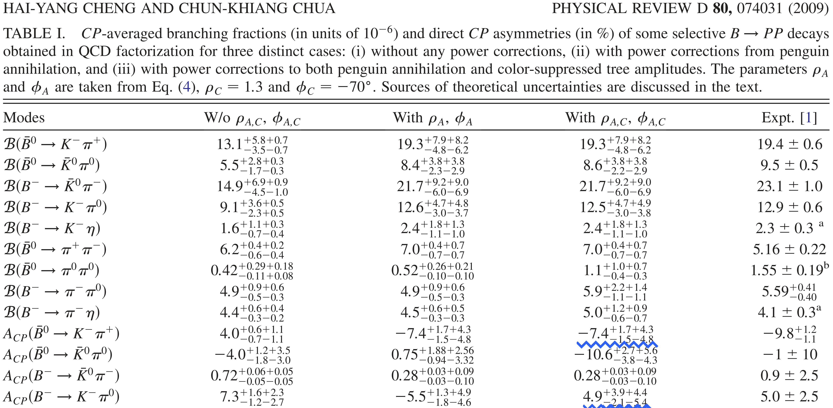

Slide 22
Bell, Beneke, Huber and XQLi:
From XinQiang’s talks @ HFCPV-2018, 2023
Bell, Beneke, Huber and XQLi, Two-loop current-current contribution to the non-leptonic QCD penguin amplitude, arXiv: 1507.03700[hep-ph]

Slide 23
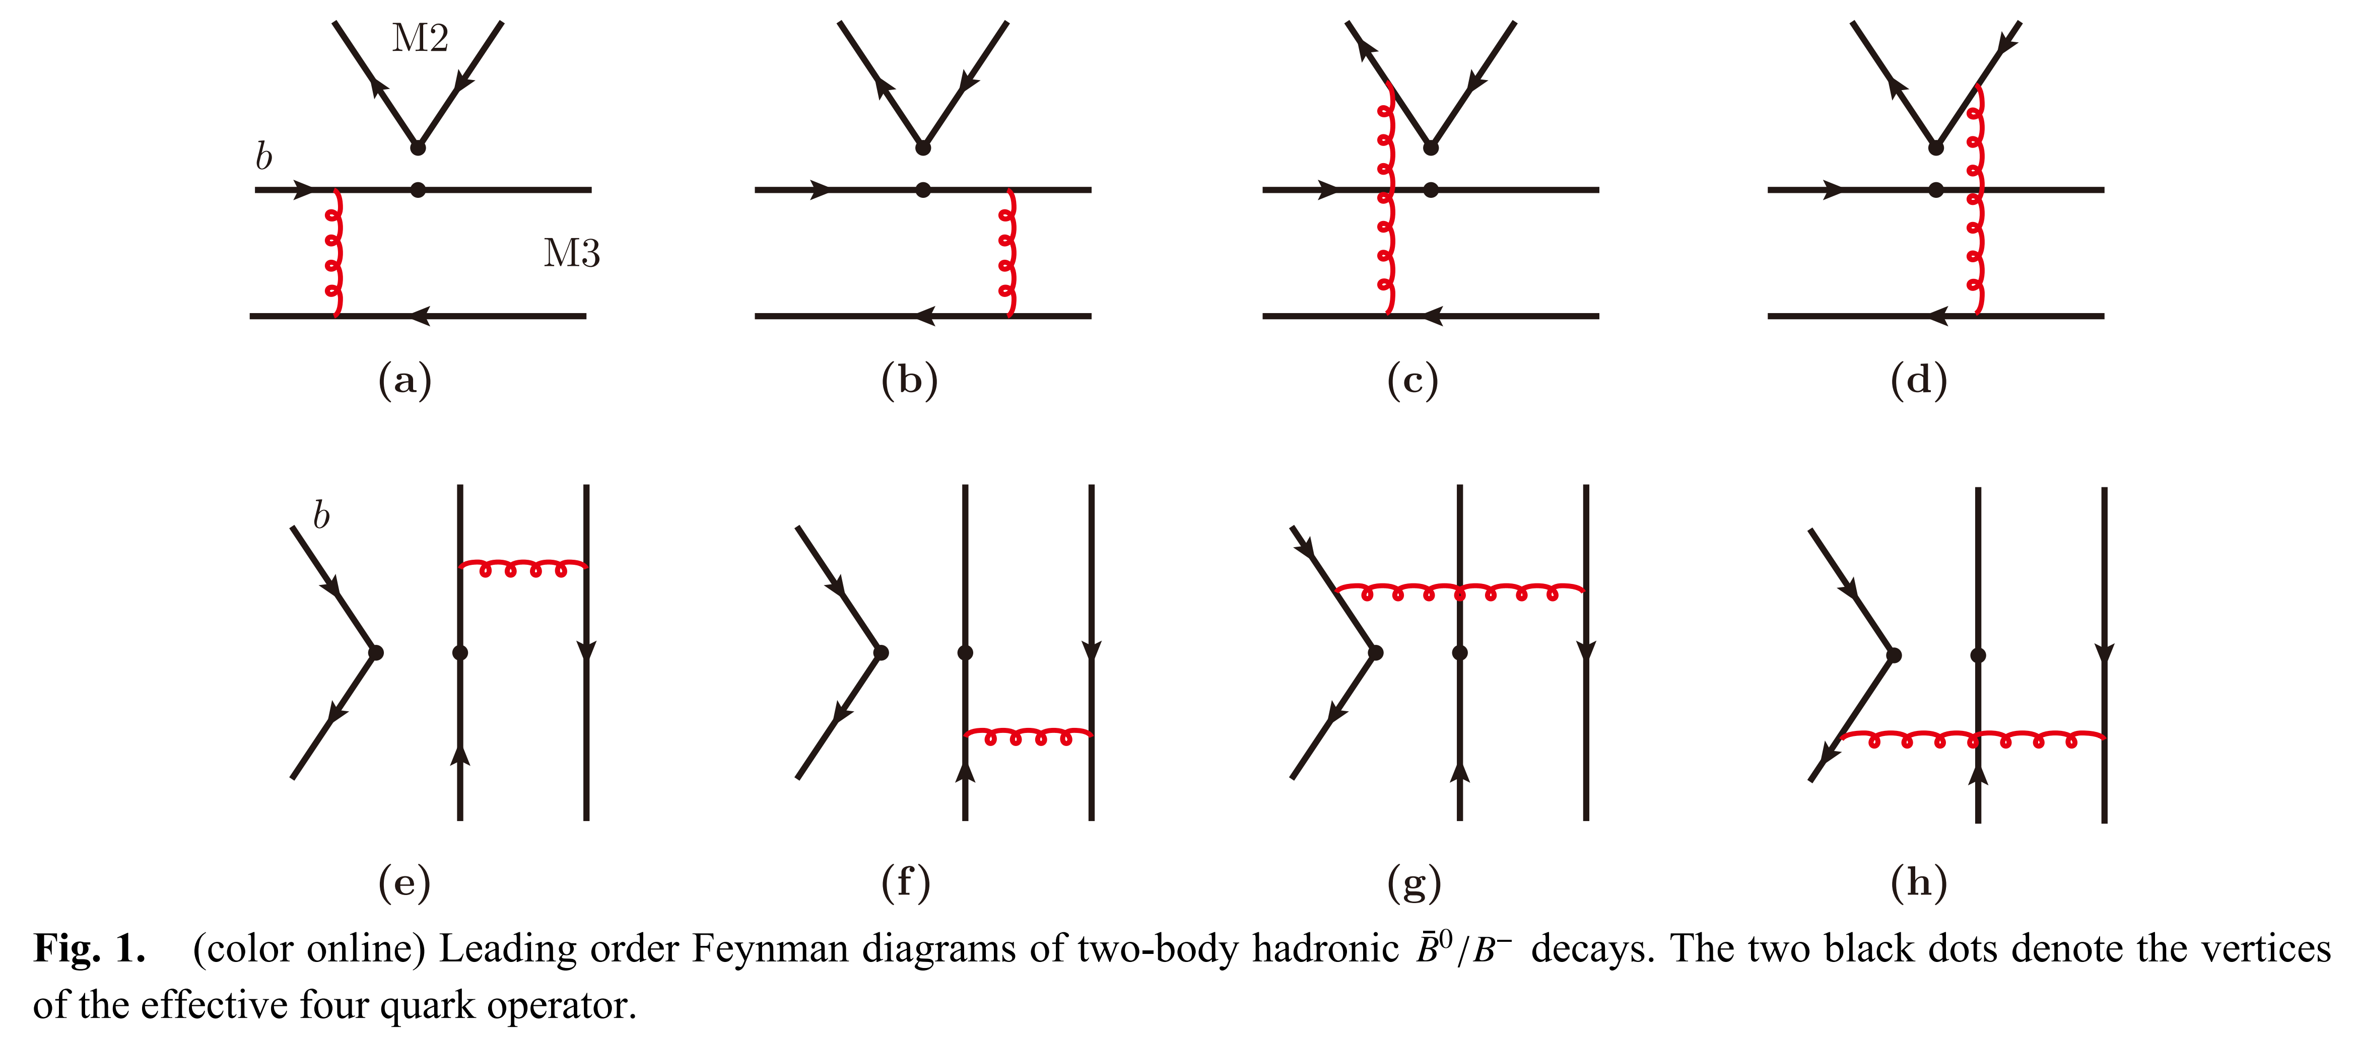
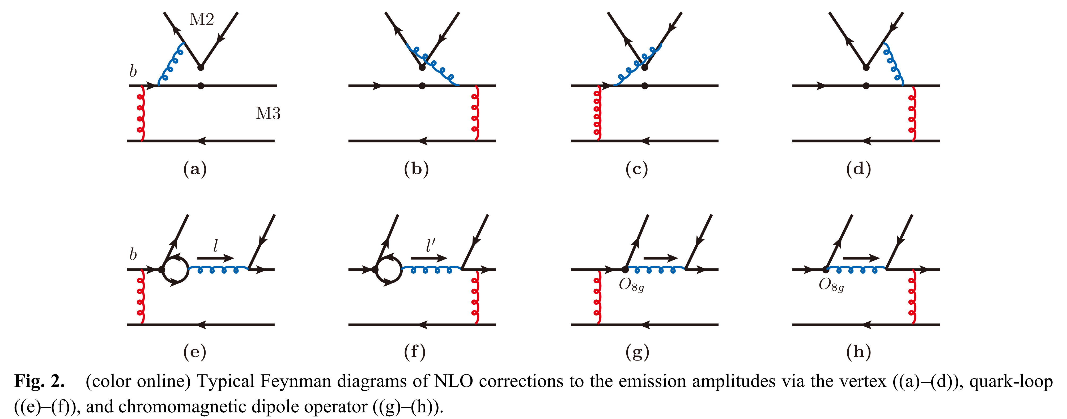
PQCD formalism
HnLi, Mishima and Sanda:
HnLi, Mishima and Sanda, Resolution to the B-> K$π$ puzzle, hep-ph/0508041
JChai et al, Charmless two-body B meson decays in the perturbative QCD factorization approach, arXiv:2207.04190[hep-ph]

Slide 24
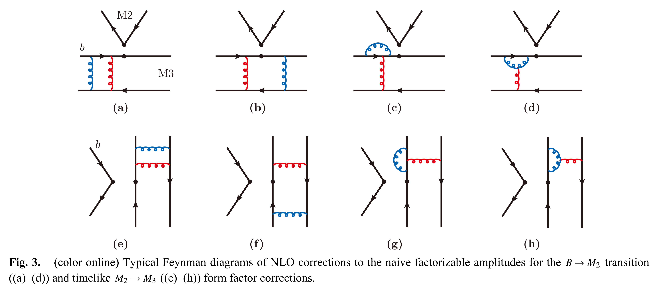
WBai et al：
WBai, MLiu, YYFan, WFWang, SCheng and ZJXiao, Revisiting the K$π$puzzle in the pQCD factorization approach, arXiv: 1305.6103[hep-ph]
JChai et al, Charmless two-body B meson decays in the perturbative QCD factorization approach, arXiv:2207.04190[hep-ph]

Slide 25
RXWang and MZYang:
In modified PQCD: different B meson WF, soft scale cutoff, soft $B→K$, $B→π$, $K→π$ form factors and color-octet hadronic matrix element introduced
The vertex corrections, the quark loops, and the magnetic penguins are also considered.
All the BRs and most CPV well consistent with data presented.
RXWang and MZYang, Branching ratio and CP violation of B-> K$π$ decays in a modified perturbative QCD approach, arXiv: 2212.09054[hep-ph]

Slide 26
Color-suppressed tree amplitude $C$ is an important but least-understood quantity in B-meson decays.
Naively enhancing the hard spectator amplitudes to $C$ cannot resolve the observed anomalies really.
The $B→ρρ$ data seriously constrained the possibility of resolving the $B→ππ,Kπ$ puzzle.
HnLi and Mishima, Implication of the $B→ρρ$ data on the B->$ππ$ puzzle, hep-ph/0602214
A large $C$ to resolve potentially the $B→Kπ$ puzzle should be from a new QCD mechanism that can differentiate pion from ρ meson.
HnLi and Mishima, Possible resolution of the B->$ππ,Kπ$ puzzles, arXiv: 0901.1272[hep-ph]
The glauber gluons through the convolution with TMD meson wave functions in the PQCD formalism can work.
The glauber divergences appearing in the NLO QCD corrections to a nonfactorizable amplitude in PQCD formalism can be factorized into a universal soft factor to restore the universality of a TMD meson wave function.
HnLi and Mishima, Possible resolution of the B->$ππ,Kπ$ puzzles, arXiv: 0901.1272[hep-ph]
HnLi and Mishima, Glauber gluons in spectator amplitudes for B->$πM$ decays, arXiv: 1407.7647[hep-ph]

Slide 27
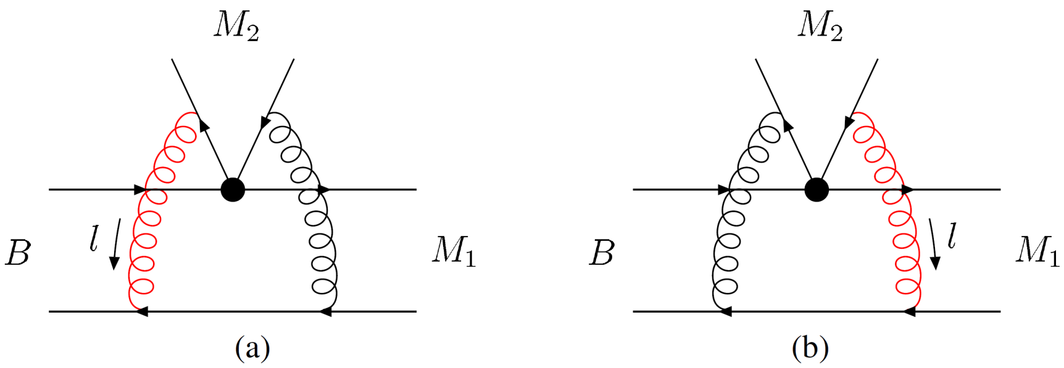
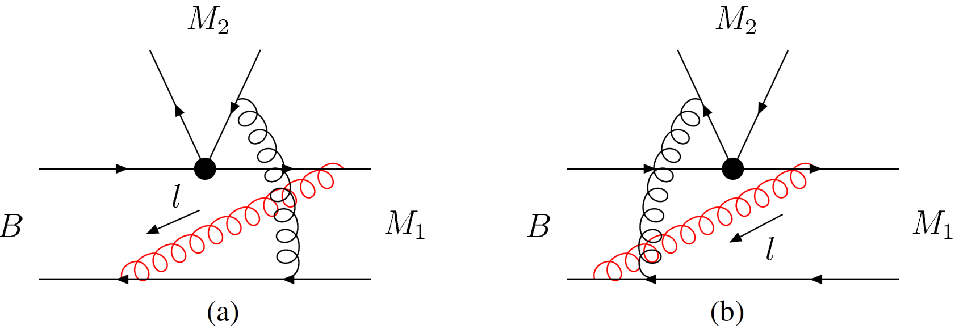
$S_{e2}$ associated with the emitted meson
$S_{e1}$ associated with the recoiled meson
The universal glauber factor exhibits the different glauber effect through the convolution with the TMD WFs containing different intrinsic b dependences for pion, kaon, and ρ meson.
XLiu, HnLi and ZJXiao, Transverse-momentum-dependent wave functions with glauber gluons in B-> ππ, ρρ decays, arXiv:1502.04162[hep-ph]
Wave function with falloff in parton TM ${\text{k}}_{\text{T}}$ : $φ_{π}<φ_{K}<φ_{ρ}$, which means pion requires a tighter spatial distribution of its leading Fock state relative to higher Fock states.
consistent with the dual role of pion as a massless NGB and as a $q\overline{q}$ bound state simultaneously.
Nussinov and Shrock, On the$π$ and K as $q\overline{q}$ bound states and as approximate Nambu-Goldstone bosons, arXiv:0811.3404[hep-ph]
Duraisamy and Kagan, Power corrections to $e^{+}e^{−}→π^{+}π^{−},K^{+}K^{−}$ and B->K$π$,$ππ$, arXiv:0812.3162[hep-ph]
Lepage and Brodsky, Exclusive processes in Quantum Chromodynamics: evolution equations for hadronic wave functions and the form-factors of mesons, SLAC-pub-2343

Slide 28
Branching Ratios | Data (10⁻⁶) | NLO | NLOG
$${BR(B}^{0}→π^{+}π^{−})$$ | $$5.10±0.19$$ | $${6.19}_{−1.48−0.34}^{+2.09+0.38}$$ | $${5.39}_{−1.31−0.25}^{+1.86+0.28}$$
$${BR(B}^{+}→π^{+}π^{0})$$ | $${5.48}_{−0.34}^{+0.35}$$ | $${3.35}_{−0.77−0.22}^{+1.08+0.23}$$ | $${4.45}_{−0.99−0.36}^{+1.38+0.39}$$
$${BR(B}^{0}→π^{0}π^{0})$$ | $$0.90±0.16$$ | $${0.29}_{−0.07−0.02 }^{+0.11+0.03}$$ | $${0.61}_{−0.12−0.12}^{+0.16+0.14}$$
$${BR(B}^{0}→ρ^{0}ρ^{0})$$ | $$0.97±0.24$$ | $${1.06}_{−0.21−0.16 }^{+0.29+0.19}$$ | $${0.89}_{−0.18−0.10}^{+0.26+0.13}$$
PDG2024
$$5.37±0.20$$
$$5.31±0.26$$
$$1.55±0.17$$
$$0.96±0.15$$
XLiu, HnLi and ZJXiao, Transverse-momentum-dependent wave functions with glauber gluons in B-> ππ, ρρ decays, arXiv:1502.04162[hep-ph]
Branching Ratios | Data (10⁻⁵) | NLO | NLOG
$${BR(B}^{0}→K^{+}π^{−})$$ | $$1.96±0.05$$ | $${2.33}_{−0.52−0.11−0.20}^{+0.74+0.12+0.21}$$ | $${2.17}_{−0.49−0.10−0.16}^{+0.71+0.11+0.17}$$
$${BR(B}^{+}→K^{+}π^{0})$$ | $$1.29±0.05$$ | $${1.53}_{−0.35−0.07−0.12}^{+0.50+0.08+0.12}$$ | $${1.40}_{−0.33−0.06−0.10}^{+0.46+0.06+0.10}$$
${BR(B}^{+}→K^{0}π^{+})$ | $$2.37±0.08$$ | $${2.72}_{−0.61−0.13−0.24}^{+0.88+0.15+0.25}$$ | $${2.41}_{−0.56−0.11−0.17}^{+0.80+0.11+0.17}$$
$${BR(B}^{0}→K^{0}π^{0})$$ | $$0.99±0.05$$ | $${1.02}_{−0.22−0.05−0.10}^{+0.32+0.05+0.11}$$ | $${0.93}_{−0.21−0.05−0.07}^{+0.30+0.06+0.08}$$
PDG2024
$$2.00±0.04$$
$$1.32±0.04$$
$$2.39±0.06$$
$$1.01±0.04$$
XLiu, HnLi and ZJXiao, Resolving the B->Kπ puzzle by glauber-gluon effects, arXiv:1510.05910[hep-ph]

Slide 29
Direct CPV | Data | NLO | NLOG
$$A_{CP}(B^{0}→K^{±}π^{∓})$$ | $$−0.082±0.006$$ | $${−0.076}_{−0.009−0.013−0.007 }^{+0.008+0.013+0.007}$$ | $${−0.081}_{−0.009−0.011−0.009 }^{+0.009+0.011+0.010}$$
$$A_{CP}(B^{±}→K^{±}π^{0})$$ | $$+0.037±0.021$$ | $${−0.008}_{−0.009−0.009−0.006 }^{+0.008+0.009+0.006}$$ | $$+{0.021}_{−0.008−0.004−0.013 }^{+0.008+0.003+0.014}$$
$$A_{CP}\left(B^{±}→K^{0}π^{±}\right)$$ | $$−0.017±0.016$$ | $${+0.003}_{−0.000+0.001+0.000}^{+0.001+0.001+0.000}$$ | $${+0.004}_{−0.001+0.002+0.000}^{+0.000+0.001+0.000}$$
$$A_{CP}(B^{0}→K^{0}π^{0})$$ | $$0.00±0.13$$ | $${−0.056}_{−0.001−0.004−0.001}^{+0.001+0.004+0.000}$$ | $${−0.089}_{−0.000−0.009−0.005}^{+0.001+0.013+0.005}$$
PDG2024
$$−0.0831±0.0031$$
$+0.027±0.0$12
$−0.003±0.0$15
$0.00±0.0$8
Glauber-gluon effects modify the direct CP asymmetry of ${B^{±}→K^{±}π}^{0}$ mode significantly with sign flipping attributed to its sensitivity to $C$.
$ΔA_{Kπ}≡A_{CP}\left({K^{±}π}^{0}\right)[0.021±0.0\text{1}6]−A_{CP}\left({K^{±}π}^{∓}\right)[−0.081±0.0\text{1}7]=0.102±0.0$23
It is stressed that the $B→ππ,Kπ$ puzzles must be resolved by resorting to a mechanism and that the Glauber gluons should be one of the most crucial mechanisms.

Slide 30
SUMMARY and OUTLOOK

Slide 31
Summary
Great efforts devoted to resolve the $Kπ$ puzzle: no evident isospin violation in ratios of BRs, nontrivial resolution to CP puzzle given without including NP;
Only large complex $C$ could resolve $Kπ$ puzzle, but cannot explain$ππ$ puzzle and hardly survive from the constraint of ${BR(ρ}^{0}ρ^{0})$ in the factorization frameworks;
New mechanism should differentiate the $π$ from other mesons, realized through the convolution of TMD meson WFs with glauber gluons in $k_{T}$ factorization;
Predictions of BRs for $B→ππ$ and of direct CP asymmetries for $B→Kπ$ in NLO PQCD with glauber gluons are well consistent with current data within large uncertainties under the constraint of ${BR(B^{0}→ρ}^{0}ρ^{0}).$

Slide 32
Outlook
More data with high precision are still demanded;
Uncertainties of theoretical inputs need to be urgently reduced;
More experimental observables?
More new contributions from NLP or QCD mechanism?
New physics beyond the standard model?
Nothing is impossible! Keep moving…

Slide 33
Thanks for your attention!
Email
liuxin@jsnu.edu.cn

Slide 34
BACK-UP SLIDES

Slide 35
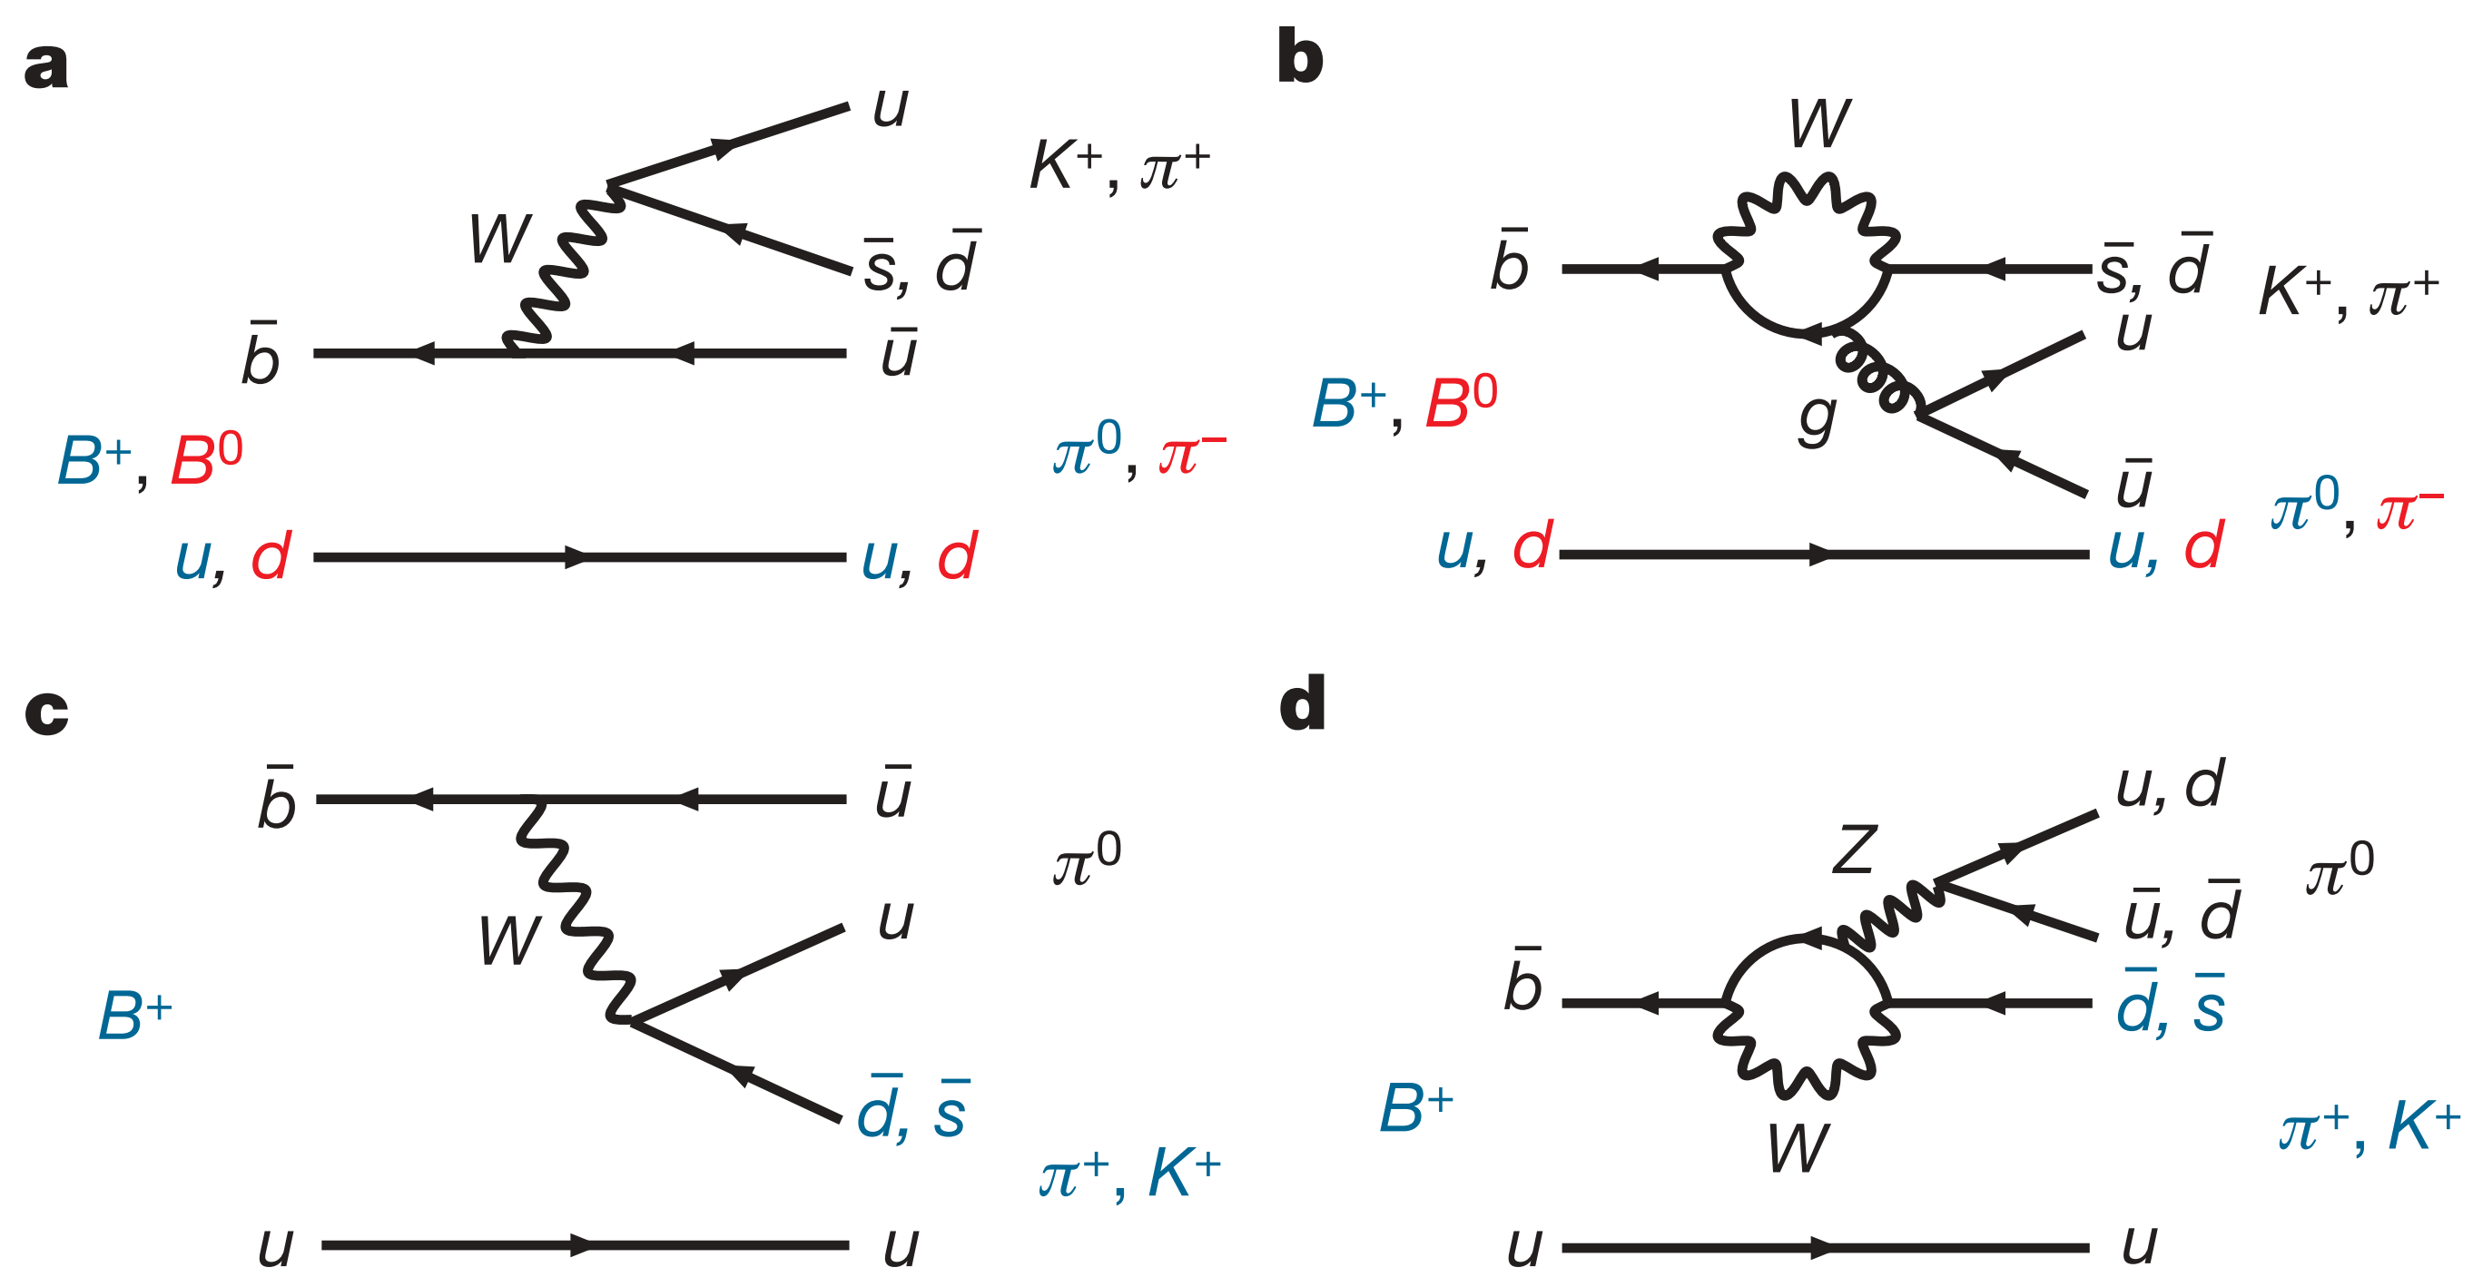
T
P
$\overline{s}$
$\overline{s}$
π⁻
π⁻
d
d
C
P_{ew}
$\overline{s}$
$\overline{s}$
K⁺
K⁺
SWLin et al (The Belle Collaboration), Difference in direct CP violation between charged and neutral B meson decays, Nature 452, 332 (2008)

Slide 36
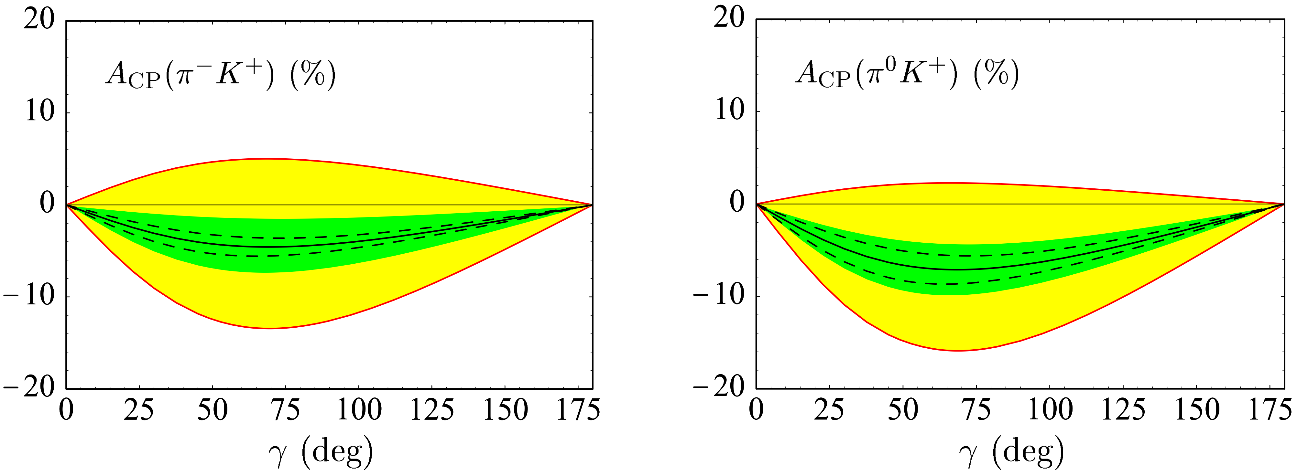
QCDF
Beneke, Buchalla, Neubert, and Sachrajda, QCD factorization in B-> Kπ, ππ decays and extraction of Wolfenstein parameters, hep-ph/0104110
Beneke and Neubert, QCD factorization for B->PP and B->PV decays, hep-ph/0308039

Slide 37
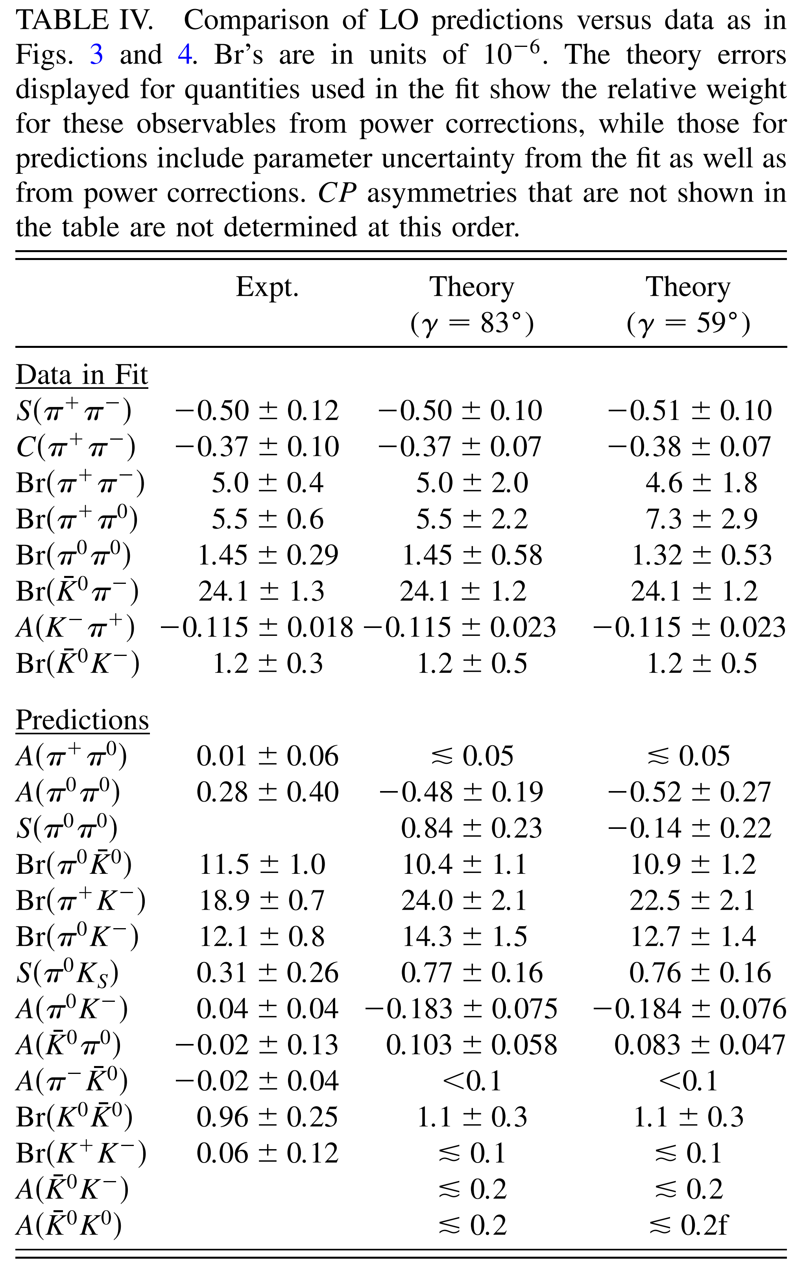
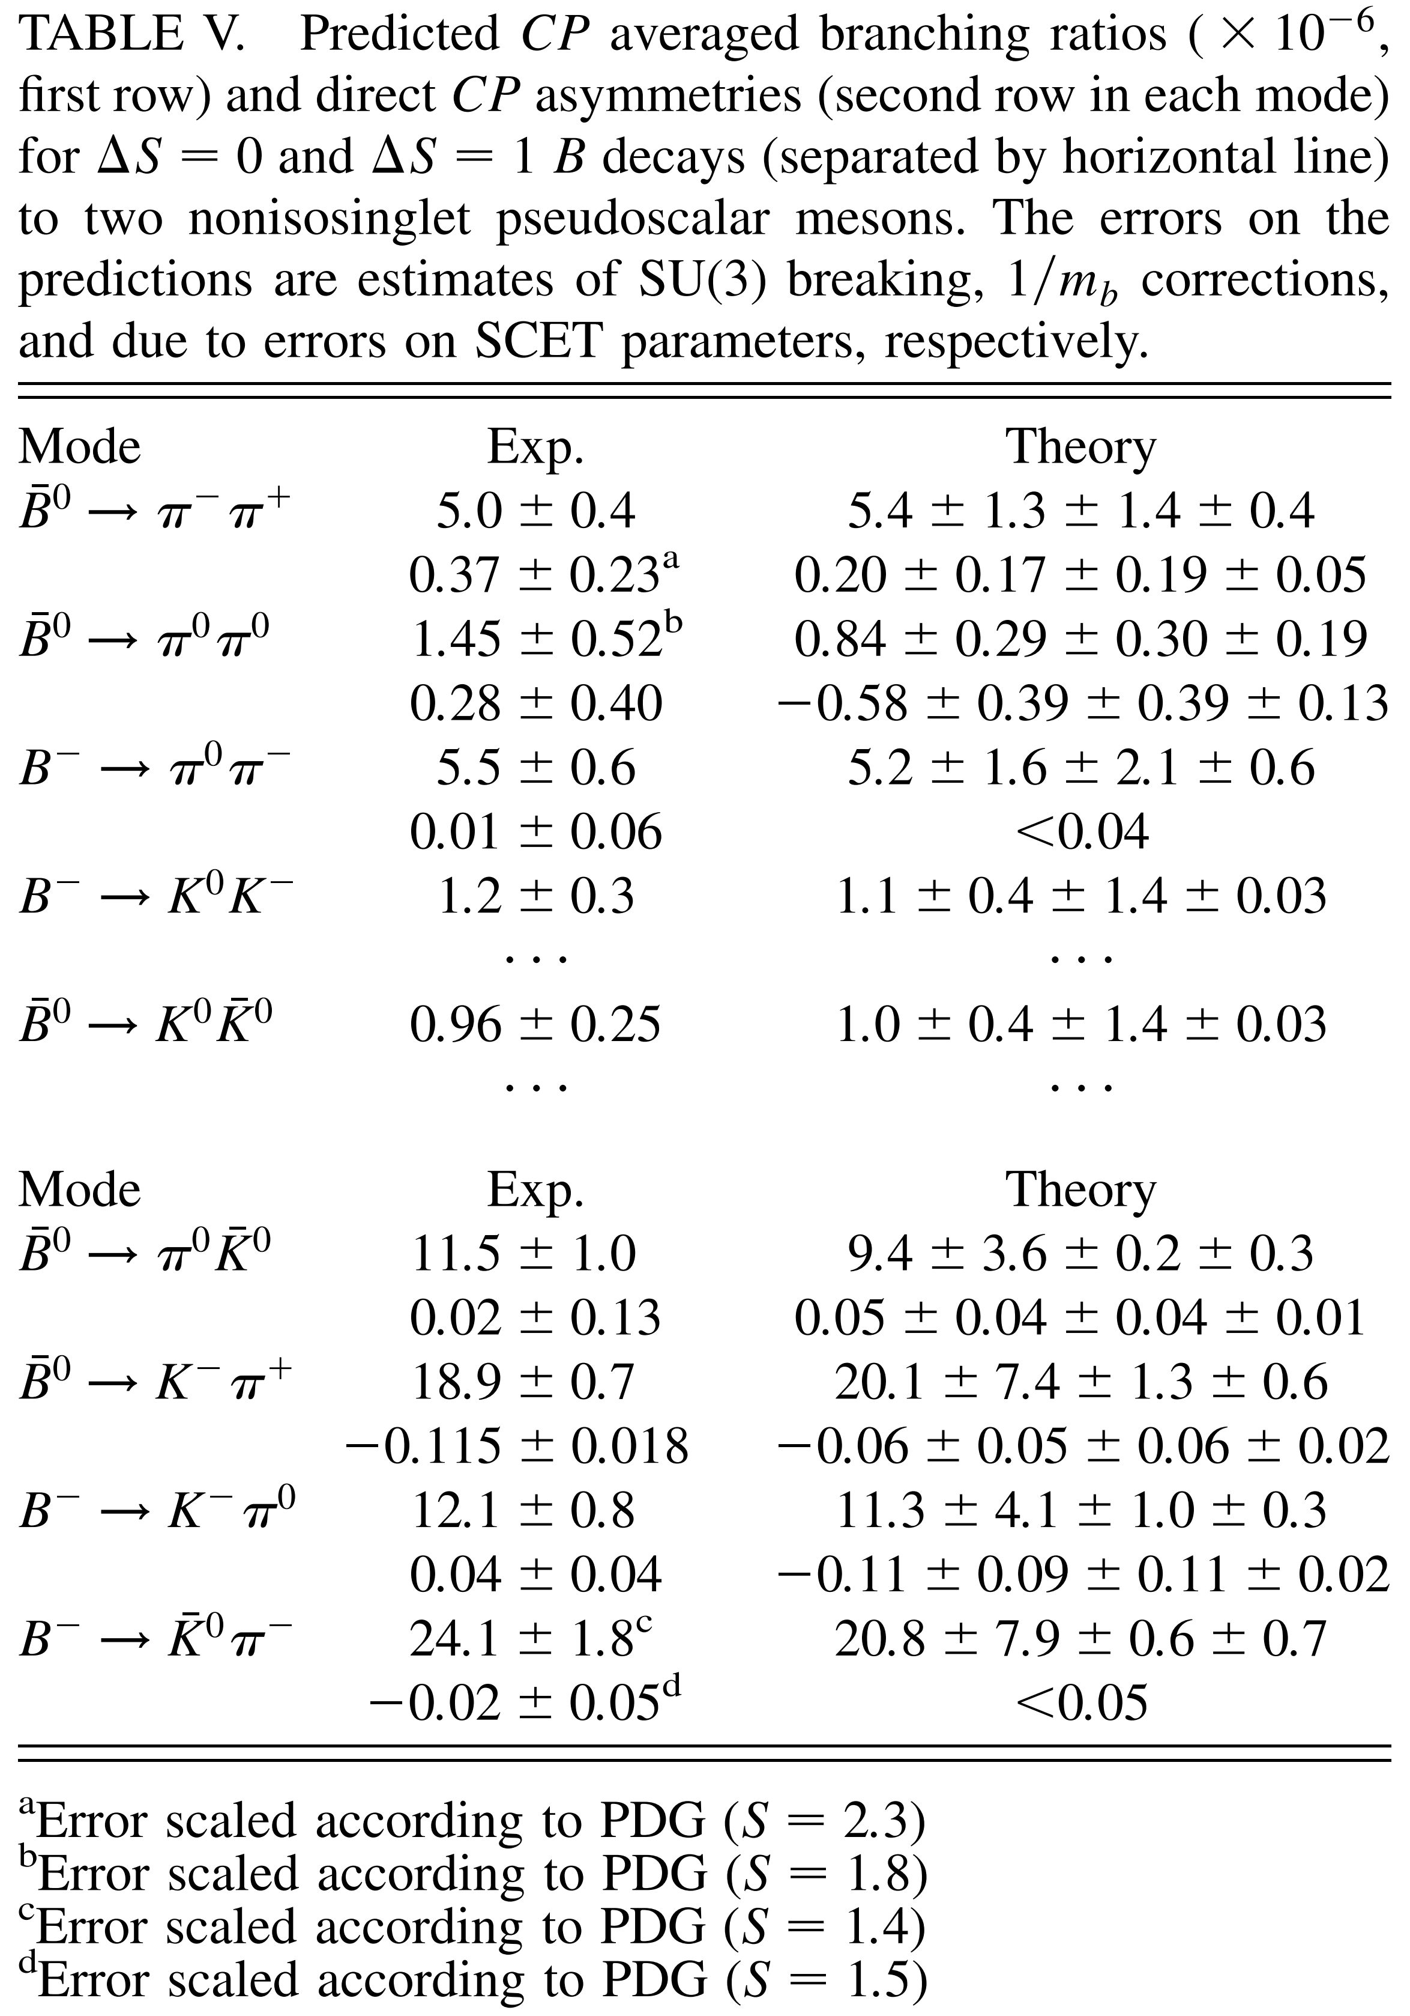
SCET
Bauer, Rothstein and Stewart, Soft collinear effective theory analysis of B-> Kπ, KK, and ππ decays, hep-ph/0510241
Williamson and Zupan, Two body B decays with isosinglet final states in soft collinear effective theory, hep-ph/0601214

Slide 38
pdgLive https://pdglive.lbl.gov/ParticleGroup.action?init=0&node=MXXX045

Slide 39
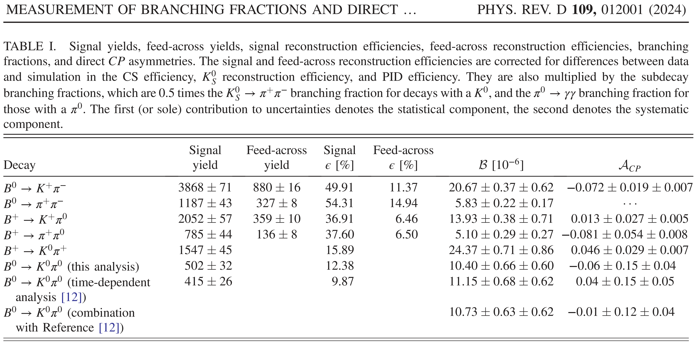
$Δ$A_{Kπ} = 0.085 ± 0.034 (Belle-II2024)

Slide 40
Collinear
Leading IR regions
l~(l⁺, l⁻, l_{T})
Soft
Glauber

Slide 41
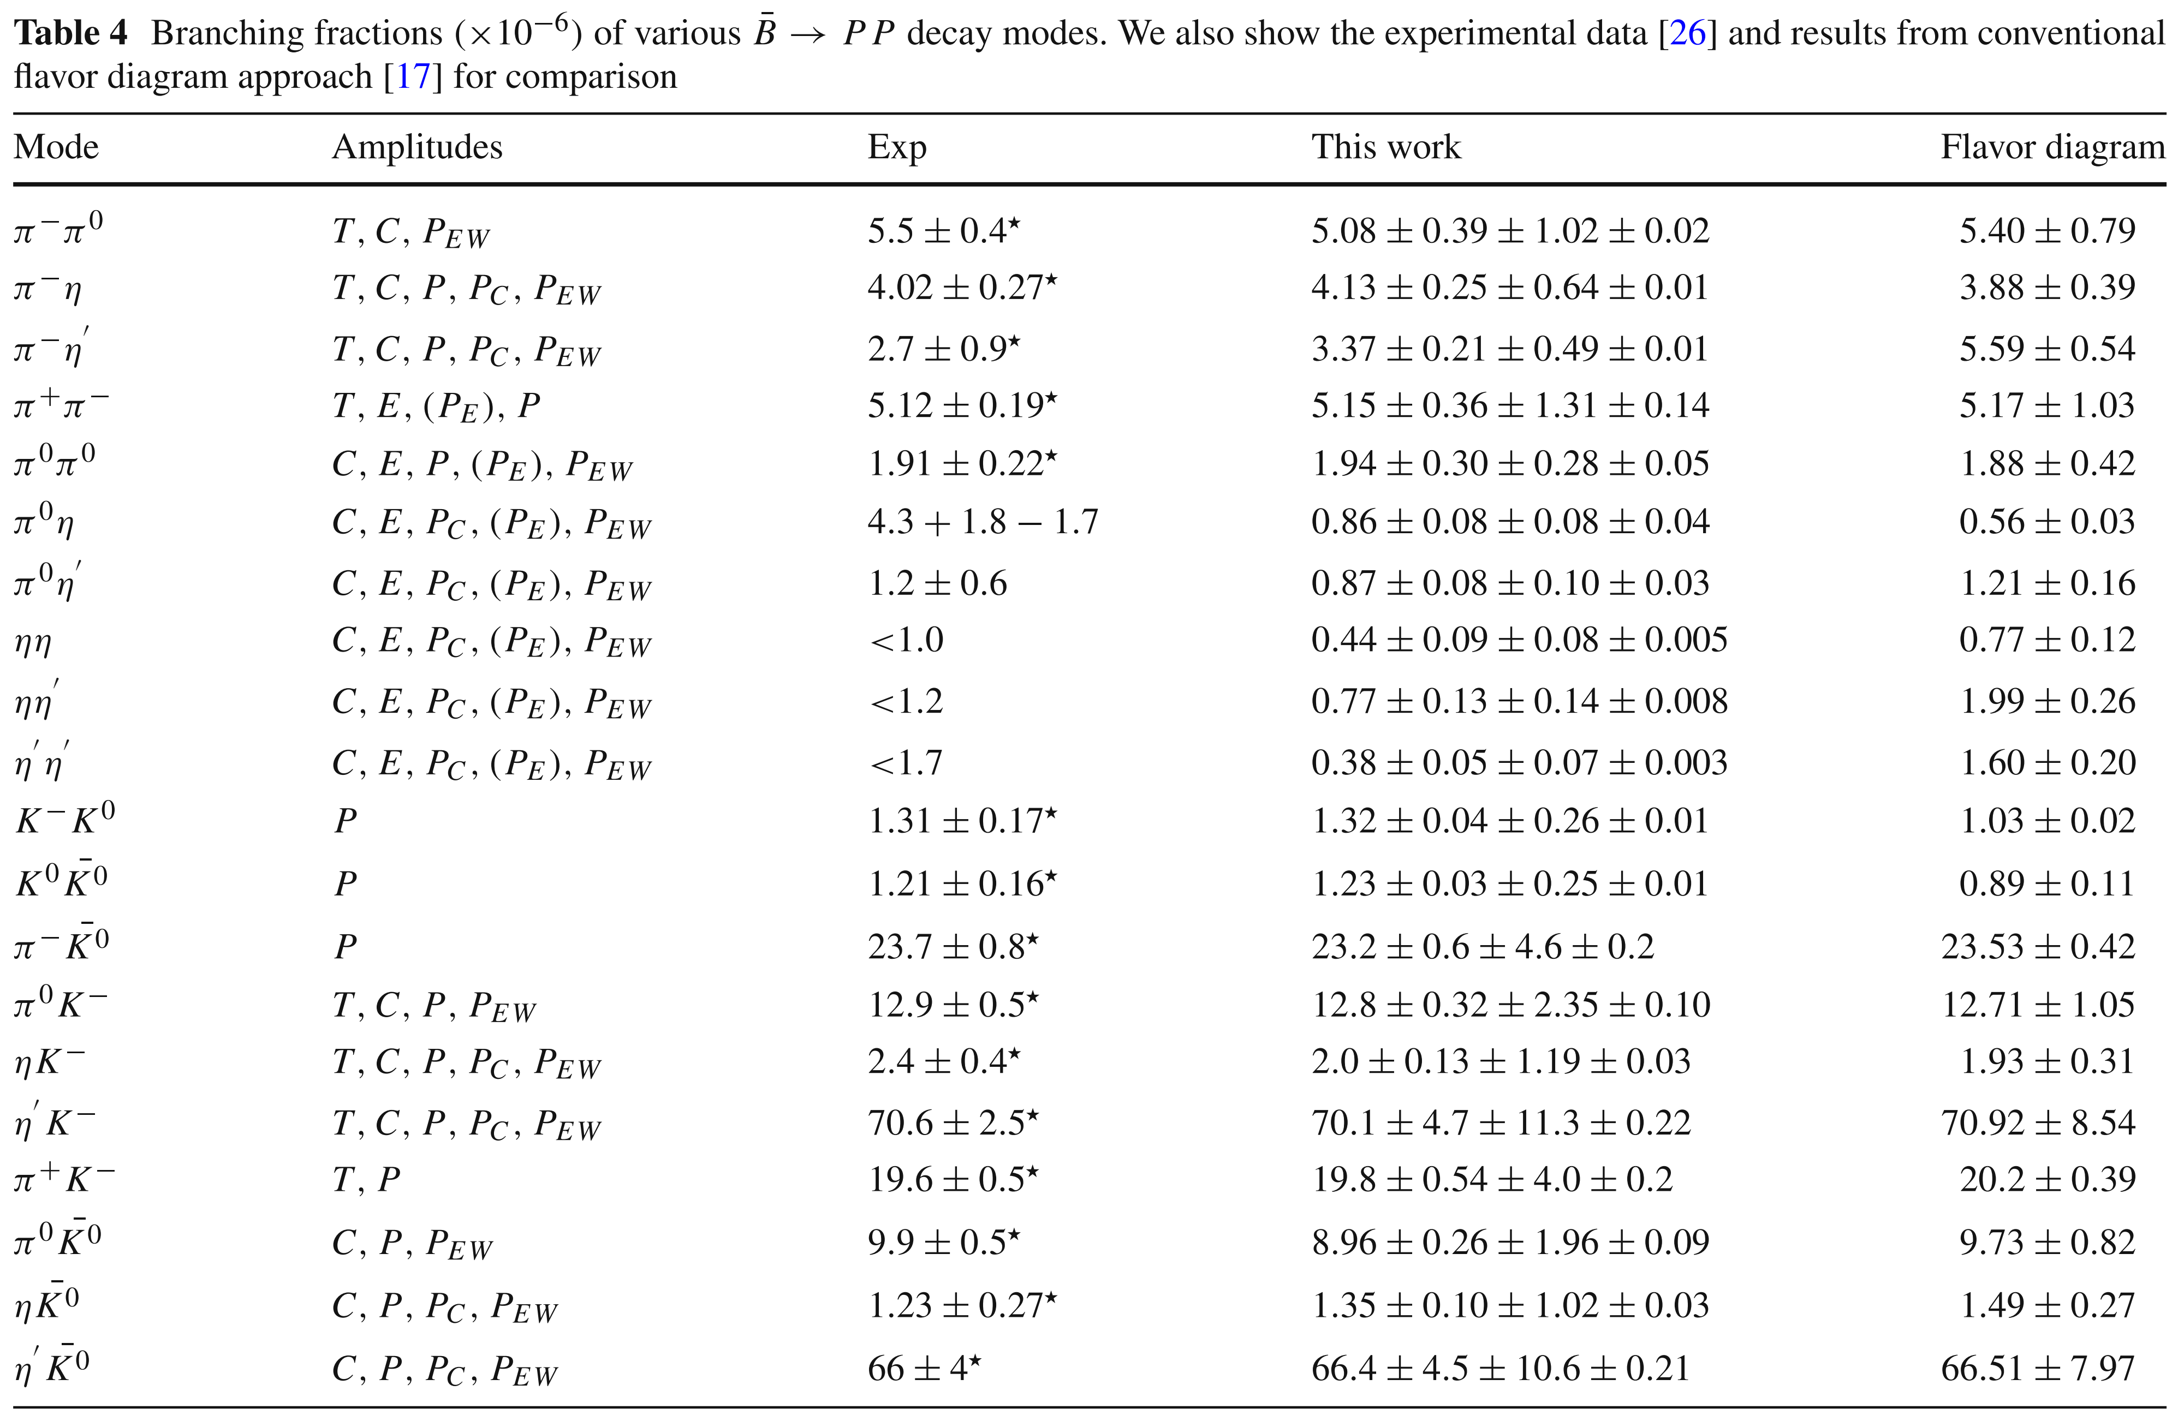
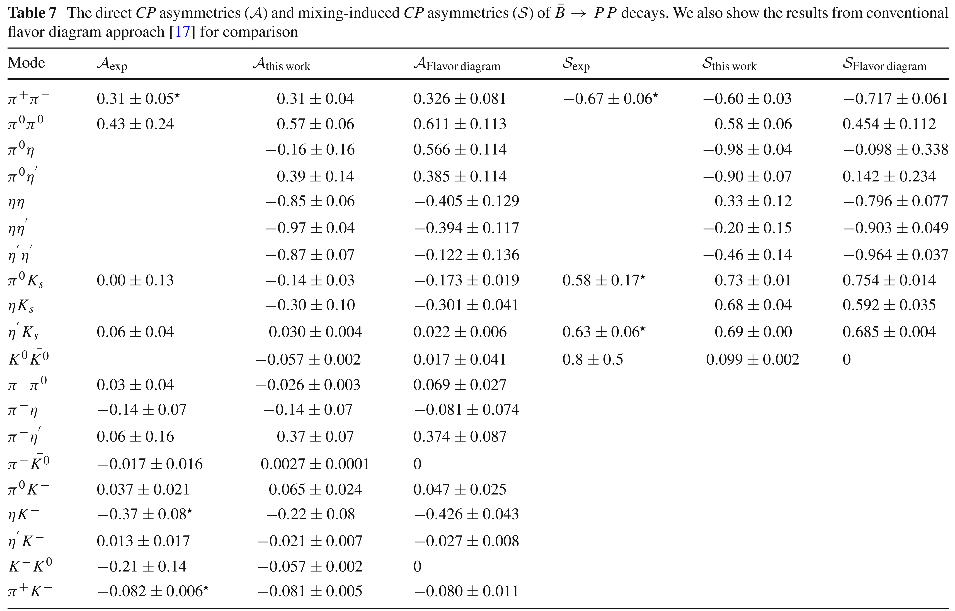
SHZhou et al:
SHZhou, QAZhang, WRLyu, and CDLu, Analysis of charmless two-body B decays in factorization-assisted topological amplitude approach, arXiv: 1608.02819[hep-ph]
Notes:
\pi\pi puzzle，即：BR(\pi^0\pi^0)<BR(\pi^0\rho^0)<BR(\rho^0\rho^0)。目前实验测量的关系是 BR(\pi^0\pi^0)~BR(\pi^0\rho^0)>BR(\rho^0\rho^0). 2016年，吕老师和他的学生结合glauber phase factor在FAT框架下的data fitting发现：可能只有 pion同时作为q\bar q束缚态及无质量NGB双重身份带来的 glauber 相位才可以解决 K\pi, \pi\pi puzzles。

Slide 42
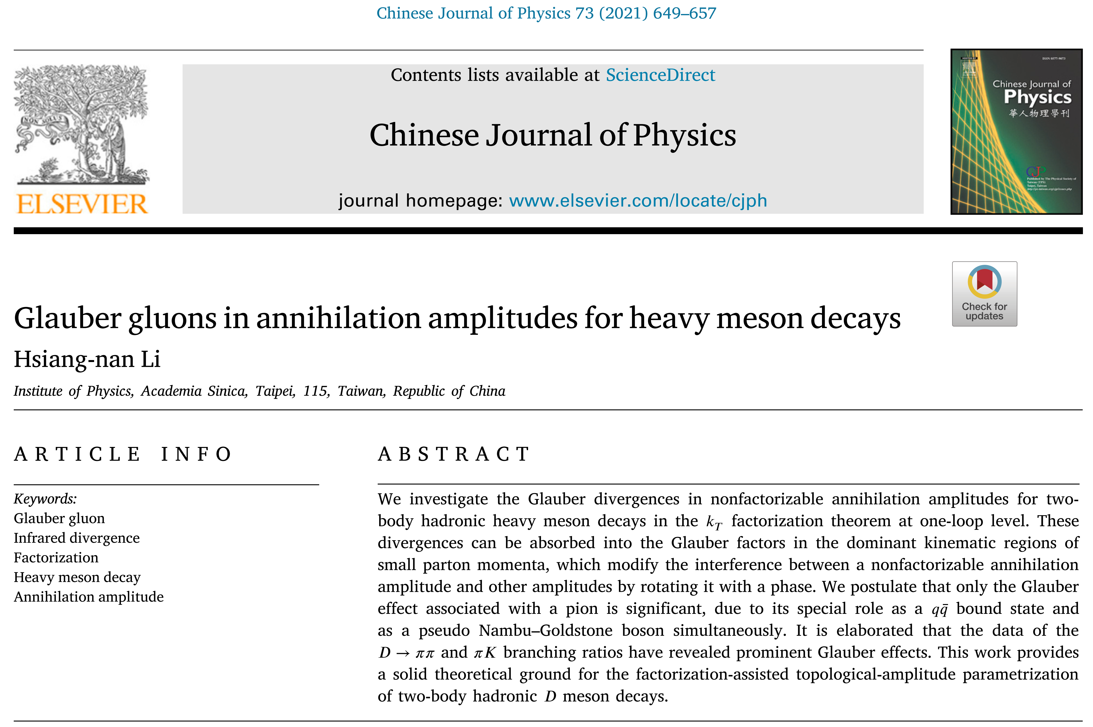
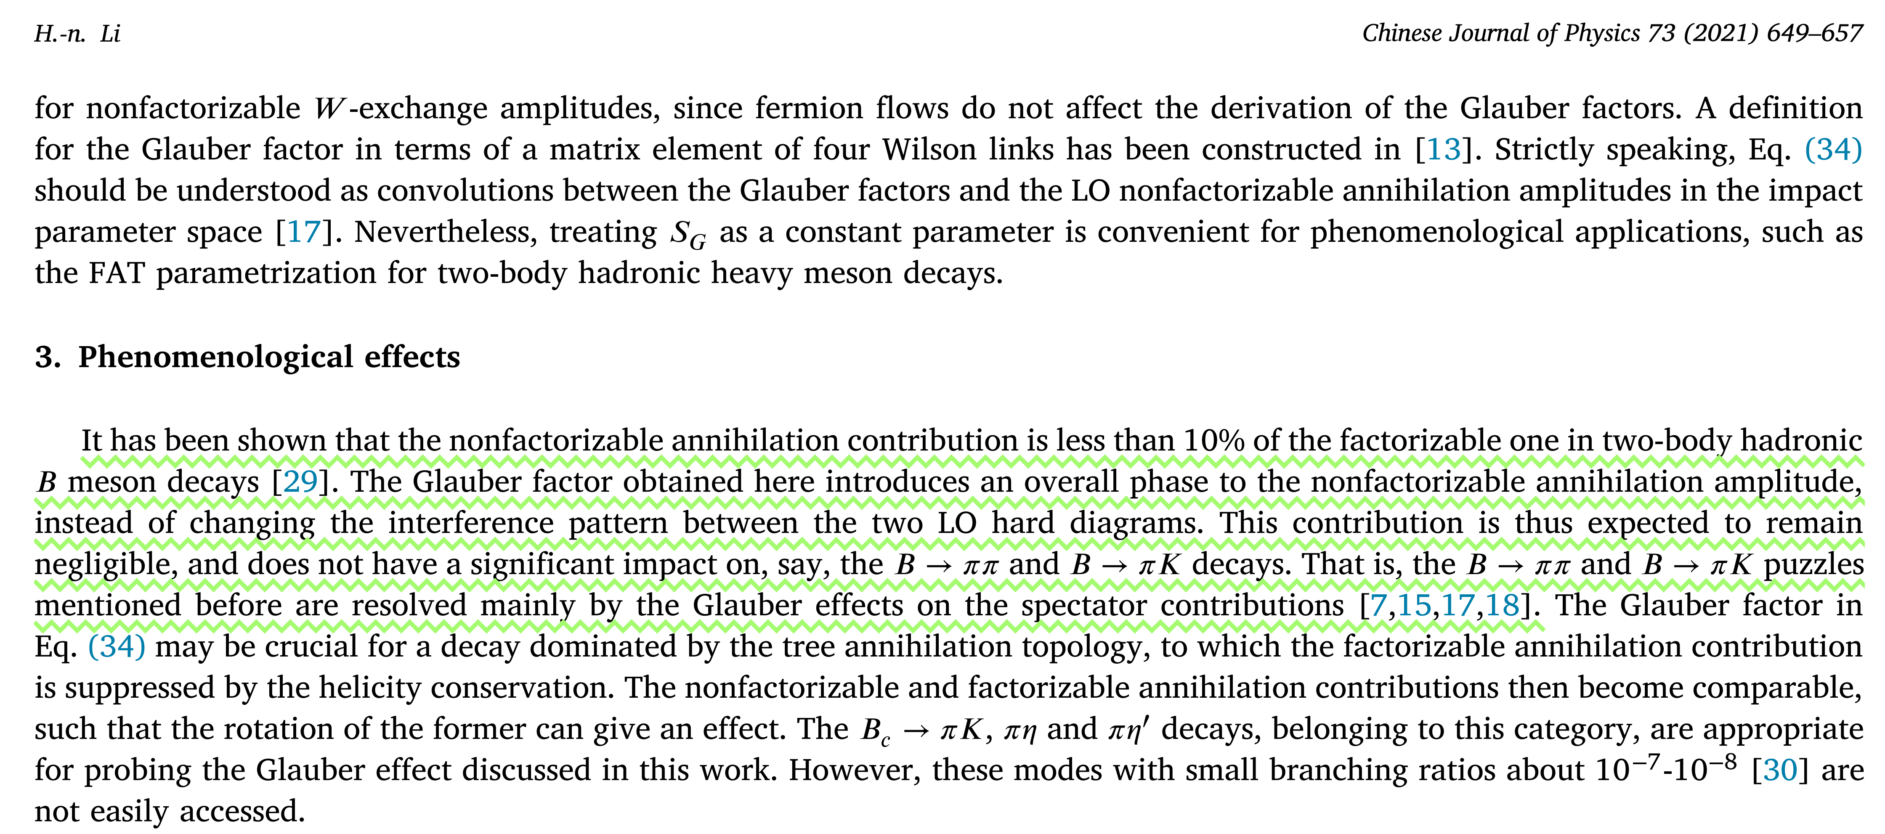

Slide 43
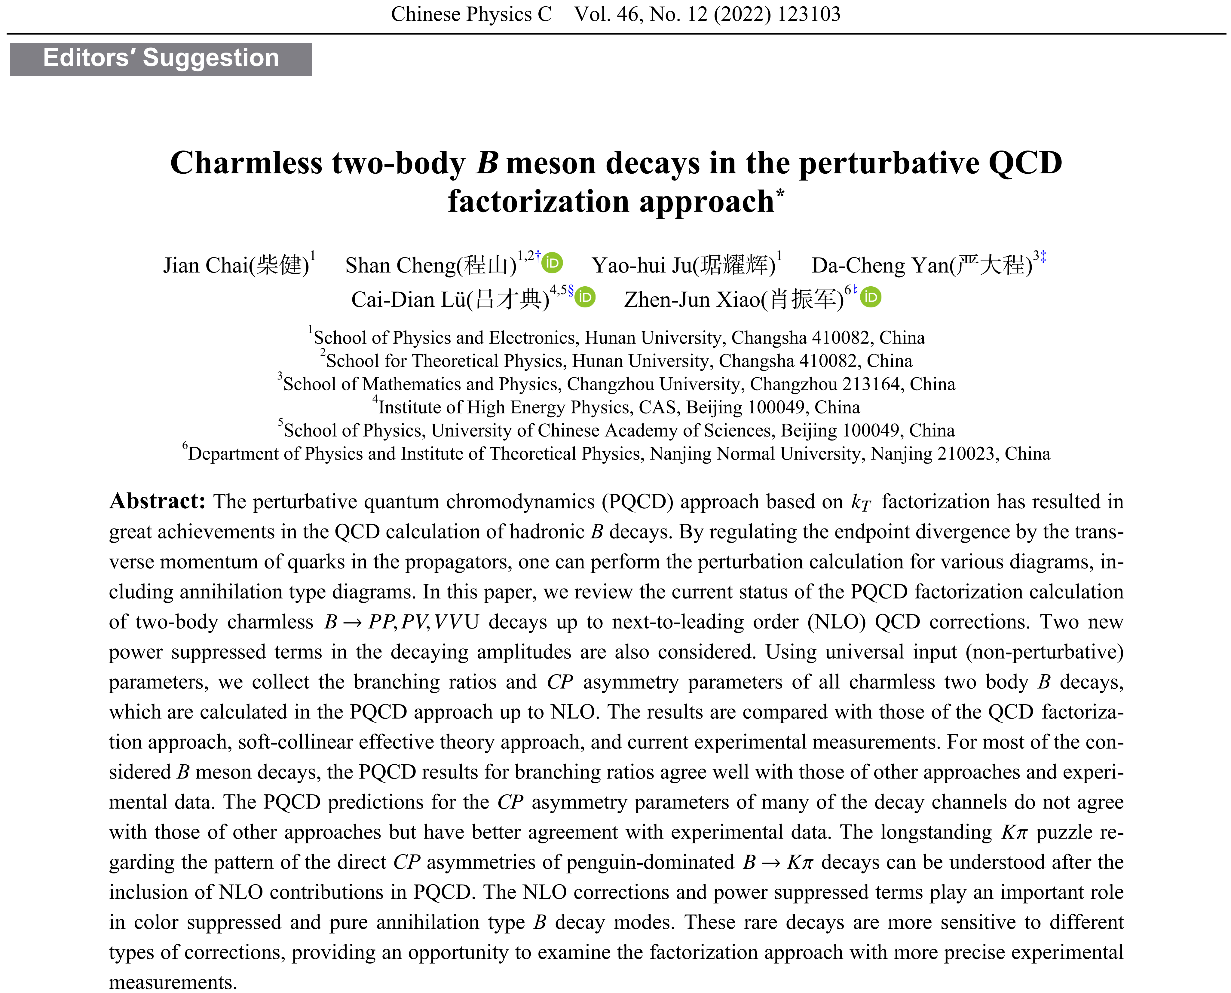
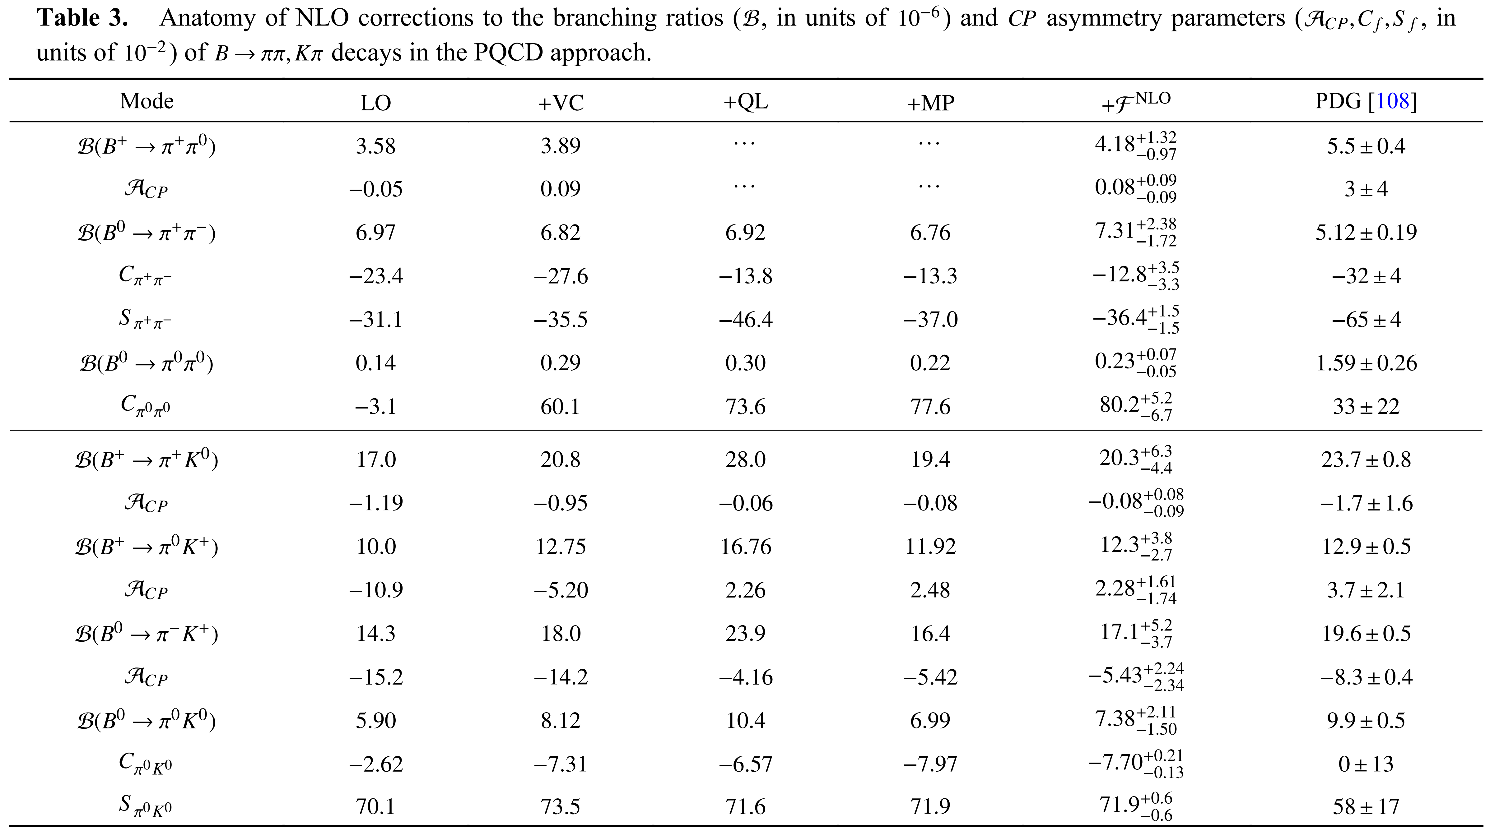
Chai, SCheng, Ju, Yan, CDLu and ZJXiao

Slide 44
Two important elements:
TMD meson wave function (different intrinsic k_{T})
parameterization of glauber phase factor
TMD meson wave function with the intrinsic k_{T} part in the Gaussian form
$$φ_{M}\left(x,k_{T}\right)=\frac{π}{2β_{M}^{2}}exp\left(−\frac{{\text{M}}^{2}}{8β_{M}^{2}}\right)\frac{φ_{M}\left(x\right)}{x(1−x)}$$
$${\text{M}}^{2}=\frac{k_{T}^{2}+m_{q}^{2}}{x}+\frac{k_{T}^{2}+m_{q}^{2}}{1−x}$$
For pion:
$${\text{M}}^{2}=\frac{k_{T}^{2}+m_{q}^{2}}{x}+\frac{k_{T}^{2}+m_{s}^{2}}{1−x}$$
For kaon:
Brodsky, THuang and Lepage, The hadronic wave function in Quantum Chromodynamics, SLAC-pub-2540
THuang, Hadron wavefunctions and structure functions in QCD, AIP Conf.Proc.68.1000
JHYu, BWXiao and BQMa, Space- and time-like pion-rho transition form factors in the light-cone formalism, 0706.2018

Slide 45
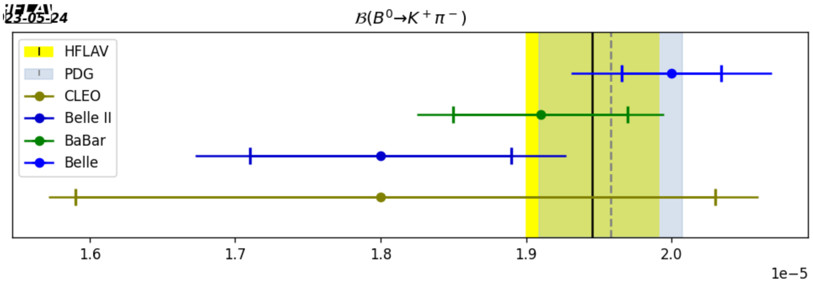
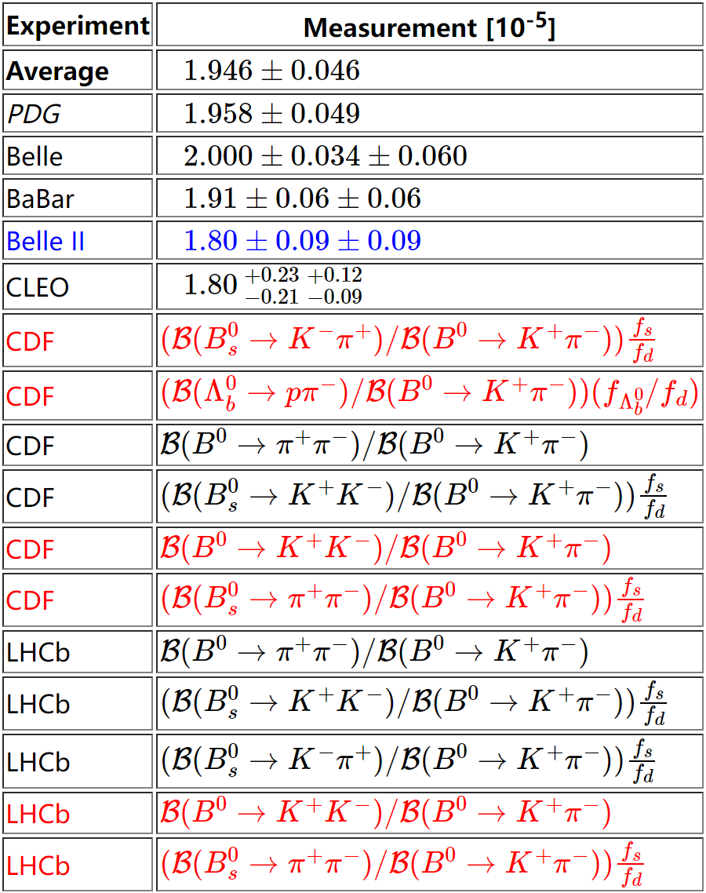
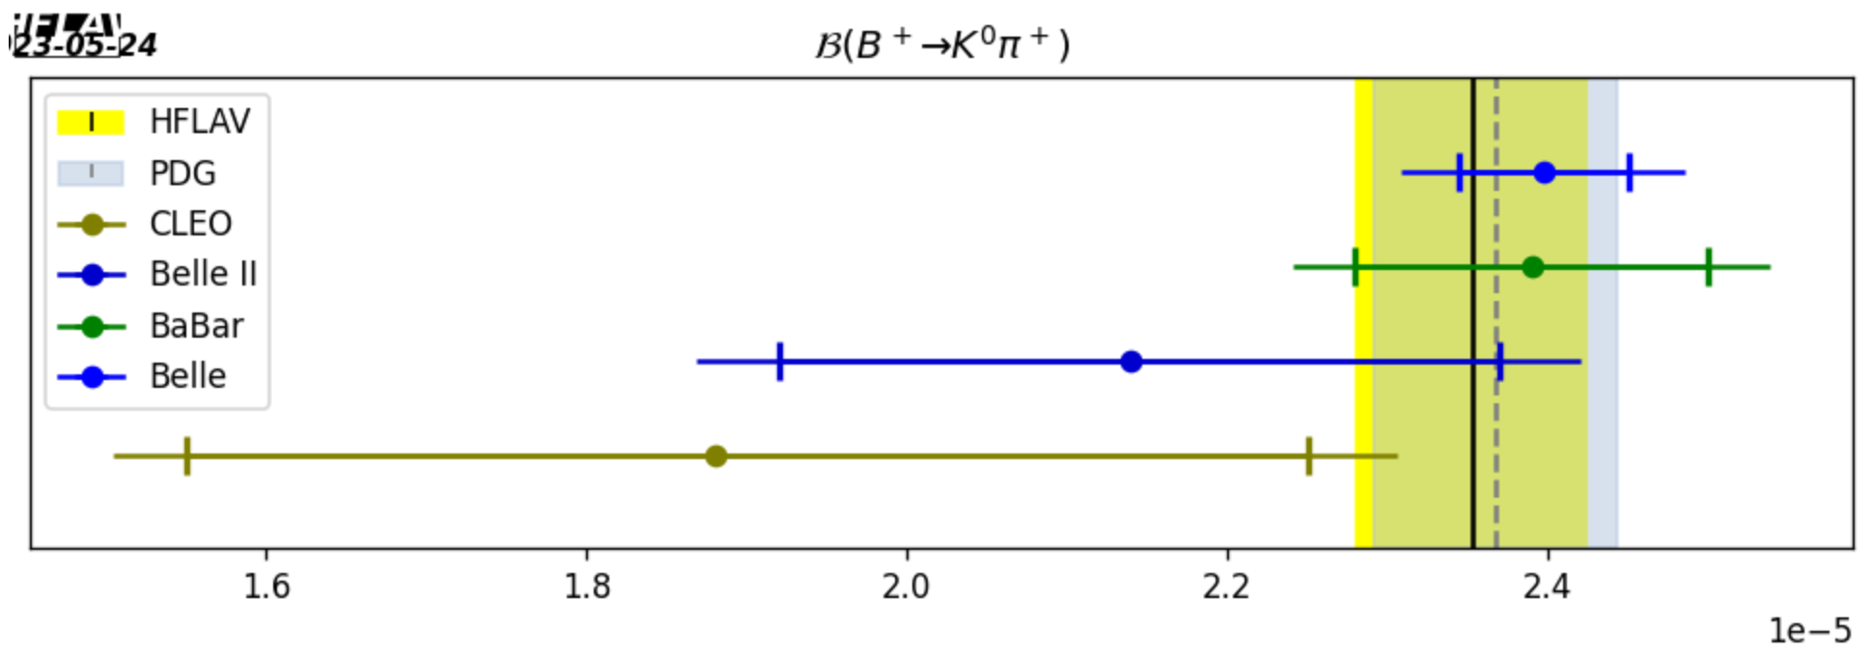
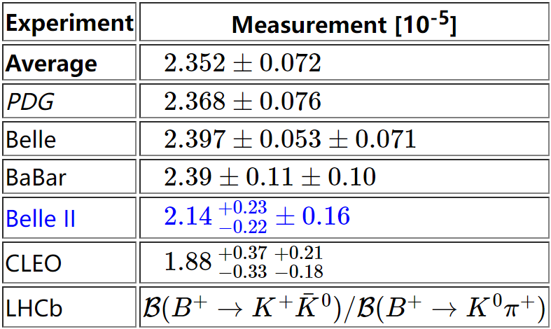
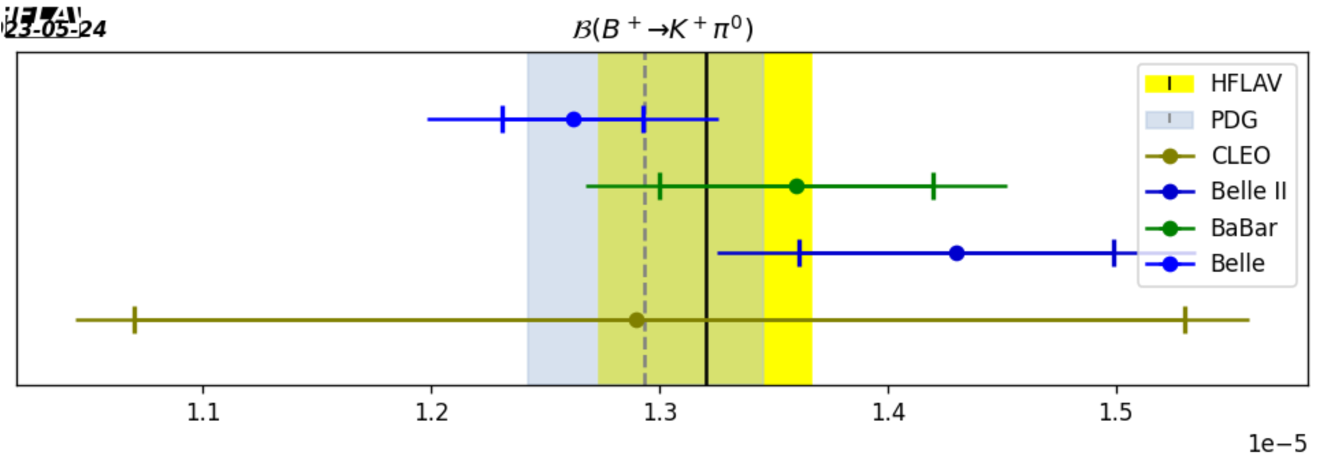
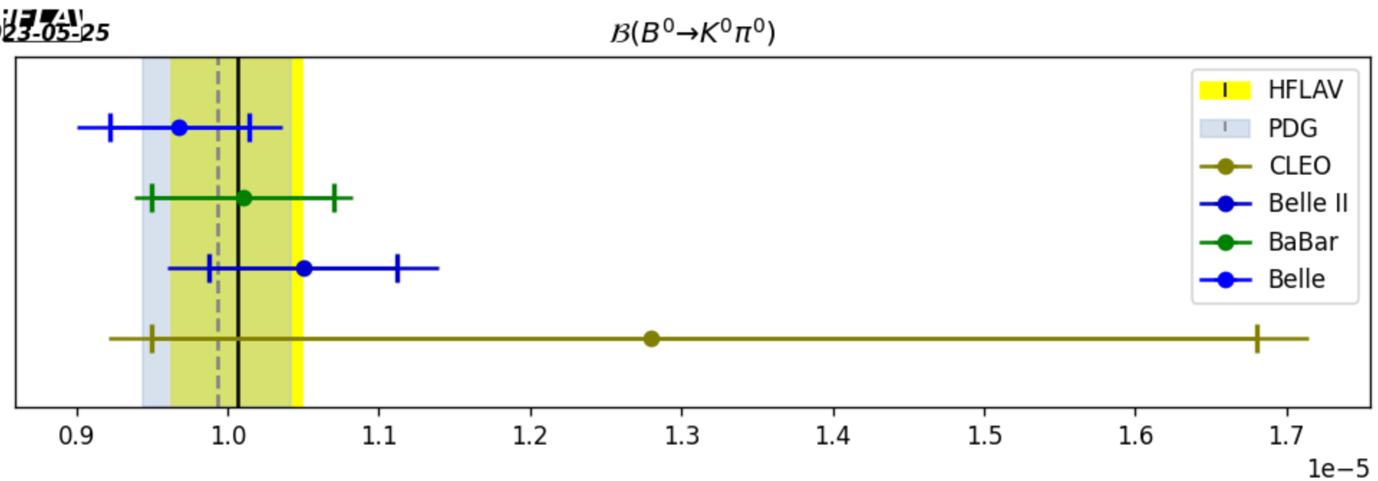
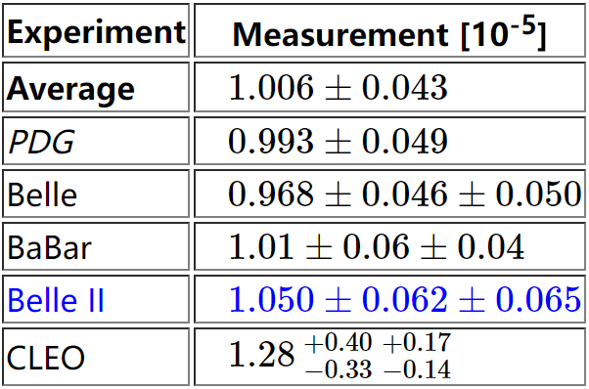
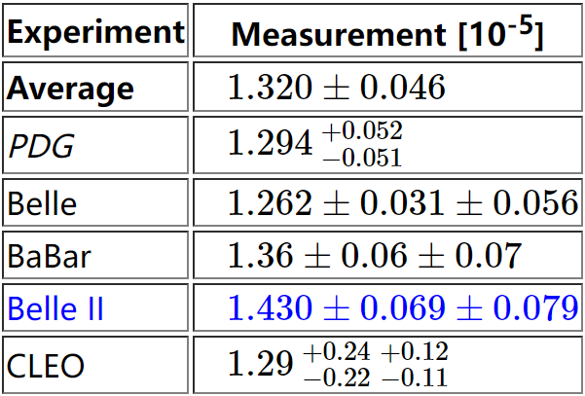
Input values that appear in red are not included in the PDG average.
Input values in blue correspond to yet unpublished results.
Rare B decays | Heavy Flavor Averaging Group https://hflav.web.cern.ch/content/rare-b-decays#averages

Slide 46
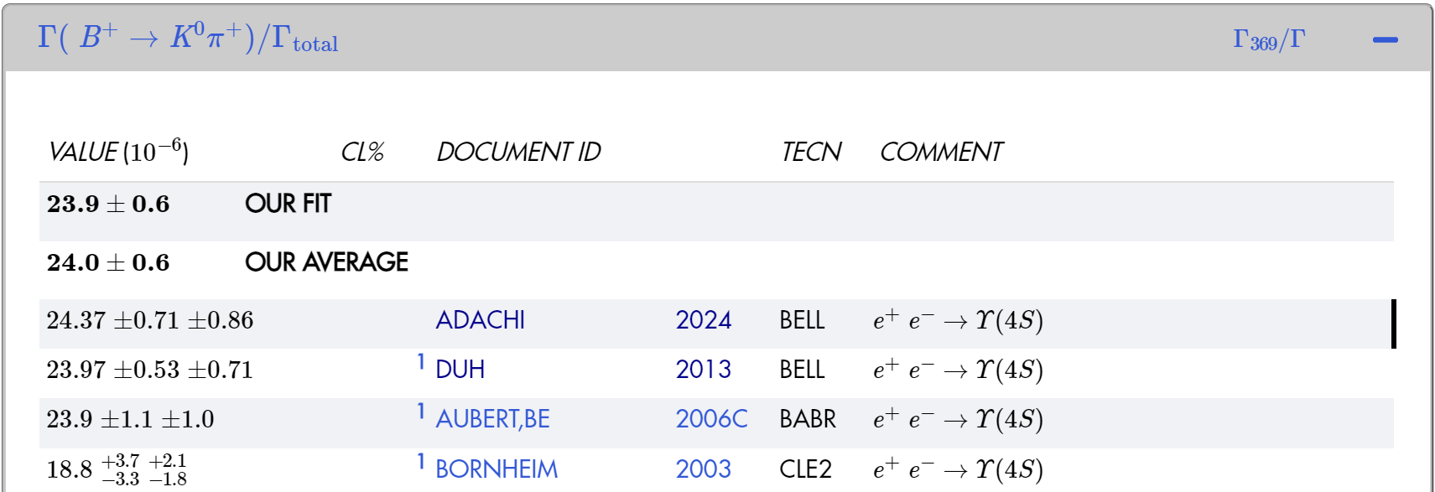
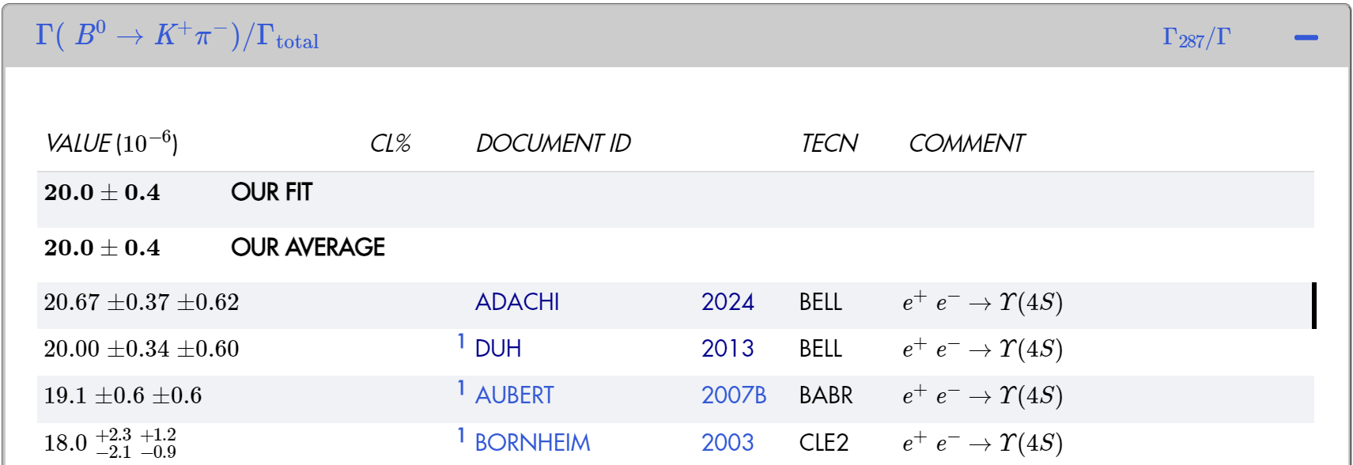
Navas et al. (Particle Data Group), the review of particle physics, to be published in Phys. Rev. D 110, 030001 (2024)
pdgLive https://pdglive.lbl.gov/ParticleGroup.action?init=0&node=MXXX045

Slide 47
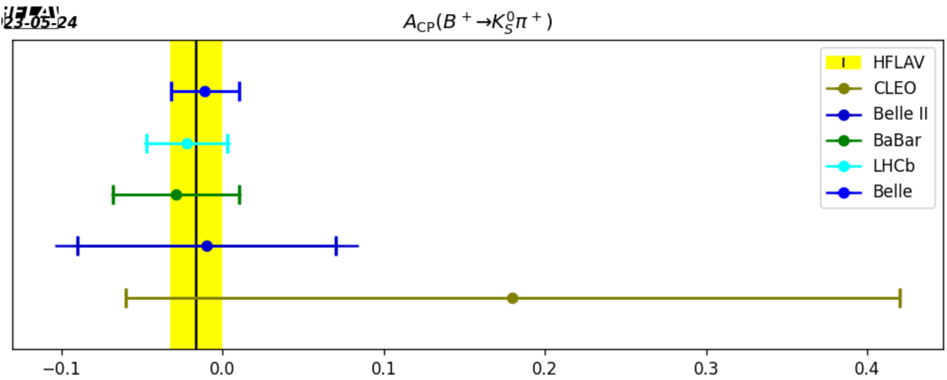
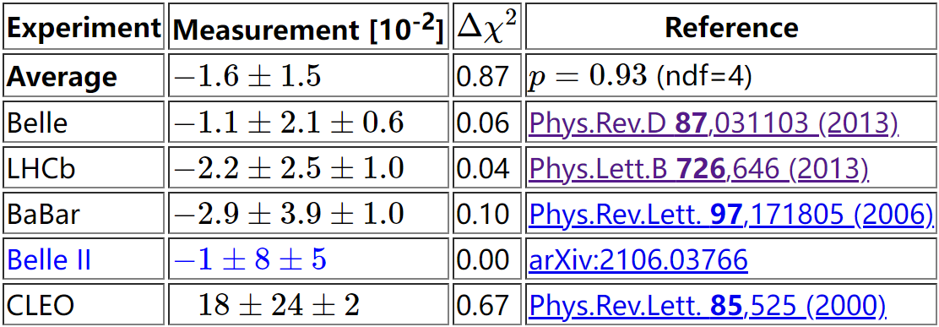
Rare B decays | Heavy Flavor Averaging Group https://hflav.web.cern.ch/content/rare-b-decays#averages

Slide 48
HnLi and Mishima:
HnLi and Mishima, Possible resolution of the B->$ππ,Kπ$ puzzles, arXiv: 0901.1272[hep-ph]
In 2007，Collins and Qiu pointed out that the ${\text{k}}_{\text{T}}$ factorization breaks down in complicated QCD processes like high-$p_{\text{T}}$ hadron hadroproduction because of the existence of soft gluons in the glauber region.
Collins and JWQiu, $k_{T}$ factorization is violated in production of high-transverse-momentum particles in hadron-hadron collisions, arXiv: 0901.1272[hep-ph]
A nonfactorizable amplitude of B-meson decay, involving dynamics of three hadrons, mimics the complicated hadron hadroproduction, hinted from the observations.
Contrary to high-$p_{\text{T}}$ hadron hadroproduction, the residual infrared divergence can be factorized into a soft factor in two-body nonleptonic B meson decays, such that the universality of a ${\text{k}}_{\text{T}}$-dependent（TMD）meson wave function is restored.
A nonfactorizable amplitude then remains calculable in the PQCD approach after parametrizing the soft factor.
Notes:
2007年，Collins和邱建伟指出，由于在Glauber region软胶子的存在，在一些复杂的QCD过程如high pT hadron hadroproduction中kT因子化会崩溃。不过，经过细致的分析和借鉴SCET已经处理过Glauber胶子的示范，湘楠老师和Mishima通过研究认为B介子衰变中的不可因子化振幅因为包含了三个强子的动力学可以模拟复杂的hadron hadroproduction。但是，与high pT hadron hadroproduction相反的是，在B介子两体非轻衰变中，残余红外发散可以因子化处理到一个soft factor，以恢复介子TMD波函数的普适性。对soft factor参数化后，不可因子化振幅在PQCD方法下仍保持可算。

Slide 49
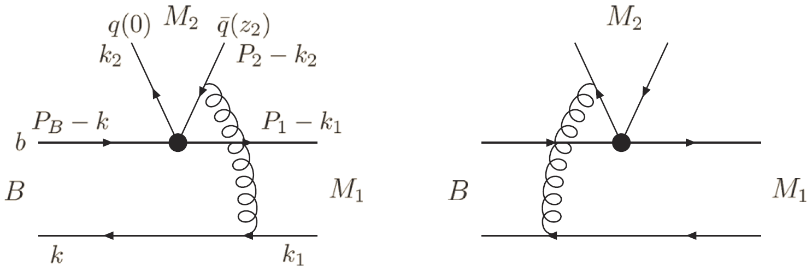
The color-suppressed tree amplitude $C$ receives a small factorizable contribution, so the soft effect on a nonfactorizable amplitude could be significant for $C$ .
NLO spectator diagrams contain the glauber divergences associated with the M₂ meson for B->M₁M₂ decay. Other NLO diagrams with the glauber divergences are referred to PhysRevD.83.034023.
Checked the k_{T} factorization of nonfactorizable spectator diagrams
Considered the factorization of meson wave function
Observed the existence of glauber gluon divergences
Got universal phase factors $S_{e}$ by all-order summation of the glauber divergences
Notes:
这样，原本由小的可因子化贡献带来的颜色压低树图振幅C将会由于soft effect对不可因子化振幅的作用而显著提升，于\pi\pi和K\pi long-standing puzzles的解决有利。这是PQCD方法下LO的不可因子化旁观者图。这是可以分离出NLO修正过程中与出射的M2介子相关联的glauber发散的典型图例，其他图可以参看相关文献。检视不可因子化旁观者图的kT因子化，考虑M2介子波函数的因子化，分离出存在的glauber胶子发散。对这些glauber发散作所有阶求和得到普适的相位因子，即soft factor

Slide 50
$$Ia≈exp⁡(iS_{e2}){\text{M}}_{a}^{(0)}$$
$$Ib≈exp⁡(−iS_{e2}){\text{M}}_{b}^{(0)}$$
Like 1-1 ⇒ $\exp\left(iS_{e2}\right)−\exp\left(−iS_{e2}\right)$ ⇒ large imaginary $C$!
NLO spectator diagrams contain the glauber divergences associated with the M₁ meson for B-> M₁M₂ decay. Other NLO diagrams with the glauber divergences are referred to PhysRevD.90.074018.
The modified TMD wave function for kaon is expressed as,
Brodsky, THuang and Lepage, The hadronic wave function in Quantum Chromodynamics, SLAC-pub-2540
THuang, Hadron wavefunctions and structure functions in QCD, AIP Conf.Proc.68.1000
JHYu, BWXiao and BQMa, Space- and time-like pion-rho transition form factors in the light-cone formalism, 0706.2018
${\overline{φ}}_{K}\left(x,b^{′},b\right)≡{{\overline{φ}}_{K}\left(b^{′},b\right)φ}_{K}\left(x\right)$ $=\frac{2β_{K}^{2}}{π}exp\left[−\frac{1}{8β_{K}^{2}}\left(\frac{m_{q}^{2}}{x}+\frac{m_{s}^{2}}{1−x}\right)\right]$
$$×exp\left[−2β_{K}^{2}x{b^{′}}^{2}−2β_{K}^{2}(1−x)b^{2}\right]φ_{K}(x)$$
Notes:
Soft factor贡献之下，a图和b图的振幅分别可以写成Ia and Ib。在LO PQCD框架下，原本a和b图振幅相减，现在由于从M2介子中的valence quark 和 valence antiquark辐射出来的glauber胶子贡献的soft factor 使得两个振幅之间由相减转变为相加，进一步改进本已得到增强的大的复颜色压低树图振幅。进一步检视反冲的M1介子的NLO修正，从中分离出glauber发散，可以因子化到另一个soft factor Se1，其功能是使得已经增大的C进行转动，进而改进其与颜色允许树图振幅之间的干涉行为，以解决\pi\pi， K\pi puzzles。

Slide 51
Determination of the shape parameters for pion, kaon and ρ meson.
$$β_{π}\sim 0.4 GeV,$$
$β_{ρ}\sim \frac{1}{3}β_{π},$
$$β_{K}\sim 0.25 GeV$$
Important implications:
Simply parameterize the glauber phase S(b) by a sinusoidal function,
S(b) = rπ sin(pb)
The soft factor $S_{e}$ has a dynamical origin similar to that of a meson wave function: the former (latter) absorbs the glauber (collinear) gluons.
Notes:
确定形状参数，pion采用文献中广为使用的0.4，根据B->\rho 和B\to K跃迁形状因子确定\beta_\rho和\beta_K。显然， (接下来就看它是否能给出预期的glauber效应？！）

Slide 52
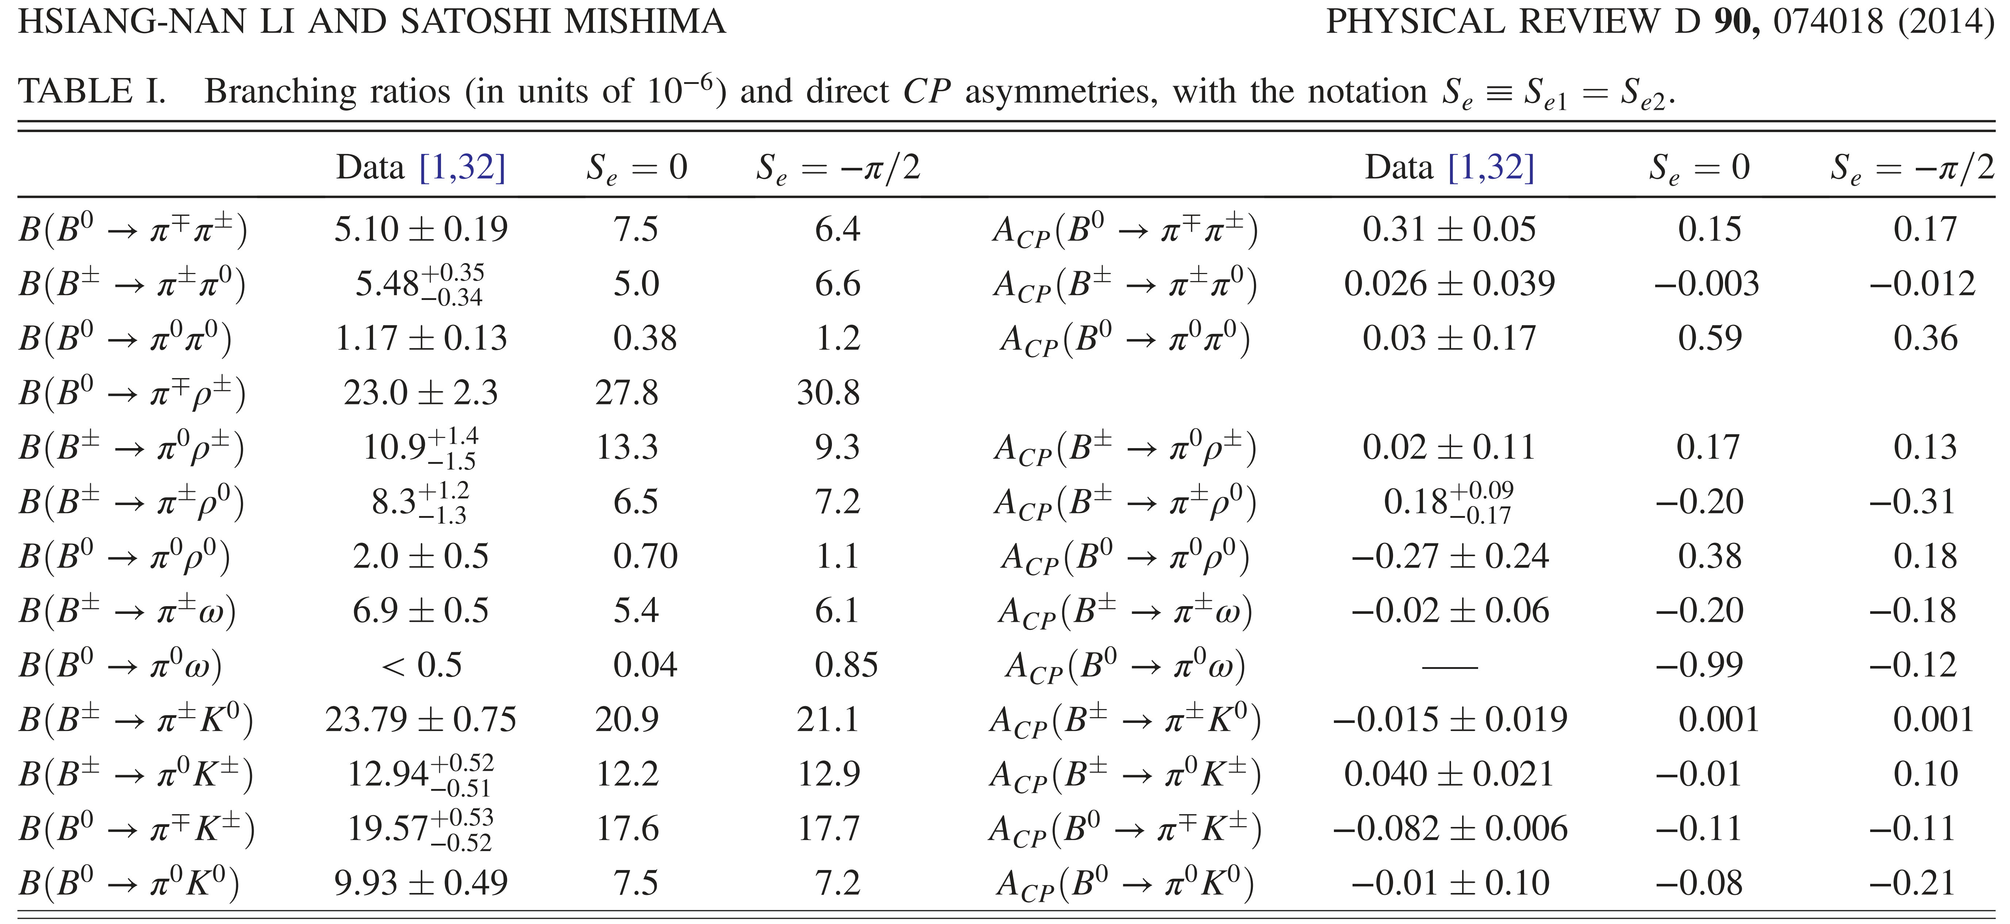
A simplified formalism neglecting the convolution between the glauber factors and the PQCD factorization formulas elaborated, generally consistent predictions given.
HnLi and Mishima, Glauber gluons in spectator amplitudes for B->$πM$ decays, arXiv: 1407.7647[hep-ph]
Notes:
他们确立了一个简化的方案，忽略glauber胶子和PQCD因子化公式之间的演化，仅考虑pion glauber相位的自由参数输入，忽略kaon及rho介子的特殊性，且认为glauber效应对与之相关衰变道的影响可以忽略，然后总体上给出了与实验测量趋势较为一致的拟合结果。

Slide 53
Modified factorization formulas:
XLiu, HnLi and ZJXiao, Transverse-momentum-dependent wave functions with glauber gluons in B->$ππ,$ $ρρ$ decays, arXiv: 1502.04162[hep-ph]
$${\text{A}}_{a}=\int{d^{2}b_{1}d^{2}b_{2}\int{d^{2}b_{s1}d^{2}b_{s2}{\overline{φ}}_{B}(b_{1}){\overline{φ}}_{1}(b_{s1}+b_{1},b_{s1}){\overline{φ}}_{2}(b_{s2},b_{s2}+b_{2})}}$$
$×exp\left[−iS\left(b_{s1}−b_{2}\right)+iS\left(b_{s2}−b_{1}\right)\right]H_{a}(b_{1},b_{2})$
$${\text{A}}_{b}=\int{d^{2}b_{1}d^{2}b_{2}\int{d^{2}b_{s1}d^{2}b_{s2}{\overline{φ}}_{B}(b_{1}){\overline{φ}}_{1}(b_{s1}+b_{1},b_{s1}){\overline{φ}}_{2}(b_{s2}+b_{2},b_{s2})}}$$
$×exp\left[−iS\left(b_{s1}−b_{2}\right)−iS\left(b_{s2}−b_{1}\right)\right]H_{b}(b_{1},b_{2})$
Notes:
因此，不可因子化旁观者夸克振幅考虑glauber胶子及改进的介子波函数的因子化公式为如下，其中跟动量分数有关的NLO因子化振幅没有列出。红框标记部分即考虑glauber胶子流入而改进的介子波函数，蓝框标记的则是来自于反冲的M1介子glauber相位，二者均贡献自M1的valence quark；绿框标记的则是来自于M2介子由valence quark 和antiquark 辐射的glauber 胶子贡献的相位，因此有正负之分。

Slide 54
Simply parameterize the glauber phase S(b) by a sinusoidal function,
S(b) = rπ sin(pb)
Two sets of parameters r and p corresponding to largest branching ratio of $B^{0}→π^{0}π^{0}$ decay
r ~ 0.47, p ~ －0.632 GeV
r ~ 0.60, p ~ 0.544 GeV
BR(B⁰→π⁺π－) = 5.90×10⁻⁶
BR(B⁰→π⁺π－) = 5.39×10⁻⁶
BR(B⁺→π⁺π⁰) = 3.88×10⁻⁶
BR(B⁺→π⁺π⁰) = 4.45×10⁻⁶
BR(B⁰→π⁰π⁰) = 0.62×10⁻⁶
BR(B⁰→π⁰π⁰) = 0.61×10⁻⁶
BR(B⁰→ρ⁰ρ⁰) = 1.07×10⁻⁶
BR(B⁰→ρ⁰ρ⁰) = 0.89×10⁻⁶
Notes:
湘楠老师对glauber相位做了一个简单的参数化形式，这里的r和p为待定的参数。当然，参数确定的原则就是经受\rho^0\rho^0限制的最大\pi^0\pi^0分支比。经过搜寻，最终发现r=0.6, p =0.544满足要求。

Slide 55
PDG: R_{c}= ${1.10}_{−0.01}^{+0.01}$
NLOG: R_{c}= ${1.16}_{−0.00}^{+0.01}$
PDG: R_{n}= ${0.99}_{−0.02}^{+0.02}$
NLOG: R_{n}= ${1.17}_{−0.02}^{+0.01}$
Belle-II: I_{kπ}= $−0.03±0.14$
NLOG: I_{kπ}= $−0.03±0.01$
$$PDG:0.54±0.05$$
$$NLOG:0.58±0.00$$
$$PDG:2.16±0.23$$
$$NLOG:{2.33}_{−0.03}^{+0.05}$$

