Slide 1
Rare b-hadron decay results
at LHCb
b-mesons, searches and observations
b-baryons, searches and observations
Selectively
王纪科
武汉大学
2024年7月，烟台

Slide 2
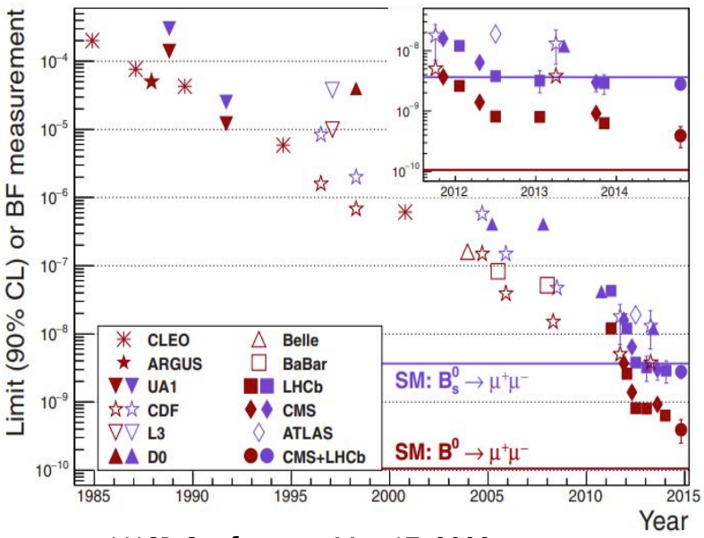
Measurement of $B_{s}^{0}→μ^{+}μ^{−}$and search for B⁰ $→μ^{+}μ^{−}$, $B_{s}^{0}→μ^{+}μ^{−}γ$
Highly suppressed in SM, (i)Cabibbo suppressed, (ii)Helicity suppressed
Extremely rare in SM ($B_{s}^{0}→μ^{+}μ^{−}$ ~(3.66±0.14) ×${10}^{−9}$, B⁰ $→μ^{+}μ^{−}$ ~(1.03±0.05) × ${10}^{−9}$ ).
powerful probes for detecting deviations from the SM due to new physics contributions mediated, for instance, by heavy Z’ gauge bosons, leptoquarks or non-SM Higgs bosons

Slide 3
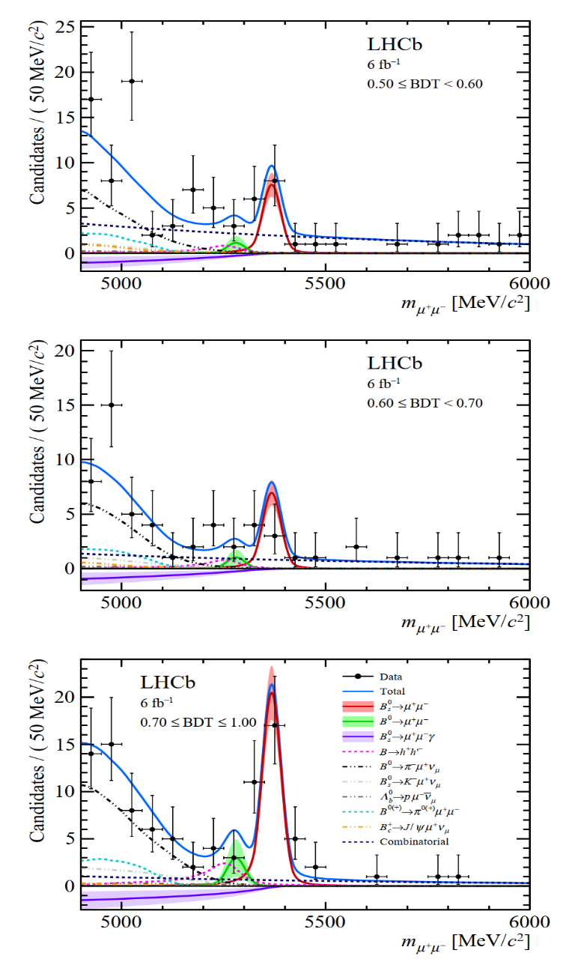
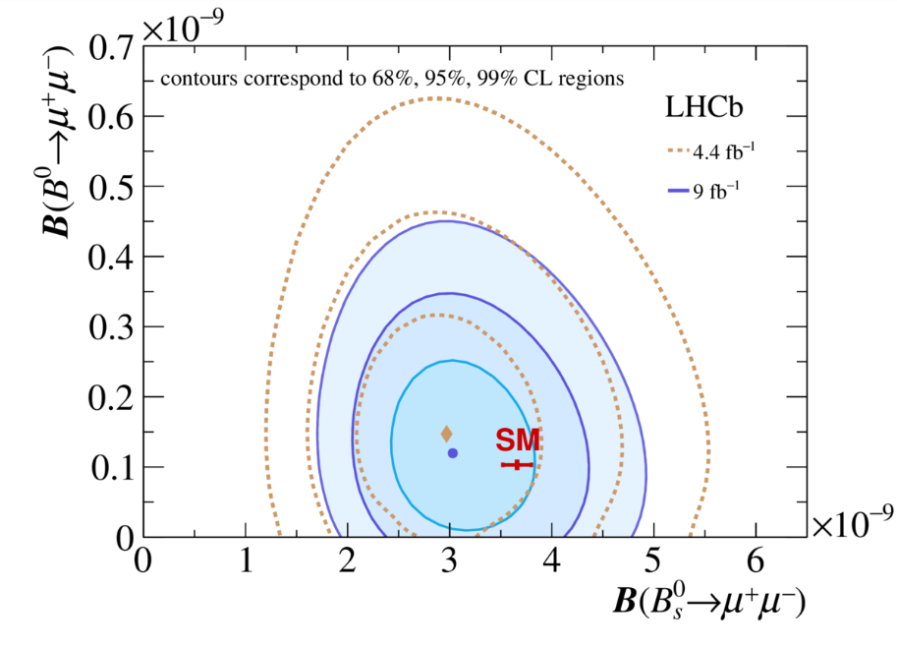
LHCb Run 1 + Run 2, $B_{s}^{0}→μ^{+}μ^{−}$
Branching ratios, consistent with SM:
Systematic uncertainties of $B_{s}^{0}→μ^{+}μ^{−}$ and B⁰ $→μ^{+}μ^{−}$are dominated by the uncertainty on fs/fd (3%) and the knowledge of the background from specific processes (9%), respectively.
Phys. Rev. Lett. 128, (2022) 041801
Phys. Rev. D105 (2022) 012010

Slide 4
Search for B_{s}⁰ →${ μ}^{+}μ^{−}γ$
The target
The $B_{s}^{0}→μ^{+}μ^{−}γ$process is a powerful probe of SM, being sensitive to C7 , C9 and C10, While $B_{s}^{0}→μ^{+}μ^{−}$is only sensitive to C10.
The photon lifts the helicity suppression of $B_{s}^{0}→μ^{+}μ^{−}$, partially compensating for the additional QED interaction.
Notes:
For the Motivation of bs2mumugamma analysis
The $B_{s}^{0}→μ^{+}μ^{−}γ$process is a powerful probe of SM, being sensitive to C seven , C nine and C10, While $B_{s}^{0}→μ^{+}μ^{−}$is only sensitive to C10.
The photon lifts the helicity suppression of $B_{s}^{0}→μ^{+}μ^{−}$, partially compensating for the additional QED interaction.
We would like to find evidence for the existence of decay, or give upper limits for branching ratios.

Slide 5
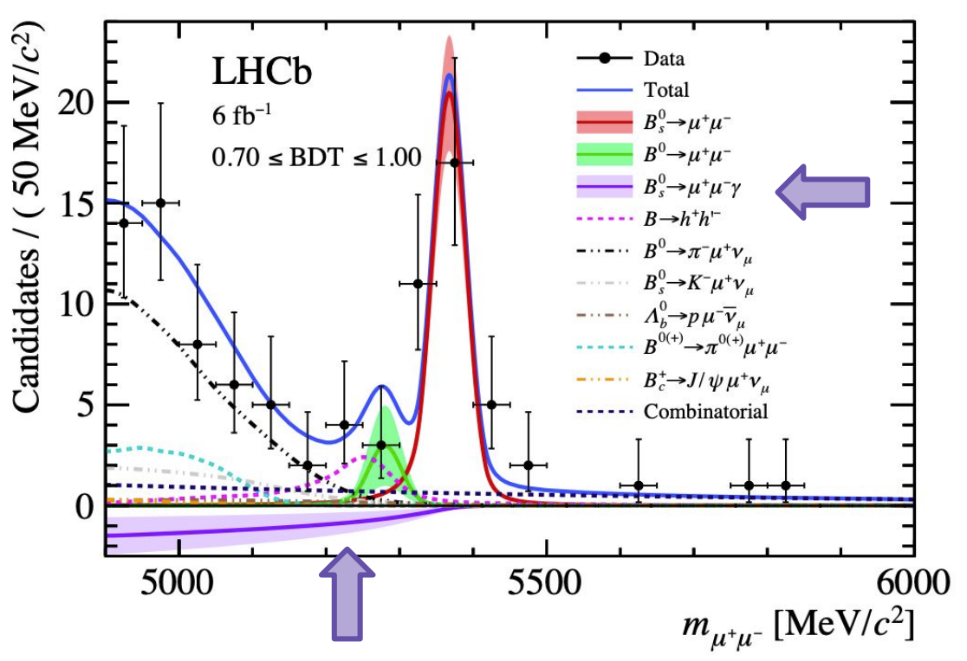
Search for B_{s}⁰ →${ μ}^{+}μ^{−}γ$
Two complementary strategies:
Indirect: no 𝛾 reconstruction, $B_{s}^{0}→μ^{+}μ^{−}γ$is measured as a partially reconstructed background of $B_{s}^{0}→μ^{+}μ^{−}$. Limit CL from 2022:
BR($B_{s}^{0}→μ^{+}μ^{−}γ$)< 1.5(2.0) 10-9 at q> 4.9 GeV/c2 at 90% (95%) CL
Only probes high q² region, missing possible new physics contributions
Direct: reconstruction of 𝛾, what we are presenting today
Blinded search: mass range: [3867 , 6867] , blind range: [5167,5567] (MeV/c²)
Full final state reconstruction, photon reconstruction worsen the resolution
Sensitive to low-q² region, therefore, to larger set of Wilson coefficients (C7, C9, C10)
Data: 6 fb⁻¹ of $\sqrt{s}=$13 TeV pp collected by LHCb during Run 2.
First direct search
First low-q² region search
Notes:
For the Motivation of bs2mumugamma analysis
The $B_{s}^{0}→μ^{+}μ^{−}γ$process is a powerful probe of SM, being sensitive to C seven , C nine and C10, While $B_{s}^{0}→μ^{+}μ^{−}$is only sensitive to C10.
The photon lifts the helicity suppression of $B_{s}^{0}→μ^{+}μ^{−}$, partially compensating for the additional QED interaction.
We would like to find evidence for the existence of decay, or give upper limits for branching ratios.

Slide 6
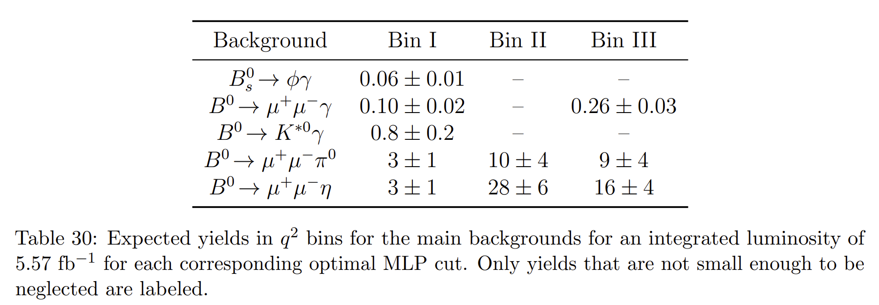
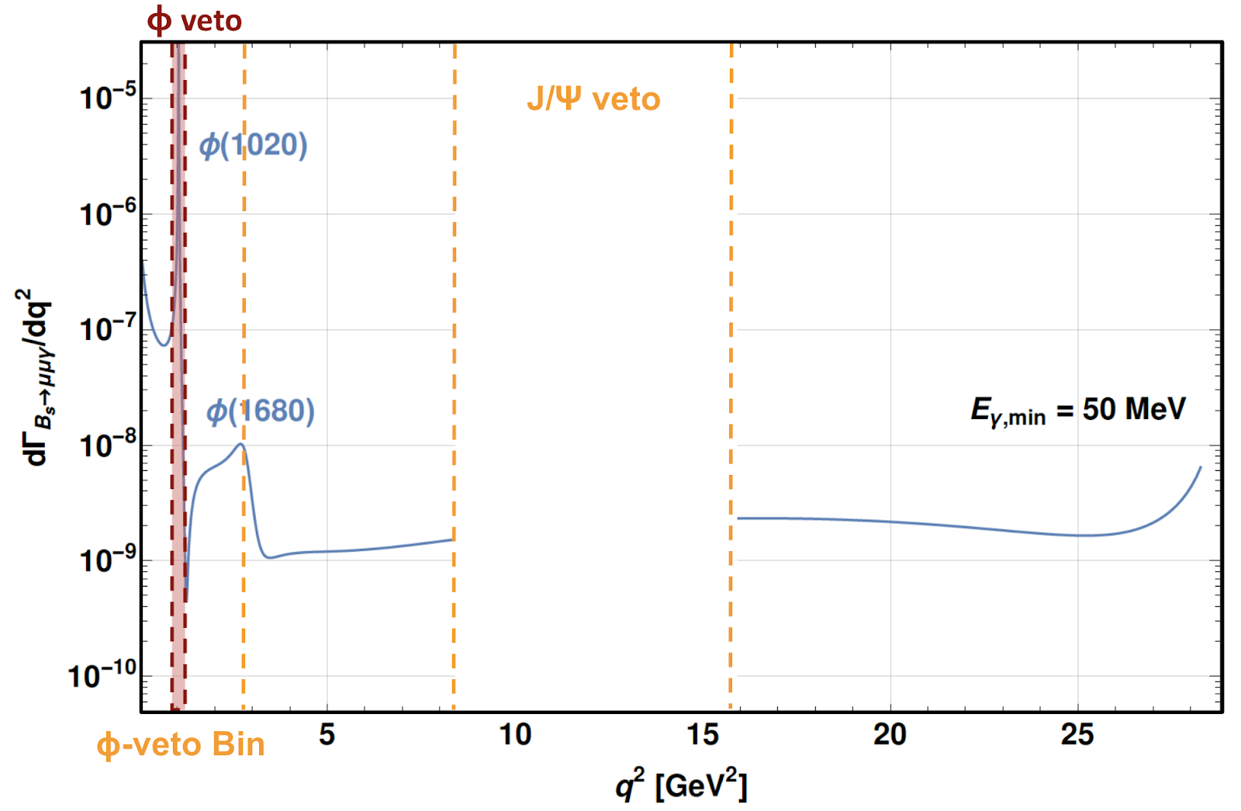
Search for B_{s}⁰ →${ μ}^{+}μ^{−}γ$
q² bins: the analysis is performed in three regions of the dimuons invariant mass
Bin ɸ-veto: 0.9896 < m(μμ)(GeV/c² ) < 1.0734 ; low-q² without ɸ
Normalization channels：B_{s}⁰ → (J/ψ → µµ)(η → γγ).
Control channel: B_{s}⁰ → Φ(→KK)𝛾
Background yields：
JHEP07(2024)101
Notes:
Veto bin： It has theoretical interest but less statistics (veto only)

Slide 7
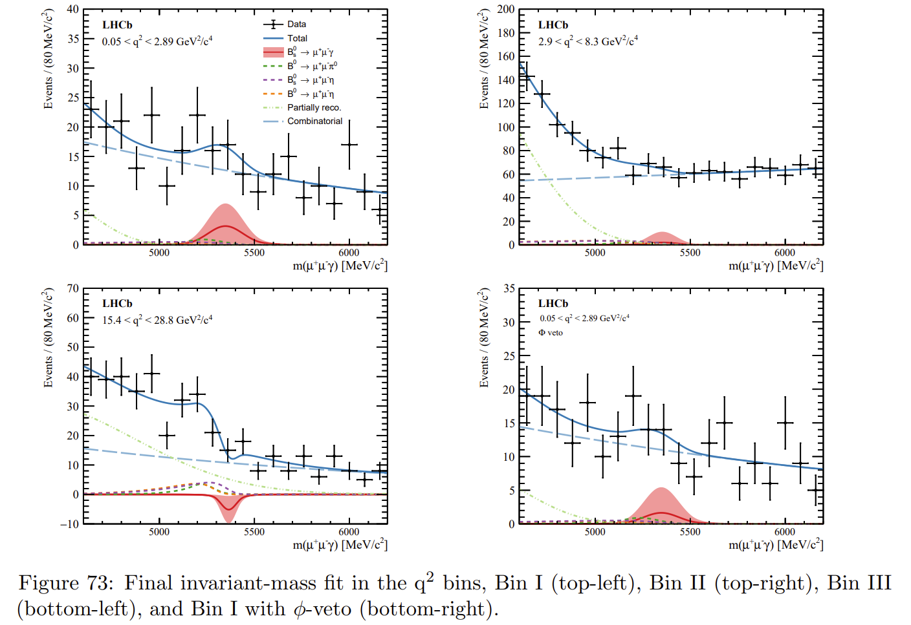
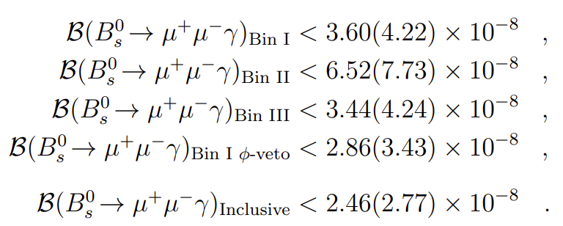
Search for B_{s}⁰ →${ μ}^{+}μ^{−}γ$
limits on the branching fractions are found to be：
JHEP07(2024)101
Notes:
The Run1 dataset is not used due to different trigger conditions

Slide 8
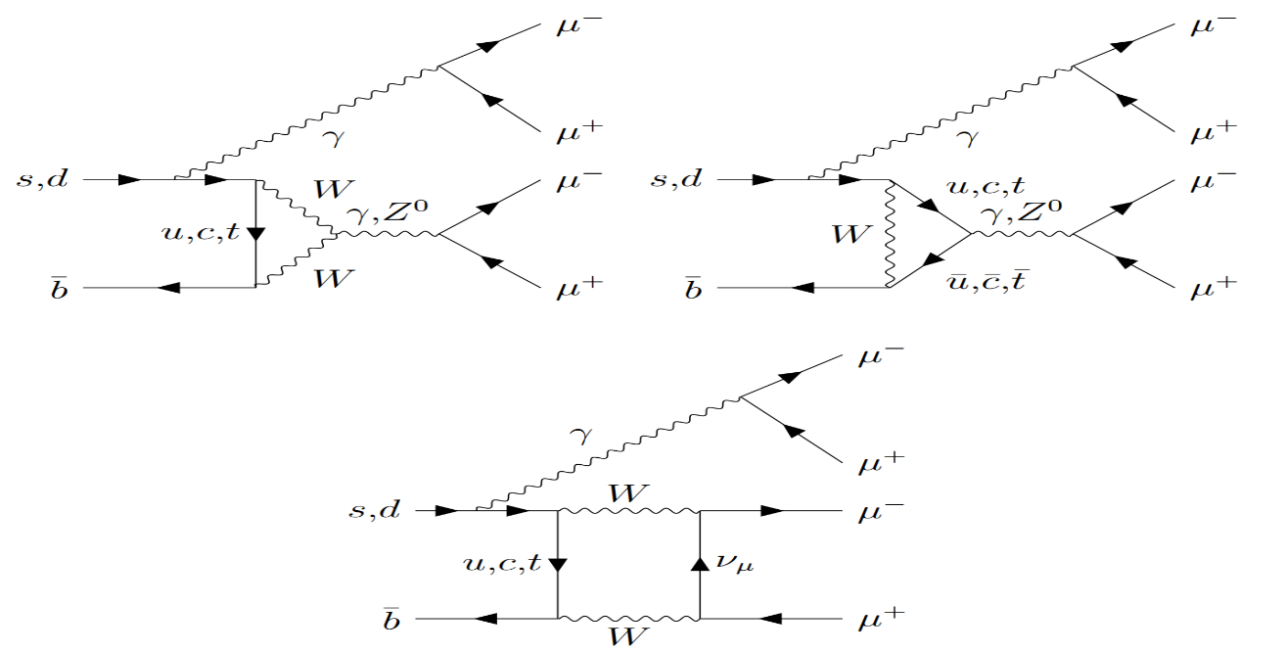
Search for the rare decays $Bs0→μ^{+}μ^{−}μ^{+}μ^{−}$and $B0→μ^{+}μ^{−}μ^{+}μ^{−}$
Highly suppressed in SM: BR (B⁰ $→4μ)\text{\sim }{10}^{−12}$, BR($B_{s}^{0}→4μ)$~ ${10}^{−10}$
For example, decays via scalar and pseudoscalar Sgoldstino particles into a pair of dimuons in the MSSM may lead to significant enhancements of the BRs
Furthermore, the decays into a pair of dimuons mediated by BSM light narrow scalars， $B_{(s)}^{0}→{a(μ}^{+}μ^{−})a(μ^{+}μ^{−})$, naturally occur in the extensions of SM
- In particular, such models can account for the long-standing tension of the anomalous magnetic
dipole moment of the muon, as well as the widely discussed anomalies in transitions

Slide 9
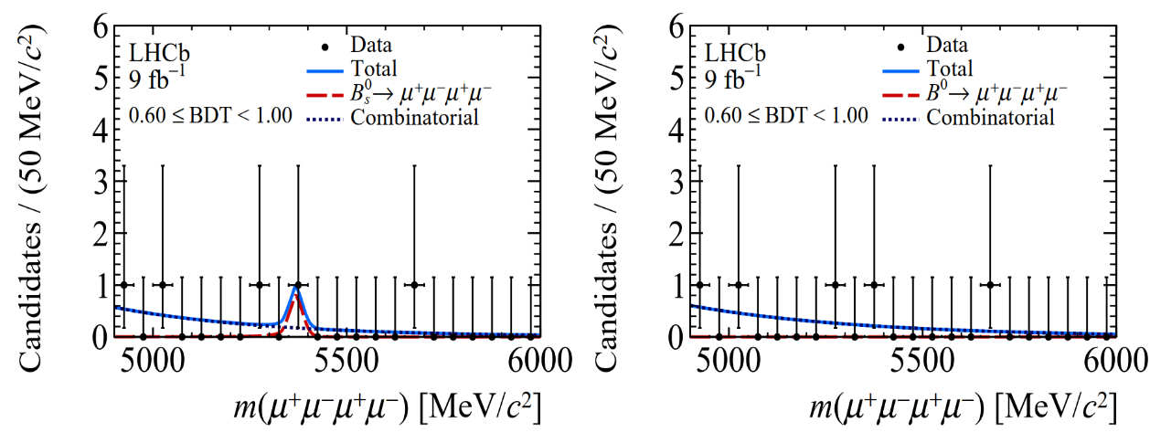
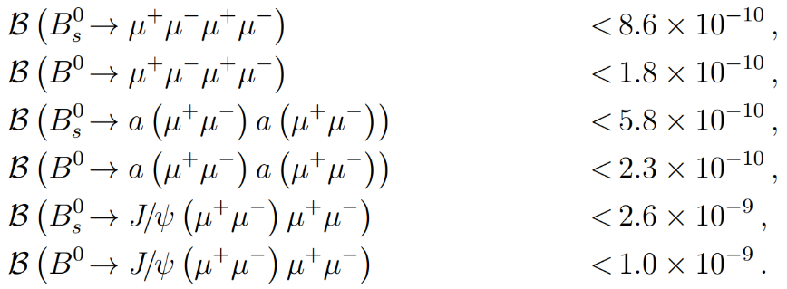
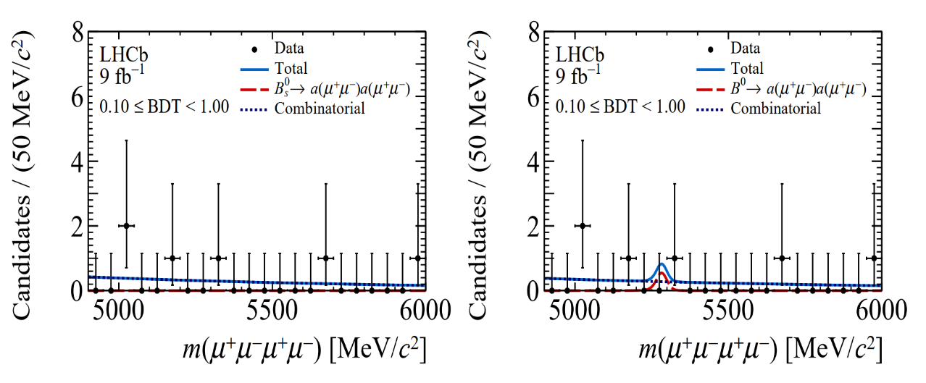
Search for the rare decays $Bs0→μ^{+}μ^{−}μ^{+}μ^{−}$and $B0→μ^{+}μ^{−}μ^{+}μ^{−}$
No evidence for the six signal decay modes, with the most significant excesses found in the $B_{(s)}^{0}→\text{J}\text{/}ψ{(μ}^{+}μ^{−})μ^{+}μ^{−}$searches, amounting to 2$σ$
The most stringent limits on each of the six decays
JHEP 03 (2022) 109

Slide 10
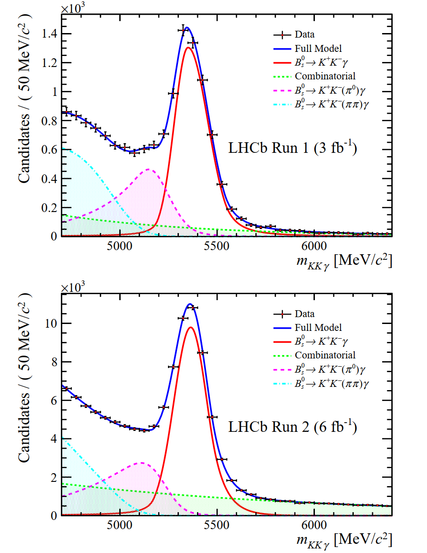
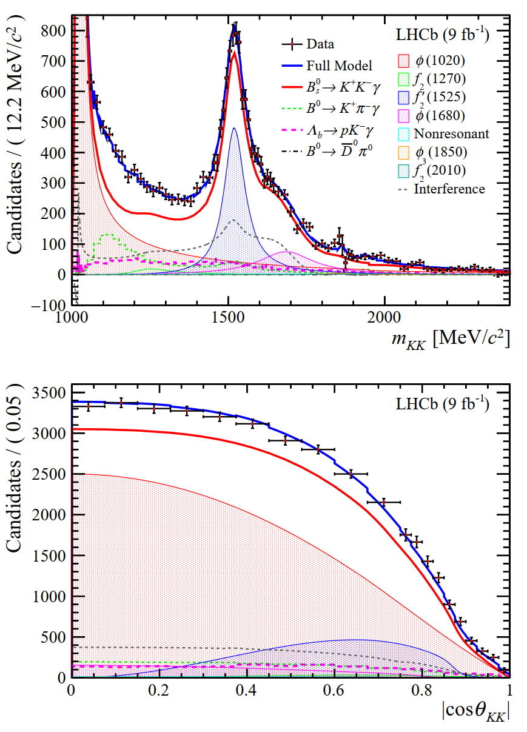
Amplitude analysis of $B_{s}^{0}$ →${ K}^{+}K^{−}γ$
The first amplitude analysis of the dikaon resonant structure in the $B_{s}^{0}$ →${ K}^{+}K^{−}γ$ decay up to a dikaon invariant mass 2400MeV
The first observation of the radiative $B_{s}^{0}$ → $f_{2}^{′}$(1525)γ decay,
the overall tensor contribution to the amplitude is dominated by $f_{2}^{′}$(1525) and measured to be:
arXiv:2406.00235v1

Slide 11
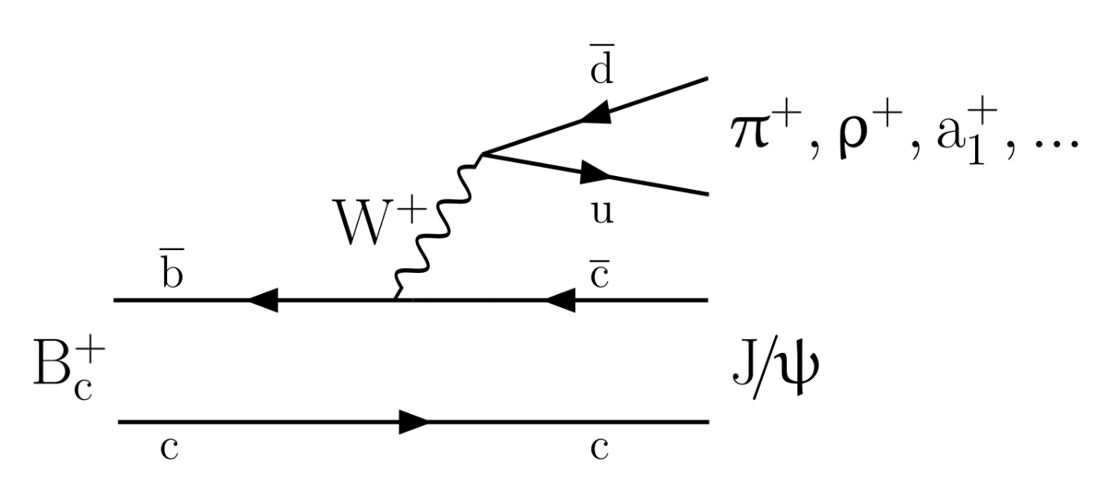
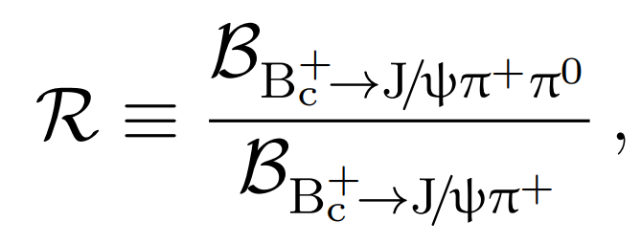
Observation of the $B_{c}^{+}→\text{J}\text{/}\text{ψ}π^{+}π^{0}$
The approach: using the form factors of the $B_{c}^{+}→$[cc] $W^{+}$ transition and the universal spectral function for the transition of the virtual $W^{+}$boson into light hadrons
Works well for all known decays of the $B_{c}^{+}$meson into charmonia with an odd number of light hadrons in the final state
The $B_{c}^{+}→\text{J}\text{/}\text{ψ}π^{+}π^{0}$mode, which is the simplest decay into a charmonium state and an even number of light hadrons, has not yet been observed previously.
expected to be dominated by the $B_{c}^{+}→$J/ψ${\text{ρ}}^{+}$ mode with a small admixture of $B_{c}^{+}→$J/ψ ${\text{ρ}(1450)}^{+}$decays. There are many predictions for the branching fraction ratio R of this decay relative to the $B_{c}^{+}$→ J/ψπ+ mode (next pages)
JHEP04 (2024) 151

Slide 12
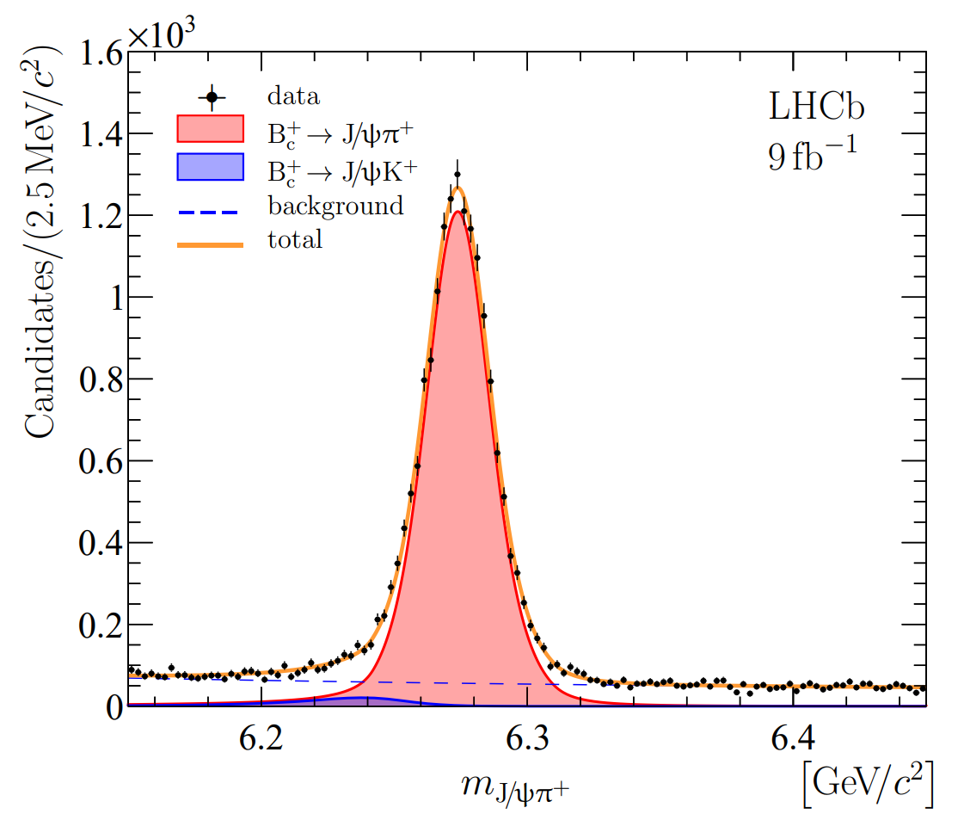
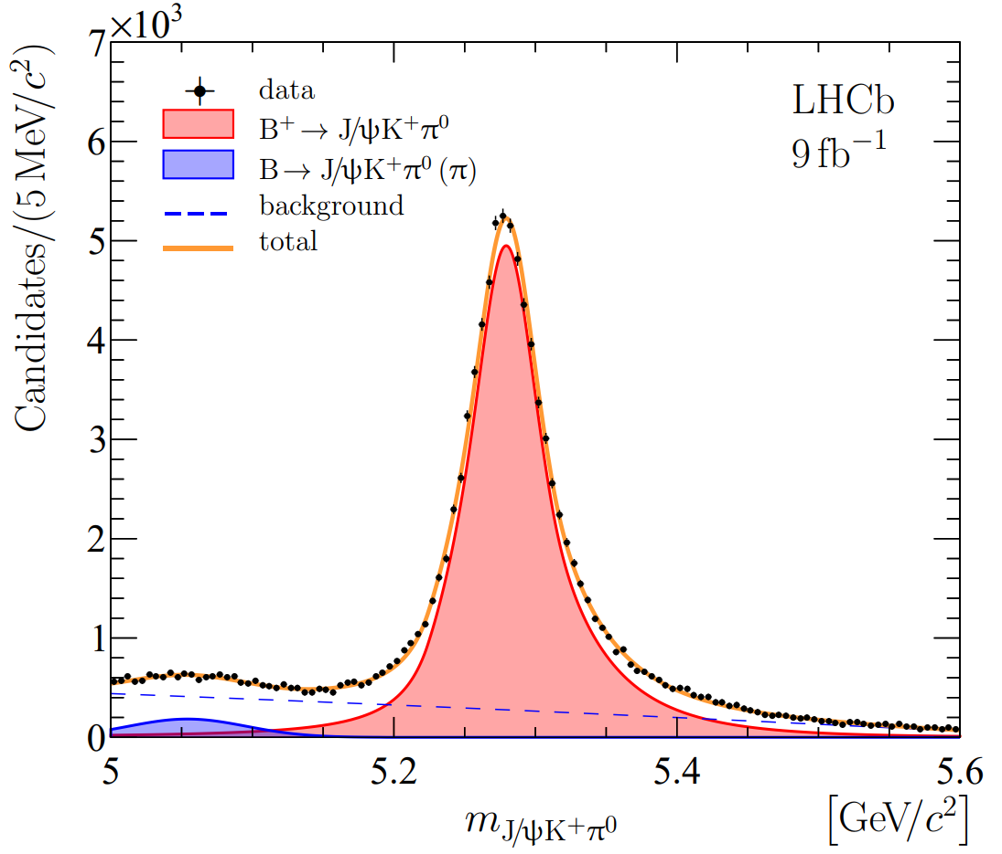
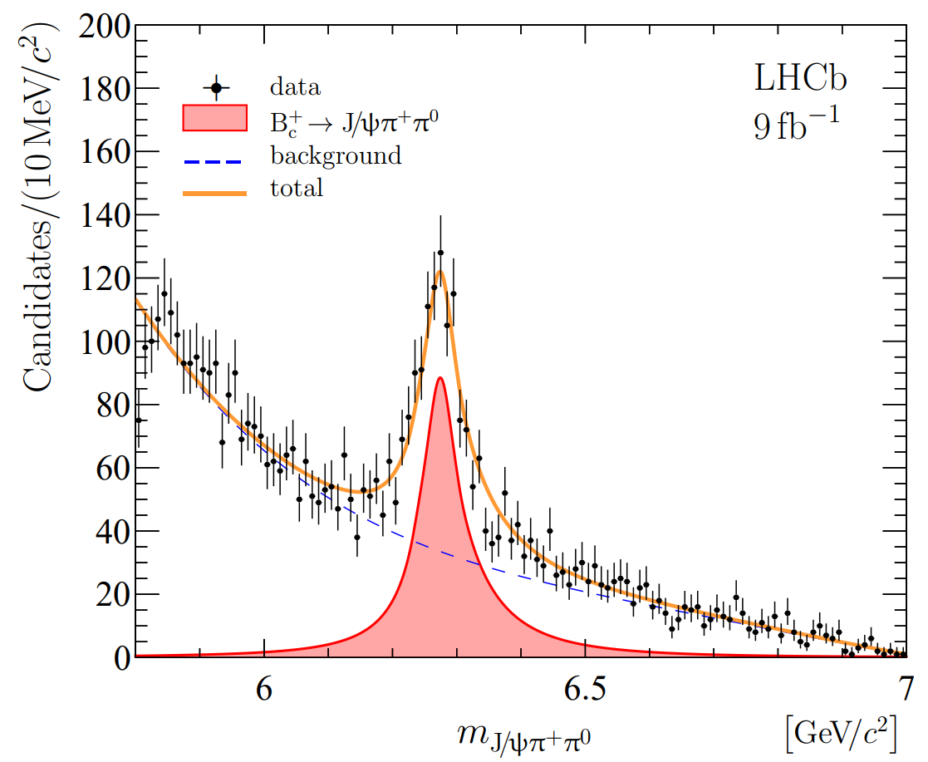
Observation of the $B_{c}^{+}→\text{J}\text{/}\text{ψ}π^{+}π^{0}$
Normalization channel: $B_{c}^{+}→\text{J}\text{/}\text{ψ}π^{+}$
Control channel: $B_{c}^{+}→\text{J}\text{/}\text{ψ}K^{+}π^{0}$
Signal channel: $B_{c}^{+}→\text{J}\text{/}\text{ψ}π^{+}π^{0}$
JHEP04 (2024) 151

Slide 13
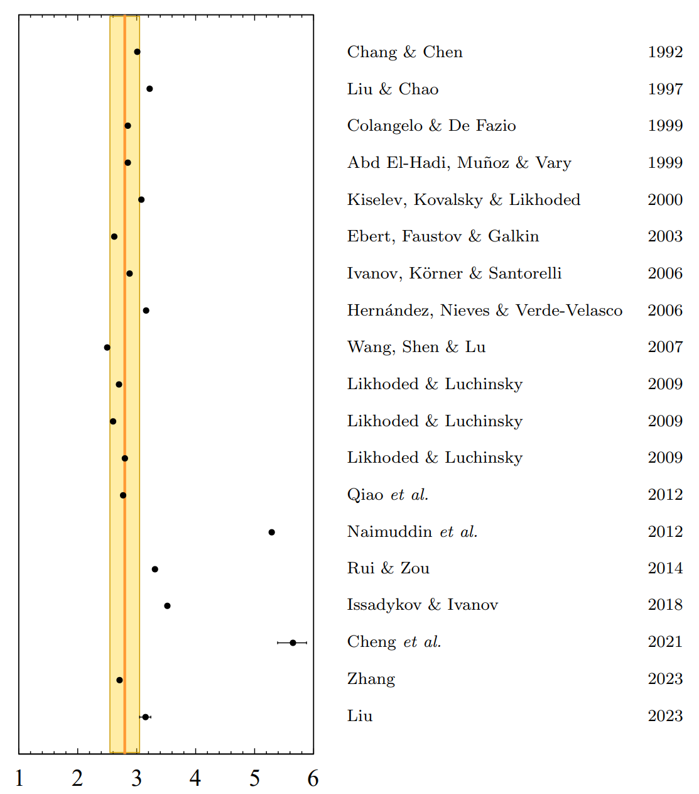
Observation of the $B_{c}^{+}→\text{J}\text{/}\text{ψ}π^{+}π^{0}$
The ratio of the $B_{c}^{+}→\text{J}\text{/}\text{ψ}π^{+}π^{0}$ branching fraction relative to the $B_{c}^{+}→\text{J}\text{/}\text{ψ}π^{+}$ channel is measured to be:
Where the first uncertainty is statistical, the second systematic and the third due to uncertainties in the B +→ J/ψK∗+ and B +→ J/ψK+ branching fractions.
JHEP04 (2024) 151

Slide 14
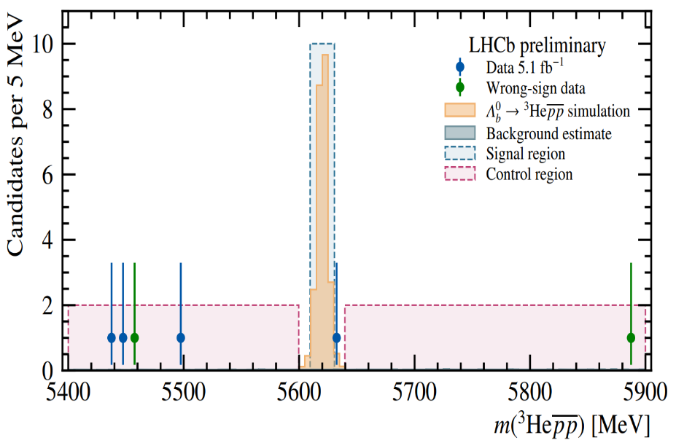
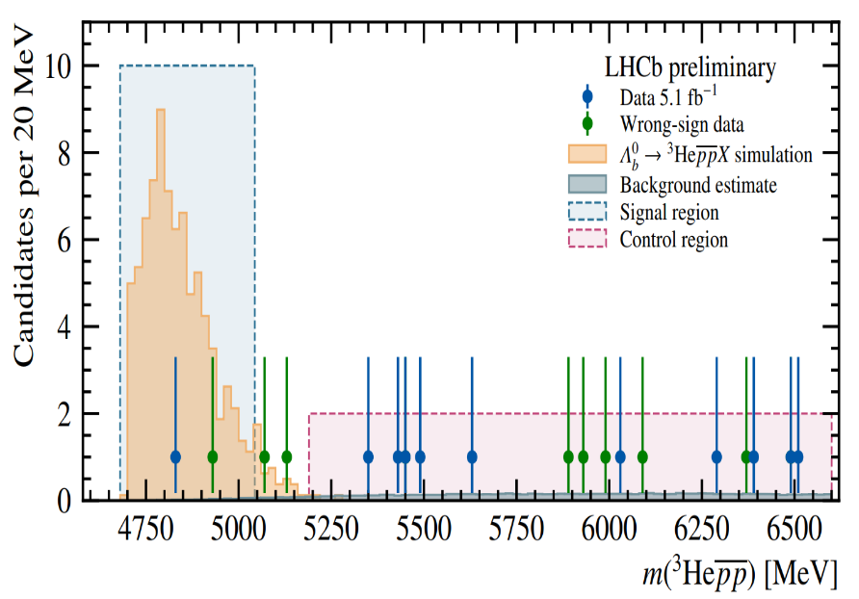
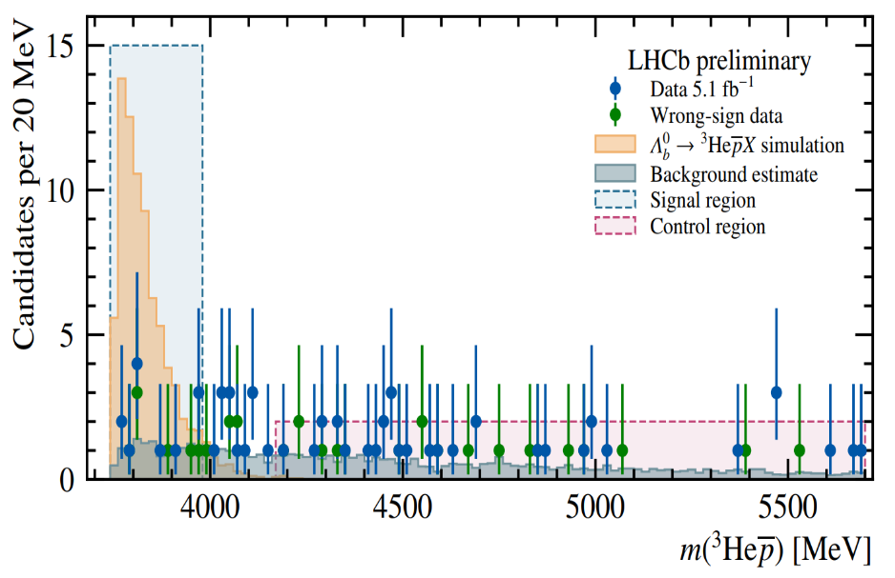
Antihelium production in ${\overline{Λ}}_{b}^{0}$ decays
The AMS-02 experiment has reported several antihelium candidates of unclear origin
Particular interest: ${\overline{Λ}}_{b}^{0}$ antibaryons are produced in dark matter annihilation, and subsequently decay into $3_{\overline{He} }$
A total of O(${10}^{11})$ $Λ_{b}^{0} /{\overline{Λ}}_{b}^{0}$decays have been produced in pp collisions at √s = 13 TeV recorded by the LHCb
These results significantly restrict scenarios for antihelium production through dark matter annihilation in Space.
lhcb-conf-2024-005

Slide 15
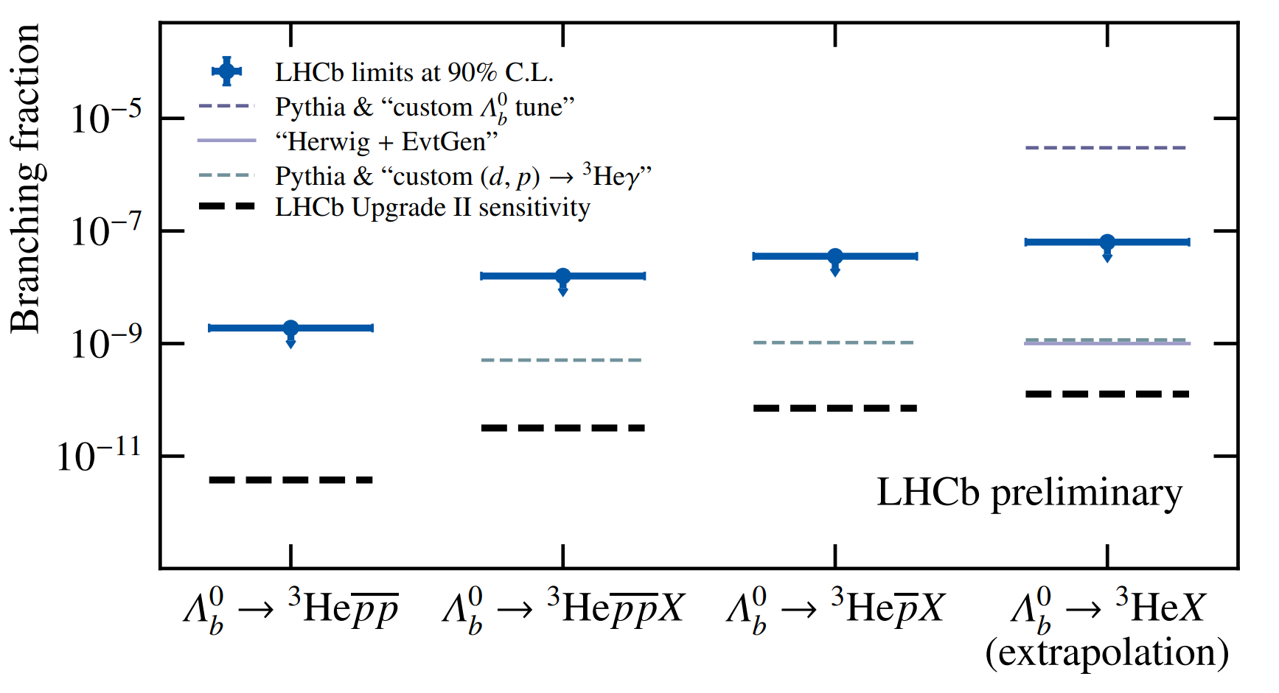
Antihelium production in ${\overline{Λ}}_{b}^{0}$ decays
The LHCb Upgrade II may lead to the first observation of antihelium from ${\overline{Λ}}_{b}^{0}$ decays, as it improves the sensitivity to O(${10}^{−11})$
lhcb-conf-2024-005

Slide 16
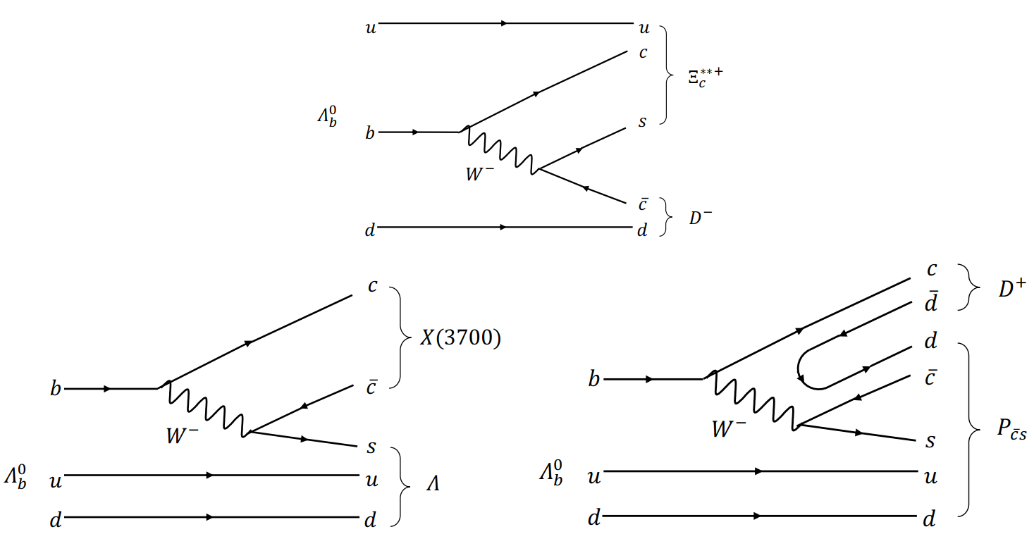
First Observation of $Λ_{b}^{0}→D^{+}D^{−}Λ$
can proceed via two types of two-body intermediate states: one involving a charmed baryon and an anti-charm meson, and the other through charmonium(-like) states.
e.g. $D^{+}D^{−}$ bound state can be produced near the $D^{+}D^{−}$mass threshold, and open-charmed pentaquark states with quark content csudd might be present in the D-Λ final stat :
Example diagrams resulting in intermediate states that might contribute to the $Λ_{b}^{0}→D^{+}D^{−}Λ$ decay
JHEP04 (2024) 140

Slide 17
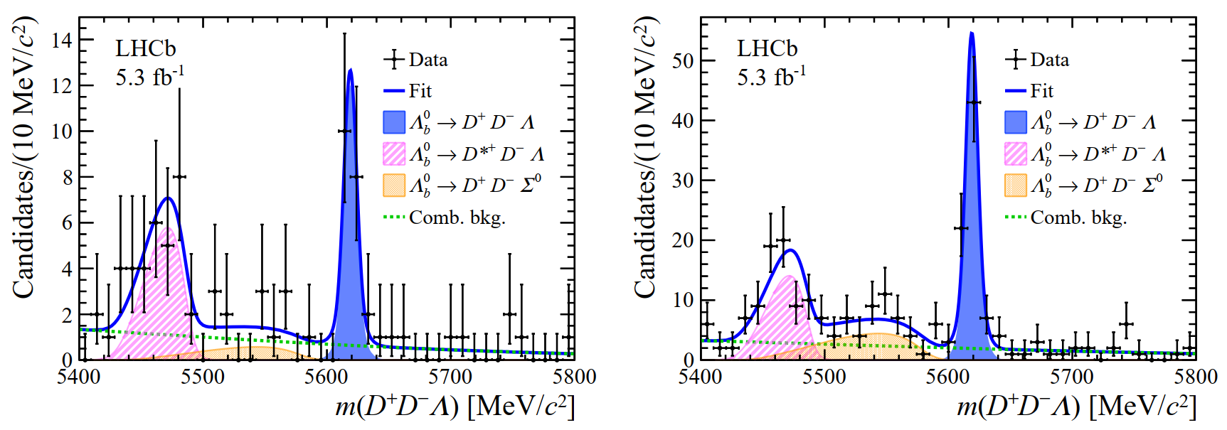
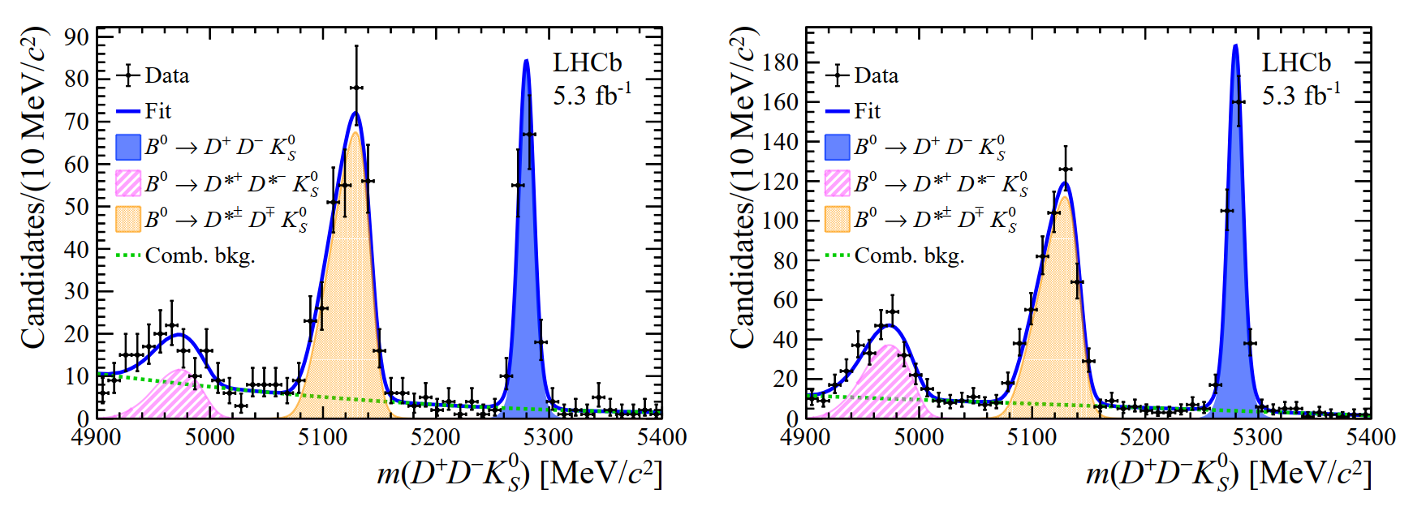
First Observation of $Λ_{b}^{0}→D^{+}D^{−}Λ$
characterized by three significant structures
- two for partially reconstructed beauty-
hadron decays
- a wide smooth combinatorial bg
The branching fraction of $Λ_{b}^{0}→D^{+}D^{−}Λ$decay is determined, a key step towards probing potential intermediate resonant states.
- call for future exploration in similar
decay channels: $Λ_{b}^{0}→D^{0}{\overline{D}}^{0}Λ$
JHEP04 (2024) 140

Slide 18
b-hadron decays to $Λ_{c}^{+}h^{−}h^{′−}$
The majority of measurements in this sector have so far been made with $Λ_{b}^{0}$ baryons, with only relatively few $Ξ_{b}^{−}$and $Ω_{b}^{−}$decays observed
distribution of multibody b-baryon decays can be probed to investigate the spectroscopy of charm baryons, including studies of potentially exotic hadrons.
Three processes, whose branching fractions are expected to be largest.
arXiv:2405.12688

Slide 19
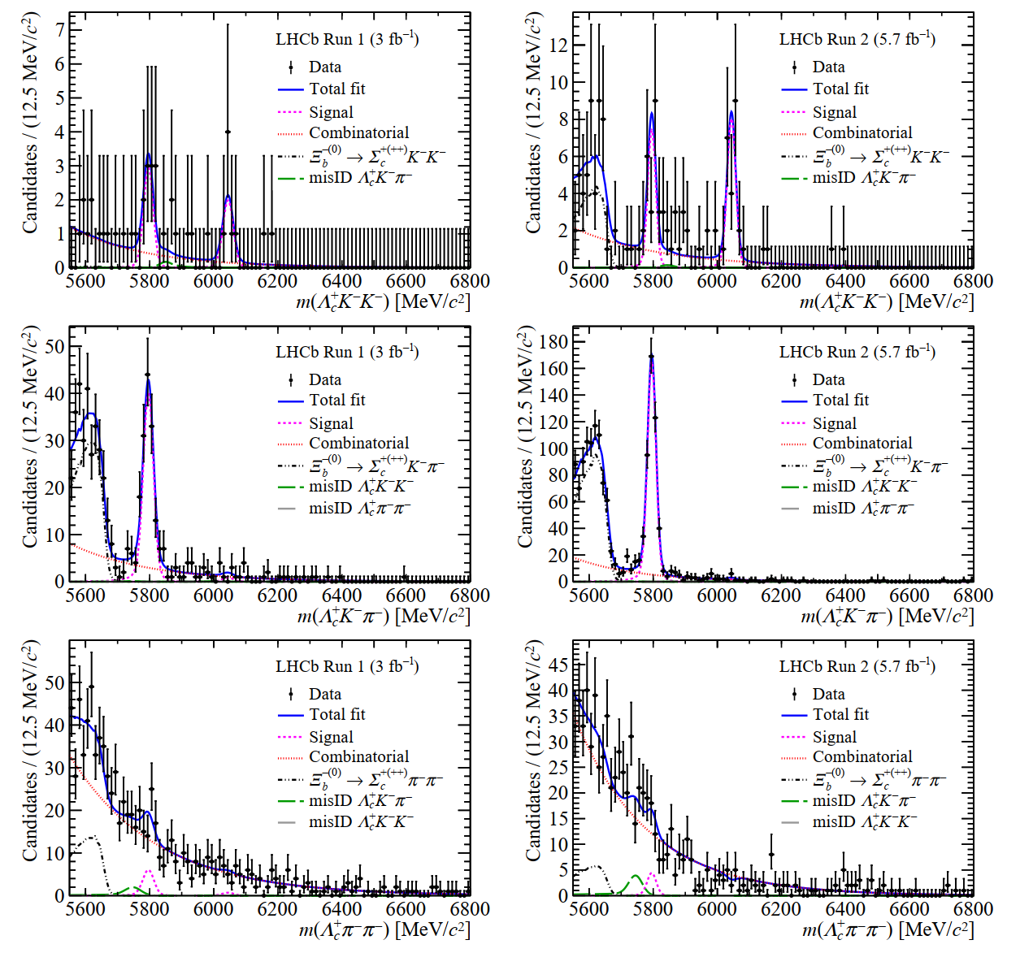
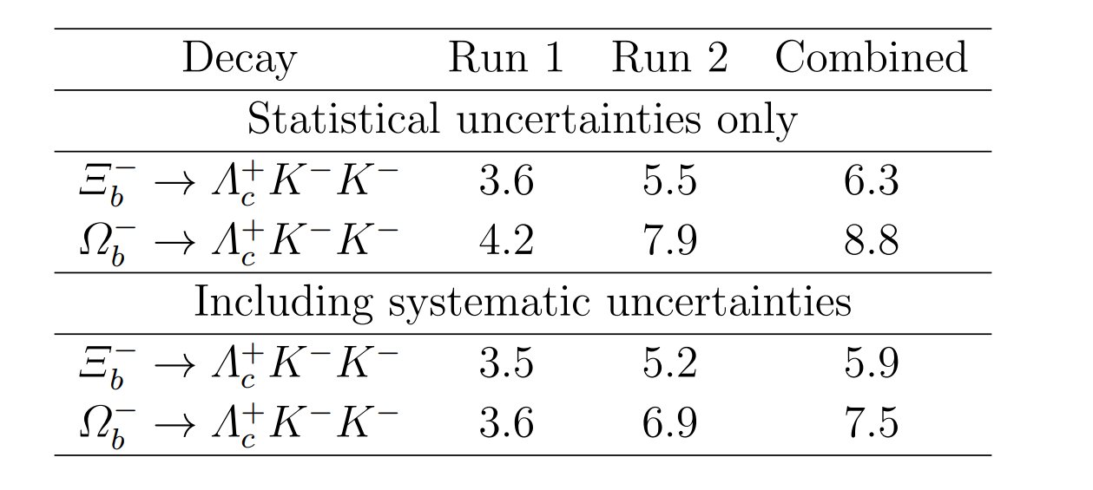
b-hadron decays to $Λ_{c}^{+}h^{−}h^{′−}$
(Right) Mass distributions of the signal channels, where the signal components include independent contributions from $Ξ_{b}^{−}$and $Ω_{b}^{−}$decays.
$Ξ_{b}^{−}→Λ_{c}^{+}K^{−}π^{−}$ is observed with large significance, $Ξ_{b}^{−}→Λ_{c}^{+}K^{−}K^{−}$ and $Ω_{b}^{−} →Λ_{c}^{+}K^{−}K^{−}$ with > 5$σ$
arXiv:2405.12688

Slide 20
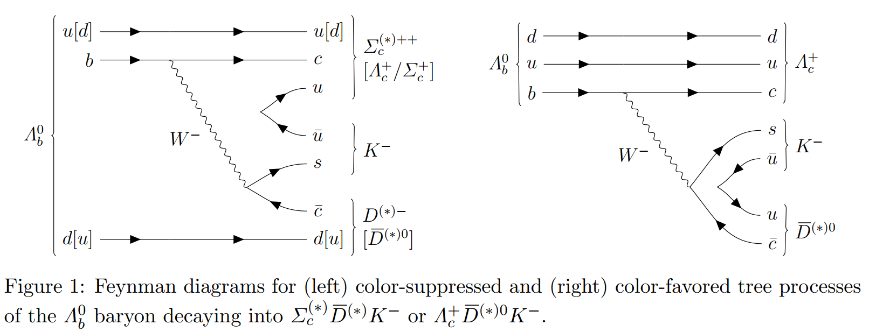
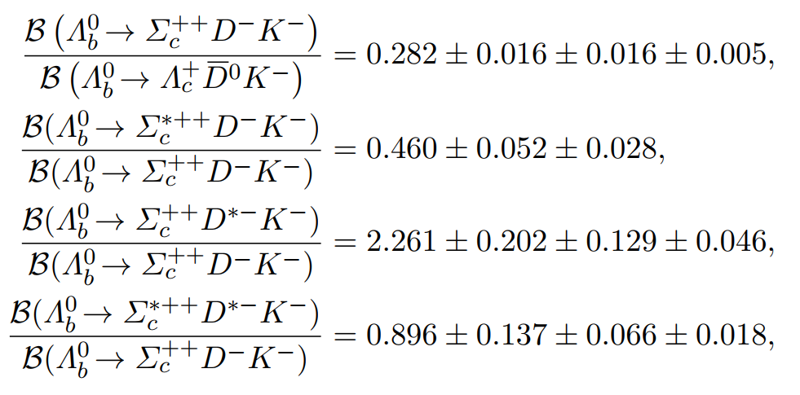
First observation of $Λ_{b}^{0}→Σ_{c}^{\left(∗\right)++}D^{(∗)−}K^{−}$
The four decays, $Λ_{b}^{0}→Σ_{c}^{\left(∗\right)++}D^{(∗)−}K^{−}$, are observed for the first time
These initial observations mark the beginning of pentaquark searches in these mode
arXiv:2404.19510

Slide 21
Summary
• LHCb provides ideal environment for searching for rare decays (and new physics) in b-hadron decays
• Several first observations, or the world’s best upper limits on the BFs are set
• More results are on the way; looking forward to new data (Run3 and beyond) to come soon!

Slide 22
谢谢大家！

Slide 23
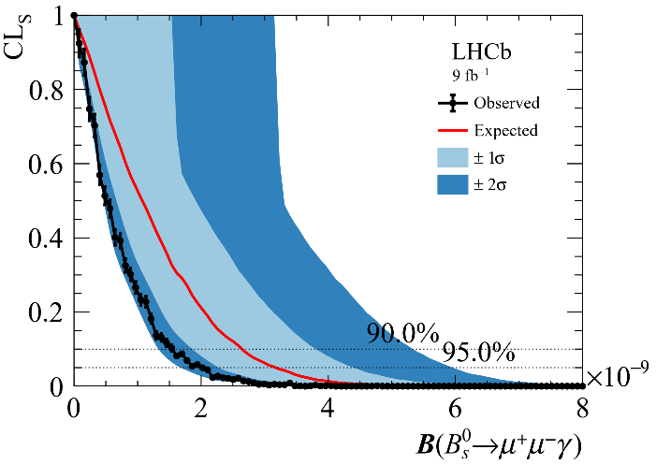
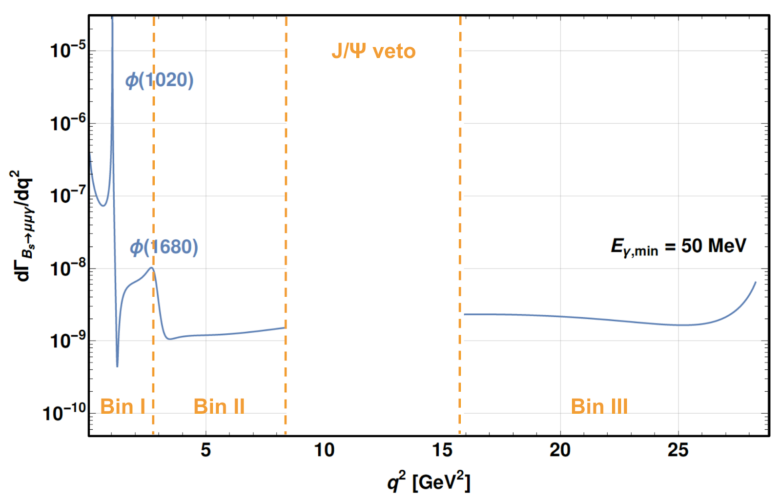
Search for $B_{s}^{0}→μ^{+}μ^{−}γ$
Compared to the $B_{s}^{0}→μ^{+}μ^{−}$amplitude, the additional suppression arising from the photon is compensated by no longer helicity suppressed, increasing the total predicted BR
The $B_{s}^{0}→μ^{+}μ^{−}γ$process is a powerful probe of SM, being sensitive to C7 , C9 and C10, While $B_{s}^{0}→μ^{+}μ^{−}$is only sensitive to C10
Direct search (coming very soon):
Direct photon search first time
Probe low $q^{2}$ regions for the first time
Indirect search:
Phys. Rev. Lett. 128, (2022) 041801
Phys. Rev. D105 (2022) 012010

Slide 24
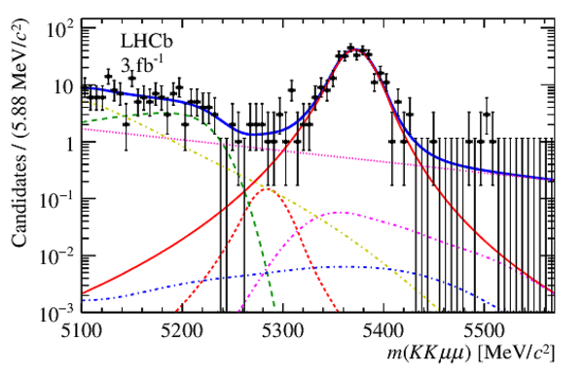
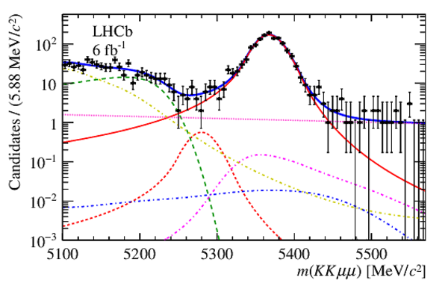
Search for the B⁰ → φµ⁺µ⁻
No statistically significant excess of the decay B⁰ → φµ⁺µ⁻
An upper limit on its BR excluding the φ and charmonium regions in the dimuon spectrum, relative to that of the decay B_{s}⁰ → φµ⁺µ⁻ is determined to be 4.4 × 10⁻³ at a 90% CL.
Using the LHCb measurement of B(B_{s}⁰ → φµ⁺µ⁻), an upper limit on B(B⁰ → φµ⁺µ⁻ ) in the full q² range is set to be 3.2 × 10⁻⁹ at a 90% CL, which is compatible with the SM prediction.
JHEP 05 (2022) 67

Slide 25
The baryon and lepton number violating decays $Bs0→pμ$⁻ and $B0→pμ$⁻
Matter-antimatter asymmetry is a serious challenge to our understanding of nature. Proposed three necessary conditions to produce such a large matter-antimatter asymmetry, one of which is baryon number violation.
Various violation processes have been searched for in τ , Λ, D, J/ψ, and B decays by the CLEO, CLAS, BESIII and BABAR experiments, but no evidence has been found so far.
? ? ?

Slide 26
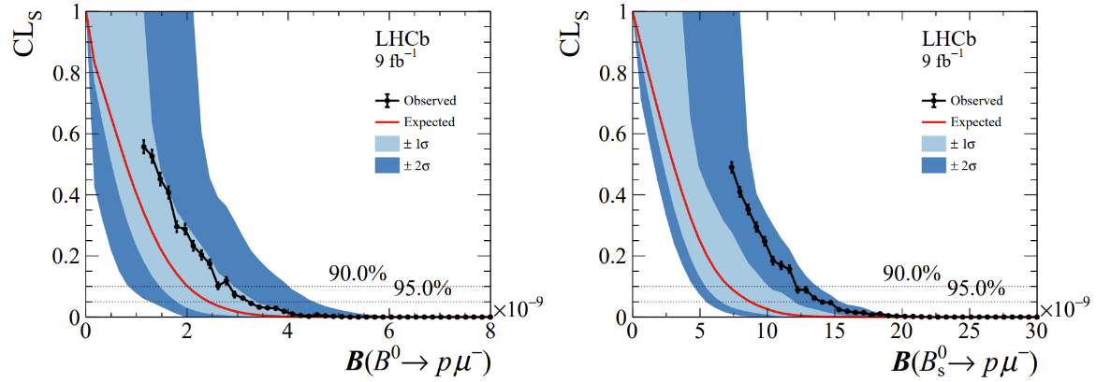
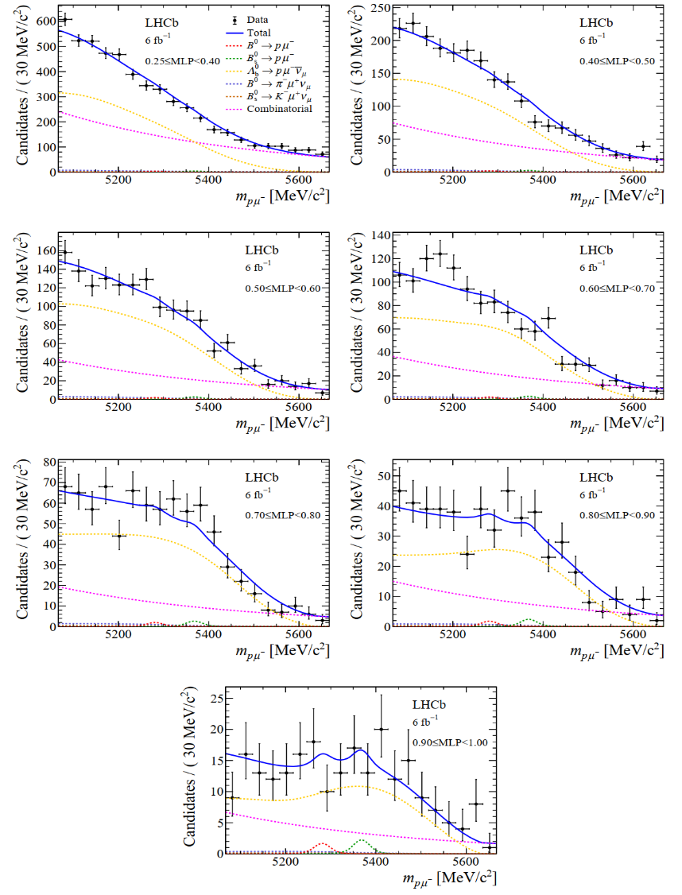
The baryon and lepton number violating decays $Bs0→pμ$⁻ and $B0→pμ$⁻
Mass distribution of signal candidates for Run 2 samples in regions of MLP.
Results from the CLs scan used to obtain the limit on BR($B0→pμ\text{−}$) and BR($Bs0→pμ\text{−}$)
the first upper limits on these decays
arXiv:2210.10412

Slide 27
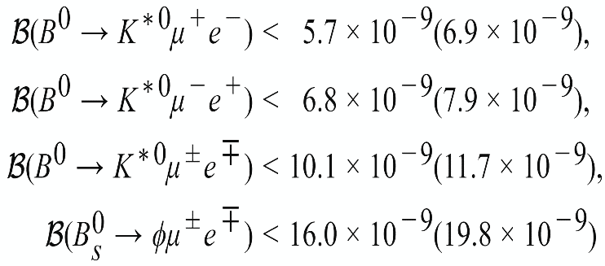
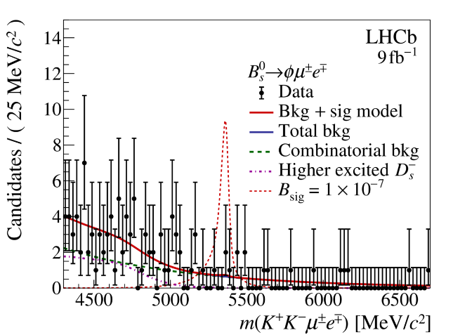
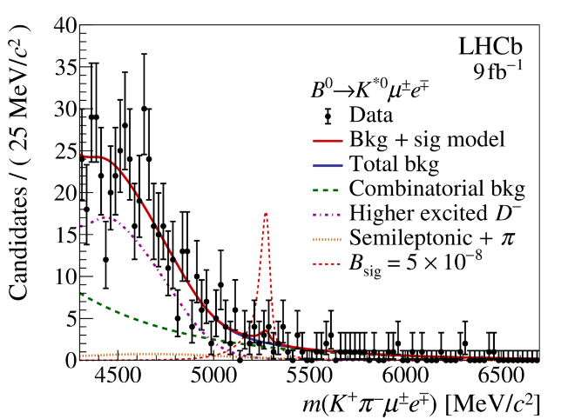
LFV decays $B_{s}^{0} →φμ^{±}e^{∓}$, $B^{0}→K^{∗0}μ^{±}e^{∓}$ and $B^{0}→K^{∗0}μ^{±}τ^{∓}$
An observation of LFV decays involving charged leptons would constitute a clear and unambiguous sign of New Physics
- Specific NP scenarios that can induce LFV b-hadron decays include models with scalar or
vector leptoquarks and models with additional Z’ bosons
the flavour anomalies in rare $b→sl^{+}l^{−}$ also make LFV important, as lepton flavour non-universality is closely connected with LFV
The world's most stringent limits to date
arXiv:2207.04005

Slide 28
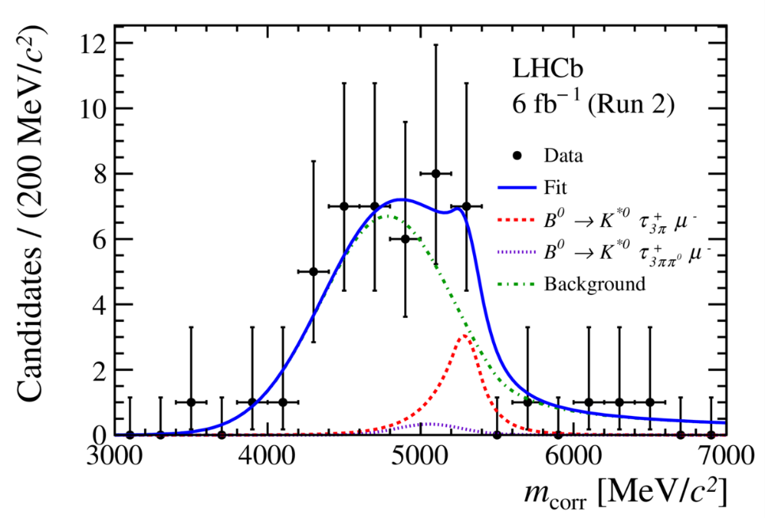
LFV decays $B^{0}→K^{∗0}μ^{±}τ^{∓}$
Not ever investigated by any prior experiment
corrected mass
BR($B^{0}→K^{∗0}μ^{−}τ^{+}$) <1.0(1.2)$×{10}^{−5}$, BR($B^{0}→K^{∗0}μ^{+}τ^{−}$) <8.2(9.8) $×{10}^{−6}$
The world's most stringent limits to date
arXiv:2209.09846

