Slide 1
1.3 GHz Fundamental Power Coupler Mechanical Problems Experienced at FNAL
Tug Arkan
TTC, Beijing
December 7, 2011

Slide 2
Acknowledgments
Ken Premo, Andrei Lunin, Cryomodule Assembly Facility (CAF) cleanroom group, Mark Champion at FNAL.
Jeff Tice, Tom Nieland, Dave Kiehl, Miguel Pinillos, Bob Kirby, Chris Adolphsen at SLAC.

Slide 3
Outline
Introduction
Problems experienced at FNAL during cavity tests at the horizontal test stand
Actions taken to remedy the problems
Results
Summary

Slide 4
Introduction
In order to support the ILC R&D, Fermilab will populate the ILCTA-NML test facility with five 1.3GHz cryomodules during the next couple of years. We procured a total of 44 fundamental power couplers (FPC) to be used on these cryomodules.
The FPCs were fabricated by a US vendor near Boston. The vendor shipped the couplers to SLAC for inspection, cleaning and high power processing. The couplers were then sent to Fermilab for installation to the cavities prior cavity testing in the horizontal test stand (HTS).
To date, 18 FPCs were sent to Fermilab and 16 HTS tests were done (15 cavities).
2 cavities failed the HTS tests due to low gradient quench induced by field emission. During the disassembly of the cold end of the FPC, several problems were encountered with the 2 cold ends.
Several meetings were held with SLAC and several visits were done to the vendor to understand the root cause of these problems.

Slide 5
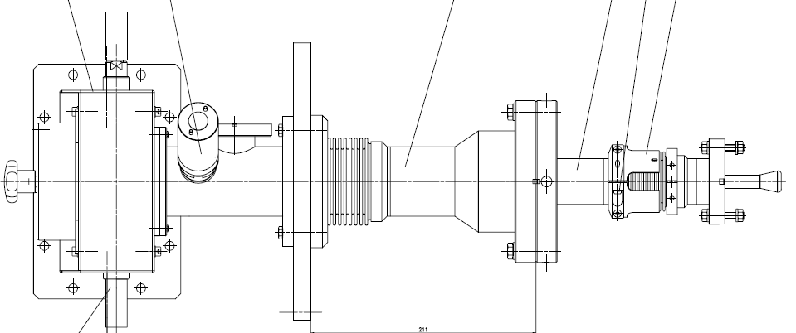
1.3GHz FPC
Cold end bellows & squirm protection clamps
Warm end bellows
CF100 Flange, warm end
CF100 Flange, cold end
NW 40 Flange
Cryostat Flange
Waveguide
-ILC will contain about 16,000 superconducting cavities. Each cavity will have a power coupler that transports ~300 KW, 1.6ms, 1.3 GHz RF pulses at 5 Hz from a waveguide feed at room temperature through a coaxial line to an antenna that protrudes into the 2K cavity beampipe.
-The design of the coupler is complex due to requirements on thermal expansion, heat load, vacuum, Qext adjustability and high voltage isolation.
-The inner stainless steel surfaces of the outer conductors are plated with a thin (10 micron) copper layer in order to reduce RF losses.

Slide 6
Coupler Process Flow
Fabrication at the vendor:
TTF drawings and fabrication & QA specs developed by DESY were used for the procurement
The detailed fabrication procedures are proprietary
Inspection, Cleaning and High Power Conditioning at SLAC:
Incoming QA specs were developed based on the DESY and LAL procedures
Cleaning and assembly in Class 10 (ISO 4) cleanroom
Baking and high power conditioning

Slide 7
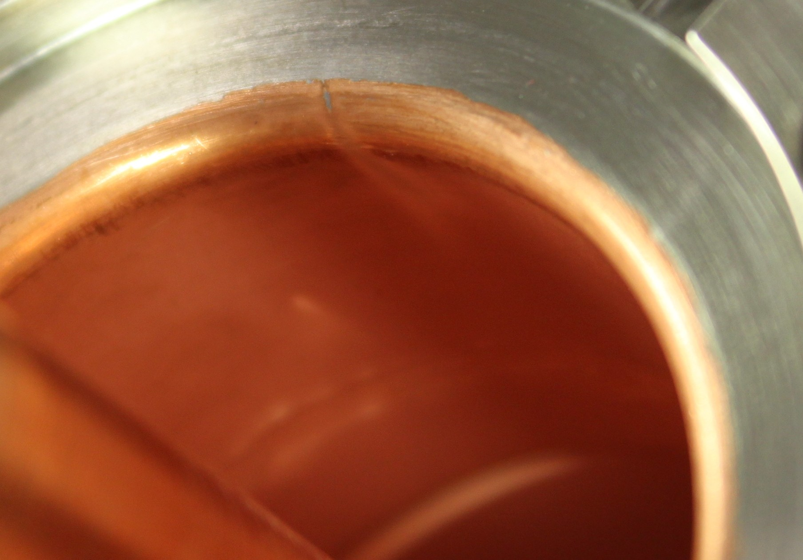
FC01 Cold End
This cold end coupler was installed on ACC-013 cavity for HTS test.
Missing copper and what appears to be a vapor trail were found inside the flange after cavity gradient test failure with field emission

Slide 8
FC01 (Cont.)
Was returned to SLAC by FNAL for examination for additional damage or defects.
Our examination located an additional area further inside the coupler that similar to the “vapor trail” located at FNAL after HTS.
Cause of failure: Antennae misalignment? Aluminum seal? Copper Plating defect?

Slide 9
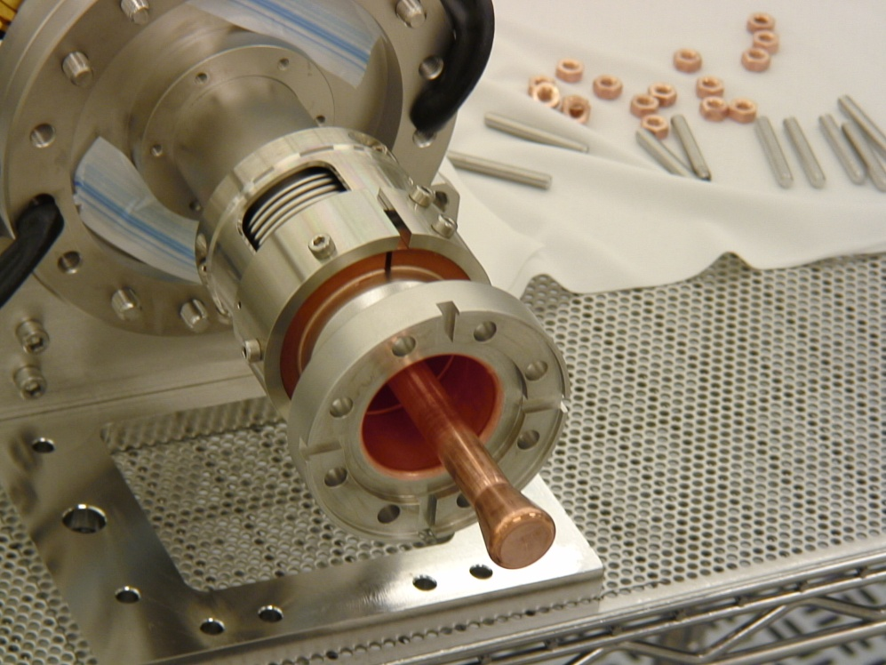
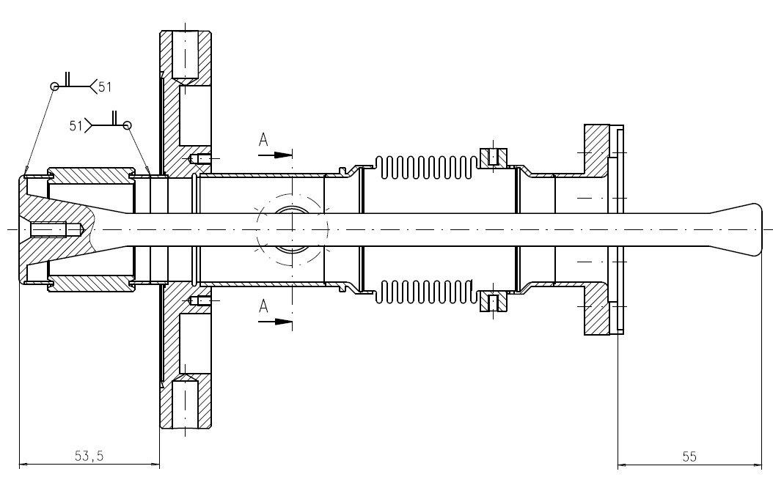
Cold End Antenna Eccentricity
Brazing of the antenna to the CF100 cold end flange is not done properly
and/or
Cold end bellows are twisted; NW40 flange and CF100 flange is not parallel
Cold end Antenna is not concentric to the NW40 flange during cold end assembly to the cavity in the CAF cleanroom
These problems were discussed with the vendor & SLAC and they were fixed for the future couplers

Slide 10
FC10 Cold End
This cold end coupler was installed on ACC-016 cavity for HTS test
The coupler had been previously sent back to the vendor (from SLAC) for mechanical rework (concentricity issues)
After return from the vendor, the coupler was inspected, processed and shipped to FNAL
Copper flakes were found on tip of antennae after HTS and cavity gradient test failure due to FE.
Cause of failure and flaking: Poor plating process during rework? Damage to first layer of plating during rework?

Slide 11
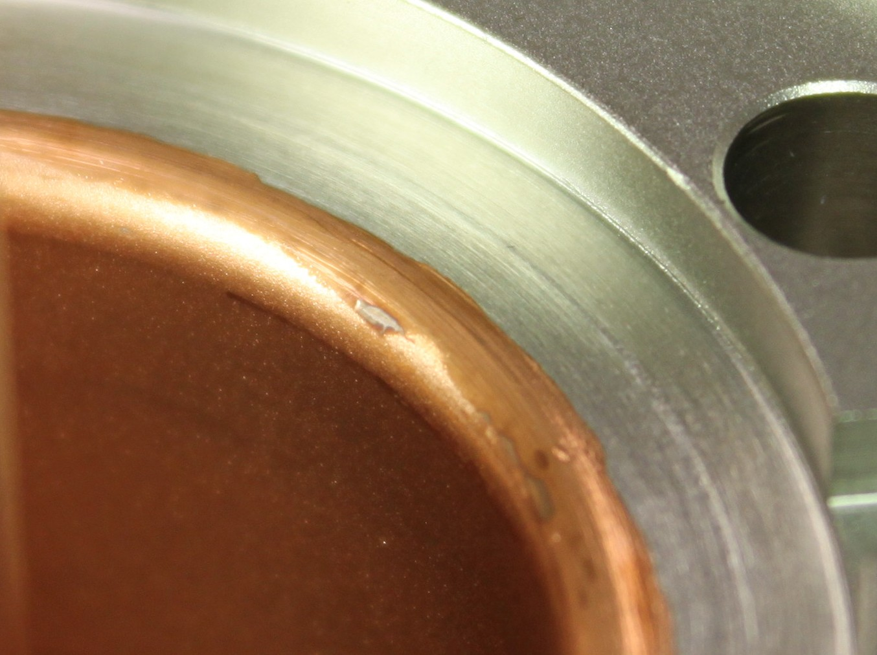
FC10
The texture of the plating is much rougher than usual and masking lines appear to be present. Copper is missing near masking lines on radius

Slide 12
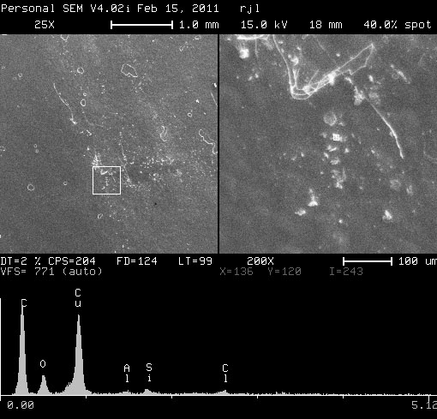
SEM analysis results of FC01, FC10
In both cases, direct access to the effected areas was not possible, so tape lifts were used, and this made correlation to specific areas of the couplers impossible.
Samples were lifted from effected areas of couplers using carbon tape.
FC01- An attempt was made to determine the makeup of the “plume=vapor trail”.
Although it was expected, traces of Cu were not found.
Aluminum was found, but was also found elsewhere.
SLAC material scientist Bob Kirby’s opinion was that he thought the plume was the result of the vaporization of a loose piece of copper, which was the result of mechanical damage to the Cu plating near the radius.
FC10- Results are inconclusive.
Due to the appearance of the plating, his opinion was that poor plating adhesion caused the delaminating of the Cu, but he could not say for sure.

Slide 13
Explanation of failures on FC01 & FC10
Both FC01 and FC10 had been sent back to the vendor for repair before SLAC processed them and we believe their subsequent failure was related to the work the vendor did:
For FC01 they had removed the excess copper in the gasket area adjacent to the location where small copper strip came off during operation (thus they may have loosened the plated copper while removing the excess).
For FC10, they had bead blasted the plated copper after they made a fix to the concentricity problems:
however, if they had masked off the copper in the gasket area and the rim; either the masking material weakened the copper adhesion or contaminated it, so electron multipacting occurred, which smoothly eroded the copper during testing, leaving the flakes it was observed at FNAL after horizontal test.
No other couplers have show these problems.

Slide 14
Ultrasonic Cleaning Test at SLAC
Purpose of ultrasonic cleaning test:
Ultrasonic processing could help to loosen poorly adhered particles of copper
Could collection of particles generated by ultrasonic processing help assess plating quality?
Equipment and setup:
Existing ultrasonic tank and transducers were used
Volume: 180 liters of ultrapure water
Power transducers: 2 x 1200W = 2400W
Frequency: 40 KHz, with sweep capability of +- 2 KHz
Max power density: 13.3 W/liter (full power and 180 liter volume)
Tooling was made to hold coupler in vertical position (antennae up)
Filtration system
Vacuum flask with replaceable filters (0.3 micron)

Slide 15
Ultrasonic Cleaning Test (cont)
Ultrasonic power test procedure and parameters:
Coupler is mounted in fixture with antennae up
Coupler is filled completely with ultrapure water
Coupler and stand is placed in ultrasonic bath
There is no mixing of bath water and water in coupler
Ultrasonic power is turned on and the couplers are processed:
15 minutes
Full power
40 KHz, no sweep
Water from the coupler is captured in the filtration system
Water is poured into funnel
Water is drawn through filter into vacuum flask
Filter is removed, labeled, and stored in containers for analysis
Rinse only test procedure and parameters
Water is poured directly into filtration system

Slide 16
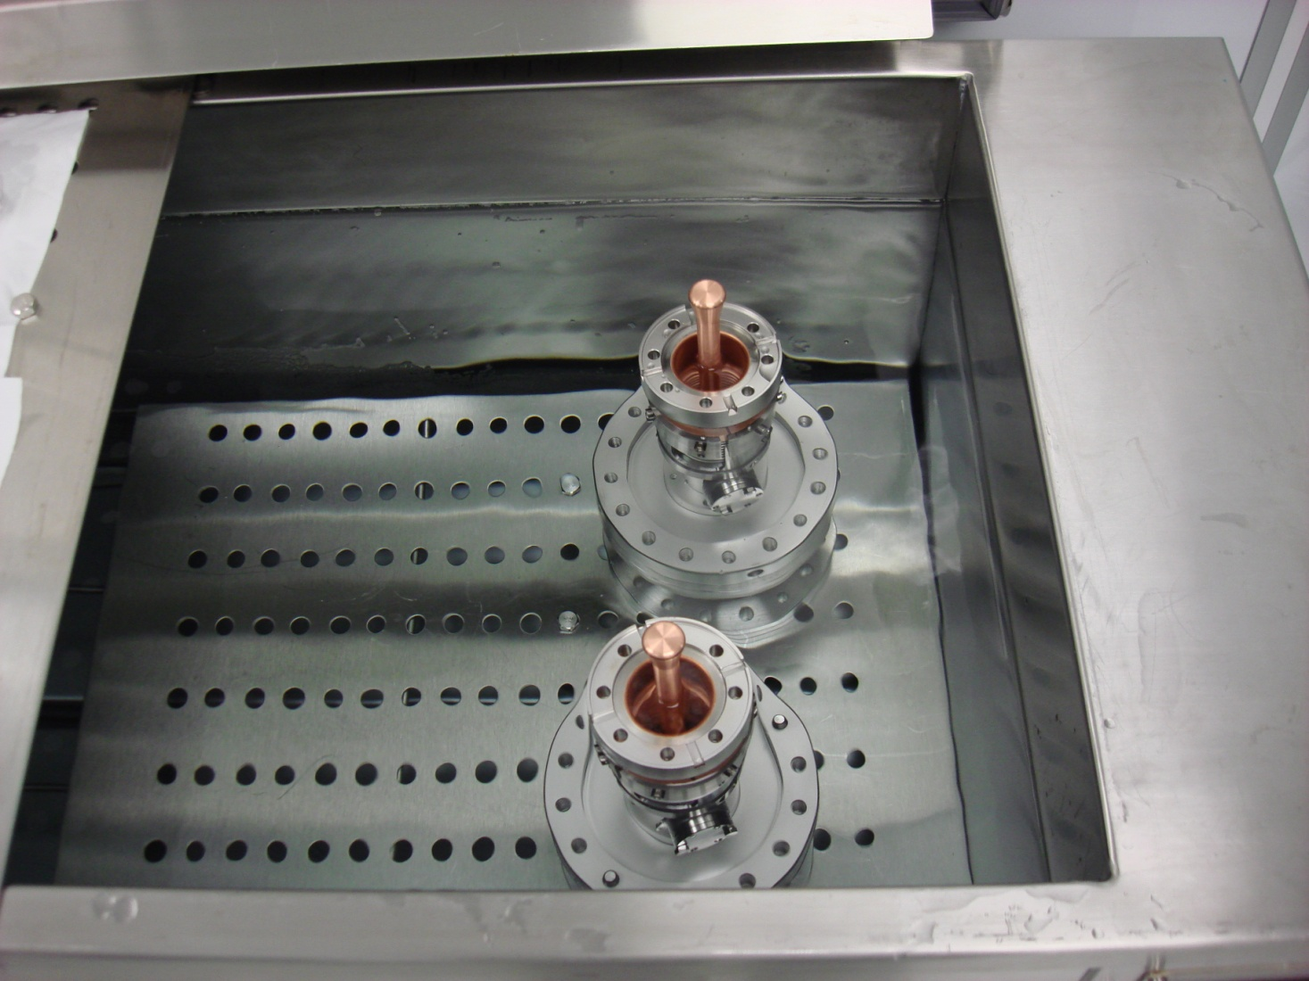
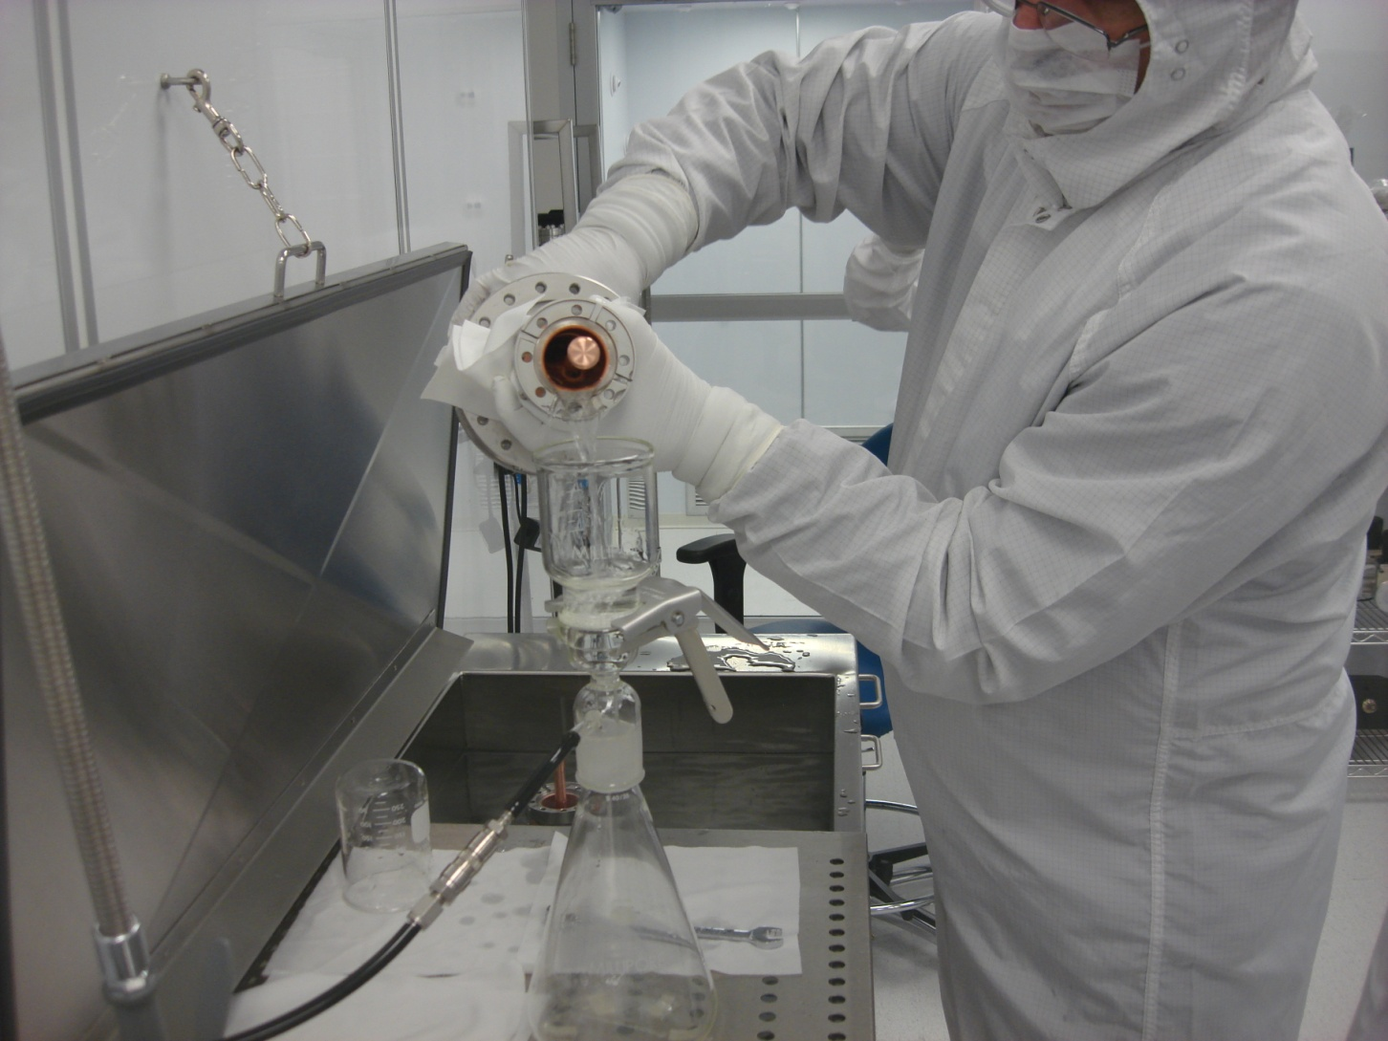
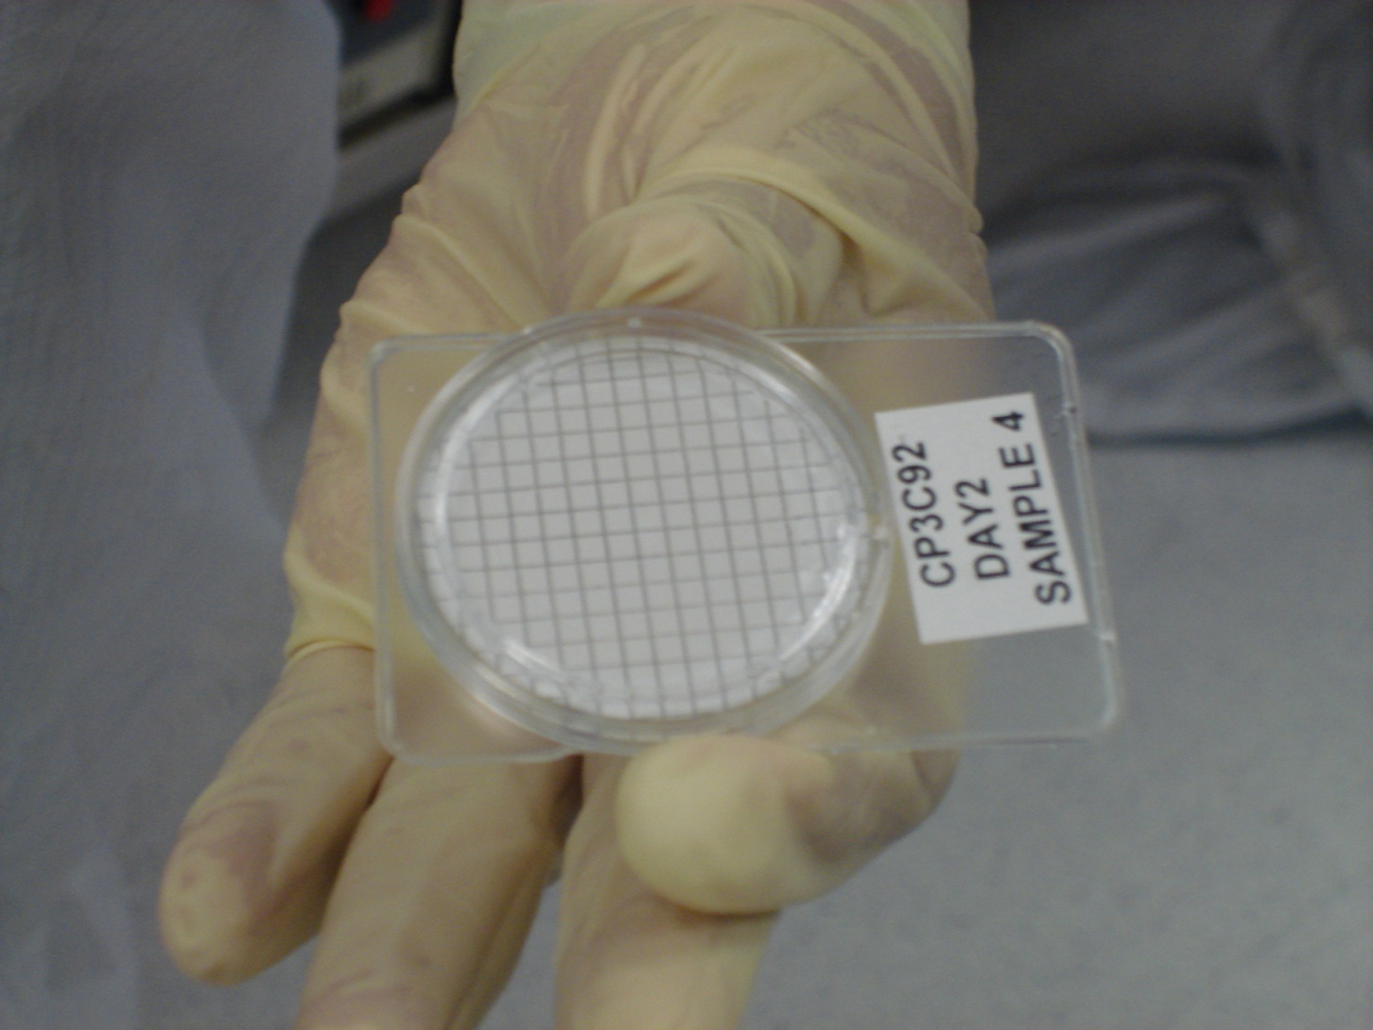
Fill with DI water
Put vertically in the US cleaner
Pour sample into funnel
Remove filter & label for further analysis

Slide 17
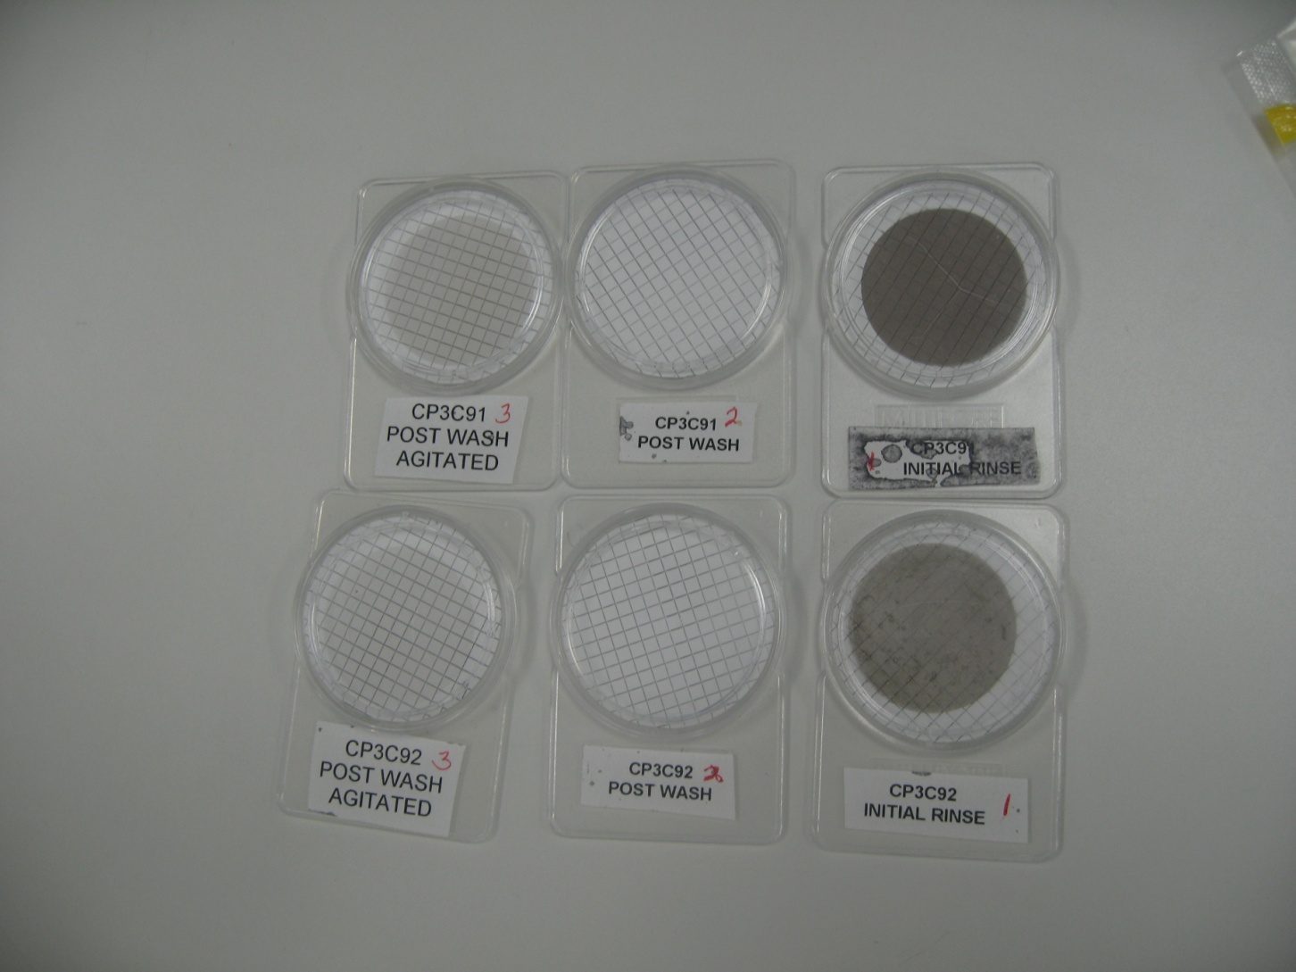
Ultrasonic Cleaning Test Results
Surprising qualitative results:
Samples were examined visually under a microscope
The following general trend was observed for both of the new couplers used for the test:
Initial rinse after 15 minute agitation:
Filters were very dark and contain many particles of copper of varying sizes, and a lot of other crud
Each subsequent filter sample after 15 minute agitation:
Filters were lighter each time, contained diminishing size and quantity of Cu particles
However, Cu particle generation did not cease, even after 60 minutes of total agitation
-Ultrasonic agitation could be too aggressive to the Cu plating surface
-Power level could be too high.
-From the tests done at SLAC, the ultrasonic power in the bath varies greatly as measured at different spots of the bath. An absolute power value cannot be specified.
-SLAC also did a test recently that showed the cooper flaking amount per unit area is nearly independent of the ultrasonic power level when varied over a factor of three. Note that KEK/Toshiba do not ultrasonically clean their couplers, FNAL/SLAC and DESY/LAL couplers are ultrasonically cleaned.

Slide 18
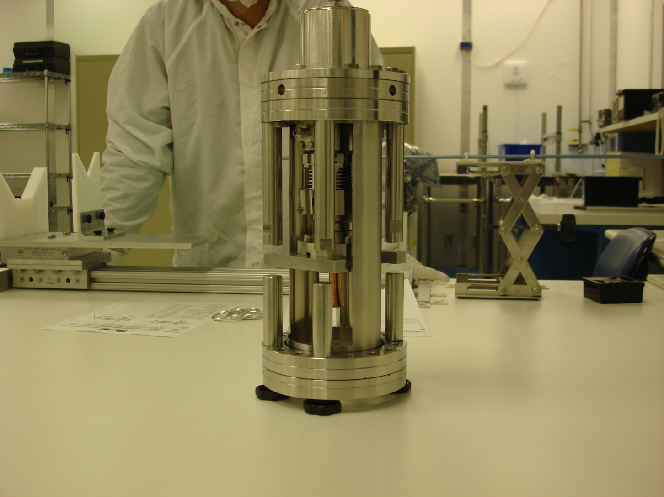
Bellows Dynamic Test
Purpose of bellows dynamic test (bellows exercise):
Bellows are the Cu plated area on the cold end that have the most deformation
Movement could help to loosen poorly adhered particles of Cu
Collection of particles generated by exercise could help assess plating quality?
Equipment and setup:
Tooling was made to hold coupler in vertical position (antennae down)
Stops were used to limit bellows travel to +- 5mm (total travel 10mm)
Procedure:
Coupler is mounted in fixture and the bellows support clamp is removed
The coupler bellows are extended and compressed to the limits of travel 10 cycles
Test:
The bellows were exercised on two new couplers
Water was poured into the coupler cavities and emptied into filtration system
Filter samples were taken and examined visually under microscope

Slide 19
Bellows Dynamic Test Results
Results were comparable for both couplers
Qualitative visual assessment of filters indicates that Cu particles are generated by the exercise
Particles are larger than those generated by ultrasonic agitation alone
Subsequent filter tests taken after an additional 15 min agitation produced similar results: many Cu particles
Conclusions of bellows exercise test:
Bellows exercise helps to loosen Cu particles
It is not conclusive that particles generated indicate poor plating quality
Bellows exercise will be incorporated into the coupler inspection procedure by SLAC: this exercise has been added to the procedure prior to ultrasonic cleaning with detergent as an additional way to assure that loose particles are removed prior to conditioning.

Slide 20
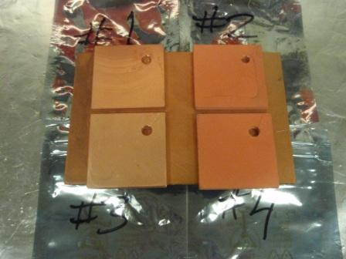
Copper Plating Quality Tests
Several flat test coupons were produced by the vendor and by SLAC for these tests.
The purpose of the tests was to cross compare coupons plated at the vendor and SLAC to understand similarities and differences used in the pre, during and post plating processes.
Coupons: 5 x 5 cm square, plated with 10 and 30 micron thick copper using the cyanide copper process.
The vendor provided 19 coupons (10 post plating bead blasted, 9 without post bead blasted).
SLAC provided 8 non-bead-blasted (4 with 10 micron thick plating and 4 with 30 micron thick plating).

Slide 21
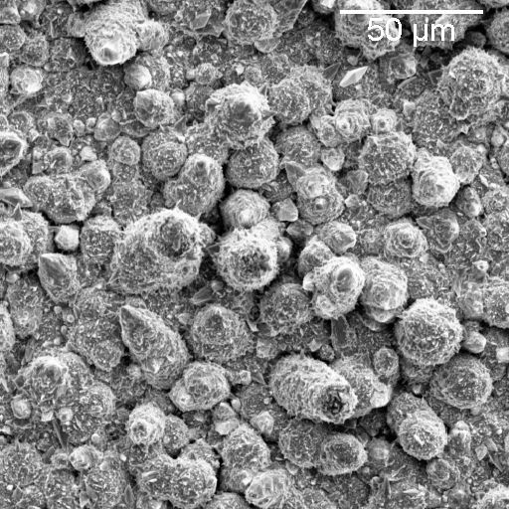
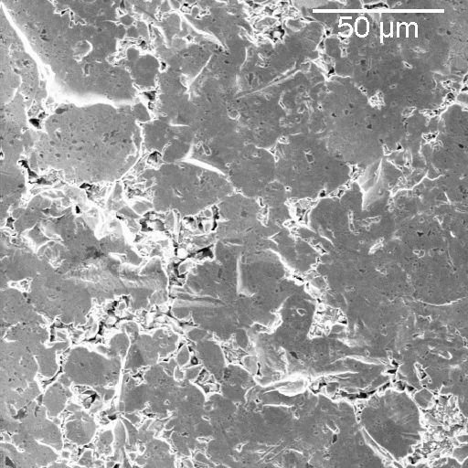
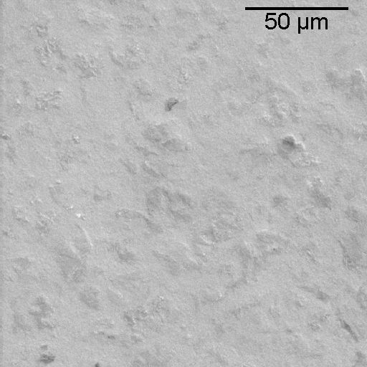
SEM Photos of the Coupons
Vendor not post bead-blasted coupon
Vendor post bead-blasted coupon
SLAC not post bead-blasted coupon
The vendor non-bead blasted surface is much rougher than that resulting from the SLAC platting process. This is likely the result of SLAC doing a periodic-reverse polarity change during the plating (25 seconds ‘forward’ plating followed by 5 seconds of ‘reverse’ platting), which the vendor did not do. The vendor bead-blasted surfaces are smoother, but crevasses and sharp edges are produced.

Slide 22
Coupon Test Procedure
To test the coupons for flaking, each one was ultrasonically cleaned three times for 15 minutes at the nominal transducer power setting of 1.6 kW, 40 kHz with no frequency sweep.
Each coupon was suspended in a pre-cleaned glass container using a stainless steel wire.
Ultrapure water was filled within 6 mm of the brim in the glass containers and in the outside tank.
Before coupon cleaning, power levels were measured with a PB-500 Magasonic Ultrasonic Energy Meter/Probe, and ranged from 8 to 30 W/inch².
Filter sampling was done after each ultrasonic bath and after a rinse cycle following the first bath.
The bath water was poured through a 47 mm diameter Millipore hydrophilic membrane that captures particles greater than 0.45 µm.
A one square mm region was photographed with a VZM-200 Digital Video Measurement System and rendered into a 3D image based on surface brightness:
Copper particles appear as peaks, and a software application was used to determine their sizes. The particles were counted by hand and grouped in three categories: greater than 25 µm, 10-25 µm and less than 10 µm. The count was limited to 50 in each category.

Slide 23
Test Results
Below table lists the particle counts averaged over both the three ultrasonic baths and the coupons of a given type:
The results show the vendor bead-blasted coupons have the highest count as may be expected given that the surface ‘nodules’ are flattened by the beads. The vendor non bead blasted values are somewhat smaller, and the SLAC non bead blasted values are at least an order of magnitude smaller, consistent with the smoother surface.
Interestingly, the particles counts in all cases did not necessarily decrease with repeated ultrasonic cleaning, which may mean the ultrasonic power level is too high for this soft copper.
Coupon Sample | Ave. # Particles > 25 µm per mm² | Ave. # Particles 10-25 µm per mm² | Ave. # Particles < 10 µm per mm²
Vendor Bead Blasted | 12 | 40 | 47
Vendor Non Bead Blasted | 3.2 | 14 | 30
SLAC 30 mm Platting | 0.55 | 2.3 | 3.0
SLAC 10 mm Platting | 0.46 | 1.8 | 2.6

Slide 24
Summary-I
Although the vendor plating with or without bead blasting produces copious copper flakes during ultrasonic cleaning, subsequent water rinses w/o agitation do not show further copper removal.
Also, after RF processing one of the coupler pairs, the two cold ends were removed from the test set-up in the Class 10 cleanroom at SLAC. A visual inspection and a filtered nitrogen blow-out with a particle counter showed no indication that particles had been generated during the 50 hours of RF operation. In the future, a filtered rinse sample will be taken from a cold section that has been installed and operated in the FNAL HTS to look for particles.
Given that recent cavities with bead-blasted couplers achieved gradients greater than 33 MV/m at FNAL suggests that the plating is not a major issue, although some of the cavities showed X-ray bursts. Nonetheless, the vendor should improve the plating process in future couplers to further reduce the possibility of cavity contamination.

Slide 25
Summary-II
Inspection and Processing Changes at SLAC
Incoming inspection
Exercise bellows prior to ultrasonic cleaning in order to help remove loose particles.
Calibrated video capture (boroscope) of 100% of interior plating surfaces. This will help with diagnostics in case of future problems.
Ultrasonic cleaning
No changes to power level and duration that is currently used (15 minutes, full power).
Post cleaning rinse time is increased to make sure all loose particles are removed.
Filter sample is taken as quality assurance step before drying and RF power conditioning.

