Slide 1
ADAPTIVE COMPENSATION
FOR LORENTZ FORCE DETUNING
IN SRF CAVITES.
FERMILAB EXPERIENCE.
Yuriy Pischalnikov Warren Schappert
(FNAL)
TTC meeting,
IHEP, Beijing, Dec 5-7, 2011

Slide 2
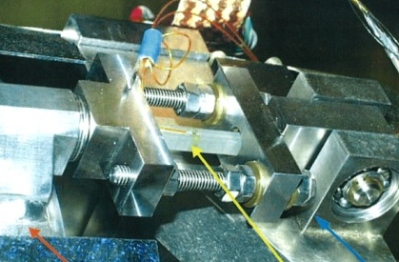
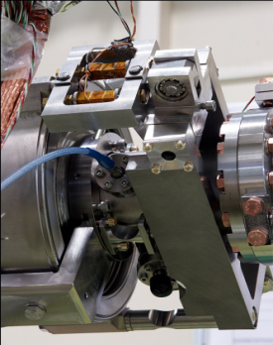
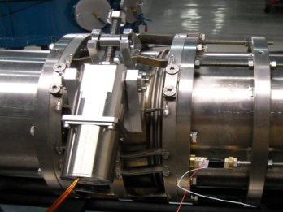
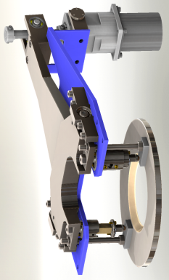
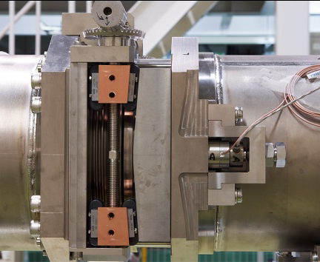
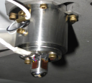
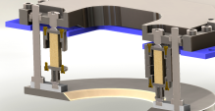
FAST/FINER TUNER
FIRST DESY FAST TUNER
SACLAY I/DESY
FNAL/INFN
FNAL- 325MHz
KEK
Notes:
10 years ago (on the PAC2001) DESY team first time reported successful application of Piezoelectrical actuator for LFD compensation.
During last 10 years significant progress have been made in designing of more reliable fast tuners. Just several implementations, deployed in different labs, presented on this slide… Fermilab Resonance control team has chance to work with all of presented tuners

Slide 3
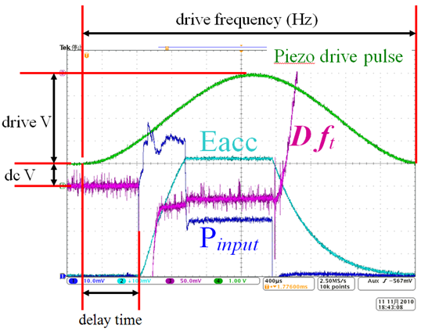
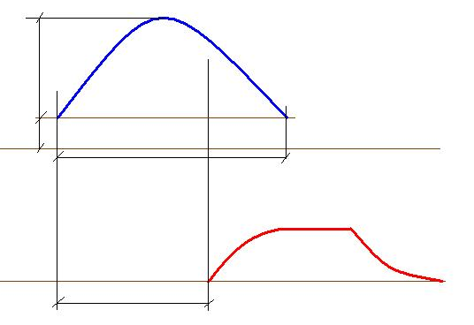
“Standard” or “Sine-wave” Algorithm
Actuators are driven by a short unipolar drive signal prior to the arrival of RF-pulse
At present, the compensation parameters (4) for each cavity selected manually…
delay between Piezo’s and RF-pulses;
- width;
amplitude;
- bias of Piezo’s pulse.
Piezo Stimulus Pulse
A_{piezo}
Bias _{piezo}
t_{piezo}
RF-pulse
Y. Yamamoto#, et al., (KEK)
At PAC2011
t_{delay}
This technique can successfully reduce the detuning of the cavity during the RF pulse from several hundreds of Hz to several tens of the Hz
At the same time:
Changes in cavity operating conditions (for example E_{acc} or He bath pressure) can require corresponding changes in compensating waveform.
Adaptive capability of “standard” approach maybe limited…
Also “short unipolar pulse” approach will not work for cavities where the length of the RF pulse is comparable or greater than the period of the dominant mechanical resonance
Notes:
The LFD compensation algorithms are the different story.
So called “standard” or “half-sine wave” algorithm has been used broadly by many groups.
Actuators are driven by a short unipolar drive signal prior to the arrival of RF-pulse.
This technique can successfully reduce the detuning of the cavity during the RF pulse from several hundreds of Hz to several tens of the Hz
Deficiency of “standard” algorithm:
at present, the 4 compensation parameters for each cavity selected manually…
delay between Piezo’s and RF-pulses;
- width;
- amplitude; and
- bias of Piezo’s pulse.
Changes in cavity operating conditions (for example E_{acc} or He bath pressure) can require corresponding changes in compensating waveform.
Adaptive capability of “standard” approach maybe limited…
“short unipolar pulse” approach will not work for cavities where the length of the RF pulse is comparable or greater than the period of the dominant mechanical resonance

Slide 4
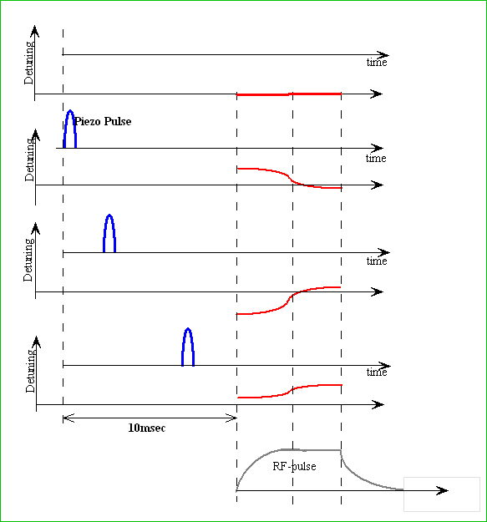
Adaptive Least Square LFD Algorithm
has been developed at Fermilab as a part of SRF Resonance Control R&D program
(Developed by Warren Schappert.)
The response of the cavity frequency to the piezo impulse (TF) can be easily measured when cavity operated in CW-mode.
Since it is often not convenient to connect a pulsed cavity to CW source we developed alternative technique to measure this response (TF) when cavity operated in RF-pulse mode.
“1”
“10”
Piezo/cavity excited with serious of small (several volts) narrow (1-2ms) pulses at various delay.
The forward, probe and reflected RF waveform recorded at each delay and used to calculate detuning.
[Response Matrix]
“34”
Typically scan started
10ms in-advance of RF pulse
Details of Adaptive LS LFD Algorithm at :
“W. Schappert, Y.Pischalnikov, “Adaptive Lorentz Force Detuning Compensation”. Fermilab Preprint –TM-2476-TD.
W. Schappert, Y.Pischalnikov, “Adaptive Lorentz Force Detuning Compensation in Superconductive Cavities”. SRF2011, Chicago 2011..
Notes:
Adaptive Least Square LFD Algorithm has been developed at Fermilab as a part of SRF Resonance Control R&D program
(Developed by Warren Schappert)
Detail description of this algoritm could be found at several publication.
I will just briefly describe of LS LFD Algorithm and will direct your attention to experimental results of practical application of our algorithm
The response of the cavity frequency to the piezo impulse (TF) can be easily measured when cavity operated in CW-mode.
Since it is often not convenient to connect a pulsed cavity to CW source we developed alternative technique to measure this response (TF) when cavity operated in RF-pulse mode.
When cavity operated at gradient below maximum operating gradient piezo/cavity excited by serious of small (several volts) narrow (1-2ms) pulses at various delay.
Typically we start scan 10-to-20ms in advance of RF pulse… and change delay with 0.25ms increment.
The forward, probe and reflected RF waveform recorded at each delay and used to calculate detuning.

Slide 5
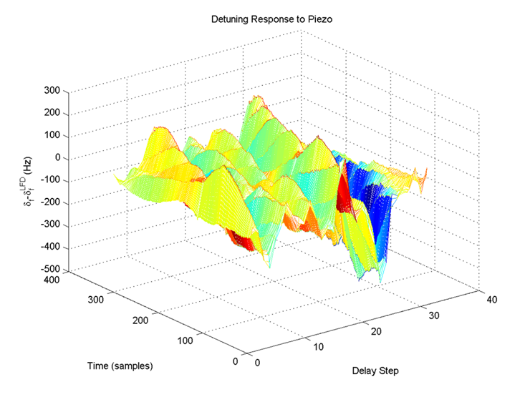
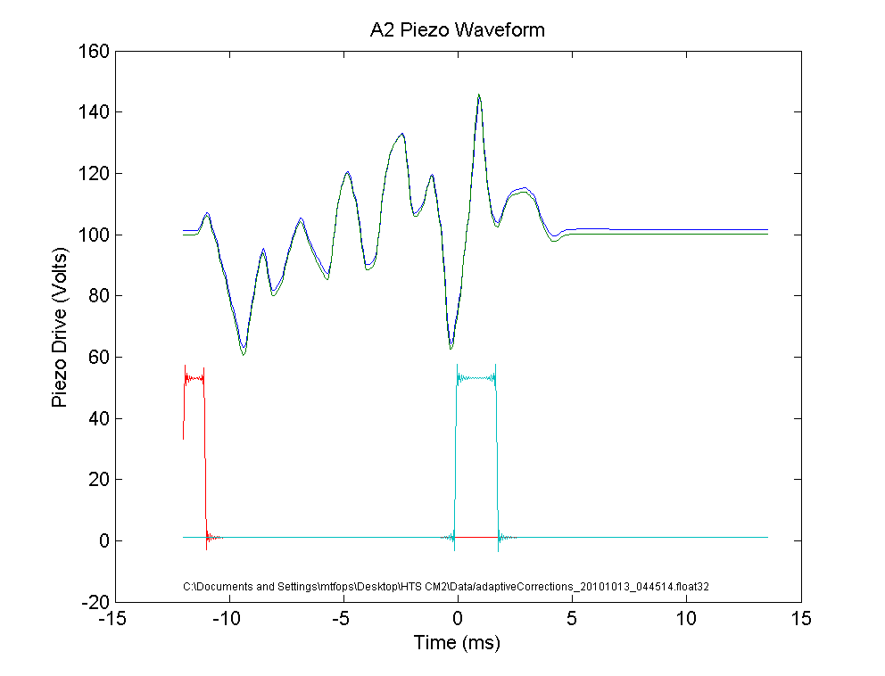
Adaptive LS LFD Algorithm ( Finding of Optimal Compensation pulse)
Response Matrix
Piezo Pulse # (or delay)
“1”
“10”
“34”
100Hz
As operating conditions vary, the RF waveforms can be used to measure any residual detuning. The response matrix can then be used to calculate the incremental waveform required to cancel that residual detuning.
Time during RF pulse
0
DETUNING
Optimal Compensation Pulse
for 1.3GHz 9cell cavity equipped
with KEK tuner
-100Hz
Invert the response matrix and determine combination of pulses needed to cancel out the LFD using LS
Any part of RF pulse could selected for Compensation:
“Fill+FlatTop” or only “FlatTop”
Notes:
Graphic representation of the response matrix, measured during “Piezo Delay Scan”, presented on this slide.
Horizontal scale is a piezo impulse delay and vertical is time of RF pulse
Value of the cavity detuning is presented by different color…
At next step we invert the response matrix and determine combination of pulses needed to cancel out the LFD using Least Square fit.
Any part of RF pulse can be selected for Compensation:
It could be “Fill+FlatTop” or only “Flat-Top”
As an example: compensation pulse for 1.3GHz cavity equipped with Slide-Jack (at S1-Global cryomodule) presented.
As operating conditions vary, the RF waveforms can be used to measure any residual detuning. The response matrix can then be used to calculate the incremental waveform required to cancel that residual detuning.
Adaptive algorithm also changing the bias on Piezo to compensate for He bath pressure fluctuations.

Slide 6
Applications
of Adaptive LS LFD Algorithm:
HTS (9-cell 1.3GHz cavity with Blade tuner);
Piezo control system routinely used for testing cavity/tuner assemblies for cryomodule production at FNAL
CM1-NML facility (9-cell 1.3GHz cavities with DESY tuner);
System deployed for operation of accelerator at NML
S1-Global(9-cell 1.3GHz with 4 different type of tuners);
Piezo control system from FNAL to test with S1-G tuners
9-cell 1.3GHz cavity with RF-pulse 8ms long (Project X R&D program);
System successfully compensate LFD on the cavity operated with 8ms pulse & E=22MV/m (at HTS). Test is going right now at FNAL CC2& NML (CM1-cavity 5&6).
SSR1- single spoke cavity;
325MHz cavity –operated at T=4,5K & Eacc=34MV/m. Compensation of LFD (3,5kHz) and microphonics (~600Hz)
DESY LLRF team expressed interest to try FNAL’s algorithm at DESY Cryomodule Test Facility (especially for detuning compensation during ‘Fill” part of RF pulse)

Slide 7
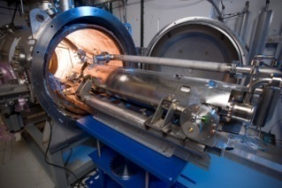

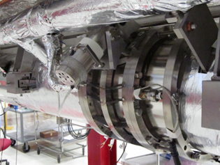
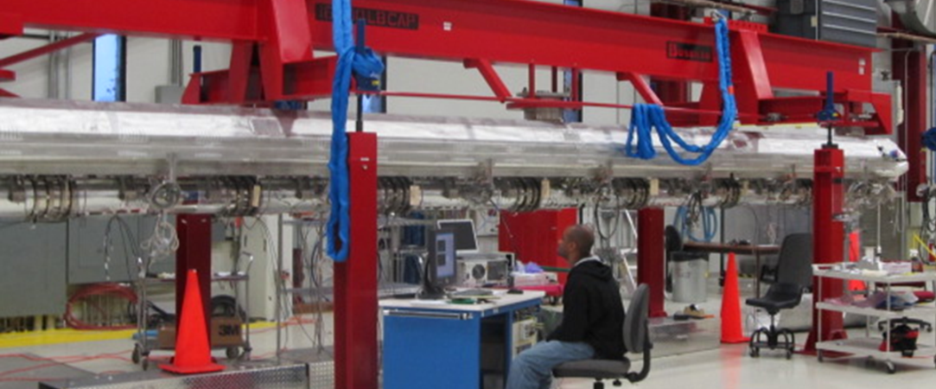
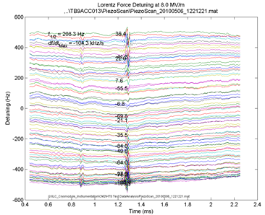
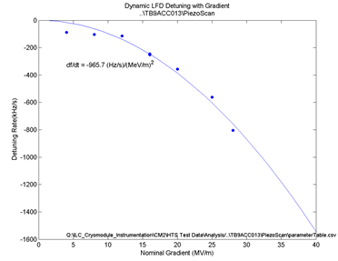
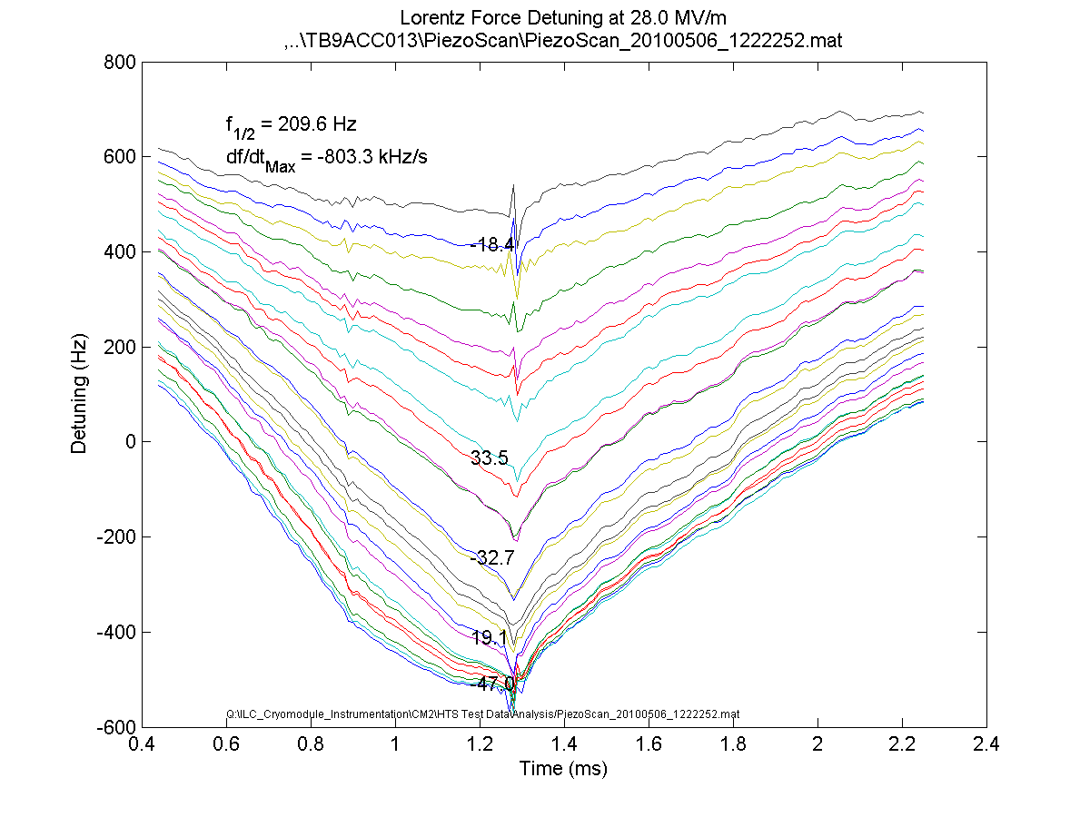
Horizontal Test Stand at MDB FNAL
HTS
Objectives: to test dressed 1,3GHz cavity/tuner for construction of cryomodules #2 -#6 for NML Facility
Average LFD during 0.8ms (flat-top) pulse for Eacc=35MV/m ~1000Hz
LFD compensation goal: ΔF less than 20Hz
Cavity ID # |  |  |  | Piezo-to-Cavity Sensitivity, Hz/V | Dynamic LFD Hz/s/(MV/m)²
ACC013 |  |  |  | 7.2 | -970
AES009 |  |  |  | 2.7 | -1240
ACCEL8 |  |  |  | 6.5 | -860
AES010 |  |  |  | 8.5 | -950
AES008 |  |  |  | 7.3 | -1600
ACC016 |  |  |  | 10.5 | -880
RI029 |  |  |  | 14 | -650
AES007 |  |  |  | 10.4 | -740
RI018 |  |  |  | 13 | -740
Average |  |  |  | 9.7 | -960
σ |  |  |  | 2.8 | 295
CM2 assembly at ICB/TD FNAL (11/23/20110)
8MV/m
LFD (slope of detuning curve during Flat-top) vs Eacc
28MV/m
Cavity detuning during RF pulse VS.
bias Voltage on Piezo
Notes:
Purposes of Horizontal Test Stand at FNAL to test dressed 9-cell tesla-style cavities for Cryomodule.
Resonance Control Group build LFD Compensation/Piezo control system (for single cavity) for HTS. This system routinely used as part of the cavity characterization procedure.
One the cavities selection criteria – capability for cavities to operate at Eacc>35MV/m.
Average LFD at Eacc=35MV/m is near 1000Hz and some cavities have up to 1500Hz.
LFD compensation goal –residual detuning less than 20Hz.
As a part of the Piezo tuner testing procedure we are measuring Dynamic LFD coefficient for each cavity.

Slide 8
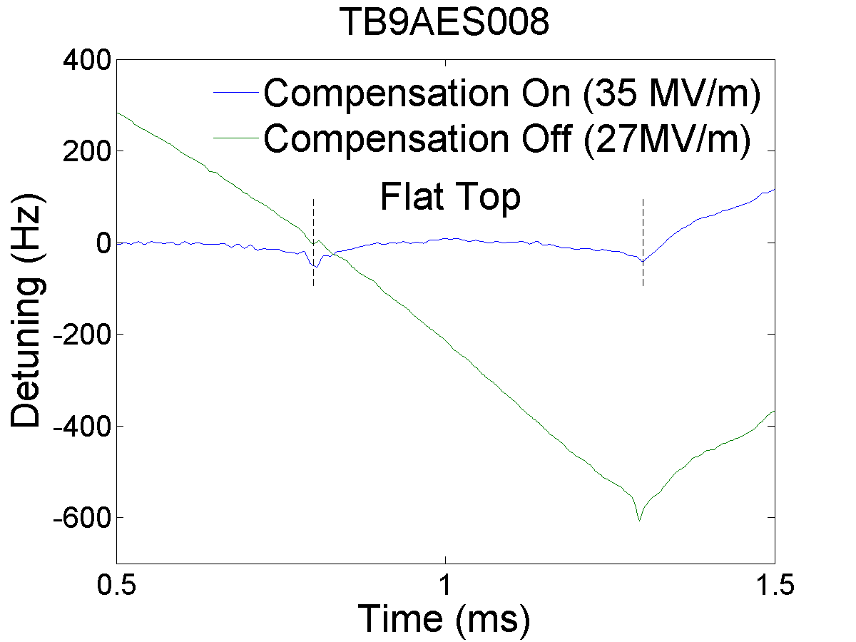
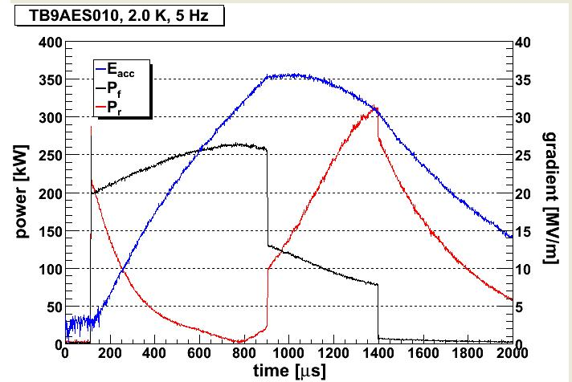
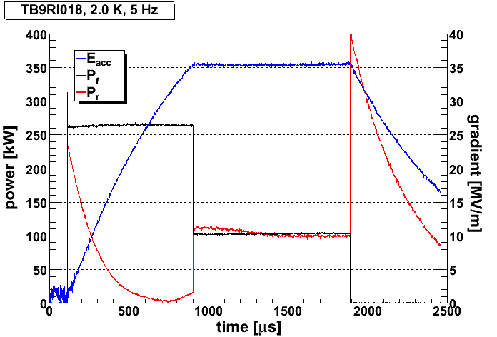
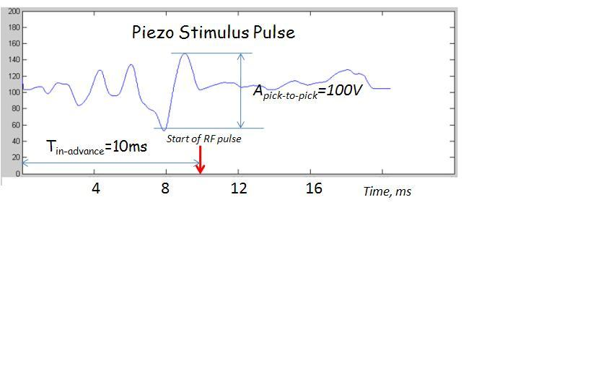
HTS at MDB FNAL
LFD during 1,3ms RF-pulse (Fill+FlatTop) ~2300Hz
After LS LFD compensation -- to less than 20Hz during 1,3ms pulse
Eacc=35MV/m
Open loop operation
Piezo OFF
Piezo ON
Piezo OFF
Piezo ON
Notes:
On the next slide results of compensation for cavity AES008 at 35MV/m presented.
System was able compensate from 1000Hz down to 20Hz of residual detuning, with piezo stimulus pulse 100V (which 50% of the piezo range).
Let me emphasize that compensation was done for Fill and Flattop of RF pulse.
This is a shape of piezo stimulus pulse selected by LS LFD system.
Plot at the right side of the slide presented Waveforms of forward, probe and reflected signals for Cavity TB9AES010 before and after compensation.

Slide 9

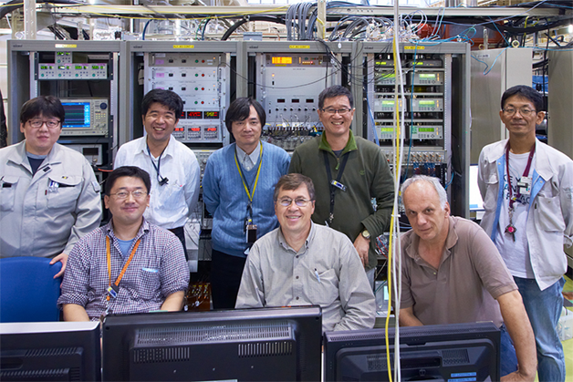
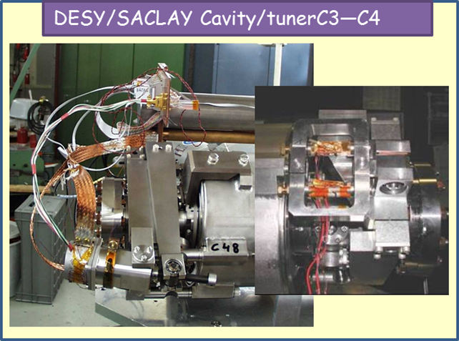
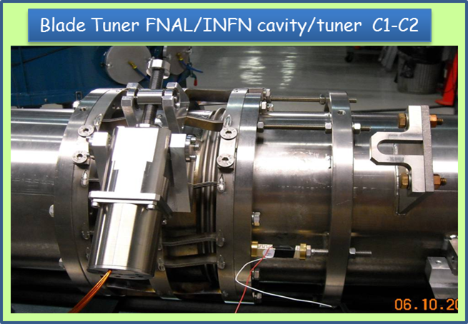
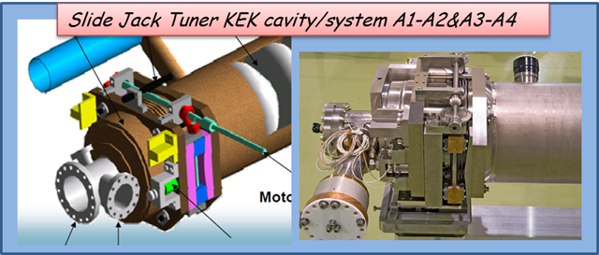
Adaptive Lorentz Force Detuning Compensation in the ILC S1-Global Cryomodule at KEK
S1-G
Notes:
FNAL’s team built and delivered to KEK piezo control system (copy of HTS system) to work (side-to-side) . LS LFD algorithm has been used for LFD compensation on 4 different type of cavity/tuner systems…
Summary of LFD compensation presented on this plot.
Interesting to compare Piezo Compensation Waveform calculated by LS LFD system for 2 different slow/fast tuners: Blade Tuner from FNAL and Slide/Jack from KEK.
Measurements of Piezo-to-Cavity TF in CW also demonstrated differences in dominant frequencies 200Hz VS 350Hz for this tuners…

Slide 10

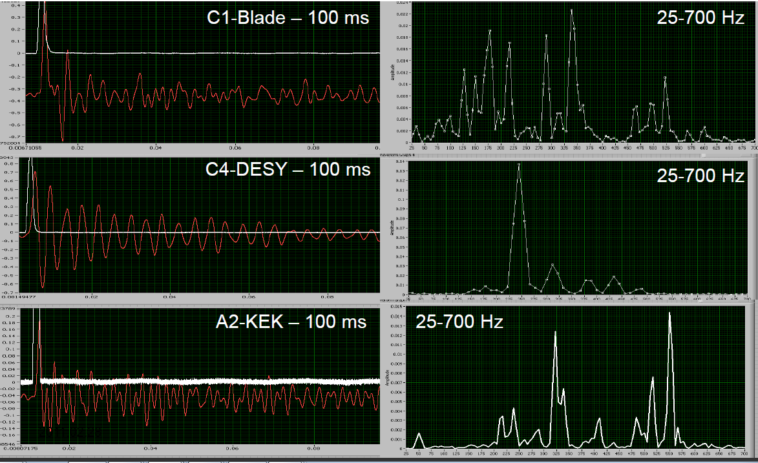
Transient spectral analysis
Response of cavity /tuner system on short piezo stimulus pulse
CW mode
250Hz
550Hz
Time, msec
Frequency, Hz
Notes:
Quite different response (vibration) of cavity/tuner system on the mechanical kick from short piezo stimulus pulse presented here.
On the left is response in time domain and on the right in the frequency domain.
As you can see KEK cavity/tuner system much stiffer and has higher mechanical resonance than FNAL & DESY.

Slide 11
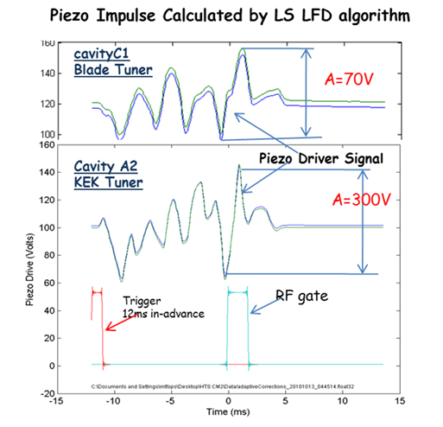
Piezo Impulse Calculated by LS LFD Algorithm
Notes:
On this slide shows examples of the piezo drive waveforms for two different types of S1-G cavities (Blade T& Slide-Jack Tuners).
The differences in the two waveforms reflect differences in the mechanical responses of the two cavities.
Piezo Stimulus pulse start excite cavity 10ms in-advance.

Slide 12

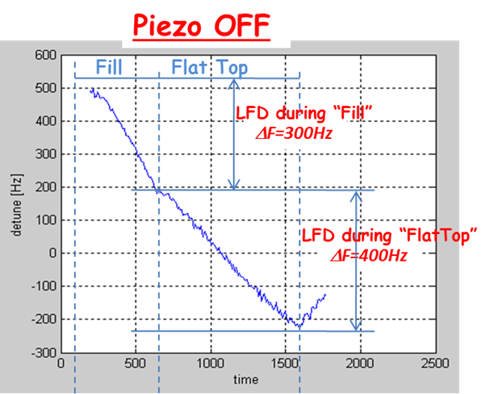
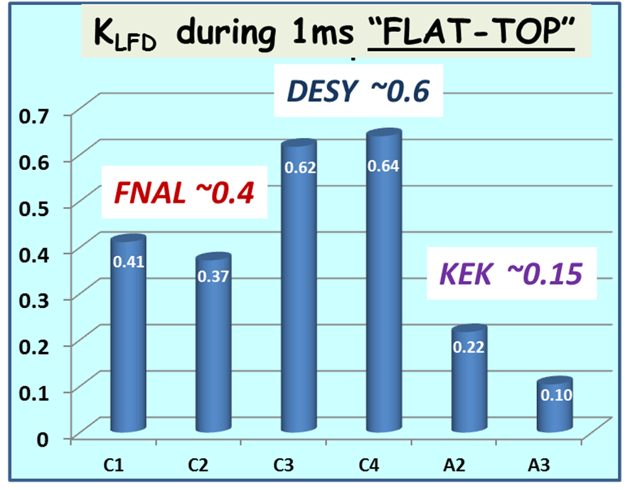
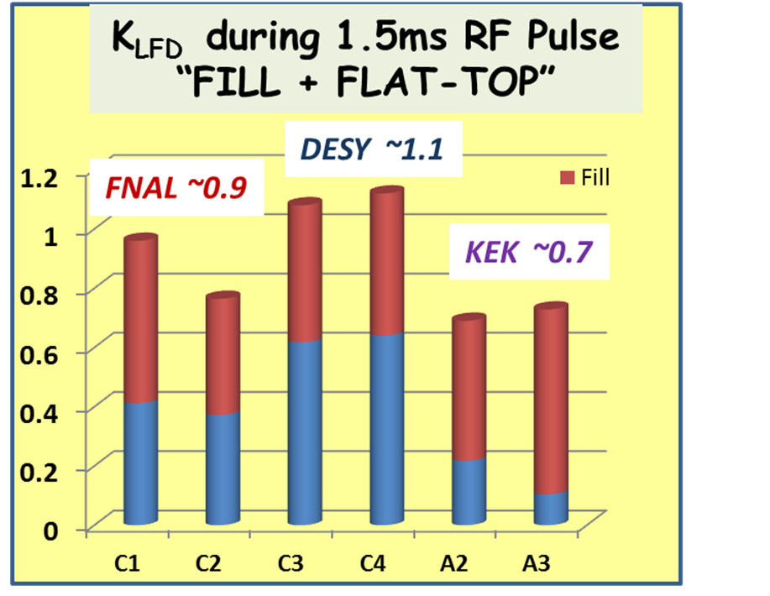
Cavity/Tuner LFD Sensitivity
ΔF=-K_{LFD}*E_{ACC}² → K_{LFD} – Cavity/Tuner Detuning Sensitivity to LF
 | FNAL/INFN | DESY/Saclay | KEK
K_{LFD} (1ms FLAT-TOP) | 0,4 | 0,6 | 0,15
K_{LFD} (1,5ms FILL+FLAT-TOP) | 0,85 | 1,1 | 0,7

Slide 13
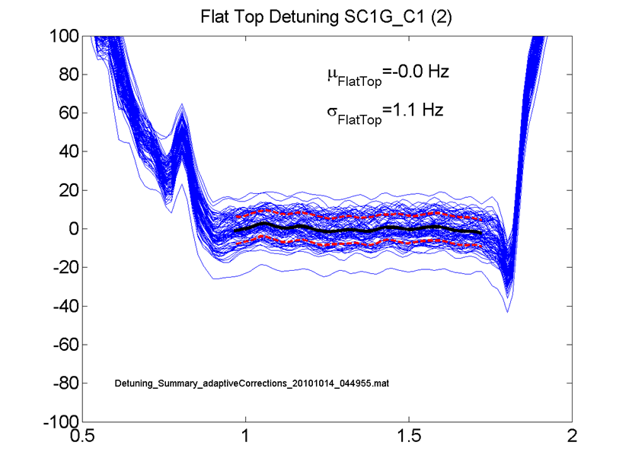

Residual Detuning Measurements for the S1-G Cavity Comparisons.
LFD Compensation during “FLAT-TOP”
To compare the performance of the four different styles of cavities, the residual detuning during the flattop was averaged over multiple RF pulses as illustrated by the black line.
The average and standard deviation over all time samples in the flattop was then calculated.
The average detuning calculated in this way indicates how well static detuning effects are compensated.
The standard deviation indicates how well dynamic detuning has been compensated. As shown for Blade Tuner the residual dynamic detuning is 1 Hz.
Detuning, Hz
Eacc=24MV/m
dF=240Hz
Time (ms)
Uncompensated Blade tuner has LFD (~250 Hz @ 24 MV/m)
Notes:
To compare the performance of the four different styles of cavities, the residual detuning during the flattop was averaged over multiple RF pulses as illustrated by the black line in this and next slide. The average and standard deviation over all time samples in the flattop was then calculated.
The average detuning calculated in this way indicates how well static detuning effects are compensated.
And RMS detuning is representation of pulse-to-pulse detuning.

Slide 14
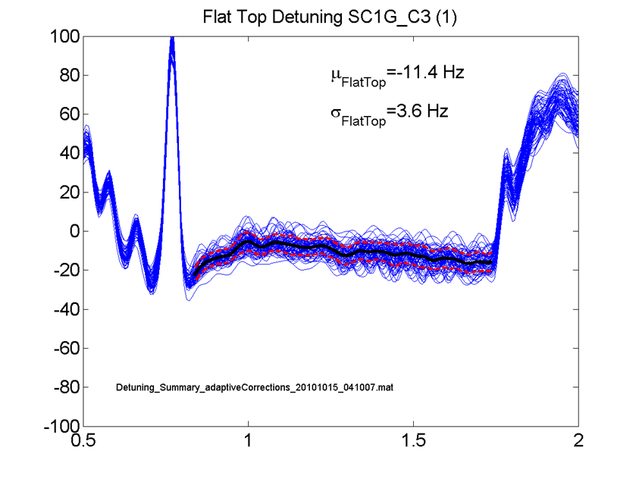

Residual Detuning Measurements for the S1-G Cavity Comparisons.
LFD Compensation during “FLAT-TOP”
Detuning, Hz
Eacc=27MV/m
dF=470Hz
Time (ms)
DESY/Saclay tuner has slower response and longer time constants (large residual vibration at high rep. rate) than Slide-Jack or Blade
Still able limit LFD to several Hz
Spikes are filtering artifacts
Notes:
To compare the performance of the four different styles of cavities, the residual detuning during the flattop was averaged over multiple RF pulses as illustrated by the black line in this and next slide. The average and standard deviation over all time samples in the flattop was then calculated.
The average detuning calculated in this way indicates how well static detuning effects are compensated.
And RMS detuning is representation of pulse-to-pulse detuning.

Slide 15
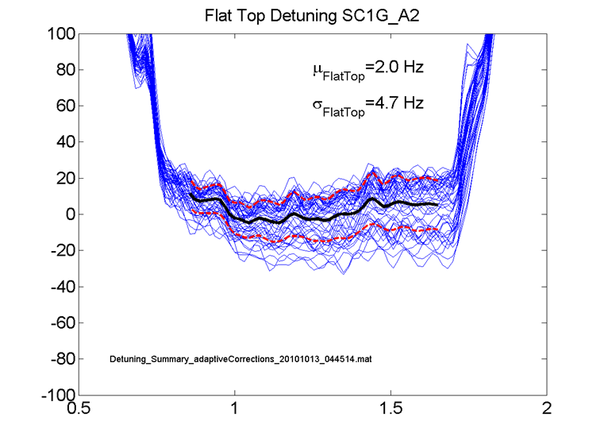

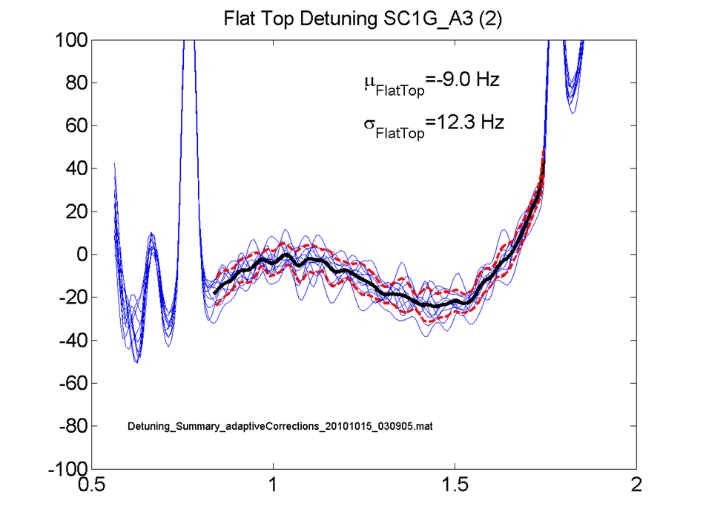



LFD Compensation during “FLAT-TOP”
End Slide-Jack tuner shows very little LFD
(~100 Hz at 34MV/m)
Concerned that stiffness might make it difficult to compensate
-12Hz offset is likely due to limitations of adaptive bias correction stability
Eacc=34MV/m
dF=250Hz
Eacc=30MV/m
dF=100Hz
Time (ms)
Notes:
This is results for Slide-Jack Tuner

Slide 16

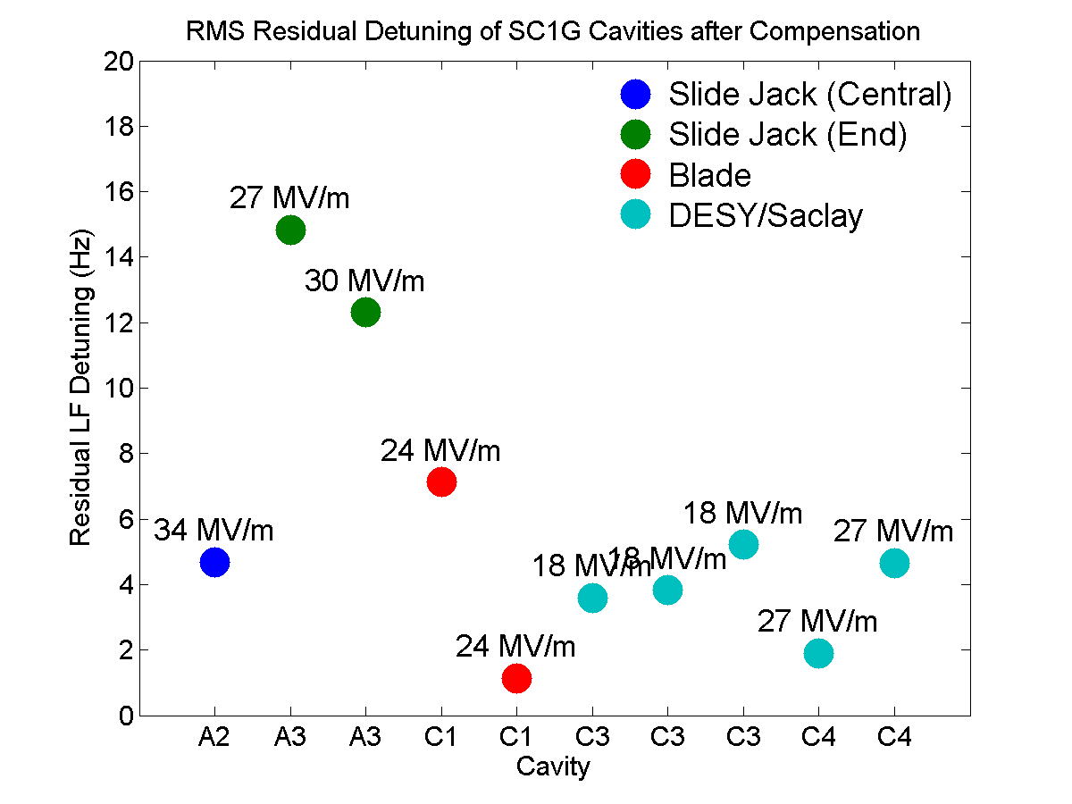
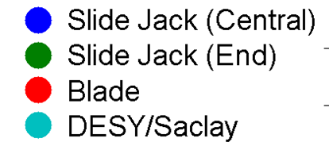
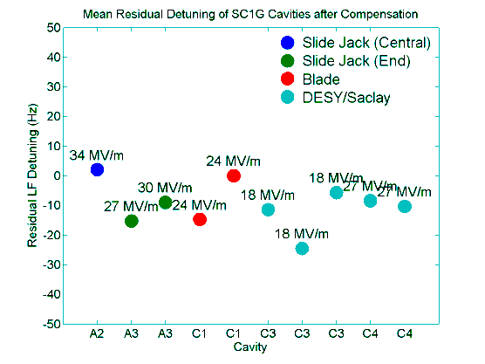
BACK-TO-BACK
COMPARISON
(LFD=100Hz)
(LFD=250Hz)
(LFD=240Hz)
(LFD=470Hz)
All tuners respond very well
Detuning control limited by adaptive bias correction rather than cavity/tuner design

Slide 17
Similar levels of residual detuning were also obtained using the standard half-sine piezo drive pulse (KEK system).
The four cavity types four distinctly different design philosophies and the mechanical response and detuning levels prior to compensation differ significantly.
Why Are the Compensation Results So Similar?
The 1ms RF pulse excites a broad mechanical response in each of the four cavity types. Reducing the detuning for such a short RF pulse requires only an impulse from the piezo. Furthermore, while stiffer cavities detune less due to the Lorentz force than more compliant cavities, they are also less responsive to the piezo and vice versa.

Slide 18
Summary
LFDC with Adaptive algorithm at S1-G
Adaptive LFD compensation system used to evaluate performance of S1-G cavities
Optimal piezo drive waveform provides a rigorous basis for back-to-back cavity/tuner performance comparisons
Residual LFD could be limited to better than 5 Hz in 3 cavity types tested (and 12Hz for “Slide-Jack End” --- it could be limitation /bandwidth of our piezo driver)
LFD control limits for ILC will likely depend more on controller and quality of the input signals than the mechanical details of cavity/tuner

Slide 19
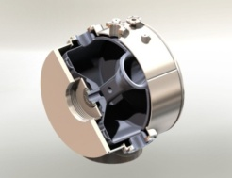
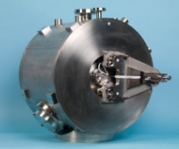
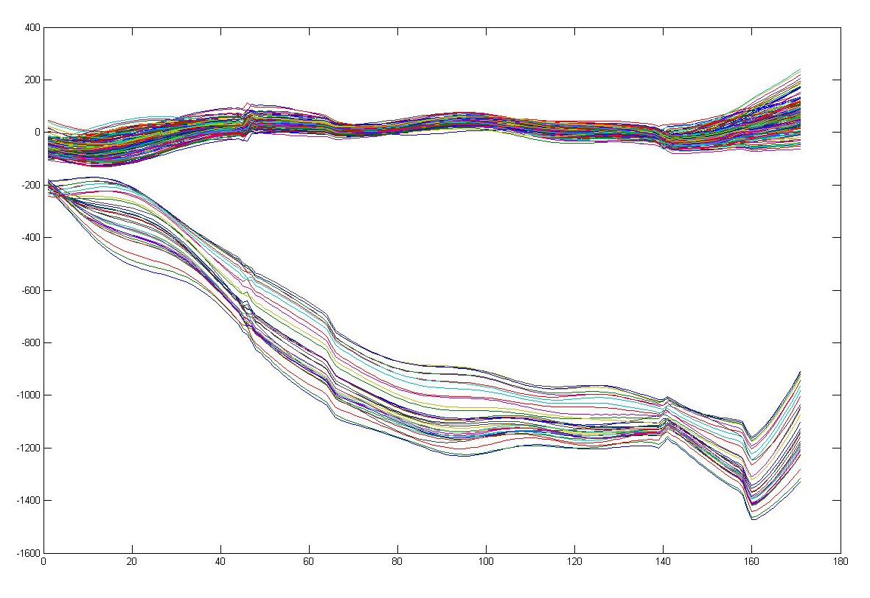
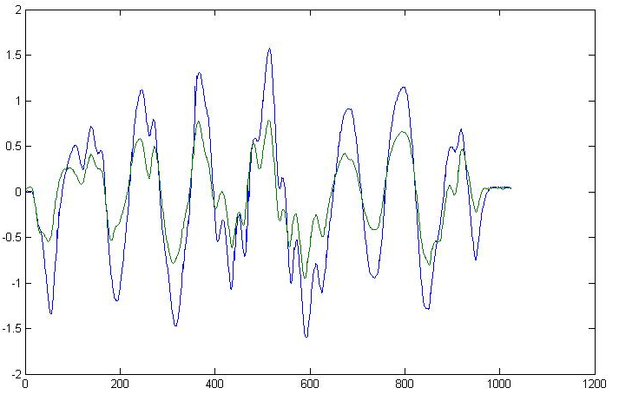
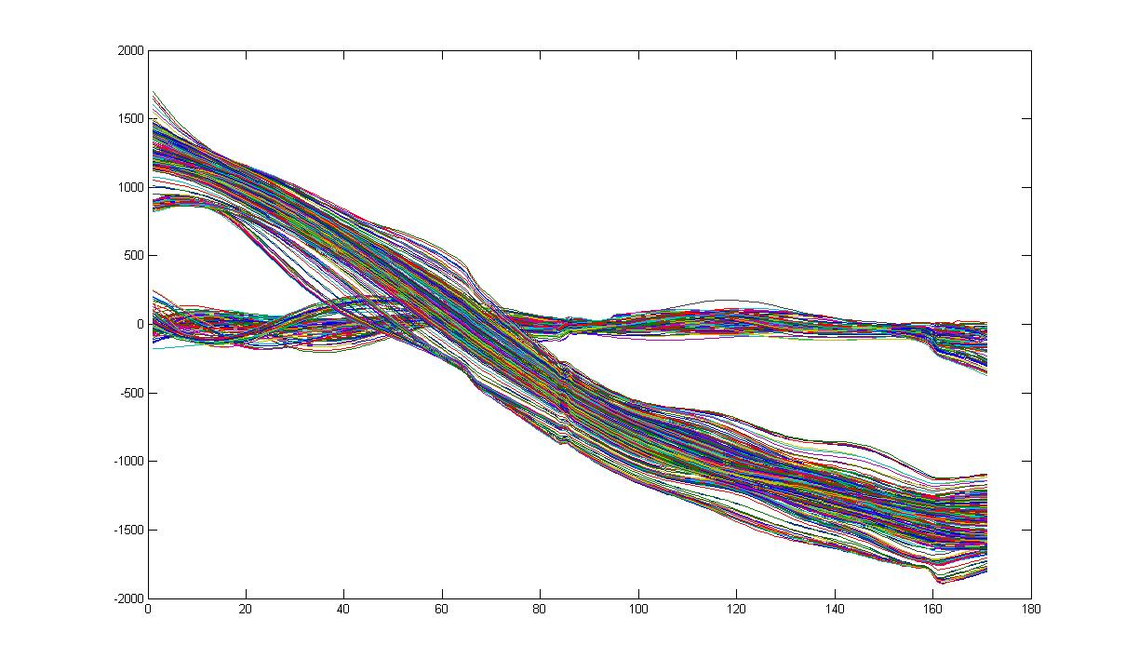
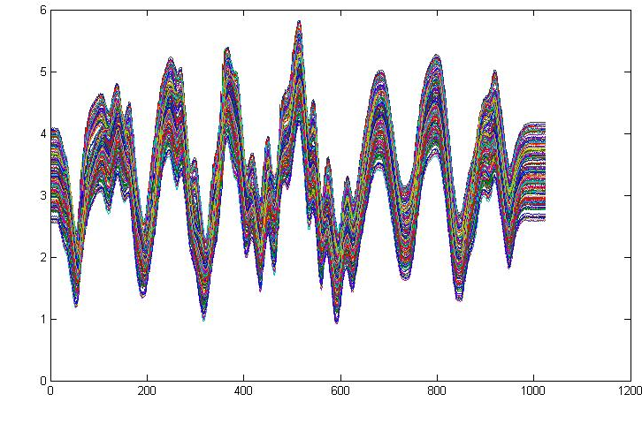
325MHz Spoke Cavity (SSR1)
(designed for HINS: 4,5K & 10MV/m ; RF-pulse 1ms-FlatTop)
T_{Fill}=1ms
T_{Flat-Top}=1ms
Eacc Piezo OFF Piezo On (ApiezoV)
20MV/m 500Hz(1000Hz) 30Hz 35V(18%)
34MV/m 1500Hz(3500Hz) 75Hz 80V(40%)
Piezo ON
Detuning, Hz
2000Hz
ΔF=-kE_{acc}²
K~1,2Hz/(MV/m)²
Piezo OFF
Piezo Stimulus Pulse generated by LS LFD
Eacc=20MV/m
Time
35V
80V
T_{Fill}=1,2ms
T_{Flat-Top}=1ms
20ms
Detuning, Hz
Piezo ON
Start RF Pulse
4000Hz
4,5 K LiqHe bath pressure compensation
Piezo Stimulus pulses Eacc=34MV/m during 180sec operation
Bias changed on 30V
(dV=30V → dF=600Hz)
Piezo OFF
30V
Eacc=34MV/m
Piezo Pulse Amplitude
Time
PAC2011 poster TUP080

Slide 20

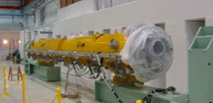
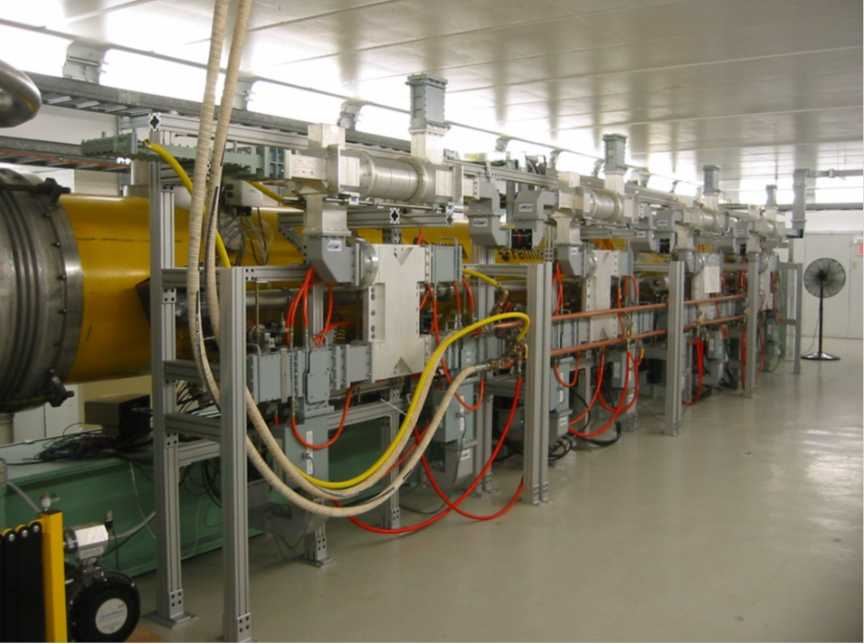
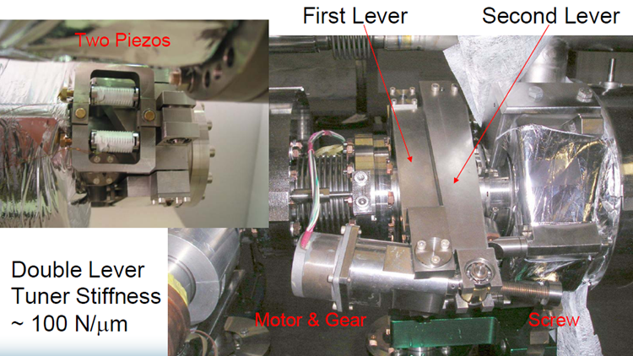
CM1 at NML
(see Elvin Harms presentation)
Saclay I/DESY Tuners

Slide 21
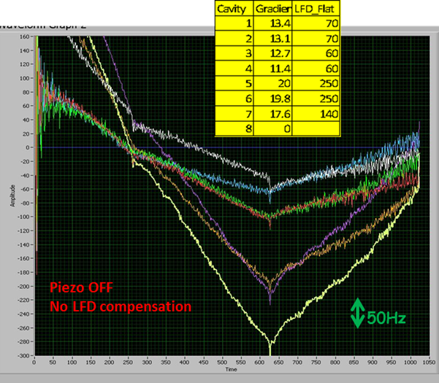
CM1
Resonance Frequency Detuning
(7 cavities) by Lorentz Forces
LFD up to 250Hz
For Eacc=20MV/m

Slide 22
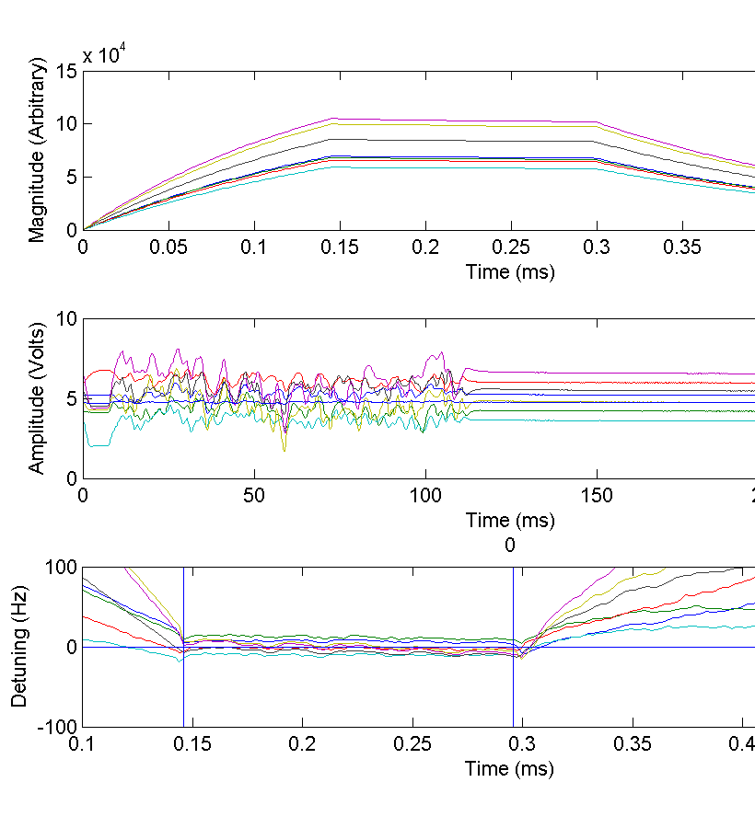
Adaptive Feed-Forward Compensation
Probe
Adaptive compensation reduces LFD during flattop to negligible levels
Residual detuning is less than pulse-to-pulse detuning variations
0.5
1.3
Piezo Pulse
8
16
Detuning
0.5
Time (ms)
1.3

Slide 23
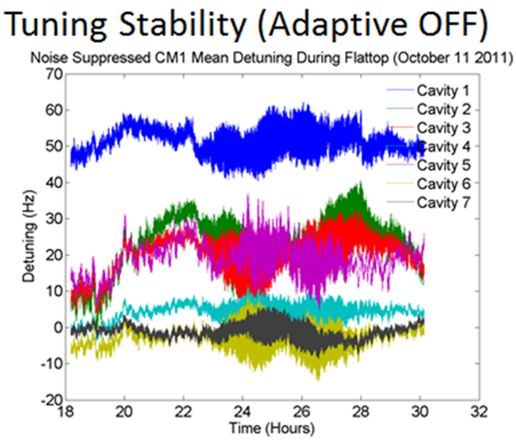
Resonance frequencies of LFD compensated CM1 cavities can drift by up to 20 Hz over 12 hour period
Frequency Shift
Notes:
Resonance frequencies of LFD compensated CM1 cavities can drift by up to 20 Hz over 12 hour period. This slide present frequency frequency stability when LFDC is on but Adaptive compensation was OFF.

Slide 24


First CM1 Stability Measurements
Adaptive LDC ON; Open Loop LLRF
Adaptive compensation can stabilize the resonance frequencies
-Mean residual detuning <5 Hz
-Pulse-to-Pulse variations below <6 Hz RMS.
20 hours

Slide 25

Improved Stability
Improving integral gain eliminates residual LFD
LLRF Feedback reduces pulse-to pulse variations
  Mean detuning <1Hz
  Pulse-to-Pulse detuning ranges from <9Hz at the end to <2 Hz in the center of cryomodule.

Slide 26

Summary
CM1 Adaptive Piezo Control System
FNAL/NML/CM1 LFD Compensation system is now operational
Adaptive Feed-forward LFD compensation
  Reduce residual LFD at 25 MV/m from 300 Hz to negligible levels
  Stabilize cavity resonance frequencies to better than 1 Hz

Slide 27


Application of Adaptive LS LFD algorithm for long RF Pulse
(“proof-of concept” test related to 3-8GeV pulsed linac-Project X)
(test performed at HTS)
Detuning of nine-cell elliptical cavity driven by an 8ms pulse with gradient Eacc=22MV/m.
Cavity detuning without piezo compensation aprox. several kHz.
This was sufficient to drive cavity completely off resonance.
Fill=4ms
FlatTop=4ms
Piezo Stimulus Pulse
10ms
8ms-RFpulse
Start of RF pulse

Slide 28
Conclusions(I)
Fermilab developed SRF cavities piezo control system (hardware/firmware/LS LFD algorithm) for adaptive compensation of LFD & microphonics
Several systems have been deployed and routinely used at facilities around FNAL (for single cavities and 8-cavities cryomodule)
In the frame of S1-G project FNAL’s system successfully has been used (side-to-side with KEK system) to compensate LFD detuning for 4 different tuners design (ILC-candidates )

Slide 29
Conclusions(II)
From S1-G project
  LFD control limits for ILC will likely depend more on controller and quality of the input signals than the mechanical details of cavity/tuner
From HTS&CM1
  Adaptive LFD compensation can reduce residual LFD from 1000Hz to negligible levels & stabilize resonance frequency to better than 1 Hz
  Adaptive LFD compensation algorithm successfully applied to compensate cavity LFD detuning
    During “fill” time of 1,3ms RF pulse
    During “long” (8ms) RF pulse

Slide 30
Additional Slides

Slide 31



Slide 32
Measuring the Detuning
RF behavior well described by ‘Cavity’ equation
Cavity equation can be manipulated to isolate the detuning
  Same formula in slightly different form has been used at DESY
Requires accurate knowledge of the forward and probe I/Q signals

Slide 33

Correcting for LLRF Cross-Contamination
Probe signal is measured accurately
Forward and Reflected signals measured by same pickup leading to cross-contamination
Cross-contamination of the forward signal can be estimated by assuming forward ‘tail’ is entirely due to contamination
Correction reduces the variation of the forward signal on the flattop to a few percent

Slide 34



Measuring the Mechanical Transfer Function in Pulsed-Mode
Excite the piezo with a series of impulses and sweep the impulse-to-RF delay
  Equivalent to measuring the piezo-to-detuning transfer function using CW
Delay-Scan used to determine optimal waveform

