Slide 1
TESLA Technology Collaboration
Beijing, 5-8 December 2011
Introduction and update since last meeting
O.Napoly, CEA-Saclay
TTC Chairman

Slide 2
We are welcome to the TTC meeting hosted in Beijing by the Institute of High Energy Physics, Chinese Academy of Sciences (IHEP, CAS), the Peking University (PKU) and the Tsinghua University (THU). Many thanks to:
Prof. Gao, Jie (Chair), IHEP Prof. Liu, Kexin (vice-Chair), PKU Prof. Tang, Chuanxiang (vice-Chair), THU
for chairing the meeting.

Slide 3
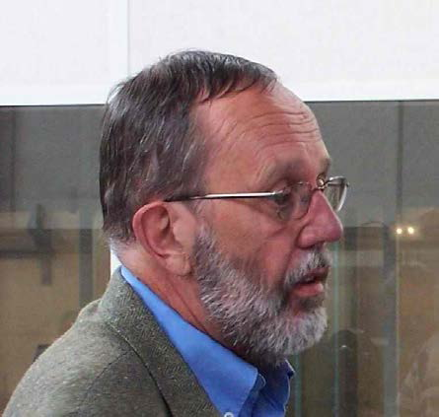
In Memoriam Bernard Aune passed on September 30, 2011
Head of CEA Accelerator Division
Head of TTF Project (~1995)

Slide 4
TTC Members

Slide 5
TTC Members
New MoU’s signed
TTC membership consists of
53 Institutes
from 12 countries
and 2 International Organisations

Slide 6
TTC committees new membership
TTC Deputy Chair: Mark Champion
TTC Executive Committee:
John Mammosser, Hans Weise, Akira Yamamoto
Technical Board Chair: Nobu Toge
Co-Chair: Wolf-Dietrich Möller
Thank you for accepting to share the responsability.

Slide 7
My Idea of the TTC
The TESLA Technology Collaboration is at the same time:
a “forum” of discussions and exchanges on Superconducting Radio Frequency (SCRF) systems cutting edge developments, from the R&D level to running accelerator aspects and, in return,
a “think tank” capable of providing top level and experienced advices and expertise to SCRF accelerator projects, from the design phase to the operation stages, including optimisation and upgrades.
The TTC “forum” culminates during the TTC meetings whose success is guaranteed by the excellence of the presentations, intellectual debates and technical findings that it convenes, by free will, from the members of the TTC institutes.
The TTC “think tank” is a unique body comprising most of the major accelerator centres and accelerator science institutes in the world, addressing a broad range of applications in scientific fundamental research.

Slide 8
Priorities of the next 3 year mandate
The priorities of my mandate will be:
To maintain the excellent quality of the recent scientific and technical material presented and discussed during the TTC meetings;
To consolidate the recent and successful integration of the proton and ions superconducting linac SCRF developments, inherited for the former TTC Chairman, Professor Yamazaki;
To broaden the scope of work by investigating new synergies, new applications and frontier projects;
To face the Cost issue, i.e. the reasons for costs escalation in the past years, and the means of cost reduction.

Slide 9
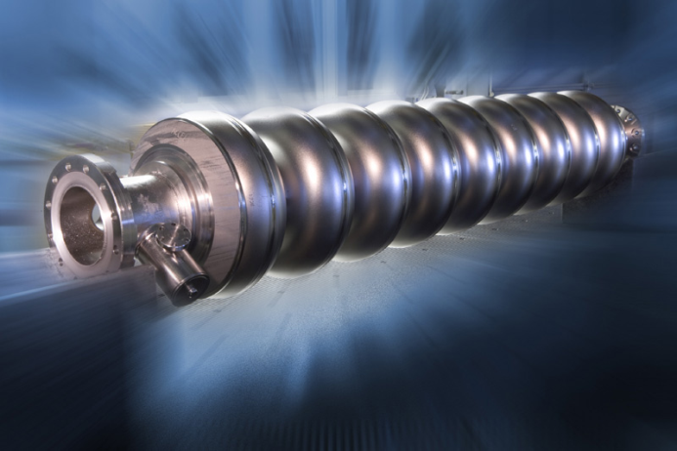
Priorities of TTC until 2007
Performances
of SCRF systems

Slide 10
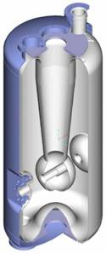
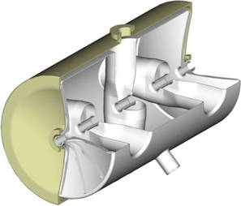
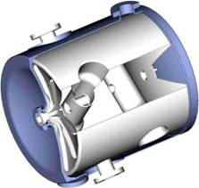
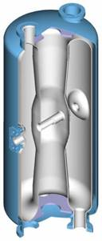
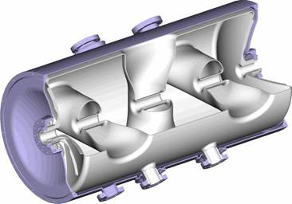
Priorities of TTC : 2008-2011
Performances
Applications
of SCRF systems

Slide 11
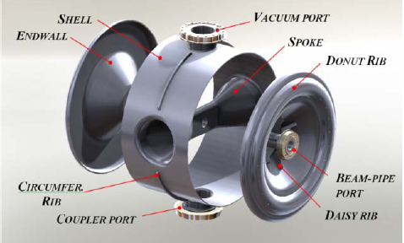
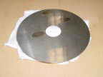
A proposal for TTC Priorities 2011-2014
Performances
‘APE’
Applications
Economics
of SCRF systems

Slide 12
Cryogenics Economics
Example of a linac with two ‘XFEL-like’ cryomodules (LUNEX5 @ SOLEIL)
Assumptions: power = 0,1 € /kWh@300 K
CoP(2K) = 700 W/W
magnetic shield = 2500€ / cavity
cryogenics = 1 M€/100 W@2K
Duty cycle, Q0, Gradient | Operational power cost | Capital cost of magnetic shields | Capital cost 2K liquefier
CW 100%, 1.10¹⁰, 15MV/m | 210 k€ / year | 40 k€ | 3,5 M€
Pulsed 1%, 1.10¹⁰, 25MV/m | 6 k€ / year | 40 k€ | 100 k€
Pulsed 0.5%, 6.10⁹, 35MV/m | 10 k€ / year | 40 k€ | 160 k€
Can one increase Q₀ with a better magnetic shielding, or any other (cheap) mean ?

Slide 13
A New Technical Board (TB)
A new (and more numerous) Technical Board membership was invited with the goal to include ‘fresh blood’, new TTC members, and to cover the new priorities.
Chairman
 | N. Toge (KEK)
 | W.D. Moeller (DESY), co-chair
Cavity and couplers
 | C. Antoine (CEA)
 | S. Bousson (CNRS-Orsay)
 | R.L. Geng (JLab)
 | C. Ginsburg (FNAL)
 | E. Kako (KEK)
 | R. Laxdal (TRIUMF)
 | D. Reschke (DESY)
 | Ji Yuan ZHAI (IHEP)
RF and Tuning
 | O. Brunner (CERN)
 | P. McIntosh (STFC)
 | S. Noguchi (KEK)
Cryomodule and cryogenics
 | H. Nakai (KEK)
 | T. Peterson (FNAL)
 | P. Pierini (INFN)
Integration and Operation
 | H. Hayano (KEK)
 | Sang-Ho Kim (SNS)
 | M. Liepe (Cornell)
 | S. Schreiber (DESY)
Honoris Causa
 | J. Mammosser (JLab)
 | C. Pagani (INFN)
 | M. Ross (GDE)
 | H. Weise (DESY)
+ three more invitations pending for an answer.

Slide 14
Technical Board Mission
According to the MoU of TTC:
“the Technical Board TB shall provide advice to the Collaboration on technical activities towards reaching the goals of the Collaboration Mission. To this end, the TB will:
compile information on the technology activities in different technical areas,
provide findings and recommendations to the CB.”
These are very abstract goals.
My proposal: the Technical Board attempts
1) to digest the findings, debates and technical needs from the meeting,
2) to highlight the most interesting paths of progress, within the APE triangle,
3) to propose developments or experimental tests to explore these paths.

Slide 15
TTC Beijing Meeting
Programme Committee:
Olivier Napoly (chair)
Mark Champion
Jie Gao
Nobu Toge & Wolf Dietrich Möller
WG1 conveners: ‘Cryomodule Test Results and Analysis’
James Kirby, Guillaume Olry, Akira Yamamoto
WG2 conveners: ‘Cavity material, fabrication, treatment and testing: new concepts and new benefits’
Claire Antoine, Camille Ginsburg, Tsuyoshi Tajima
WG3 conveners: ‘Cryogenics and cryostats : savings in cooling power’
Li Qiand Liu, Tom Peterson, Paolo Pierini

