Slide 1
Athmospheric Surface Treatments of Niobium
A. Camacho*^, A.A. Rossi* and V. Palmieri*^,
* INFN – Legnaro National Laboratories
^ University of Padua

Slide 2
Material Study or Cavity construction?
Samples or Cavities?

Slide 3
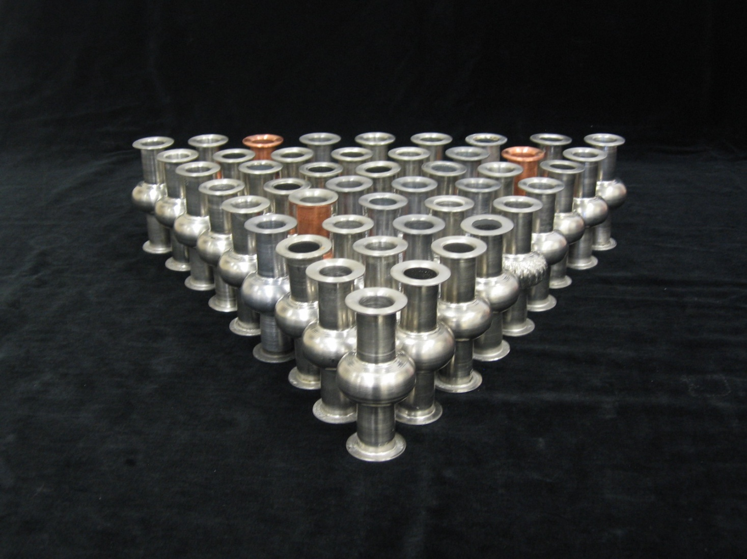
Low research budget → Large amount of cavities
6 GHz

Slide 4
Samples Real cavities
Pillbox cavities, etc
Calorimetric methods
6 GHz cavities
Resistive
R_{S} Differential measurements
1,5 /1,3 GHz monocells
Inductive
H_{c1} Measurement
Microstrip Resonators
1,3 GHz 3-cell cavity
1,3 GHz 9-cell cavities

Slide 5
6 GHz CAVITY MINILAB
No electron beam welding, neither for flanges
Obtained by spinning from Nb scraps
Short fabrication time
Fast and low cost BCP and EP treatments
Inexpensive Cryogenics
Quick RF Measurements

Slide 6
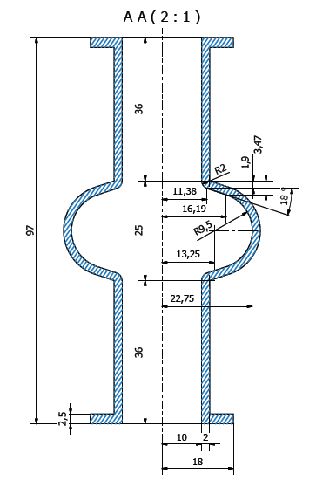
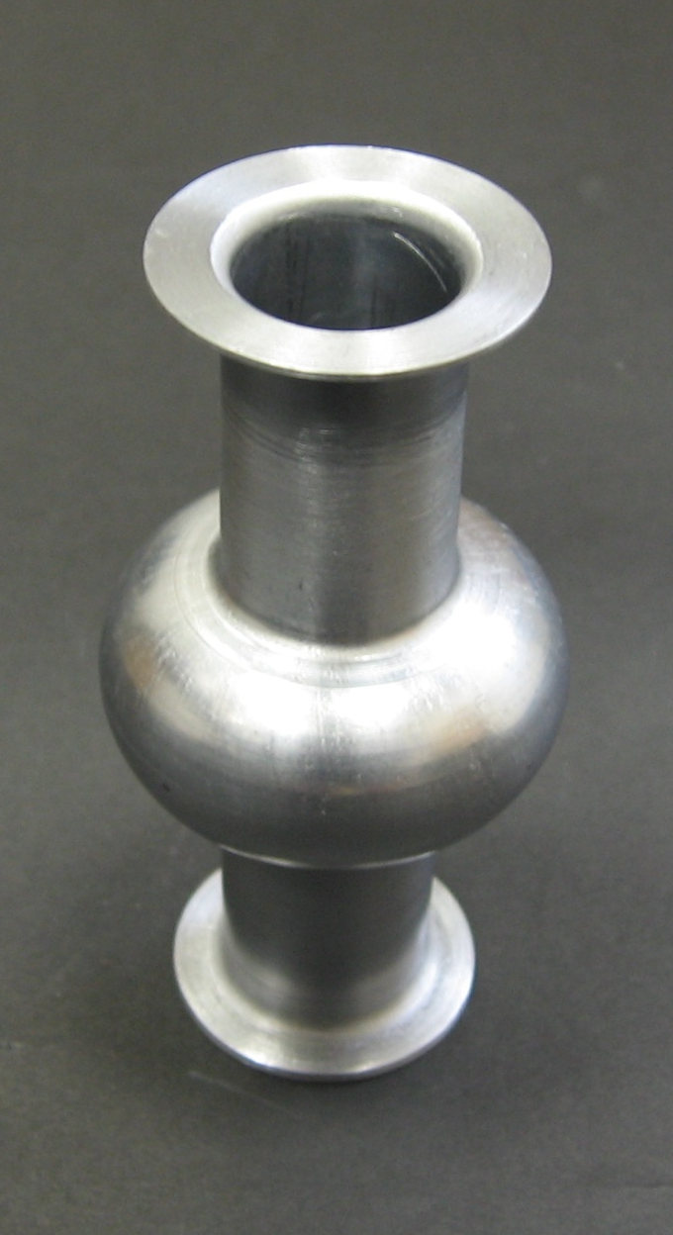
6 Ghz Cavity Geometry
36 mm
Seamless flanges
20 mm
[mm]
Flange Area = 7 cm²
Notes:
Modifica quote lunghezza cavità: cut off e cella

Slide 8
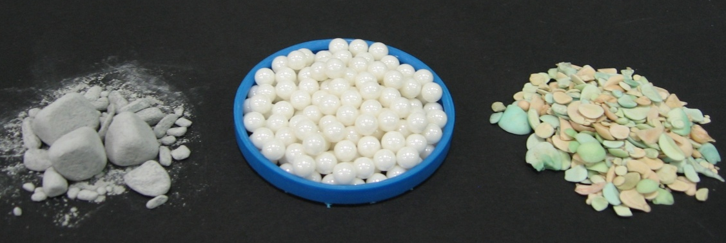
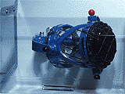
Mini Mechanical Tumbling
SiC
ZrO₂
Al₂O₃ + SiO₂

Slide 9
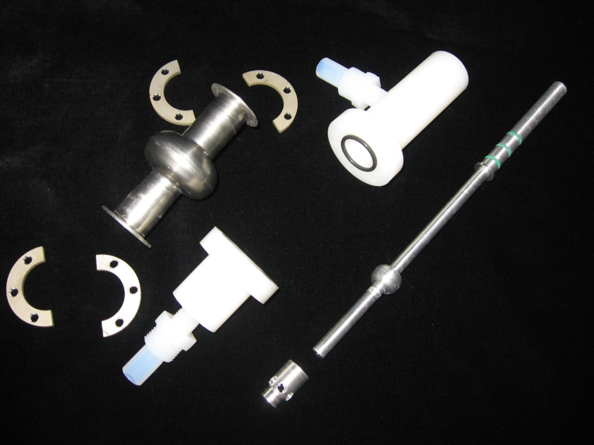
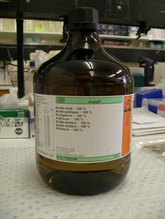
Mini EP

Slide 10
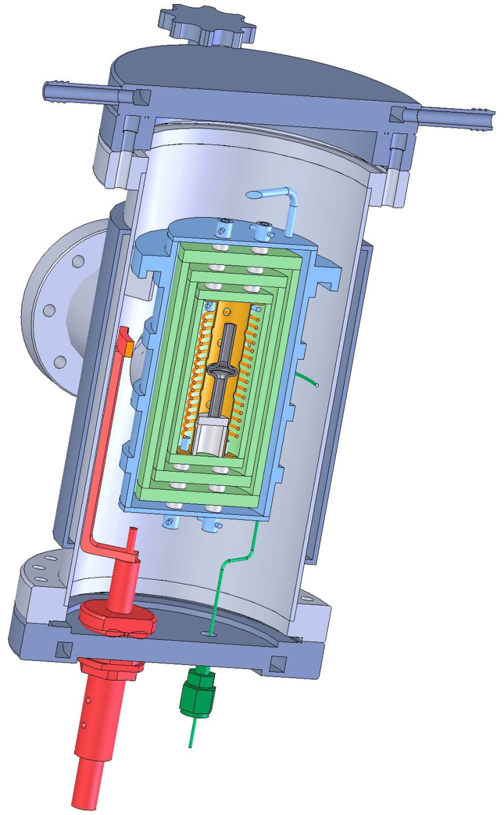
6 GHz CAVITY MINI-furnace

Slide 11
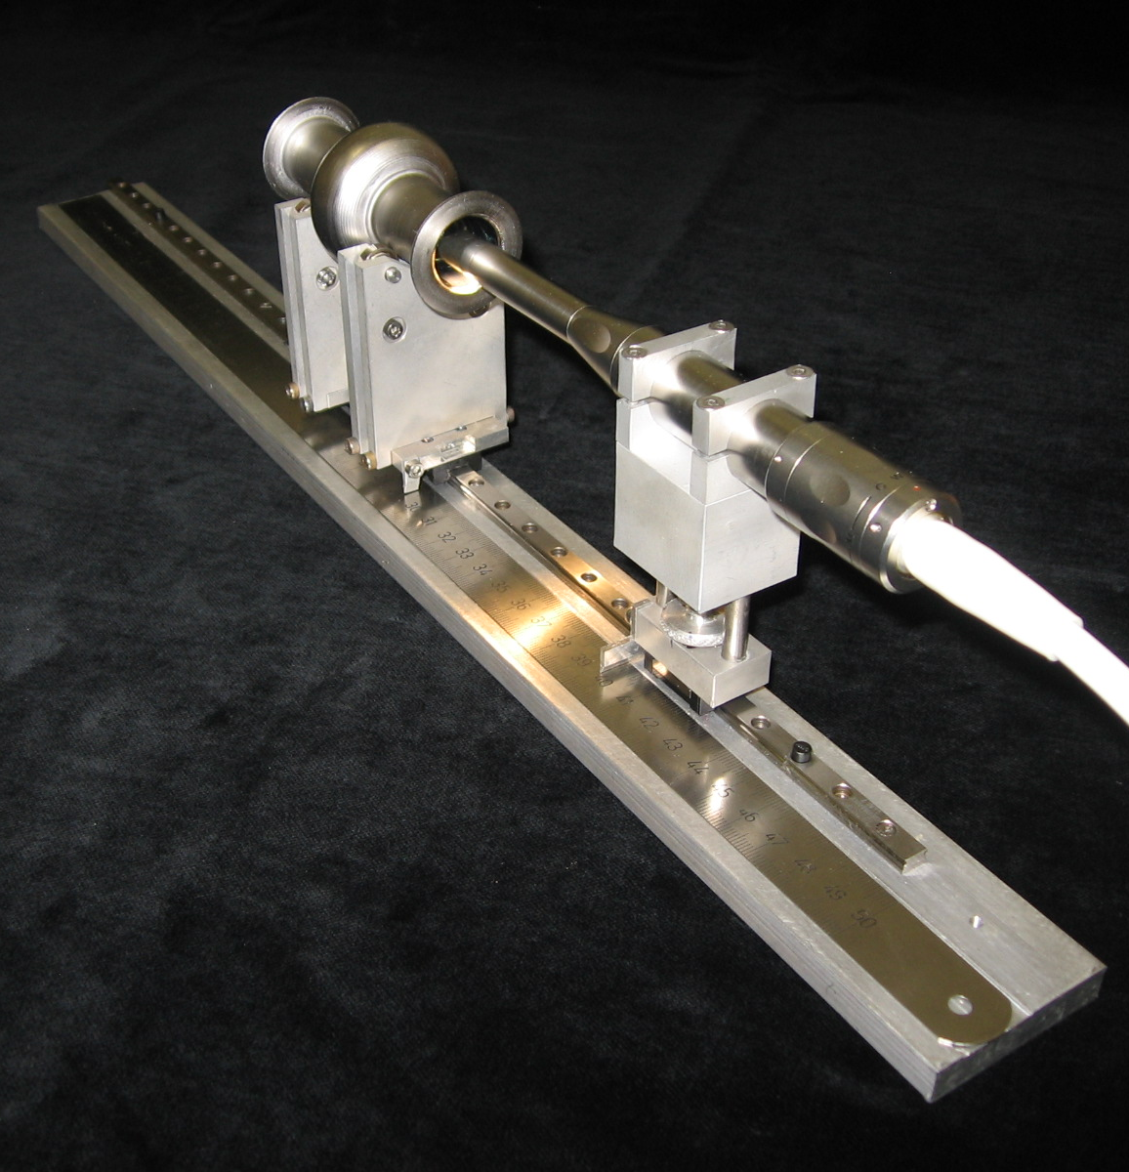
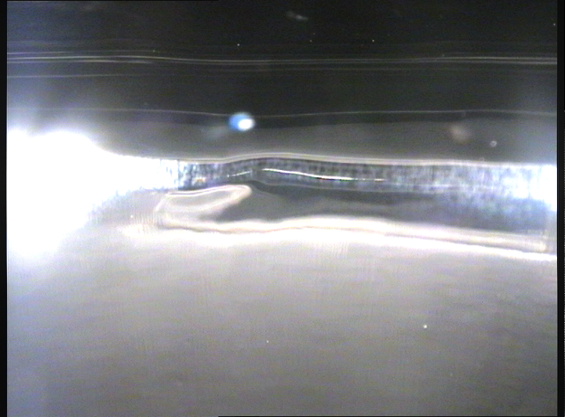
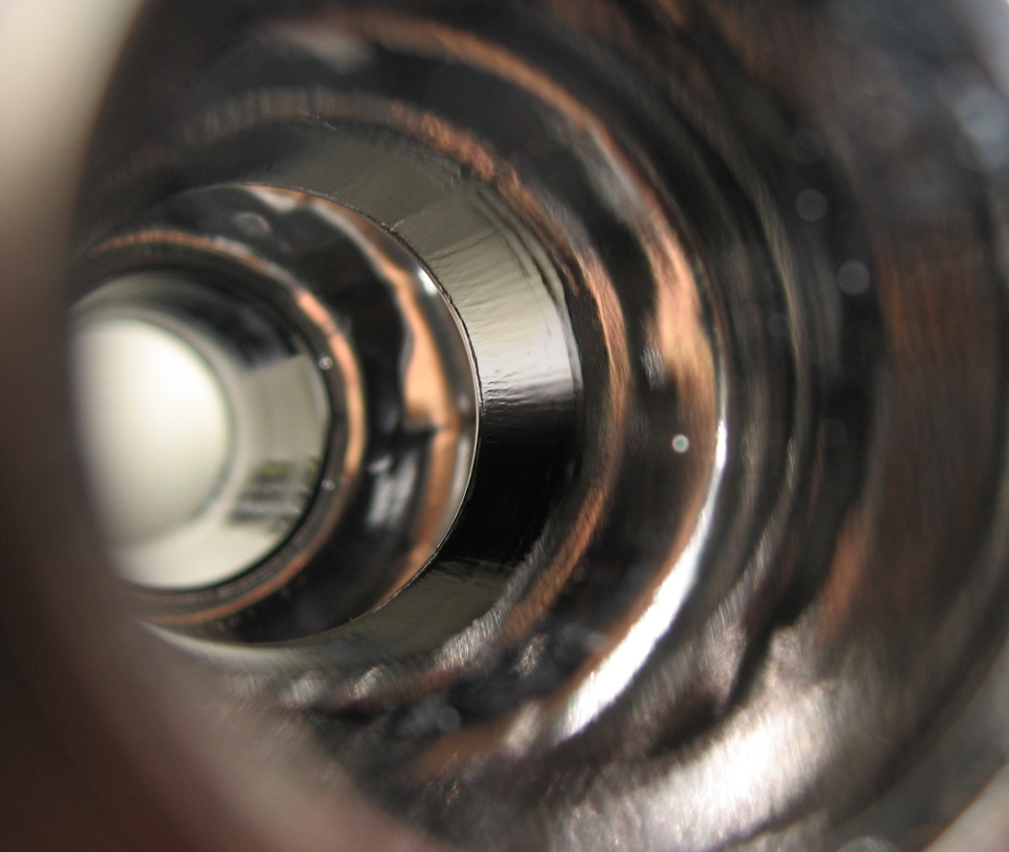
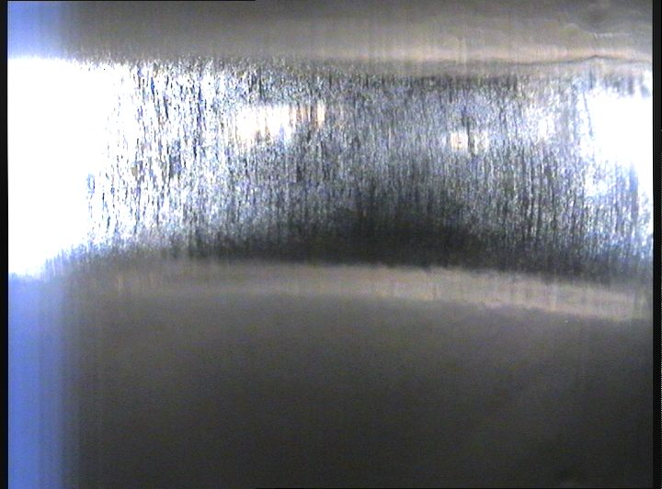
6 GHz CAVITY MINI-Camera

Slide 12
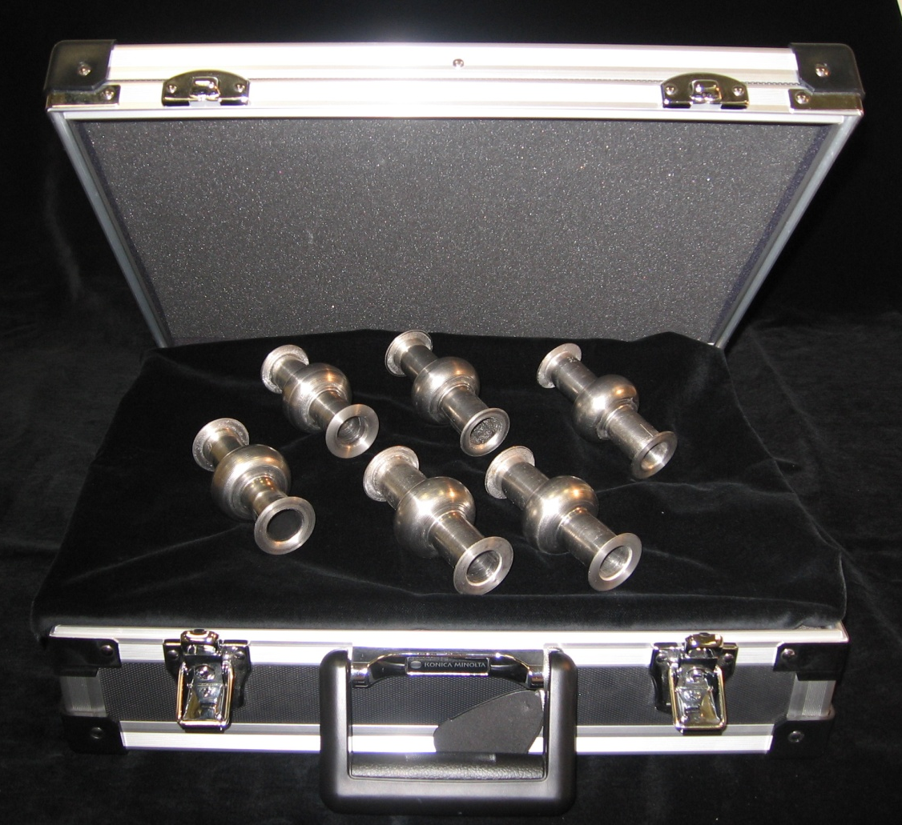
Ready for the RF measurement

Slide 13
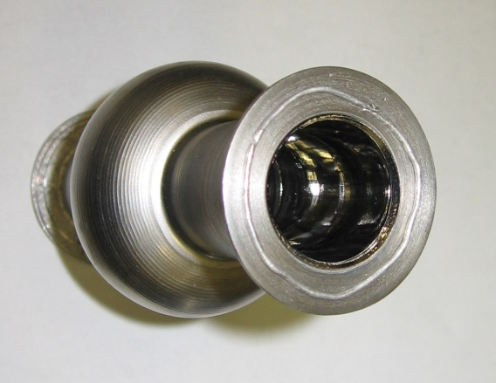
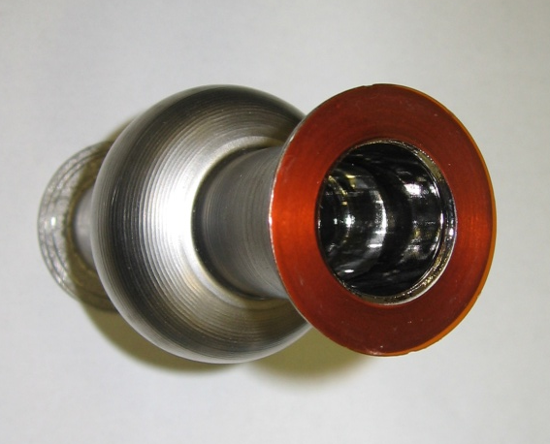
6 GHz CAVITY: MINI-Kapton gasket

Slide 14
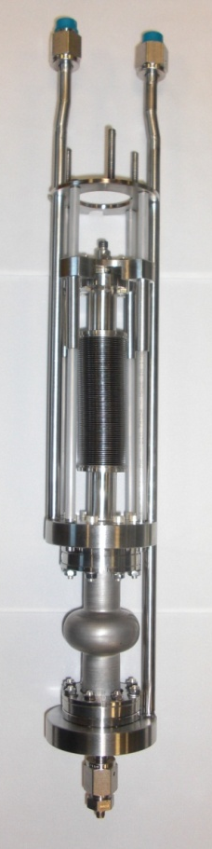
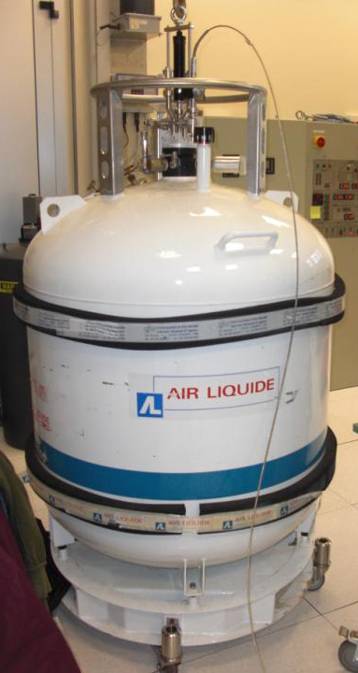
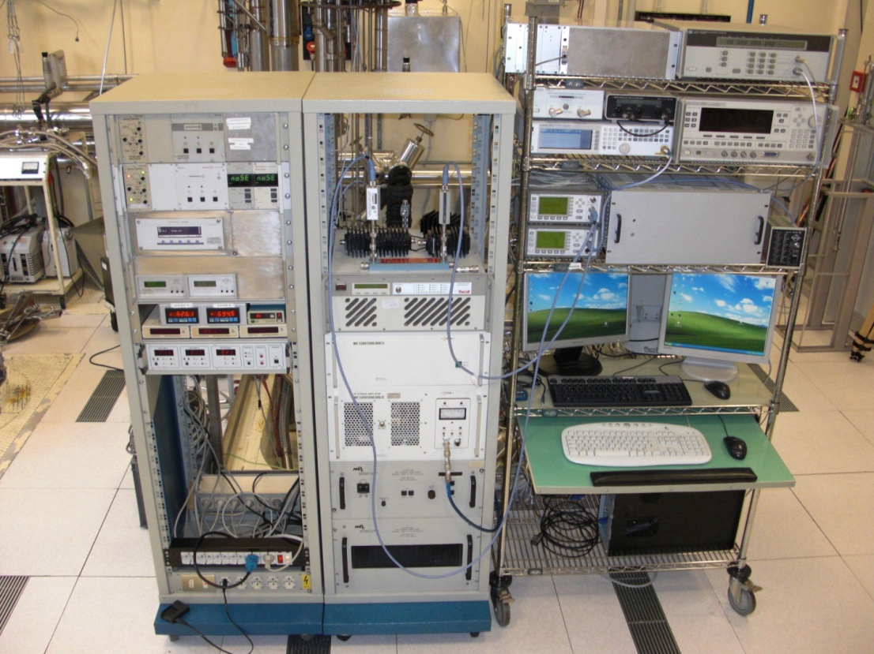
Quick RF Measurements
The insert has been conceived to even enter into a 450 lt Helium dewar
INSERT
DEWAR
RF measuring system

Slide 15
High Temperature Rapid Metathesis
(Nitriding in Mushy State)

Slide 16
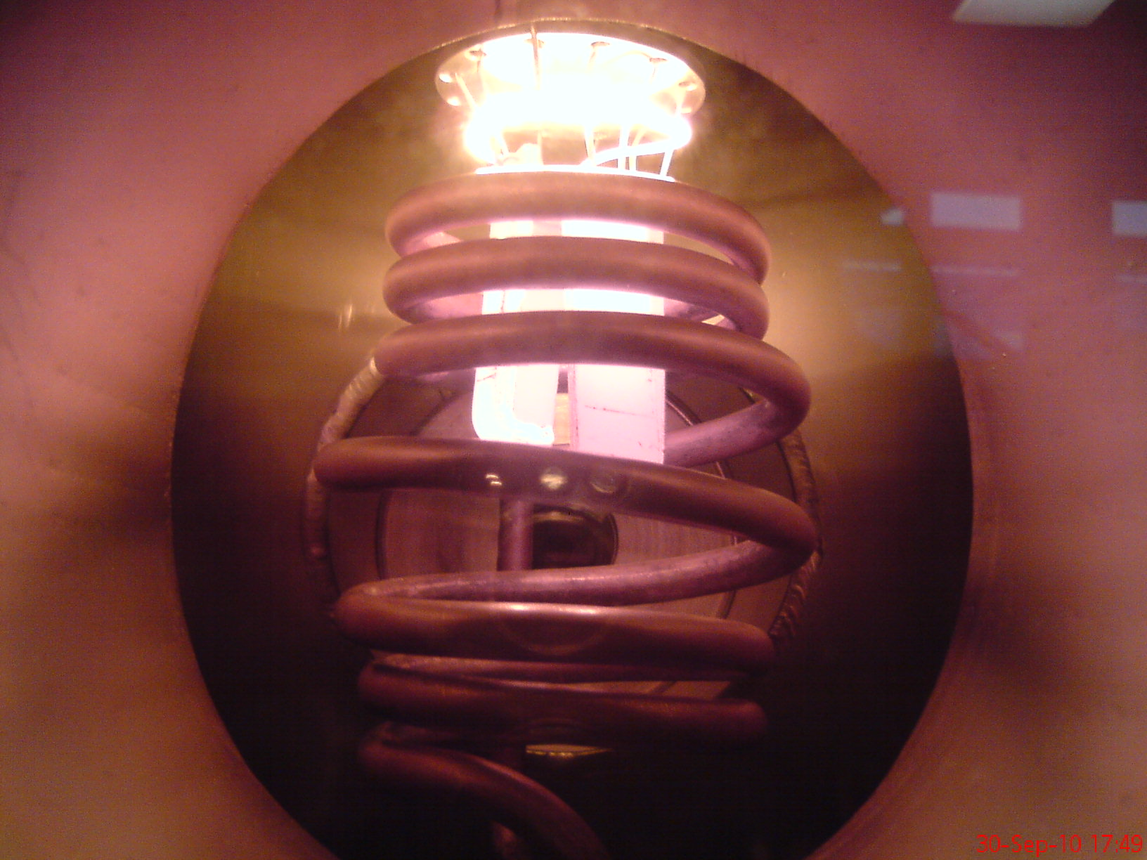

Slide 17
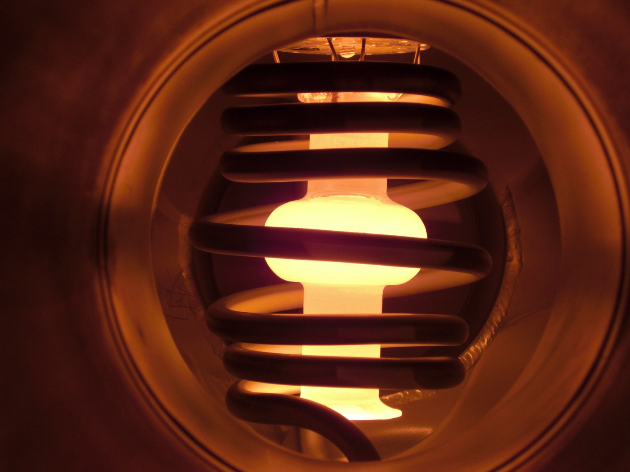

Slide 18
The Homologous Temperature
T [K]
θ =
T_{m} [K]
0
1
for Nb 2467 °C

Slide 19
T [K]
θ =
T_{m} [K]
Premelting
Mushy State
0,9
0,96
0,98
1
2196 °C
2357 °C
2412 °C
2467 °C

Slide 20
Bulk Nb
6 Ghz @4,2K

Slide 21
High Temperature Rapid Metathesis
(Nitriding in Mushy State)
The Process is:
Fast ( takes only few sec)
Cheap (Vacuum Technology Free)
Simple (No need of special expertise)

Slide 22
Premelting
(also Surface melting)
Even below its melting point (T_{m}), quasi-liquid films can be observed on crystalline surfaces

Slide 23
Premelting
(also Surface melting)
The thickness of the quasi-liquid film is T - dependent
This effect is common for all crystalline materials

Slide 24
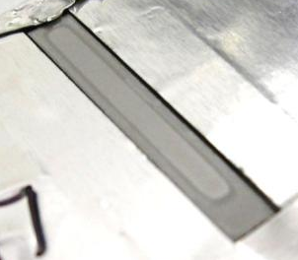
NbN
Nb
NbN
Nb
3 mm

Slide 25
Nb₅N₆; N₄N₃ Over-Stoichiometric
δ-NbN _{1-x};
γ-Nb₄N_{3-x} Under-Stoichiometric
α-Nb (N) (bcc solid solution)
Niobium

Slide 26

Nb₅N₆; N₄N₃
δ−NbN _{1-x};
  η-NbN (hexagonal);
δ’−NbN (hexagonal);
β-Nb2N (hexagonal); γ-Nb₄N_{3-x}
α-Nb (N) (bcc solid solution)
Niobium

Slide 27
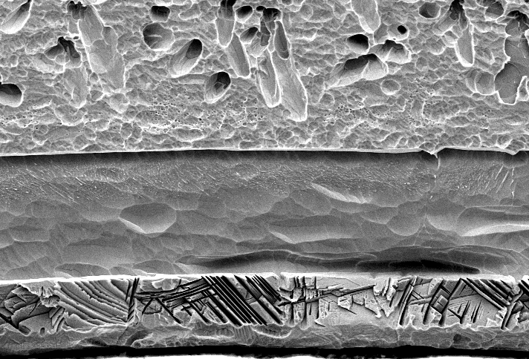
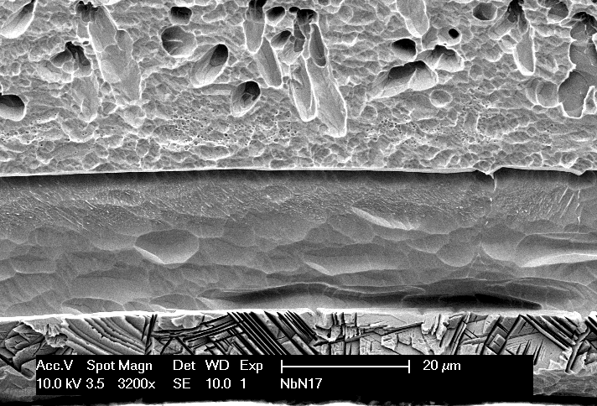
Surface layers

Slide 28
T_{m} of Nb
Temperature
3 – 30 sec
Time

Slide 29
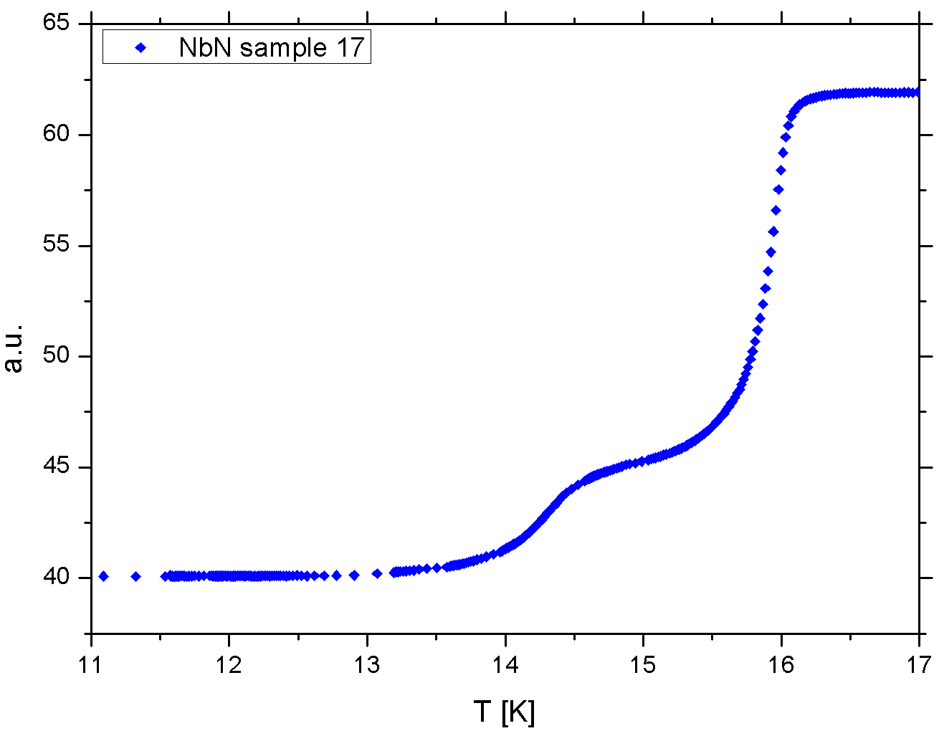
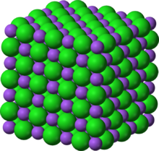
δ-Nb N
γ-Nb N

Slide 30
As the δ-NbN → γ-Nb₄N_{3-x} phase transformation is a very fast, quasi-continuous
Transition,
it cannot be avoided by quenching

Slide 31
The good layer is
the most external one

Slide 32
NbN
BCP 3’
Pure Nb
BCP 3’

Slide 34
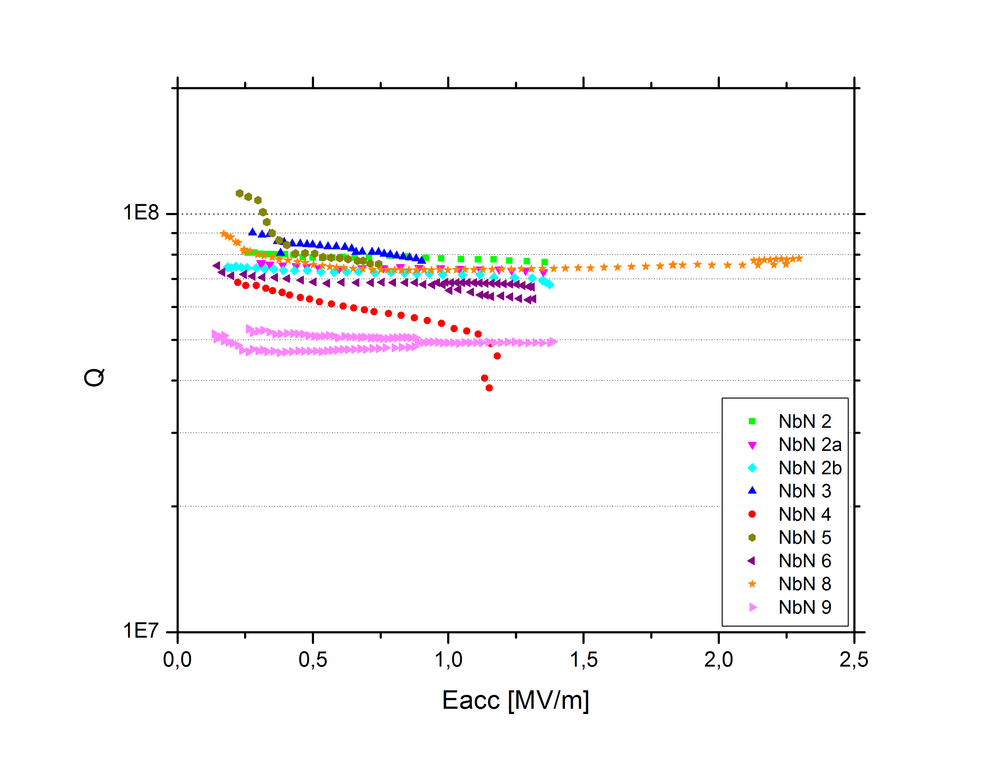
NbN @4,2K
T = 4,2 K
Bulk Nb

Slide 35
High Temperatures for
Nb Purification

Slide 36
5 min at 2300°C
IL - EP
IL - EP
Classical – EP
Classical – EP
Classical – EP
Classical – EP
5 min at 2300°C

Slide 37
Conclusions 1
6 Ghz cavities allow a fast and dense statistics

Slide 38
Conclusions 2
No vacuum required!
5min @ 2300°C seem to purify Nb
Nitriding performed atAtmospheric pressure
At 4,2 K the Q-value at low field increases of even a factor 5

