Slide 1
TESLA Technology Collaboration Meeting
Beijing, 5-8 December 2011
Collaboration Board Report
O.Napoly, CEA-Saclay
TTC Chairman

Slide 2
CB Meeting Agenda
Approval or addition to agenda 5’
Approval of the minutes of the last meeting (sent on Sept. 11, 2011, re-sent on Nov. 8,2011) 5’
Summary of Chairman activities over past 9 months 15’
Update on MoU signatures and TTC Membership
Comments/Approval by CB of TB composition
Amendment to TTC MoU proposed by Brookhaven National Laboratory 10’
TTC support to Padova University Master on surface treatments for industrial applications V. Palmieri, 10’
Application of ESS-AB W. Hees, 20’ presentation + 10’ discussion
Venue and date of next TTC Meeting 10’
Any other issues and/or matters 5’
Total 1h30’

Slide 3
Participants
Olivier Napoly, CEA (chair)
Camille Ginsburg, FNAL, representing Mark Champion (co-chair)
Chris Adolphsen, SLAC
Sergio Calatroni, CERN
Jie Gao, IHEP
James Kirby, FNAL
Robert Laxdal, TRIUMF
Wolgang Müller, TU Darmstadt, by Webex
Carlo Pagani, INFN Milano
Vicenzo Palmieri, INFN Legnaro
Hans Weise, DESY and representing University of Rostock
Russell Wells, LBNL
Kaoru Yokoya KEK
Excused:
Georg Hoffstaetter, Cornell University
EC Member:
Akira Yamamoto, KEK
Support:
Jiyuan Zhai, IHEP

Slide 4
TTC Members

Slide 5
TTC Members
7 New MoU’s signed
TTC membership consists of
53 Institutes
from 12 countries
and 2 International Organisations

Slide 6
BNL Amendments
The membership of Brookhaven National Laboratory was approved unanimously at the TTC Collaboration Board meeting at Frascati, on December 6, 2005.
But no MoU was exchanged and signed since then.
When Ilan Ben-Zvi was contacted in June 2011, the Chief Intellectual Property Counsel of Brookhaven Science Associates (BSA) requested some amendments to the MoU, for instance:
Article 5 Collaboration Membership
(4) Research under the MOU by Member Institution, Brookhaven Science Associates, LLC (BSA), indicated below will be conducted under and subject to specific research or technology transfer agreements authorized under the BSA M&O contract with the U.S. Department of Energy.
Article 6 Intellectual Property
(5) Joint Inventions belong to each of the Members whose personnel have made them, and subject to U.S. Government rights for Joint Inventions generated by a BSA employee Member.

Slide 7
TTC IP
Article 6 Intellectual Property
(1) Subject to the provisions of laws applicable to Member
Institutions and subject to the agreement of eventually involved
third parties the Members will make all efforts to make available
to each other free of charge, in writing or in any other
appropriate form, the knowledge in their possession relevant for
the purposes of the Collaboration. They will not hold each other
liable for exactness or completeness of information, which they
will transmit according to their best knowledge.
(2) Each Member may use scientific or technical information
generated in the frame of the Collaboration for its own internal
research and development purposes, free of charge. Any
commercial use of any such information shall be the subject of
a separate agreement to be negotiated by the Members on a
case-by-case basis. Each of the Members may in principal
share information generated by work in the frame of this
Collaboration with other institutions, except for proprietary or
confidential information.
(3) Knowledge, information, or material that is expressly
designated and marked as “Proprietary” or “Confidential” shall
not be disclosed to any party without the explicit consent of the
proprietor. Members shall use best efforts to prevent the
disclosure to unauthorized third parties of any such Proprietary
or Confidential information.
TTC Article 6 is very safe and protective for the TTC Members.
The CB agreed not to touch it.
(4) Inventions developed solely by personnel of one Member
belong exclusively to that Member.
(5) Joint inventions belong to each of the Members whose
personnel have made them. Such Members shall (a) discuss
the circumstance of the Joint Invention; (b) prepare an invention
disclosure relating to the Joint Invention, if not already
accomplished; and (c) if each of such Members deem it
appropriate, prepare and file one or more patent applications
covering the Joint Invention. Such Members shall determine by
mutual agreement payment of costs for filing and maintaining
such patent applications.
(6) The contributions of a Member having left the Collaboration will remain at the disposal of the Collaboration until the relevant
technology project is terminated.

Slide 8
BNL Amendments
Decision from the CB:
The CB does not want to change anything in the MoU associated with intellectual property. The free sharing of information is a key tenet of the collaboration.
The TTC Chair will contact BNL again, to remind them that many US DOE laboratories have signed the MoU as is, and to inform them that it would be almost impossible to make such substantive changes to the MoU. Furthermore, all TTC members have a choice whether or not to share work with the collaboration, with sharing strongly encouraged.
Finally, he will point out that a sentence about leaving the collaboration is already in the MoU.

Slide 9
Technical Board (TB)
The Technical Board membership was approved by the CB.
Cryomodule and cryogenics
 | H. Nakai (KEK)
 | T. Peterson (FNAL)
 | P. Pierini (INFN)
Integration and Operation
 | H. Hayano (KEK)
 | Sang-Ho Kim (SNS)
 | M. Liepe (Cornell)
 | S. Schreiber (DESY)
Honoris Causa
 | J. Mammosser (JLab)
 | C. Pagani (INFN)
 | M. Ross (GDE)
 | H. Weise (DESY)
 | A. Yamamoto (KEK)
Chairman
 | N. Toge (KEK)
 | W.D. Moeller (DESY), co-chair
Cavity and couplers
 | C. Antoine (CEA)
 | S. Bousson (CNRS-Orsay)
 | R.L. Geng (JLab)
 | C. Ginsburg (FNAL)
 | E. Kako (KEK)
 | R. Laxdal (TRIUMF)
 | D. Reschke (DESY)
 | Ji Yuan ZHAI (IHEP)
RF and Tuning
 | O. Brunner (CERN)
 | P. McIntosh (STFC)
 | S. Noguchi (KEK)
America: 8
Asia : 7
Europe: 10

Slide 10
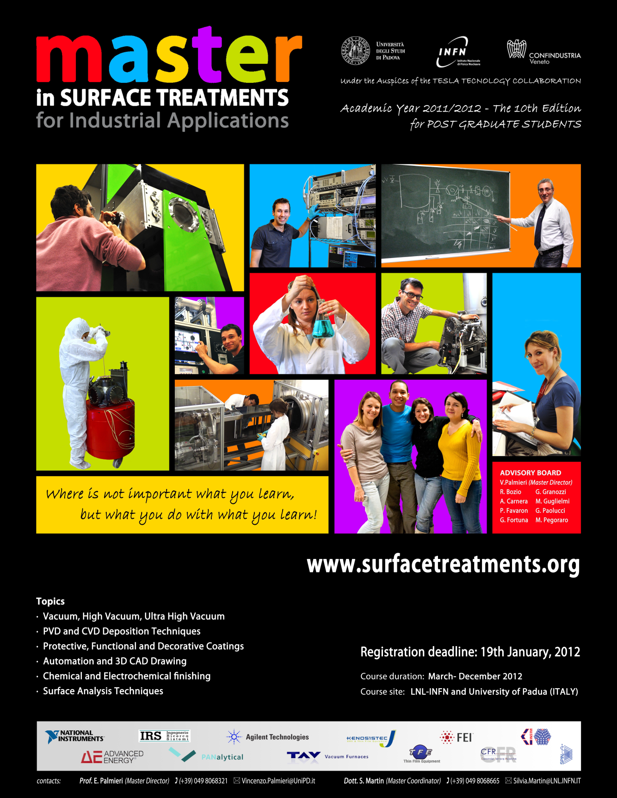
Master at Padova
The Collaboration Board agreed to continue its ‘moral’ support to the Master organized by the University of Padova, and to authorize the TTC inscription on the poster.

Slide 11
ESS-AB in TTC
Application for TTC membership was presented by W. Hees (ESS-AB)
Design very similar to SNS
except long pulse only,
no compressor ring.
2.5 GeV SCRF Linac
with a 50 MeV warm injector

Slide 12
ESS-AB in TTC
A major Europe project,
supported by the strong
SEK and DKK currencies…
Timescale fits with E-XFEL.
All TTC Partners,
Jlab and FNAL
also in the ‘loop’.

Slide 13
ESS-AB in TTC

Slide 14
ESS-AB in TTC

Slide 15
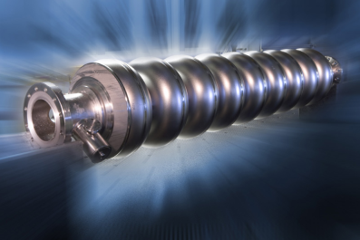
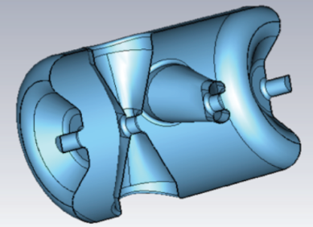
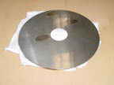
ESS-AB in TTC
W.Hees was congratuled…
and invited to make an oath over the Triangle
Performances
‘APE’
Applications
Economics
of SCRF systems

Slide 16
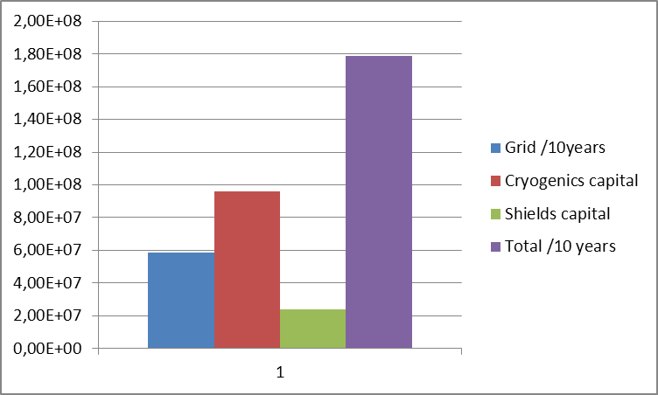
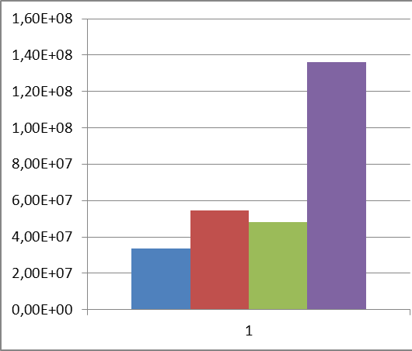
Cryonomics
If I am allowed to extrapolate the 75% increase of Q₀ shown by E. Kako with a double magnetic shielding, to ILC cavities with Eacc = 31.5 MV/m
and with the assumptions: grid power = 0,1 € /kWh@300 K
CoP(2K) = 700 W/W
magnetic shield = 1500€ / cavity
cryogenics = 1 M€/100 W@2K
P_{dyn.} = 9.6 kW@2K
P_{dyn.} = 5.5 kW@2K
€
€
Q0 = 8 10¹⁰ (RDR ?)
Q0 = 1.4 10¹⁰

Slide 17
TTC Meeting: Close-up
Next SCRF Conference in France in September 2013 (tbc), in about 21 months from now.
CB voted for one TTC meeting in between, around October 2012 ± 3 months
in North America.

Slide 18
TTC Meeting thanks...
Programme Committee:
particularly Wolf Dietrich Möller
WG1 conveners: ‘Cryomodule Test Results and Analysis’
James Kirby, Guillaume Olry, Akira Yamamoto
WG2 conveners: ‘Cavity material, fabrication, treatment and testing: new concepts and new benefits’
Claire Antoine, Camille Ginsburg, Tsuyoshi Tajima
WG3 conveners: ‘Cryogenics and cryostats’
Li Qian Liu, Tom Peterson, Paolo Pierini

Slide 19
TTC Meeting
We have been beautifully hosted by the Institute of High Energy Physics, Chinese Academy of Sciences (IHEP, CAS), the Peking University (PKU) and the Tsinghua University (THU). Many thanks to:
Prof. Gao, Jie (Chair), IHEP Prof. Liu, Kexin (vice-Chair), PKU Prof. Tang, Chuan Xiang (vice-Chair), THU
Jiyuan Zhai and, Yilin Liu, IHEP
and their staff, for the perfect organisation, and for ‘supporting’ Webex presentations.

