Slide 1
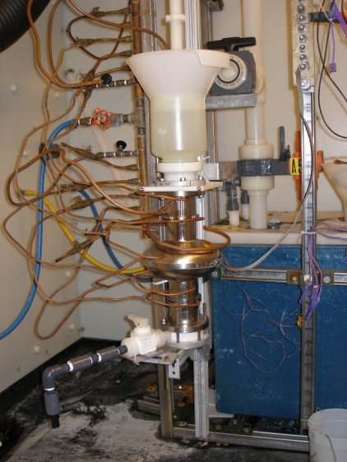
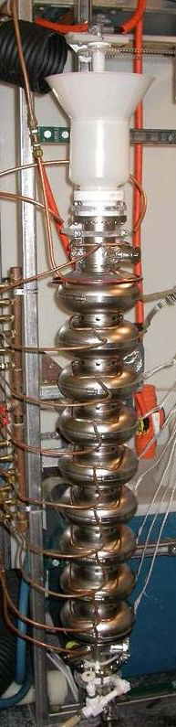
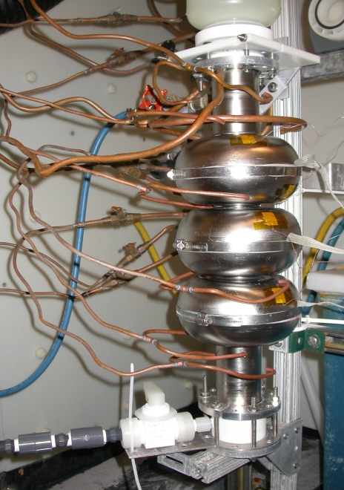
Updates of Vertical Electro Polishing at Cornell
Fumio Furuta,
Georg H. Hoffstaetter
Cornell University
Laboratory for Elementary-Particle Physics
Recent results of VEP’ed cavities.
Analysis on VEP removal.
Temperature oscillation asymmetry.

Slide 2
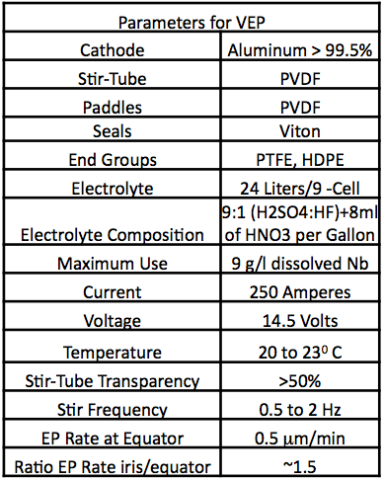
What is Vertical Electropolish?
Aluminum Electrode
Does Not Rotate
Cavity
Al Electrode
0.5 to 1 Hz
PVDF Impeller
PVDF Electrode Cover
It Rotates
H. Padamsee & A.C. Crawford, PAC07, WEPMS009

Slide 3
Why Vertical Electropolish?
Vertical Electropolishing has the Following Benefits:
  Eliminates rotary acid seals
  Eliminates sliding electrical contact
  Eliminates the cavity vertical/horizontal position control fixtures
  Simplifies the acid plumbing/containment
  The outside of the cavity is actively cooled, providing better temperature control of the polishing reaction.
  Lower capital equipment cost.

Slide 4
Recent results of single cell + VEP
Qo
*NR, AES: TESLA shape
*LR: re-entrant shape
Hpk [mT]

Slide 5
Recent results of 9-cell + VEP
Qo
Hpk [mT]

Slide 6
Achievements of VEP for ILC requirements
Qo
Eacc [MV/m]

Slide 7
Analysis on VEP removal
Preliminary
Hpk [mT]
>Single cells are NR1-3, AES1-002, AES1-006, Re-entrant(60mm).
>9-cells are A9, A10, AES5, Re-entrant(70mm).
>Cavity treatment: Bulk VEP (140~300um) + hydrogen degas + micro VEP + 110CBake.
>Some cavities tumbled to remove defects.
>*HNO₃ in electrolyte, 8ml/3.5L.
>**EP after degas was replaced by 100nm oxypolish.
Micro VEP removal [um]

Slide 8
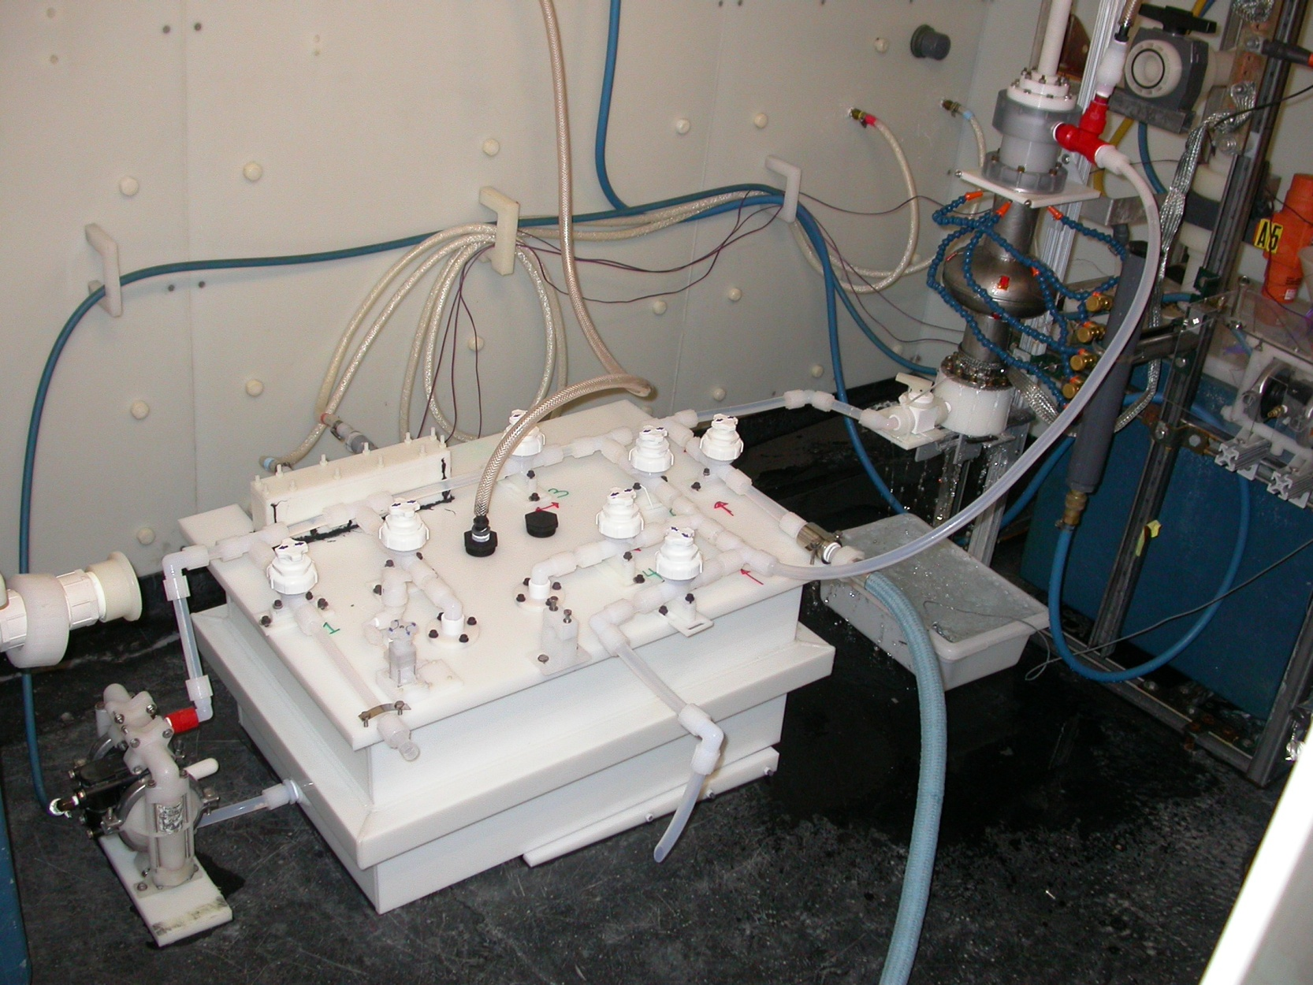
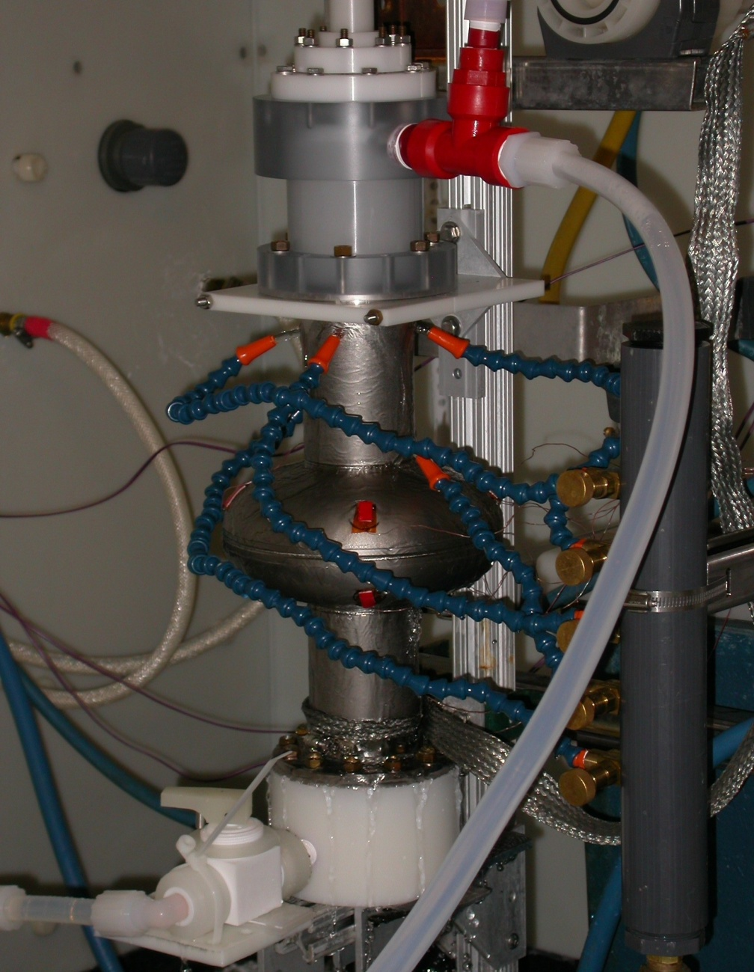
VEP system with Recirculation
VEP 2.1: Recirculation

Slide 9
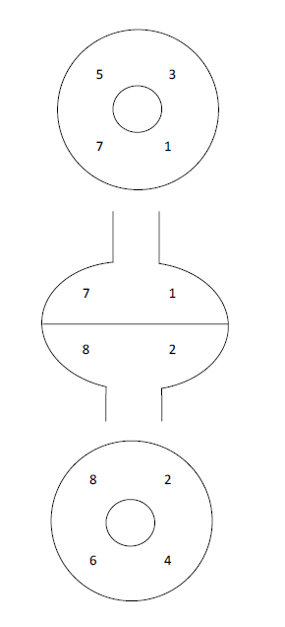
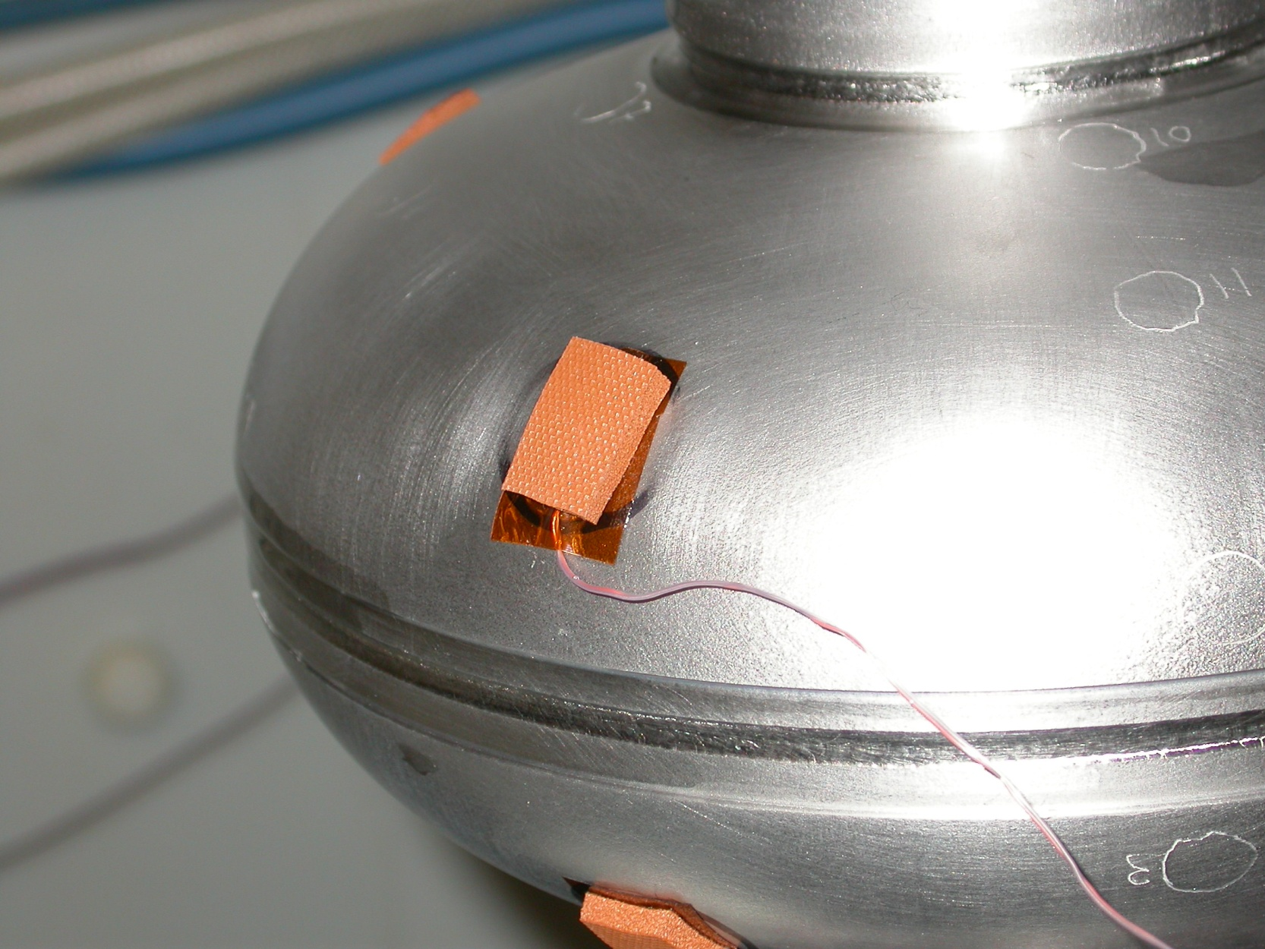
Temp. monitoring setup
Resolution of thermocouples: 0.02°C
Agitation: 0.85Hz
Acid Recirculation(1Hz)
Location of thermocouples ->
60 second window
Sample rate of
  TC: 1.5 Hz
  Current: 5 Hz
Top half cup
bottom half cup
Thermometers

Slide 10
Temperature Oscillations Asymmetry
VEP of AES2-1 w/ acid circulation
Preliminary
Top half Cup
Bottom half Cup

Slide 11
Interpretation
Frequency of top ≈ 2 * frequency of bottom
No obvious correlation between temperature & electrolyte motion
Upper cup
  T increase correlated for Type 1 & Type 2 current spike
Lower Cup
  T increase correlated with Type 2 current spike
  T decrease correlated for Type 1 current spike
Meter stick for VEP development
  Top and bottom oscillations must be identical
Further analysis on temperature/current correlation

Slide 12
Summary
Recent results.
>TESLA single cell achieved 39MV/m with Qo of 2.1e10 by VEP.
>Feasibility of VEP + oxypolish was demonstrated with TESLA 9-cell.
36MV/m was achieved so far.
>preliminary results show VEP removal dependence on gradient.
>Temperature oscillation asymmetry was found during single cell VEP.
We will check reproducibility of these processes.
These may have hint to high gradient Q-slope issue of VEP.
Ongoing R&Ds for VEP establishment.
1)Demonstration of high gradient w/ high Qo.
step1. TESLA shape(okay) -> Re-entrant shape.
step2. single cell -> 9-cell.
2) Demonstration of reproducibility and high yield.
3) Optimization of parameters.
voltage, current, temp, removal, agitation, etc.
4) Understanding of VEP process.
Temp. oscillation asymmetry, circulation, etc.

