Slide 1
SRF Pb/Nb photoinjector; recent results
Jacek Sekutowicz

Slide 2
Acknowledgments
Collaboration since 2005 P. Kneisel (JLAB), G. Ciovati (Jlab),
R. Nietubyc, R. Mirowski, J. Witkowski (NCBJ), T. Rao (BNL), J. Smedley (BNL),
C. Engling, B. van der Horst, K. Jensch, D. Klinke, D. Kostin, A. Poerschmann, A. Schmidt, X. Singer, W. Singer (DESY).
Test at HZB of 1.6-cell in HoBiCaT in 2011 and coming test in 2012
T. Kamps, W. Anders, R. Barday, D. Böhlick, A. Frahm, M. Dirsat, F. Hoffmann, A. Jankowiak, S. Klauke, J. Knobloch, O. Kugeler, P. Kuske, J. Rudolph, A. Matveenko, A. Neumann,
T. Quast, M. Schenk, M. Schuster, S. Schubert, J. Völker (HZB),
J. Teichert (FZD),
V. Volkov (BINP), I. Will (MBI)

Slide 3
Outline
Pb/Nb SRF injector
Parameters
What has been demonstrated
New cavity and its baseline test
New coating setup

Slide 4
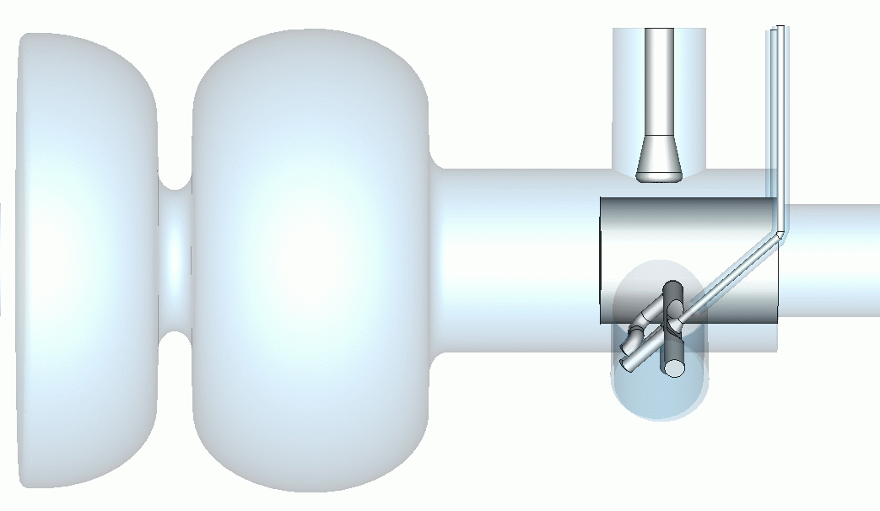
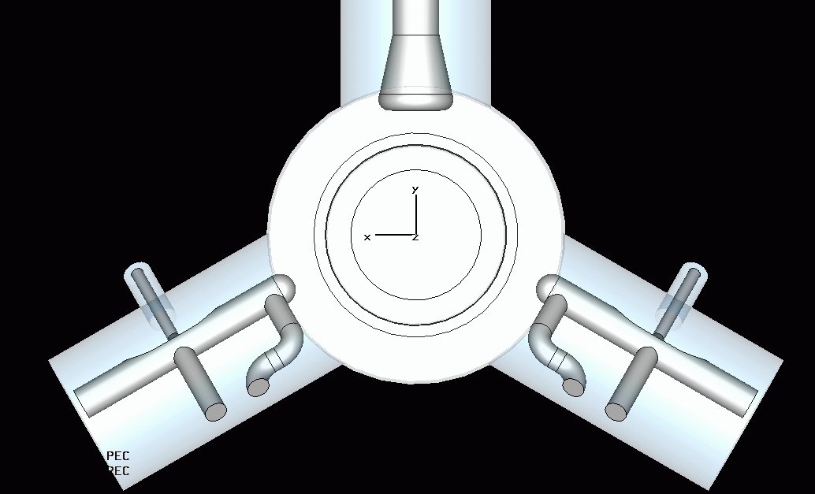
SRF Injector
Our goal is ~ 1 mA – class injector delivering high quality bunches (1 nC @ 1µrad) for the lp and cw operation of the XFEL facility.
It is all superconducting gun with superconducting Pb cathode.
Input Coupler
Emitting
Pb spot
Laser Light
Electron beam
HOM couplers
Parameter | Unit | Value
Spot radius | [mm] | 1.5
Nominal E_{cath} at cathode | [MV/m] | ~50
QE at 213 nm | - | 1.4 E -3
QE at 260 nm | - | 3.5 E-4

Slide 5
Parameters
Nominal Energy / Eacc | GeV / MV/m | 17.5 / 23.5 | 7 / 7.5
Beam pulse length lp and cw | ms | 100 | cw
Repetition rate | Hz | 1 | -
# bunches/s |  | 25000 | 250 000
Bunch spacing (an example) | ns | 4000 | 4000
Bunch charge | nC | 1 | 0.25
Beam current (an example) | mA | 0.25 | 0.062
Laser pulse energy / power for 213 nm | µJ / W | 4 / 0.1 | 1 / 0.25
Laser pulse energy / power for 260 nm | µJ / W | 14 / 0.35 | 3.5 / 0.88

Slide 6
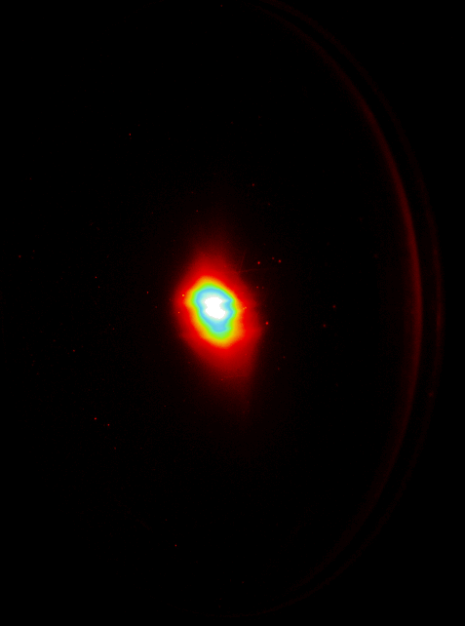
What has been demonstrated
Many parameters have been demonstrated or reached values were close to the spec, but not yet all together in the cryogenic test of a 1.6-cell cavity.
Parameter | Unit | Spec | Maximum Measured | Comment
E_{peak} without Pb | MV/m | - | 61 | 1.6-cell, DESY#1, August 2008
E_{peak} with Pb | MV/m | 50+ | 45 | 1.6-cell, DESY#1, December 2008
QE at 213 nm | 10⁻³ | 1.4 | 2.7 | Pb samples deposited with 10 cm long arc
QE at 260 nm | 10⁻⁴ | 3.5 | 4.8 | Pb samples deposited with 10 cm long arc
Test results of the BESSY 1.6-cell cavity in HoBiCaT in 2011
The first beam April 21st, 2011
Cathode QE_{max} | 1*10⁻⁴ @258 nm (non uniform)
Electric peak field | 20 MV/m
Electron energy | 1.8 MeV
Bunch charge | 6 pC
Normalized emittance | 2 mm mrad

Slide 7
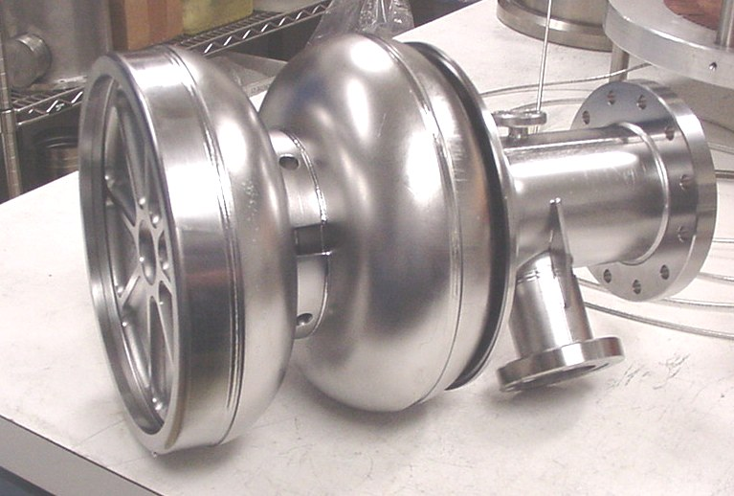
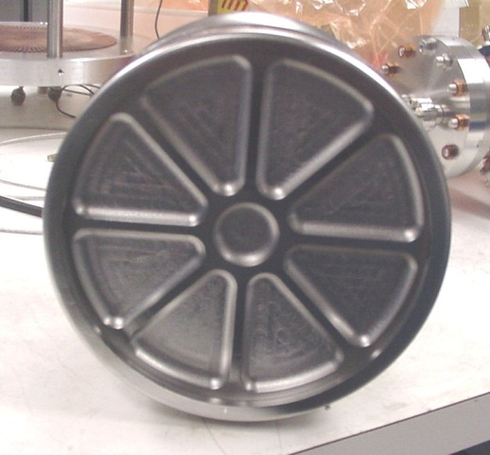
New cavity and baseline test
The 2nd cavity was constructed (D. Klinke) and built (P. Kneisel), to test the new coating setup and to learn more about the tuning and LLRF during operation.
Very stiff end-plate made of large grain Nb disc.

Slide 8
New cavity and baseline test
Baseline tests (P. Kneisel and G. Ciovati)
Cavity was BCP treated, heat treated at 600 C, HPR, but not baked at 120°C

Slide 9
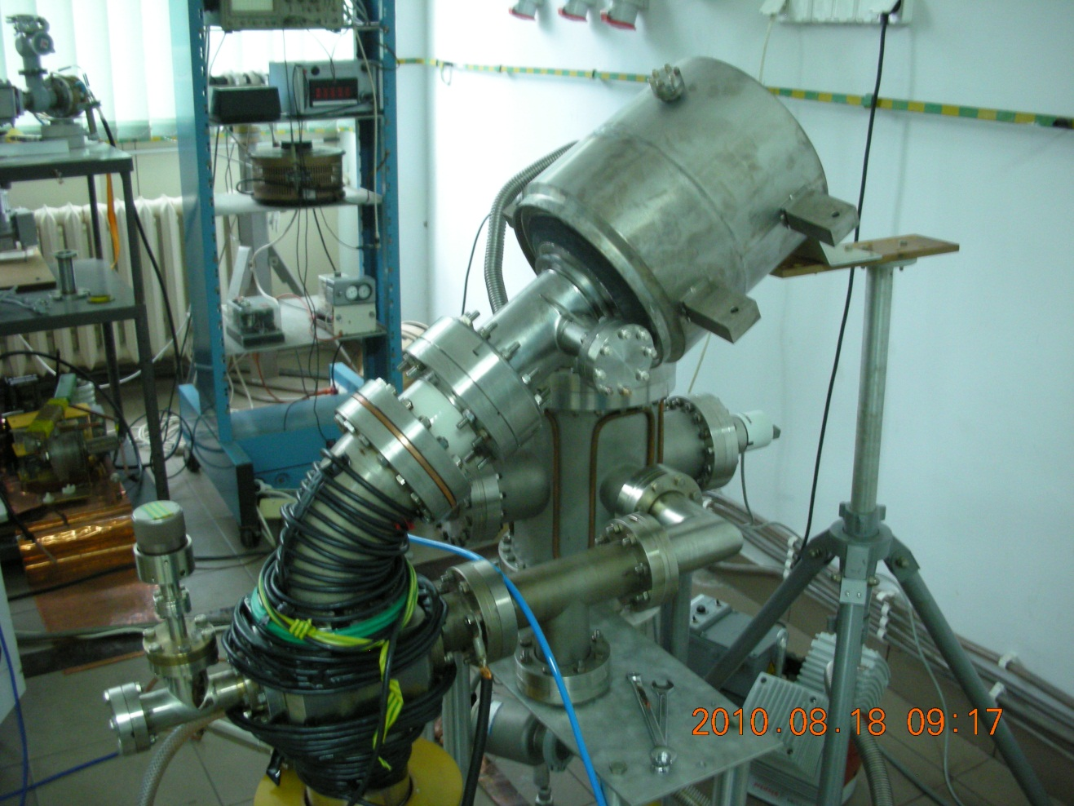
New coating setup
Old setup with long distance between the source of Pb ions and the end-plate.
1.6-cell cavity in helium vessel
Source of Pb ions
Lead deposition setup at NCNR in Swierk / Poland

Slide 10
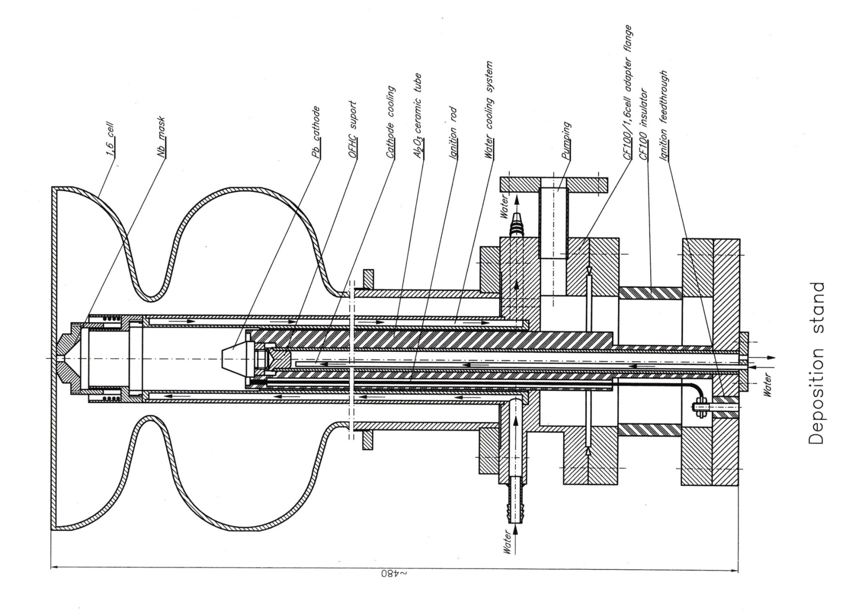
New coating setup
New coating setup is placed inside the cavity, very close to the end-plate. The distance is as short as for the best performing samples.
1.6-cell cavity
Source of Pb ions

Slide 11
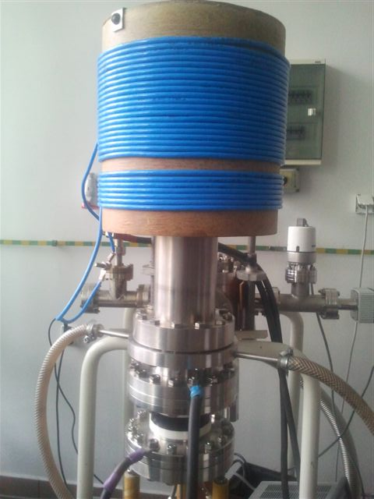
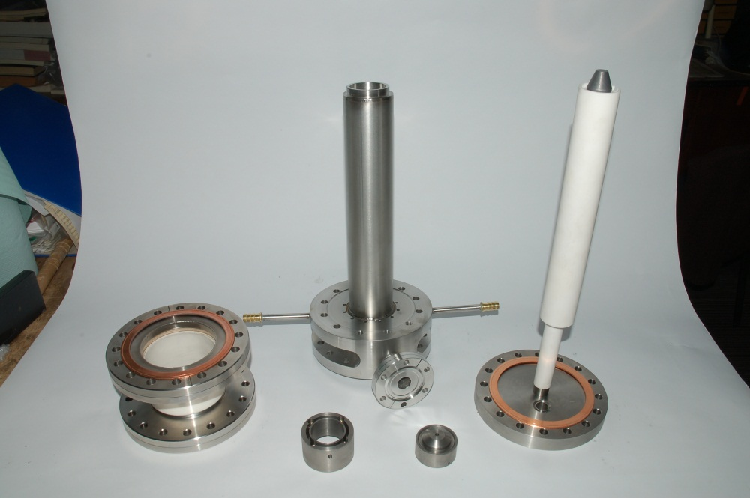
New coating setup
Elements of the new setup and the setup assembled for commissioning.

Slide 12
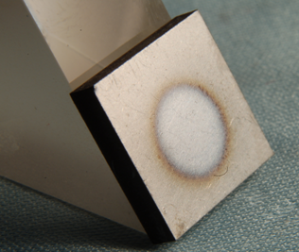
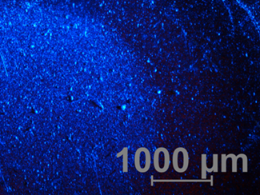
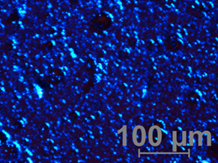
New coating setup
Commissioning of the setup began on November 28th.
Example of the coating;
Arc parameters : U_{cathode} = 14.9 V, I_{arc} = 5 A, coating time t = 30 s
The first observation:
a. Process is fast-> current and voltage should be lower to avoid droplets.
Heating of the mask is too strong -> pulsed deposition 3 x 10s with several minutes break.
We will implement a disk-like filter to reduce the amount of droplets.
Optimization of the coating parameters will take next 2 weeks. Coating of the new cavity in December.

