Slide 1
Centrifugal Barrel Polishing at Fermilab
(Tuesday, December 6th at 10:20)
Tesla Technology Collaboration
IHEP, Beijing
December 5th-8th, 2011

Slide 2
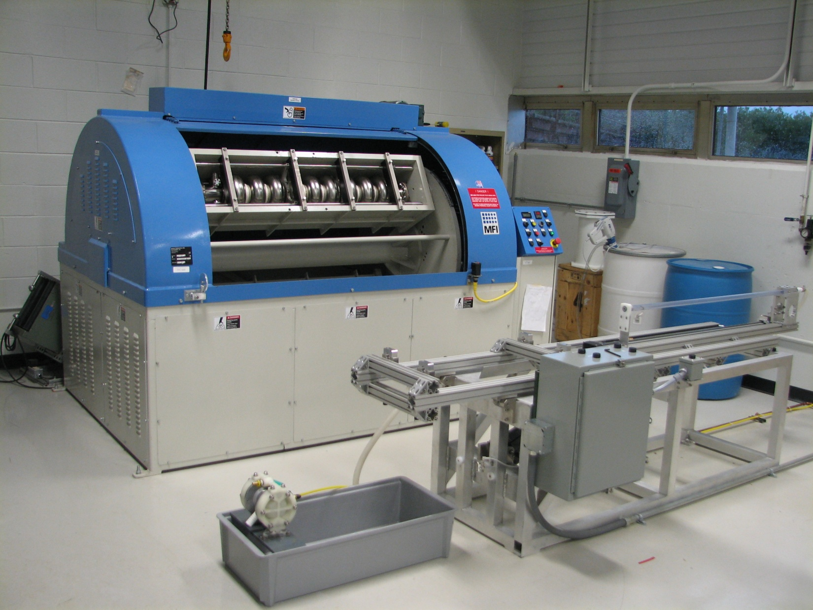
What is Centrifugal Barrel Polishing?
Centrifugal Barrel Polishing(CBP) is an alternative processing technique that polishes the inside of superconducting rf cavities by rotating the cavities at high speeds while filled with an abrasive media.
Individual Barrels rotate 115 RPM in opposite direction to main shaft
Main Shaft up to 115 RPM

Slide 3
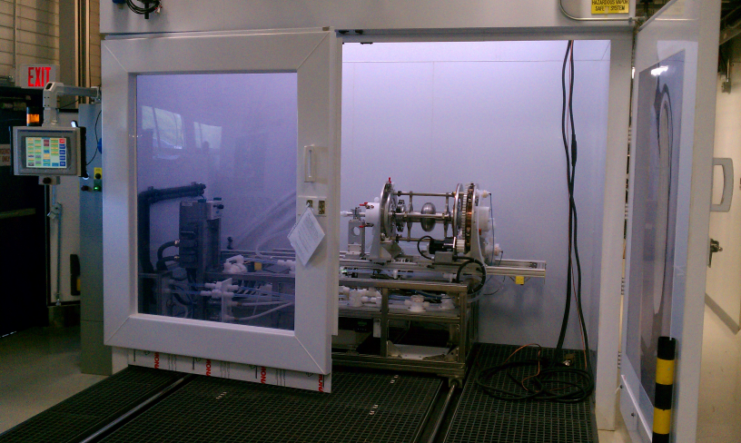
Alternative to what? - Electropolishing
Centrifugal Barrel Polishing
  Cheaper Installed Cost
  No toxic chemicals
  Removes damage from manufacturing process
  Gives order of magnitude better surface finish
  May improve quality factor, accelerating gradient, and yield
  Easier to industrialize

Slide 4
How Cavities Would be Processed with CBP
Baseline Cavity Process Path
Proposed CBP Process Path
Proposed “Hydrogen Free” CBP Process Path
120-150 Micron Electropolishing
High Temperature Bake
Light Material Removal
(Alcohol Rinse)
High Pressure Rinse
Assembly
(Low Temperature Bake)
RF Test
Water Rinse
120-150 CBP
High Temperature Bake
Light Material Removal
High Pressure Rinse
Assembly
(Low Temperature Bake)
RF Test
Chemical Rinse
120-150 CBP
High Pressure Rinse
Assembly
(Low Temperature Bake)
RF Test
Chemical Rinse
800 C for 2 hours – Hydrogen Contamination
20 Micron EP
For Sulfur Precipitate Removal
1200 psi, Ultrapure Water
Class 10 Clean-room
48 Hour, 120 C

Slide 5
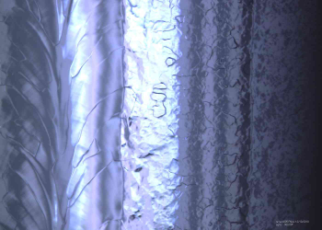
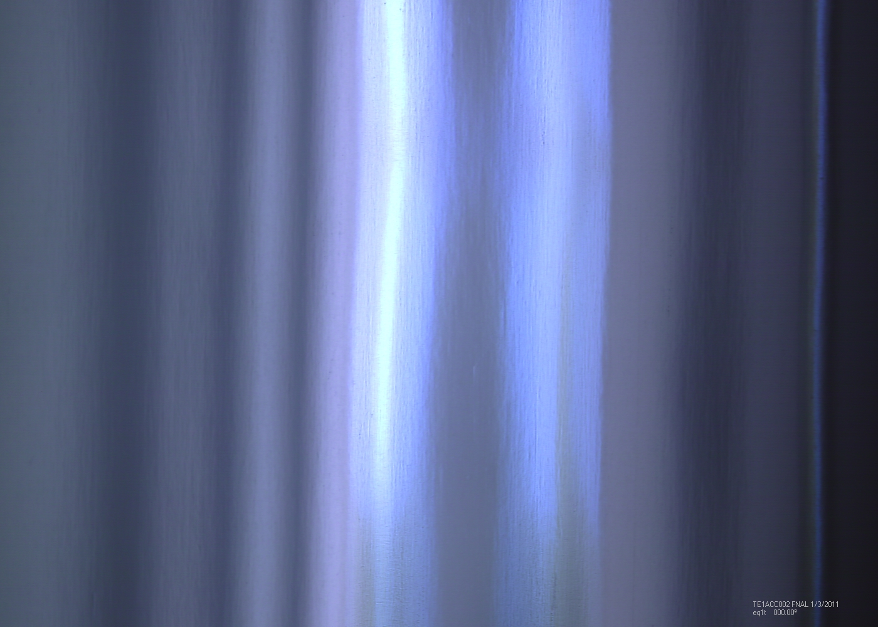
Summary of Results on CBP(Not all presented)
Produces homogeneous finish removing defects associated with electron beam welding process.
Mirror-like finish (15 nm R_{AVG} compared to 100nm R_{AVG} achievable by baseline technique).
Improvement of Accelerating Gradient and Quality Factor over baseline technique(EP) on “good” cavities
Repair of cavities with a spot defect.
Repair of cavities with gross defects.
Repair of cavities with inclusions.
  Implies higher yields possible with CBP as a baseline technique.
Not repairable with baseline processing
Weld bead of electropolished cavity(left) and CBP cavity (right)

Slide 6
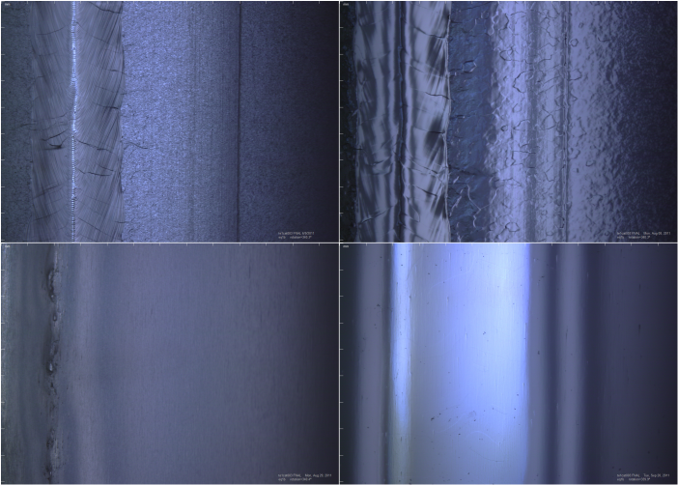
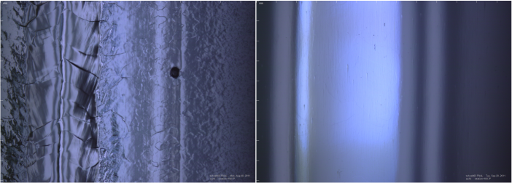
Mirror Finish from CBP on Single Cell Cavity CAT003
- which had extremely Marginal Weld Bead
As Received
After Baseline Process
After Standard CBP
Inclusion not removed by EP, completely removed by CBP
After Heavy CBP
Shows even extremely marginal surfaces can be recovered……Means Higher Yields!
Images at same location of same cavity after different processing steps.

Slide 7
Single Cell Cavities CAT003 & CAT004 Improvement after CBP
Quality Factor
-CAT003 Baseline processing with EP – 2K
-CAT004 Extensive CBP – 2K
Accelerating Gradient MV/m
CAT003 – Baseline EP, 200+ microns CBP, 15 micron EP, 3 hr 800 C bake, 15 micronEP, HPR, 120 C bake
CAT004 - 200+ microns CBP, 15 micron EP, 3 hr 800 C bake, 15 micronEP, HPR, 120 C bake

Slide 8
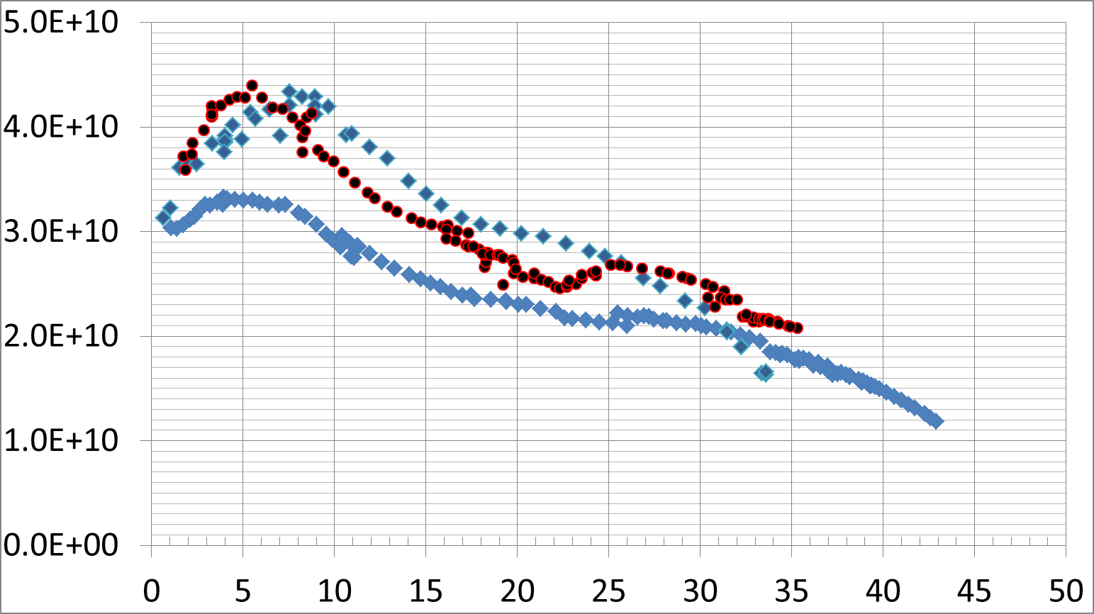
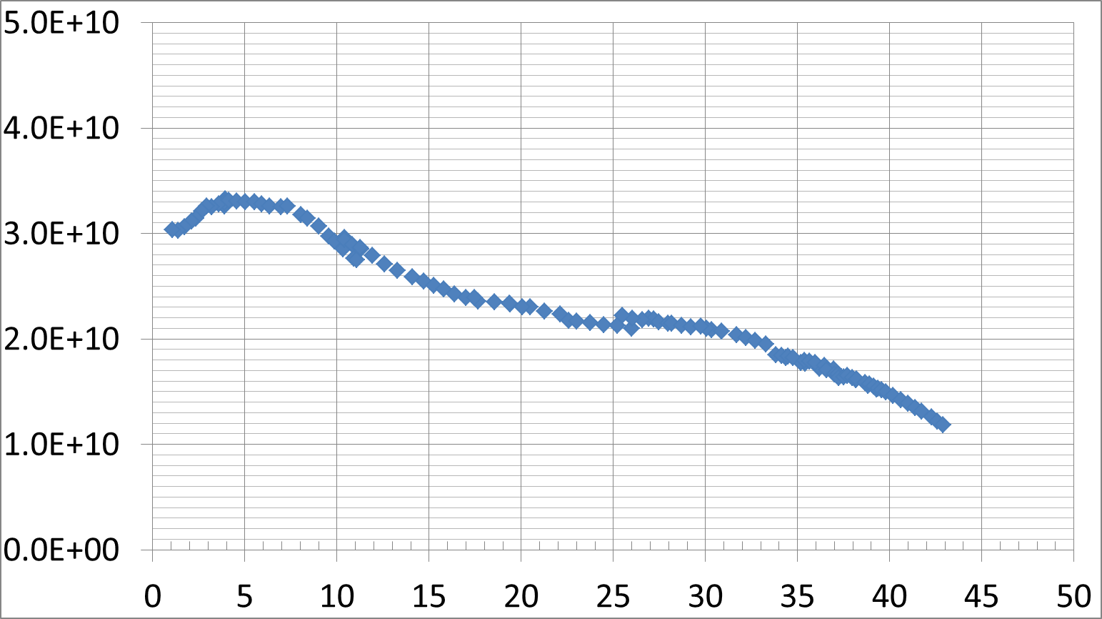
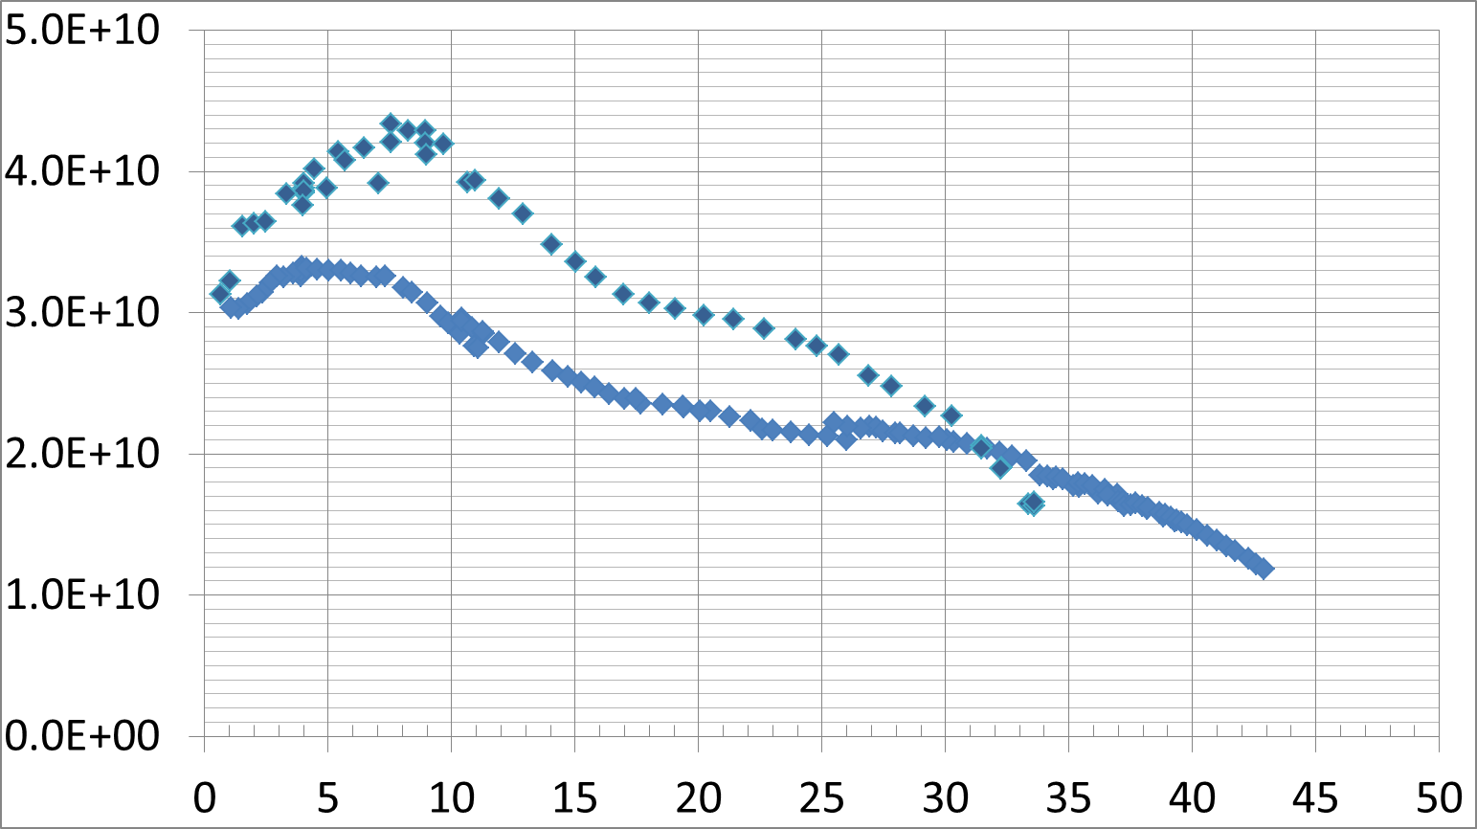
Seeing higher quality factors with CBP.
TE1ACC002 – CBP/20 micron EP/HF Rinse
TE1RCAT003 – CBP/30 micron EP
Project X
Quality Factor
TE1ACC002 – CBP/20 micron EP
ILC
Accelerating Gradient MV/m
All test results @2k!
Surface is smoother and more homogeneous.
Final surface chemistry from EP.
Do subsurface dislocations have some impact?
Hydrogen depth profile changed?

Slide 9
800C RGA Data for Hydrogen
Pressure, torr
Time, min
Blue Trends - Tumbled, 3hour 800 C Hold
Orange Trends - Electropolished, 2hour 800 C Hold

Slide 10
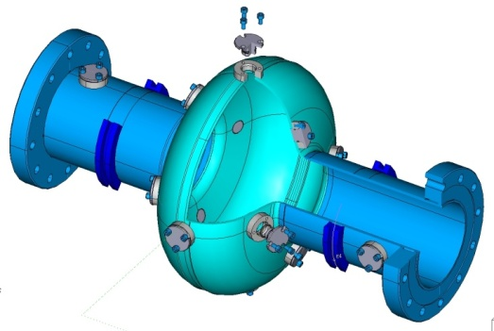
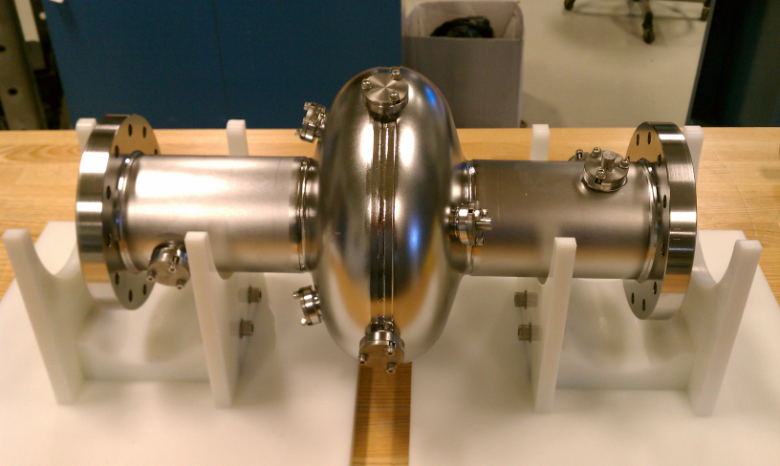
Niobium Coupon Cavity
Can do CBP, EP, and HPR
Coupons removable for morphological and chemical analysis
SEM, EDS, EBSD, Surface Profilometer, Laser Confocal Microscope at Fermi
SIMS, TEM as needed through collaborative work

Slide 11
Future Work
Coupon Cavity
  Examine chemical and structural effects of each processing step
  Fine tune CBP for time, cavity performance, & cost
9 Cell Repair
  AC114 – 9 Cell Large Grain from DESY
  AES011-016
  NR001/2
Set a baseline CBP process and tumble 5 virgin 9-cell fine grain 1.3 GHz cavities.
Thin Film Support (Single Cell 1.3 GHz Tesla)
  Supply niobium single cell
  Develop CBP for copper and aluminum
650 MHz Tumbling

Slide 12
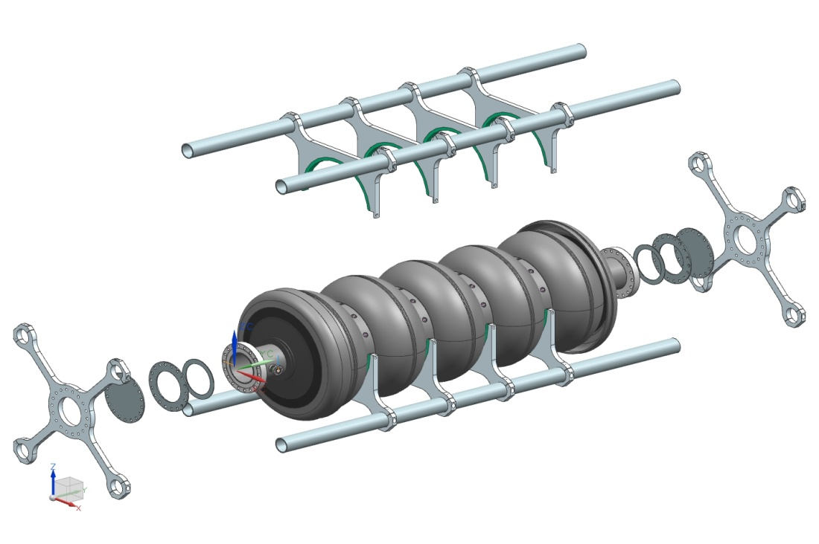
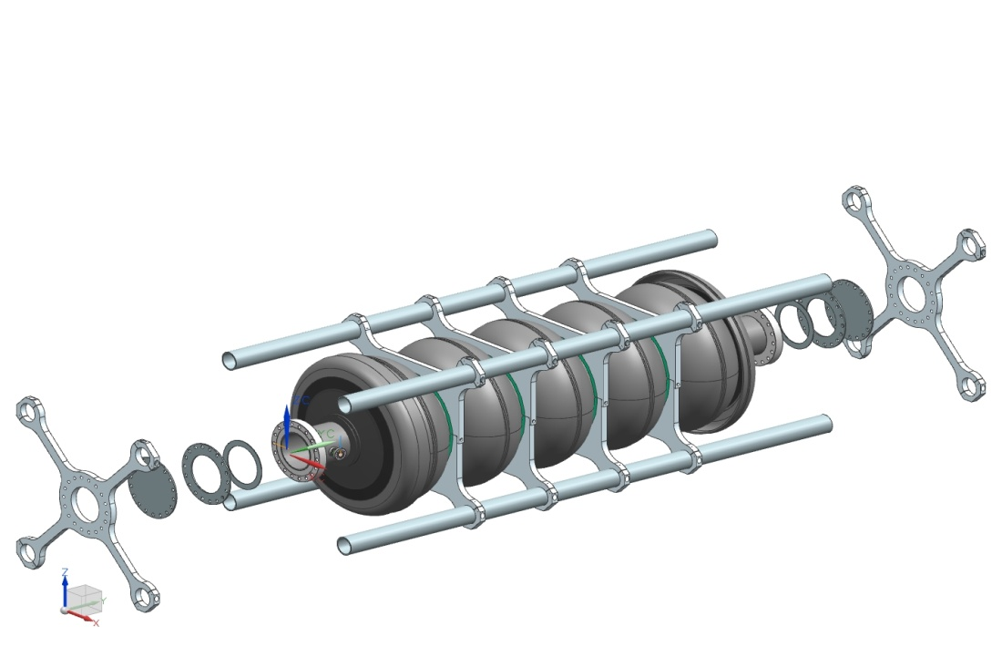
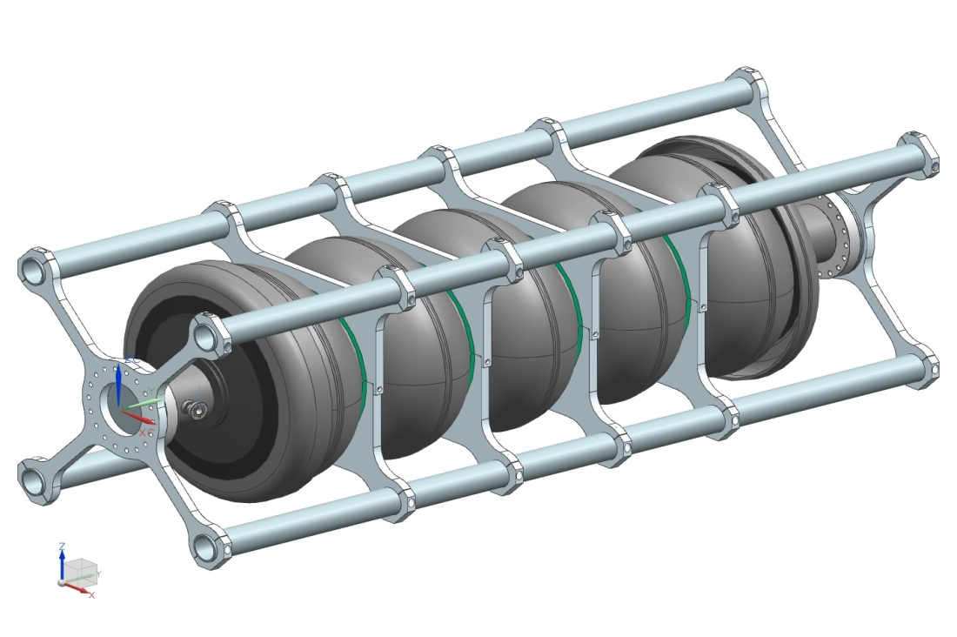
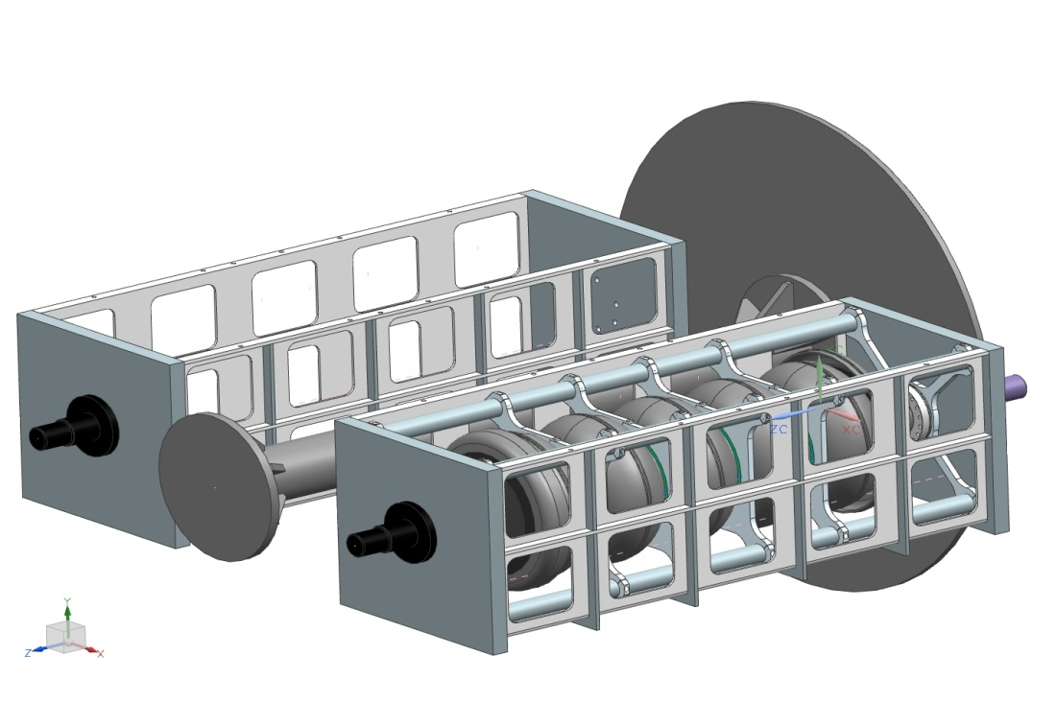
Proposed 650 Barrel and Frame
Should work on Beta = 0.6 and 0.9

Slide 13
Questions?

Slide 14
Issue
A series of six AES cavities (AES011 – AES016) were manufactured that have pitting.
The pitting is throughout the entire cell and not just near the equatorial weld(seen on AES013).
The pitting was made more visible after EP. This could be because EP made the pitting worse, made it more visible, or exposed more pits (Also AES013).
After 1000 C bake more pitting appeared from EP.
AES013 went through baseline processing and reached 17 MV/m.
The pitting was seen to be worse on some half cells. The thought was that it may be a material issue.
TB9AES012 was tumbled and the pitting was removed. After 30 microns EP the pitting returned. Tested to 35 MV/m.
TB9AES012 also seems to have a small weld porosity issue.

Slide 15
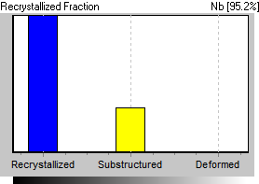
Recrystallized fraction
Batch 1
Batch 2
Batch 3
Before bulk EP
After bulk EP

Slide 16
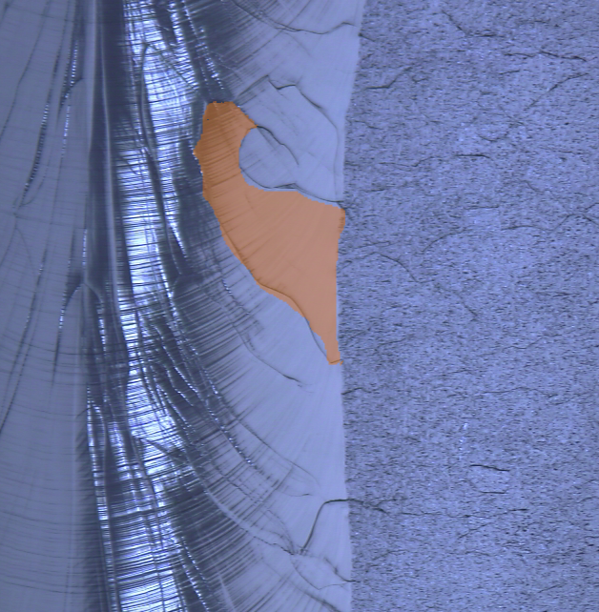
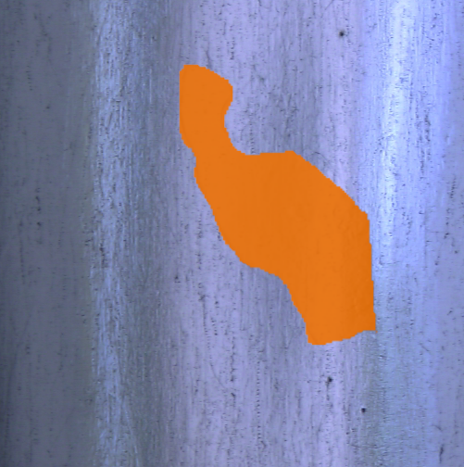
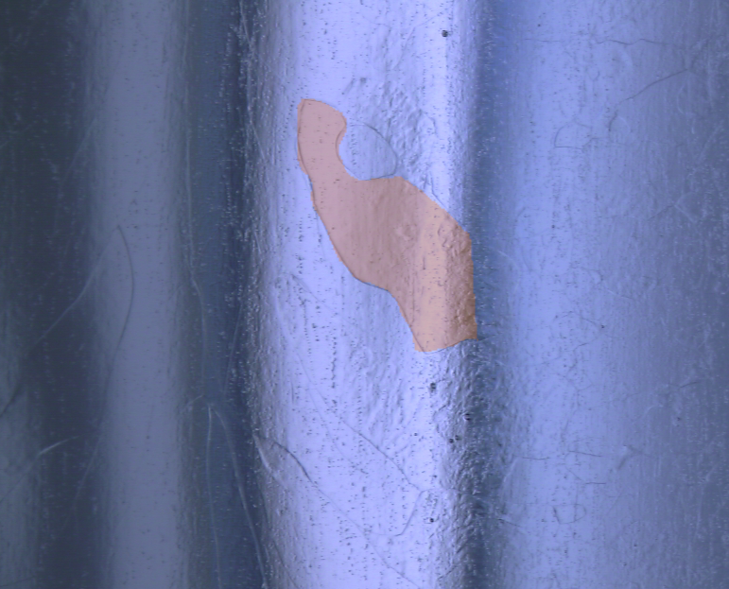
TB9AES012 – Cell 1B Equator
Pits Uncovered
This picture is taken of the cavity after barrel polishing (120-150 microns).
This picture is taken of the cavity after barrel polishing and 30 microns EP.
Defect remains after light EP
This picture is taken of the cavity as received.
These defects are not barrel polishing related. They are uncovered voids.
A single grain has been artificially colored orange to more easily identify the location.
More pits appear and general appearance of area is odd(rough). Different chemical composition here?

Slide 17
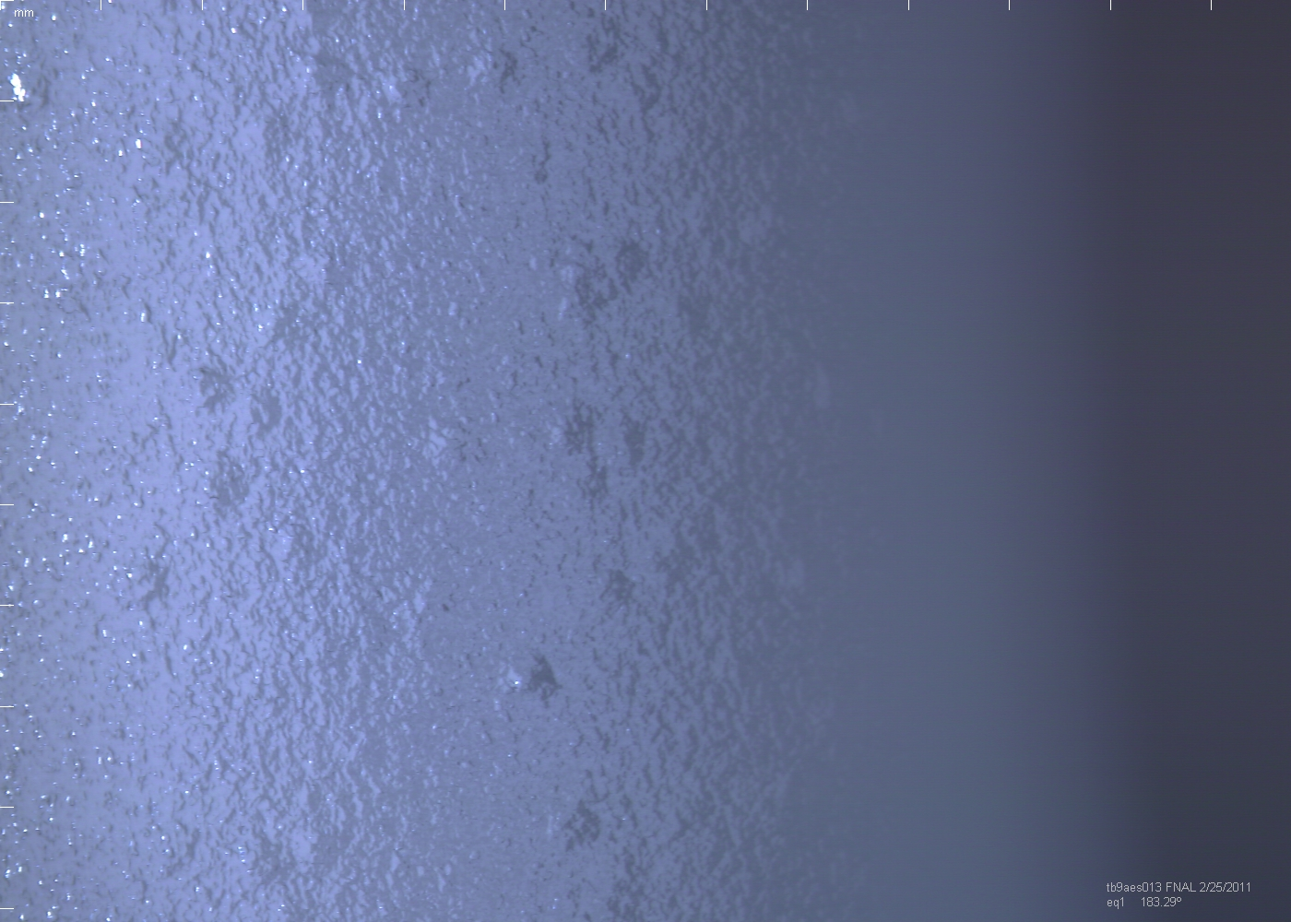
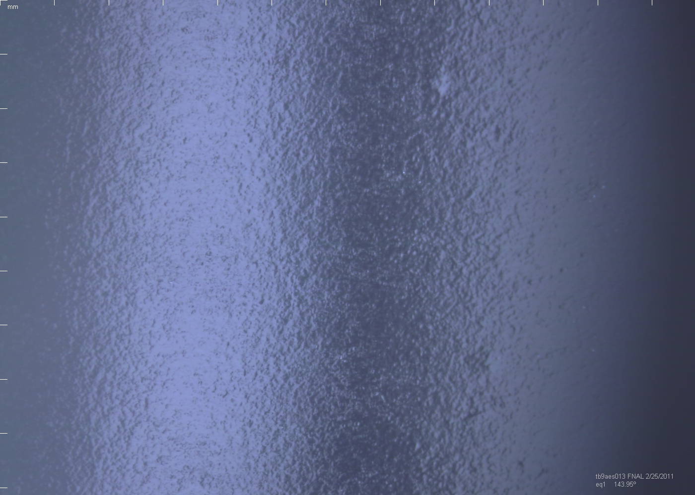
Pictures Away from the weld of TB9AES013
(All previous pictures taken around weld bead and equator of TB9AES012)
1B
1T

Slide 18
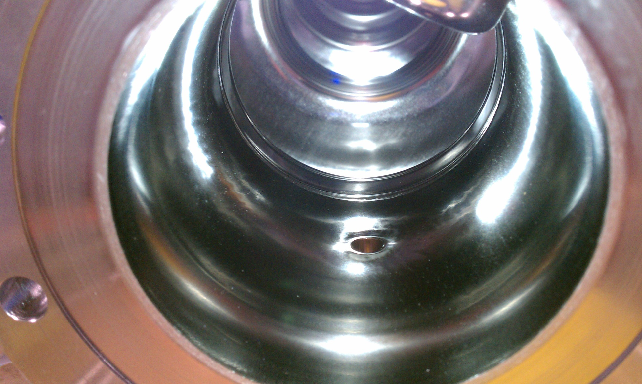
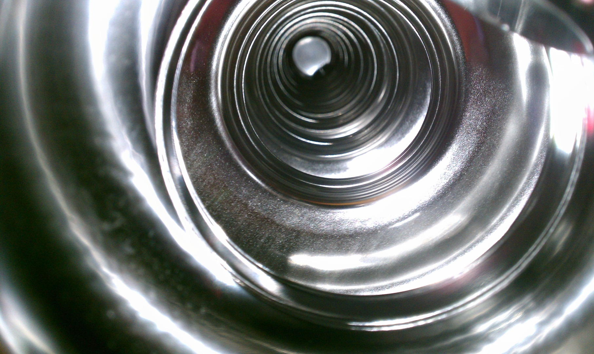
TB9AES012 After Tumbling & 30 Micron EP General Small Pitting Everywhere

