Slide 1
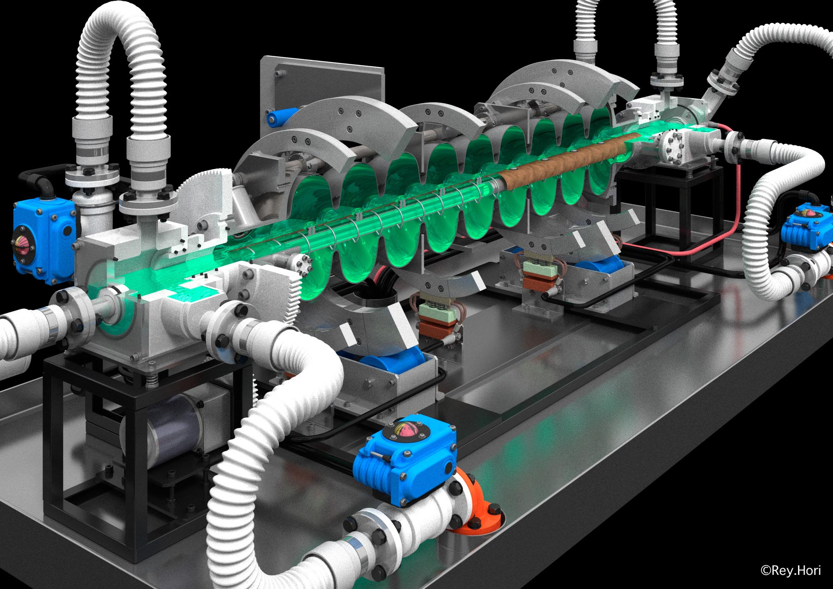
Surface Treatment Studies in KEK
TTC meeting@Beijing 12052011
S. Kato, M. Nishiwaki, T. Noguchi, T. Saeki, M. Sawabe, H. Monjushiro,
M. Sato, K. Ueno, H. Hayano
KEK, Tsukuba, Ibaraki, Japan
P.V. Tyagi, V. Chouhan
GAUS, Tsukuba, Ibaraki, Japan

Slide 2
Studies on Nb surface contaminations in EP process
(1) Surface contaminations on Lab-EP sample coupon.
(2) Surface contaminations on sample coupon in single cell cavity.
(3) Field Emitter Scanning microscope (FES) development.
(4) Formation of Sulfur in EP solutions
(5) Capturing of Sulfur in Cavity EP process

Slide 3
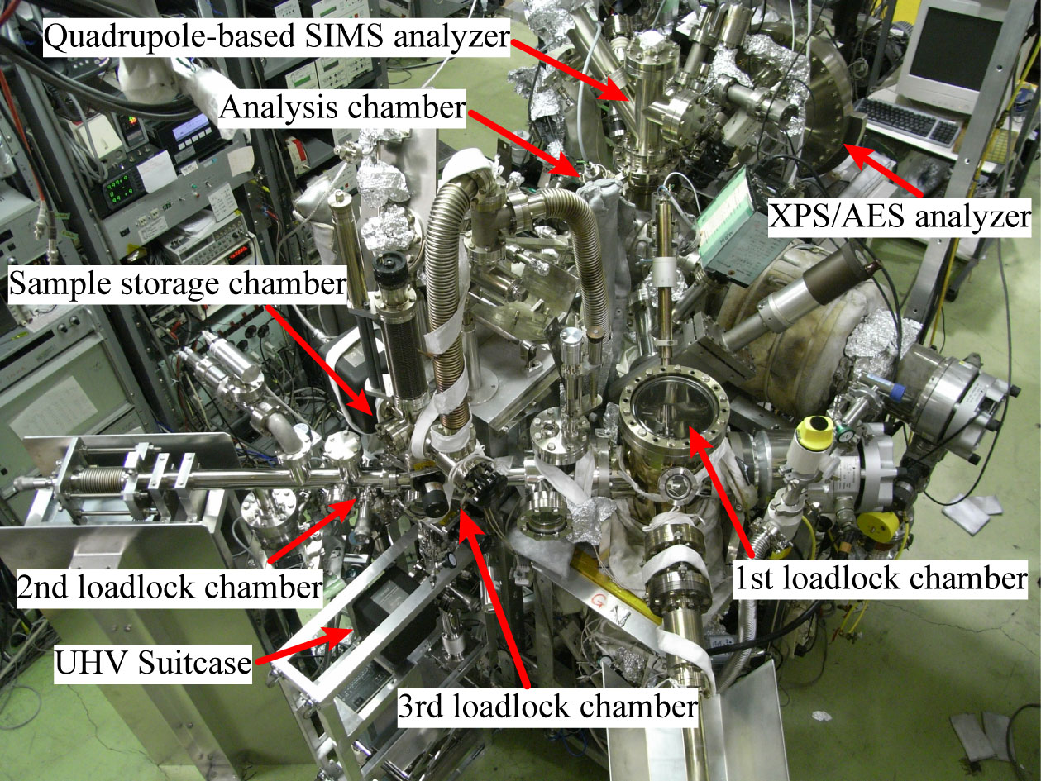
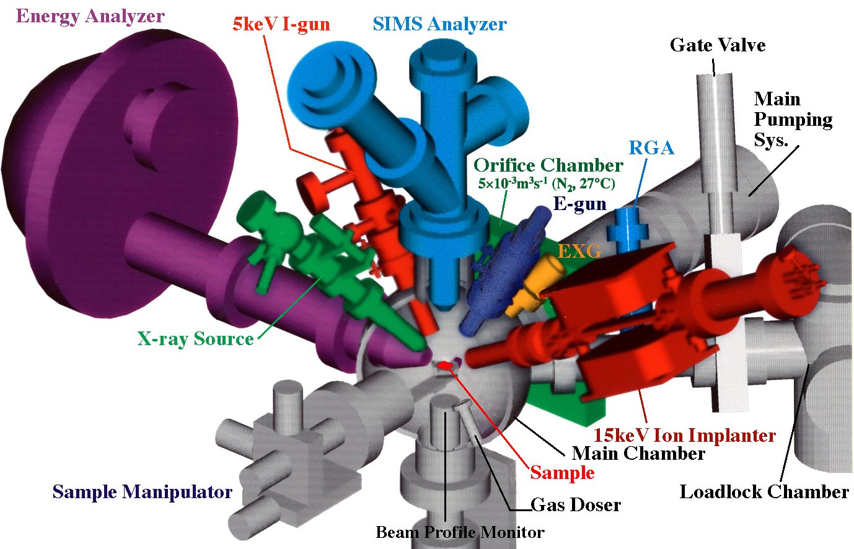
Surface Analysis System
Analysis chamber consists: electron energy analyzer, ion mass spectrometer, x-ray source, electron gun, ion gun, extractor gauge, residual gas analyzer.
(XPS, SIMS)
Base pressures; analysis chamber: 10⁻⁹ Pa, LL1: 10⁻⁷ Pa, LL2: 10⁻⁸ Pa,
LL3: 10⁻⁷ Pa, sample storage chamber: 10⁻⁸ Pa.
P.V. Tyagi

Slide 4
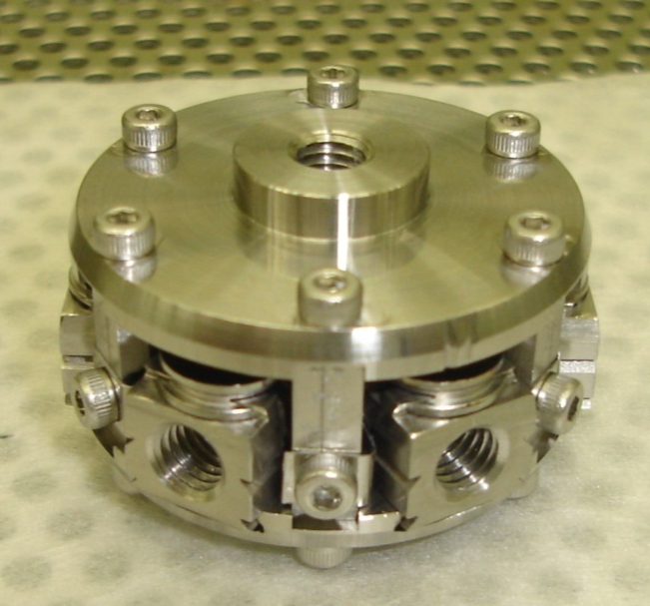
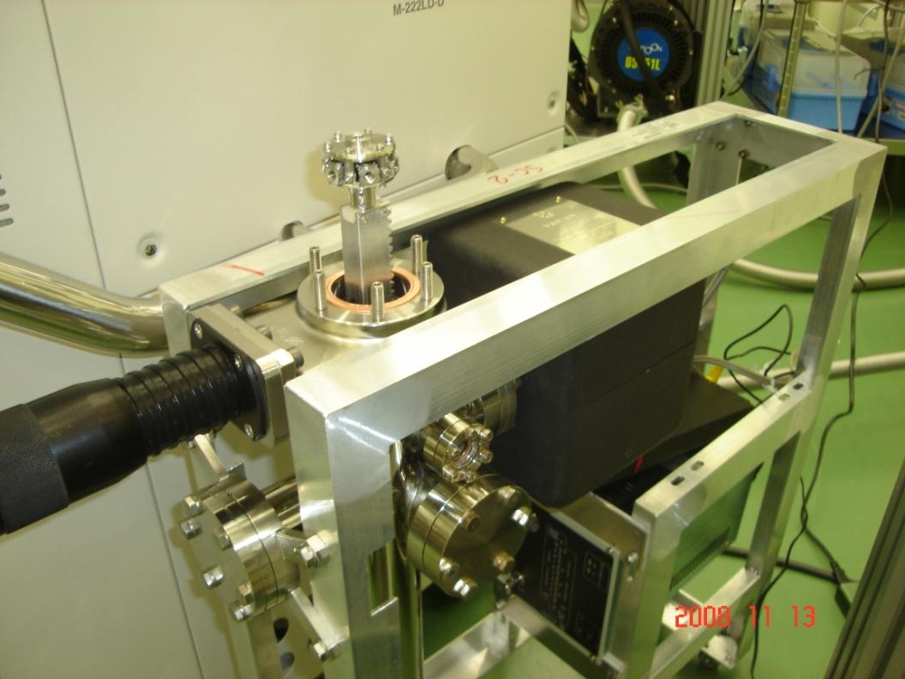
Samples Transportation with clean condition
Multi Sample holder Carousel
Vacuum Suitcase With Carousel
Transferring samples to multi holder carousel, then put into vacuum suitcase.
Vacuum suitcase consists: one battery operated ion pump and one linear motion drive.
The base pressure in suitcase: 10⁻⁷ Pa.
Sample carousel is transferred to XPS chamber by load-lock system.
P.V. Tyagi

Slide 5
Laboratory EP Experiments
P.V. Tyagi

Slide 6
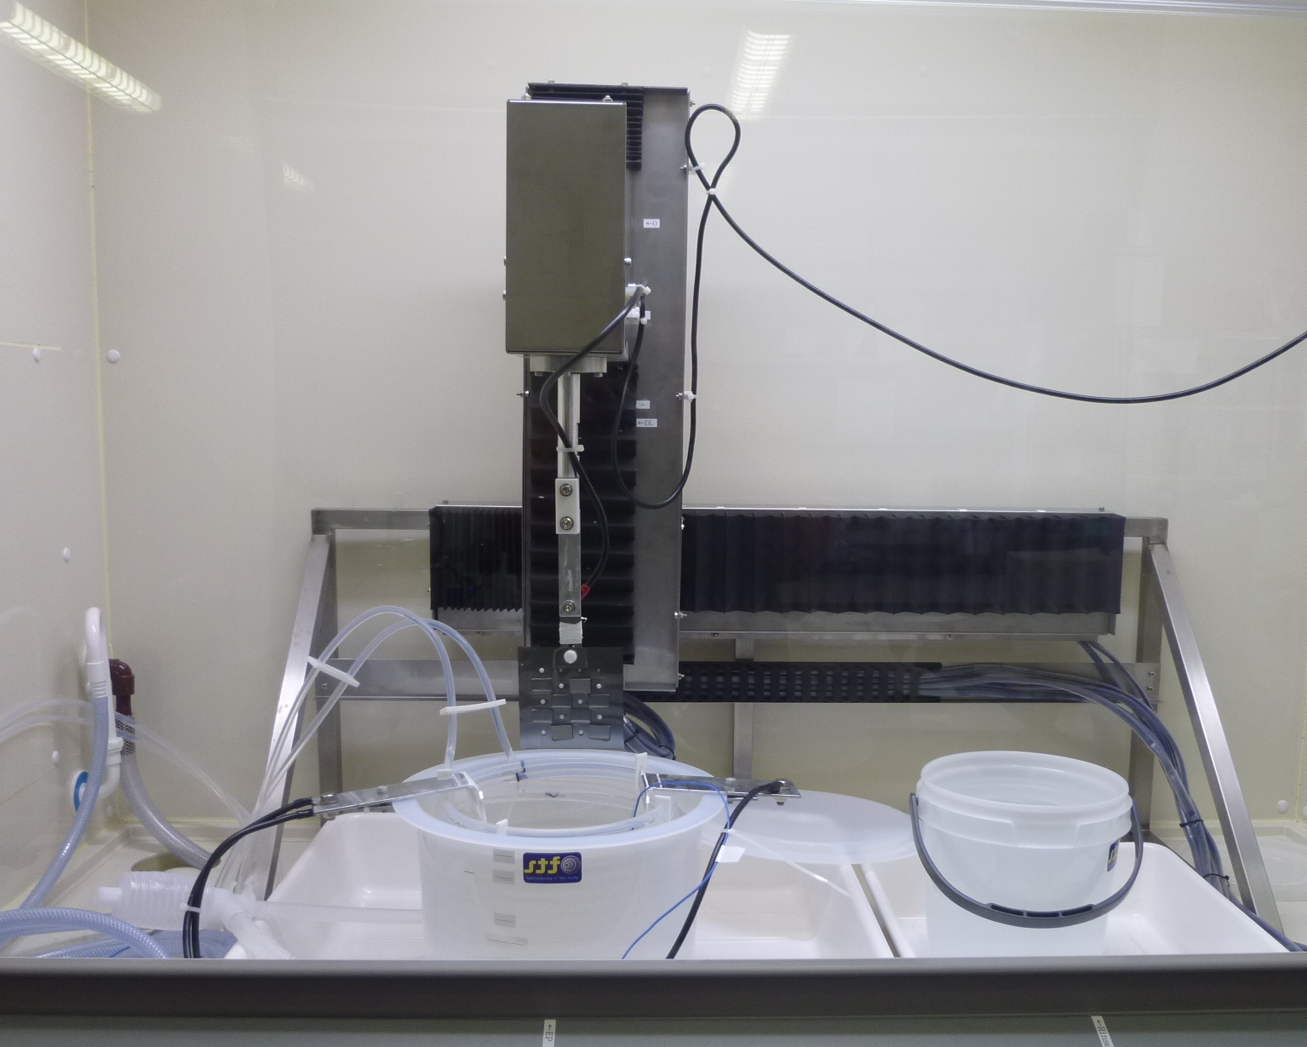
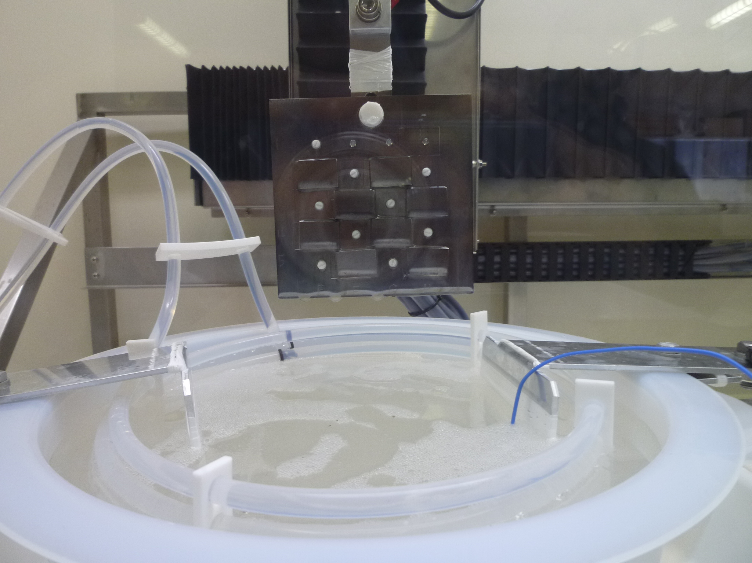
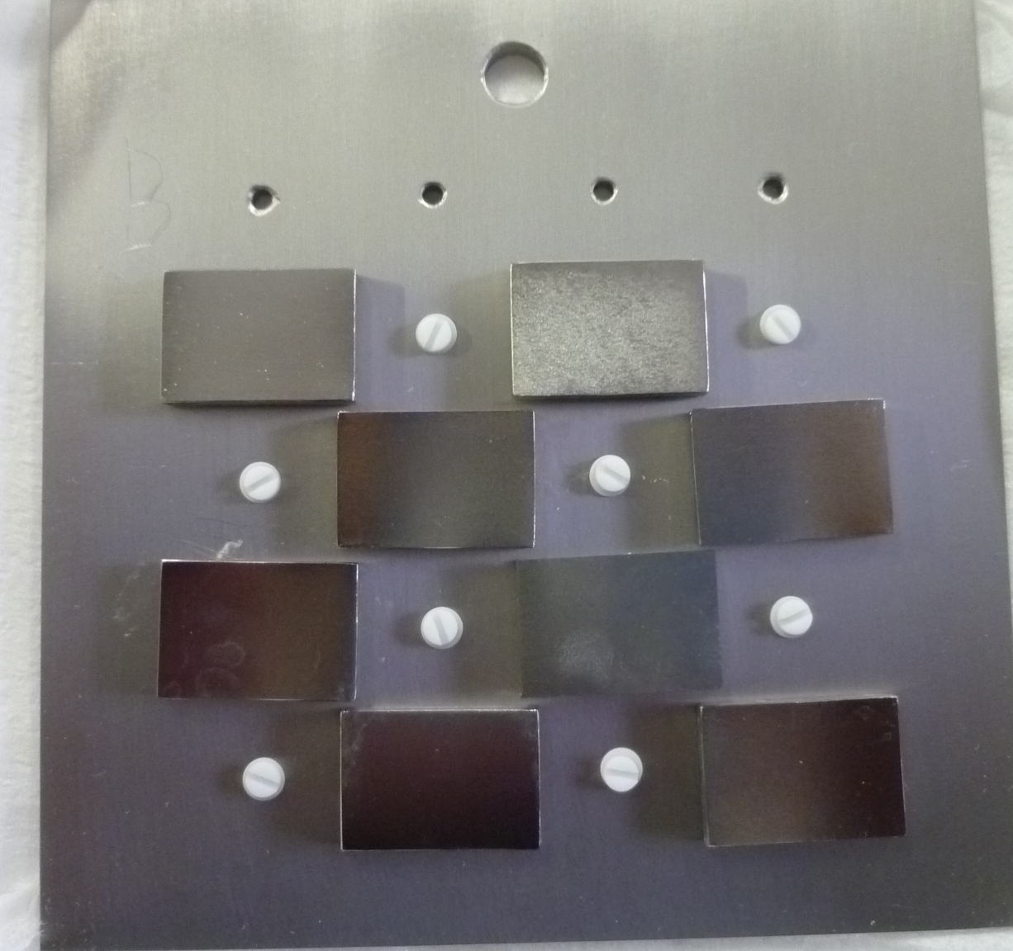
Laboratory Electropolishing System
Laboratory Electropolishing
Closer View of Nb Plate in Laboratory Electropolishing
Nb Base Plate (100x100x2.8 mm³)
Attached With
Nb Rectangular Sample (20x14x2.8 mm³)
Assembled Nb plate was electropolished at Lab-EP facility.
Lab-EP experiments were conducted with different current density.
The plate was twisted up to 180⁰ during the EP in order to agitate the process.
The twisting speed was 5-6 rpm.
P.V. Tyagi

Slide 7
Parameters of Laboratory EP experiments
Experiments | Purpose | Average Current Density (mA/cm²) | EP Acid Temperature (⁰C) | Nb Conc. in EP acid (g/l) | Removal Depth (μm)
Lab EP 1 | To see the effect of low current density with aged EP acid on EP performance at laboratory lavel | 33 | 27 | 7.3 | 20
Lab EP 2 | To see the effect of high current density with aged EP acid on EP performance at laboratory level | 50 | 30 | 7.6 | 20
Elements | Lab EP 1 Experiment with Low Current Density (atomic %) | Lab EP 2 Experiment with High Current Density (atomic %)
Nb | 16.5 | 5.1
C | 29.7 | 25
O | 53.7 | 60
F | <0.1 | <0.1
S | 0.3 | 10.3
XPS Analysis
Results
P.V. Tyagi

Slide 8
XPS analysis on Lab EP 1 (With Low Current Density)
and Lab EP 2 (With High Current Density)
Comparison of XPS Spectra of the Samples Treated in LabEP 1 and LabEP 2 Experiments
O
S
F
Intensity [CPS]
Intensity [CPS]
Intensity [CPS]
Binding Energy [eV]
Binding Energy [eV]
Binding Energy [eV]
A Peak shift in sulfur as well as oxygen spectrum was again found in case of sample treated with high current density.
The chemical state of sulfur was confirmed as a mixture of SO₄⁻⁻ and SO₃⁻⁻ once again in the same manner as cavity EP 2 experiment.
P.V. Tyagi

Slide 9
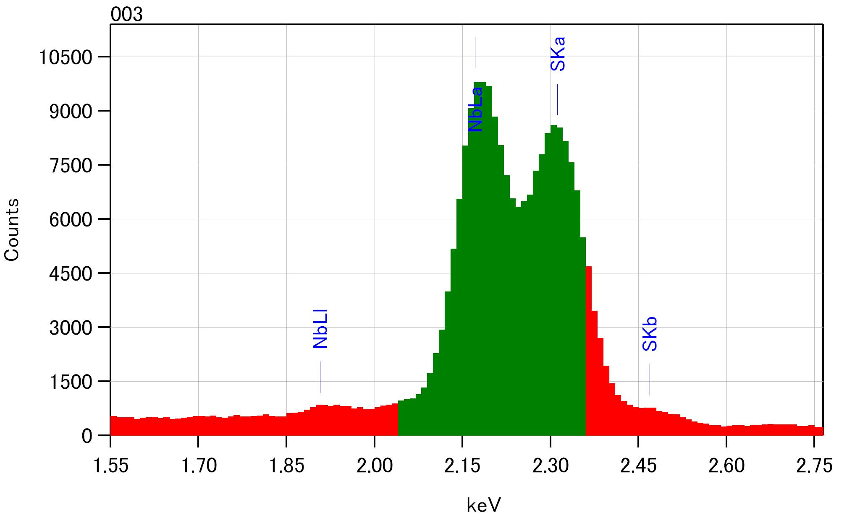
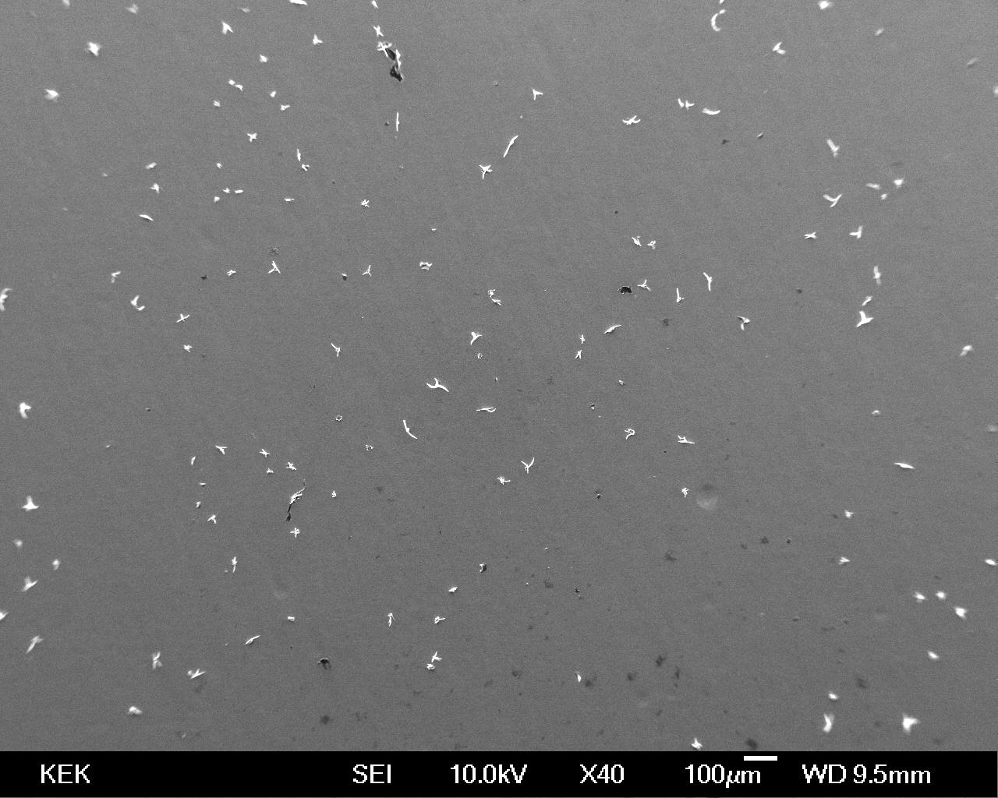
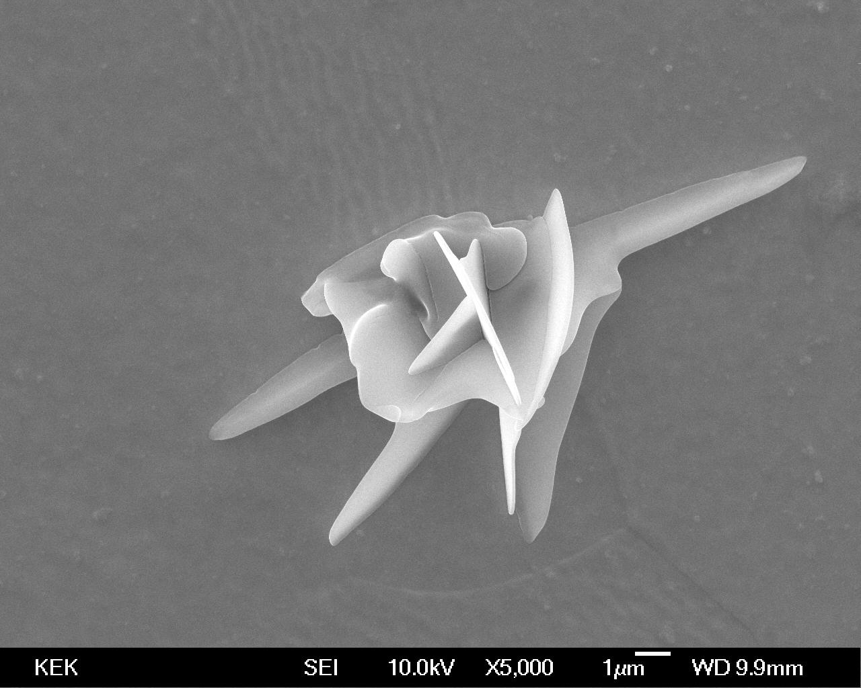
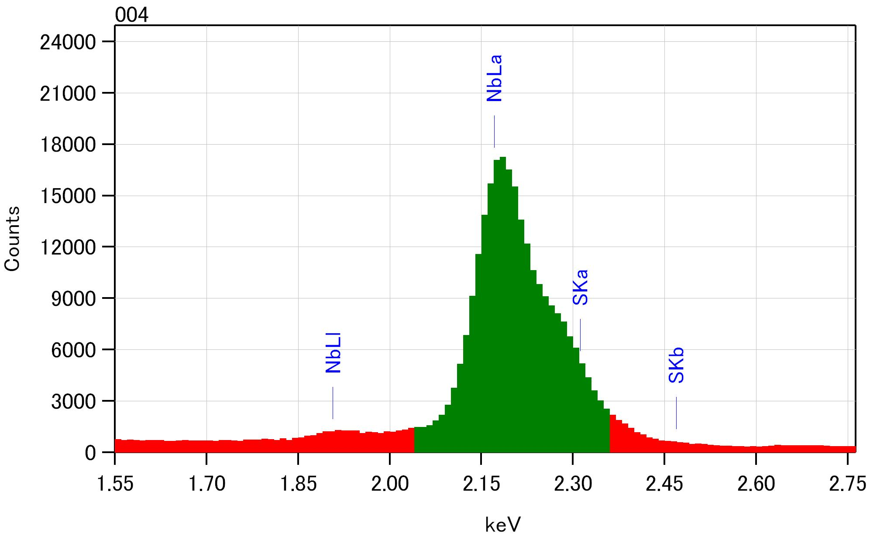
SEM and EDX Observation of Sample Surfae
Eped in Lab EP 2 (With High Current Density)
SEM Image of Sample Surface
EDX Spectrum of Sample Surface
10 µm
1 mm
SEM observations showed that the surface was covered with many particles.
EDX analysis confirmed that these particles are sulfur particles.
In addition, a large amount of oxygen was found in particles.
P.V. Tyagi

Slide 10
Cavity EP Experiments
P.V. Tyagi

Slide 11
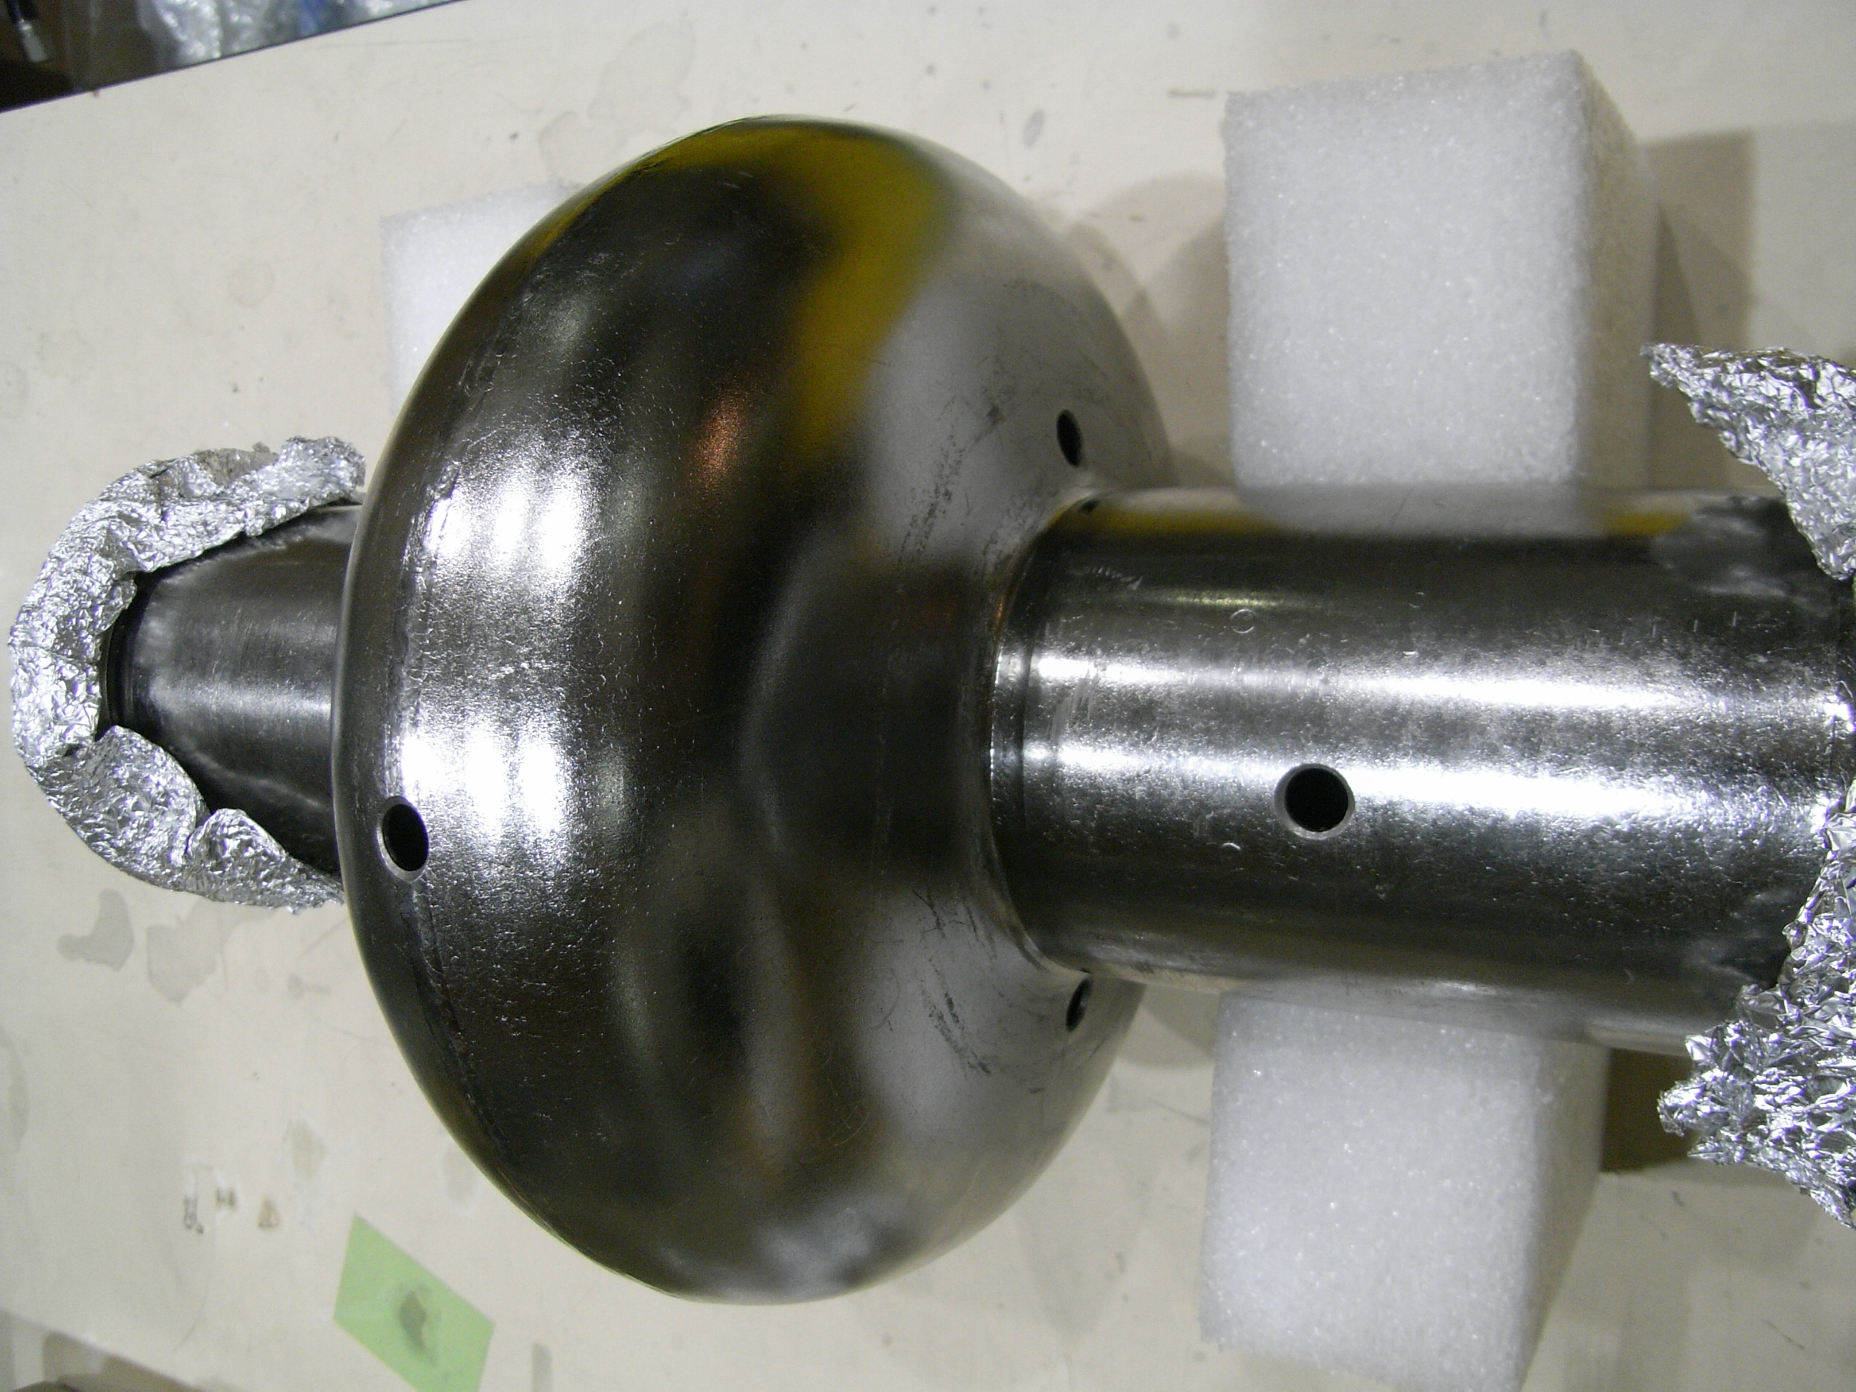
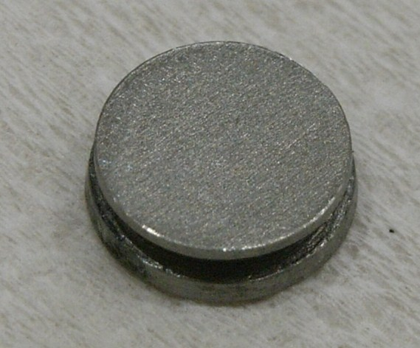
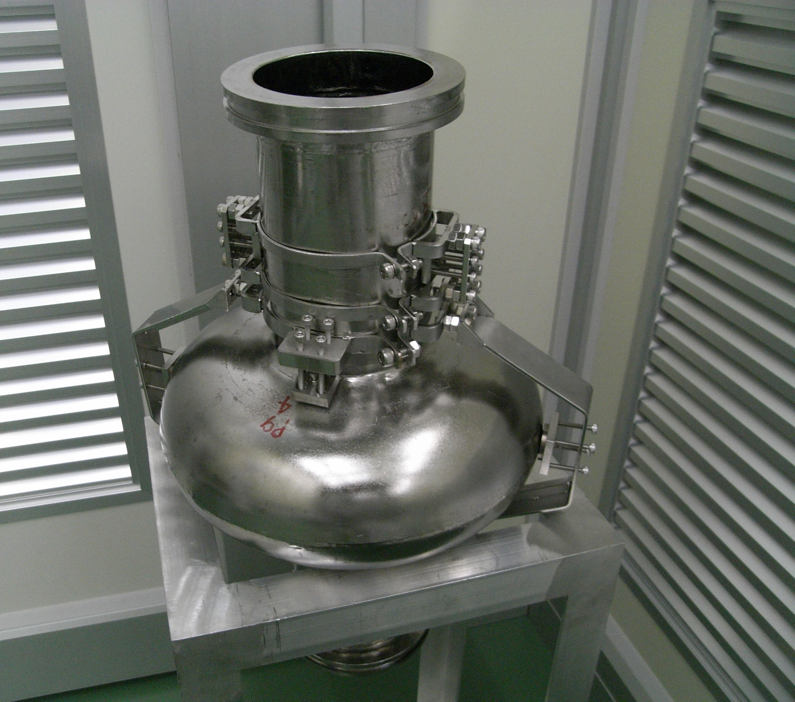
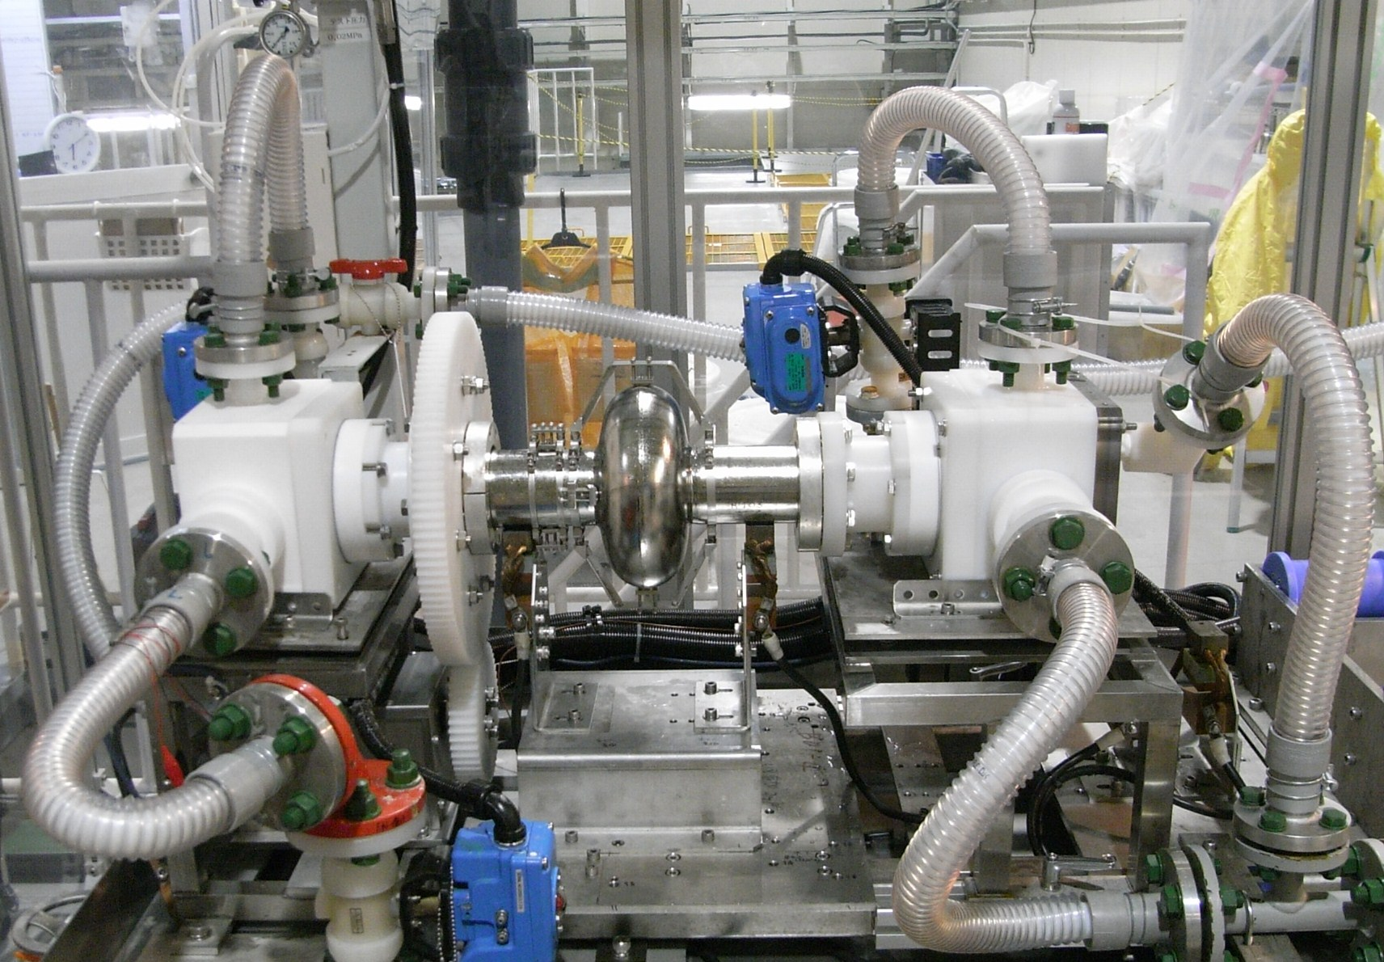
Cavity Electropolishing Experimental Details
Disc Type Nb Sample
Φ = 8 mm, t = 2.8 mm
Nb SRF Cavity Drilled With Three Pairs of Holes
Equator hole
Iris hole
Φ = 8 mm
Beam pipe hole
Six disc type Nb samples are
required for an experiment.
A real single cell Nb cavity was
drilled with six holes.
Samples were mounted at
cavity holes with holding jig.
P.V. Tyagi

Slide 12
Condition of Cavity EP experiments
Experiments | Purpose | Average Current Density (mA/cm²) | EP Acid Temperature (⁰C) | Nb Conc. in EP acid (g/l) | Removal Depth (μm)
Cavity EP 1 | To see the effect of fresh EP acid on EP performance | 48 | 25 | 0 | 20
Cavity EP 2 | To see the effect of aged EP acid over the fresh EP acid on EP performance | 48 | 25 | 7.9 | 50
Cavity EP 3 | To see the effect of low current density with aged EP acid on EP performance | 30 | 25 | 6 | 20
P.V. Tyagi

Slide 13
Cavity EP 1 Experiment With Fresh EP Acid
Comparison of XPS Spectra among Equator, Iris and Beam Pipe Samples
O
S
C
Intensity [CPS]
Intensity [CPS]
Intensity [CPS]
Binding Energy [eV]
Binding Energy [eV]
Binding Energy [eV]
Depth Profiles of the Samples
Oxide layer FWHM : 1.5 nm
Oxide layer FWHM : 1.8 nm
Oxide layer FWHM : 2 nm
Atomic Compositions [%]
Equator Sample
Atomic Compositions [%]
Atomic Compositions [%]
Iris Sample
Beam Pipe Sample
Depth [nm]
Depth [nm]
Depth [nm]
P.V. Tyagi
Depth [nm]

Slide 14
Cavity EP 2 Experiment With Aged EP Acid
Comparison of XPS Spectra Among Equator, Iris and Beam Pipe Samples
O
S
F
Intensity [CPS]
Intensity [CPS]
Intensity [CPS]
Binding Energy [eV]
Binding Energy [eV]
Binding Energy [eV]
Depth Profiles of the Samples
Oxide layer FWHM : 1.5 nm
Oxide layer FWHM : 2.5 nm
Oxide layer FWHM : 1.9 nm
Atomic Compositions [%]
Equator Sample
Atomic Compositions [%]
Iris Sample
Atomic Compositions [%]
Beam Pipe Sample
Depth [nm]
Depth [nm]
Depth [nm]
Equator and beam pipe samples: sulfur and fluorine up to 1 nm.
Iris sample: sulfur and fluorine up to 2 nm.
P.V. Tyagi

Slide 15
Cavity EP 3 Experiment With Low Current Density (Aged EP Acid)
Comparison of XPS Spectra Among Equator, Iris and Beam Pipe Samples
O
S
F
Intensity [CPS]
Intensity [CPS]
Intensity [CPS]
Binding Energy [eV]
Binding Energy [eV]
Binding Energy [eV]
Depth Profiles of the Samples
Oxide layer FWHM : 1.5 nm
Oxide layer FWHM : 1.8 nm
Oxide layer FWHM : 1.8 nm
Atomic Compositions [%]
Equator Sample
Atomic Compositions [%]
Iris Sample
Atomic Compositions [%]
Beam Pipe
Sample
Depth [nm]
Depth [nm]
Depth [nm]
The FWHM of oxide layer was similar to cavity EP 1 and 2 experiments but in case of cavity EP 3 experiment, 20 % of oxide layer was found at 5 nm depth also.
P.V. Tyagi

Slide 16
Elements | Equator sample surface (atomic %) | Iris sample surface (atomic %) | Beam pipe sample surface (atomic %)
Nb | 19 | 18 | 16
C | 37 | 40 | 34
O | 44 | 43 | 50
F | <0.4 | <0.4 | <0.4
S | <0.5 | <0.5 | <0.5
Cavity EP 1 Experiment With Fresh EP Acid
Cavity EP 2 Experiment With Aged EP Acid
Elements | Equator sample surface (atomic %) | Iris sample surface (atomic %) | Beam pipe sample surface (atomic %)
Nb | 16 | 10 | 20
C | 18 | 16 | 27
N | 2 | 6 | 0
O | 58 | 59 | 49
F | 3 | 3 | 4
S | 4 | 7 | 2
Cavity EP 3 Experiment With Low Current Density (Aged EP Acid)
Elements | Equator sample surface (atomic %) | Iris sample surface (atomic %) | Beam pipe sample surface (atomic %)
Nb | 18 | 17 | 16
C | 35 | 29 | 33
O | 45 | 54 | 51
F | 0.9 | 0.2 | 0.4
S | 0.5 | < 0.1 | 0.2
P.V. Tyagi

Slide 17
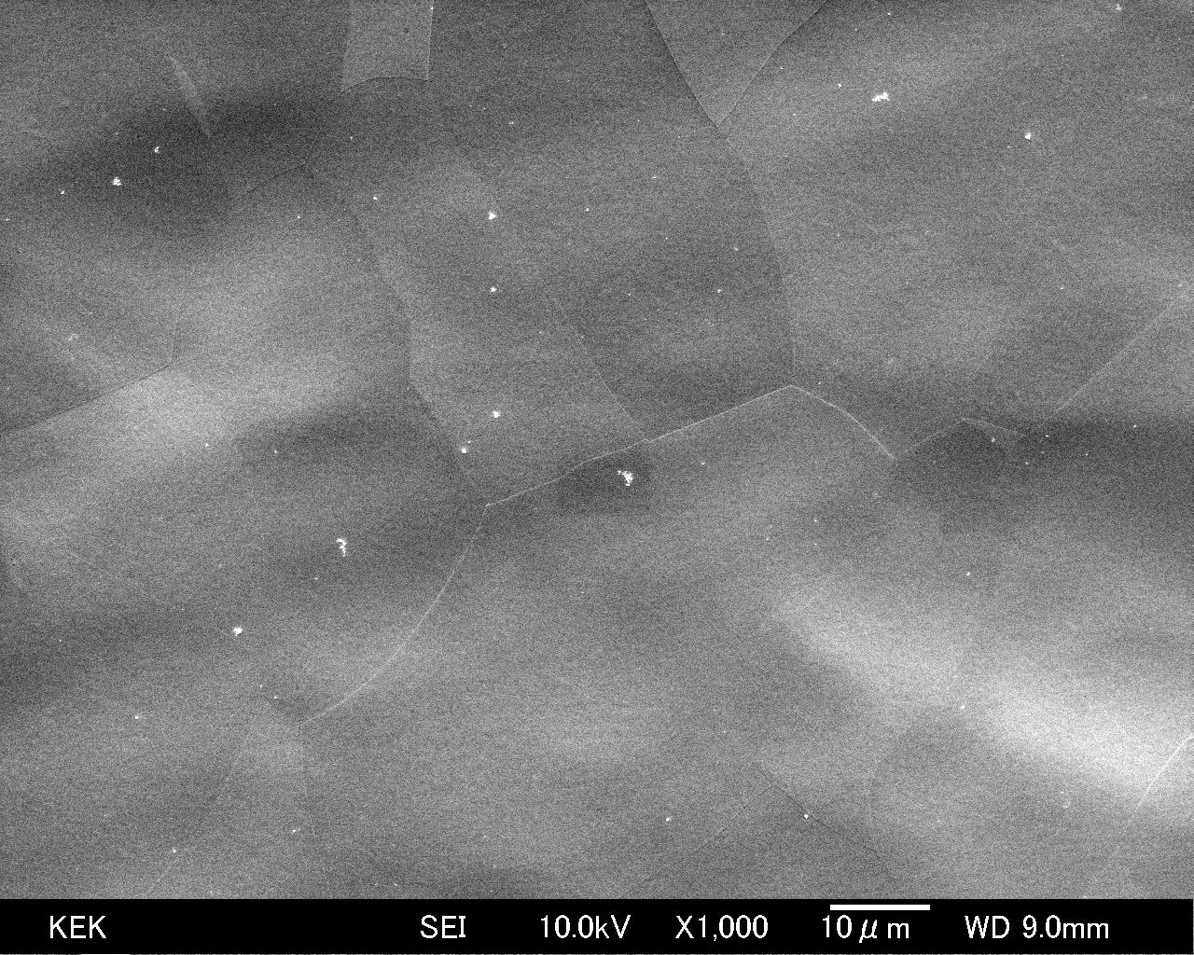
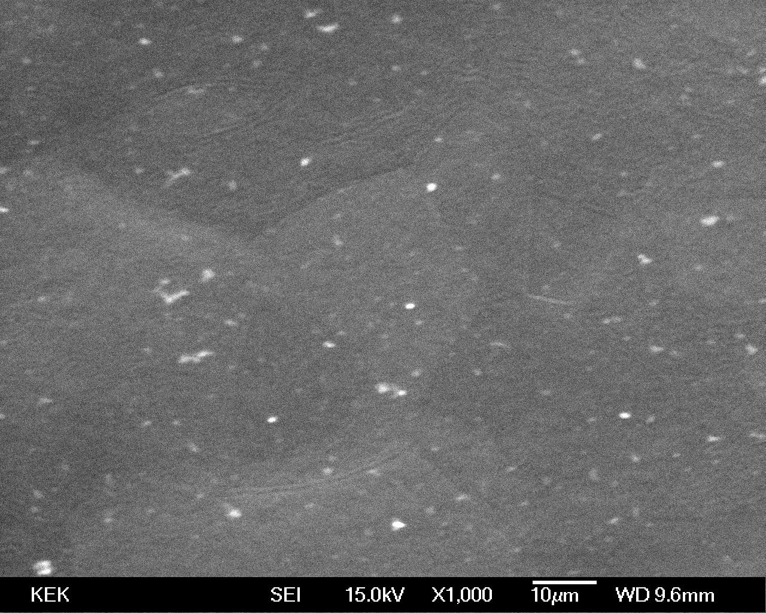
SEM Observations
SEM Images of Beam Pipe Sample
EPed in Cavity EP 1 Experiment (Fresh EP Acid)
EPed in Cavity EP 2 Experiment (Aged EP Acid)
Surfaces were covered with many particles.
Particles size was several sub-micrometers to few micrometers.
A high density of particles was observed on the surfaces treated with aged EP acid.
P.V. Tyagi

Slide 18
FES (Field Emitter Scanning microscope) study
S. Kato

Slide 19
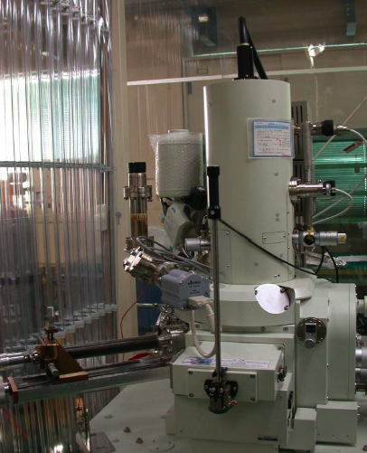
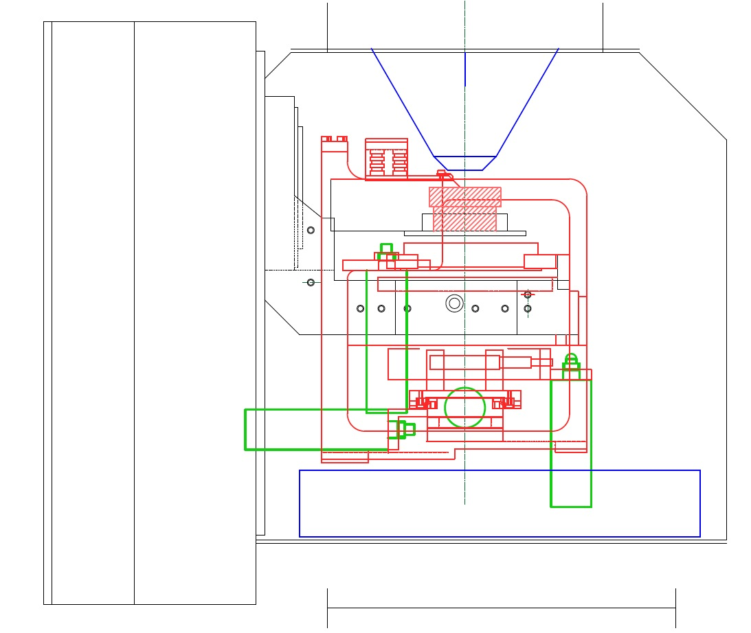
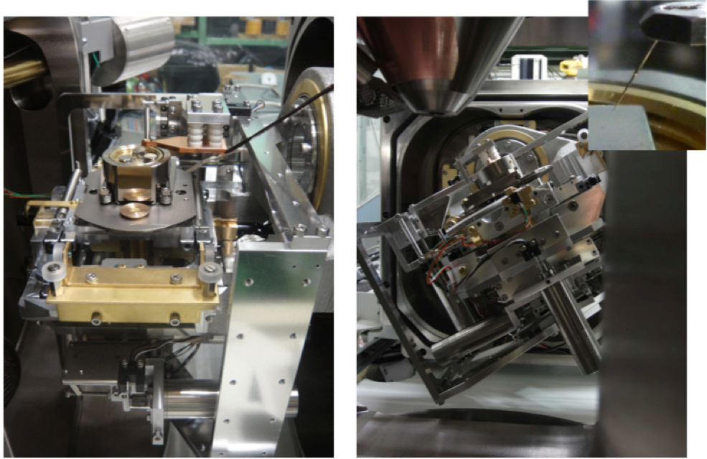
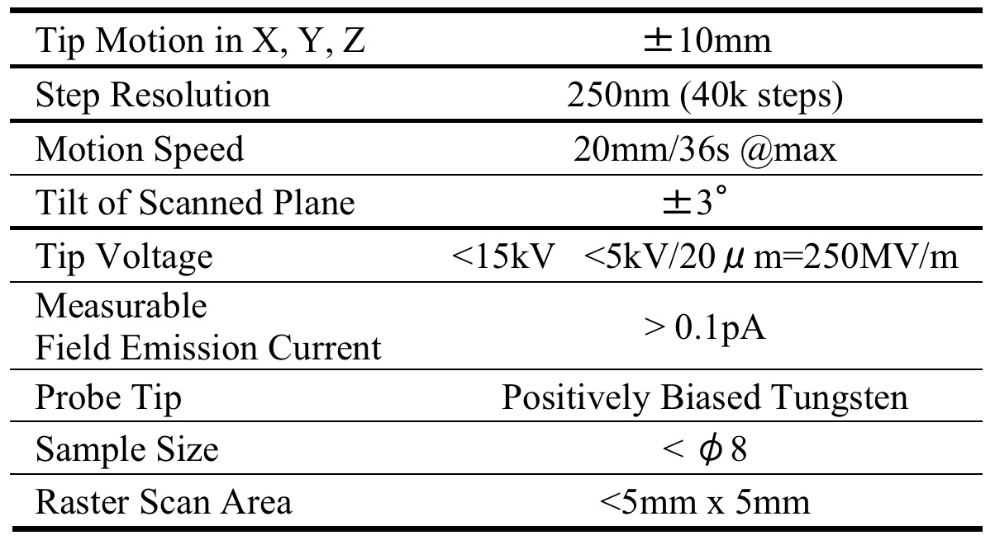
Combined System of FES and SEM-EDX
Cross sectional schematic view of the SEM stage and FES.
SEM Object
Lens
Probe Tip
Sample
Holder
FES Support
5 x
Actuators
NEG Modules
5 Axis Stage
200 mm
S. Kato

Slide 20
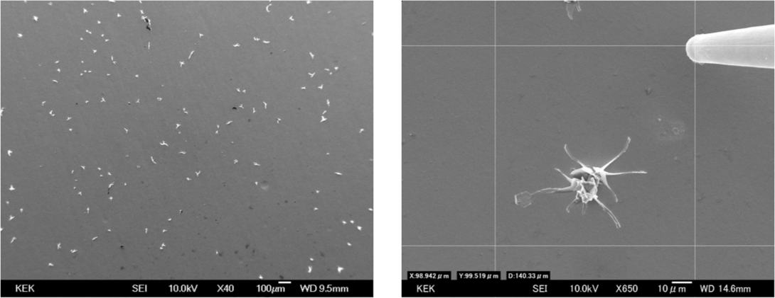
SEM image of petals on Nb surface EPed with a high current density(50mA/cm²) and an aged acid(7.6g/l) (left). SEM image showing one petal, the scanning tip and the scanned area of 100x100 μm² with 4 lines. (right).
The EP generated a large quantity of sulfate particles which were confirmed with XPS(X-ray Photoelectron Spectroscopy) and SEM-EDX techniques. These sulfate petals seem to be grown product as a result of surface segregation of sulfate.
S. Kato

Slide 21
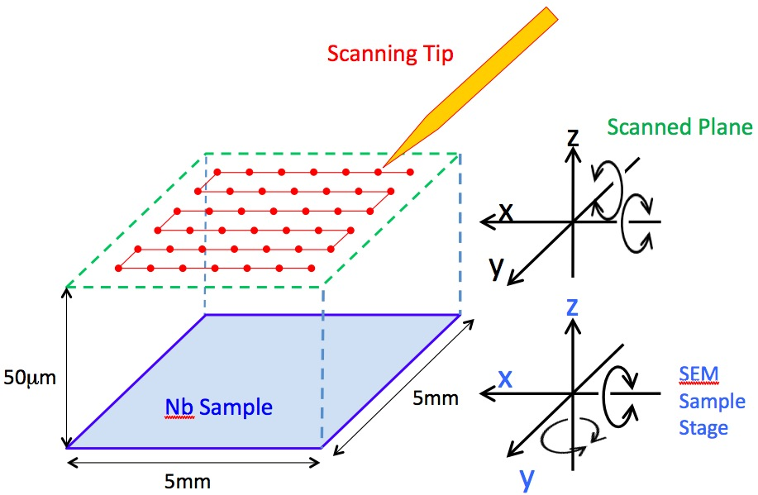
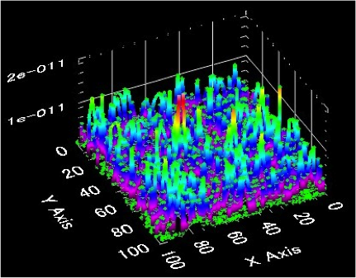
FES emission current mapping. The units for the vertical axis and for the X, Y axes are ampere and μm, respectively.
3.5kV for 20um distance
( ~ 17.5 MV/m )
2um step scan
for 100 x 100 um
There were some small current peaks in a range of 1-10pA and unfortunately the scanning did not reveal the petal itself on the FES image. However the small peaks might be interestingly corresponding to both the rooted sulfate part at the petal feet that would be (semi)conductive and the small conductive sulfate with a size of 10-100 nm.
S. Kato

Slide 22
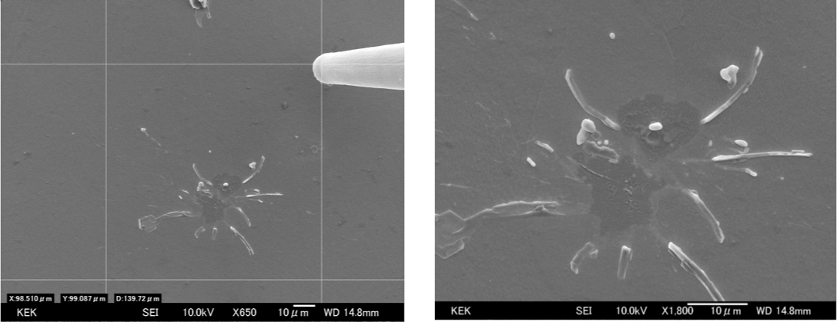
SEM image after the FES mapping.
After the FES mapping, it was observed that strong blast of the petal occurred during the scanning and the main part of this insulating emitter disappeared. There remained some roots of the blasted petal in the Nb sub-surface, the fragments and the round melted particles.
S. Kato

Slide 23
Formation of Sulfur in EP solutions
H. Monzyushiro

Slide 24
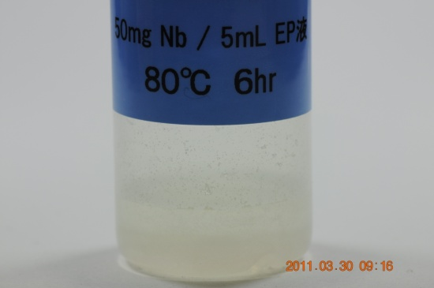
Dissolution of Nb Metal powder in EP and HF solutions
Raman spectroscopy
NbF₆⁻ and Sulfur are detected in EP + Nb
only NbF₆⁻ is observed in HF + Nb
H. Monjushiro

Slide 25
Observation of Shapes of Sulfur micro-particles
during Nb dissolution in EP solution by Electron Microscope
Filtration (0.45μm)
Nb powder
50 mg
40 ℃
Electron Microscope
EP solution
5.0 mL
Carbon Adhesive Tape
H. Monjushiro

Slide 26
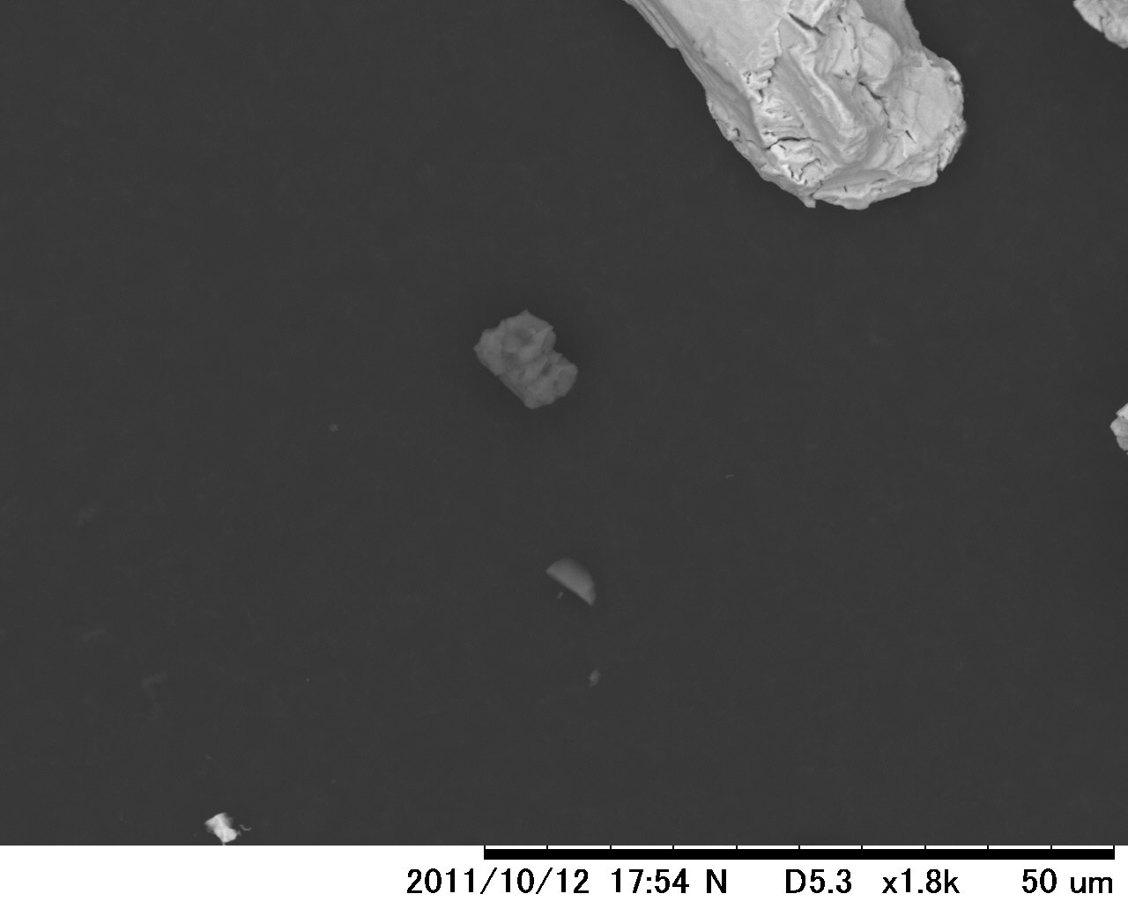
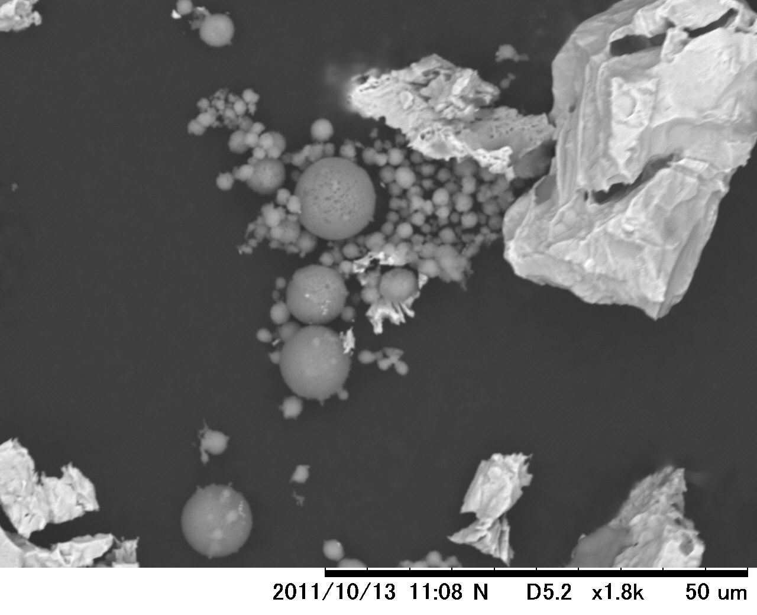
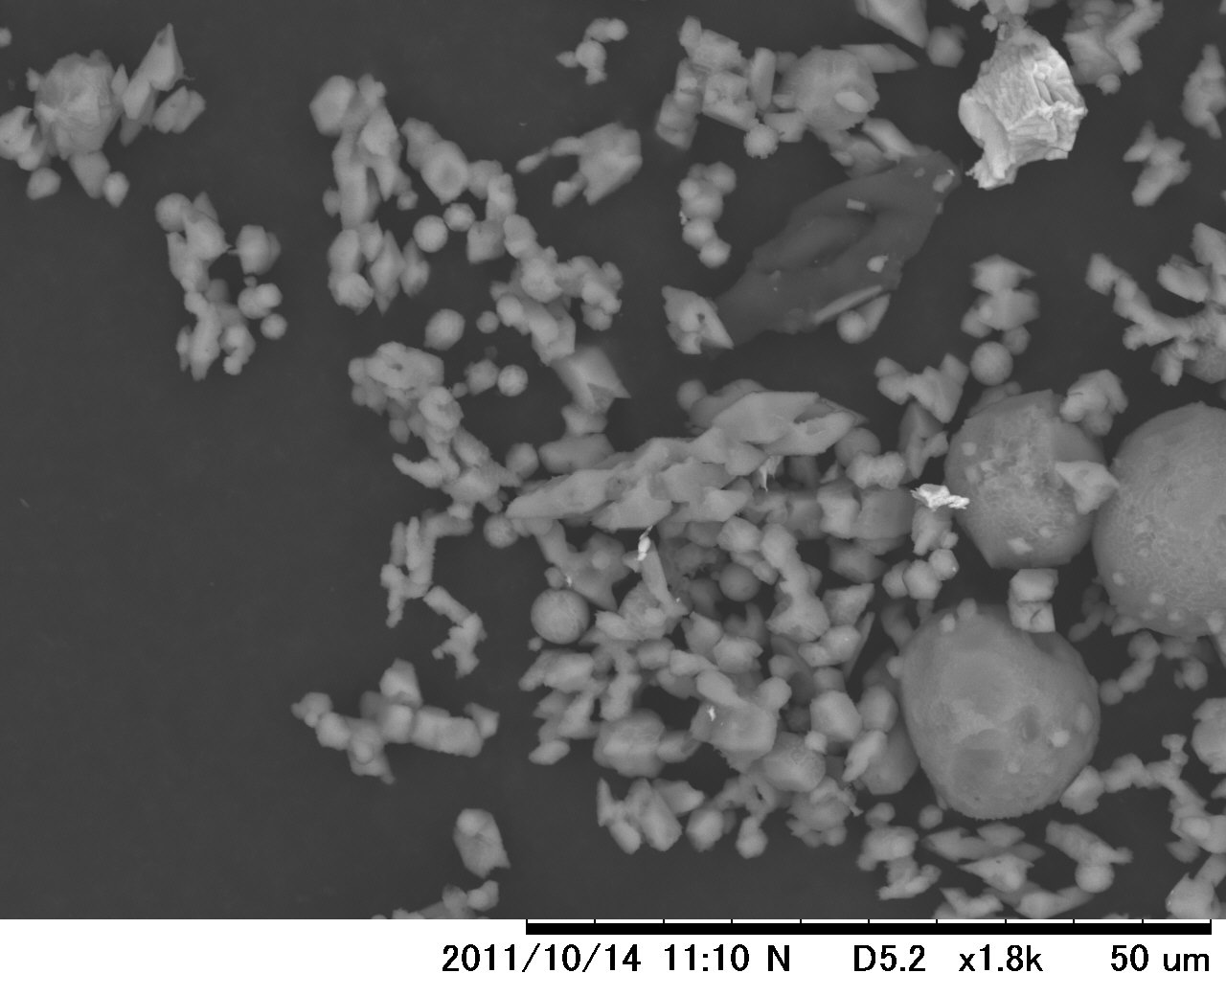
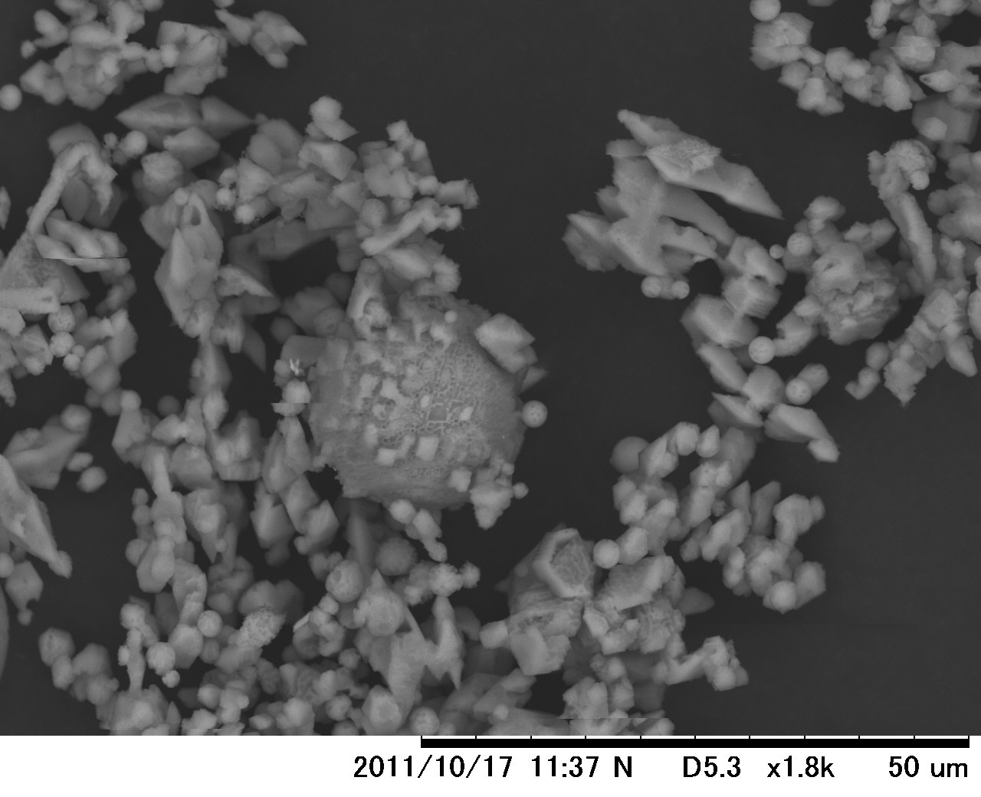
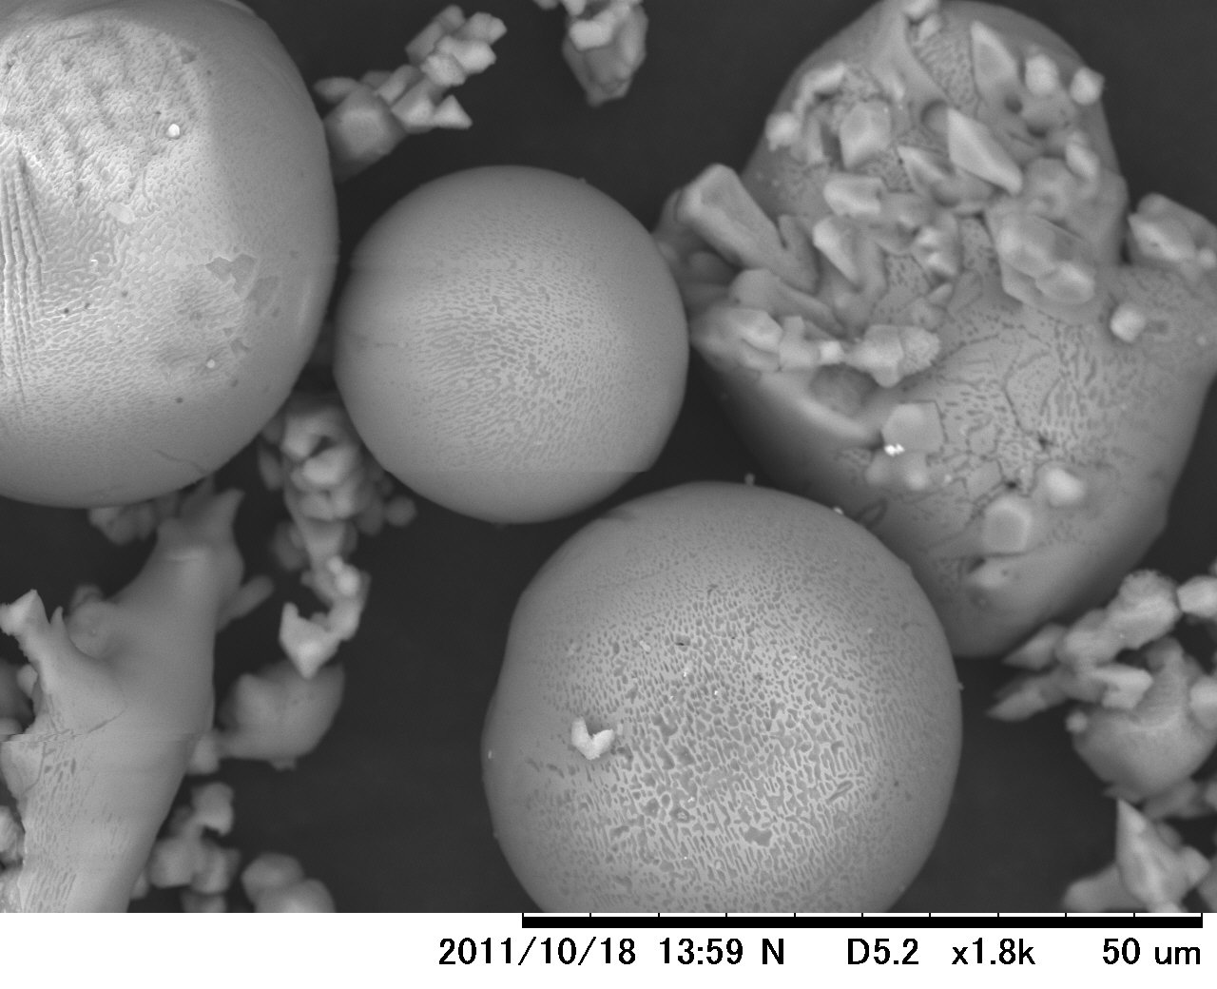
Nb powder dissolution in EP solution
40℃, 5 hr
40℃, 23 hr
40℃, 45 hr
Nb powder
Sulfur
40℃, 70 hr
40℃, 105 hr
Octahedron + Sphere
Growth of Sphere
H. Monjushiro

Slide 27
Capturing of Sulfur in Cavity EP process
M. Sawabe

Slide 28
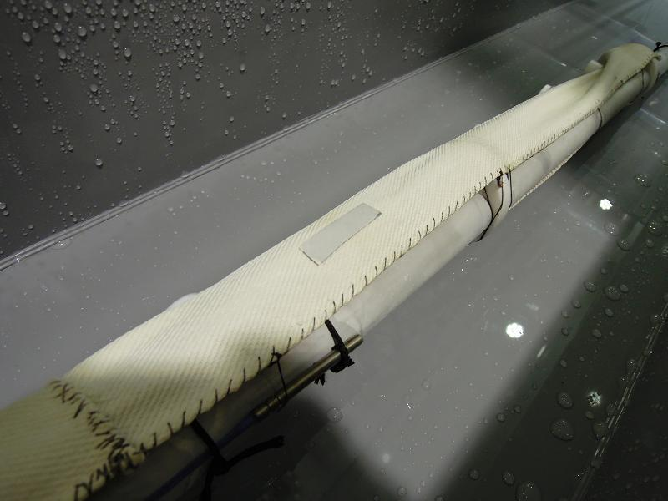
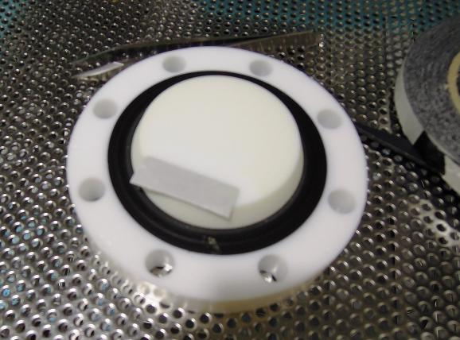
Capturing residuals after cavity EP process
By using carbon adhesive tape, surface contamination of cathode-bag and PTFE flange were sampled and viewed by SEM.
Carbon tape
Carbon tape
Sampling at cathode bag
Sampling at PTFE flange
M. Sawabe

Slide 29
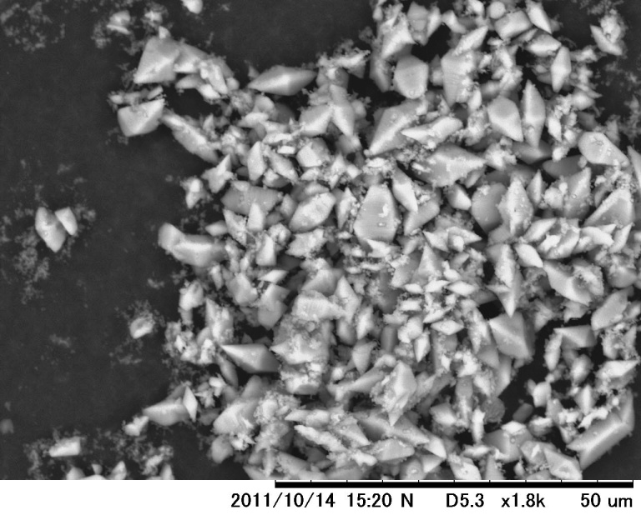
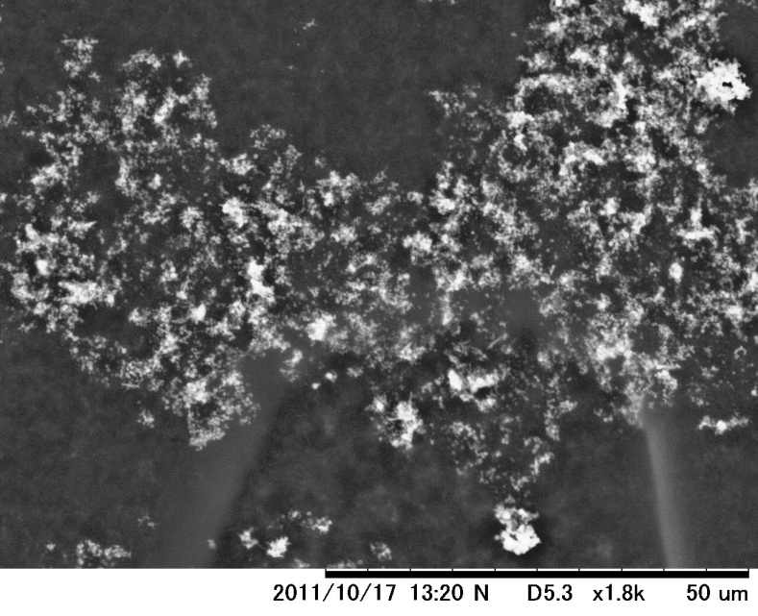
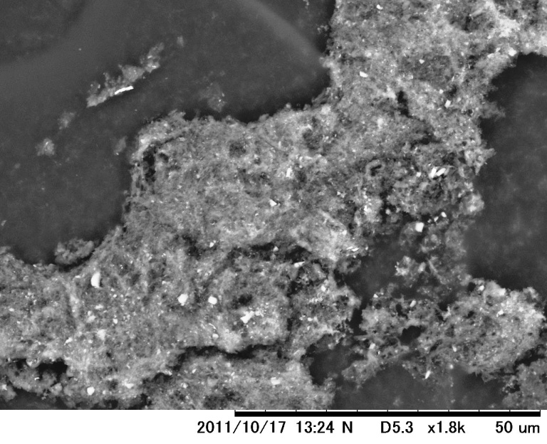
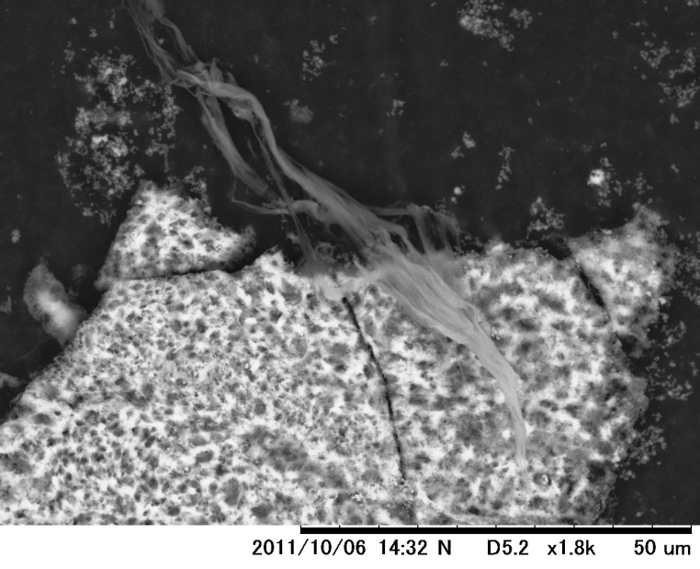
Sulfur shapes found in cathode-bag and PTFE flanges
Crystals
(Octahedron)
powder
plate
strings
M. Sawabe

Slide 30
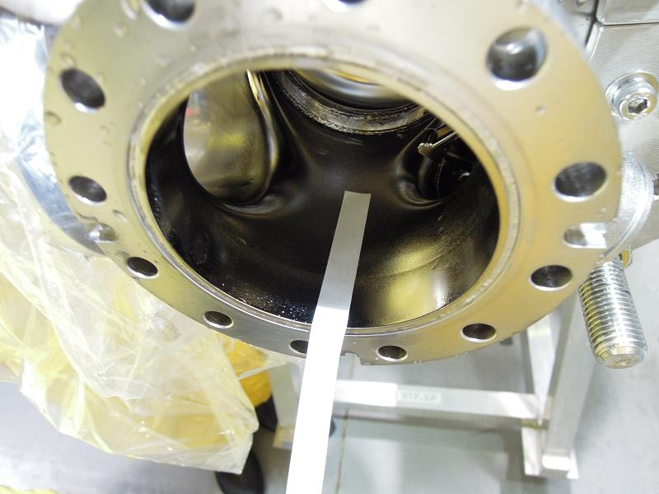
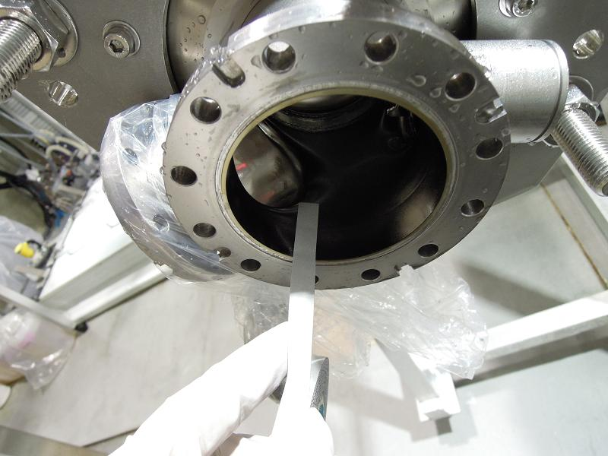
Capturing residuals on cavity beam pipe after cavity EP process
During MHI-015 9-cell cavity bulk-EP process
Before FM-20 Ultrasonic rinse
After FM-20 Ultrasonic rinse
FM-20 : degreaser which is used at STF
M. Sawabe

Slide 31
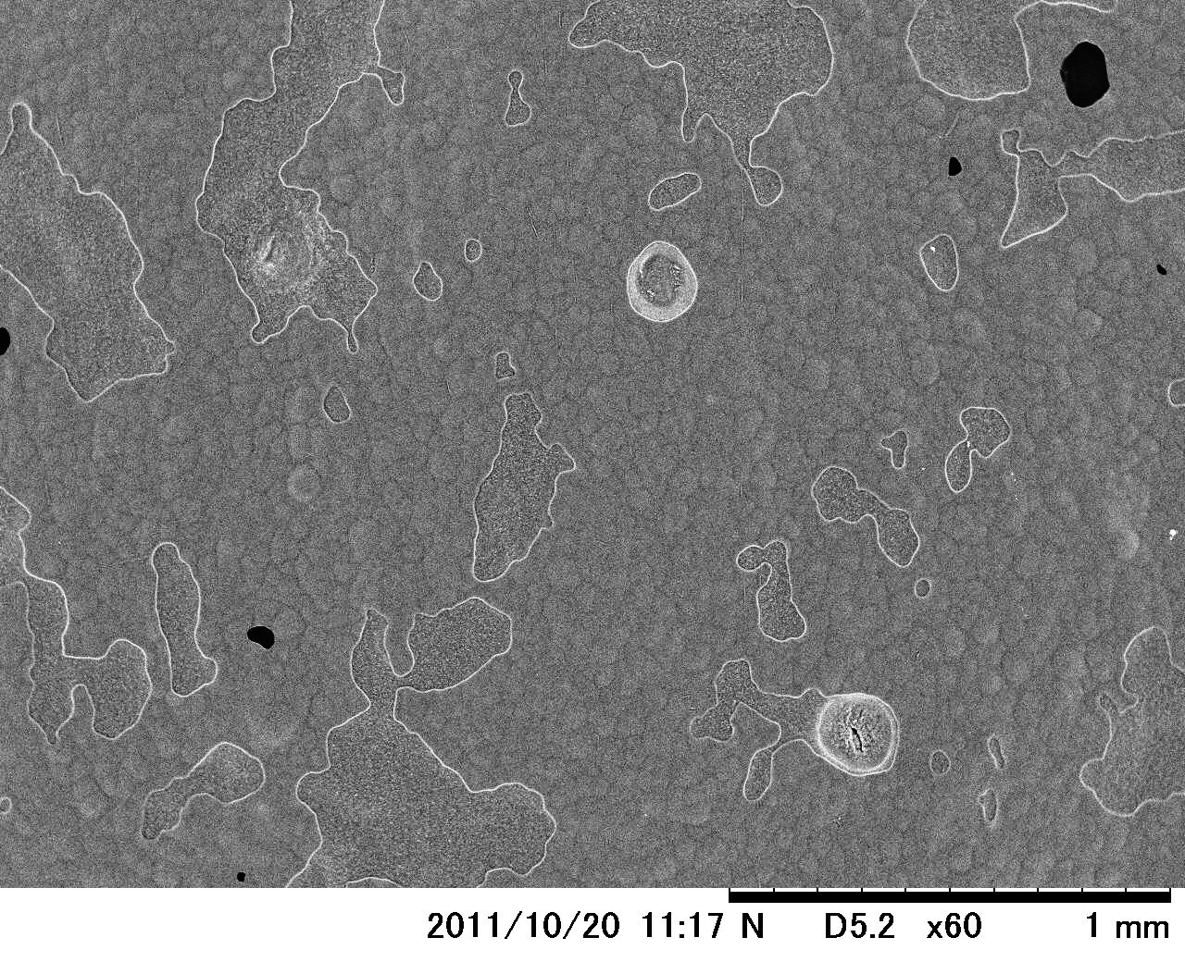
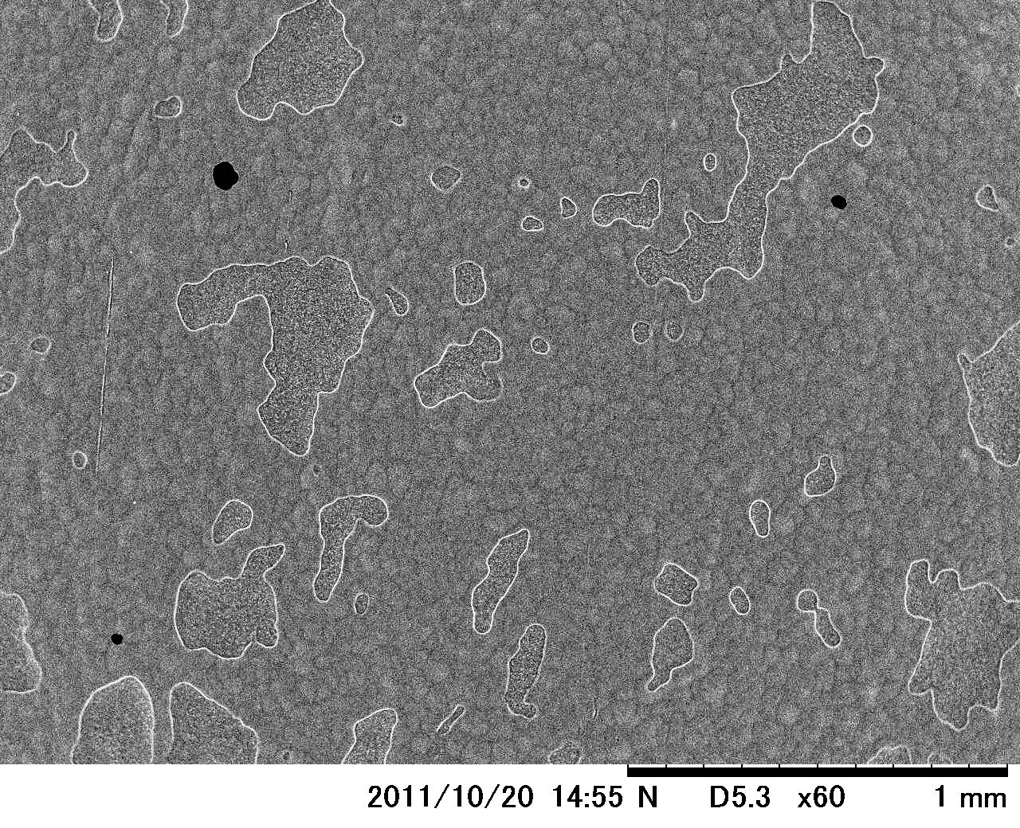
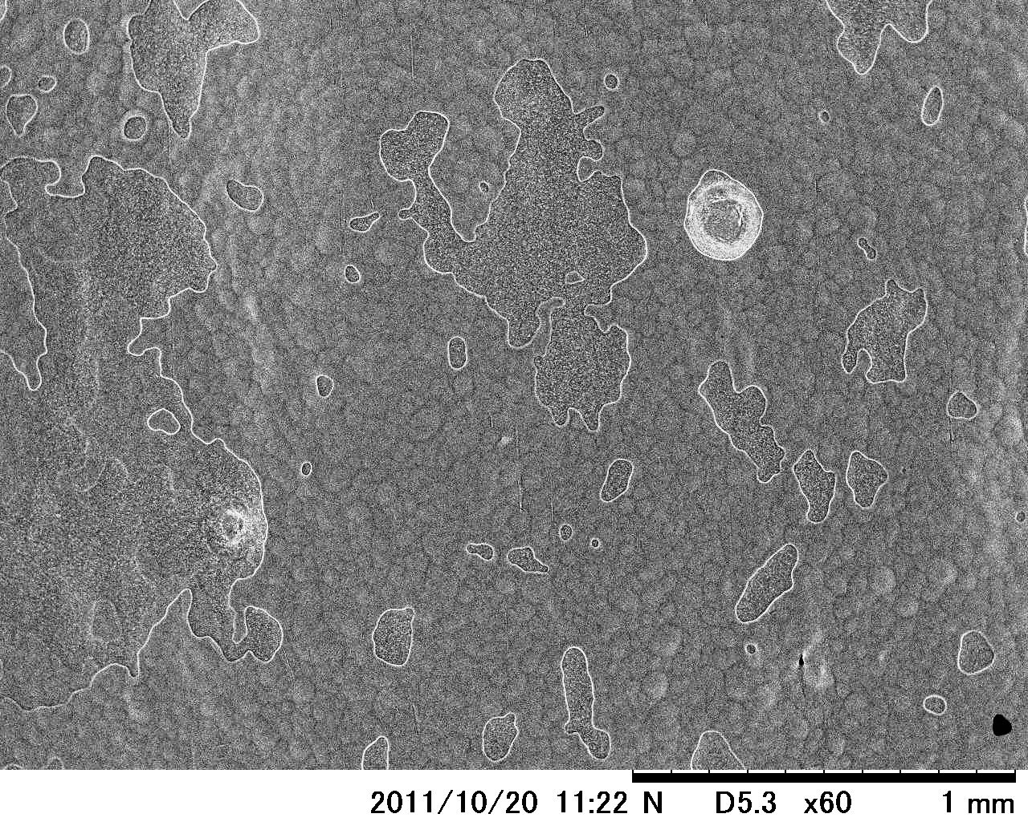
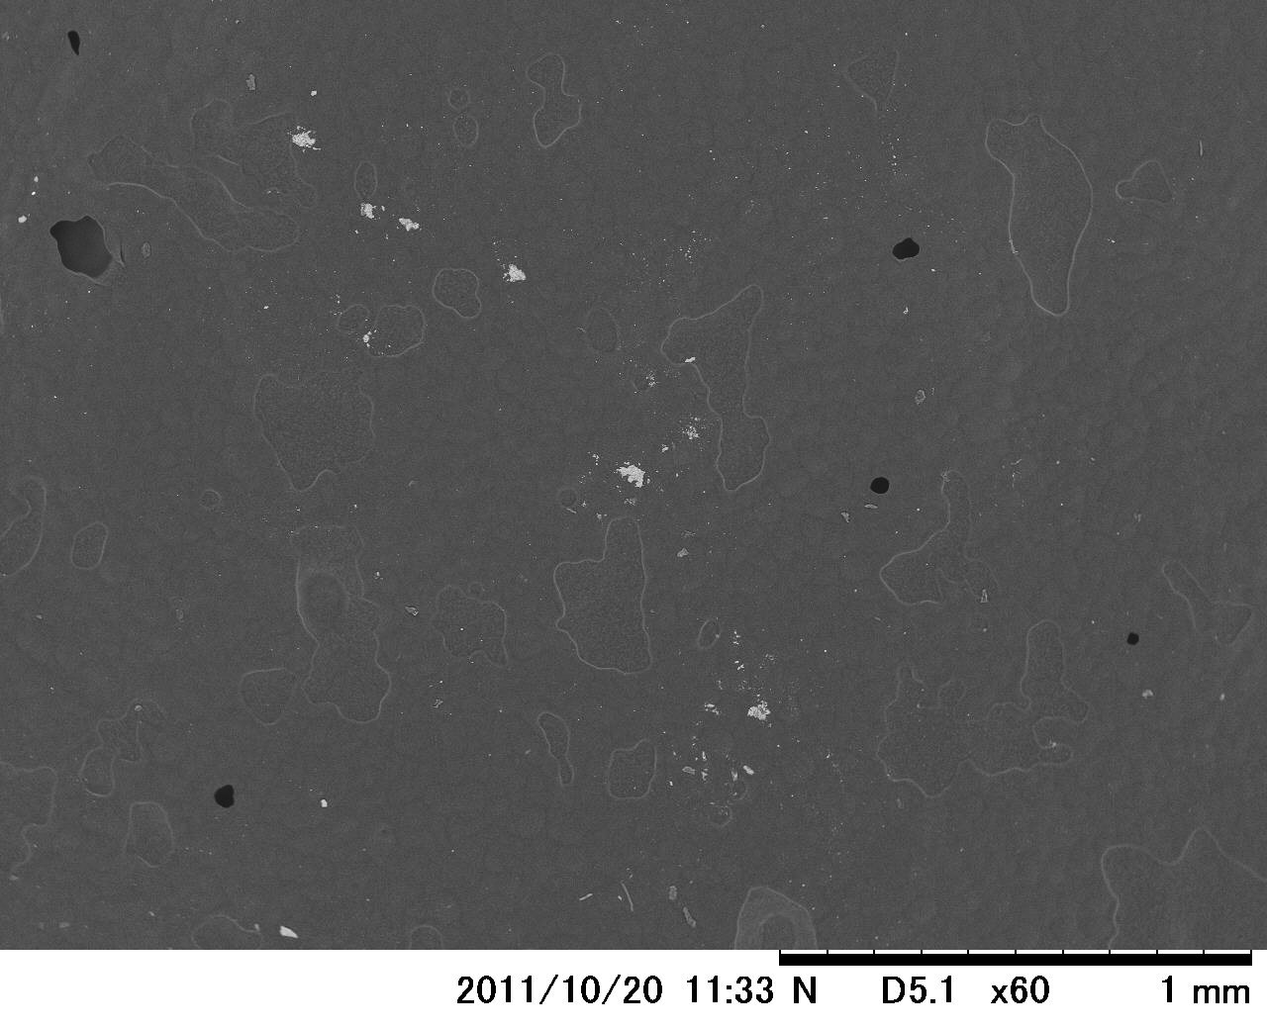
MHI-015: Before FM-20 Ultrasonic rinse
MHI-015: After FM-20 Ultrasonic rinse
Sulfur rings were observed
Sulfur were almost removed, but a few still there
M. Sawabe

Slide 32
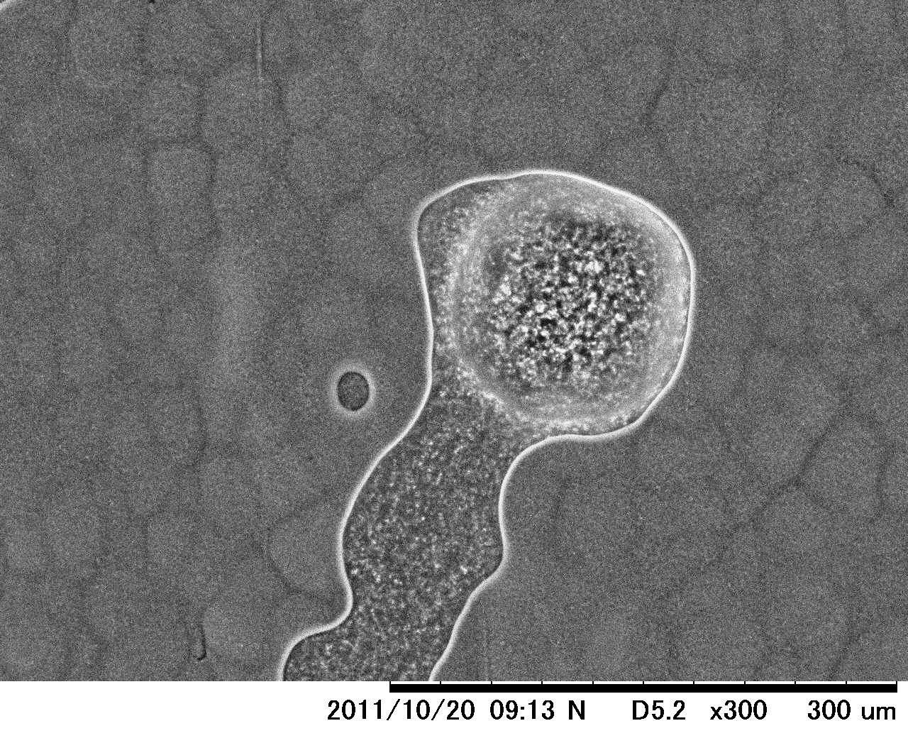
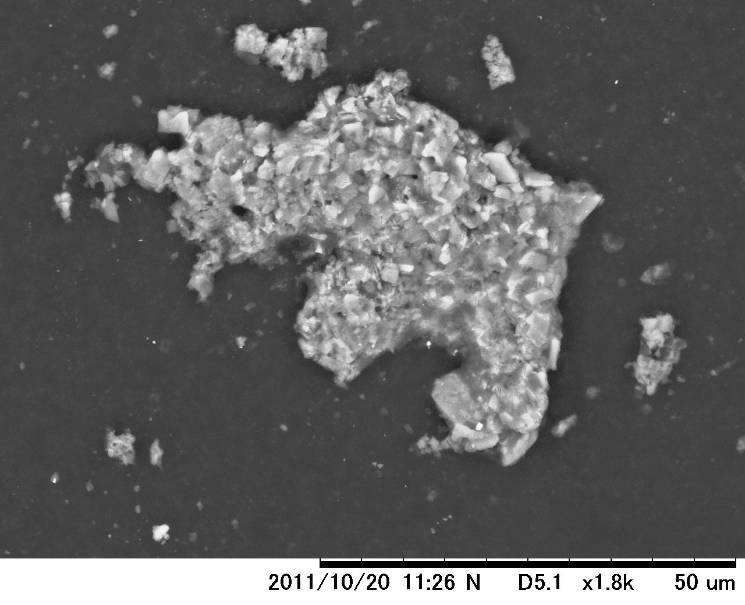
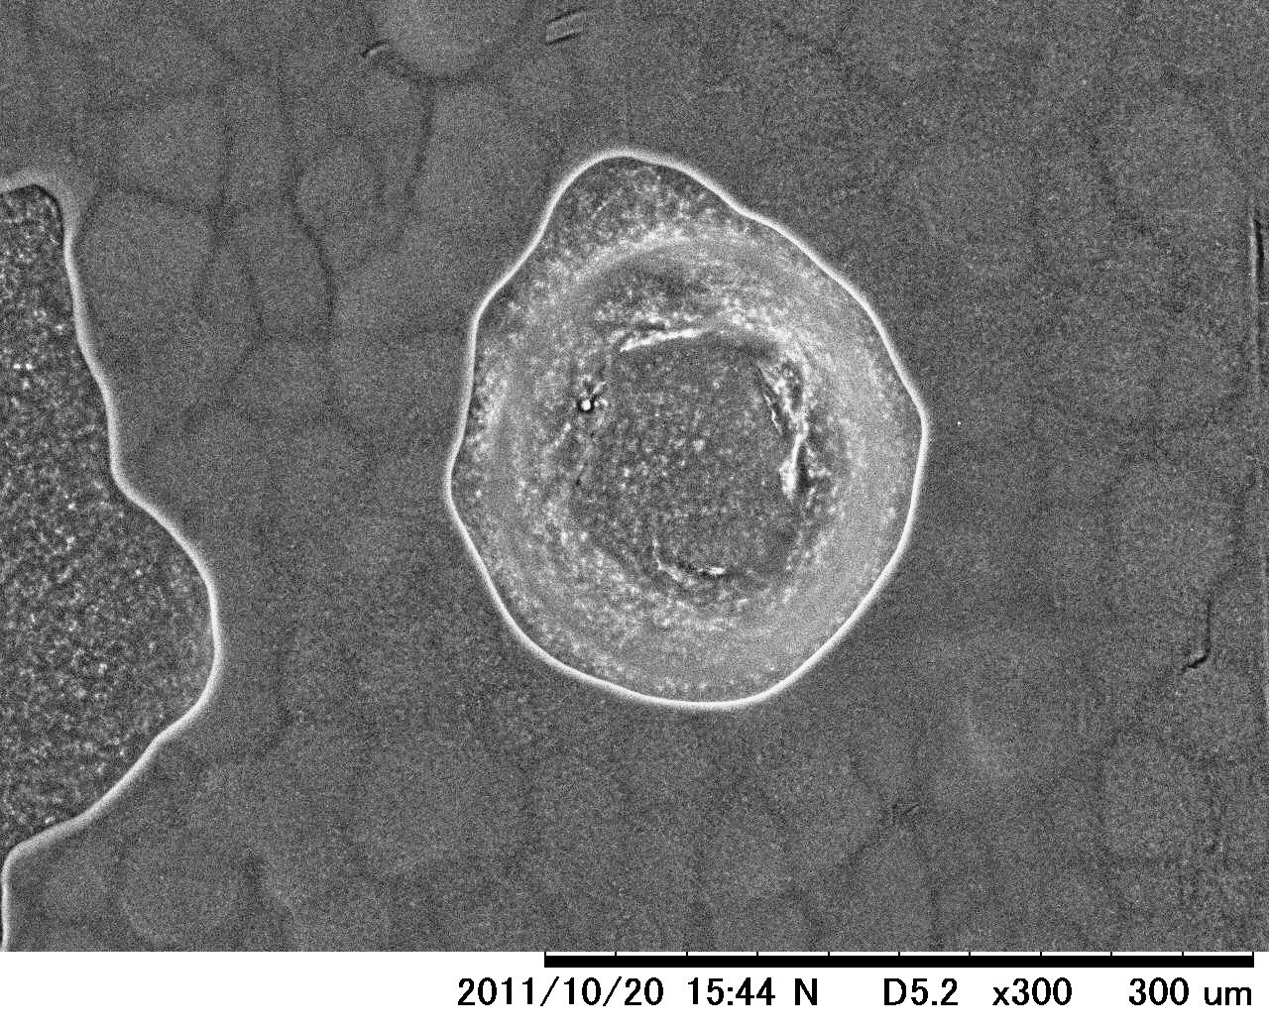
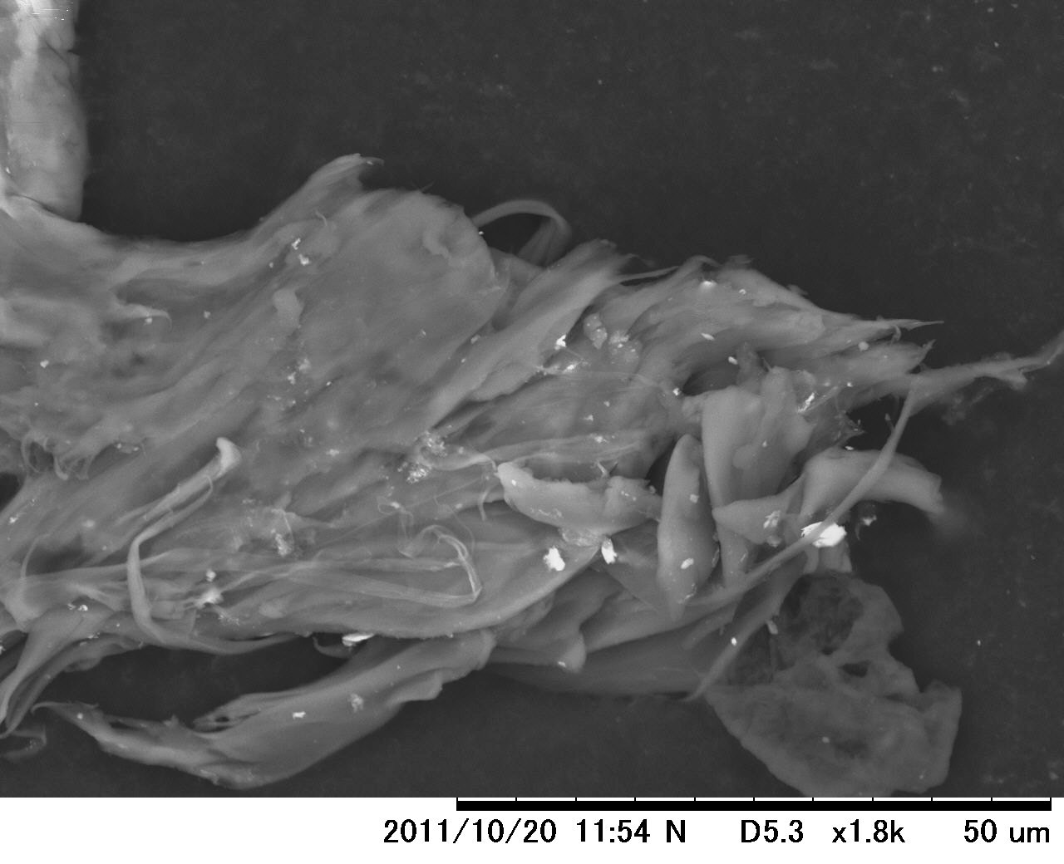
MHI-015: Before FM-20 Ultrasonic rinse
MHI-015: After FM-20 Ultrasonic rinse
Sulfur rings were observed
Sulfur were crystal form, and string form
M. Sawabe

Slide 33
Summary
(1) Surface contaminations on Lab-EP sample coupon.
High current density EP produce much sulfur in Nb surface.
(2) Surface contaminations on sample coupon in single cell cavity.
Aged EP acid EP produce much sulfur and fluorine in Nb surface.
Aged EP acid but low current density EP produce less sulfur.
(3) Field Emitter Scanning microscope (FES) development.
FES is still under development for emitter study on Nb surface.
(4) Formation of Sulfur in EP solutions
growth of sulfur and its shape change are observed.
(5) Capturing of Sulfur in Cavity EP process
sulfur removal by ultrasonic rinse using degreaser is confirmed, but not perfect.

Slide 34
END of Slide

