Slide 1
ECAL Digitization Overview
2023/05/17
Jiaxuan Wang

Slide 2
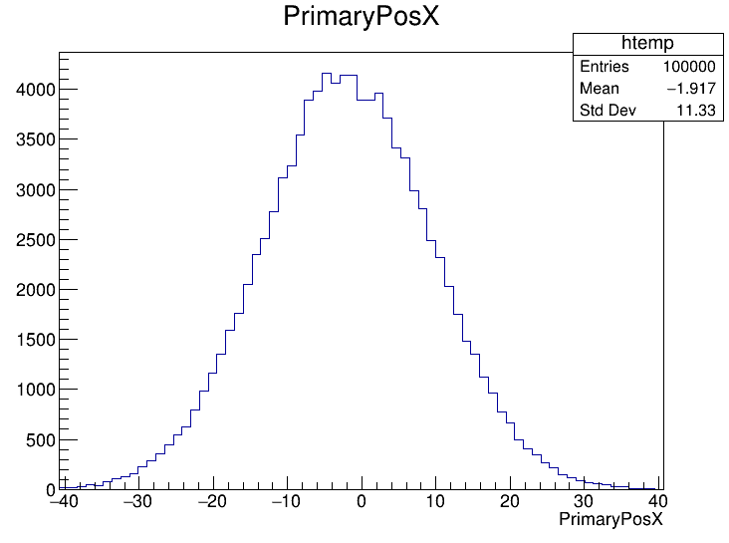
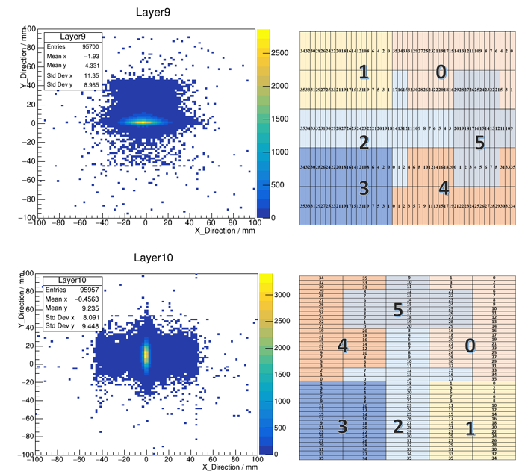
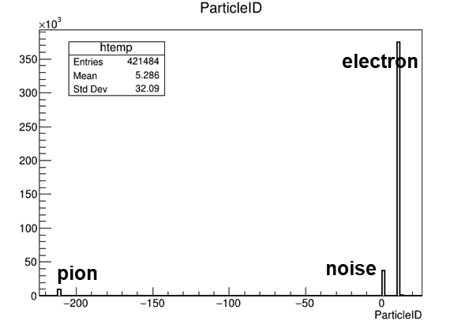
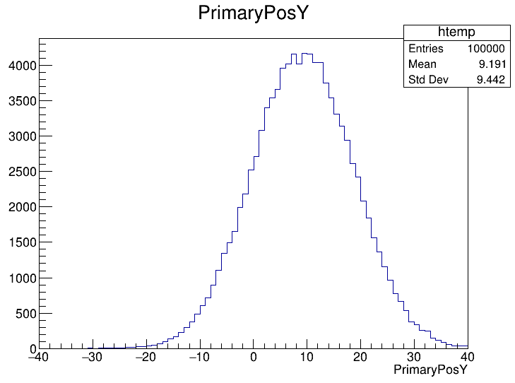
Digitization
Flow chart
File : 40GeV e-
Test beam data
MC 40GeV e-
Beam size : selected from energy gravity center distribution
Mixed with 2.5% pion
Digitization format
Same with test beam data

Slide 3
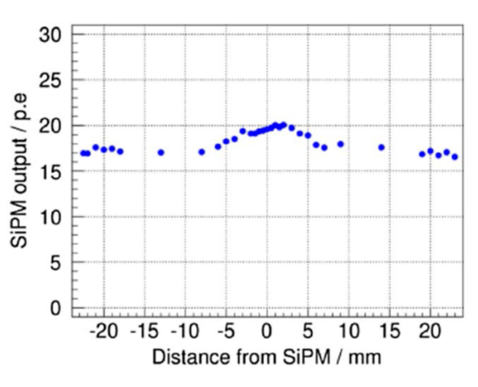
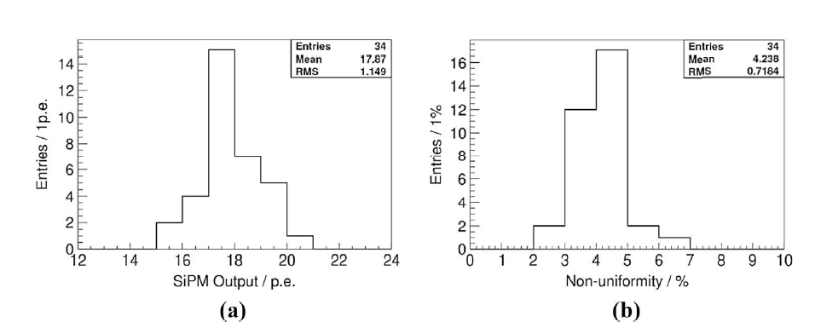
Photon produce
Photon production
Photon number
$E_{MIP}$ = $E_{Truth}$ / 0.305 MeV
p.e. = $E_{MIP}$ / light yield(p.e./MIP)
SiPM gain (ADC/p.e.)
MIP MPV (ADC/MIP)
photon = p.e./PDE
Poisson smear
Non-uniformity of light output(~0.042)
SiPM
ADC conversion
$$N_{photon}=\frac{Hit_E∗MIP_MPV}{0.305∗SiPM_Gain∗PDE}$$
yazhou

Slide 4
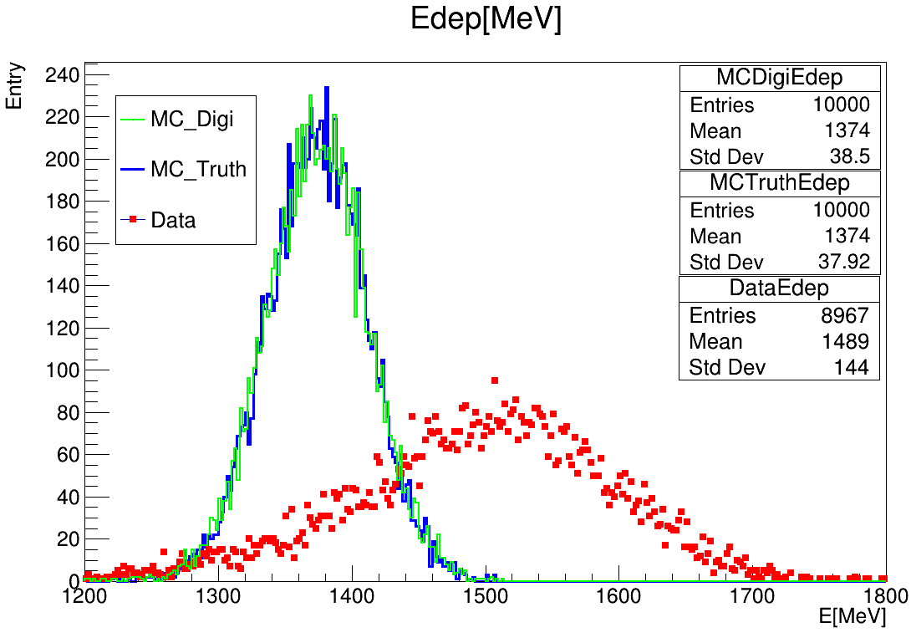
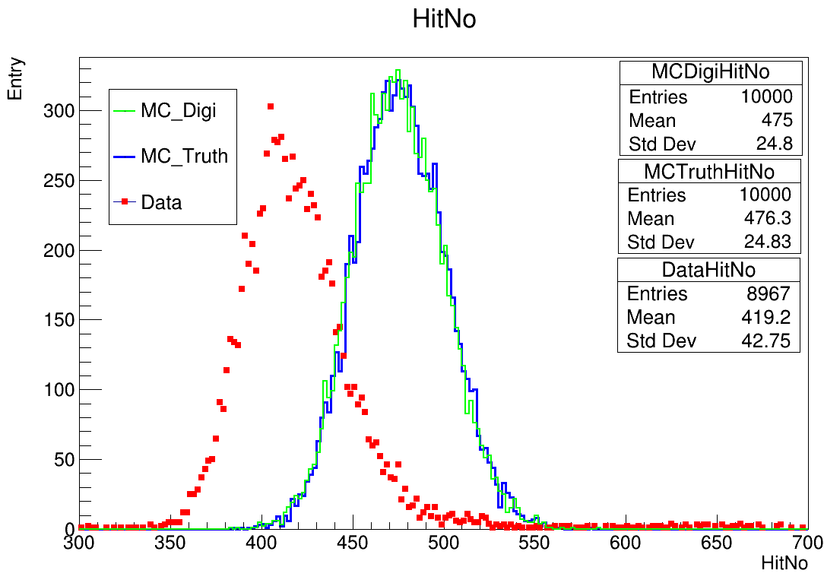
Digitization : photon produce
10K 40GeV electron events
Event cut ${: E}_{rec }>50MeV, hitNo≥100$
Hit cut : dead channel cut, 0.8 MIP cut
The physics process during photon produce hardly affect the energy and hitNo

Slide 5
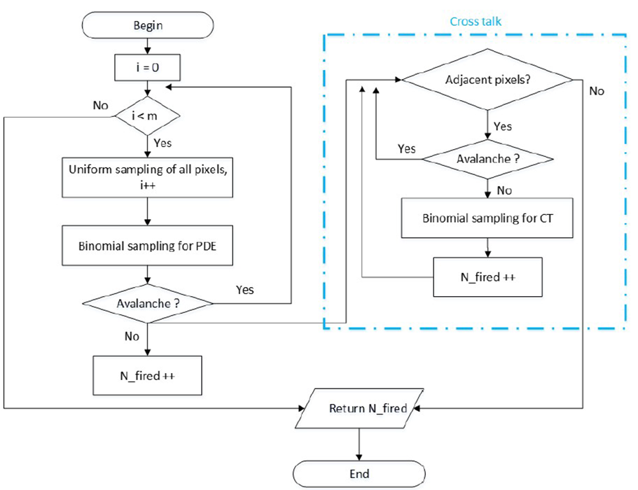
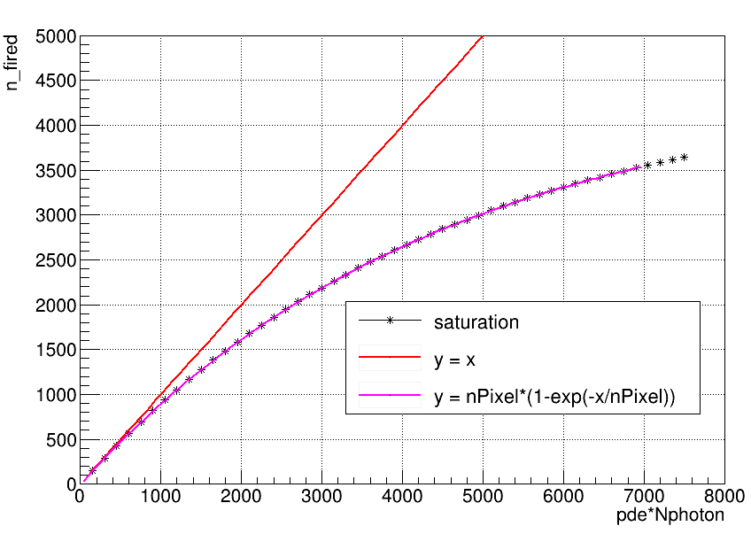
SiPM pixel saturation
Hamamatsu SiPM S12571-010P, S12571-015P
10000, 4489 pixels respectively
~ 8 , 22 p.e./MIP
SiPM saturation model
100*100 ，67*67 pixel placement
Uniform sampling a pixel from pixel array
Binomial sampling for PDE
IF NOT avalanche, then let it avalanche
Get total fired pixel number
Formula matches the SiPM saturation model very well

Slide 6
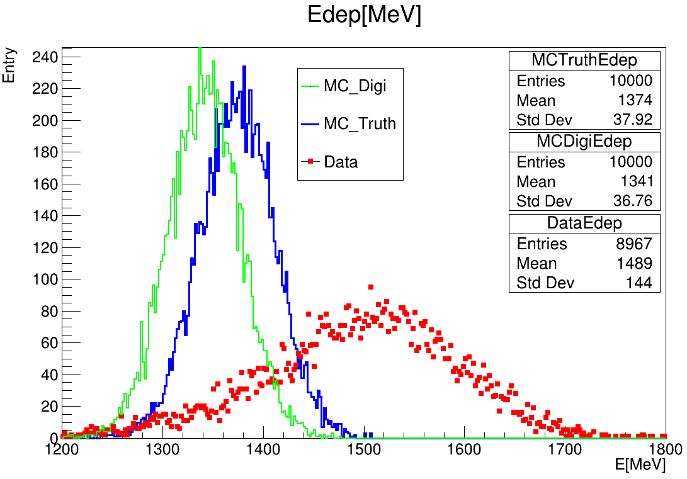
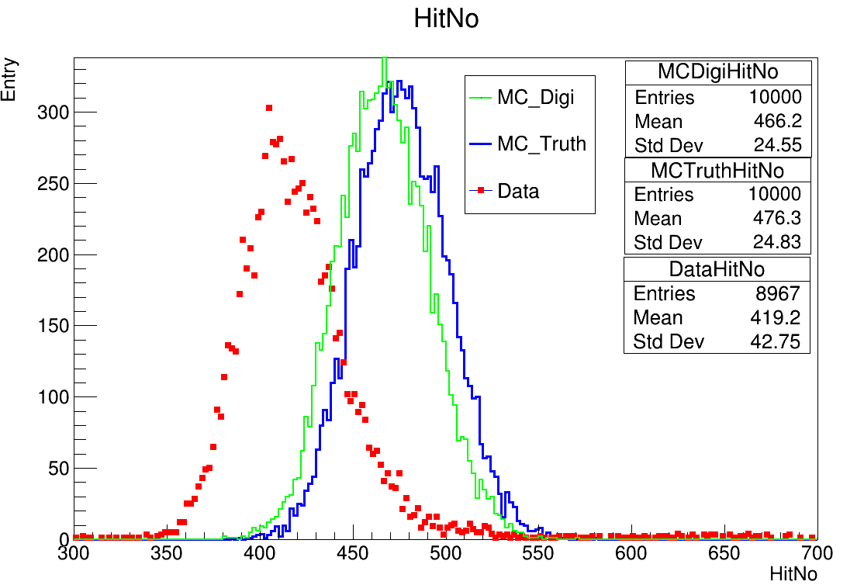
Digitization : SiPM pixel saturation
Total deposited energy decrease after introducing saturation effect
HitNo also decreases slightly

Slide 7
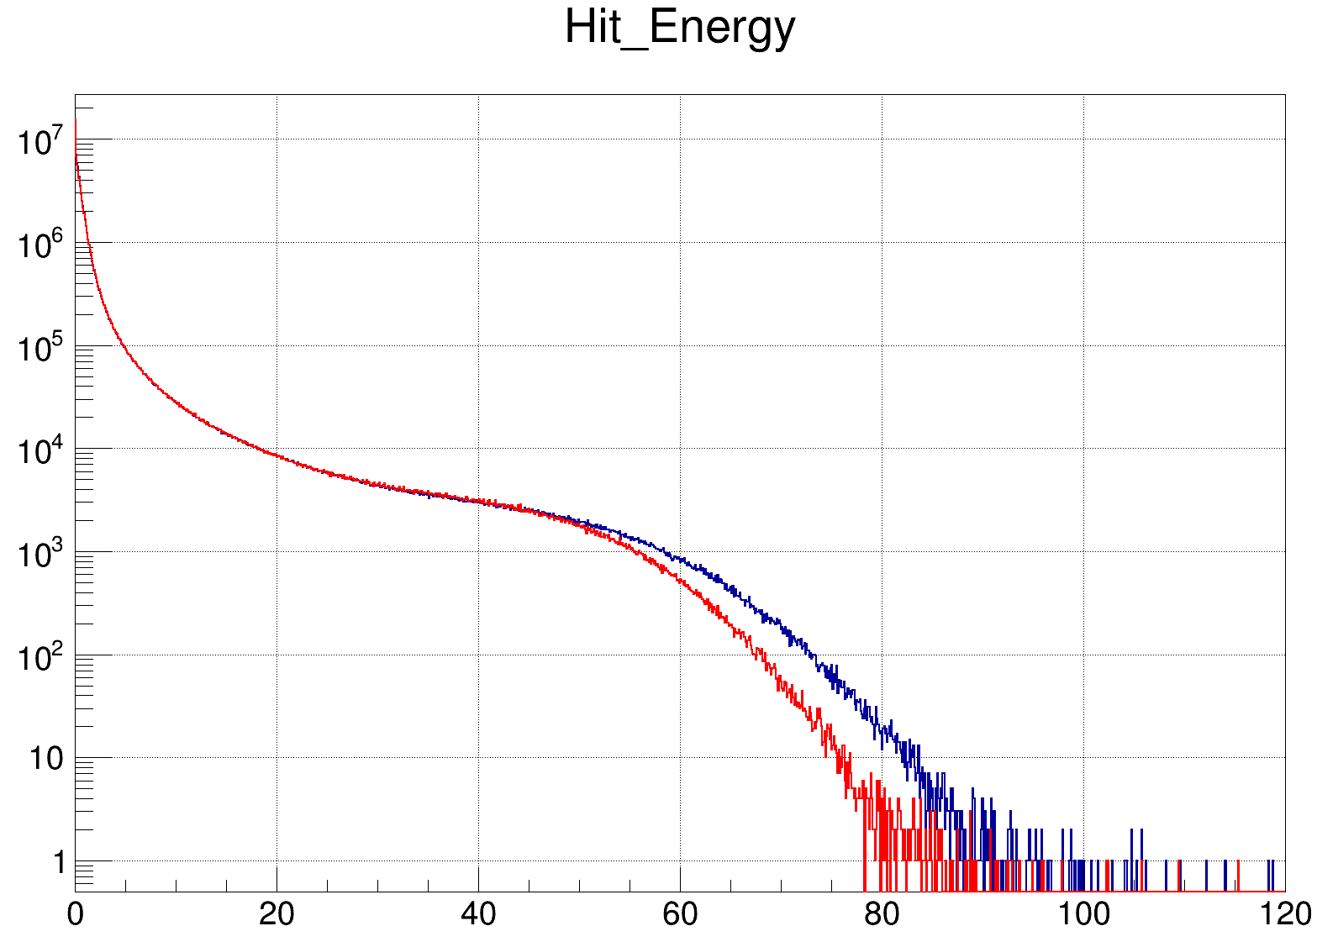
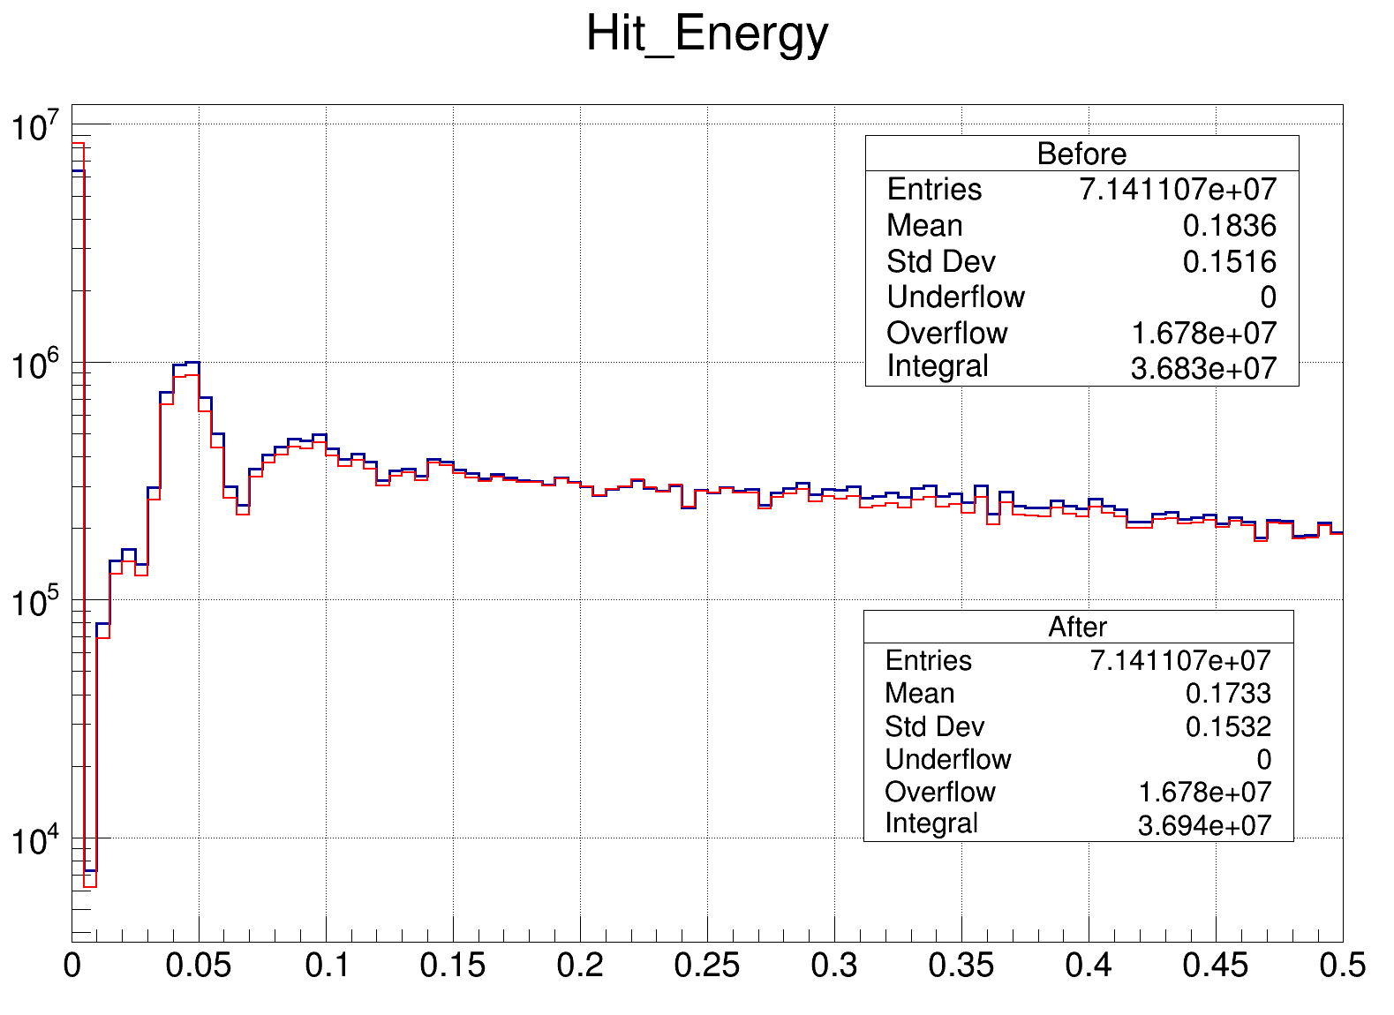
Digitization : SiPM pixel saturation
Get digitization file with SiPM saturation
Calibrate the digitization file and get hit energy

Slide 8
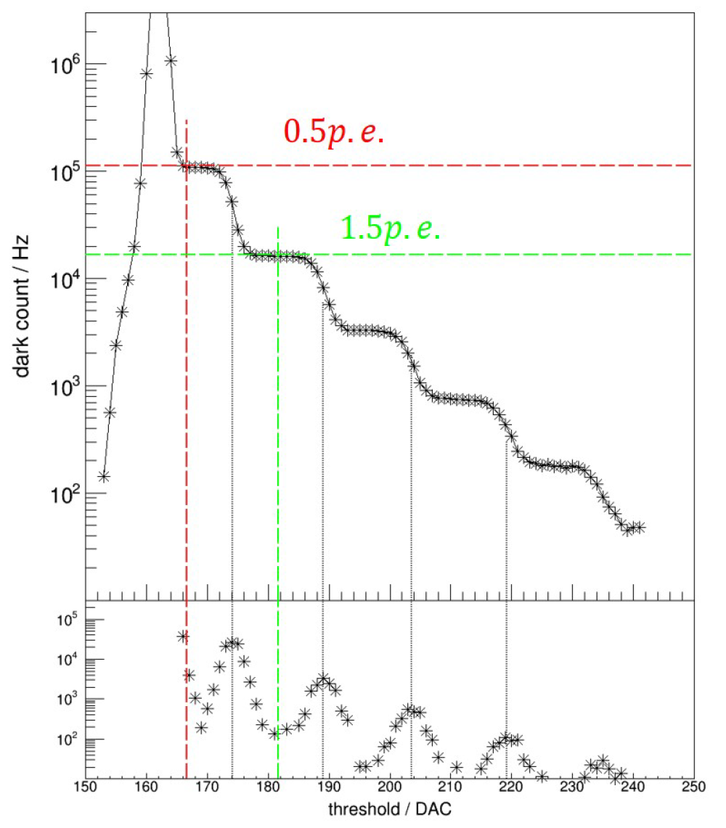
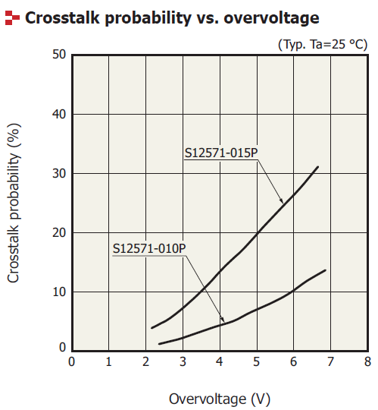
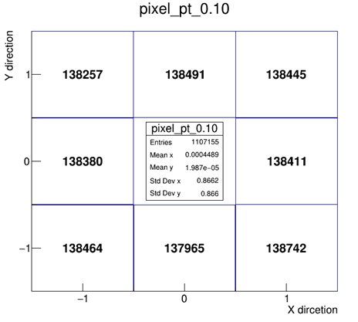
SiPM Crosstalk
Hamamatsu SiPM S12571-010P, S12571-015P
Optical crosstalk may not be ignored
P_{CT} = (N_{2p.e.} + N_{3p.e.} + N_{4p.e.} + ...)/(N_{1p.e.} + N_{2p.e.} + N_{3p.e.} + ...)
Crosstalk Model
100*100 ，67*67 pixel placement
Uniform sampling a neighboring pixel from eight directions
Set P_{CT} as probability of optical crosstalk occurs in one of neighboring pixel

Slide 9
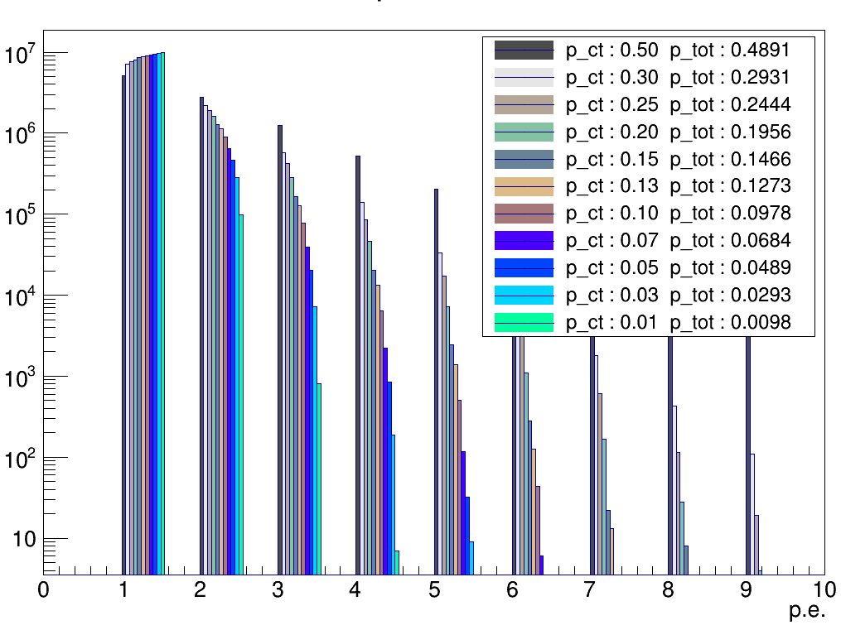
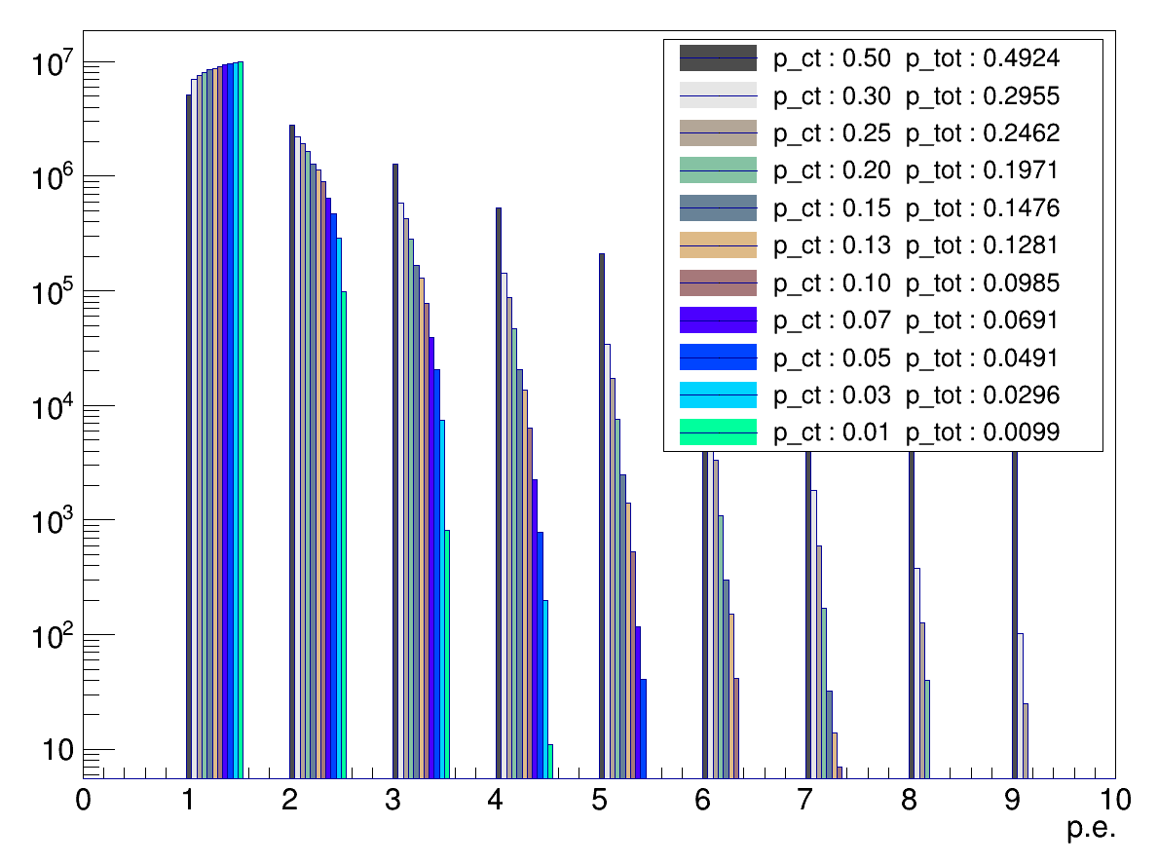
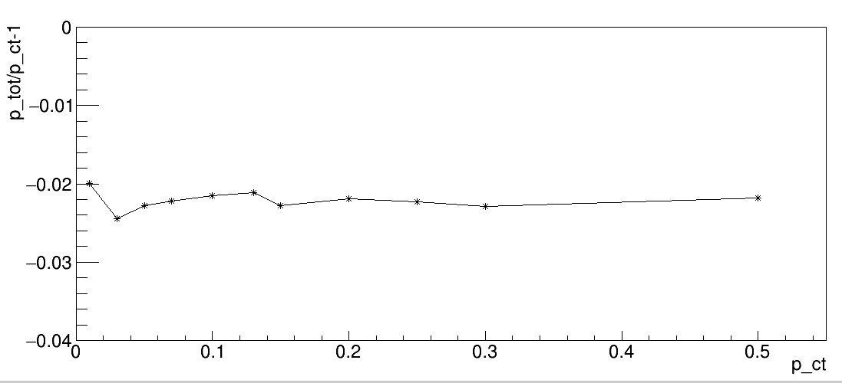
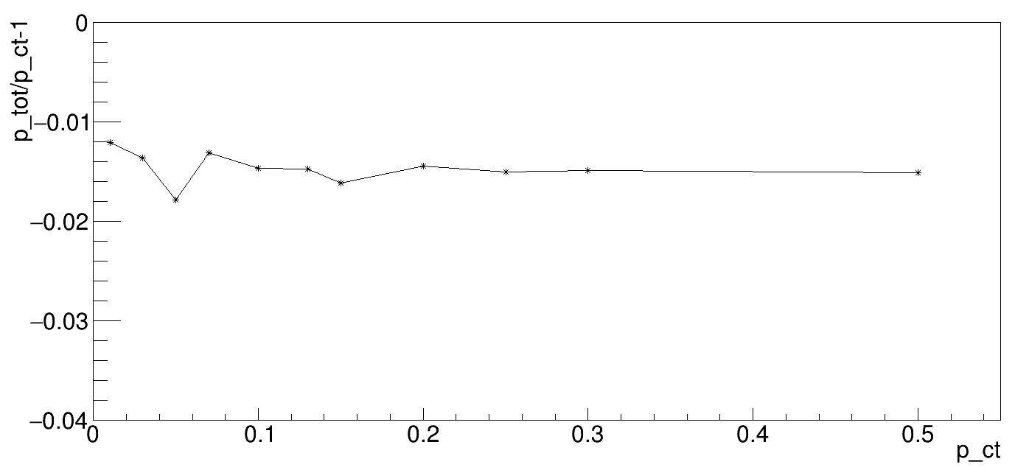
Crosstalk model : Scan crosstalk probability
10um SiPM
P_ct : probability of crosstalk between adjacent pixels
P_tot : probability of crosstalk calculated by P_{CT} = (N_{2p.e.} + N_{3p.e.} + N_{4p.e.} + ...)/(N_{1p.e.} + N_{2p.e.} + N_{3p.e.} + ...)
P_tot is slightly less than P_ct
15um ~2.2%
10um ~1.5%
10um SiPM

Slide 10
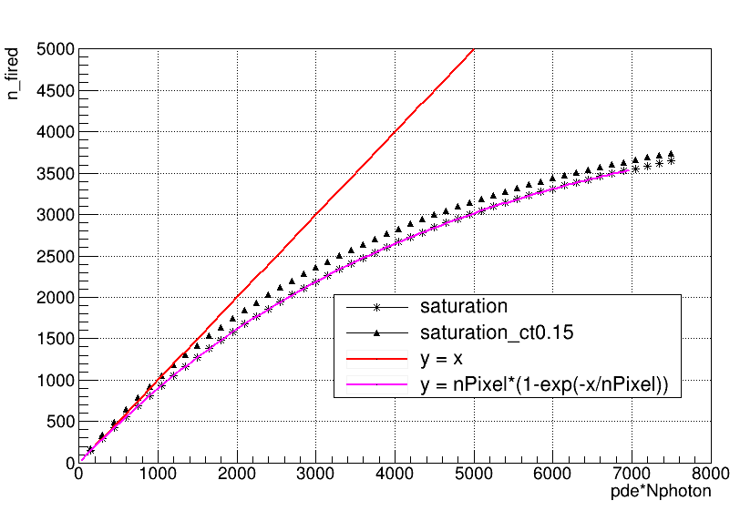
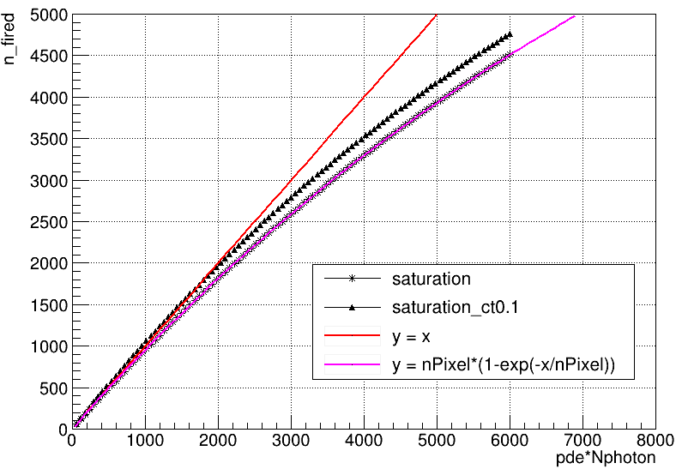
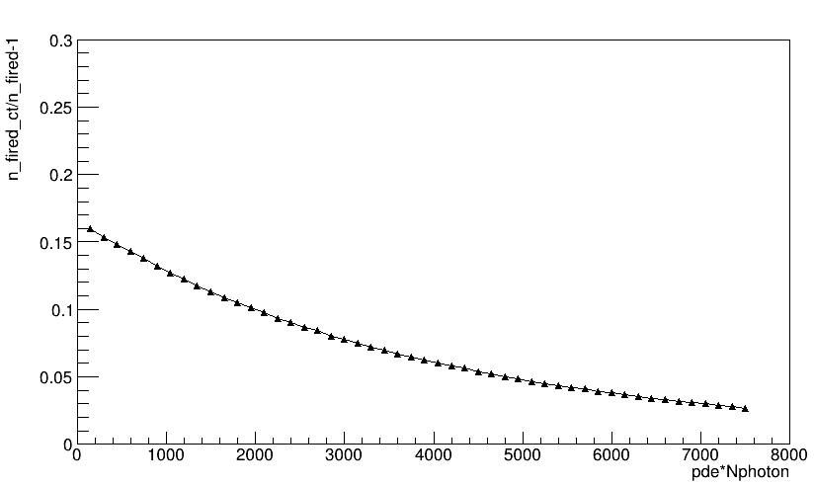
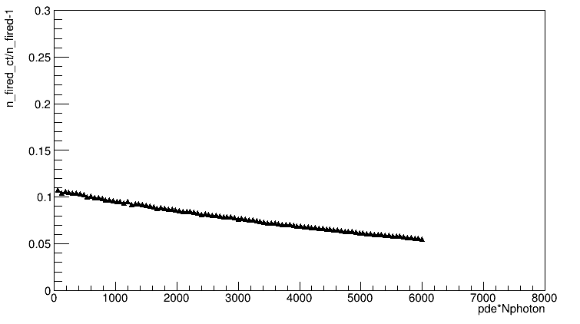
Crosstalk model : comparison
15um SiPM
Formula match SiPM saturation very well
Crosstalk would increase the n_fired
The discrepancy between with/without crosstalk model will decrease
15um SiPM
10um SiPM

Slide 11
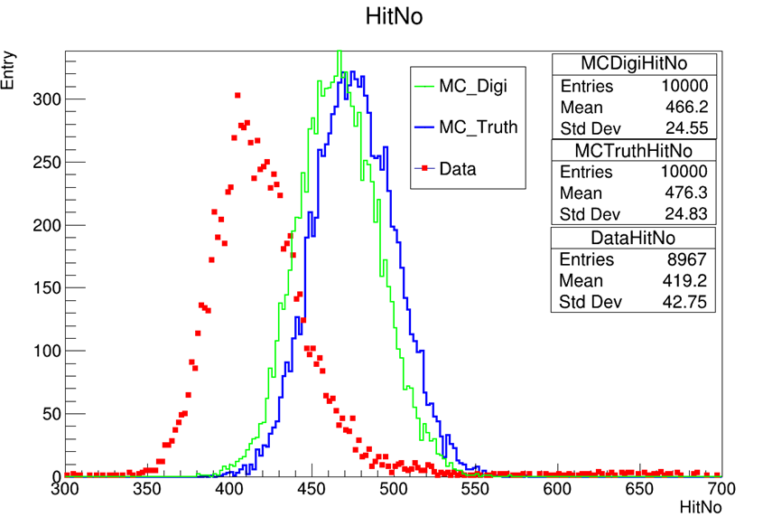
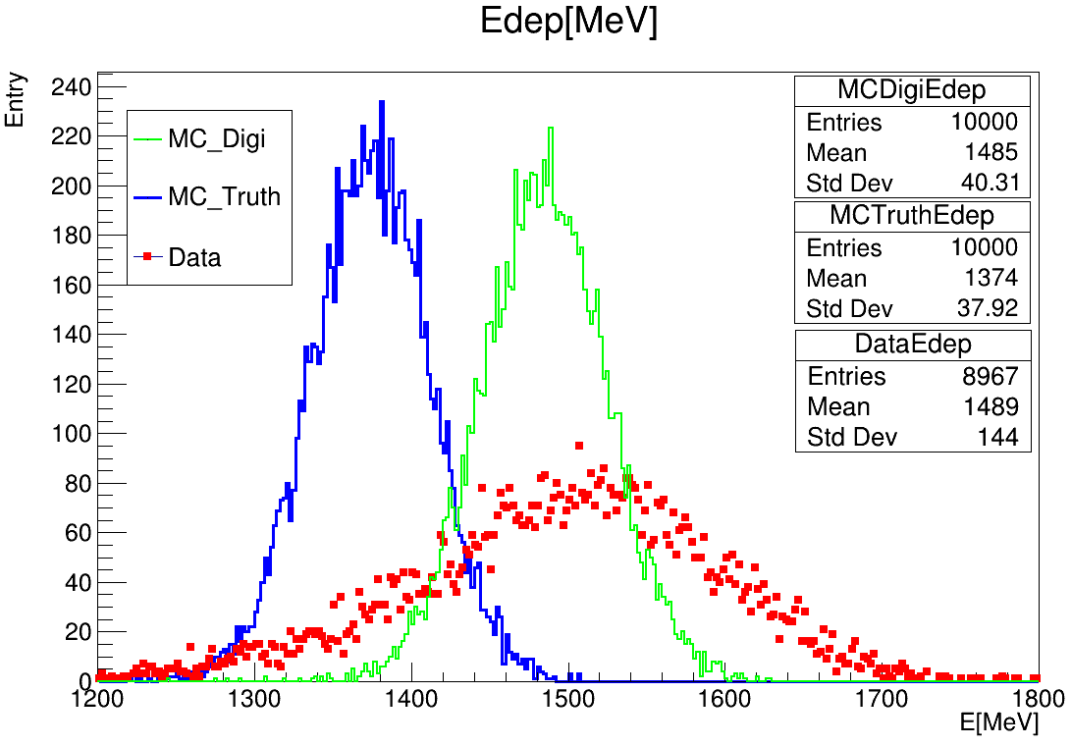
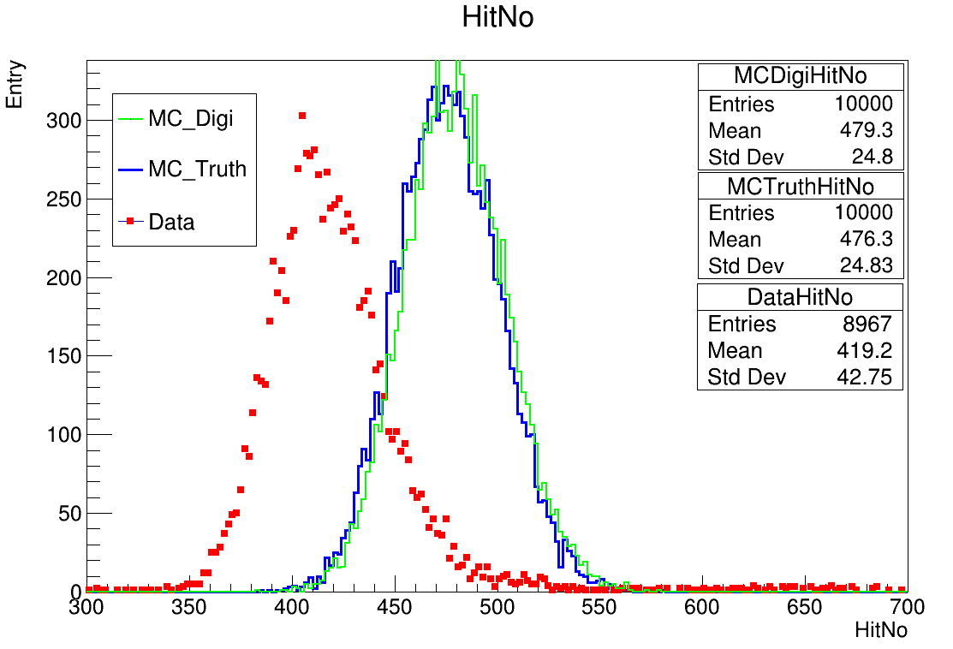
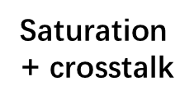
Digitization: crosstalk model
Energy mean value increases by 8%
Saturation
Saturation

Slide 12
Digitization : ADC
ADC && gaussian smear
ADC Mean = $N_{p.e.}$ * SiPM Gain
ADC Sigma = 3 * sqrt($N_{p.e.}$)?
High-low gain mode ADC
Pedestal fluctuation
High-low gain saturation
High gain saturation: high adc > switch point , let high adc =4000
Low gain saturation : low adc > 3000, let low adc = 3000

Slide 13
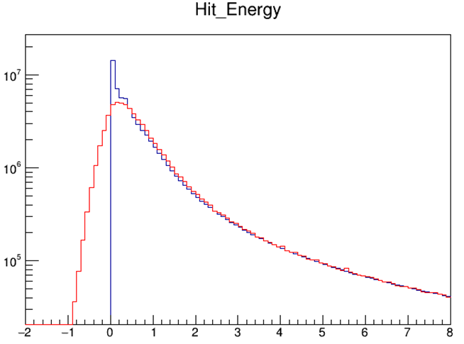
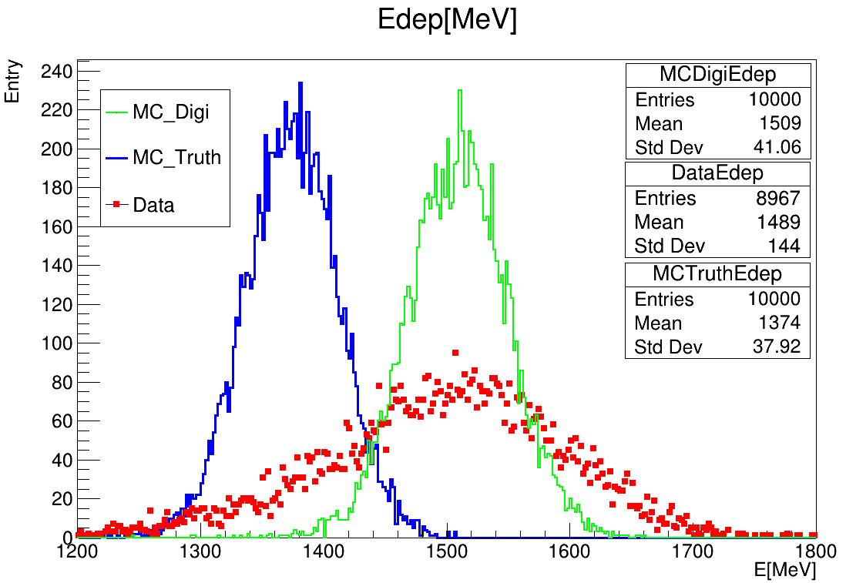
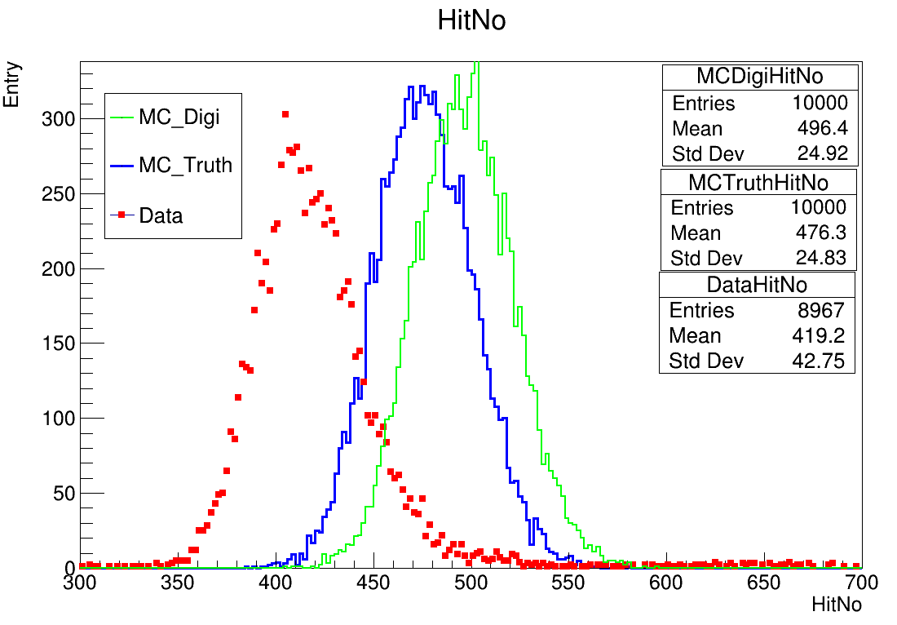
Digitization : ADC
The spectrum of hit energy becomes lower and width due to ADC smear

Slide 14
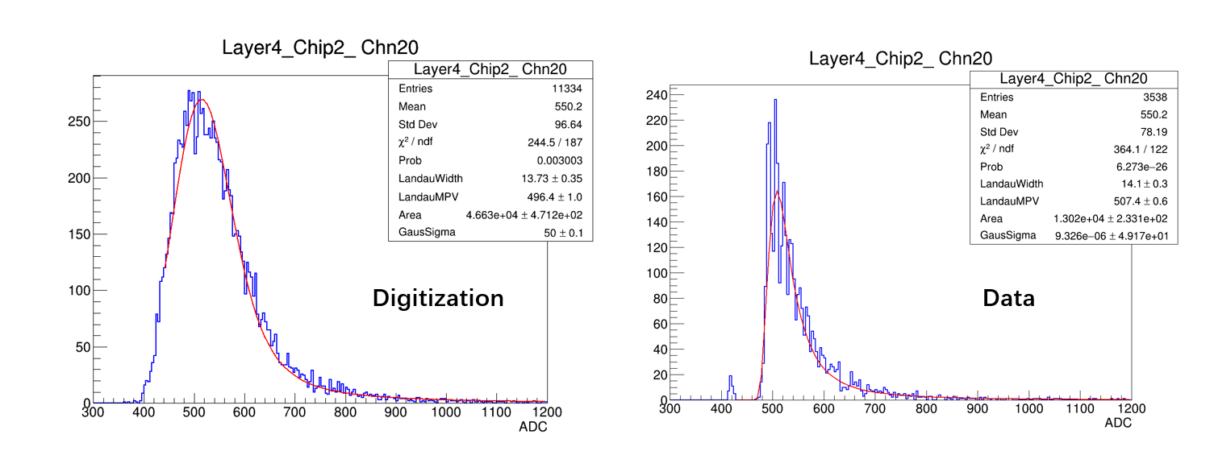
Summary && prospect
Digitization process finished and verified
Energy mean value could be explained by the digitization, energy sigma still unknown
HitNo mean value is still large than data
Muon MC Digitization check
Reconstruct MIP spectrum

Slide 15
Backup
Photon produce
SiPM
Model
ADC
Convert
$$E_{Truth}$$
$$N_{photon}$$
$$N_{fired}$$
ADC

