Slide 1






Beam Tests of the CEPC AHCAL Prototype
Hongbin Diao
State Key Laboratory of Particle Detection and Electronics
University of Science and Technology of China

Slide 2
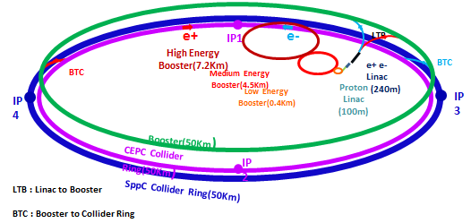
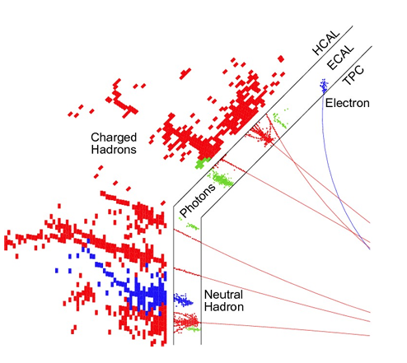
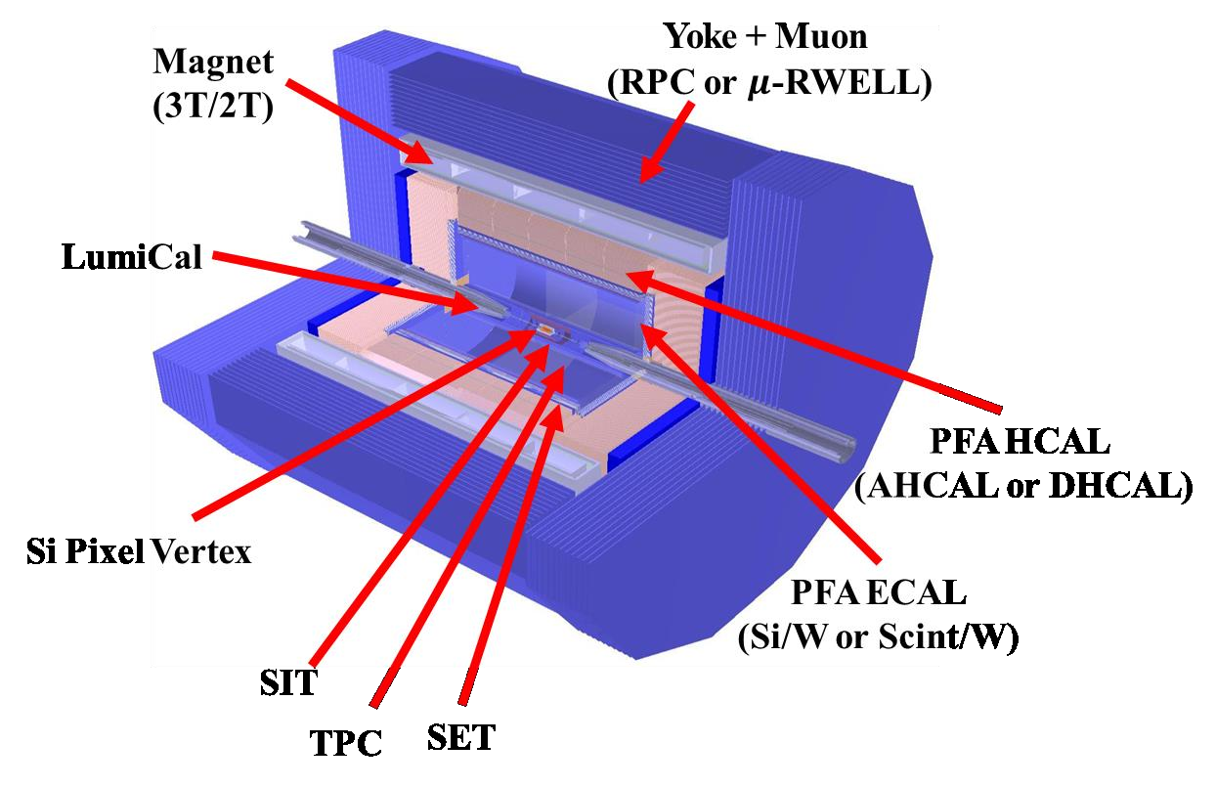
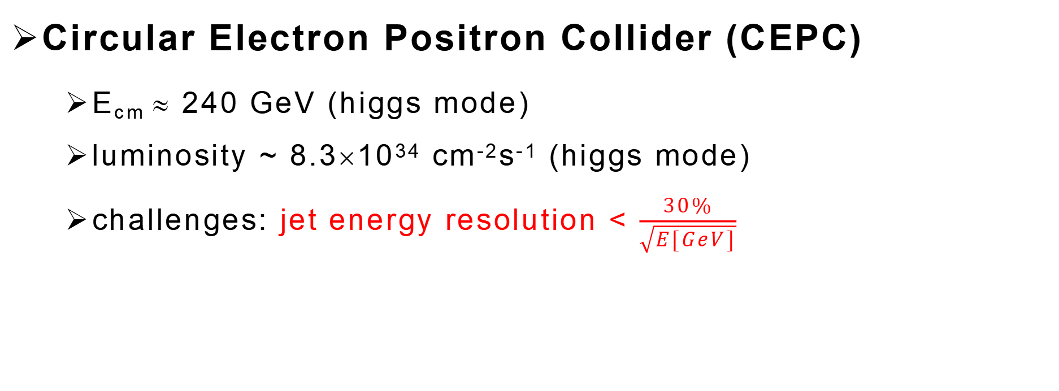
Motivation
Circular Electron Positron Collider (CEPC)
  E_{cm} ≈ 240 GeV (higgs mode)
  luminosity ~ 8.3×10³⁴ cm⁻²s⁻¹ (higgs mode)
  challenges: jet energy resolution < $\frac{30\%}{\sqrt{E[GeV]}}$
Particle Flow Algorithm (PFA)
  High granularity
  Good track finding
  Good energy resolution

Slide 3
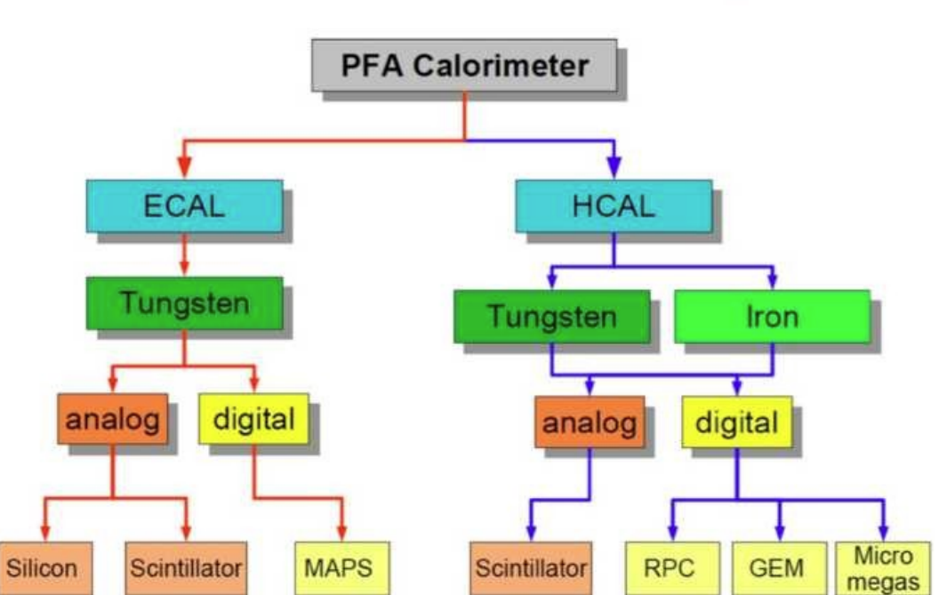
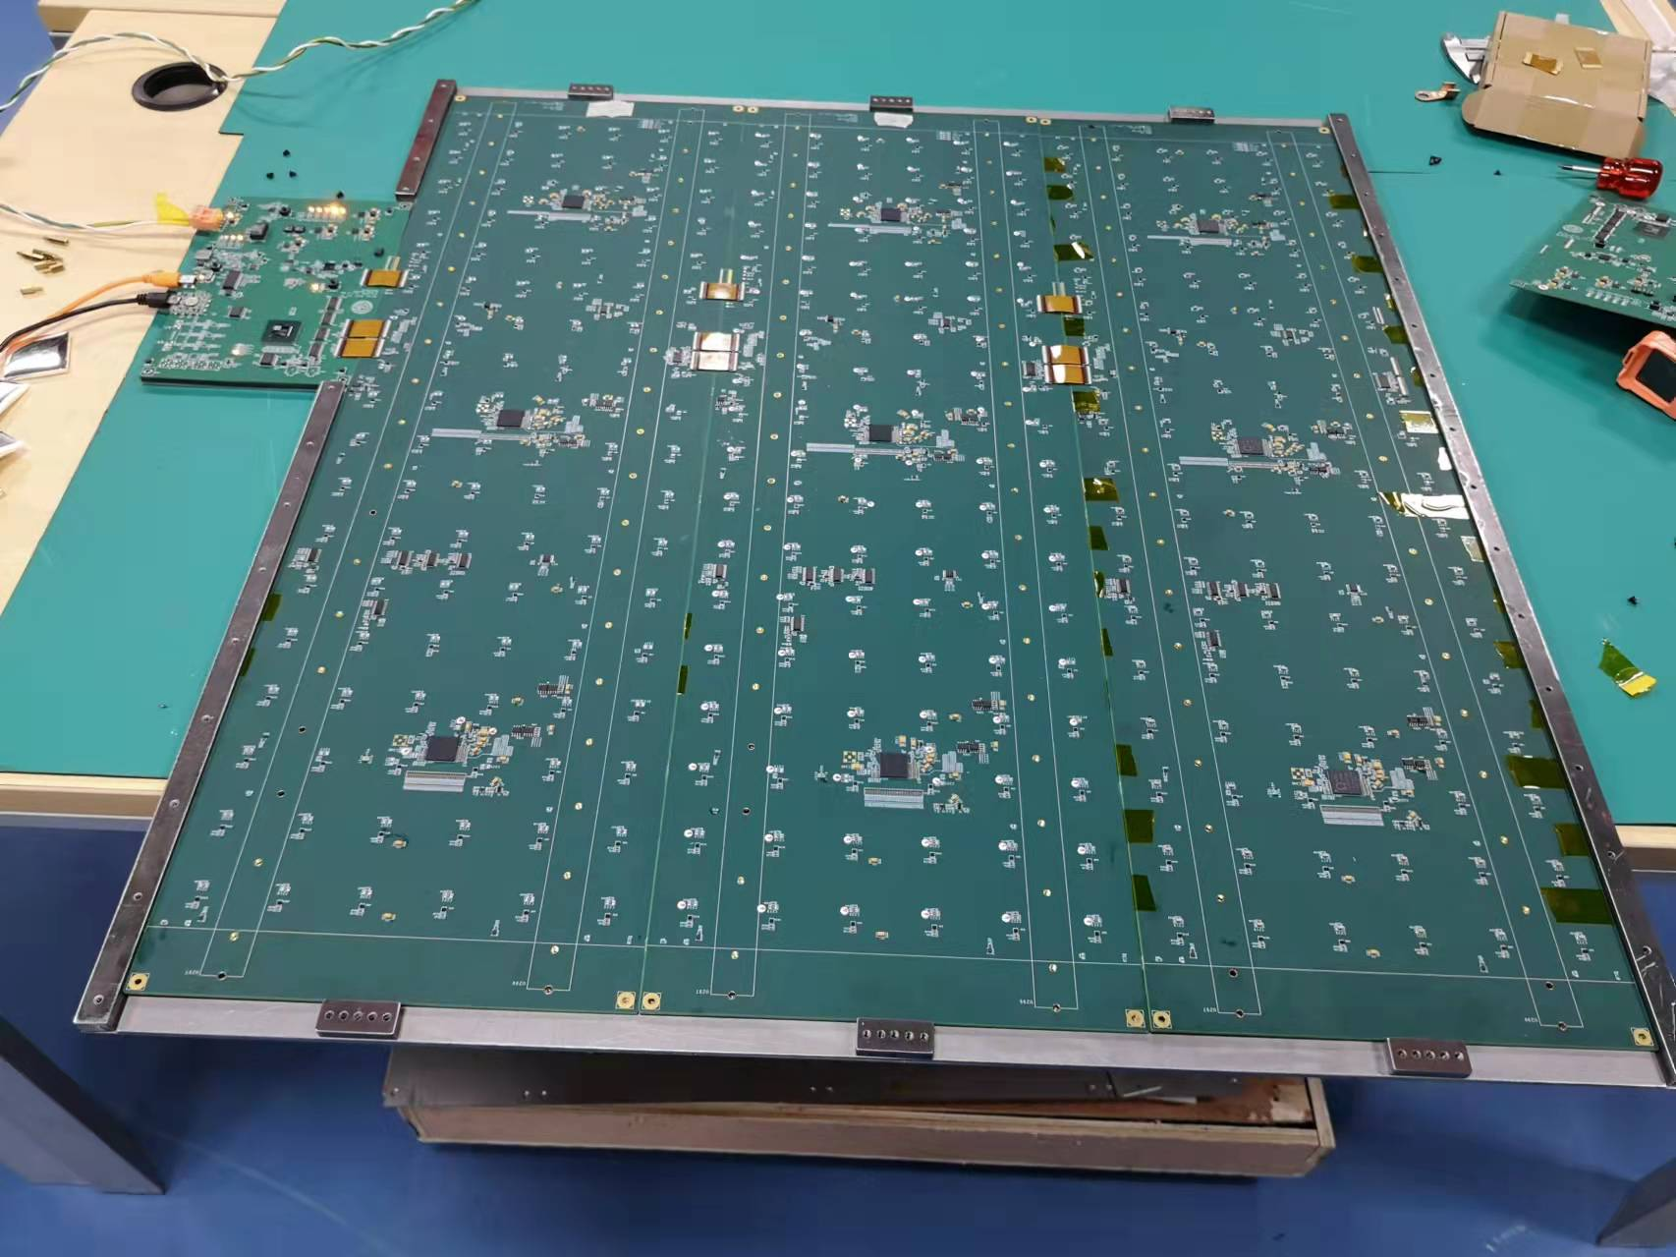
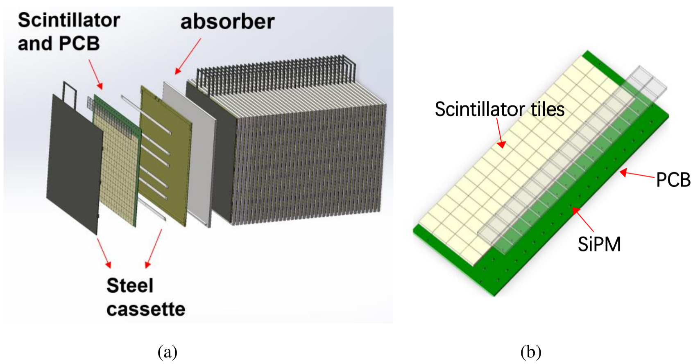
AHCAL Prototype
an Analogue readout Hadronic Calorimeter prototype has been developed
Total layers | 40
Sensitive area | 72cm*72cm
Granularity | 4cm*4cm*0.3cm
Total channels | 12960
NIL | 4.6
Energy Resolution | <60%@ 1 GeV
Weight | 5.0T
Plastic
Glass
AHCAL

Slide 4
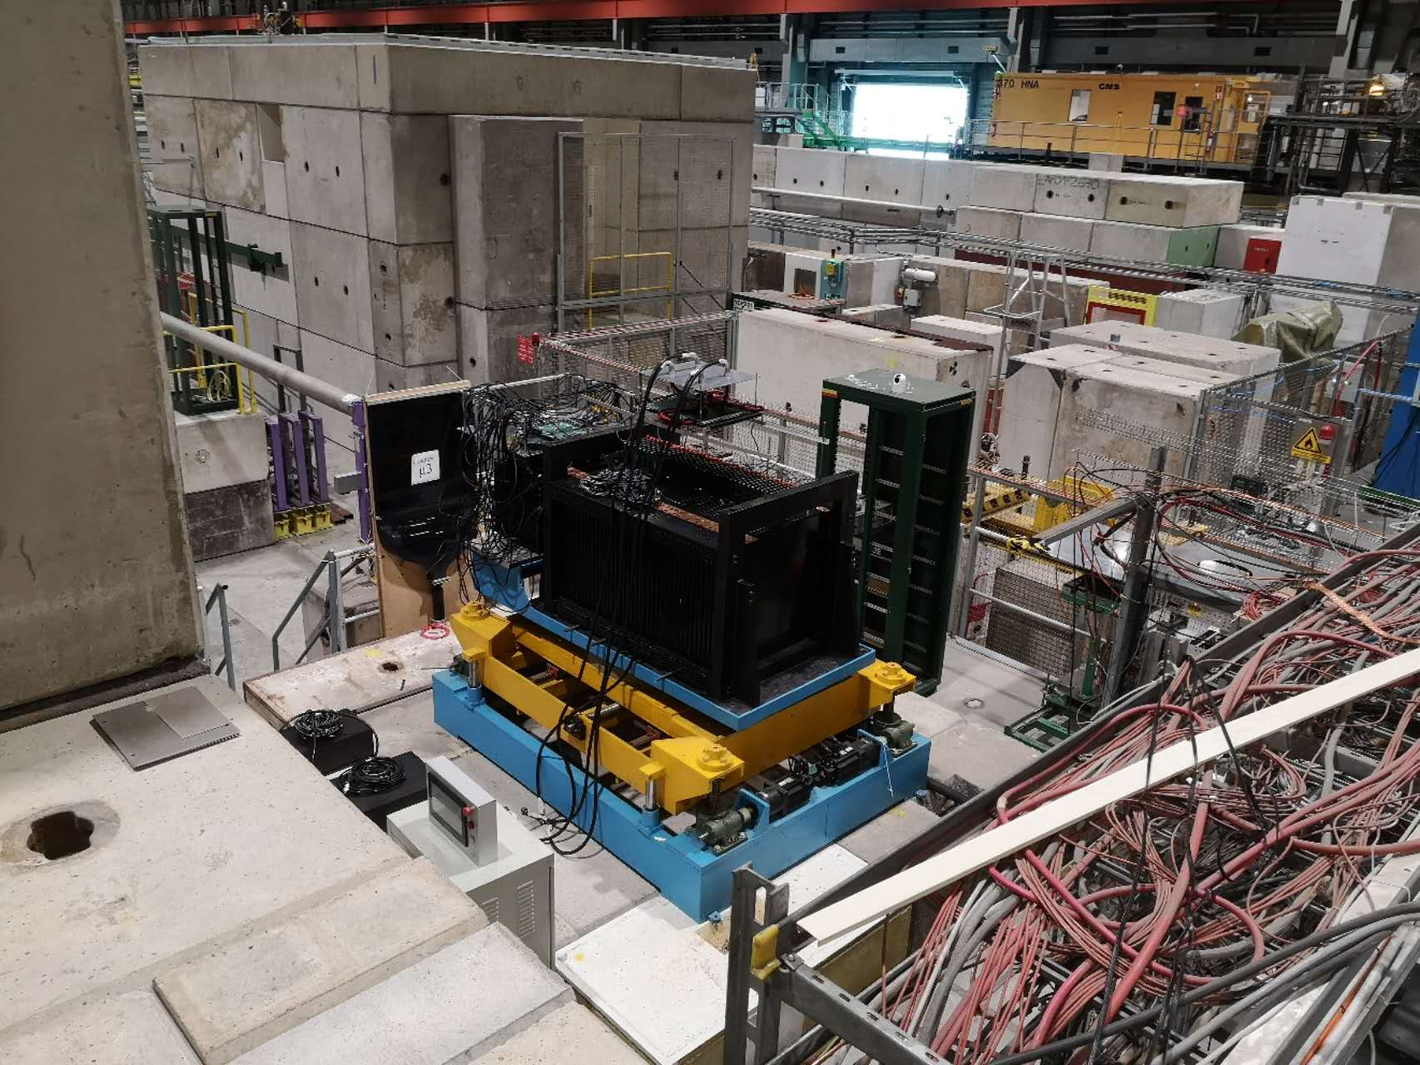
Beam Tests
3 beam tests have been done at CERN
  muon position scan(100GeV/c)
  pion (1-120GeV/c)
  electron (1-120GeV/c)
2022 SPS H8
2023 PS T9
2023 SPS H2

Slide 5
Outline
Parameters Calibration
Simulation & Digitization
Energy Reconstruction
Pedestal
Non-uniform of Scintillator
Event Selection
High-low ratio
Photon Flucturation
MIP
SiPM response
Energy Reconstruction
Single PhotoElectron
Electronic Flucturation

Slide 6
Outline
Parameters Calibration
Simulation & Digitization
Energy Reconstruction
Pedestal
Non-uniform of Scintillator
Event Selection
High-low ratio
Photon Flucturation
MIP
SiPM response
Energy Reconstruction
Single PhotoElectron
Electronic Flucturation

Slide 7
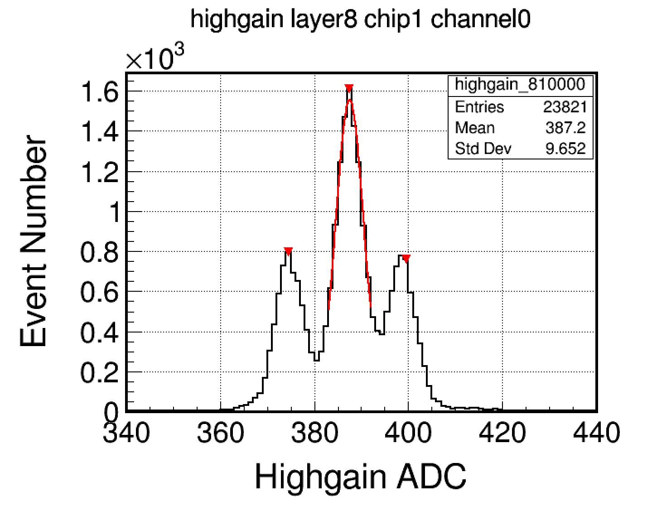
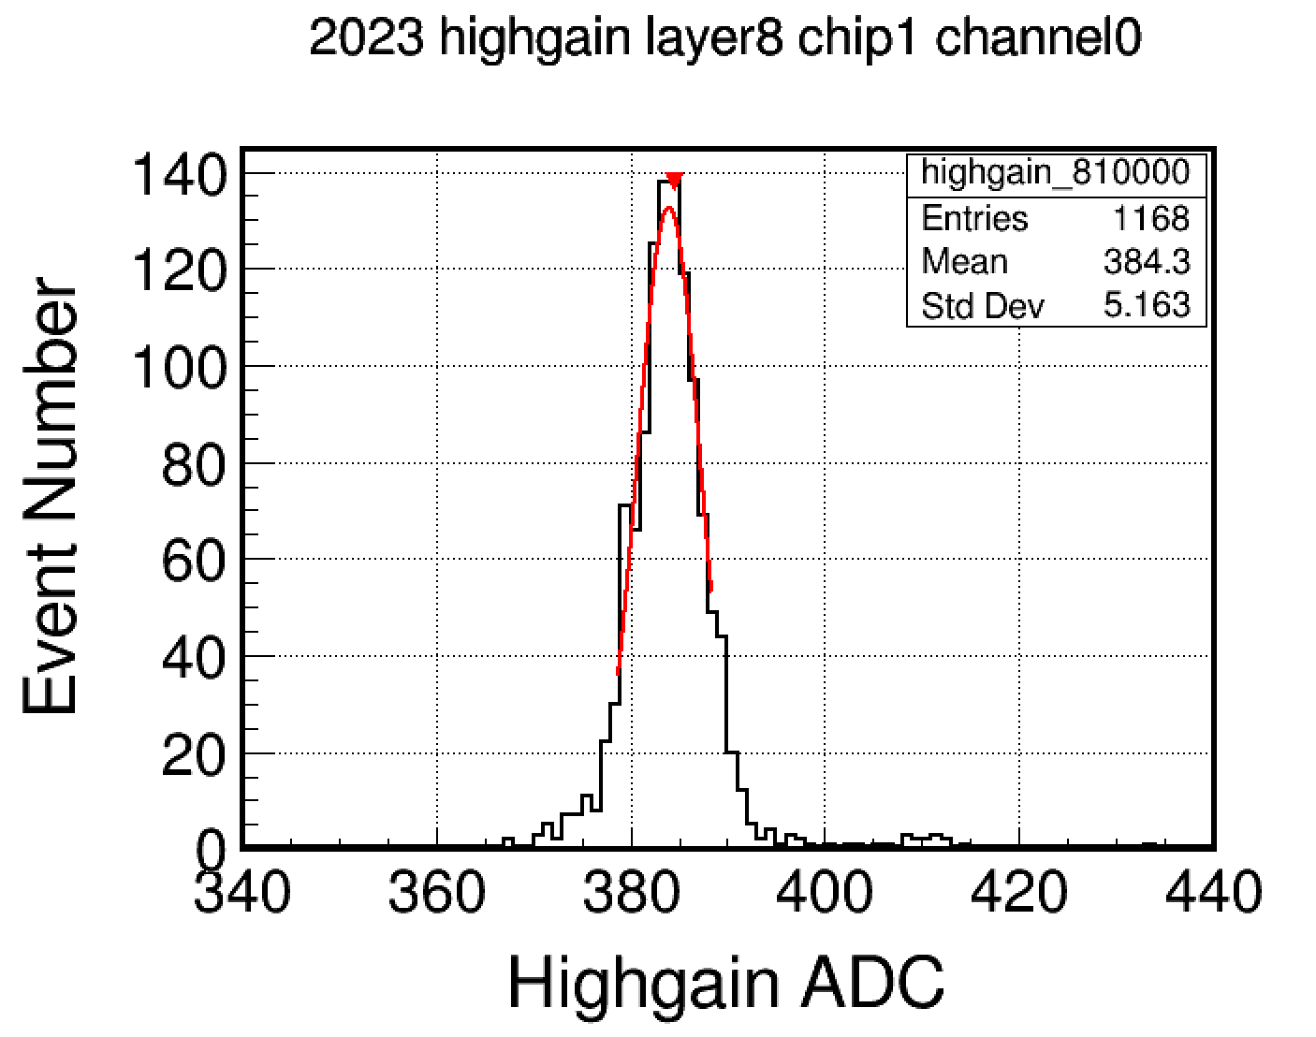
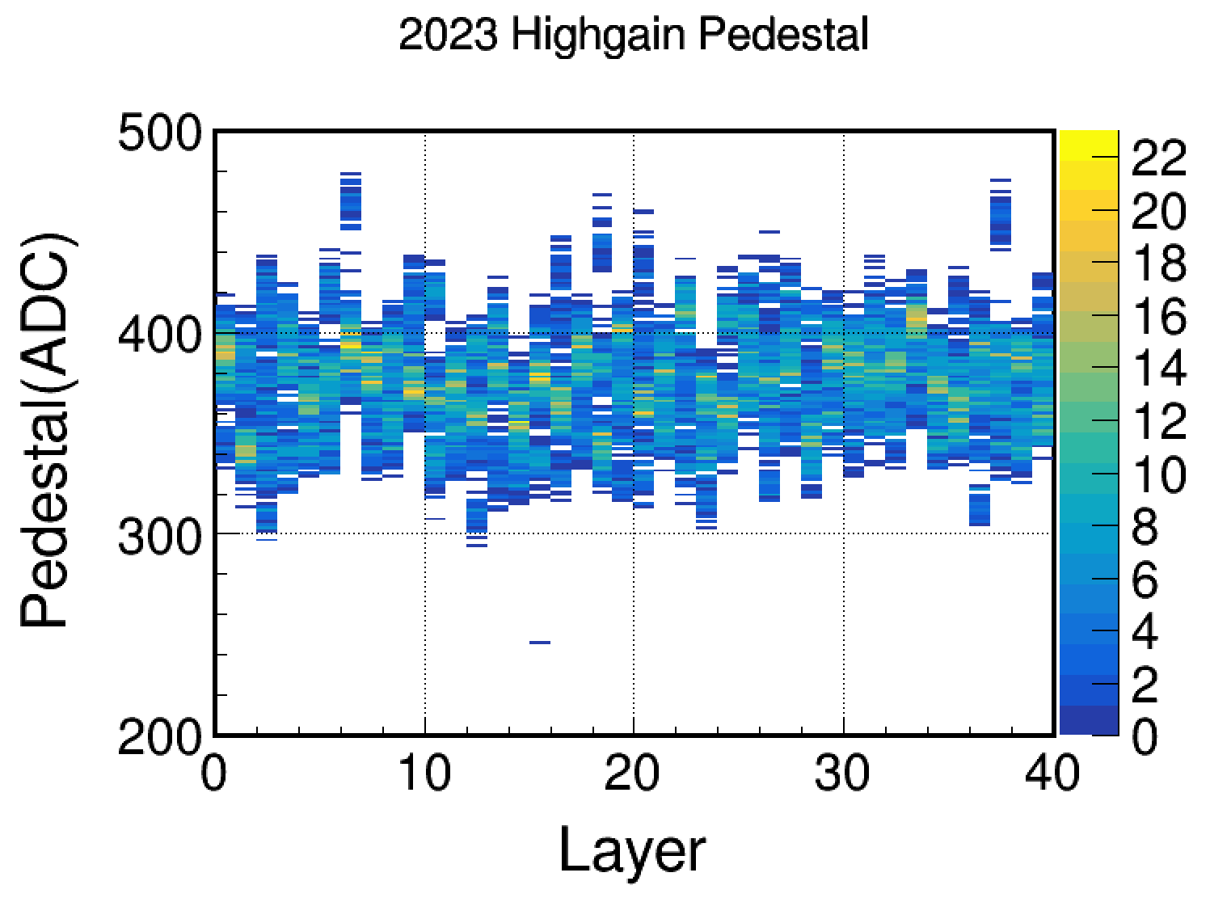
Pedestal Calibration
the mean of electronic offset is pedestal, its width is noise level
normally(HitTag=0), pedestal have multiple peaks due to crosstalk
use force-trigger-mode now to prevent this problem
hittag=0 mode
force trigger mode

Slide 8
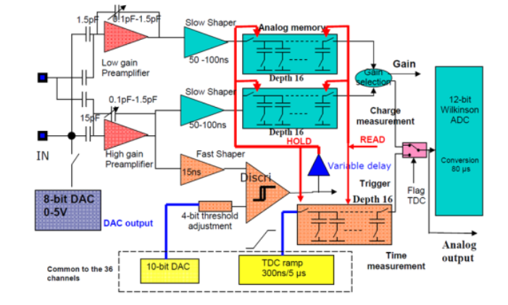
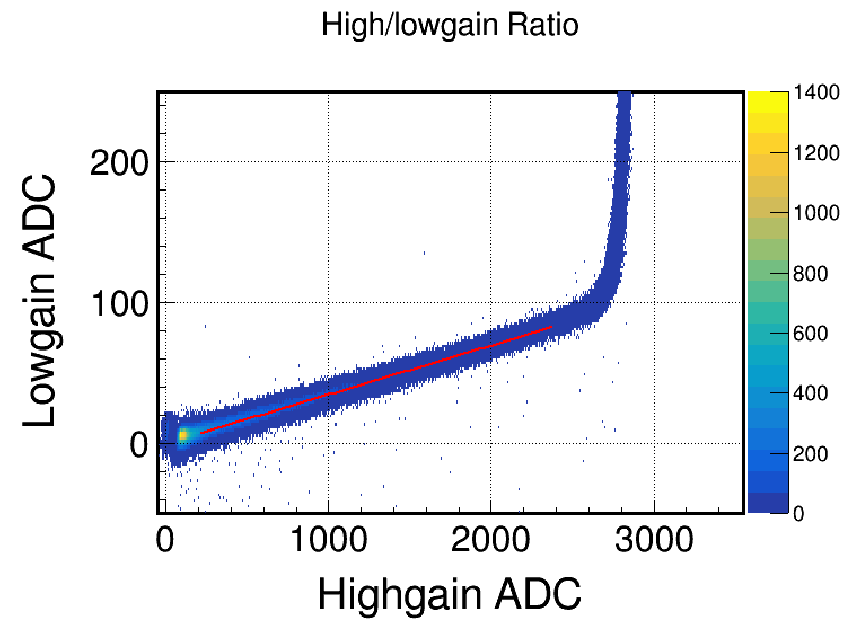
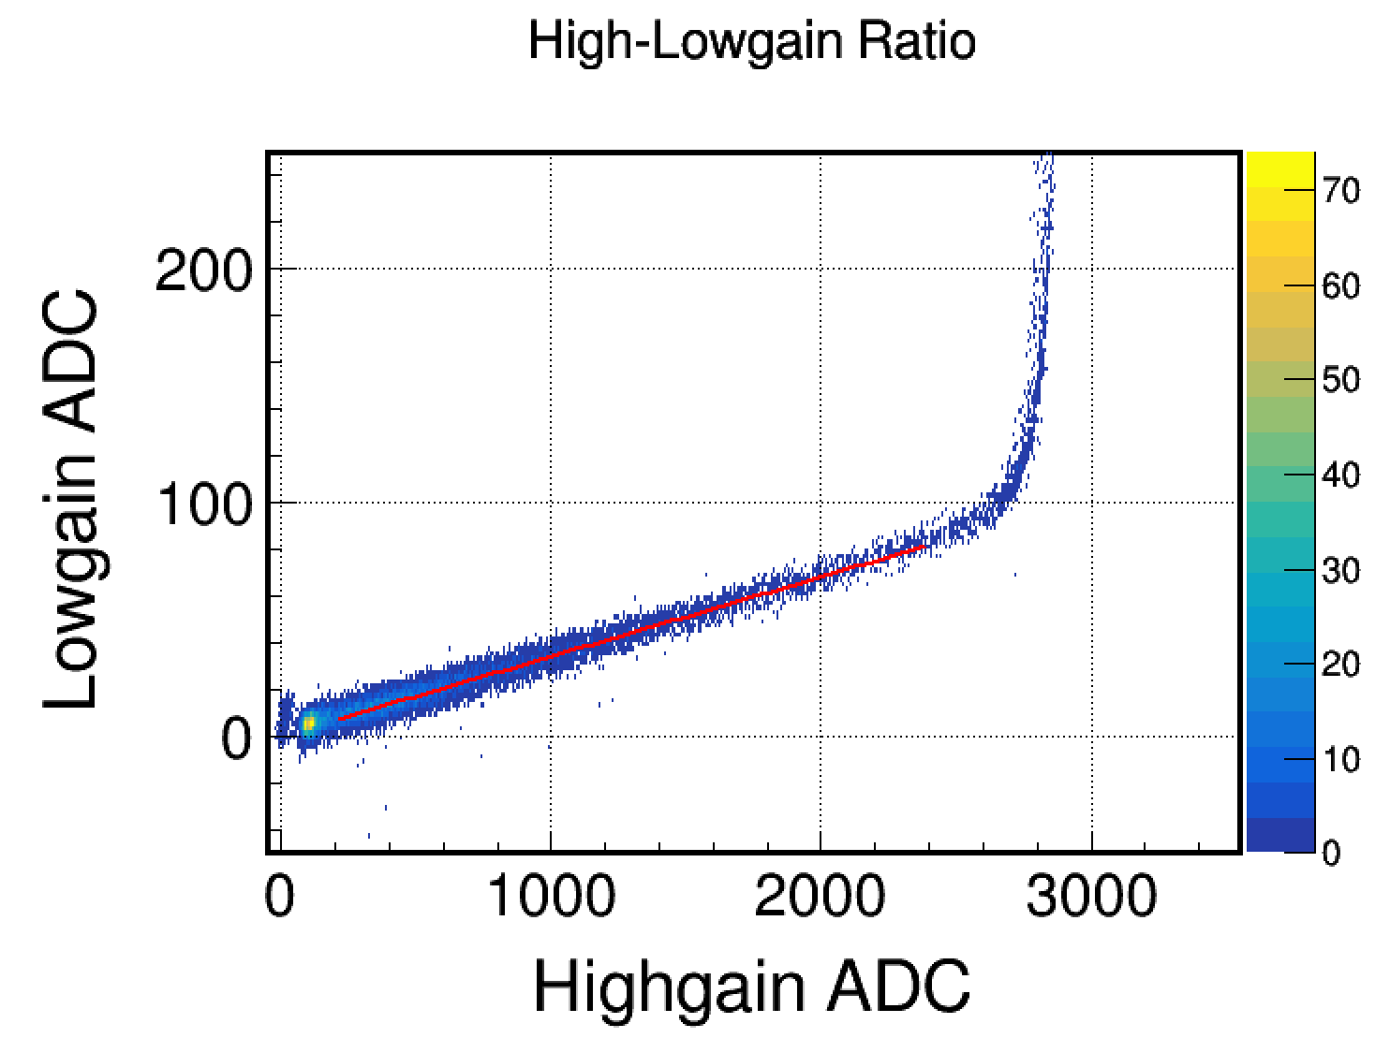
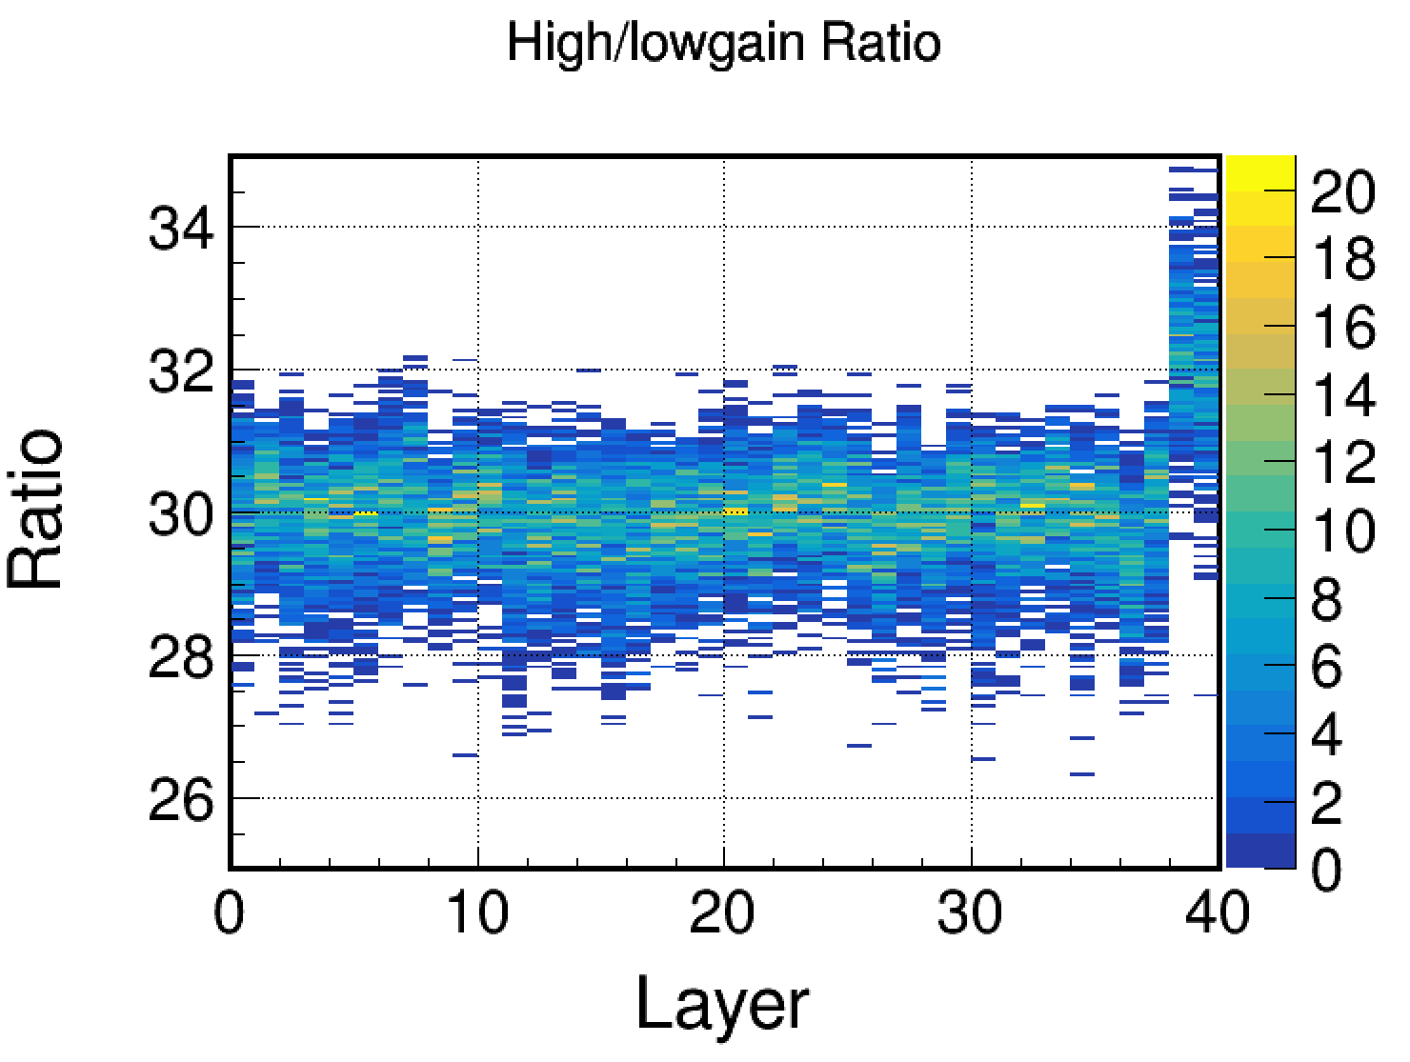
High-Lowgain Calibration
SPIROC2E chip has two gain modes to cover wider dynamic range
using beam test data, calibrate high-lowgain ratio
set fit range as (200,max highgain-500)
200
max-500
fit range
e-
pi-

Slide 9
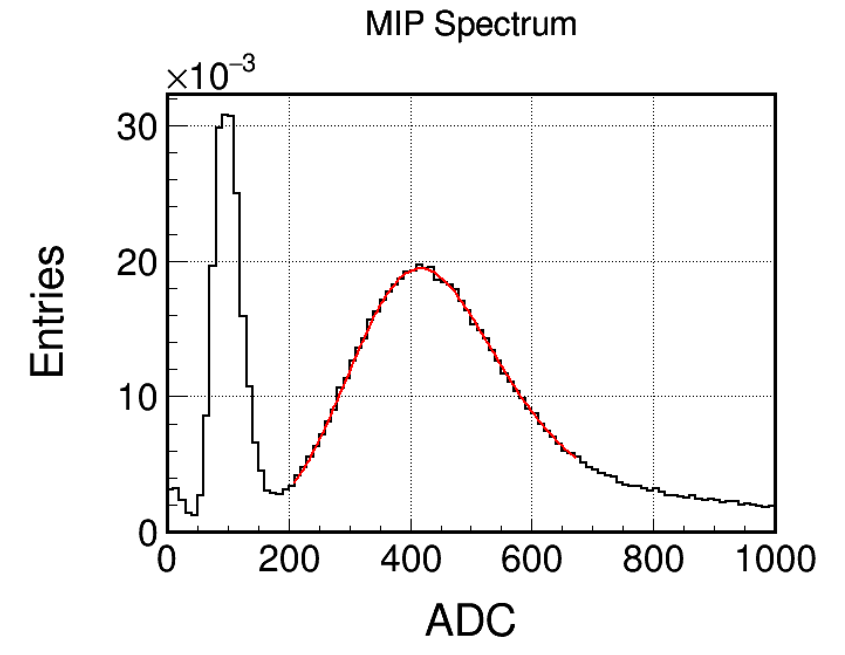
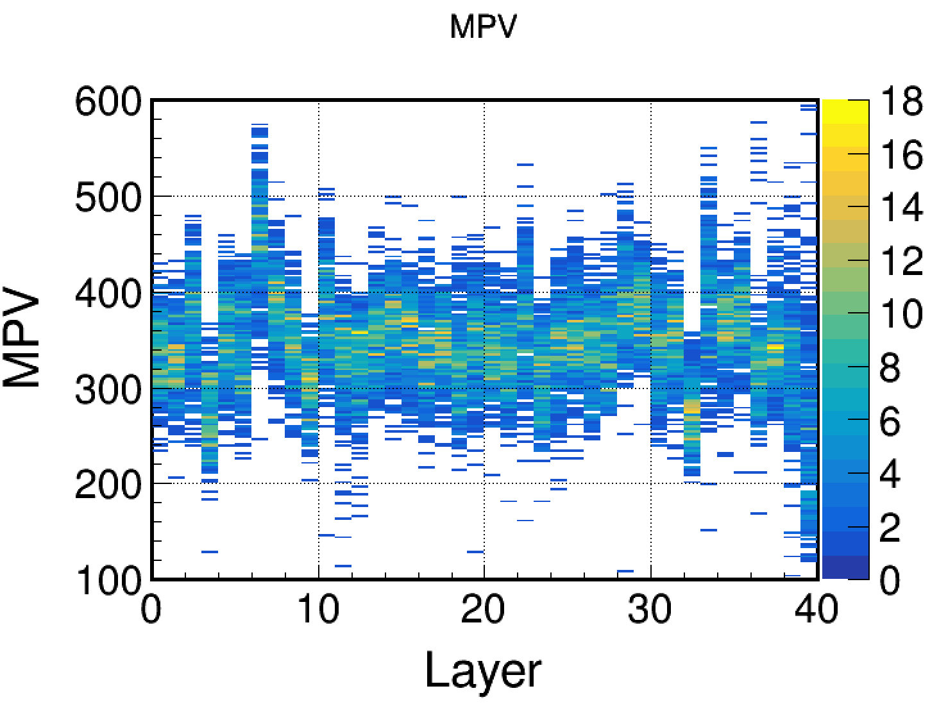
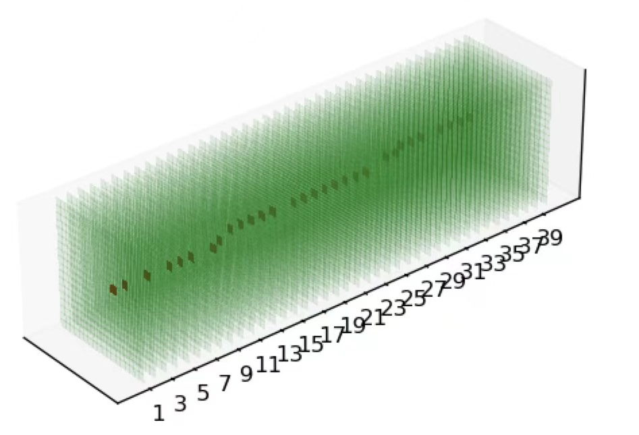
MIP Calibration
MIP is the key to reconstruct energy
MPV value is obtained by fitting 100GeV/c muon
need temperature correct
MIP event
noise
MIP

Slide 10
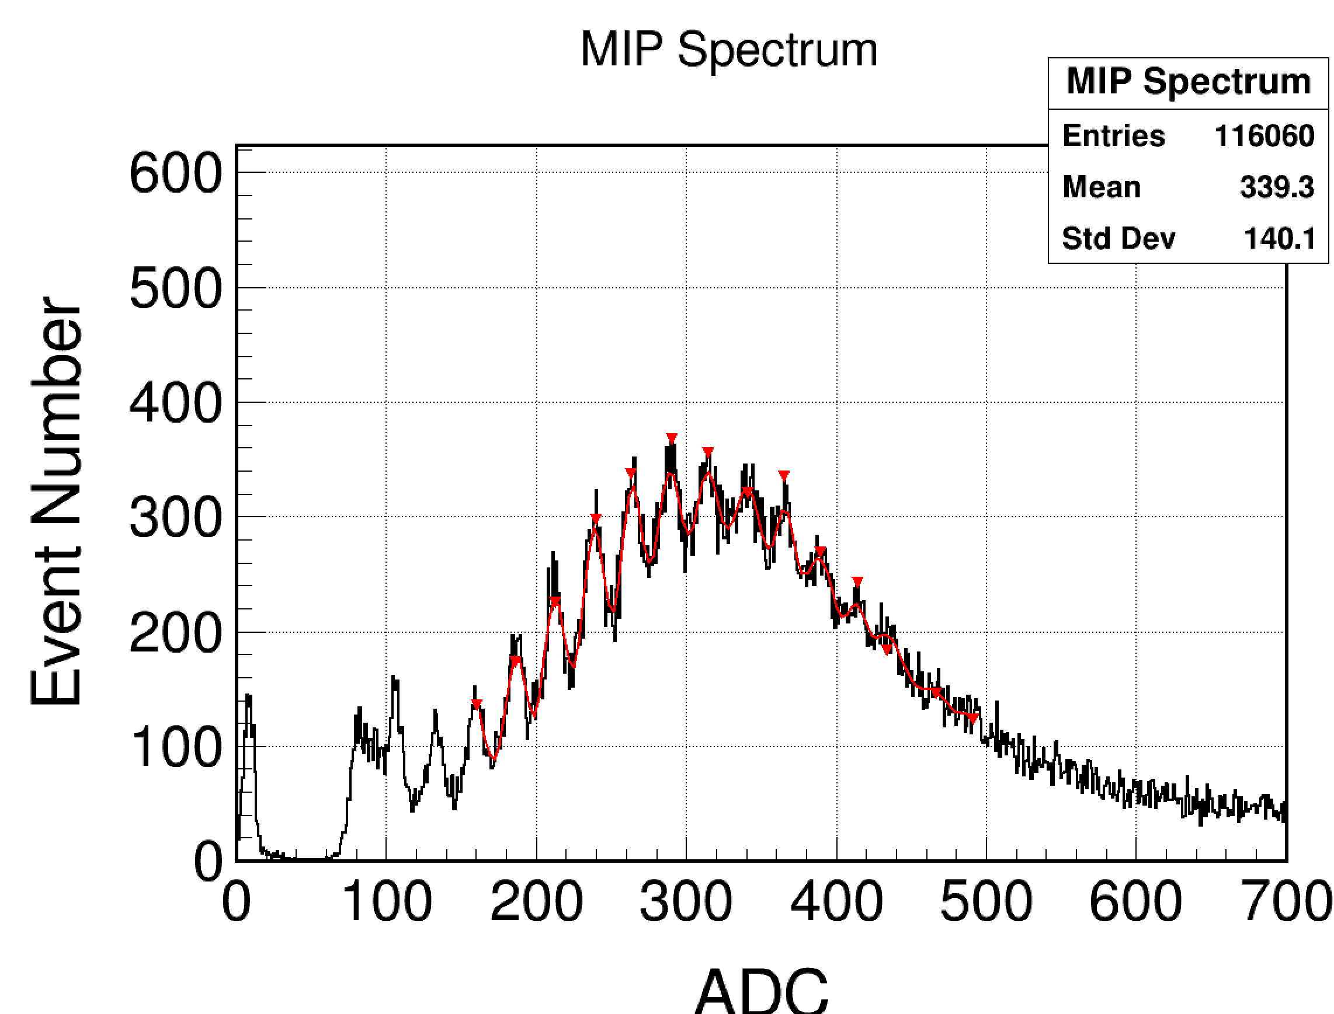
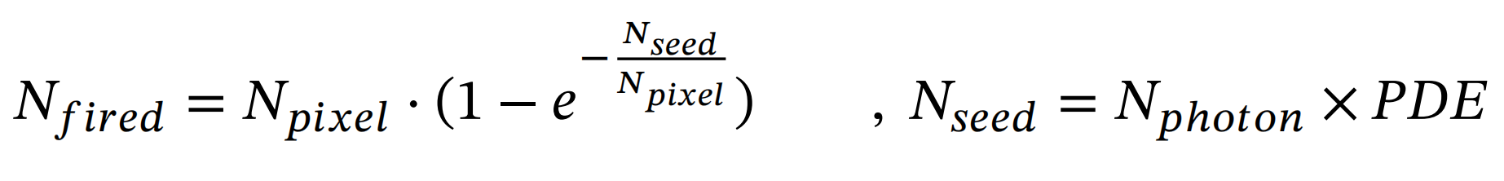
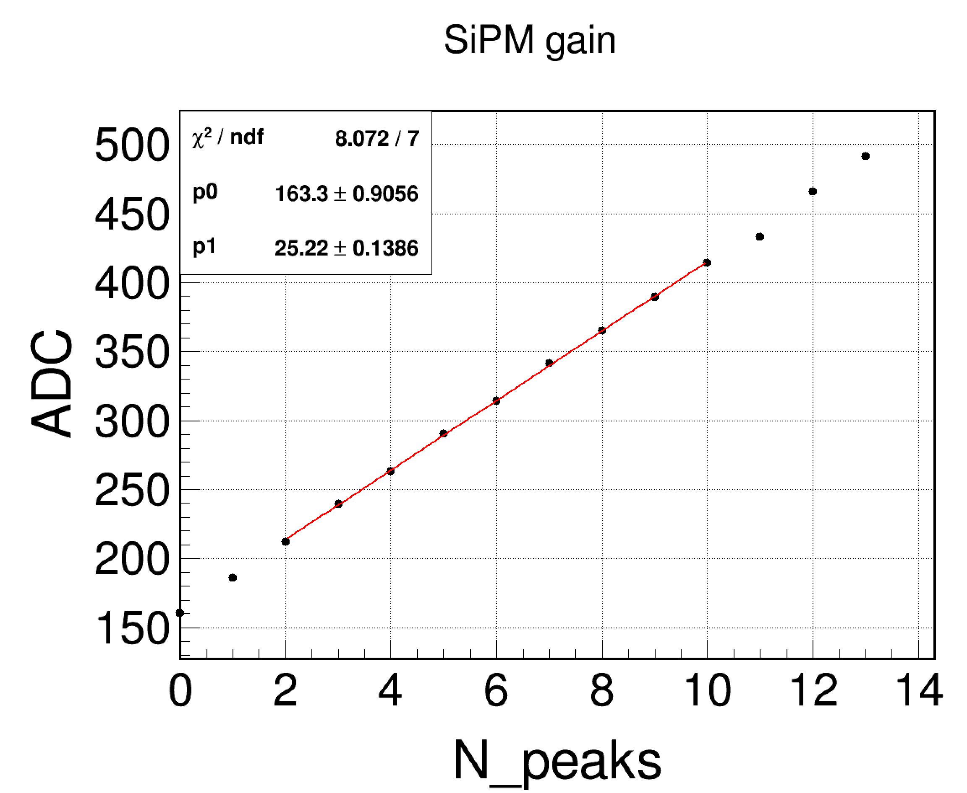
SPE Calibration
SiPM is a photon-counting device using multiple APD pixels operating in Geiger mode
Its reponse is not linear strictly
to correct this effective, single photoelectron (SPE) calibration is necessary
muon data(MIP) are fitted with multi-gaussian to calculate SiPM gain for each channel

Slide 11
Outline
Parameters Calibration
Simulation & Digitization
Energy Reconstruction
Pedestal
Non-uniform of Scintillator
Event Selection
High-low ratio
Photon Flucturation
MIP
SiPM response
Energy Reconstruction
Single PhotoElectron
Electronic Flucturation

Slide 12
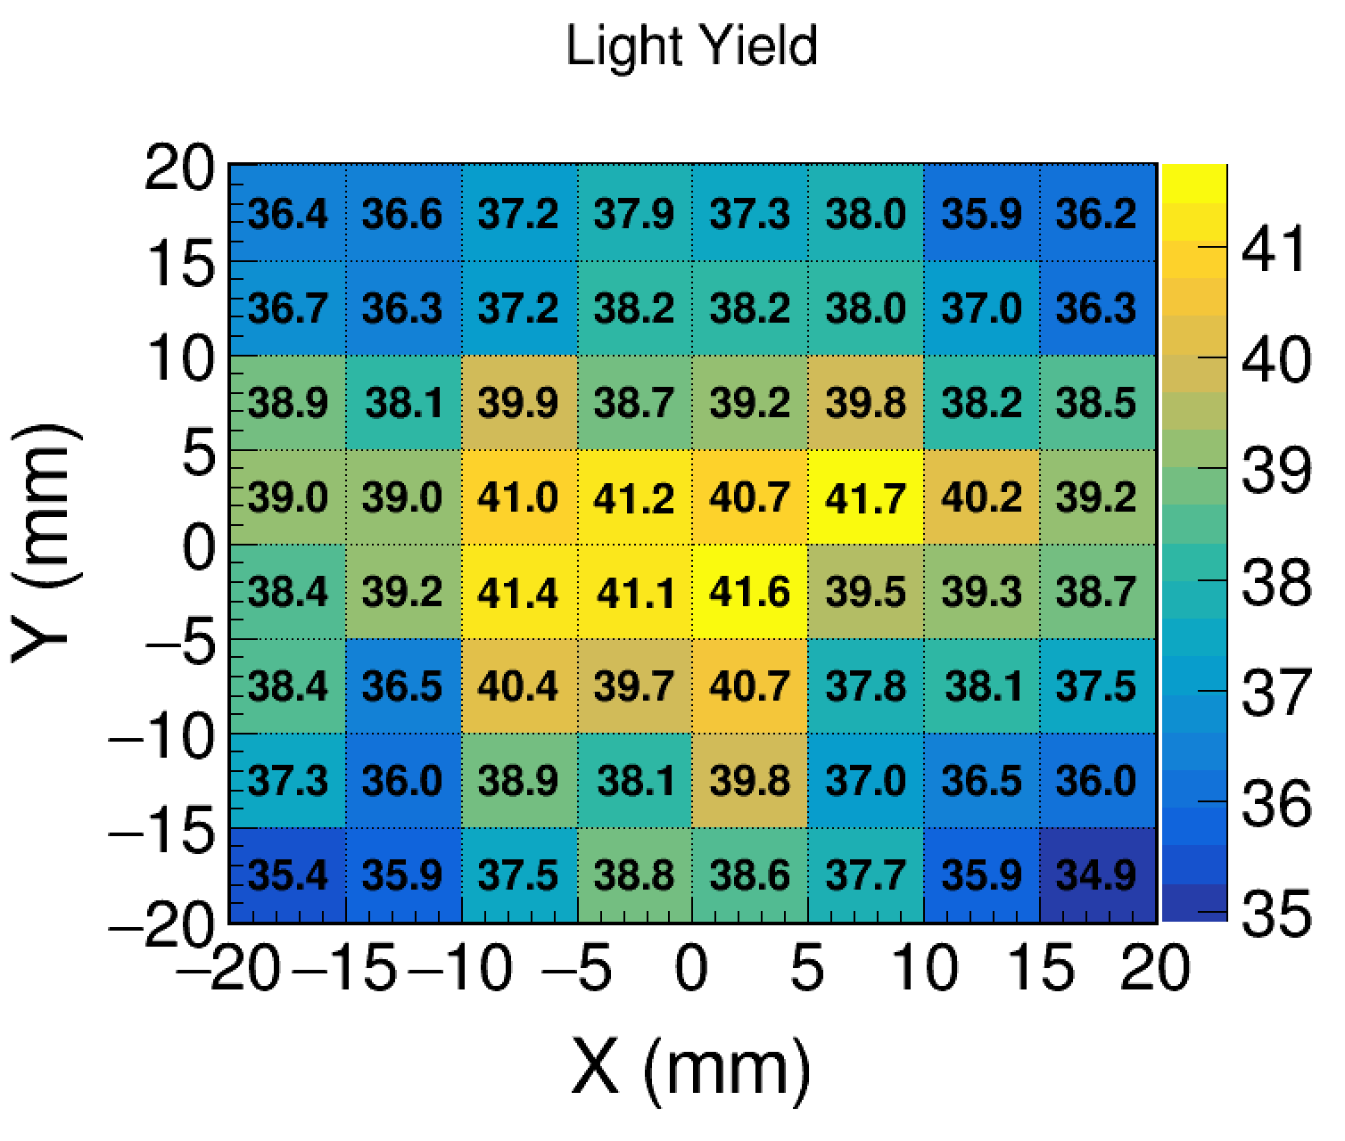
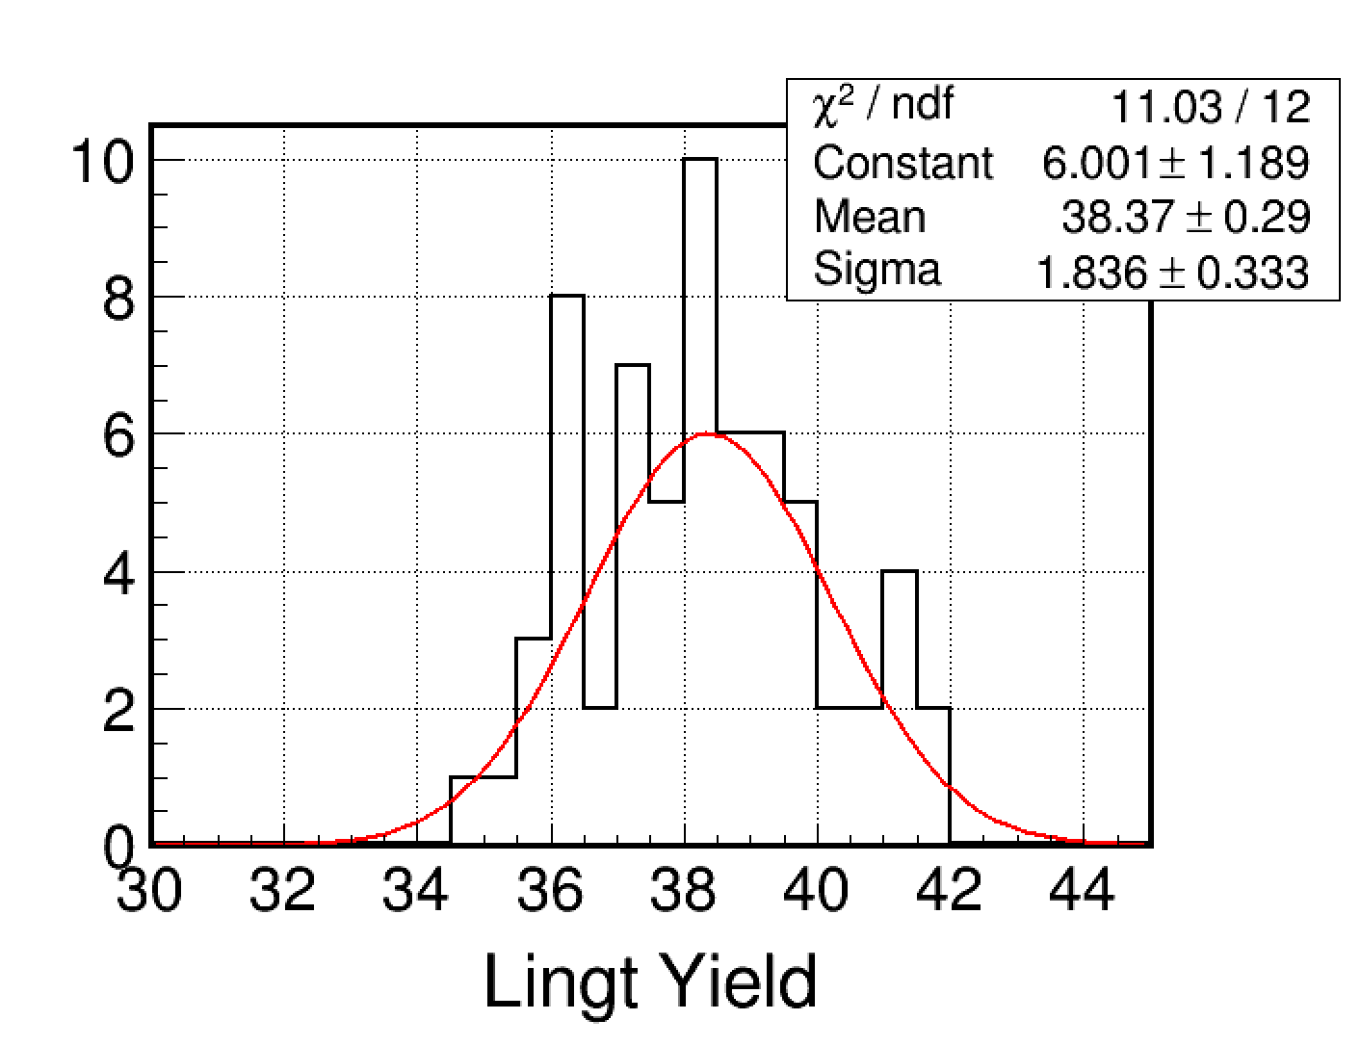
Digitization I
Scintillator
  energy to photon (poisson sampling)
  4.8% gaussian smear from non-uniformity of scintillator
  photon electron conversion (binomial sampling)
scintillator
SiPM
light yield uniformity in one scintillator

Slide 13
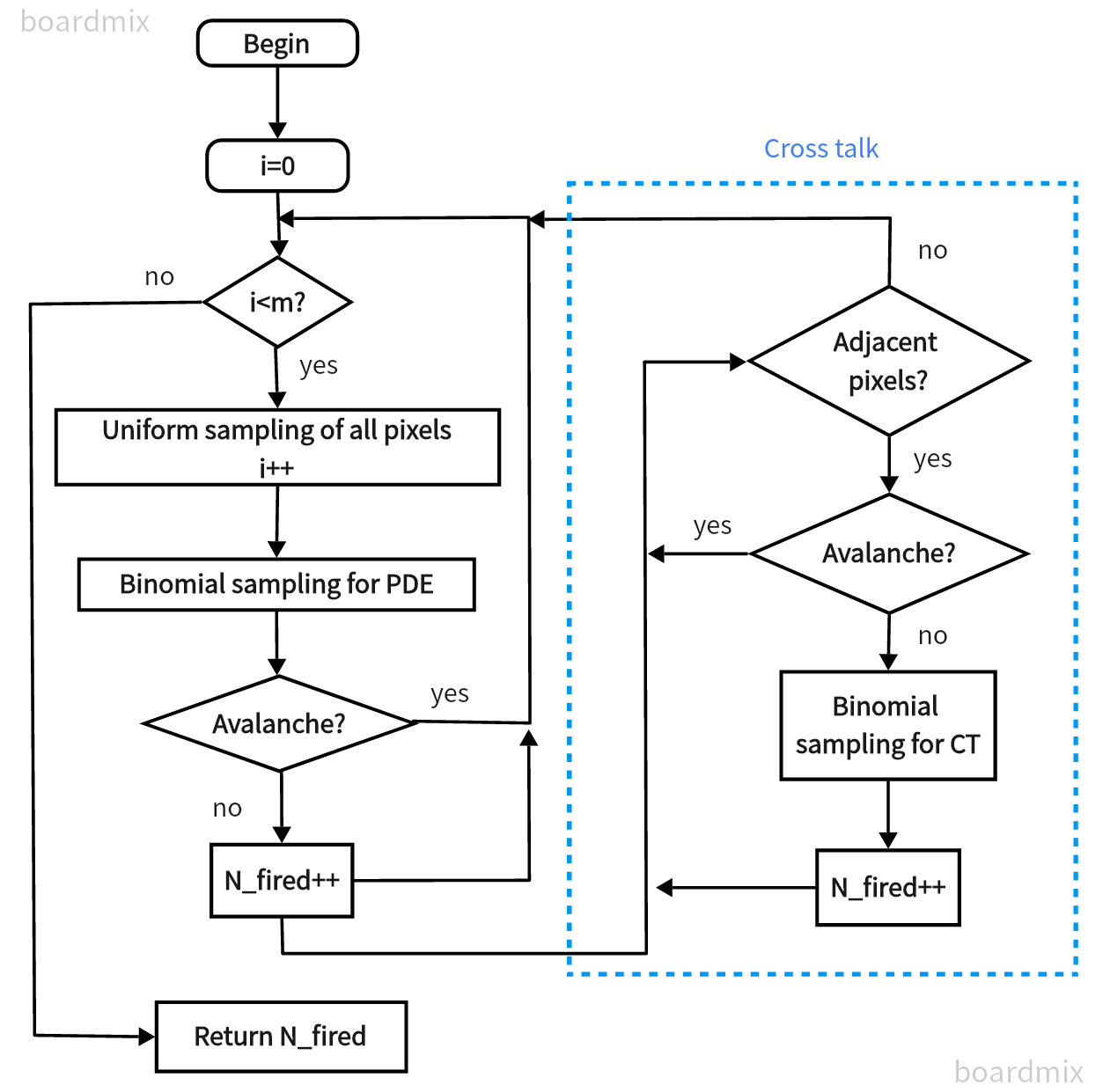
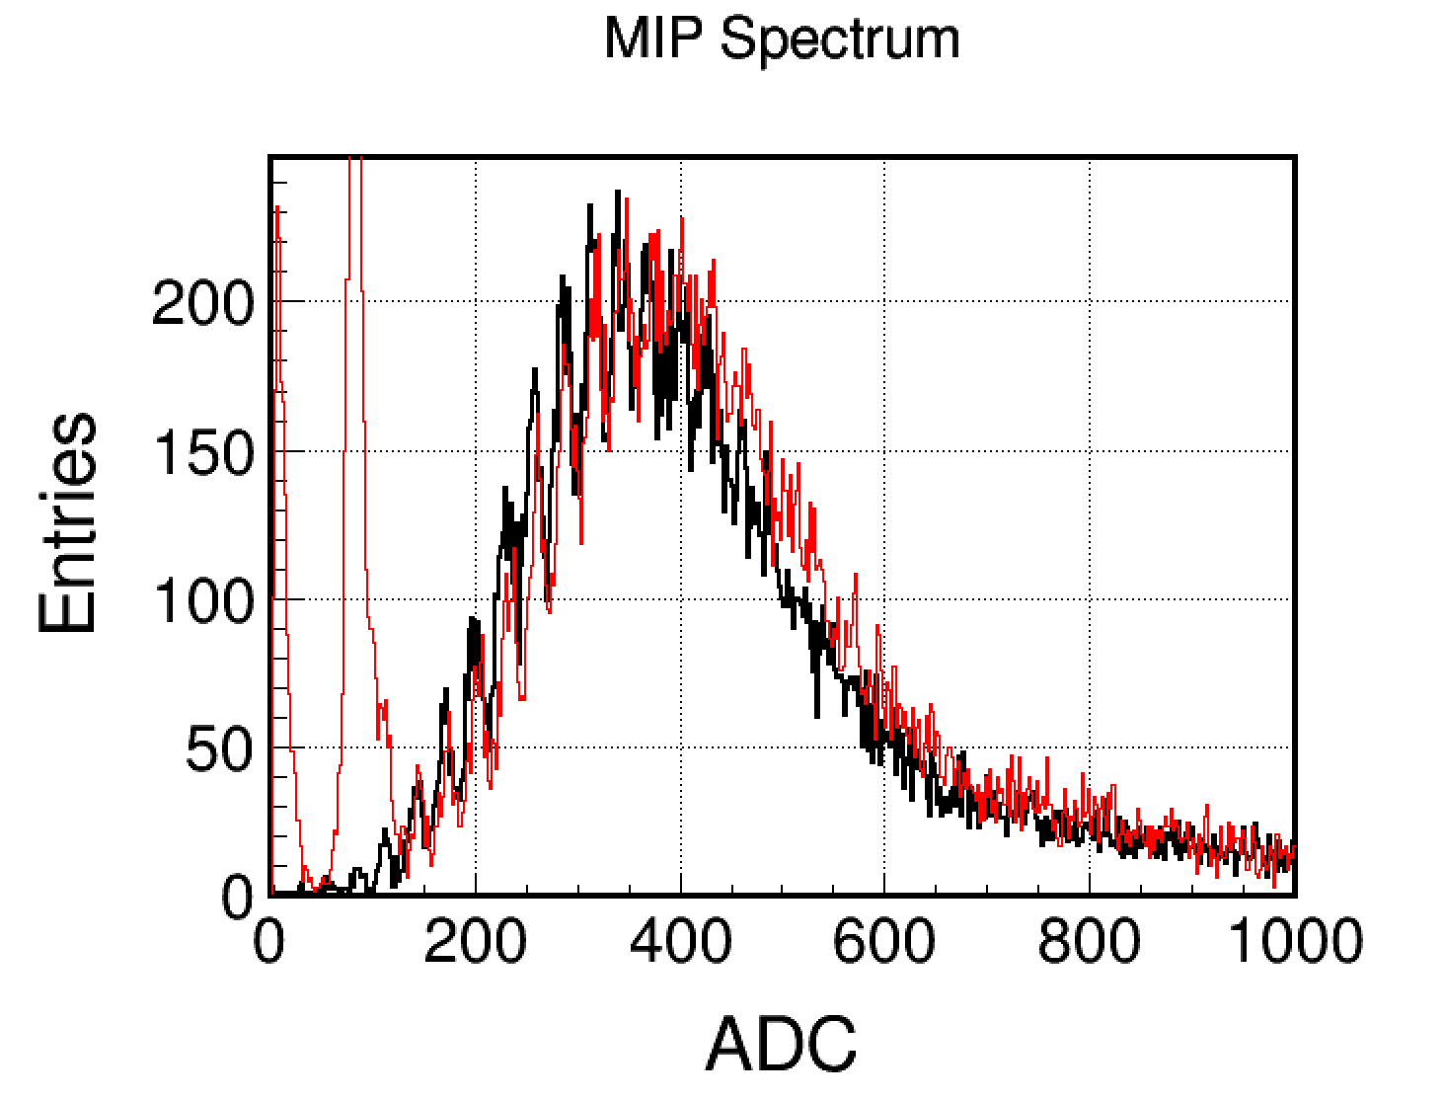
Digitization II
SiPM response
  SiPM saturation and flacturation
  SiPM gain smear
fired pixels to data format ADC
data
MC digi

Slide 14
Outline
Parameters Calibration
Simulation & Digitization
Energy Reconstruction
Pedestal
Non-uniform of Scintillator
Event Selection
High-low ratio
Photon Flucturation
MIP
SiPM response
Energy Reconstruction
Single PhotoElectron
Electronic Flucturation

Slide 15
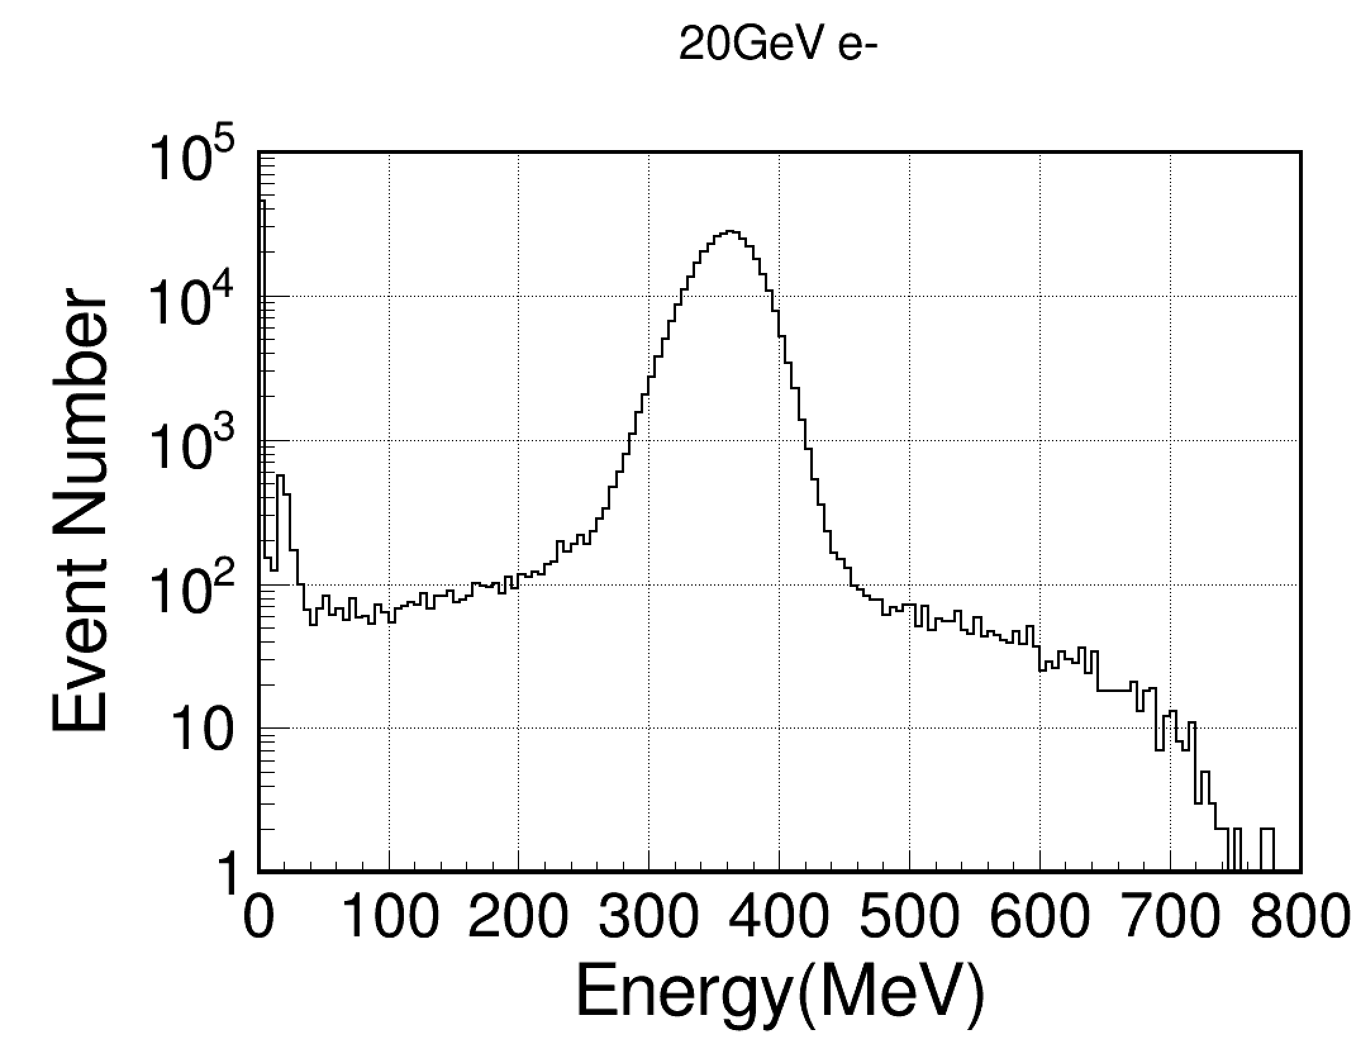
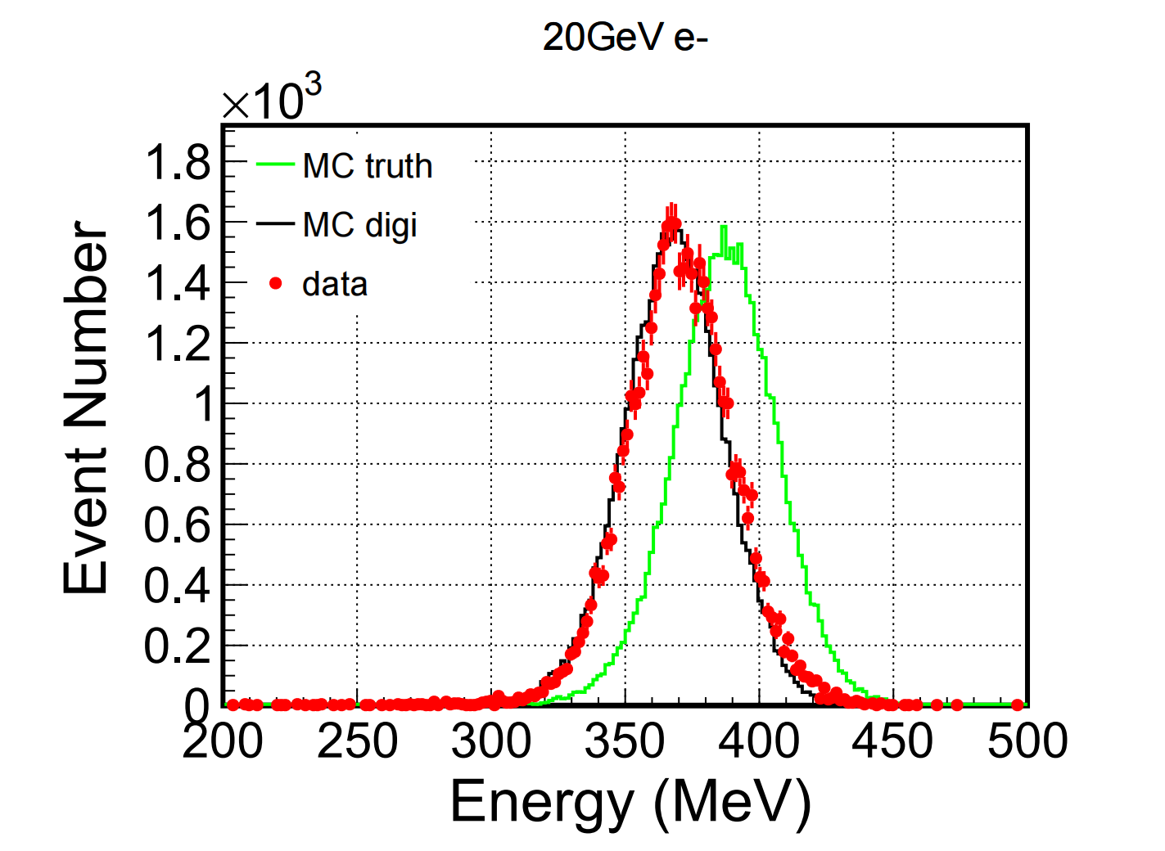
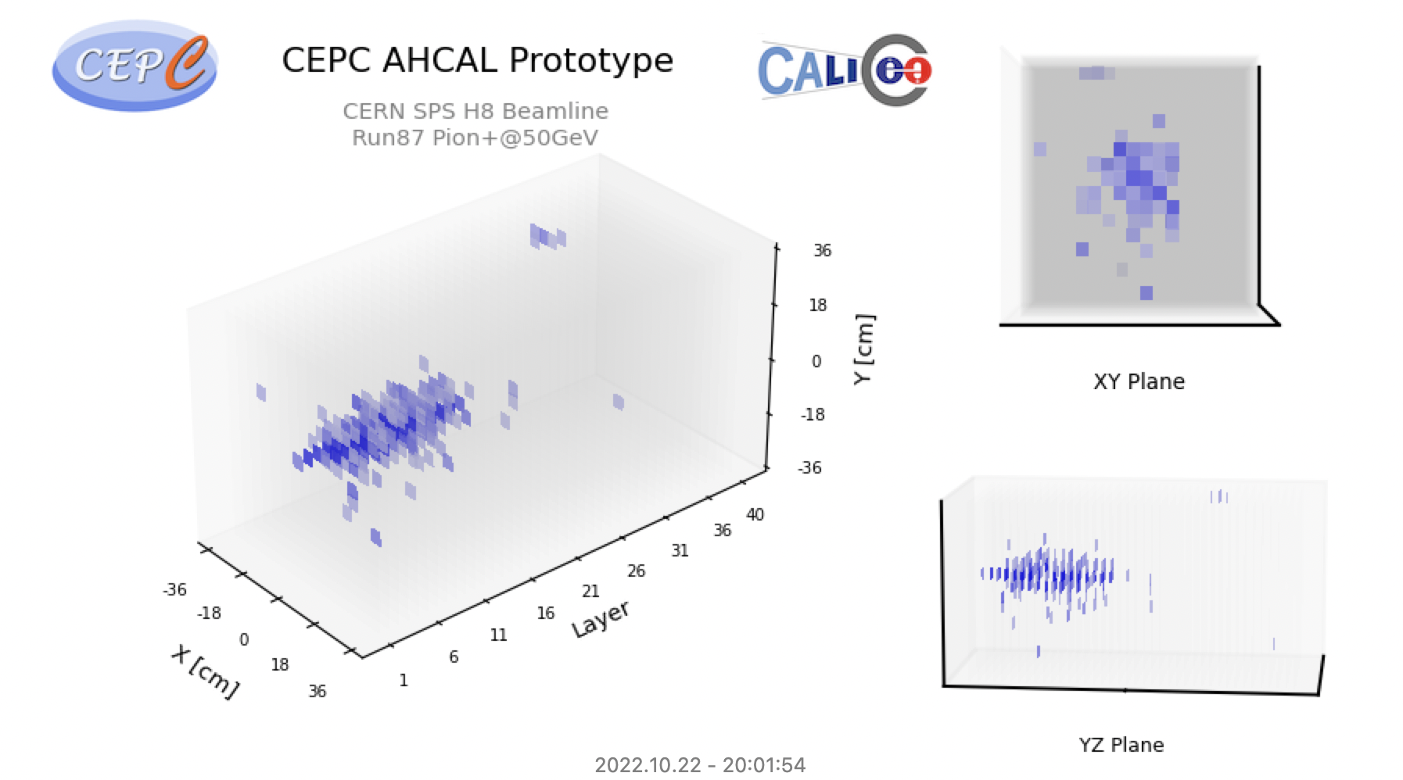
Energy Reconstruction
Focus on electron response mainly
Beamtest data need to be selected to improve purity
  hit number
  shower start position
  ...
energy deposite in sensitive volume of 20GeV e-
muon
e-

Slide 16
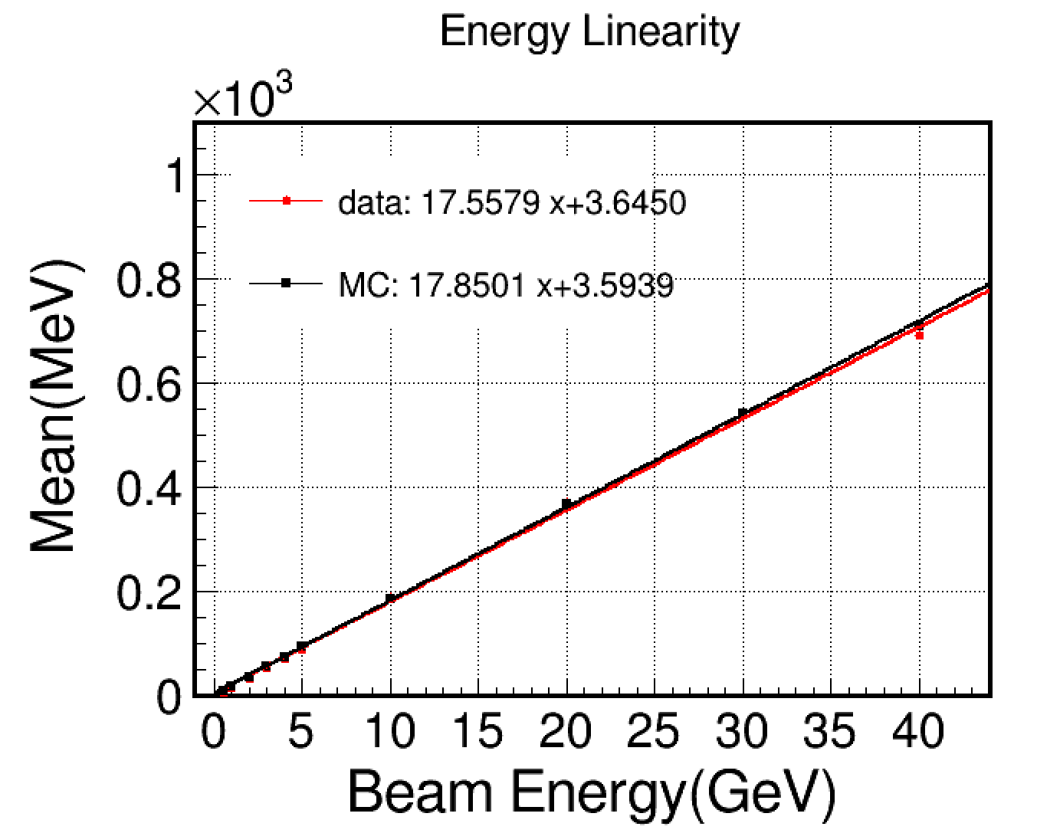
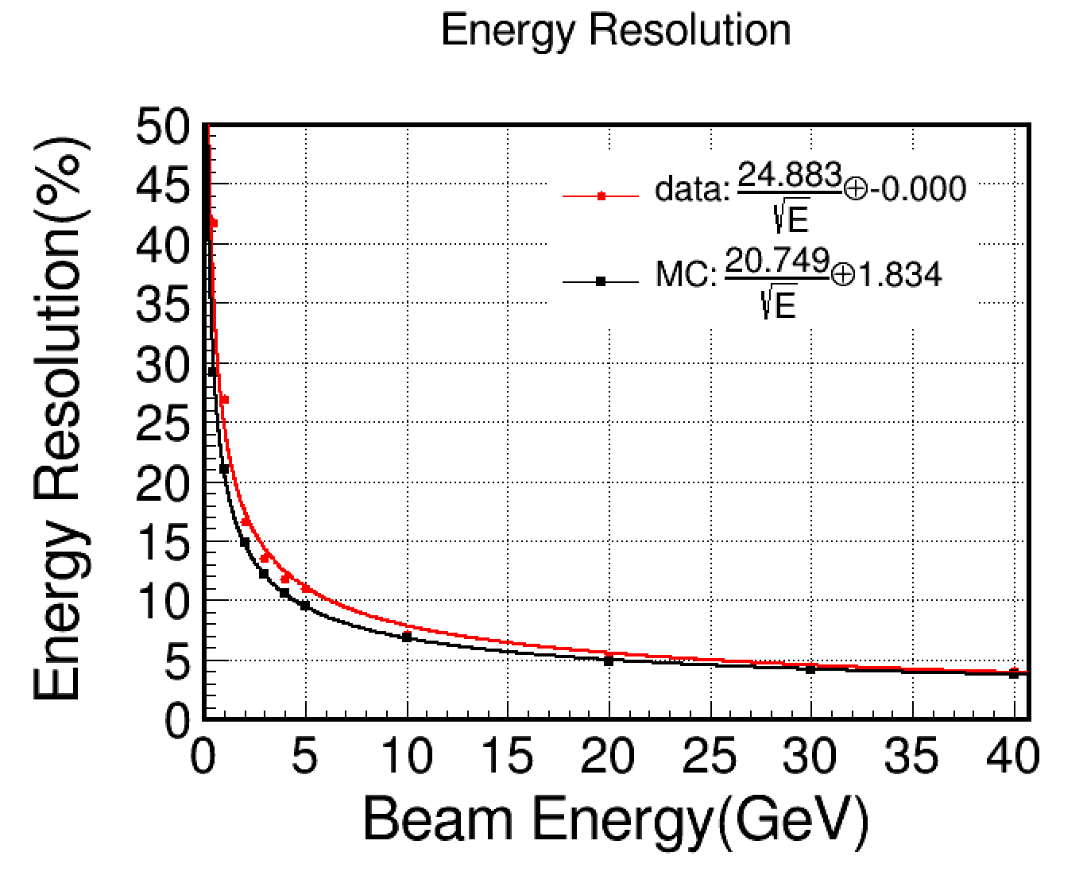
Energy Linearity and Resolution
preliminary results show, at low energy level, the energy linearity and resolution is well
preliminary
preliminary

Slide 17
Summary and Plan
Summary:
  based on the beam tests of AHCAL prototype
  carry out full-process analysis on high energy particle
    calibrate basic parameters
    reconstruct energy of electron
    optimize MC simulation and digitization
  preliminary results show, at low energy level, the aggrement between beamtest and MC is well
Plan:
  high energy electron and pion analysis
  using the high granularity, carry out research on particle identification and PFA method, lay the foundation for the deep study of CEPC
Thanks!

Slide 18
Backup

Slide 19
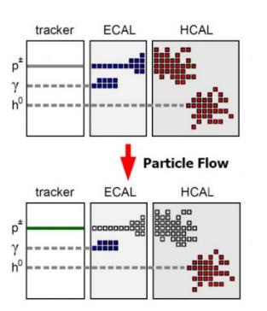
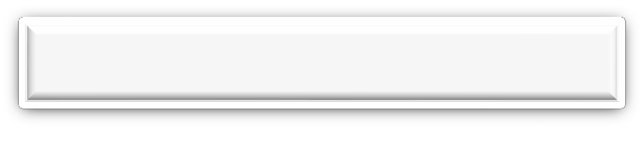
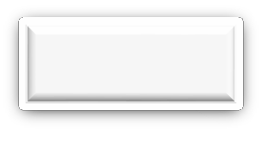



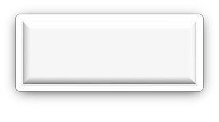

Motivation
PFA make use of the optimal detector subsystem to determine the energy/momentum of each particle in a jet.
require
distinguish among energy deposits of individual particles
require
High, three-dimensional spatial granularity
charged particles (~60%)
Tracker
photons (~30%)
ECAL
neutral hadron(~10%)
HCAL

Slide 20
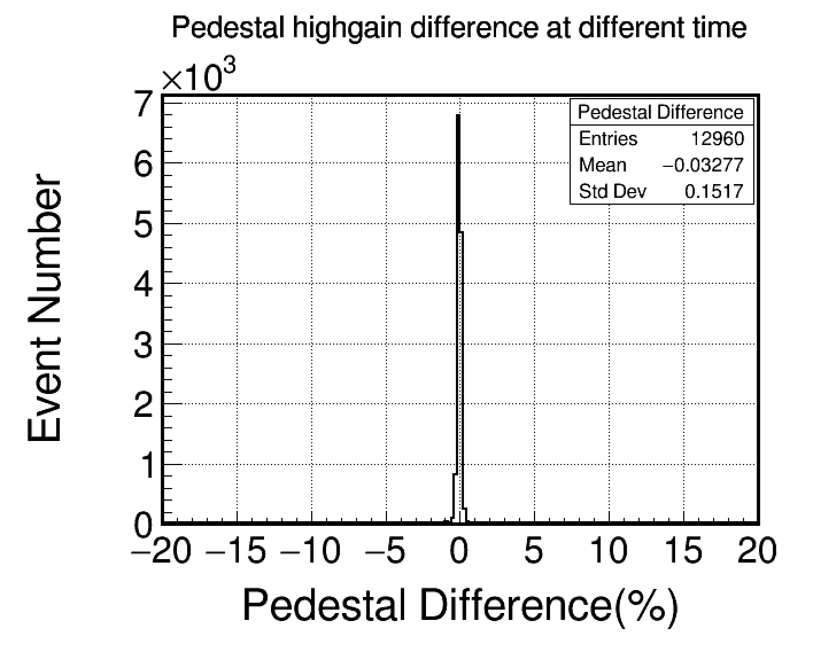
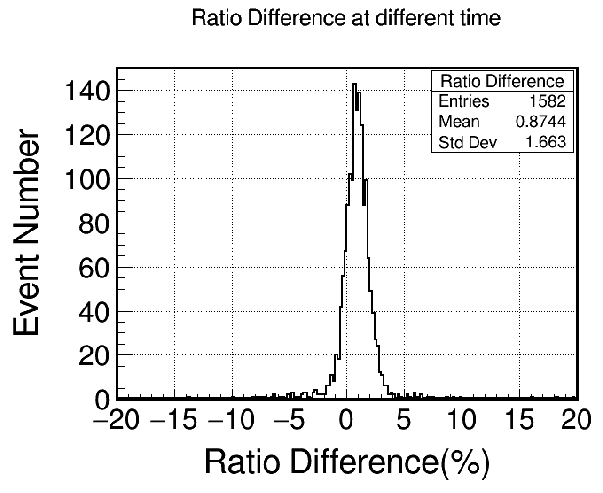
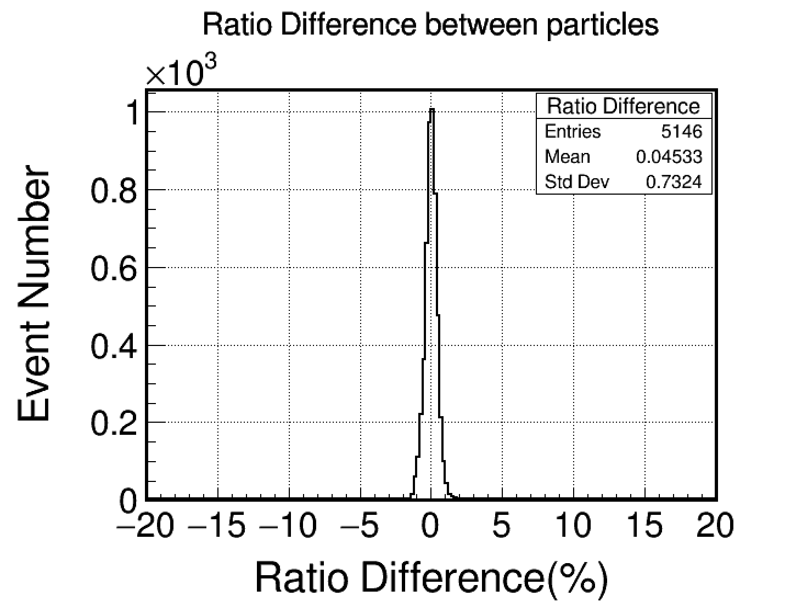
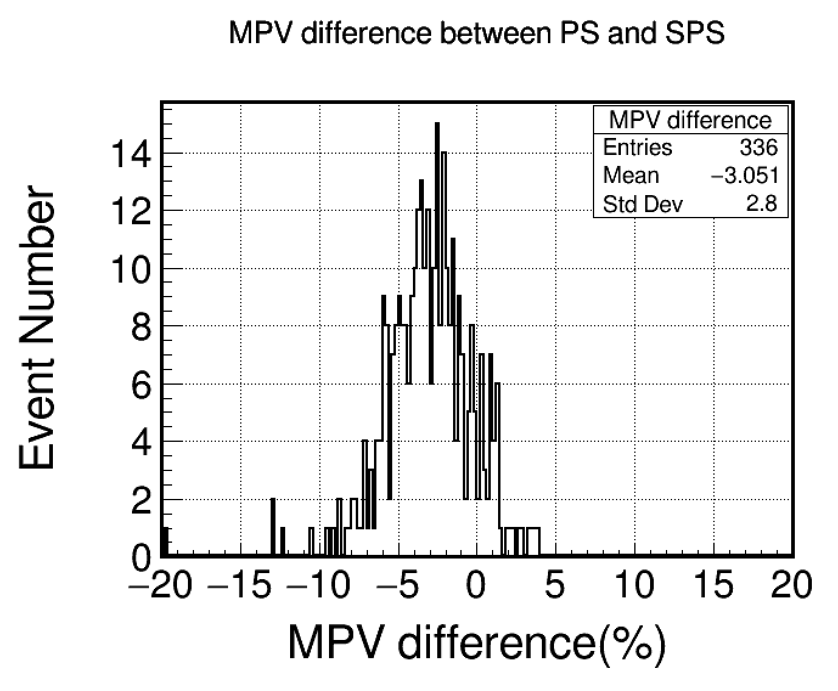
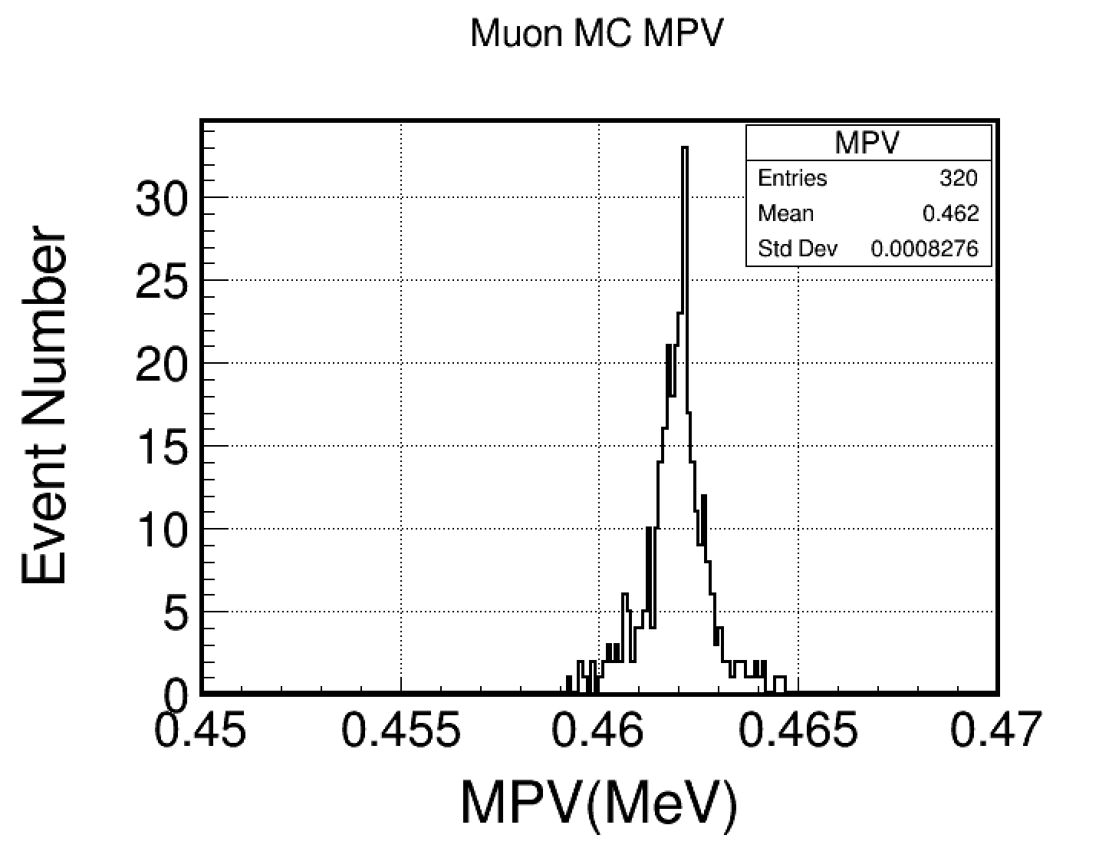
Calibration

Slide 21
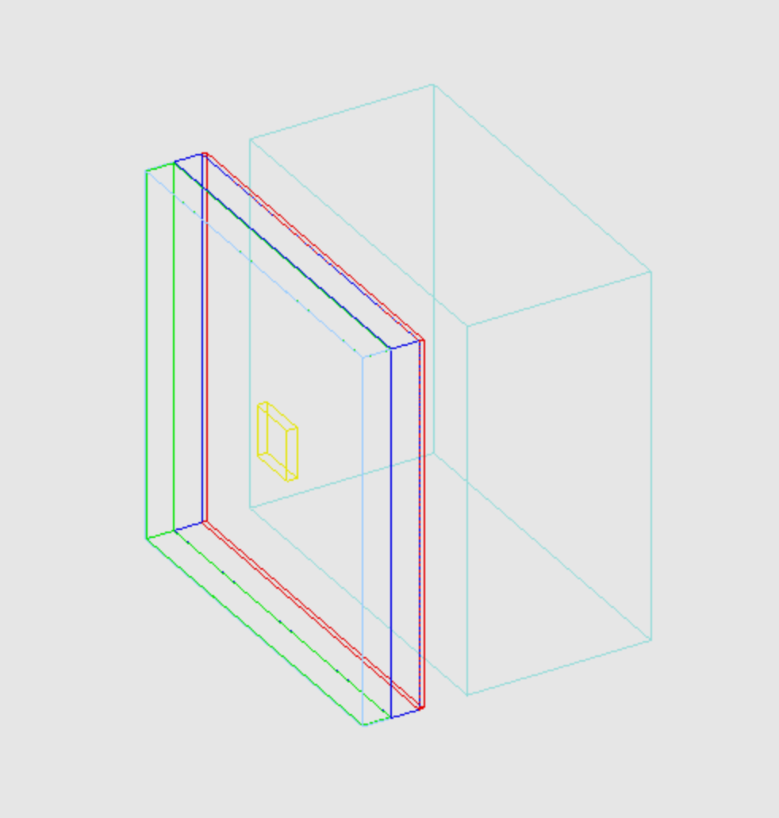
Simulation Based on Geant4
code is based on baohua(ihep colleague)
incident particles: electron, pion, muon
particle flow size: 20mm
incident particle
geometry construct
front trigger detector: polystyrene
gap: air, 1.5m
Absorber: steel: 2 mm
Scintillator: polystyrene: 3 mm
PCB: FR4
Cu
gap: air
Absorber: steel: 18 mm

Slide 22
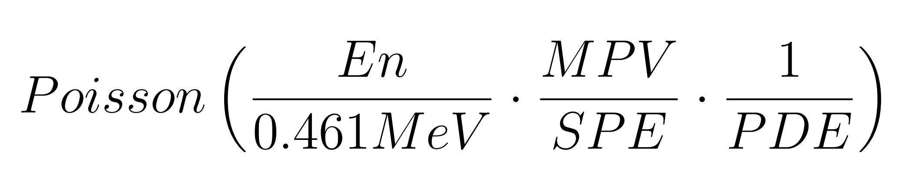
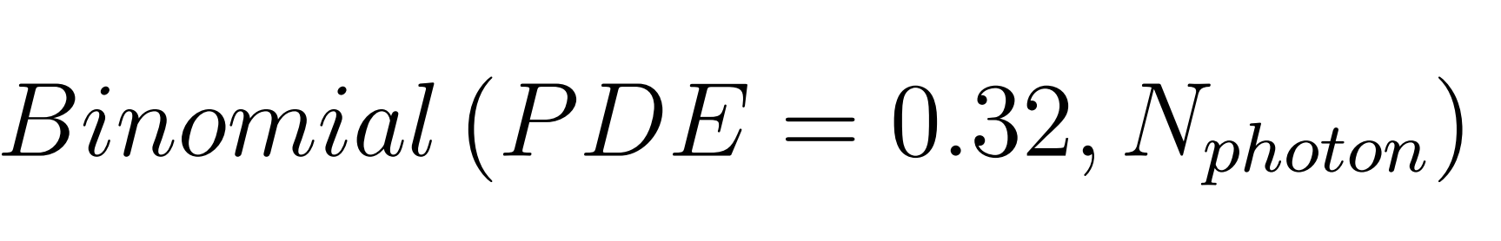
Digitization
4.8%(1.836/38.37) gassian smear caused by non-uniformity of light yield
energy to photon (poisson distribution)
photon to photoelectron (binomial distribution)
fill
poisson sampling
True energy
photon
photoelectron
light yield smear
binomial sampling

Slide 23
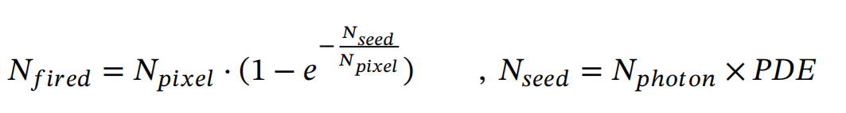
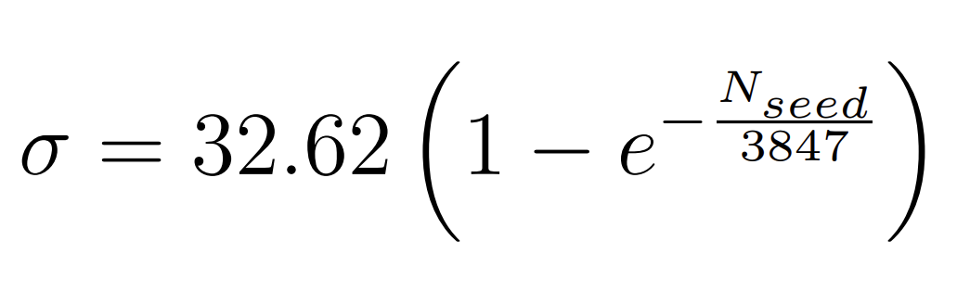
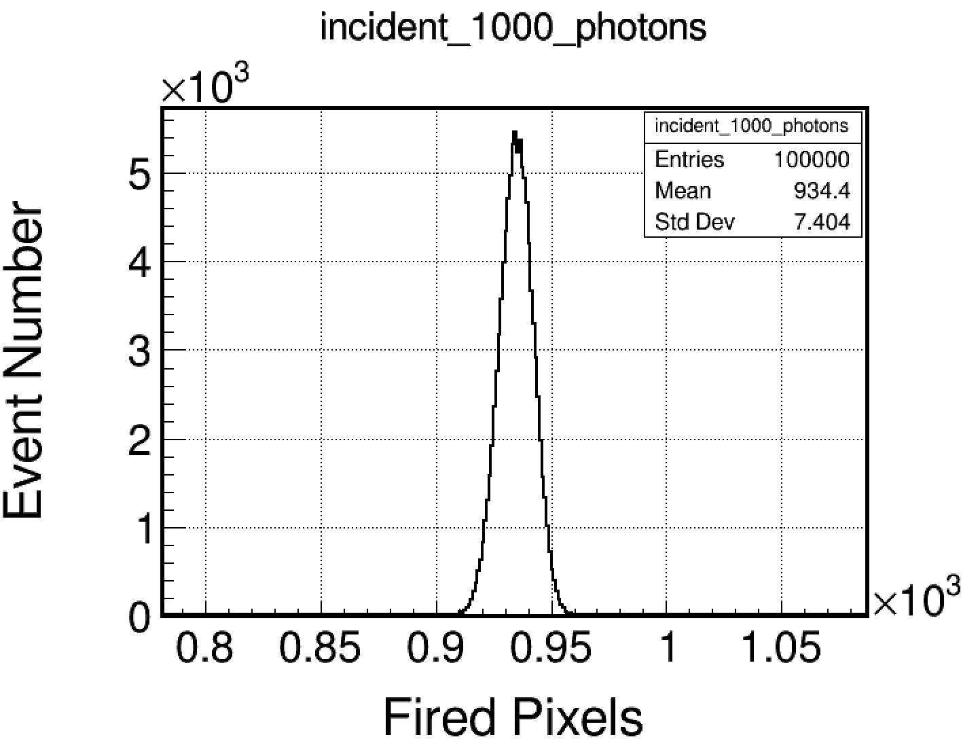
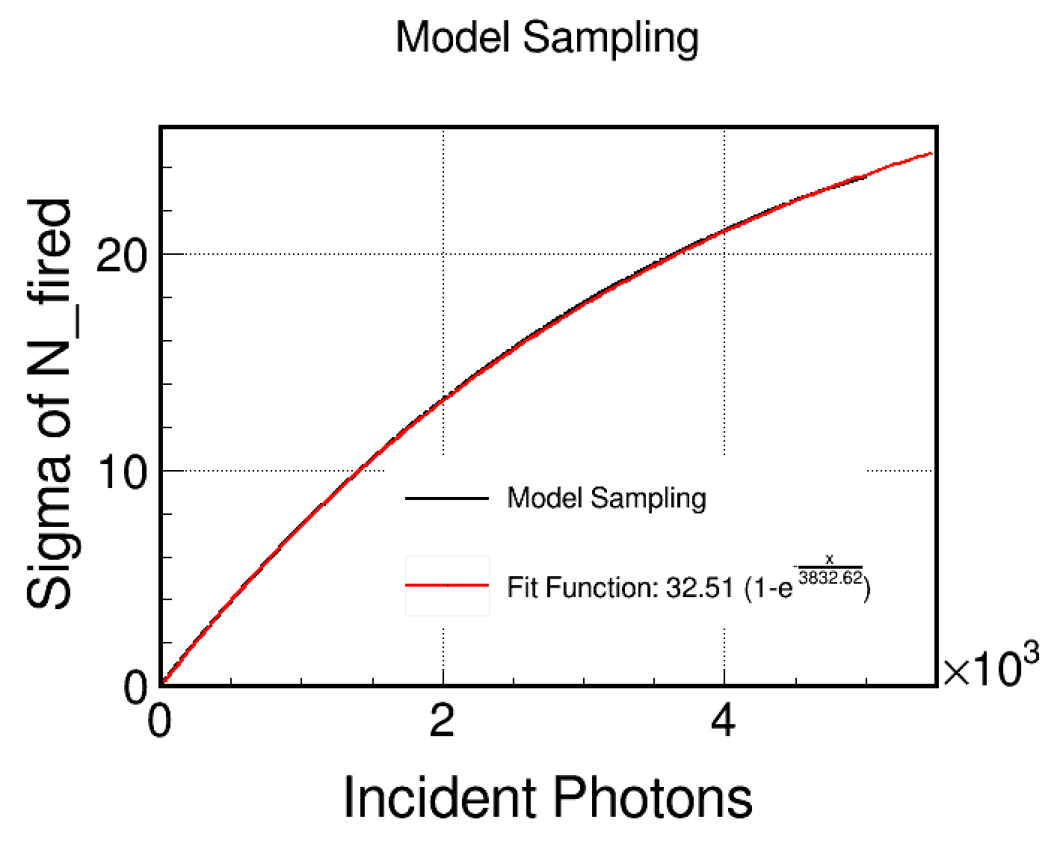
Digitization SiPM Model
SiPM reponse is not linear strictly
4. SiPM response
  gaussian smear with sigma

Slide 24
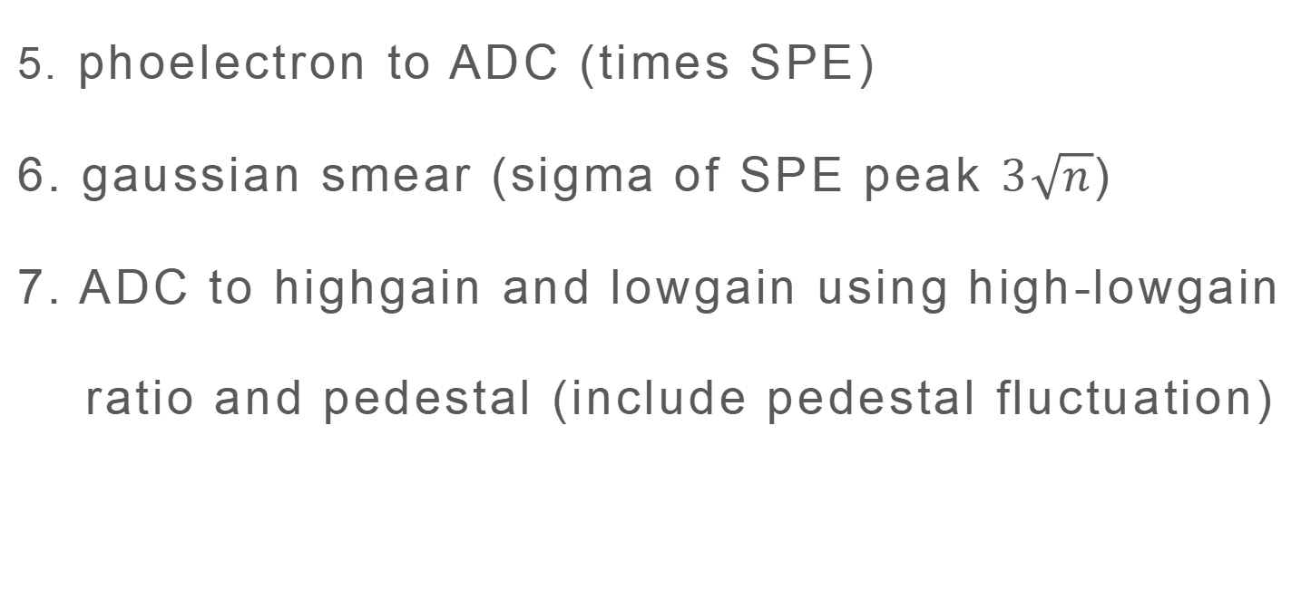
Digitization
5. phoelectron to ADC (times SPE)
6. gaussian smear (sigma of SPE peak $3\sqrt{n}$)
7. ADC to highgain and lowgain using high-lowgain
ratio and pedestal (include pedestal fluctuation)
beamtest format
poisson sampling
SiPM reponse model
True energy
photon
photoelectron
ADC
high/lowgain
light output smear
binomial sampling
SPE smear

Slide 25
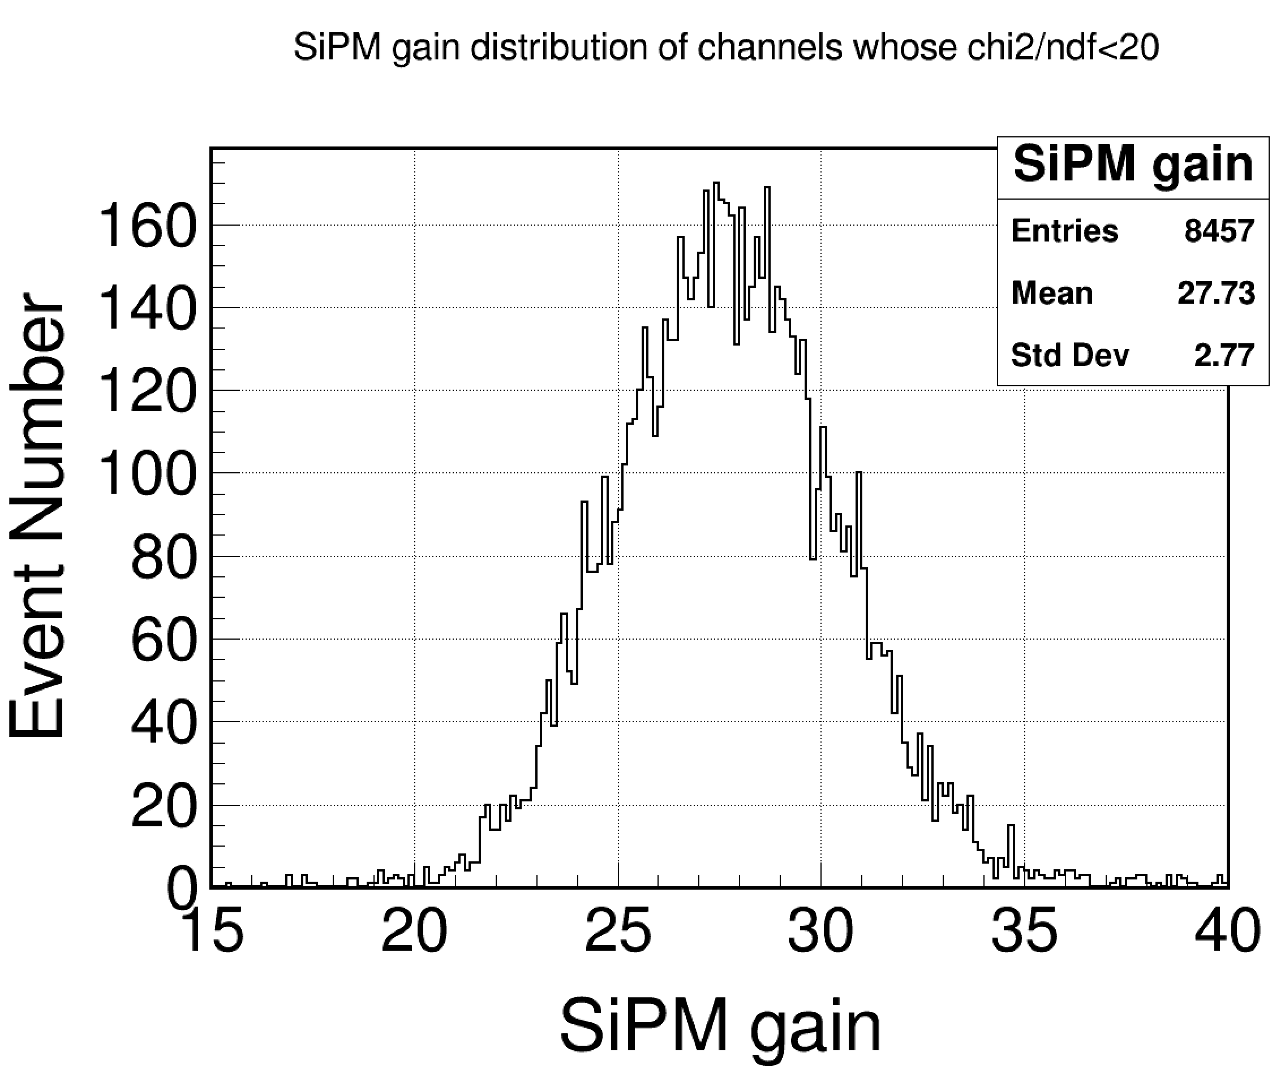
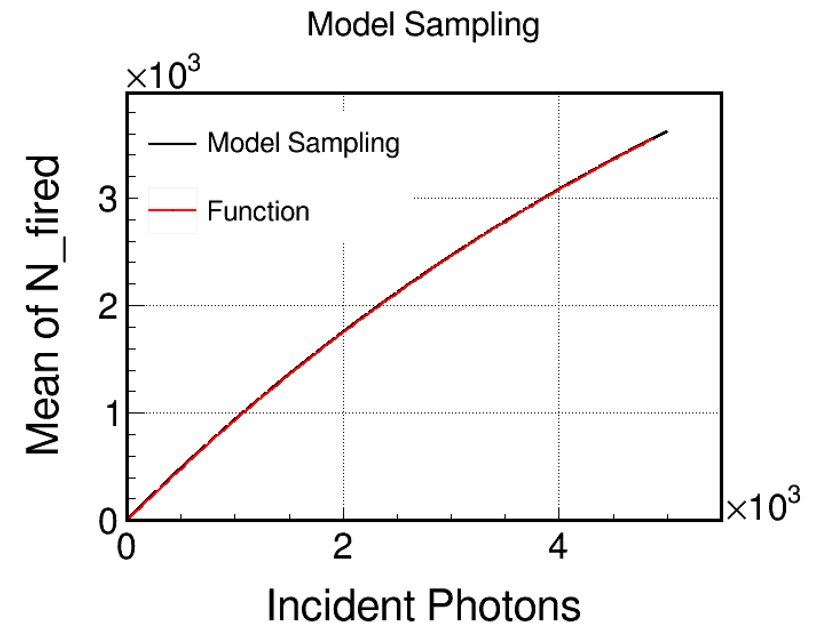
SPE and mean of SiPM

Slide 26
Event Select Criterion
set threshold as 0.5 MIP
hit number > f(beam energy)
shower start (the first layer that have >=5 hit) < 5
  the energy ratio of the last 5 layer < 5% to remove MIP
  find energy center of each layer and let the max distence of them < 200mm
  energy center of the first 30 layers are in the central chip, that is in (120,120)mm
  energy center of layer4 to layer6 are in (15,25)mm
  calculate energy in 5×5 cells around energy center in the first 30 layers

Slide 27
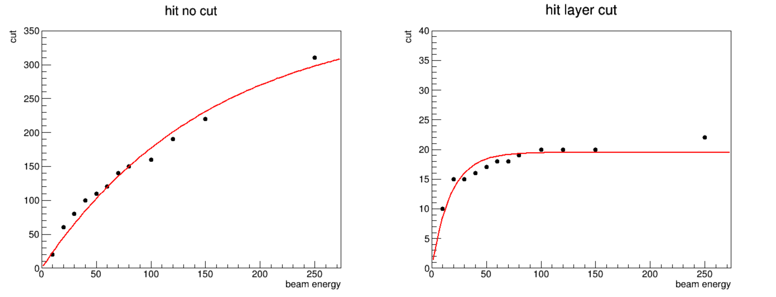
Hitno and Hit layer
  f(x)=372.285*(1-exp(0.0064584*x))

