Slide 1
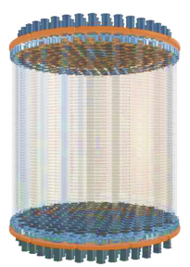


Dark Matter Direct Search
孟月
上海交通大学

Slide 2
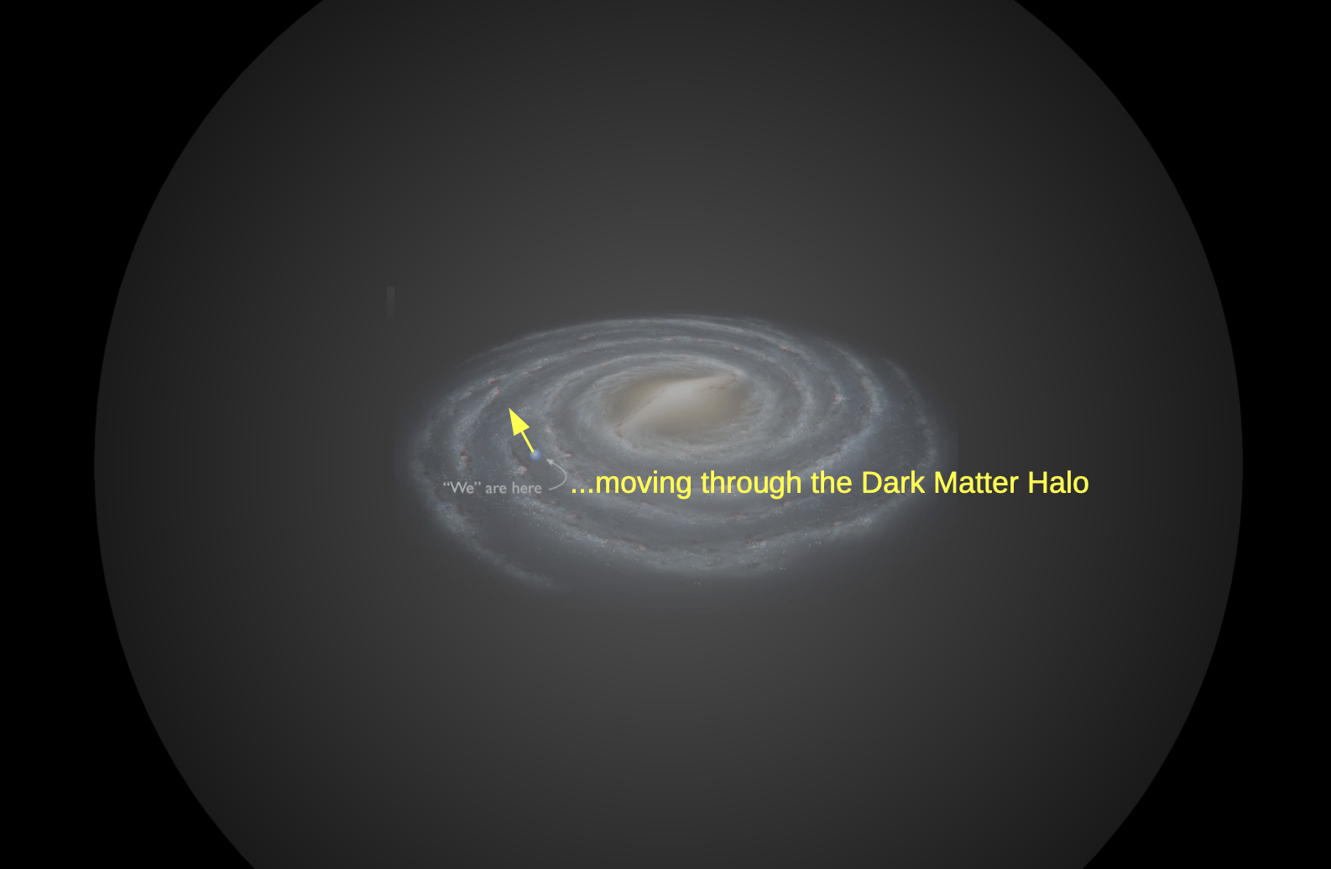
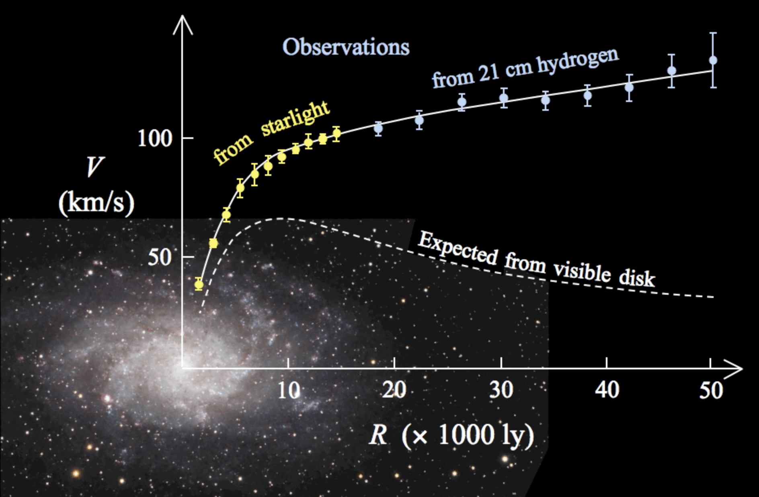
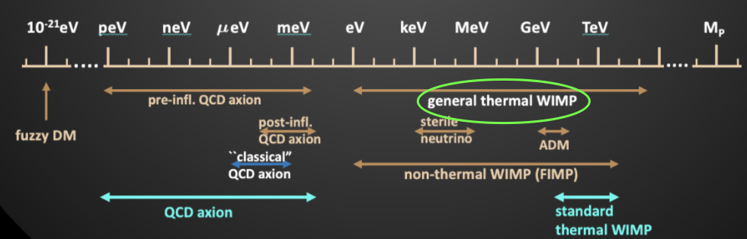
Dark matter
The solar system is cycling the center of galaxy with on average 220 km/s speed
Rotation curve of spiral galaxy M33
From Marc Schumann
From Wikipedia
Gravitational evidences suggest dark matter is the dominant form of matter in Universe!
Notes:
[36s] We’ve already learned from astrophysical and cosmological observations that Dark Matter is the dominant contribution of matter in our Universe. In the so-called direct detection strategy, we measure the signals of the recoil nucleus following their scattering with WIMPs. The recoil energy can be deposited in three channels: light, ionization, and heat. Therefore, various detection techniques are used in earthbound experiments.

Slide 3
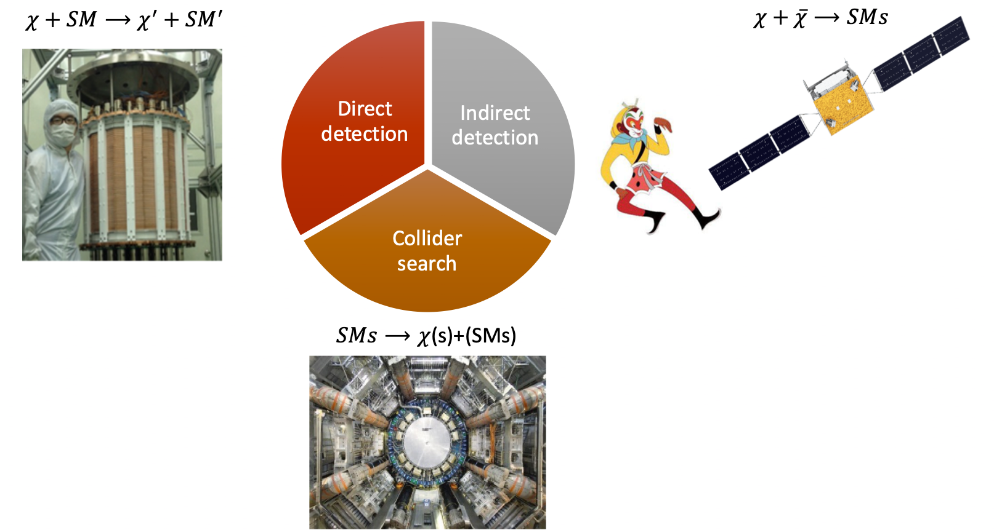

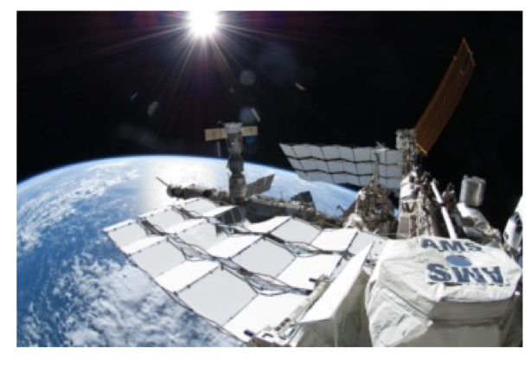
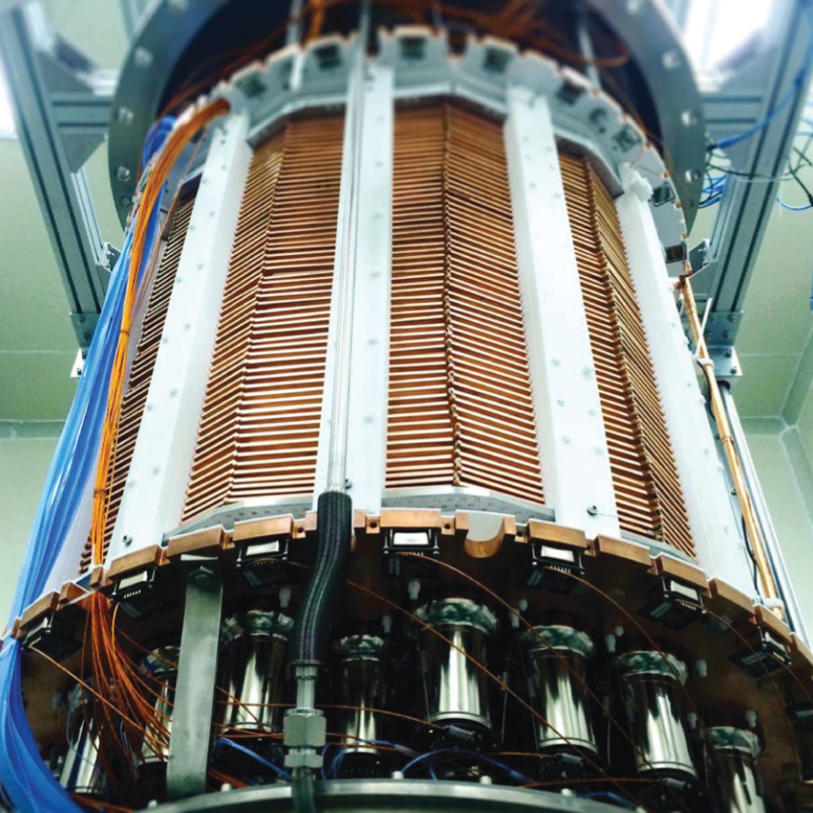
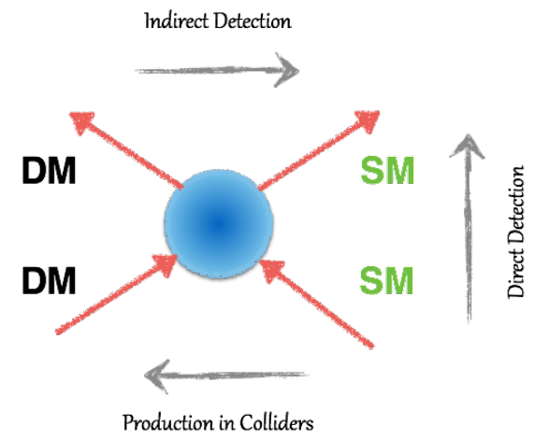
Dark matter detection
From Wikipedia
Notes:
[36s] We’ve already learned from astrophysical and cosmological observations that Dark Matter is the dominant contribution of matter in our Universe. In the so-called direct detection strategy, we measure the signals of the recoil nucleus following their scattering with WIMPs. The recoil energy can be deposited in three channels: light, ionization, and heat. Therefore, various detection techniques are used in earthbound experiments.

Slide 4
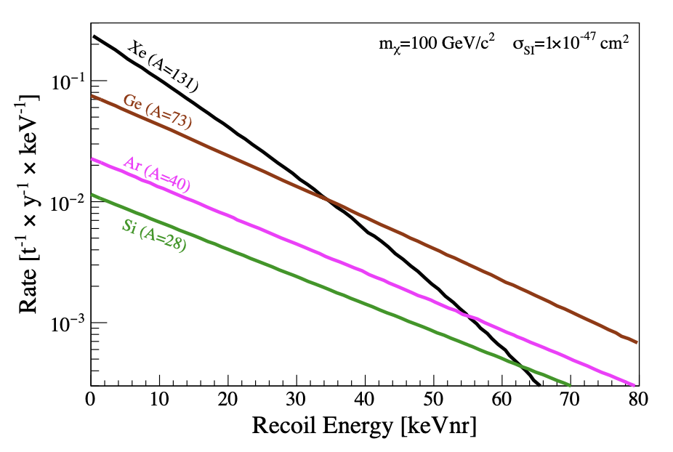
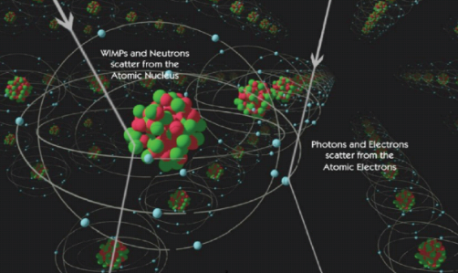
The dark matter direct detection
Nuclear recoils
Elastic Scattering of WIMPs off target nuclei
Nuclear recoil spectra
γ
1903.03026
χ
χ
γ
Samuel Velasco/Quanta Magazine

Slide 5

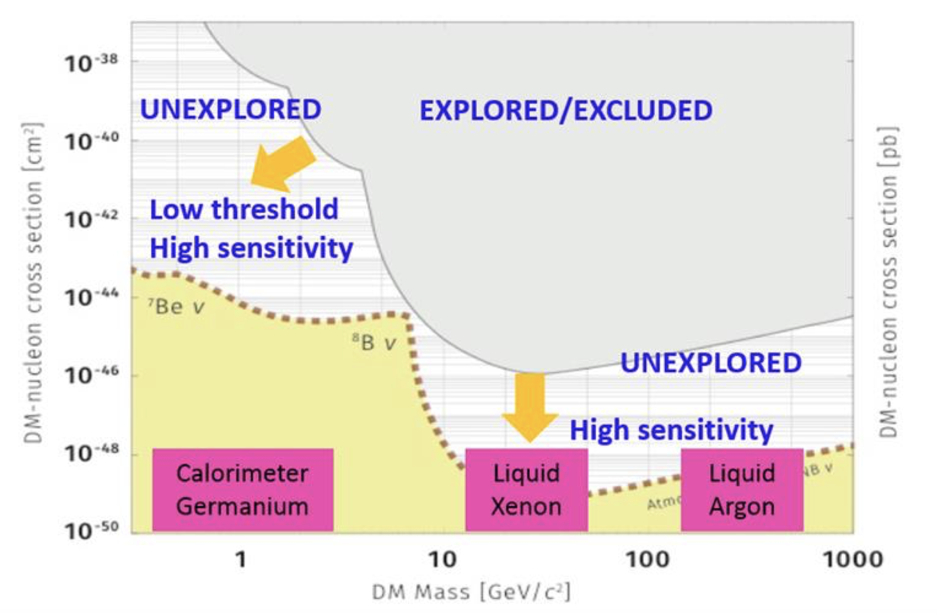
The dark matter landscape

Slide 6

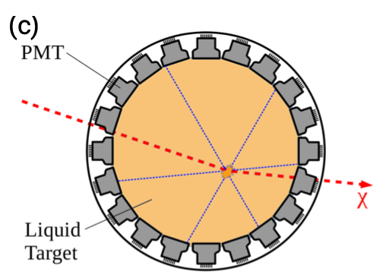


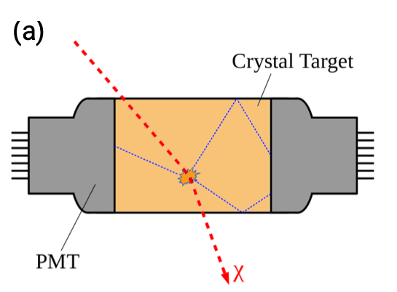
Dark matter detection technologies
WIMP
Ionization
Target
Light
Liquid noble-gas detectors,
Scintillator crystals

Slide 7
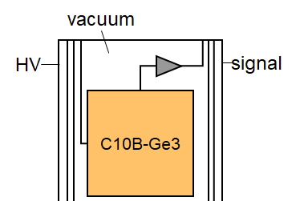
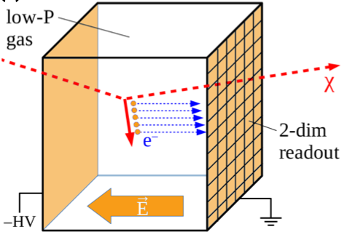

Dark matter detection technologies
WIMP
Ionization
Germanium/Silicon detectors,
Directional detectors
Target
Light

Slide 8
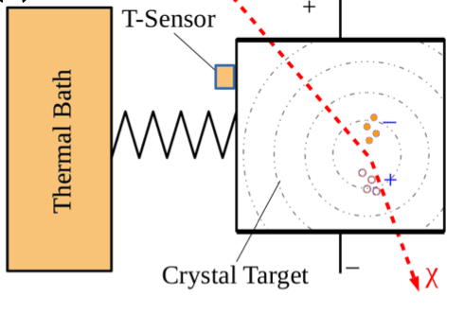
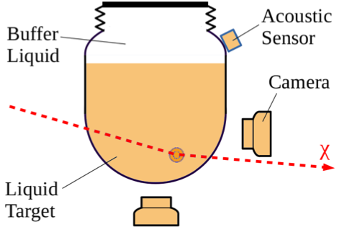
Dark matter detection technologies
WIMP
Ionization
Target
Light
Heat
Superheated liquids, Cryogenic bolometers
Notes:
the dark matter particle physics properties, such as mass, coupling and interaction cross section, with baryonic matter:

Slide 9
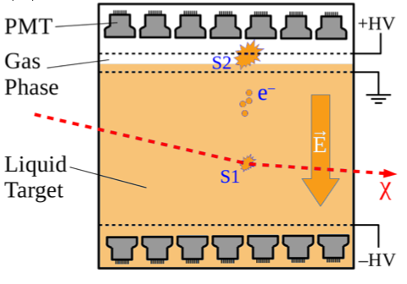
Dark matter detection technologies
WIMP
Ionization
Germanium/Silicon detectors,
Directional detectors
Liquid noble-gas dual-phase time projection chambers
Cryogenic bolometers with charge readout
Target
Light
Heat
Liquid noble-gas detectors,
Scintillator crystals
Superheated liquids, Cryogenic bolometers
Scintillating cryogenic bolometers

Slide 10
Dark matter detection technologies
CDEX, CoGent, DMTPC, DRIFT,MIMAC
WIMP
Ionization
Germanium/Silicon detectors,
Directional detectors
PandaX, LZ, XENON, ArDM,
Darkside
Liquid noble-gas dual-phase time projection chambers
Cryogenic bolometers with charge readout
CDMS, EDELWEISS
Target
Light
Heat
Liquid noble-gas detectors,
Scintillator crystals
Superheated liquids, Cryogenic bolometers
Scintillating cryogenic bolometers
DAMA/LIBRA, KIMS, DEAP, XMASS, CLEAN, COSINE
PICO, Picasso, Simple, Coupp
CRESST II

Slide 11
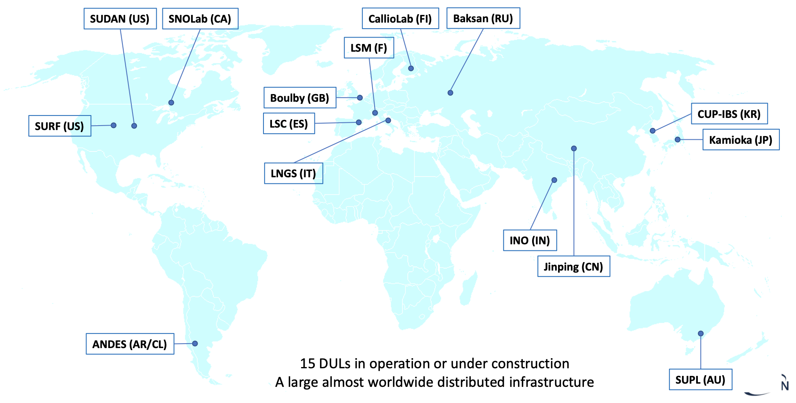
Underground Laboratories and DM Experiments
CDMS
CoGeNT
DEAP/CLEAN
PICASSO
PICO
Underground lab map from Ezio Previtali’s talk in TAUP2021
ZEPLIN
DRIFT
EDELWEISS
MIMAC
ArDM
COSINE
KIMS
LZ
XMASS
CRESST
DAMA/LIBRA
XENONnT
DARKSIDE
PANDAX
CDEX
Notes:
[30s] To get rid of the cosmic ray background, rare event search experiments are conducted in underground labs. This slide shows the deep underground labs all over the world, including the Center for Underground Physics here in Korea. [Click] You can also find The China Jinping Underground Lab or CJPL.

Slide 12
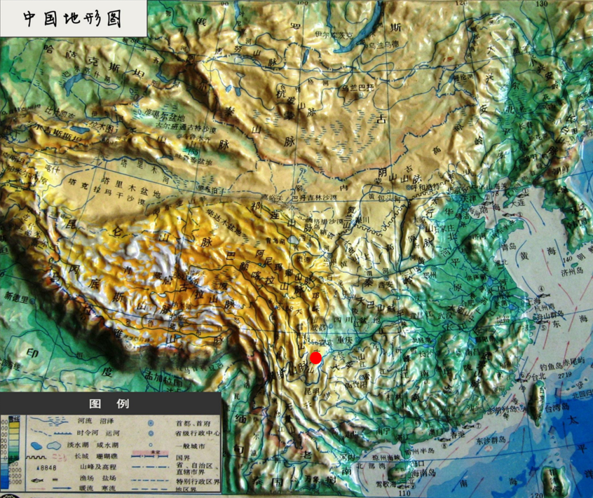
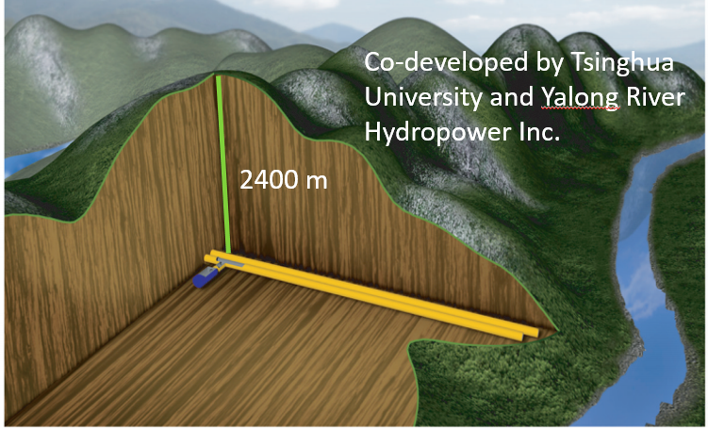
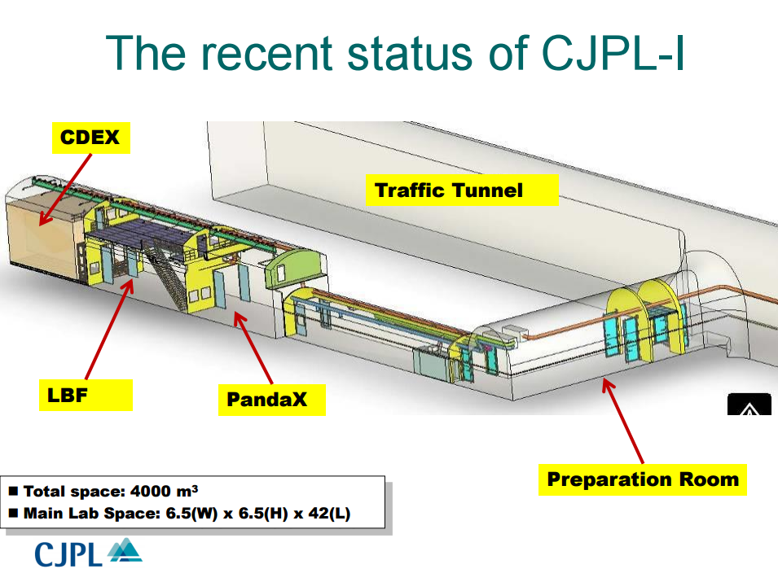
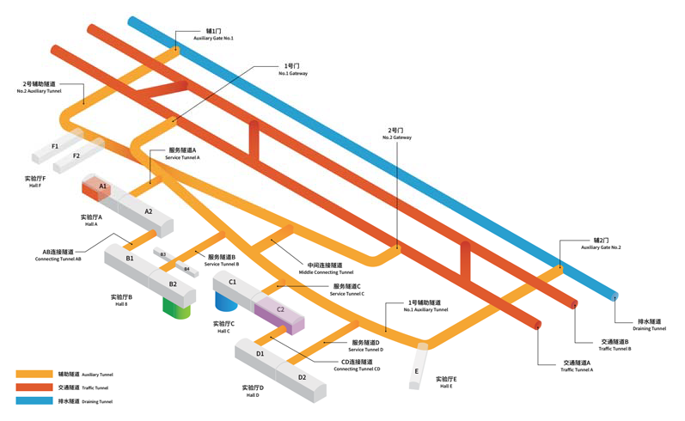
China Jinping Underground Laboratory – CJPL
  Ideal site
    Deepest (6800 m.w.e )
    Muon rate: ~ 1 count/week/m²
    Horizontal access
  From CJPL-I to CJPL-II
    In 2015, CJPL-II start construction
    In 2019, PandaX-4T and CDEX moved to the B2 hall of CJPL-II
Notes:
[45s] The CJPL is located in the Jinping Mountain of Sichuan province. With an overburden of roughly 2400 m, it has an extremely low cosmic-ray muon flux and muon-induced background rate. CJPL is one of the most ideal sites for low background experiments. In 2015, the second phase of CJPL started construction, and in 2019, the PandaX-4T detector moved to the B2 hall of CJPL-II.

Slide 13

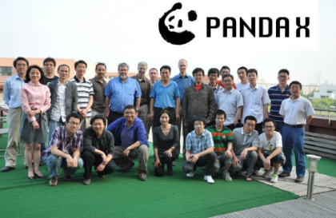
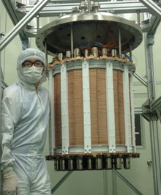

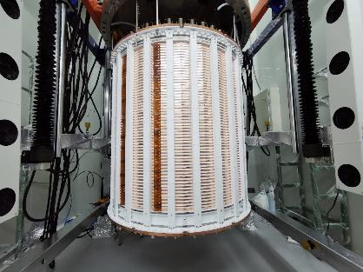
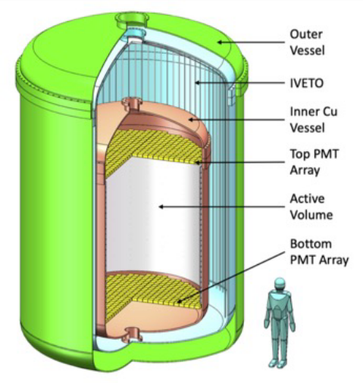
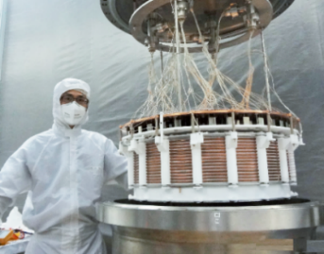
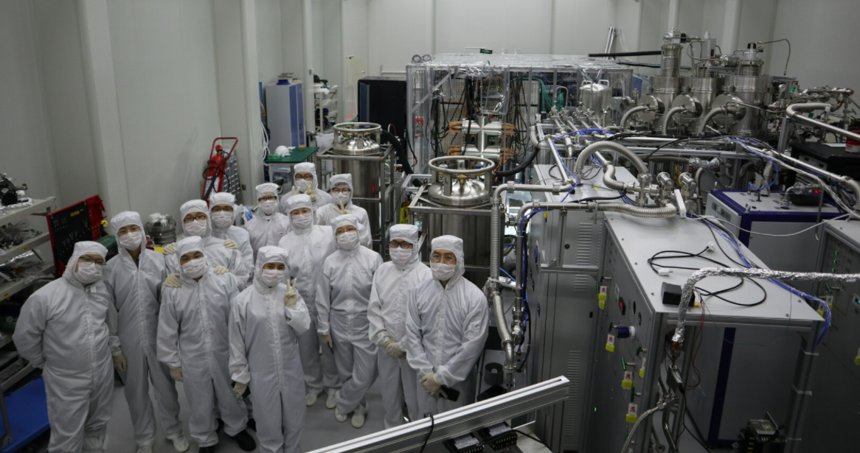
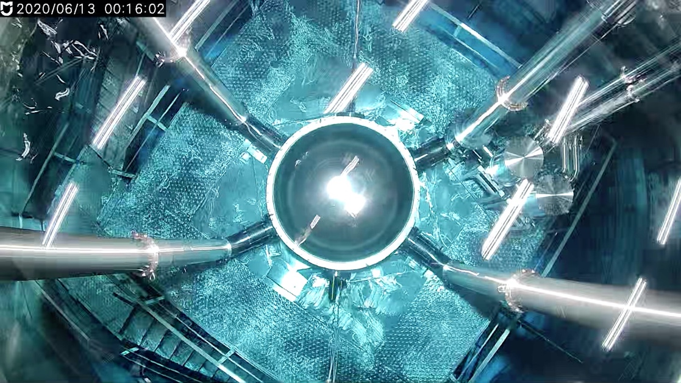
PandaX Roadmap
Particle and Astrophysical Xenon Experiments
PandaX-II, 580 kg operation
PandaX-4T
Commissioning (Run0)
Collaboration formed
Ongoing
2014.5-10
2019.8
2021.11
2009.3
2016.7-2019.7
2020.11-2021.5
PandaX-xT
PandaX-I, 120 kg
operation
PandaX-4T moved to CJPL-II
PandaX-4T Run1
Notes:
[1min10s] PandaX is short for Particle and Astrophysical Xenon Experiments, and here you see the roadmap. It started in 2009 and was built to search dark matter particles and explore neutrino physics. We started from PandaX-I with 120kg liquid xenon in 2014. And PandaX-II, using 580kg liquid xenon, started in 2016. Now, we come to the third phase, PandaX-4T, with 3.7-tonne liquid xenon in the sensitive volume. We have finished our commissioning run and science Run1 data taking, and the data analysis is ongoing. For the next-generation liquid xenon experiment, PandaX-xT, which contains dozens of tonnes of liquid xenon, is already on our schedule. We will upgrade step by step and finally reach the sensitivity all along to the final neutrino floor.
PandaX团队成立于2009年，经过十余年的探索和发展，目前已经到了第三代探测器，也就是PandaX-4T，灵敏体积内包含3.7吨的液氙。4T探测器也是国际暗物质直接探测领域，第一个成功运行的多吨级Xe探测器。随着灵敏体积的不断增加，放射性的本底水平也控制得越来越低，这些都是我们提高探测灵敏度所作的努力。

Slide 14

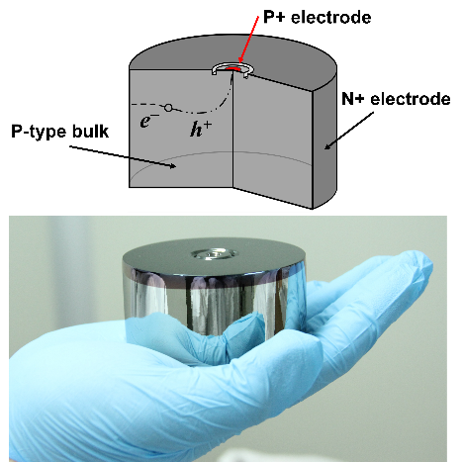
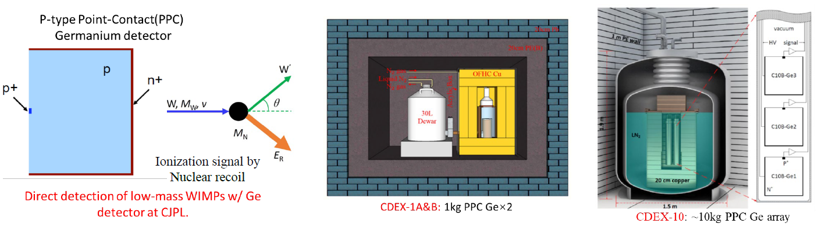
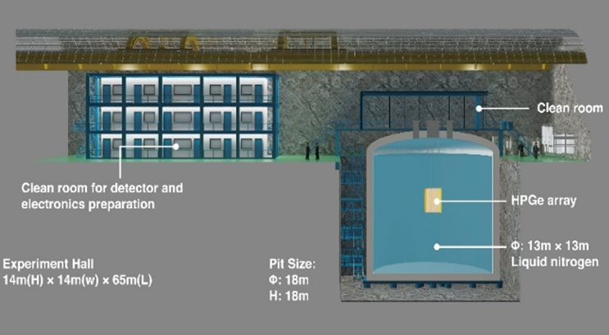
From Litao Yang
CDEX-1 (2009-2016): Development of PPC Ge detector, bkg understanding
CDEX-10 (2016-2022): Performances of Ge array detector immersed in LN₂
CDEX-50 (2021-202X): 50kg Ge detector arrays for DM searches
CDEX-300ν (2021-202X): 300kg enriched Ge detector arrays for 0νββ Exp.
CDEX-50
(DM)
CDEX-300ν
(0νββ)
CDEX-1000
CDEX-1
CDEX-10
{
2009-2016
2016-2022

Slide 15
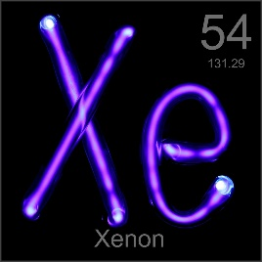
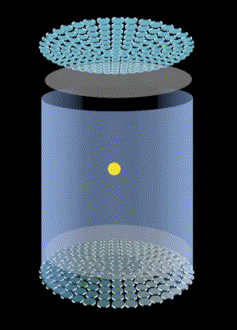
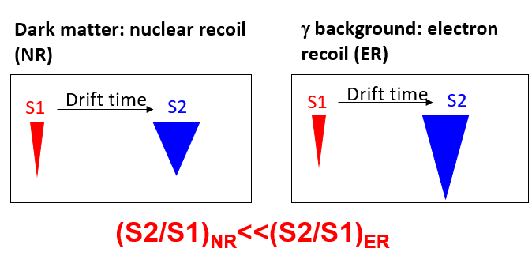
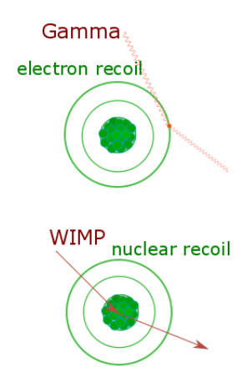
Dual Phase Liquid Xenon TPC
Purity liquid xenon target, enhanced DM signals, achievable liquefication temperature, high light & charge yield
Good ER/NR discrimination by S2/S1 ratio
3D reconstruction rejects external background
Notes:
The key technology we used is the so-called dual-phase liquid xenon time projection chamber. Xenon is a heavy noble gas element with a nucleon number of about 130. It could significantly enhance the dark matter signals compared to other light elements. Besides, its liquefication temperature is about minus 100 centigrade degrees which could be easily achieved. Xenon has a high light and charge yield. When a dark matter particle comes into the detector, it will release the scintillation light and the ionization electrons. The light will be collected by the top and bottom PMT arrays called S1. The electrons will drift to the liquid-gas surface, and then be extracted by the extraction field, get amplified, and release another light signal, called S2. The nuclear recoil event and the electron recoil events can be distinguished by the S2 over S1 ratio. For the conventional WIMP signals, it performs like a nuclear recoil. According to the S2 distribution of the top PMT arrays, together with the time difference between S2 and S1, we could establish the 3D position of an event and reject the external background.

Slide 16
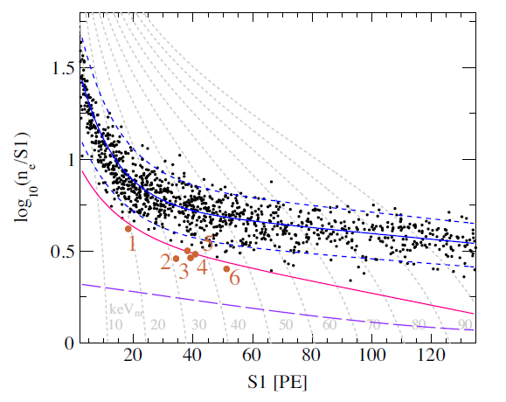
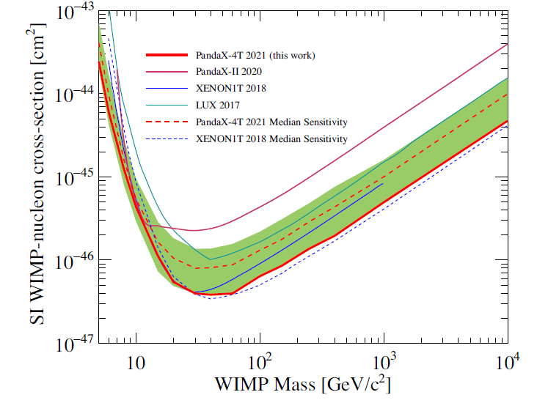
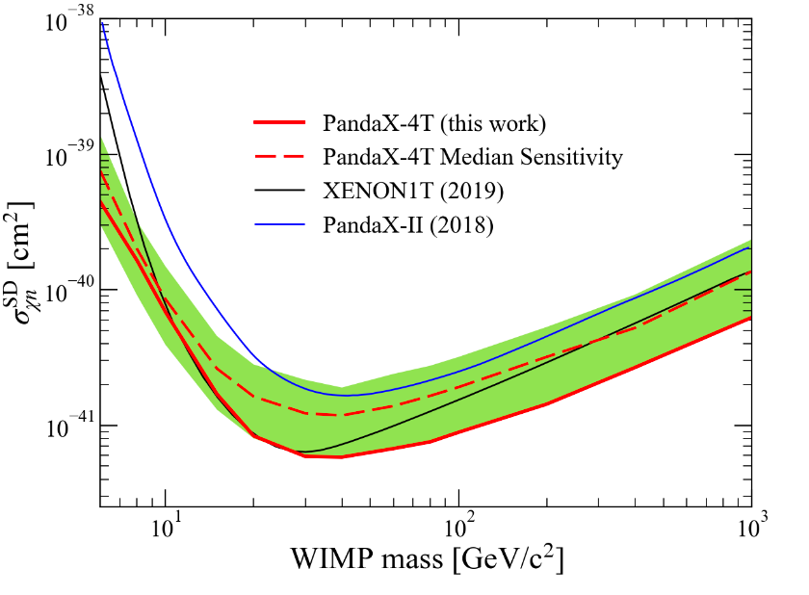
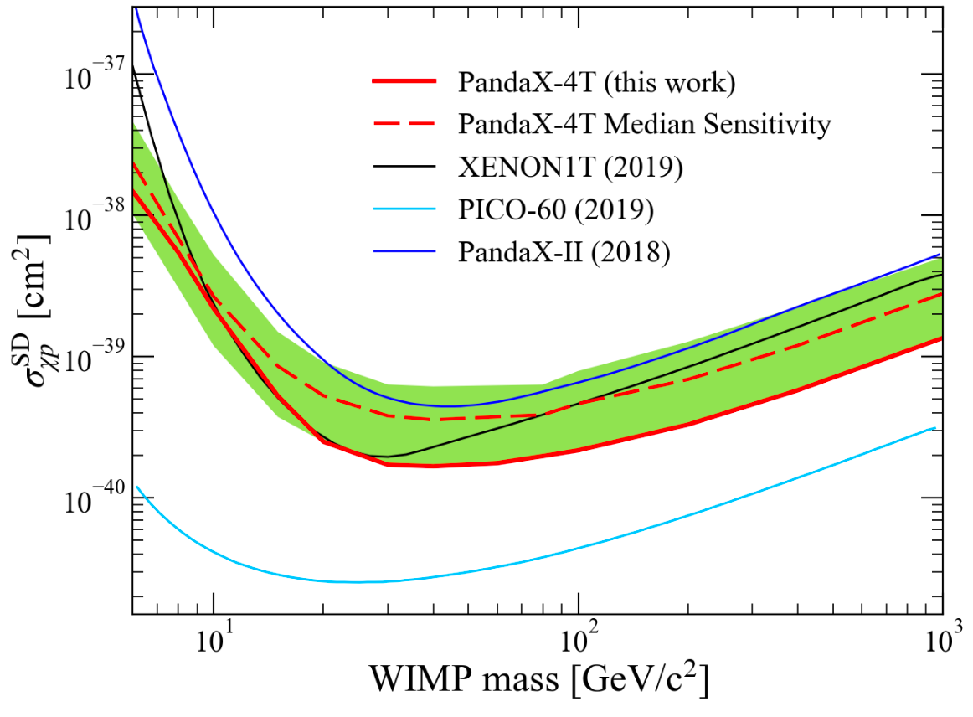
PandaX-4T First Result – WIMPs (SI & SD)
Y. Meng et al. PRL 127, 261802 (2021)
0.63 tonne·year
Z. Huang et al. PLB 834, 137487 (2022)
1058 candidates (expected 1054±39), 6 below NR median curve (expected 9.8±0.6)
Sensitivity improved from PandaX-II final analysis by 2.9 times (30 GeV/c²)
Scattering cross-section could be connected to the spin of the nucleus
Notes:
Finally, with 0.63 tonne year exposure, over 1000 candidates are identified in our region of interest and 6 of them is observed below the NR median curve compare to the expected background is 9.8. Therefore, no event excess above our background level. Here is our final exclusion parameter space for the spin independent WIMP-nucleon scattering. The sensitivity is improved from PandaX-II by about 3 times.

Slide 17
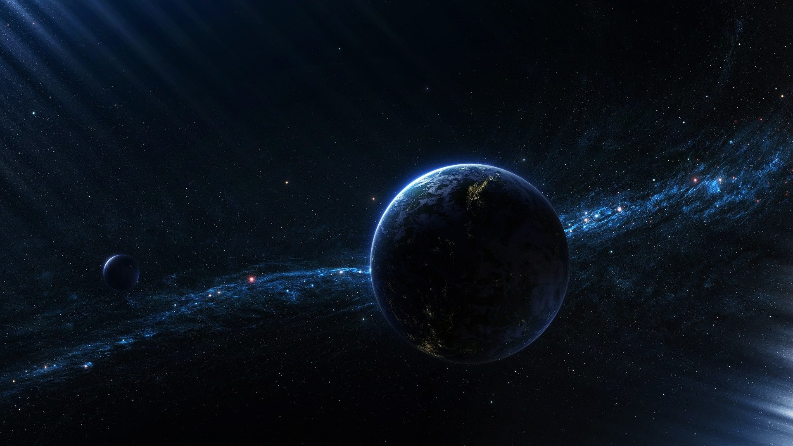
How dark is dark matter?
How dark is dark matter?
Image Credit: Public Domain
Notes:
接下来我就对PandaX-4T实验在最近一年所取得的暗物质探测结果给大家做一个简要汇报。我们知道暗物质的“暗”是来源于，在天文学观测上，通过电磁相互作用的手段都不能观测到它，但截至目前人类的探索，暗物质究竟有多“暗”？这个问题其实是可以给出一个定量的限制的。

Slide 18

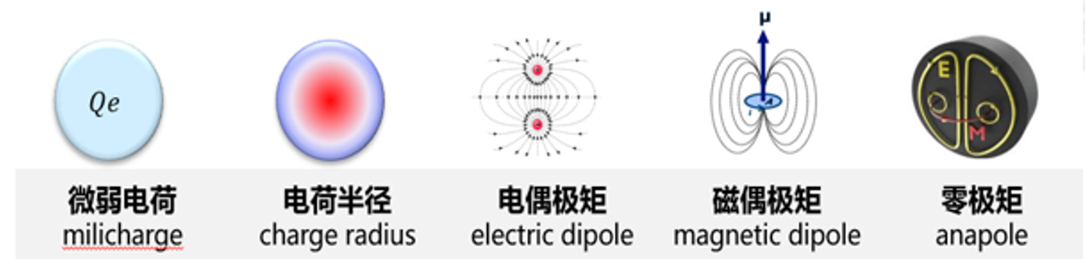
Luminance of Dark Matter
Possible residual weak EM properties
Coupling with photons
$$ℒ=Qe\overline{χ}γ^{μ}χA_{μ}+\frac{μ_{χ}}{2}\overline{χ}σ^{μν}χF_{μν}+i\frac{d_{χ}}{2}\overline{χ}σ^{μν}γ^{5}χF_{μν}+b_{χ}\overline{χ}γ^{μ}χ∂^{ν}F_{μν}+a_{χ}\overline{χ}γ^{μ}γ^{5}χ∂^{ν}F_{μν}$$
millicharge
magnetic dipole electric dipole charge radius anapole
EFT
tree-level
higher-order loop-level
Notes:
Next, I’d like to tell you about our efforts on constraining the luminance of dark matter, or more intuitively, how dark is dark matter. By saying the luminance, I am talking about the possible residual weak electromagnetic properties or the possible coupling with photons. We have known much about the gravitational interaction for DM, as for EM interaction, we usually assume it is neutral. Here we try to give it a explicit constraint.
We studied those possible EM properties systematically based on the EFT approach, including the millicharge, the magnetic and electric dipole, the charge radius, and the anapole, each corresponding to a term in the full Lagrangian, from the tree-level to higher-order loop level.
在这项研究中，我们通过考虑暗物质粒子与光子的相互作用，借助有效场论的方式对暗物质粒子的可能残留的电磁性质进行分析。这些电磁性质，对应于EFT拉氏量里面的各项，包括微弱电荷，磁偶极，电偶极，电荷半径，以及零级矩。

Slide 19
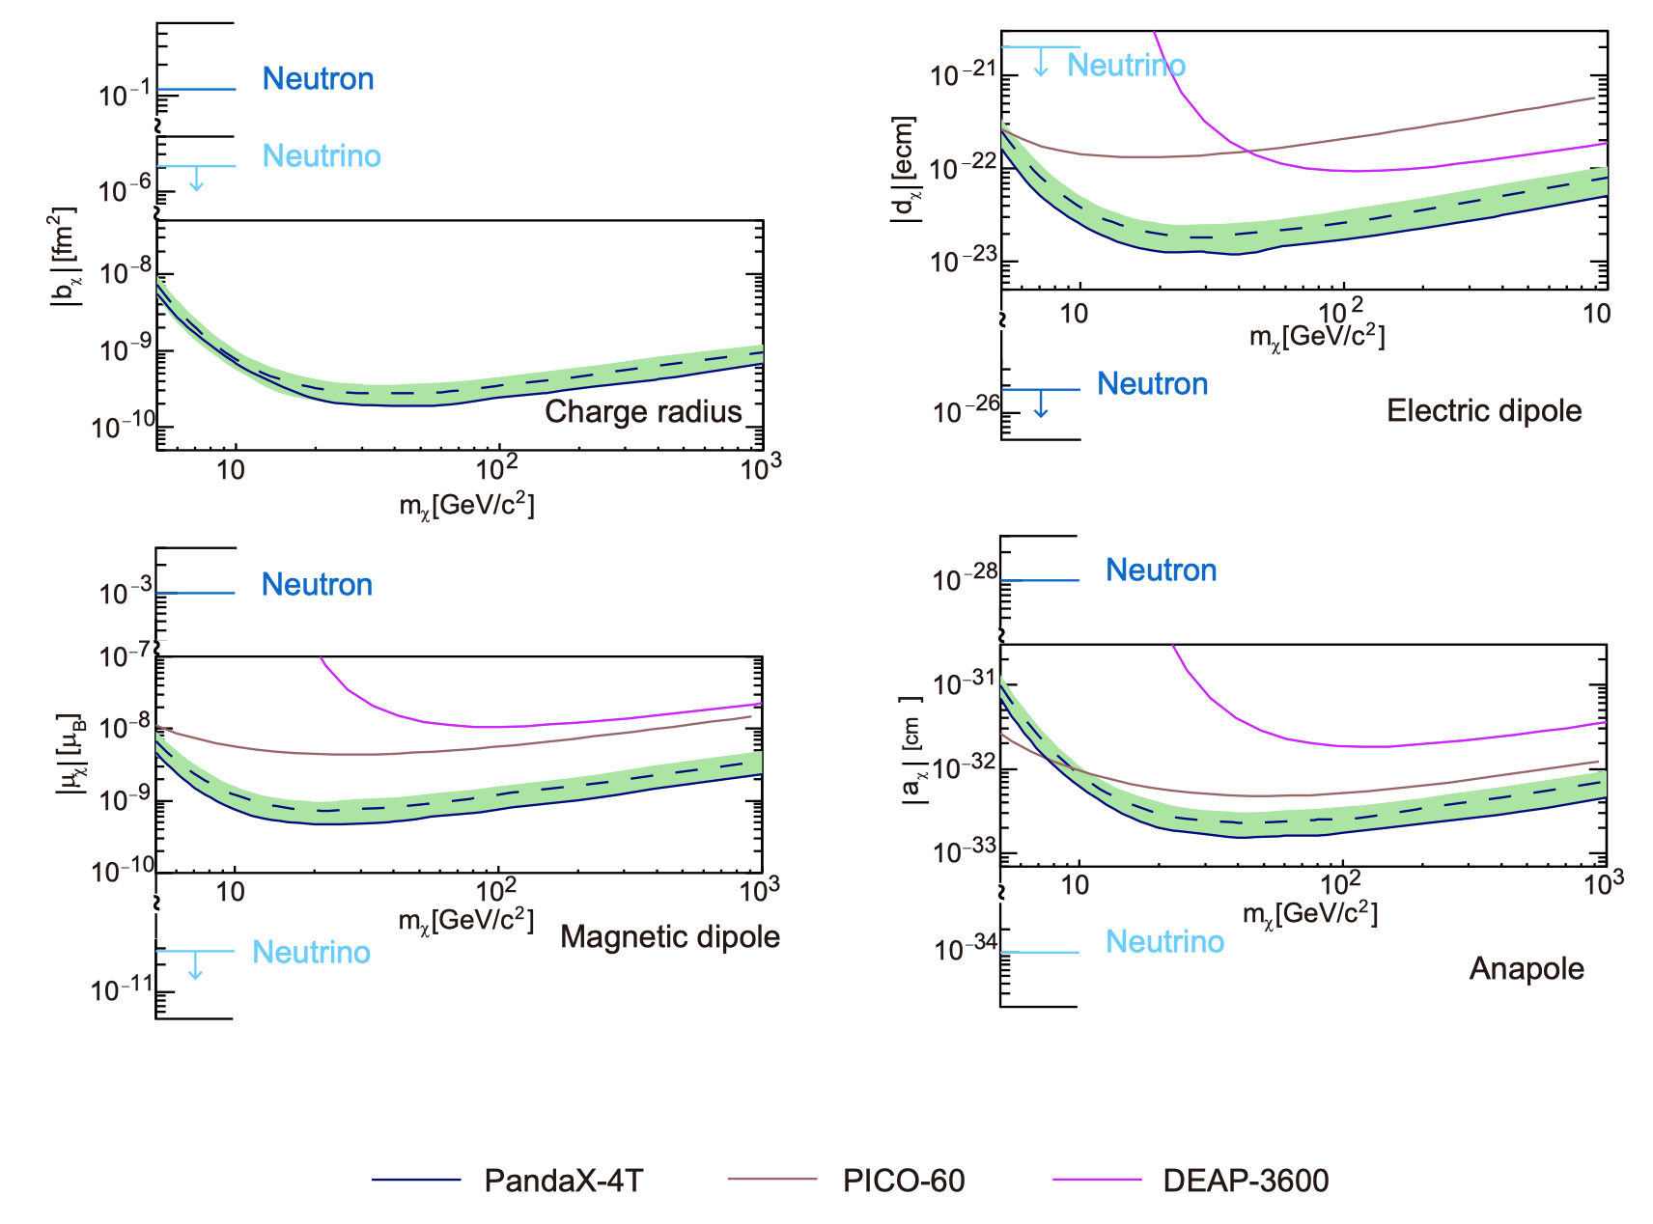
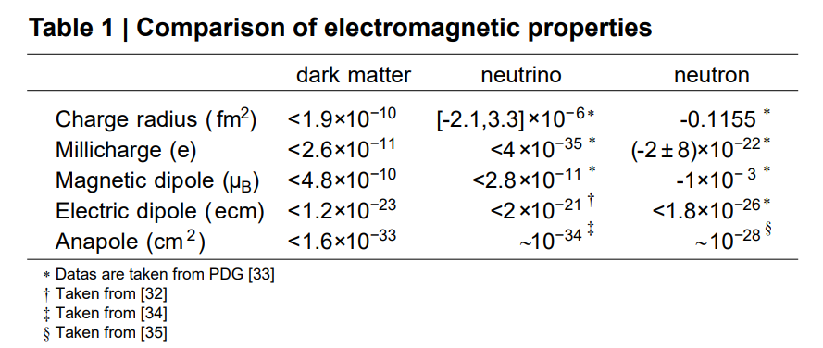
Dark Matter is Much Darker Than Anticipated
First experimental constraints on DM charge radius
  4 orders of magnitude smaller than neutrino
Other EM properties
  Up to 3 – 10 times improvement
X. Ning et al. Nature 618 (2023) 7963, 47-50
Notes:
Finally, based on the likelihood fit to the PandaX-4T data, we obtain the first experimental constraint on DM charge radius. We know that neutrino has the smallest charge radius limit among fundamental particles. And our constraint on DM charge radius is 4 orders of magnitude smaller the neutrino. And we also get an up to 3-10 times improvements for other EM properties, compared with previous measurements from PICO and DEAP. These results have been published in Nature this year.
The conclusion is that DM is significantly darker than previously anticipated
我们首次给出了暗物质的电荷半径的实验限制，并且这个限制在40GeV暗物质质量区间比中微子还要小4个数量级。而对于其余几个电磁性质我们的结果也都比之前的实验提升了3到10倍，这项工作今年发表在了Nature上。

Slide 20
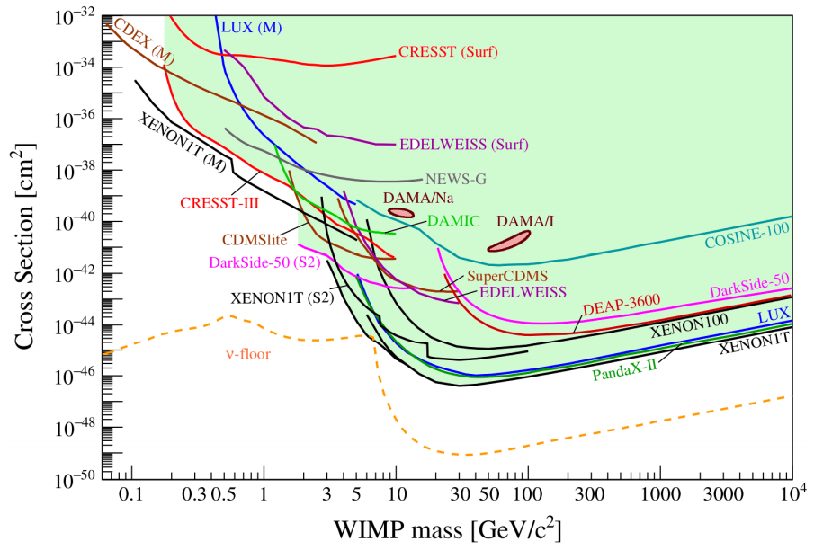
Towards sub-GeV Dark Matter
Generally very weak signals from sub-GeV DM
Several novel approaches
  lower threshold (S2-only)
  Migdal effect
  mass-energy conversion (χ-ν)
  Boosted mechanism
Notes:
The liquid xenon detectors are designed to be most sensitive to 10GeV to 100GeV dark matter, while sub-GeV dark matter generally produce very weak signals that cannot surpass the detection threshold. However, there are several novel approaches to
除此之外，我们试图充分发掘实验数据，通过多种新颖的手段来开展对sub-GeV的暗物质信号的寻找。这些方式包括了通过研究更小的电离信号来直接降低探测阈值，借助Migdal效应，以及考虑全新的相互作用形式，包括暗物质-中微子的转换机制和暗物质的加速机制。下面我将逐一展开介绍。

Slide 21
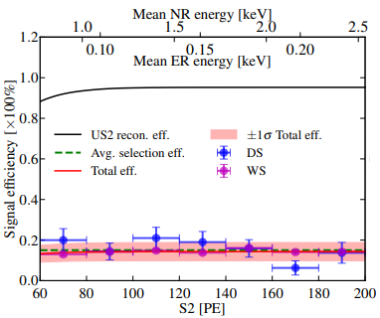
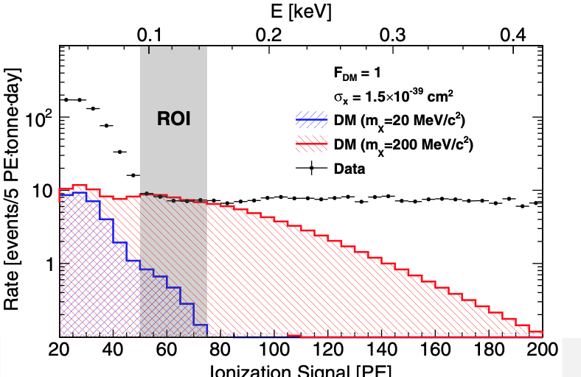
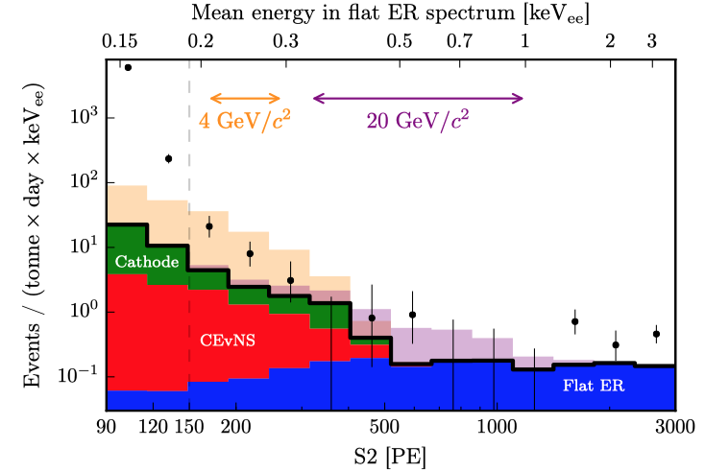
Ionization-only for Lower Threshold
Ionization-only: no scintillation signal requirement
  ROI S2 [60, 200]PE: threshold down to ~100 eV (from ~1 keV)
  Tight quality cuts on the ionization signal
Key challenge: background components
  No full picture in previous xenon-based experiments
  Conservative results only
PandaX-II
XENON1T
Notes:
First we can lower the threshold manually by look into the ionization-only signal. To achieve this, we focus on a very low signal range of 60 to 200 PE for ionization charge, which corresponds to an energy threshold down to 100 electro-Voltz.
开始我提到了，对于传统的GeV WIMP-like暗物质我们是研究配对的闪烁光信号和电离信号所重建的事例。为了进一步降低探测能量阈值，我们只研究较小的电离信号，能量阈值从1keV降到了0.1个keV。当然这需要我们重新研究筛选条件、效率以及本底构成。特别是极低能附近的本底模型，在已有的包括PandaX-II和XENON1T的发表结果中都没有一个full picture，因此只能给出很保守的结果。

Slide 22
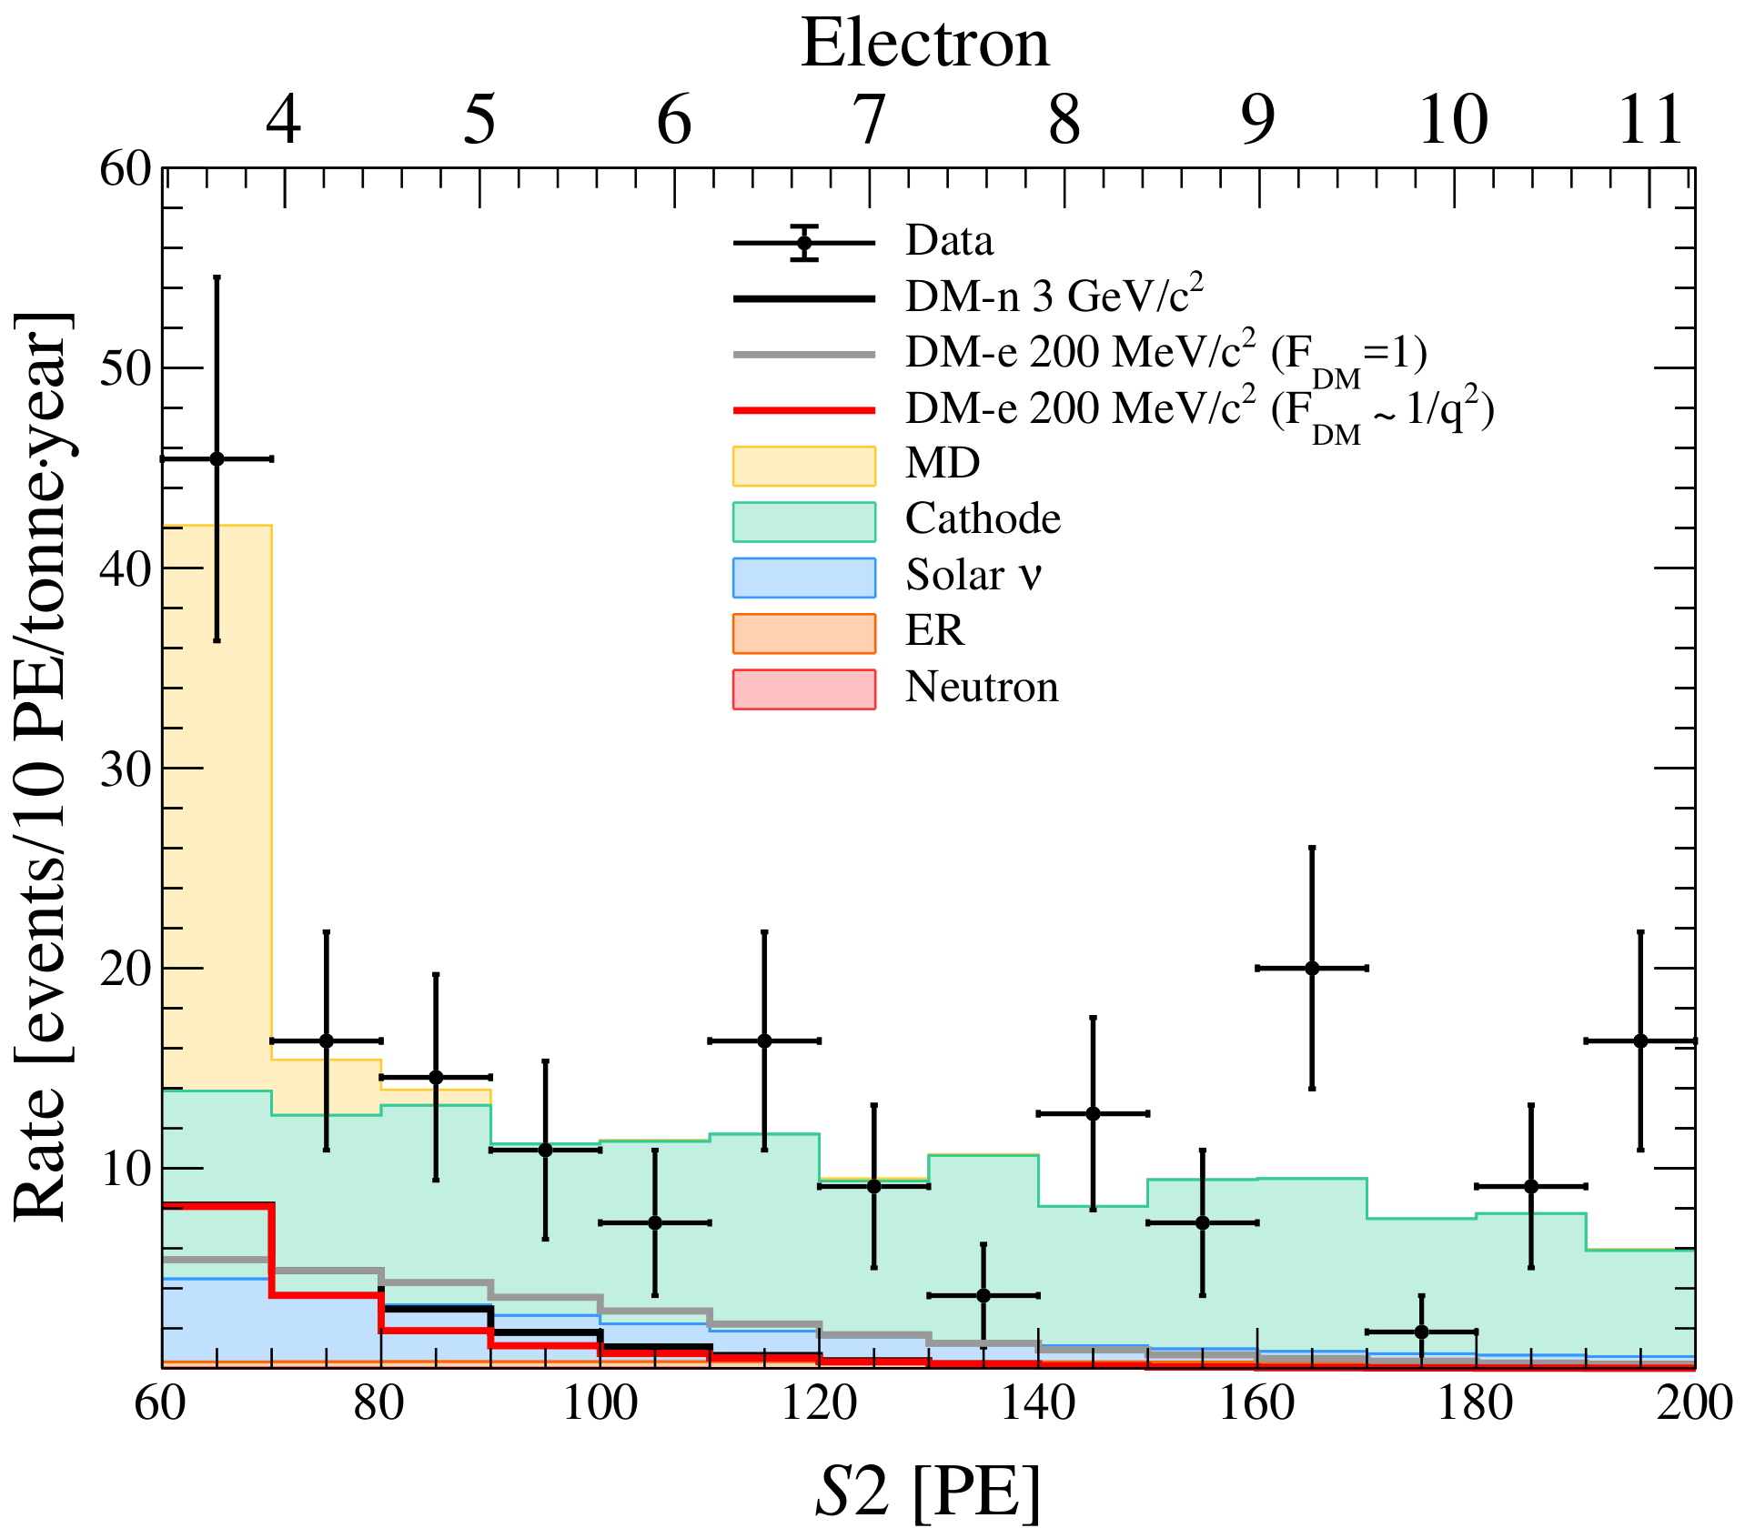
Ionization-only Data of PandaX-4T
First complete understanding of all the main background
  Micro-discharging (MD)
    Small charge, strong run-condition dependence
  Cathode activity
    Large charge, large pulse-shape width
Blind analysis of 0.55 tonne-year exposure
  105 events
  Best-fit background: 95.8 ± 11.3 events
Notes:
For the first time, we study the background components in detail and identify the micro-discharging and cathode activity from the control region.
PandaX-4T实验中，我们首次构建了完整的极低能区本底模型，特别是发现了电极微打火形成的本底贡献。并且通过常规的基于变量分布的事例筛选以及BDT的机器学习算法，我们对PandaX-4T 0.5吨年的数据进行了盲分析，最终在数据中发现105个事例，与预期本底没有显著超出。

Slide 23


Constraints on DM-e⁻ Scattering
Most stringent constraints are derived
  DM-electron interaction with heavy mediator, $2×{10}^{−41}$cm²
S. Li et al. PRL 130, 261001 (2023), Editors’ Suggestion
Notes:
By taking all the background components into account, we derive the most stringent constraints for the DM-electron interaction down to the 10^-41 centimeter square level, under blind analysis of 0.55 tonne-year exposure.
因此我们得到了对于heavy mediator暗物质与电子的最强作用截面限制，达到10e-41cm2。

Slide 24



Dark Mediator Model and Migdal Effect
DM-nucleon interaction with a dark mediator / dark photon
vector or scalar
NR-induced ER signals by the Migdal effect
  Probe low-mass DM via ER energy deposition
Notes:
，The second approach to search for sub-GeV dark matter is utilizing the Migdal effect. Here we consider the physics scenario in which a vector or scalar force mediator ϕ coherently mediates the interaction between the DM and nucleon, and the mediator mass is comparable to or even smaller than the momentum transfer in nuclear recoils.
A special case is dark photon, Dark photons can provide possible explanations of anomalies, including muon g-2 and so-called small-scale problems in galactic astronomy
When a DM particle scatters with a xenon atom, the nucleus undergoes an abrupt momentum change with respect to the orbital electrons, resulting in the excitation or ionization of the atomic electrons due to the lack of transient movement of the electron cloud. This effect leads to the possible generation of ER signals in the keV range that accompany the primary NR. Therefore, even if the NR energy deposition is below the detection threshold, the ER energy deposition due to the Migdal effect can still be detected, providing a way to probe low-mass DM particles that are otherwise not detectable in PandaX.
对于light mediator,我们后续也展开了针对性的研究，这时动量转移在微分能谱中的贡献将有所体现。Light mediator的一个特殊例子就是dark photon，dark photon对一些现有的观测anormaly，比如muon g-2可以提供解释。此外，我们也考虑了Midgdal效应的影响，在这个过程中，不同于单纯原子核被反冲，整个Xe原子产生移动，核外电子有几率被激发和电离，从而产生keV的电子反冲信号。

Slide 25


Search for DM-n Interactions with a Dark Mediator
With ionization-only data, set most stringent constraints
  DM-nucleon interaction with dark mediator, for DM mass [30 MeV, 2 GeV]
Assume dark mediator is a dark photon
  Rule out significant parameter space of such thermal relic dark-matter model
  Complementary with future experiment (like DarkSHINE)
D. Huang et al. PRL 131, 191002 (2023)
Notes:
With the ionization-signal-only data and utilizing the Migdal effect, we set the most stringent limits on the cross section for dark matter masses ranging from 30 MeV to 2 GeV. Our results indicate a significant improvement in sensitivity over previous experiments, enhancing the potential for low-mass DM detection
Under the assumption that the dark mediator is a dark photon that decays into scalar dark matter pairs in the early Universe, our results provide a direct test of dark-photon-mediated DM as the thermal relic, and rule out the scalar DM model in the mass range between 30 MeV and 1 GeV.
最终，我们对于30MeV到2GeV的暗物质与氙核相互作用给出了最灵敏的限制，并且针对dark photon作为dark mediator的情况，我们的结果排除了thermal relic DM model的很大一片参数空间。我们的实验也和未来像DarkSHINE这样的实验形成完美互补。

Slide 26



Exotic Search Channel: DM-𝜐 Conversion
Characteristic mono-energetic signal:
Xe-nucleus targets, m_{x} = 40 MeV, E_{R} ~ 6.5 keV
Electrons targets, m_{x} = 40 keV, E_{R} ~ 1.5 keV
$$E_{R}=\frac{m_{χ}^{2}}{2(m_{T}+m_{χ})}$$
Challenge: accurate NR signal response model!
40 MeV/c² DM-nucleus
ν
J. Dror et al, PRL 124, 181301 (2020)
Notes:
Besides the search of standard WIMP, we also studied many kinds of exotic [igzotik] dark matter models. In this talk, I will mention the dark matter-neutrino conversion as one example. In this exotic process, Dark matter particle is absorbed entirely, with an out-going neutrino. Similar to WIMP scattering process, it will induce detectable nuclear recoil (NR) and electronic recoil (ER) signals, respectively. It will generate characteristic mono-energetic signal, which is quite different from our known backgrounds.
NR但能峰，NR signal model
与散射过程不同，轻质量的暗物质还可能被氙核或核外电子完全吸收，并释放一个中微子。对于给定质量的DM,这会在反冲能谱上产生一个特征的单能峰信号。暗物质被氙核吸收的质量尺度达到几十个MeV,而对于被电子吸收的情况，甚至达到了几十keV的范围。此外与氙核的相互作用，我们是国际上首个对单能的核反冲信号开展搜寻，这对于我们所构建的核反冲的信号响应模型提出了更高的要求。

Slide 27





Mono-energetic Signal Search Results
$χ+$Xe $→υ+\text{Xe}$
$χ+e$ $→υ+\text{e}$
e$ν→χ$e, ee$→χν$
L. Gu et al. PRL 129, 161803 (2022), Editors’ Suggestion
D. Zhang et al. PRL 129, 161804 (2022) , Editors’ Suggestion
Notes:
We didn’t observe an excess either for the nuclear recoil events or the electronic recoils. And Our result is much more sensitive than the collider search and consistent with the astrophysical observations.
(level of fine-tuning of UV model to satisfy CMB); Existing constraints from relic density (overproduction e$ν→χ$e, ee$→χν$) ，cosmological observation of Universe expansion ($χ→3ν)$ and X-ray satellites ($χ→γγν）$
最终，针对与氙核的x-v转化过程给出了比对撞机探测好6个数量级的排除限制，而与电子的x-v转化则是和之前XENON1T的低能超出形成一定的tension，在低质量范围比天文学的观测给出更好的限制。
(level of fine-tuning of UV model to satisfy CMB); Existing constraints from relic density (overproduction e$ν→χ$e, ee$→χν$) ，cosmological observation of Universe expansion ($χ→3ν)$ and X-ray satellites ($χ→γγν）$

Slide 28



CDEX Fermionic Dark Matter Search
From Litao Yang
If DM particles are Fermion, they can induce neutral current absorption with nucleus or electron
Limits on Nucleus Absorption Cross-Section (σ_{NC}):
  CDEX achieves the lowest DM mass reach (10 MeV) among direct detection experiments to date
Limits on Electron Absorption Cross-Section (σ_{e}v_{𝜒}):
  For vector and axis-vector operators: New Experiment results for m_{𝜒} = 0.1~10 keV
PRL 129, 221802 (2022)
arXiv:2404.09793
axis-vector operators

Slide 29






Boosted DM from Atmosphere
Large kinetic energy to overcome threshold
Boosted mechanism
  Mesons from cosmic-ray dump in atmosphere may decay into light boosted-DM
Benchmark model
  Up-philic scalar mediator (no flavor change)
  DM is generated via
https://www.sohu.com/a/569454456_120946554
$$η→π^{0}S→π^{0}χ\overline{χ}$$
Elastic
Quasi-elastic
A dedicated MC attenuation simulation
  For $T_{χ}$> 0.2 GeV, QE becomes significant
  Elastic & Quasi-elastic process is included.
reached flux
L. Su, L. Wu, NZ, B. Zhu, Phys. Rev. D 108, 035004
Notes:
Light DM can have large kinetic energy via a boosting mechanism, to overcome the detector threshold. When the cosmic ray inelastically dumps into the atmosphere, it can generate energetic mesons.
These mesons will further decay to light-boosted DMs under proper theoretical assumptions.
The benchmark model we choose is the up-philic scalar mediator model. The scalar mediator only couples to up quark, to get rid of the flavor change problem.
In this work, We only consider eta meson, because there are no dedicated measurements on eta decay to pion plus invisible.
Since the kinetic energy of DM is large, the quasi-elastic process during earth attenuation should be considered.
It happens when the DM is energetic enough to scatter directly with a single nucleon.
From the reached flux spectrum, we can find that the quasi-elastic process impacts a lot. It shifts the reached flux to an even lower region, and will surely suppress the upper boundary of detector sensitivity to a weaker level.
最后是关于一种新的暗物质加速机制的研究。宇宙线与地球大气作用可以产生大量的eta介子，eta介子可以decay成pi0和一个scalar mediator, S. 这个scalar mediator进一步decay成χχ-bar，这时的χ和χ-bar具有很高的动能，从而可以有足够能量沉积在氙探测器中。在这个过程中，有两个事情需要指出。一方面，暗物质具有很高的动能，如果相互作用较强，会被地球岩石全部散射掉无法进入探测器中。另一方面，对于暗物质动能较大的区间，准弹过程变得主导不可忽略。这篇文章的模型是基于南师大武雷老师研究组的理论工作合作完成的。

Slide 30


Constraints on boosted DM
Cosmic-ray beam dump gives a unique window to search this scalar-mediated DM-nucleon interaction
Same model could be searched in other experiments
X. Ning et al. PRL 131, 041001 (2023)
Notes:
We then set a limit on DM-nucleon interaction with a scalar mediator. The upper region is where DM is shielded by the earth.
We also set limits to the model parameters. This result can be directly tested by other kinds of experiments like beam dump MinibooNE and the meson precision measurement experiment.
加速暗物质打开了探索scalar-mediated的全新窗口。
实验结果也可以被其他实验进行检验。

Slide 31






Boosted DM-electron: SRDM
From Litao Yang
Solar Reflected Dark Matter
velocity distribution
PRL 132, 171001 (2024)
CDEX-10 SRDM results

Slide 32

Towards neutrino
Solar B-8 neutrino flux measurement
Xe-136 2vDBD
Notes:
The liquid xenon detectors are designed to be most sensitive to 10GeV to 100GeV dark matter, while sub-GeV dark matter generally produce very weak signals that cannot surpass the detection threshold. However, there are several novel approaches to
除此之外，我们试图充分发掘实验数据，通过多种新颖的手段来开展对sub-GeV的暗物质信号的寻找。这些方式包括了通过研究更小的电离信号来直接降低探测阈值，借助Migdal效应，以及考虑全新的相互作用形式，包括暗物质-中微子的转换机制和暗物质的加速机制。下面我将逐一展开介绍。

Slide 33

PandaX-4T Search for ⁸B CEνNS
To enhance sensitivity on ⁸B (like a 6 GeV WIMP), need to lower the selection threshold (S1↓, S2 ↓)
Major challenge: Accidental background (AC, non-physical S1 and S2 randomly paired)
Blind analysis: 0.48 ton-year data, excluding data with an increase in noise rate (micro-discharge)
Similar as
6 GeV WIMP
33
Notes:
As the sensitivity improves, we are approaching the solar neutrino floor, that the boron-8 analysis is first applied. To enhance the sensitivity on B8, we need to lower the selection threshold, both for S1 and S2. While the major challenge is the accidental background, often called AC, meaning the non-physical S1 and S2 which are randomly paired. We perform blind analysis with 0.48 tonne-year data, excluding those with a higher noise rate due to micro-discharge.

Slide 34


Constraints on ⁸B neutrino
W. Ma et al. PRL 130, 021802 (2023)
A multi-variate (BDT) algorithm trained to suppress AC background
Leading constraint on ⁸B neutrino flux through CEνNS
Assuming a nominal ⁸B background, set strongest constraints on light WIMP of 3 -10 GeV
Notes:
To suppress the AC background, we use a multi-variate machine learning algorithm called “boosted decision tree”or BDT in short. Only one event was observed. Thus, finally, we obtain the leading constraint on boron-8 neutrino flux through CEvNS. And if assuming a nominal ⁸B background, we also set the strongest constraints on light WIMP of 3 -10 GeV mass.

Slide 35






¹³⁶Xe 2$υ$DBD Half-life Measurement
PandaX-4T: ¹³⁶Xe/Xe 8.86%, 59.6kg in FV, up to 2.8MeV
First natural xenon measurement with a dark matter detector
2.27 $±$ 0.03 (stat) $±$ 0.10 (syst) x 10²¹ years
Consistent with ¹³⁶Xe-enriched experiments.
Region1
Research Vol 2022, 9798721 (2022)
Region2+3+4
Notes:
Besides the dark matter search, some neutrino physics can also be studied with the same data. For example, the first analysis of the two-neutrino double beta decay half-life measurement of Xenon-136 is finished with the natural xenon, that the energy region is up to 2.8 MeV. Our result is consistent with Xe136-enriched experiments, such as EXO and KAMLAND-ZEN. And it’s a major step forward for the NLDBD search with the liquid xenon TPC, which could answer the question whether the neutrino is its own anti-particle or not.

Slide 36



New 0νββ result from CDEX
From Litao Yang
Natural BEGe, 1.1kg, 186.4 kg·day exposure
Establish data analysis procedure and PSD method, 50% reduction of background in ROI than CDEX-1
First CDEX result from BEGe, $T_{1/2}^{0ν}≥5.6×{10}^{22} yr$,$90\% C.L.$
PRD 106, 032012 (2022)

Slide 37



PandaX-4T: After Commissioning
2020/11 – 2021/04 | Commissioning (Run 0) 95 days: ~0.6 tonne-year
2021/07 – 2021/10 | Tritium removal xenon distillation, gas flushing, etc.
2021/11 – 2022/05 | Physics run (Run 1) 164 days: ~1.0 tonne-year
2022/09 – 2023/09 | CJPL B2 hall construction xenon recuperation, detector upgrade
Expect to resume data taking soon
Notes:
And some information after our commissioning run: as mentioned above, tritium background is identified in the commissioning data, So we perform a dedicated offline xenon distillation. After refilling the xenon back to the detector, we collected our first physics run data (called Run1), and the data is under blind analysis. Now, the CJPL-II is under construction, and we use this time window to upgrade our detector.

Slide 38



Future plan: PandaX-xT
Next-generation liquid xenon experiment
  with >30 tonne liquid xenon in the sensitive volume
  decisive test on WIMP and key test on Dirac/Majorana neutrino
Notes:
I also included one slide showing the future plan of PandaX, we are aiming to build up the “Ultimate” liquid xenon experiment, referred to as the PandaX-xT. It’s an idea for using at least 30 tonne of liquid xenon in the sensitive volume in a future TPC, and to perform decisive tests on WIMP and the nature of neutrinos.

Slide 39

Future Plan - CDEX @CJPL-II
Prepare for HPGe experiment in Hall C1 @ CJPL-II
1725m³ liquid nitrogen, shielding and cooling system (inner: 𝜙13m*H13m)
Inner bkg level: <10⁻⁴ cpkkd@1keV, <10⁻⁶ cpkkd@2MeV
Five top flanges for detector deployment
  1×φ1.5m, centrally
  4×φ750mm, on a 6m
  diameter circle

Slide 40


CDEX-50
Ge detectors array directly immerse into LN₂ for cooling and shielding
target mass (Ge) reaches ~50kg
Bkg level: <0.01 cts/(keV∙kg∙day) @1 keV
Energy threshold for data analysis: 160 eV
WIMP SI sensitivity reaches 10⁻⁴⁴ cm²
JCAP 07 (2024) 009

Slide 41



CDEX-300ν Overview
LN₂ tank shared with CDEX-50, in Hall C @ CJPL-II
Reentrant tube containing LAr submerged in LN₂
Ge detector array immersed in LAr (veto) tube
Ge array divided into 19 strings (10-11 det/string, 200 det. in total ~225kg)
An exposure for ⁷⁶Ge 0νββ: >1t·y, T_{1/2} > 10²⁷y
13m
13m

Slide 42
Summary & Outlooks
PandaX-4T and CDEX are exploring various types of DM and neutrino
Planning future PandaX-xT project and CDEX50+CDEX-300v
Stay tuned!
Thank You！
Notes:
Here are some take-home messages. PandaX-4T is one of the new generation multi-tonne xenon experiments. And we have been doing intense searches for various types of physics, not only DMs, but also neutrinos. More exciting results are expected from the PandaX group, and as usual, we highly welcome new collaborators! That’s all for my talk today, thank you for listening and I’d be happy to take questions.

Slide 43
Backups

Slide 44

Dual Phase Xenon TPC
Pure liquid xenon target, enhanced DM signals, achievable liquefication temperature, high light & charge yield
Good ER/NR discrimination by S2/S1 ratio
3D reconstruction rejects external background
Notes:
划水，but强调最大的优势，对于外行
We use the same detection technology as LZ, that is the dual phase xenon TPC. Thus I won’t talk much about the detection principle.
Here I want to emphasize the advantage of dual phase xenon TPC. With massive xenon target, we have larger prob. to detect DM particles. And it also has good discrimination power for dark matter and gamma bkg. The 3D position can also be reconstructed accurately.
(The key technology we used is the so-called dual-phase liquid xenon time projection chamber. Xenon is a heavy noble gas element with a nucleon number of about 130. It could significantly enhance the dark matter signals compared to other light elements. Besides, its liquefication temperature is about minus 100 centigrade degrees which could be easily achieved. Xenon has a high light and charge yield. When a dark matter particle comes into the detector, it will release the scintillation light and the ionization electrons. The light will be collected by the top and bottom PMT arrays called S1. The electrons will drift to the liquid-gas surface, and then be extracted by the extraction field, get amplified, and release another light signal, called S2. The nuclear recoil event and the electron recoil events can be distinguished by the S2 over S1 ratio. For the conventional WIMP signals, it performs like a nuclear recoil. According to the S2 distribution of the top PMT arrays, together with the time difference between S2 and S1, we could establish the 3D position of an event and reject the external background.)

Slide 45



Photon-mediated Interaction
Nuclear recoil signature
  Charge radius: similar to SI
  MD and ED: $1/E_{R}$
  Millicharge: $1/E_{R}^{2}$
30 and 100 GeV/c² DM
recoil energy
Notes:
Those properties can match to non-relativistic effective field theory and further link to the nuclear recoil signatures. The typical shape of the charge radius recoil spectrum, the light blue curve here, is similar to that of the commonly assumed SI scattering. Owing to the massless photon propagator, the recoil spectra for the dark matter magnetic and electric dipole moments both have a 1/E dependence, leading to a rate enhancement at small recoil energy. As for dark matter with millicharge, the 1/E2 dependence of the cross-section yields a unique sharp feature at very low E.
The right plot shows how these signals distribute in the two-dimensional parameter space, overlaid with the data points from PandaX-4T

Slide 46


Boosted DM in Detector
Earth attenuation
  Monte Carlo simulation with both QE and elastic process included
DM flux
Nuclear recoil energy

Slide 47

Future Plan: PandaX-xT
Next generation liquid xenon experiment
  with >30 tonne sensitive volume
  decisive test on WIMP with 200 tonne-year
Notes:
I also included one slide showing the future plan of PandaX, we are aiming to build up the “Ultimate” liquid xenon experiment, referred to as the PandaX-xT. It’s an idea for using at least 30 tonne of liquid xenon in the sensitive volume in a future TPC, and to perform decisive tests on WIMP

Slide 48



Neutrino Floor
Coherent Elastic Neutrino-Nucleus Scattering (CEvNS)
C. O’Hare PRL 127, 251802 (2021)
Notes:
First is our research on neutrino floor. The neutron floor is generated by the coherent …. scattering, or the so-called CEvNS from solar neutrinos and atmospheric /ˌætməsˈferɪk/ neutrinos.
PandaX-4T has touched the solar neutrino floor.

Slide 49

Towards the Neutrino Floor
Lowering selection threshold for solar ⁸B CEvNS
  Cut on the scintillation signal (S1) from 2 PE to 0.3 PE
  Optimizing signal selection cuts with waveform simulation
Accidental paired (AC) background modeling and rejection
before BDT cut
Notes:
In other words, PandaX-4T has the potential to detect the B8 neutrino via CEvNS reaction, by lowering the selection threshold of the scintillation signals S1 from 2 PE to 0.3 PE.
In this case, accidental paired background, or the AC, is the major background. We optimize the signal selection cuts with waveform simulation.
The final efficiency, shown as the red curve here, is improved compared to the previous WIMP analysis, shown as the dashed magenta curve.
We also study the accidental paired bkg, or the AC bkg carefully and make a good modeling. The right figure shows the S1 spectra comparison between BK prediction and PandaX-4T data, also overlaid the B8 CEVENS with 50 times multiplication. We can see that our prediction is roughly consistent with the data points.
MOTIVATION: 给外行，沉积能量低，

Slide 50

Constraints on ⁸B Neutrino and Light WIMP
A multi-variate (BDT) algorithm trained to suppress AC background
Blind analysis with 0.48 tonne-year data
Leading constraint on ⁸B neutrino flux through CEνNS
Assuming a nominal ⁸B background, set strongest constraints on light WIMP of 3 -10 GeV
Phys. Rev. Lett. 130, 021802 (2023)
Notes:
To suppress the AC background, we use a multi-variate machine learning algorithm called “boosted decision tree”or BDT in short.
With the BDT cut applied, after unblinding only one event was observed, which is downward fluc compared to the our prediction. Thus, finally, we obtain the leading constraint on boron-8 neutrino flux through CEvNS, which is also consistent with std solar model.
And the behavior of B8 neutrino is similar to that of 6 GeV WIMP particles, so if assuming a nominal ⁸B background as std solar model, we also set the strongest constraints on light WIMP of 3 -10 GeV mass.

Slide 51

PandaX-4T Layout
System Layout
Notes:
Here is our PandaX-4T global layout at CJPL-II. The central part is a hyper-pure water tank for the background shielding and the 4T TPC locates inside it. On the top of the water tank is our clean room, with our electronics and DAQ system, the cryogenics and the circulation system inside. And out of the clean room, the left is the xenon distillation system and the right is the xenon gas storage system.

Slide 52



Cryogenics System
Pressure and temperature stability within 0.5% and 0.1K .
JINST 16 P07046 (2021)
Adjust Coldhead
temperature
Cryogenics
Loop2 In
Purification
Loop1 Maintenance
Parameters | Heating load (No purification) | Maximum Cooling Power | Filling/Recuperation flow rate | Outer Vacuum
Value | ~50 W | ~580 W | ~1 ton/day | <2E-4 Pa
Notes:
I will start with the xenon handling system. In the left figure, you can see our cryogenics system and the purification system. As I mentioned, the liquid xenon needs a cryogenic environment and keeps the liquid level and gas pressure stable. We use commercial cryocoolers to apply the cooling power of more than 500 Walts. During the running, the pressure and the temperature are stable within 0.5% and 0.1Kelvin.

Slide 53



Distillation System
JINST 16 T06007 (2021)
Structured packing (inside)
M-T diagram for Kr removal
Distillation method (different boiling point) for the LXe intrinsic background Kr & Rn removal
~10⁶ reduction factor for Kr removal with 10 kg/h
Reversed operation mode working for Rn removal
Notes:
For other noble gas contamination, like the main intrinsic background Krypton and Radon, the distillation method is applied, based on their different boiling point. Here is our distillation tower which is about 10-meter high. This is our structured packing inside the tower. By the M-T diagram, the krypton removal ability gives a reduction factor of 10^6 with 10kg/h. And this is the first tower for both the krypton and radon removal. Two different operation processes could be achieved by reversing the operation mode. Besides the krypton and radon, the distillation system might be helpful for tritium removal, which plays an important background in the PandaX-4T commissioning.

Slide 54




TPC Conditions
Applied fields:
 | Set1 | Set2 | Set3 | Set4 | Set5
Gate(kV) | -4.9 |  | -5 | -5
Cathode (kV) | -20 | -18.6 | -18 | -16
Notes:
Back to the detector itself. Left are some pictures of the TPC, and the right figure shows the electric field we used, including the drift field and the extraction field. [Click] The liquid-gas surface is between the Gate and Anode. During the commissioning run, the Gate and Cathode voltages are stable.

Slide 55

PMT Arrays
Bottom PMT arrays
169 top + 199 bottom R11410-23 3-inch PMTs, with the average gain of 5.5×10⁶;
LED calibration every week, monitor gain stability;
Notes:
The S1 and S2 are collected by the PMT arrays, they are the eyes of the detector. In PandaX-4T, 3-inch PMTs are used with an average gain of 5.5 times 10^6. We did LED calibrations every week to calibrate the PMT gain and monitor the stability.

Slide 56

Electronics
From PMT to DAQ server;
CERN V1725 Digitizer, 250 MS/s;
Self-trigger mode: read out pulses above 20 ADC (~ 1/3 PE);
Notes:
After the lights are collected by the photo sensors, those data will be digitized by the V1725 from CERN and stored on our server. The self-trigger mode is applied during PandaX-4T running. The waveforms will be stored, and we require the read-out pulses above 20 ADC, which is roughly one-third photoelectron.

Slide 57



Calibration System
Gaseous source injection panel
Calibration tubes
D-D generator
Calibration source | Position
^{83m}Kr/²²⁰Rn | Injected from gas panel
²⁴¹Am-Be | Calibration tubes
D-D neutron | Beam pipe
Notes:
Next, about the calibration system. To know about the signal response in the PandaX-4T detector, both electron recoil and nuclear recoil events need to be calibrated. For the electron recoil calibration, the injected Kr-83-meta and Rn-220 are applied by the gaseous source injection panel just coupled to the purification system. As for the nuclear recoil calibration, the Am-Be source and the Deuteron-Deuteron neutron are used. There are three parallel calibration tubes just outside the inner vessel, and you can see the DD generator tube pointing to the center of the TPC.

Slide 58


Detector Response
²²⁰Rn
D-D
ER leak ratio (below NR median curve) is 0.4%±0.2%
Efficiencies separately determined from ER or NR calibration data are all consistent
Notes:
This is our events distribution in the calibration data. The ER and NR band are separated with only 0.4% ER events leak below the NR median curve. On the right is our efficiency curve for WIMP search, which is about 78% at 40 keV.

Slide 59


Backgrounds
Expected below-NR-median events: 9.8 (0.6) evts
Tritium background is identified in the Commissioning Run (Run0).
ER (Rn+Kr+Material+Tritium) background dominated in the selection region
Background per unit target is improved from PandaX-II by 4 times (<10 keV)
Notes:
We all know that background is another key issue for the dark matter search. We did a very careful background analysis and I will quickly show the result in our commissioning run. The left figure shows the background budget. You can see the ER background, including the material, Kr, Rn and tritium, is dominated in our selection region. And the background per unit target is improved from the PandaX-II by 4 times.

Slide 60



Enriched Ge material
200kg ⁷⁶Ge (>86%) arrived, half from Russia and half from China
Whole technical chain established
The mass production power (hundreds of kg per year) of enriched ⁷⁶Ge material has been setup in China

