Slide 1


Circular Electron Positron Collider
CEPC impedance budget update in EDR (including collimators) and limitations to luminosities
Na Wang, Yuan Zhang
Institute of High Energy physics
Contributors:
Yuan Zhang, Yudong Liu, Saike Tian, Haisheng Xu, Jintao Li, Xiaoyu Liu (IHEP)
2024 CEPC Workshop EU Edition, 8-11 Apr. 2024, Marseille, France

Slide 2
Outline
Review of the impedance budget in TDR
Impedance issues to be addressed in EDR
Impedance budget update (including collimators)
Limitations to Luminosities
Summary

Slide 3
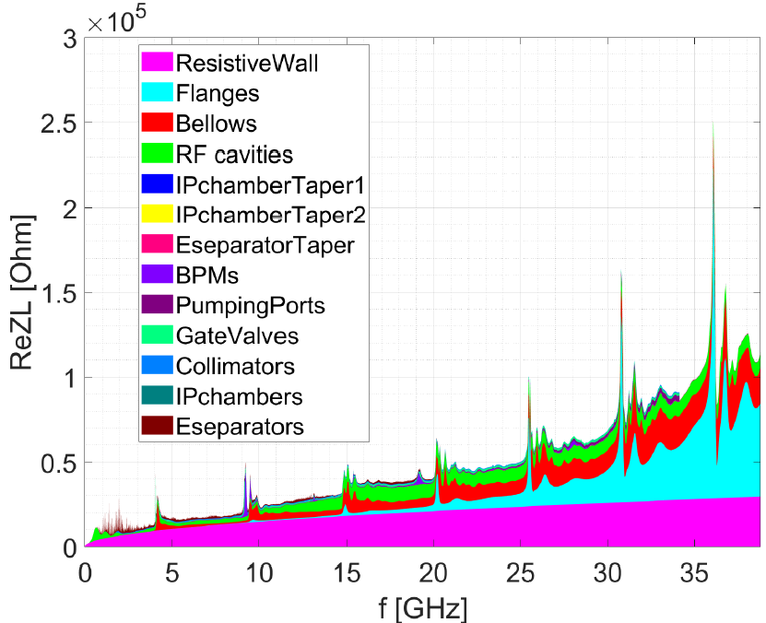
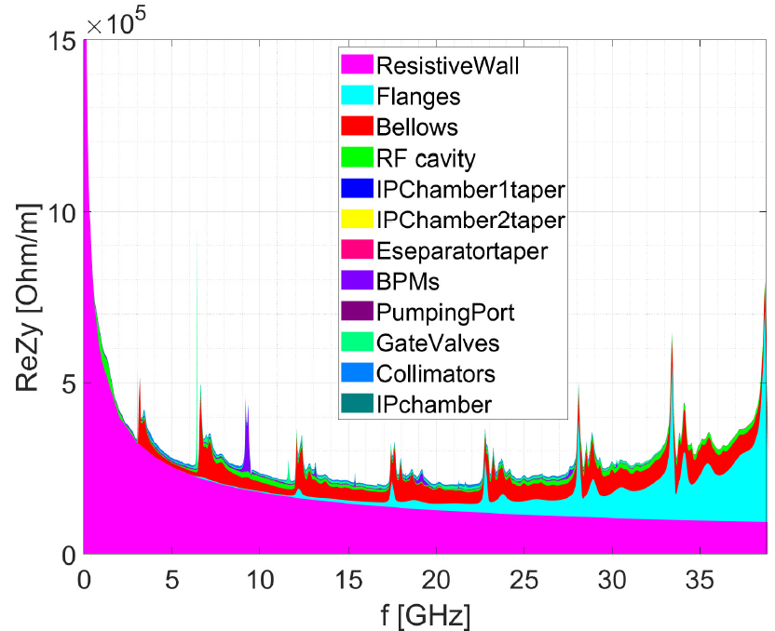
Review of the impedance budget in TDR
Impedance modeling
  Impedance of the key vacuum components has been evaluated
ReZL
ReZy
The impedance contributed by Inj./ext. elements, feedback kickers, absorbers, masks and collimators outside the IR region are not included.

Slide 4
Review of the impedance budget in TDR
Impedance budget @σ_{z}=3mm
Components | Number | Z||/n, mΩ | L, nH | k_{loss}, V/pC | k_{y}, kV/pC/m
Resistive wall | - | 6.2 | 329.2 | 363.7 | 11.3
RF cavities | 60 | 0.5 | 24.8 | 101.2 | 0.5
Flanges | 37714 | 5.2 | 276.1 | 37.3 | 5.2
BPMs | 1808 | 0.04 | 2.0 | 9.5 | 0.2
Bellows | 15949 | 2.9 | 154.6 | 87.4 | 3.9
Gate Valves | 500 | 0.2 | 11.4 | 14.5 | 0.4
Pumping ports | 5316 | 0.3 | 18.4 | 2.3 | 0.2
Collimators | 16 | 0.04 | 1.7 | 23.4 | 0.6
IP chambers | 2 | 0.004 | 0.2 | 0.3 | 0.05
Electro-separators | 20 | -0.1 | -5.4 | 34.5 | 0.1
Taper transitions | 48 | 0.04 | 2.3 | 2.5 | 0.09
Total |  | 15.3 | 815.3 | 676.6 | 22.5

Slide 5
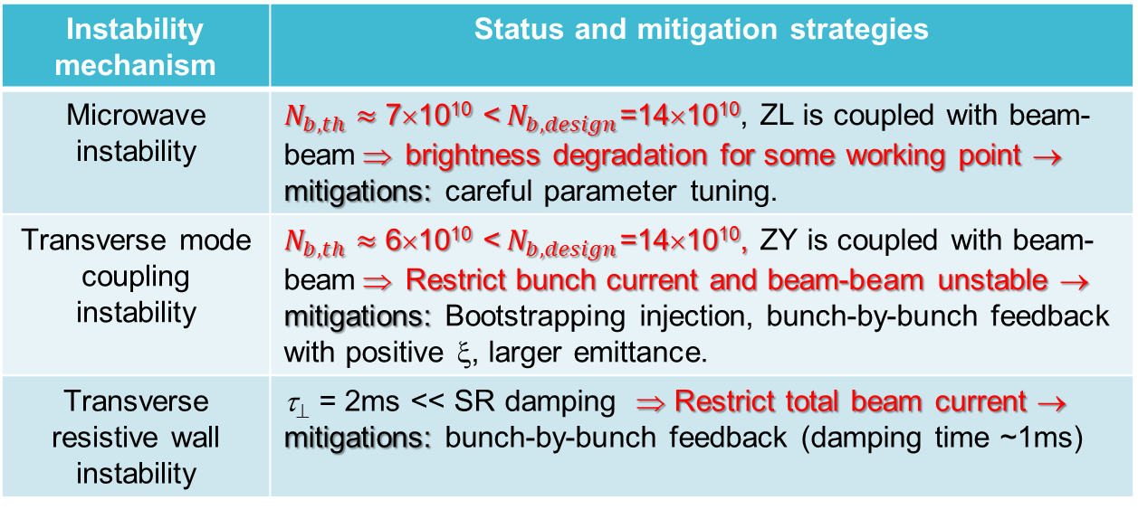
Influence of the impedance
宽带阻抗 → 相空间畸变/质心振荡→ 单束团流强阈值
窄带阻抗 → 多束团耦合振荡→ 限制总流强
对撞亮度
（束流能量损失→发热）
No apparent show stoppers for Higgs, W and tt
Limitation to Z luminosity → performance can be reached with mitigation strategies
Instability mechanism | Status and mitigation strategies
Microwave instability | $N_{b, th}≈$ 7×10¹⁰ <$N_{b, design}$=14×10¹⁰, ZL is coupled with beam-beam ⇒ brightness degradation for some working point → mitigations: careful parameter tuning.
Transverse mode coupling instability | $N_{b, th}≈$ 6×10¹⁰ <$N_{b, design}$=14×10¹⁰, ZY is coupled with beam-beam ⇒ Restrict bunch current and beam-beam unstable → mitigations: Bootstrapping injection, bunch-by-bunch feedback with positive ξ, larger emittance.
Transverse resistive wall instability | τ⊥ = 2ms << SR damping ⇒ Restrict total beam current → mitigations: bunch-by-bunch feedback (damping time ~1ms)
⬧ Missing impedance elements
⬧ Negative impact from mitigation strategies/Prove their effectiveness
⬧ Coupling among different factors

Slide 6
Impedance issues to be addressed in EDR
Develop the impedance model with more realistic hardware designs, along with possible impedance mitigations
Contributions from the missing elements → increase the impedance budget → Limitations to the Luminosity
  Inj./ext. elements, feedback kickers, absorbers, masks and collimators outside the IR region are not included.
Influence of the High Order Modes (HOMs) should be further identified
  IR Chambers, Electro-separators, Collimators…
Influence of updated impedance on beam instabilities, along with mitigations
  Bunch current threshold
  Luminosity

Slide 7
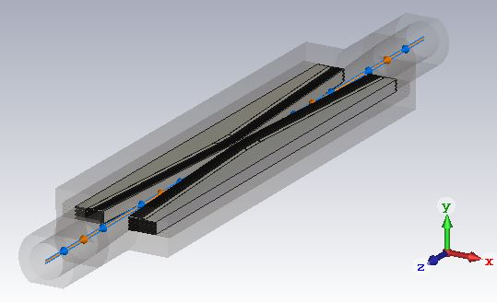
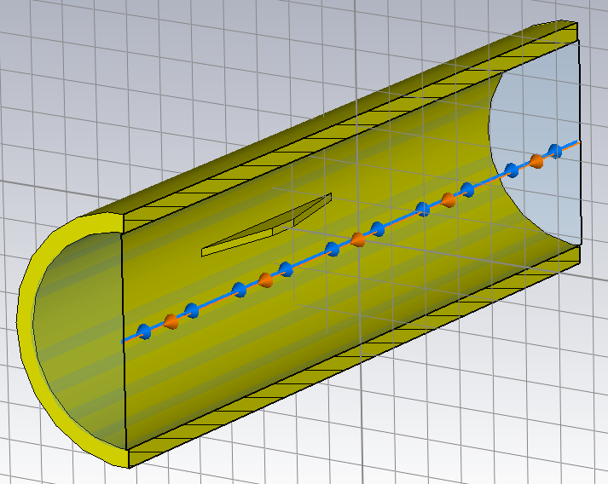
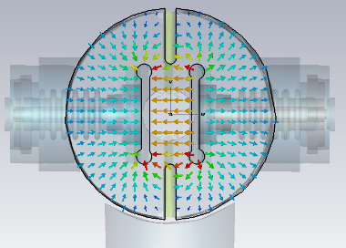
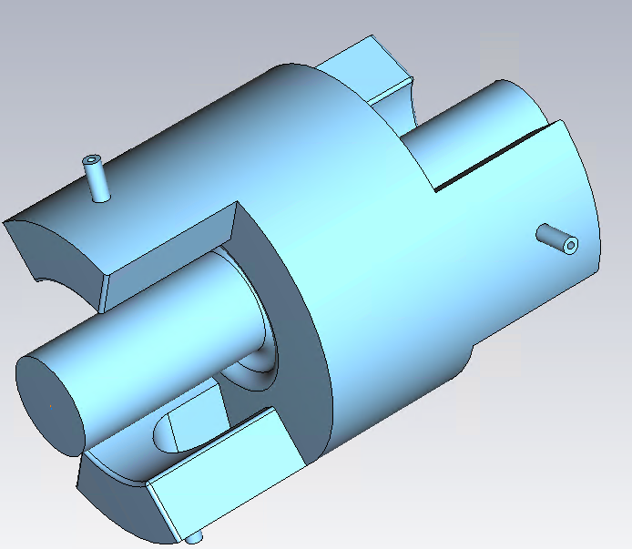
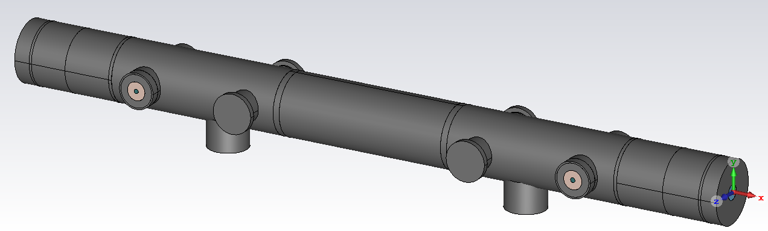
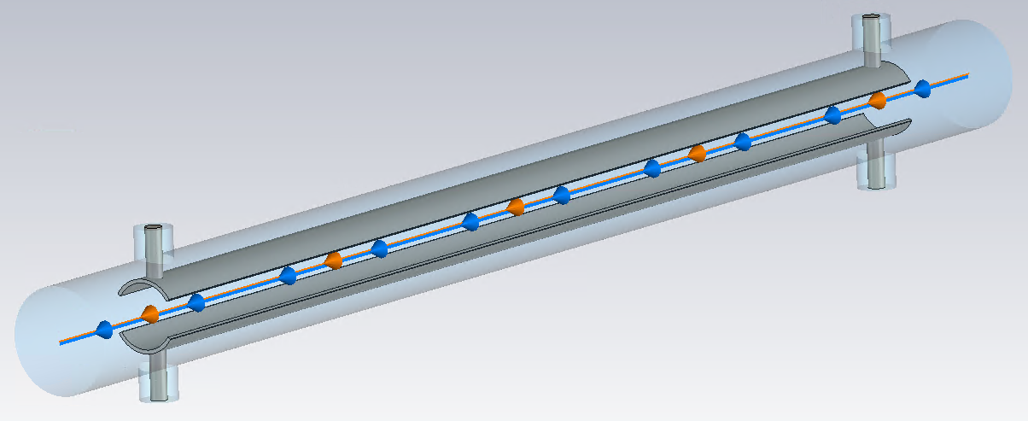
Impedance budget update
Collimators
Resistive wall
Masks
Electro separators
Feedback kickers
Collimator
Masks
Long. feedback kicker
Trans. feedback kicker
Electro separators

Slide 8
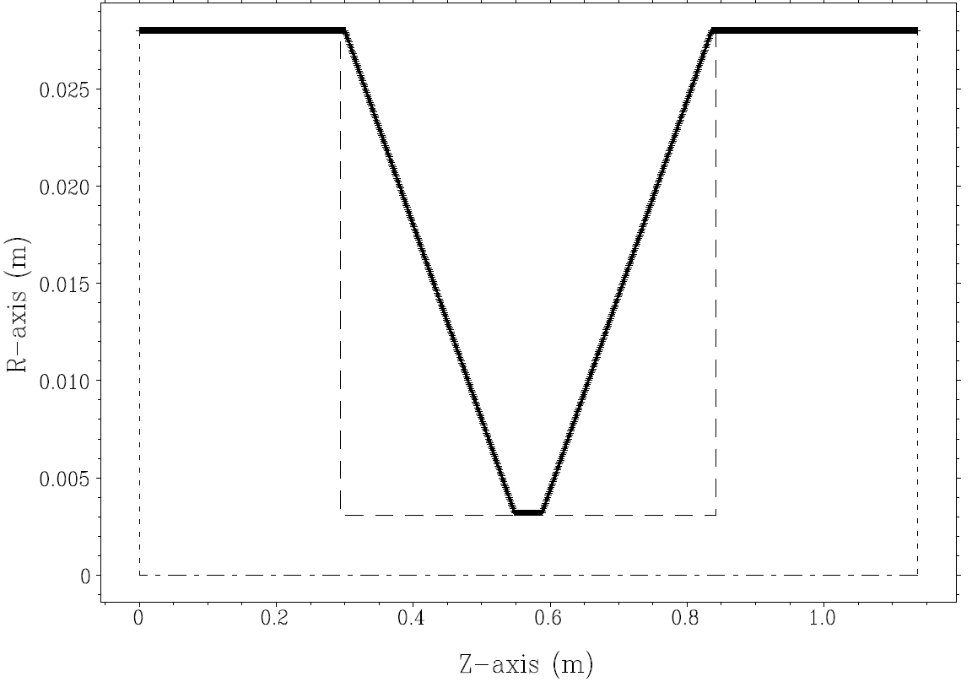
1. Collimators
58 collimators (IR + machine protection, 8 Circle+30Horizontal+20Vertical, flattop=40mm)
Horizontal/Vertical:
Circular:
Simplified into subgroups:
Geometrical impedance
Resistive wall impedance

Slide 9
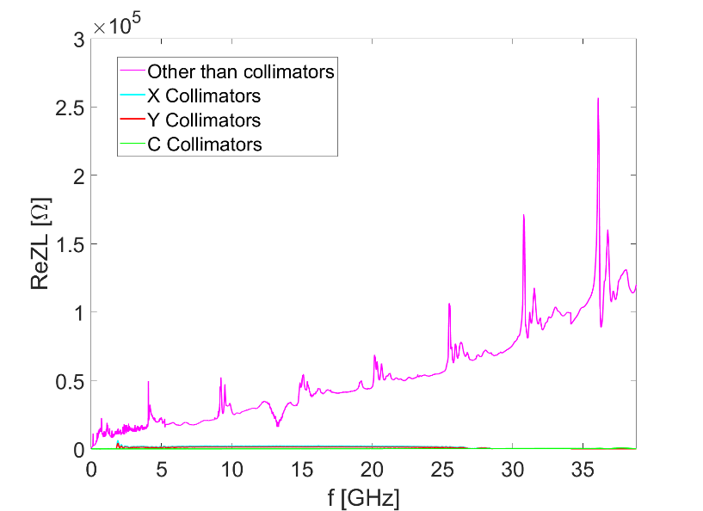
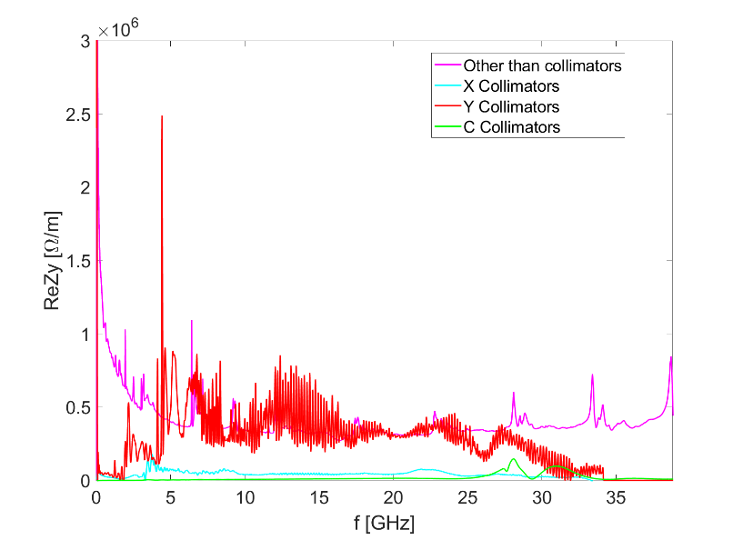
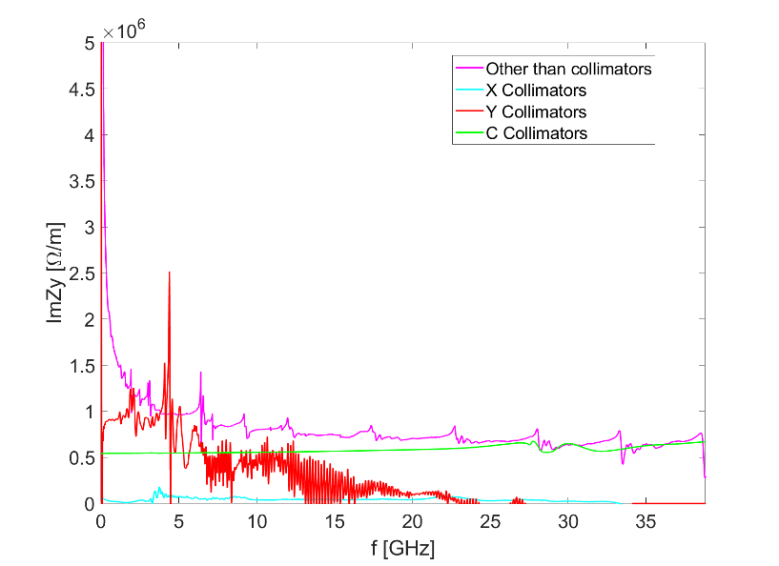
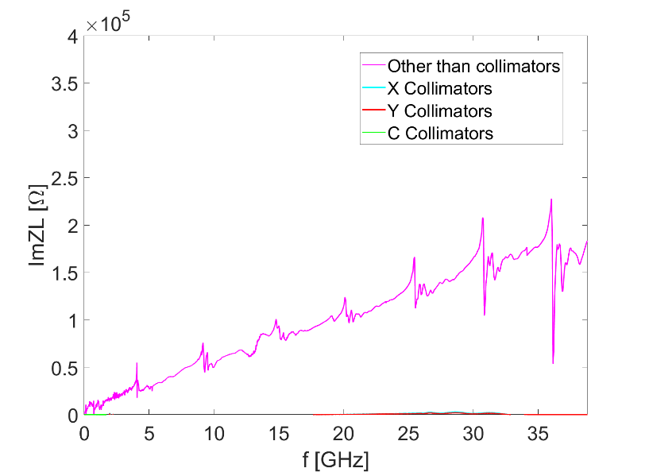
Collimators-geometrical impedance
H/V collimator simulated with half gap of 3mm
Transverse impedance:
Aperture scaled by (ri/rsimulation)^1.5 or (ri/rsimulation)^0.5
Beta function (@midlle of the drift) normalized
Mainly contribute to the transverse impedance

Slide 10
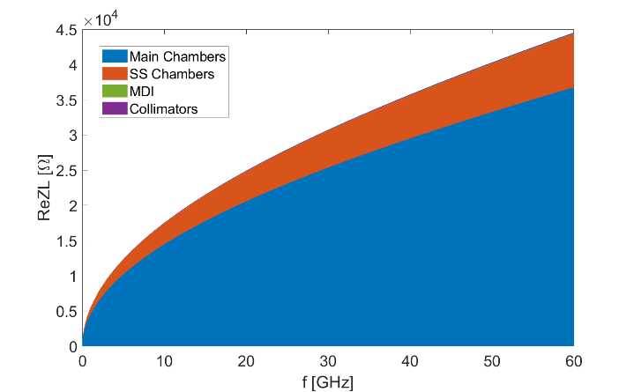
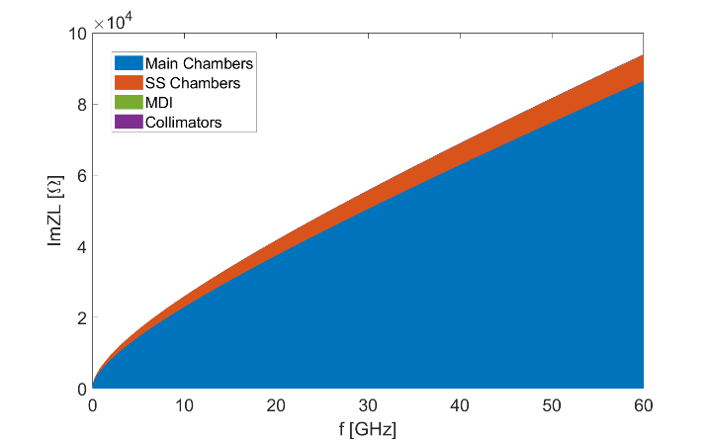
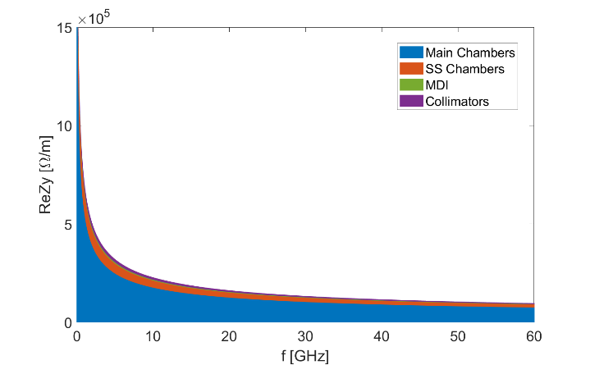
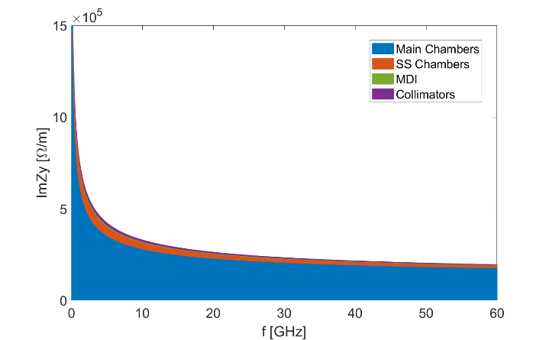
2. Resistive wall
Resistive wall impedance updated by considering different type of vacuum chambers
  main vacuum chamber with NEG coating, IP chamber, collimators and stainless steel chamber (flanges, bellows, BPMs)) ⇒ The impedance contributed by the main vacuum chamber dominates both the longitudinal and transverse RW impedance
Broadband effective impedance @σ_{z}=3mm
ReZL
ImZL
Components | Z||/n, mΩ | k_{loss}, V/pC | k_{y}, kV/pC/m
Main chamber | 6.1 | 355.7 | 11.3
SS chamber | 0.7 | 73.4 | 1.7
IP chamber | 6.9E-3 | 0.7 | 0.2
Collimators | 1.4E-2 | 1.4 | 0.6
RW Total | 6.8 | 431.2 | 13.8
Ring Total | 16.5 | 876.9 | 64.2
ReZy
ImZy
RW takes 40~50% of the total ZL and 20% of total ky @σ_{z}=3mm
TRWI growth time reduced from 2.2ms to 1.7 ms (5 turns)

Slide 11
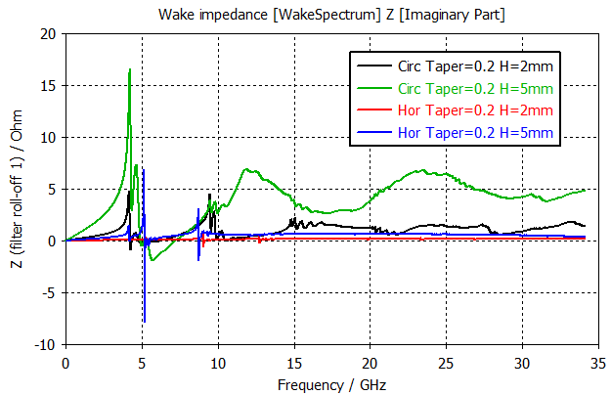
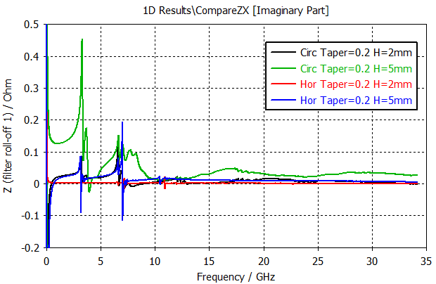
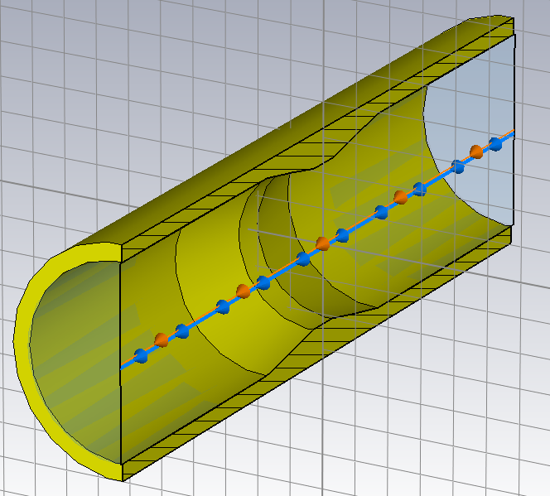
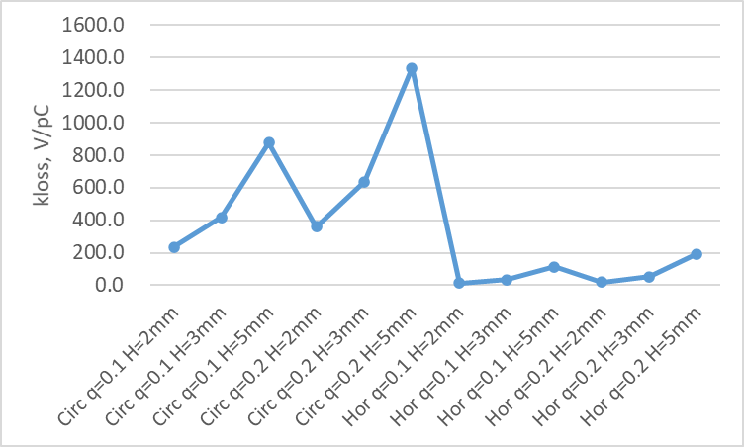
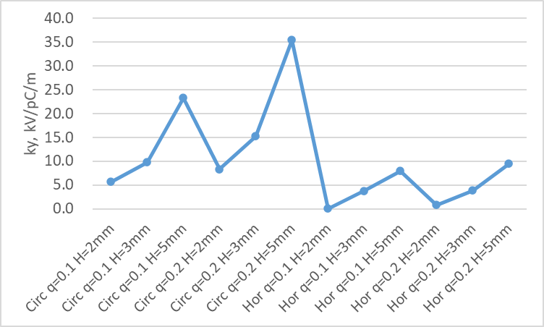
3. Masks
Masks will be installed before each bellows with RF shielding and BPM to protect the downstream elements, with possible height of 2~5mm and total number of ~17k.
Impedance for cylindrical symmetrical mask and horizontal mask is compared.
Longitudinal thickness: 10mm
Horizontal mask：vertical heigh 2mm
ZL
Zx
Loss factor
kick factor
Lower impedance for horizontal mask
Impedance increase with mask height and decrease with tapering angle (not holds for small height)
Considering contribution from all masks, the mask height should below 3mm, and horizontal mask recommended.

Slide 12
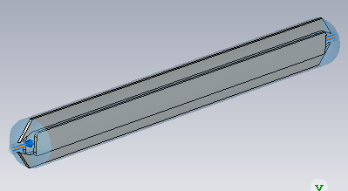
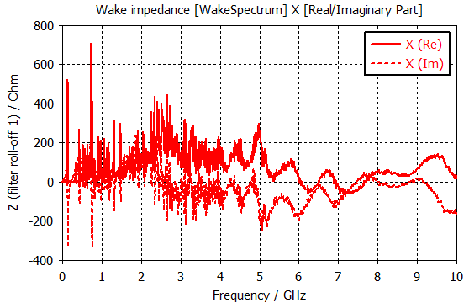
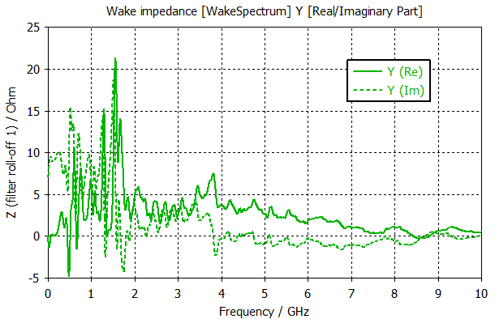

4. Electro Separators
More detailed modeling
Impedance update
  Power loss per beam: 18kW→23kW
  Mode analysis on HOMs
Possible mitigations: Optimize the shape of the electrode, ground plate, taper section; damping material surround the supporting component and feedthrough of the electrodes.
Vertical impedance (shift=3mm)
Dominant longitudinal modes: f₁=66.6MHz (R_{s}=50.6kΩ), f₂=87.7MHz (R_{s}=27.5kΩ)
Dominant horizontal modes: f₁=32.2MHz (R_{s}=15.3MΩ/m), f₂=59.4MHz (R_{s}=14.7MΩ/m)
Dominant vertical modes: f₁=306MHz (R_{s}=0.3MΩ/m), f₂=604MHz (R_{s}=0.3MΩ/m)
Above the transverse CBI threshold for Z ($fReZ_{||}$<650kΩ⋅GHz, $ReZ_{y}$<0.9MΩ/m)
wake fields are not converged to zero

Slide 13
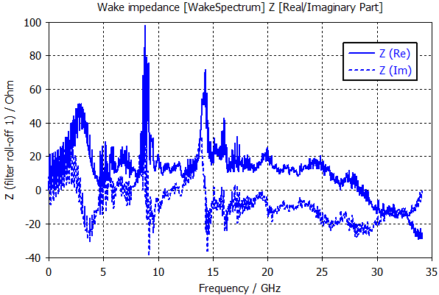
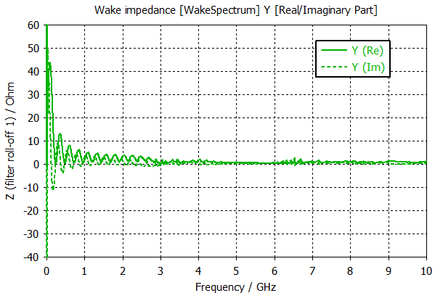
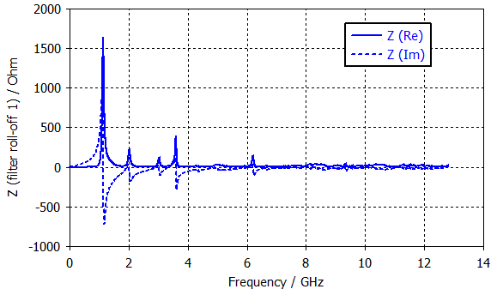
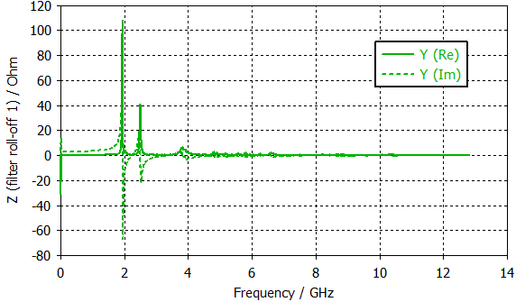
5. Feedback kickers
Transverse and longitudinal feedback kickers are required to damp the coupled bunch instabilities (Transverse damping ≤1ms, longitudinal damping ≤12ms).
Preliminary simplified model been used in the impedance evaluations
  small contribution to the total broadband impedance budget
  Narrowband resonances should be further checked with more detailed designs
Transverse FB kicker:
Slot pipe kicker (distance between electrodes = 34mm, r_pipe=28mm)
Longitudinal FB kicker:

Slide 14
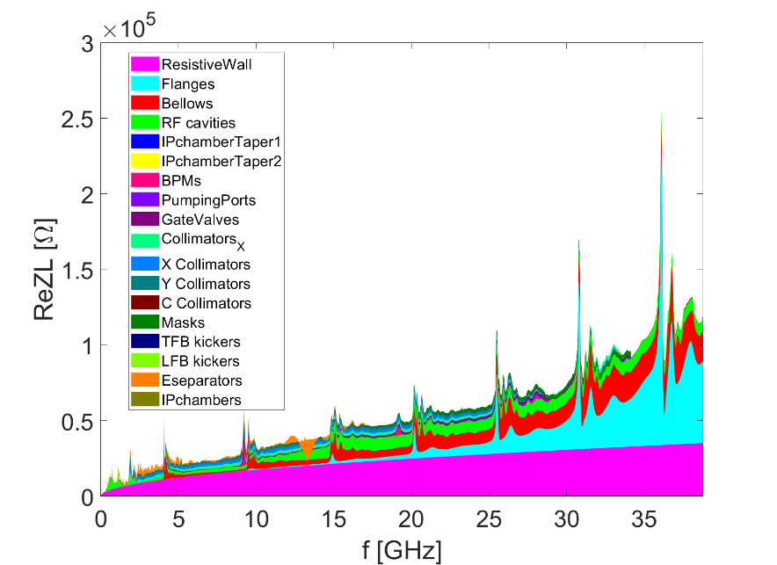
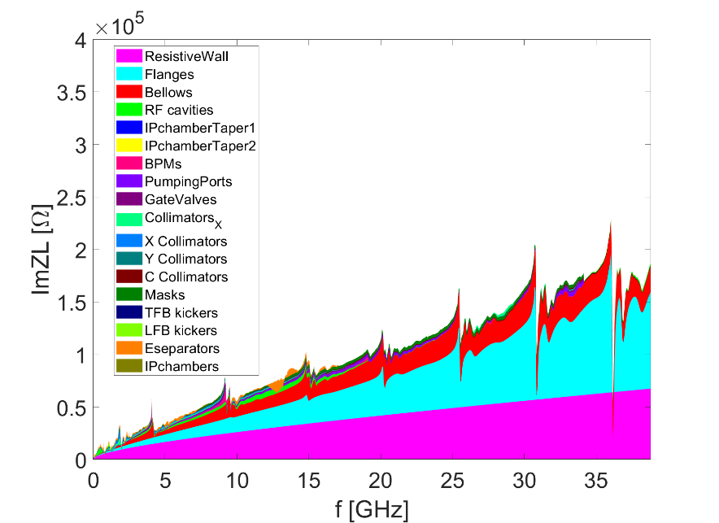
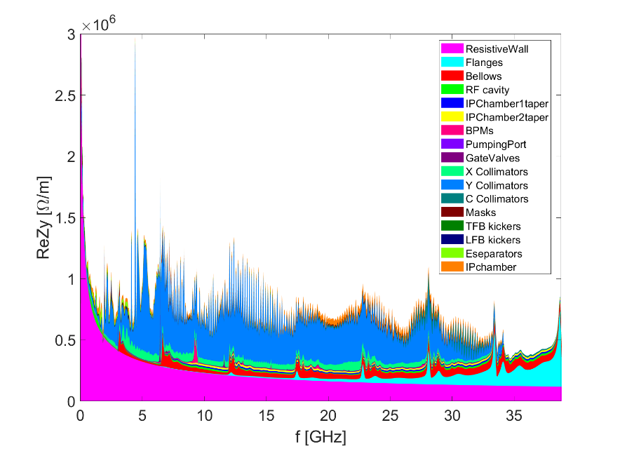
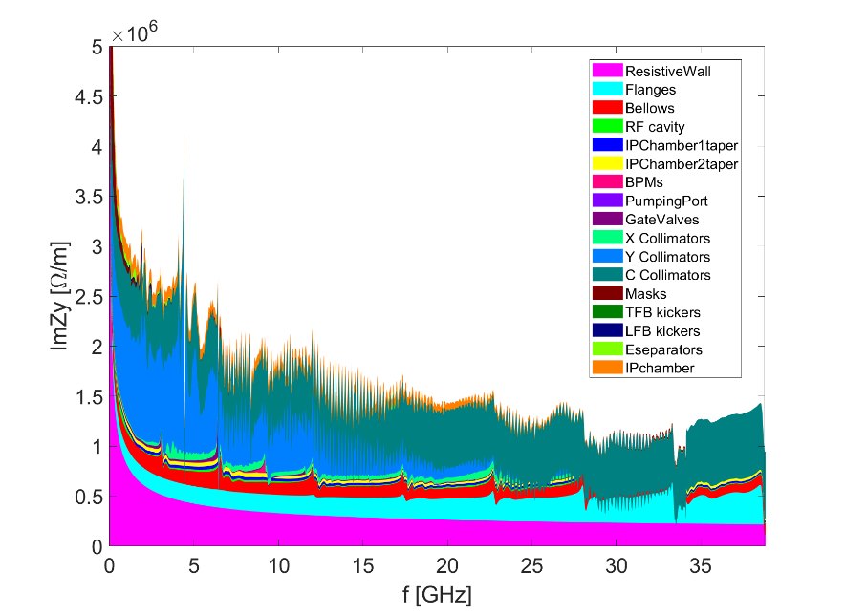
Summary on the impedance budget update
纵向阻抗：
  dominated by the RW, flanges, bellows and RF cavities
横向阻抗：
  dominated by the RW, flanges, bellows and collimators

Slide 15
Impedance budget table update
Components | Number | Z||/n, mΩ | L, nH | k_{loss}, V/pC | k_{y}, kV/pC/m
Resistive wall | - | 6.8 | 361.0 | 431.2 | 13.8
RF cavities | 60 | 0.5 | 24.8 | 101.2 | 0.5
Flanges | 37714 | 5.2 | 276.1 | 37.3 | 5.2
BPMs | 1808 | 0.04 | 2.0 | 9.5 | 0.2
Bellows | 15949 | 2.9 | 154.6 | 87.4 | 3.9
Gate Valves | 520 | 0.2 | 11.4 | 14.5 | 0.4
Pumping ports | 5316 | 0.3 | 18.4 | 2.3 | 0.2
H Collimators | 30 | 0.06 | 3.2 | 45.2 | 3.2
V Collimators | 20 | 0.04 | 2.1 | 30.1 | 15.6
Circ Collimators | 8 | 0.09 | 4.6 | 0.8 | 15.7
Masks | 17757 | 0.5 | 24.6 | 19.5 | 0.8
Feedback kickers | 8 | -0.04 | -1.9 | 5.2 | 0.1
IP chambers | 2 | 0.004 | 0.2 | 0.3 | 2.9
Electro-separators | 20 | -0.1 | -5.4 | 34.5 | 0.1
Taper transitions | 48 | 0.04 | 2.3 | 2.5 | 0.09
Total |  | 16.5 | 819.8 | 876.9 | 64.2

Slide 16
Impedance evolution
The transverse impedance budget increased dramatically ⇐ mainly contributed by the collimators for the machine protection
  Influences: single bunch current threshold, beam-beam interaction/luminosity reach
  Careful machine protection & collimator design with low impedance + instability mitigations
2018
Elliptical cross section (CDR)
Circular cross section
More contributors included (TDR)
2021
More detailed chamber material, collimator updated,β weighing
2023_V1
Collimators for machine protection, masks and feedback kickers included
2023_V2
More detailed collimator design, resistive wall and Eseparator updated
2024
Evaluate with rms bunch length of 3mm

Slide 17
Limitations to Luminosities/Beam current threshold
Rough estimations of the instability threshold based on analytical criterions.
 | Higgs | W | Z | ttbar
Single bunch threshold (Long) Z||/n [mΩ] | 6.5 | 4.1 | 0.7 | 14.4
Single bunch threshold (Trans) k_{y} [kV/pC/m] | 69.7 | 40.2 | 12.4 | 109.8
Although the criterion usually underestimates the threshold, we do observed its influence on the beam-beam interaction
^{[PRAB 23, 104402 (2020);} ^{PRAB 25, 011001 (2022)]}.
Impedance budget
Z||/n, mΩ | 16.5
k_{y}, kV/pC/m | 64.2
TMCI unstable

Slide 18
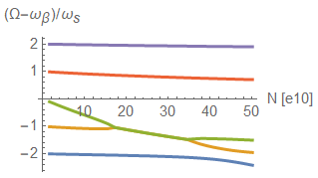
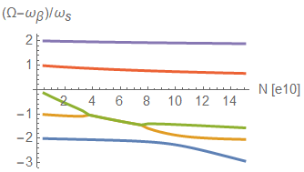
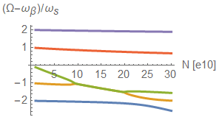
Single bunch current threshold
Frist order estimation
  The impedance presents single bunch current limitation for W/Z, some safety margin reserved for Higgs.
  Instability happens when the two modes couples, and then decouples at higher intensities.
  Earlier studies show that longitudinal impedance will further decrease the threshold for Z, mitigation strategies are needed.
Higgs
Z
W
Design
13×10¹⁰
Design
14×10¹⁰
Design
13.5×10¹⁰

Slide 19
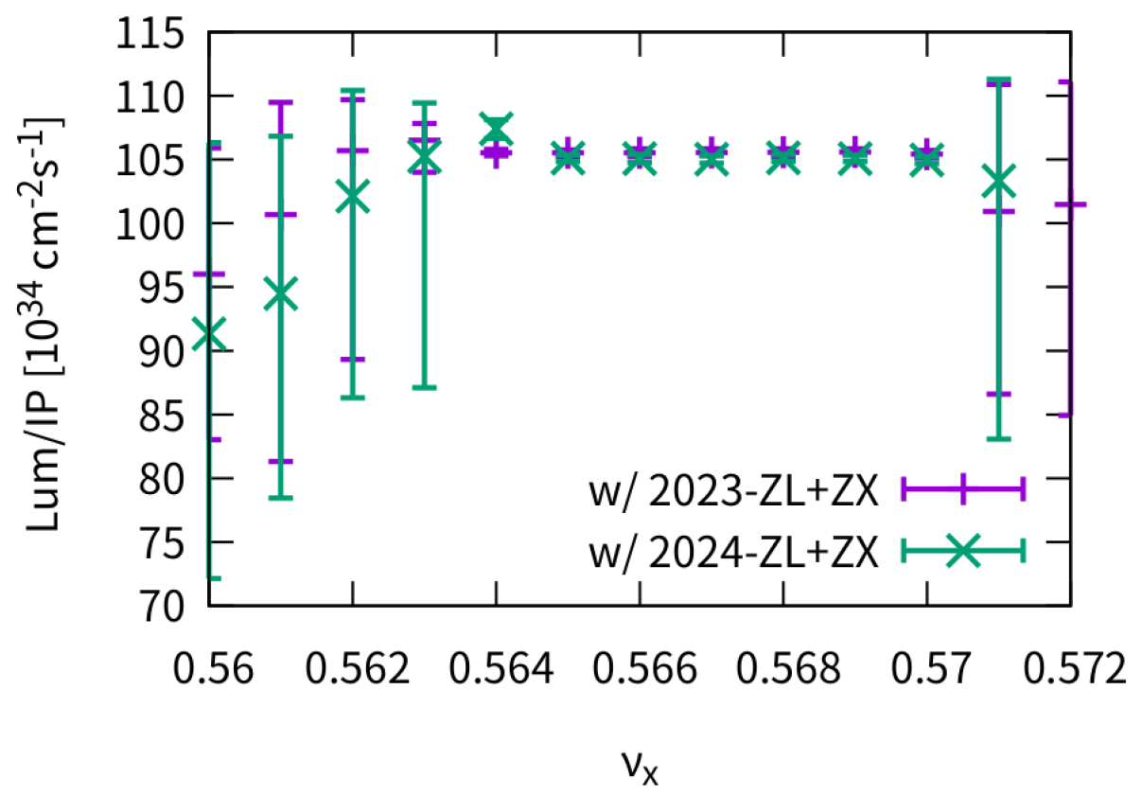
Limitations to Luminosities (for Z)
Yuan Zhang
水平方向的对撞稳定性
考虑纵向阻抗
考虑水平方向阻抗
Resistive feedback （damp rate=0.05）
水平色品 5
与 2023 的阻抗（not TDR）没有显著差别
为了实现稳定对撞，上述抑制方法是必须的（反馈+色品）

Slide 20
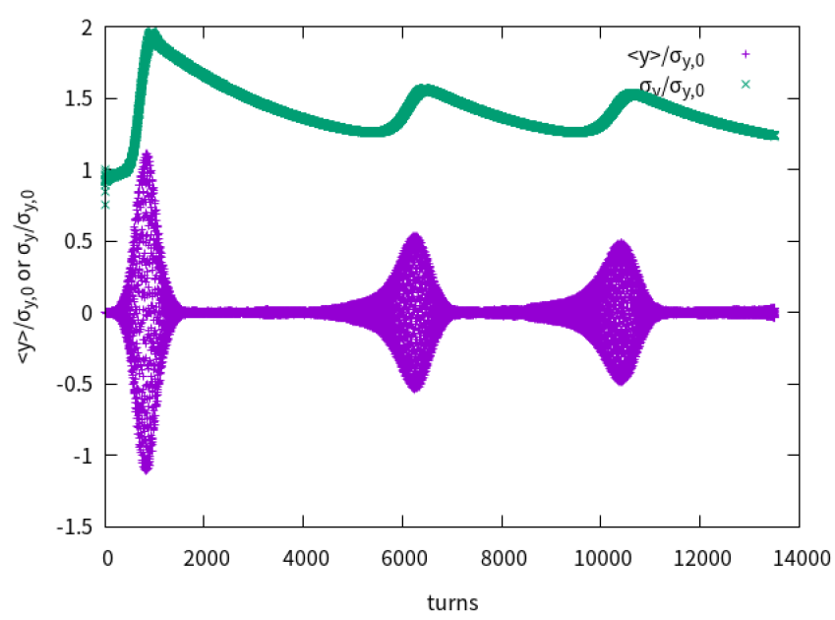
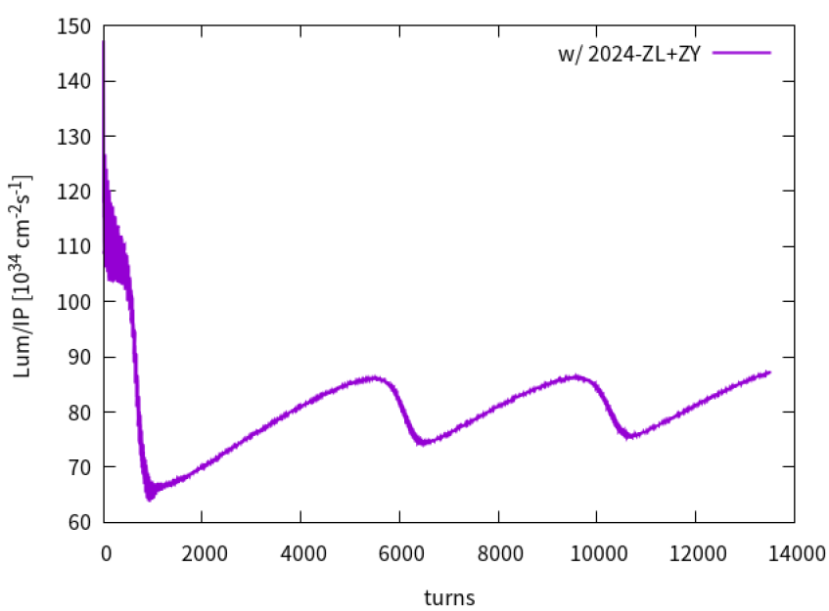
垂直方向的对撞稳定性
Yuan Zhang
考虑纵向阻抗
考虑垂直方向阻抗
Resistive feedback （damp rate=0.05）
垂直色品 10
2023 的阻抗（not TDR）在同样条件下可以保持稳定
Beam-beam + ZT 的复合效应导致的 TMCI 太强，对撞无法稳定
  不稳定性导致质心振荡和尺寸增长
  尺寸增长后，束束作用减弱，TMCI 减弱，然后尺寸开始减小
  尺寸减小后，束束作用增强，TMCI 增强，然后质心振荡和尺寸增长

Slide 21
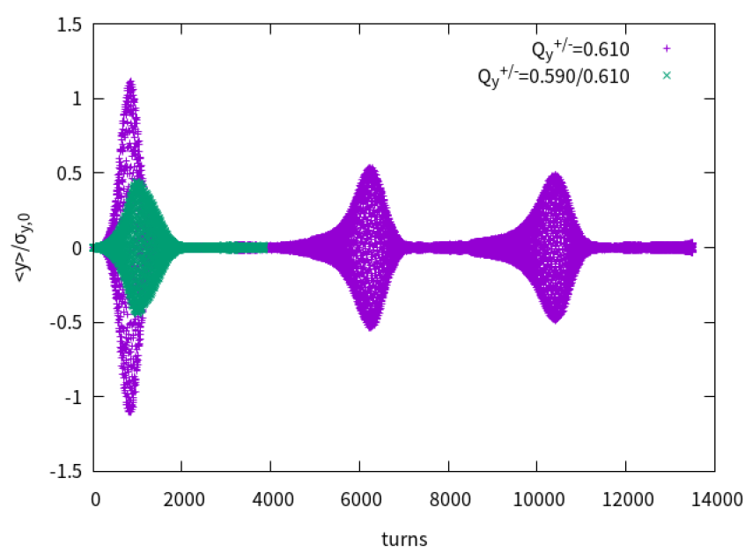
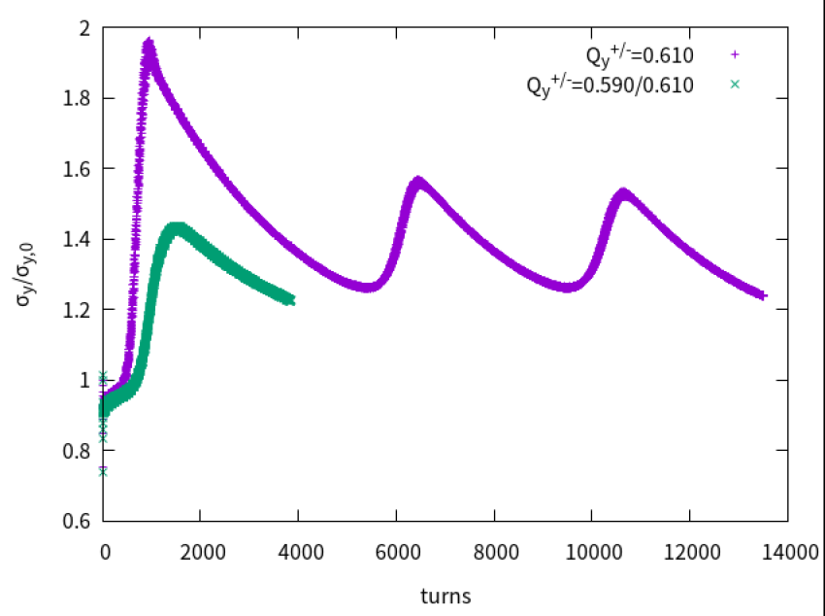

非对称工作点的对撞（垂直）
Yuan Zhang
$ΔQ_{y}=0.02$ could not help suppress the instability
Resistive feedback （damp rate=0.05）
垂直色品 10

Slide 22
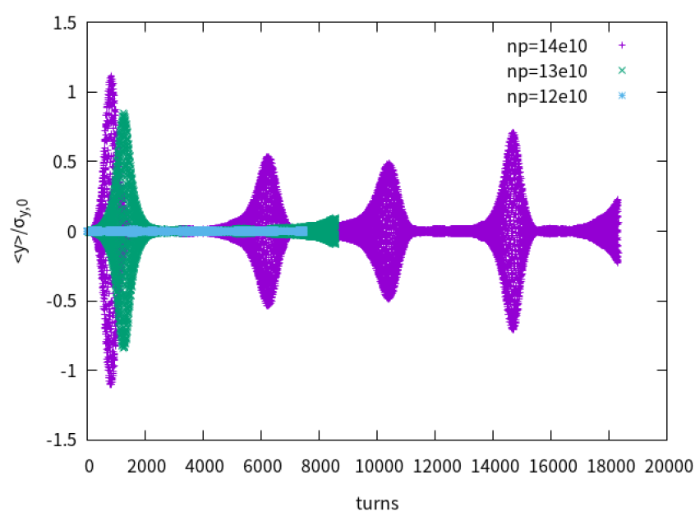
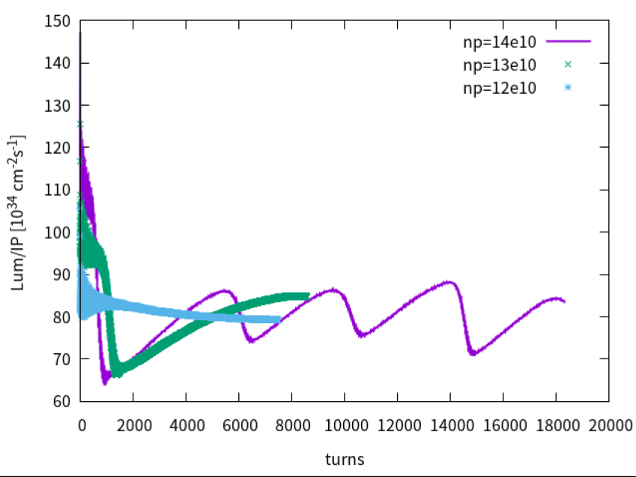
Instability vs bunch population
Yuan Zhang
Threshold : np=12e10, but…

Slide 23
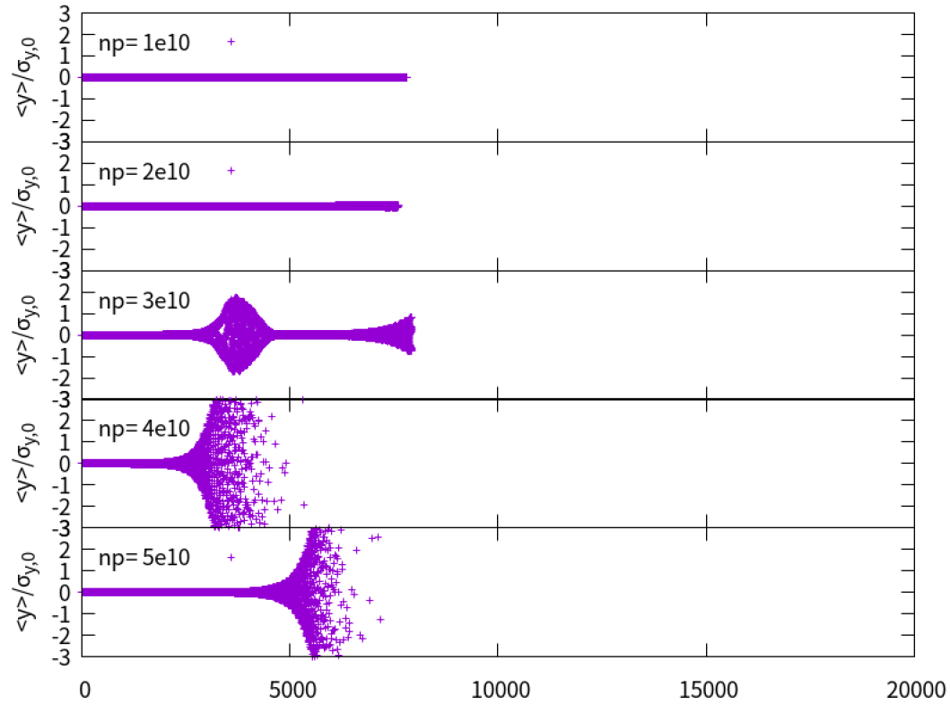
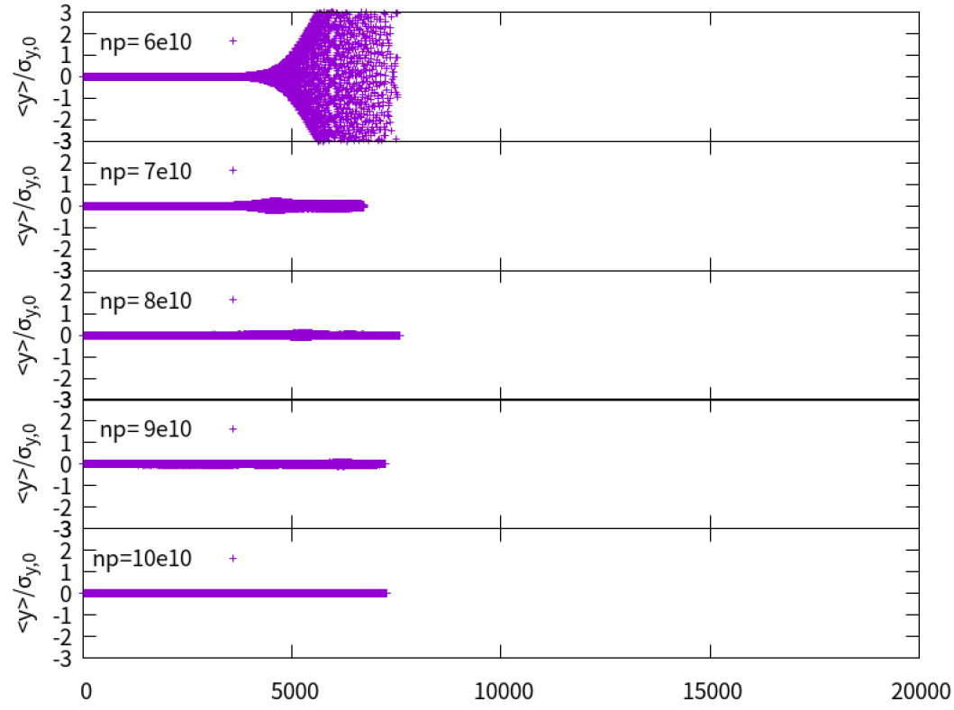
Instability vs bunch population (2)
Yuan Zhang
There exist instability at low bunch population (np=3e10-7e10) !!!

Slide 24
Summary
Impedance increased by a factor of 2~3, mainly due to the collimator impedance
  First estimation shows single bunch current limitation for W/Z, some safety margin reserved for Higgs.
  Shows limitations for Z luminosity reach (with FB, ξ and asymmetry tune): beam-beam unstable at low bunch population (np=3e10-7e10), then stable collision up to 12e10 (with luminosity of 80e34 cm⁻²s⁻¹), with even higher intensity, a dynamical luminosity of around 80e34 cm⁻²s⁻¹ will be reached → However, luminosity is further limited by boot strapping.
Possible mitigations
  Possible optimization on the machine protection & collimation design?
  Nonlinear collimator as adopted in SuperKEKB → will introduce additional nonlinear effects to the lattice
  Search for new mitigation strategies ?
Parameter [unit] | Higgs | Z | W | tt
Beam energy E_{k} [GeV] | 120 | 45.5 | 80 | 180
L_{max}/IP (10³⁴cm⁻²s⁻¹) | 5 | 115 | 16 | 0.5
Design bunch Population [10¹⁰] | 13 | 14 | 13.5 | 20
TMCI threshold [10¹⁰] | 16 | 4 | 10 | /

Slide 25
Thank you for your attention!

Slide 26
Main beam parameters (30MW)
Parameter [unit] | Higgs | Z | W | tt
Beam energy E_{k} [GeV] | 120 | 45.5 | 80 | 180
L_{max}/IP (10³⁴cm⁻²s⁻¹) | 5 | 115 | 16 | 0.5
Emittance (H/V) [nm/pm] | 0.64/1.3 | 0.27/1.4 | 0.87/1.7 | 1.4/4.7
Beam current [mA] | 16.7 | 803.5 | 84.1 | 3.3
Bunch number | 268 | 11934 | 1297 | 35
Bunch Population [10¹⁰] | 13 | 14 | 13.5 | 20
Momentum compaction α_{p} [10⁻⁵] | 0.71 | 1.43 | 1.43 | 0.71
Bunch length σ_{z} (natural/total) [mm] | 2.3/4.1 | 2.5/8.7 | 2.5/4.9 | 2.2/2.9
Energy spread (natural/total) [10⁻⁴] | 10/17 | 4/13 | 7/14 | 15/20
Betatron tune ν_{x}/ν_{y} | 445.10/445.22 | 317.10/317.22 | 317.10/317.22 | 445.10/445.22
Synchrotron tune | 0.049 | 0.035 | 0.062 | 0.078
Radiation damping [ms] | 44/44/22 | 816/816/408 | 150/150/75 | 14/14/7
Design queries
Small α_{p}
Short natural σ_{z}
Slow damping at low E_{k}

