Slide 1

CEPC Controlled Hardware Analysis & Analysis on Alcove-Number Optimization
环形正负电子对撞机
Circular Electron Positron Collider
20 May, 2024
Dapeng Jin
Institute of High Energy Physics, CAS, Beijing

Slide 2
Outline
Key issues of CEPC control
Requirement analysis and preliminary design
Analysis on Alcove-Number Optimization

Slide 3
Key issues of CEPC control

Slide 4


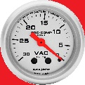
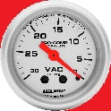

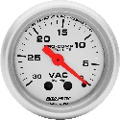
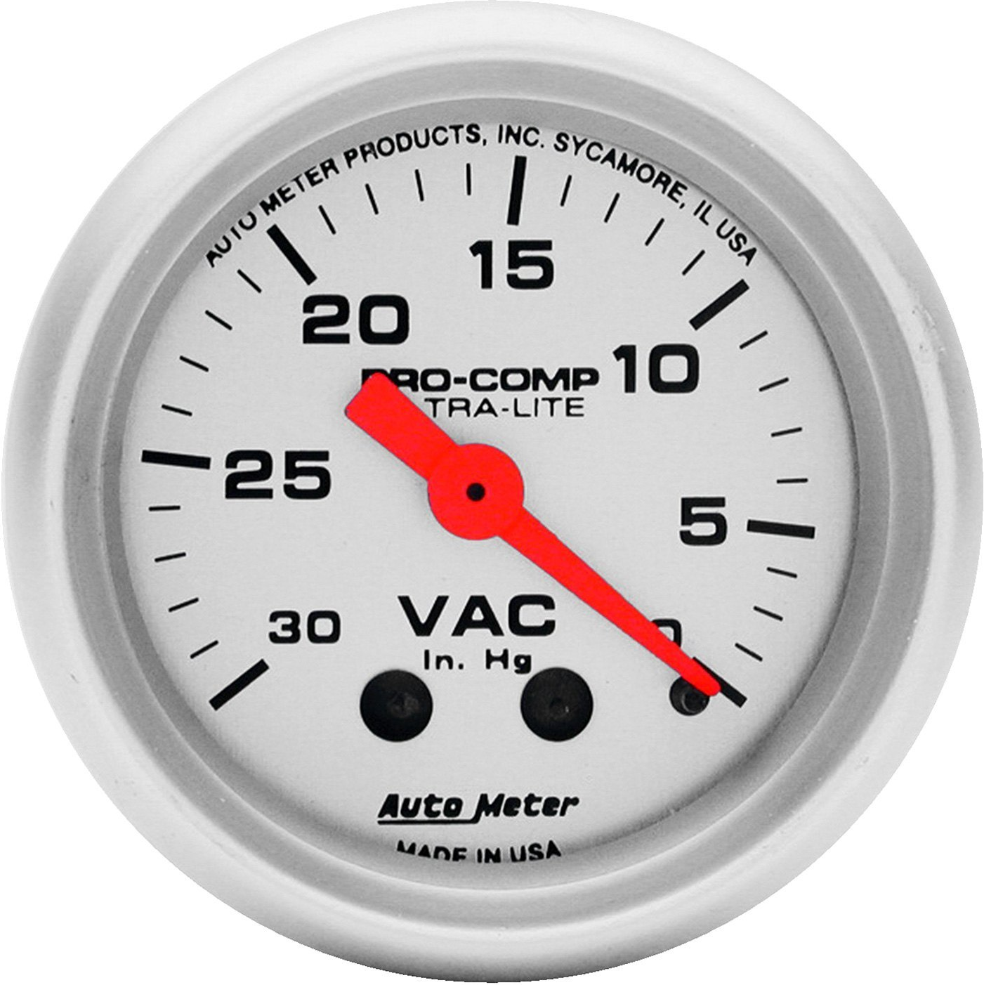
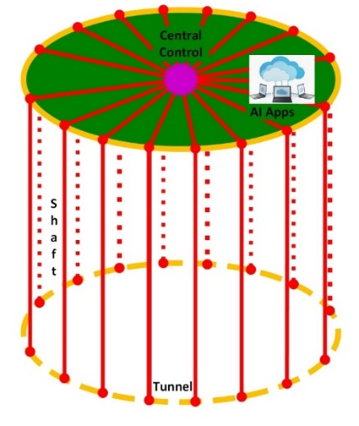
Brief of CEPC & key issues of control system
Control network with DAQ
Timing system
Clock(Reference line)
MPS
Orbit feedback…
BI
Mag. & PS
VAC
Ctrl./DAQ/
Timing/Clock
Part of control along the beam

Slide 5
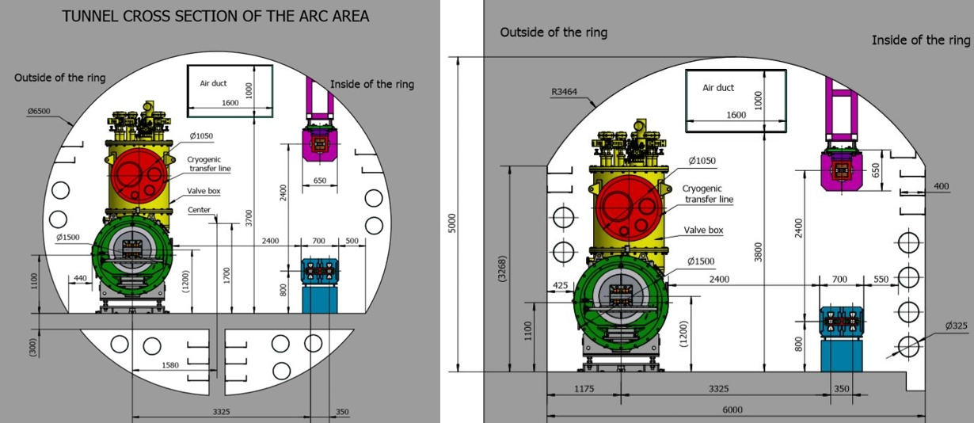
Key issues of control system
Three nets : Clock, timing, control & DAQ
Signal transmission in tunnel : Radiation protection & wireless transmission?
Global software services

Slide 6
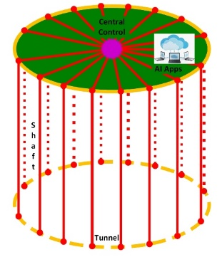
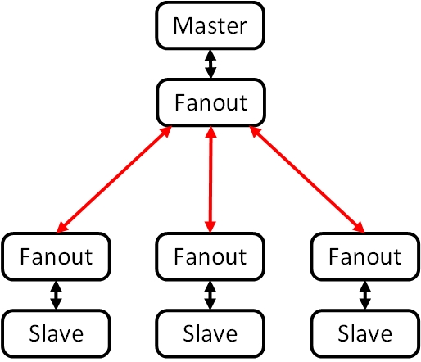
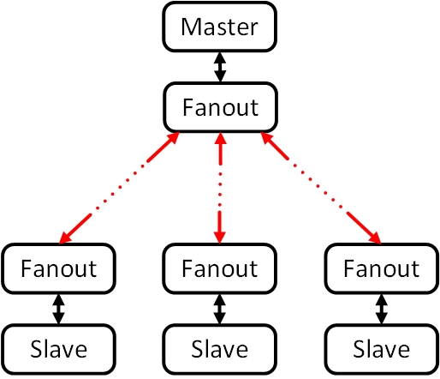
Key issues of control system
Problem : Delay variation over several clock cycles due
to the long optical fibers and temperature change.
Possible solutions:
Global measurement and compensation : multi-clock
Ground routing self-measurement and compensation

Slide 7
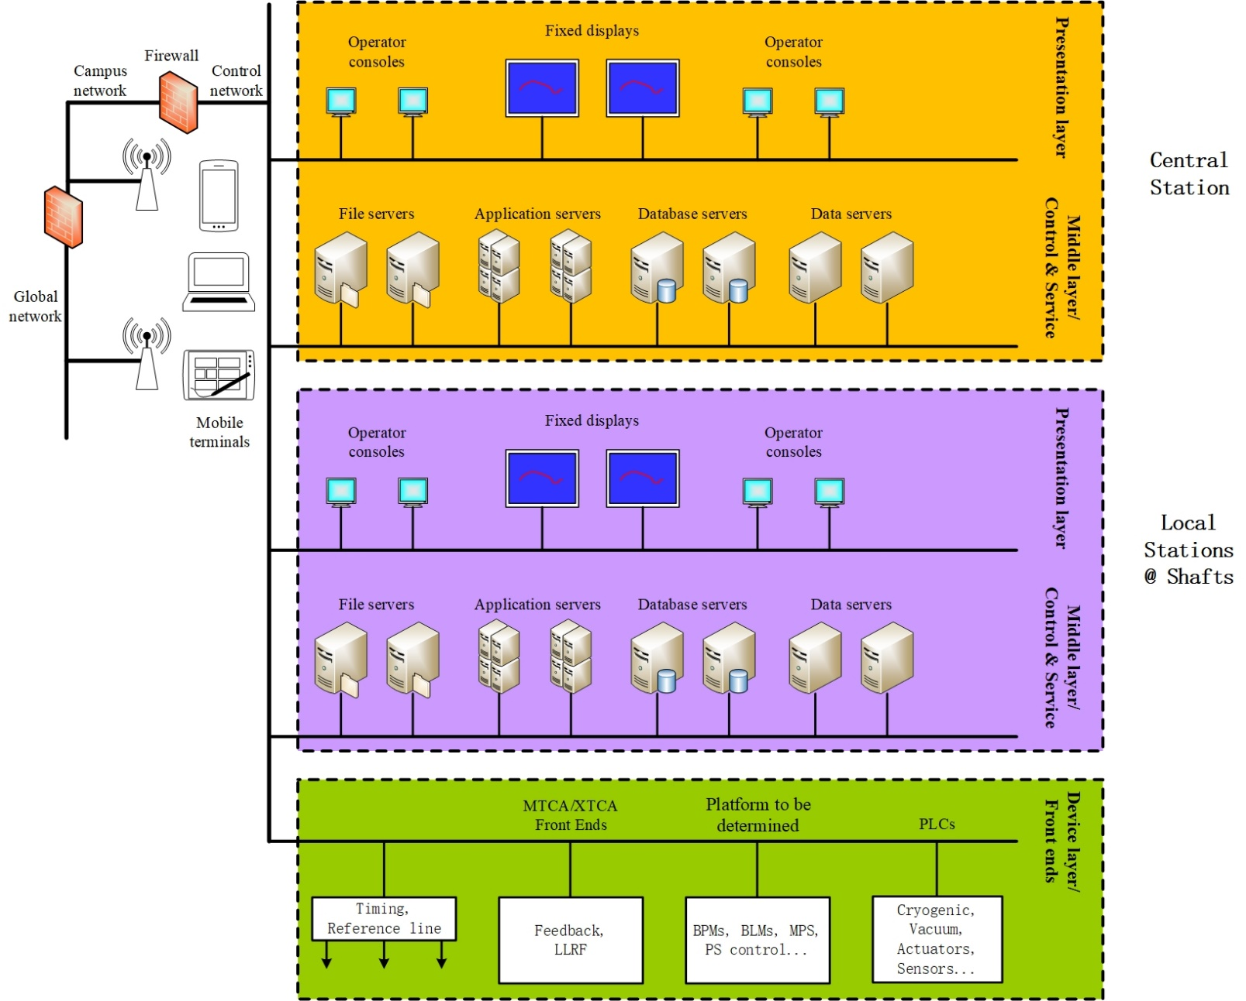
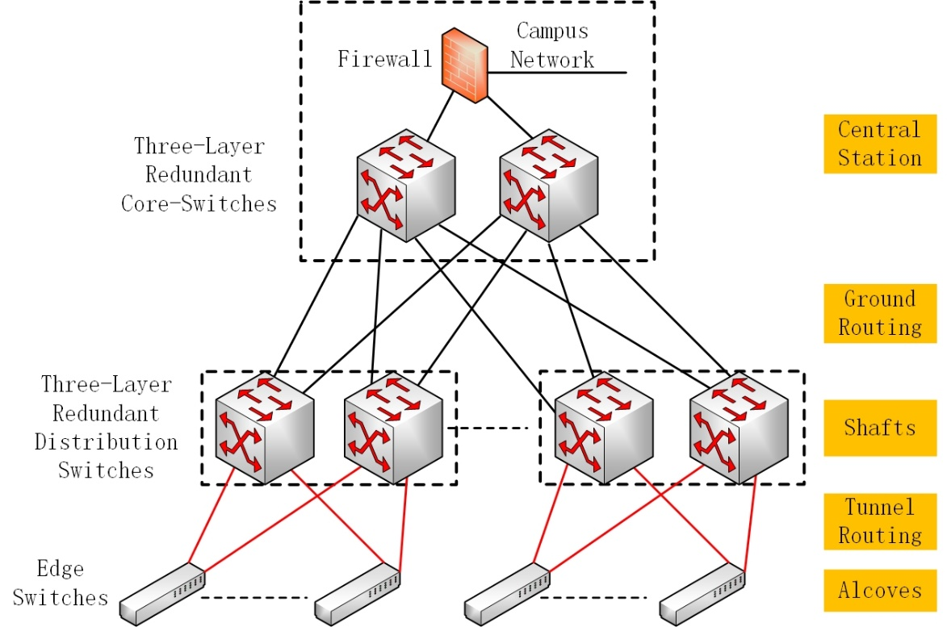
Key issues of control system
Automation of development and maintenance.
Backup strategy & remote recovery.
AI application.

Slide 8

机器（设备）健康诊断及优化
束流动力学研究及优化
束流轨道、亮度研究及优化
电源性能研究及优化
真空研究及优化
智能控制
…
数据获取、存储、分发
电源
束测
高频
真空
亮度
温度
…

Slide 9
Key issues of control system
Performance improvement based on precise(1ns – 10us) correlated data from the front end. Distributed logic analyzer.
Fault prediction for planned maintenance to improve availability.
Several-hundred GB data for each DAQ.

Slide 10
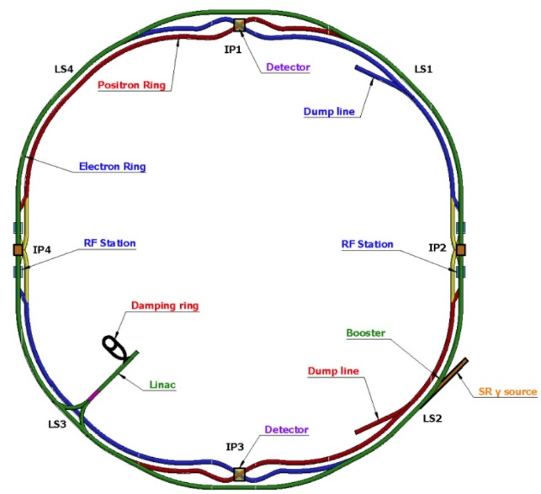
Key issues of control system
Source & acceleration & confinement.
Key components: source, acc. structure, mag. & PS, BI(monitoring and feedback)
Precise clock : (from reference line or timing)
Source, acc. structure, beam feedback, tune measurement… : both phase & jitter (5ps to 100fs), reference line, few stations
BI(BPM, BCM…) : jitter (5ps to <1ps), timing possible, BPM distributed around
Timing : (mostly delay adjustable)
BI : < 50ps
PS : ~5ns

Slide 11
Requirement analysis and preliminary design

Slide 12
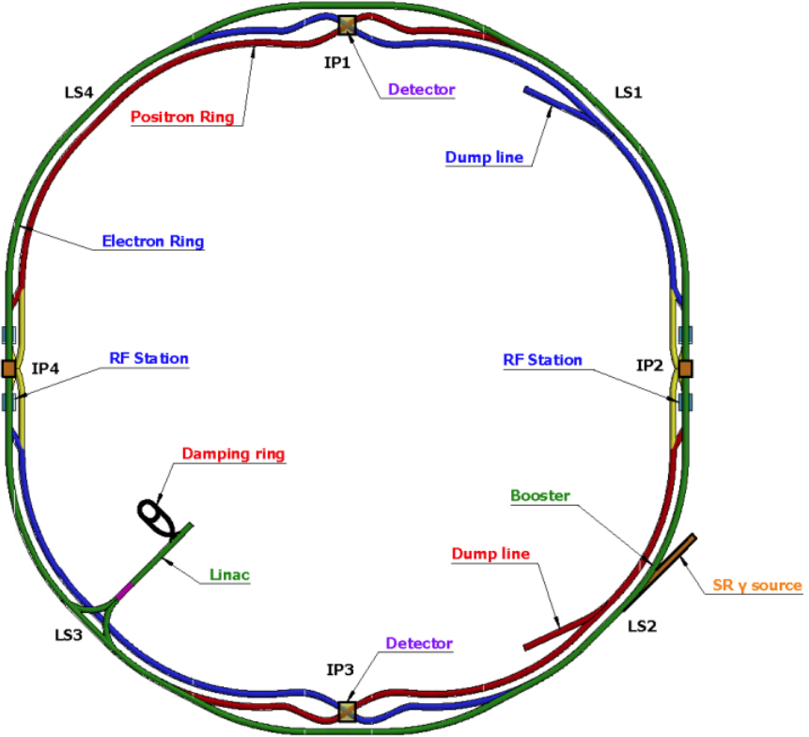
Brief analysis
Controlled devices distribution
Linac & damping ring
Ring & transfer lines
Main controlled systems
Radio frequencies
Beam instrumentations
Power supplies
Vacuum
Environment : temperatures, water leakage…
Particle physics
 | Radio Frequencies | Beam Instrumentations | Power Supplies | Vacuum & others | Particle Physics
Network | √ | √ | √ | √ | ---
Timing | √ | √ | √ | --- | √
Reference Line | √ | √(Partly) | --- | --- | √

Slide 13
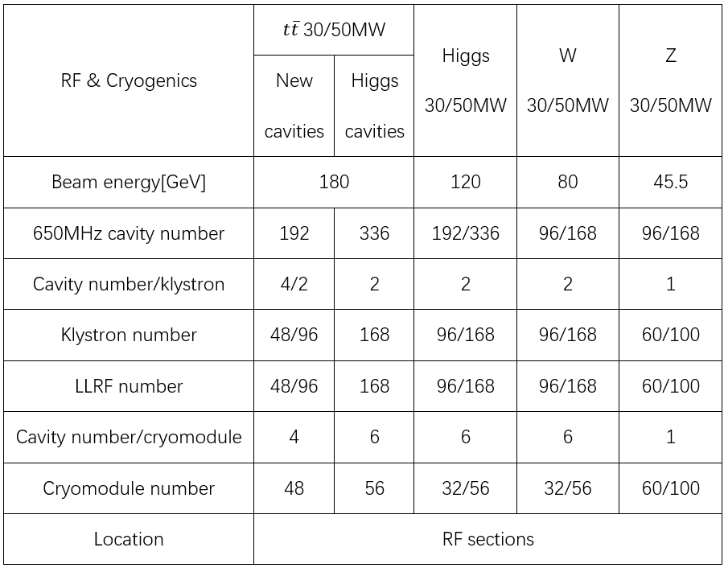
Brief analysis : storage ring
LLRF 96, cryomodule 32.
Reference line and timing for LLRF.
Network to all.

Slide 14
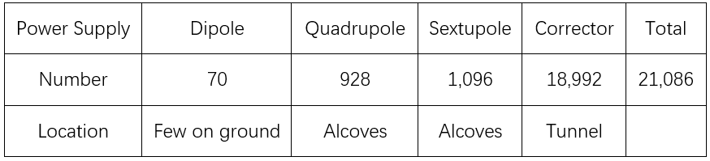
Brief analysis : storage ring
Timing to all power supplies.
Timing uncertainty to be clarified and proper technique to be used.
~100 alcoves, ~210 power supplies/section.
Network to all.

Slide 15
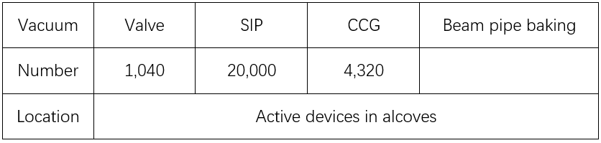
Brief analysis : storage ring
Control of valves and shutdown of the valves according to the neighbored CCGs’ interlock signals.
Readout and monitoring of values from CCGs and SIPs.
~100 alcoves, ~10 valves & 200 SIPs & 43 CCGs/alcove. One control cabinet for valve-control. ~16 serial-port servers and one industrial computer for readout and monitoring.
Network to all controllers.

Slide 16
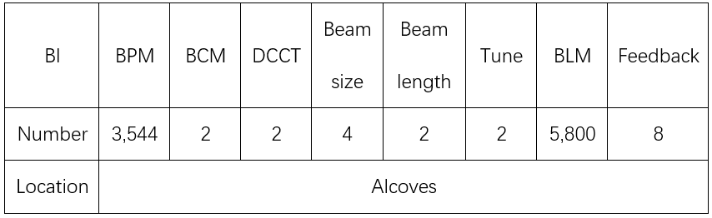
Brief analysis : storage ring
Timing to all.
Reference line maybe to BPMs and to few others.
~100 alcoves, ~36 BPMs & 60 BLMs/alcove.
Network to all.

Slide 17
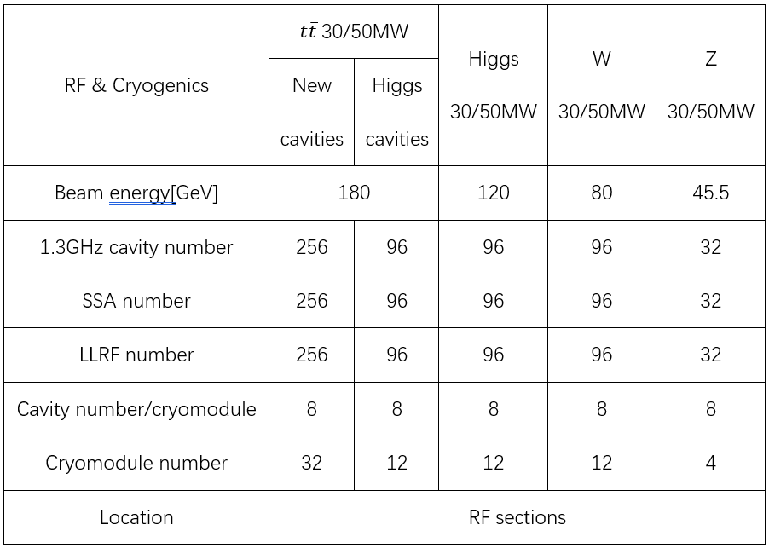
Brief analysis : booster
LLRF 96, cryomodule 12.
Reference line and timing for LLRF.
Network to all.

Slide 18
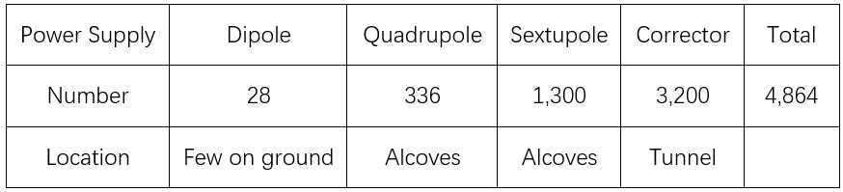
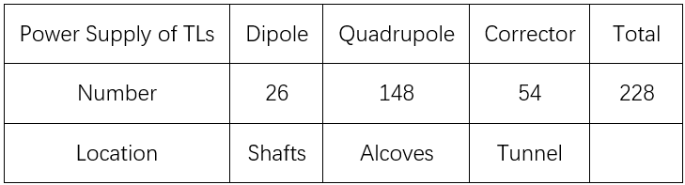
Brief analysis : booster
Timing to all power supplies.
Timing uncertainty to be clarified and proper technique to be used.
~100 alcoves, ~48
power supplies/section.
Network to all.

Slide 19
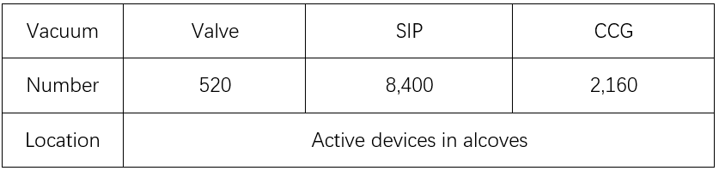
Brief analysis : booster
Control together with the storage ring.
~100 alcoves, each alcove with total ~15 valves, ~284 SIPs, ~65 CCGs.
Network to all controllers.

Slide 20
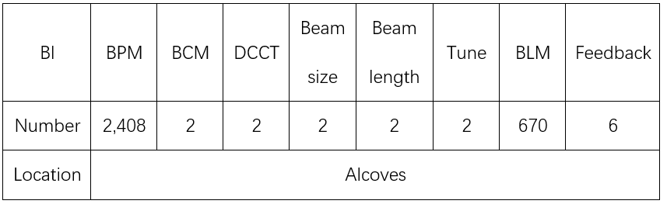
Brief analysis : booster
Booster to storage rings
32 BPMs
Timing to all.
Reference line maybe to BPMs and to few others.
~100 alcoves, ~24 BPMs & 7 BLMs/alcove.
Network to all.

Slide 21
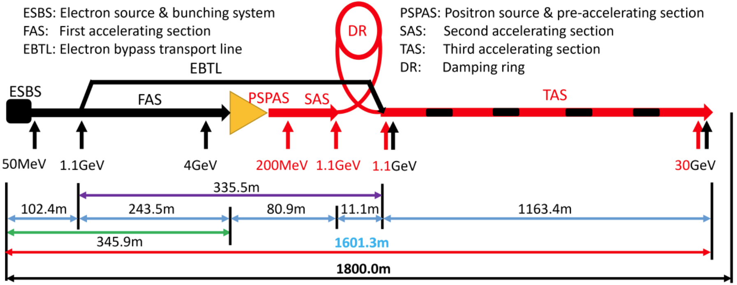
Brief analysis : LINAC, damping ring & its TLs
Total 276 LLRFs, reference line and timing to all.
Network to all.

Slide 22
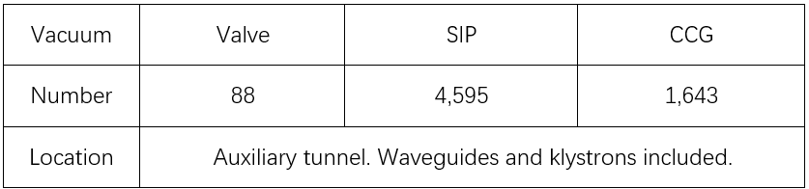
Brief analysis : LINAC, damping ring & its TLs
Total 789 power supplies with 583 of LINAC, 206 of damping ring & its TLs.
Timing to all.
Network to all.
Control together with vacuum stations, valve control cabinets as less as possible.
Network to all controllers.

Slide 23
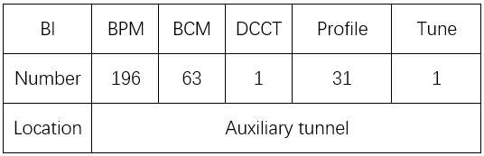
Brief analysis : LINAC, damping ring & its TLs
LINAC to booster
28 BPMs & 2 PRs
Timing to all.
Network to all.
Injection & extraction : few at fixed stations. Timing to all. Network to all.

Slide 24
Brief analysis : machine protection
Overall operation management.
Fast protection(<1ms) for the storage ring and booster. FPGA based.
Slow protection(tens of ms) for others. PLC based.

Slide 25
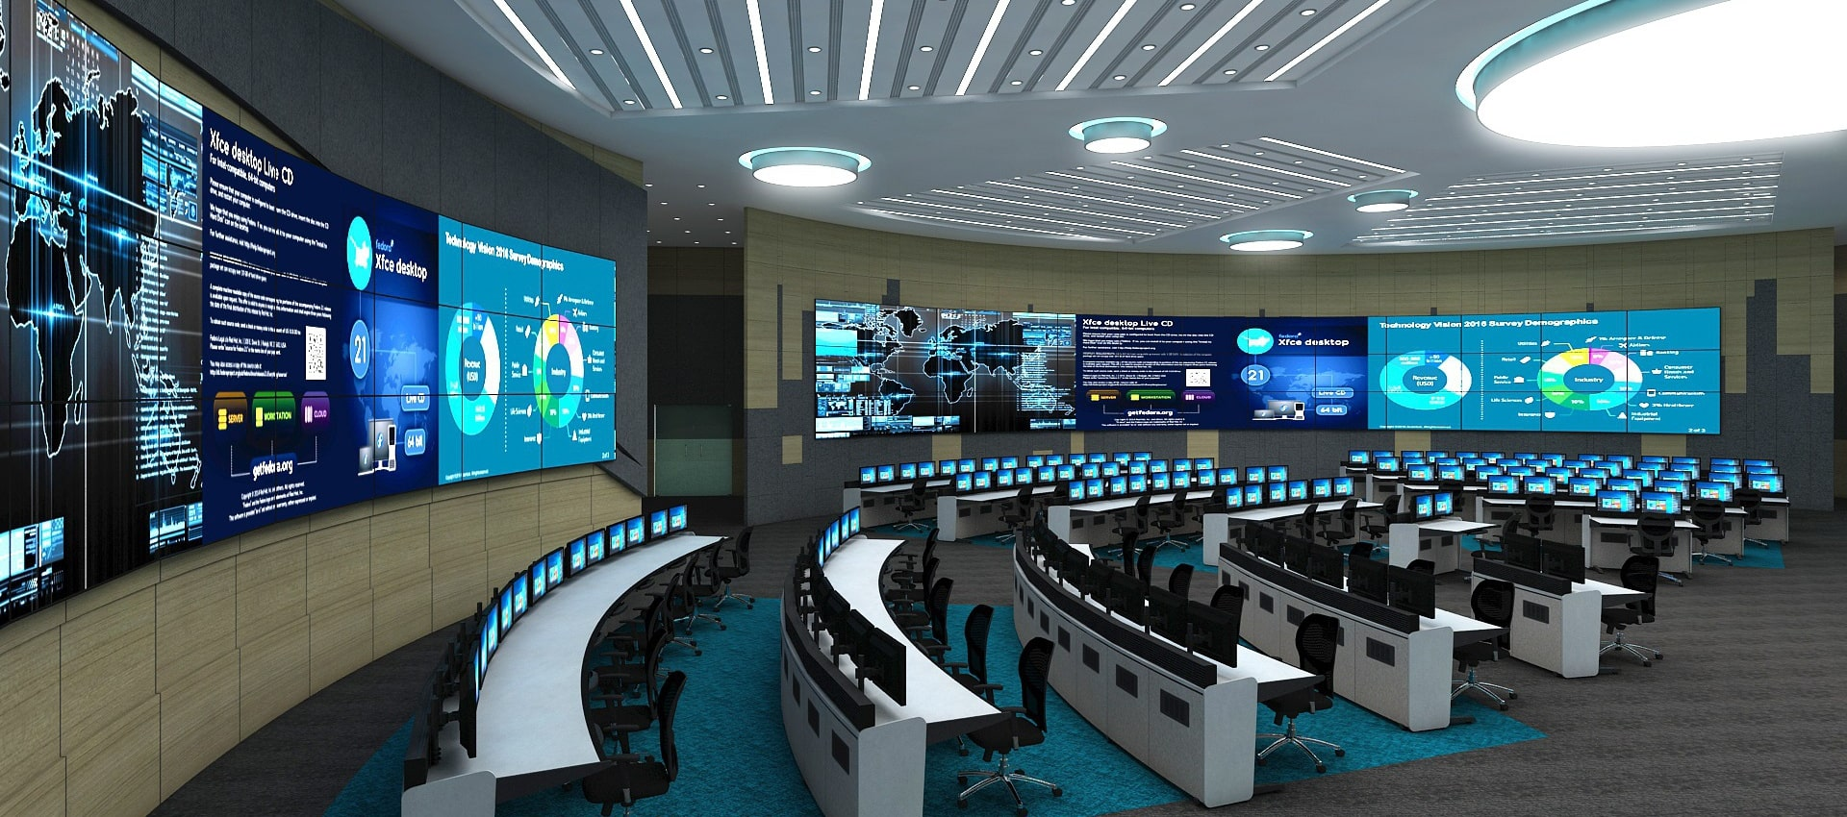

Brief analysis : central control & servers

Slide 26
Brief analysis : temp. monitoring of vac. chambers
Current design : 102,500 Pt100 based monitoring, ~one every 3m for both booster and collider.

Slide 27
Brief analysis : tunnel inspection
Cameras used in non-radiation-hard areas.
Robot based inspection used in radiation-hard areas.

Slide 28
Brief analysis : others
Control utilities : fibers, cables, UPS, cabinets…
Joint design among campus network & computing, radiation protection, utility & ventilation…

Slide 29
Next to do
Efforts to solve the long distance time drift compensation due to temperature changes.
Much work on the development of the DAQ system and intelligent analysis.
Design efforts to improve the reliability and availability with low cost.
Further design and detailed estimate of cost.

Slide 30
Analysis on alcove-number optimization

Slide 31
Brief introduction
There is a balance among cables, utility & ventilation, number of alcoves and accelerator control.
Cost, radiation protection and any other benefits.
Three meetings on Feb. 4th, Feb. 27th and Mar. 26th.
Preliminary environment : 35℃ & 70% humidity in tunnel, 27 ℃ & 60% humidity in alcoves.
Attendees : GAO Jie, LI Yuhui, LIN Guoping, HUANG Jinshu, SUI Yanfeng, CHEN Bin, LONG Fengli, MA Yongsheng, DONG Haiyi, MA Zhongjian, TANG Guangyi, LEI Ge, LI Gang, MA Xinpeng, WANG Haijing, WANG Yiwei, JI Daheng, WANG Bin, WEI Yuanyuan, WEI Shujun, JIN Dapeng

Slide 32
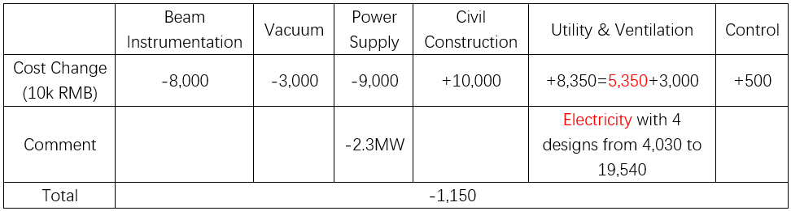
Preliminary assessment
If the number of alcoves increases from ~100 to ~200, then
~12 million RMB/y electricity saved with -2.3MW for 5000-hour operation.

Slide 33
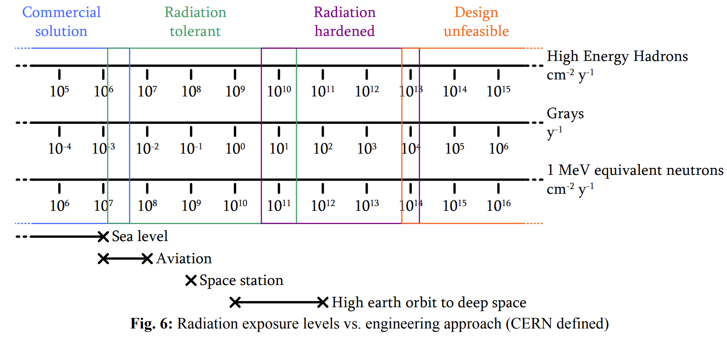
Preliminary assessment
Absorbed dose of fibers and silicon in tunnel without shielding : ~10Gy/h.

Slide 34
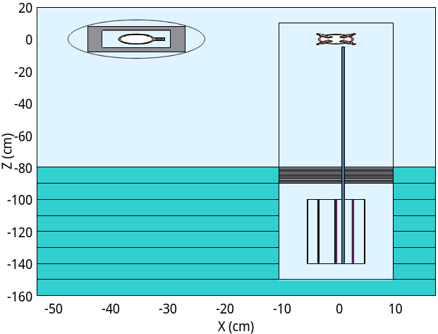
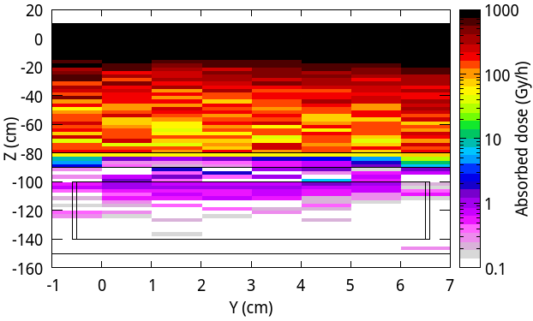
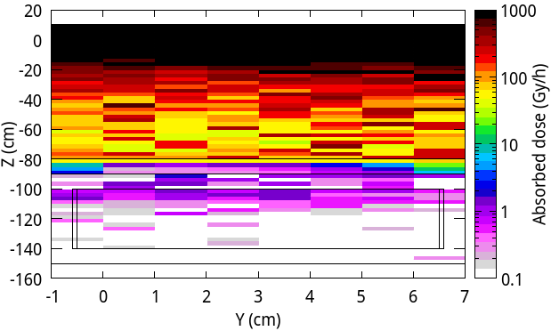
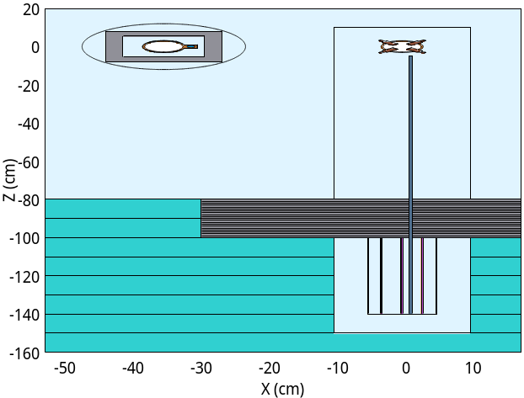
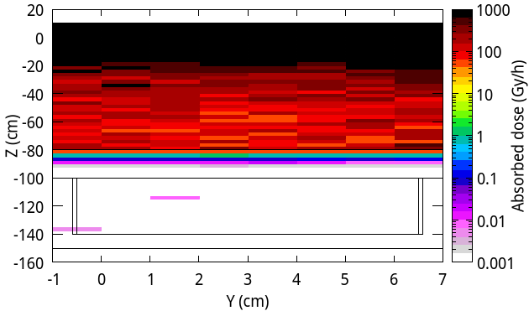
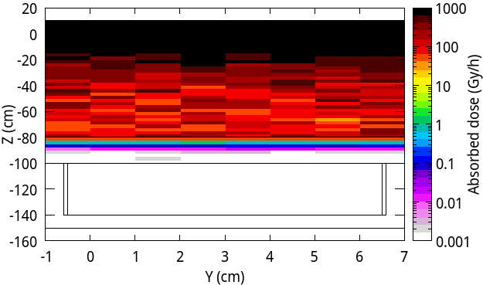
Preliminary assessment
Si
For CEPC, shielding in the tunnel can be done.
10cm lead
20cm lead

Slide 35
Preliminary assessment
Si
For SppC, shielding in the tunnel can hardly be done due to the high flux of neutrons and hadrons.
All the active devices may be put in the alcoves including the 22,192 corrector-power-supplies of CEPC. So, more alcoves seem to be better for the future SppC.

Slide 36
Thanks for your attention!

