Slide 1
Considerations of the Wireless Application on CEPC Detector
Jun Hu
On behalf of the Elec-TDAQ system of the CEPC Ref_TDR

Slide 2
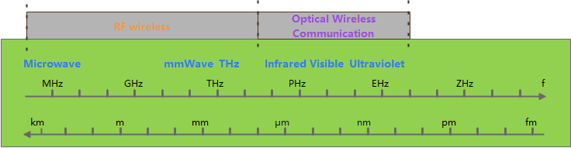
Research progress
Electromagnetic Spectrum
WiFi (2.4GHz, 5GHz)
  large antenna volume, high power consumption, narrow frequency band, and high interference
Millimeter Wave (24GHz，45GHz，60GHz，77GHz)
Optical wireless communication (OWC) / Free Space Optical (FSO)

Slide 3
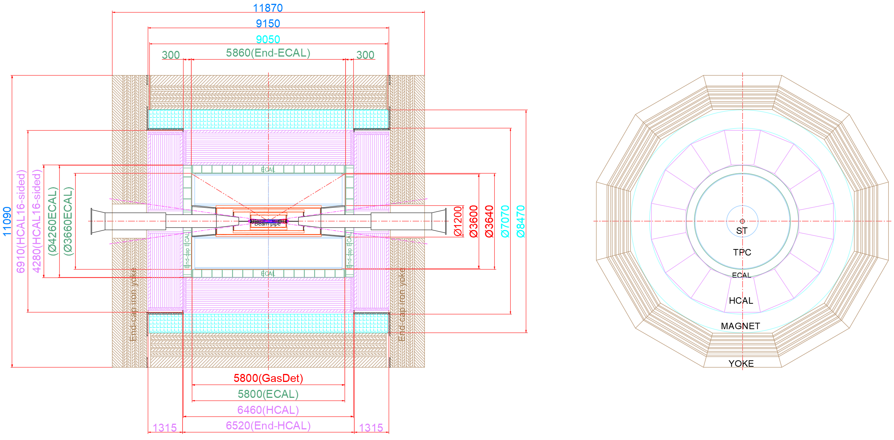
Outline
Radial data readout between layers of barrel
Axial data readout from barrel to endcap
Data readout in the endcap

Slide 4
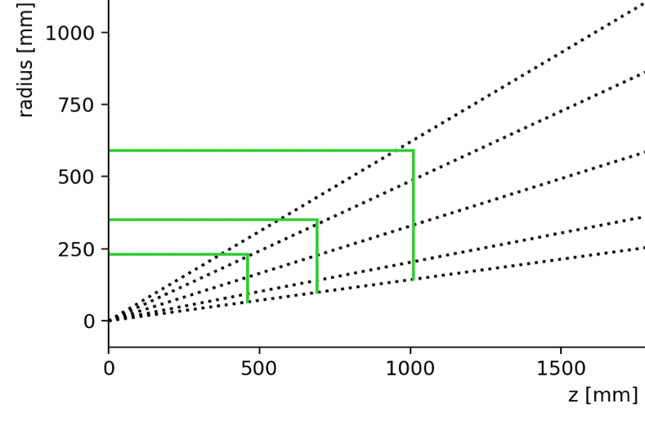


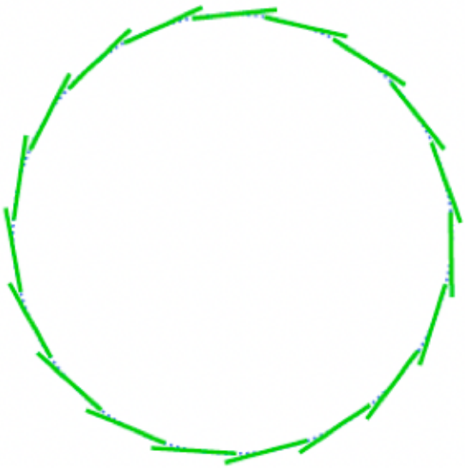

Radial data readout
Silicon inner tracker
Axial readout
repeater
Radial readout
  Repeaters: Amplify and re-transmit RF signals over long distances or through layers.
Radial readout with mm-wave
  12- 24 cm transmission distance
  Data rate : < 30Mbps
Axial readout to endcap
  Only at the outermost layer or dedicated aggregation layer.
Ladder/support
TX
Repeater
Repeater
RX
TX
Repeater
RX
Multi-endpoints with mm-wave
TX
RX

Slide 5
Layout of ladder for barrel
Sensor chip
Optical convertor & fibre
Hybrid PCB
Mechanical support (one side only)
repeater
mm-wave transceiver + antenna

Slide 6
Axial data readout
LGAD
Ladder
Power
Cascade mixed endpoints structure
  ~15 cm distance / link.
  Data rate: <Mbps
  NO level-2 data aggregation,
  Only 1 link for 1 long ladder.
DC-DC
Fiber
Aggr.
Optical
mm Wave
Flex
RX
mux
TX
RX
mux
TX
RX
mux
TX
Mixed endpoints

Slide 7
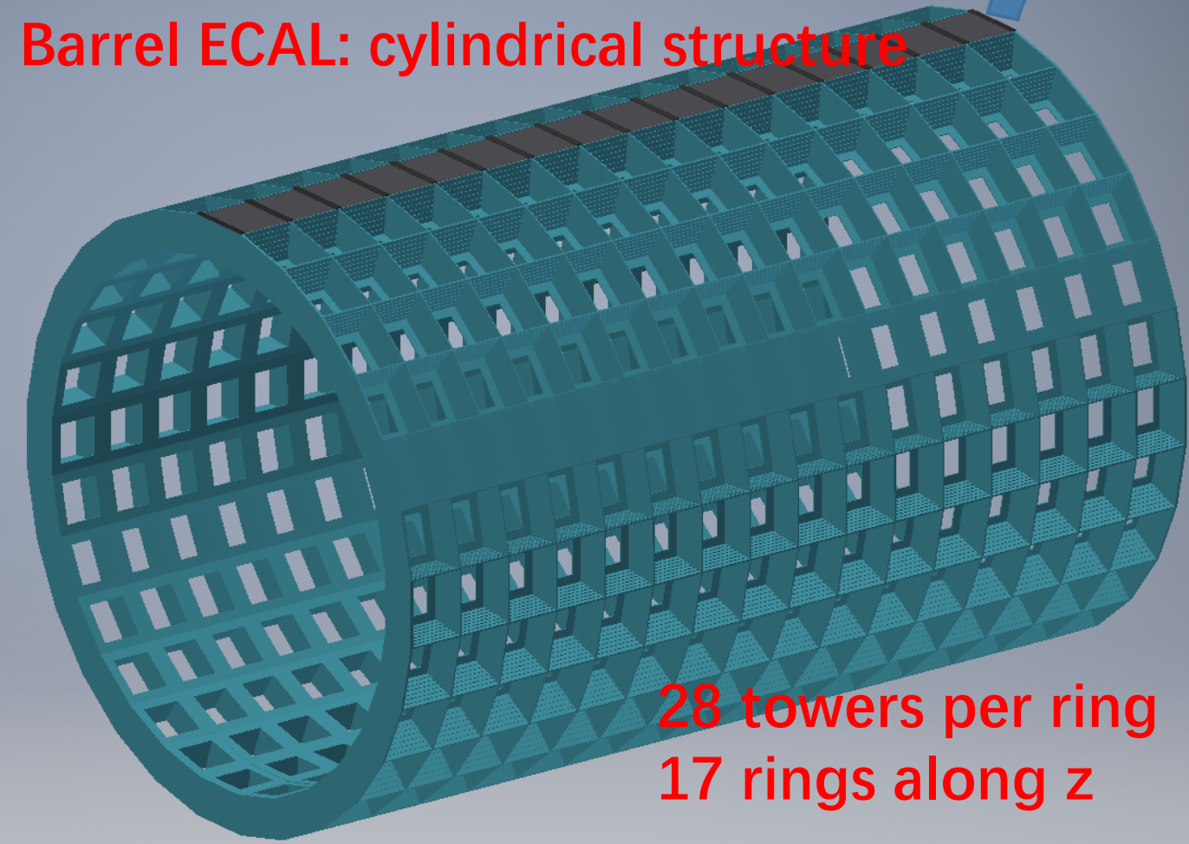
Calorimeter
Multi-endpoints transmission structure
  After module aggregation readout, from barrel to endcap
  40cm -500cm distance.
    Mm-wave with repeater
    Optical wireless communication
  Data rate:~100Mbps
  Hight limitation is not a issue for wireless.

Slide 8
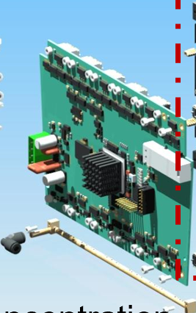
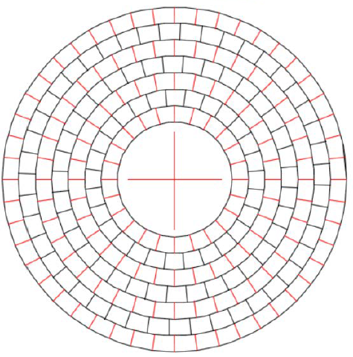
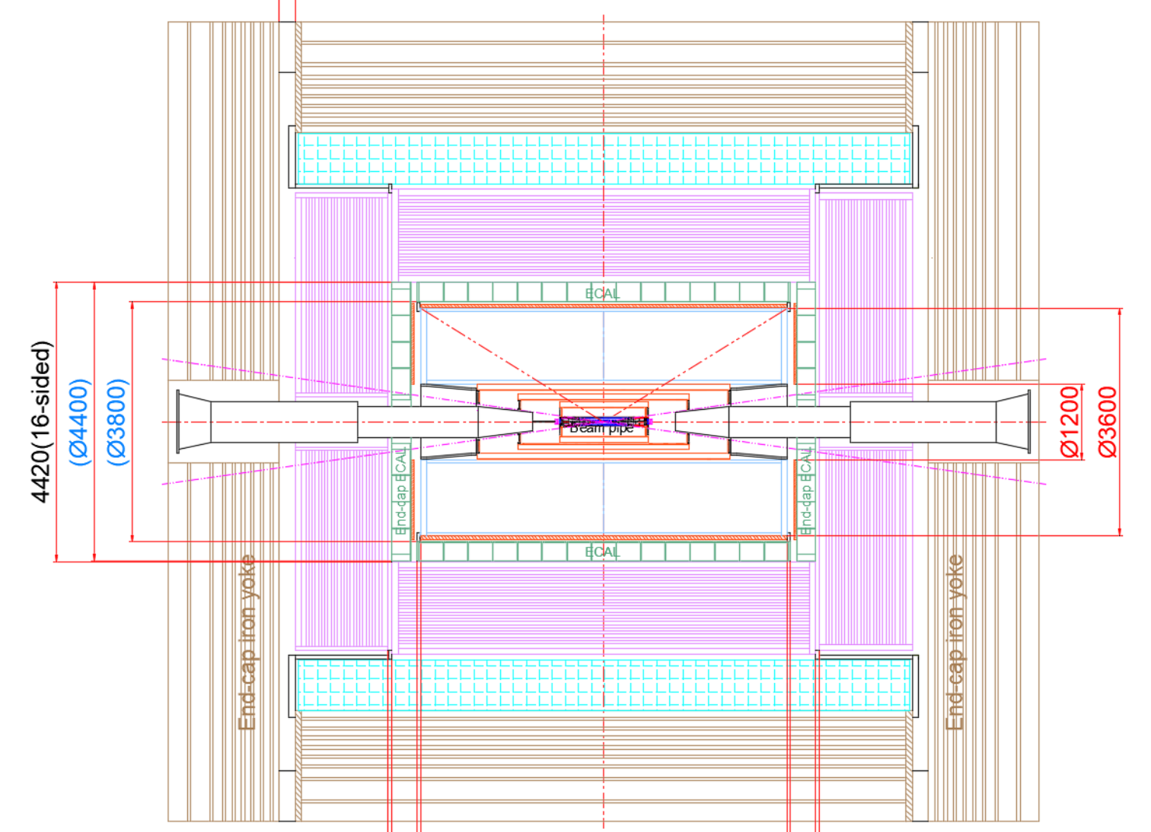
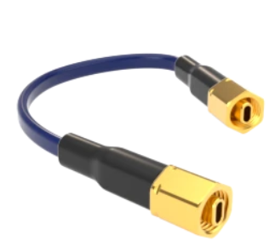
Endcap
TPC baseline
Radial data readout transmission
  Data aggregated radially through wireless from the center to the outside.
  Only lead out cables at the edge of the endcap.
  Module readout ~100Mbps
Fiber to BEE
Each modules will lead out a fiber
to edge of endcap
RF Waveguide
  Can be bend
  Extend distance
Mmwave / opti

Slide 9
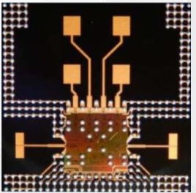
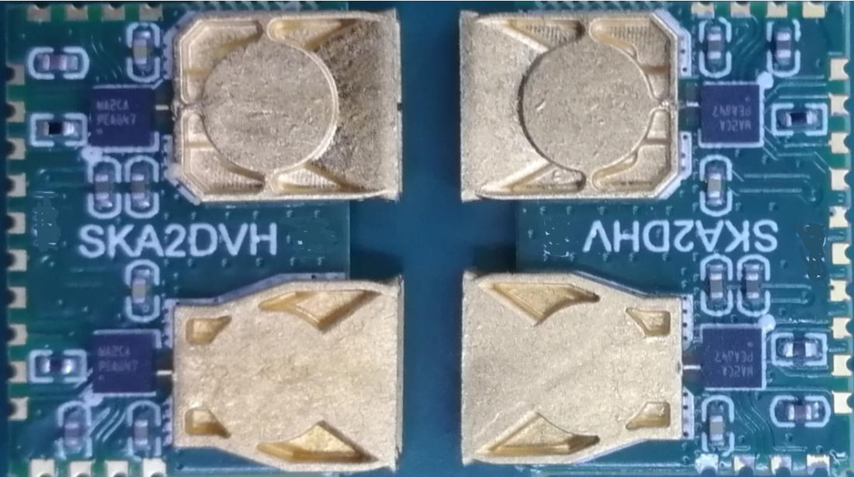
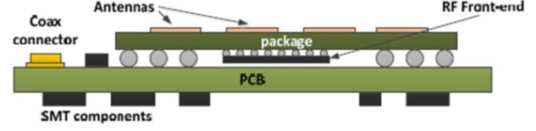
MM-wave development
mm-wave | Now | Requirement
Data rate | ~ 1Gbps | 1Gbps
Distance | 6cm | 10-30cm
Size | 2.2X2.2X0.8mm(transceiver)+ 8mmX8mmX4mm(antenna) | 10mmX10mmX2mm(integrated for bidirectional transmission)
ST60A2
Custom antenna
Step 0: Full commercial module
Basic performance test
Step 1: Design a small PCB module with custom antenna and ST60A2
Higher bandwidth test
Evaluate the interference with detector
Under design, cheap and easy
Step 2: Integrate the antenna and available mm wave RF chips (45G/60G/77G) into the package (AIP)
Less cost and mature technological
Radiation hard test.
Step 3: Custom radiation RF front-end + custom Antenna in one chip
Final solution of minimum material budget.
The most challenging, significant investment in R&D costs

Slide 10
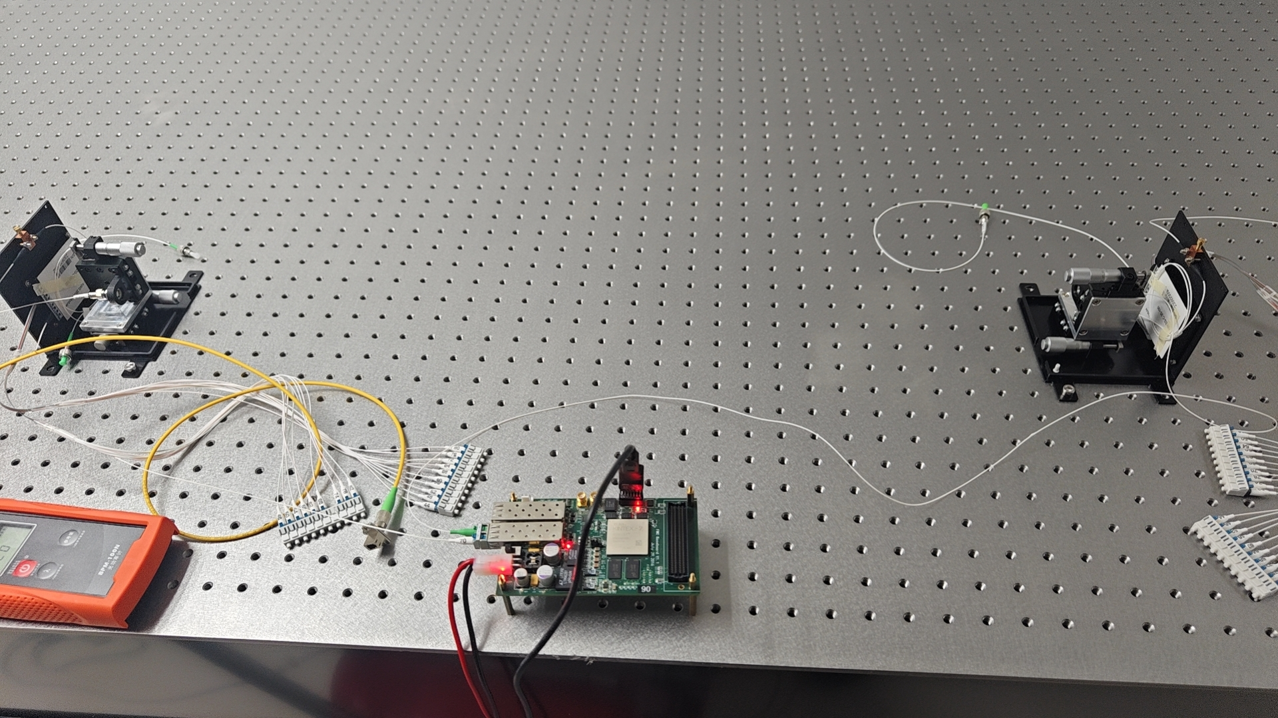
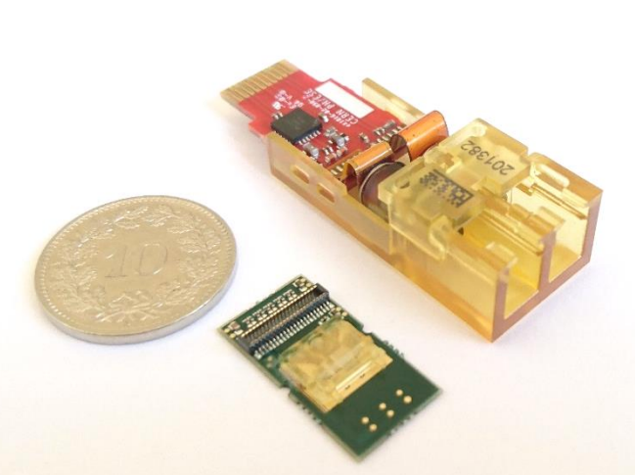
Free Space Optical
Transceiver design
Optical path design with mechanical support
~0.8m – 6m
TX
RX
FPGA readout board
FSO with commercial components (up to 120Gbps bandwidth)
Endcap
Transceiver
ladder
Cern VTRx+ transceiver

Slide 11
Summary
Significant advantages of use wireless technology to replace optical fibers：
  Reduction in connectors & cables
  -> lower material budget
  -> reduced cost
  Simplified fiber routing
  ->from barrel to endcap
  ->from endcap to the outside
Significant challenges
  Need more tests
  -> Interference with detector (should be OK, need test)
  -> Clock transmission
  Need more designs
  -> Transceiver: radiation hardness, power consumption
  -> Antenna / lens: position and direction
  -> RF/optical path based on the module location.
  Requires high reliability.
  Power cables are still exists.
Thank you!

Slide 12
BACKUP

Slide 13
LGAD方案
光纤，电源线
光纤，电源线
二级汇总
6 staves
总长：5880mm
980mm
7modules
LGAD
PCB
ASIC
一级汇总、供电
柔性板
二级
汇总板
Power, HV, clk，data,control
柔性板
供电，光纤

Slide 14
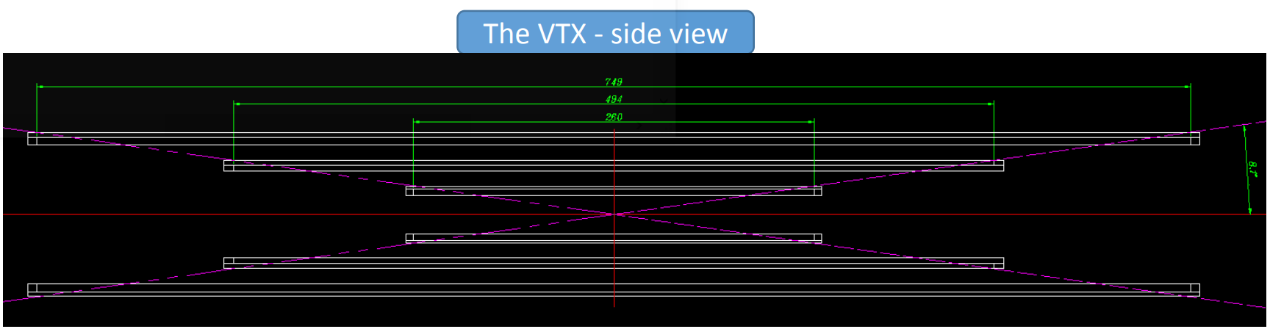

Slide 16
FSO
FSO
Radiation hardens
Silicon photonic chips
DWDM
Lens size is a key limitation inside detector

Slide 17
Basic structure
TX
RX
Point to point
TX
Repeater
Repeater
RX
Multi endpoints:
  Use repeaters to expand the distance or through layers
  Need more space in outer layer
Mixed endpoints
  Serial transmission
  Need special design in multiplexing
  Save space
RF Waveguide
  Can be bend
  extend distance
TX
Repeater
RX
Multi endpoints
TX
RX
RX
mux
TX
RX
mux
TX
RX
mux
TX
Mixed endpoints

