Slide 1
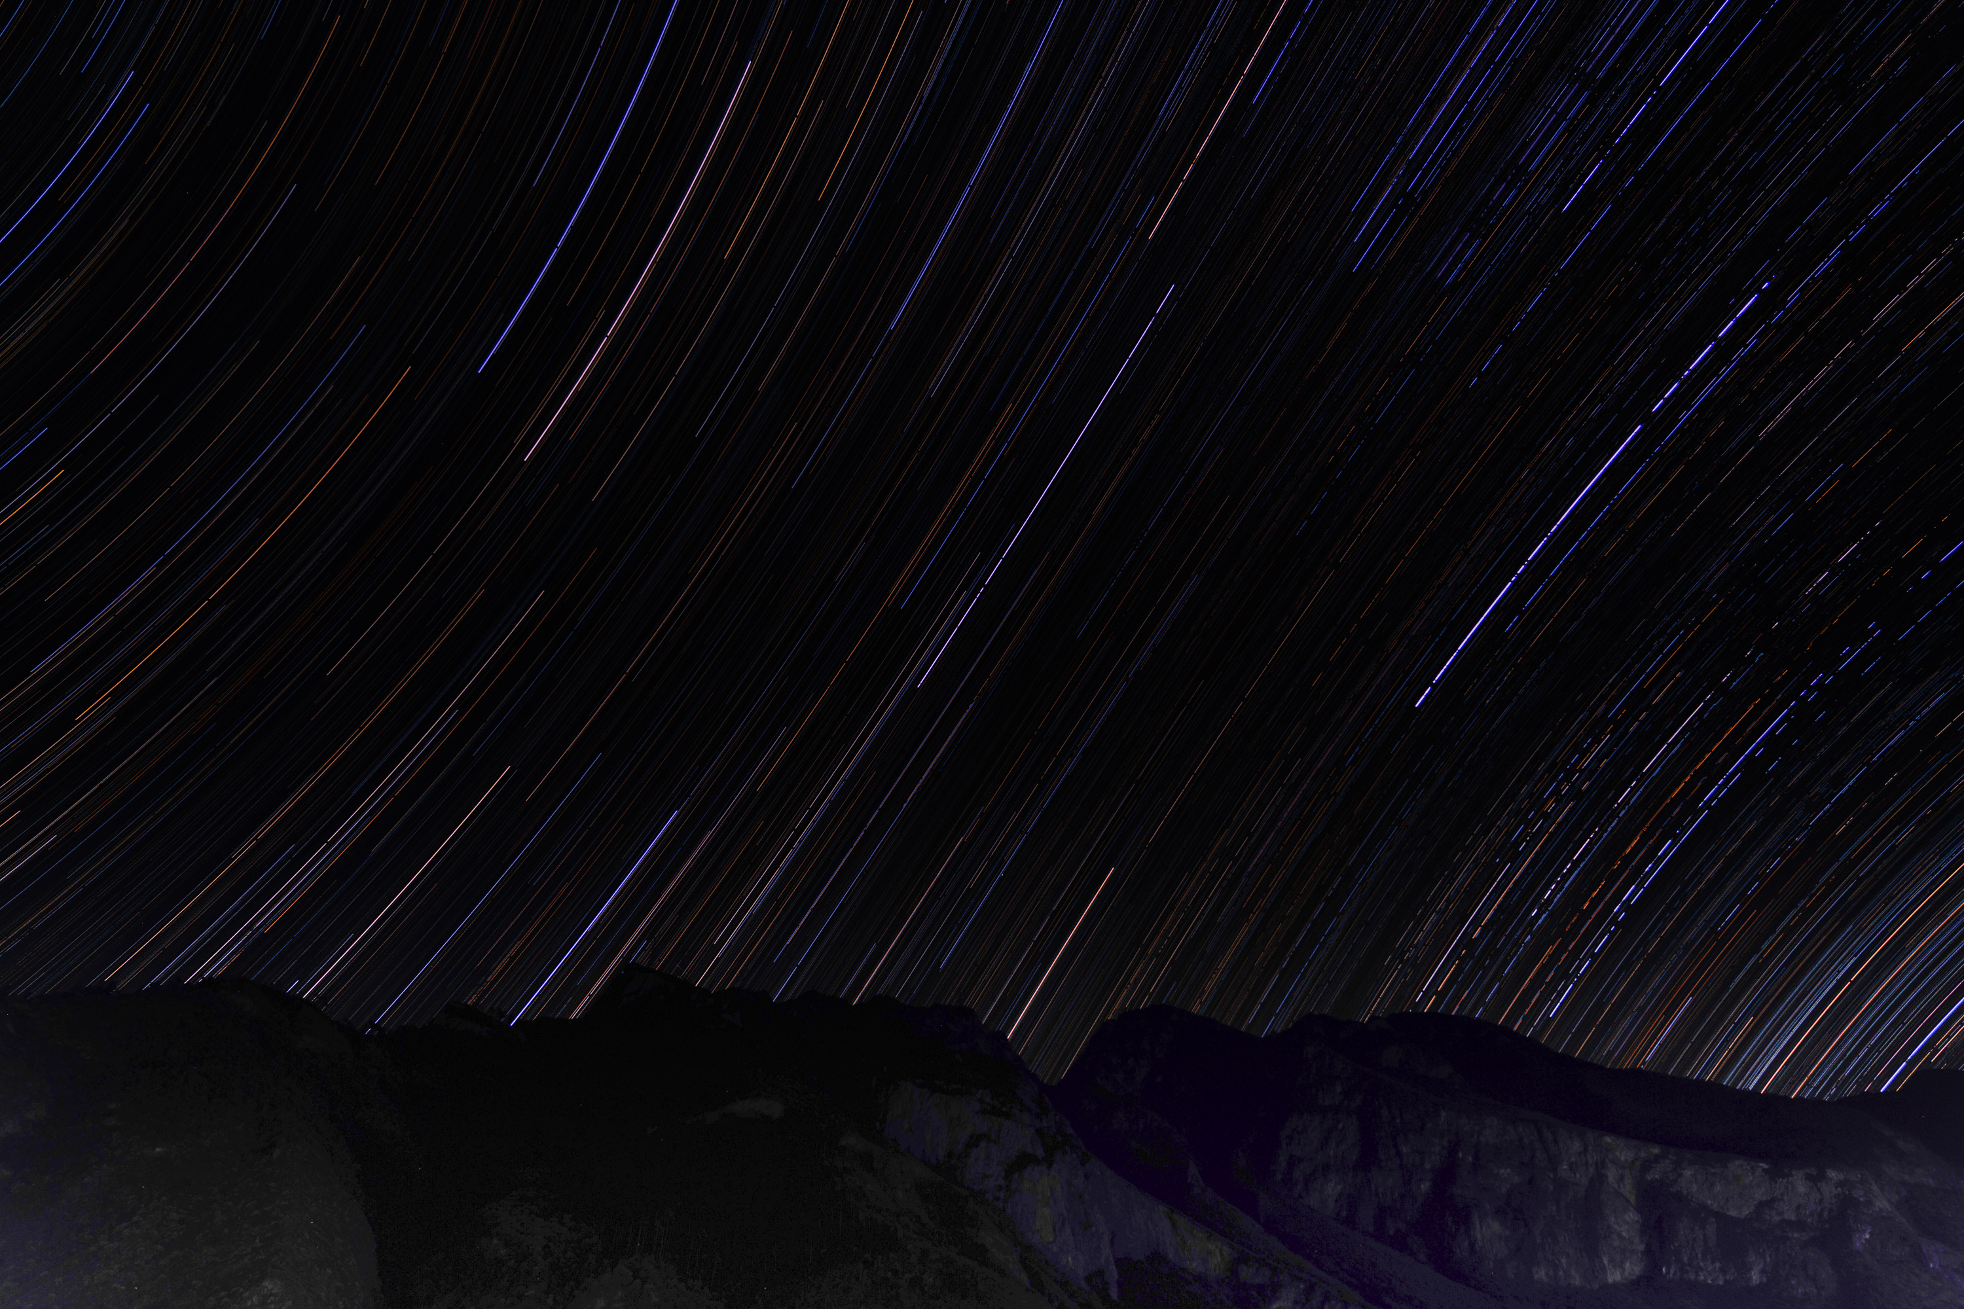
Large Liquid Xenon Detectors for Neutrinoless Double Beta Decay
HAN, Ke (Shanghai Jiao Tong University)
上海交通大学 韩柯
For the PandaX Collaboration
2024/5/13

Slide 2
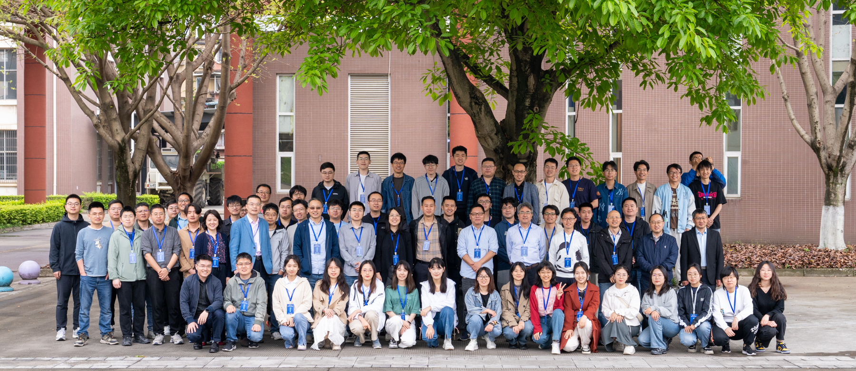
PandaX: Particle and Astrophysical Xenon Experiment
15 institutions, ∼100 collaborators

Slide 3
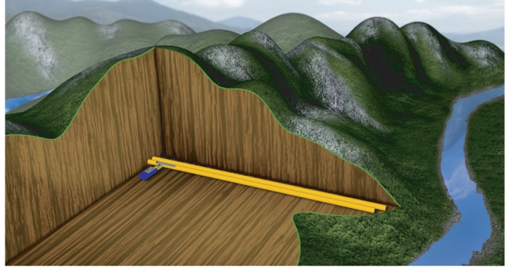
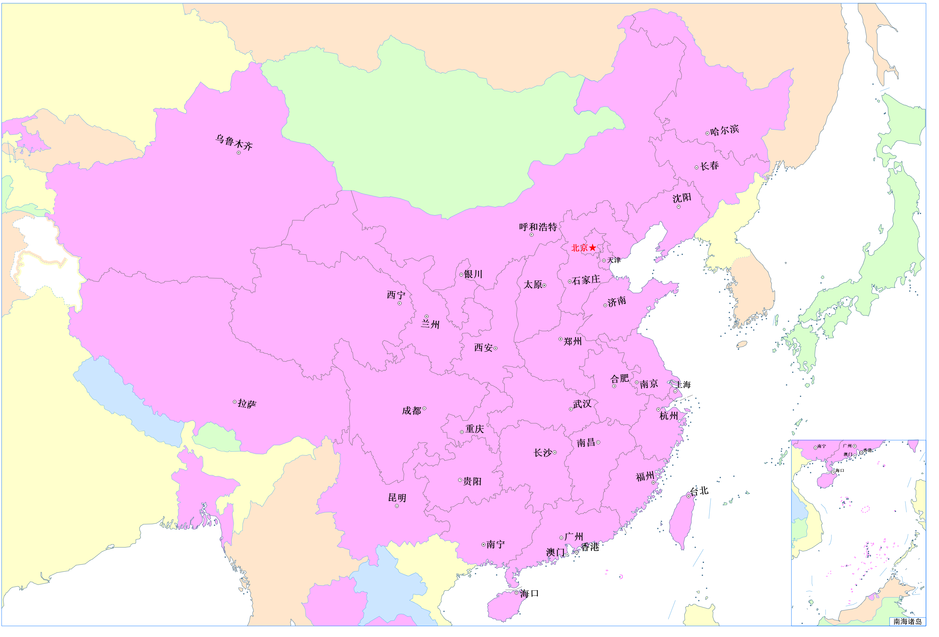
CJPL: Deepest underground lab
Deepest (6800 m.w.e): < 0.2 muons/m²/day
Horizontal access with ~9 km long tunnel: large truck can drive in.
National key science research facility for dark matter searches, neutrino physics, and astroparticle physics, etc.
2430m
8750m
CJPL-I
CDEX
PandaX

Slide 4
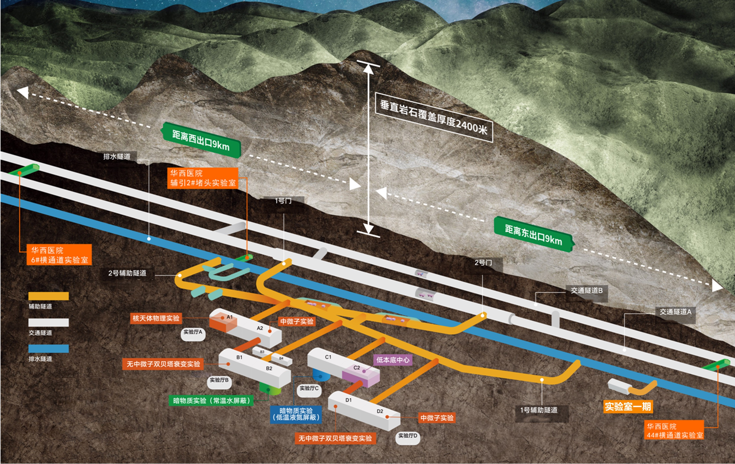
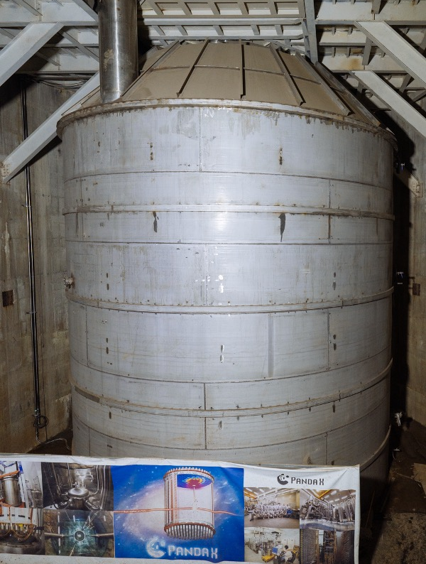
CJPL-II: much enlarged underground lab space
From: The China Jinping Underground Laboratory and Its Early Science; Ann.Rev.Nucl.Part.Sci. 67 (2017) 231-251

Slide 5
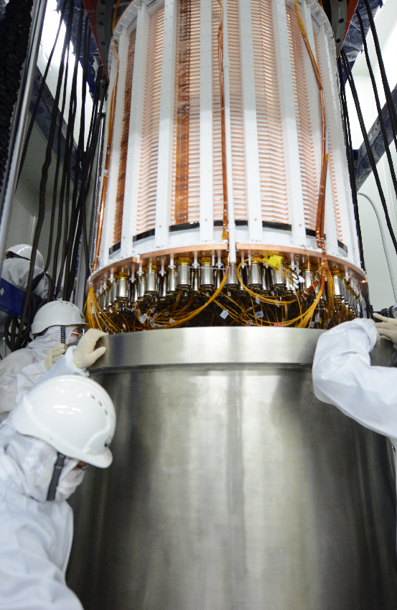
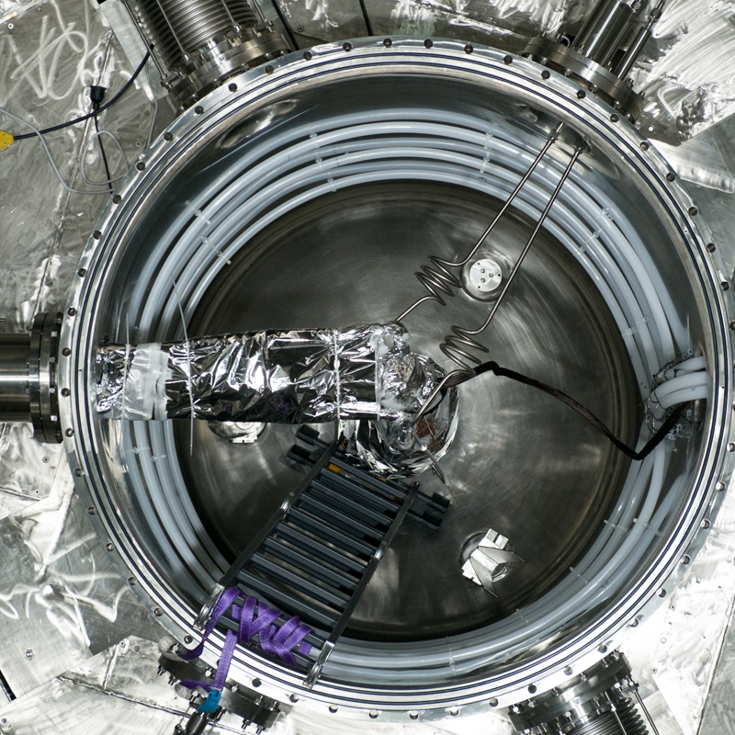
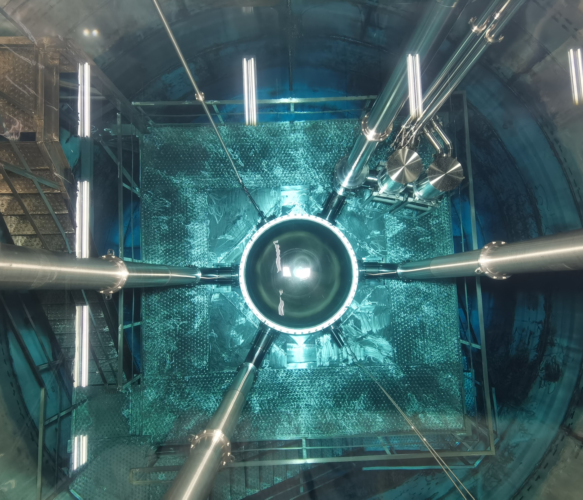
PandaX-4T
A multi-ton dual-phase xenon TPC at B2 hall of China Jinping Underground Laboratory
1.2 m (D) ×1.2 m (H); Sensitive volume: 3.7-ton LXe; 3-inch PMTs: 169 top / 199 bottom
Water shielding

Slide 6


Slide 7
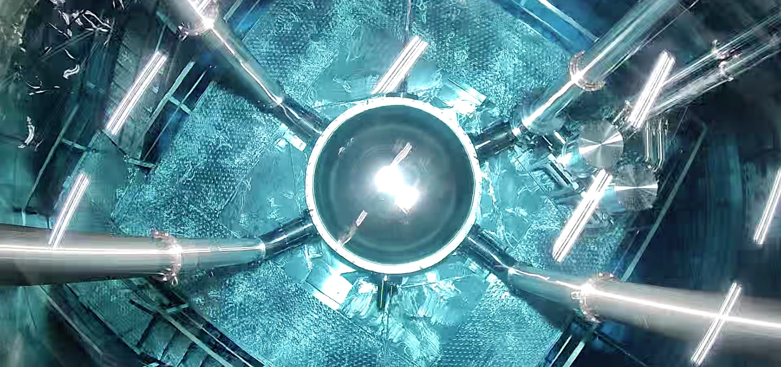
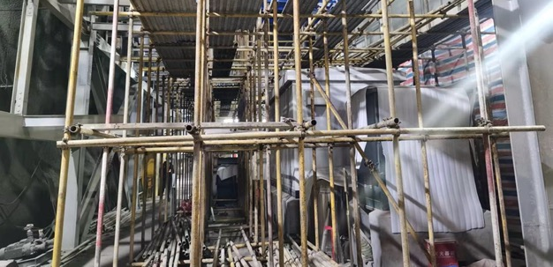
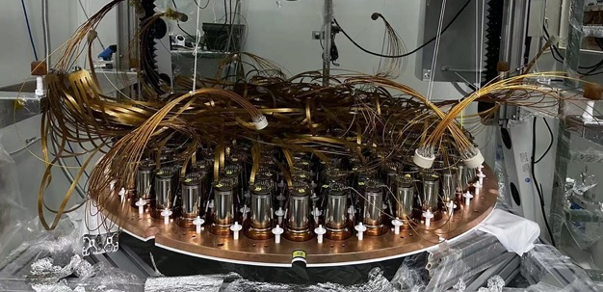
PandaX-4T timeline
2020/11 – 2021/04 | Commissioning (Run 0) 95 days data
2021/07 – 2021/10 | Tritium removal xenon distillation, gas flushing, etc.
2021/11 – 2022/05 | Physics run (Run 1) 164 days data
2022/09 – 2023/12 | CJPL B2 hall construction xenon recuperation, detector upgrade
Detector is under-preparation for Run 2

Slide 8
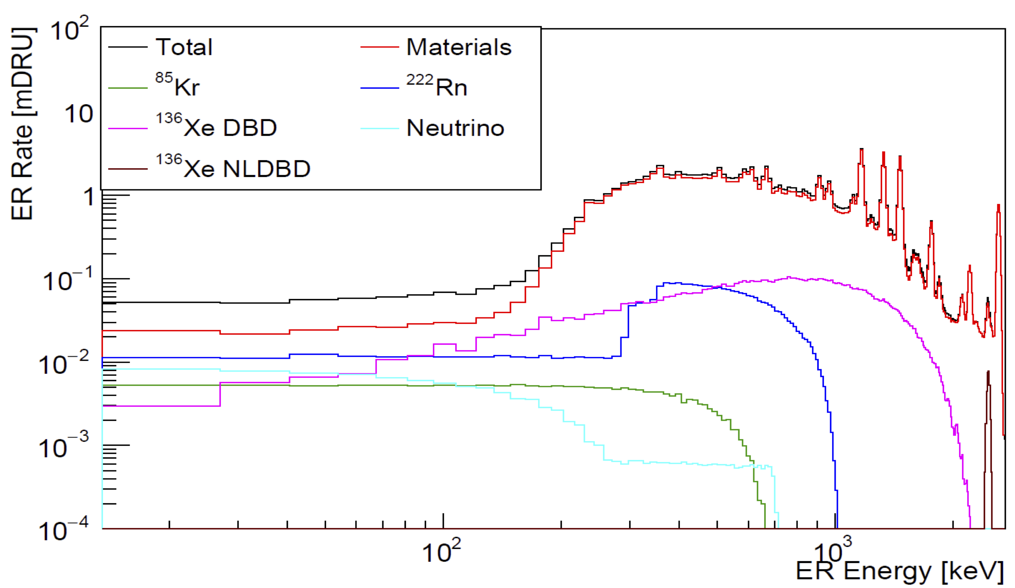
Simulated spectrum for PandaX-4T

Slide 9
Simulated spectrum for PandaX-4T
DM

Slide 10
Simulated spectrum for PandaX-4T
DM
Double beta decay

Slide 11
Simulated spectrum for PandaX-4T
DM
Solar pp neutrino
Double beta decay

Slide 12
Simulated spectrum for PandaX-4T
DM
Solar pp neutrino
Double beta decay
Solar ⁸B neutrino

Slide 13
Wide E range, multiple “interesting” isotopes for neutrino
氙-136 2νββ
以及 0νββ
氙-134 2νββ
以及 0νββ
氙-124
2νDEC
氙-124 0νDEC
太阳 ⁸B
中微子
WIMP 等
暗物质信号
太阳 pp
中微子
核物理：贝塔能谱精确测量、稀有核衰变等
keV
10 keV
100 keV
1 MeV

Slide 14
Wide E range, multiple “interesting” isotopes for neutrino
氙-136 2νββ
以及 0νββ
氙-134 2νββ
以及 0νββ
氙-124
2νDEC
氙-124 0νDEC
太阳 ⁸B
中微子
WIMP 等
暗物质信号
太阳 pp
中微子
核物理：贝塔能谱精确测量、稀有核衰变等
keV
10 keV
100 keV
1 MeV

Slide 15
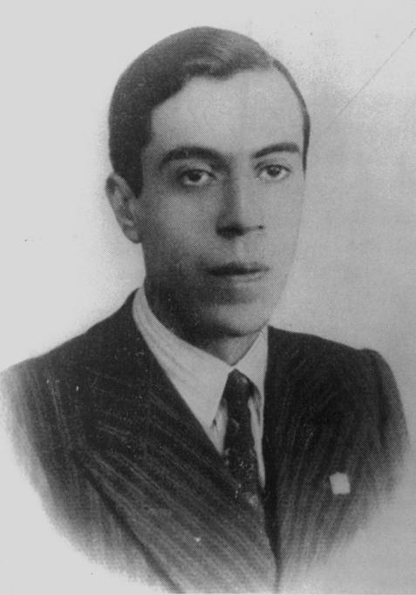

Majorana neutrino and Double beta decay
From Physics World
1935, Goeppert-Mayer
Two-Neutrino double beta decay
1937, Majorana
Majorana Neutrino
1939, Furry
Neutrinoless double beta decay
1930, Pauli
Idea of neutrino
1933, Fermi
Beta decay theory
$${}_{54}^{136}{Xe→{}_{56}^{136}{Ba+2e^{−}+(2\overline{υ})}}$$

Slide 16
Candidate Isotopes
J.M. Yao, J. Meng, Y.F. Niu, P. Ring, Prog.Part.Nucl.Phys. 126 (2022), 103965

Slide 17
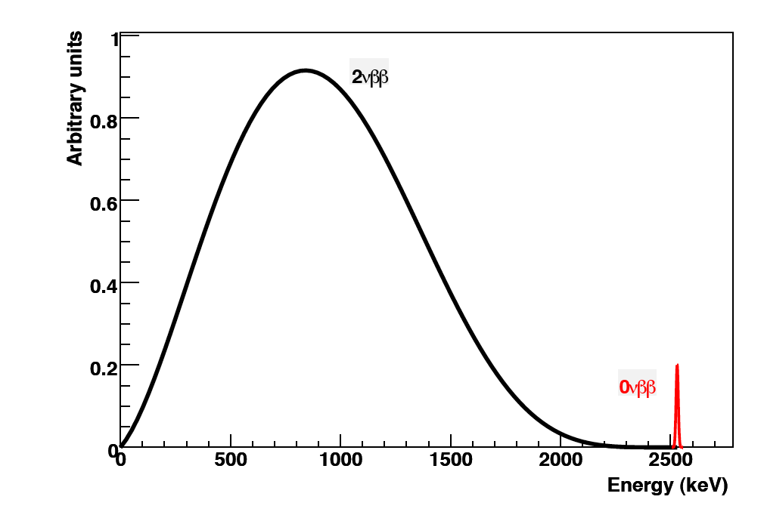


Detection of double beta decay
Examples:
Measure energies of emitted electrons
Electron tracks are a huge plus
Daughter nuclei identification
$${}_{54}^{136}{Xe→{}_{56}^{136}{Ba+2e^{−}+(2\overline{υ})}}$$
$${}_{52}^{130}{Te→{}_{54}^{130}{Xe+2e^{−}+(2\overline{υ})}}$$
2νββ
0νββ
T-REX: arXiv:1512.07926
Sum of two electrons energy
Simulated track of 0νββ in high pressure Xe

Slide 18
0νββ probes the nature of neutrinos
Majorana or Dirac
Lepton number violation
Measures effective Majorana mass: relate 0νββ to the neutrino oscillation physics
Normal Inverted
Phase space factor
Current Experiments
Nuclear matrix element
Effective Majorana neutrino mass:

Slide 19
Impressive experimental progress
~100 kg of isotopes
~100-person collaborations
Deep underground
Shielding + clean detector
0νββ half-life limit (year)
Grams of isotopes
Table-top experiment
Above-ground
Little shielding
Year
Partial list of selected isotopes; Pre-1984 data points from review article by Haxton and Stephenson, Jr.

Slide 20
Nuclear Physics A 1033 (2023) 122628

Slide 21
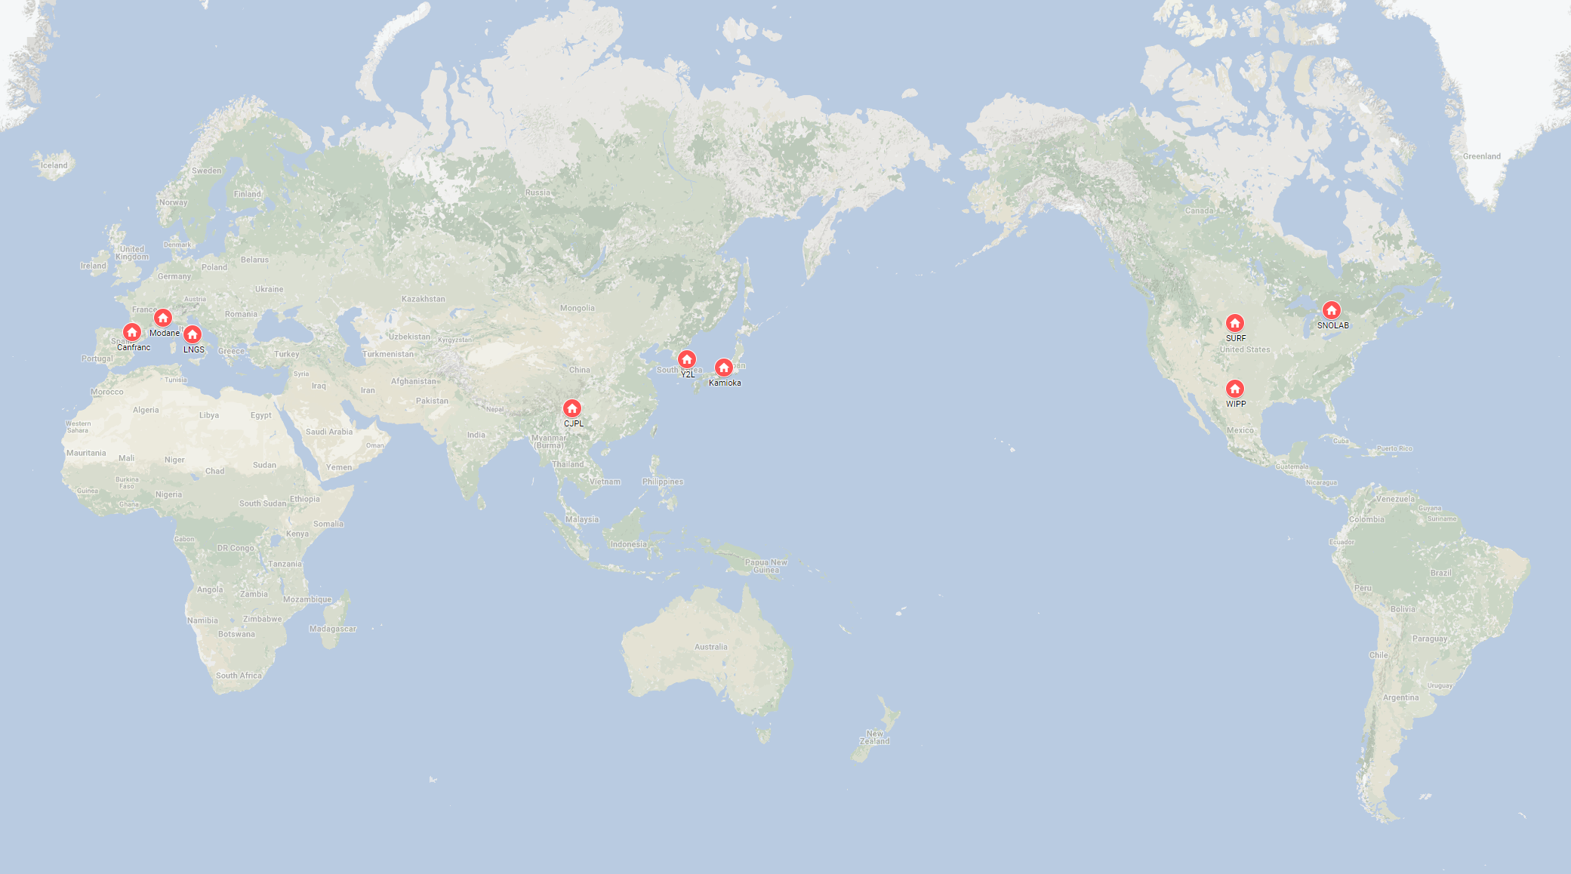
Major 0νββ experiments around the world
CJPL
PandaX
CDEX … …
Y2L
AMoRE
Kamioka
KamLAND-Zen
CANDLES
SURF
Majorana
LNGS
CUORE
CUPID
LEGEND
SNOLAB
SNO+
nEXO
Canfranc
NEXT
Modane
SuperNEMO
WIPP
EXO-200
Major players

Slide 22
Wide E range, multiple “interesting” isotopes for neutrino
氙-136 2νββ
以及 0νββ
9% Isotopic Abundance, Q=2427 keV
10% Isotopic Abundance, Q= 826 keV
氙-134 2νββ
以及 0νββ
氙-124
2νDEC
氙-124 0νDEC
太阳 ⁸B
中微子
WIMP 等
暗物质信号
太阳 pp
中微子
核物理：贝塔能谱精确测量、稀有核衰变等
keV
10 keV
100 keV
1 MeV

Slide 23
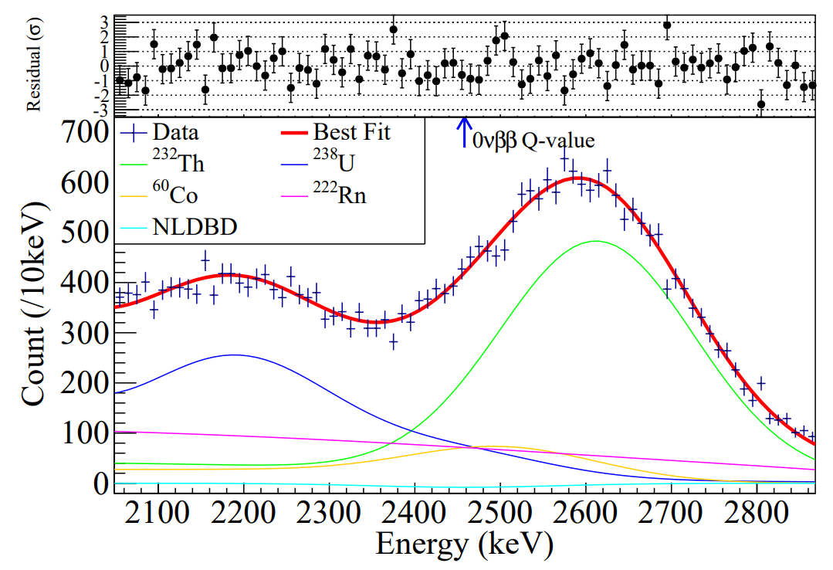
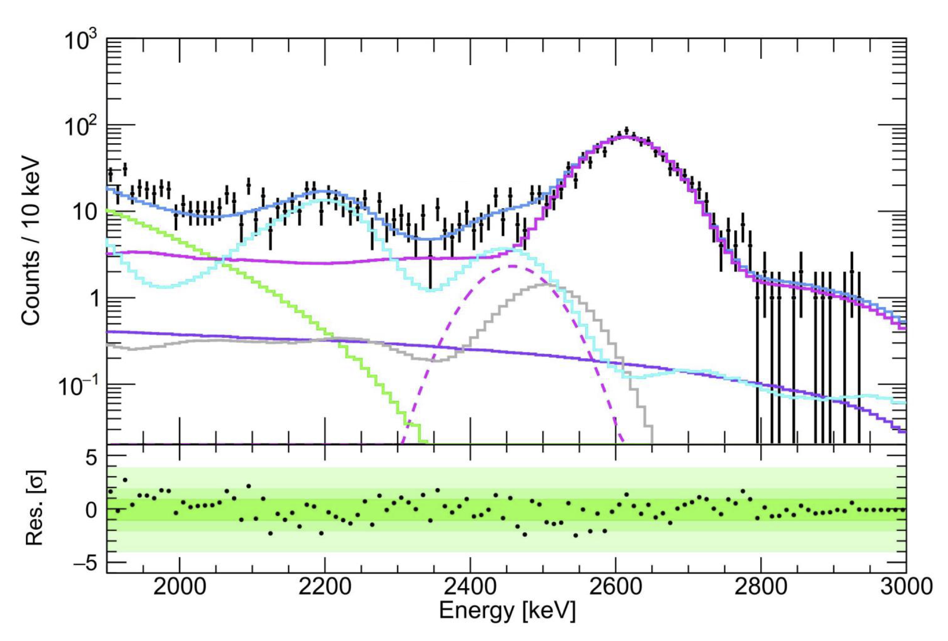
Search for ¹³⁶Xe 0νββ with LXe TPC
 | Bkg rate (/keV/ton/y) | Energy resolution | FV mass (kg) | Run time | Sensitivity/Limit (90% CL, year) | Year
PandaX-II | ~200 | 4.2% | 219 | 403.1 days | 2.4 ×10²³ | 2019
XENON1T | ~20 | 0.8% | 741 | 202.7 days | 1.2 × 10²⁴ | 2022
PandaX-4T | 6 | 1.9% | ~650 | ~250 days | > 10²⁴ | Expeted 2024
PandaX-4T PRELIMINARY
PandaX-II

Slide 24
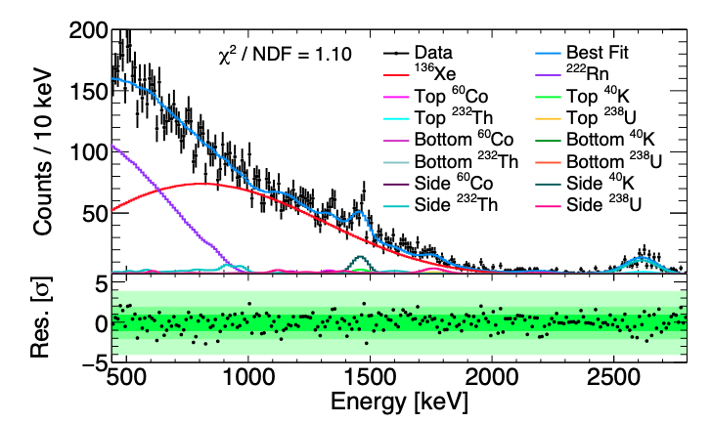
¹³⁶Xe 2νββ half-life measurement
¹³⁶Xe 2νββ half-life measured by PandaX-4T: 2.27 ± 0.03(stat.) ± 0.09(syst.) × 10²¹ year
440 keV – 2800 keV range is the widest ROI
Comparable precision with leading results
First such measurement from a natural xenon TPC
Research, 9798721 (2022)

Slide 25
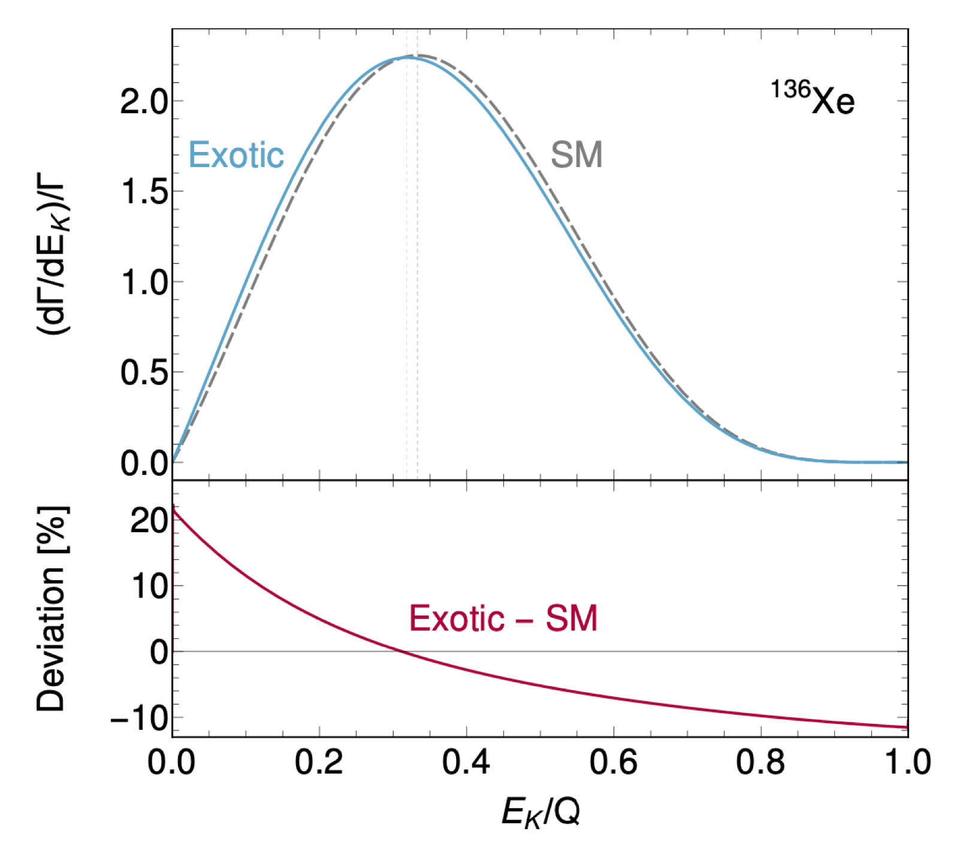
More Physics with ¹³⁶Xe 2νββ spectrum
NME of 2νββ may be energy dependent and cause 2νββ shape change
BSM physics, such as right-handed leptonic currents would affect the energy distribution
Yu-Feng Li et al
Deppisch et al, (2020)

Slide 26
¹³⁴Xe 2νββ and 0νββ
Q=826 keV; Half-life from theoretical predictions: 10²⁴-10²⁵ yr; Never been observed
Current 2νββ (0νββ) half-life limit from EXO-200 : 𝑇 >8.7x10²⁰ yr (1.1x10²³ yr) at 90% CL
Discovery within reach with a natural Xe TPC
EXO-200 (2017)

Slide 27
¹³⁴Xe (0)2νββ searches at PandaX-4T
PandaX-4T: more ¹³⁴Xe; much less ¹³⁶Xe; wider energy range; discovery possible
 | ¹³⁴Xe mass | ¹³⁶Xe abundance | Analysis threshold | Live Time
PandaX-4T | 68.7 kg | 8.9% | 200 keV | 94.9 days
EXO-200 | 18.1 kg | 81% | 460 keV | 600 days

Slide 28
¹³⁴Xe (0)2νββ searches at PandaX-4T
PandaX-4T: more ¹³⁴Xe; much less ¹³⁶Xe; wider energy range; discovery possible
 | ¹³⁴Xe mass | ¹³⁶Xe abundance | Analysis threshold | Live Time
PandaX-4T | 68.7 kg | 8.9% | 200 keV | 94.9 days
EXO-200 | 18.1 kg | 81% | 460 keV | 600 days

Slide 29
¹³⁴Xe (0)2νββ searches at PandaX-4T
PandaX-4T: more ¹³⁴Xe; much less ¹³⁶Xe; wider energy range; discovery possible
 | ¹³⁴Xe mass | ¹³⁶Xe abundance | Analysis threshold | Live Time
PandaX-4T | 68.7 kg | 8.9% | 200 keV | 94.9 days
EXO-200 | 18.1 kg | 81% | 460 keV | 600 days

Slide 30

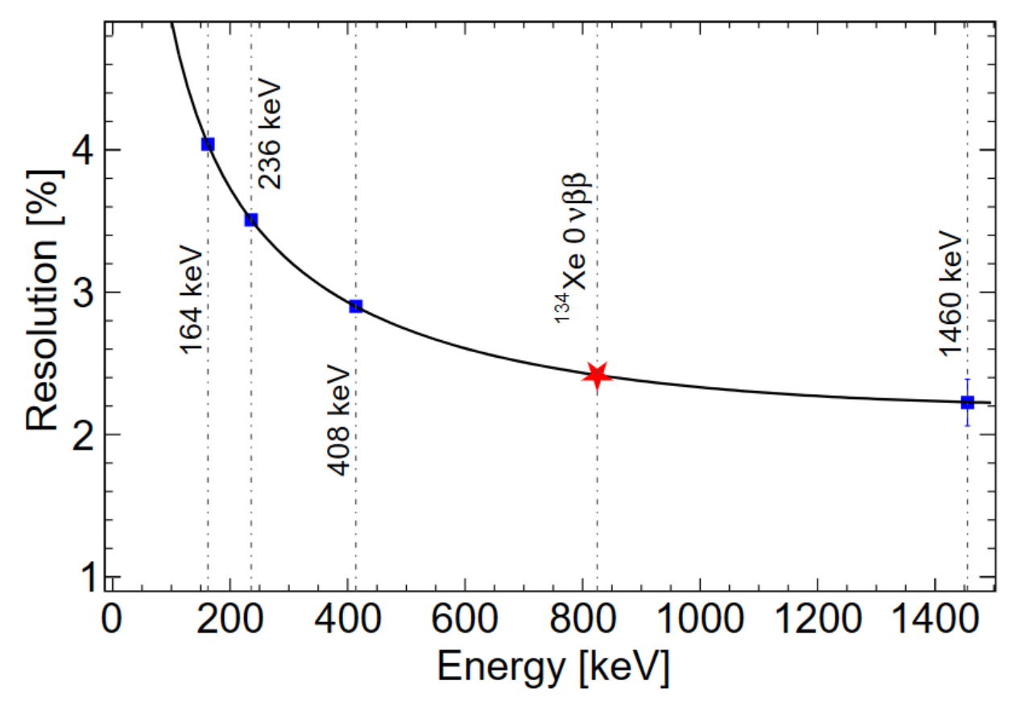
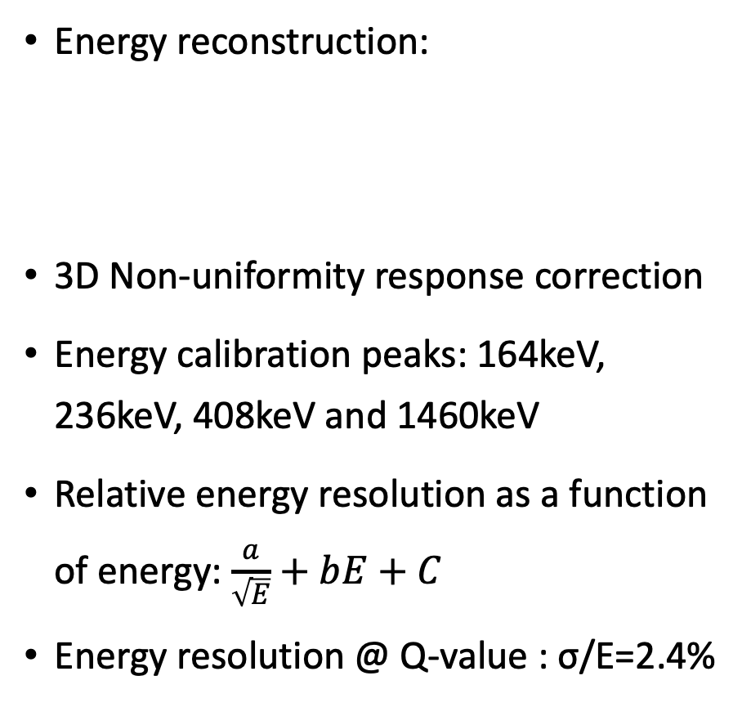
Extending detector response in [200, 1000] keV
Energy reconstruction:
3D Non-uniformity response correction
Energy calibration peaks: 164keV, 236keV, 408keV and 1460keV
Relative energy resolution as a function of energy: $\frac{a}{\sqrt{E}}+bE+C$
Energy resolution @ Q-value : σ/E=2.4%
PDE: photon detection efficiency for S1
EEE: electron extraction efficiency
SEG_{B}: single-electron gain for S2_{B}

Slide 31
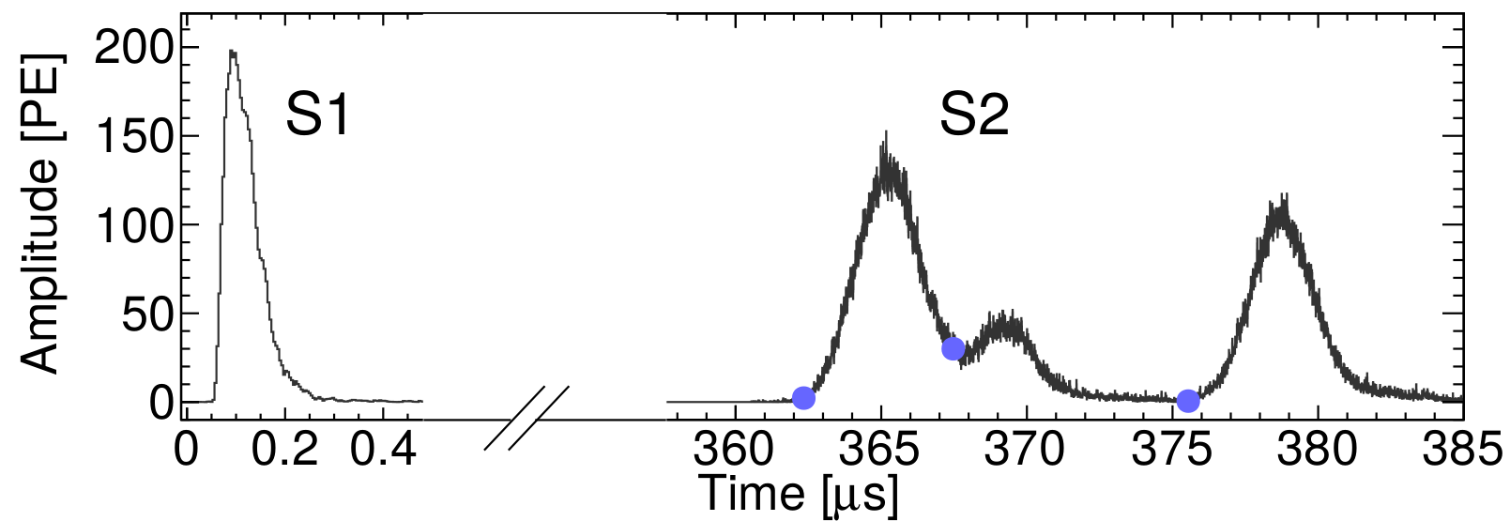
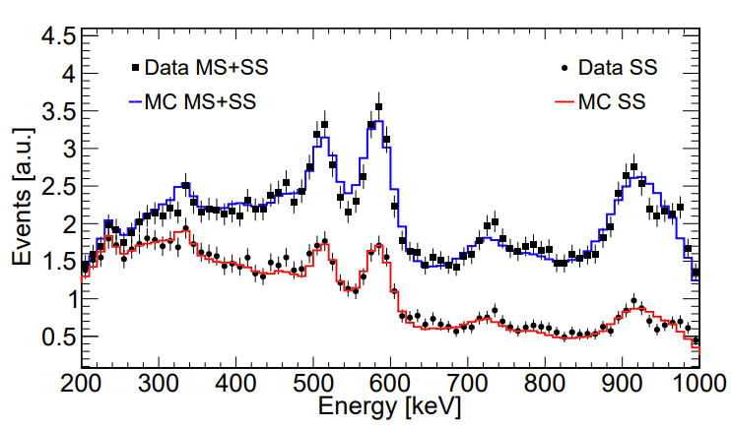
Events selection efficiencies
Data quality cut efficiencies: (99.94 ± 0.03)%
  S1, S2, S1/S2: remove non-ER and alpha events
  Top and bottom S1 charge asymmetry vs. drift time
SS selection:
  MeV gammas events are mostly MS events, while signals are mostly SS events
  Identifying MS and SS with PMT waveforms
  Validated with ²³²Th calibration data agreement in the ROI is at 6.4%, taken as systematics

Slide 32
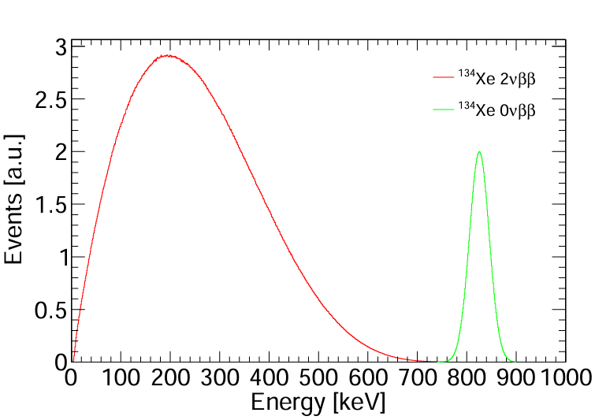
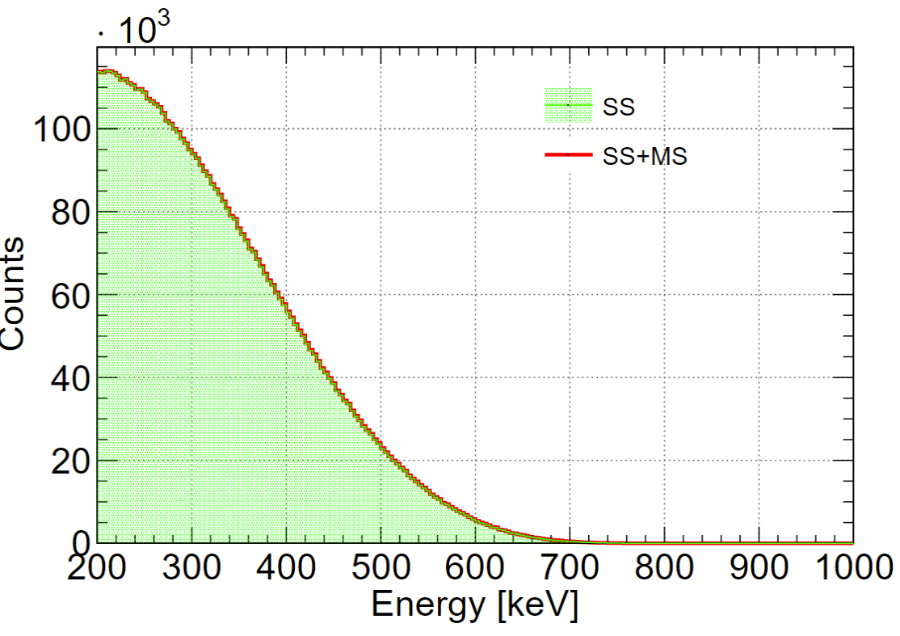
Signal efficiencies
¹³⁴Xe 2𝜈𝛽𝛽 and 0𝜈𝛽𝛽 events generated with the theoretical calculation
The signal events went through PandaX-4T simulation and data processing chain
ROI [200,1000]keV cut:
  2𝜈𝛽𝛽: 60.56%
  0𝜈𝛽𝛽: 99.98%
SS ratio in ROI:
  2𝜈𝛽𝛽: 99.89%
  0𝜈𝛽𝛽: 98.23%
Physical Review C 85, 034316 (2012)

Slide 33
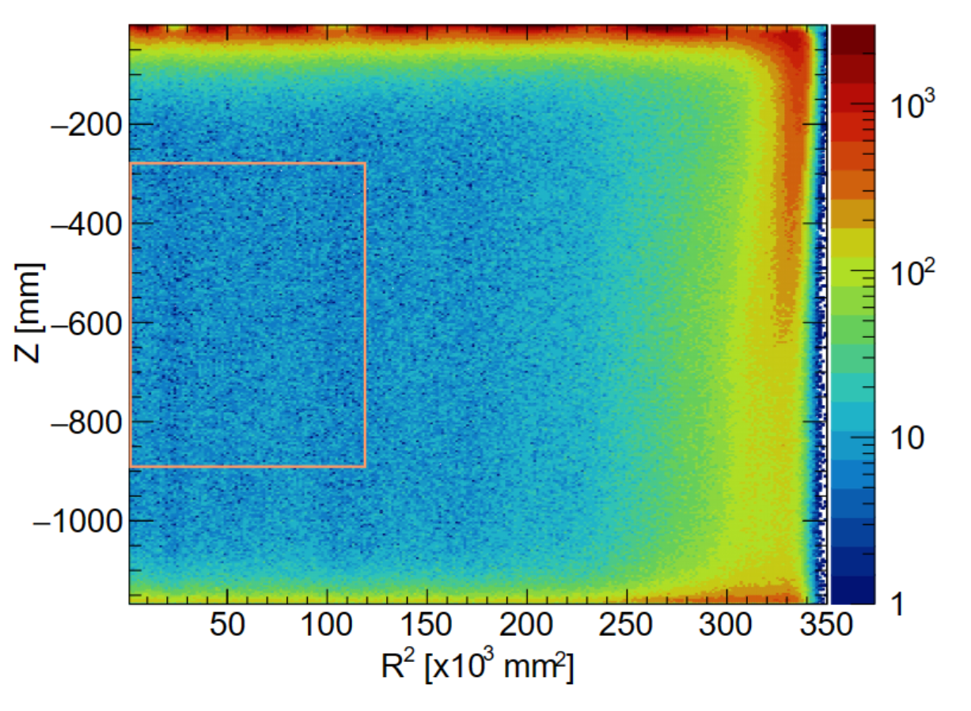
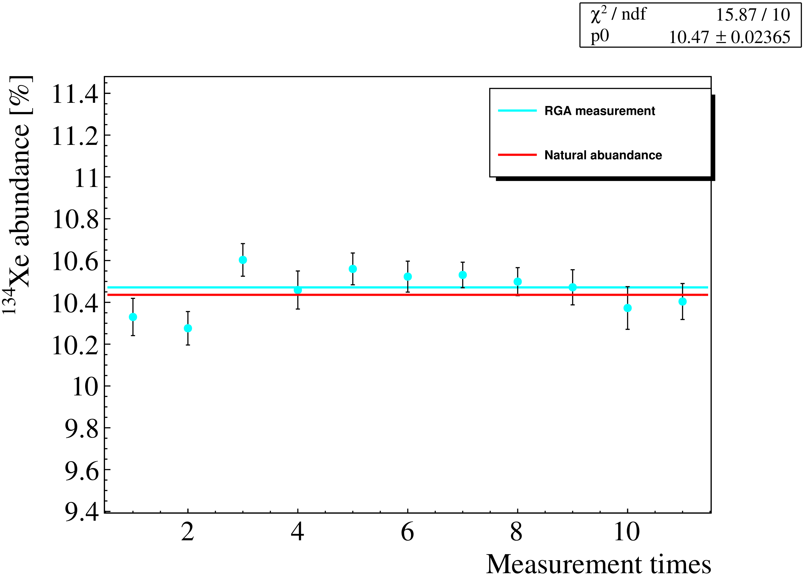
Fiducial Volume (FV) and exposure
The same data set and FV used in ¹³⁶Xe analysis
94.9 live-days of data from the initial data release
656 kg natural xenon within the selected FV
Measured ¹³⁴Xe abundance: 10.47%
Target mass uncertainty: FV selection (1.6%), abundance (0.2%), LXe density (0.03%)
Total isotopic exposure: 17.9 kg·yr

Slide 34
Background model
 | Component | Input Counts | Constraint
 | ⁶⁰Co | 130 | 13%
Materials | ⁴⁰K | 133 | 8%
 | ²³²Th | 950 | 5% | Measured in ¹³⁶Xe 2𝜈𝛽𝛽 analysis
 | ²³⁸U | 274 | 8% | Research 2022 (2022) 9798721
 | ¹³⁶Xe | 12372 | 5%
 | ²¹²Pb | 1012 | 29% | Measured by its daughter ²¹²Po alpha decay
 | ⁸⁵Kr | 296 | 52% | Determined by β−γ emission through the metastable state ^{85m}Rb
LXe | ¹³³Xe | 3423 | 10% | Estimated the β+γ shoulder of ¹³³Xe between 90 and 120 keV
 | ²¹⁴Pb | 19429 | Free | Determined by ²²²Rn
 | ¹²⁵Xe | - | Free | short-lived xenon isotopes induced by neutron calibration
 | Other Xe | - | Free | ¹²⁷Xe and ^{129m}Xe

Slide 35
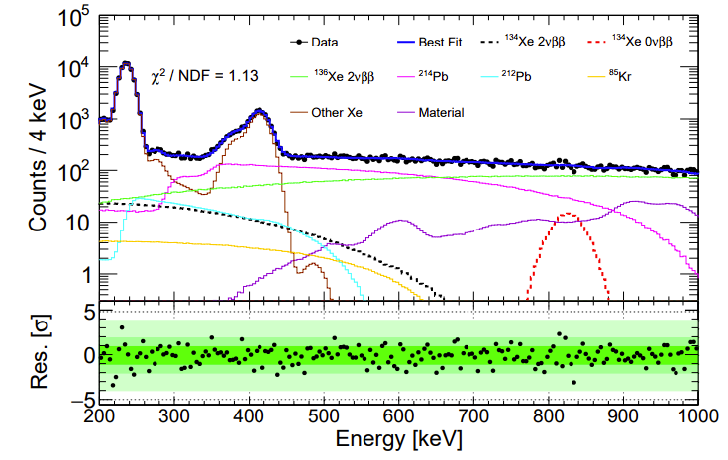
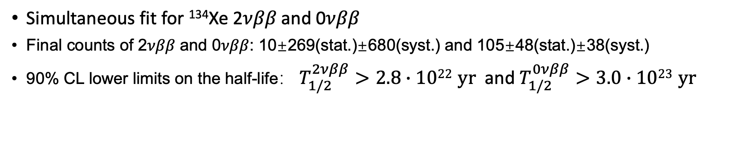
¹³⁴Xe half-life limits @ PandaX-4T
Simultaneous fit for ¹³⁴Xe 2𝜈𝛽𝛽 and 0𝜈𝛽𝛽
Final counts of 2𝜈𝛽𝛽 and 0𝜈𝛽𝛽: 10±269(stat.)±680(syst.) and 105±48(stat.)±38(syst.)
90% CL lower limits on the half-life： $T_{1/2}^{2νββ}>2.8∙1022 yr$ and $T_{1/2}^{0νββ}>3.0∙1023 yr$
 | Sources | 2𝜈𝛽𝛽 [counts] | 0𝜈𝛽𝛽 [counts]
Statistical |  | 269 | 48
 | Target mass | - | -
 | Efficiency | 119 | 10
 | Energy resolution | - | -
Systematic | Background | 521 | 19
 | Bin size | 85 | 13
 | Energy scale | 410 | 28
 | Total | 680 | 38
Likelihood
Function
Manually
PandaX, Phys.Rev.Lett. 132 (2024) 15, 152502

Slide 36
3D Position
Energy
Time
LXe
TPC

Slide 37
Coincidence
Particle ID
Fiducialization
SS/MS
ER/NR
3D Position
Energy
Time
LXe
TPC

Slide 38
Nuclear decay
Multi-Messenger
Exotic 𝜈 property
Other DM
Solar 𝜈
WIMP
Majorana 𝜈
Coincidence
Particle ID
Fiducialization
SS/MS
ER/NR
3D Position
Energy
Time
LXe
TPC

Slide 39
Nuclear decay
Multi-Messenger
Exotic 𝜈 property
Other DM
Solar 𝜈
WIMP
Majorana 𝜈
Coincidence
Particle ID
Fiducialization
SS/MS
ER/NR
3D Position
Energy
Time
LXe
TPC
Larger
Cleaner
Detector

Slide 40
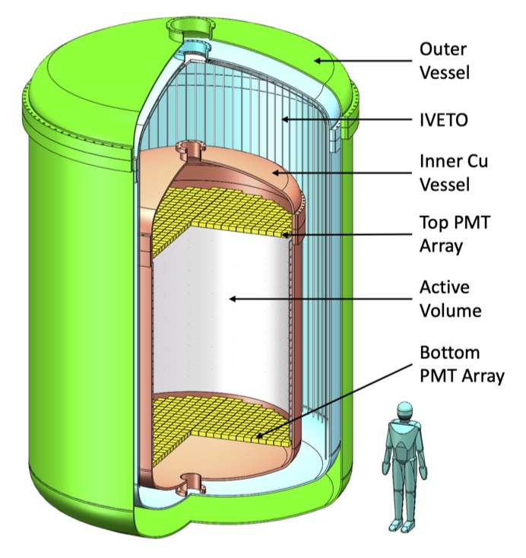
PandaX-xT: Multi-ten-tonne Liquid Xenon Observatory
Active target: 43 ton of Xenon
  Decisive test to the WIMP paradigm
  Explore the Dirac/Majorana nature of neutrino
  Search for astrophysical or terrestrial neutrinos and other ultra-rare interactions
Notable improvements:
  High-granularity, low-background 2-in PMT array
  Cu/Ti vessel for improved radiopurity
  Inner liquid scintillator veto
arXiv:2402.03596

Slide 41
PandaX-xT: Multi-ten-tonne Liquid Xenon Observatory
Active target: 43 ton of Xenon
  Decisive test to the WIMP paradigm
  Explore the Dirac/Majorana nature of neutrino
  Search for astrophysical or terrestrial neutrinos and other ultra-rare interactions
Notable improvements:
  High-granularity, low-background 2-in PMT array
  Cu/Ti vessel for improved radiopurity
  Inner liquid scintillator veto + outer water veto
arXiv:2402.03596

Slide 42
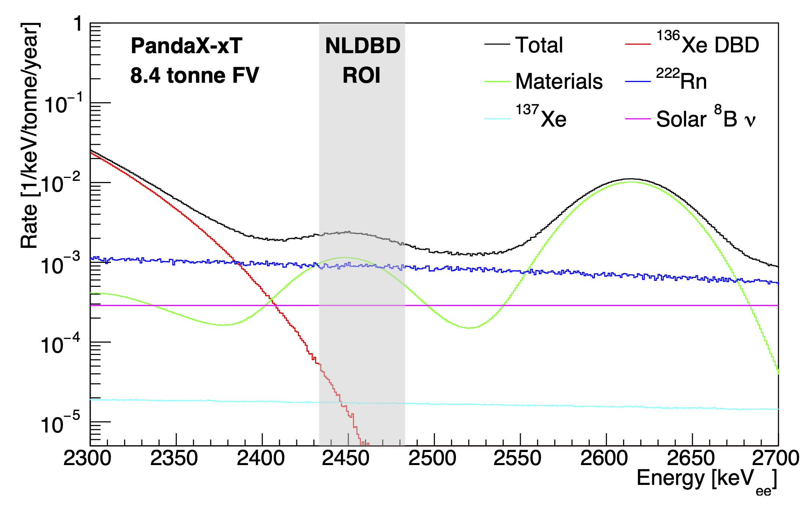
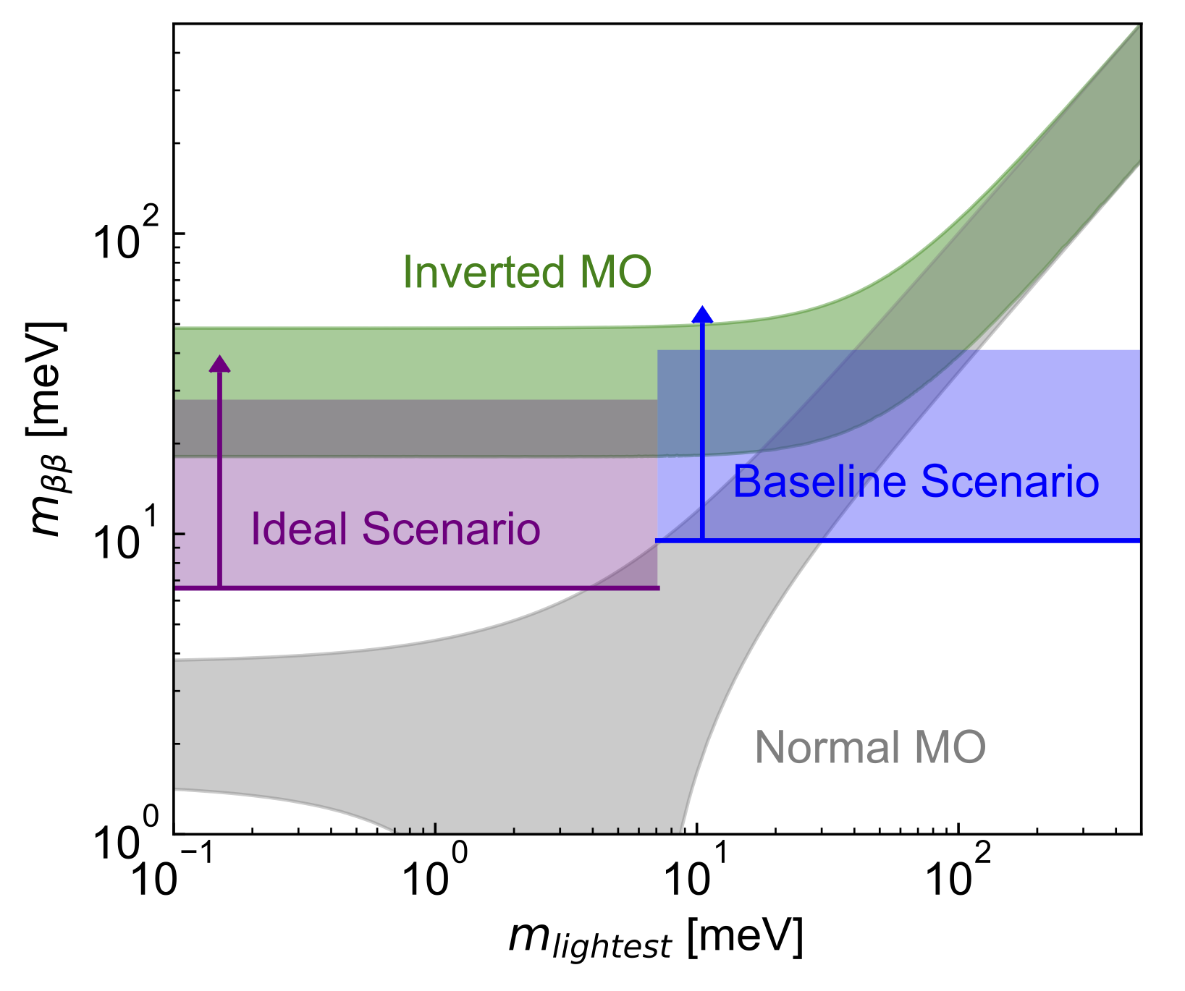
PandaX-xT for 0νββ
4 ton of ¹³⁶Xe: one of the largest 0νββ experiments
Effective self-shielding: Xenon-related background dominates in the 8.4-tonne center FV
41 meV
10 meV

Slide 43
Head-to-head with other DM/0νββ experiments
 | Bkg rate (/keV/ton/y) | Energy resolution | Mass (ton) | Run time | Sensitivity/Limit (90% CL, year)
PandaX-4T | 6 | 1.9% | 4 | 94.9 days | > 10²⁴
XENONnT | 1 | 0.8% | 6 | 1000 days (expected) | 2 × 10²⁵
LZ | 0.3 | 1% | 7 | 1000 days (expected) | 1 × 10²⁶
KamLAND-ZEN | 0.002 | 5% | 0.8 (¹³⁶Xe) | 1.5 years | 2.3 × 10²⁶
nEXO | 0.006 | 1% | 5 (¹³⁶Xe) | 10 years | 1.35 × 10^{28 **}
DARWIN | 0.004* | 0.8% | 40 | 10 years | 2 × 10²⁷
PandaX-xT | 0.002* | 1% | 43 | 10 years | 3⨉10²⁷
* Major difference from cosmogenic ¹³⁷Xe; ** $\frac{S}{\sqrt{B}}$sensitivity is 6⨉10²⁷ yr, for detector performance comparison in the table.

Slide 44
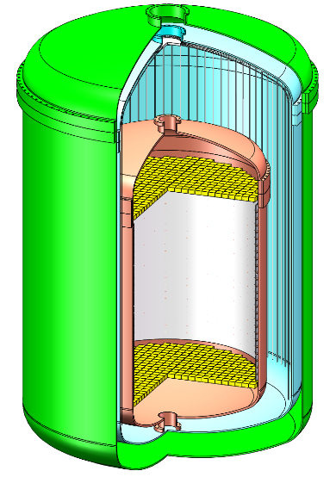
Possible isotope seperation/enrichment
Xenon with artificially modified isotopic abundance (AMIA) for smoking gun discovery
  A split of odd and even nuclei
  Further enrichment of ¹³⁶Xe
  to improve sensitivity to spin-dependence of DM-nucleon interactions and 0νββ
AMIA1
AMIA2

Slide 45
Neutrino and nuclear physics program at PandaX
氙-136 2νββ
以及 0νββ
氙-134 2νββ
以及 0νββ
氙-124
2νDEC
氙-124 0νDEC
太阳 ⁸B
中微子
WIMP 等
暗物质信号
太阳 pp
中微子
核物理：贝塔能谱精确测量、稀有核衰变等
keV
10 keV
100 keV
1 MeV
Re-think the LXe TPC as a Total-Absorption 5D Calorimeter
Fully exploit the entire energy range of LXe TPC
Fully utilize the multiple isotopes of natural xenon for rich physics

Slide 46

Thank you very much
We welcome new collaborators at PandaX-xT

Slide 47
Wide E range, multiple “interesting” isotopes for neutrino
氙-136 2νββ
以及 0νββ
氙-134 2νββ
以及 0νββ
氙-124
2νDEC
氙-124 0νDEC
太阳 ⁸B
中微子
WIMP 等
暗物质信号
太阳 pp
中微子
核物理：贝塔能谱精确测量、稀有核衰变等
keV
10 keV
100 keV
1 MeV

Slide 48
PandaX LXe TPC: Total-Absorption 5D Calorimeter
氙-136 2νββ
以及 0νββ
氙-134 2νββ
以及 0νββ
氙-124
2νDEC
氙-124 0νDEC
太阳 ⁸B
中微子
WIMP 等
暗物质信号
太阳 pp
中微子
核物理：贝塔能谱精确测量、稀有核衰变等
keV
10 keV
100 keV
1 MeV

Slide 49
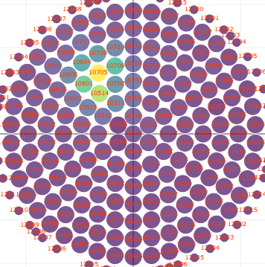
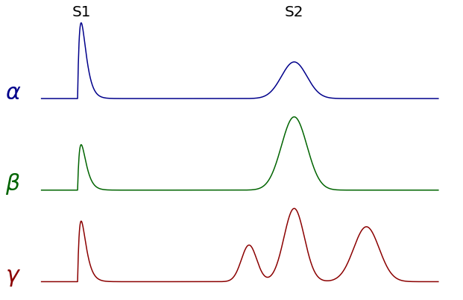
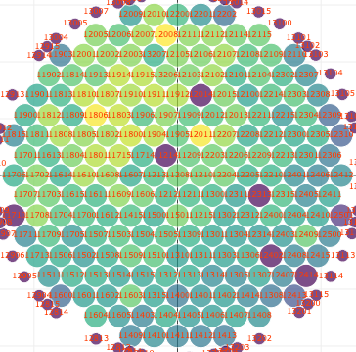
PandaX LXe TPC: Total-Absorption 5D Calorimeter
Precisely measure 3D position, energy, and timing information in the energy range from sub-keV to 10MeV
Large monolithic volume: total absorption; ~20 x MeV ɣ attenuation length
Single-site (SS) and multi-site (MS) event for event topology and particle ID
SS
MS

Slide 50
Why ²¹⁴Pb beta decay spectra are critical for LXe detectors?
Internal background from ²²²Rn, can not be removed except distillation
The spectral shape strongly influence s fits at MeV level (2.0% contribution to 2νββ half-life uncertainty)
The featureless spectrum directly determines the physics sensitivity at 1-100 keV level
Fang, Li, et al
PandaX-4T 2νββ fit
More realistic 2νββ spectrum
PandaX-xT, assuming 0.5 μBq/kg ²²²Rn

Slide 51
²¹⁴Pb beta decay spectra are complicated
Branching ratio is not precisely known
Shape calculation is not exact
2.7257 | 2.75 | 2.75
45.495 | 44.5(7) | 45.9
39.845 | 39.0(5) | 40.2
10.903 | 12.7(9) | 11.0
Geant4 | NNDC NDS2021 | NDS 2009
DDEP
Haselschwardt et al. PRC 102, 065501 (2020) with NDS 2009 br.

Slide 52
Motivation

Slide 53
Beta
Spectra
From
Marlom,
Suhonen

Slide 54
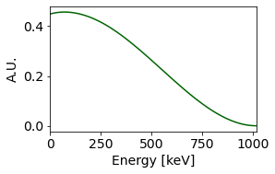
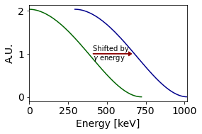
PandaX-4T for beta decay measurement
To G.S.: 𝛽 only
To E.S.: 𝛽 + 𝛾
𝛾
β
β
𝛾

Slide 55
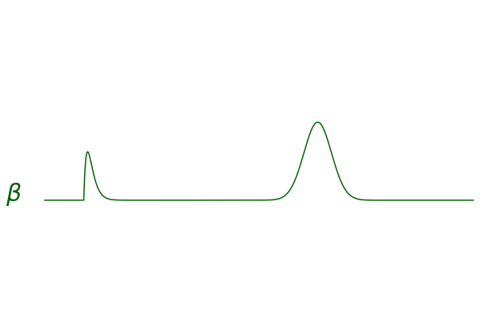
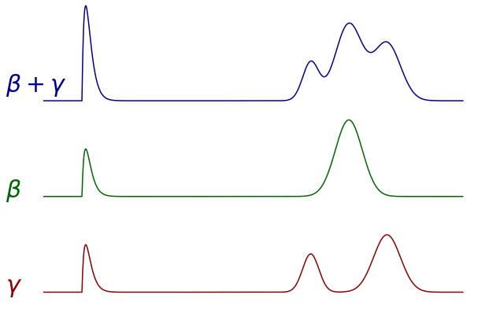
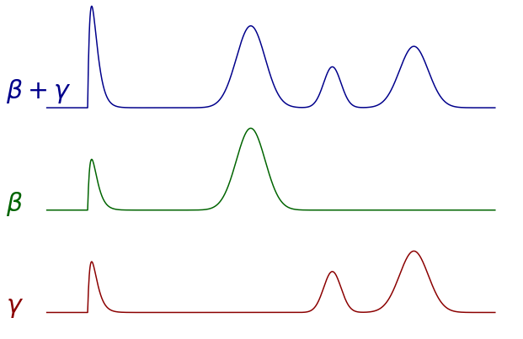
single- and multiple-site events
SS
SS
MS
𝛾
β
β
𝛾
β

Slide 56
PandaX-4T ²¹⁴Pb data from ²²²Rn calibration
ILLUSTRATION

Slide 57
PandaX-4T ²¹⁴Pb data from ²²²Rn calibration
ILLUSTRATION

Slide 58
PandaX-4T ²¹⁴Pb data from ²²²Rn calibration
ILLUSTRATION

Slide 59
PandaX-4T ²¹⁴Pb data from ²²²Rn calibration
ILLUSTRATION

Slide 60
PandaX-4T ²¹⁴Pb data from ²²²Rn calibration
ILLUSTRATION

Slide 61
PandaX LXe TPC: Total-Absorption 5D Calorimeter
Precisely measure 3D position, energy, and timing information in the energy range from sub-keV to 10MeV
Large monolithic volume: total absorption; ~20 x MeV ɣ attenuation length
Single-site (SS) and multi-site (MS) event for event topology and particle ID
SS
MS

Slide 62
Competitive in other neutrino physics topics as well
Coherent scattering of solar ⁸B neutrino: from a first observation in LXe TPC to precision measurement
Electron scattering of solar pp neutrino: competitive precision at a wider energy range
Neutrinos with abnormal magnetic moments: a better sensitivity than astrophysical observations
SNO 2013
SSM (HZ)
SSM (LZ)
PandaX-xT
200 t-y
arXiv:2402.03596

Slide 63
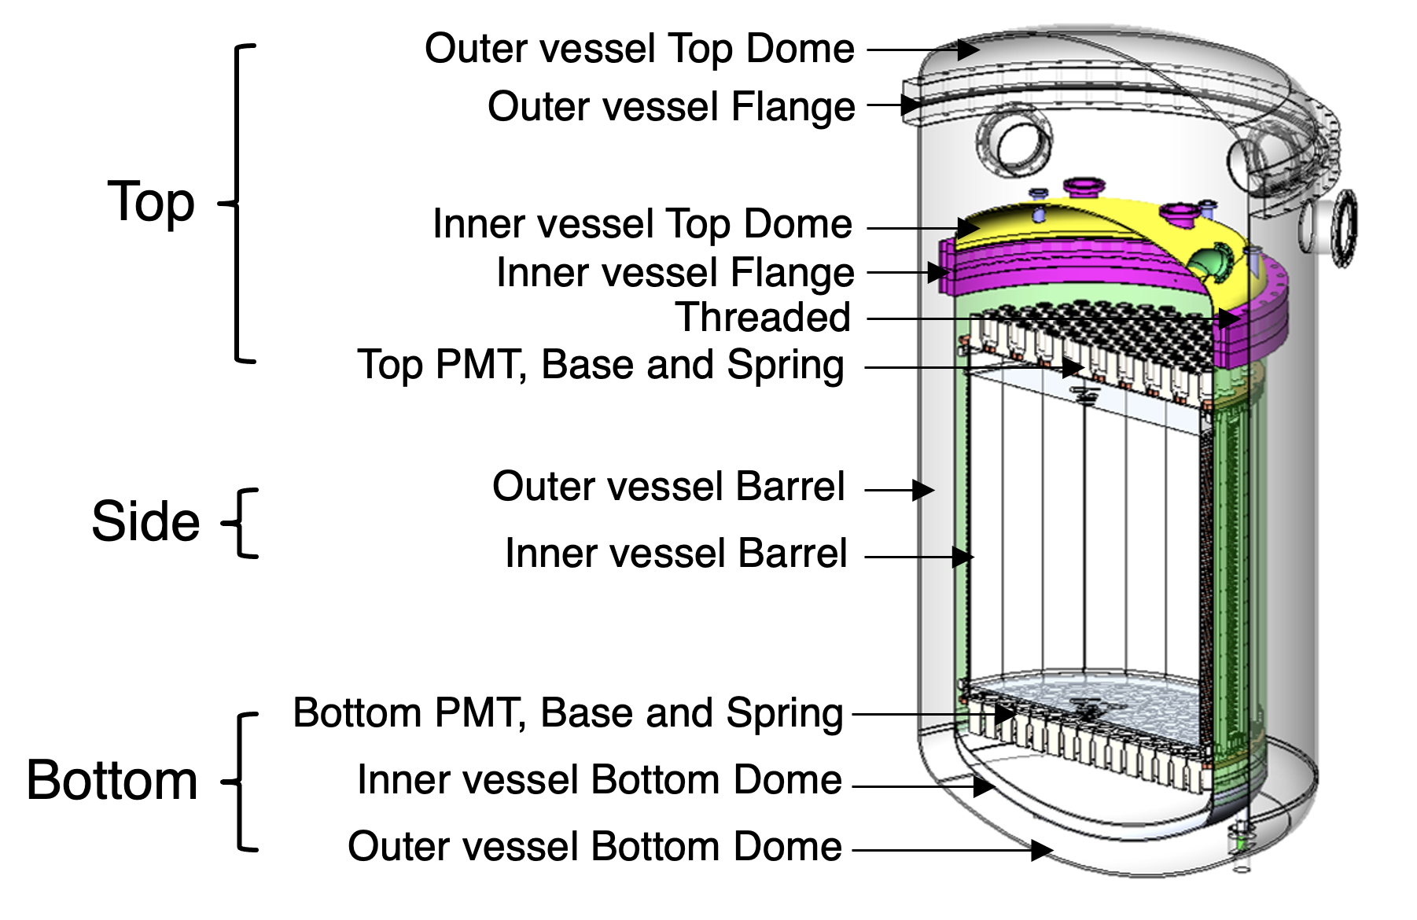
More accurate background models
Better than the input values based on HPGe assay results and high energy alpha events

Slide 64
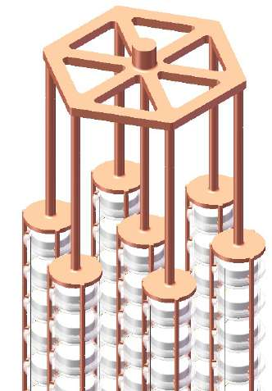
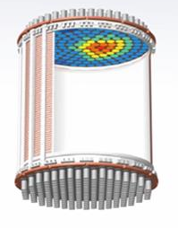
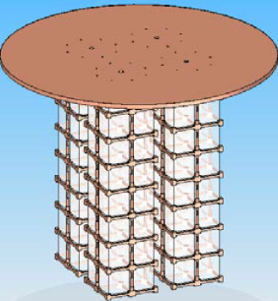
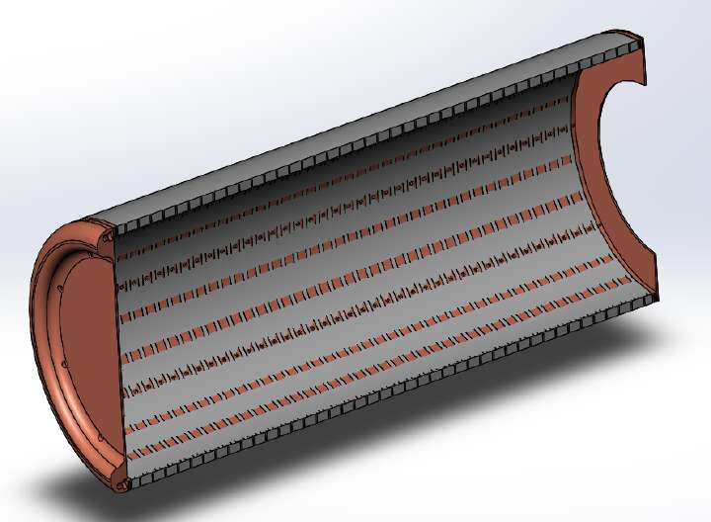
Expected 0νββ experiments at CJPL-II
PandaX
Xe TPC
CUPID-China
Bolometer
CDEX
HPGe
NνDEx
Ion TPC

Slide 65
Nuclear Data Sheets 175, 1 (2021) NNDC
E.S. to G.S. decay is not necessarily through a single gamma. May bring more complication to SS/MS discrimination.
Unclear what caused the change from 2009 to 2021

Slide 66
What parameters may determine the spectrum shape?
Measured Q-value of the decay (and levels of E.S.)
Measured Branching ratio
g_{A}
eMEC (mesonic enhancement current, which only affect DeltaJ=0, thus only the 0+ to 0- decay)
sNME (Small Relativistic Vector NME)
  Numerically branching ratio = A* sNME² + B*sNME + C
  Therefore for each branching ratio, there are two possible sNME values.
atomic Exchange effect (from PRC 2020 paper), not discussed in recent emails

Slide 67
What combination has been calculated?
Measured Q-value of the decay (and levels of E.S.): All the values from databases; different databases differ by 0.1%. Those are regarded as constants for now. (interests in measuring this)
Measured Branching ratio
  PRC 2020 paper used NDS2009 branching ratios
g_{A} =0.85
eMEC = 2.423 (changed a few times, go with B.R.)
sNME
2.7257 | 2.75 | 2.75
45.495 | 44.5(7) | 45.9
39.845 | 39.0(5) | 40.2
10.903 | 12.7(9) | 11.0
Geant4 | NNDC NDS2021 | NDS 2009
Decay States | sNME 1 | sNME 2
G.S. 11.0 | -0.1144661 | -0.0120148 (PRC 2020)
G.S. 12.7 | -0.1182289 | -0.0076773
E. S. 39.0 | -0.4404444 | -0.0890288

Slide 68
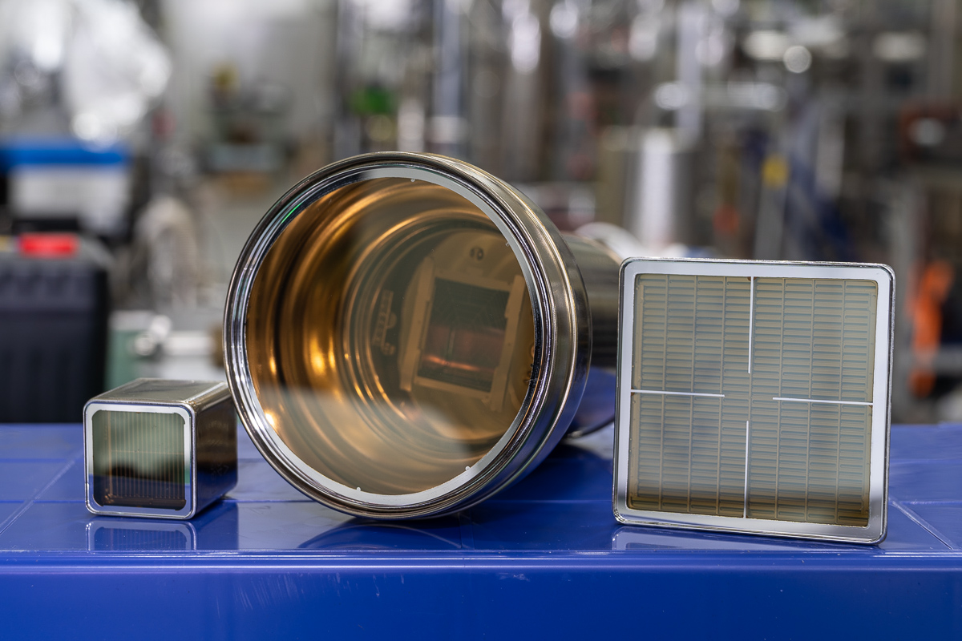
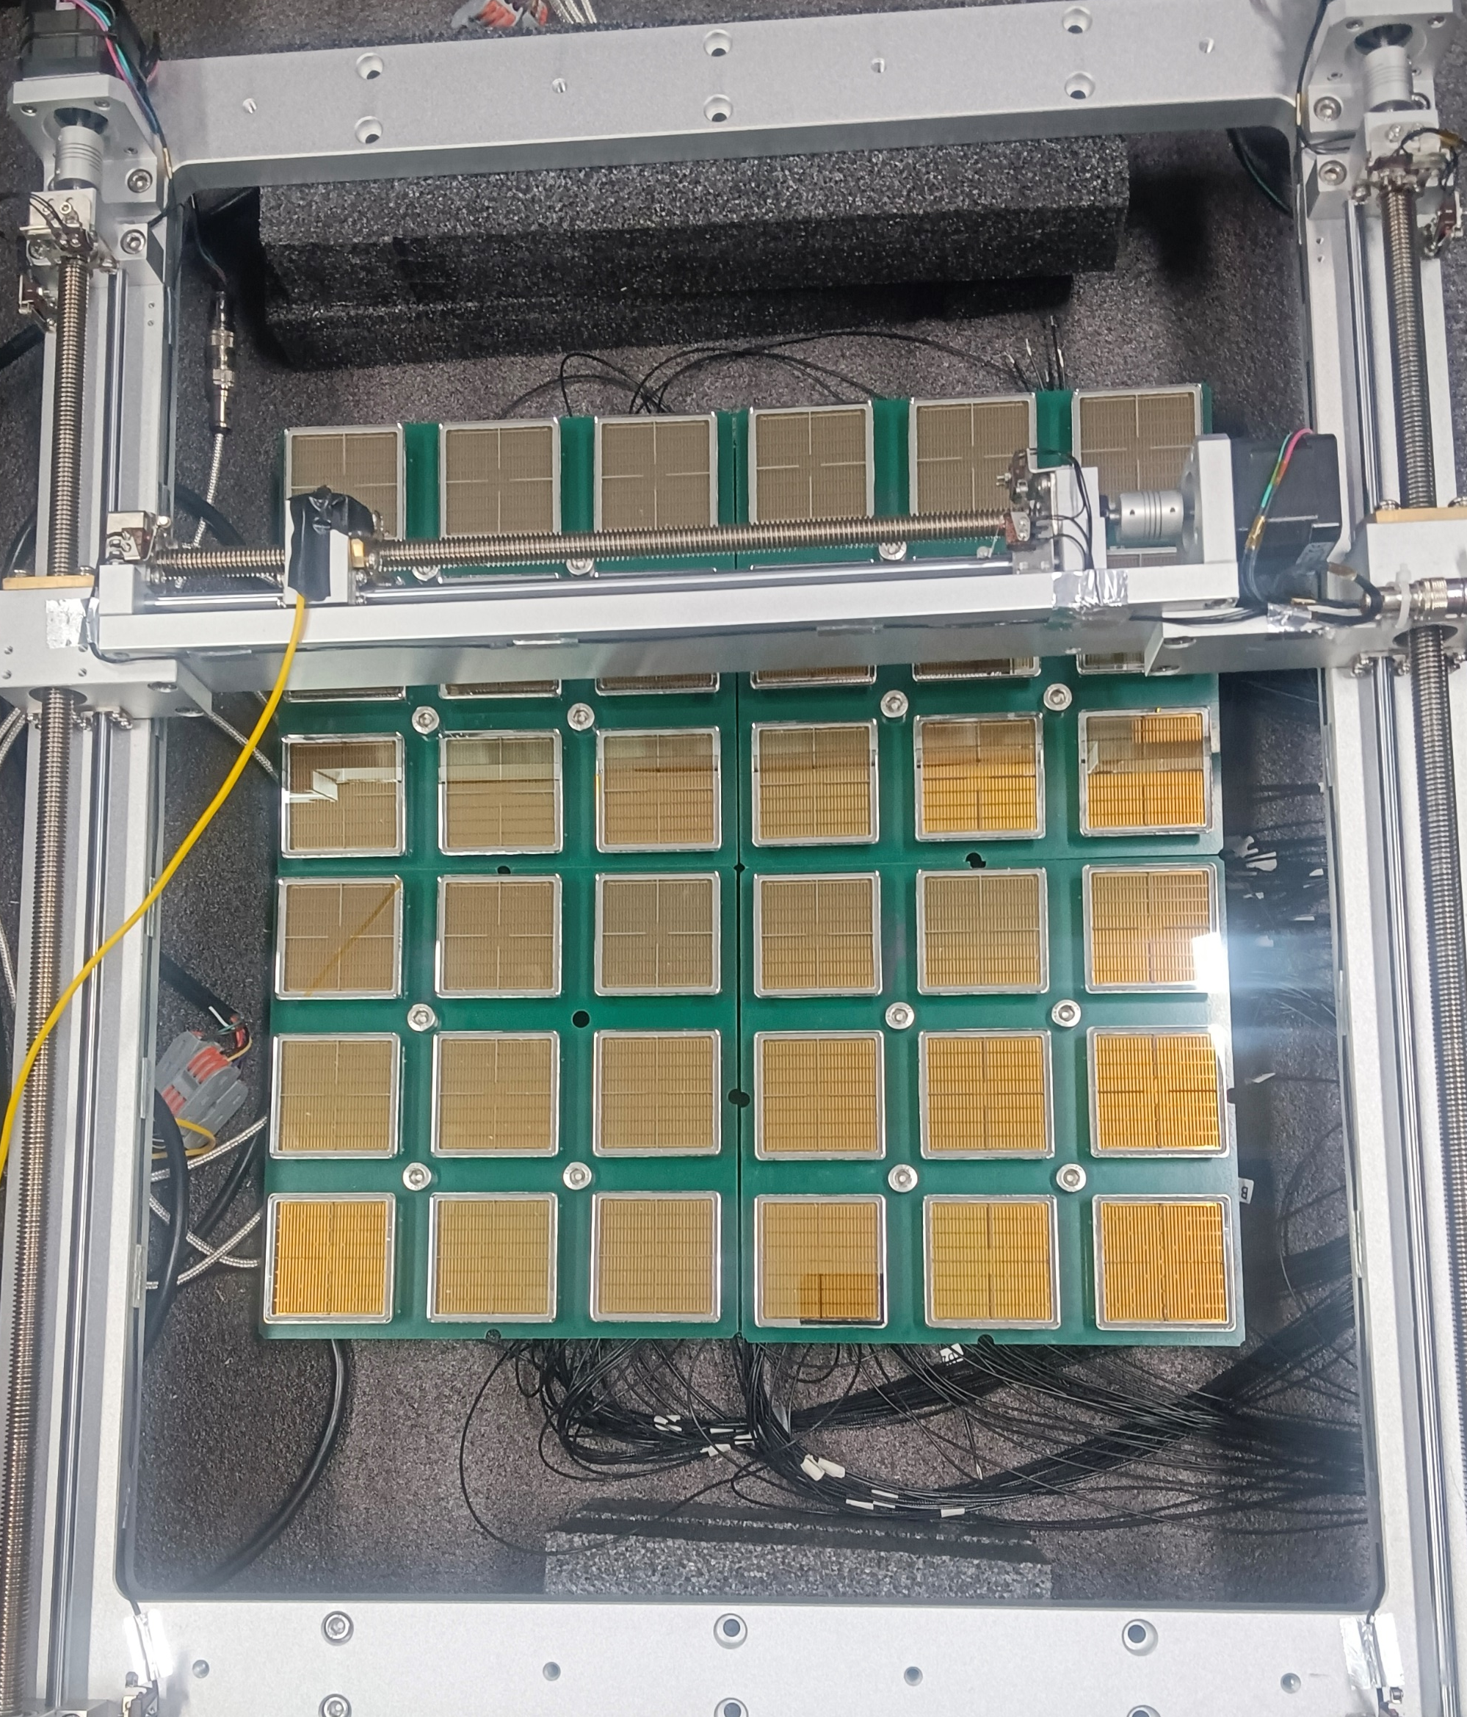
New 2” multi-anode R12699 PMT for LXe TPC
Higher granularity while maintaining low dark noise: best of both large PMT and SiPM
  Improved position reconstruction for better event topology
  2” array has an effectively wider dynamic range for DM and 0νββ simultaneously
  Faster timing for possible pulse shape analysis or Cerenkov/Scintillation separation
Collaboration between PandaX and Hamamatsu for a low-radioactivity version of R12699
R8520 R11410 R12699
Conceptual array for a PandaX-4T-sized TPC

Slide 69
