Slide 1

中国科学院高能物理研究所
Institute of High Energy Physics, CAS
CEPC Detector Magnet Ref TDR
Physical Design of Magnet V2.0
Feipeng NING
2024.04

Slide 2

Outline
Magnet parameters;
Magnetic field uniformity;
Cooling system comparison;
Yoke and stray field;
Questions
Notes:
Two changes: first, add yoke to reduce the range of stray field; second, the size of HCal increase, so size of the solenoid and the yoke increase accordingly.

Slide 3
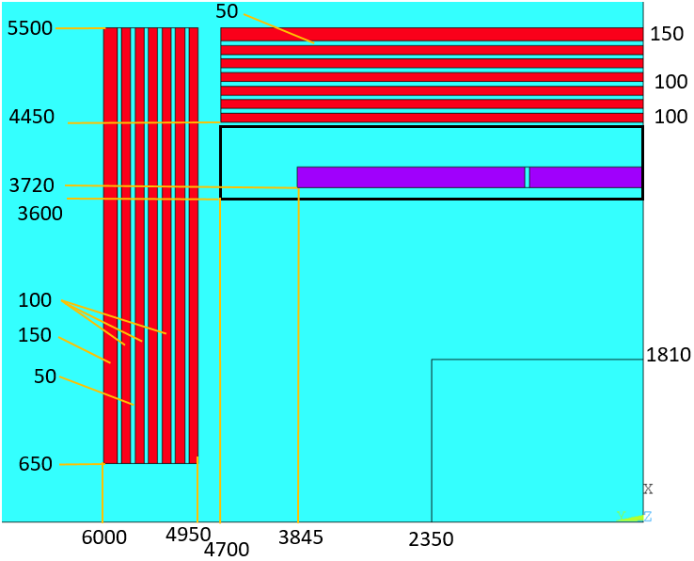
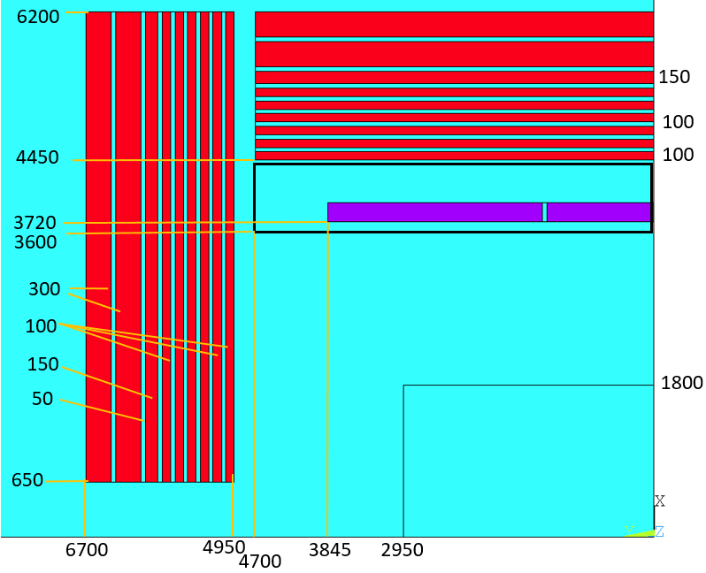
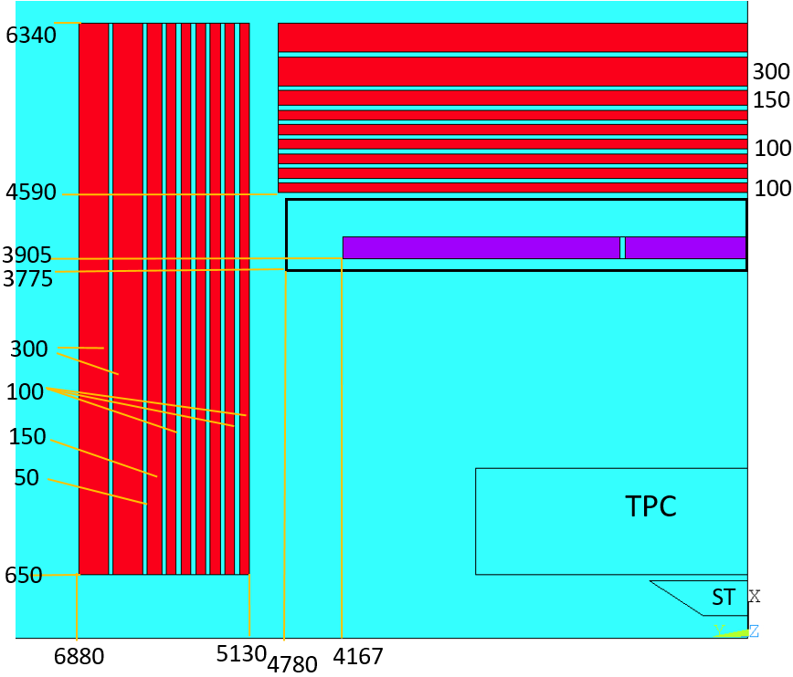
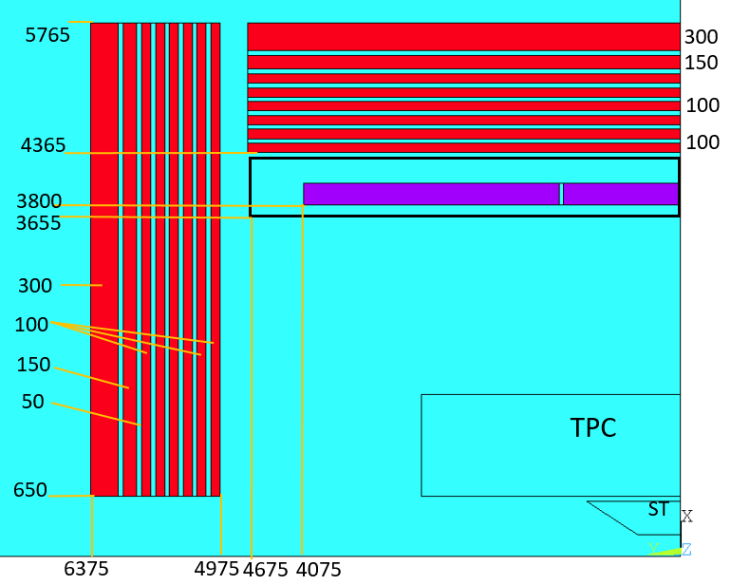
1. Magnet parameters
Magnet Interface：
V1.0
V1.1
V1.2
V2.0
Reduce the range of stray field
HCal size increased
Several parameters have changed:
 | V1.0 | V1.1 | V1.2 | V2.0
Yoke mass (ton) | 3000 | 6150 | 6424 | 4323
Size (Diameter*length, unit m²) | 11*12 | 12.4*13.4 | 12.68*13.76 | 11.53*12.75
Notes:
Two changes: first, add yoke to reduce the range of stray field; second, the size of HCal increase, so size of the solenoid and the yoke increase accordingly.

Slide 4
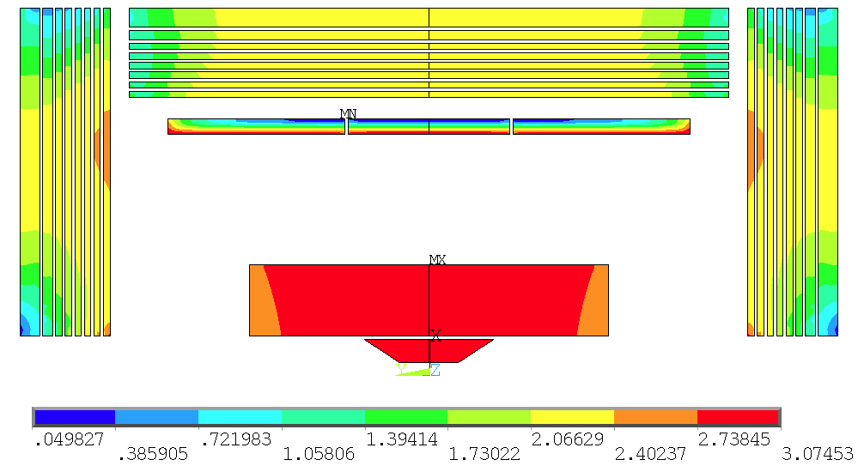
1. Magnet parameters
Magnet Interface：
Central field (T) | 3.0
Operating current (A) | 17052
Inductance | 11.63
Stored energy (GJ) | 1.6912
Total Weight (ton) | About 230
Several parameters have changed:
Yoke mass (ton) | 4323
Size (Diameter*length, unit m²) | 11.53*12.75
Notes:
Two changes: first, add yoke to reduce the range of stray field; second, the size of HCal increase, so size of the solenoid and the yoke increase accordingly.

Slide 5
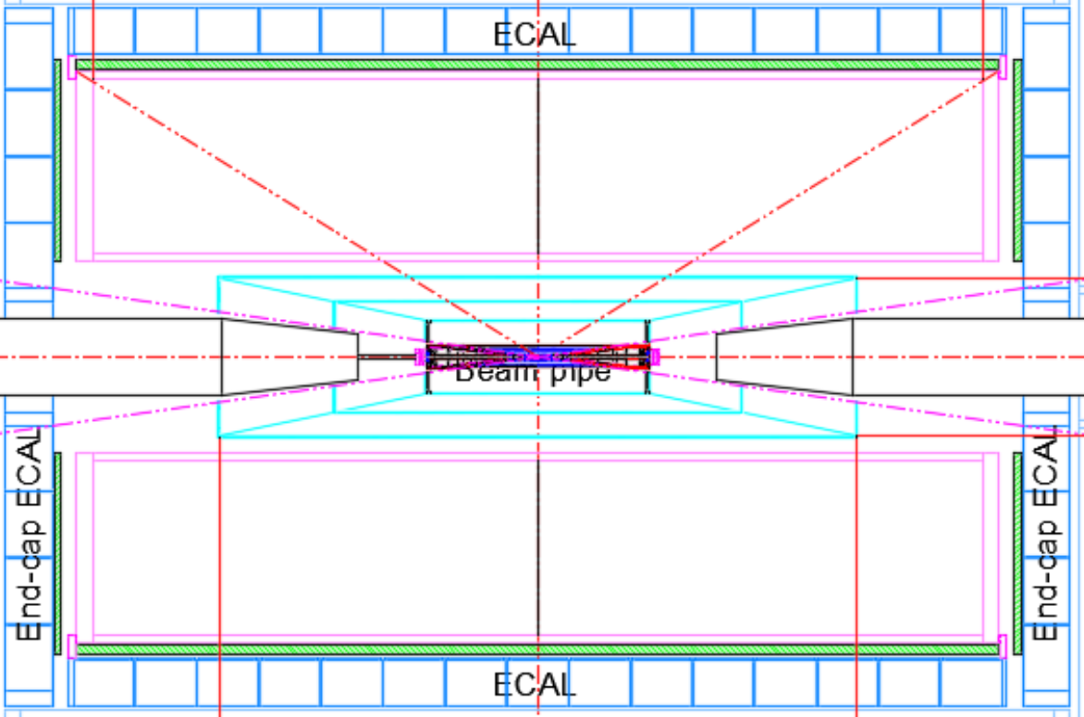
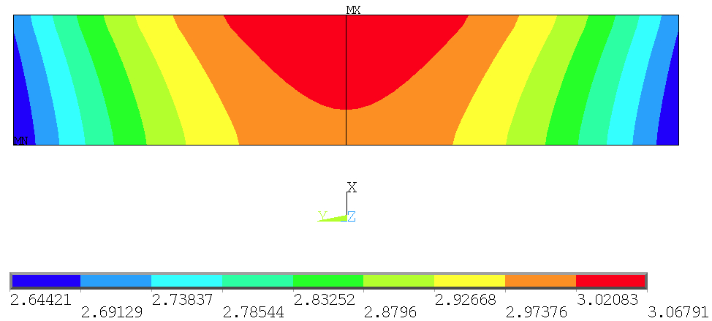

2. Magnetic field distribution
Magnetic field distribution of the TPC:
TPC area size：
Inner diameter: 1200mm, outer diameter: 3600mm，Length: 5800mm；
Dimensions after removing support structures ： Inner diameter: 1300mm, outer diameter: 3500mm，Length: 5600mm
Bmax=3.07453
Bmin=2.61418
Bmax-Bmin =0.4603
Peak-Peak non-uniformity:
$B_{p}=\frac{B_{max}−B_{min}}{B_{center}}$ = 15.3%

Slide 6
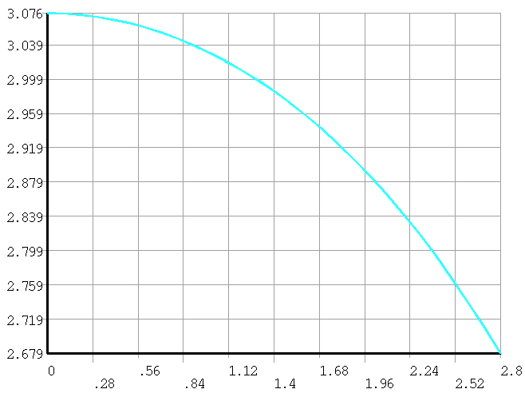
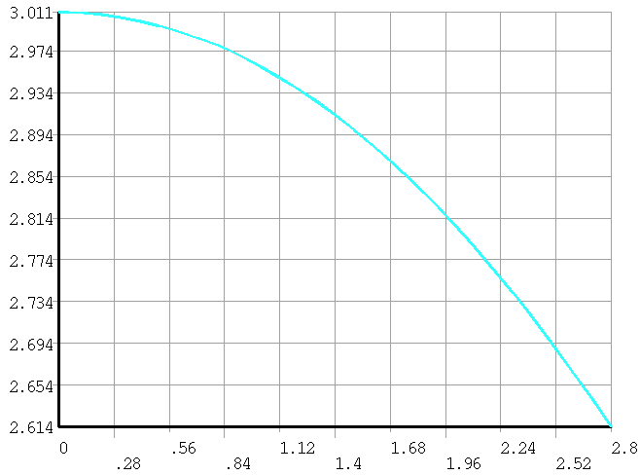
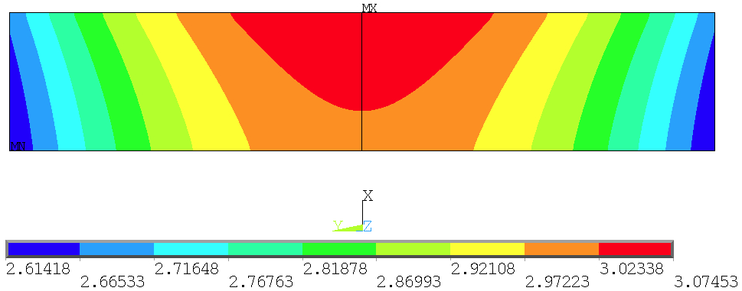
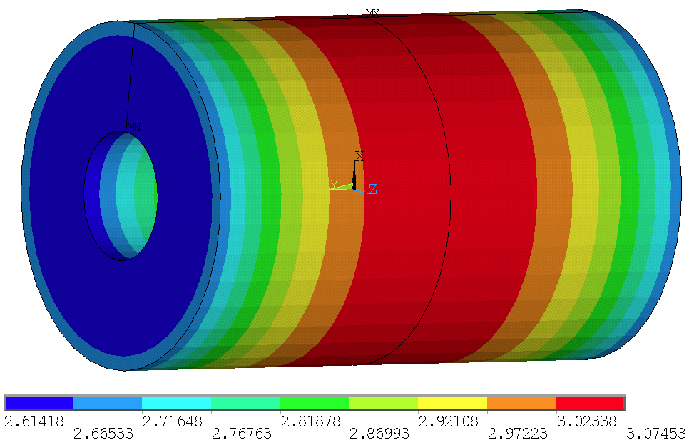
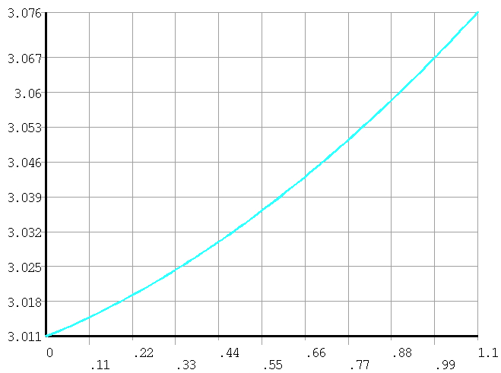
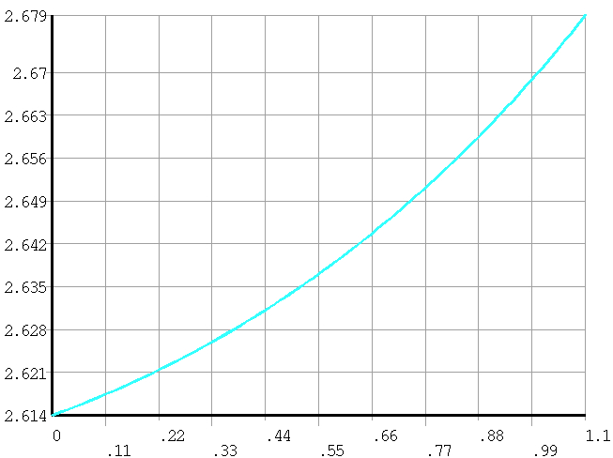
2. Magnetic field distribution
Magnetic field distribution of the TPC:
The field uniformity of the TPC is not bad.
1
1
2
3
4
△B=0.397 T
△B=0.397 T
2
2.8
2.8
3
4
△B=0.065 T
△B=0.065 T
1.1
1.1

Slide 7
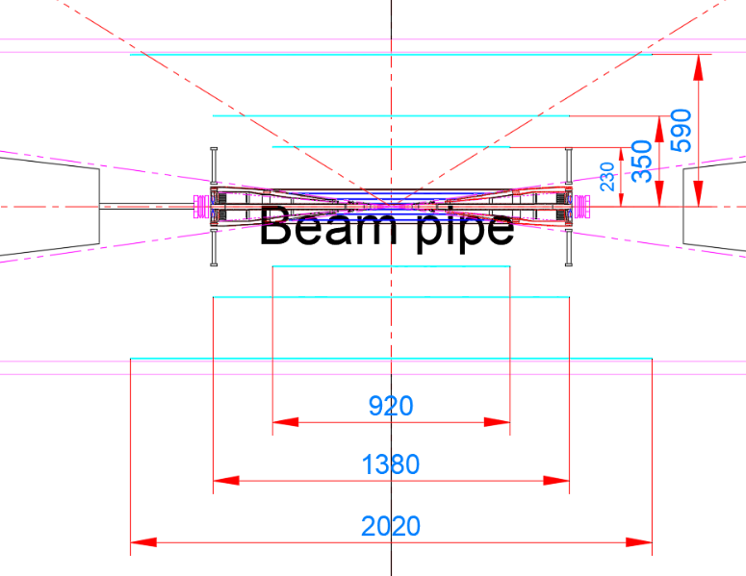
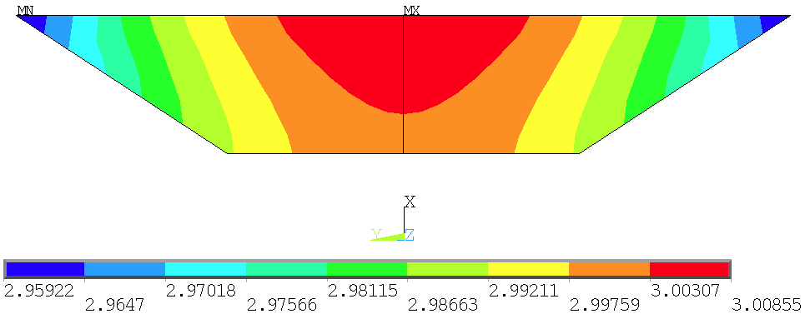
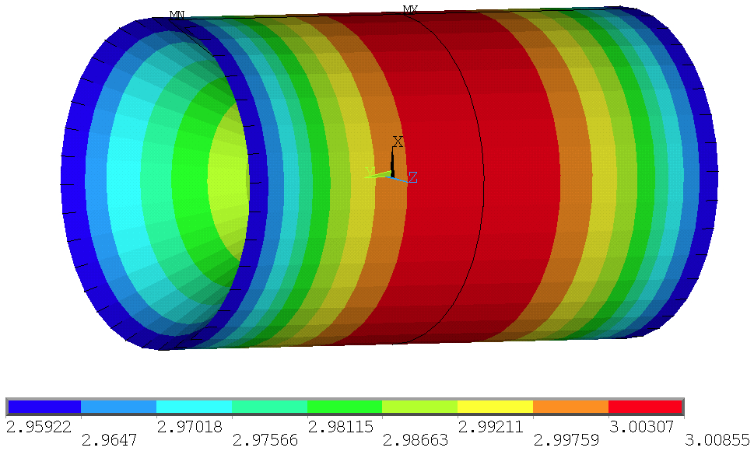

2. Magnetic field distribution
Magnetic field distribution of the Silicon Tracker:
ST area size：
Inner diameter: 230mm, outer diameter: 590mm，
Inner length: 920mm, outer length: 2020mm
Bmax= 3.00855
Bmin = 2.95922
Bmax-Bmin= 0.04933
Peak-Peak non-uniformity:
The uniformity of the ST is very good.
$B_{p}=\frac{B_{max}−B_{min}}{B_{center}}$ = 1.64%

Slide 8
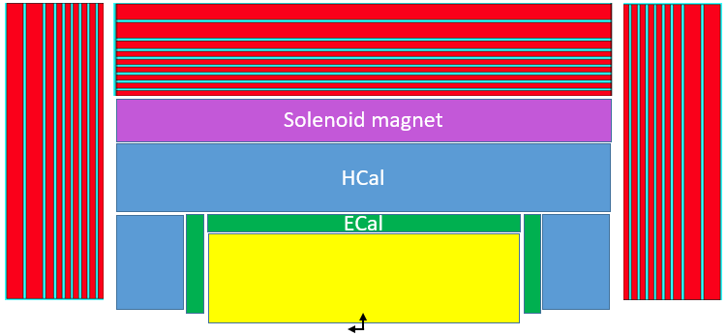
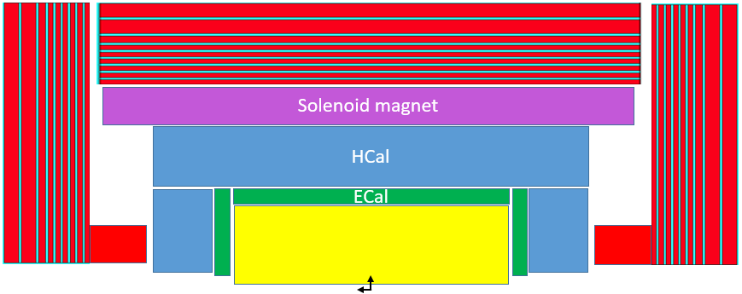
Optimization methods:
2. Optimize the uniformity of Tracking volume
Add pole head；
Extend the coil and add compensation coils:
Improve the accuracy of magnetic field mapping, New measurement methods and approaches:
  Step length: 1 mm - 10 μm;
  Measurement accuracy: Maybe 0.01%

Slide 9
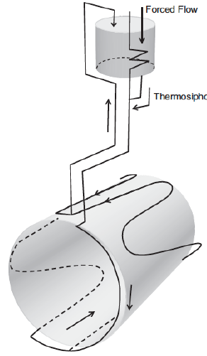
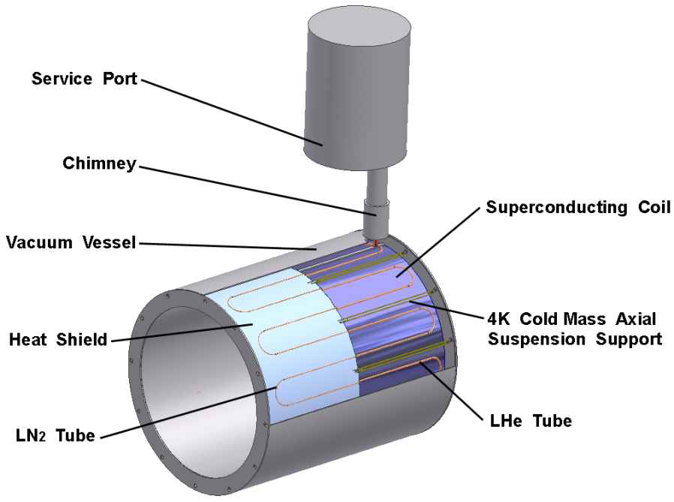
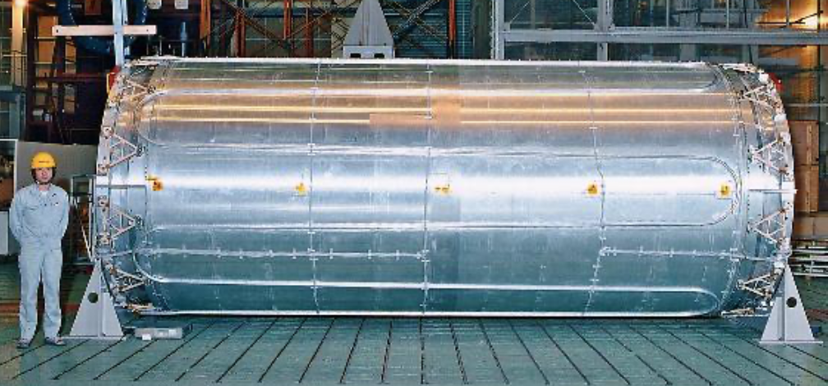
Cooling methods: forced flow
3. Cooling system
Need radial thickness: at least 600mm

Slide 10
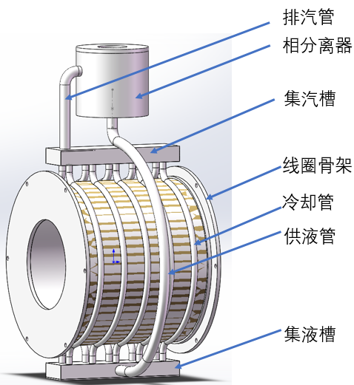
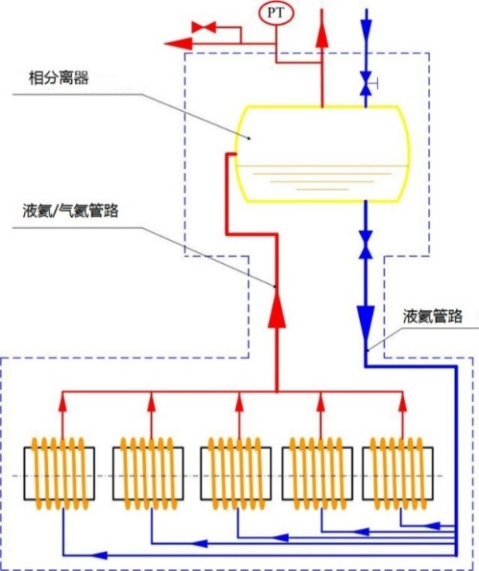
Cooling methods: thermal siphon
3. Cooling system
Need radial thickness: at least 700mm

Slide 11
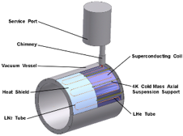

3. Cooling system
 | 迫流冷却方案 | 热虹吸方案 √
尺寸及结构 | 厚度600mm 需要头尾各一个相分离器 | 厚度700mm 仅需要一个顶部相分离器，但占据顶部空间
性能 | 供液能力和压降：依赖于源头压力提供供液能力，且与管道长度和布置方式挂钩，一般情况下只能提供约0.2-0.3bar的压力，若采用三管布置（10*20mm2，每根管长125m），大约能够提供16.7g/s液氦流量，每段压降也有0.147bar； 换热能力：对流换热，412.1W/m² | 供液能力强：提供相当于52.2g/s液氦流量的冷却能力； 压降：热虹吸方案靠重力自驱动，几乎不存在迫流冷却中的压降问题； 换热能力：相变换热，1200W/m²
优势 | 体积小，结构紧凑，相关迫流冷却的实验数据和计算方法丰富，计算较为准确 | 换热系数高，不用受到源头压力和压降的限制，且技术相对成熟，有CMS的成功经验，
劣势 | 冷却能力受压降限制，无法提供很大流量，而若采用多股流并联的方法降低压降，则会产生流量分配问题 | 需要在顶部增设相分离器，导致体积更大；目前在热虹吸方面没有加工和测试经验，需要积累实验数据
COST

Slide 12
Stray field:
4. Yoke and stray field
CMS: Generally speaking, the stray field has been found, in the vicinity of the barrel element separations, and at about 1 m distance from the last iron layer, to be of the order of 0.12 T. This is the area in which some electronic racks will be installed in close proximity on balconies fixed to the magnet yoke, and the presence of this stray field must be fully taken into account from the beginning.
（轭铁上1m处磁场小于0.12T）
LHC-b: The field in the region of the photo-detectors of RICH1 is below 50 Gauss.
CEPC Booster: less than 50 Gauss.

Slide 13
4. Yoke and stray field
漏磁场对加速器的影响。
  王逗回复：Booster增强器处（IP外25m）小于50高斯，或者增强器局部屏蔽的方案。
  王毅伟回复：
    从束流光学角度，要求的原则是抵消轴向积分场，然后计算合成场的径向场影响。
    因此，IP到Q1A之前轴向积分为零，Q1A入口到Q3出口保持处处轴向为零，Q3出口到下个磁铁之前积分为零。
    Q3出口到30m的积分强度为0.4233 T*m，可以在Q3之后（约10.2m位置），挨着Q3的地方加一个短的反抵螺线管（比如1m）
    提供0-30m的螺线管-反抵螺线管的总数据，我们可以再详细计算下径向场的影响。
  随艳峰回复：束测无要求。
  金大鹏回复：加速器控制没有特别要求。

Slide 14
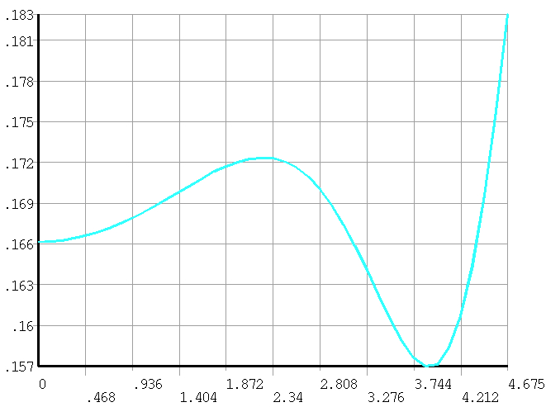
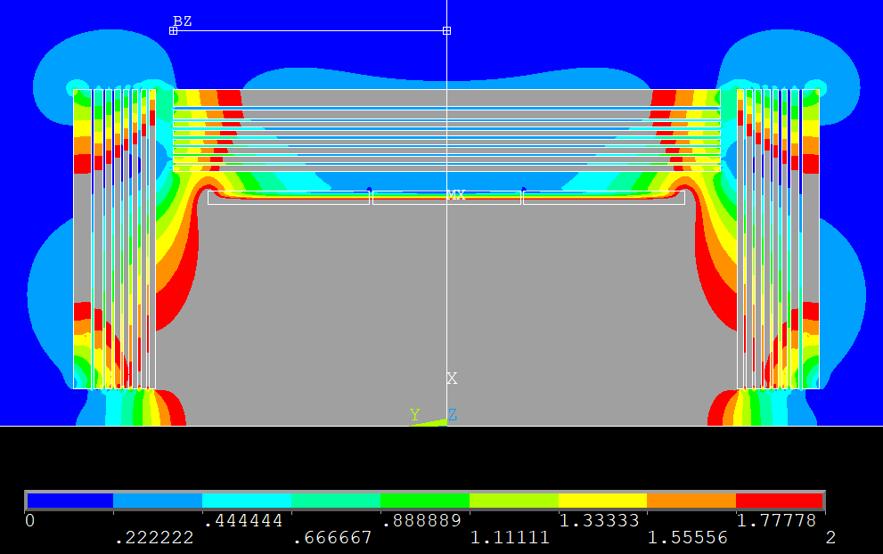
4. Yoke weight optimization
CMS: B(1m on barrel yoke) < 0.12T
At present B(1m) 0.167~0.173 T.
Do we need to optimize?

Slide 15
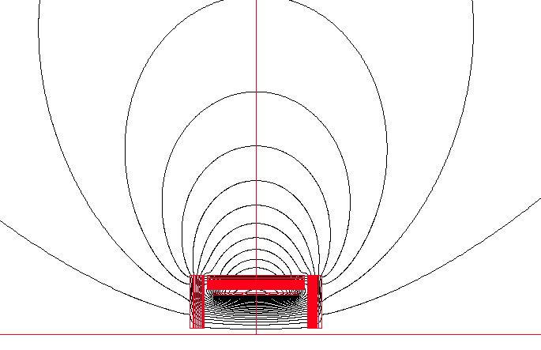
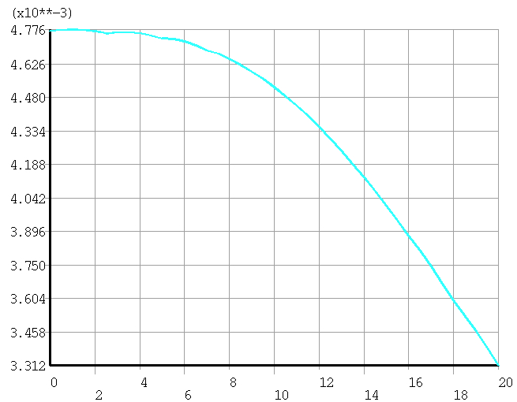
4. Stray field at the booster ring
Still meeting the requirement of less than 50 Gauss
25m
From 48 Gs to 33 Gs
The detector stray field can reach the booster and influences the beam dynamics of booster.
The current study shows that the correction to the detector stray field seems possible at low field (less than 50 gauss) level by orbit correction.
Dou Wang, Yuan Zhang, Daheng Ji, Feipeng Ning, Impacts of Detector Stray Field on Booster, AP NOTE, ACC-AP-NOTE-2020-001, Receive Date (October 15, 2020)

Slide 16
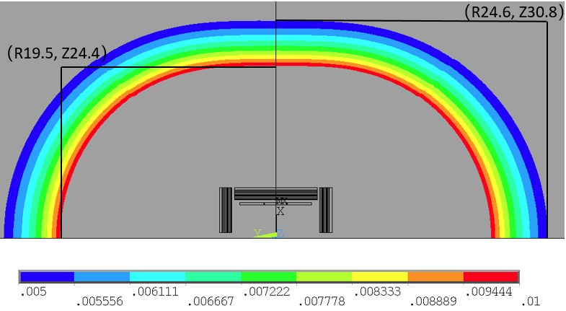
Stray field:
4. Yoke and stray field
Stray field |  | Ref TDR V1.0 | Ref TDR V1.1 | Ref TDR V1.2 | Ref TDR V2.0
50 Gs | R direction | 25.6 m | 21.5 m | 23.4 m | 24.6 m
 | Z direction | 32 m | 26.6 m | 29 m | 30.8 m
100 Gs | R direction | 20.4 m | 17.1 m | 18.6 m | 19.5 m
 | Z direction | 25.3 m | 20.9 m | 22.8 m | 24.4 m
50 Gauss and 100 Gauss distribution

Slide 17
5. Questions?
问题：
1，均匀度需不需要继续优化？
2，提高磁场测量和步长的精度是否会减小对均匀度的要求？
3，漏磁场是否需要继续优化？
Questions:
1, Do we need to continue optimizing the uniformity?
2, Will the accuracy of magnetic field measurement reduce the requirement for uniformity?
3, Do we need to continue optimizing the stray field distribution?

