Slide 1
A Request for Decision
WANG Meng 王萌
CEPC detector TDR plenary, 2024.5.7

Slide 2
on TPC vs. DC

Slide 3
performance comparison
 | unit | TPC, Higgs | TPC, Z | DC, Higgs | DC, Z
B-field | T | 3 | 2 | 3 | 2
Performance
material budget barrel | X0 | 0.55% |  | 1.14%
material budget endcap | X0 | 15% |  | plate 22.5% + cables 1.8%
Npoint of measurement/full-trk |  | 2300 | 2300 | 66 | 66
point resolution in rφ, max | μm | 100 (full) | 400 (full) | 100 | 100
point resolution in rz | μm | 100 - 500 | 200 - 800 | 2000 | 2000
momentum resolution: σ(pT)/pT = a·pT ⨁ b
a | 1/GeV | 1.2E-05 | 2.7E-05 | 2.1E-05 | 3.2E-05
b |  | 6.0E-04 | 9.0E-04 | 7.7E-04 | 1.2E-03
K/π separation power @ 20GeV |  | 3σ | 3σ | 3.2 σ | 3.2 σ
dE/dx or dN/dx resolution |  | 2.9% | 2.9% | 2.5-2.6% | 2.5-2.6%
hit rate, max | /s/pad | 600 | 31.5k |  | 70 kHz/cell
occupancy, max |  | 0.001% | 1.6% |  | 11%
note |  | pad 0.5x0.5 mm2, ch 2x3e7 |  | cell 18x18mm2, 27.6 kCells

Slide 4
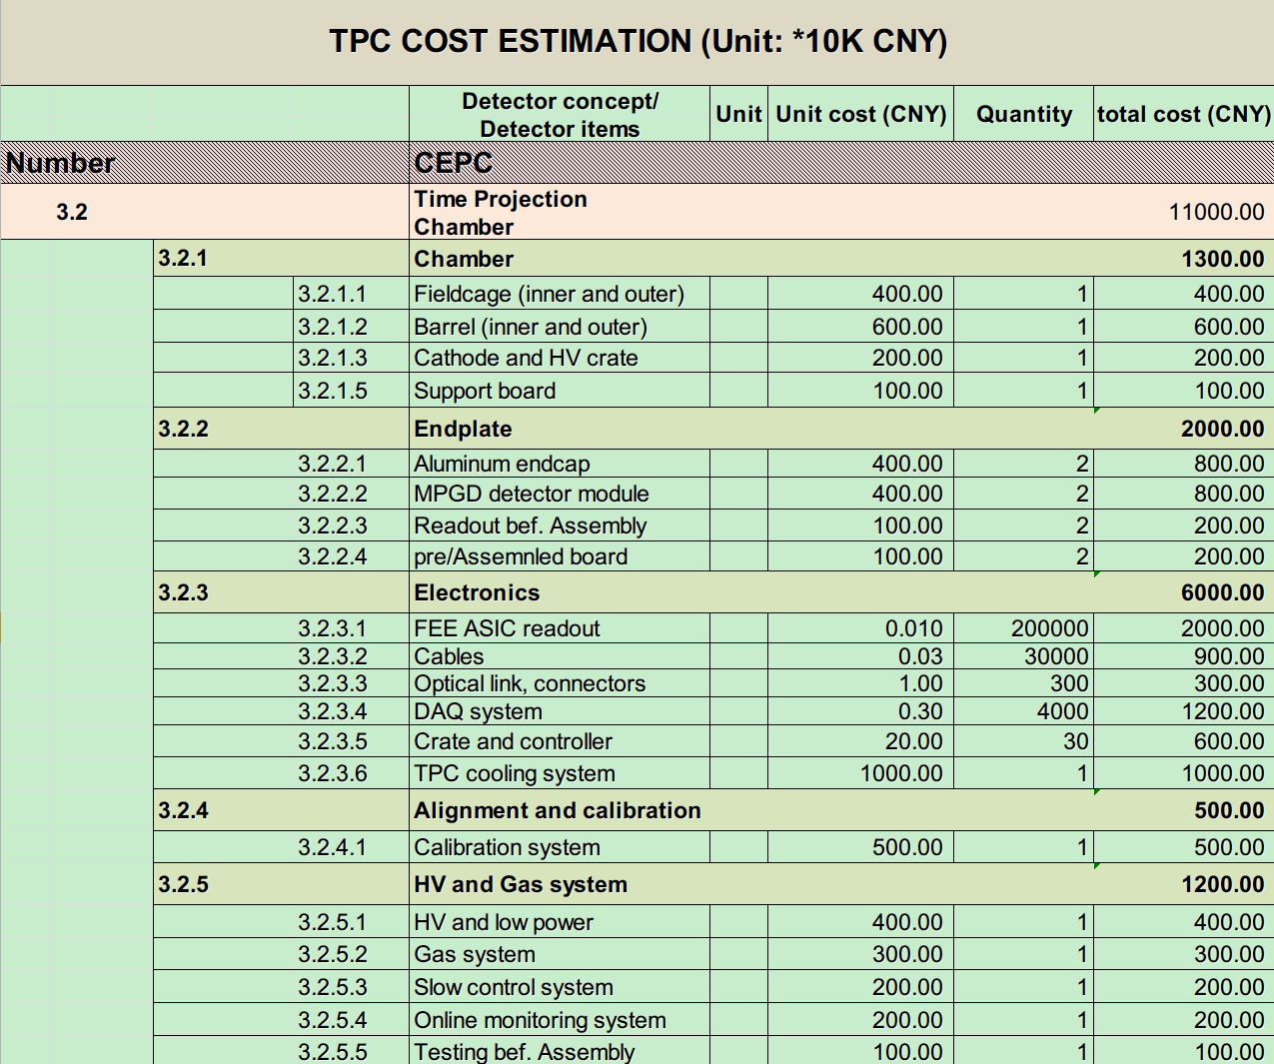
cost estimation of TPC
Cost estimation
  ~110 Million RMB
  Detector: ~50 M
  Electronic/DAQ: ~60 M
Easy-to-install modular design
  Full-size aluminum machining → Modular Machining
  Full size of the readout coverage
  High granularity readout

Slide 5
cost estimation of DC
1.1 |  | Chamber | 10⁴CNY | unit | 3130.00
 | 1.1.1 | End plate | 405 | 2 | 810.00
 | 1.1.2 | Outer frame structure | 500.00 | 1 | 500.00
 | 1.1.3 | Inner and outer cylinders | 150.00 | 1 | 150.00
 | 1.1.4 | Wire | 710.00 | +20% spare | 710.00
 | 1.1.5 | Feedthrough | 530.00 | +20% spare | 530.00
 | 1.1.6 | Wire test system | 80 | 1 | 80
 | 1.1.7 | Wiring tooling | 350 | 1 | 350
1.2 |  | Electronics |  |  | 5170.00
 | 1.2.1 | Readout Channel | 0.17 | 27623*1.1 (10% backup) | 5170.00
1.3 |  | HV and Gas system |  |  | 340.00
 | 1.3.1 | High Voltage system | 320.00 | 6HV crates, 50modules | 320.00
 | 1.3.2 | Gas system | 120.00 | 1 | 120.00
total |  |  |  |  | 8740

Slide 6
on LGAD

Slide 7
Outer Tracker options
LGAD can provide pico-second level of temporal resolution ➔ TOF
Assuming LGAD’s spatial resolution as good as that of Si microstrip and pixel ➔ Tracker
three options for Outer Tracker plus TOF
  LGAD only
  Si microstrip + LGAD
  Si pixel + LGAD
cost estimation of BARREL Outer Tracker

Slide 8
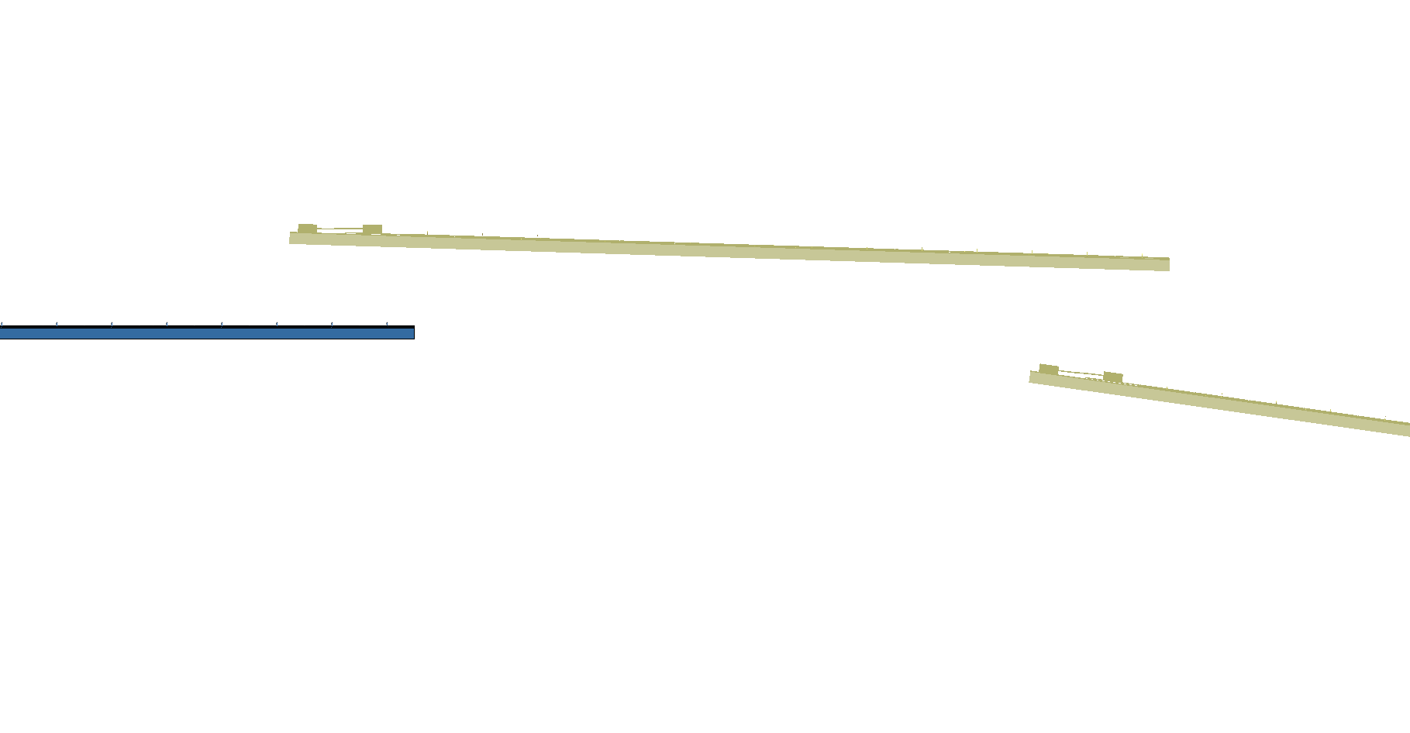
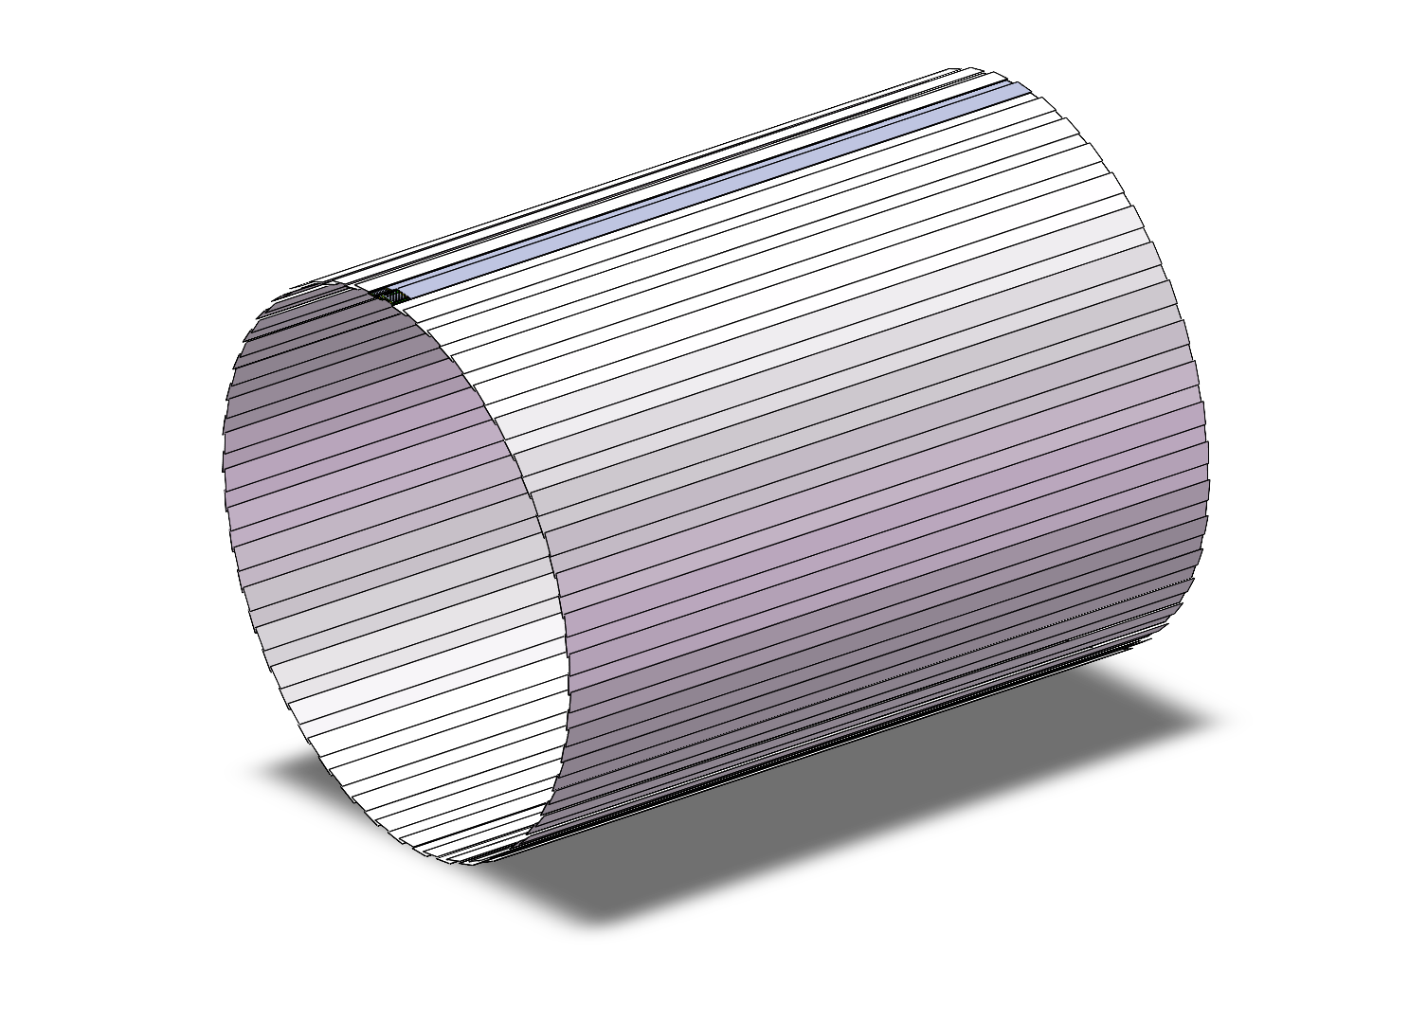
Cost estimation of LGAD
The cost of the LGAD
Parameters of LGAD as TOF+oTracker
CEPC barrel | Cost （RMB）
LGAD sensor | 35M（70m²）
Electronics total | 4.86M
Total (sensor+elec.) | 39.86M
Electronics R&D | 14.6M
Total | 54.46M
 | CEPC TOF barrel
Area (m²) | ~ 70
Granularity | 70mm × 0.1mm (10 cm²，128 channel/chip）
Capacitance | ~10 pF
Charge | >15fC
Channel number | ~ 1×10⁷ (10644480)
Module assembly | Wire bonding at strip
MIP Time resolution | ~50 ps
Spatial resolution | ~ 10 μm (R-Φ)，~ 1 mm (R-Z direction）
Number of Module | 3780 (14cm*14cm)
Number of channels per module | 2816 (22 chips，128 channel/chip）
Data size | 16 bit (9 TOT, 7 TOA) + channel(7bit, 128) +bunch ID(8bit) + chip ID (4-5 bit) ~40-48 bits
One layer ToF
R= 1800 mm
H～5800mm

Slide 9
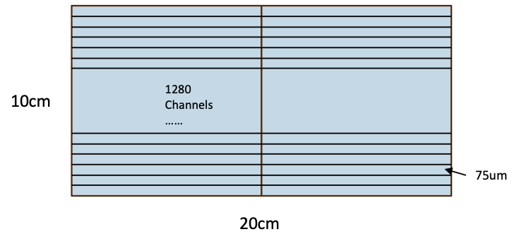
cost estimation of Si µ-strip
Electronics + Sensor = 1825 + 3637 = 5462 (10k RMB)
Items | Unit Cost (RMB) | Quality | Total (10k RMB)
FEE PCB | 200 | 3306 | 67
FEE ASIC | 0.09 | 4231680 | 38
Collector + Flex Board | 700 | 684 | 48
Optical Fiber | 200 | 684 | 14
Connector (Fiber) | 2000 | 684 | 137
Connector (Flex) | 100 | 3306 | 33
Cables (20m) | 400 | 684 | 28
Electronics Necessary R&D (*) |  |  | 1460
Sensors | 5500 | 6612 | 3637
Total |  |  | 5462
* Only considered material. Not including ecapsulation and wirebonding

Slide 10
cost estimation of Si pixel
Note: cost on mechanical support and cooling not considered yet
Category 类别 | Item 名称 | Total (10k CNY) 小计（万元） | Unit cost (CNY) 单价（元） | Unit 单位 | Quantity 数量 | Note 备注
Sensor chip | Sensor chip | 3459 | 18,000 | Wafer | 1920 | 3.3 MCNY for NTO + 18k/wafer; assume 50% yield
Common electronics | Hybrid PCB | 417 | 700 | Piece | 5964
 | Optical fibre | 119 | 200 | 20m | 5964
 | Optical connector | 1193 | 2,000 | Piece | 5964
 | PCB connector | 60 | 100 | Piece | 5964
 | Power cable | 239 | 400 | 20m | 5964
Total |  | 5487

Slide 11
Thanks!

Slide 12
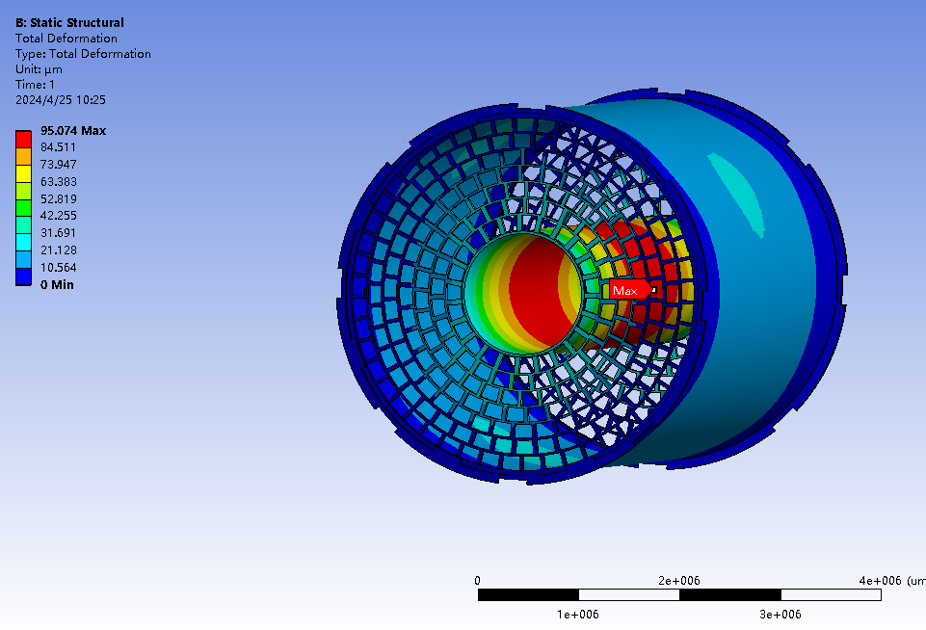
Material budget of TPC
Low material of the TPC endcap
15%X₀ in total, including
Readout plane, front-end-electronics 4%
Cooling 2%
Power cables 9%
Low material of the TPC barrel
0.55% X₀ in total, including
Material budget of TPC barrel
Layer of the barrels | D[cm] | X₀[cm] | d/X₀[%]
Copper shielding | 0.001 | 1.45 | 0.07
CF outer barrel | 0.010 | 25.28 | 0.04
Mirror strips | 0.003 | 1.35 | 0.19
Polyimide substrate | 0.005 | 32.65 | 0.02
Field strips | 0.003 | 1.35 | 0.19
CF inner barrel | 0.010 | 25.28 | 0.04
Sum of the material budget |  |  | 0.55

Slide 13
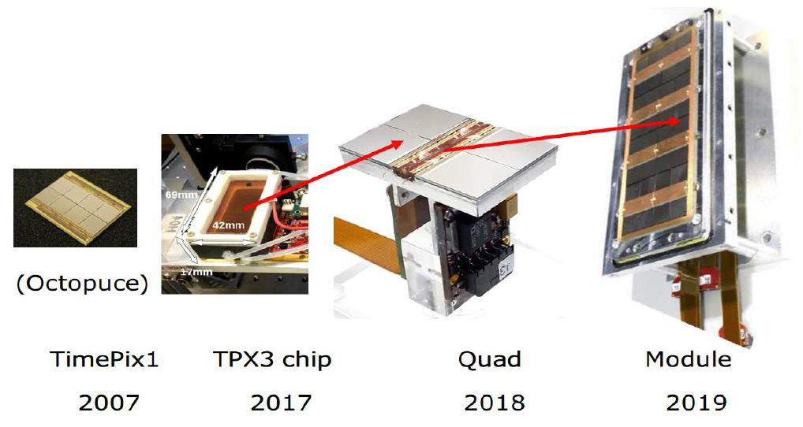
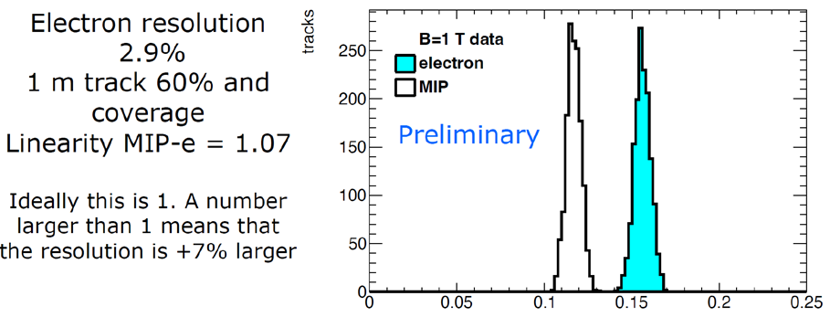
  Pixelated readout TPC beam test for PID
    Pixelated readout TPC is a good option at high luminosity Z on circular e+e- collider (2x36 cm⁻²s⁻¹)
      High spatial resolution under 2T or 3T magnetic field
      Better momentum resolution
      High-rate operation (MHz/cm²)
      dE/dx and Cluster counting (in space)
      Very low voxel occupancy
13

Slide 14
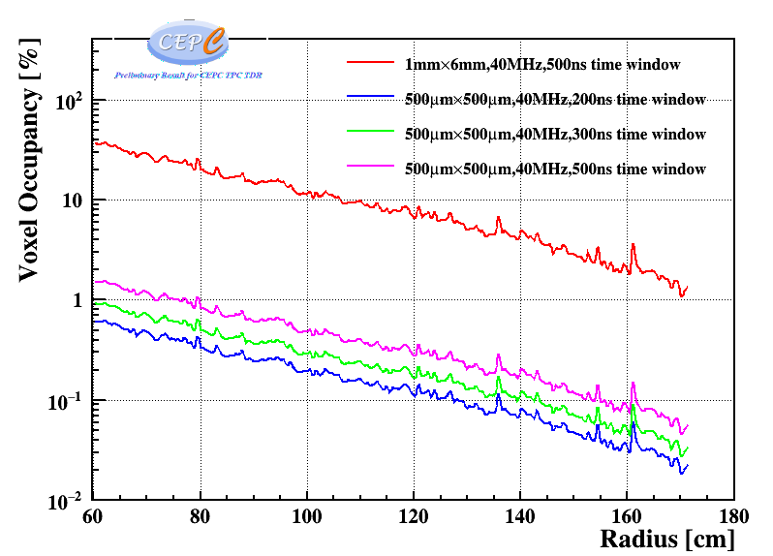
Voxel Occupancy
基于CEPC Soft实现对Z-pole模式下，分析完成了TPC探测器腔体内占空比研究和确认
  对于单个500μm×500μm 读出像素，40MHz采样率，单位时间总的Voxel数为4×10⁷/s
  z向Voxel大小为V_{d}×25ns~2mm，单个Voxel大小~0.5×0.5×2=0.5 mm³
  对于500ns时间窗，z向平均占用20个voxel
    实际将采用200ns左右时间窗
  最内层Voxel Occupancy=20×31.5k/4×10⁷ ~1.58%
  对于1mm×6mm Pad，最内层Voxel Occupancy~35%
结果表明：现有MDI设计下，TPC探测器占空比保持非常低，满足探测与物理需求
半径方向上不同大小读出像素单元，时间窗下Occupancy
Notes:
下面将从模拟和实验两个部分介绍该季度取得研究进展。
首先，完成了beam效应在TPC中产生原初离子密度的模拟。下面分别是采用的探测器几何模型以及z-pole模式下多次对撞后TPC中离子密度的分布，平均每次对撞，TPC中将产生约27.37k离子，任意时刻平均原初离子密度约2.43nC/m3

Slide 15
Drift Chamber

Slide 16
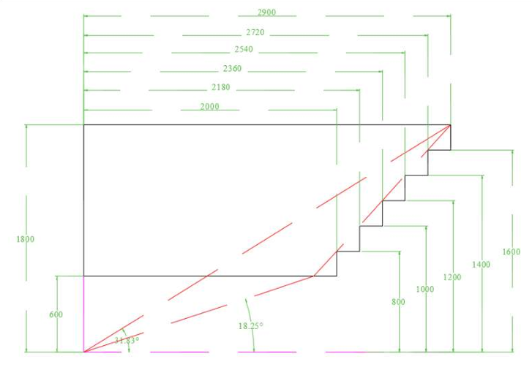
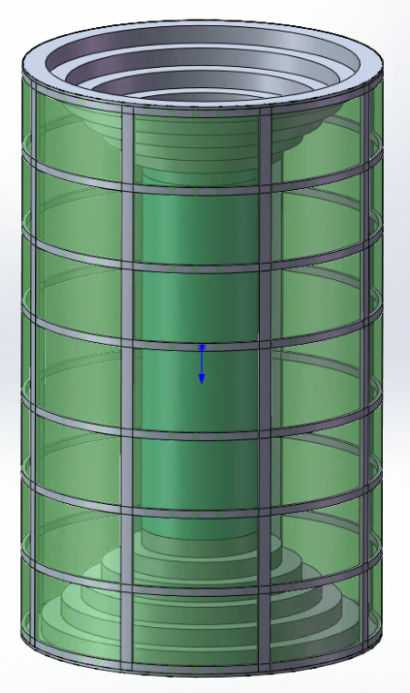
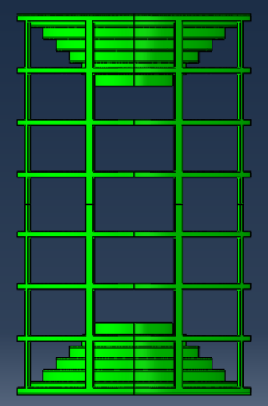
Overall Design (preliminary)
CF Frame structure：8 longitudinal hollow beams + 8 annular hollow beams + inner CF cylinder and outer CF cylinder
Length : 5800mm
Outer diameter: 3600mm，Inner Diameter: 1200mm；
Thickness of each end plate: 25mm/20mm，weight :1100kg /880kg

Slide 17
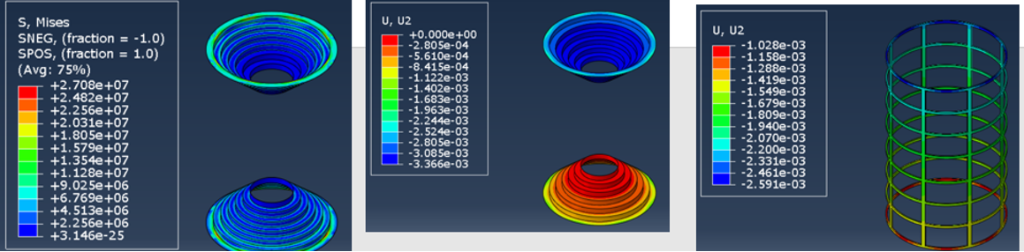
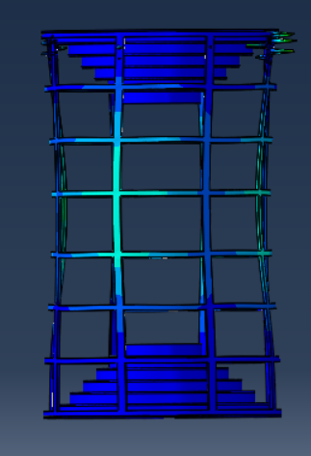
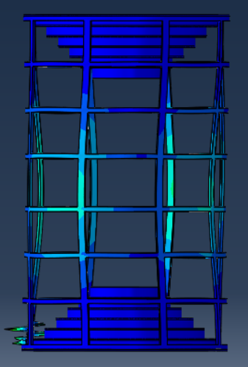
Results of FEA
Loads: Wire tension
+ Axial self weight
End plate thickness: 20mm
Stress 27.1MPa,
Endplate deformation 3.4mm,
CF frame deformation 1.6mm
The structure is stable
Vertical self weight
Buckling coefficient : ~12
Horizontal self weight
Buckling coefficient : ~14

Slide 18
Layout design of wiring

Slide 19
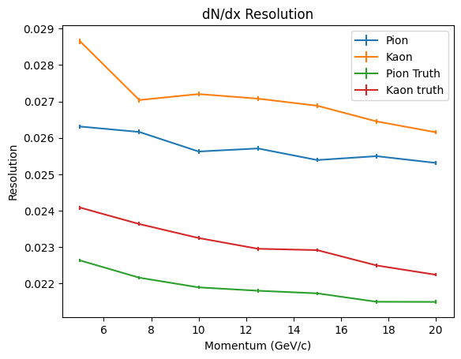
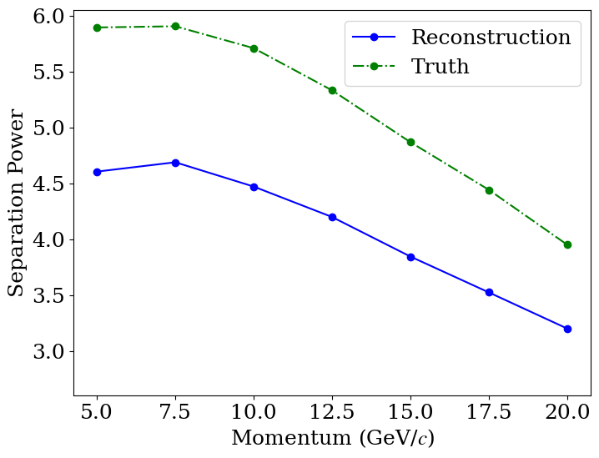
dN/dx Resolution and separation power
dN/dx resolution: 2.5%-2.6% for pion
2.6%-2.7% for Kaon
1.2 m track length
For 20 GeV/c K/π, Separation power: $3.2\text{σ}$

Slide 20
LGAD

Slide 21
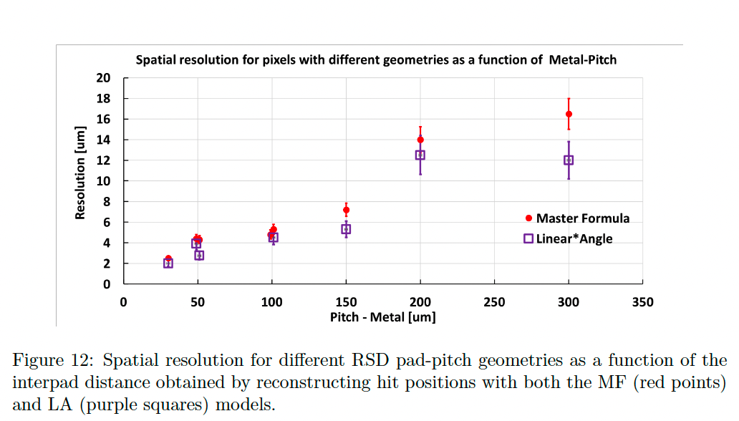
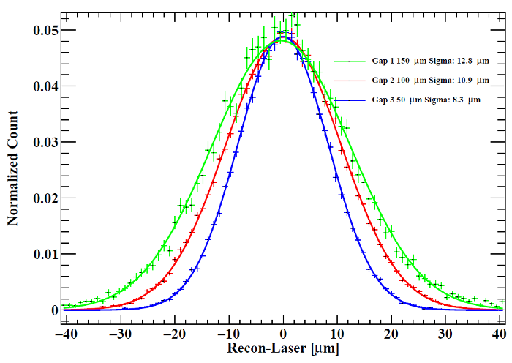
LGAD：
The cost of the LGAD and AC-LGAD as silicon strip is same .
The AC-LGAD/LGAD could offer good spatial resolution as showed in picture.
https://doi.org/10.1016/j.nima.2024.169203
https://doi.org/10.1016/j.nima.2021.165319

Slide 22
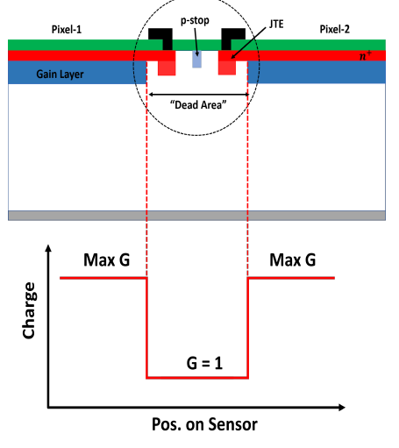
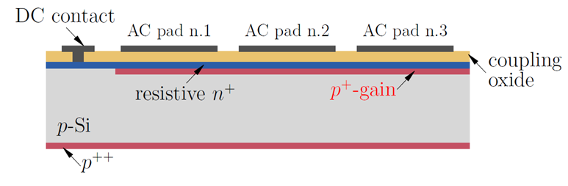
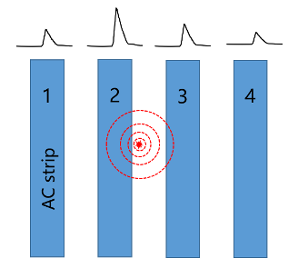
Candidate of ToF for CEPC
Candidate of ToF for CEPC
LGAD：high timing resolution（30 ps）, low gain, high S/N,
AC-LGAD：4 dimension detection、no dead region

Slide 23
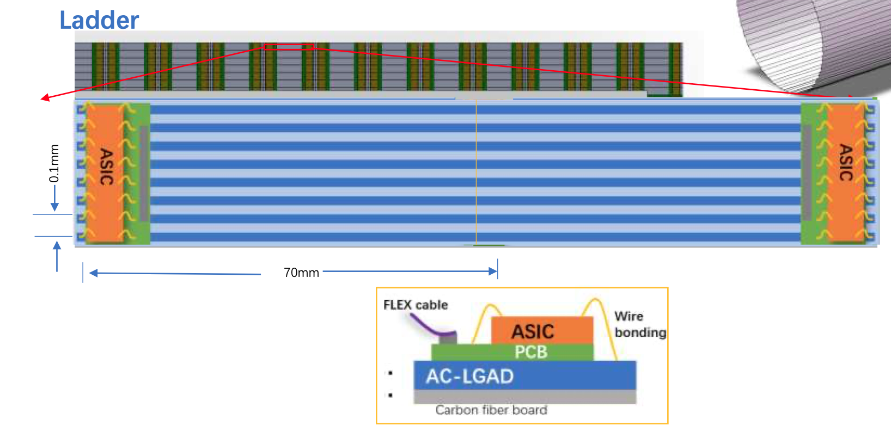
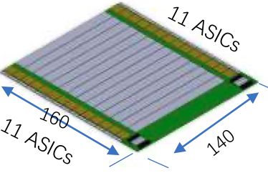
LGAD：Arrangement of the ToF with strip LGAD：Barrel
One layer ToF
R= 1800 mm
H～5800mm
One layer: 3780 modules
  90 ladders，45 ladders each side,
  42 modules/ladder，
  22 ASIC/module，128 Channel/ASIC
Module
140mm x 160mm

Slide 24
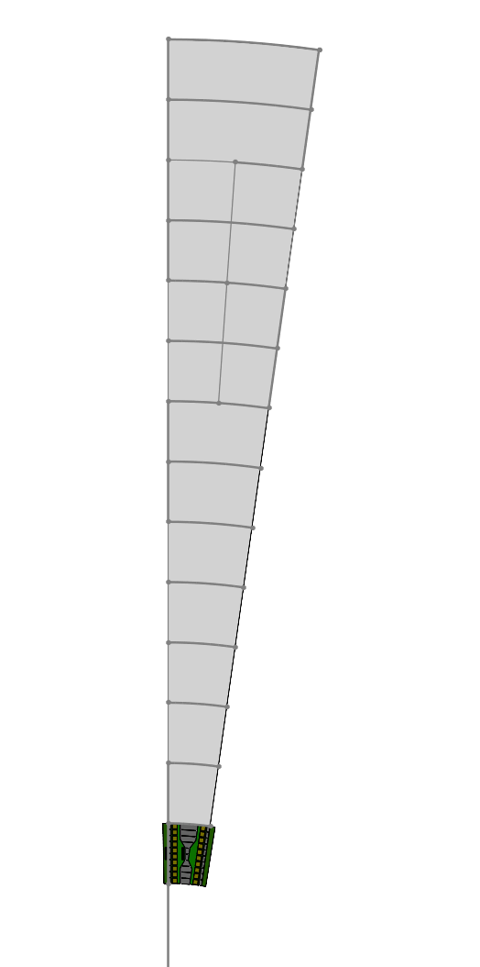
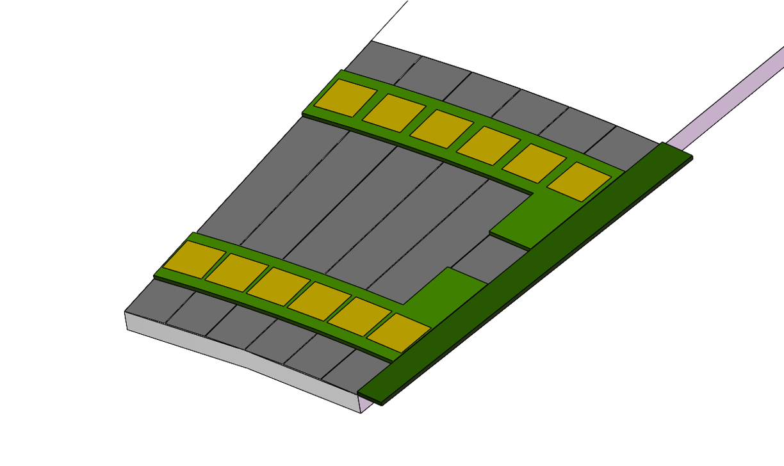
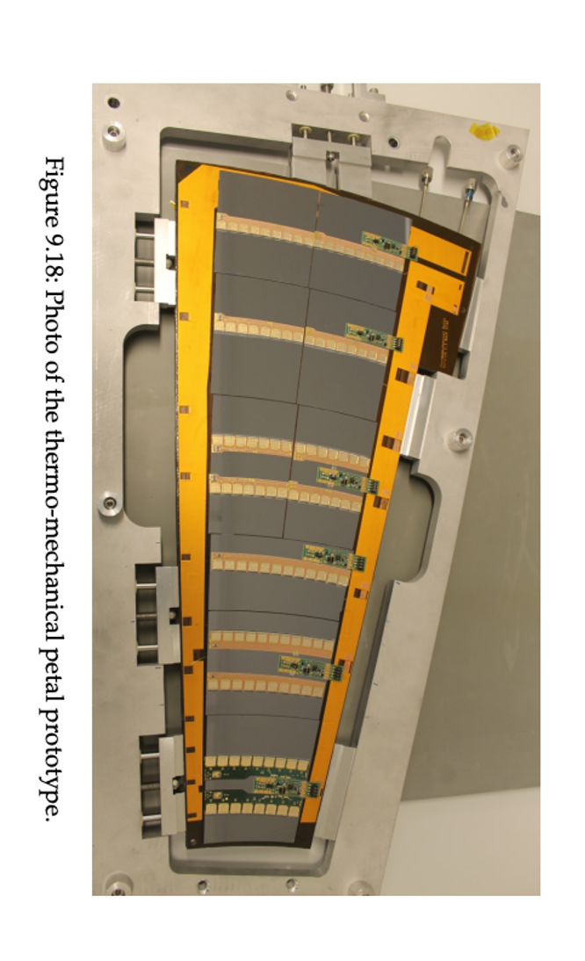
LGAD：Arrangement of the TOF with strip LGAD ：Endcap
Petals： one petal each 8°× 45 = 360°
Total modules：~ 450 (14cm )
R：400 mm - 1800 mm
 | CEPC TOF endcap
Area (m²) | ~19.4
Granularity | 70mm × 0.1mm
Capacitance | ~10 pF
Charge | >15fC
Channel number | ~ 2×10⁶
Module assembly | Wire bonding at strip
MIP Time resolution | ~50 ps
Spatial resolution | ~ 10 μm （r or φ）
Number of Module | ~ 900 (14cm*) (8°×45(petals number) = 360°)
Number of channels per module | 2816 (22 chips，128 channel）
Module
Longest side：140mm
8°

Slide 25
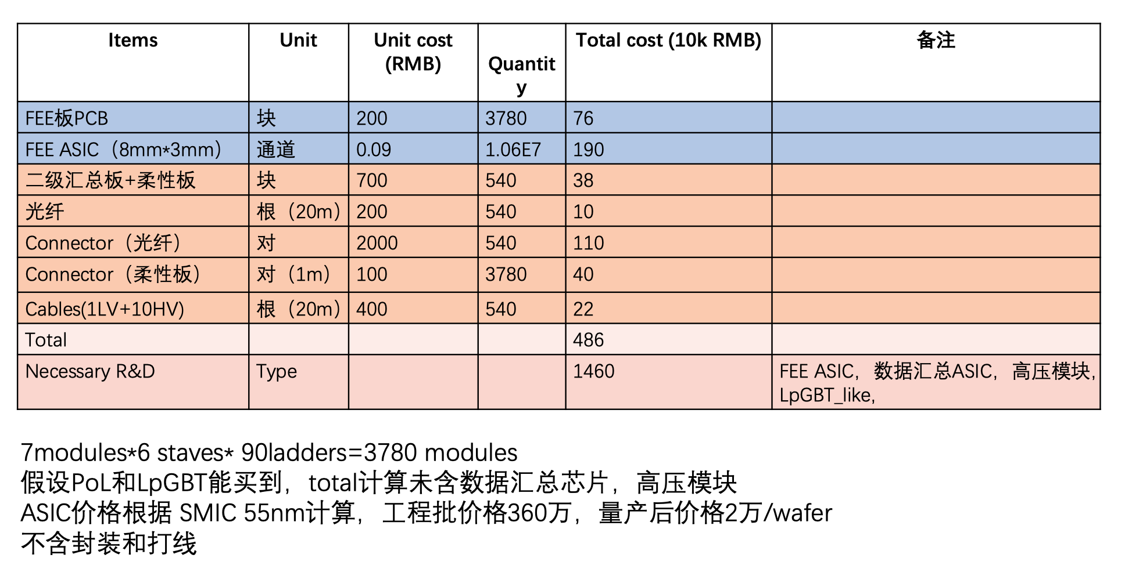
LGAD: Electronic System Cost of LGAD ToF and OTracker

Slide 26
Si pixel

Slide 27
Event rate assumption
Assuming:
  Physics event rate 112 kHz => 1 MHz for all event including physics, bkg, noise
  Track multiplicity: 100
  Cluster size: 3
CMOS sensor
  Pixel size: 25 $×$ 150 um².
  Bits per hit: 48 bit.
Outer tracker
  Radius 1800 mm.
  Length 5800 mm.
Hit density: 0.74 kHz / cm².
Data rate per chip: 140 kb/s

Slide 28
Sensor chip
$20×20 mm^{2}$
Modules mounted on both sides of staves to cover inefficient area
Cooling pipes embedded in stave/ladders
Module: 28 chips
* Rate per module: 4.0 Mb/s
* Note: lpGBT supports up to 28 e-links

Slide 29
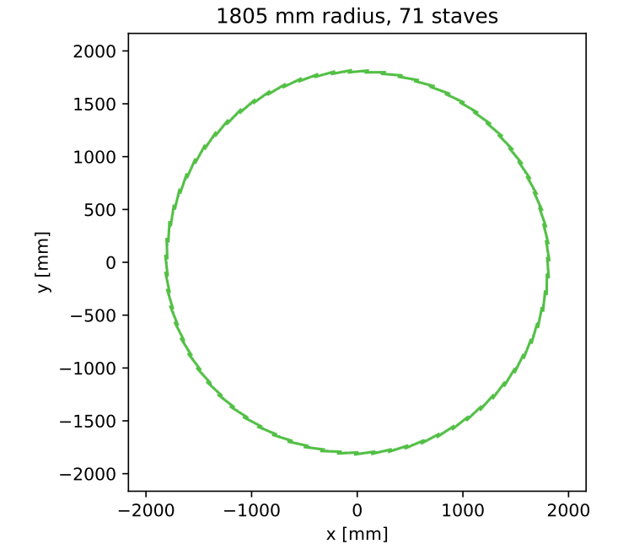
71 staves
5964 modules
1.67 million chips
1 ladder (5880 mm) = 42 modules $×$ 2 sides
Sensor chip
Optical convertor & fibre
Hybrid PCB
Mechanical support (one side only)
Optical convertor & fibre

Slide 30
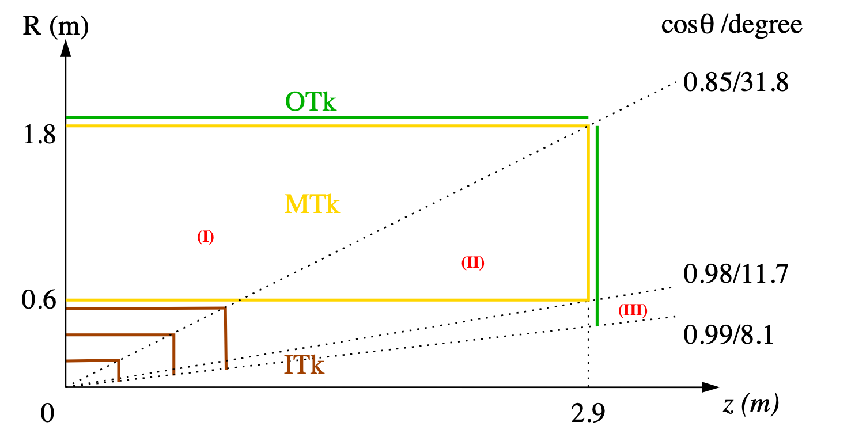
CEPC tracking system, draft
Three tracking regions
barrel: full Gas + Si trackers
endcap: partial Gas tracker
forward: Si tracker only

Slide 31
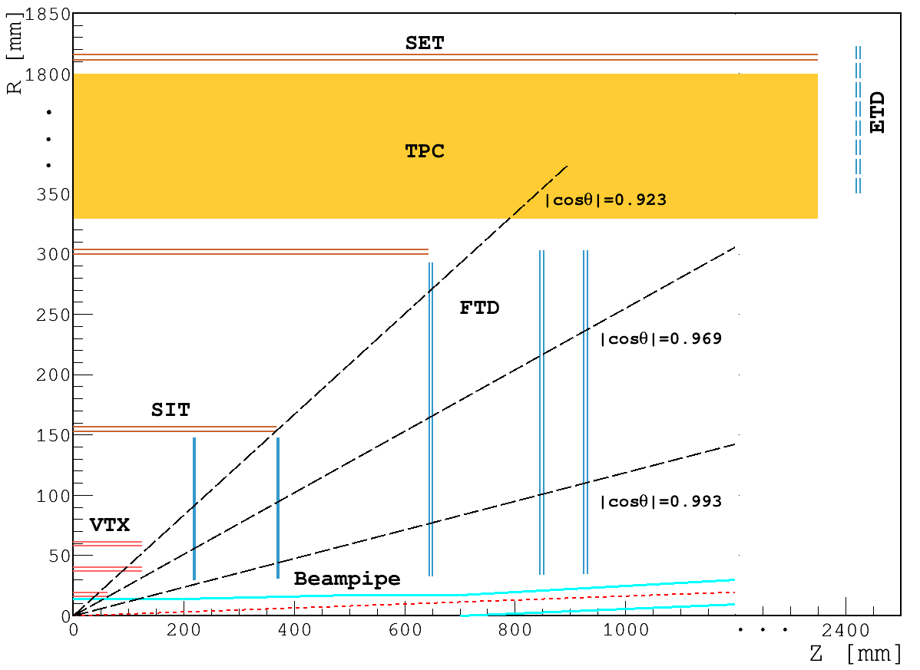
CDR layout for acronyms

