Slide 1
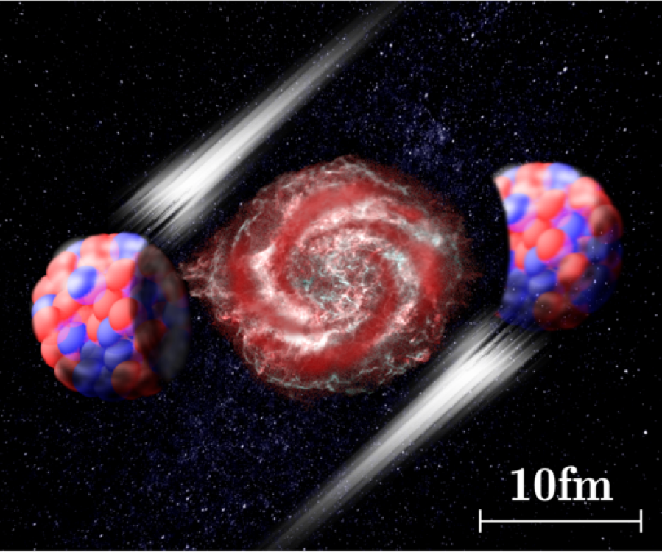
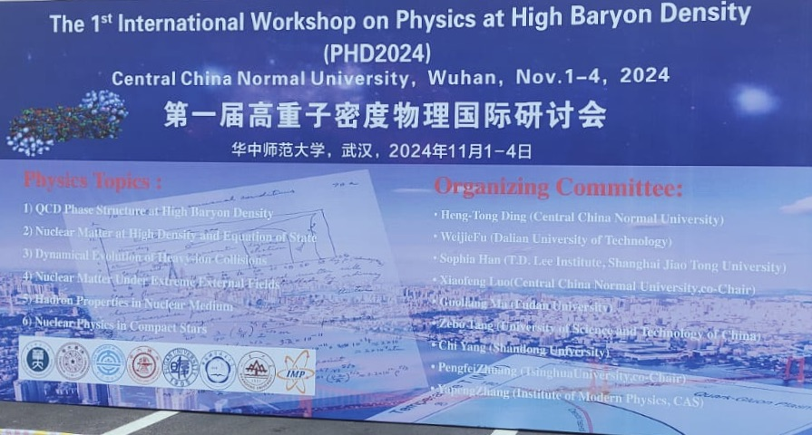


Event-by-Event Fluctuation Measurements in Nucleus-Nucleus Collisions
1/34
Bedanga Mohanty
National Institute of Science Education and Research
India

Slide 2


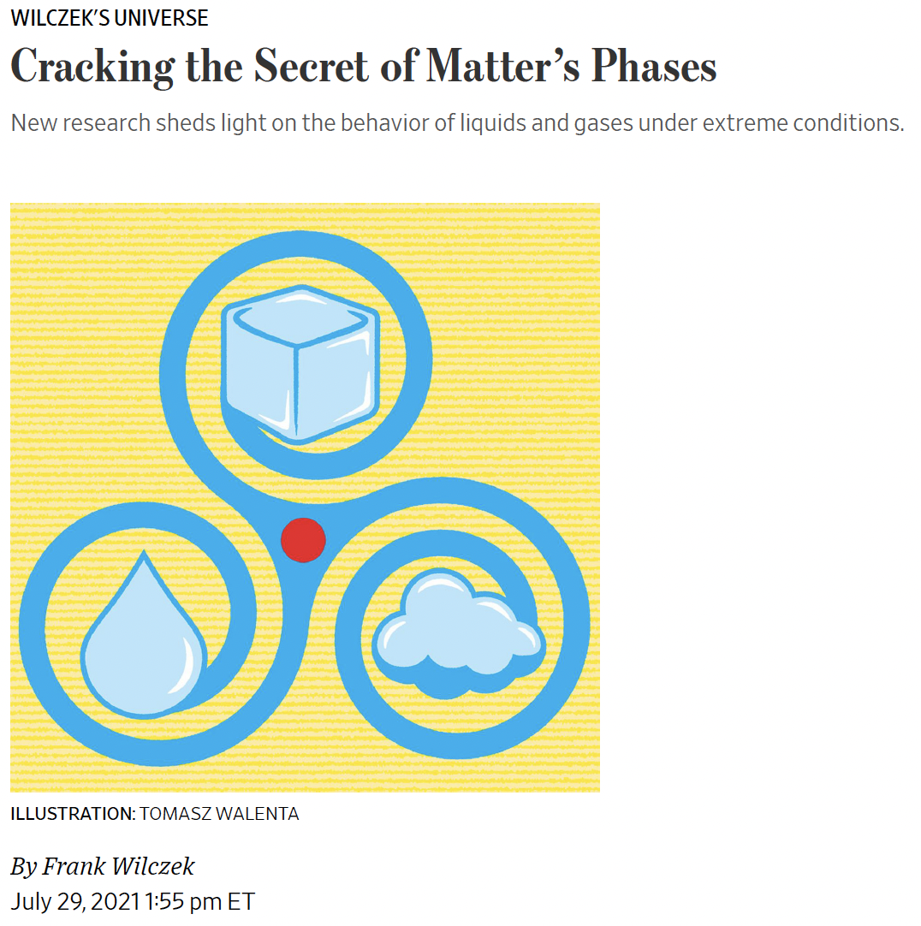
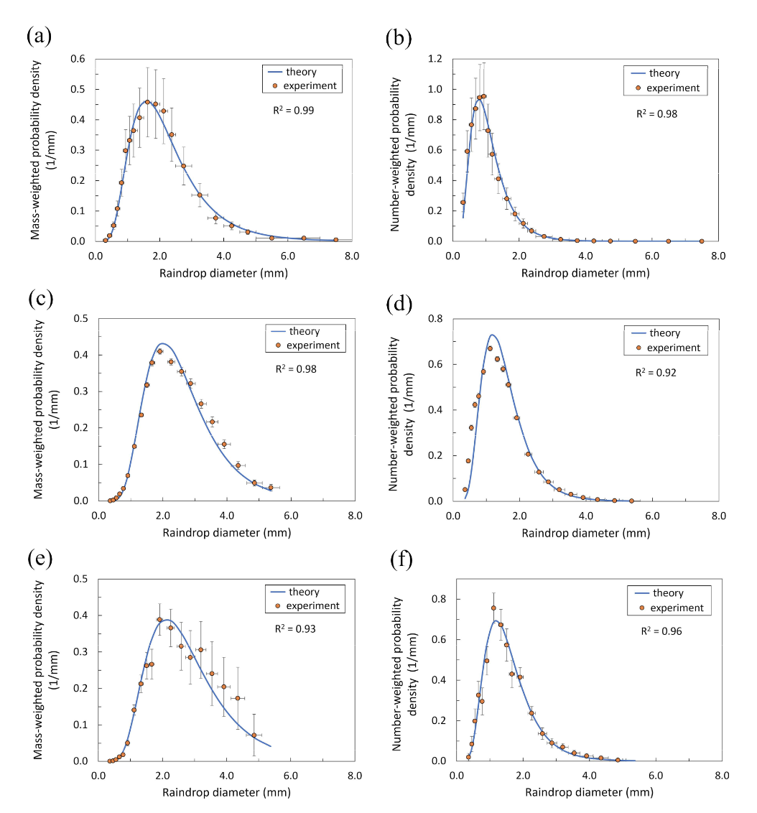
Event-by-event vs. Average
2/34
Distribution : gamma, Weibull, lognormal, Marshall–Palmer’s exponential equation, and other mathematical functions ?
First principles of matter and energy conservation and in the stationary state
both the mass and number fractions of raindrop diameters follow a lognormal distribution Law.
In the early 1990s, Krishna Rajagopal and I predicted that there would be a critical point— around 10 trillion degrees—where the distinction between nuclear and quark matter fades away. That point’s existence could be confirmed, we proposed, by observing fluctuations in the fireballs that have nearly the critical temperature and pressure.
Event-by-event physics carries much more information than average over events

Slide 3
Relativistic heavy-ion collisions at LHC
ALICE: arXiv:2211.04384
Time evolution of heavy-ion collisions
Phase diagram of QCD
Event-by-event physics with conserved numbers (or their proxies), related to
correlation length and conserved number susceptibilities of the system
3/34

Slide 4
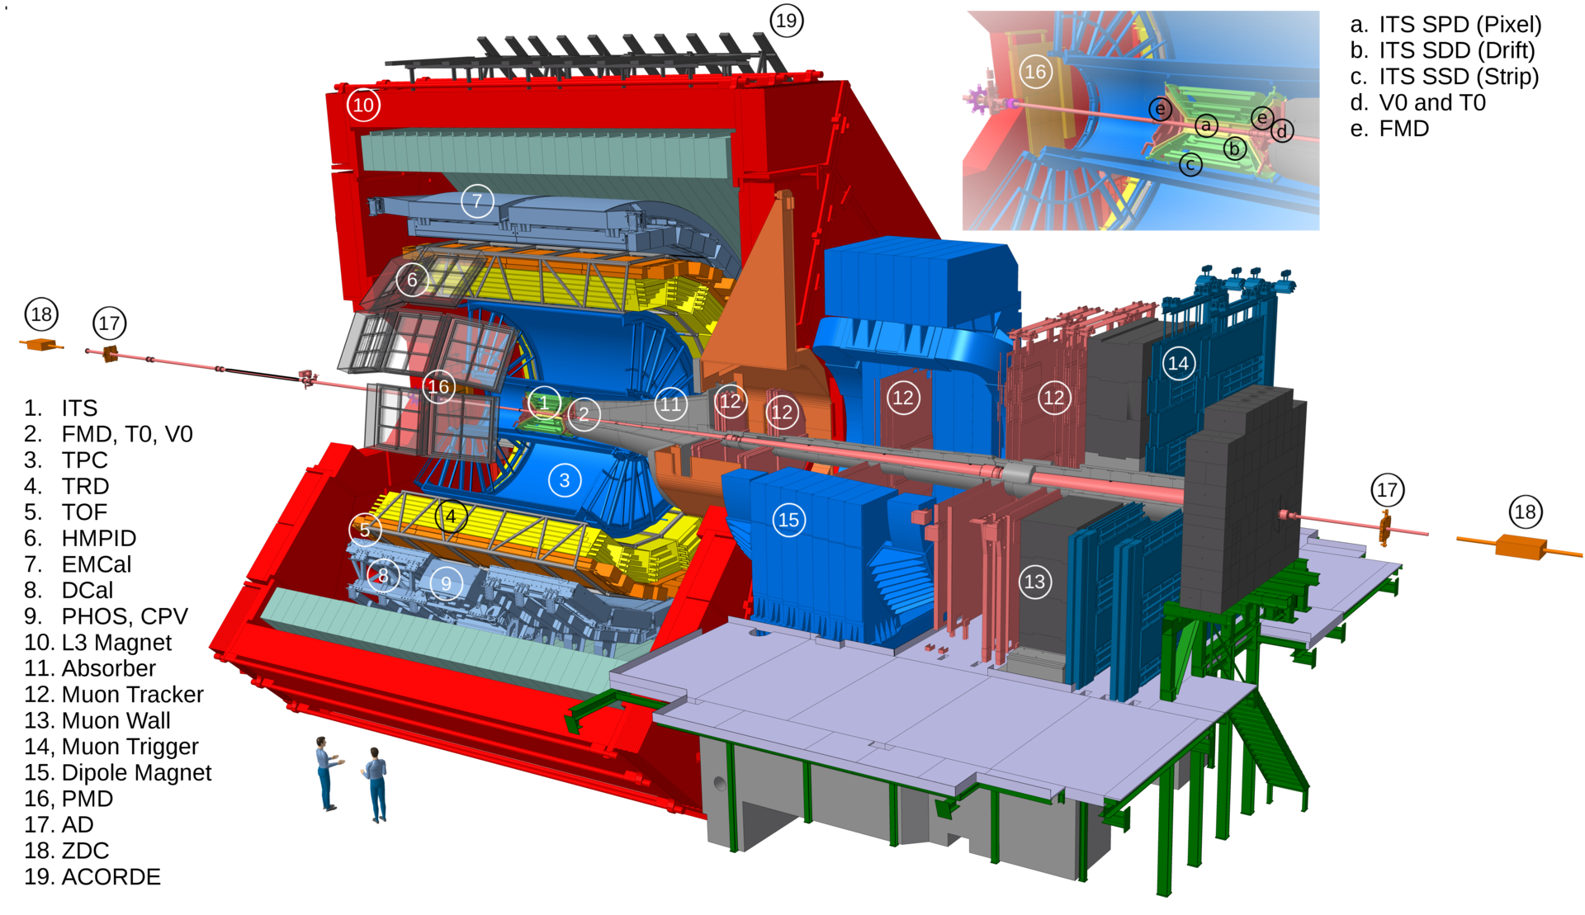
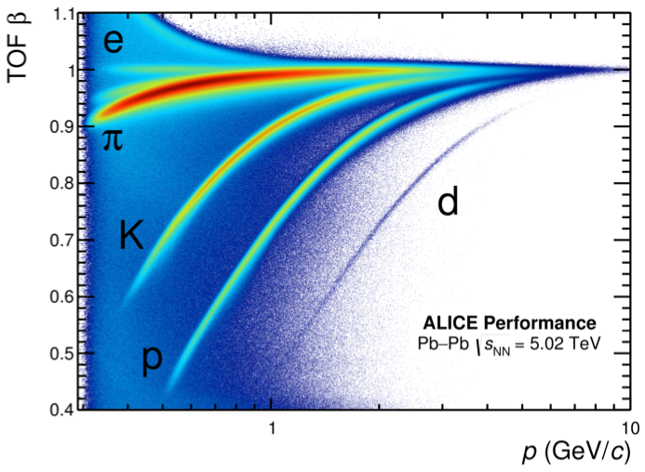
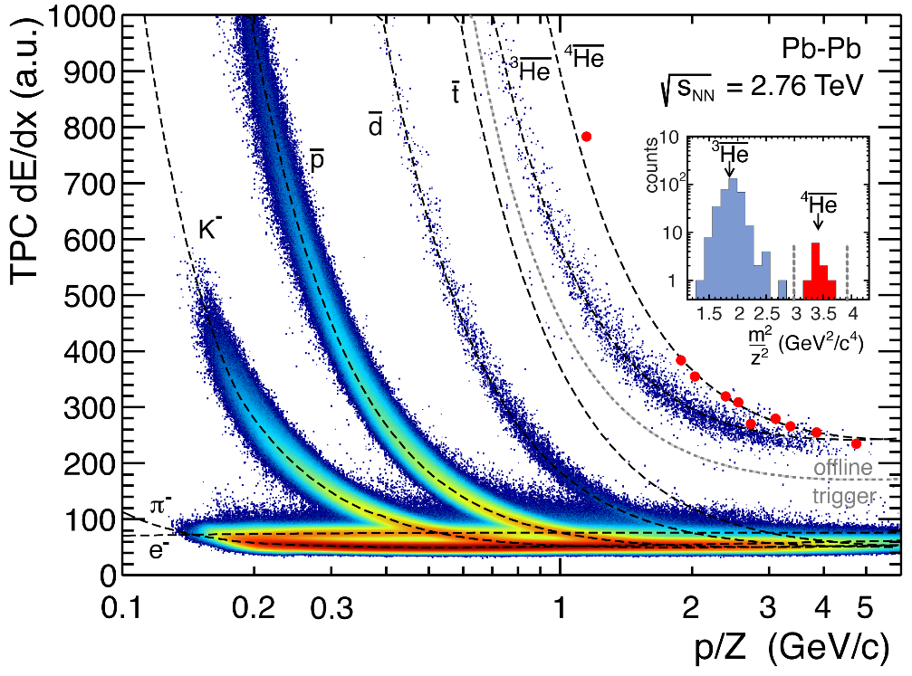
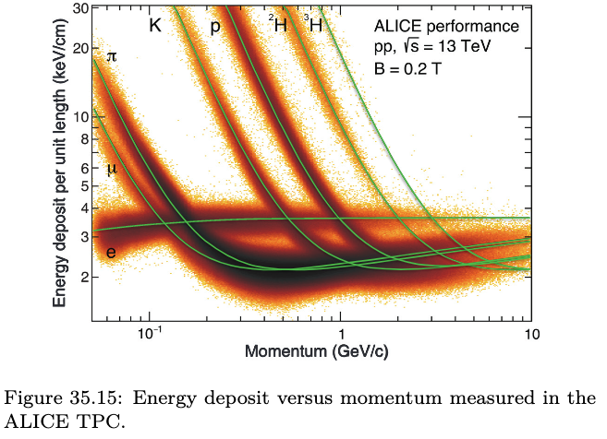
ALICE detector
Uniform acceptance at midrapidity and excellent particle identification capability
(Particle Data Group),
Prog. Theor. Exp. Phys. 2022, 083C01 (2022)
Part of PDG
4/34

Slide 5
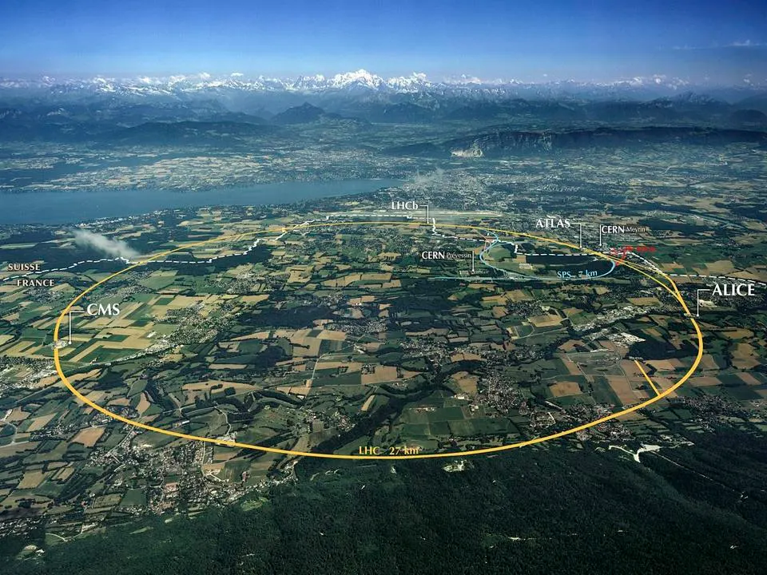
https://home.web.cern.ch/science/accelerators/large-hadron-collider
Results from alice at Large Hadron Collider
(only second and third order)
5/34

Slide 6
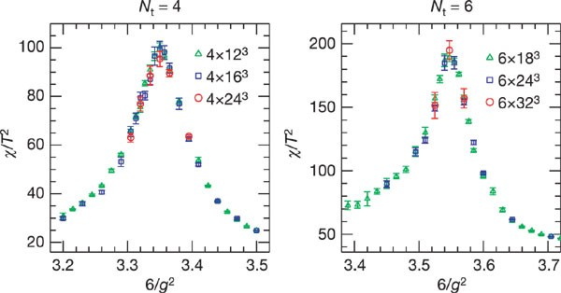
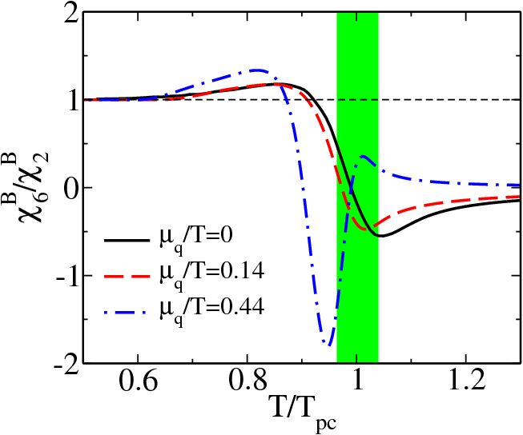
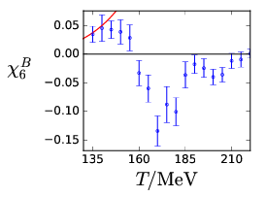
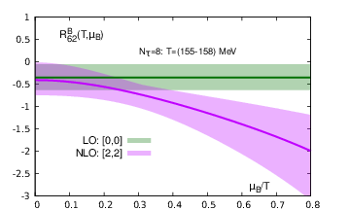
QCD phase structure at μ_{B} = 0 MeV
Theory
Observable for experiment
Eur. Phys. J. C 71 1694 (2011)
JHEP 10 (2018) 205
PHYSICAL REVIEW D 101, 074502 (2020)
Lattice QCD: Cross over at μ_{B} = 0 MeV
Nature 443 (2006) 675-678
Transition Temperature: ~ 156.5 ± 1.5 MeV - Phys.Rev.D 85 (2012) 054503
χ^{B}₆/χ^{B}₂ or C^{B}₆/C^{B}₂ < 0
Study the sign of high order baryon correlations
6/34

Slide 7
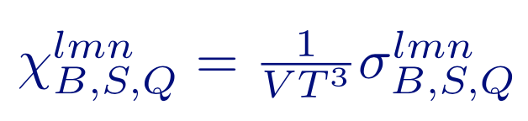
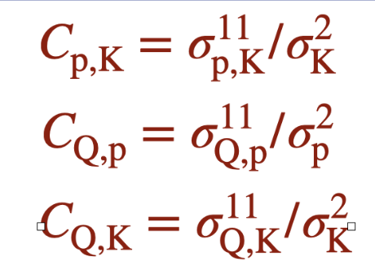
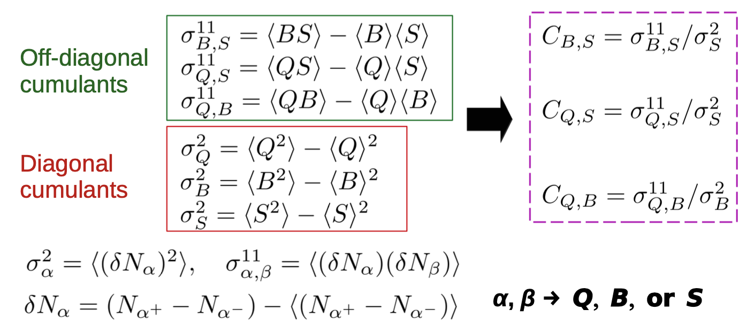
Experimental Observable
Lessons learned from second order fluctuations
7/34

Slide 8
LHC results: 2nd and 3rd order fluctuations in net-proton number
ALICE: Phys. Lett. B 807 (2020) 135564
8/34
baryon number conservation and long-range correlations

Slide 9
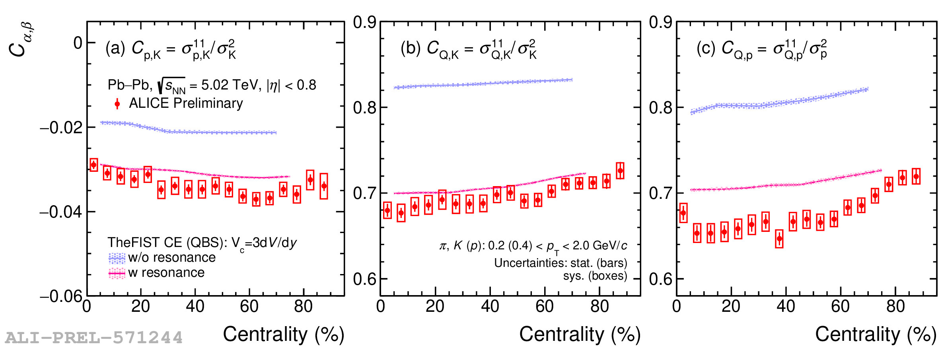
Effect of resonance
Baryon-Strangeness Correlations
Electric Charge- Strangeness Correlations
Baryon-Electric Charge Correlations
Swati Saha (ALICE): SQM2024 and ICHEP2024
Significant effect of resonances at LHC energies
9/34

Slide 10
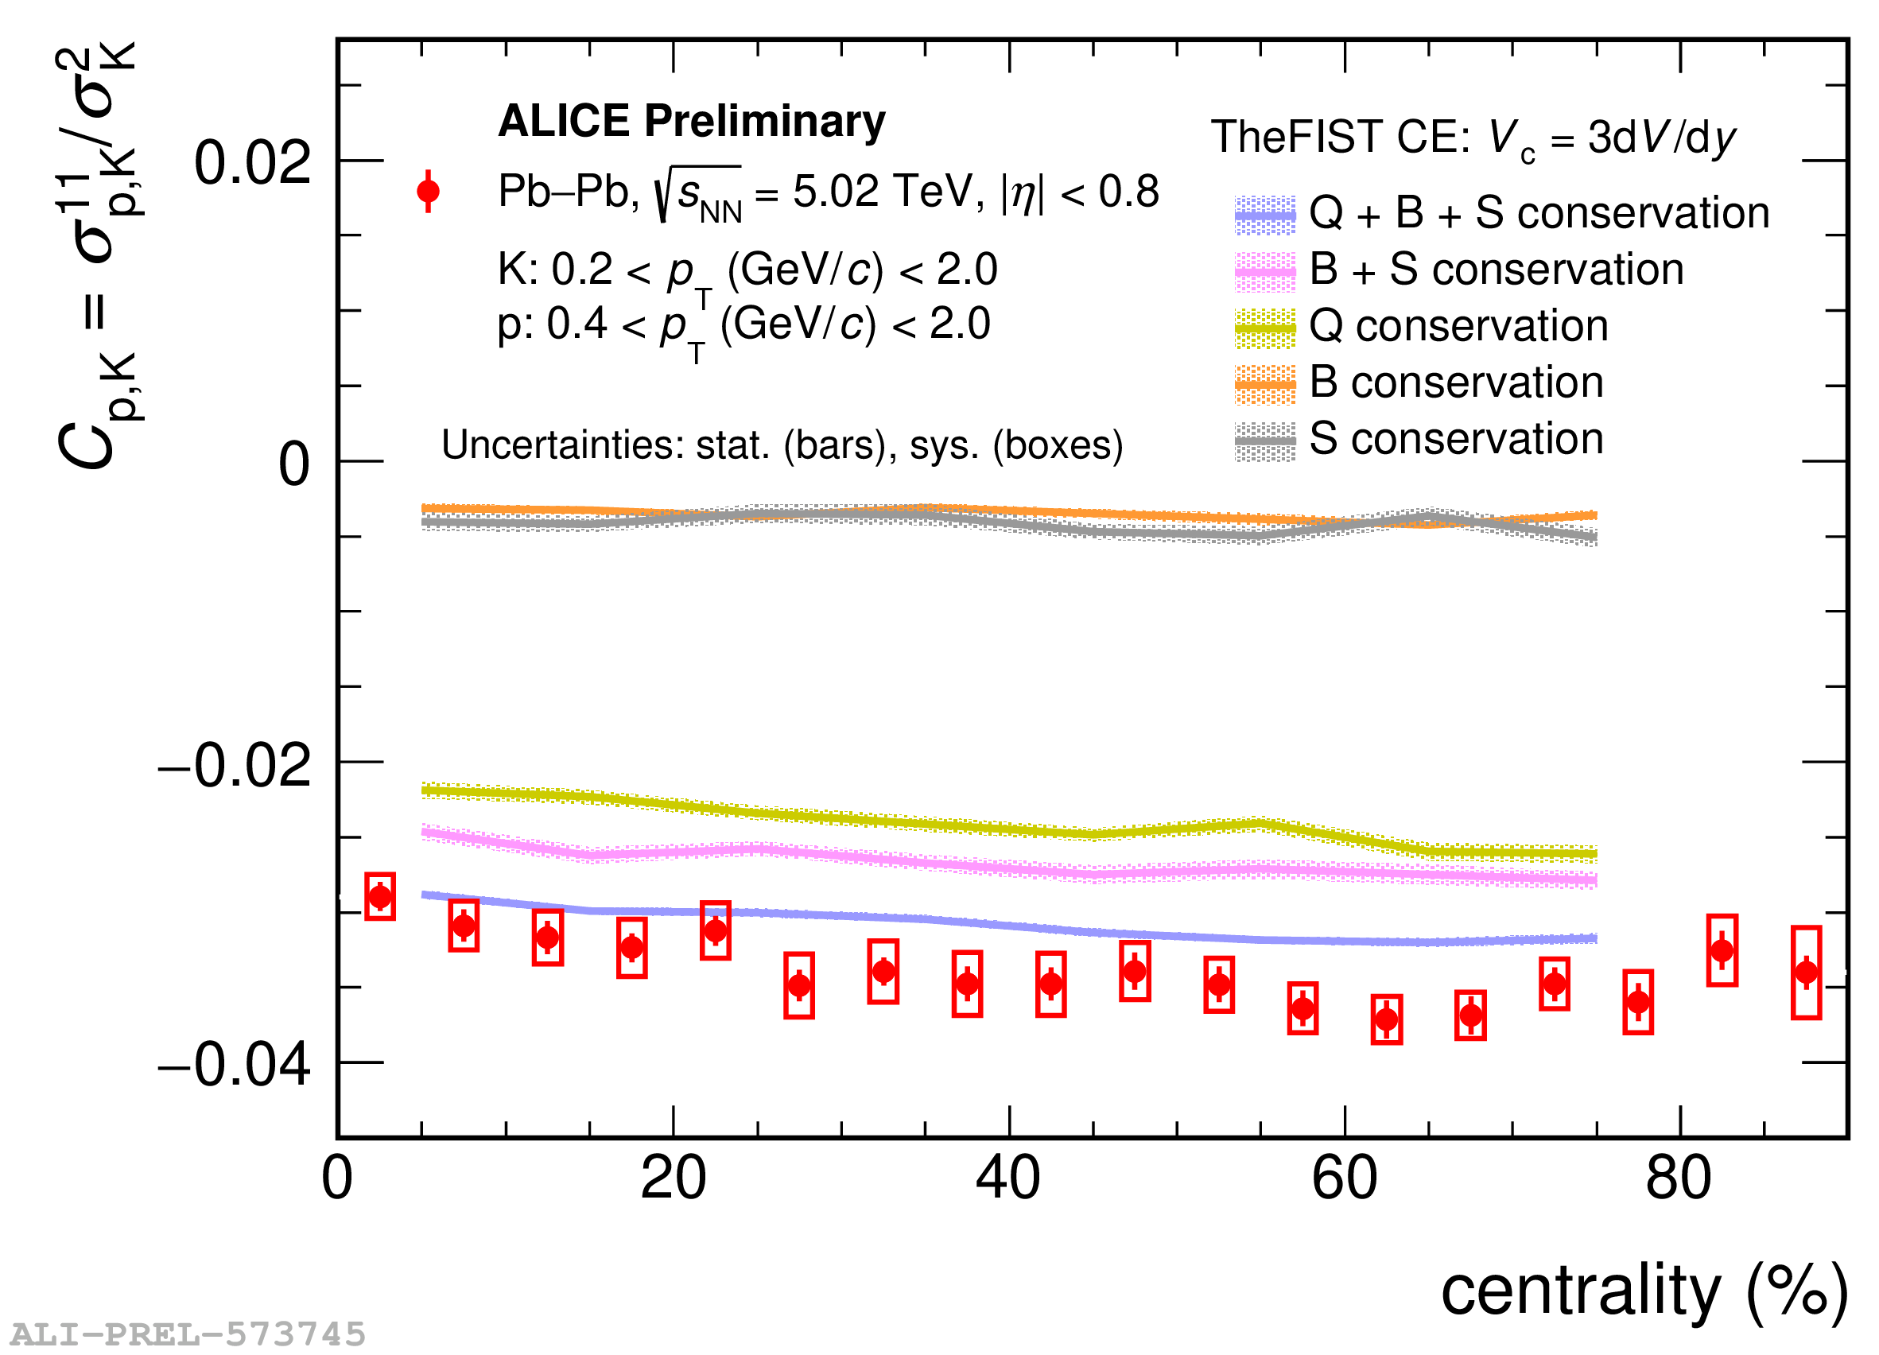
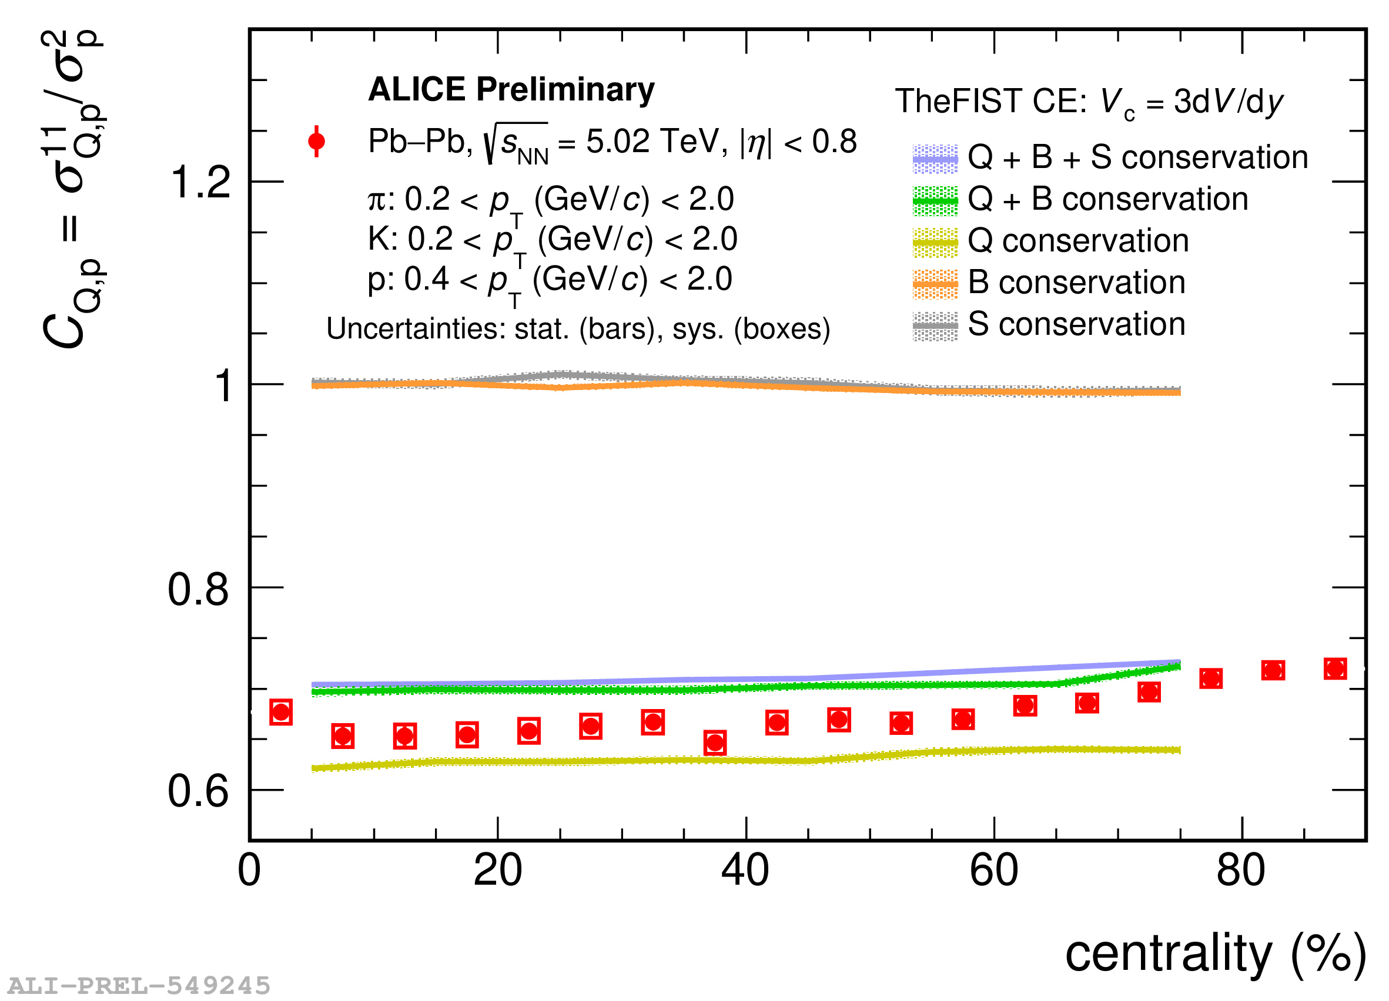
Effect of conservation
Baryon-Strangeness Correlations
Baryon-Electric Charge Correlations
Swati Saha (ALICE): SQM2024 and ICHEP2024
Conservation of all charges plays an important role
10/34

Slide 11
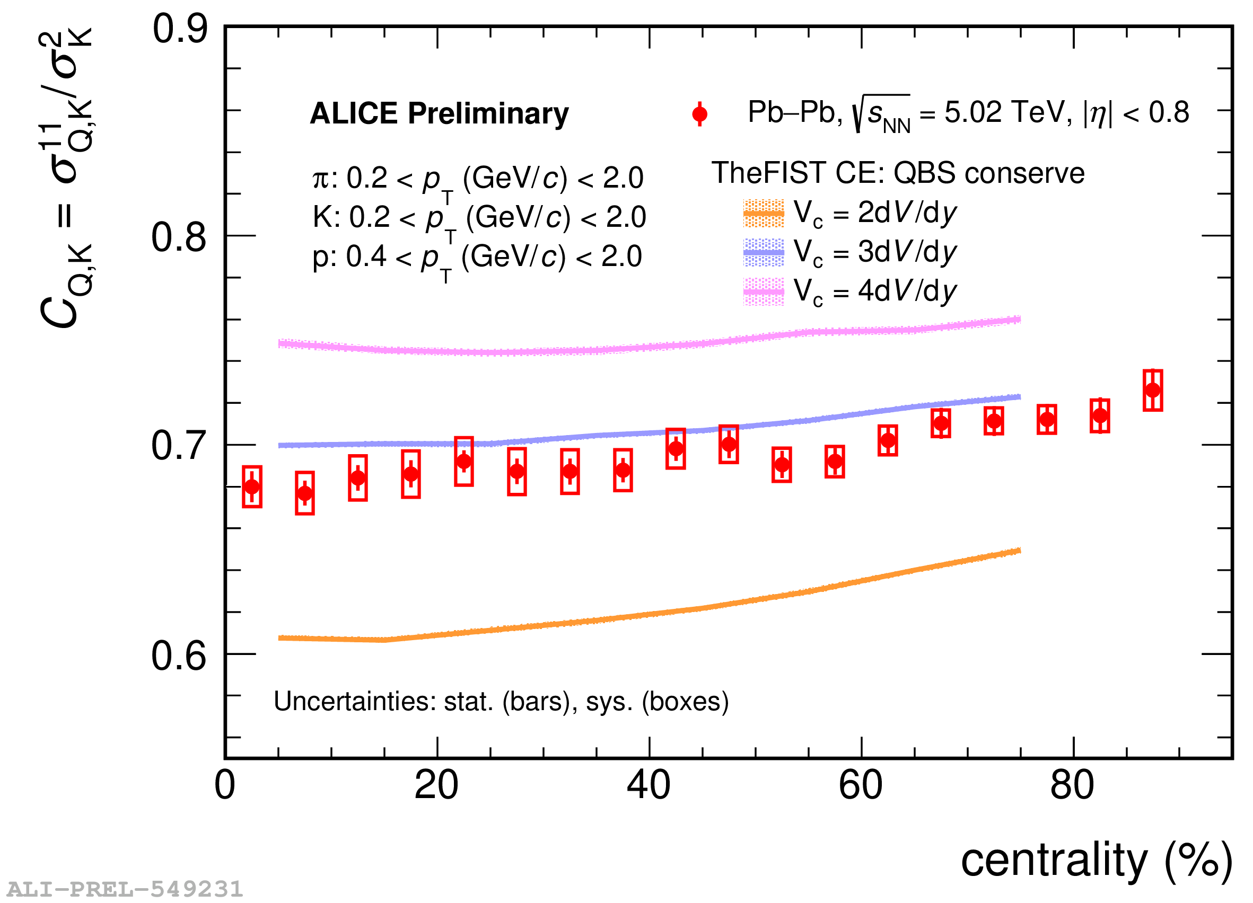
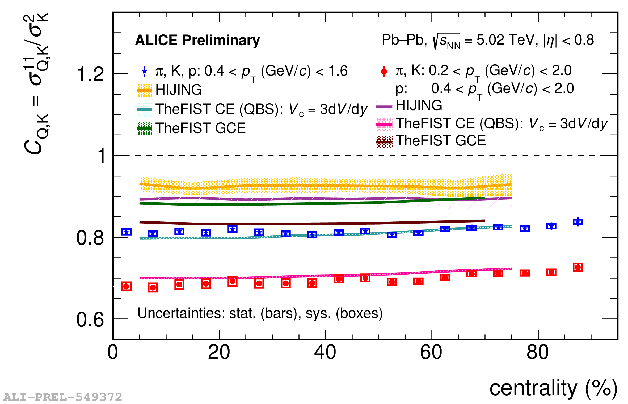
Effect of correlation volume
Swati Saha (ALICE): SQM2024 and ICHEP2024
Electric Charge- Strangeness Correlations (as an example)
Correlation volume seems to play a role in understanding measurements
11/34

Slide 12
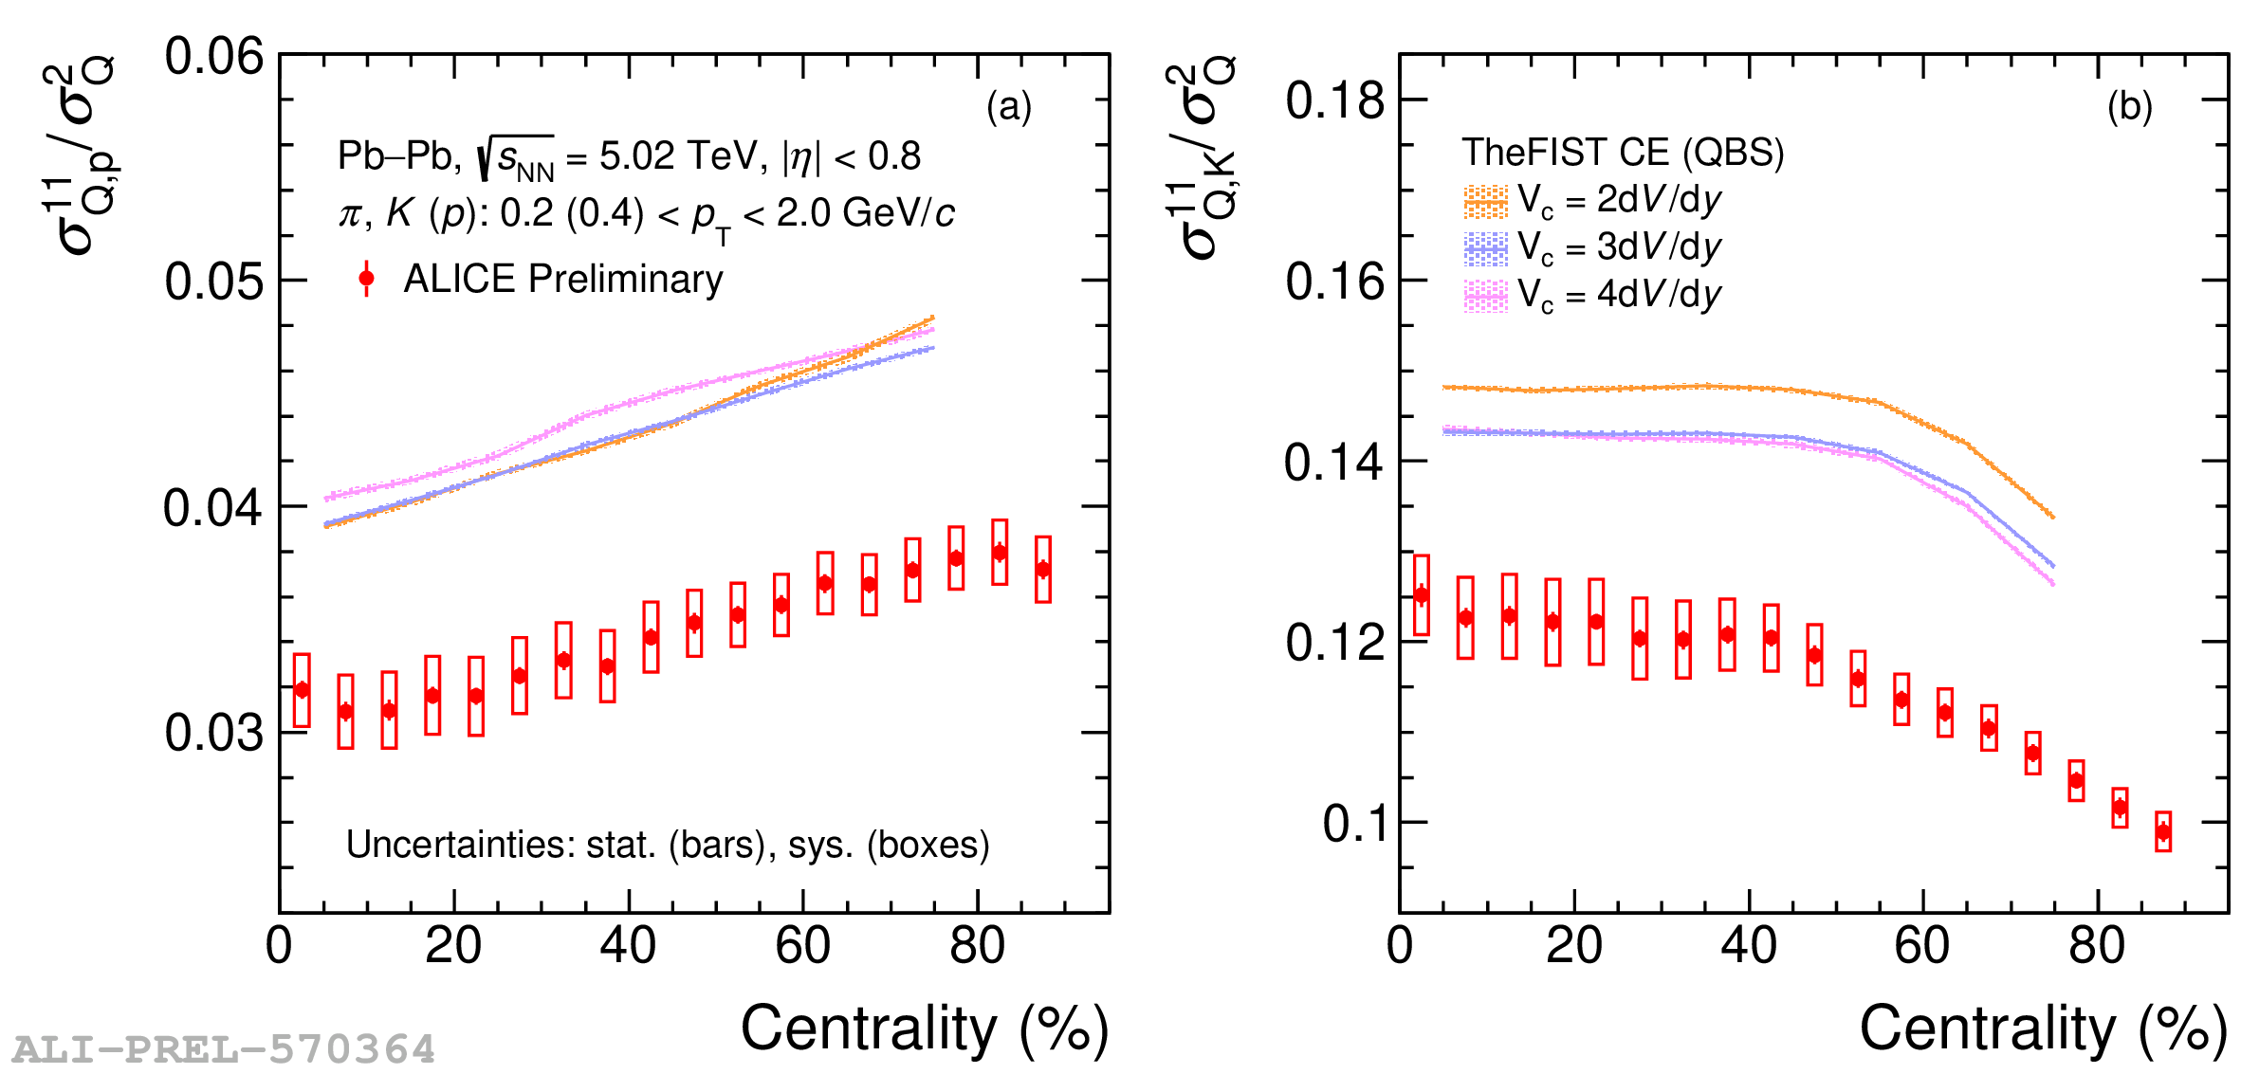
Effect of correlation volume
Observable where correlation volume effect cancels
Swati Saha (ALICE): SQM2024 and ICHEP2024
12/34
Model and Data do not agree – could be residual acceptance effects or physics?

Slide 13
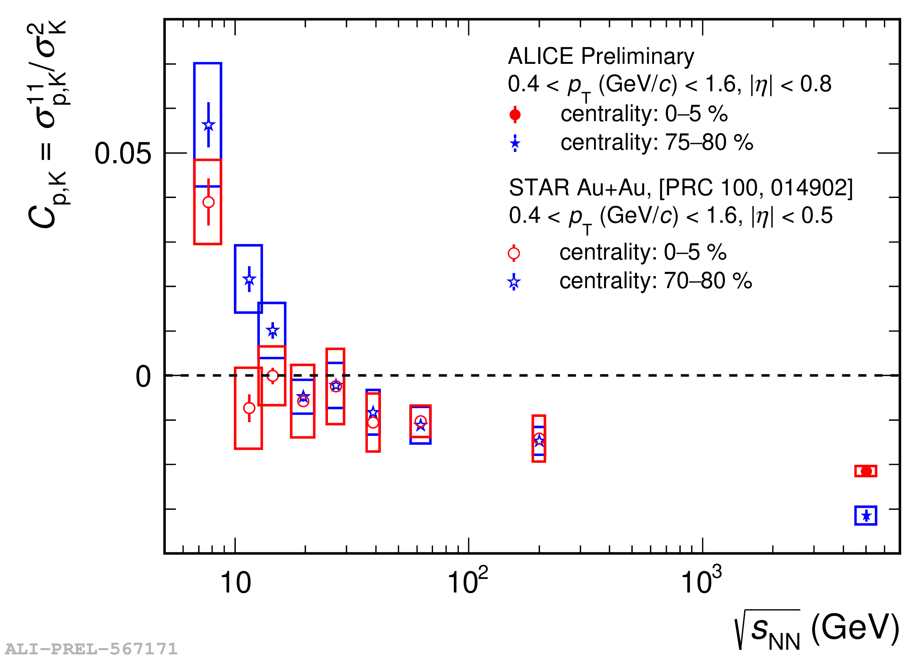
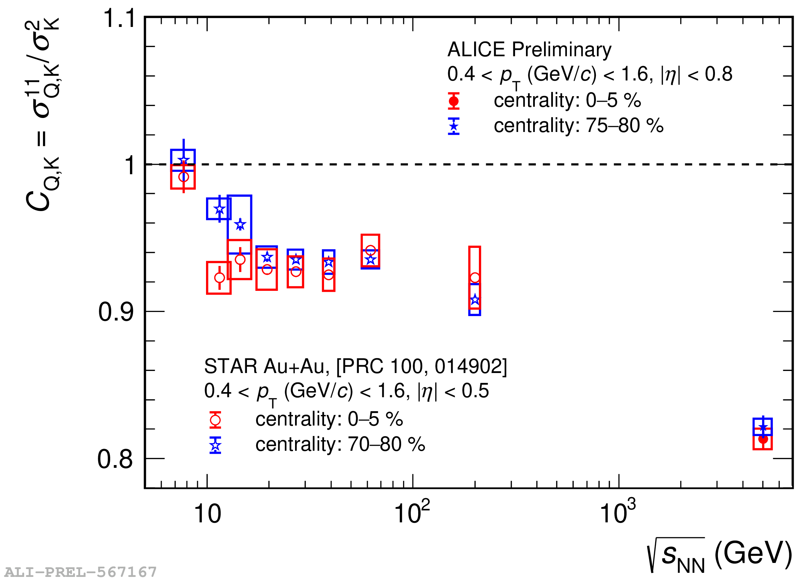
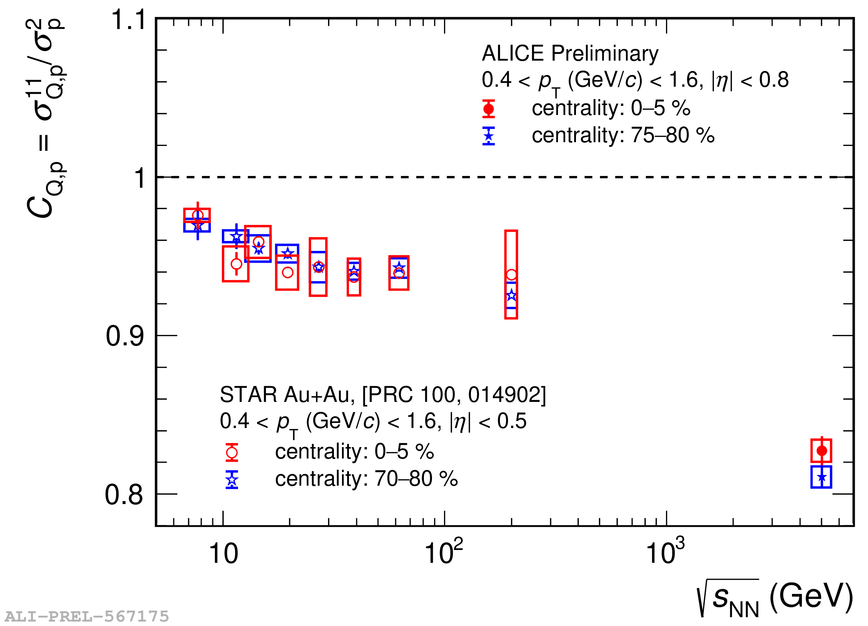
Energy dependence
Baryon-Strangeness Correlations
Electric Charge- Strangeness Correlations
Baryon-Electric Charge Correlations
Decrease in correlations with increase in beam energy
Baryon-strangeness correlations change sign
13/34
Swati Saha (ALICE): SQM2024 and ICHEP2024

Slide 14













Lattice QCD and Magnetic Field
Can we test this in experiments?
14/34
Phys. Rev. Lett. 132 (2024) 201903 and arXiv: 2312.08860

Slide 15
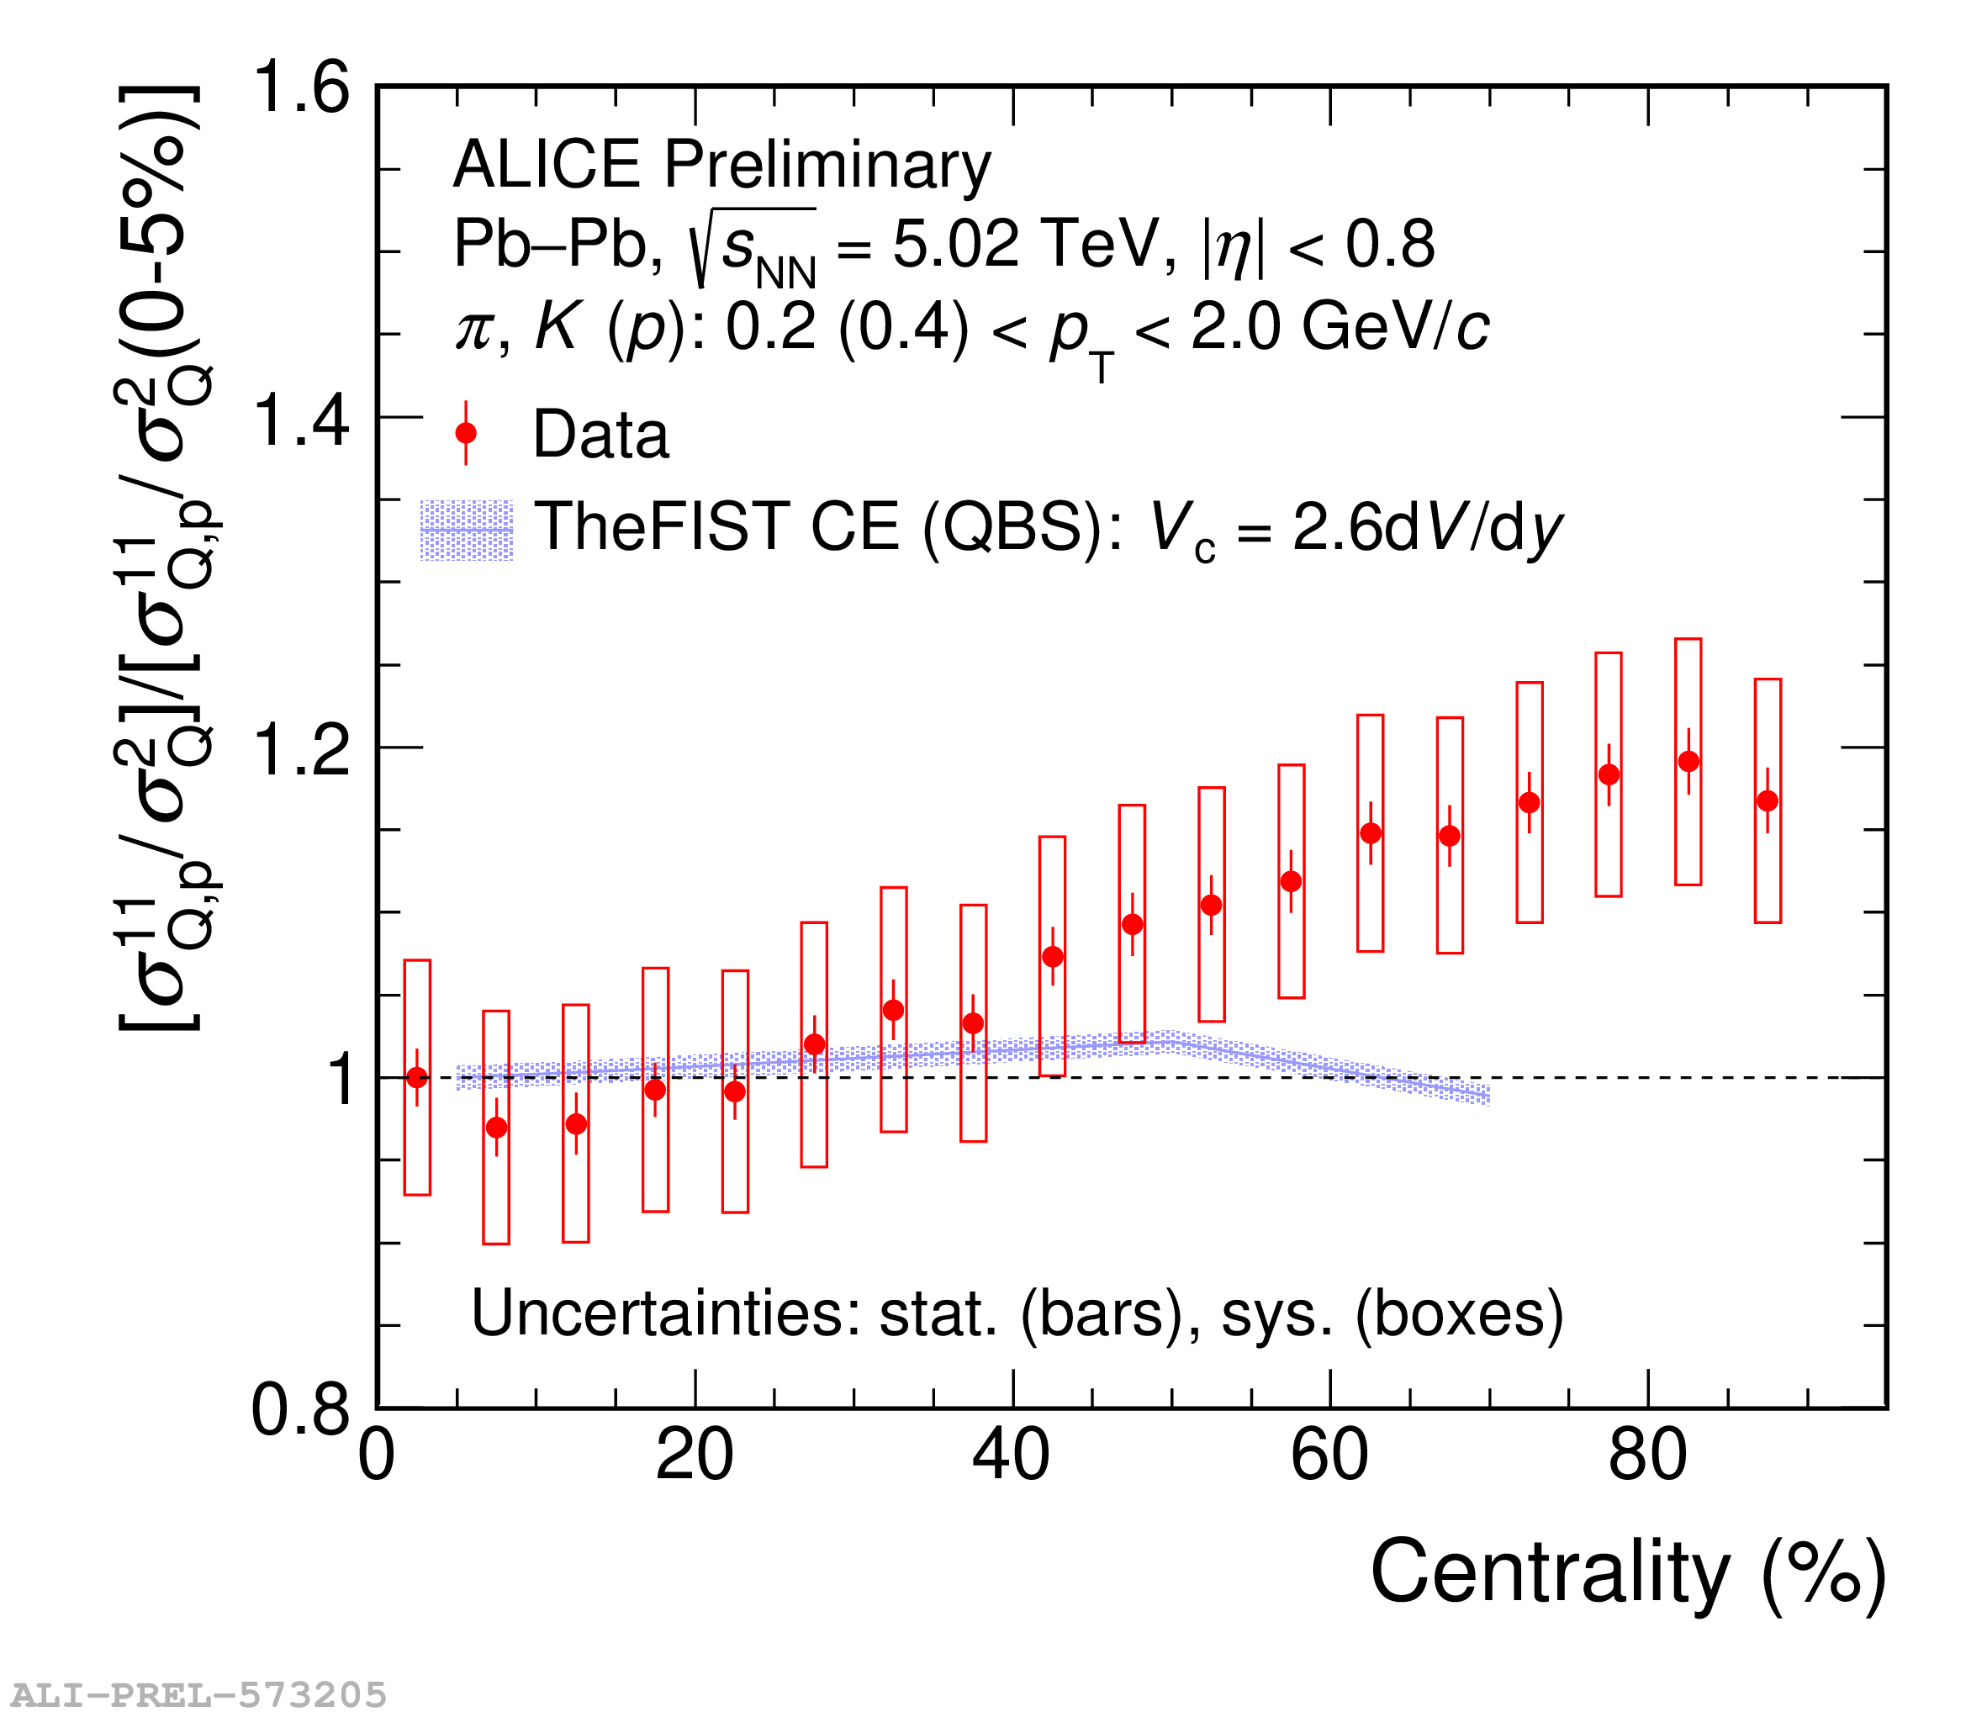
Effect of Initial Magnetic Field on Fluctuations
Swati Saha (ALICE): SQM2024 and ICHEP2024
More magnetic field
Less magnetic field
Whether imprints of a strong magnetic field exist
in the final stage of heavy-ion collisions?
15/34

Slide 16
Conclusions: LHC results
Measurement of net-proton number fluctuations up to 2nd and 3rd order
LHC Data helps us to understand the role of
        Conservation laws
        Resonance decays
        Long range correlations
  on fluctuation measures as we set the stage for higher order measurements.
Interesting results for observable claimed to be sensitive to initial magnetic field effects
Need measurements for 6th order to see effect of cross over
16/34

Slide 17
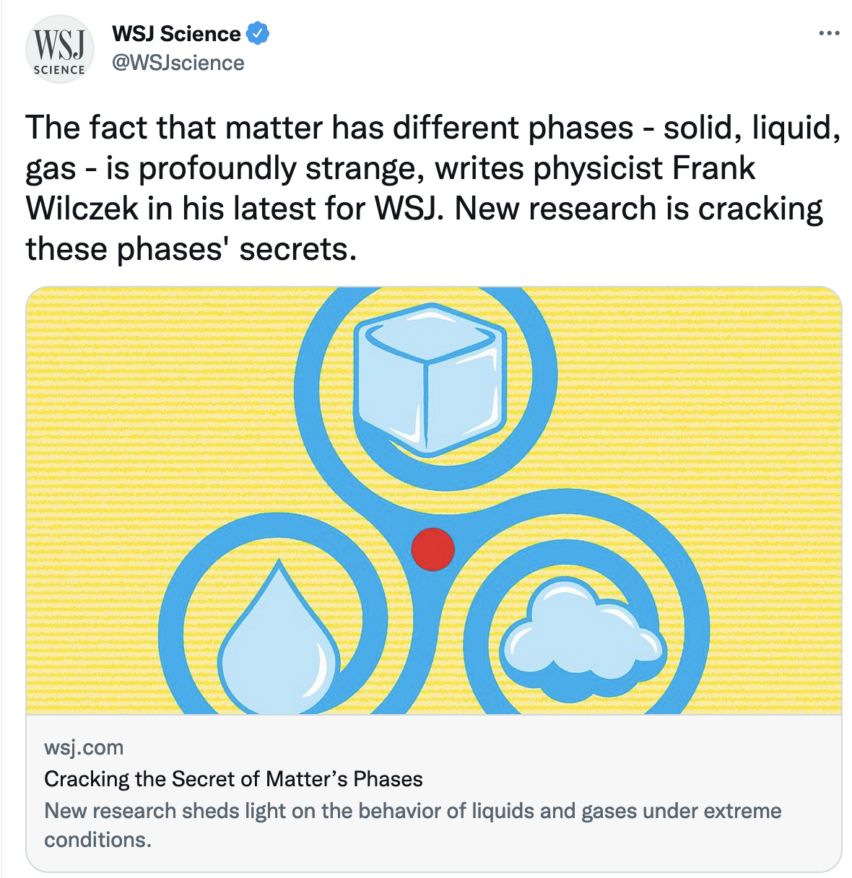
17/34
Experimenters at Brookhaven have reported hints of just such behavior. They are now analyzing a much bigger data set to nail it down (or not). If all goes well, they’ll have demonstrated that deep ideas invented to understand problems in physical chemistry and thermal engineering continue to be useful far beyond their down-to-earth origins.

Slide 18
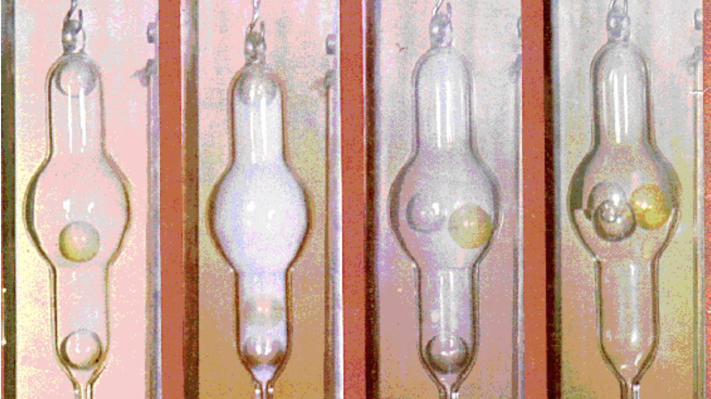
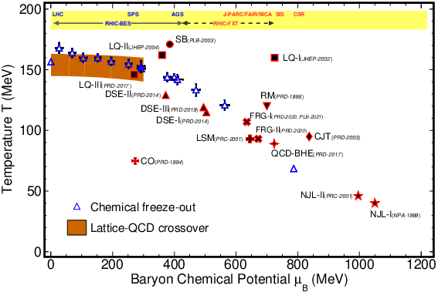
Where is the Critical Point ?
Prog.Part.Nucl.Phys. 125 (2022) 103960
18/34

Slide 19
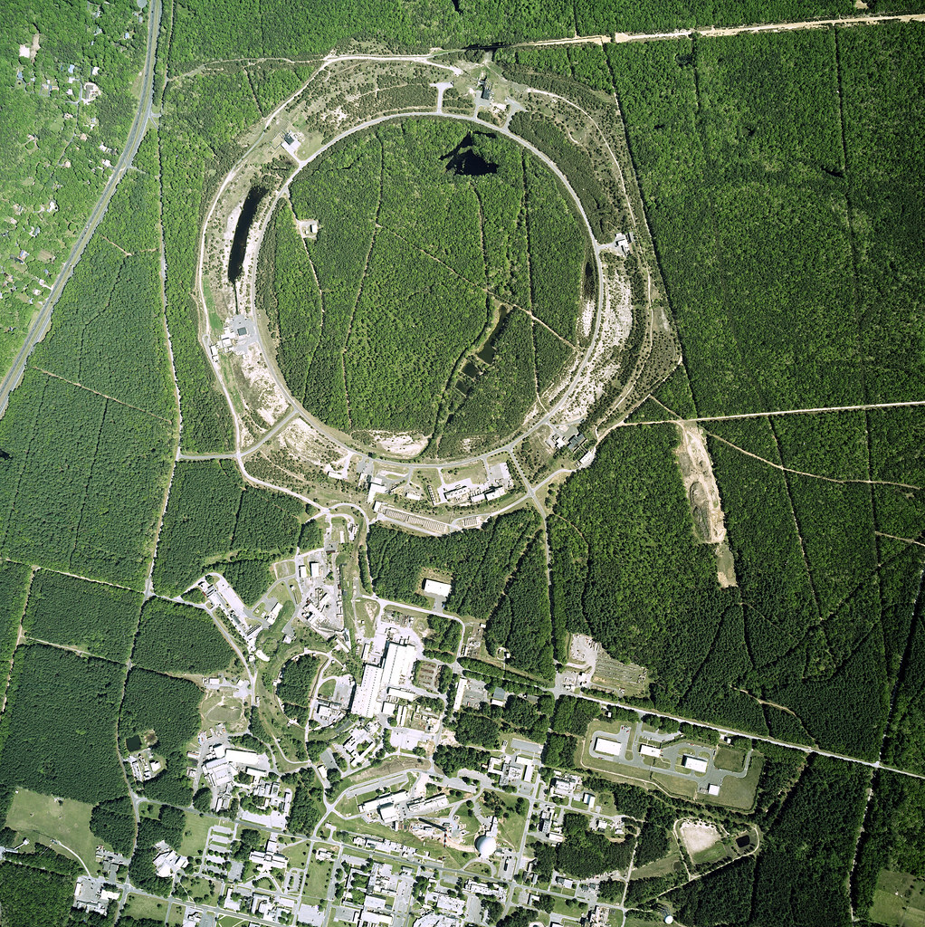
https://www.bnl.gov/rhic/
Results from the STAR experiment at Relativistic Heavy Ion Collider
19/34

Slide 20
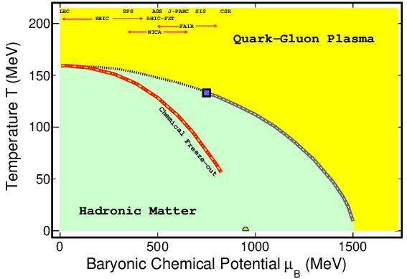
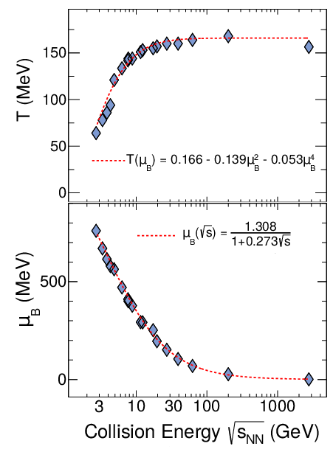
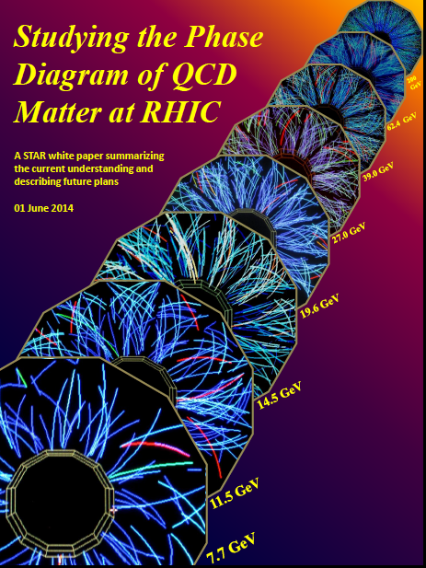
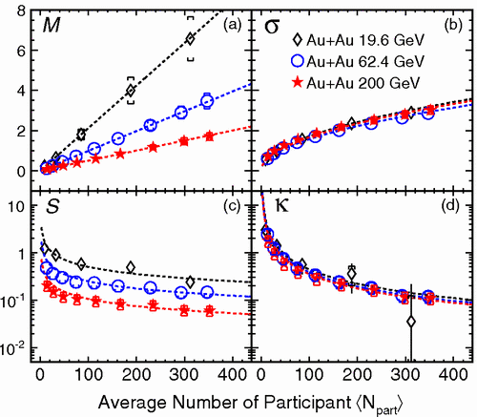
Beam Energy Scan Program @ RHIC
Landmark point on the QCD phase diagram
Prog.Part.Nucl.Phys. 125 (2022) 103960
Access to phase diagram: varying collision energy of heavy-ion varies the temperature and baryon chemical potential.
20/34
STAR: Phys.Rev.Lett. 105 (2010) 022302

Slide 21
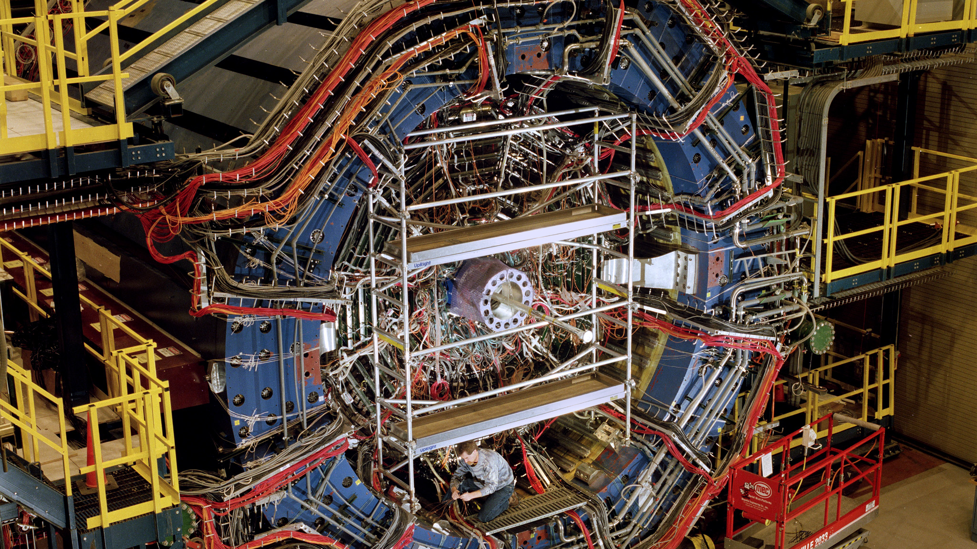
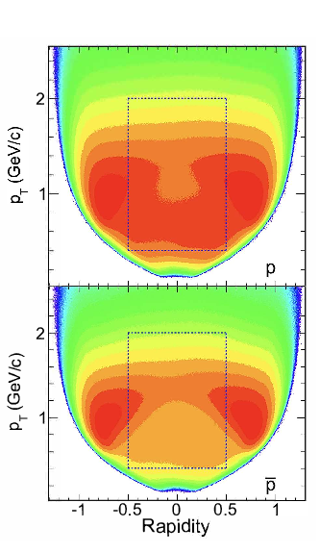
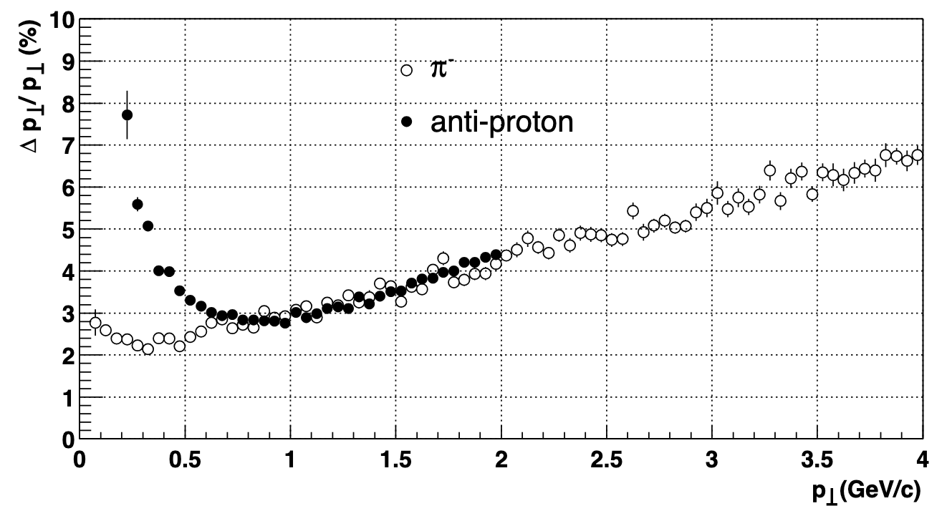
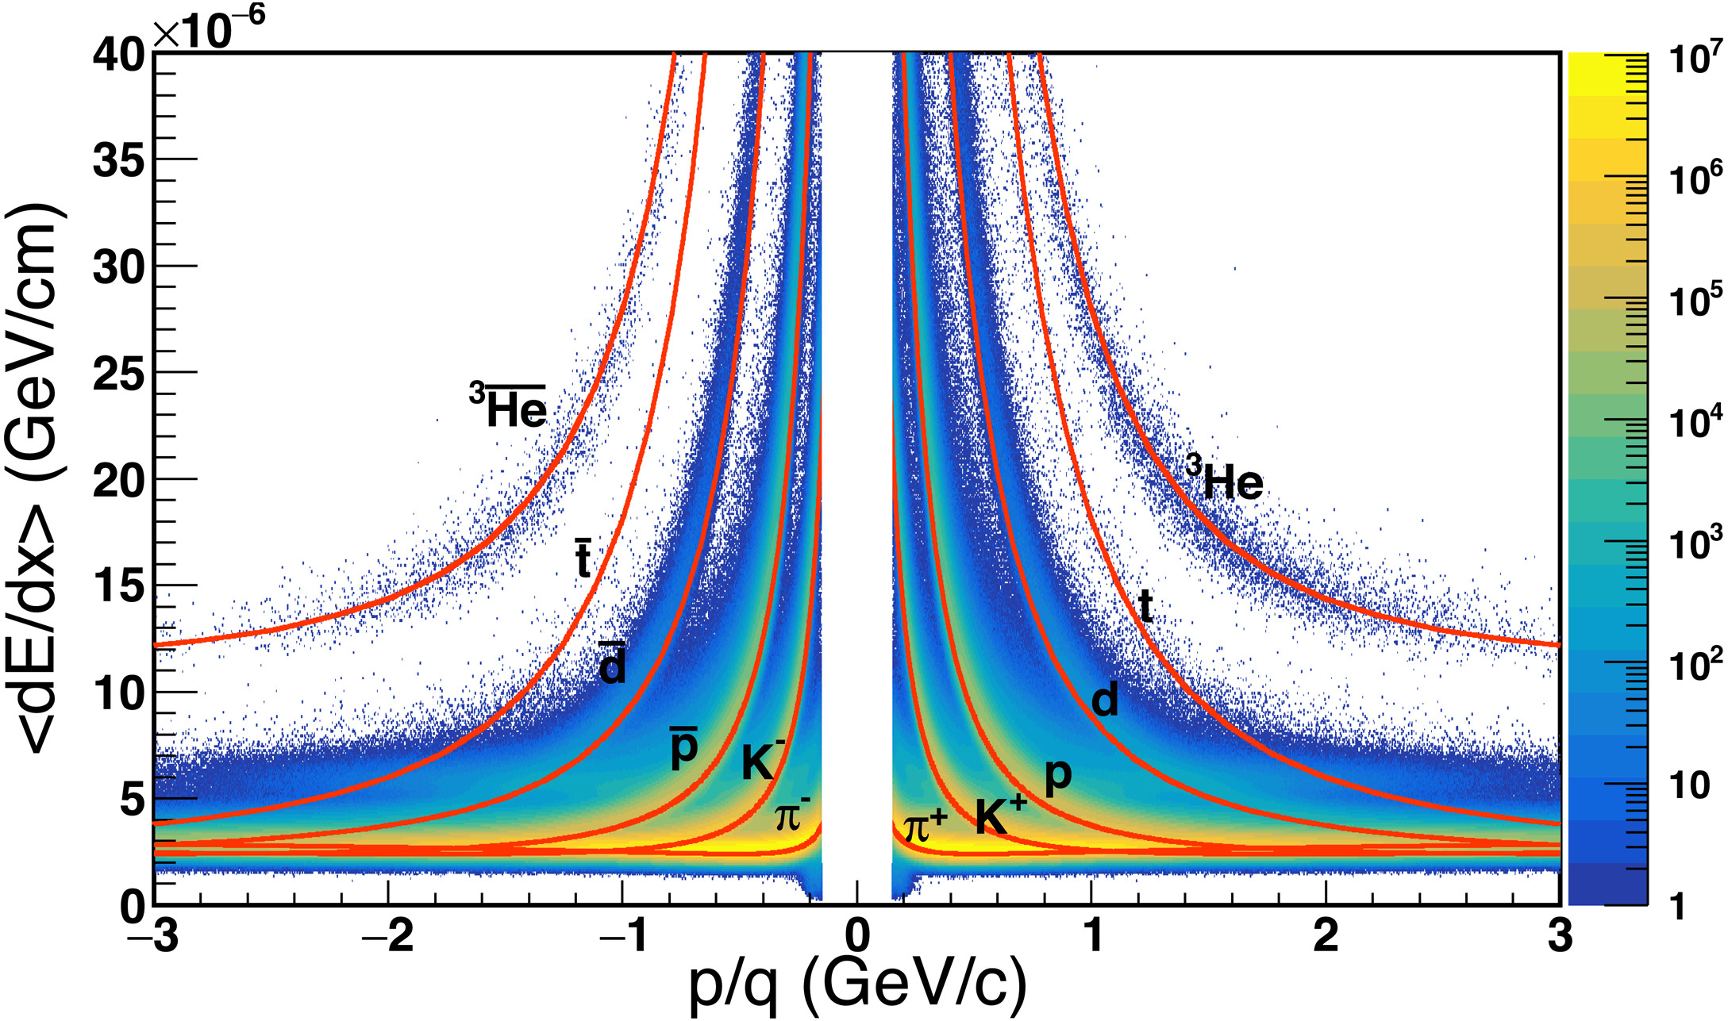
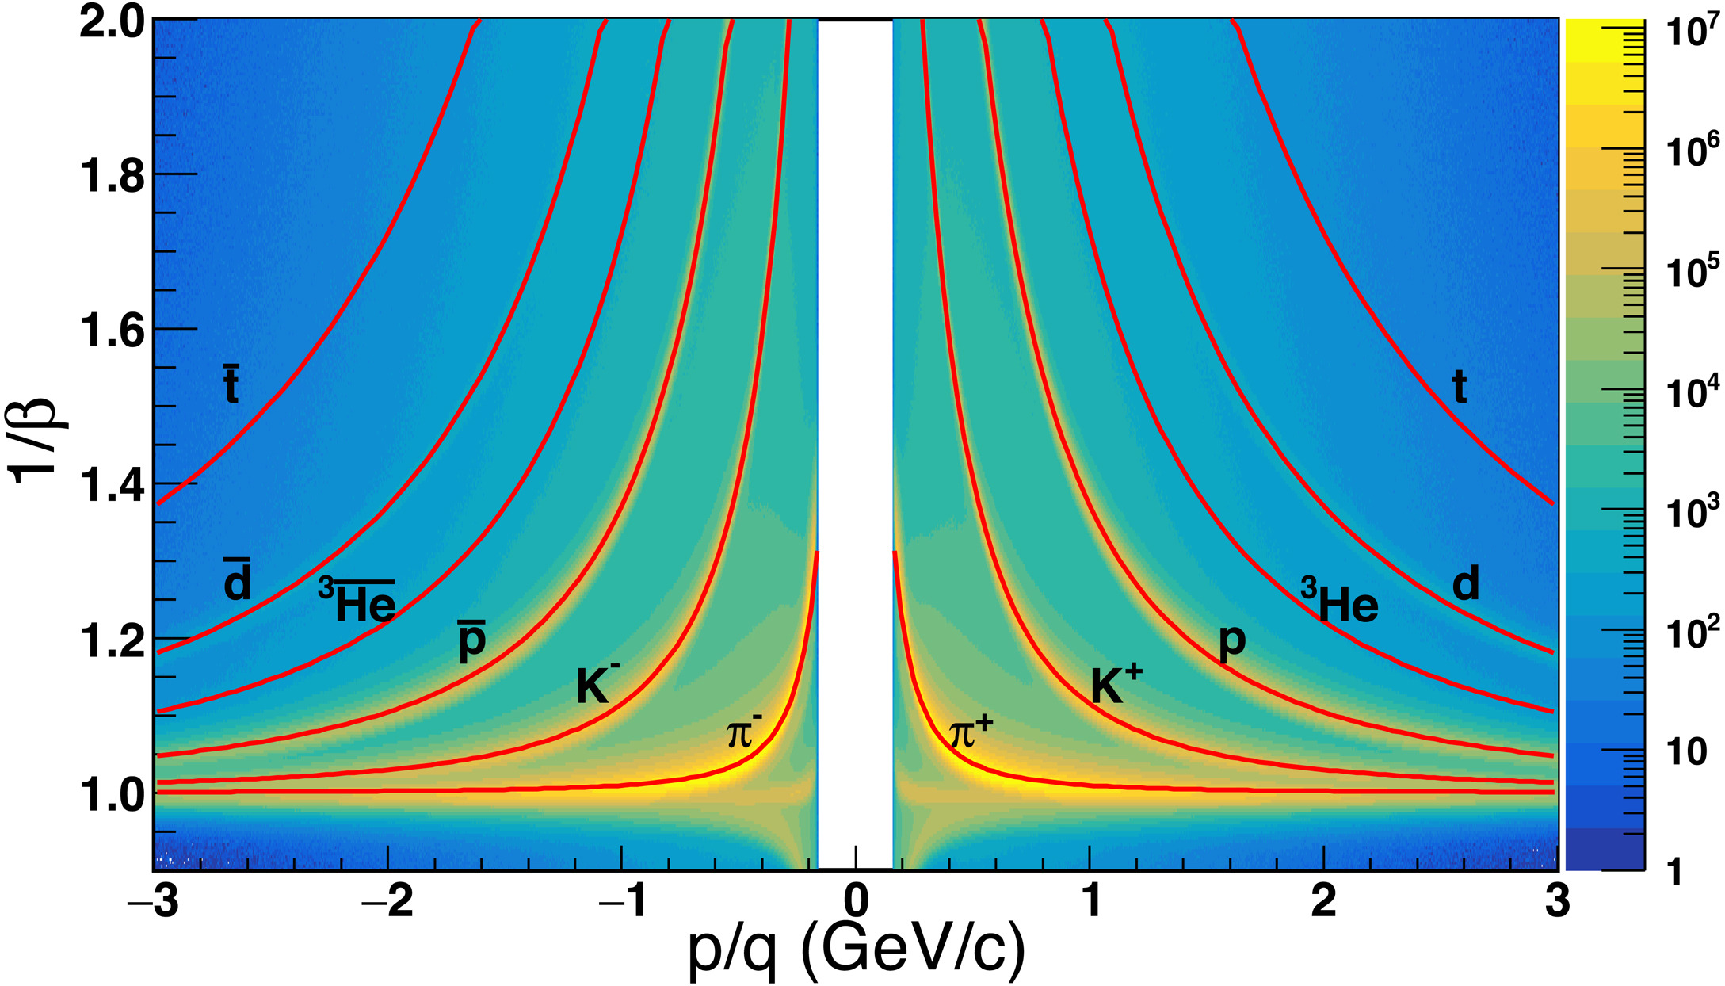
STAR Experiment
STAR: Detector
RHIC: Accelerator with capability to collide heavy-ions at varying colliding energies
Excellent particle identification
Uniform acceptance
21/34
Good momentum resolution
Nucl.Instrum.Meth.A 499 (2003) 624-632

Slide 22

Observable
Event-by-event fluctuations in conserved number multiplicity
PHYSICAL REVIEW LETTERS 126, 092301 (2021)
$C_{2}\sim ξ^{2}$ $C_{4}\sim ξ^{7}$
$\frac{χ_{q}^{(4)}}{χ_{q}^{(2)}}=κσ^{2}= \frac{C_{4,q}}{C_{2,q }}$ $\frac{χ_{q}^{(3)}}{χ_{q}^{(2)}}=Sσ= \frac{C_{3,q}}{C_{2,q }}$
Experimentally measured moments or cumulants of multiplicity distributions relates to Susceptibility (χ) calculated in theory.
Signature: Non-monotonic variation of net-proton number cumulants with collisions energy
22/34

Slide 23
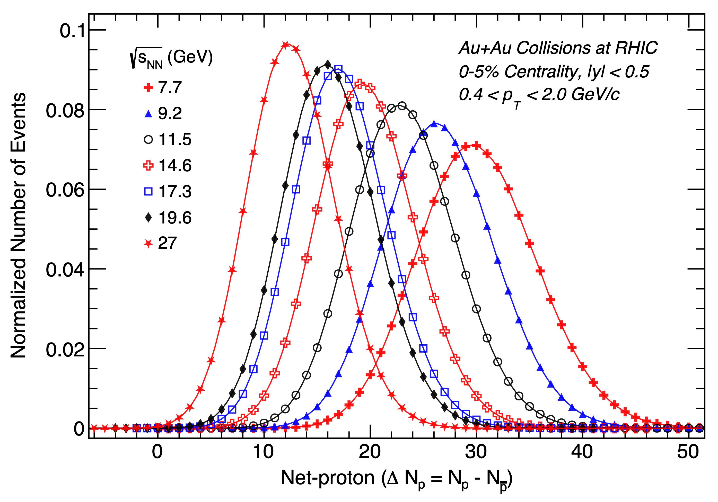
Beam Energy Scan Phase-I vs. Phase-II
10-18-fold increase in statistics
Two new collision energies
A. Pandav (STAR Collaboration) – CPOD2024
23/34

Slide 24
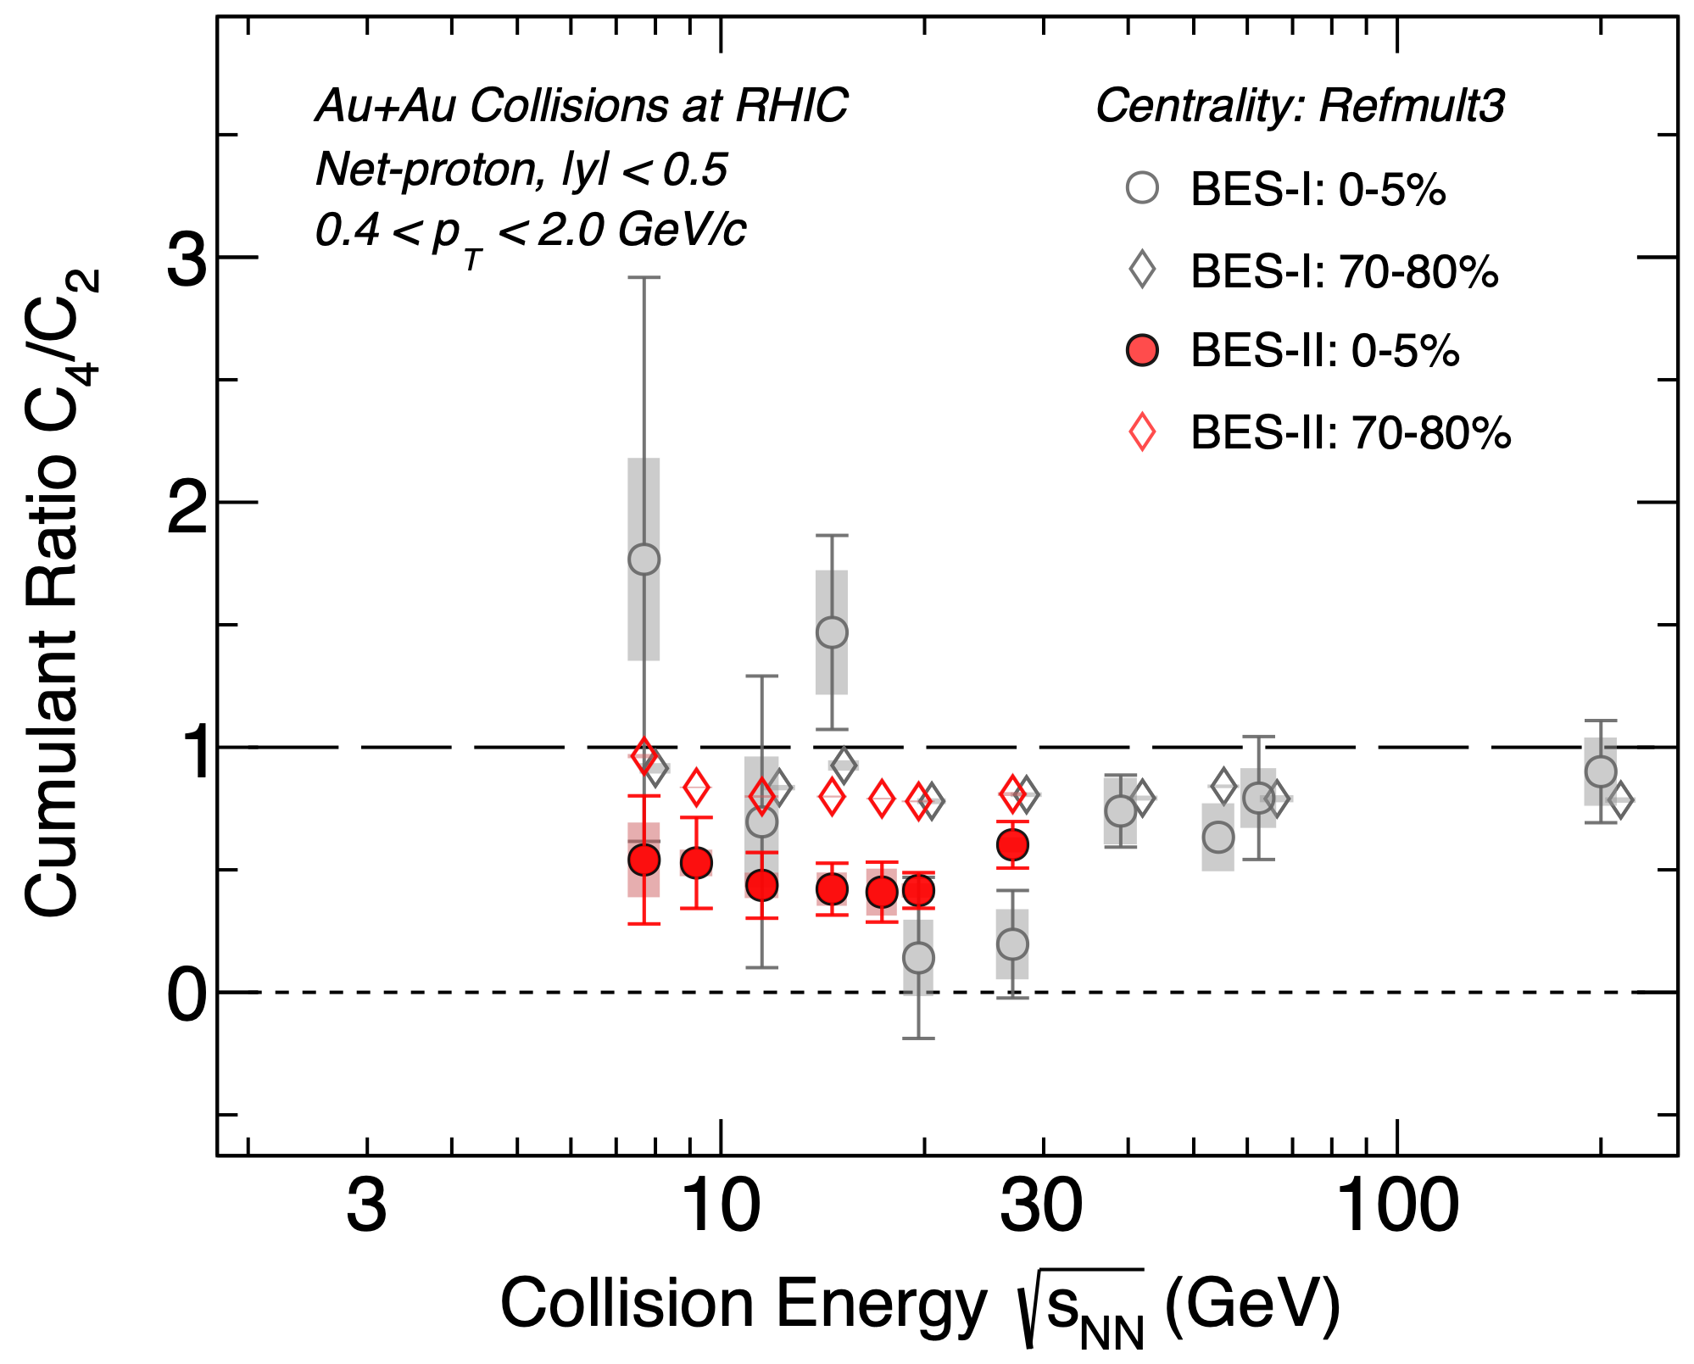
Beam Energy Scan Phase-I vs. Phase-II
STAR Preliminary
1-2 σ level consistency with BES-I
A. Pandav (STAR Collaboration) – CPOD2024
24/34

Slide 25
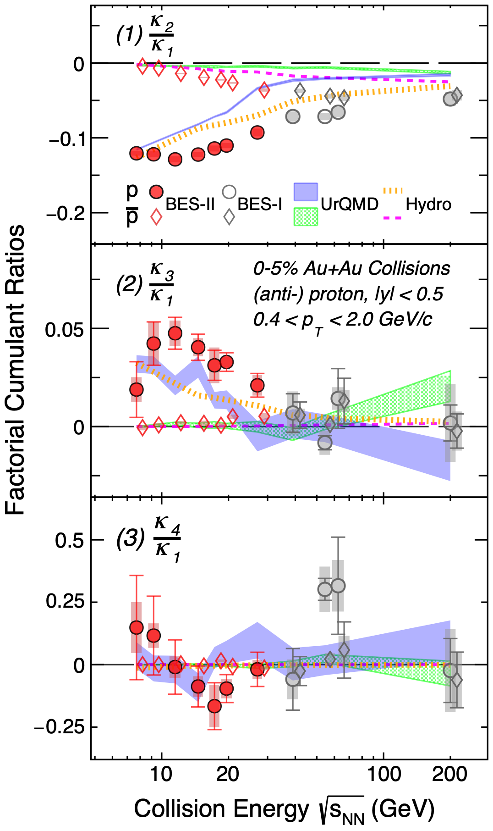
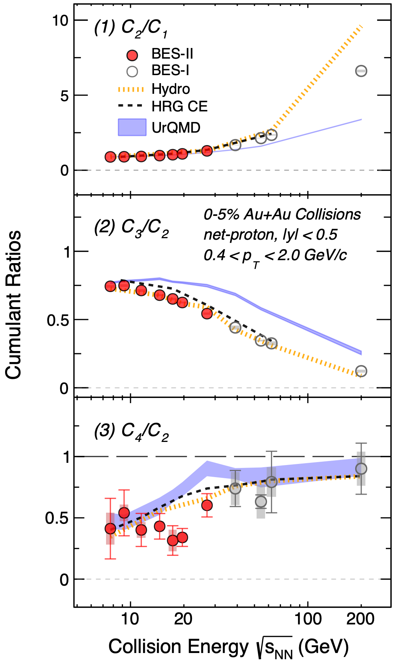
25/34
A. Pandav (STAR Collaboration) – CPOD2024
Results on QCD Critical Point Search
STAR Preliminary
STAR Preliminary
Quantitative differences exist between data and non-CP models

Slide 26
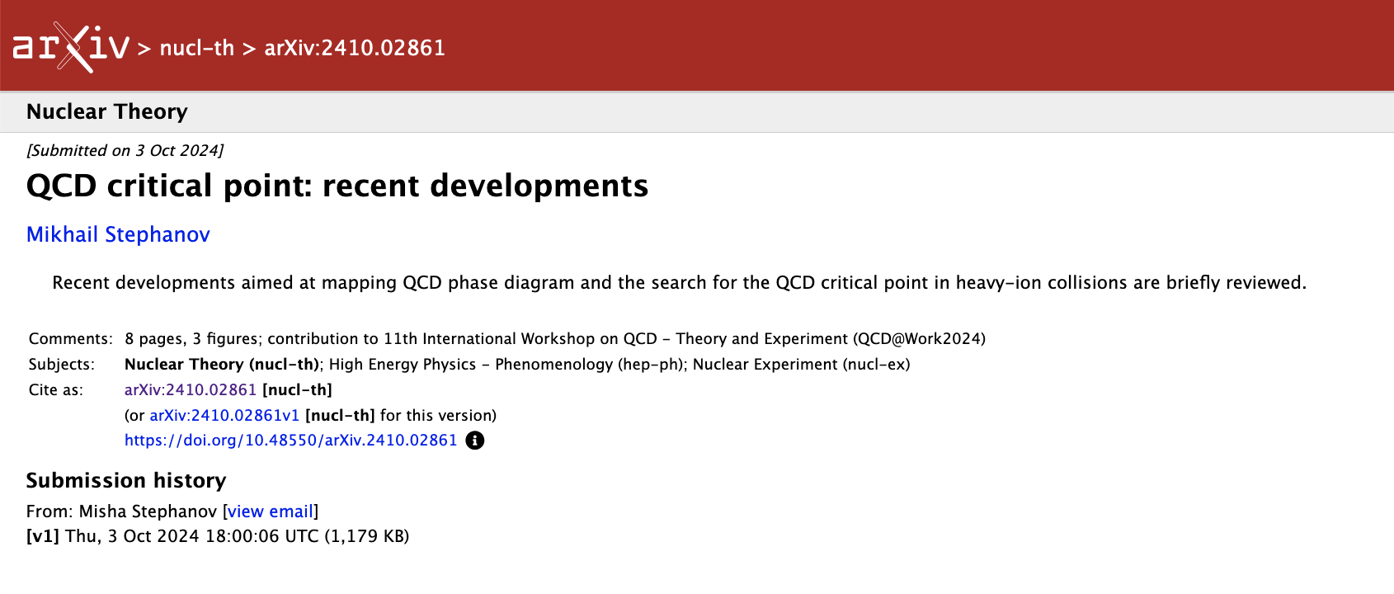
CP-Model based interpretation
M. Stehphanov : arXiv: 2410.02861
“One expects a peak (bump) in the 2nd and 3rd order cumulants and a dip followed by a peak in the 4th order cumulant as μ_{B} increases of collision energy decreases”
STAR Preliminary
Caveats
Baseline
Based on Ising model (singular & regular)
Does not tell the location of CP
CP based model in qualitative agreement with measurements
26/34

Slide 27
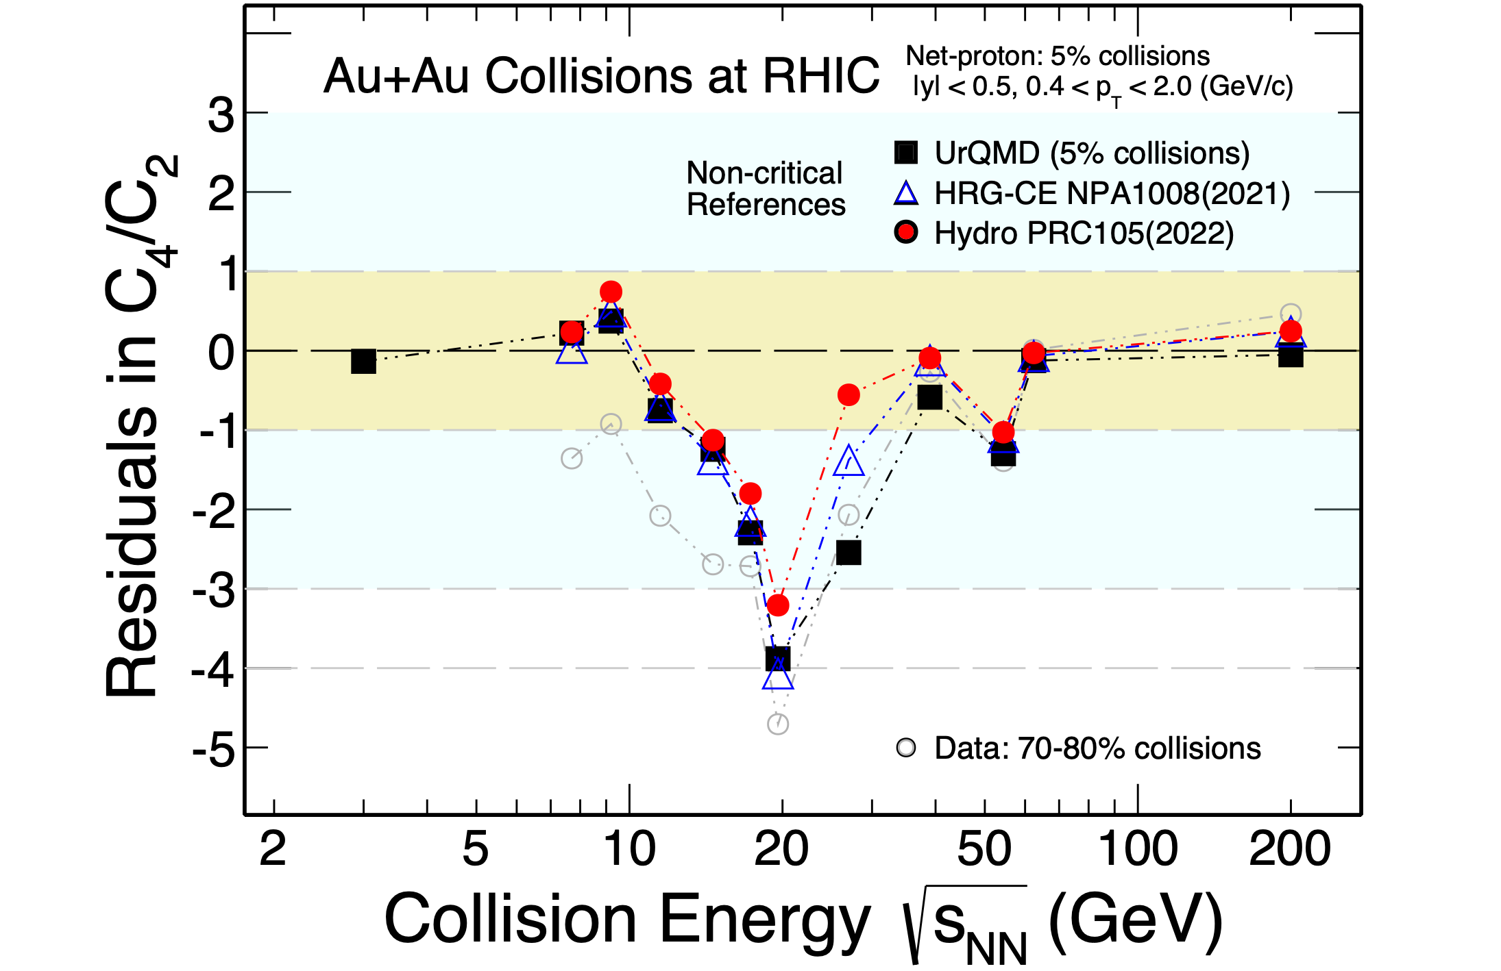
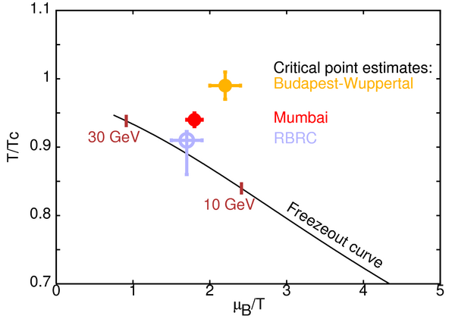
Relative to lattice-based expectation
STAR Preliminary
Lattice results at high μ_{B} needs specific methods. Need to keep in mind system size, continuum extrapolation and scale setting
Intriguing experimental result
Need theory to confirm/rule out presence of QCD CP
27/34

Slide 28
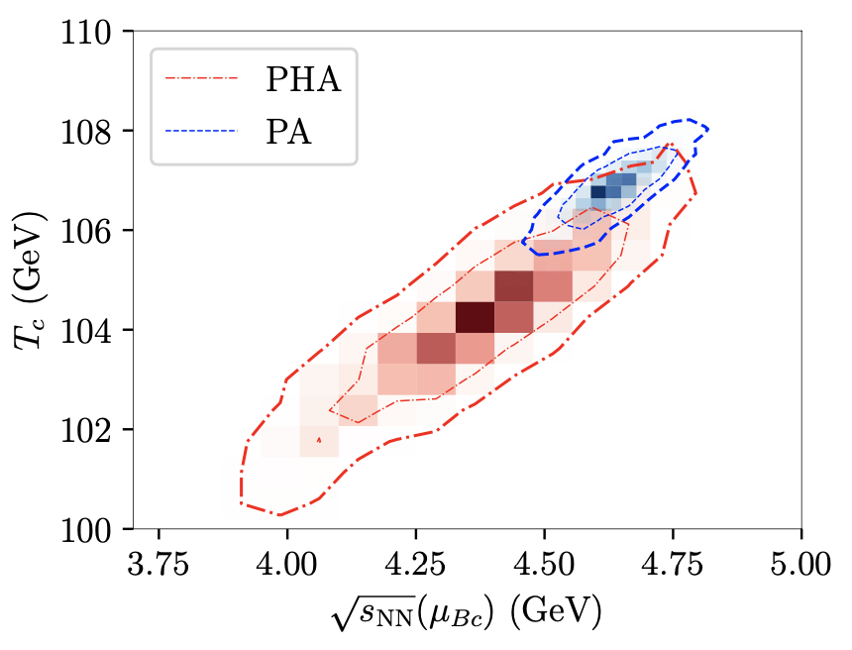
Where is the critical point ?
Little Bang to Femto Nova program ?
Dyson-Schwinger equations (DSEs) and the functional renormalization group (fRG) approach: Phys. Rev. D 110, 014036 (2024)
Important to understand the assumptions and limitations for each theoretical model
28/34
Holography: arXiv:2309.00579

Slide 29
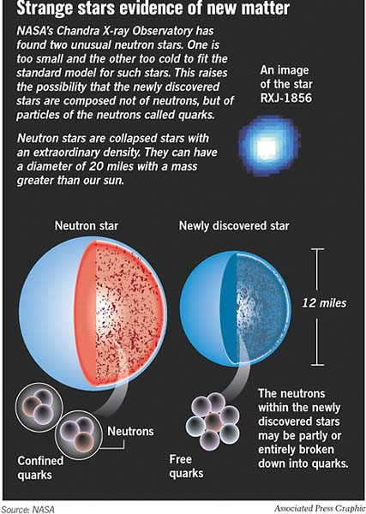
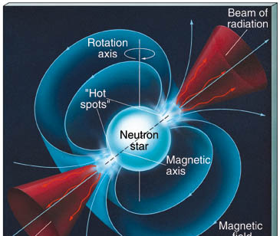
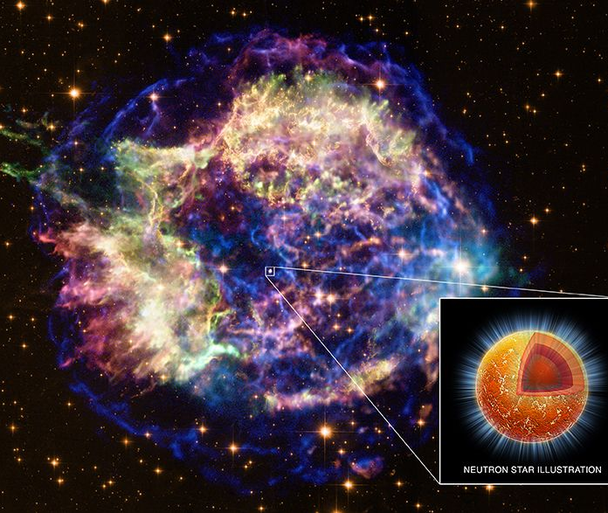
Supernova to Femto-Nova
29/34
Little-Bang and Femto-Nova in Nucleus-Nucleus Collisions
e-Print: 2009.03006 [hep-ph] (with Kenji Fukushima and Nu Xu)
Rotations up to 40000 per minute
Magnetic Fields up to trillion Gauss
Density 3 times normal matter

Slide 30


~ 10¹⁸ Gauss Magnetic Field
Compress Matter → QGP
~ 3 normal nuclear matter density (2.3×10¹⁷ kg/m³)
$$ℏ$$
Kilonova
Neutron star merges
~ 10⁵ $ℏ$Angular Momentum
Theoretical support for Femto-Nova
30/34

Slide 31






Densities ~10¹⁸ kg/m³ !
Facility for Anti-proton and Ion Research (FAIR)
And
Nuclotron-based Ion Collider fAcility (NICA)
31/34

Slide 32


Little bang to Femto nova program
Systematic study of the phase structure of QCD Phase diagram.
2. Opportunity for a dedicated study of high
baryon density matter
  Finding direct signals of true phase transition and critical point.
  Understanding the properties of high baryon density, rotating QCD matter under magnetic field.
  Understanding nuclei, hyper-nuclei and exotic nuclei formation and properties
3. Complementary to research programs at RHIC-BES, CERN, FAIR, NICA, J-PARC & CEE-HIAF
e-Print: 2004.04681 [hep-ph]
And miles to go before I sleep …..
Little-Bang and Femto-Nova in Nucleus-Nucleus Collisions
e-Print: 2009.03006 [hep-ph] (with Kenji Fukushima and Nu Xu
32/34

Slide 33






Criticality
Test of Thermal models
Polarization
Hyper-Nuclei
Femto-Nova
High baryon
density
experiments
CEE@HIAF
33/34

Slide 34










Acknowledgements
Acknowledgements
Thanks for this opportunity
34/34

