Slide 1

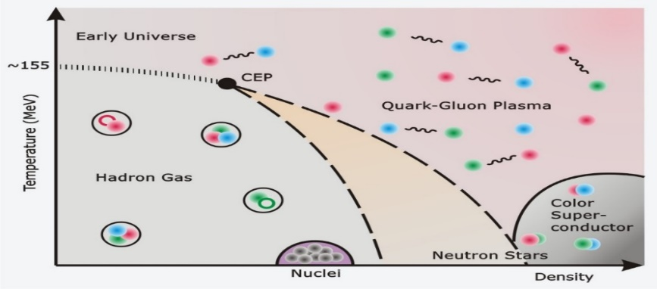





Dense QCD Matter under a Strong External Field
Pengfei Zhuang, Tsinghua University
$$T$$
$$？$$
$$n_{B}$$
$$？$$
$$B,ω$$
Pengfei Zhuang, PHD2024, CCNU, Wuhan, 20241002 0

Slide 2
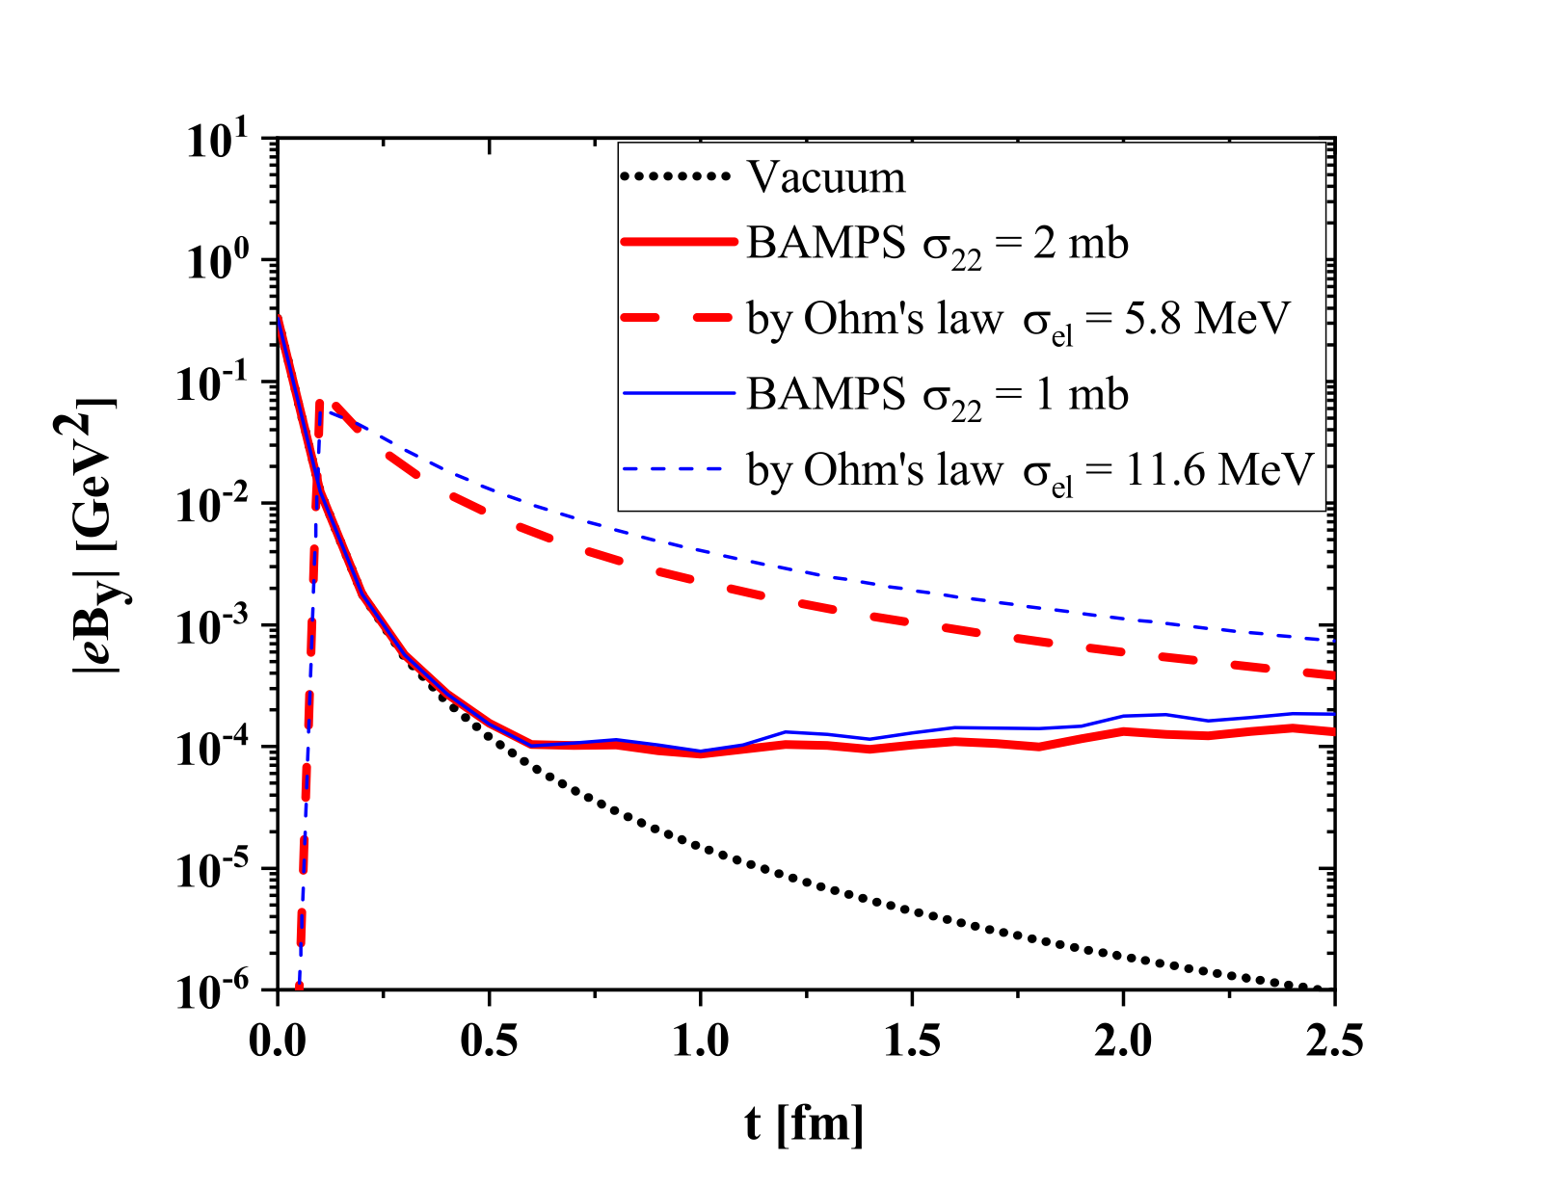
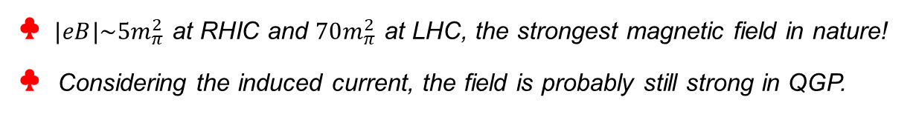
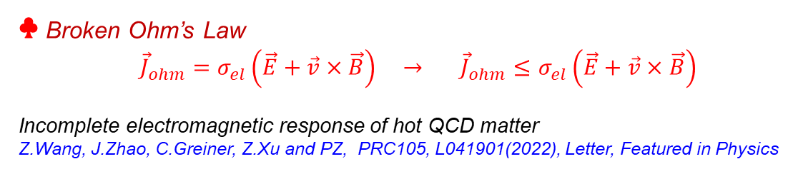
Magnetic Field
♣ $|eB|\sim 5m_{π}^{2}$ at RHIC and $70m_{π}^{2}$ at LHC, the strongest magnetic field in nature!
♣ Considering the induced current, the field is probably still strong in QGP.
K.Tuchin, (with Ohm’s law)
BAMPS (without Ohm’s law)
♣ Broken Ohm’s Law
${\vec{J}}_{ohm}=σ_{el}\left(\vec{E}+\vec{v}×\vec{B}\right) →$ ${\vec{J}}_{ohm}≤σ_{el}\left(\vec{E}+\vec{v}×\vec{B}\right)$
Incomplete electromagnetic response of hot QCD matter
Z.Wang, J.Zhao, C.Greiner, Z.Xu and PZ, PRC105, L041901(2022), Letter, Featured in Physics
♣ Question:
Suppose the magnetic field in QGP is still strong, can we see its effect on QCD
matter at RHIC and LHC ?
Pengfei Zhuang, PHD2024, CCNU, Wuhan, 20241002 1

Slide 3
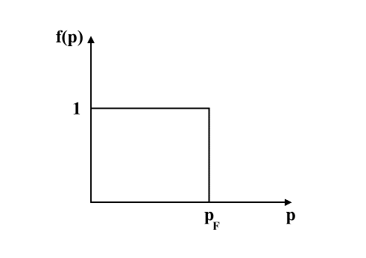
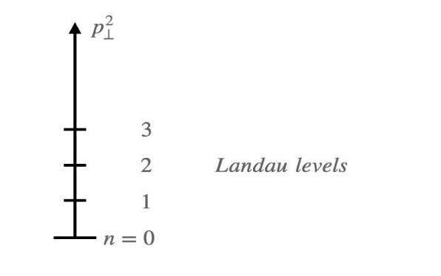



Competition between B and T ($μ_{B}$)
1) Competition between B and T:
$\vec{B}$ breaks down the translation invariance, but T restores the invariance.
$→$ Is the B field strong enough to be measured in thermal medium with$T\sim 300−500 MeV$?
2) Competition between B and $μ_{B}$:
What will happen when the sharp Fermi surface meets discrete Landau levels?
$$p_{⊥}^{2}=2n\left|qB\right|$$
Pengfei Zhuang, PHD2024, CCNU, Wuhan, 20241002 2

Slide 4
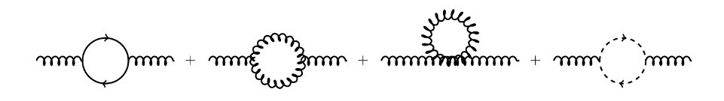
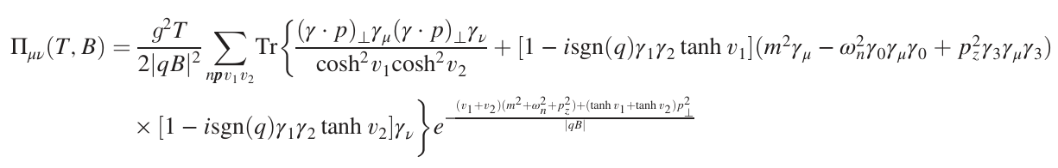


Gluon Propagator
G.Huang, J.Zhao and PZ, Phys.Rev.D107, 114035(2023)
Gluon self-energy at one-loop level
Quark propagator $G(p)$ and loop $Π_{μν}(T,B,k=0)$:
Gluon loop ${\overline{Π}}_{μν}(T,k)$ is independent of the magnetic field
Schwinger propagator, 1951
Resummation of the ring diagrams $→$ full gluon propagator
$$Π, all the one−loop polarization$$
Pengfei Zhuang, PHD2024, CCNU, Wuhan, 20241002 3

Slide 5
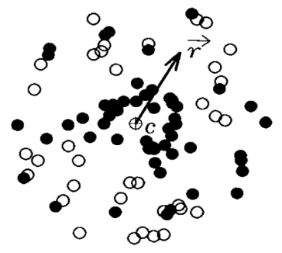

Screening Mass
G.Huang, J.Zhao and PZ, Phys.Rev.D107, 114035(2023)
Debye screening of a pair of charged particles $q\overline{q}$:
$\frac{1}{r}→\frac{1}{r}e^{−m_{D}r}=\frac{1}{r}e^{−r/r_{D}}$
screening mass $m_{D}$
screening length $r_{D}$
Pole of the propagator at gluon momentum $k_{0}^{2}=0 and {\vec{k}}^{2}=−m_{D}^{2}$ $→$ screening mass:
Pengfei Zhuang, PHD2024, CCNU, Wuhan, 20241002 4

Slide 6
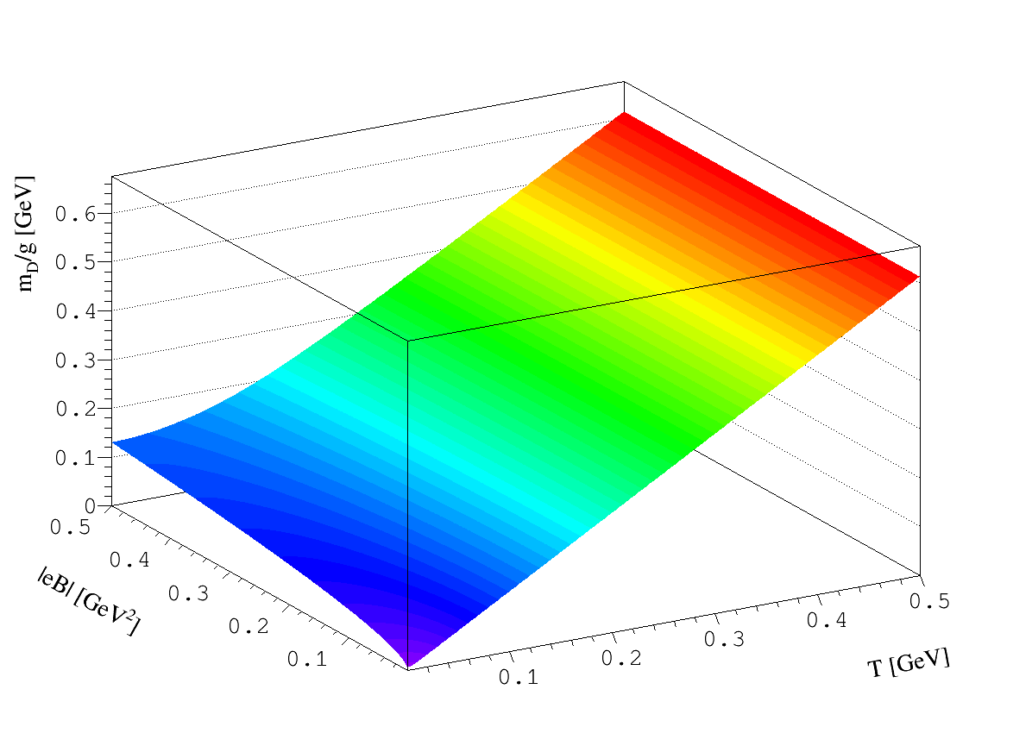

Competition between B and T
● $m_{D}/g$ is $g$ independent.
● $m_{D}\left(0,B\right)=0.13$GeV at $eB=25m_{π}^{2}.$
● the B effect is gradually cancelled by thermal motion !
G.Huang, J.Zhao and PZ, Phys.Rev.D107, 114035(2023)
Even if the magnetic field in QGP is strong enough, its effect on QCD matter is weak at high temperature, due to the cancelled from the thermal motion. .
Pengfei Zhuang, PHD2024, CCNU, Wuhan, 20241002 5

Slide 7
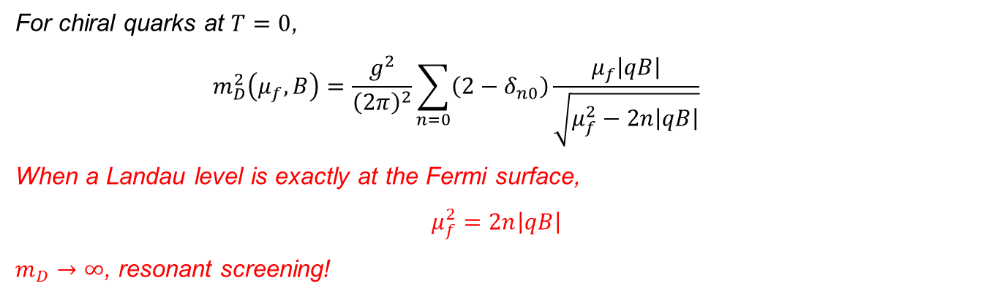

Competition between B and $μ_{B}$
G.Huang, J.Zhao and PZ, Phys.Rev.D108, L091503(2023)
For chiral quarks at $T=0$,
$$m_{D}^{2}\left(μ_{f},B\right)=\frac{g^{2}}{{\left(2π\right)}^{2}}\sum_{n=0}{\left(2−δ_{n0}\right)\frac{μ_{f}\left|qB\right|}{\sqrt{μ_{f}^{2}−2n\left|qB\right|}}}$$
When a Landau level is exactly at the Fermi surface,
$$μ_{f}^{2}=2n\left|qB\right|$$
$m_{D}→∞$, resonant screening!
The color interaction in dense and magnetized QCD matter is completely screened, it becomes the Shubnikov-de Hass oscillation at $T≠0$.
Pengfei Zhuang, PHD2024, CCNU, Wuhan, 20241002 6

Slide 8
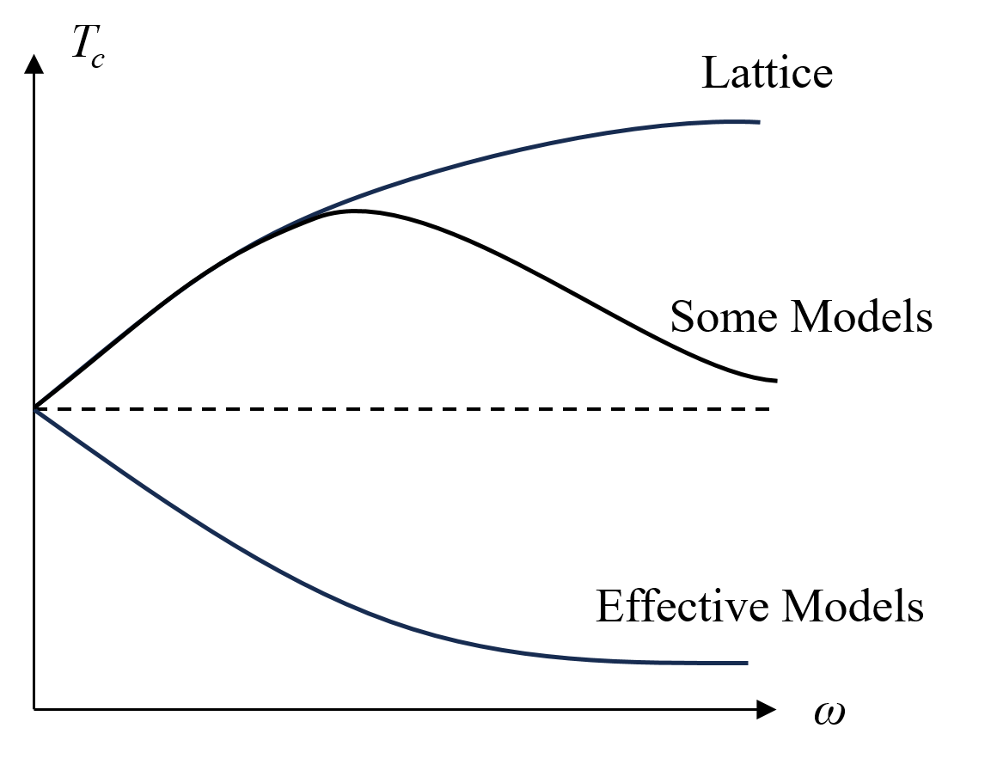
Rotation Puzzle
favor confinement
favor deconfinement
Does a rotation favor confinement or deconfinement ?
We need analytic calculations in QCD.
Yin Jiang, this afternoon
Also the work by Defu Hou group: arXiv:2407.03633
Pengfei Zhuang, PHD2024, CCNU, Wuhan, 20241002 7

Slide 9

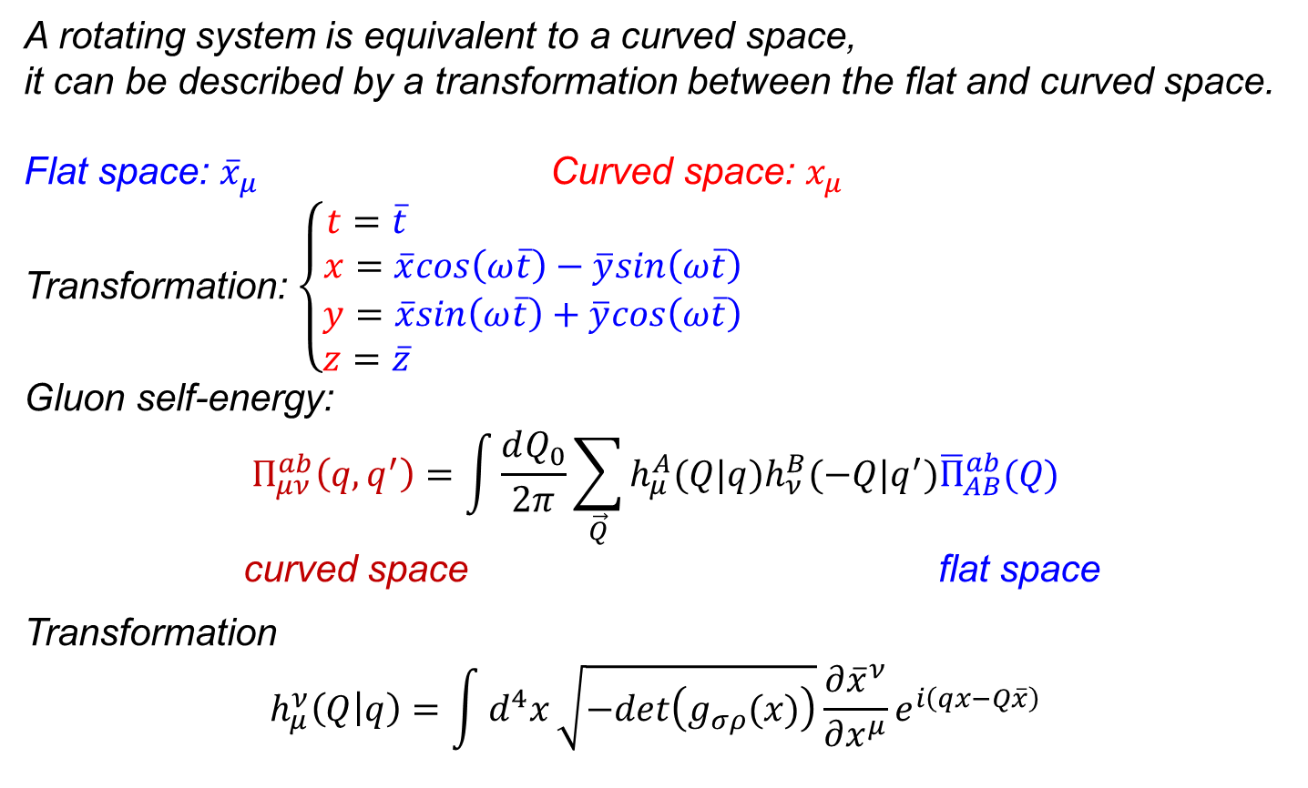
Gluon Propagator in Curved Space $\left(ω≠0\right)$
G.Huang, S.Chen, Y.Jiang, J.Zhao and PZ, ArXiv:2410.09108
A rotating system is equivalent to a curved space, it can be described by a transformation between the flat and curved space.
Flat space: ${\overline{x}}_{μ}$ Curved space: $x_{μ}$
Transformation: $\left\{\begin{matrix}\begin{matrix}t=\overline{t} \\ x=\overline{x}cos\left(ω\overline{t}\right)−\overline{y}sin\left(ω\overline{t}\right)\end{matrix} \\ \begin{matrix}y=\overline{x}sin\left(ω\overline{t}\right)+\overline{y}cos\left(ω\overline{t}\right) \\ z=\overline{z} \end{matrix}\end{matrix}\right.$
Gluon self-energy:
$$Π_{μν}^{ab}\left(q,q^{′}\right)=\int{\frac{dQ_{0}}{2π}\sum_{\vec{Q}}{h_{μ}^{A}(Q|q)h_{ν}^{B}(−Q|q^{′}){\overline{Π}}_{AB}^{ab}(Q)}}$$
curved space flat space
Transformation
$$h_{μ}^{ν}\left(Q | q\right)=\int{d^{4}x}\sqrt{−det\left(g_{σρ}(x)\right)}\frac{∂{\overline{x}}^{ν}}{∂x^{μ}}e^{i\left(qx−Q\overline{x}\right)}$$
Pengfei Zhuang, PHD2024, CCNU, Wuhan, 20241002 8

Slide 10
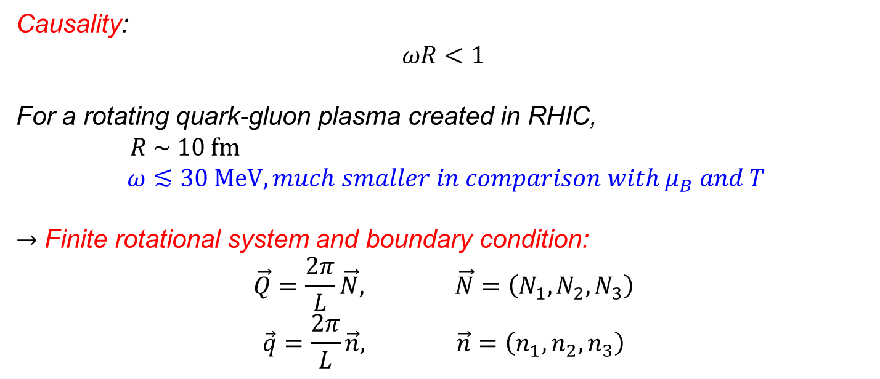
Causality and Boundary Condition
G.Huang, S.Chen, Y.Jiang, J.Zhao and PZ, ArXiv:2410.09108
Causality:
$$ωR<1$$
For a rotating quark-gluon plasma created in RHIC,
$$R \sim 10 fm$$
$$ω≲30 MeV, much smaller in comparison with μ_{B} and T$$
$→$ Finite rotational system and boundary condition:
$$\vec{Q}=\frac{2π}{L}\vec{N}, \vec{N}=\left(N_{1},N_{2},N_{3}\right)$$
$$\vec{q}=\frac{2π}{L}\vec{n}, \vec{n}=\left(n_{1},n_{2},n_{3}\right)$$
Pengfei Zhuang, PHD2024, CCNU, Wuhan, 20241002 9

Slide 11
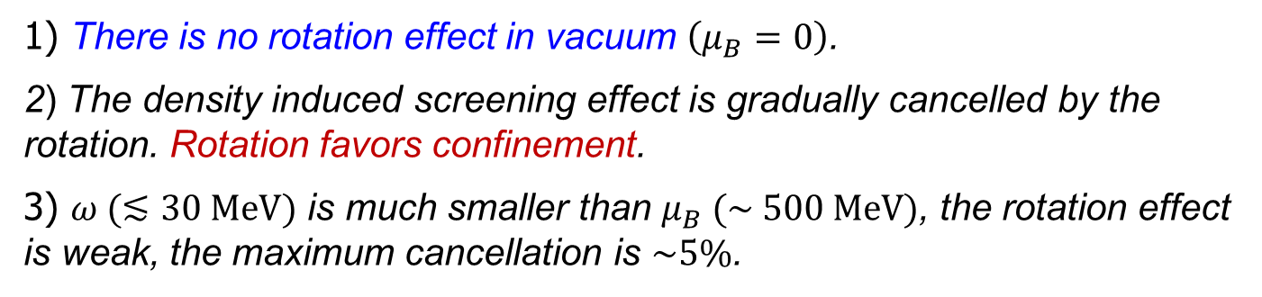

Rotation Effect at Large $μ_{B}$
G.Huang, S.Chen, Y.Jiang, J.Zhao and PZ, ArXiv:2410.09108
1) There is no rotation effect in vacuum $\left(μ_{B}=0\right)$.
2) The density induced screening effect is gradually cancelled by the rotation. Rotation favors confinement.
3) $ω (≲30 MeV)$ is much smaller than $μ_{B} (\sim 500 MeV)$, the rotation effect is weak, the maximum cancellation is $\sim 5\%$.
Pengfei Zhuang, PHD2024, CCNU, Wuhan, 20241002 10

Slide 12

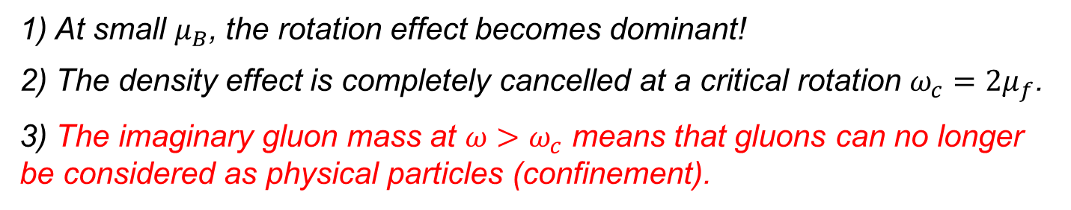
Rotation Effect at Small $μ_{B}$
G.Huang, S.Chen, Y.Jiang, J.Zhao and PZ, ArXiv:2410.09108
1) At small $μ_{B}$, the rotation effect becomes dominant!
2) The density effect is completely cancelled at a critical rotation $ω_{c}=2μ_{f}$.
3) The imaginary gluon mass at $ω>ω_{c}$ means that gluons can no longer be considered as physical particles (confinement).
Pengfei Zhuang, PHD2024, CCNU, Wuhan, 20241002 11

Slide 13
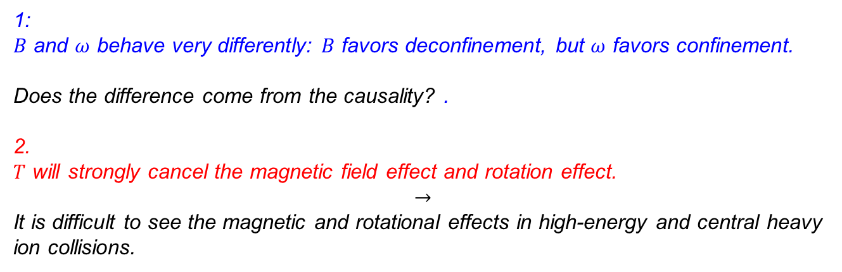
Conclusion
1:
$B$ and $ω$ behave very differently: $B$ favors deconfinement, but $ω$ favors confinement.
Does the difference come from the causality? .
2.
$T$ will strongly cancel the magnetic field effect and rotation effect.
$$→$$
It is difficult to see the magnetic and rotational effects in high-energy and central heavy ion collisions.
Thank you for your attention!
Pengfei Zhuang, PHD2024, CCNU, Wuhan, 20241002 12

