Slide 1
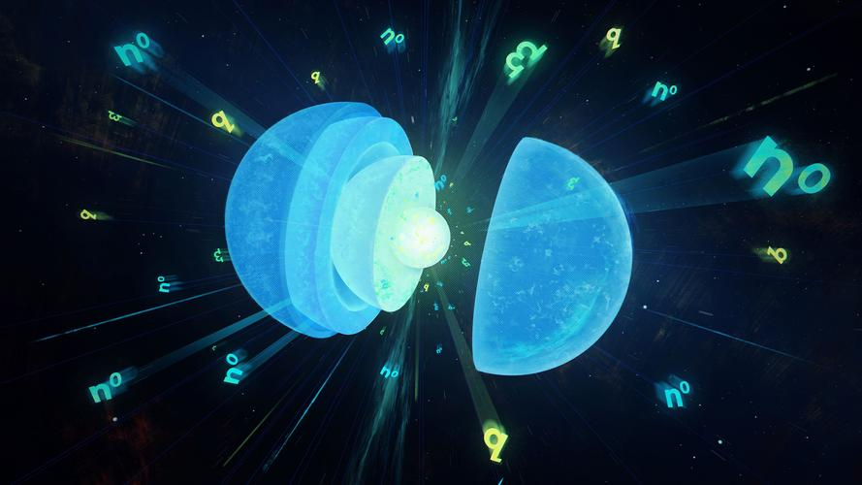
The 1st International Workshop on Physics at High Baryon Density
Extended Nambu--Jona-Lasinio model for quark and nuclear matters
Gaoqing Cao (曹高清)
Sun Yat-sen University
GC, arXiv:2403.19331.
2024.9.2@CCNU

Slide 2
outline
QCD phase diagram and quarkyonic matter
Extended NJL model
Numerical results and discussions
Summary and perspective

Slide 3
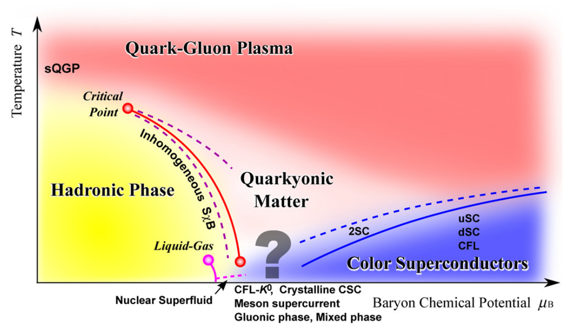
All-happy QCD phase diagram
K. Fukushima and T. Hatsuda, Rep. Prog. Phys. 74 (2011) 014001
Chance: lower energy HICs for fixed target

Slide 4
Quarkyonic matter
L. McLerran and R. D. Pisarski, NPA 796, 83 (2007).
$$μ_{B}$$
$$Λ_{QCD}$$
Chiral symmetry restored
quarks
$$+$$
baryons
confinement
momentum space
1. Fermi sea: nearly free quarks;
2. Fermi surface： mainly confined baryons;
3. Found in LQCD simulations with $N_{C}=2$
V. V. Braguta et. al., PRD.94.114510 (2016)

Slide 5
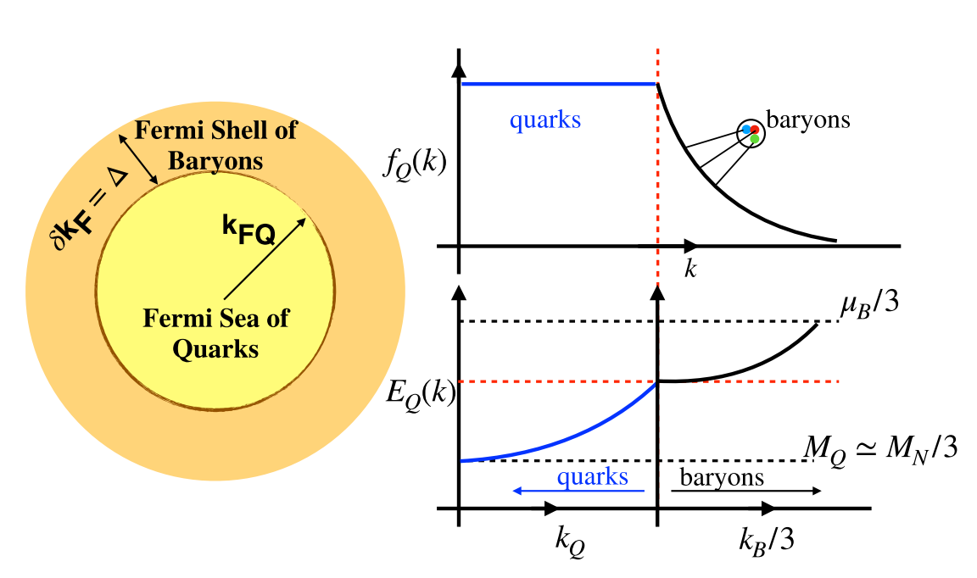
Quarkyonic matter in neutron stars
L. McLerran and S. Reddy, PRL 122, 122701 (2019)

Slide 6
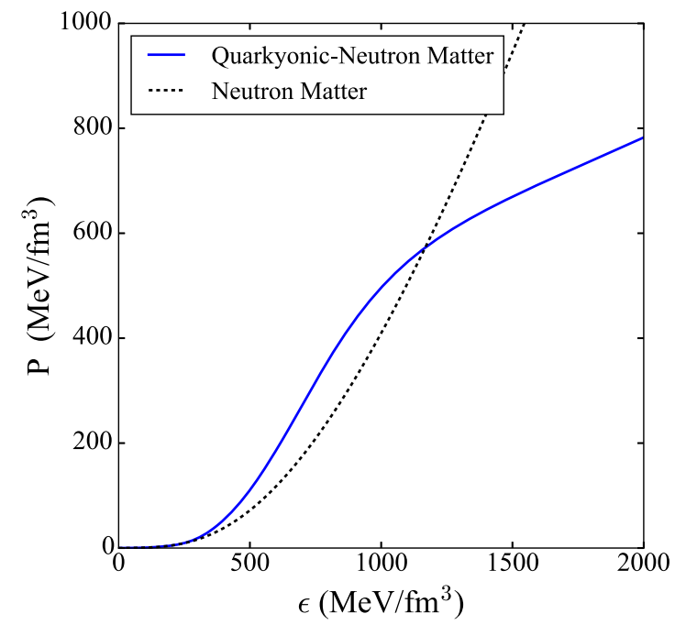
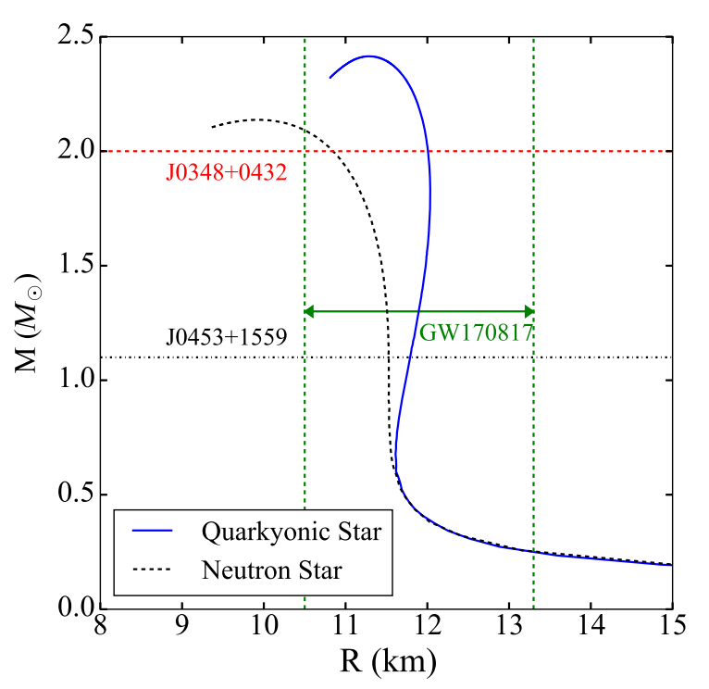
Neutron potential
Equation of state
Mass-radius relation

Slide 7
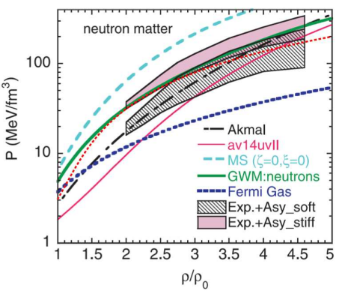
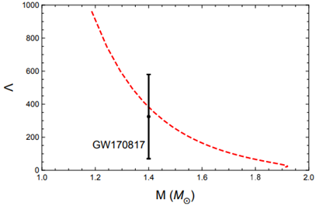
Chiral effective field model
Quark-meson model + Walecka model
$$L=L_{q}+L_{m}+L_{N}$$
$$π,ω,ρ$$
$$q,N$$
$$q,N$$
GC and J. Liao, JHEP 10, 168 (2020); GC, Phys. Rev. D 105, 114020 (2022).

Slide 8
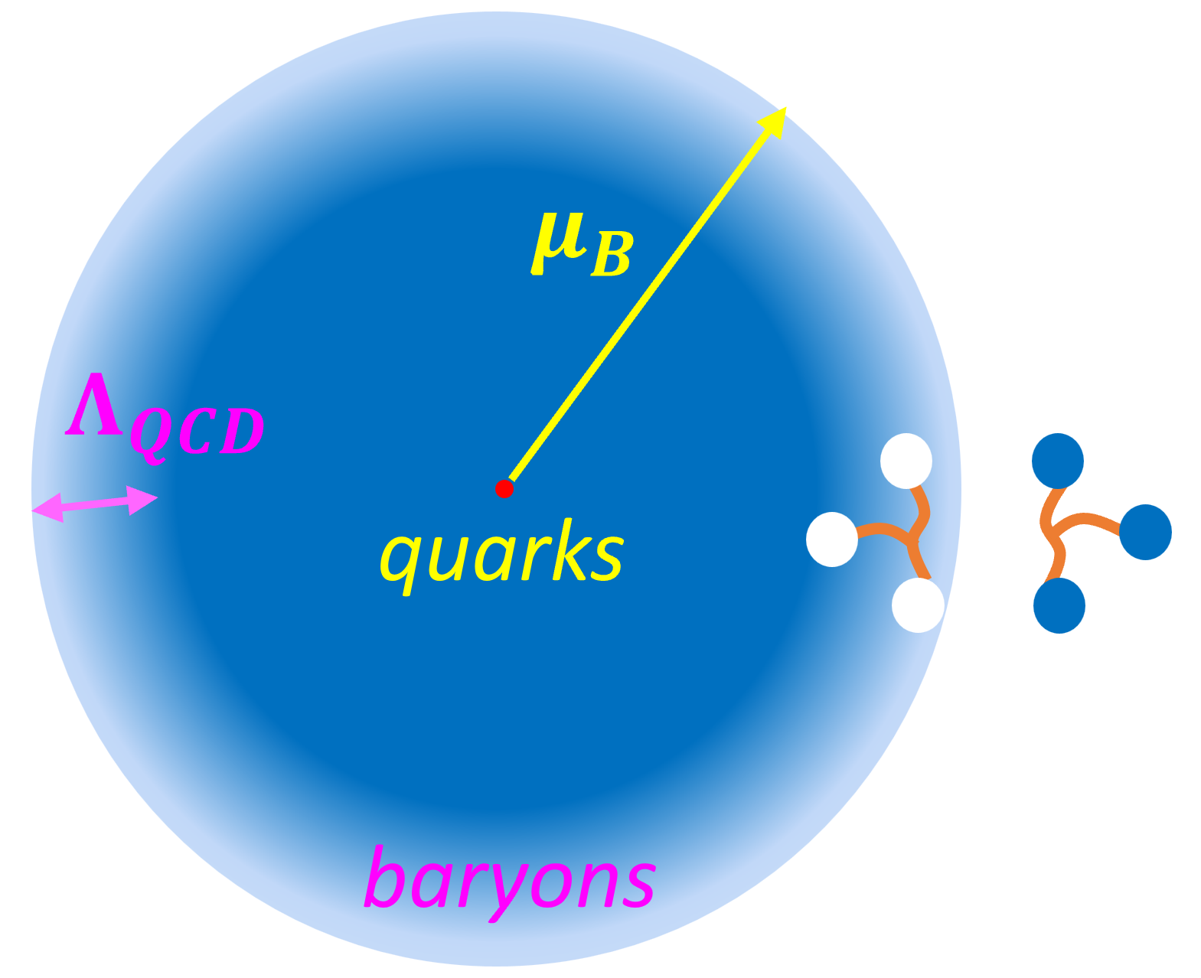
drawback: artificially introduce “blocking” chemical potential for nucleons
BCS theory: fermion pairing near the Fermi surface in mean field and random phase approximations
introduce six-quark interaction in NJL model,
and three quarks pair into nucleons

Slide 9
Nucleons in terms of quarks
Mesons：$σ\sim \overline{ψ}ψ, π\sim \overline{ψ}iγ^{5}τψ$
QCD sum rules：
B. L. Ioffe, Nucl. Phys. B 188, 317-341 (1981)
Take Fiertz transformations:
X. m. Jin, et. Al., Phys. Rev. C 49, 464-477 (1994).
Lattice QCD：scalar channels dominate

Slide 10
Extended NJL model
Principles for the introduction:
1. Desired three-quark state for nucleons;
2. Keep the original symmetries：chiral, Lorentz;
3. Bare nucleon term the same as Dirac field;
4. Coupling constant captures confinement.

Slide 11
Beyond mean field approximation
Mean field approximation
Thermodynamic potential
RPA
Contributions of pions

Slide 12
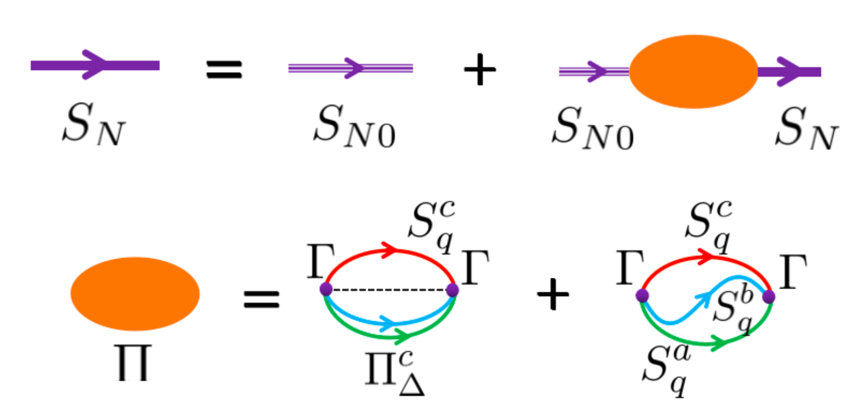
RPA for nucleons and beyond
HS transformation
RPA scheme for dressed nucleon
propagator

Slide 13
Coupling and current quark mass
Dressed propagator
Nucleon vacuum mass is large
$${\overline{Π}}_{0},{\overline{Π}}_{s}∝{\tilde{G}}_{3}$$
Coupling
Small quark mass
Large quark mass

Slide 14
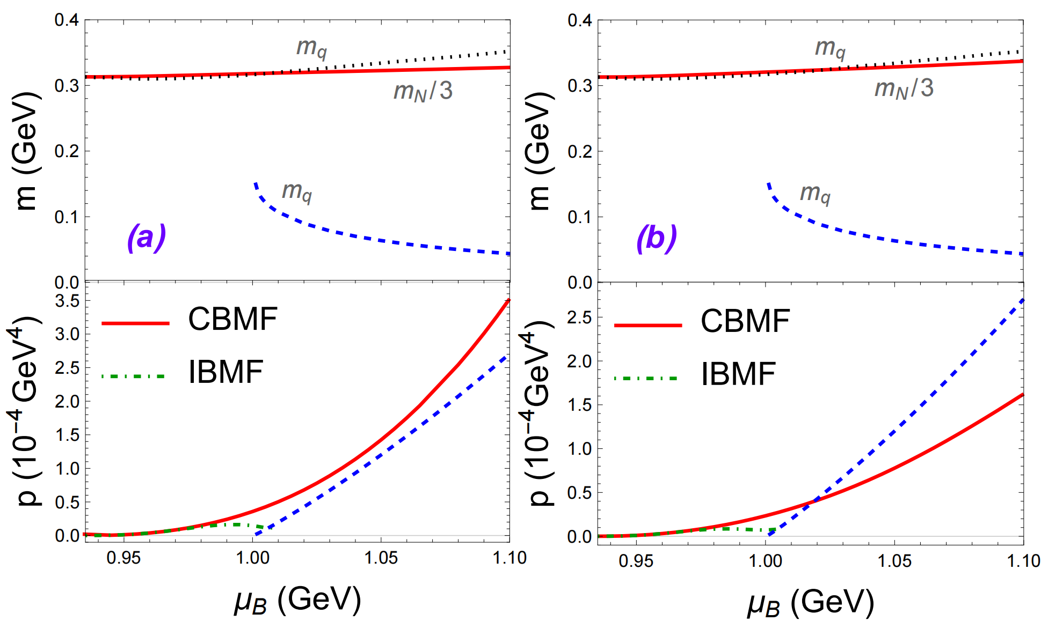
Results for small quark mass
IBMF：dynamical mass $m_{q}$with $Ω_{0}$
CBMF： dynamical mass $m_{q}$with $Ω_{0}+Ω_{N}$

Slide 15
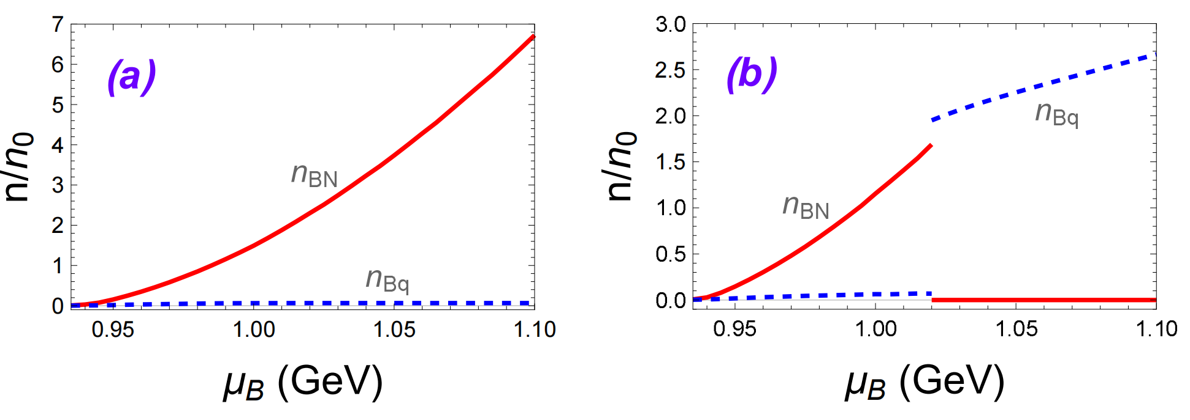
1. For larger $d$, there is first-order transition
between nuclear and quark matters
2. Associated with chiral symmetry restoration
3. no quarkyonic matter

Slide 16
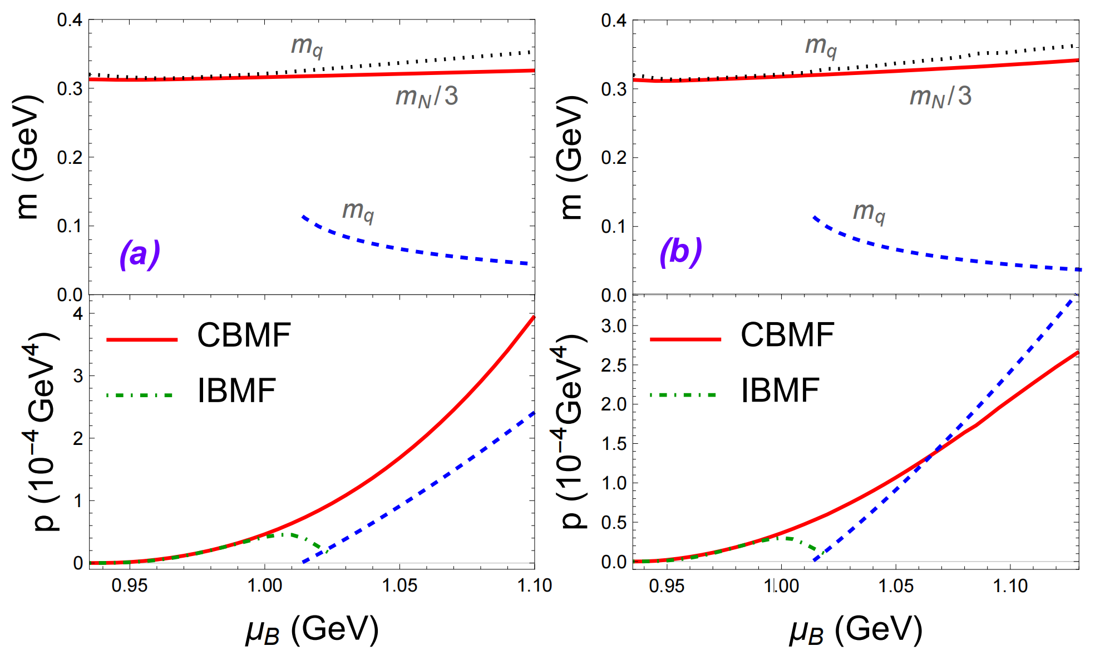
Results for large quark mass
For larger $d$, there is first-order transition

Slide 17
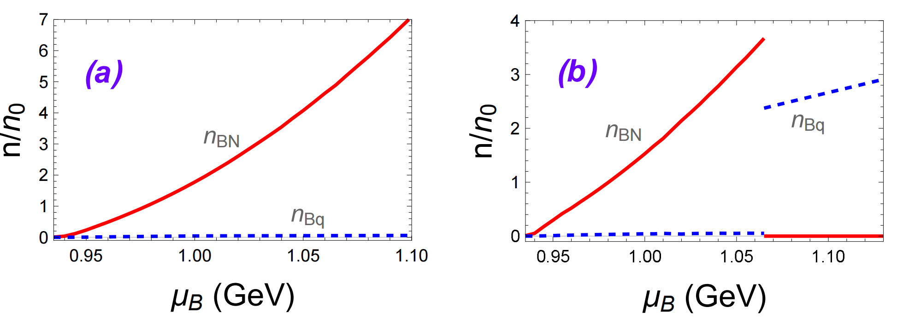
(b) Baryon density decreases with chemical potential at the transition point
Nonphysical

Slide 18
Summary and perspectives
Establish a self-consistent NJL model for quark and nuclear matters
For small quark mass and large $d$，there is first-order transition between nuclear and quark matters, but no quarkyonic matter
Saturation properties and neutron stars
Thanks!

