Slide 1

Topological Machine Learning on Intermittency
Rui Wang (王瑞)
(CCNU)
Collaborators:Zhiming Li(李治明),Yuanfang Wu (吴元芳),
Chuanshen Hu(胡川申), Chengrui Qiu(裘诚睿)

Slide 2
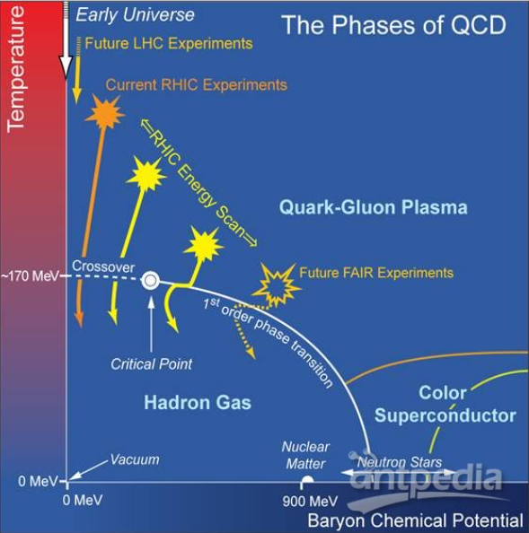
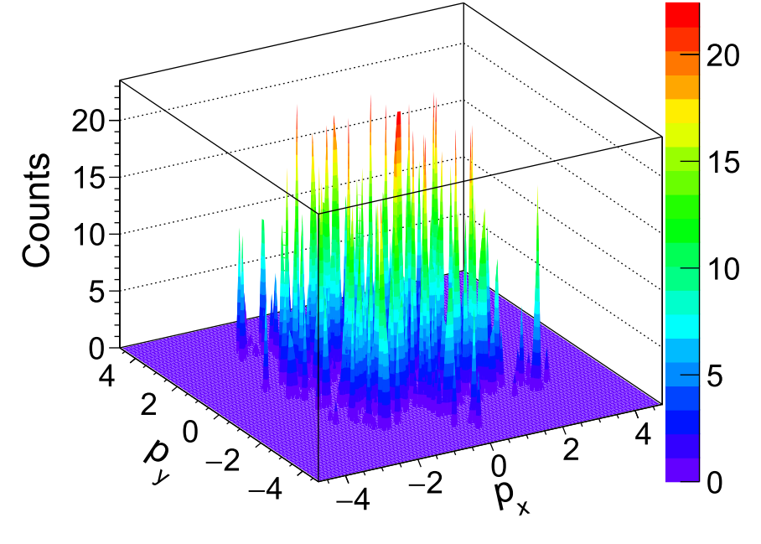
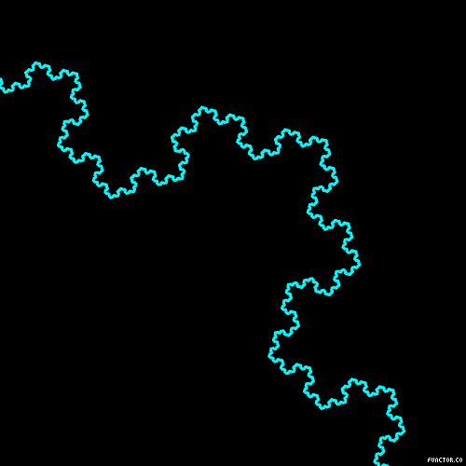
1.1 Search for the QCD phase diagram
Experimental observables:
Local density fluctuation of conserved charges
Intermittency：
fractal, self-similar, scale-invariant
Goal: Exploring the QCD phase diagram and Critical Point.
N. Antoniou, et al., Phy. Rev. Lett. 97,032002 (2006)
J. Wu, Z. Li, et al., Phys. Lett. B 801, 135186 (2020)
Z. Li, Mod. Phys. Lett. A 37, 2230009 (2022)

Slide 3
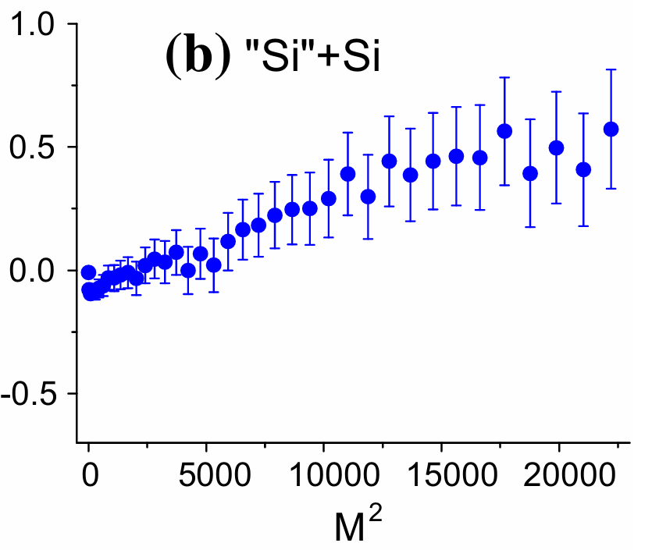
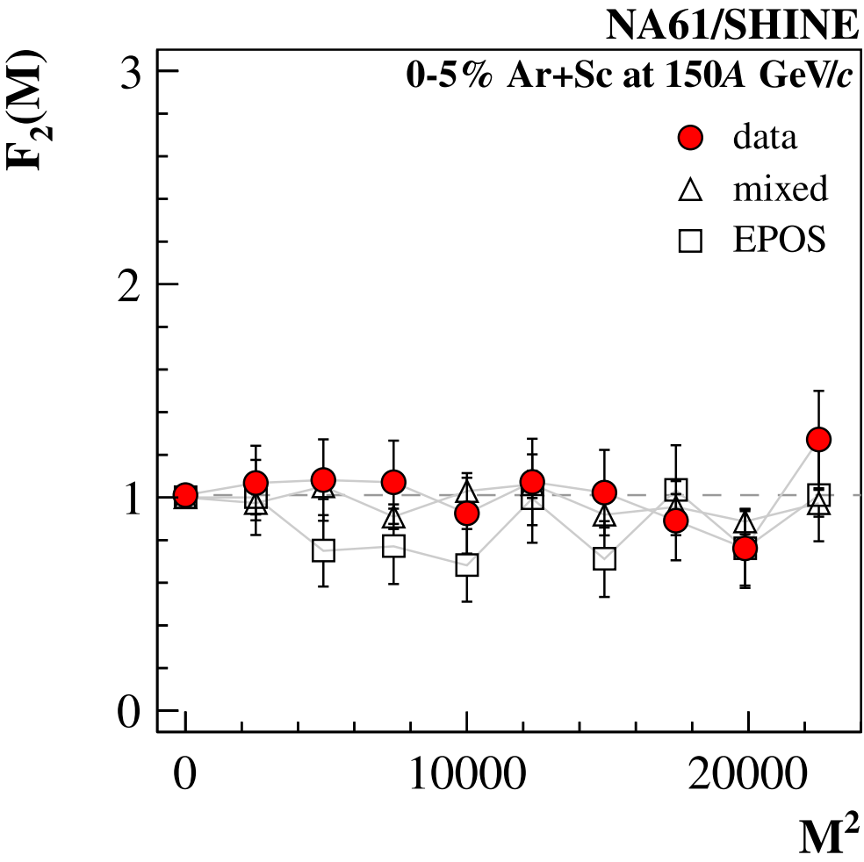
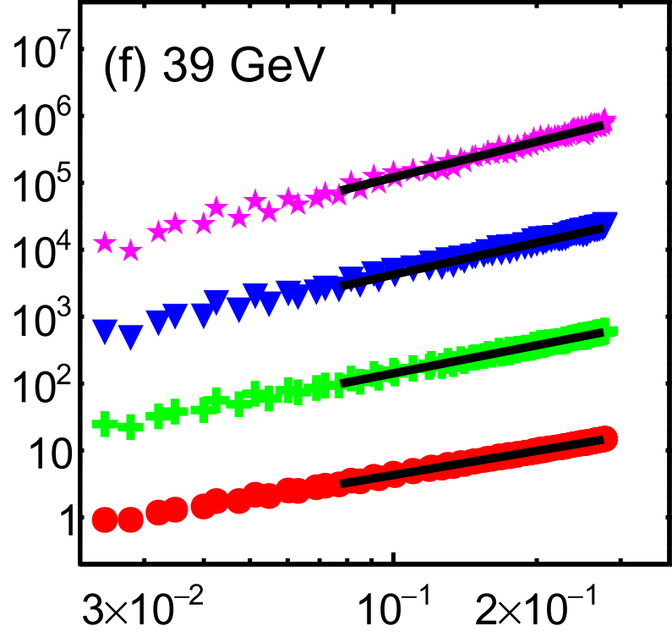

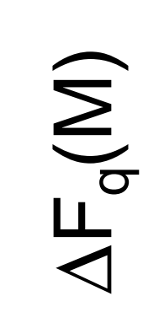
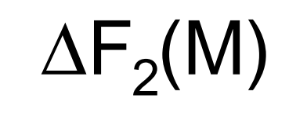
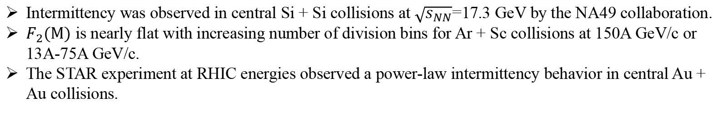
1.2 Intermittency result from experiment
Intermittency was observed in central Si + Si collisions at $\sqrt{s_{NN}}$=17.3 GeV by the NA49 collaboration.
$F_{2}(M)$ is nearly flat with increasing number of division bins for Ar + Sc collisions at 150A GeV/c or 13A-75A GeV/c.
The STAR experiment at RHIC energies observed a power-law intermittency behavior in central Au + Au collisions.
T. Anticic et al. (NA49 Coll.), Eur. Phys. J. C 75, 1 (2015).
H. Adhikary et al. (NA61/SHINE Coll.), Eur. Phys. J. C 83, 1 (2023)
M. I. Abdulhamid, B. E. Aboona, J. Adam, et al., Phys. Lett. B 845, 138165 (2023).

Slide 4
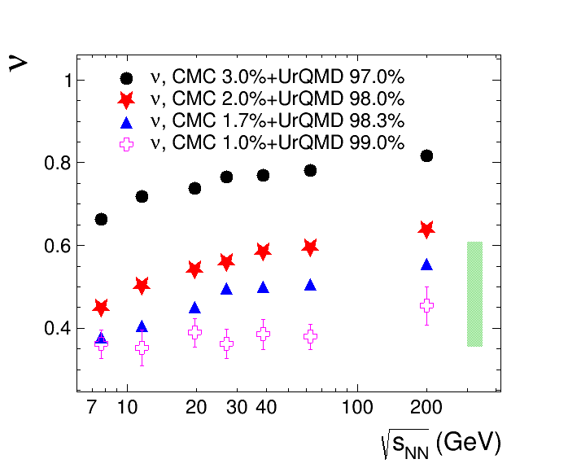
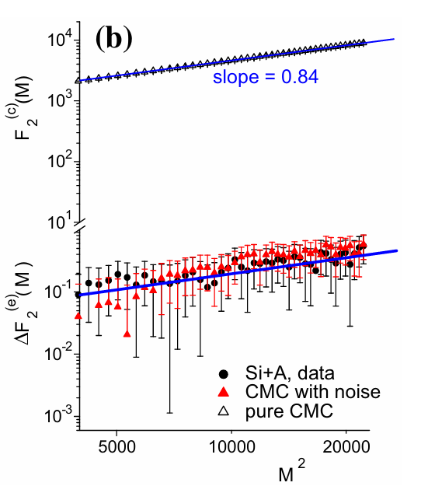
1.2 Intermittency result from experiment
T. Anticic et al. (NA49 Coll.), Eur. Phys. J. C 75, 1 (2015).
J. Wu, Z. Li, X. Luo, et al., Phys. Rev. C 106, 054905 (2022).
The intermittency observed in NA49 can be reproduced by a mixed sample with 99% background random tracks and 1% signal particles generated from a Critical Monte Carlo (CMC) model.
The STAR experimental results are consistent with a mix of approximately 1-2% signal particles.

Slide 5
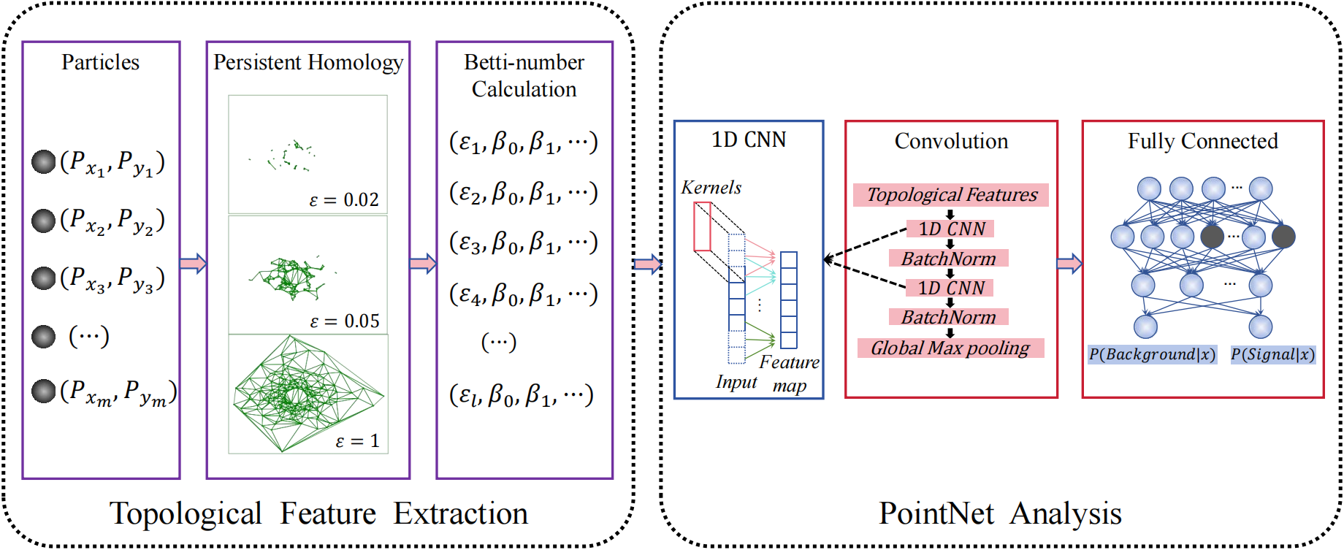
2.1 TopoPointNet
The TopoPointNet architecture used in the analysis consists of two main modules.

Slide 6
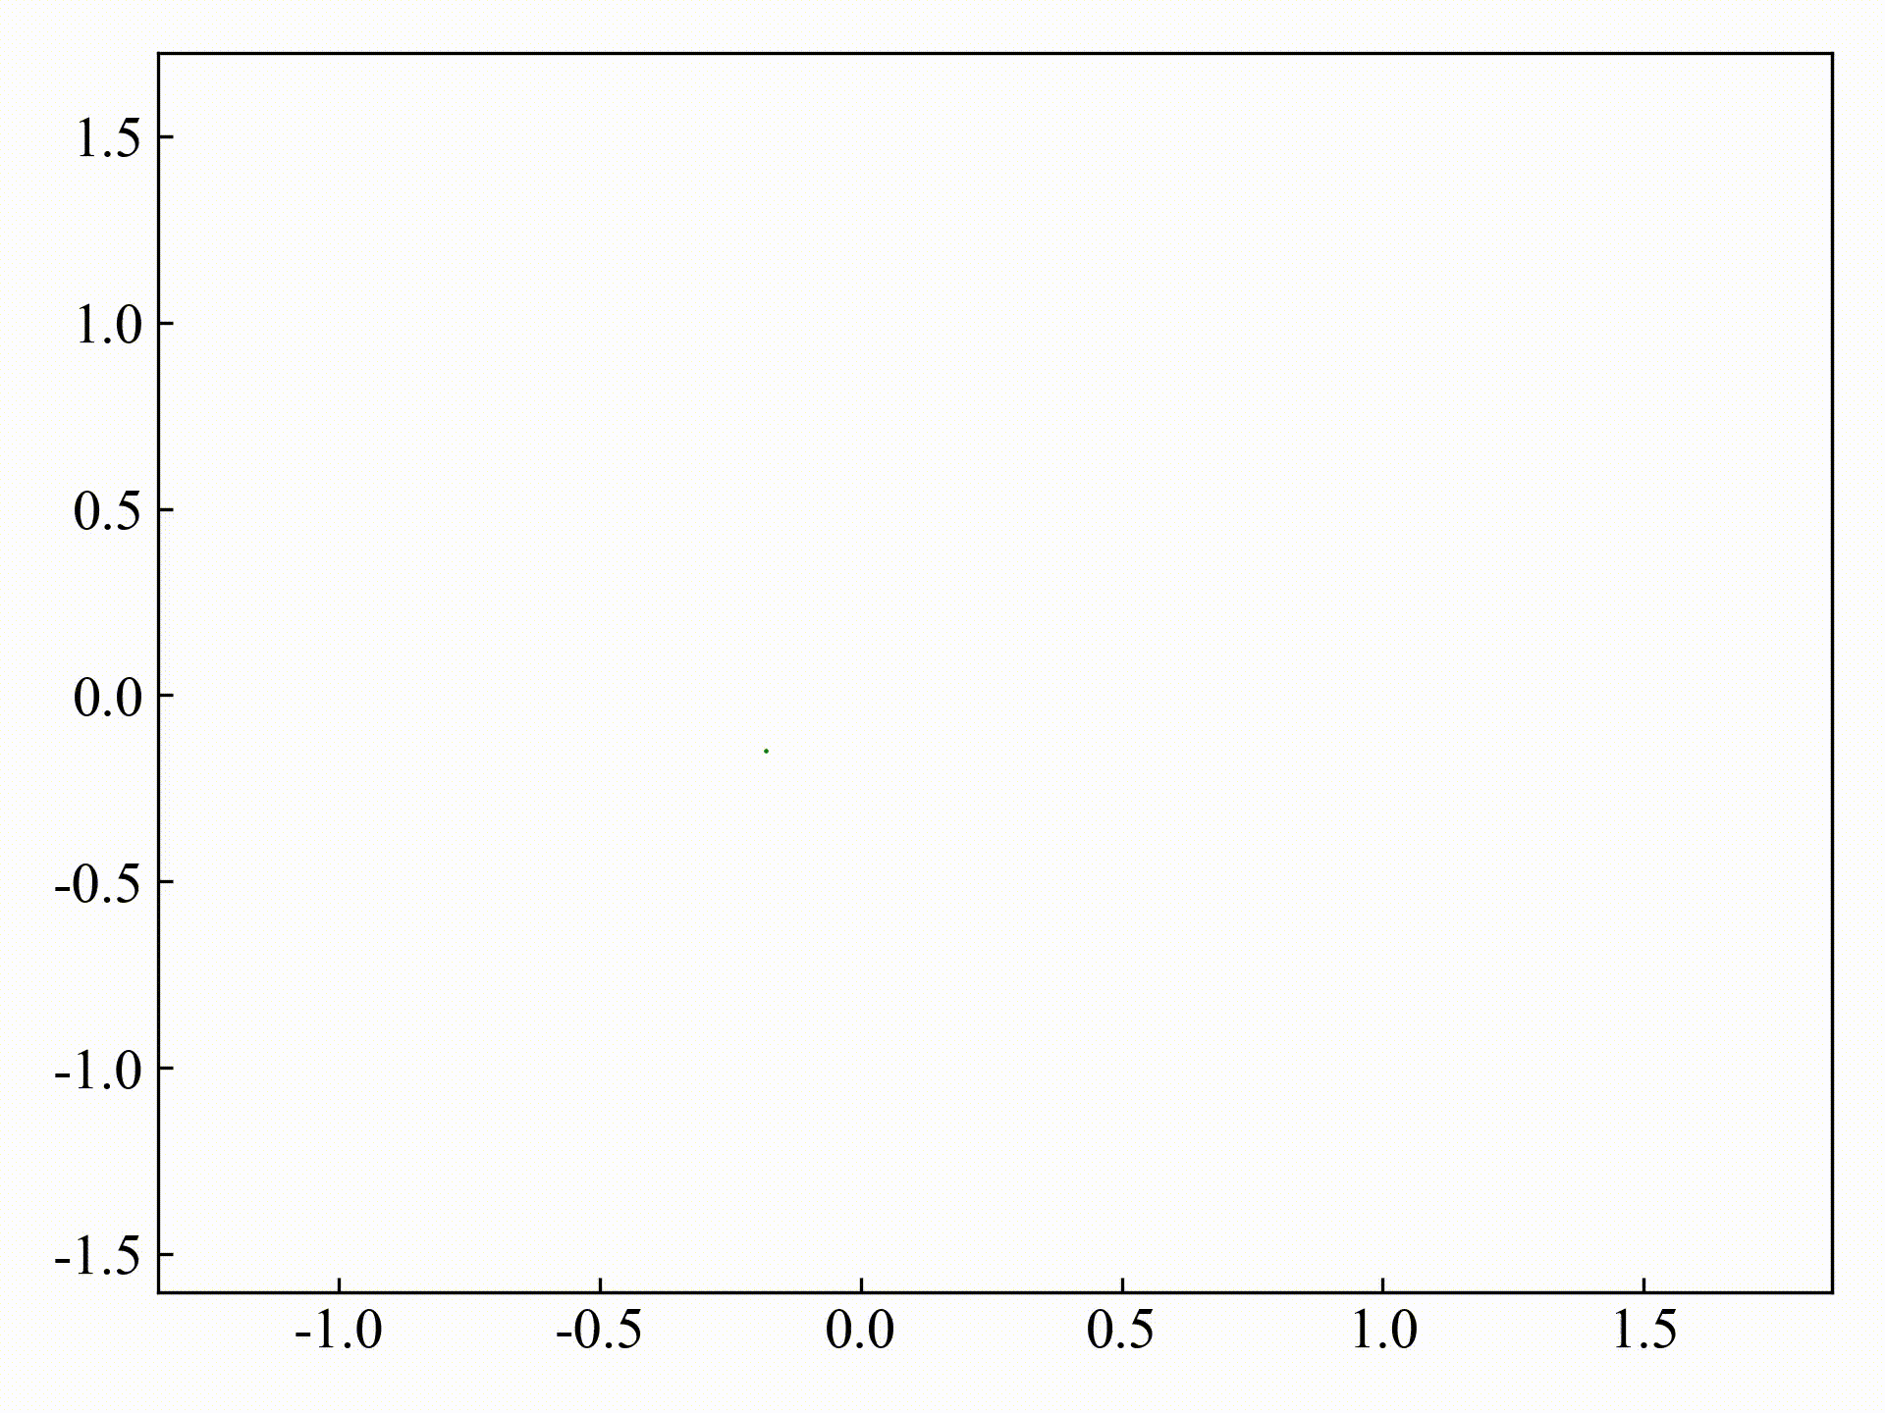
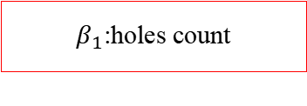

2.2 Persistent homology and Topological feature
a
b
$β_{0}$:Components count
c
d
$β_{1}$:holes count
2-complex
0-simplex
(a point)
1-simplex
(a seament)
2-simplex
(a triangle)
3-simplex
(a tetrahedron)

Slide 7
2.1 TopoPointNet
The TopoPointNet architecture used in the analysis consists of two main modules.

Slide 8
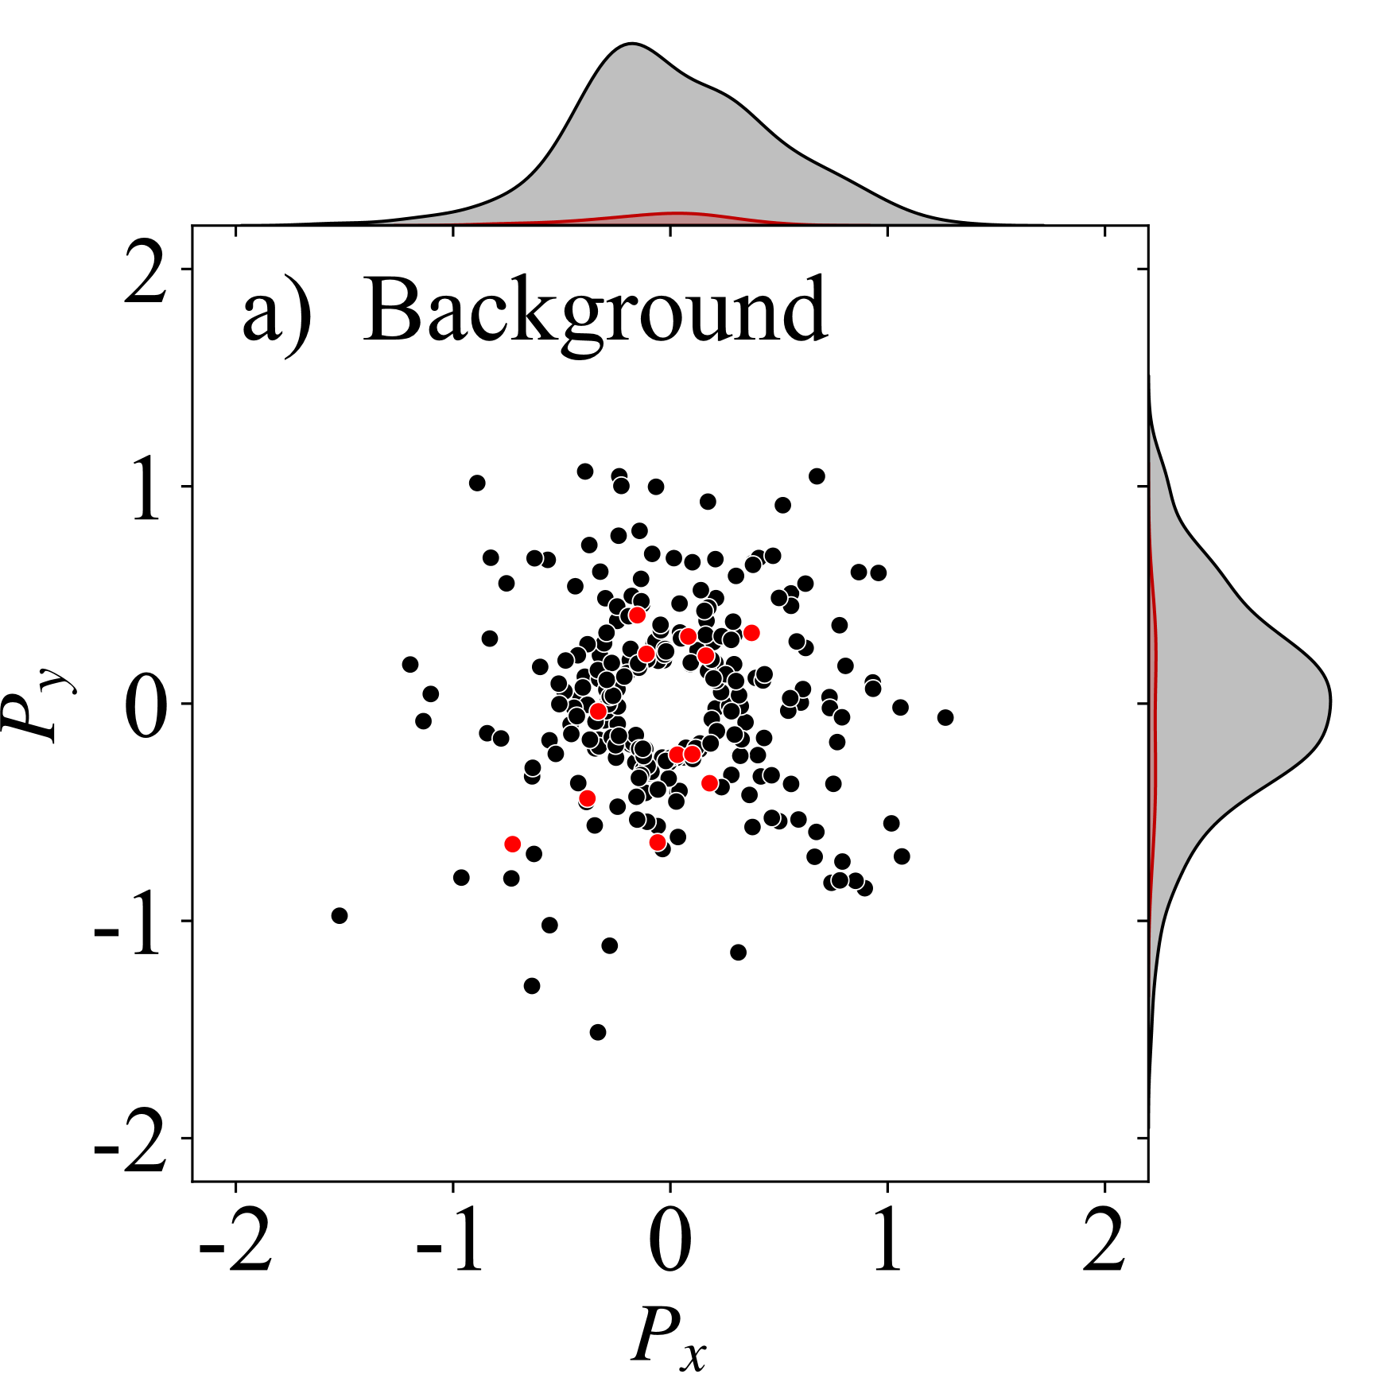
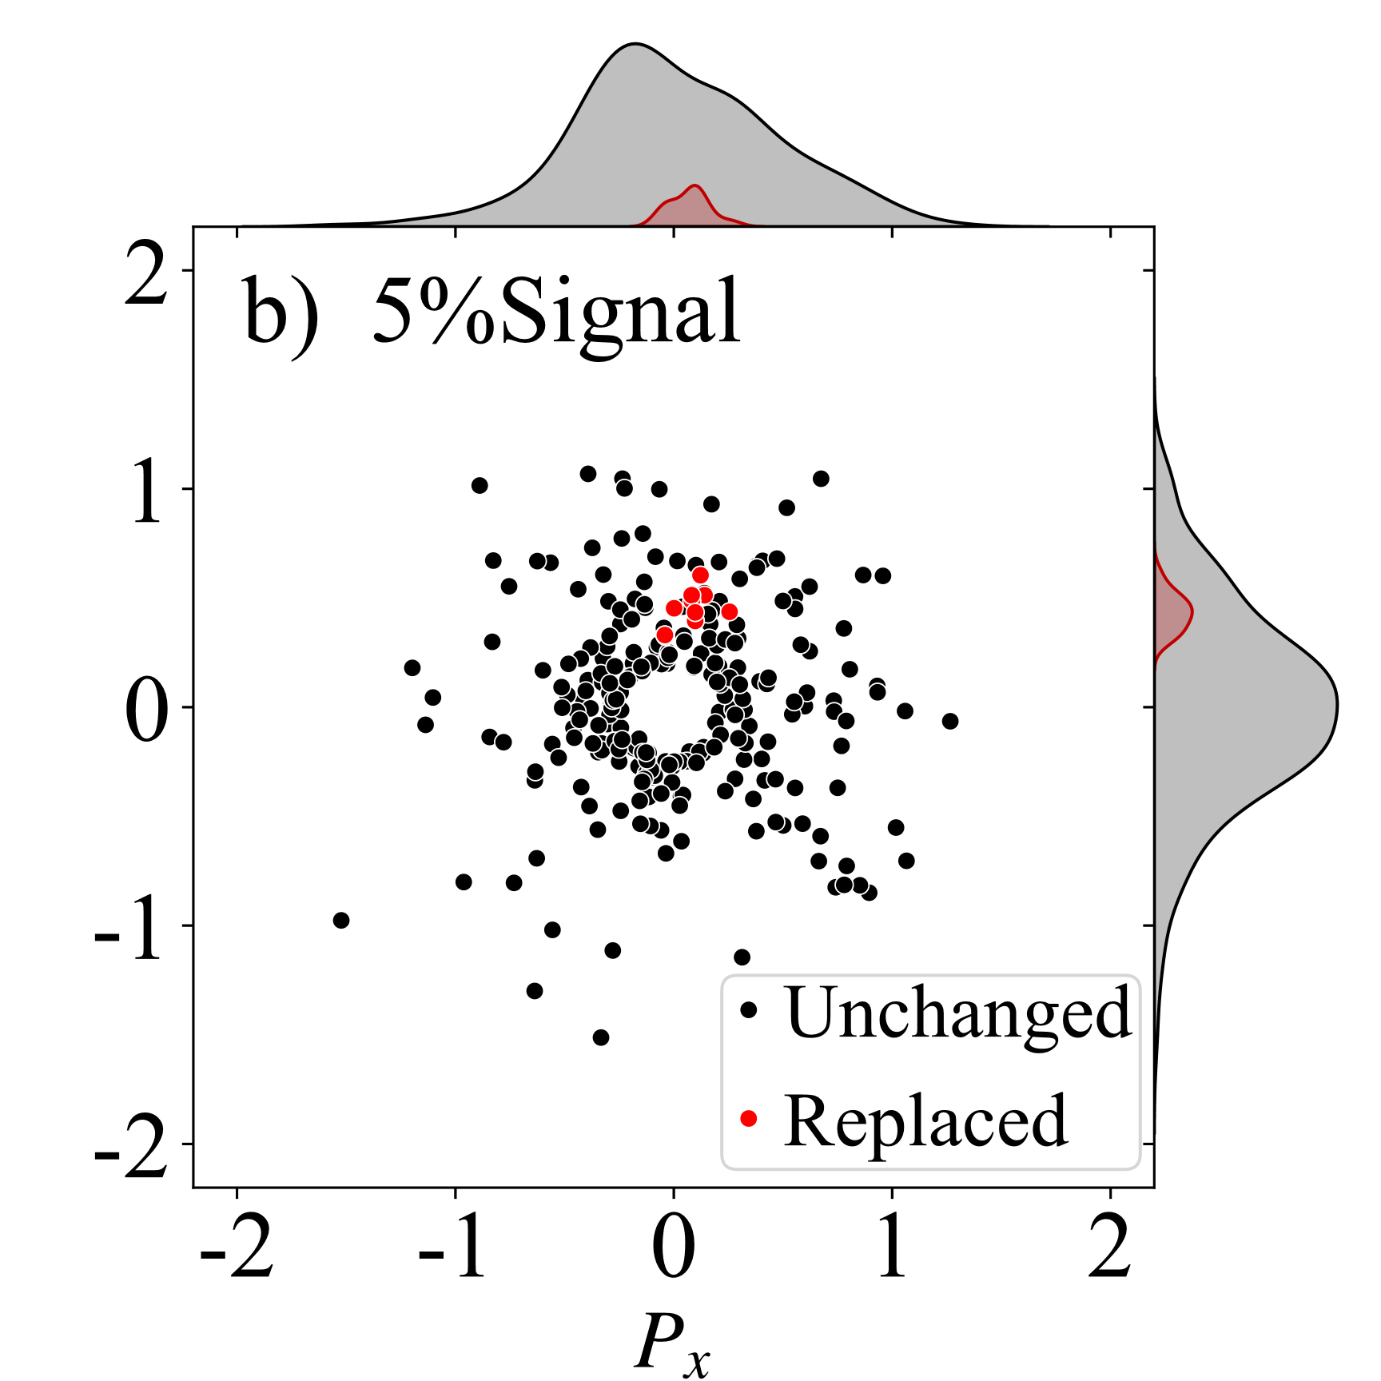
2.3 Events Distributions
The CMC and UrQMD models are used for generating signal and background events, respectively.
The two-dimensional momentum distributions from (a) background and (b) 5% signal events.

Slide 9
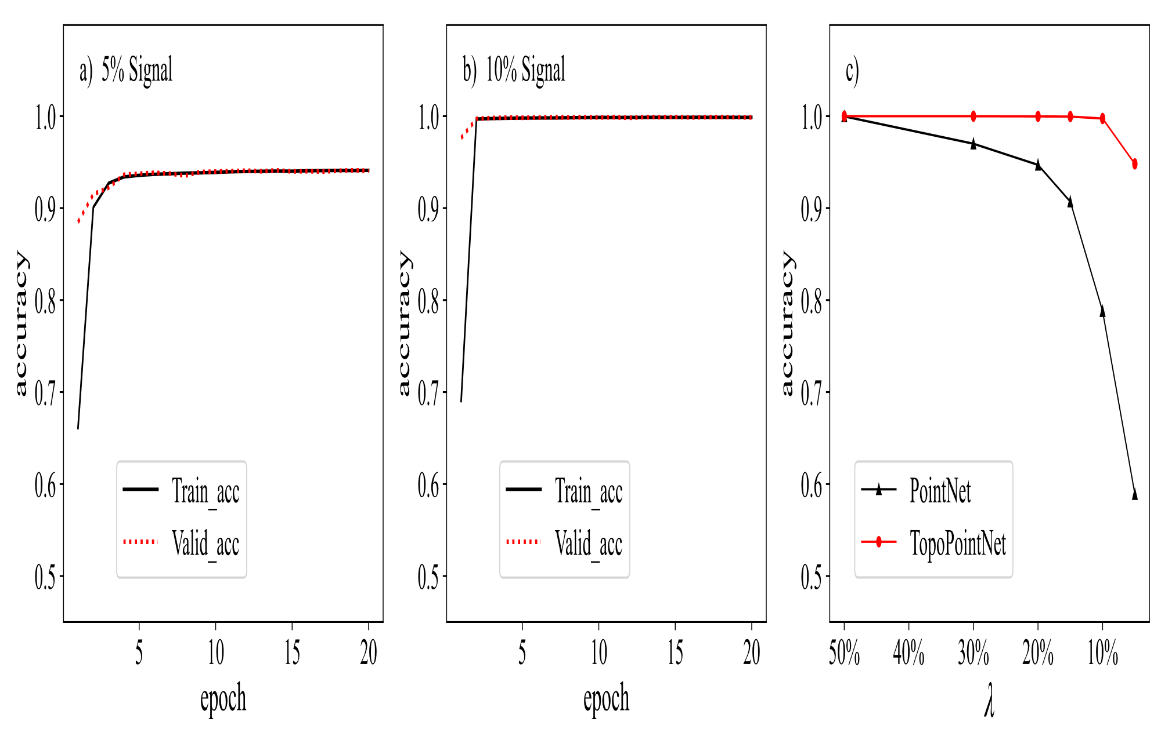
3.1 Result from TopoPointNet
The testing accuracy is 94.69% for 5% signal events and 99.85% for 10% signal events.
For comparison, we removed the topological feature extraction module. We found the testing accuracy of the PointNet without TDA decreases significantly faster with decreasing λ compared to TopoPointNet, reaching 58.89% for 5% signal events.

Slide 10
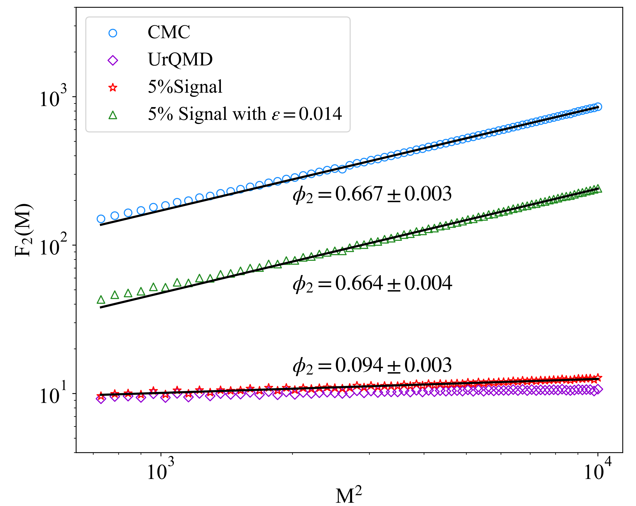
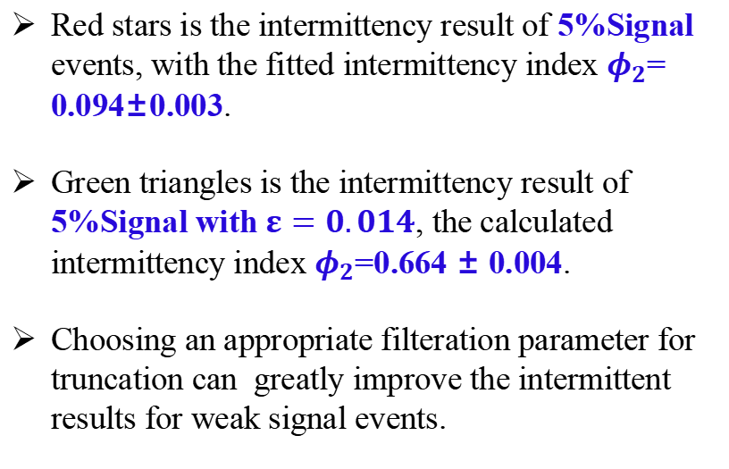
3.2 Intermittency analysis by DTFE
Red stars is the intermittency result of 5%Signal events, with the fitted intermittency index $φ_{2}$= 0.094±0.003.
Green triangles is the intermittency result of 5%Signal with $ε=0.014$, the calculated intermittency index $φ_{2}$=0.664 ± 0.004.
Choosing an appropriate filteration parameter for truncation can greatly improve the intermittent results for weak signal events.

Slide 11
4.1 Summary and outlook
We demonstrated the application of topological data analysis for extracting topological features in heavy-ion collisions.
Through the topopointnet, a test accuracy of 94.7% was achieved for the 5% signal events.
By selecting a filtration level cut, the second-order intermittency index for the 5% signal events is very close to that of pure CMC signal events.
Extending this study to three-dimensional space in future work is highly anticipated, as it would allow for the exploration of higher dimensional topological features, such as the 2nd Betti number.
Additionally, integrating other machine learning techniques, such as unsupervised learning, could broaden the applicability of this approach to complex systems.
Thank you!

Slide 12
Backup Slides

Slide 13
Signal Proportion | 5% | 4% | 3% | 2%
Test Accuracy | 94.81% | 89.3% | 78.9% | 66.9%
Average Signal Partical | 13.9 | 11.1 | 8.4 | 5.6

Slide 14
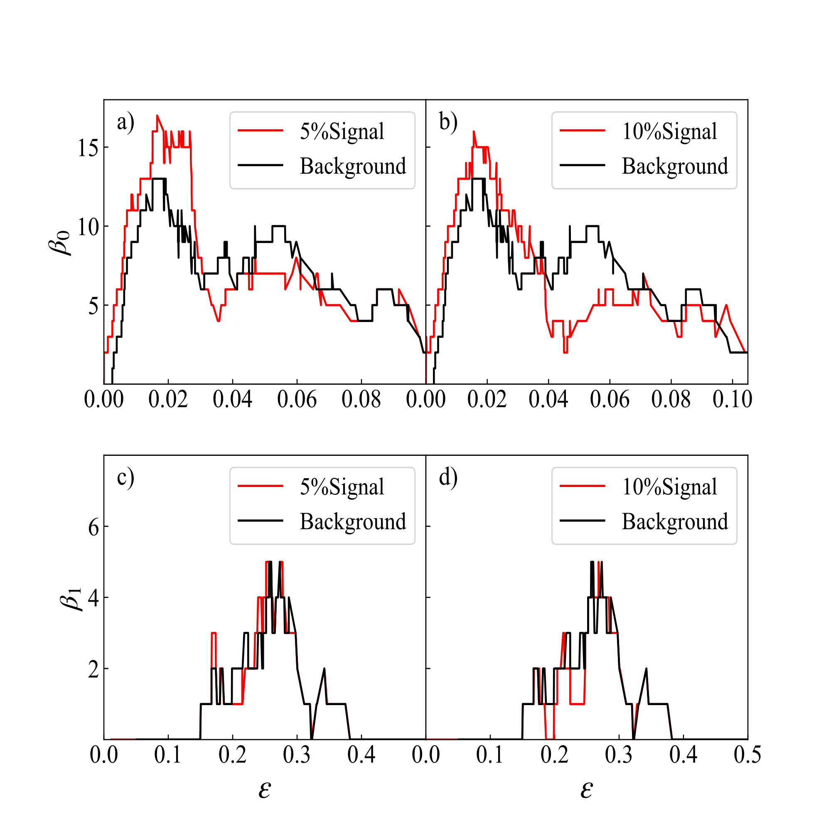
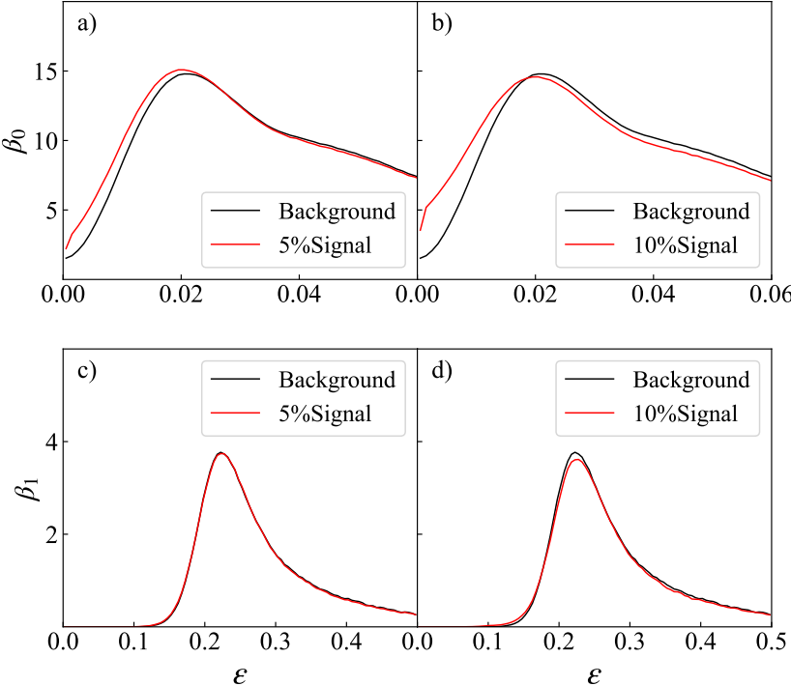
Single Event
Average Event

