Slide 1
The 1st International Workshop on Physics at High Baryon Density (PHD2024)
New Developments on Pixel Tracker
XiangMing Sun (孙向明)
Central China Normal University (华中师大)
November 3 , 2024
Notes:
Good morning and good afternoon. This is Yaping Wang, from Central China Normal University.
Today I will talk about the assembly of modules and supermodules for the Inner Tracking System of the NICA/MPD experiment.

Slide 2
Outline
Background
Exploration of Domestic Processes for MAPS
GBT Series ASICs Development
Module Assembly
Summary and Plan

Slide 3
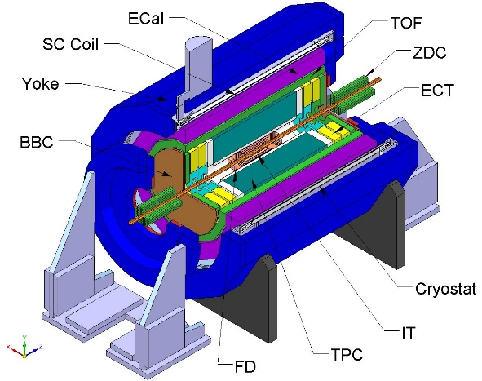
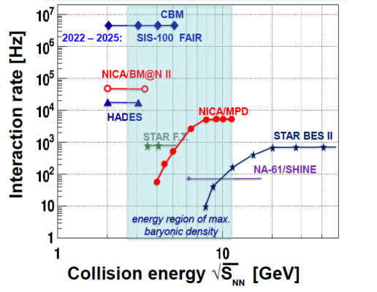
Background——MPD detector
The MPD enables a wide variety of physics measurements via high-luminosity scans in energy and system size with excellent PID and large acceptance
Order of phase transition and search for QCD critical point → structure of QCD phase diagram
Hypernuclei and equation of state at high baryon densities → inner structure of compact stars
Collision ring
((circumference 503 meters))
Superconducting synchronous acceleration loop
(circumference 251.5 meters)
MPD
Multi functional detector

Slide 4
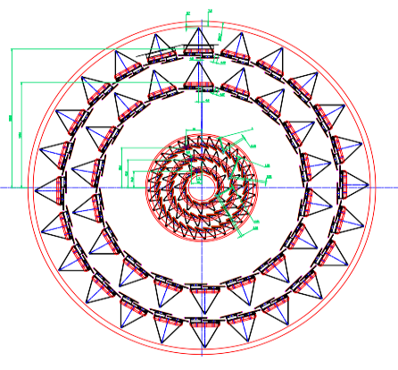
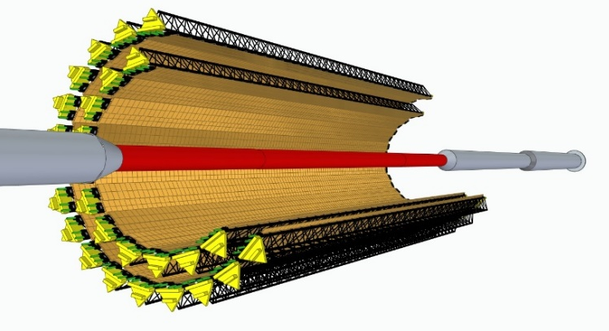
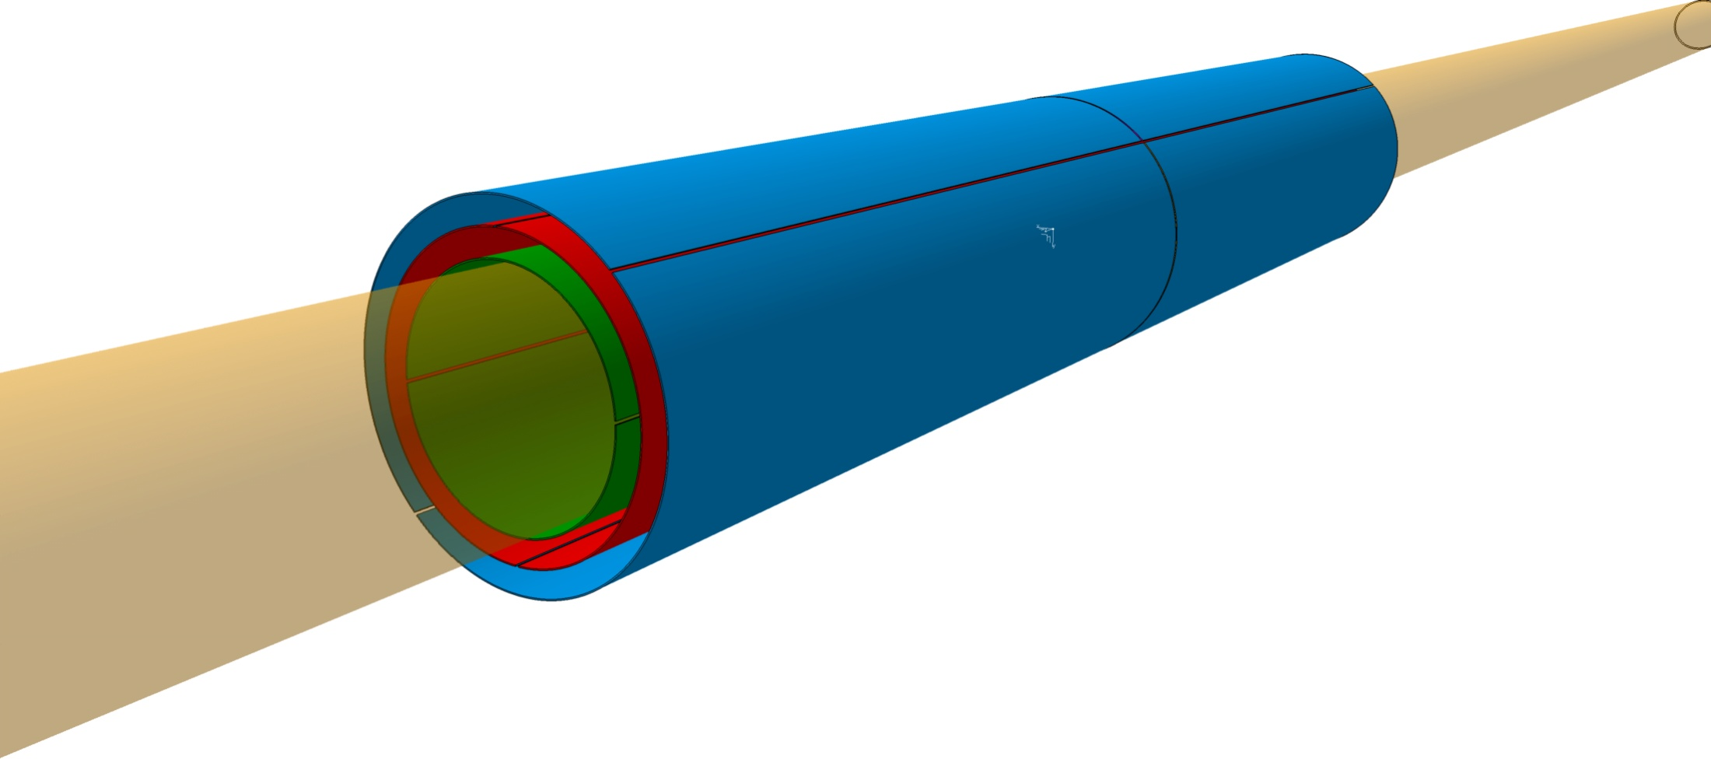
Background——ITS detector for MPD
MPD is based on the latest MAPS technology to construct a silicon pixel inner trace detector, which will enable it to accurately reconstruct collision vertices and measure the generation of charm hadrons in high brightness environments.
Based on MAPS technology
2 barrel layers (inner three layers, outer two layers)
5-layer cylindrical surface
4.5 x 10⁹pixels
3.3 m² detection area
|η| ≤ 2.0
Monolithic Active Pixel Sensor(MAPS)
Integrating sensors and readout circuits on the same silicon wafer
Low material quality
Low cost
Low input capacitance ->achieve low power consumption
Outer two-layer of silicon pixel vertex detector based on MAPS chip
Internal three-layer based on large-sized MAPS chip

Slide 5
Outline
Background
Exploration of Domestic Processes for MAPS
GBT Series ASICs Development
Module Assembly
Summary and Plan

Slide 6
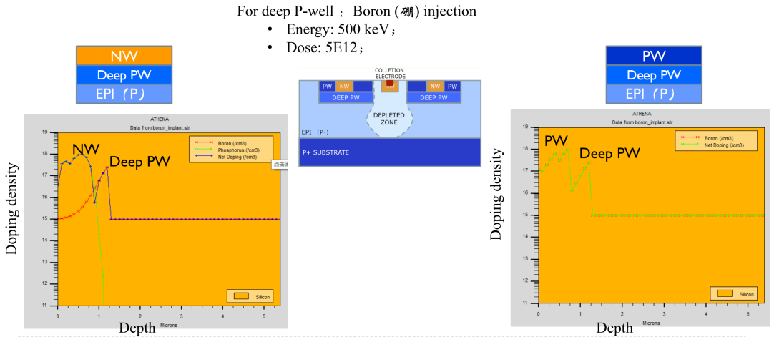
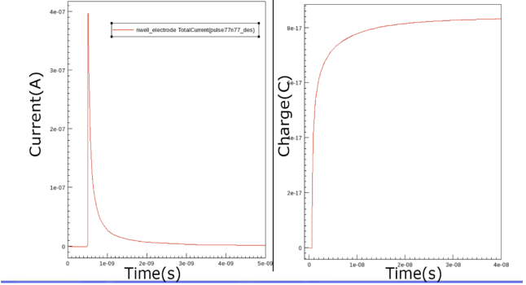
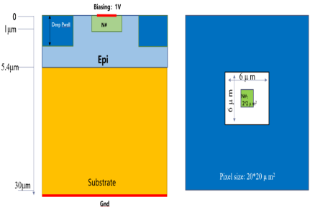
Research on 55nm CIS Process Pixel Chip——Process development
Simulation of TCAD for increasing deep P-wells
R&D of Domestic Process for MAPS
The domestically produced 55 nm CIS process production line only has 3 wells (N-well, P-well, and deep N-well)
Add deep P-wells based on existing production line processes
Simulation of TCAD Devices for Pixels
Deep P-well: A substrate N-well that shields PMOS transistors within the pixel region to avoid charge collection competition, improve charge collection efficiency, and allow pixel circuits to use both N-type and P-type transistors simultaneously, making it suitable for complex pixel circuits.
Deep N-well: A substrate P-well that isolates NMOS transistors in the peripheral circuit region, allowing the entire wafer substrate to be subjected to reverse voltage.
Reverse bias the substrate by 6V~12V, increase the depletion layer region, and improve the charge collection rate.
Determine the impurity concentration and injected energy

Slide 7
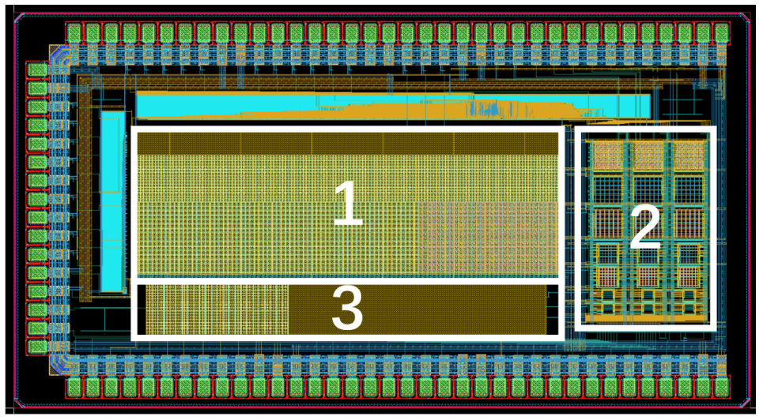
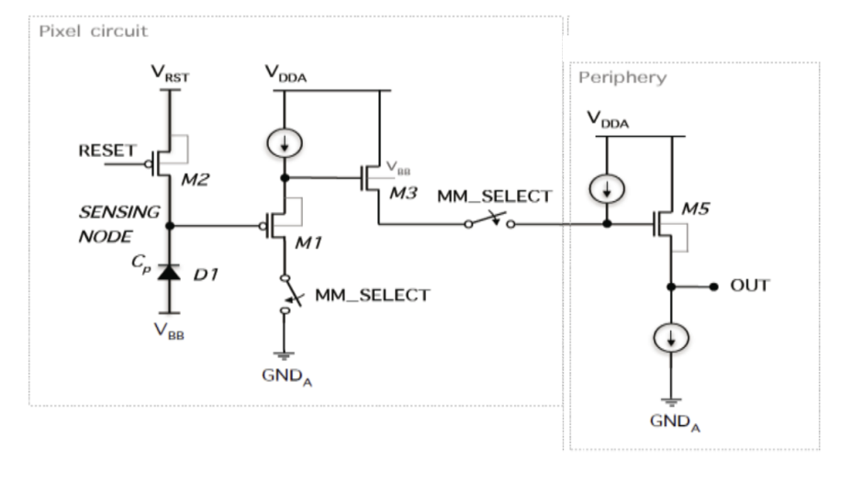
Research on 55nm CIS Process Pixel Chip——Chip Design
Pixel Array Process Validation Chip
Composed of three arrays with different purposes
Includes 3 types of pixel spacing (8um × 8um, 16um × 16um, and 24um × 24um)
Used for studying pixel geometry, charge collection electrodes, charge collection time, leakage current, sensing diode capacitance, and front-end circuit performance

Slide 8
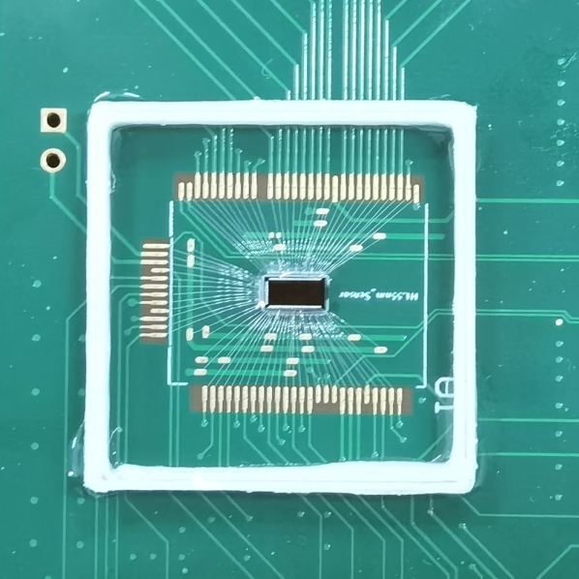
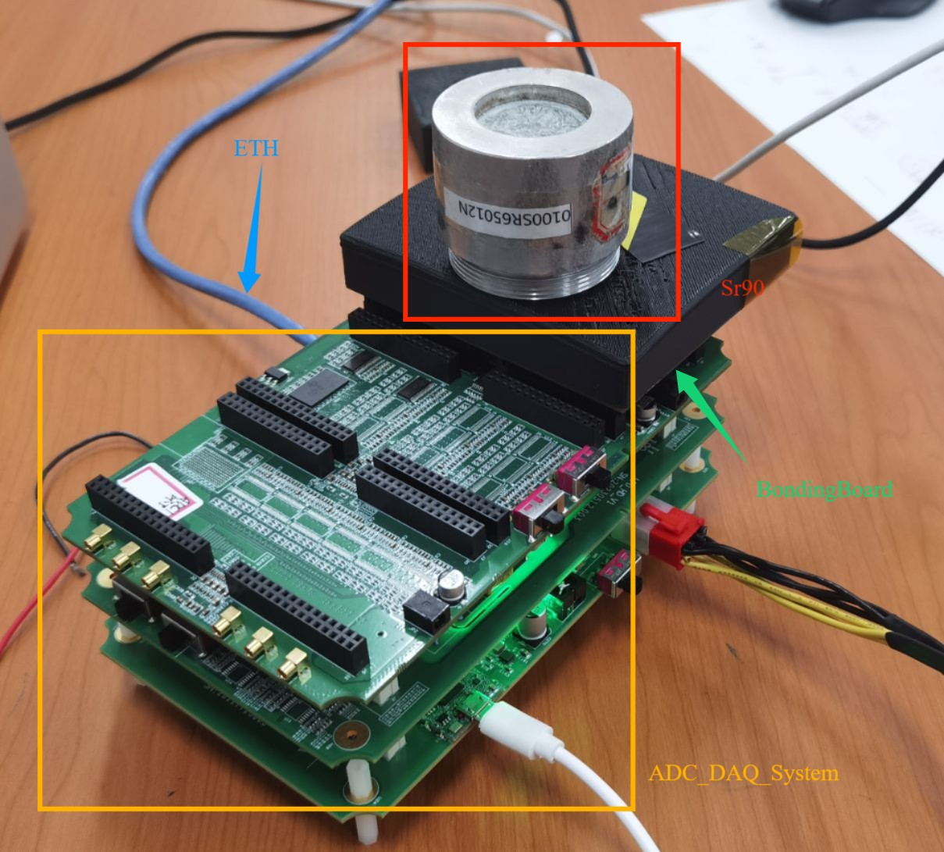
Research on 55nm CIS Process Pixel Chip——Testing System
Pixel array process validation chip testing system
Test System Characteristics:
Equipped with 16 Channel ADC (sampling rate 20MHz, 12 bits)
Provide 8 Channels of DAC Analog Voltage
Cache is 16 bit DDR3 with a Capacity of 256M
Gigabit Ethernet Data Transmission
Firmware Implementation Case Trigger

Slide 9
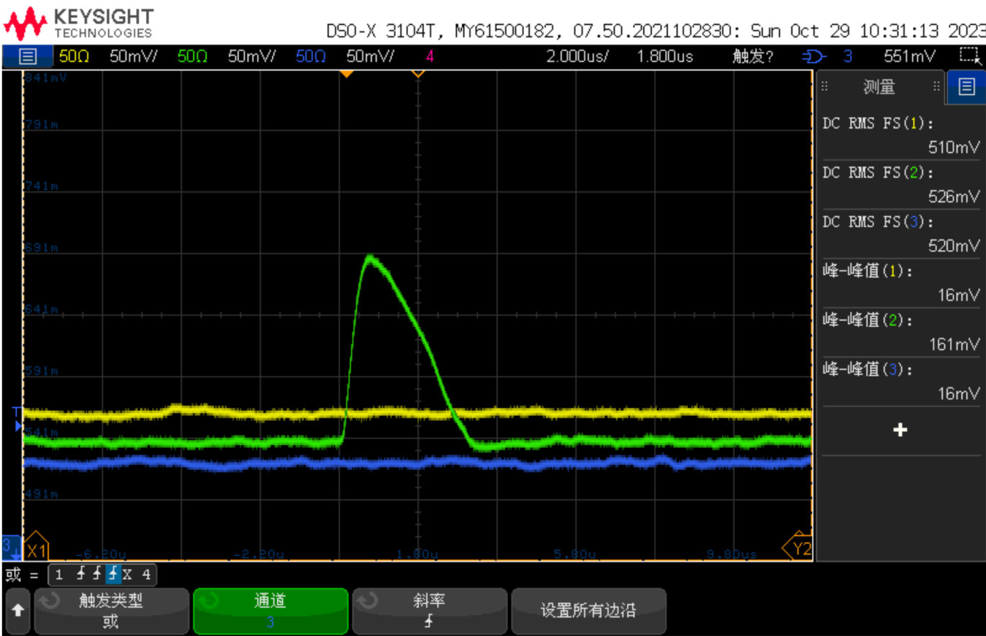
Research on 55nm CIS Process Pixel Chip——Chip Test
⁵⁵Fe Test
For the first time in China, the pixel chip designed based on domestic technology has detected the ⁵⁵Fe signal
⁵⁵Fe signal observed by pixel array chip, 160mV

Slide 10
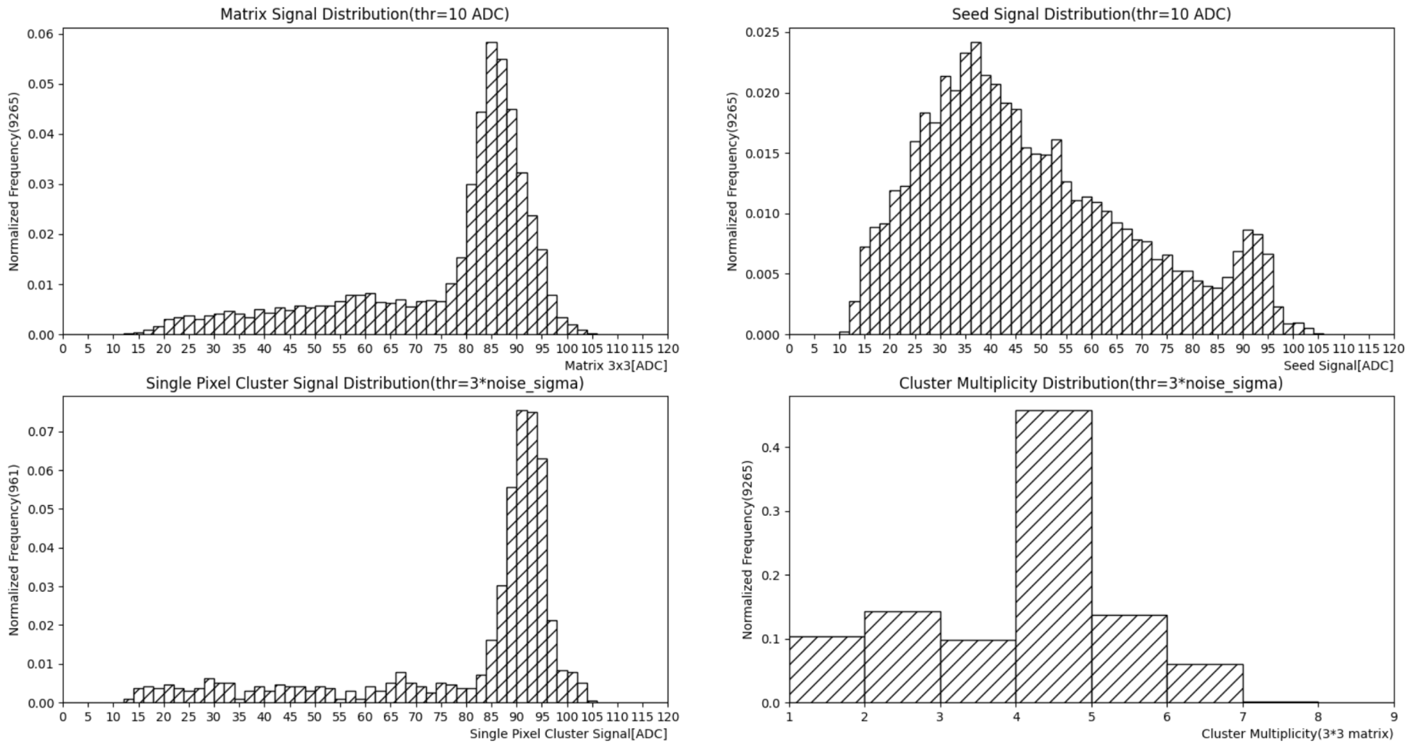
Research on 55nm CIS Process Pixel Chip——Chip Test
⁵⁵Fe Energy Spectrum
Peak value 86
Collecting Peaks
Energy spectrum of cluster seed signals
Energy spectrum of 3x3 matrix signal
Calibration peak92
Energy spectrum of single pixel clusters
Cluster multiplicity
Calibration peak ADC Value 92 -> 1640 e⁻
CCE=86/92=93.5%

Slide 11
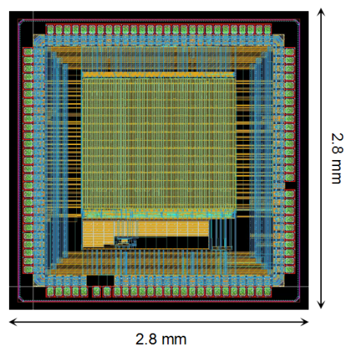
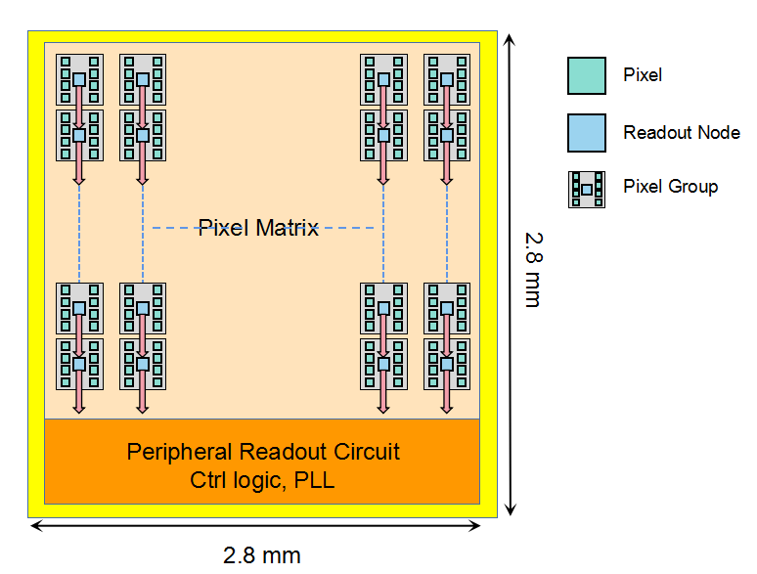
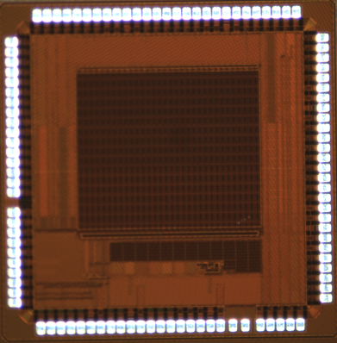
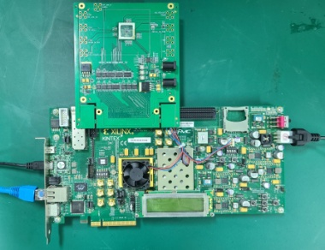
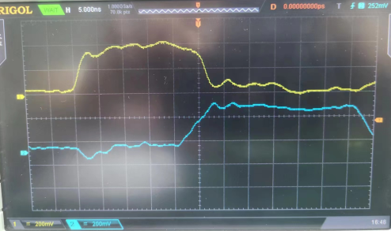
Research on 55nm CIS Process Pixel Chip - Chip Design and Testing
Read architecture verification chip MIC6_V1
Preliminary test results
Multiple dual columns of the chip were tested
Inject the write request signal req at the top of the dual row, and the chip outputs the ack signal normally at the top.
After 25ns, a request signal req appeared at the bottom of the double column, and the 22 bit test data was correctly transmitted to the bottom of the double column. There are 16 asynchronous handshake read nodes in the dual column, and each node requires 25ns/16=1.56ns to complete data transmission, which is 640MHz.
Read out 8 pixels every 1.56ns (under extreme conditions)
Chip Characteristics:
55 nm CIS Process
Pixel Array:64x64
Pixel Size:24umx20um
ENC < 4.4 e-
Arrival Time Resolution:5-10 ns
Node Based Zero Compression, Parallel Readout Architecture
Column Based Asynchronous Readout

Slide 12
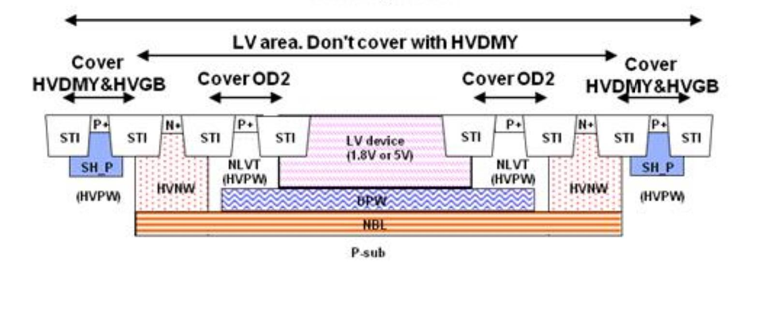
Research on 180 nm High Voltage Process Pixel Chip
High Voltage: 70V, achieving a large depletion layer
Four Well Process: NW, PW, DPW, DNW, achieving high voltage isolation
6 Layers of Metal
Top Metal Thickness: 4 microns, achieving a small voltage drop
Block Resistance: 3Kohm/block, Capacitance: 2fF/um2, Achieving Small Area
Stable Process and Guaranteed Production Capacity
180 nm BCD Process：

Slide 13
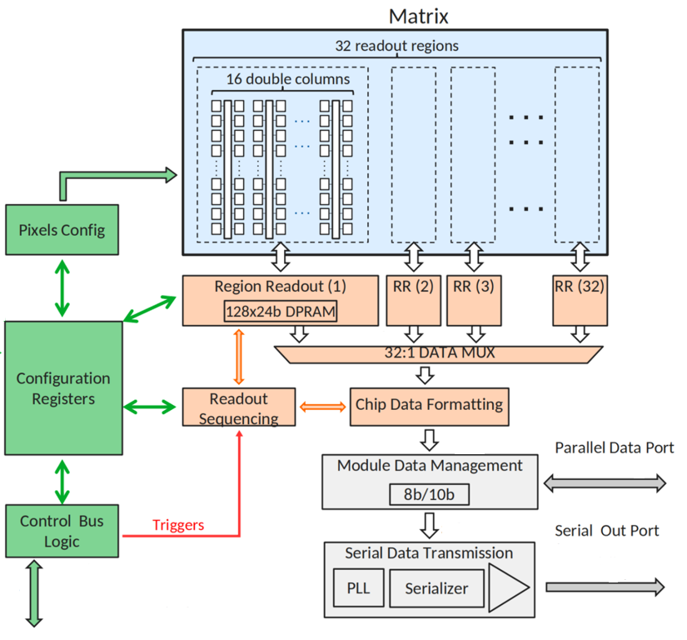
Research on 180 nm High Voltage Process Pixel Chip
MIC6_V2：
Chip Size: 2 cm X 0.695 cm
Divided into Two Regions: low voltage region NW (1.8V) and high voltage region HVNW (70V)
The Pixel Size (25 μ m x 34 μ m) Includes 7 Sizes of Diodes
The Peripheral Module includes a Digital Readout Module Bandgap, VDAC, IDAC, Serilizer And PLL, etc.

Slide 14
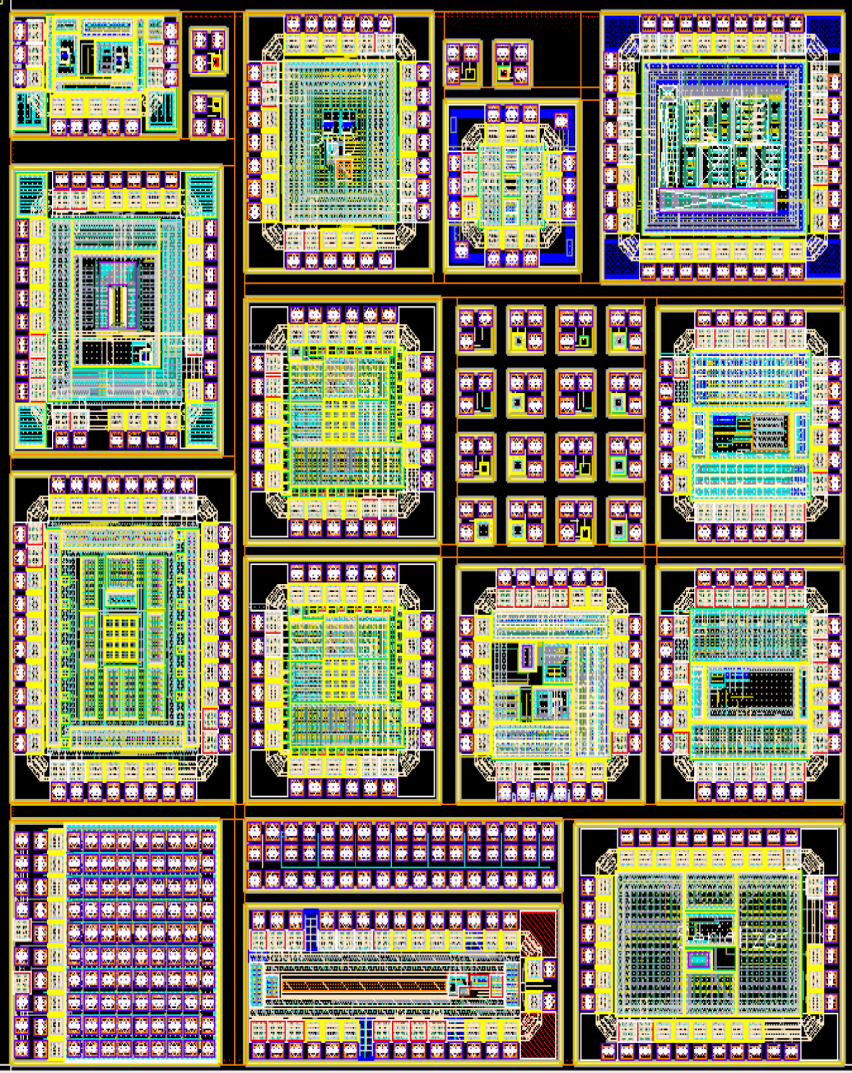
Research on 180 nm High Voltage Process Pixel Chip——Chip Design
15
 | MPW Chip List
1 | serializer
2 | FEE
3 | MOS radiation
4 | PLL 2.2G
5 | current DAC
6 | diode+SF
7 | diode_ALPIDE
8 | PLL 200M
9 | diode array
10 | diode+SF DT
11 | TDC
12 | ADC
13 | voltage DAC
14 | CSAHIGHHIT
15 | PDH+bandgap+Abuffer
14
13
12
11
10
9
8
7
6
5
4
3
2
1
The First Tape-out

Slide 15
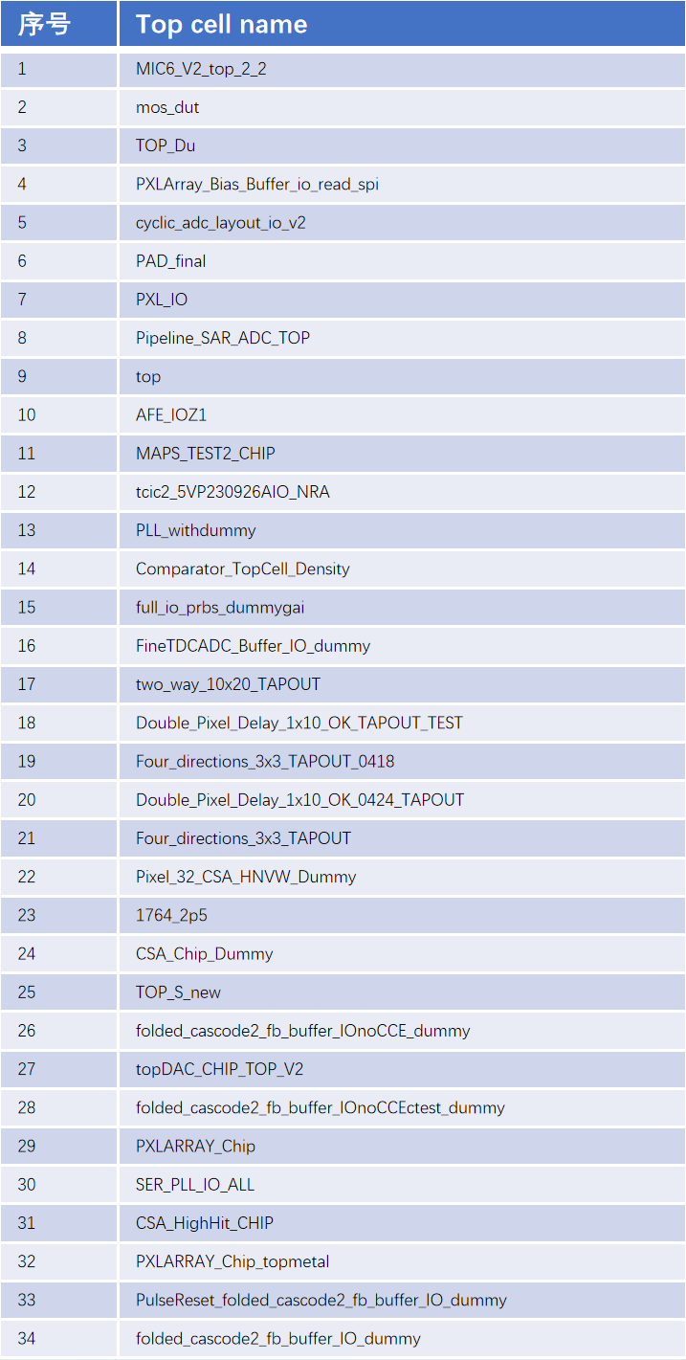
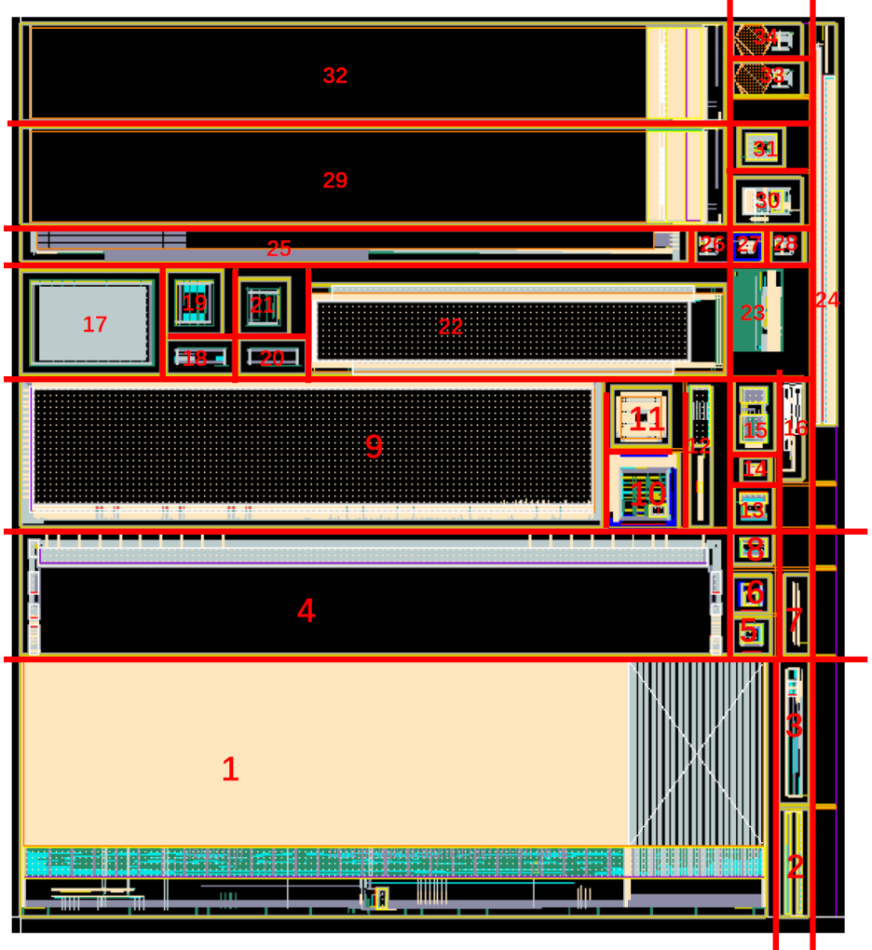
Research on 180 nm High Voltage Process Pixel Chip——Chip Design
The Second Tape-out

Slide 16
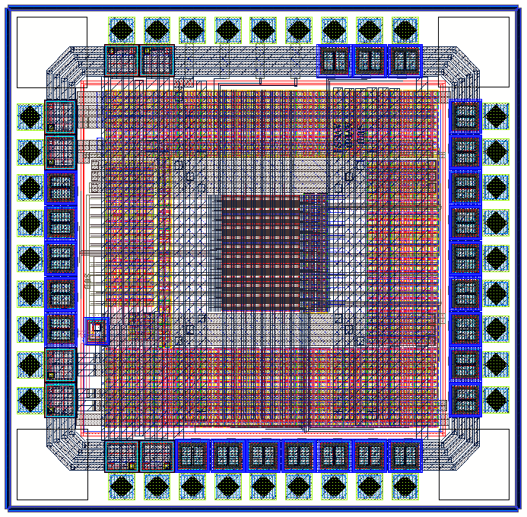
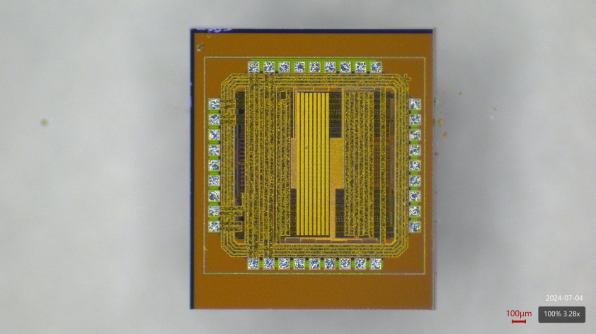
Research on 180 nm High Voltage Process Pixel Chip——Chip Test
Pixel Array Testing Chip
Testing System
Pixel Structure：Diode + SF
Pixel Size：30 × 30 um
Array Size：（4 × 4）× 6
Chip Size：1580um × 1550um
PXL<0:7> : DIODE RESET
PXL<8:15> : PMOS RESET

Slide 17
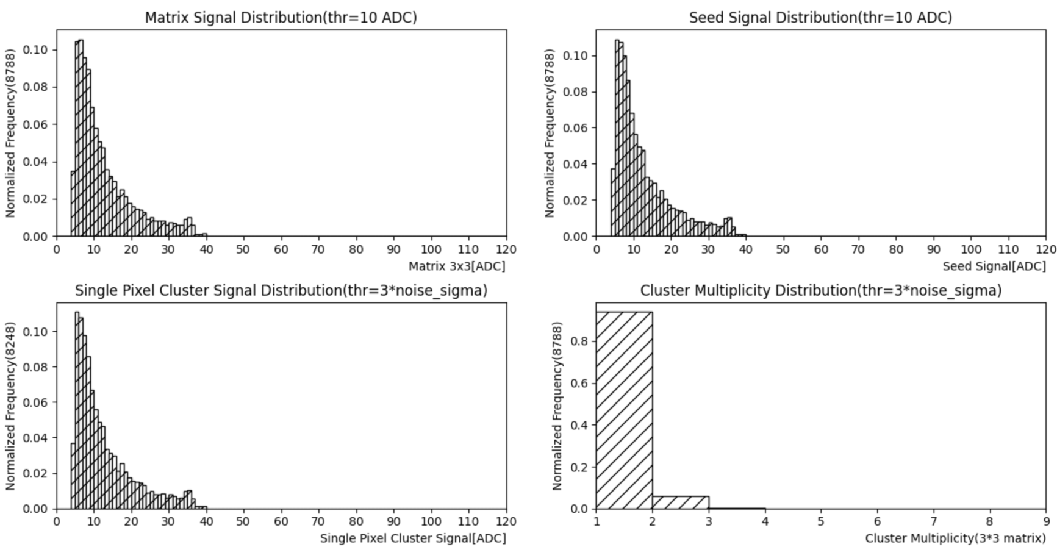
Research on 180 nm High Voltage Process Pixel Chip——Chip Test
⁵⁵Fe Energy Spectrum（Substrate Bias Voltage 0V）
Energy spectrum of 3x3 matrix signal
Energy spectrum of cluster seed signals
Energy spectrum of single pixel clusters
Cluster multiplicity
The signal of ⁵⁵Fe source did not fully reach the sensing area, and no calibration peak was measured.
The position of 'calibration peak' is at ADC Value 35.5 -> 1640e⁻.

Slide 18
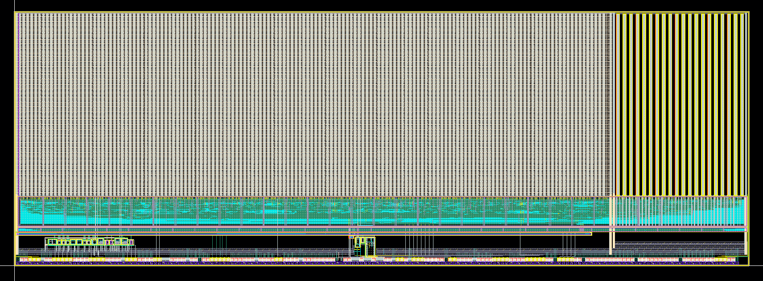
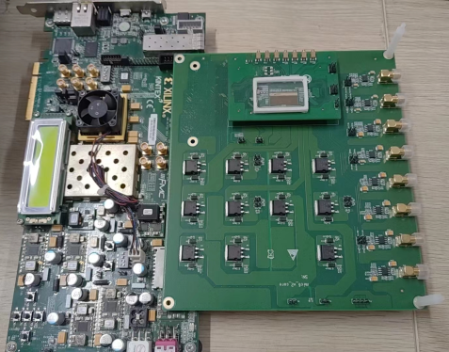
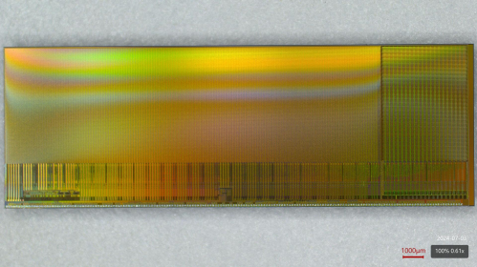
Research on 180 nm High Voltage Process Pixel Chip——MIC6_V2
1
2
0.695 cm
3
2 cm
Chip Size: 2 cm X 0.695 cm
Divided into two regions: low voltage region NW (1.8V) and high voltage region HVNW (70V)
The pixel size (25 μ m x 34 μ m) includes 7 sizes of diodes
The peripheral module includes a digital readout module Bandgap, VDAC, IDAC, Serilizer And PLL, etc.
MIC6_V2 Chip photo
Test system photos

Slide 19
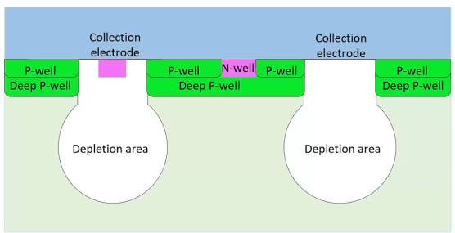
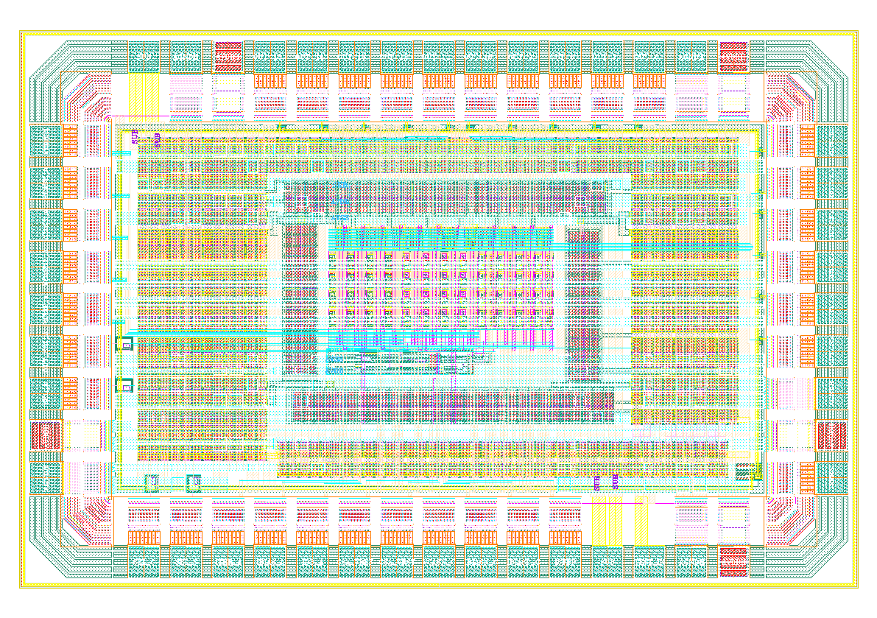
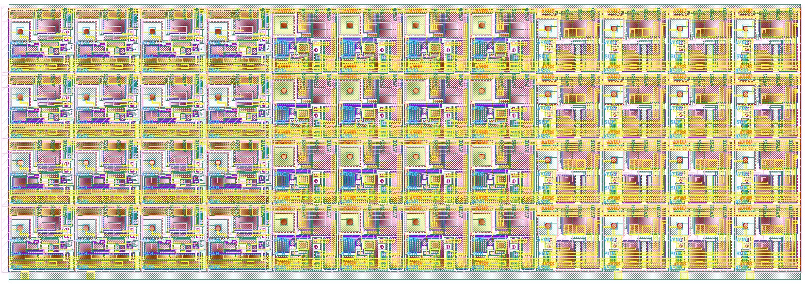
Research on 130nm Bulk CMOS Process Pixel Chip——Chip Design
130 nm Bulk CMOS Process：
3 well（NW、PW、DNW） -> 4 well （NW、PW、DNW、DPW）
6 layers of metal
Support high resistance silicon substrates
high resistance silicon substrates
Design of Pixel Array Testing Chip
MAPS + ALPIDE
MAPS + CSA
MAPS + SF
Pixel Structure：
MAPS + ALPIDE
MAPS + CSA
MAPS + SF
Array Size：（4 × 4）× 3
Chip Size：1.8mm × 1.2mm
Sensor: Diode
ENC < 8e-
FE Power: 40nA * 3.3V
Threshold < 1ke-
Integration Period < 10us
Pixel pitch: 40um
Sensor: Diode
ENC < 50e-
CSA_Av ~ 80mV/ke-
PeakingTime < 10us
FE Power: 300nA × 3.3V
Pixel pitch: 40um
Sensor: Diode
Pixel pitch: 40um
SFP BIAS: 1uA

Slide 20
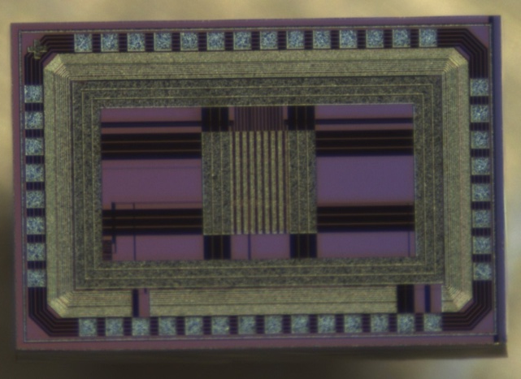
Research on 130nm Bulk CMOS Process Pixel Chip——Chip Test
Pixel Array Testing Chip
补充芯片照片
测试系统照片
Testing System

Slide 21
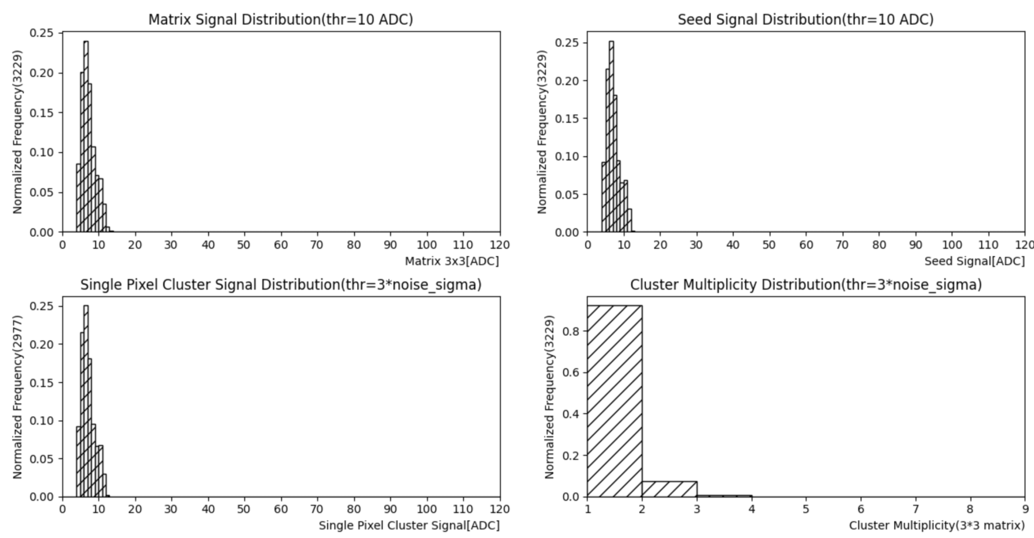
Research on 130nm Bulk CMOS Process Pixel Chip——Chip Test
⁵⁵Fe Energy Spectrum (High Resistance Substrate -9V Bias)
Energy spectrum of 3x3 matrix signal
Energy spectrum of cluster seed signals
Energy spectrum of single pixel clusters
Cluster multiplicity
The signal of ⁵⁵Fe source did not fully reach the sensing area, and no calibration peak was measured.

Slide 22
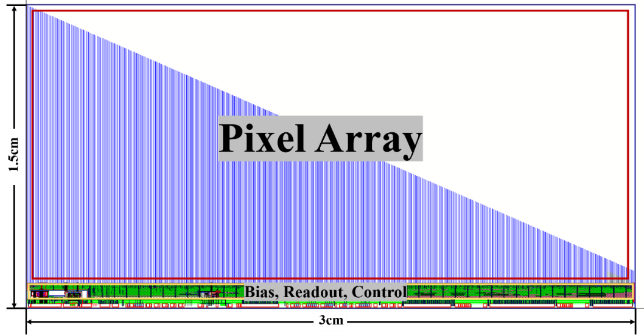
Research on 130nm Bulk CMOS Process Pixel Chip——MIC6_V3
Fully functional MAPS chip MIC6_V3
Process: 130 nm bulk CMOS
Chip Size: 15mm x 30mm
Pixel Array: 512 × 1024
Pixel Size: 30.53 µ m × 26.8 µ m
Peaking Time: < 1us
Integral Time: 5-10 us
Parallel Data Port: 80 MHz I/O CMOS 3.3 V
High Speed Serial Data Port: 1.1 Gb/s, 8B10B encoding
Configuration Interface: SPI
Two Readout Modes: trigger mode and continuous mode
Single pixel can be masked; Pixel includes built-in testing functionality
Zero Compression Readout

Slide 23
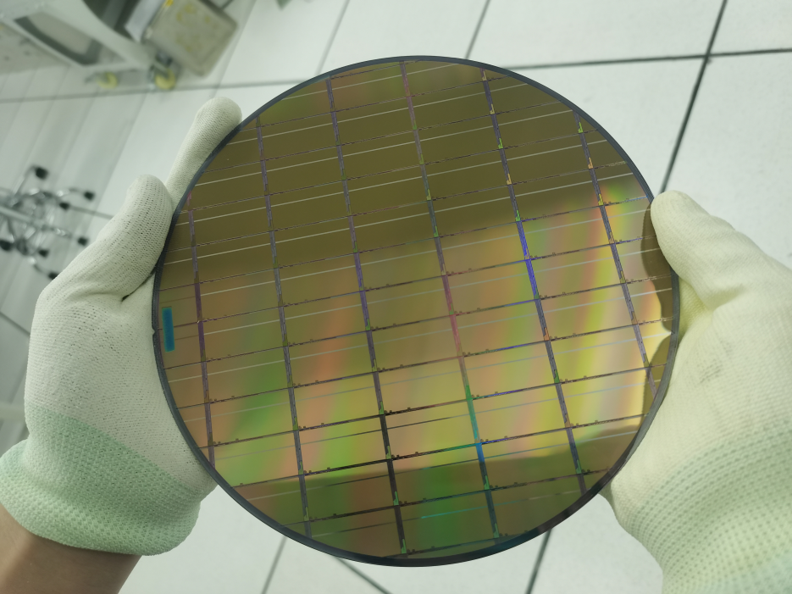
Research on 130nm Bulk CMOS Process Pixel Chip——MIC6_V3
Six MIC6_V3 wafers have been sent back in July 2024. There are still 6 wafers on the production line, and it can be decided whether slight modifications to the chip layout are needed before continuing production based on potential issues discovered during testing.
Photo of MIC6_V3 wafer

Slide 24
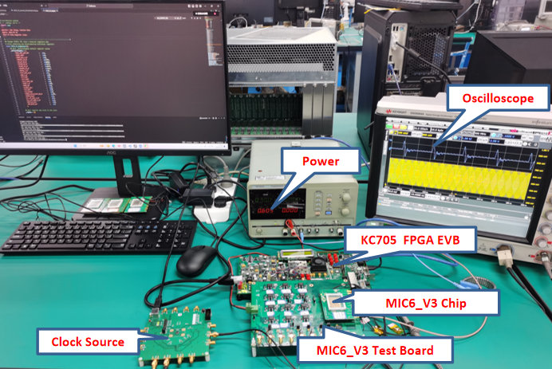
Research on 130nm Bulk CMOS Process Pixel Chip——MIC6_V3 Chip Test
The functional test results of MIC6_V3 full-featured chip are quite optimistic. Tests have shown that iDAC, vDAC, pixel circuit, PLL, parallel to serial converter, pixel configuration circuit, SPI controller, dual column readout and reset circuit AERD, as well as digital circuits responsible for data readout, framing, and encoding, are all working properly.
All functional tests were successful !
Photo of MIC6_V3 test system
O_SCLK Waveform
O_MOSI Waveform
Serial data readout
SPI write and read test results

Slide 25
Research on 130nm Bulk CMOS Process Pixel Chip——MIC6_V3 Chip Test
For the first time in China, a fully functional MAPS chip designed based on domestic technology has detected the ⁹⁰Sr source signal.
Pixel array AERD address and digital peripheral address read successfully.

Slide 26
Research on Pixel Technology
⁹⁰Sr test | 55 nm CIS technology | 180 nm High Voltage technology 0V bias | 180 nm High Voltage technology -9V bias | 130 nm Bulk CMOS process Low resistance substrate | 130 nm Bulk CMOS process High resistance substrate 0V bias | 130 nm Bulk CMOS process High resistance substrate -9V bias
MPV (ADC Value) | 10(178e⁻) | 10 (462e⁻) | To be tested | 6.5 | 8.5 | 12
Case rate (per hour) | 4100 | 1440 | To be tested | 840 | 2760 | 11700
Pixel size | 24u×24u | 30u x 30u |  | 40u x 40u

Slide 27
Outline
Background
Exploration of Domestic Processes for MAPS
GBT Series ASICs Development
Module Assembly
Summary and Plan

Slide 28
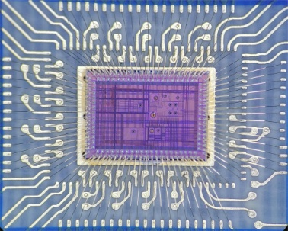
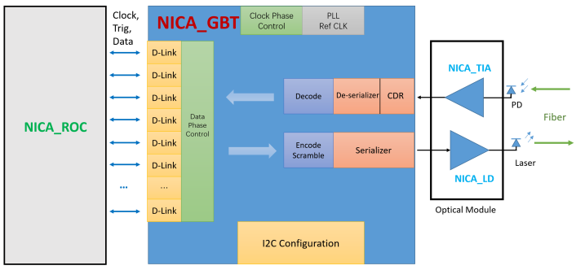
GBT ASIC
GBT ASIC includes：
GBT_V1 practical pictures under microscope
What else needs to be done:
Encode, Decode (Digital part) design, test and iterative design if needed
Phase Aligner test, iterative design(if needed) and integration
Clock Phase control design, test and integration
Overall ASIC integration (Large-scale anlog-digital-mixed ASIC)
The above work are planned to be achieved in 2025~2026
BGA package (design, manufacture, test)
Chip test (BGA)
TIA
LD

Slide 29
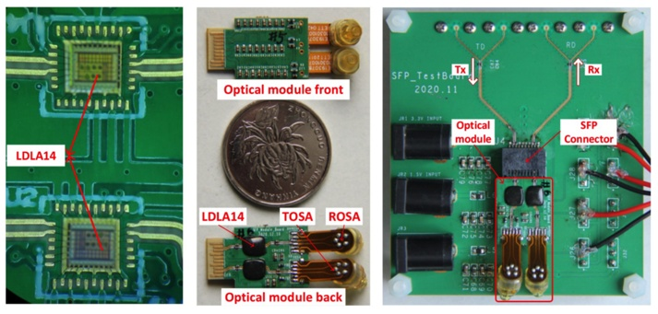
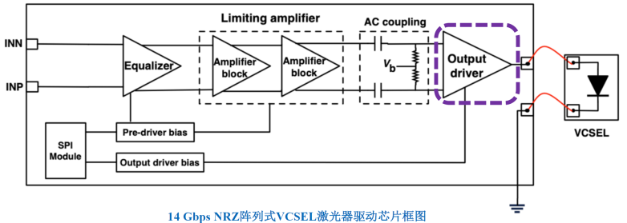
LD, TIA ASICs and optical module
LD
Core design has been tested and verified Done √
What else needs to be done?
Optimize the design (chip area and the power consumption)
The final version integration (full four-channel form)
TIA
Core design has been tested and verified Done √
What else needs to be done?
Optimize the design (data rate and the power consumption)
The final version design
Optical module
Prototype has been designed and tested Done √
What else needs to be done?
Optimize the design (related to stable and reliable mechanics, assembly ..)
The final version.
Clear and wide-open 10 Gbps optical eye has been captured in the LDAr ASIC optical test

Slide 30
Outline
Background
Exploration of Domestic Processes for MAPS
GBT Series ASICs Development
Module Assembly
Summary and Plan

Slide 31
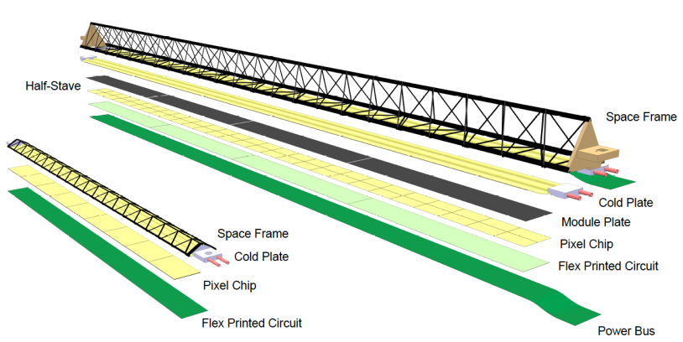
ALICE ITS2 Project
OB Stave
supermodule
OB HIC (module)
IB Stave
supermodule
50/100 𝜇m
IB HIC (module)
Inner Tracking System 2
7 layers of MAPS, 12.5G pixels
ALPIDE chip
Monolithic Active Pixel Sensor (MAPS)
5 𝜇m impact parameter resolution
7 cylinders covering ~10 m² area
Innermost radius: 23 mm
Inner Barrel (IB): ~0.35% X₀
3 Inner Layers (48 x 9-chip Staves）
Outer Barrel (OB)： ~0.8% X₀
2 Outer Layers (90 x 14-HIC Staves)
2 Middle Layers (54 x 8-HIC Staves)
Notes:
Besides the OB HIC production, we also work on the stave production for the MPD ITS, then we constructed a clean room.
The CMM machine has been installed in last year, and stave assembly tooling and test system will be purchased from ALICE this year.
Once the stave assembly tooling are available, the ALICE collaboration will send trainers from European side to China to provide training sessions for us.
As discussed with Russian colleagues, JINR team will send mechnics parts to Wuhan for the stave assembly training. This is very important to China side.

Slide 32
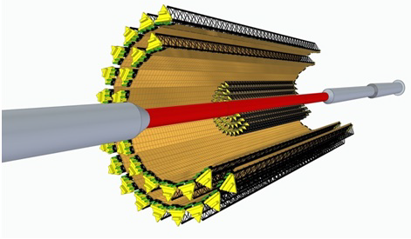
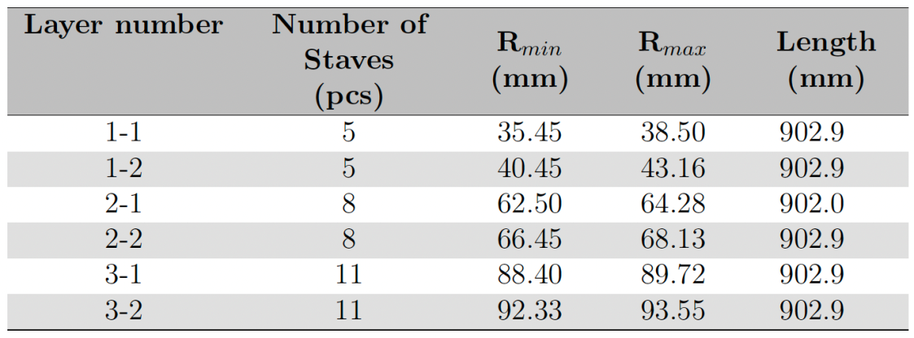
MAPS-based Inner Tracking System (ITS) at MPD
The ITS detector will enable charm-hadron measurement and isolate collision vertex at high luminosity environment for the MPD experiments
Based on the art-of-the-state MAPS technique
Charm production in heavy ion collisions at energies
Clean measurement of (multi-)strange hadron production
Notes:
The proposed ITS is technically based on the advanced Monolithic Active Pixel Sensor technique. To the physics goal, it enable the MPD to measure the charm hadron production at NICA energies, and also benefit the measurements of strange and multi-strange hadron production with background suppressed significantly.
The ITS consists of 5 MAPS layers, its active area is about 3.5 square meter, 4.5 Giga pixels in total.
The two Outer layers are grouped as Outer Barrel, planed to be installed in MPD stage-1
The three Inner layers are grouped as Inner Barrel, planed for the MPD stage-2.
The Outer barrel will use the thin large area pixel chip, ALTAI, manufactured by 180 nm CMOS imaging sensor process.
The Inner barrel will based on the ultra-thin wafer-scale area bent pixel chip with 65 nm technique.

Slide 33
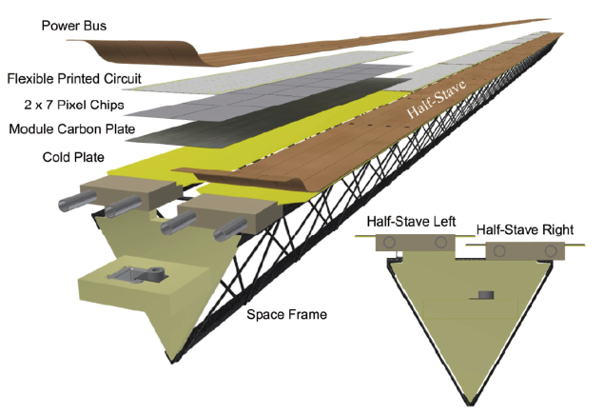
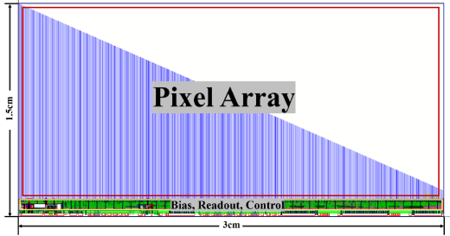
The OB Module Structure
MICA chip
100 𝜇m thick
Material thickness: ~0.8% X₀
Supermodule (Stave):
2 half-stave (HS), each HS consists of 7 HICs
Outer Barrel (OB): 2 layers, consists of 42 (18+24) staves
Middle Barrel (MB): 1 layer, consists of 12 staves
Module (HIC): 2x7 MICA chips aligned on flexible PCB
Following the ALICE ITS2 HIC/Stave assembly & testing techniques/procedures, CCNU joined the ALICE ITS2 OB HIC mass production, and has constructed fully OB+MB HIC/Stave production lines.
MPD ITS OB HIC Production:
• 756 working HICs needed to assemble the OB
• 832 assembled HICs with 10% spare
• 1088 assembled HICs assuming a total yield of 76.5%
• Target rate: 2~3 HICs per day per site in average, lasting for ～2 years with 2 sites (~2 years)
MPD ITS OB Stave Production:
• 108 working HICs needed to assemble OB
• 133 assembled HSs (take into account spare and stave production yield)
• Target rate: 1 HS per week per site in average, lasting for more than 1 year with 2 sites (~1.5 years)
Notes:
We have contributed to the ALICE ITS2 project in past 10 years, including ALPIDE pixel chip design and ITS2 OB HIC assembly R&D, mass production and testing.
To the ITS2 OB HIC production, we constructed production line as shown in below picture, and have a technican teams with well trained.
we participated in the mass production, totally produced 450 modules, and kept 2~3 modules per day. Since 2019, we have been involving the ITS2 commissioning and calibration.

Slide 34
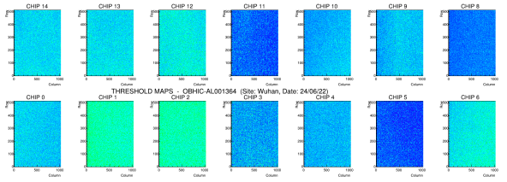
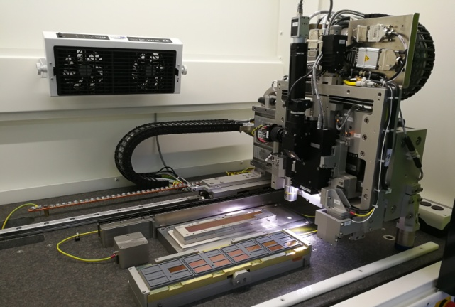
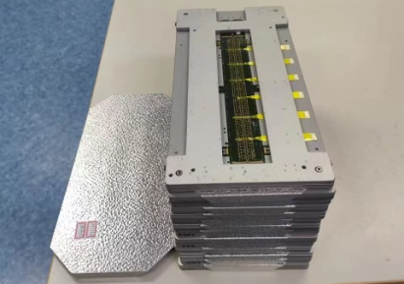
The OB HIC module assembly & testing @CCNU
HIC module assembly and test：(1) Chip alignment positioning resolution within 5 𝜇m@3𝜎；(2) Automatic ultrasonic wire bonding with pull force larger than 7.5g；(3) Qualification and endurance testing
MAPS chip alignment
Threshold map of 14 chips in a HIC
chip & FPC gluing
ALICIA machine
Testing
MPD dummy HICs
Chip side (2 x 7)
curing
Wire bonding
FPC-to-ALTAI interconnection
HIC module
Assembly QA (peel test, pull test)
FPC side
Notes:
This slide shows the OB HIC production procedure.
We re-use the ALICE ITS2 HIC production line, the chip alignment positioning resolution can be controlled better than 5 micrometer.
And the automatic ultrasonic wire bonding (can make the wire pull force larger than 7.5g to apply to the strong magnetic field).
Finally, we will carry out single HIC qualification testing and batch HICs endurance testing.

Slide 35
The OB HIC module assembly & testing @CCNU
1. Chip Alignment
2. FPC preparation & glue spreading
3. Pre-curing & fully curing
1.5 hours/HIC (14 ALPIDE chips)
5 hours pre-curing, 24 hours fully curing
4. Wire-bonding
5. Peel & pull force test
1.5 hours/HIC
(2286 wires bonded)
6. Qualification & endurance testing
7. Assembled ITS OB HIC
Notes:
This slide shows the OB HIC production procedure.
We re-use the ALICE ITS2 HIC production line, the chip alignment positioning resolution can be controlled better than 5 micrometer.
And the automatic ultrasonic wire bonding (can make the wire pull force larger than 7.5g to apply to the strong magnetic field).
Finally, we will carry out single HIC qualification testing and batch HICs endurance testing.

Slide 36
The OB stave supermodule assembly & testing @CCNU
Stave module assembly and testing：
Custom assembly tooling & testing system from ALICE/ITS2
Coordinate Measuring Machine (CMM) used for components positioning & alignment
7. Boxed for testing and shipping
6. Power bus installation
3. HIC gluing onto Cold Plate
1. HIC tabs cut
8. Outer barrel layer integration & testing
4. HIC-to-HIC interconnection soldering
5. Two HSs on Space Frame
2. HIC alignment on Cold Plate
Notes:
This slide shows the OB stave production procedure, which has been applied firstly in the ALICE ITS2 project.
Both China and Russia site purchase the custom assembly tooling and testing system from the ALICE ITS2 team.
The key equipment, Coordinate Measuring Machine have been purchased in both China and Russia sites.

Slide 37
Readiness of infrastructure for MAPS detector
Constructed ALICE ITS2 OB HIC module production line，module assembly R&D, and 20% module mass production (450 HICs with yield 85%, and chip positioning accuracy 5 𝜇m@3𝜎)
ITS2 stave supermodule production line is under-construction, and a CMM machine installed. Technician trainings will be provided by ALICE ITS team
Wire pull tester, peel force tester, and digital measurement microscope, etc., are equipped for module quality assurance
Chip-level module assembly & testing @ ISO6 clean room
Stave-level module assembly & testing @ ISO7 clean room
Notes:
We have contributed to the ALICE ITS2 project in past 10 years, including ALPIDE pixel chip design and ITS2 OB HIC assembly R&D, mass production and testing.
To the ITS2 OB HIC production, we constructed production line as shown in below picture, and have a technican teams with well trained.
we participated in the mass production, totally produced 450 modules, and kept 2~3 modules per day. Since 2019, we have been involving the ITS2 commissioning and calibration.

Slide 38
Summary and Plan
Exploration of Domestic Processes for MAPS
Progress of Readout Electronics
Developmemt of GBT-like series ASICs
Assembly of HIC module and stave supermodule
Thanks for your attention!

Slide 39
Readiness of infrastructure for MAPS detector
Full production line of the ALICE ITS2 OB stave assembly & testing are available in CCNU
Notes:
These pictures show the HIC modues prodcued by Wuhan site and the Wuhan team.
Here there is a certificate issued by the ALICE spokesperon, Dr. Luciano Musa for the Chinese contributionn to the ALICE ITS2 OB HIC production, reach 85% production yield in 450 HIC modules.

Slide 40
Outline
Background
Exploration of Domestic Processes for MAPS
Progress of Readout Electronics
GBT Series ASICs Development
Module Assembly
Summary and Plan

Slide 41
Summary and Plan
Exploration of Domestic Processes for MAPS:
Three different processes suitable for MAPS pixel chips were explored, and the pixel array test chips based on the three processes all measured ⁵⁵Fe and ⁹⁰Sr spectra;
Design MIC6_V2/V3 full-featured MAPS chip, chip testing is underway, and some testing has been completed.
Progress of Readout Electronics：
The design and test of FPGA-based Readout Unit (RU) has been finished;
The design and test of Power Unit (PU) has been finished；
Completed the design and test of ROC ASIC prototype.

Slide 42
Summary and Plan
GBT-like series ASICs development：
Core design has been tested and verified;
Needs to be done:
the GBT ASIC:Design, testing, and integration of Encode, Decode, and other modules;
the LD, TIA and optical module:optimize the design,the final version integration.
Thanks for your attention!

