Slide 1
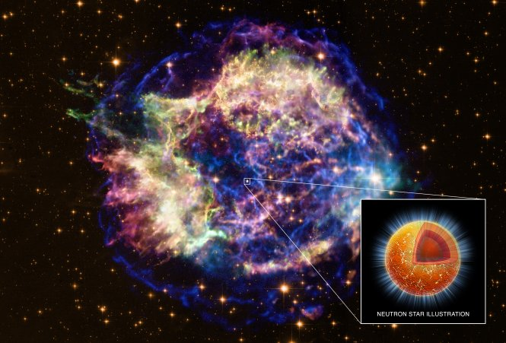
Open the black box:
To quantitatively determine neutron star EoS from connecting consistently nuclear physics and astronomy
LI Ang 李昂
liang@xmu.edu.cn
Xiamen U.
Many thanks for
Invitation!
The 1st International Workshop on Physics at High Baryon Density (PHD2024)
CCNU, Wuhan, Nov. 1-4 2024

Slide 2
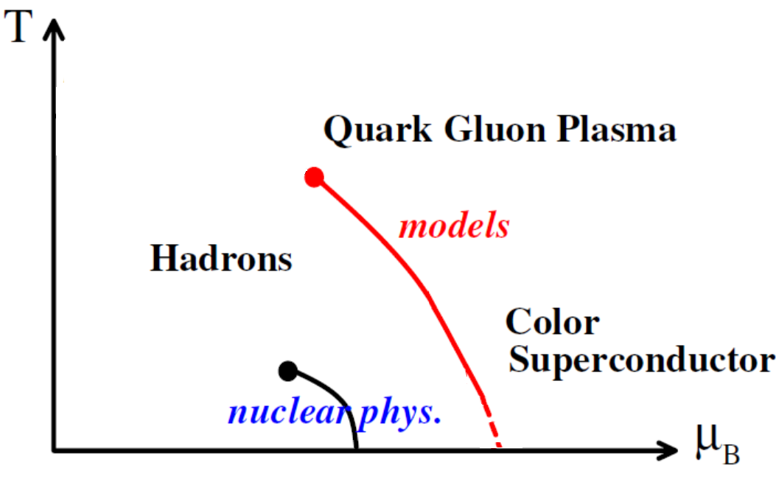
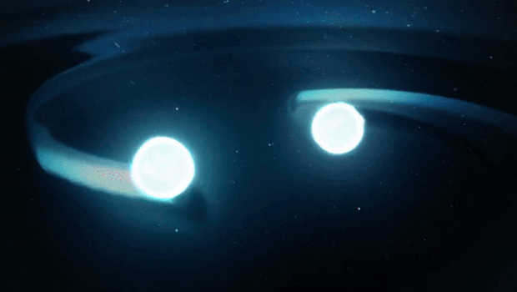

Neutron star as dense matter probe
QCD: The theory which describles the interaction of nucleons and quarks;
Lattice QCD (LQCD) and Heavy-ion collisions (HICs) sensitive primarily to high T, low μ regions;
Electronmagetic (EM) and gravitational wave (GW) observations of neutron stars serve as ideal probe of cold, dense QCD.
Crossover
(μ=0, T~150MeV) from LQCD;
eg: Y. Aoki, et al, Nature 2006
Color-Flavor-Locked phase at symptotically high density
Empirically known around normal nuclear matter density.
Neutron star
Quark star
Discover
February 2002
Sasaki NPA 2009

Slide 3
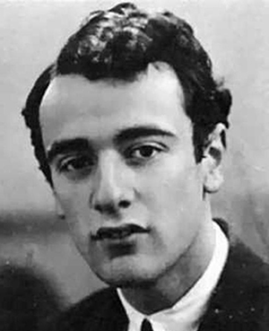
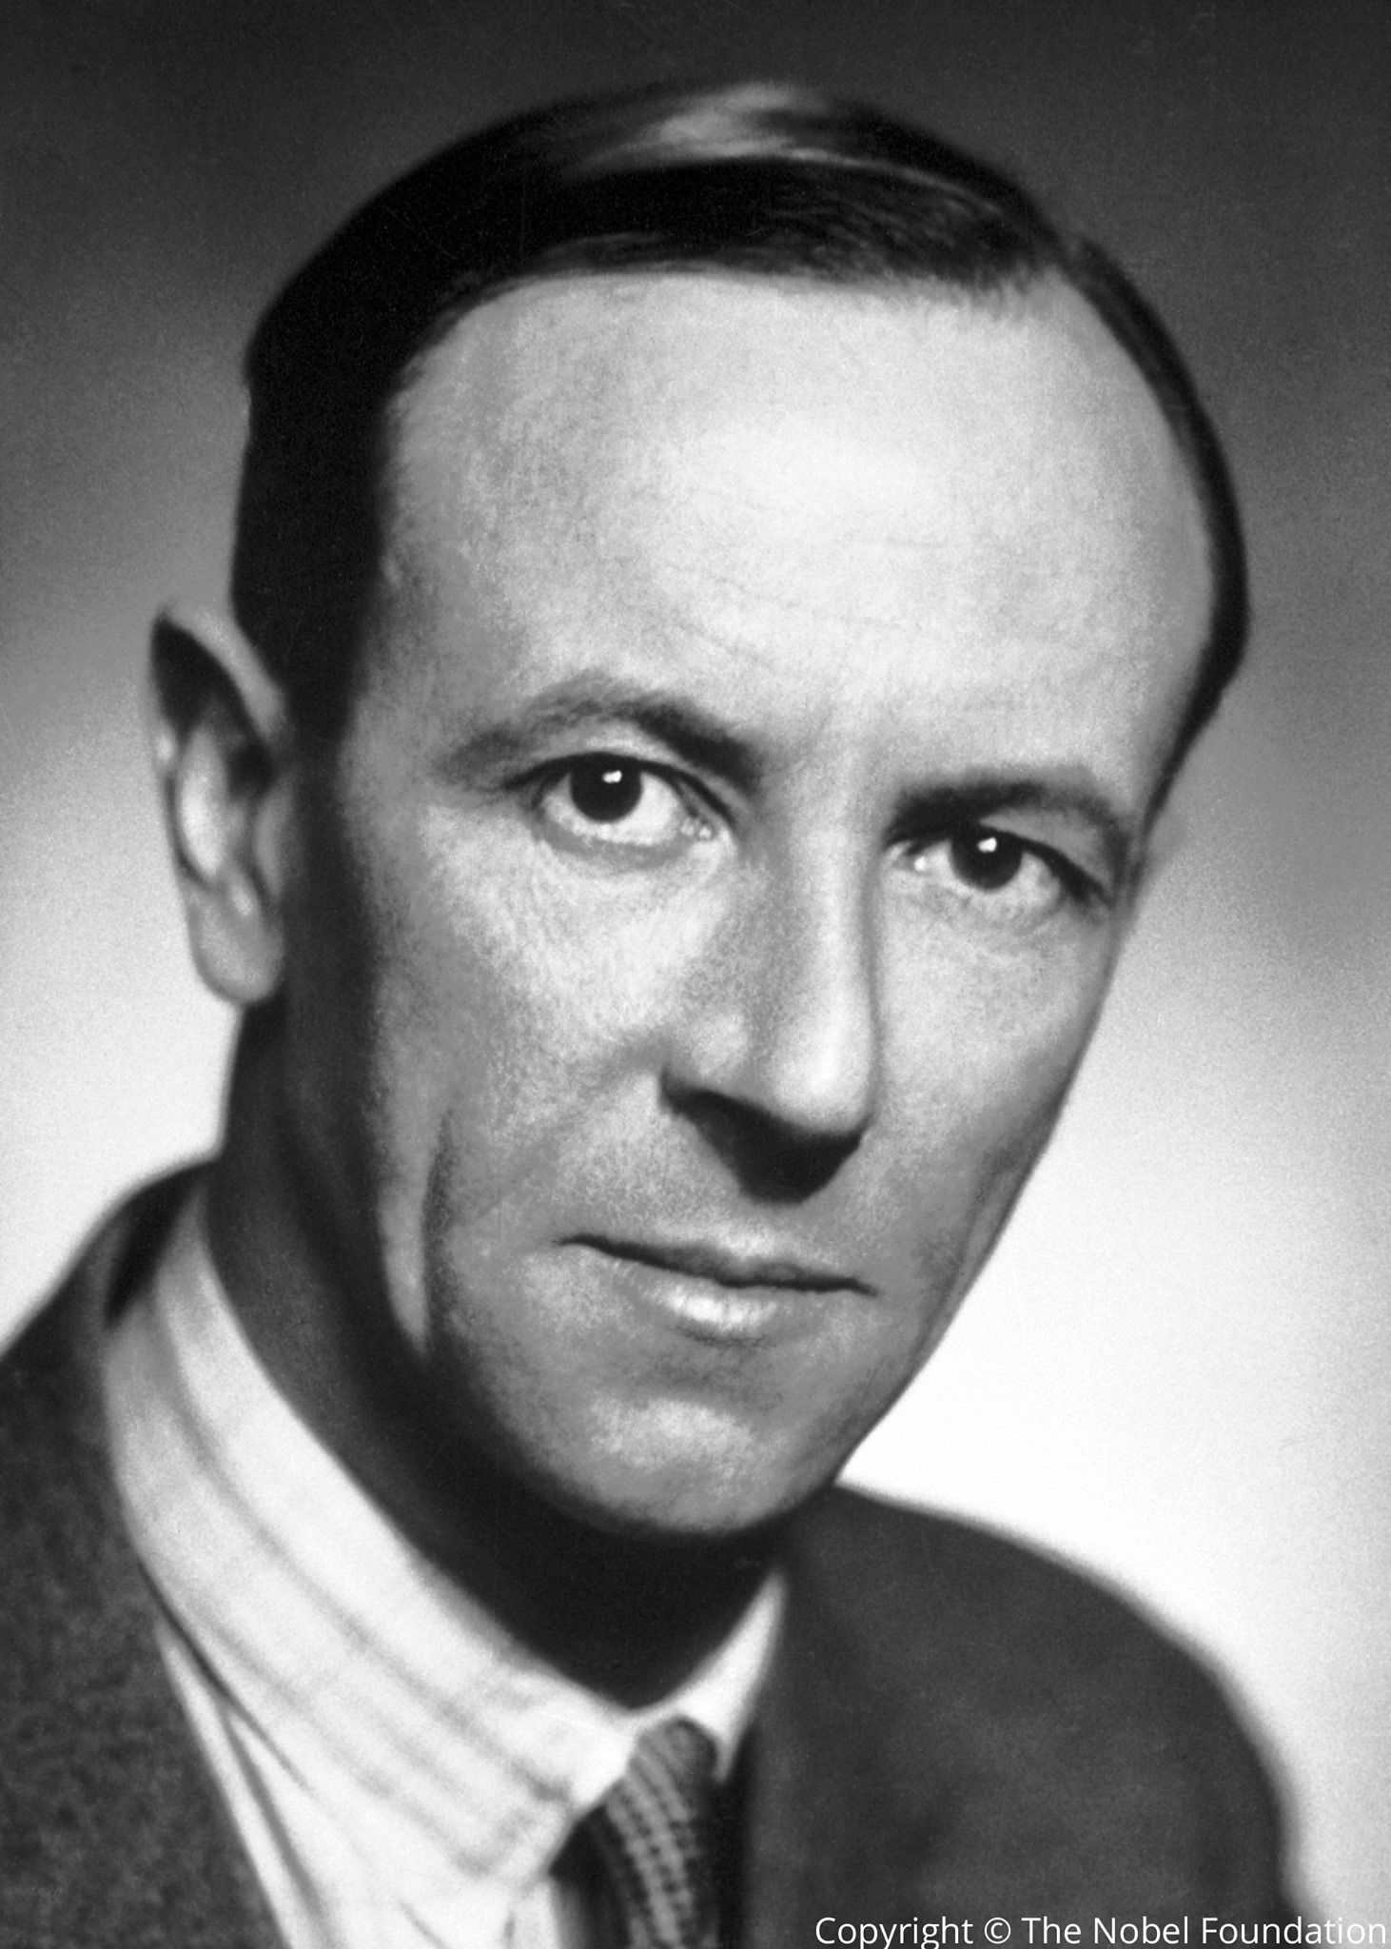
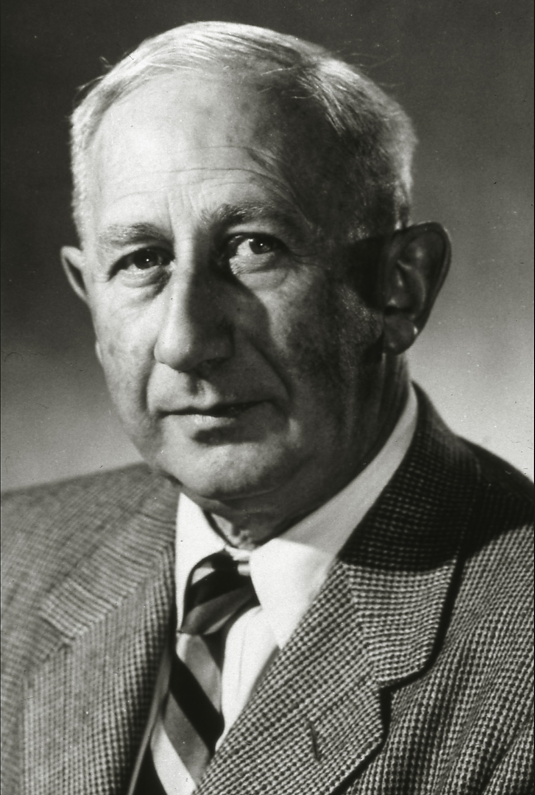
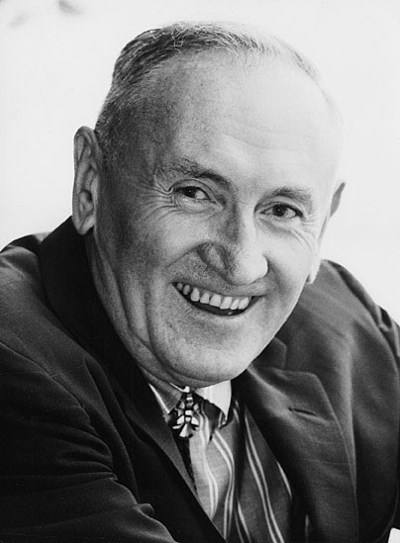
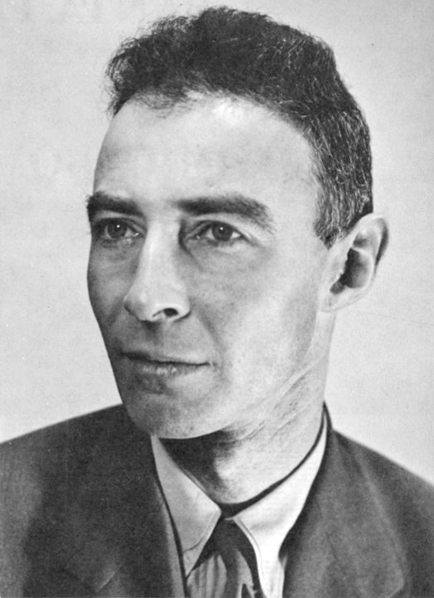
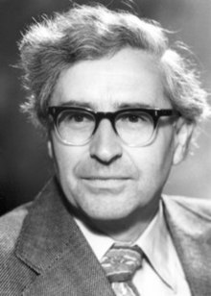

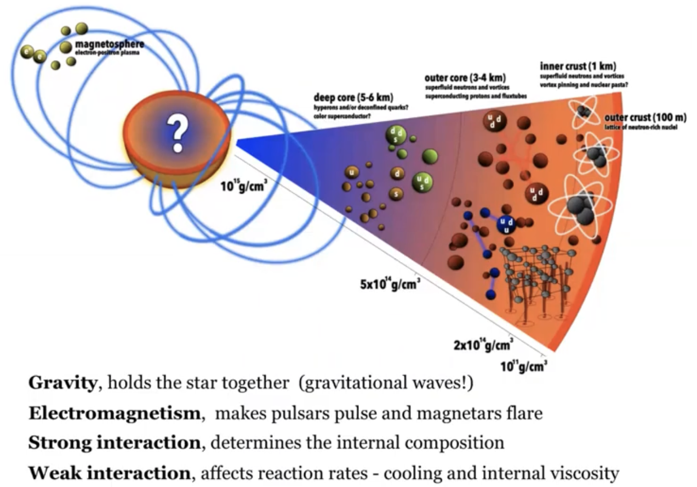
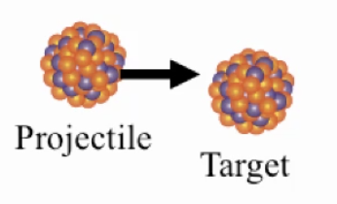
https://www.nature.com/articles/d41586-020-00590-8
The golden age of neutron star has arrived!
Lev Landau
James Chadwick
Walter Baade
Antony Hewish
Fritz Zwicky
Dame Jocelyn Bell Burnell
1932-
J. Robert Oppenheimer
1967
Nobel prize 1974
Fundamental Physics Breakthrough Prize 2018
“the density of matter becomes so great that atomic nuclei come in close contact, forming one gigantic nucleus.”
RIBF, HIRFL-CSR, BRIF, FRIB, J-PARC, ROAN, GSI, RHIC-STAR, NICA, HIAF-CEE, FAIR-CBM,,…
A ~ 10⁵⁷; For R=10 km, M=1.4 M⨀ ,
average density ~(2-3) nuclear density 𝜌₀
~1-10 𝜌₀
‘multi-messenger’
‘multi-wavelength’
(~several hundreds MeV)
(by N. Addersson)
GW, photons, neutrinos
LIGO/Virgo/KAGRA, CE, ET,
NICER, eXTP, EP, SWOM,
FAST, QTT, SKA,...

Slide 4

Why is understanding the EoS important for nuclear/astrophysicists?
类型
one or two-family compact stars
质量半径关系
mass-radius relation
低质量间隙mass gap between NS and BH
脉冲星
glitch crisis
LMXB
双中子星并合binary evolution and the remnants
产生和演化
supernova and
star formation
EoS
mainly p(𝜌)
极限质量
the maximum mass
核对称能
symmetry energy
伽马射线暴SGRB central engine and kilonova
超子危机?
hyperon interaction
hypernuclei
QCD
strangness phase transition
incompressibility
(this talk)

Slide 5

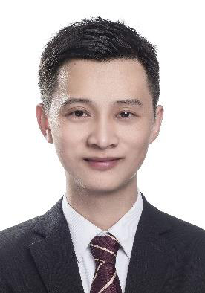







Neutron star group @XMU
Join us study star on the beach!
arXiv:2408.15022 submitted
arXiv:2402.02799 PRD
arXiv:2312.17102 ApJ
arXiv:2312.12185 ApJ
arXiv:2312.04305 MNRAS
arXiv:2305.16058 PRC
arXiv:2305.08401 ApJ
arXiv:2304.12050 PRD
arXiv:2211.04978 PRD
arXiv:2211.02007 ApJ
arXiv:2205.10631 ApJ
arXiv:2204.05560 ApJ
arXiv:2203.04798 PRD
arXiv:2201.12053 PRC
arXiv:2108.00560 ApJ
arXiv:2107.13997 ApJL
arXiv:2107.07979 MNRAS
arXiv:2103.15119 ApJ
arXiv:2011.11934 ApJ
arXiv:2009.12571 MNRAS
arXiv:2007.05116 JHEAp (review)
arXiv:2006.00839 ApJ
arXiv:2005.12875 ApJS
arXiv:2005.02677 PRD
arXiv:2001.03859 PRC
Zhenyu Zhu 朱镇宇 Zhiqiang Miao 缪志强 Zhonghao Tu 涂中豪
Nucl_Astrophys_xmu (厦大天文核天体物理小组)
Many-body theory; NS oscillation Superfluidity;
Merger simulation Hybrid star; Neutron star cooling;
Numerical relativity Bayesian analysis Nuclear pinning force
Graduated in 2021;
postdoc in CCRG-RIT
Graduated in 2023;
postdoc in TDLee inst.
Wenli Yuan 苑文莉 Peng Liu 刘鹏 Xiangdong Sun 孙向东 Shuochong Han 韩烁冲
Quark star; Glitch; Hyperon matter; Many-body theory;
Pulsar observation Many-body theory Nuclear transport
Graduated in 2023;
postdoc in PKU
https://astro.xmu.edu.cn/People/Faculty/la.htm
with 5 undergraduate students

Slide 6
Outline
Basic for neutron star structure and the EoS
Recent works from connecting #consistently neutron star observations and nuclear experiments
What we learn so far
(Biased selected results; Highlighing work done by our group)

Slide 7
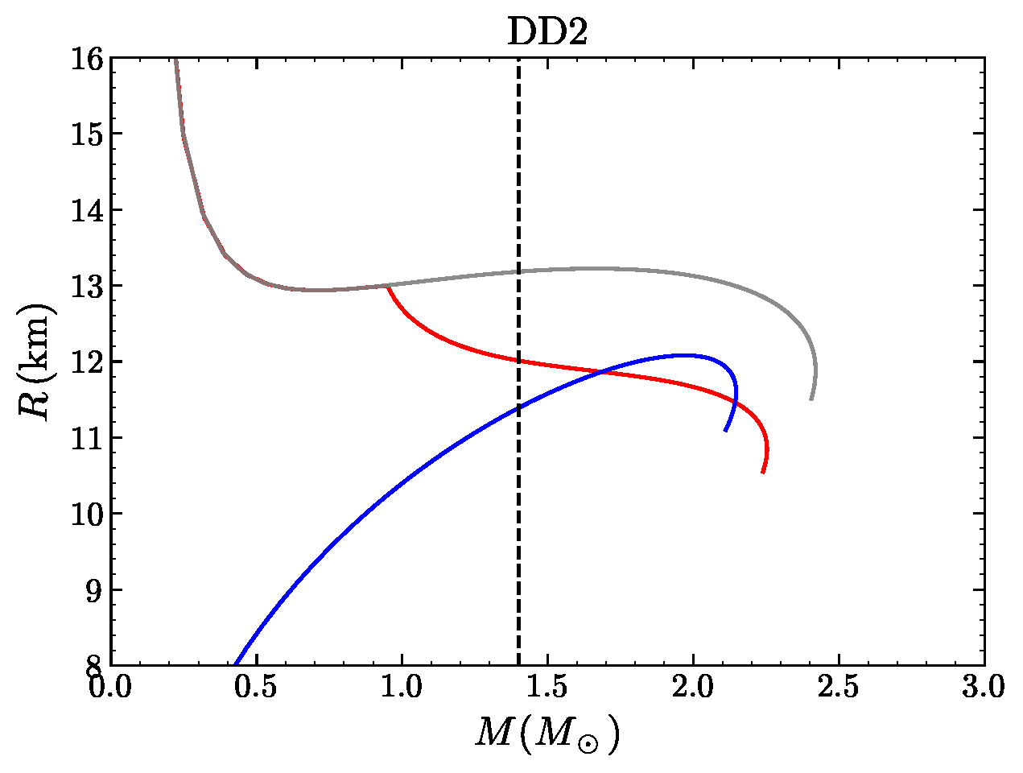
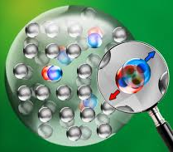
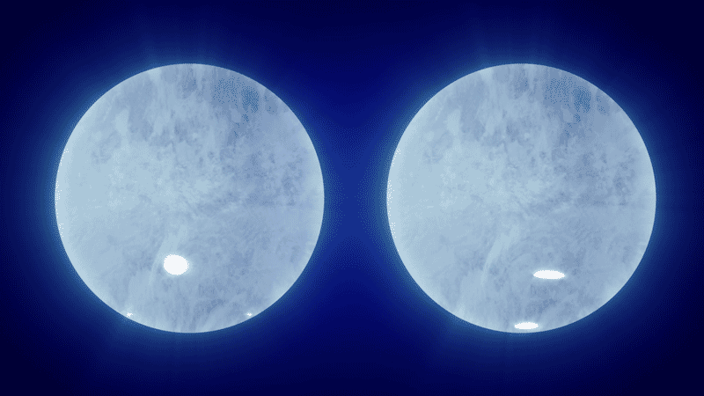
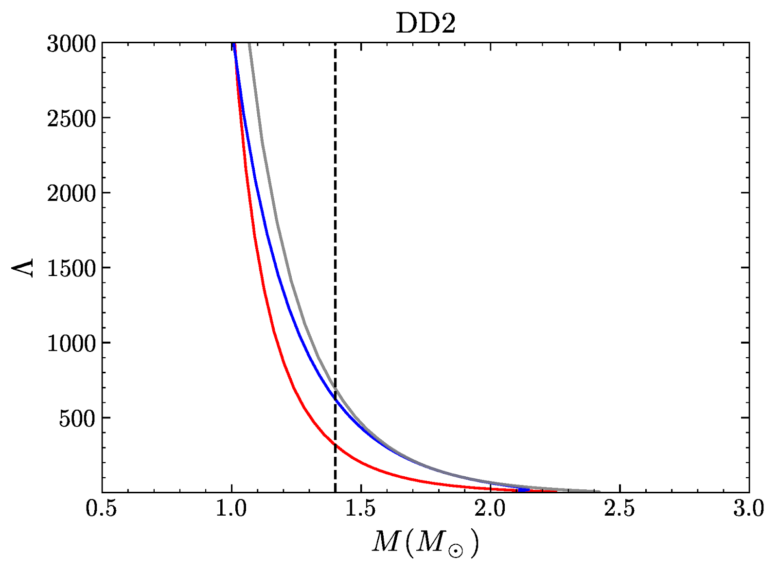
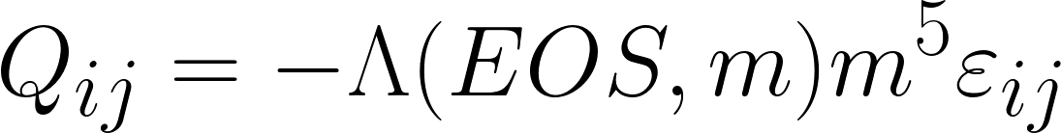
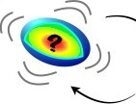
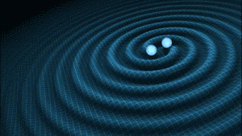
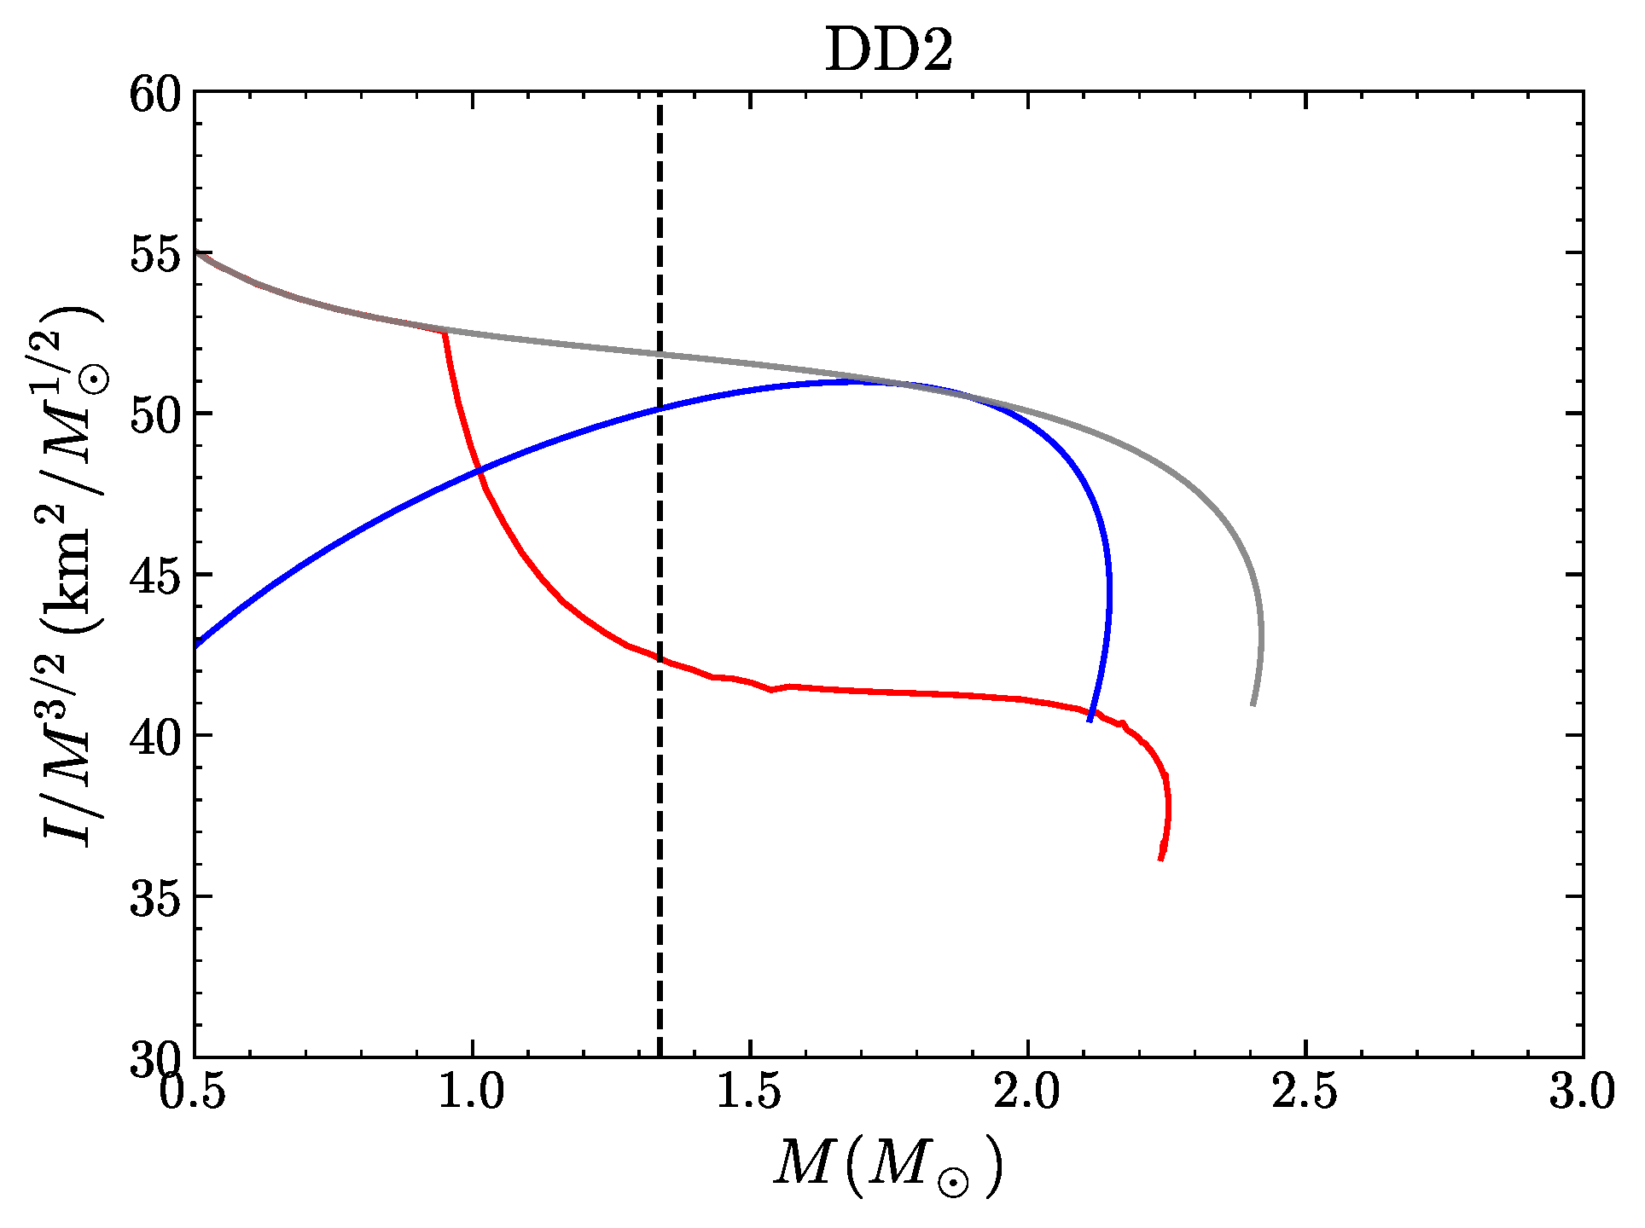
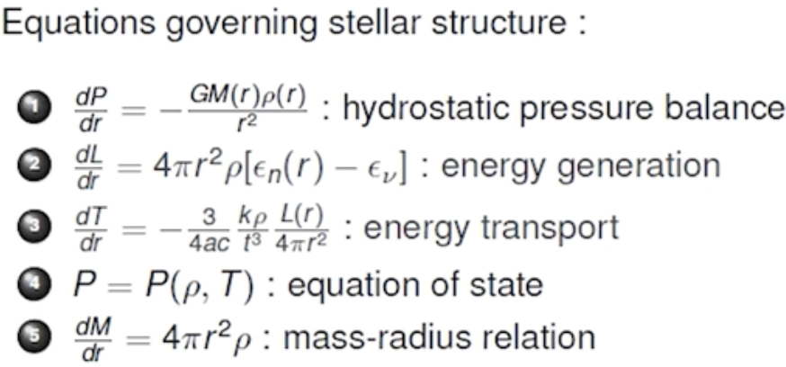
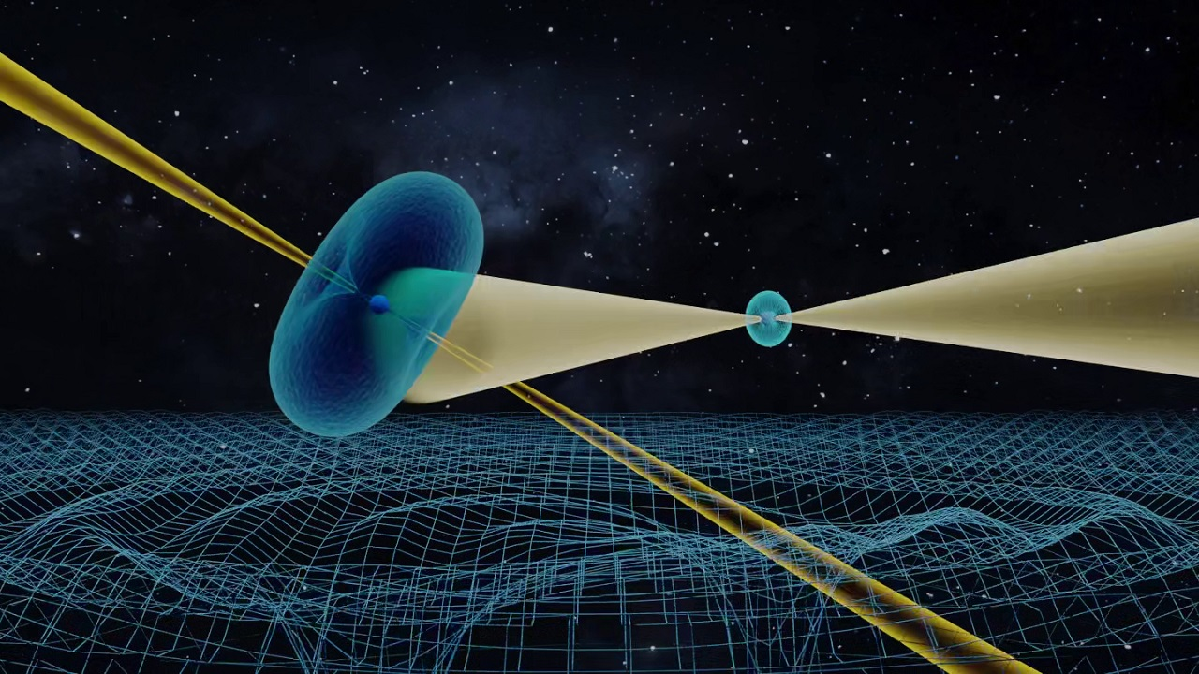
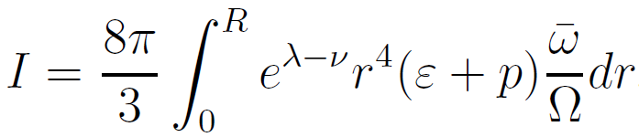
some neutron star EM & GW observables have an intrinsic correlation with EoS
Microhysics
neutron star
mass & radius
@NICER, …, eXTP;
Hydrostatic equlibrium
quark star
hybrid star
PSR J0030+0415
PSR J0740+6620
EoS
(GR version) TOV eq.
tidal deformability
@LIGO/Virgo/KAGRA, ... CE, ET;
Perturbed hydrostatic equlibrium
GW170817
GW190425
(Newtonian version)
moment of inertia
(MOI)
@平方公里陣列射電望遠鏡(SKA)
PSR J0737-3039

Slide 8
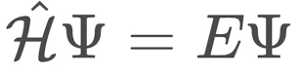
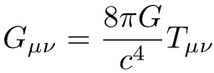
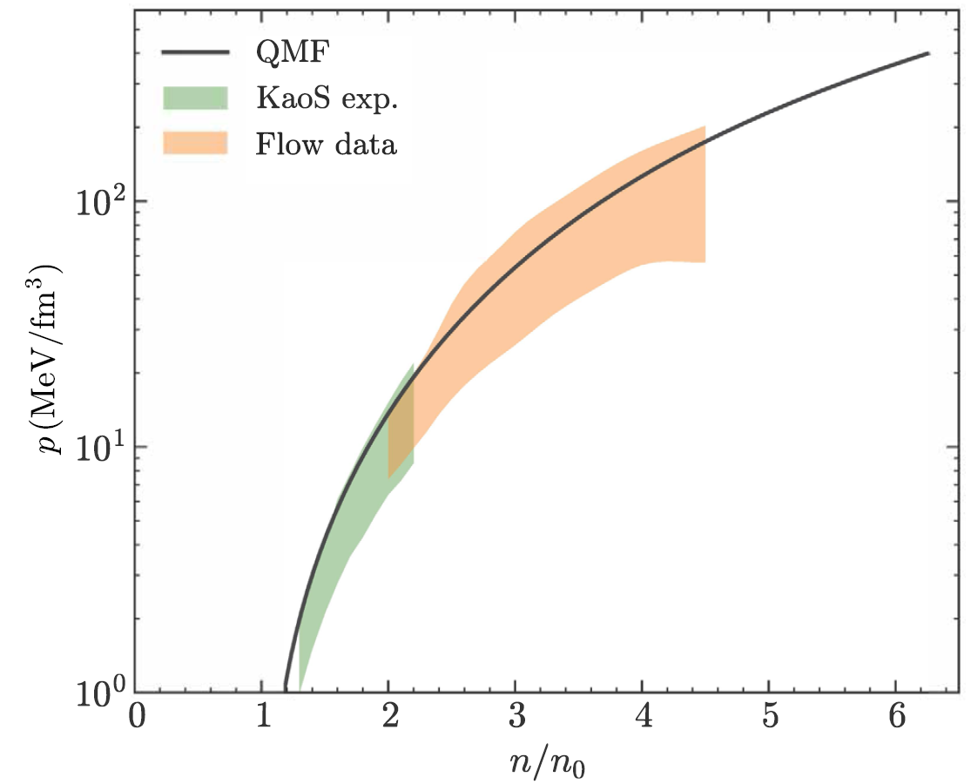
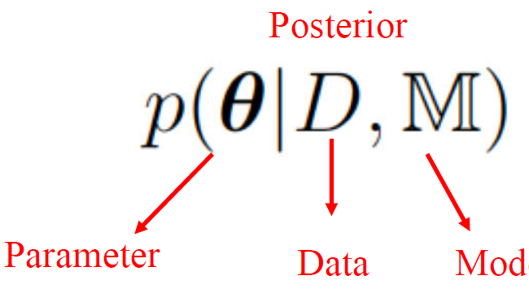
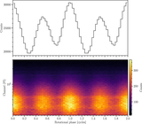
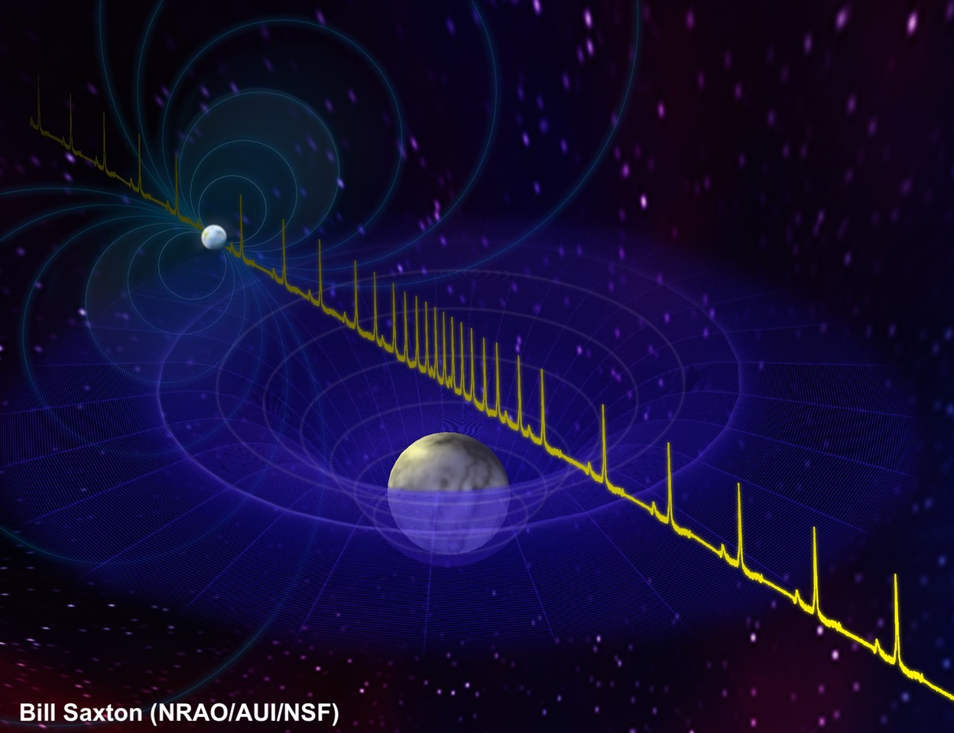
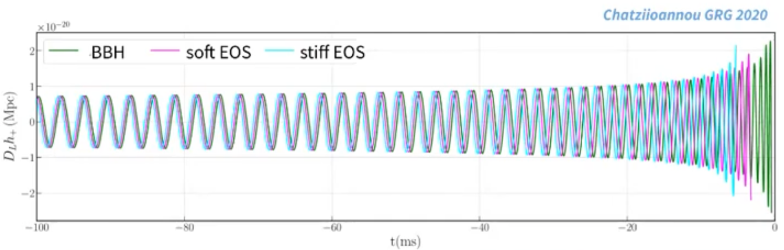
Combining
uncertain measurements !
3. EoS inference from NS obs.
(GW, photons, neutrinos)
1. Model for interaction 2. EoS prior
pasting test
(RMF, SHF, BHF, …)
between particles
Physics on the EoS, the composition and the underlying strong interaction

Slide 9
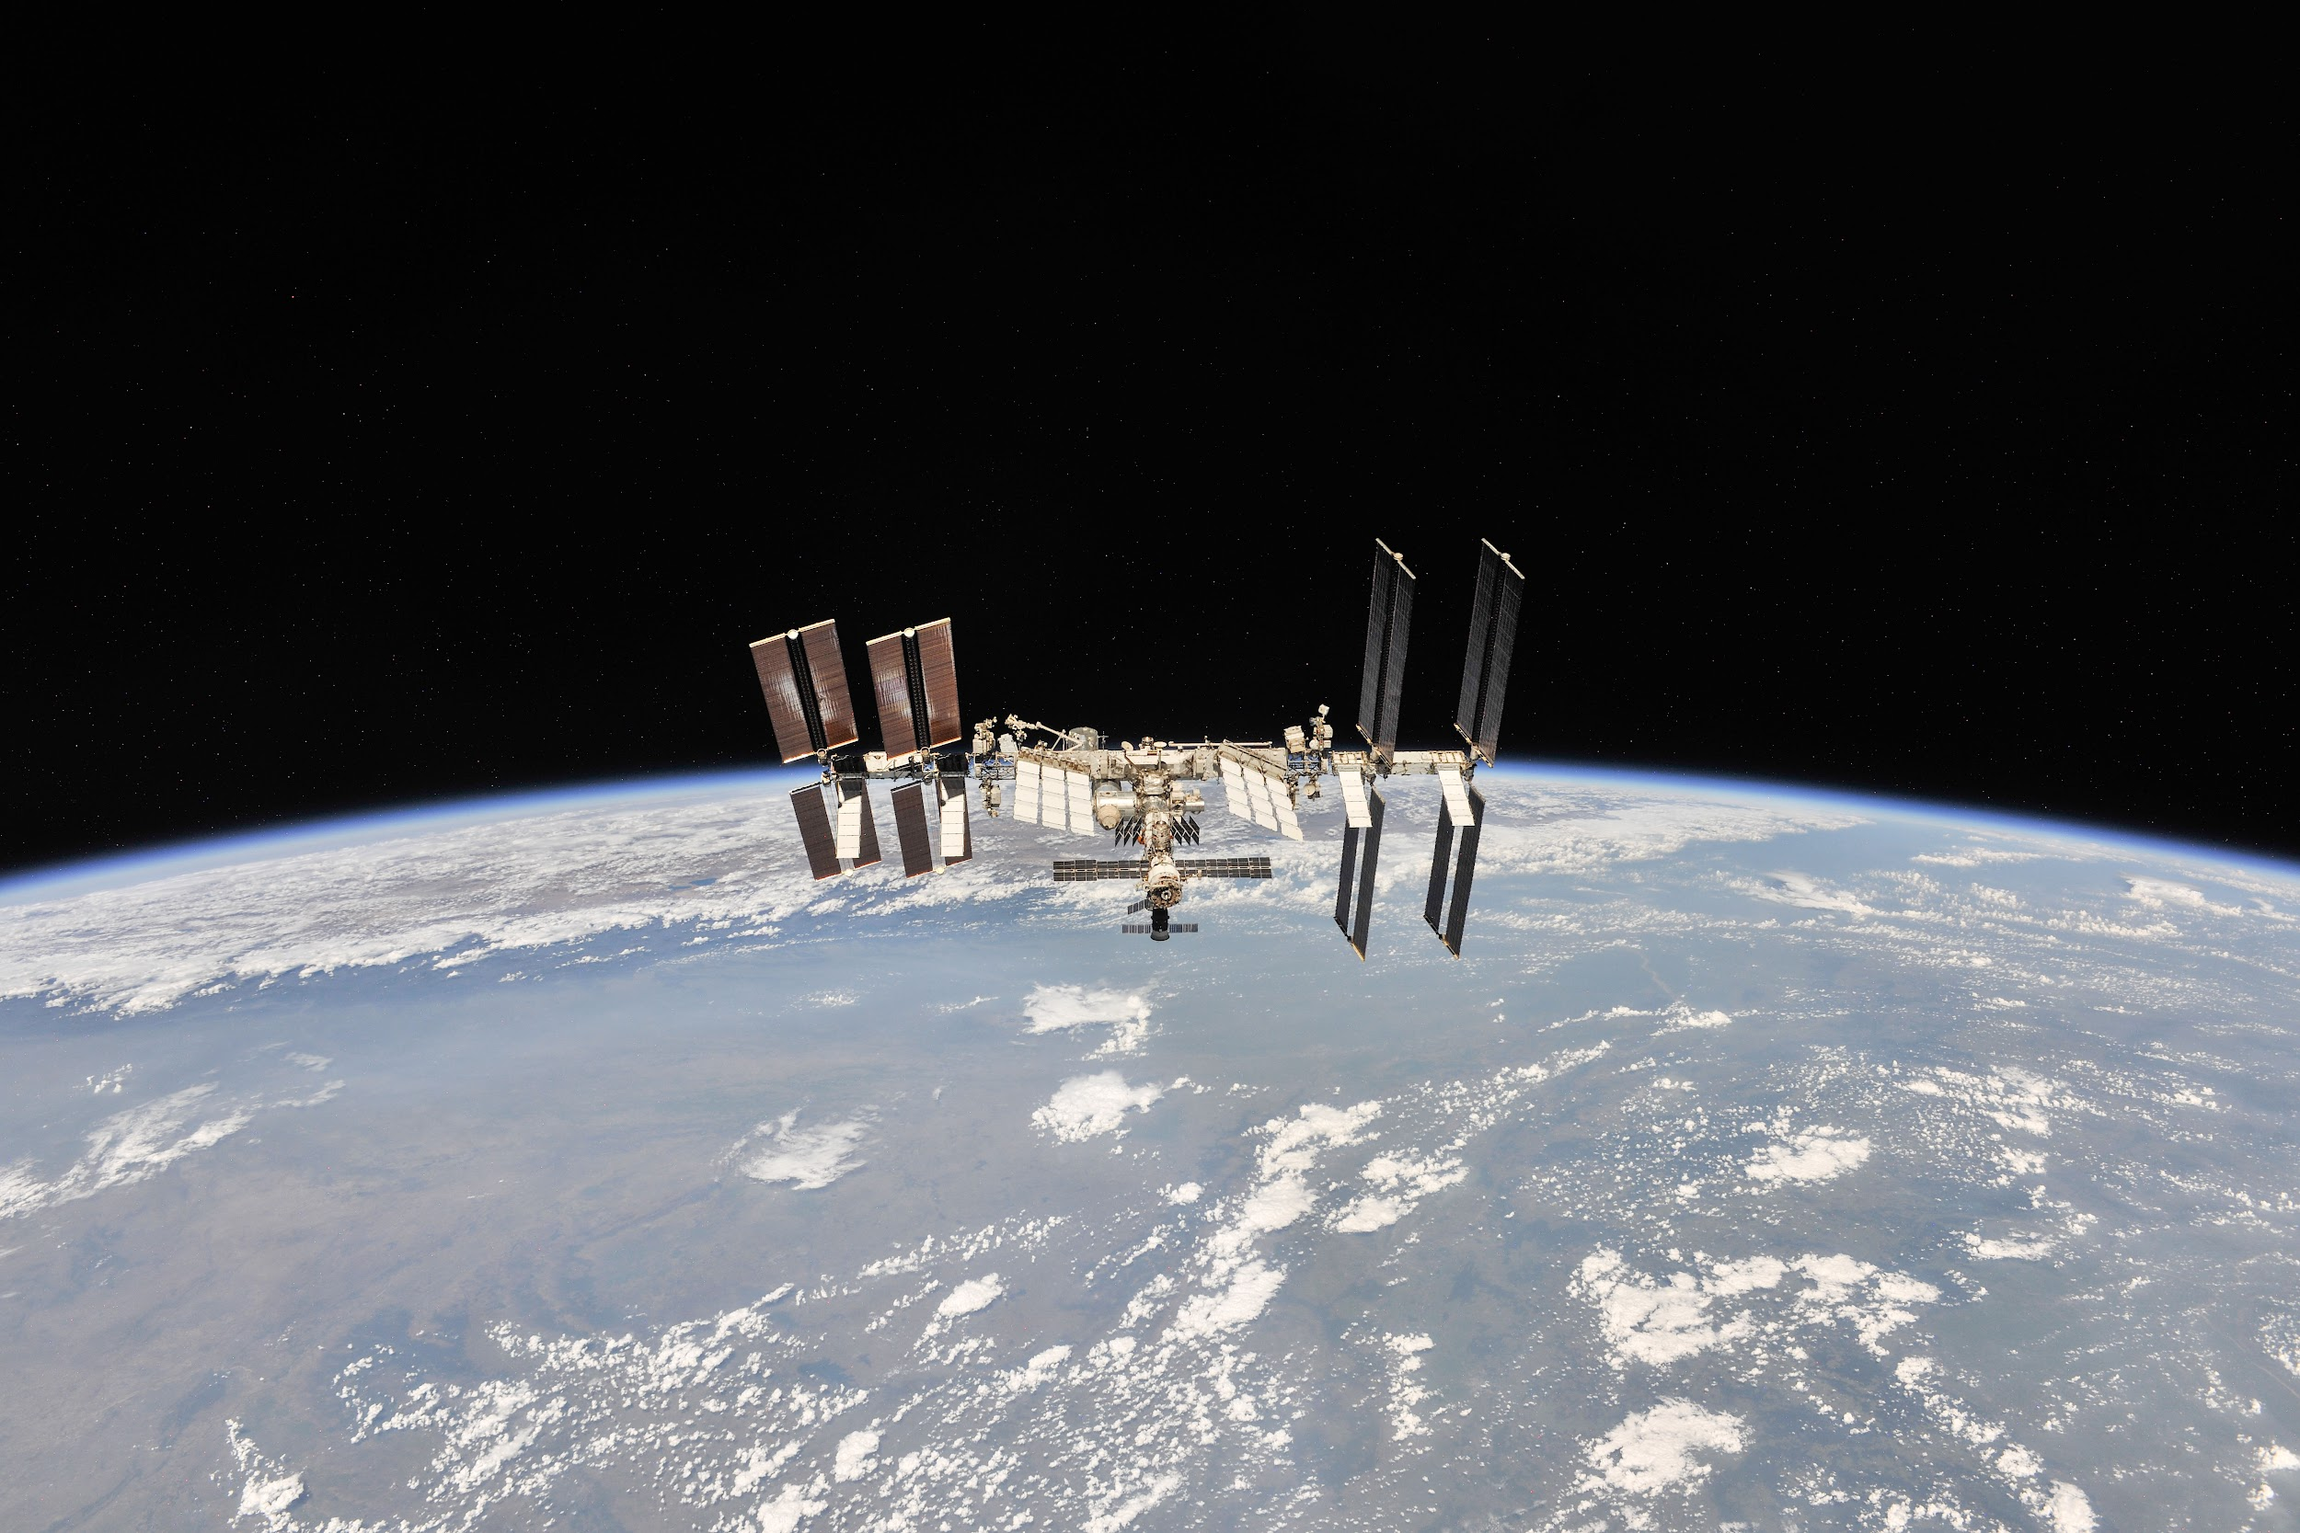
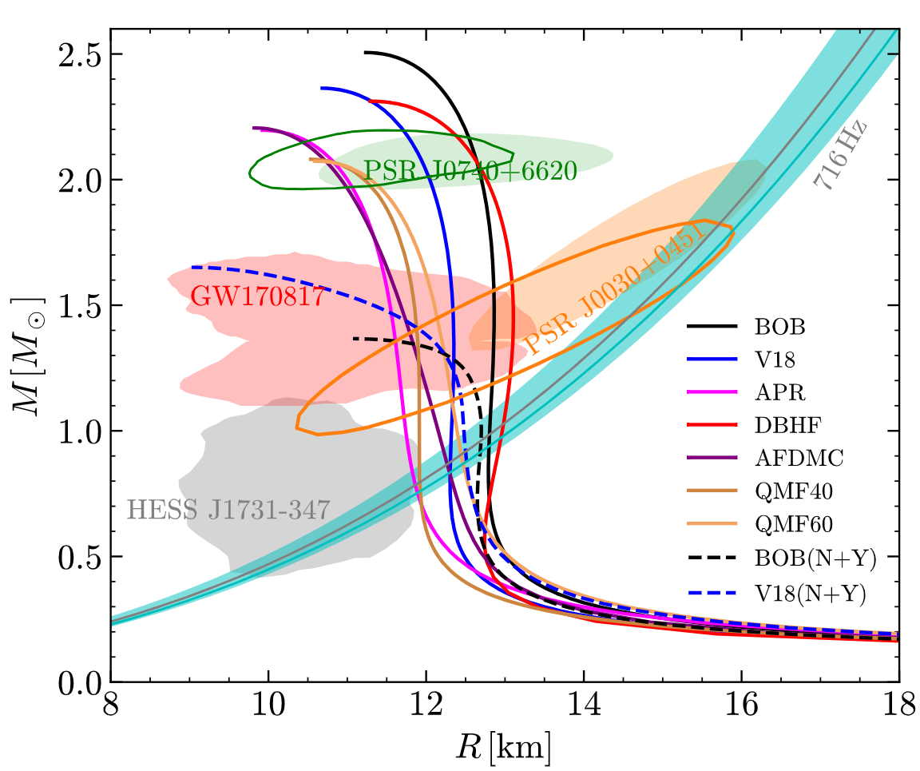
NICER view of PSR J0030+0451: MSP parameter estimation
Riley et al. 2019
Follow the propagation of light from the NS surface to the observer through the curved spacetime around the star;
XMM-Newton data can provide (indirect) NICER background constraint:
The introduction of the XMM-Newton data (EPIC MOS1 and MOS2) led to a reduction in background estimates from NICER-only data, resulting in higher compactness value:
Main difficulty lies in the degeneracy between MANY parameters it employs: (in addition to M, R)
source D; H column density, parameters needed to describe the surface T map, angles encoding the orientation of this map with respect to the rotational axis and the observer’s LOS;
+XMM data
Significant uncertainties in M,R estimate may be from low counts in the detected lightcurve or noisy data can lead to degeneracies between the model parameters or multi-modal posteriors:
2402.02799
X-ray telescopes with large effective area, high energy resolution, and high time resolution in the soft X-ray band, as well as adequate imaging capability to discriminate the background:
NICER (2017), EP-FXT (2024), eXTP(~2030), ATHENA(~2030).

Slide 10
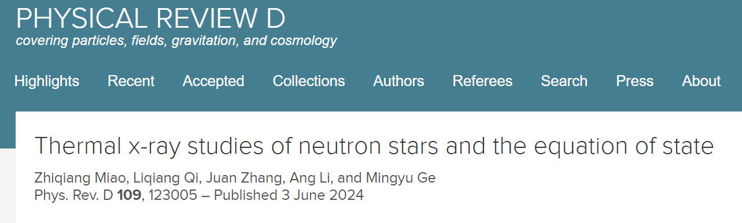
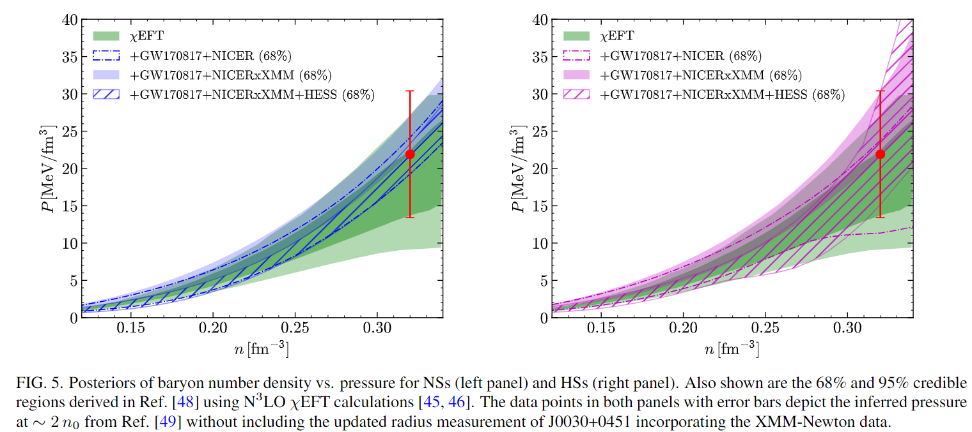
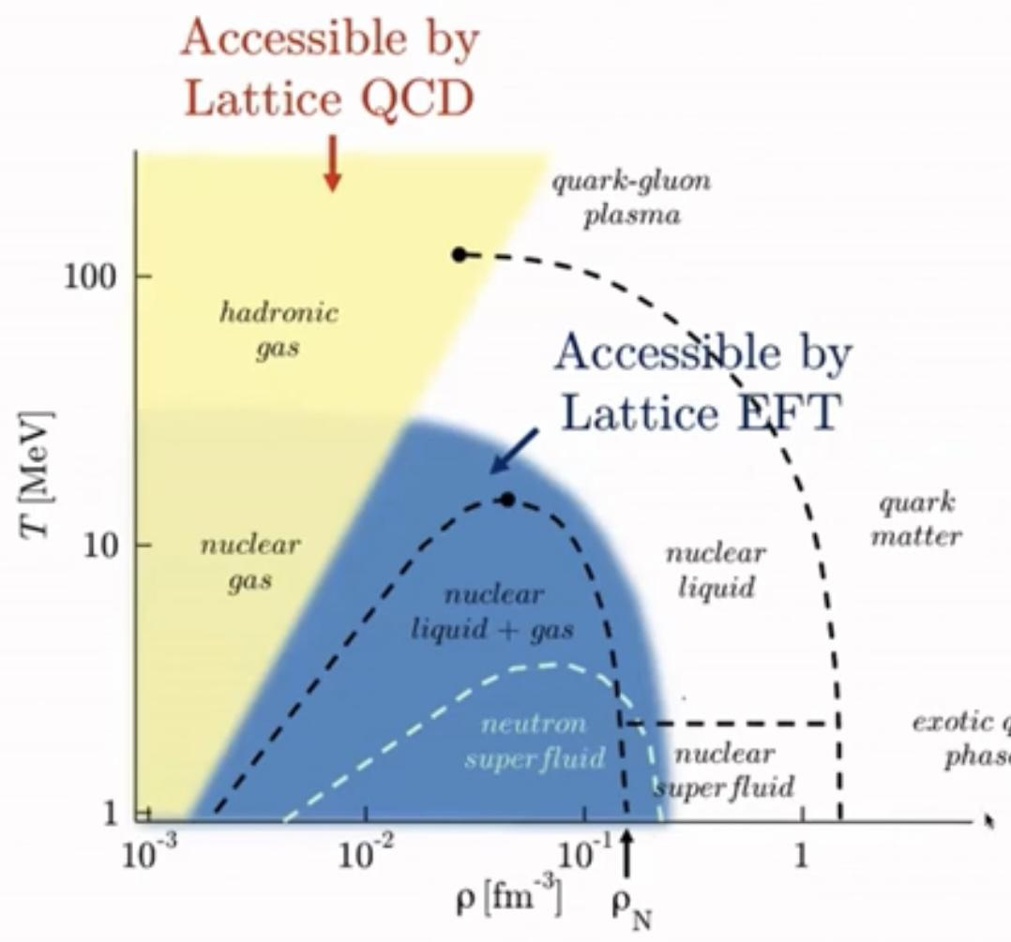
Constraint on the pressure at densities ∼1-3n₀ effectively tightened
2402.02799
P2n0
(N³LO)
w.o. XMM-Newton data
Not computable?
Computable
(by D. Lee)

Slide 11
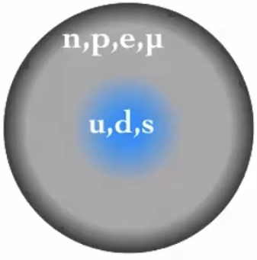
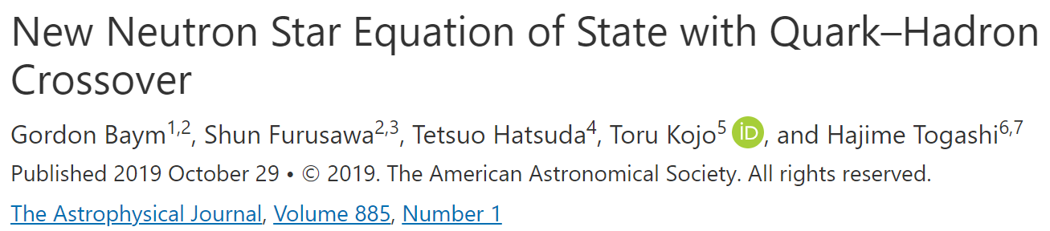
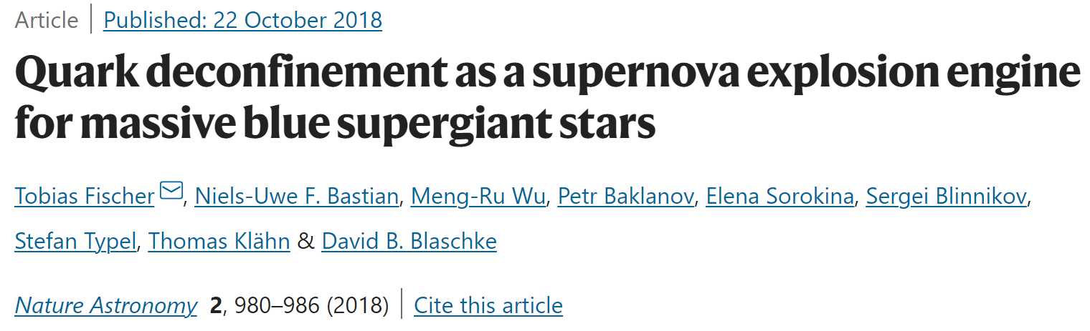
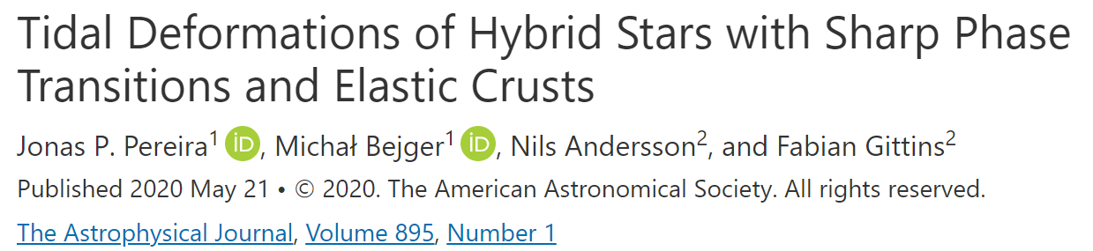
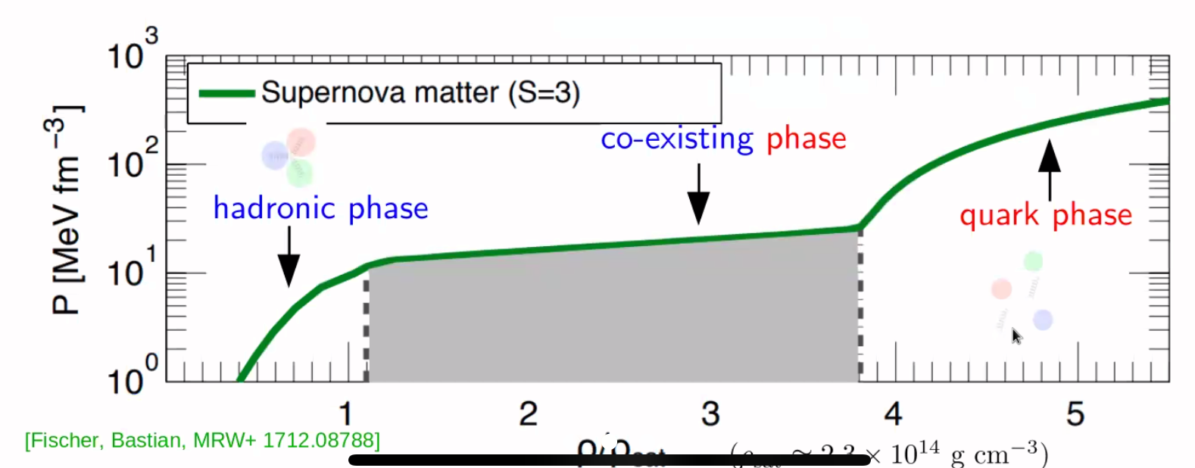
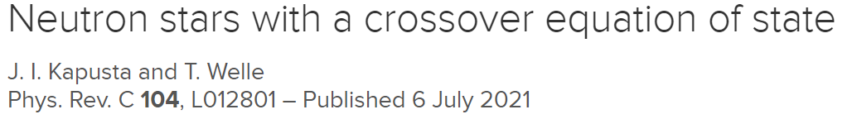
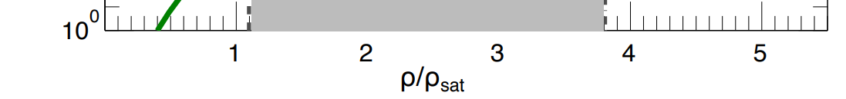
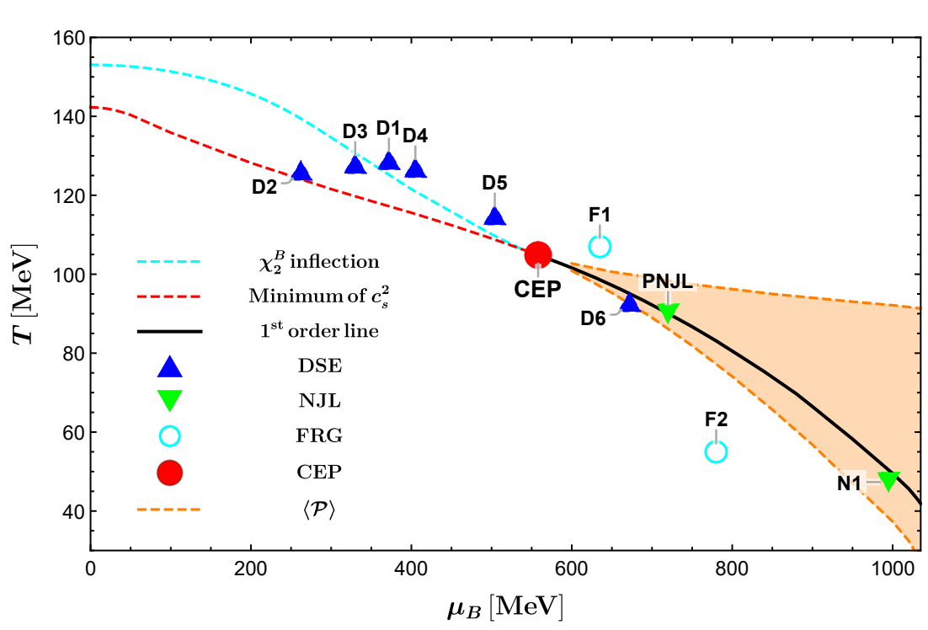
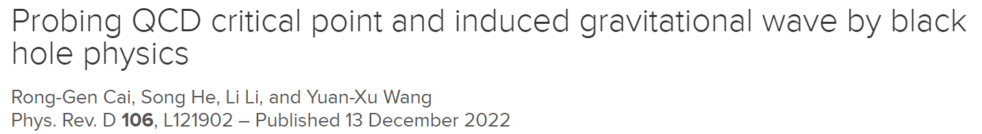
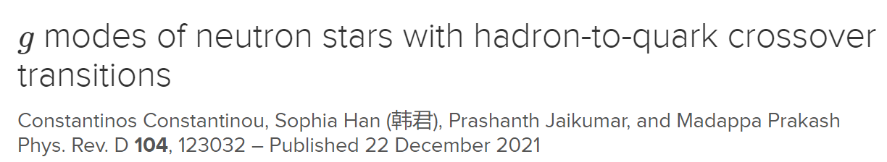
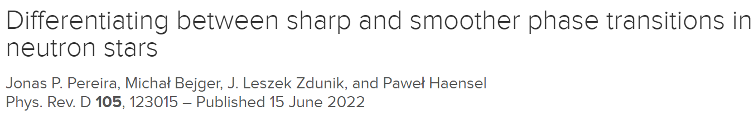
Phase transitions are of central interest in physics
Open issues:
Order of transitions? Physics on interfaces? Finite T effects? hep-ph? nucl-th? cond-mat? astro-ph.HE?
Cai et al., 2201.02004 PRD

Slide 12
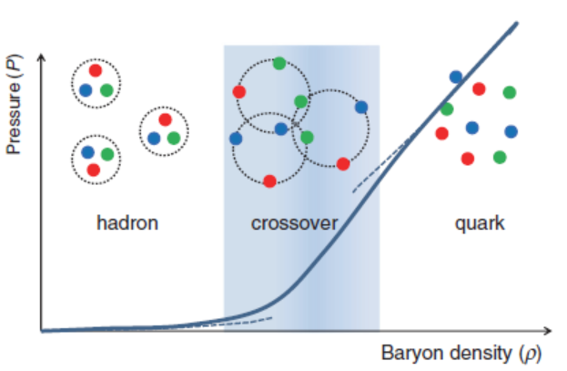
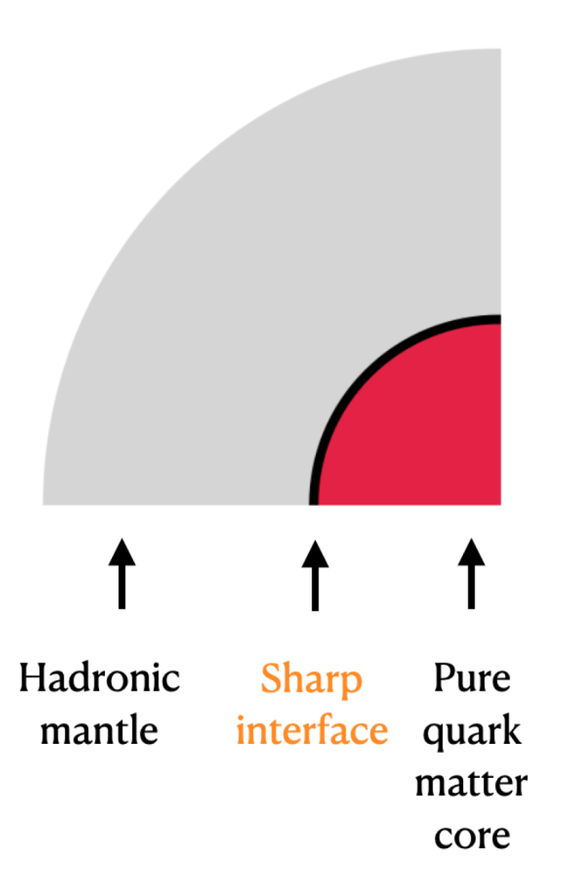
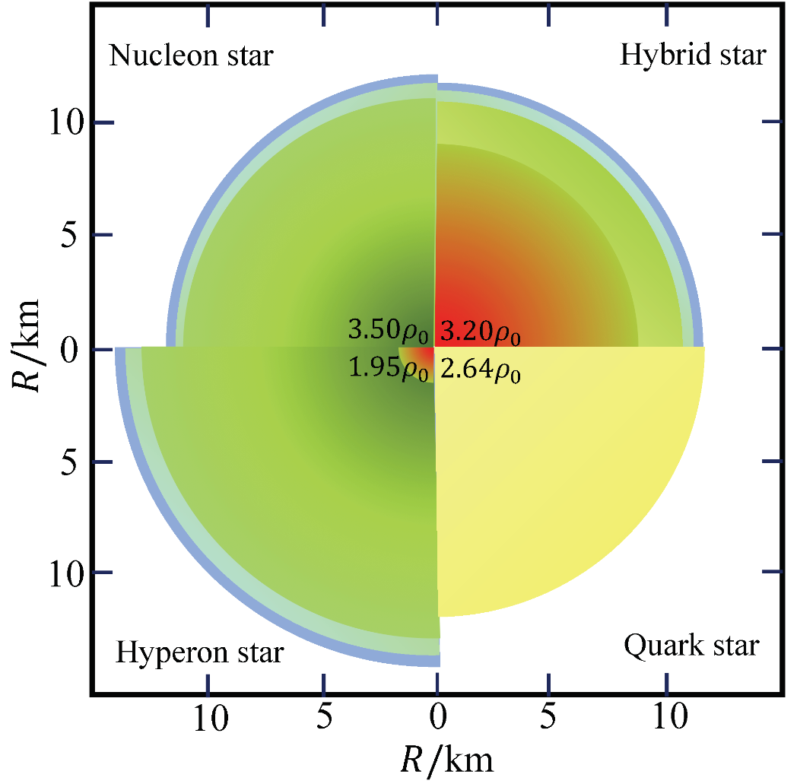
Hadrons to quarks if too dense or too hot
crossover
1st order
Crossover
(μ=0, T~150MeV) from lattice QCD;
Color-Flavor-Locked phase at symptotically high density; pQCD applicable.
Empirically known around normal nuclear matter density.
Sasaki NPA 2009

Slide 13
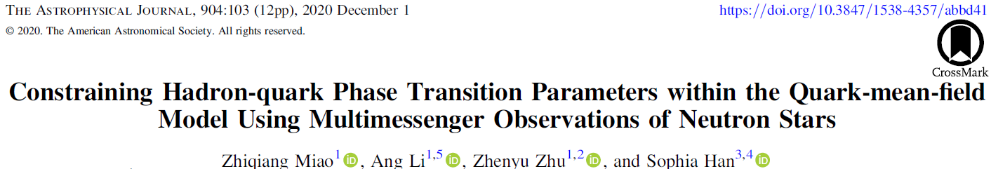


Strangeness phase transitions dominate when appear
2006.00839
QMF hadronic EOS (symmetry energy slope L= 30-60) plus Constant-speed-sound (n_{trans}, 𝚫Ɛ, c_{QM}) paramtrization characterizing high-density (quark matter) phase;
Interplay of nuclear symmetry energy with strangeness phase transition: Measuring Λ alone may NOT completely determine the density dependence of the symmetry energy.
small effects of L on Λ

Slide 14




Span uncertainty in EoS at supranuclear density
(n_{trans}, 𝚫Ɛ, c_{QM})
Esym0, L₀,...
‘unified’ EoS
nonuniform nuclear matter
Esym(n)
Assuming
considerable hadron-quark interface tension
uniform nuclear matter
(E/A, K₀,...n₀)
quark matter
‘hybrid star’
full parameter space rom 1/sqrt(3) (the conformal limit in perturbative QCD matter) to 1 (the causal limit)

Slide 15





Strangeness phase transition para. from GW170817+NICER+MOI(mocked) obs.
~2ρ₀
2103.15119 ApJ
~0.7
upcoming ~10% accuracy MOI measurement @SKA
~1100MeV
Cai et al., 2201.02004 PRD
{transition density, transition strength,
sound speed squared in quark matter}
critical chemical potential
Astro.

Slide 16




Static + Dynamic tide
Static tidal: Quasi-equilibrium approximation, (i.e., the tidal field changes slowly); Tidal deformability (l=2)
Dynamic tidal: tidal-induced composition mode (or interfacial mode), discontinuity g-mode oscillation.
Part of orbital energy transferred to internal oscillation; Coupling of stellar oscillations with tidal multipolar fields
Green/Yellow： detectable region of 3rd generation GW detectors for 1.4/1.8M⊙ BNS system
2305.08401
Available GW170817 data exclude low transition threshold（ptrans/εtrans ≲ 0.12）and weak transiton（Δε/εtrans ≲ 0.06）

Slide 17

Connect consistently nuclear physics and GW+EM observations to probe the EoS at different density regimes (2021-)
Data:
GW event of GW170817(+GW190425) & kilonova light curve of AT2017gfo,
NICER⁢⁢⨉XMM-Newton’s measurement of mass and radius of 2 PSRs,
(Mocked) SKA’s moment of inertia measurement on PSR J0737-3039,
Neutron-skin from PREX-II, CREX and the ab initio predictions on ²⁰⁸Pb,⁴⁰Ca
Pang et al. 2022
2021 2022 2023 2024
Massive PSRs (radio)
+ GW (static tide)
+ X-ray (NICER)
+mocked MOI (radio)
+DM
+n skin
+hypernuclei
+kilonova (optical+)
+GW (dynamic tide)
+X-ray (XMM-Newton)
+FOPI
(in preparation)
2107.07979
2305.16058
2305.08401
2204.05560
2205.10631
2103.15119
2402.02799
2211.02007

Slide 18


Black box = EoS microphysics
Procedure used until now
Piecewise polytrope EoS: Logarithm of the adiabatic index (𝜞) of the EoSs are treated as polynomial: Little to no microphysics;
Better procedure
More physics at the EoS modelling stage;
Support quantitative studies of the EoS at different density regimes;
With prior explicitly considering phase transition;
Can discuss the composition of matter and the underlying strong interaction;
Allow for straightforward extensions to higher-dimensional models, accommodating the inclusion of additional particles within NSs, even dark matter;
Facilitate a connection with the ongoing research efforts in the field of relativistic HIC.

Slide 19


Brief summary of news from the data
mostly around saturation
核结构finite nuclei (especially neutron-rich, superheavy);
核反应collective flow/transport/meson production in HIC;
e.g., STAR@RHIC 3GeV, 4.5GeV
neutron star binary:
GW+短伽玛暴SGRB+千新星kilonova
PSR J0030+0451
PSR J0740+6620 (Cromartie et al. 2019)
NUCL ASTRO
(Riley et al. 2019)
(Miller et al. 2019)
(currently most massive neutron star)
GW170817 (the ‘golden’ event)
GW190425
(Riley et al. 2021)
PSR J0737-3039
(Miller et al. 2021)
upcoming ~10% accuracy moment of inertia measurement

Slide 20


Where & how the phase transition happens is a matter of hot debate not only in astrophysics but also within the theory of high energy (~GeV) heavy-ion collisions.
Effect of temperature dependence taken into account in the transport model simulations through the phase space distributions during the reactions;
HIC: nearly symmetric hot matter
Neutron star: beta-stable cold matter
Different EoS input->

Slide 21






2211.04978
Input for HIC study via AMPT
Input for NS study
FOPI Au+Au elliptic flow @ 400 MeV -1.5 GeV per nucleon
subthreshold K+ production @KaoS
The single baryonic potential used in the transport model is derived from the QMF EOS:
Notes:
so one should prepare different kind of EoS input based on one EoS model,
We compared the phase transition parameters of the two systems
and perform a preliminary test of ….

Slide 22


e.g., proton directed/elliptic flow (3GeV): Transition density sensitive
Two colliding nuclei produce collective motion of nucleons and fragments, depends sensitively on the gradient of pressure (i.e., soft/stiff EOS);
STAR@RHIC 3GeV, 4.5GeV
(Abdallah et al., PLB 2022; Abdallah et al., PRC 2021)
Favor a relatively low phase transition density <~2.5n₀, consistent with NS obs.
from Referee “The work presents an interesting and long-standing problem of creating a bridge between astrophysics, GW physics, and heavy-ion collisions.”
2211.04978

Slide 23
What we learn so far
Produce self-consistent framework for EoS modeling
Check if constraints from all available constrains are fulfilled
Demonstrate the consistency between laboratory and astrophysical nuclear matter in neutron stars by considering low-density nuclear physics constraints (from ²⁰⁸Pb neutron-skin thickness) and high-density astrophysical constraints (from neutron star global properties).
Prepare priors for a set of EoS parameters, also incorporating phase transitions
Statistically establish the effective stiffness of neutron star EoS
General requirements adopted (e.g., causality) indicate the EoS is moderately stiff, with sound speed squared peaked at ~0.8c_{s}² in NS matter, not subject to the type of phase transitions.
Examine whether current data favour (strong) 1st-order phase transition inside NS cores
Current data compatible with both possibilities; Evidence of a phase transition strengthened for stiff hadronic EoSs (like DD2); Perform preliminary test of the consistency of the parameters in the betastable NS matter and in the nearly symmetric nuclear matter formed in HIC
Confront single Λ-hypernuclei data with the neutron star observational data
With the relaxation of the commonly-assumed SU(3) symmetry, the data of single Λ hypernuclei ensures a large enough scalar hyperon coupling to match the large vector hyperon coupling
Suggest possibility to distinguish neutron stars with quark stars from simultaneous measurement of the stellar radius and the moment of inertia
If the MOI is measured large for PSR J0737-3039 A, 𝐼_{𝐴}≳1.4×10⁴⁵g cm², it is most likely a quark star rather than a neutron star with or without a quark core, provided that the accuracy of the radius measurement is at least∼1 km
Comprehensive analysis of multi-messenger, multi-wavelength data ongoing to probe the EoS at different density regimes…
Thank you.

Slide 24

What we learn so far
Produce self-consistent framework for EoS modeling
Check if constraints from all available constrains are fulfilled
Demonstrate the consistency between laboratory and astrophysical nuclear matter in neutron stars by considering low-density nuclear physics constraints (from ²⁰⁸Pb neutron-skin thickness) and high-density astrophysical constraints (from neutron star global properties).
Prepare priors for a set of EoS parameters, also incorporating phase transitions
Statistically establish the effective stiffness of neutron star EoS
General requirements adopted (e.g., causality) indicate the EoS is moderately stiff, with sound speed squared peaked at ~0.8c_{s}² in NS matter, not subject to the type of phase transitions.
Examine whether current data favour (strong) 1st-order phase transition inside NS cores
Current data compatible with both possibilities; Evidence of a phase transition strengthened for stiff hadronic EoSs (like DD2); Perform preliminary test of the consistency of the parameters in the betastable NS matter and in the nearly symmetric nuclear matter formed in HIC
Confront single Λ-hypernuclei data with the neutron star observational data
With the relaxation of the commonly-assumed SU(3) symmetry, the data of single Λ hypernuclei ensures a large enough scalar hyperon coupling to match the large vector hyperon coupling
Suggest possibility to distinguish neutron stars with quark stars from simultaneous measurement of the stellar radius and the moment of inertia
If the MOI is measured large for PSR J0737-3039 A, 𝐼_{𝐴}≳1.4×10⁴⁵g cm², it is most likely a quark star rather than a neutron star with or without a quark core, provided that the accuracy of the radius measurement is at least∼1 km
Comprehensive analysis of multi-messenger, multi-wavelength data ongoing to probe the EoS at different density regimes…
Thank you.

