Slide 1
Neutron Star vs Quark Star in the Multimessenger Era
Zheng Cao(曹政) advisor: Lie-Wen Chen
arxiv: 2308.16783

Slide 2
目录 Contents
1
Introduction to compact star and EOS
2
Astrophysical Observation and Physics-Agnostic EOS
3
Results of Bayesian inference
4
Summary

Slide 3
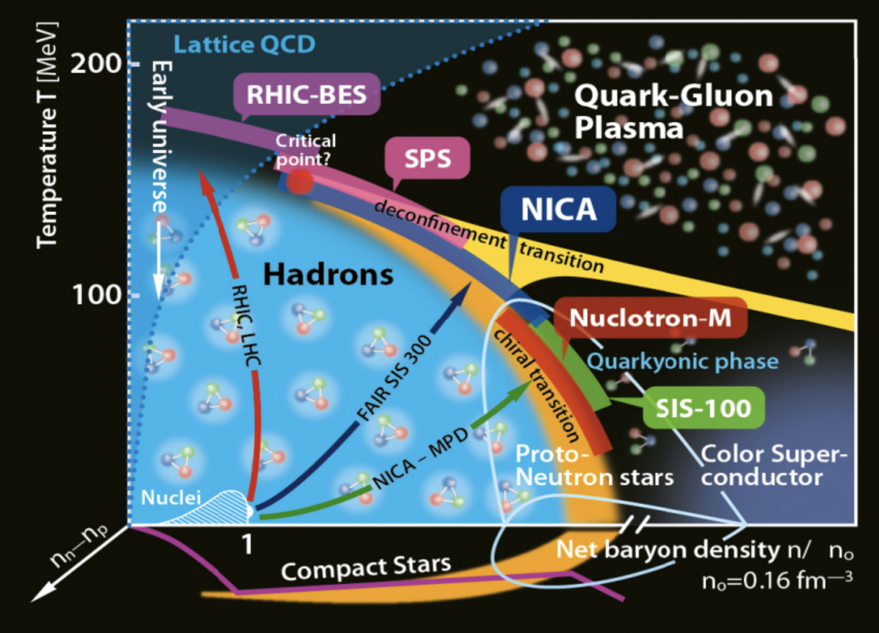
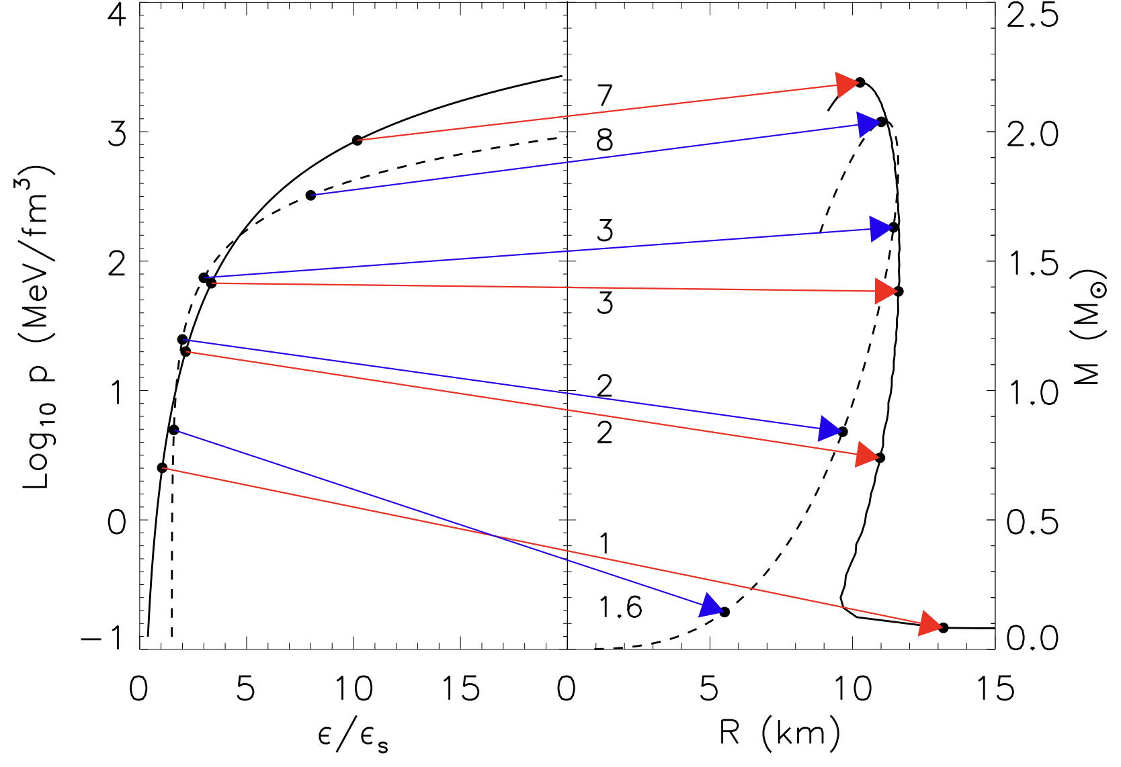
Introduction: compact star and equation of state
Compact star:
high baryon density, low temperature
Dense matter
equation of state p(ε)
Mass-radius relation
of Compact Stars(CSs)

Slide 4
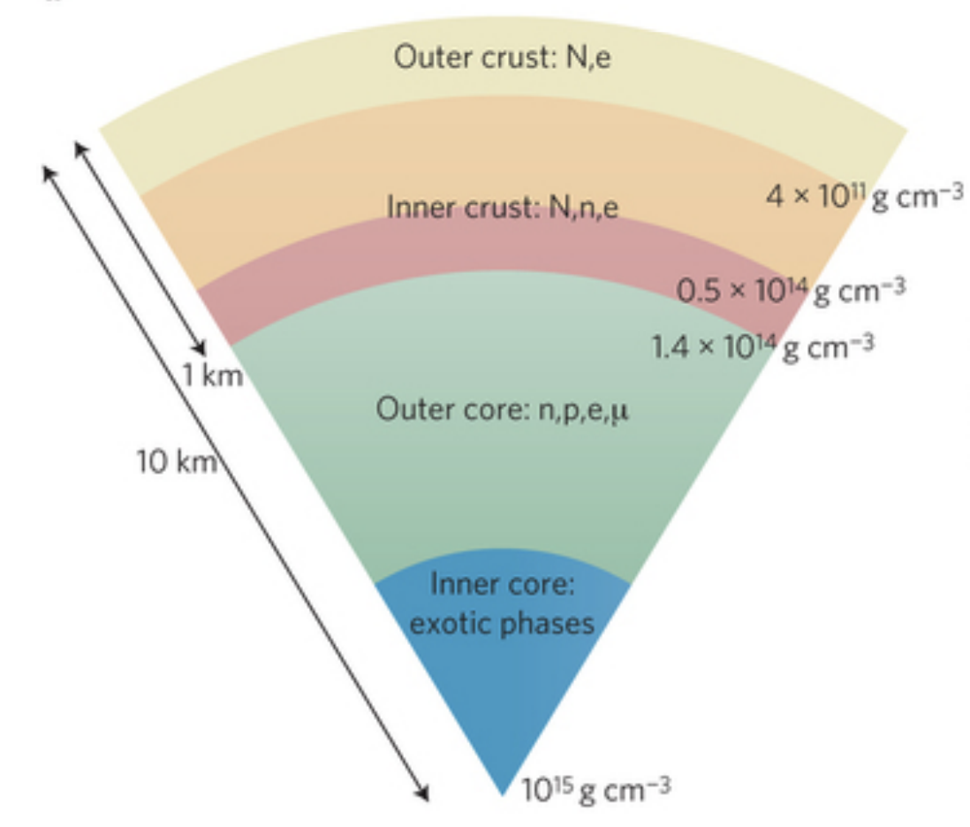
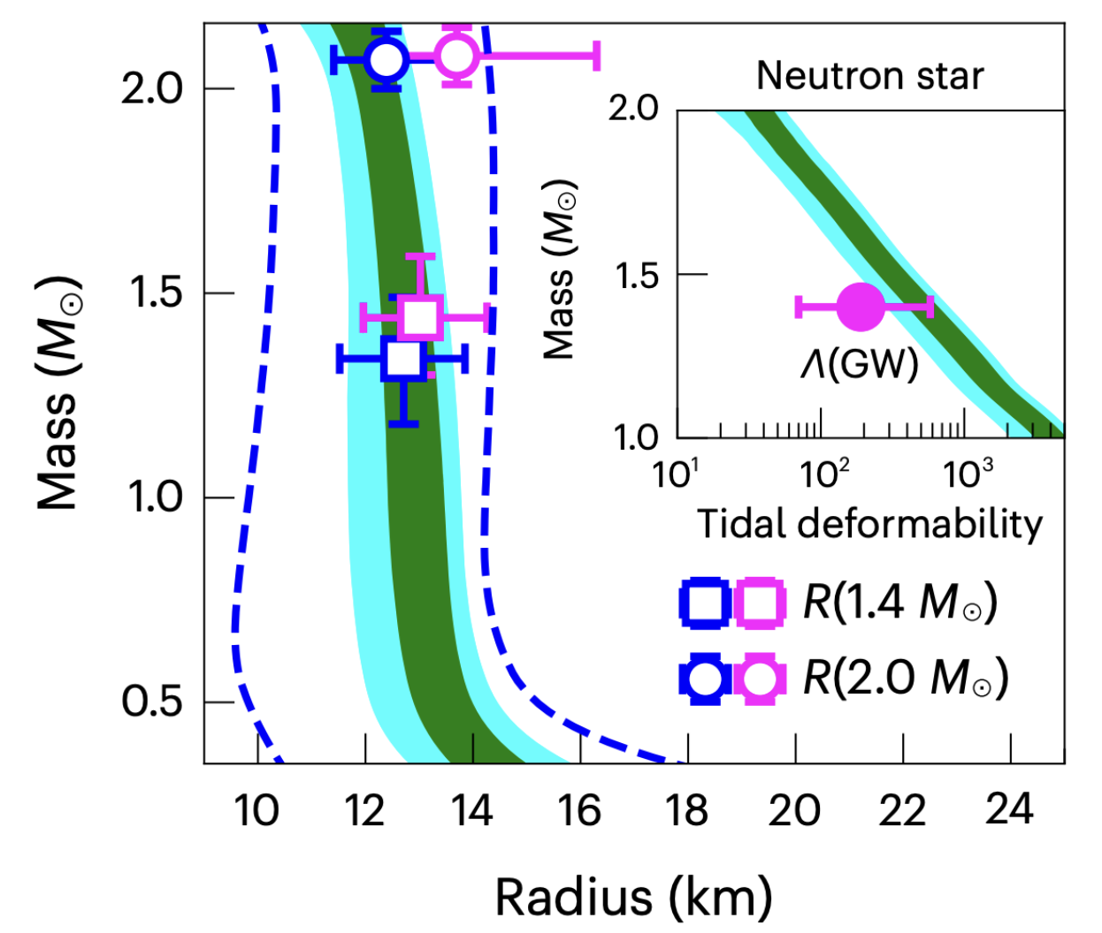
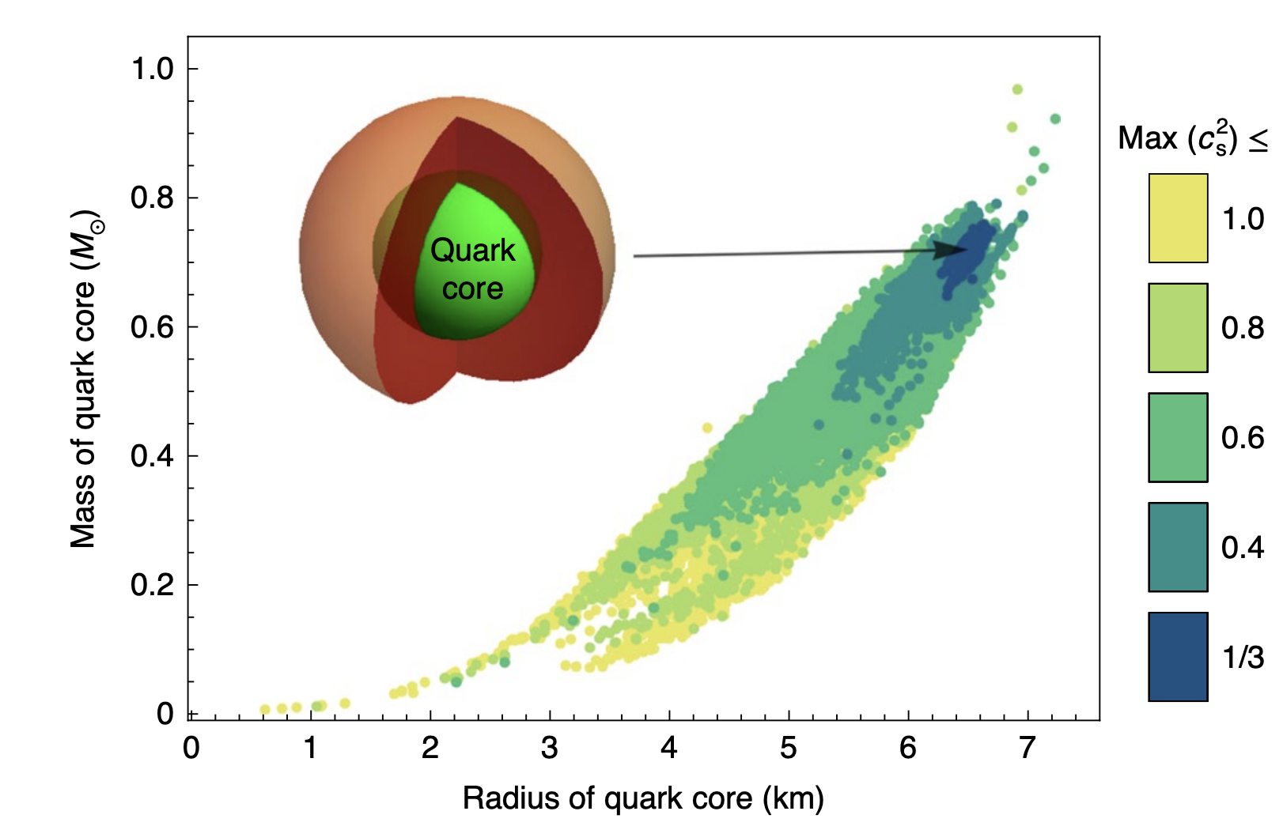
What’s the nature of compact star?
The component of the compact star is unclear!
strange quark star, hyperon star, etc.
one possiable
structure of
compact star
Tsang et al. Nature Astron. 2023
Annala et al. Nature Phys. 2020
F. Weber, PPNP54, 193 (2005)
Notes:
QCD phase diagram, not clear

Slide 5
目录 Contents
1
Introduction to compact star and EOS
2
Astrophysical Observation and Physics-Agnostic EOS
3
Results of Bayesian inference
4
Summary

Slide 6
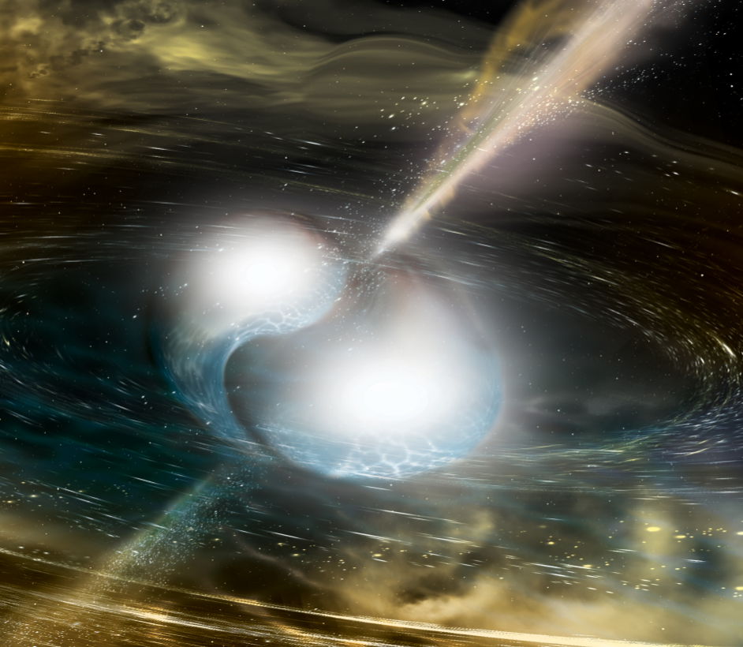
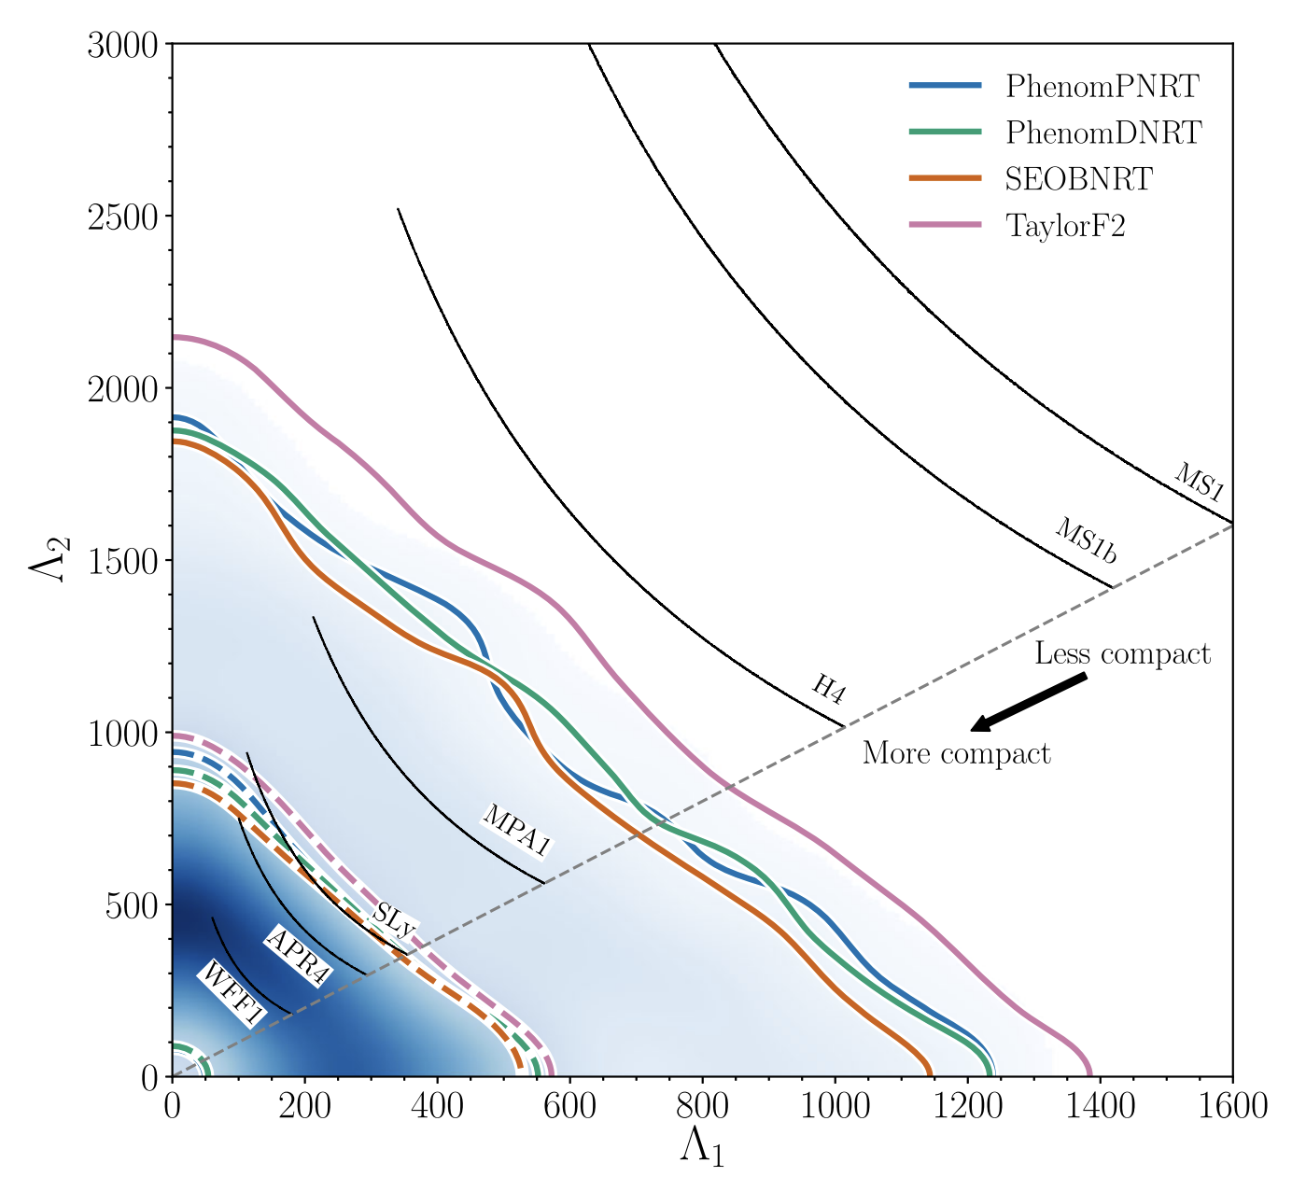
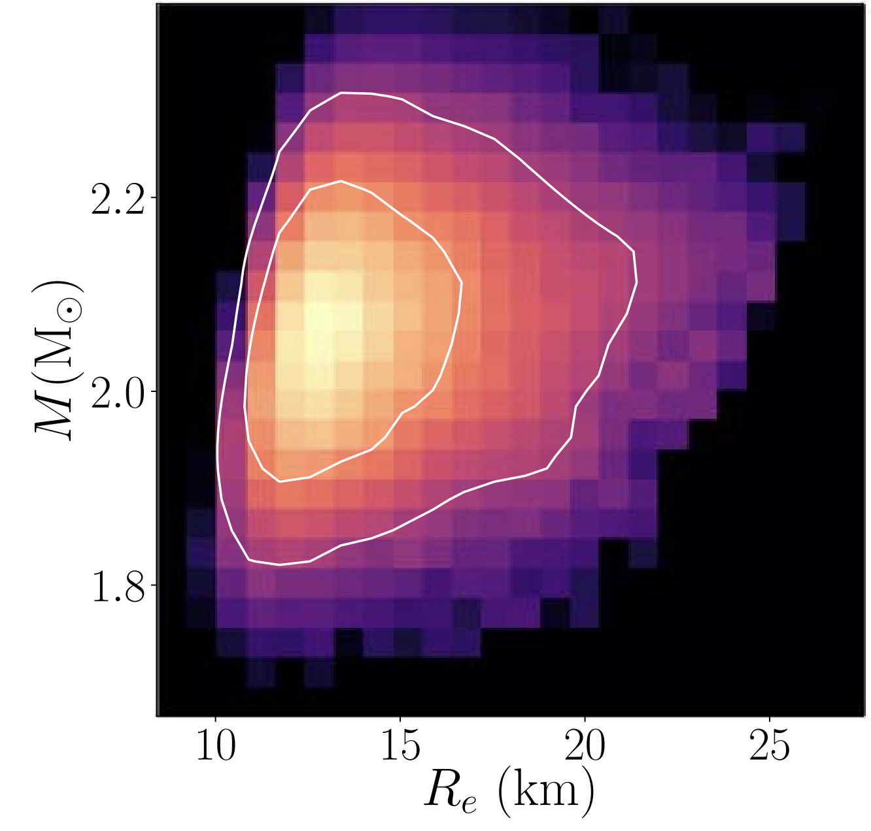
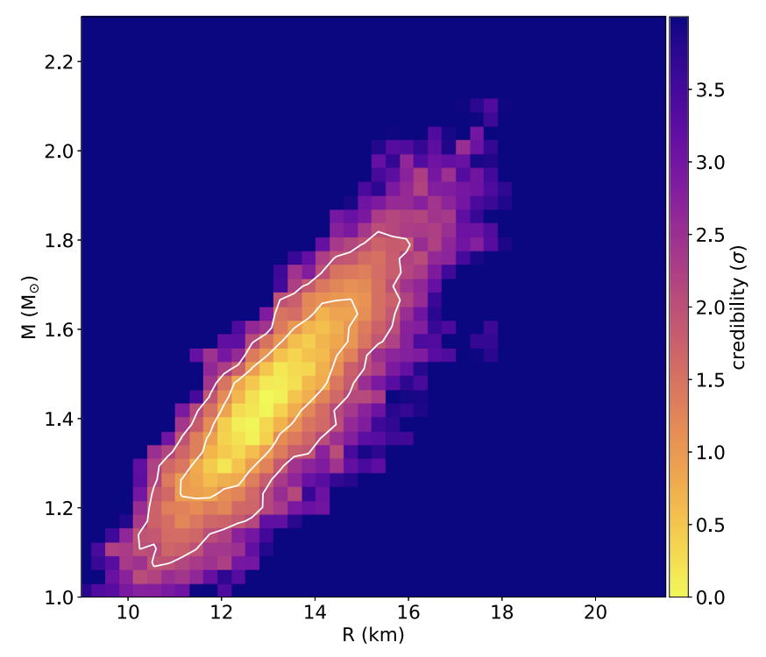


Astrophysical Observation
Gravitational Wave measurements
Mass-Radius measurements
Miller et al., APJL, 2021
Miller et al., APJL, 2019
The equation of state plays an important role!

Slide 7
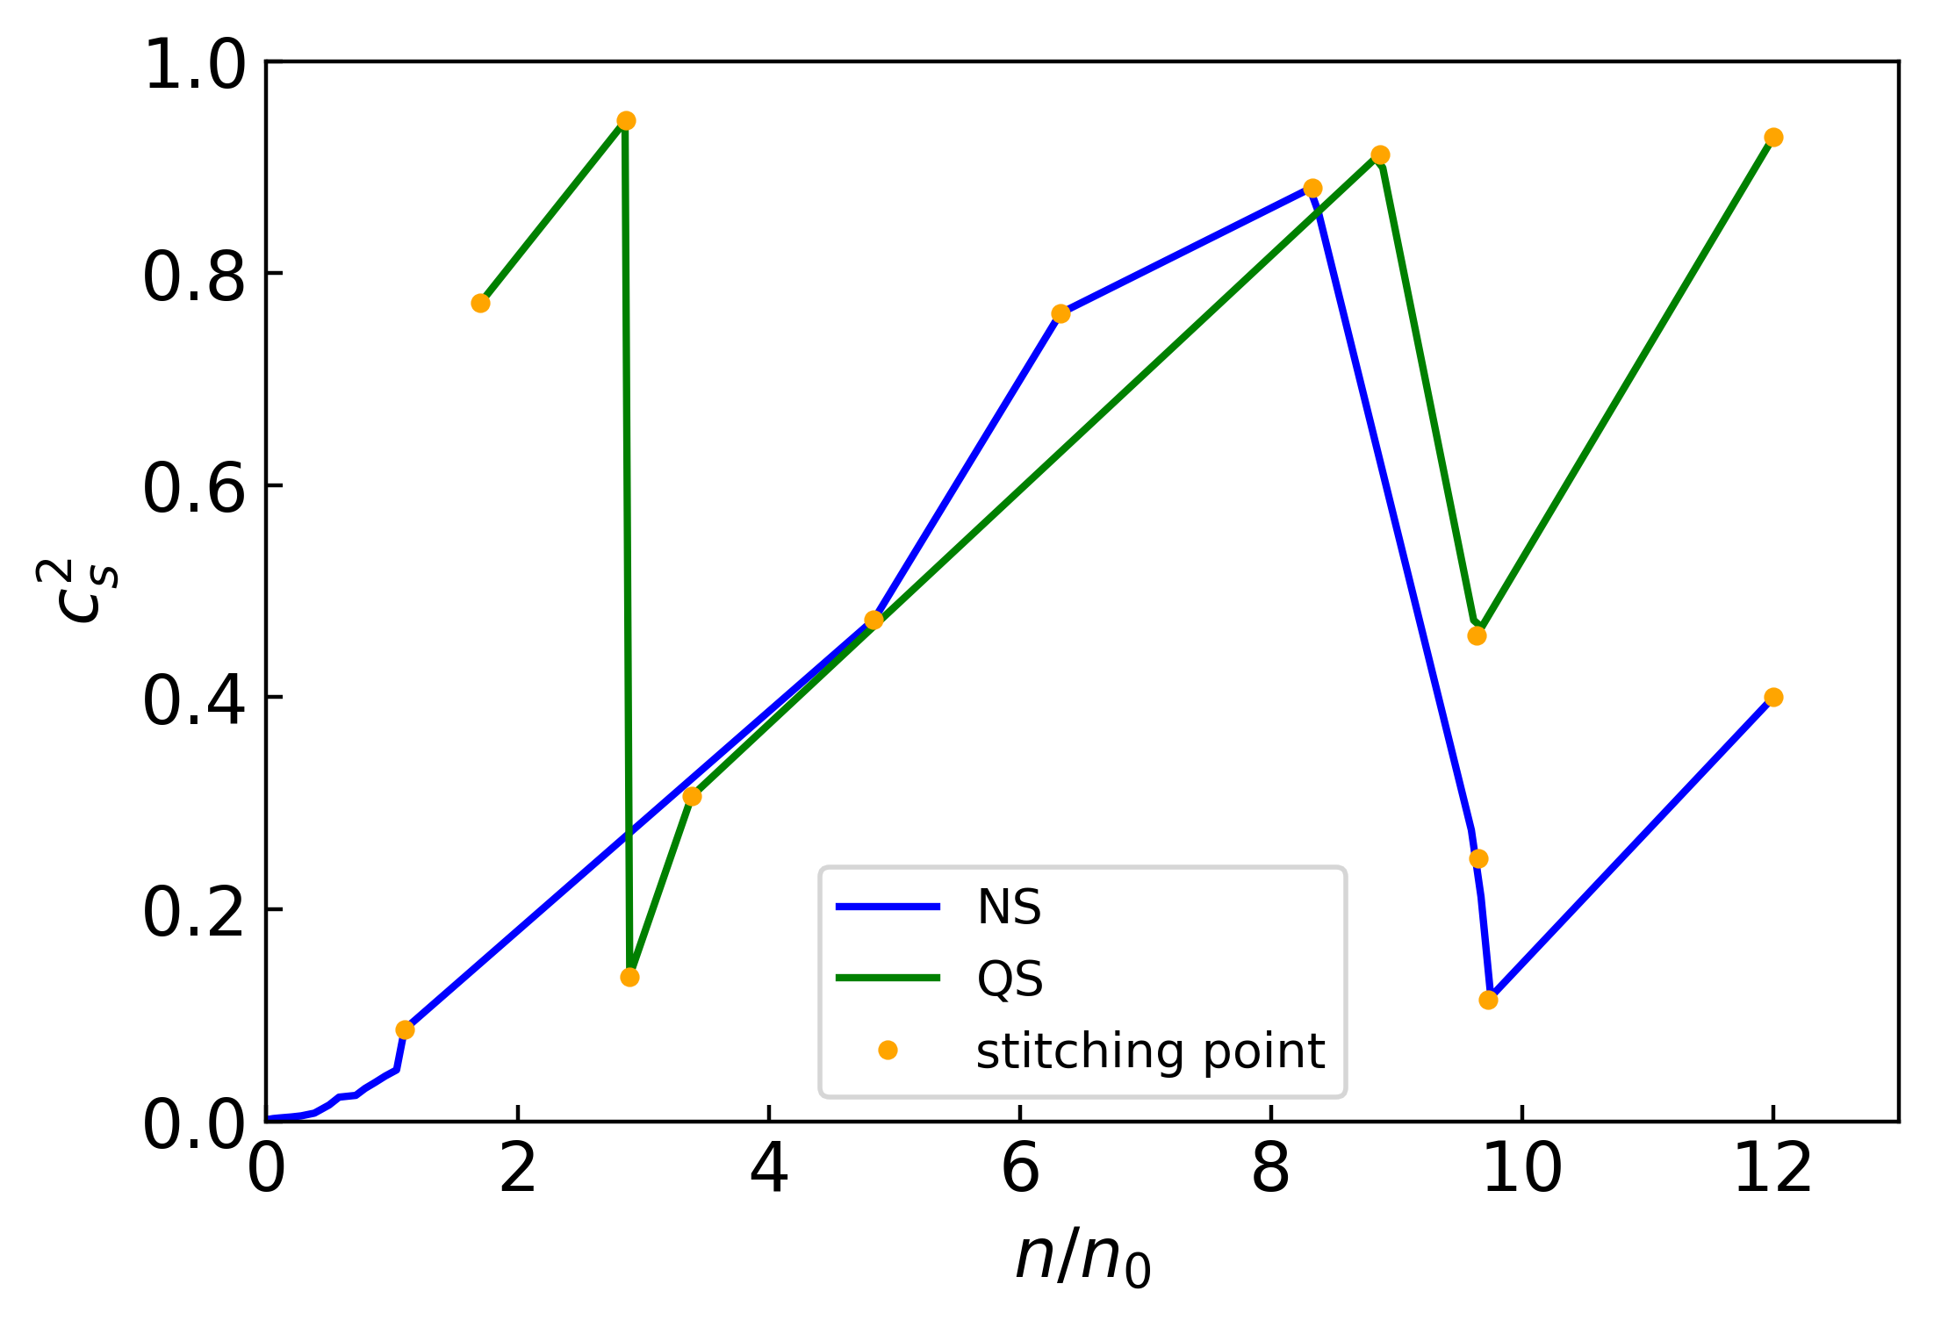
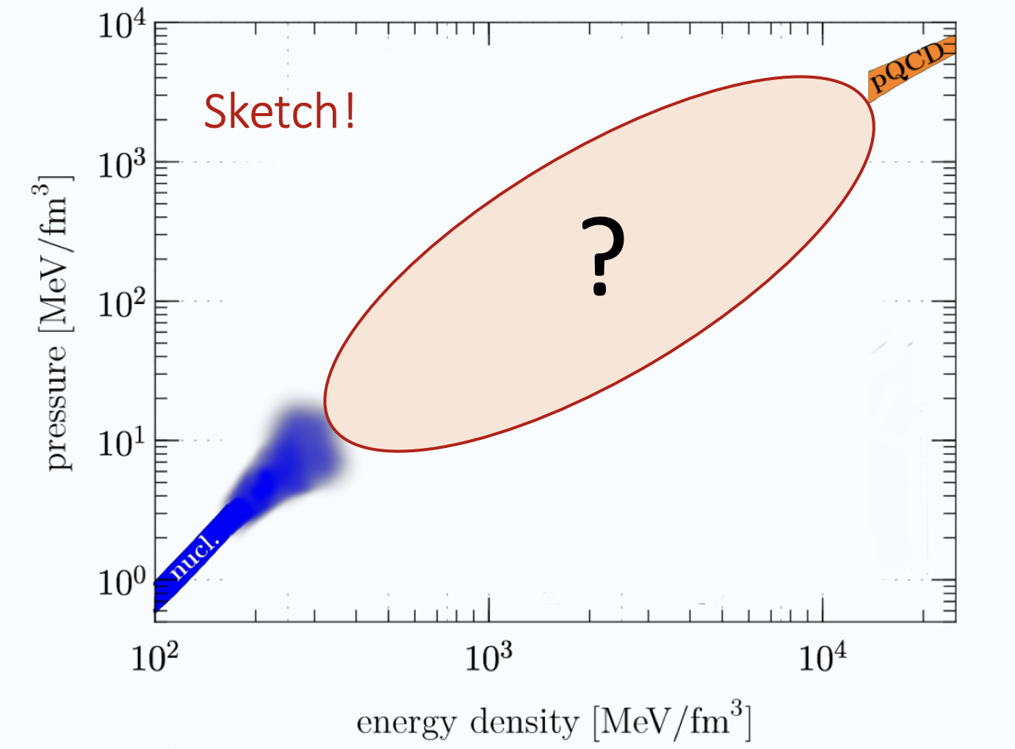
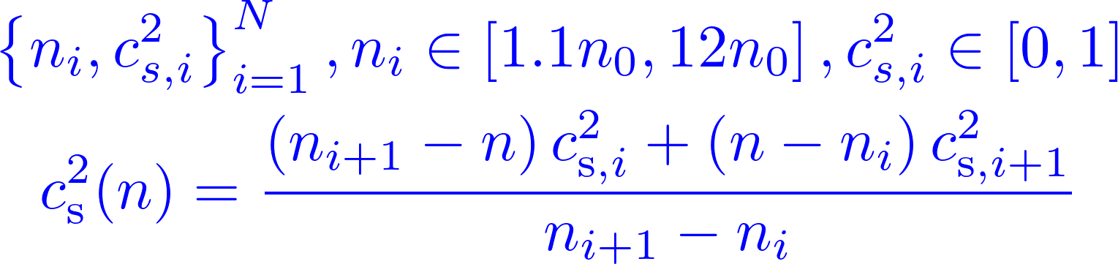
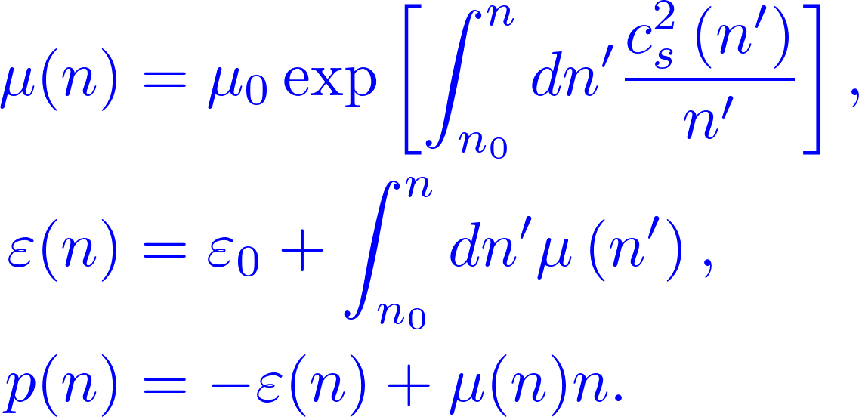
Physics-Agnostic Equation of State
EOS for quark star:
zero pressure point: parameterizing properties directly
higher densities: speed of sound extension
Calculations from perturbative quantum chromodynamics (pQCD) can also constrain the equation of state of compact stars.
(Komoltsev et al. PRL 2022)
piecewise-linear interpolation
Thermodynamics relations:
EOS for neutron star (w/o quark core):
below 1.1n₀: BPS crust + chiral effective field theory
higher densities: speed of sound extension
EOS at low densities is relatively clear

Slide 8
目录 Contents
1
Introduction to compact star and EOS
2
Astrophysical Observation and Physics-Agnostic EOS
3
Results of Bayesian inference
4
Summary

Slide 9
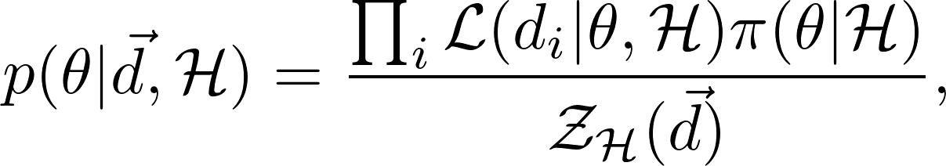
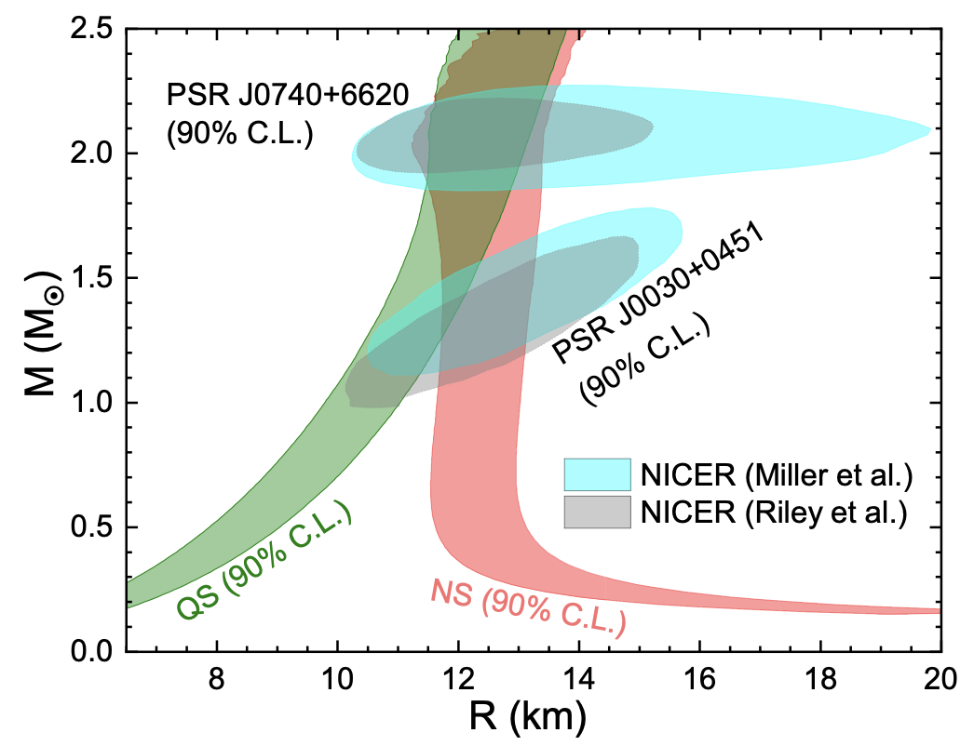
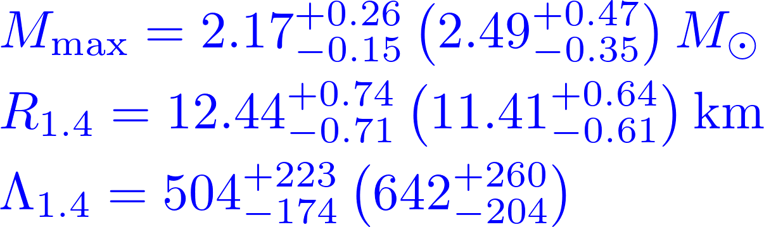
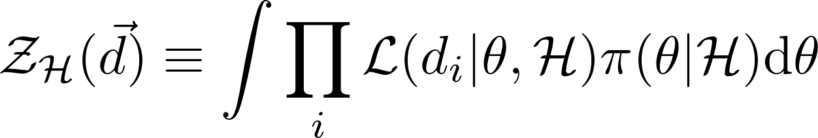

Results
Bayesian
Inference:
Properties of Neutron star (Quark star) at 90% C.L.:
Evidence:
NS scenario is strongly favored!
mass-radius relation of neutron star and quark star at 90% C.L.

Slide 10
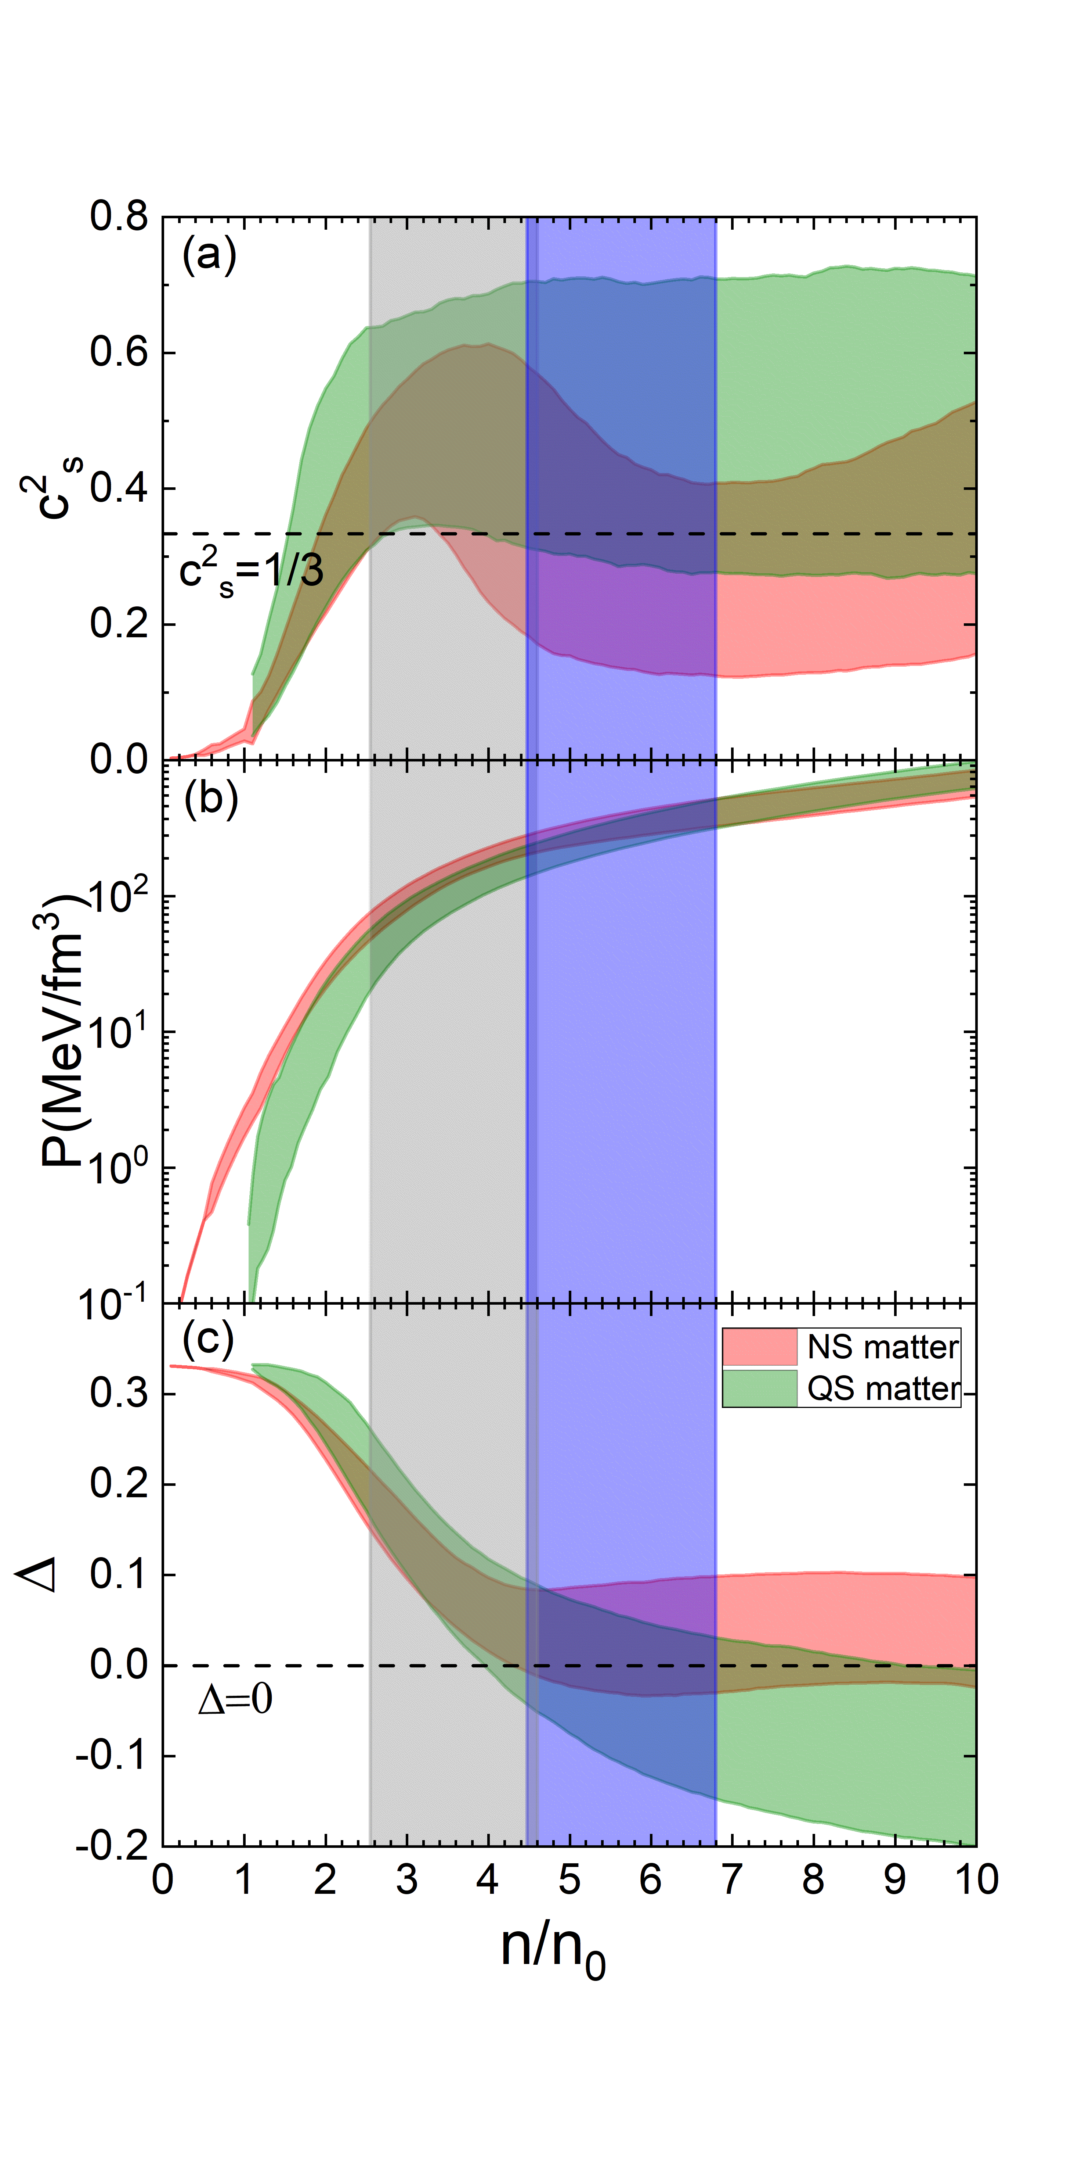
Results
Properties of compact star matter
1. A clear peak in NS matter
around 3-4 n₀, disappears in the QS case
2. Properties of NS matter approach to its
conformal limit in the core of heavy
neutron star.

Slide 11
目录 Contents
1
Introduction to compact star and EOS
2
Astrophysical Observation and Physics-Agnostic EOS
3
Results of Bayesian inference
4
Summary

Slide 12
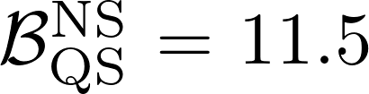
Summary
Based on:
(1) radio measurements of masses of massive pulsars
(2) mass-radius information of PSR J0030+0451 and PSR J0740+6620
(3) tidal deformabilities extracted from the GW events GW170817 and GW190425
(4) theoretical ab initio calculations of ultra-dense matter from perturbative
quantum chromodynamics and low density nuclear matter from chiral effective field theory
We find that:
(1) Disfavor quark star with
(2) Properties of neutron star (quark star) at 90% C.L.
(3) Exist a peak of c_{s}² around 3~4 n₀ in NS matter, while it disappears in the QS case
Thanks！

