Slide 1
Heavy-Flavor-Conserving
Weak Decays of Heavy Baryons:
A Story That Has Lasted 32 Years
Hai-Yang Cheng
Academia Sinica, Taipei
In collaboration with Chia-Wei Liu and Fanrong Xu
Henan Normal University
May 7, 2024

Slide 2
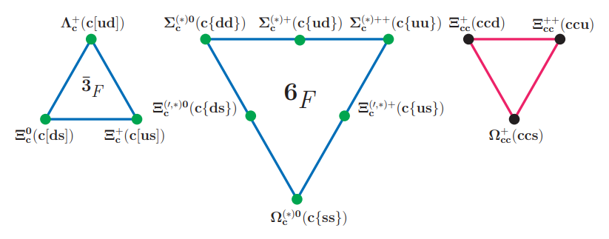


For singly charmed baryons, light diquark = 3×3 = 3+6 in antitriplet and sextet SU(3) representation,
3: Λ_{c}⁺, Ξ_{c}⁺, Ξ_{c}⁰ all decay weakly
6: Ω_{c}⁰, Ξ’⁺_{c}, Ξ’⁰_{c}, Σ_{c}^{++,+,0} only Ω_{c}⁰ decays weakly
Ω_{c}^{*0}, Ξ^{*+}_{c}, Ξ^{*0}_{c}, Σ_{c}^{*++,+,0} (J^{P} = 3/2⁺)
spin [$q_{1}q_{2}]=0$
spin {$q_{1}q_{2}\}=1$

Slide 3



Hadronic weak decays of charmed baryons
$$M\left(ℬ_{i}→ℬ_{f}+P\right)=i{\overline{u}}_{f}(A−Bγ_{5})u_{i}$$
Dynamical model calculation of nonfactorizable amplitude
1. Pole model:
Consider low-lying pole contributions:
s-wave is governed by ½⁻ resonances (very tedious, troublesome!) p-wave is dominated by ½⁺ ground-state baryons
2. Relativistic QM: Korner, Kramer, Ivanov,… overlap integrals
Nonrelativistic QM: Zhao,…
3. Current algebra: Kamal, HYC,… (not really justified, but empirically working)
s-wave is reduced to a commutator term in soft meson limit

Slide 4
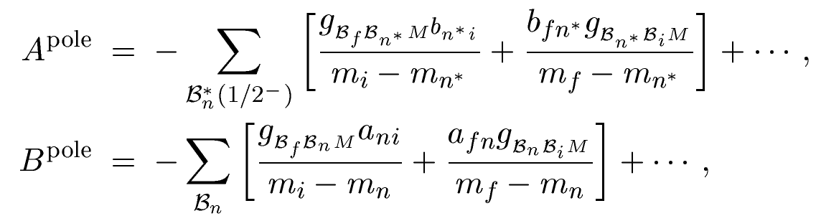


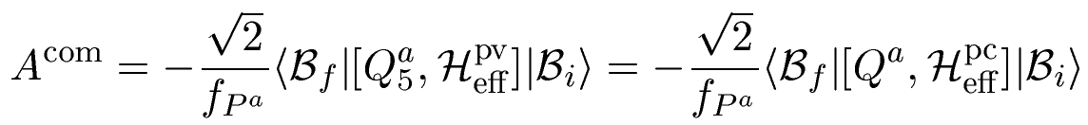

$$M\left(ℬ_{i}→ℬ_{f}+P\right)=i{\overline{u}}_{f}(A−Bγ_{5})u_{i}$$
In soft pion limit, $A^{pole}→A^{com}$
In soft pion limit, PV amplitude is reduced to a commutator term expressed
in terms of PC matrix elements

Slide 5
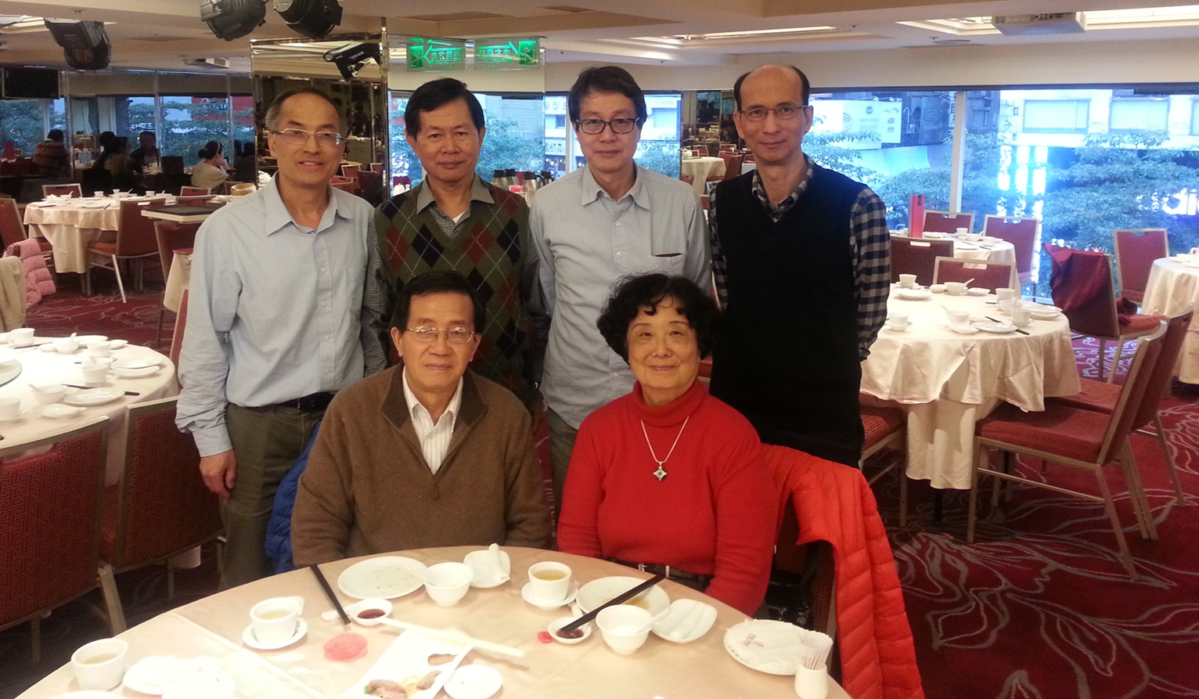


Heavy quark symmetry and chiral dynamics (1992)
Wise
Burdman, Donoghue
Tung-Mow Yan (顏東茂), HYC, Chi-Yee Cheung (張志義), Guey-Lin Lin (林貴林),
Yeu-Chung Lin (林育中), Hoi-Lai Yu (余海禮) = (CLY)²

Slide 6
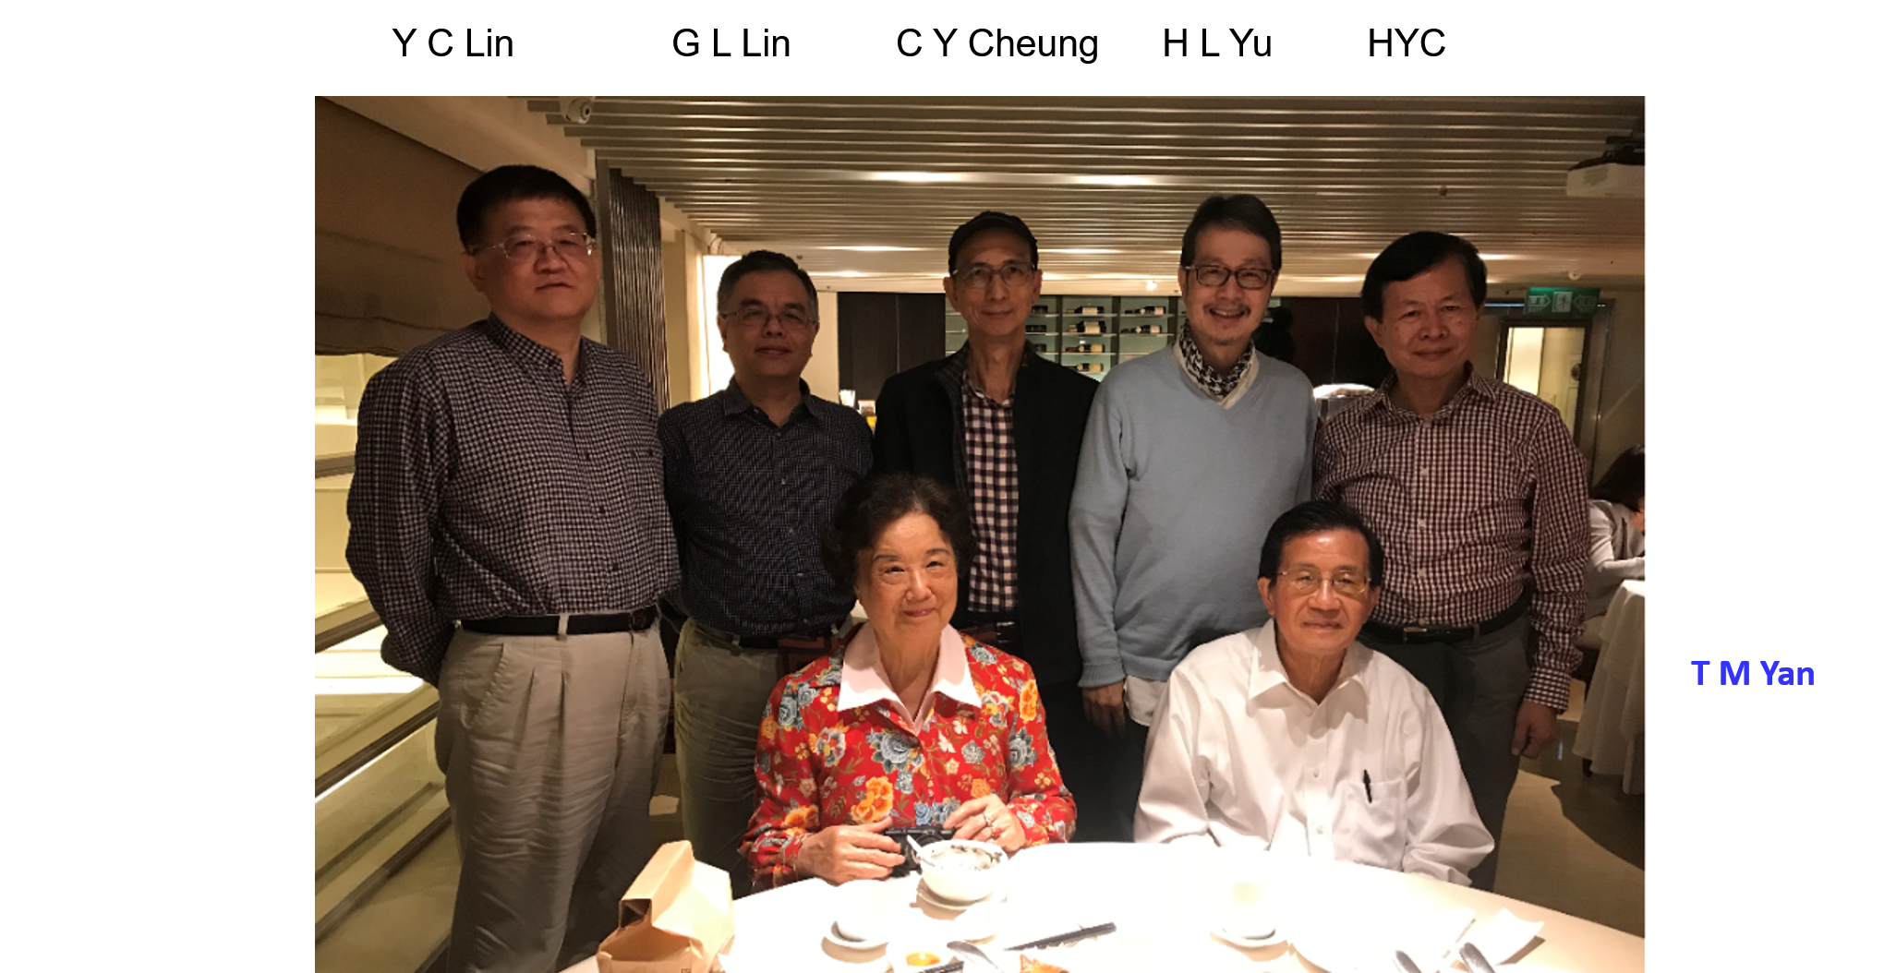
In the same year, we proposed to study heavy-flavor-conserving (HFC) decays such as $Ξ_{Q}→Λ_{Q}π, { Ω}_{Q}→Ξ_{Q}π$ ($Q=c,b)$
11/30/2018

Slide 7



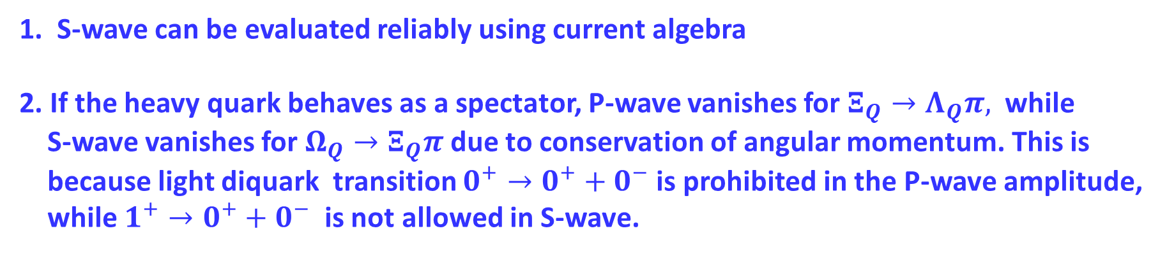
HFC weak decays has two great advantages:
1. S-wave can be evaluated reliably using current algebra
2. If the heavy quark behaves as a spectator, P-wave vanishes for $Ξ_{Q}→Λ_{Q}π,$ while
S-wave vanishes for $Ω_{Q}→Ξ_{Q}π$ due to conservation of angular momentum. This is
because light diquark transition $0^{+}→0^{+}+0^{−}$ is prohibited in the P-wave amplitude,
while $1^{+}→0^{+}+0^{−}$ is not allowed in S-wave.
In heavy quark limit,
vanish in model calculation
⇒ vanishing axial-vector form factor for antitriplet baryons

Slide 8
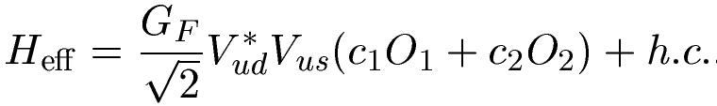
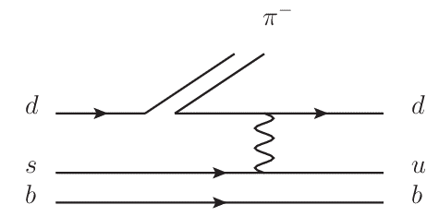
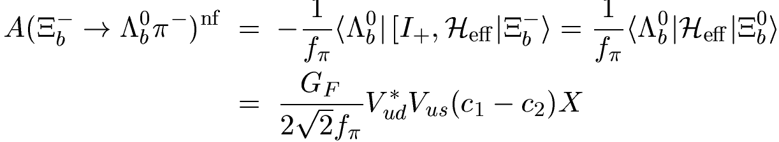

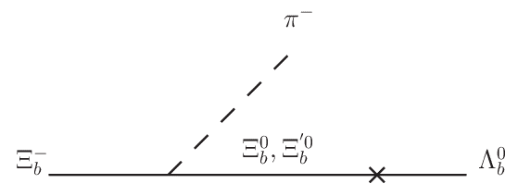

$Ξ_{b}^{−}→Λ_{b}^{0}π^{−}$:
S-wave:
P-wave:
⇒ vanishing axial-vector form factor
P-wave vanishes in heavy quark limit as b quark doesn’t participate in weak interactions!

Slide 9
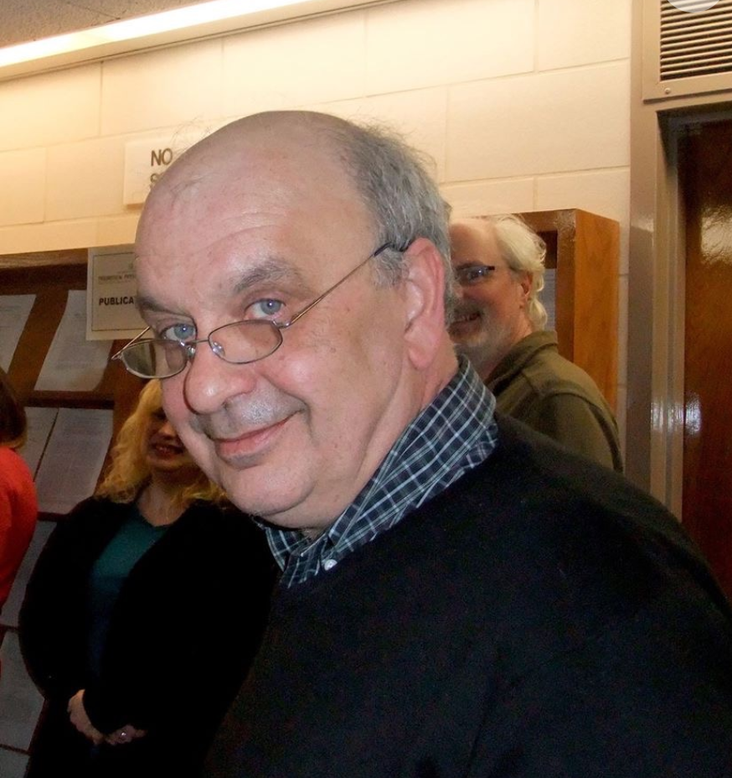
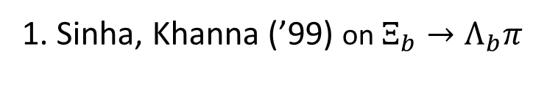
1. Sinha, Khanna (’99) on $Ξ_{b}→Λ_{b}π$
2. Voloshin (’00); Li, Voloshin (’14); Voloshin (’15); Voloshin (’19) on $Ξ_{Q}→Λ_{Q}π$
Mikhail Voloshin (1953-2020)

Slide 10
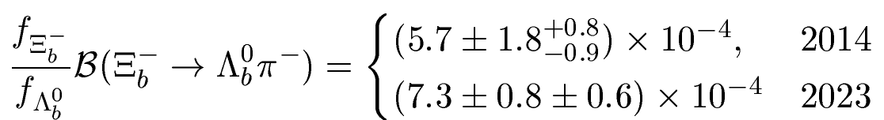


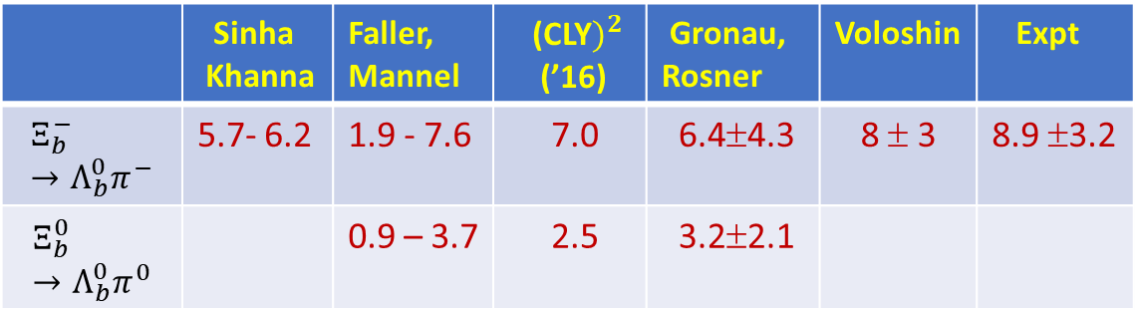
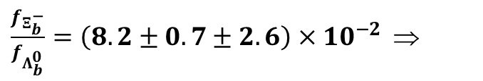
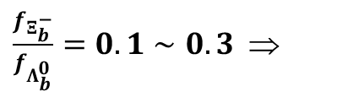
HFC decay $Ξ_{b}^{−}→Λ_{b}^{0}π^{−}$ was measured by LHCb in 2014 and improved in 2023
$\frac{f_{Ξ_{b}^{−}}}{f_{Λ_{b}^{0}}}=0.1∼0.3$ ⇒
(2014)
$\frac{f_{Ξ_{b}^{−}}}{f_{Λ_{b}^{0}}}=\left(8.2±0.7±2.6\right)×{10}^{−2}$ ⇒
(2023)
BFs (${10}^{−3})$ of $Ξ_{b}→Λ_{b}π$
1999 2015 2016 2016 2019 2023
 | Sinha Khanna | Faller, Mannel | (CLY$)^{2}$ (’16) | Gronau, Rosner | Voloshin | Expt
$$Ξ_{b}^{−}→Λ_{b}^{0}π^{−}$$ | 5.7- 6.2 | 1.9 - 7.6 | 7.0 | 6.4±4.3 | 8 ± 3 | 8.9 ±3.2
$$Ξ_{b}^{0}→Λ_{b}^{0}π^{0}$$ |  | 0.9 – 3.7 | 2.5 | 3.2±2.1

Slide 11
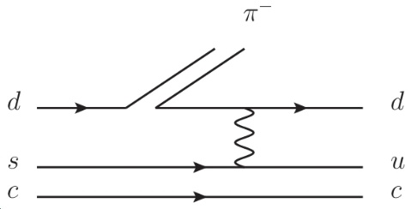
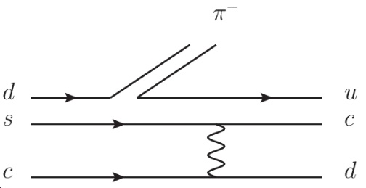
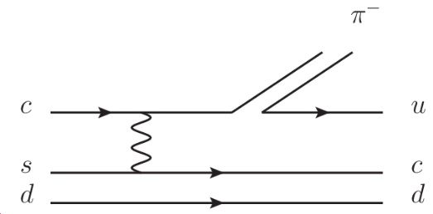
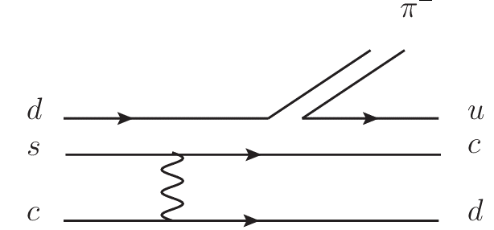
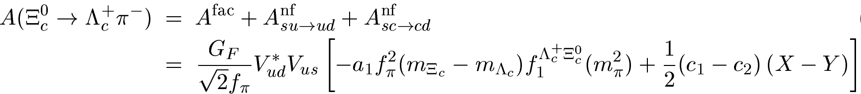
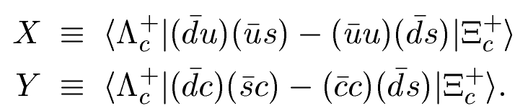






Unlike $Ξ_{b}→Λ_{b}π$, $Ξ_{c}→Λ_{c}π$ receives additional “nonspecator” W-exchange through $cs→dc$ transition apart from W-exchange through $su→ud$.
$$su→ud$$
$$cs→dc$$
$$V_{cd}^{∗}V_{cs}=−V_{ud}^{∗}V_{us }$$
for $su→ud$
for $cs→dc$
Due to the relation $V_{cd}^{∗}V_{cs}=−V_{ud}^{∗}V_{us, }$the interference between W-exchanges $cs→dc$ and $su→ud$is destructive!

Slide 12
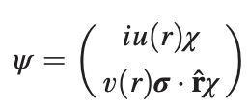
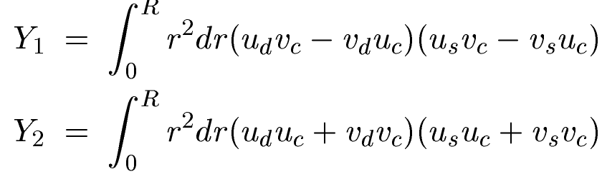


Hadronic matrix elements
for $su→ud$
for $cs→dc$
MIT bag model
Improved bag model: homogeneous bag model (Geng, Liu, Tsai)
Nonrelativistic quark model (Niu, Wang, Zhao)
Diquark model
Related to charmed baryon decay width differences (Voloshin)

Slide 13

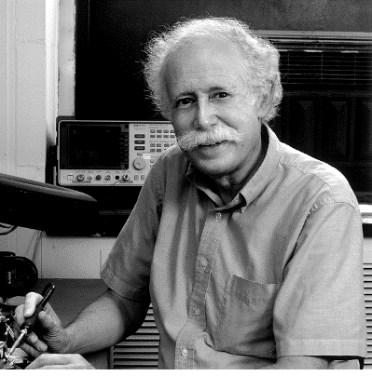
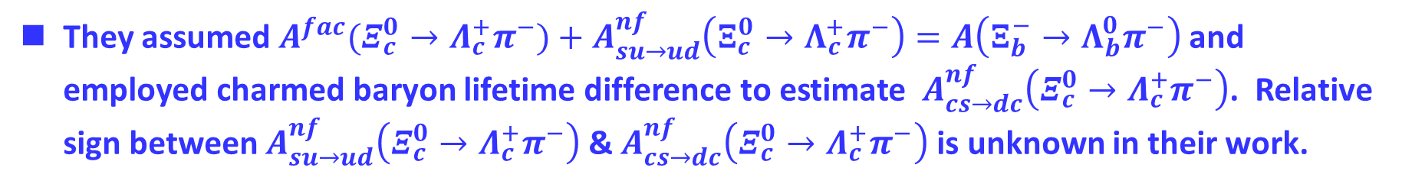
Gronau & Rosner (’16)
S-wave amplitudes of hyperon decays can be described in terms of two parameters F & x
$$A\left(Ξ_{b}^{−}→{Λ_{b}^{0}π}^{−}\right)=\left(5F−2\right)x/3$$
Gronau & Rosner used the best fit values in hyperon decays: F = 1.652 and x = 0.8605
They assumed $A^{fac}(Ξ_{c}^{0}→Λ_{c}^{+}π^{−})+A_{su→ud}^{nf}\left(Ξ_{c}^{0}→Λ_{c}^{+}π^{−}\right)=A\left(Ξ_{b}^{−}→Λ_{b}^{0}π^{−}\right)$ and employed charmed baryon lifetime difference to estimate $A_{cs→dc}^{nf}\left(Ξ_{c}^{0}→Λ_{c}^{+}π^{−}\right)$. Relative sign between $A_{su→ud}^{nf}\left(Ξ_{c}^{0}→Λ_{c}^{+}π^{−}\right)$ & $A_{cs→dc}^{nf}\left(Ξ_{c}^{0}→Λ_{c}^{+}π^{−}\right)$ is unknown in their work.

Slide 14

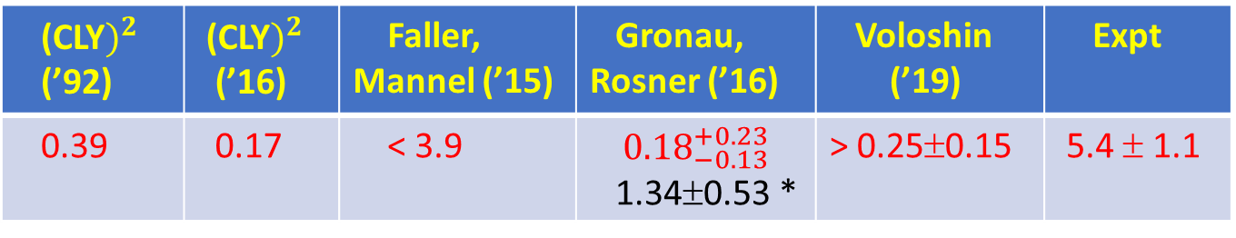

BFs (${10}^{−3})$ of $Ξ_{c}^{0}→Λ_{c}^{+}π^{−}$ calculated in various models
(CLY$)^{2}$ (’92) | (CLY$)^{2}$ (’16) | Faller, Mannel (’15) | Gronau, Rosner (’16) | Voloshin (’19) | Expt
0.39 | 0.17 | < 3.9 | $${0.18}_{−0.13}^{+0.23}$$ 1.34±0.53 * | > 0.25±0.15 | 5.4 ± 1.1
(${10}^{−3})$
* For constructive interference between $cs→dc$ and $su→ud$
$Ξ_{c}^{0}→Λ_{c}^{+}π^{−}$ was measured by LHCb in 2020 and Belle in 2022
{
(0.55 ± 0.18)% LHCb
(0.54 ± 0.14)% Belle
$BF\left(Ξ_{c}^{0}→Λ_{c}^{+}π^{−}\right)=$
Due to destructive interference between W-exchanges $cs→dc$ and $su→ud,$
predicted BF of order $\left(1∼3\right){10}^{−4}$ is too small compared to the data

Slide 15
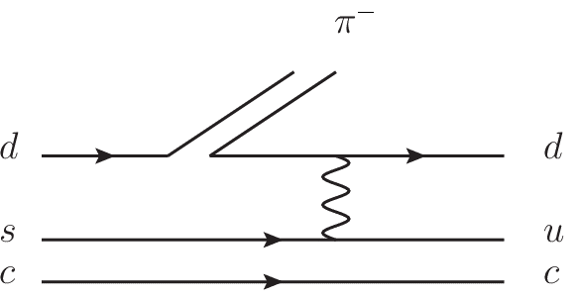
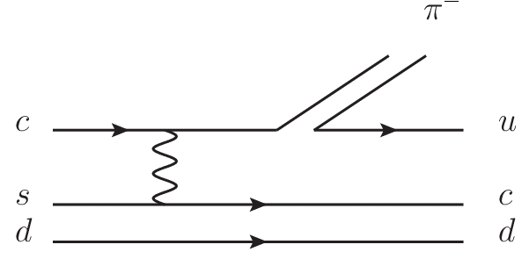
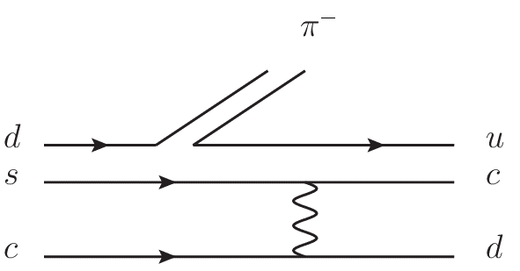
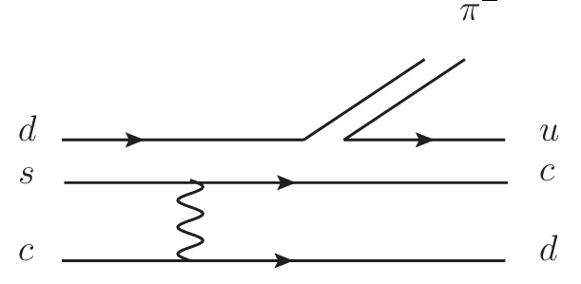

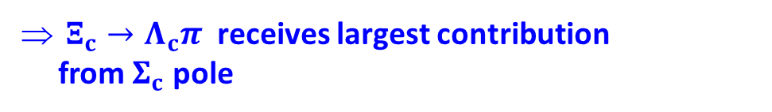



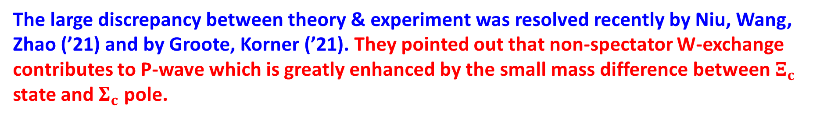






The large discrepancy between theory & experiment was resolved recently by Niu, Wang, Zhao (’21) and by Groote, Korner (’21). They pointed out that non-spectator W-exchange contributes to P-wave which is greatly enhanced by the small mass difference between $Ξ_{c}$ state and $Σ_{c}$ pole.
$$π^{−}$$
$$π^{−}$$
$$Ξ_{c}^{0}$$
$$Σ_{c}^{0}$$
$$Λ_{c}^{+}$$
$$Ξ_{c}^{0}$$
$$Ξ_{c}^{′0}$$
$$Λ_{c}^{+}$$
×
×
$\frac{m_{Λ_{c}^{+}}+m_{Σ_{c}^{+}}}{m_{Ξ_{c}^{0}}−m_{Σ_{c}^{0}}}=265$
⇒ strong enhancement of P-wave
$Ξ_{c}→Λ_{c}π$ receives largest contribution
from $Σ_{c}$ pole
P-wave induced through $cs→dc$ W-exchange was
overlooked in all previous studies before 2021!

Slide 16




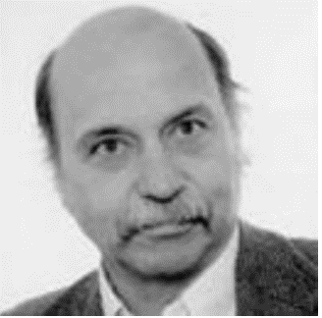
“Study of heavy quark conserving weak decays in the quark model”
Phys. Lett. B 826, 136916 (2022)
Peng-Yu Niu Qing Wang Qiang Zhao
“Topological tensor invariants and the current algebra approach: Analysis of 196 nonleptonic two-body decays of single and double charm baryons - a review”
Eur. Phys. J C 82, 297 (2022)
Stefan Groote Jurgen G Korner

Slide 17
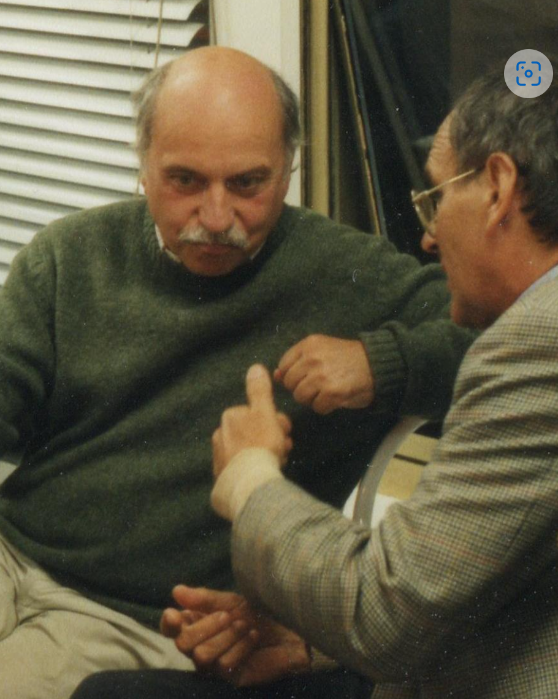
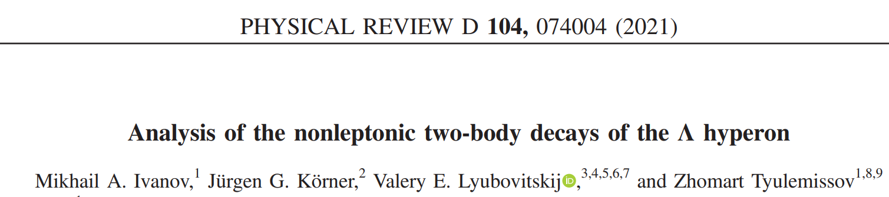
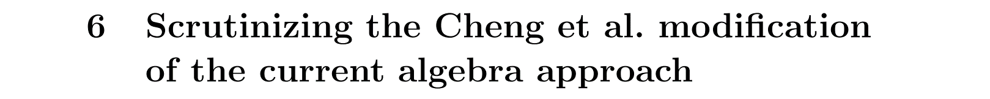
Jürgen G. Körner (1939-2021)
Korner-Pati-Woo theorem (1971)
Korner, Kramer, Willrodt, “Weak Decays of Charmed Baryons”
Z. Phys. C2, 117 (1979)

Slide 18
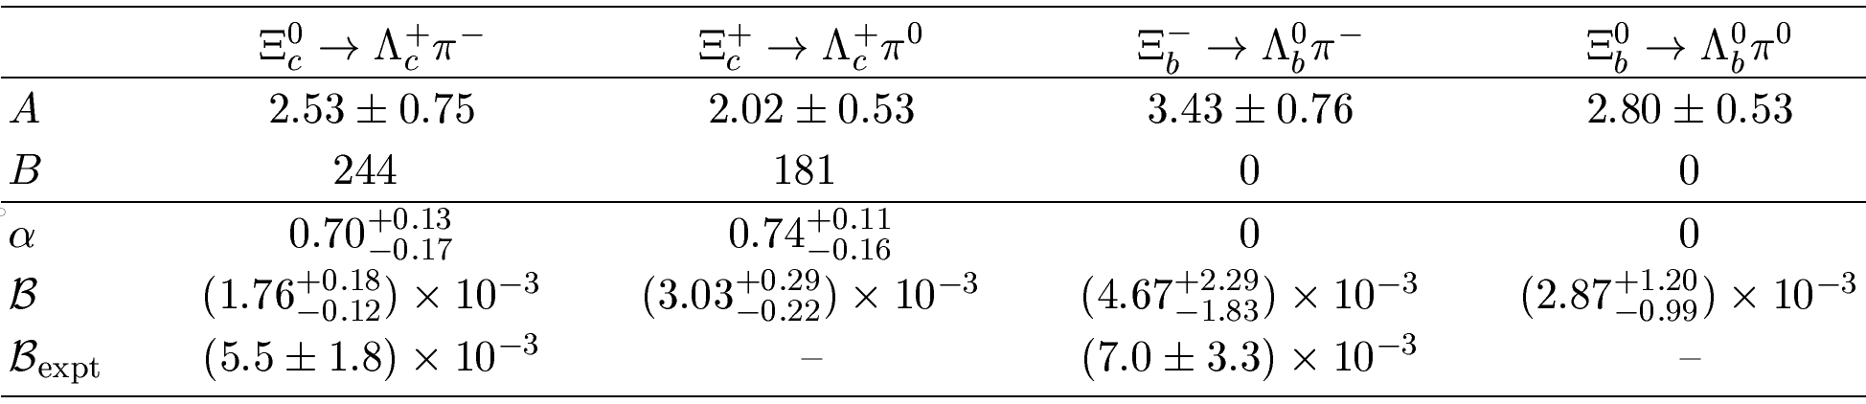


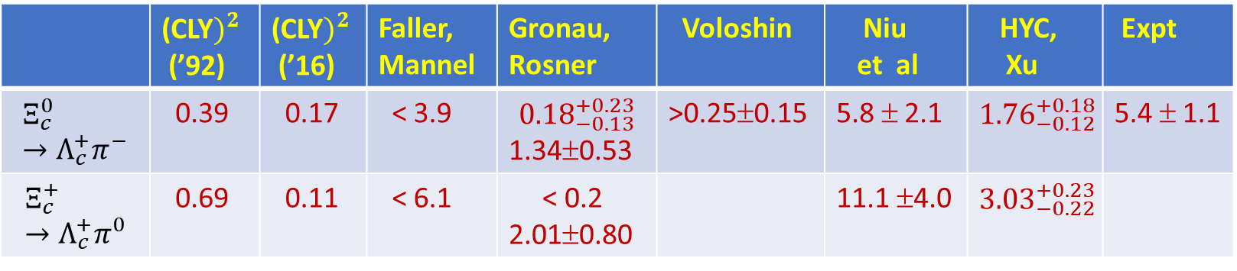
Fanrong Xu, HYC (2022):
P-wave is larger than S-wave by two orders of magnitude for $Ξ_{c}→Λ_{c}π$
While P-wave vanishes in $Ξ_{b}→Λ_{b}π$, it dominates in $Ξ_{c}→Λ_{c}π$
 | (CLY$)^{2}$ (’92) | (CLY$)^{2}$ (’16) | Faller, Mannel | Gronau, Rosner | Voloshin | Niu et al | HYC, Xu | Expt
$$Ξ_{c}^{0}→Λ_{c}^{+}π^{−}$$ | 0.39 | 0.17 | < 3.9 | $${0.18}_{−0.13}^{+0.23}$$ 1.34±0.53 | >0.25±0.15 | 5.8 ± 2.1 | $${1.76}_{−0.12}^{+0.18}$$ | 5.4 ± 1.1
$$Ξ_{c}^{+}→Λ_{c}^{+}π^{0}$$ | 0.69 | 0.11 | < 6.1 | < 0.2 2.01±0.80 |  | 11.1 ±4.0 | $${3.03}_{−0.22}^{+0.23}$$
(${10}^{−3})$
Our result for $Ξ_{c}^{0}→Λ_{c}^{+}π^{−}$ based on the MIT bag model for 4-quark matrix elements still needs to be improved

Slide 19
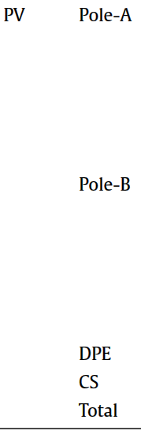
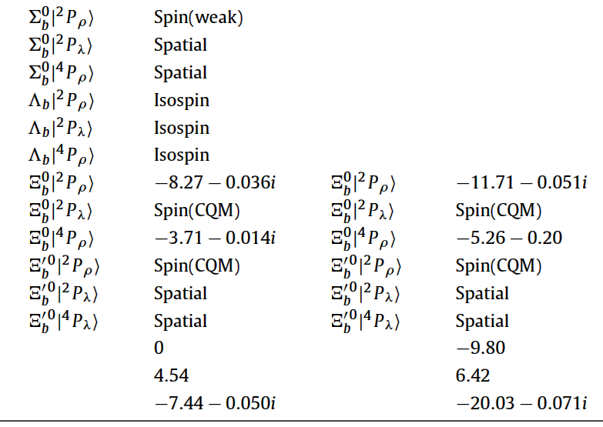
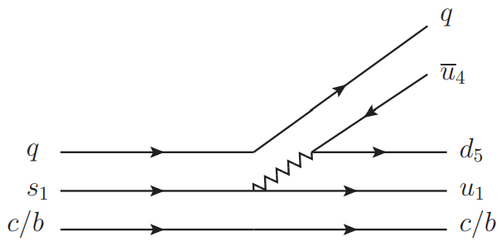

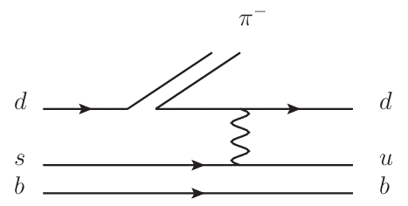
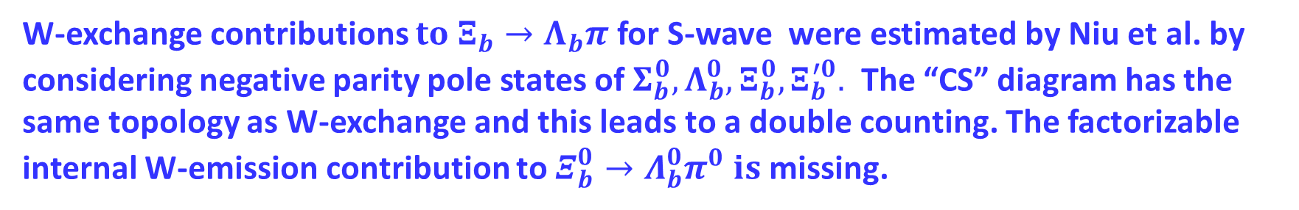
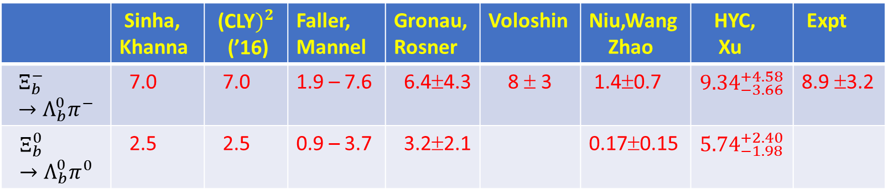
 | Sinha, Khanna | (CLY$)^{2}$ (’16) | Faller, Mannel | Gronau, Rosner | Voloshin | Niu,Wang Zhao | HYC, Xu | Expt
$$Ξ_{b}^{−}→Λ_{b}^{0}π^{−}$$ | 7.0 | 7.0 | 1.9 – 7.6 | 6.4±4.3 | 8 ± 3 | 1.4±0.7 | $${9.34}_{−3.66}^{+4.58}$$ | 8.9 ±3.2
$$Ξ_{b}^{0}→Λ_{b}^{0}π^{0}$$ | 2.5 | 2.5 | 0.9 – 3.7 | 3.2±2.1 |  | 0.17±0.15 | $${5.74}_{−1.98}^{+2.40}$$
W-exchange contributions $to Ξ_{b}→Λ_{b}π$ for S-wave were estimated by Niu et al. by considering negative parity pole states of $Σ_{b}^{0},Λ_{b}^{0}, Ξ_{b}^{0}, Ξ_{b}^{′0}.$ The “CS” diagram has the same topology as W-exchange and this leads to a double counting. The factorizable internal W-emission contribution to $Ξ_{b}^{0}→Λ_{b}^{0}π^{0} is$missing.

Slide 20
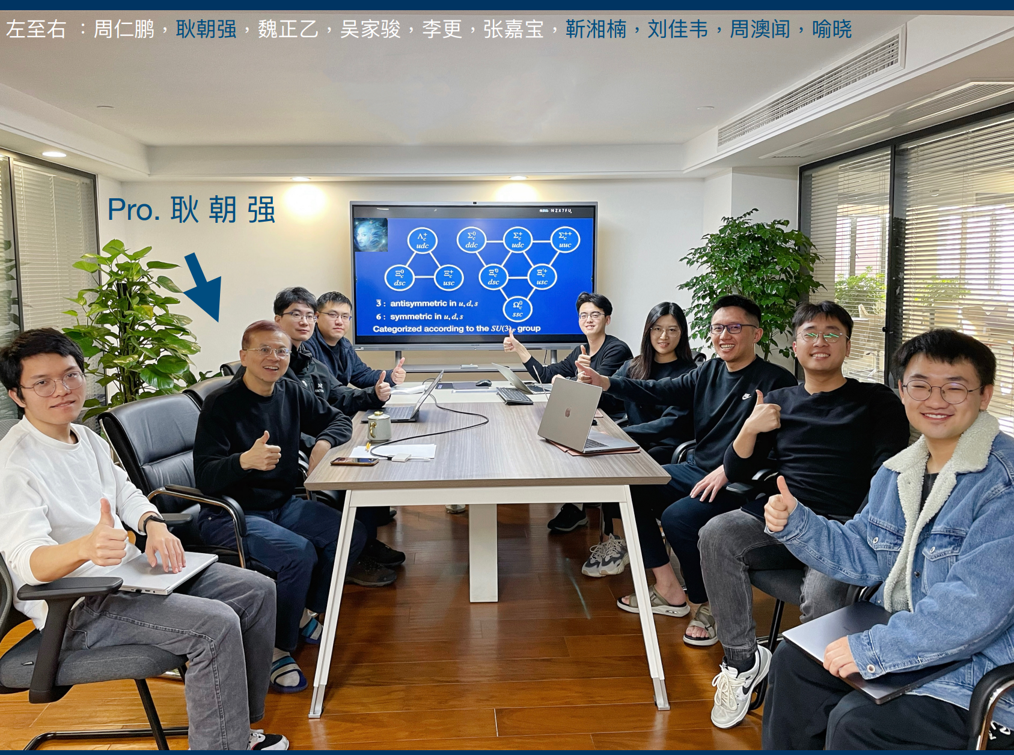

Slide 22

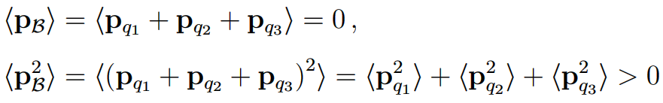



Static bag model has an issue with center-of-mass motion (CMM) of the bag
Chao-Qiang Geng, Chia-Wei Liu, Ten-Hsueh Tsai (’20);
Liu, Geng (’22)
Bag quarks are unentangled; they obey free Dirac equation
(recall that )
because
The variance of is referred to CMM of the bag. A physical bag with a definite momentum should not have CMM as
MIT bag model: Poincare invariance is not kept

Slide 23



In homogeneous bag model (HBM) by Geng, Liu, Tsai
Wave function is invariant under space translation
Quarks are no longer constrained in specific regions
Quarks are bounded and entangled in the following way:
CMM is thus taken away from the static bag

Slide 24
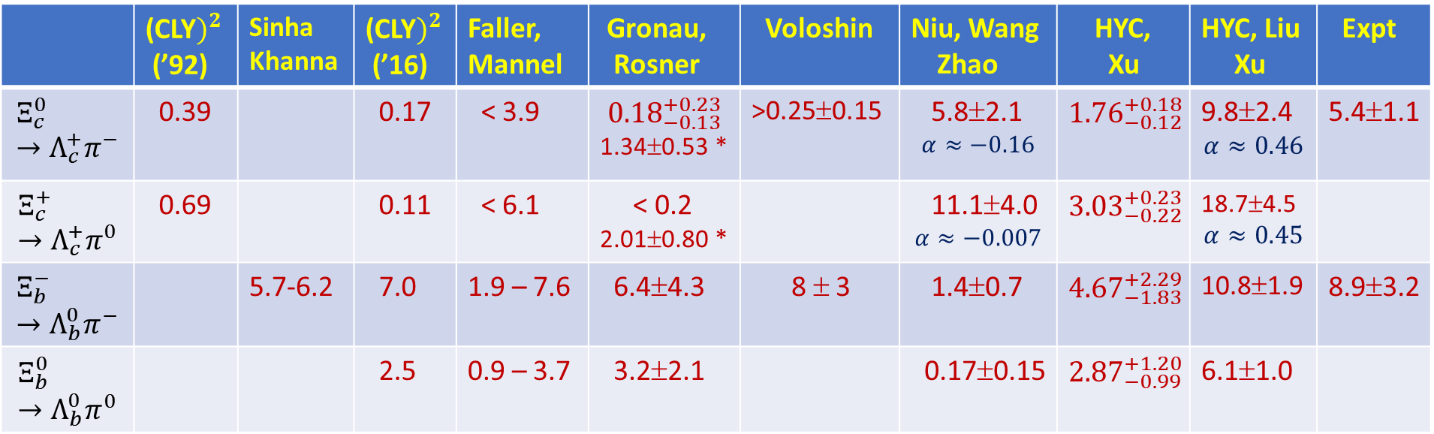

Matrix elements in the HMB model are found to be nearly twice larger than the MIT bag modes (Liu, Xu, HYC)
 | (CLY$)^{2}$ (’92) | Sinha Khanna | (CLY$)^{2}$ (’16) | Faller, Mannel | Gronau, Rosner | Voloshin | Niu, Wang Zhao | HYC, Xu | HYC, Liu Xu | Expt
$$Ξ_{c}^{0}→Λ_{c}^{+}π^{−}$$ | 0.39 |  | 0.17 | < 3.9 | $${0.18}_{−0.13}^{+0.23}$$ 1.34±0.53 * | >0.25±0.15 | 5.8±2.1 $$α≈−0.16$$ | $${1.76}_{−0.12}^{+0.18}$$ | 9.8±2.4 $$α≈0.46$$ | 5.4±1.1
$$Ξ_{c}^{+}→Λ_{c}^{+}π^{0}$$ | 0.69 |  | 0.11 | < 6.1 | < 0.2 2.01±0.80 * |  | 11.1±4.0 $$α≈−0.007$$ | $${3.03}_{−0.22}^{+0.23}$$ | 18.7±4.5 $$α≈0.45$$
$$Ξ_{b}^{−}→Λ_{b}^{0}π^{−}$$ |  | 5.7-6.2 | 7.0 | 1.9 – 7.6 | 6.4±4.3 | 8 ± 3 | 1.4±0.7 | $${4.67}_{−1.83}^{+2.29}$$ | 10.8±1.9 | 8.9±3.2
$$Ξ_{b}^{0}→Λ_{b}^{0}π^{0}$$ |  |  | 2.5 | 0.9 – 3.7 | 3.2±2.1 |  | 0.17±0.15 | $${2.87}_{−0.99}^{+1.20}$$ | 6.1±1.0
* For constructive interference between $cs→dc$ and $su→ud$
scaled up from $μ_{H}$ to $μ_{c,b}$

Slide 25
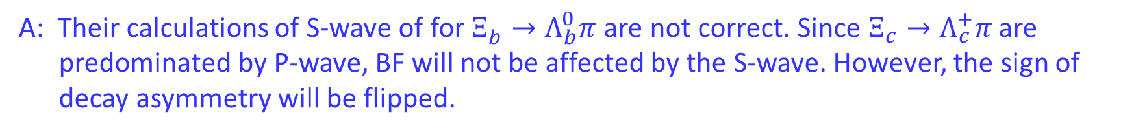
Q: The predictions of $Ξ_{c}^{ }→Λ_{c}^{+}π^{ }$by Zhao et al. agree with experiment, why is that their
predictions are lousy for $Ξ_{b}^{ }→Λ_{b}^{0}π^{ }$?
A: Their calculations of S-wave of for $Ξ_{b}^{ }→Λ_{b}^{0}π^{ }$are not correct. Since $Ξ_{c}^{ }→Λ_{c}^{+}π^{ }$are
predominated by P-wave, BF will not be affected by the S-wave. However, the sign of
decay asymmetry will be flipped.

Slide 26

Summary
Current algebra is applicable to HFC decays
$Ξ_{c}→Λ_{c}π$ is dominated by P-wave pole terms, induced by W-exchange through $cs→dc$ transition, while $Ξ_{b}→Λ_{b}π$ proceeds only through S-wave
Estimations of non-perturbative parameters in homogenous bag model are better than MIT bag model.
$Ω_{b}^{−}→Ξ_{b}^{0}π$ receives only factorizable P-wave contributions; $Ω_{c}→Ξ_{c}π$ acquires additional nonspectator W-exchange for both PV & PC amplitudes

Slide 27


1992 1999 2015 2016 2016 2019
2021 2022 2022 2023
 | (CLY$)^{2}$ (’92) | Sinha Khanna | Faller, Mannel | (CLY$)^{2}$ (’16) | Gronau, Rosner | Voloshin | Expt
$$Ξ_{c}^{0}→Λ_{c}^{+}π^{−}$$ | 0.39 |  | < 3.9 | 0.17 | $${0.18}_{−0.13}^{+0.23}$$ 1.34±0.53 * | >0.25±0.15 | 5.4±1.1
$$Ξ_{c}^{+}→Λ_{c}^{+}π^{0}$$ | 0.69 |  | < 6.1 | 0.11 | < 0.2 2.01±0.80 *
$$Ξ_{b}^{−}→Λ_{b}^{0}π^{−}$$ |  | 5.7-6.2 | 1.9 – 7.6 | 7.0 | 6.4±4.3 | 8 ± 3 | 7.0±3.3
$$Ξ_{b}^{0}→Λ_{b}^{0}π^{0}$$ |  |  | 0.9 – 3.7 | 2.5 | 3.2±2.1
Niu, Wang Zhao | HYC, Xu | HYC, Liu Xu | Expt
5.8±2.1 | $${1.76}_{−0.12}^{+0.18}$$ | 9.8±2.4 | 5.4±1.1
11.1±4.0 | $${3.03}_{−0.22}^{+0.23}$$ | 18.7±4.5
1.4±0.7 | $${4.67}_{−1.83}^{+2.29}$$ | 10.8±1.9 | 8.9±3.2
0.17±0.15 | $${2.87}_{−0.99}^{+1.20}$$ | 6.1±1.0
* For constructive interference between $cs→dc$ and $su→ud$

Slide 28
Backup Slides

Slide 29
Model-independent approach
Chau, HYC, Tseng (’96); Kohara (’91); Zhao, Wang, Hsiao, Yu (’20); Hsiao, Wang, Zhao (’22)
1. Diagrammatic scheme
One inner W-emission and three W-exchange diagrams
Need information of decay asymmetry to extract s-wave and p-wave amplitudes separately
2. SU(3) approach
Savage, Springer (’90); Sharma, Verma (’97); Lu, Wang, Yu (’16); Geng, Hsiao, Liu, Tsai (’17); Geng, Liu, Tsai (’19); Huang, Xing, He (’22); Zhong, Xu, Wen, Gu (‘23)
Parameters for s- and p-waves obtained by performing a global fit to the data of BFs and decay asymmetries

Slide 30




S- & P-wave amplitudes (${10}^{−7}),$BFs (${10}^{−3})$ & decay asymmetries of $Ω_{c}^{0}→Ξ_{c}π \& Ω_{b}^{−}→Ξ_{b}π$
 | A | B | BF | $α$
$$Ω_{c}^{0}→Ξ_{c}^{+}π^{−}$$ | 3.06±0.15 | $−91\text{±}6$ | 2.0±0.2 | $≈−1.00$
$$Ω_{c}^{0}→Ξ_{c}^{0}π^{0}$$ | -2.17±0.12 | $$69\text{±}4$$ | 1.1±0.1 | $≈−1.00$
$$Ω_{b}^{−}→Ξ_{b}^{0}π^{−}$$ | 0 | $$16.1\text{±}0.1$$ | $$(6.5\text{±}0.7){10}^{−2}$$ | 0
$$Ω_{b}^{−}→Ξ_{b}^{−}π^{0}$$ | 0 | $$3.49\text{±}0.02$$ | $$(3.2\text{±}0.3){10}^{−3}$$ | 0

