Slide 1
Gravitational wave and testing of gravity
Wen Zhao
Department of Astronomy,
University of Science and Technology of China
Collaboration With: A.Wang Team (Baylor Univ. and ZJUT), T.Zhu (ZJUT), L.Wen Team (UWA), B.Li Team(Durham Univ.)

Slide 2
General Relativity (GR)
GR is the most successful theory of gravity.
Problems of GR:
（1）”Dark matter” problem in galactic
and cosmological scales
（2）”Dark energy” problem in
cosmological scale
（3）Birth of the Universe and
singularity problem
（4）Singularity problem in black holes
（5）Quantum gravity?
GR includes two parts：Equivalence Principle + Einstein Equation. GR is successful in Solar Systems tests, Binary Pulsars, Cosmological Tests, Gravitational Lensings, and so on. In this talk, I will focus on the tests in gravitational-wave observation.

Slide 3
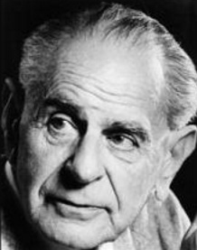
How to test GR?
According to Popper’s argument: Scientists can never truly “prove” that a theory (e.g. GR) is correct, but rather all we can do is to disprove, or more accurately to constrain a hypothesis. The theory that remains and cannot be disproved by observations becomes the status quo.
----K.Popper, The Logic of Scientific Discovery, 1934
According to this argument, in order to test GR, we must compare its predictions with alternative theories of gravity.

Slide 4
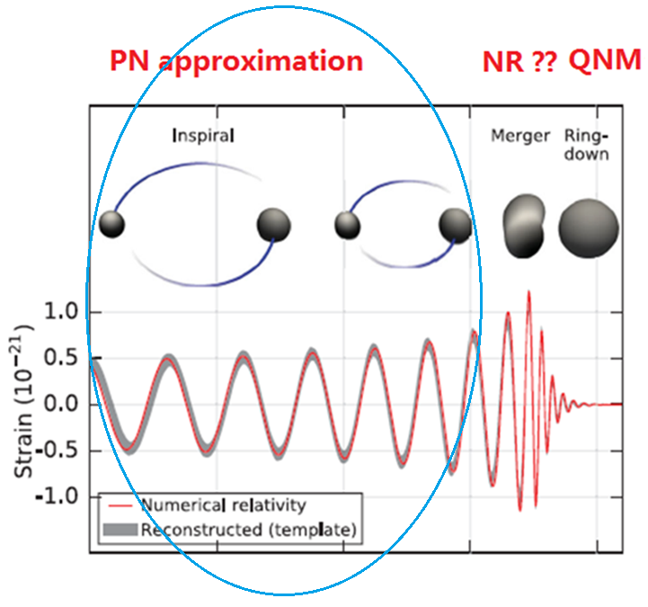
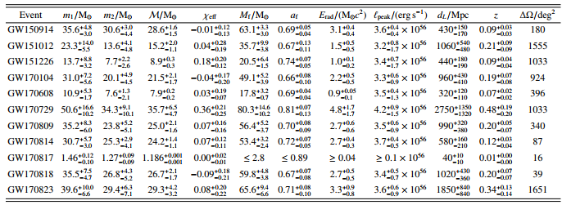
Gravitational radiation of compact binary systems

Slide 5
Calculating the waveforms of GW in compact binary systems: General Process
Deriving the field Eqs. from action of theory.
In far zone, we expand the field Eqs. in the weak-field approximations, which depend on the motion of binary systems in near zone.
In the near zone, we solve the evolution of binary systems, where we always define the effective mass and the sensitivity (due to the interaction between matter and external field).
Solving the field Eqs. in far zone, and defining the GW polarization modes from Riemann tensor. Meanwhile, we calculate the sensitivity of different bodies to derive the full GW waveforms in time domain.
We use stationary phase approximation (SPA) to derive the GW waveforms in frequency domain, and calculate the response of detectors by considering the detector antenna pattern functions.
We extend to high post-Newtonian orders and construct the GW templates in modified gravity.

Slide 6
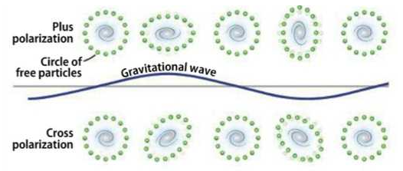
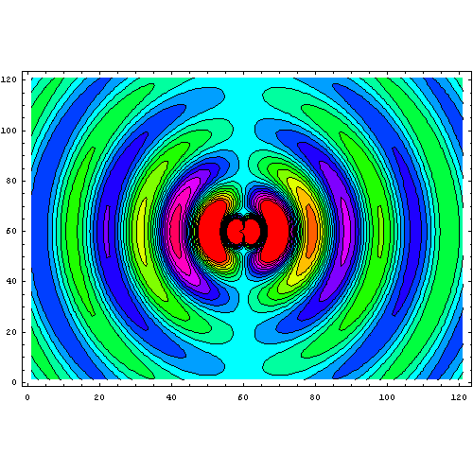
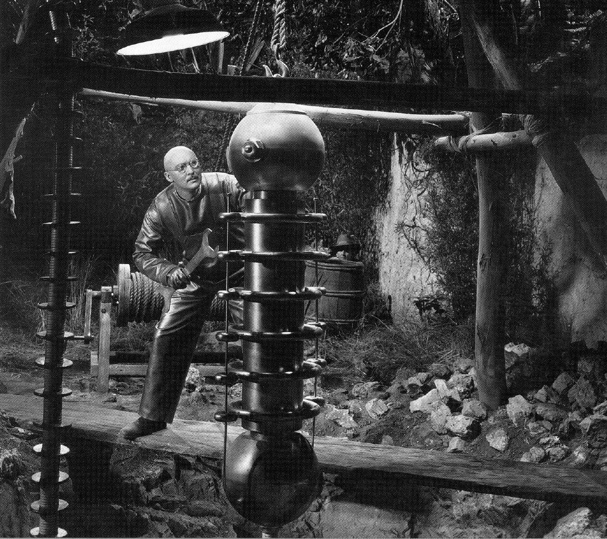
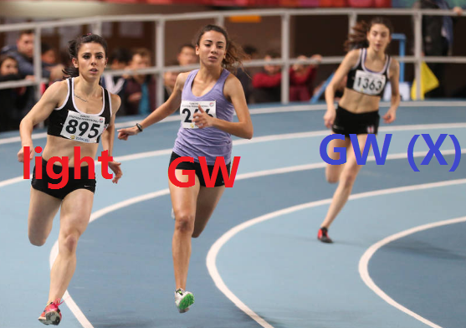
Gravitational radiation in General Relativity
(1) Two polarization modes:
“h+(t)” and “hx(t)” (transverse)
(2) Lowest gravitational radiation: Acceleration of quadrupole moment
(3) Speed of GW:
= Speed of light
Case #1:
Try it in your own lab!
M = 1000 kg
R = 1 m
f = 1000 Hz
r = 300 m

Slide 7
Two ways for testing of gravity
Model-dependent way:
For a specific gravity, we calculate the GW waveforms, and then constrain it by observations.
Model-independent way:
Testing some properties of GW by data directly, and applying to a set of modified gravities.

Slide 8
Basic ideal of the method
For a or a set of specific gravitational theories, we calculate the waveforms of gravitational waves.
In data analysis, we constrain the deviation of these waveforms from those in General Relativity, and constrain the model parameters.

Slide 9
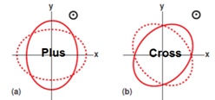
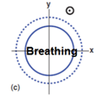
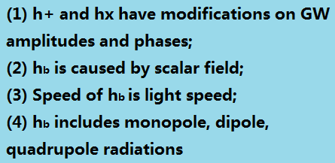
1. Waveform of GW in Brans-Dicke Gravity

Slide 10
Constraining by neutron star-balck hole gravitational wave events

Slide 11
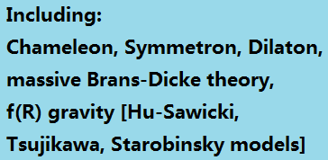
2. Waveform of GW in SMG ------ General Screened Modified Gravity
● General Action in Einstein Frame:
● In order to suppress fifth-force in high density environments and pass the solar system tests, we should properly choose V(𝛟) and A(𝛟) functions. Such scalar-tensor gravity with screening mechanism is often called Screened Modified Gravity (SMG).

Slide 12
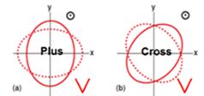
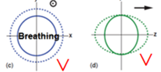
Time-domain Waveforms

Slide 13
Time-domain Waveforms

Slide 14
Constraining by neutron star-balck hole gravitational wave events

Slide 15
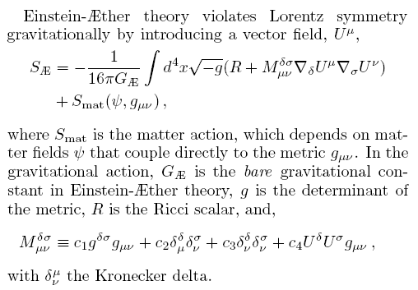
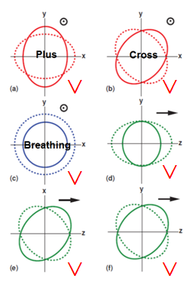
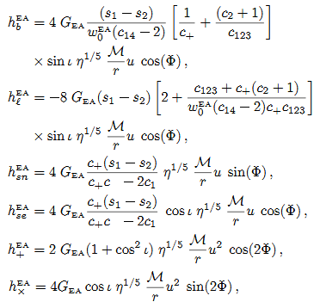
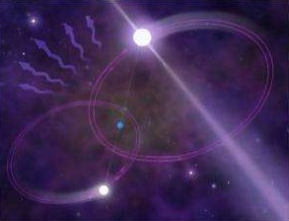
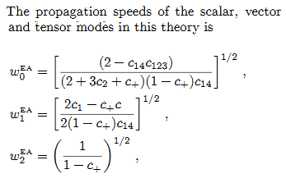
3. Waveform of GW in Einstein-aether Gravity

Slide 16
4. Parity-violating gravities
As well known, parity symmetry is violation in nature.
Although, GR is parity-conserved, various parity-violating gravities (e.g. Chern-Simons gravity, ghost-free scalar-tensor gravity, symmetric teleparallel equivalence of GR theory, Horava-Lifshitz gravity) have been proposed in the literature.
In the general parity-violating gravities, the equations of motion of GW for the circular polarization modes (i.e. left-hand and right-hand modes) are decoupled, which can be written as follows:

Slide 17
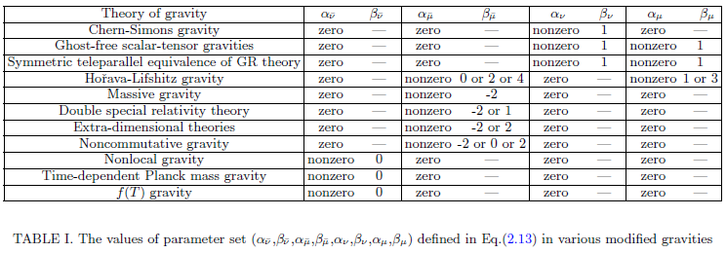
GWs in general parity violating gravities
Parameters in various modified gravities
WZ, Zhu, Qiao, and Wang, PRD 101, 024002 (2020)

Slide 18
Effects on GW waveforms of circular polarization modes:
Effects on GW waveforms of detector’s responses:
Qiao, Zhu, WZ & Wang, PRD 100, 124058 (2019)
WZ, Zhu, Qiao & Wang, PRD 101, 024002 (2020)

Slide 19
Constraint: Lower limit from GW events
The strongest constraint so far, Mpv > 0.07GeV
10¹⁷ stronger than the double pulsars constraint
Future detection has potential to give: Mpv > O(0.1) TeV
WZ, Liu, Wen, Zhu & Wang, EPJC 80, 630 (2020)
Wang, Niu, Zhu & WZ, ApJ 908, 58 (2021)
Hu, Li, Niu & WZ, PRD 103, 064057 (2021)

Slide 20
Two ways for testing of gravity
Model-dependent way:
For a specific gravity, we calculate the GW waveforms, and then constrain it by observations.
Model-independent way:
Testing some properties of GW by data directly, and applying to a set of modified gravities.

Slide 21
Basic ideal of the method
For some fundamental properties of gravity [speed, polarization, Lorentz symmetry, parity symmetry, etc], we study the consequence if they are different from those in General Relativity.
We test or constrain them from data analysis.

Slide 22
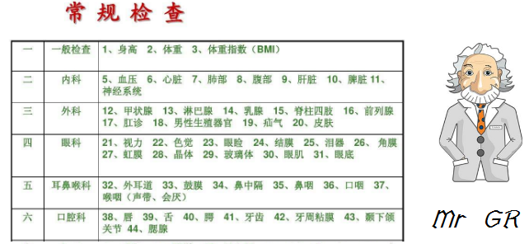

Slide 23
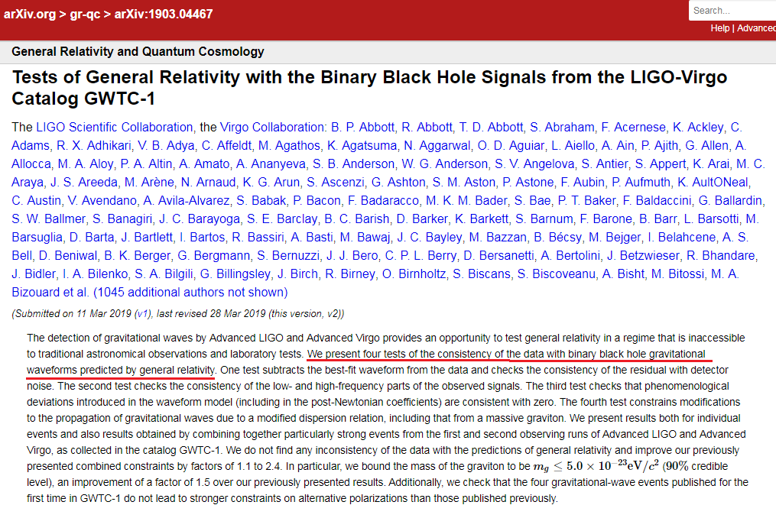

Slide 24
Model-independent tests -----1. testing the coefficient of GW phases

Slide 25
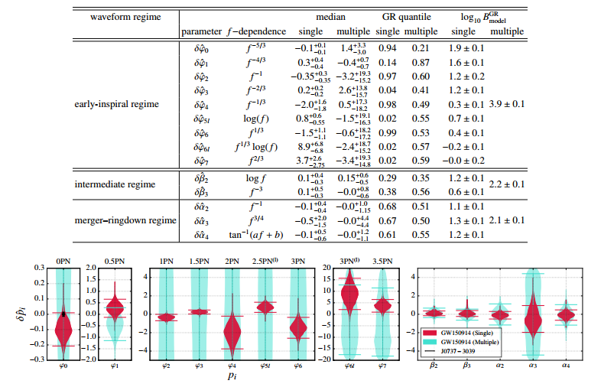

Slide 26
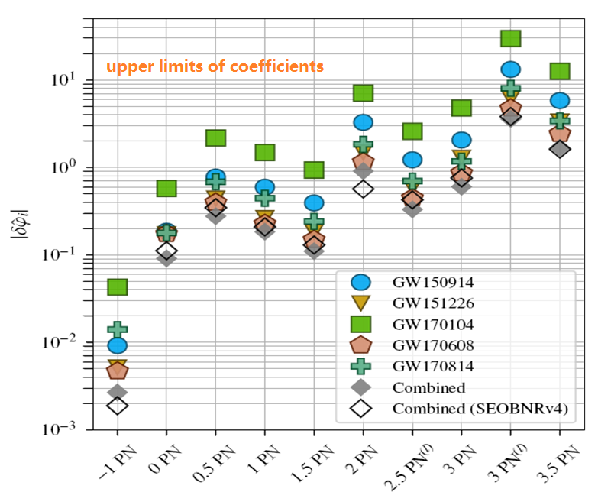

Slide 27
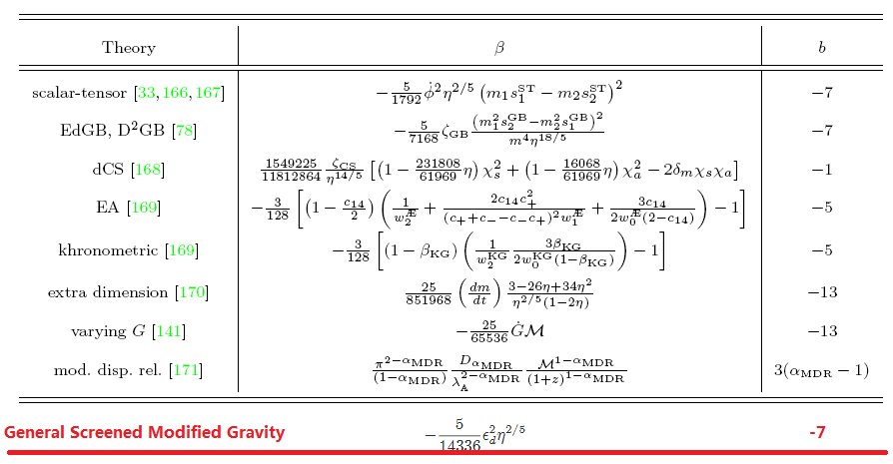
Model-independent tests ------2. Parameterized Post-Einsteinian framework

Slide 28
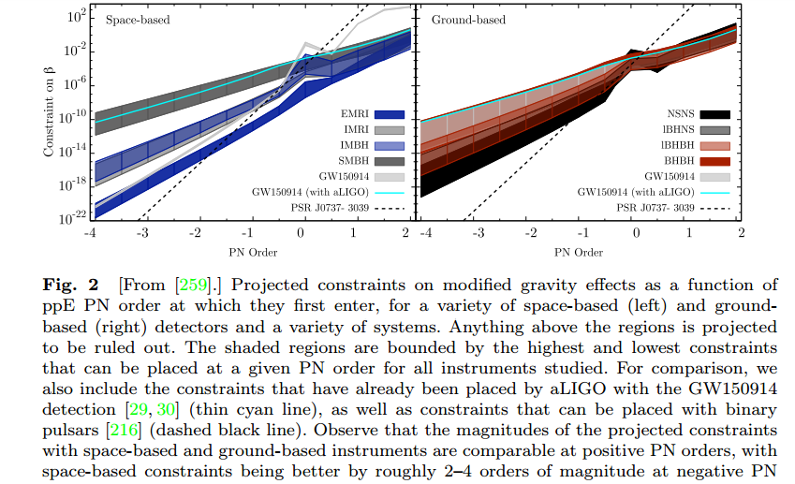

Slide 29
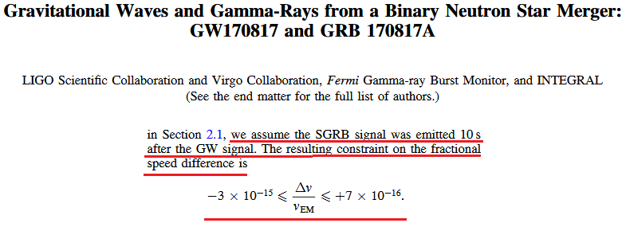
Model-independent tests ------3. testing the GW speed
Difference of arrival times of GW and EM counterparts

Slide 30
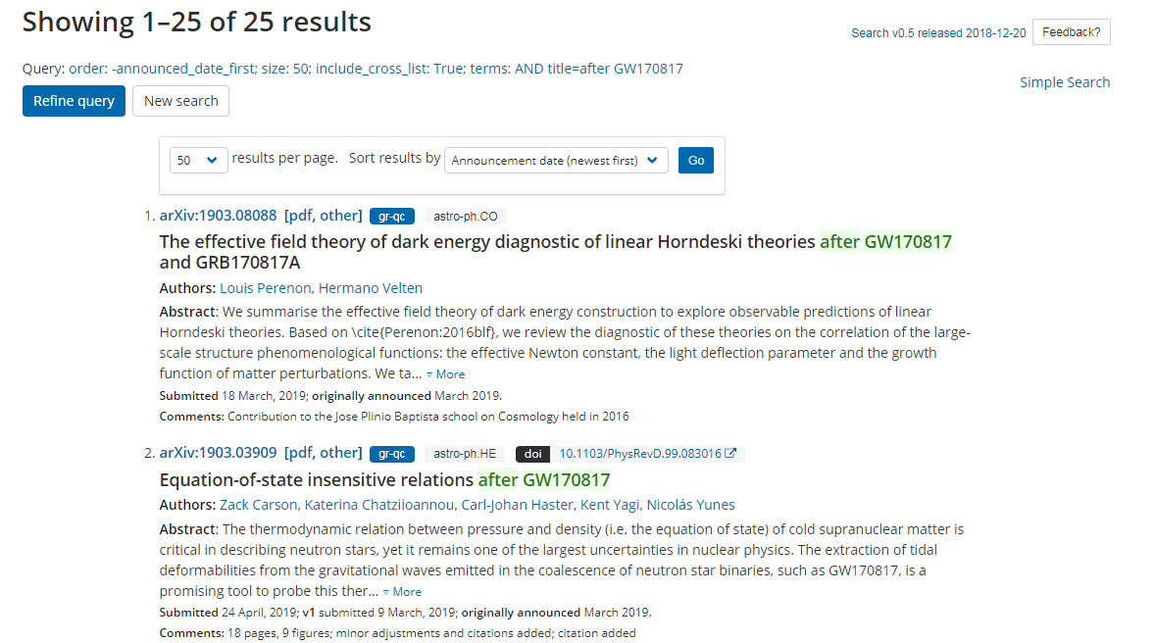

Slide 31
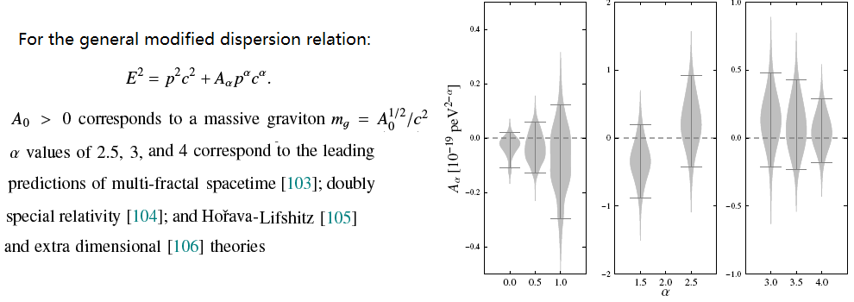
Model-independent tests ------4. testing the dispersion relation

Slide 32
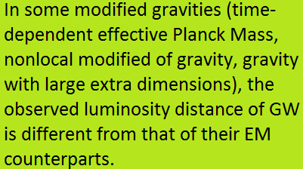
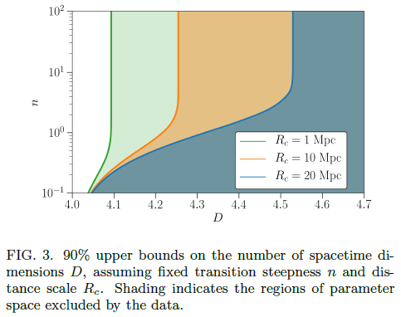
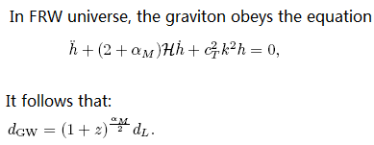
Model-independent tests ------5. testing the luminosity distance of GW

Slide 33
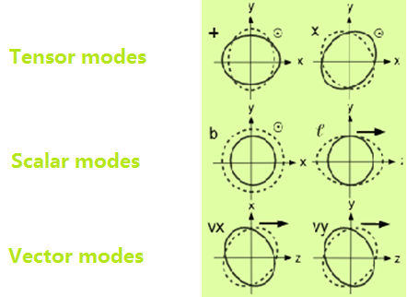
Model-independent tests ------6. testing the GW polarizations

Slide 34
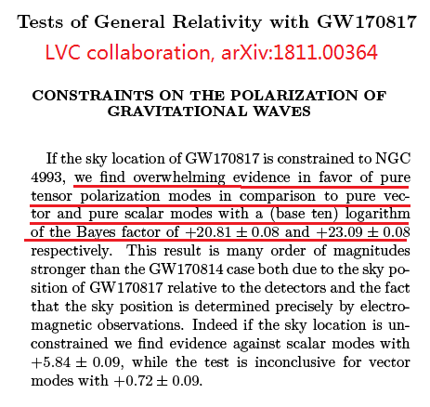

Slide 35
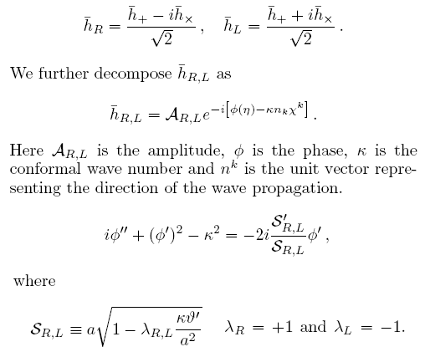
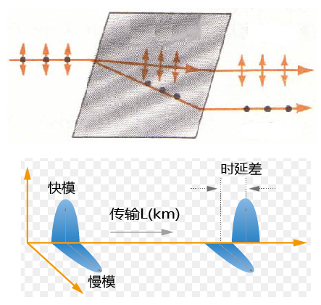
Model-independent tests ------7. testing parity symmetry of gravity

Slide 36
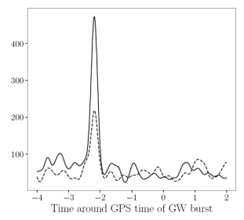
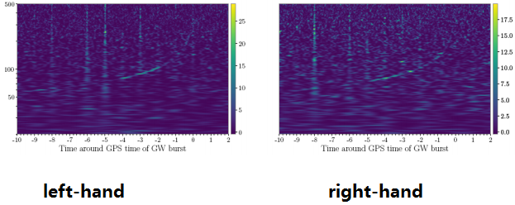
Testing parity symmetry of gravity
If a nearly edge-on GW170817-like event is observed by the existing GW detector network:
* Two circular polarization modes can be decomposed, and the arrival time difference can be measured.
* The energy scale of parity violation in gravity can be constrained at > 10keV.

Slide 37
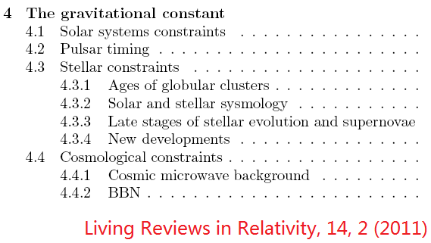
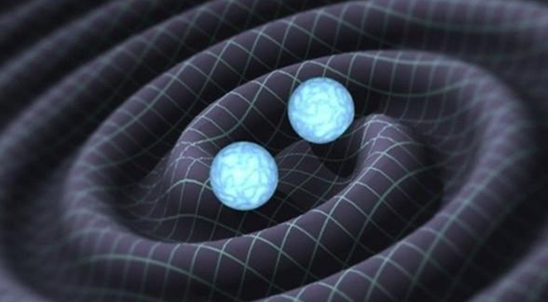
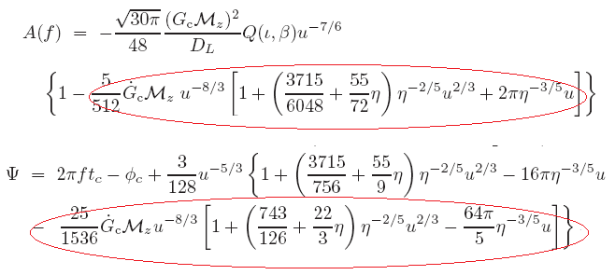
Model-independent tests ------8. testing the evolution of Newton’s constant G

Slide 38
Model-independently tests ------9. measuring G at high-redshift ranges
In general modified gravity, G is not a constant, which depends on time, position and/or ambience. We want to measure G at different redshifts.
The intrinsic peak luminosity of SNIa depends on G, through the Chandrasekhar mass MCh ~ G^{-3/2} .
If the distance of SNIa can be measured (but how?), they can be treated as an indicator to constrain G in different z ranges.

Slide 39
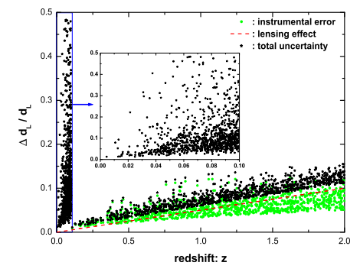
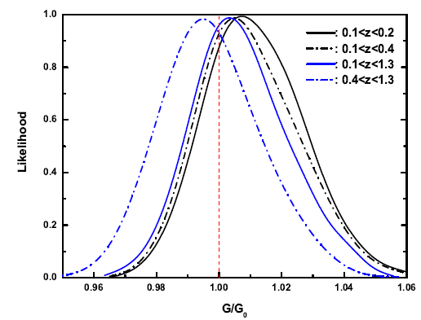
The GW standard sirens provide a model-independent way to measure the distance of GW events.
They can be used to determine the distance of SNIa by interpolation, if
the GW and SNIa samples have
similar redshift ranges.
We find that, combining the GW observations of 3G detectors with SNIa, one can constrain the ratio
G/G0 at the 1.5%.

Slide 40
Conclusions
GW provides a powerful method to test the fundamental properties of gravity in strong-gravitational fields.
Thanks!

