Slide 1
Lagrangian Formulation for higher spin field
Chen Ruixiang
2024.5.11

Slide 2
Contents
01
The principle to construct a Lagrangian
02
Lagrangian Formulation for integral spin
03
An alternative method
04
Brief Introduction on fermion case

Slide 3
The principle to construct a Lagrangian
Poincare invariance
Symmetric under the Poincare group.
Unitarity
Conservation of probability. S-matrix must be unitary.
The influence of Poincare invariance:
1.Keep all Lorentzian indices contracted.
2.Particles transform under irreducible unitary representations of the Poincare group(equivalent to positivity of energy).

Slide 4
The principle to construct a Lagrangian
The influence of unitarity:
The kinematic term in the formula cannot have more than two derivatives(Schwartz, 24.2)

Slide 5
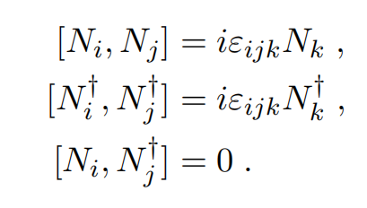
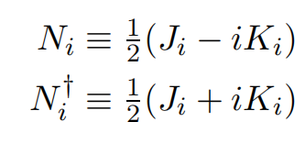
Lagrangian Formulation for integral spin
The representation of poincare group
We have two different SU(2) Lie algebras that are exchanged by hermitian conjugation,which can denoted as D(i,j)

Slide 6
Lagrangian Formulation for integral spin
Casimir operator
Their eigenvalues m² and m²s(s+1) can be used to identified the representation of poincare group(particles)
For a massive particle with spin s, it has 2s+1 states.
How to embed these state into tensor field?

Slide 7
Lagrangian Formulation for integral spin
The vector representation V^{μ} can be identified as D(1/2,1/2)=0⊕1
For a tensor field with n indices
(0⊕1)⊗(0⊕1)⊗(0⊕1)...=(1⊗1⊗1...)⊕...
1⊗1⊗1... =0⊕1⊕2...⊕n
We need to choose a symmetric, traceless and tranverse tensor
n in total
n in total symmetric,
traceless
D(s/2,s/2)
tranverse

Slide 8
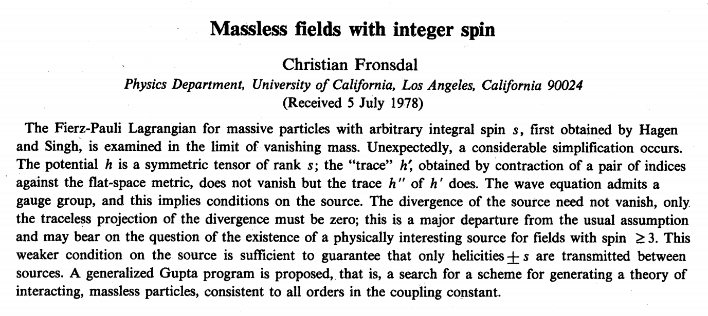
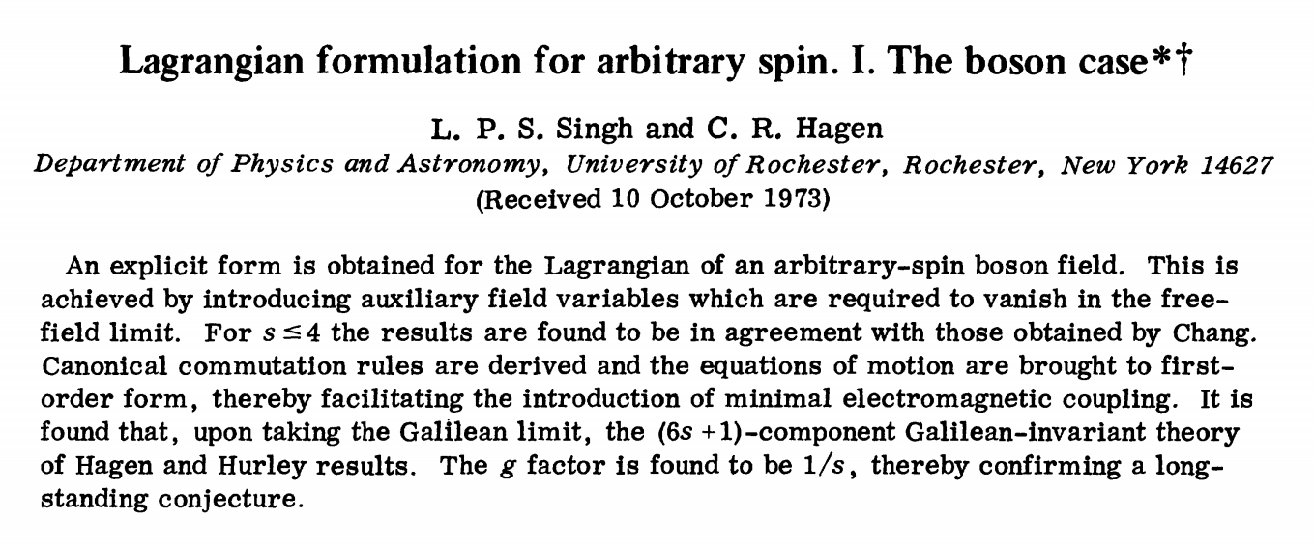
Lagrangian Formulation for integral spin
Reference of this part
1. L.P.S.Singh and C.R.Hagen, “Lagrangian formulation for arbitrary spin. Ⅰ. The boson case,” Phys. Rev. D9 (1974) 898–909.
2. C.Fronsdal, “Massless fields with integer spin,” Phys. Rev. D18 (1978) 3624.

Slide 9
Lagrangian Formulation for integral spin
Constrains on field:
1. Symmetric and traceless
2. Klein-Gordon equation
3. Transverse
Fierz and Pauli noted that the introduction of minimal electromagnetic interactions in Eqs. (1) leads to inconsistencies which can be avoided by requiring that all equations involving derivatives be obtainable from a Lagrangian*.
(1a)
(1b)
M. Fierz and W. Pauli, Proc. R. Soc. A173, 211 (1939).

Slide 10
Lagrangian Formulation for integral spin
To construct a Lagrangian that will yield (1), additional fields (the so-called auxiliary fields) have to be introduced.
Start with spin 1 equation
Contraction with ∂_{ν} yields , and (2) becomes K-G equation.
This can be realized by following case in general field
(2)
But this equation is not symmetric and traceless in μ_{i}

Slide 11
Lagrangian Formulation for integral spin
The correct form is (spin-2)
Contraction with ∂_{ν} yields only if the coefficient of the second term is 2, and cannot be obtained from equation
Introduce an auxiliary field ф⁽⁰⁾ coupled to ф⁽²⁾ so that from its EOM ss and ф⁽⁰⁾=0 can obtained.
The unique form
the symmetric, traceless part of the enclosed tensor

Slide 12
Lagrangian Formulation for integral spin
Contract (4) with ∂_{μ}∂_{ν}
Thus the desired result is obtained if and only if c=2/3,a=2.
Similarly, for spin-3
one needs to obtain transverse condition, which means a vector field ф⁽¹⁾ need to be introduced.
(4)
(5)

Slide 13
Lagrangian Formulation for integral spin
In this case, when contract the first equation with ∂_{μ}∂_{ν}, new demand emerge
This need to introduce another field ф⁽⁰⁾,
Contract (6) with ∂_{μ}∂_{ν}∂_{λ}, (7) with ∂_{μ} to obtain the new demand
(6)
(7)

Slide 14
Lagrangian Formulation for integral spin
In general, to obtain the transverser condition,
one must successively obtain ф^{(s,λ)}=0,for λ=2,3,...,s
which need to introduce s-1 auxiliary fields ф⁽⁰⁾,ф⁽¹⁾,...,ф^{(s-2)}
Thus, the most general quadratic second-order Lagrangian involving these fields is

Slide 15
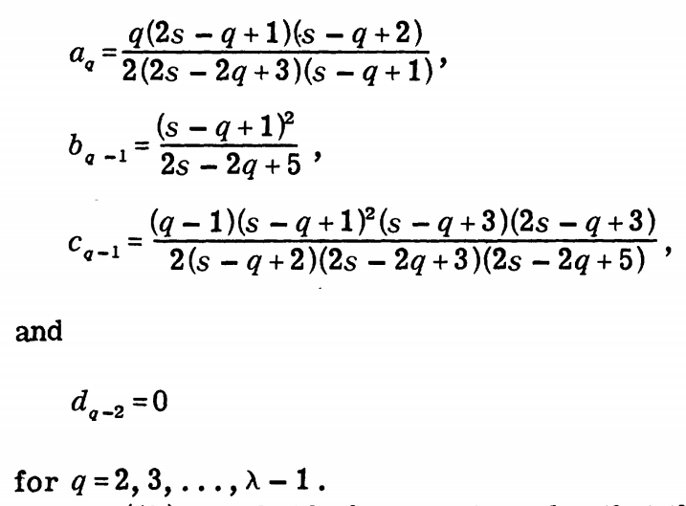
Lagrangian Formulation for integral spin
After a lengthy calcultion,
following results were obtained.

Slide 16
Alternative Method
Lagrangian also can be determined as follows:
Separate out the longitudinal and transverse modes:
The most general kinetic terms of dimension 4 we can write down are
( for example: h=P_{L}h+(1-P_{L}h), P_{L} tranverse projection operator)

Slide 17
Alternative Method
Inserting the replacements
The 4-derivative kinetic term can be eliminated uniquely by taking x=−y
A similar analysis for the rest of the Lagrangian leads to
the unique Lagrangian for a massive spin-2 field

Slide 18
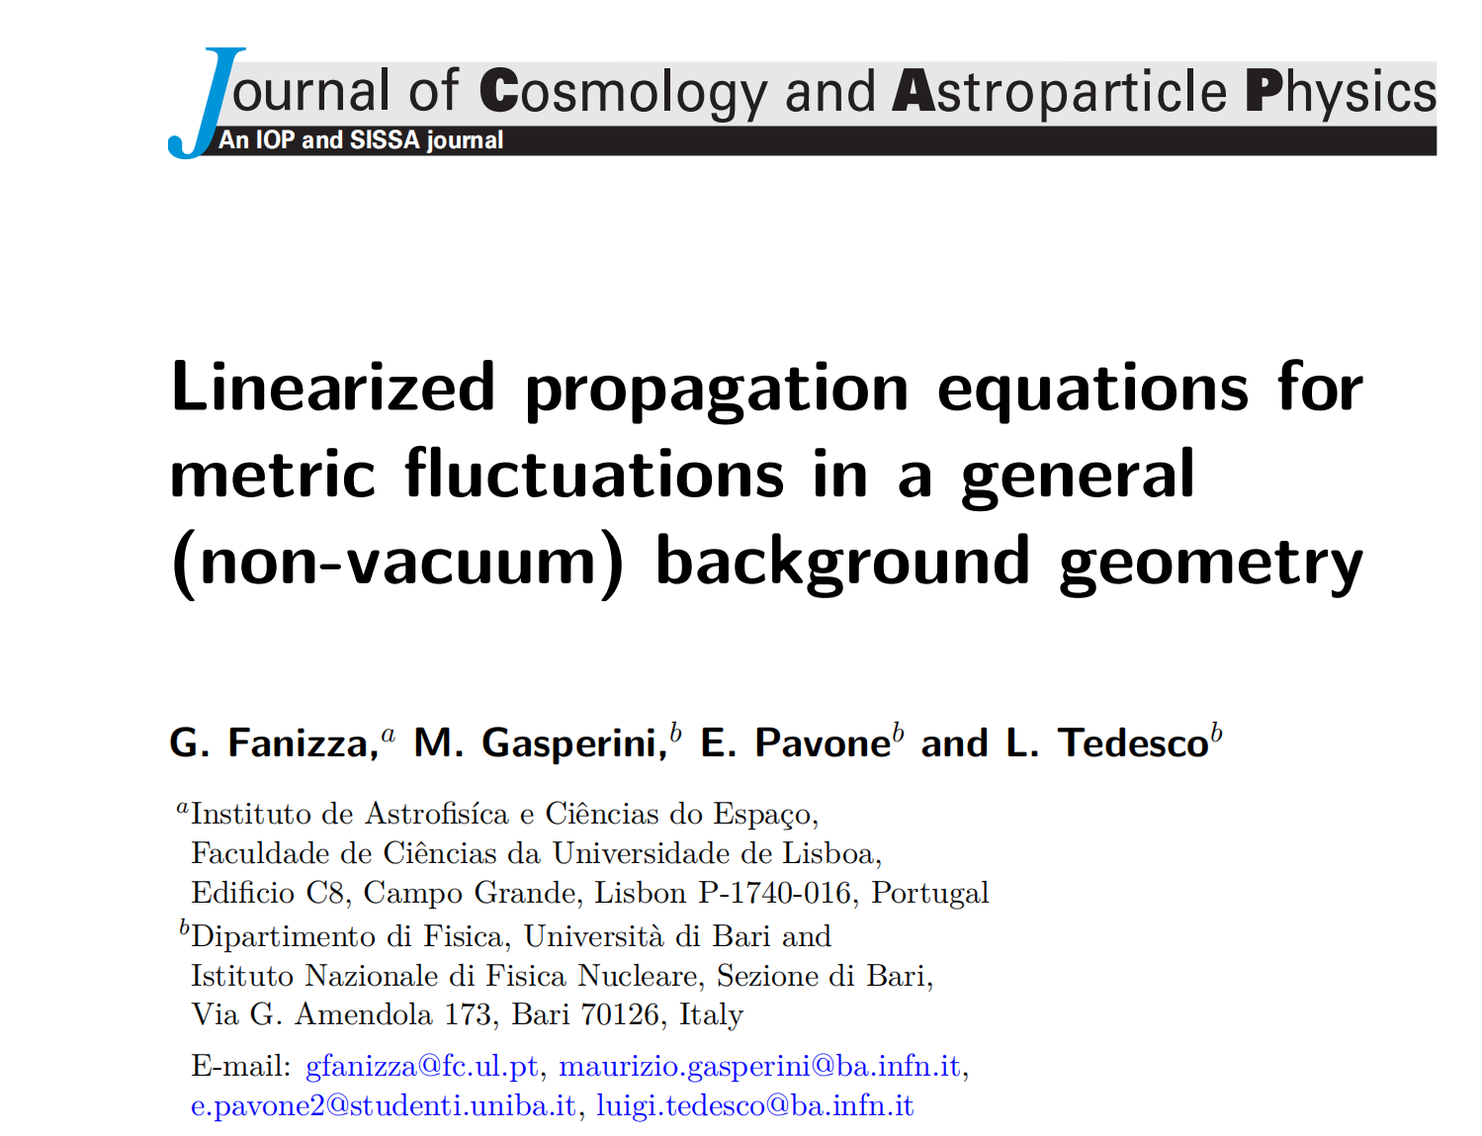
Alternative Method
In the massless limit, this happens to be the leading terms in the expansion of the Einstein–Hilbert Lagrangian
A brief proof will be given later
according to arXiv:2105.13041

Slide 19
Alternative Method
Equivalence of these two method:
1. Auxiliary fields.
The seperation act as a realization of the decompositon
2. Equation of motion.
Insert the seperation in lagrangian and derive EOMs.
K-G equation(traceless,tranverse part) and tranverse conditon can be deduced from EOMs.

Slide 20
Massless higher spin field
It is impossible to have an interacting theory of massless particles with spin greater than 2. The required gauge invariance would be so restrictive that nothing could satisfy it.
Details can be found in Schwartz, 9.5.1

Slide 21
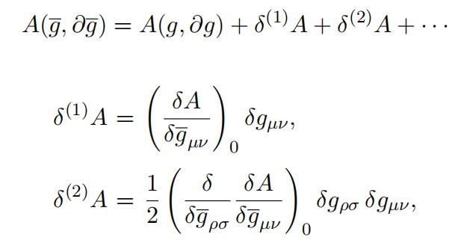
EOMs for Metric Fluctuations
Bsaic formula:
Consider the Einstein model of gravity
Expand the infinitesimal variation of the action as follows:

Slide 22
EOMs for Metric Fluctuations
First order:
The last contribution to equation can be written as an integral over the boundary hypersurface and are eliminated by the addition of an appropriate boundary action(Gibbons-Hawking-York boundary term).

Slide 23
EOMs for Metric Fluctuations
Second order:
Terms in second line give no contribution to the the action because they exactly cancel each other.
EOM: , linearized Einstein equation

Slide 24
EOMs for Metric Fluctuations
Compute them in general background metric
Similar to former spin-2 massless particle’s EOM in Minkowski space.

Slide 25
Higher J boson fields in AdS/QCD
In AdS/CFT, the supergravity action S_{SG} is evaluated on the
classical solution.
Thus auxiliary fields can be set to 0, and impose transverse and traceless condition
There is only one way to contraced indices.

Slide 26
Brief Introduction on fermion case
There are 2 methods to describe a fermion field:
1. Complicated spinor formalism of Fierz and Pauli[1].
2. Quantity has mixed property of Dirac spionr and of symmetric tensor of rank k developed by Rarita and Schwinger[2].
1/2 Dirac spinor: D(1/2,0)⊕D(0,1/2)
Combine 1/2 spinor with spin-n field: (D(1/2,0)⊕D(0,1/2))⊗D(n/2,n/2)=
D(n/2+1/2,n/2)⊕D(n/2,n/2+1/2)⊕...
1. M, Fierz and W. Pauli, Proc. Roy. Soc. A173, 211 (1939)
2. W. Rarita and J. Schwinger, Phys. Rev. 60 61 (1941).

Slide 27
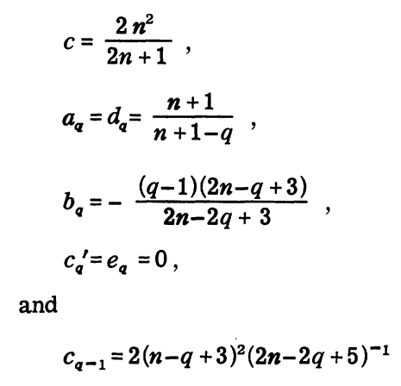
Brief Introduction on fermion case
To seperate the spin n+1/2 part, we have the following conditions:
Also auxiliary field need to be introduced.

Slide 28
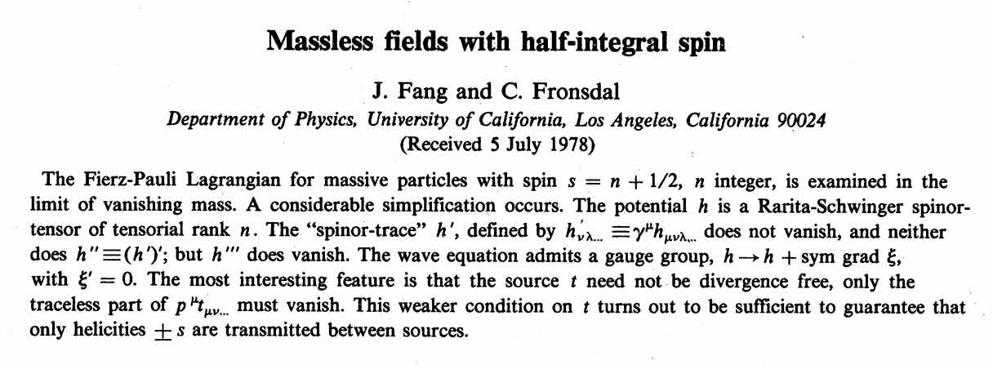
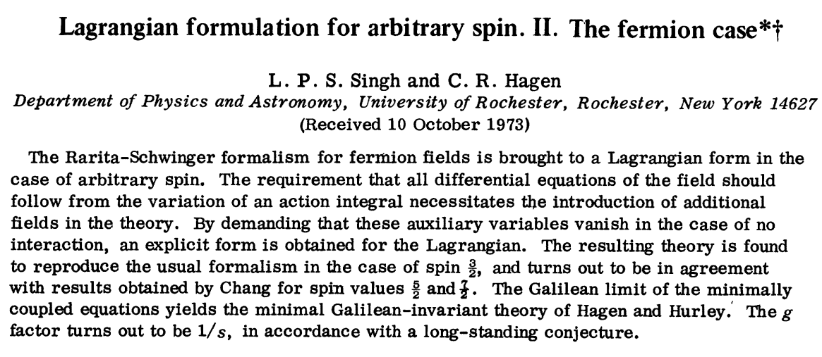
Brief Introduction on fermion case
More details can be found in these articles.

Slide 29
THANK YOU

