Slide 1

中国科学院高能物理研究所
Institute of High Energy Physics, CAS
CEPC Detector Magnet
Stray field and yoke
Feipeng NING
2024.05

Slide 2

Outline
Latest size of the Magnet;
Yoke and stray field；
The magnetic field distribution required by the software.
Notes:
Two changes: first, add yoke to reduce the range of stray field; second, the size of HCal increase, so size of the solenoid and the yoke increase accordingly.

Slide 3
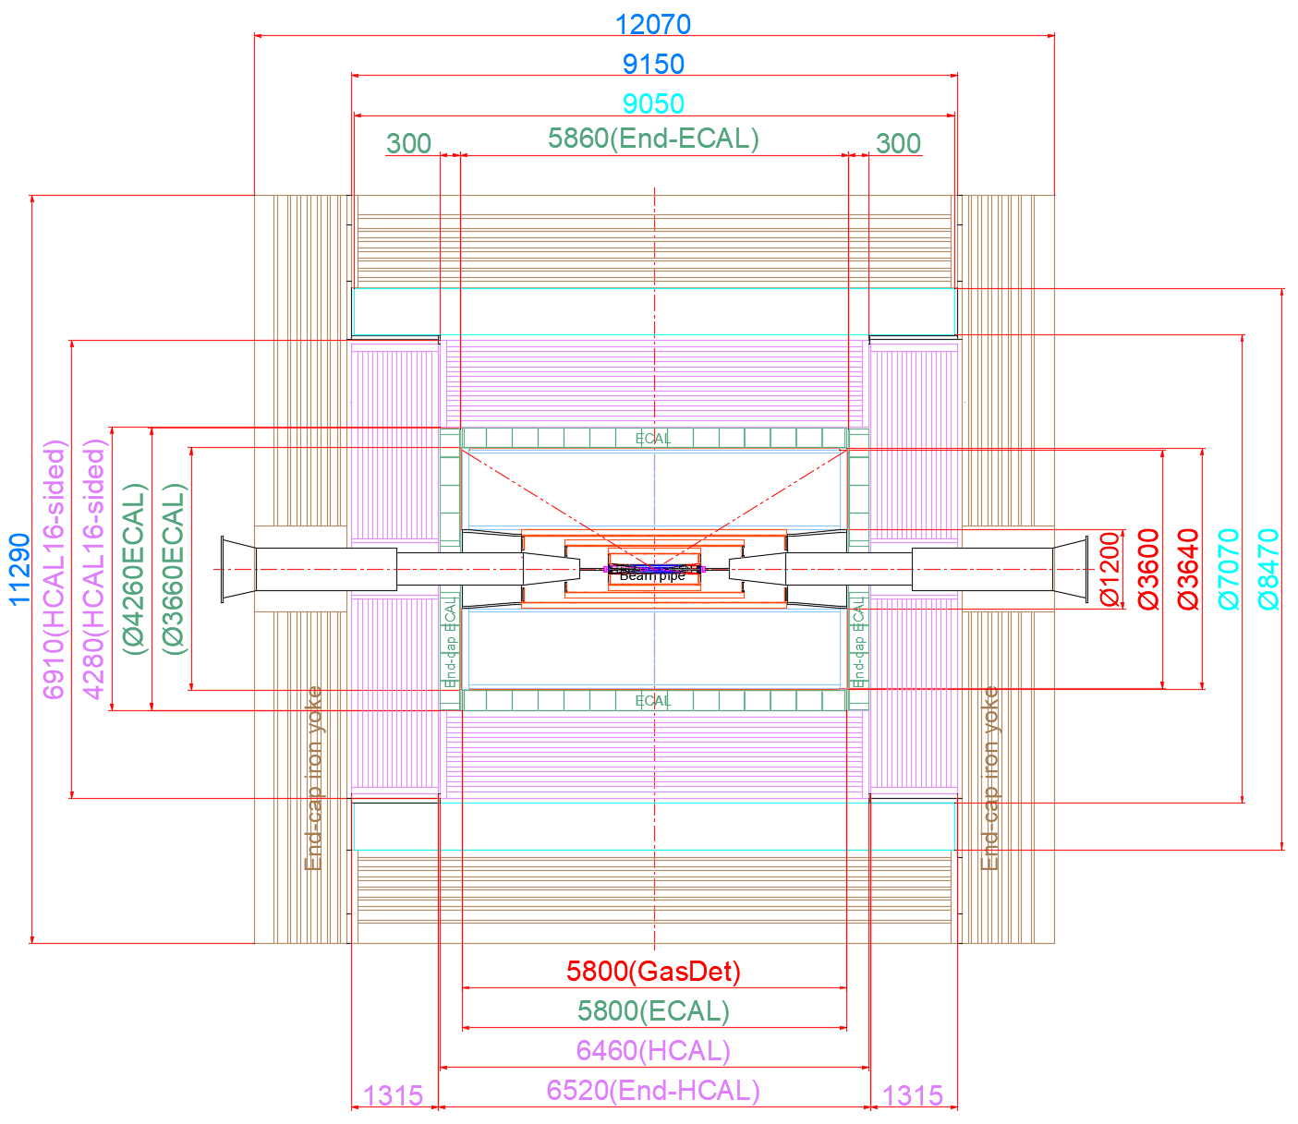
1. Latest size of the magnet
Inner diameter | 7070 mm
Thickness | 700 mm
Outer diameter | 8470 mm
Length | 9050 mm

Slide 4
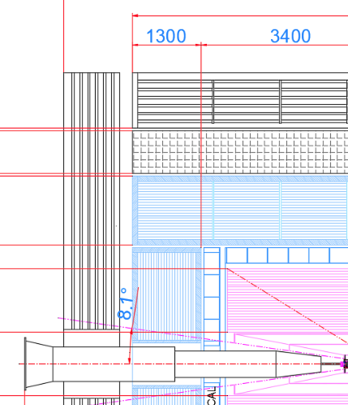
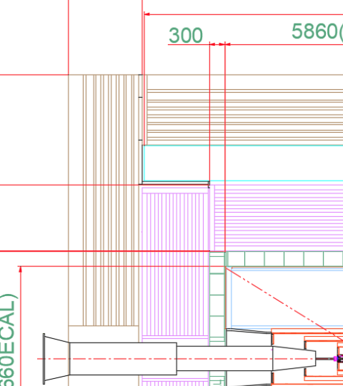
1. Latest size of the magnet
The gap between the barrel and the end: From 250 mm to 60 mm
250 mm
60 mm

Slide 5
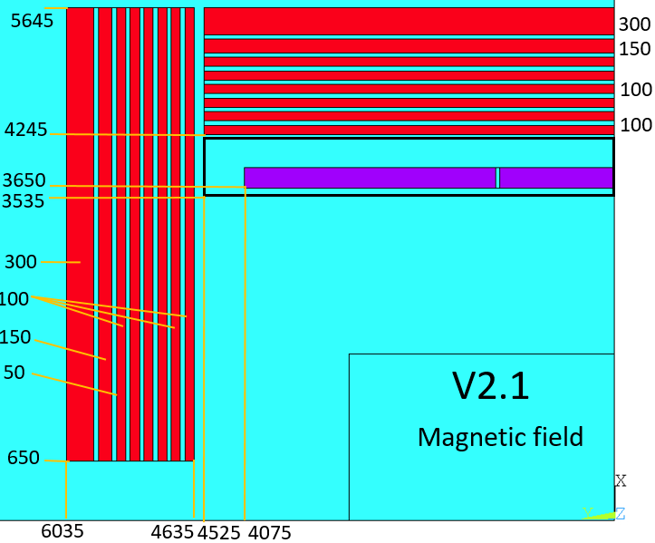
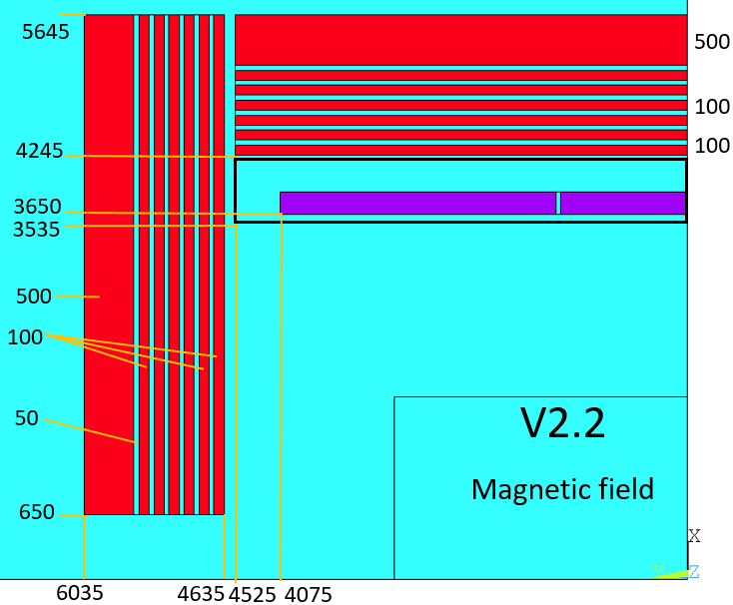
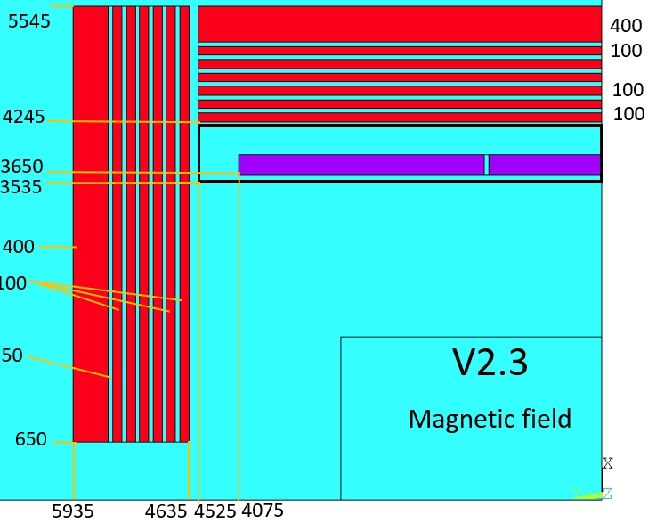
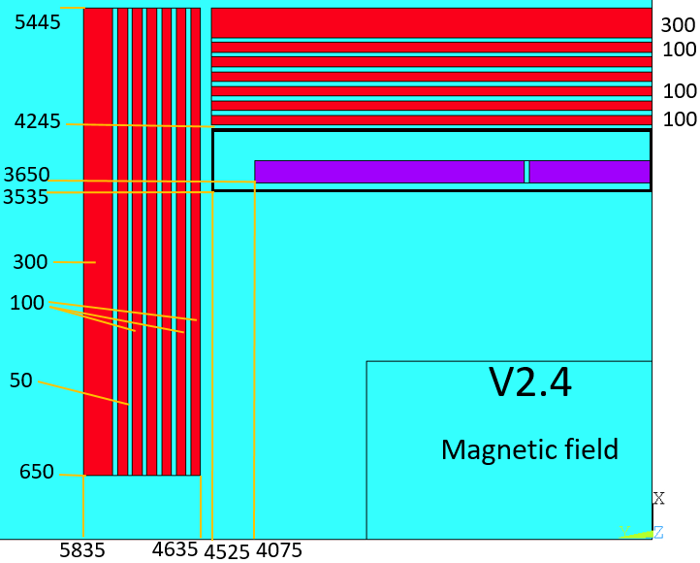
2. Yoke and stray field
Yoke size：
 | V2.1 | V2.2 | V2.3 | V2.4
Barrel yoke (ton) | 2480 | 2590 | 2340 | 2080
Each End yoke (ton) | 839 | 879 | 771 | 669
Total Yoke (ton) | 4158 | 4348 | 3882 | 3418
Diameter(m) & length (m) | 11.29&12.07 | 11.29&12.07 | 11.09&11.87 | 10.89&11.67
Notes:
Two changes: first, add yoke to reduce the range of stray field; second, the size of HCal increase, so size of the solenoid and the yoke increase accordingly.

Slide 6
2. Yoke and stray field
Magnet parameters:
Magnet V2.3：
Inner diameter | 7070 mm
Thickness | 700 mm
Outer diameter | 8470 mm
Length | 9050 mm
Coil parameters:
Inner diameter | 7300 mm
Operating current | 16717.5 A
Cable length | 33 km
Inductance | 11 H
Stored Energy | 1.54 GJ
Total mass | 220 tons
Yoke mass (ton) | 3882
Thickness of the yoke (m) | 1.3
Diameter(m) & length (m) | 11.09*11.87
Notes:
Two changes: first, add yoke to reduce the range of stray field; second, the size of HCal increase, so size of the solenoid and the yoke increase accordingly.

Slide 7
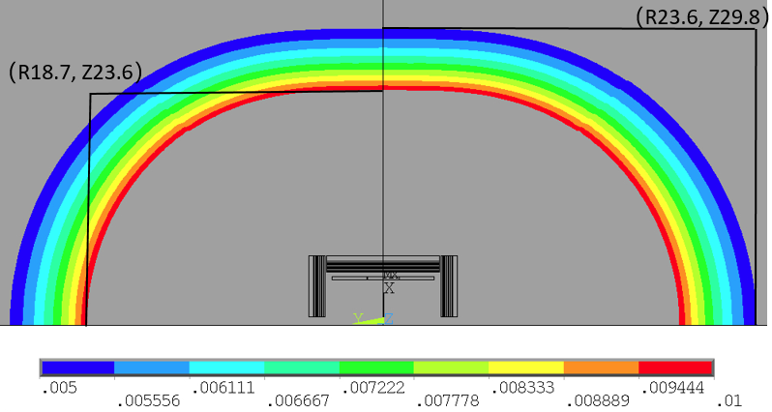
50 Gauss and 100 Gauss distribution:
2. Yoke and stray field
Stray field |  | V2.1 | V2.2 | V2.3 | V2.4
50 Gs | R direction | 23.3 m | 23.0 m | 23.6 m | 24.3 m
 | Z direction | 29.3 m | 28.9m | 29.8 m | 30.6 m
100 Gs | R direction | 18.4 m | 18.2 m | 18.7 m | 19.2 m
 | Z direction | 23.2 m | 22.9 m | 23.6 m | 24.3 m
100 Gauss
50 Gauss
50 Gauss and 100 Gauss distribution

Slide 8
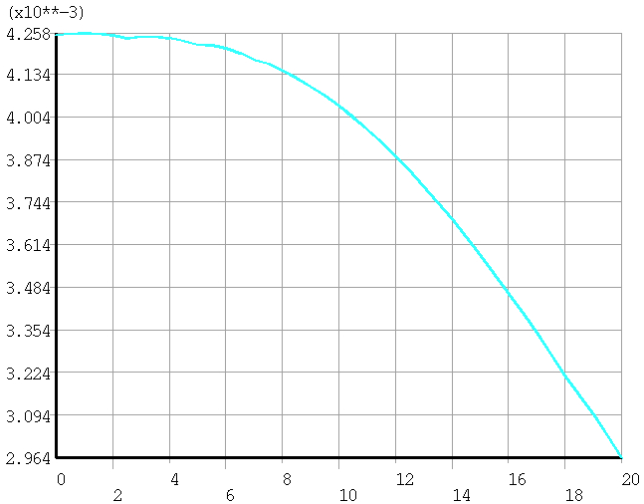
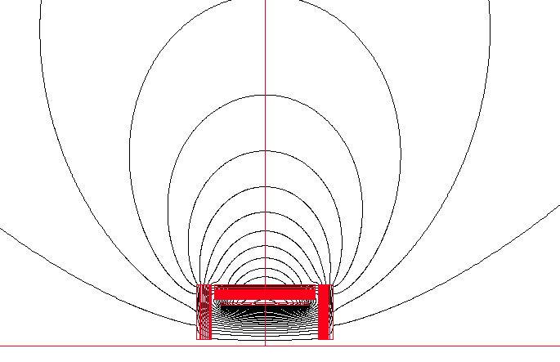
2. Stray field at the booster ring
V2.3
25m
From 42.6 Gs to 30 Gs
The detector stray field can reach the booster and influences the beam dynamics of booster.
The current study shows that the correction to the detector stray field seems possible at low field (less than 50 gauss) level by orbit correction.
Dou Wang, Yuan Zhang, Daheng Ji, Feipeng Ning, Impacts of Detector Stray Field on Booster, AP NOTE, ACC-AP-NOTE-2020-001, Receive Date (October 15, 2020)

Slide 9
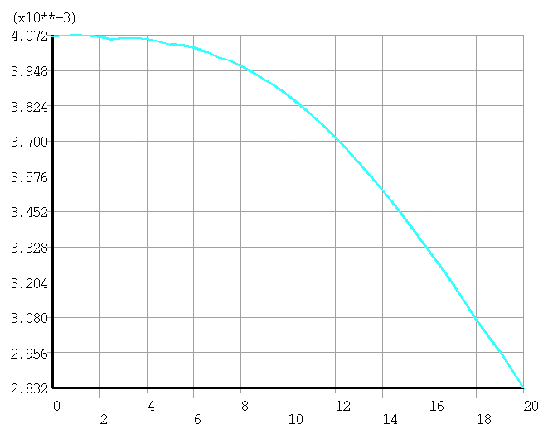
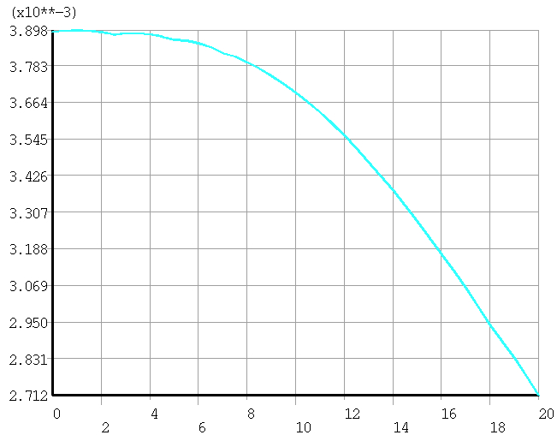
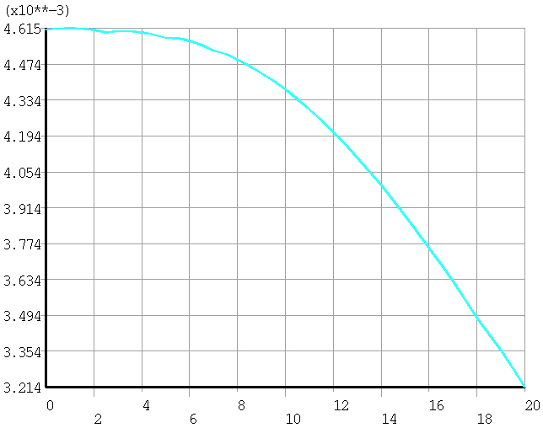
2. Stray field at the booster ring
All versions meet the requirement of less than 50 Gauss
V2.1
V2.2
V2.3
V2.4
 | V2.1 | V2.2 | V2.3 | V2.4
Stray field (Gauss) | 40.7 | 39.0 | 42.6 | 46.2
Total Yoke (ton) | 4158 | 4348 | 3882 | 3418

Slide 10
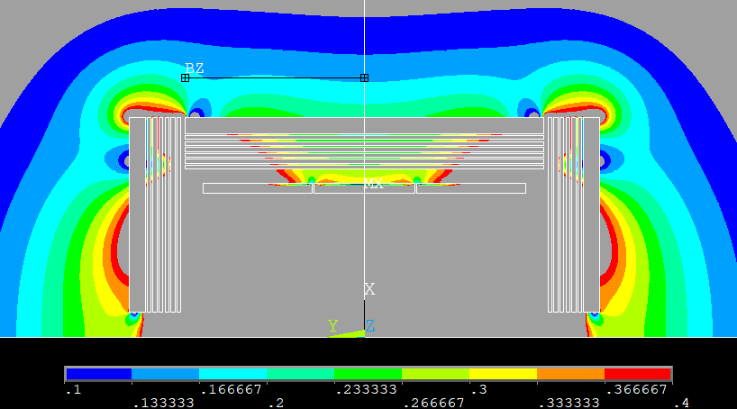
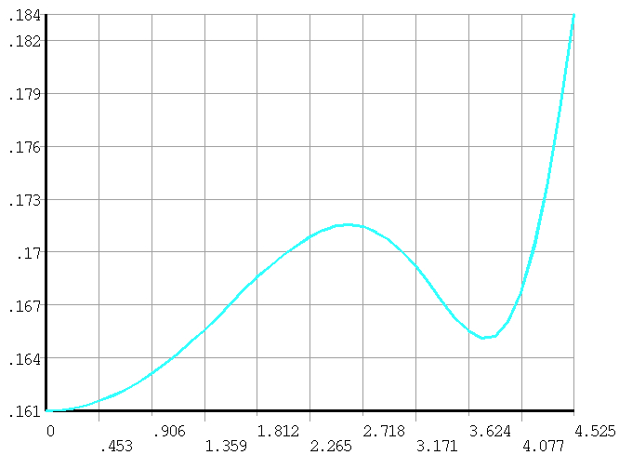
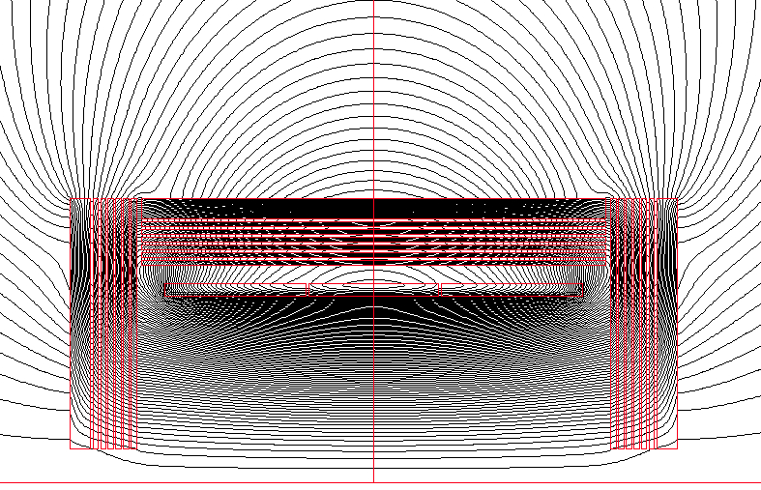
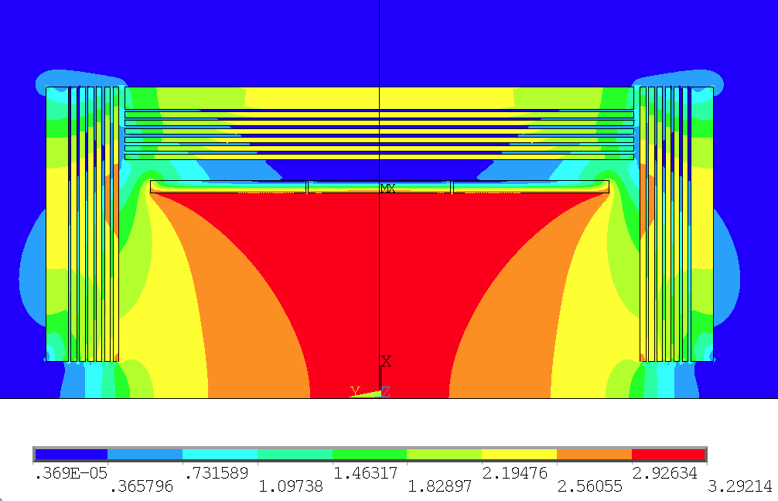
2. Yoke and stray field
At present B(1m) 0.16~0.18 T. Bigger than 0.12 T (CMS required)
1 m

Slide 11
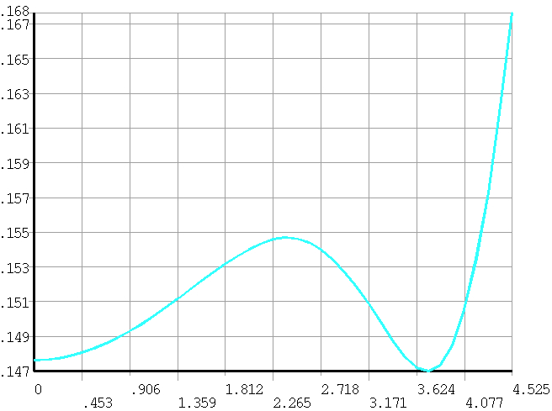
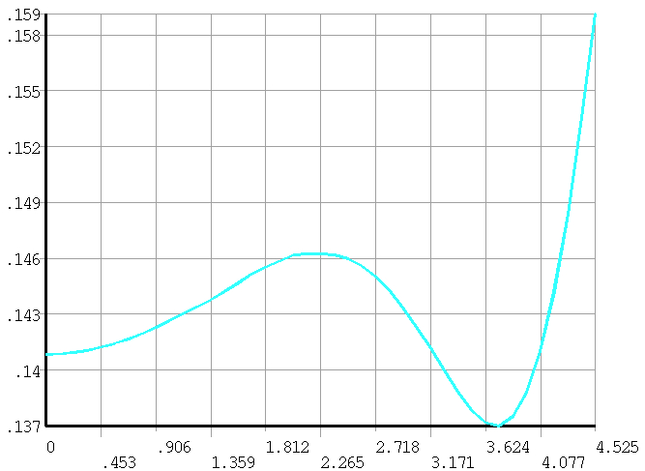
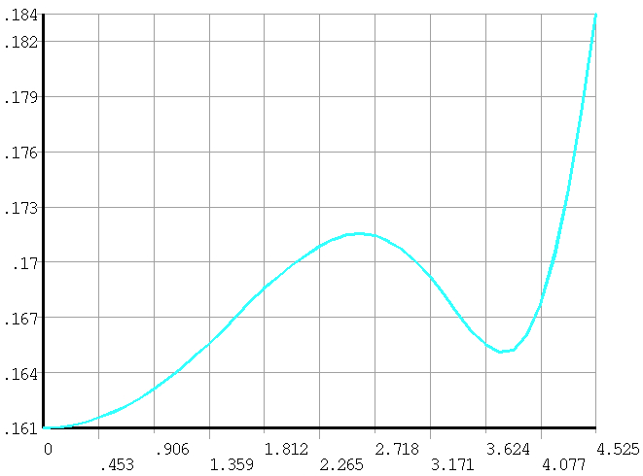
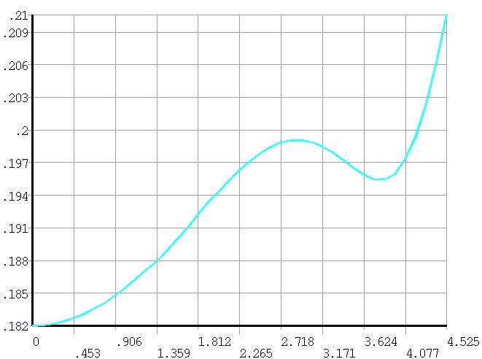
2. Yoke and stray field
Magnetic field at 1 m away on barrel yoke.
V2.1
V2.2
 | B (T)
V2.1 | 0.147~0.155
V2.2 | 0.14~0.146
V2.3 | 0.16~0.173
V2.4 | 0.18~0.2
V2.3
V2.4
Bigger than 0.12 T (CMS required)

Slide 12
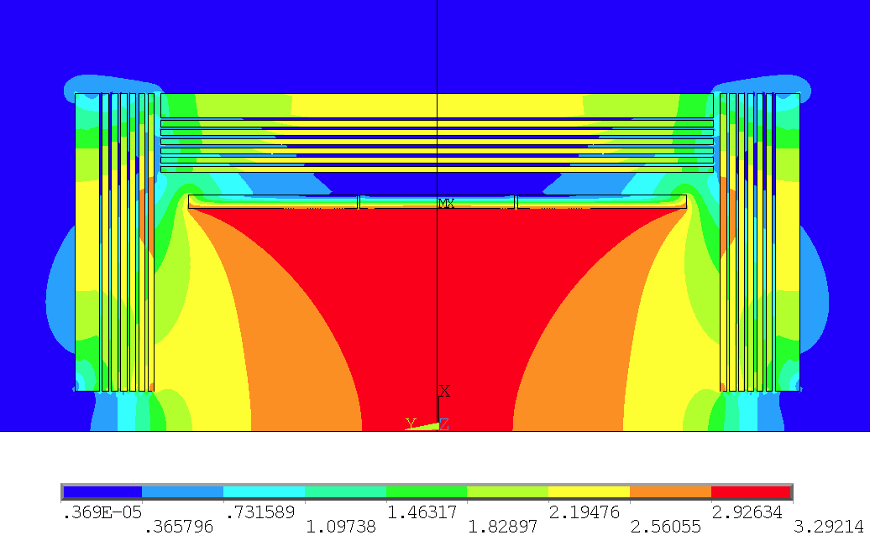
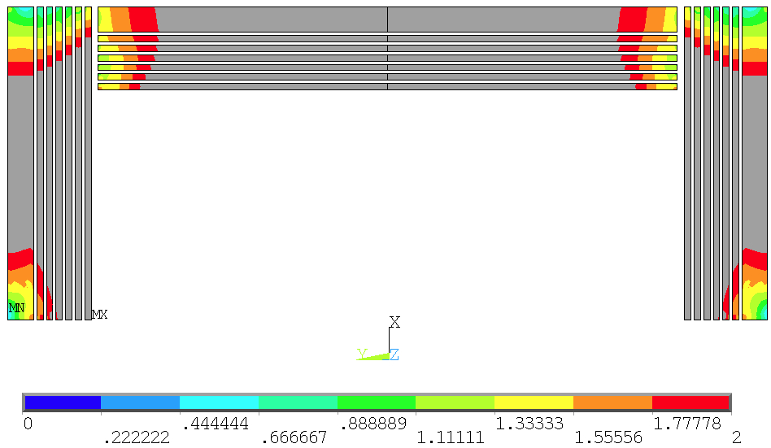
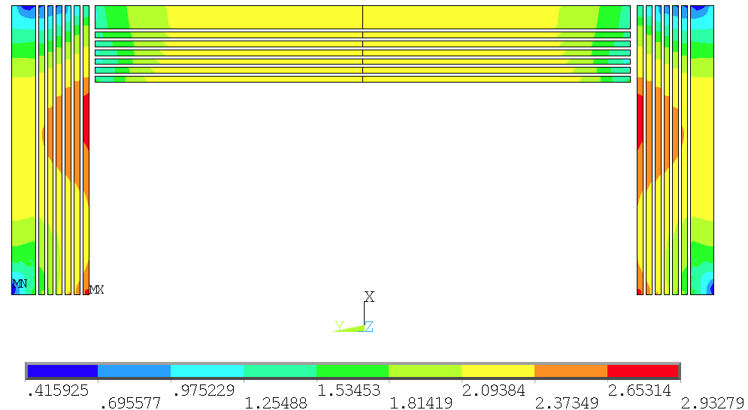
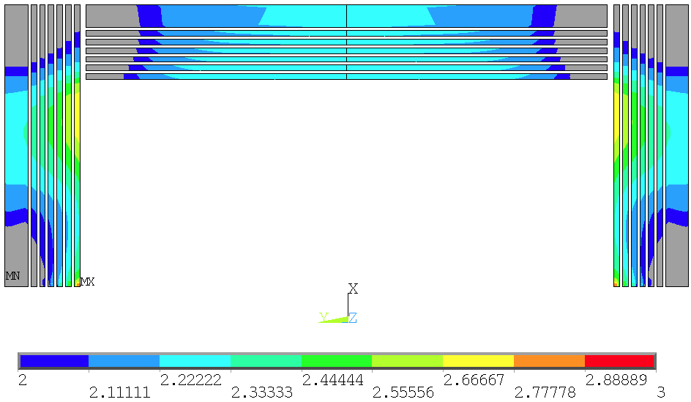
2. Yoke and stray field
Magnetic field saturation region

Slide 13
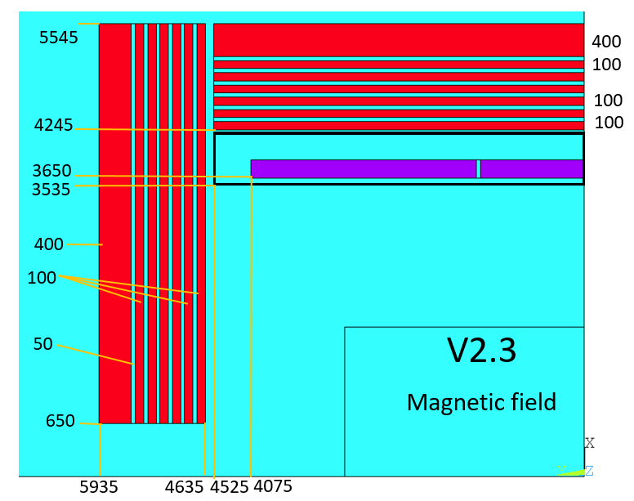
3. The magnetic field distribution required by the software.
Magnetic field mapping is important.
Diameter and length: 3660mm*5860mm
软件部分最关注的是磁场的非线性，就是重建时两点之间磁场是怎样的，平均值和实际值之间的差值是多大，这个值不是梯度。
Different data acquisition intervals（10cm, 5cm, 1cm）
1830
This work is currently in progress.
2930

Slide 14
Conclusion
The size of superconducting magnet is confirmed.
The area of stray field is related to the design of the yoke.
The work of providing magnetic field distribution for the software part is still ongoing.
The mechanical design of the magnet has begun.

