Slide 1
A Request for Decision on
TPC vs. DC
WANG Meng 王萌
CEPC detector TDR plenary, 2024.5.14

Slide 2
performance comparison
 | unit | TPC, Higgs | TPC, Z | DC, Higgs | DC, Z
B-field | T | 3 | 2 | 3 | 2
Performance
material budget barrel | X0 | 0.55% |  | 1.14%
material budget endcap | X0 | 15% |  | plate 22.5% + cables 1.8%
Npoint of measurement/full-trk |  | 2300 | 2300 | 66 | 66
point resolution in rφ, max | μm | 100 (full) | 400 (full) | 100 | 100
point resolution in rz | μm | 100 - 500 | 200 - 800 | 2000 | 2000
momentum resolution: σ(pT)/pT = a·pT ⨁ b
a | 1/GeV | 1.2E-05 | 2.7E-05 | 2.1E-05 | 3.2E-05
b |  | 6.0E-04 | 9.0E-04 | 7.7E-04 | 1.2E-03
K/π separation power @ 20GeV |  | 3σ | 3σ | 3.2 σ | 3.2 σ
dE/dx or dN/dx resolution |  | 2.9% | 2.9% | 2.5-2.6% | 2.5-2.6%
hit rate, max | /s/pad | 600 | 31.5k |  | 70 kHz/cell
occupancy, max |  | 0.001% | 1.6% |  | 11%
note |  | pad 0.5x0.5 mm2, ch 2x3e7 |  | cell 18x18mm2, 27.6 kCells

Slide 3
comparison of cost estimation
 | Time Projection Chamber (TPC) |  |  | 9250.00 | [10k RMB] | Drift Chamber (DC) |  |  | 8021.64 | [10k RMB]
Nr | item | unit price | quantity | total | note | Item | unit price | quantity | total | note
1 | Chamber |  |  | 950.00 |  | Chamber |  |  | 650.00
1.1 | Barrel inner cylinder | 150.00 | 1 | 150.00 | 宁波材料所 | Inner cylinder | 40.00 | 1 | 40.00 | 厂家报价
1.2 | Barrel outer cylinder | 500.00 | 1 | 500.00 | 宁波材料所 | Outer cylinder | 110.00 | 1 | 110.00 | 厂家报价
1.3 | Fieldcage (inner and outer) | 200.00 | 1 | 200.00 | 牧泰来科技公司 | Carbon-Fibre Frame | 500.00 | 1 | 500.00 | 厂家报价
1.4 | Cathode and HV crate | 100.00 | 1 | 100.00 | 非标预估费用
2 | Endplate |  |  | 2300.00 |  | Endplate |  |  | 1861.36
2.1 | Aluminum endcap | 500.00 | 2 | 1000.00 | 合肥聚能科技公司 | Aluminum endcap | 405.00 | 2 | 810.00 | 厂家报价
2.2 | MPGD detector module | 1.82 | 550 | 1000.00 | 非标预估费用 | Feedthrough | 0.002 | 235700 | 471.40 | 厂家报价
2.3 | Readout PCB boards | 0.37 | 550 | 200.00 | 牧泰来科技公司 | Sense Wire | 0.0003 | 158900 | 47.67 | 厂家报价
2.4 | pre-assembly and testing | 100.00 | 1 | 100.00 | 非标预估费用 | Field Wire | 0.0011 | 483900 | 532.29 | 厂家报价
3 | Electronics |  |  | 4950.00 |  | Electronics |  |  | 4640.28
3.1 | FEE ASIC readout | 0.010 | 200000 | 2000.00 | 非标预估费用 | FEE Preamp | 0.240 | 2207 | 529.68 | 依据现有芯片测算
3.2 | Cables, connectors | 0.03 | 20000 | 600.00 | 非标预估费用 | FEE Digital Board | 1.68 | 2207 | 3707.76 | 依据现有芯片测算
3.3 | BEE Readout PCB board | 1.40 | 500 | 700.00 | 非标预估费用 | FEE Mix Cable | 0.12 | 2207 | 264.84 | 报价
3.4 | Trigger/DAQ system | 11.00 | 50 | 550.00 | 非标预估费用 | BEE Board and DAQ | 2.00 | 69 | 138.00 | 依据现有芯片测算
3.5 | Crate and controller | 20.00 | 30 | 600.00 | 非标预估费用
3.6 | Electronics cooling system | 500.00 | 1 | 500.00 | 非标预估费用
4 | Alignment and calibration |  |  | 500.00 |  | Wiring |  |  | 430.00
4.1 | Calibration system | 450.00 | 1 | 450.00 | 非标预估费用 | Wiring tool | 350.00 | 1 | 350.00 | 依据之前系统估价
4.2 | pre-assembly and testing | 50 | 1 | 50.00 | 非标预估费用 | Wire test system | 80.00 | 1 | 80.00 | 依据之前系统估价
5 | HV and Gas system |  |  | 550.00 |  | HV and Gas system |  |  | 440.00
5.1 | HV and low power | 0.40 | 500 | 200.00 | 中检维康科技公司 | HV Crate | 10.00 | 6 | 60.00 | 厂家报价
5.2 | Gas system | 200.00 | 1 | 200.00 | 天津液空 | HV Module | 3.00 | 50 | 150.00 | 厂家报价
5.3 | Slow control system | 50.00 | 1 | 50.00 | 深圳利兴隆公司 | HV cable / fan-out | 110.00 | 1 | 110.00 | 厂家报价
5.4 | Online monitoring system | 50.00 | 1 | 50.00 | 深圳利兴隆公司 | Gas system | 100.00 | 1 | 100.00 | 厂家报价
5.5 | Testing bef. Assembly | 50.00 | 1 | 50.00 | 非标预估费用 | Slow Control | 20.00 | 1 | 20.00 | 依据现有系统测算

Slide 4
mini-review on TPC and DC of CEPC
CEPC day on April 23rd
on April 1st at IHEP, https://indico.ihep.ac.cn/event/22016/
committee: Ouyang Qun(chair), Li Yulan, Liu Jianbei, Zhao Lei, Wang Jianchun, Wei Wei
participants: a few foreign experts in addition to Chinese members of two groups
Charge of the review
  justify the feasibility of both TPC and DC
  identify critical R&Ds for TDR
  prioritise the choice of technology, if possible
  justify cost estimations
Key recommendations
  Both scenarios are feasible, but are challenging in key techniques as well.
  Most of results are based on simulation and lack of experimental validation, which is NOT enough for TDR.
  According to their current R&D status, it is impossible to give a choice.
  It’s recommended to take further reviews, for which a list of support materials are suggested.
  It’s suggested that cost estimations shall be reviewed separately.

Slide 5
in my opinion
I fully agree with the recommendations of the mini-review committee.
We are forced to choose is mainly due to the PID requirement, which is dominantly relevant to the Z-pole run.
However, we will start with the Higgs run for more than ten years.
Should CEPC be approved by the 15th-Five, we need something deliverable immediately
  TPC, for instance, with non-pixelated readout, would be a choice of promising;
  We may continue our R&D for the PID-oriented TPC and DC with a serene certainty.
Hence, I would recommend TPC for our reference-detector TDR.

Slide 6
Thanks!

Slide 7
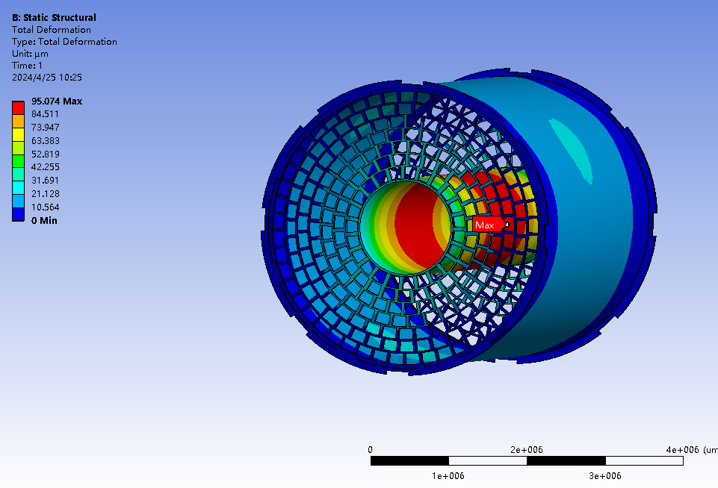
Material budget of TPC
Low material of the TPC endcap
15%X₀ in total, including
Readout plane, front-end-electronics 4%
Cooling 2%
Power cables 9%
Low material of the TPC barrel
0.55% X₀ in total, including
Material budget of TPC barrel
Layer of the barrels | D[cm] | X₀[cm] | d/X₀[%]
Copper shielding | 0.001 | 1.45 | 0.07
CF outer barrel | 0.010 | 25.28 | 0.04
Mirror strips | 0.003 | 1.35 | 0.19
Polyimide substrate | 0.005 | 32.65 | 0.02
Field strips | 0.003 | 1.35 | 0.19
CF inner barrel | 0.010 | 25.28 | 0.04
Sum of the material budget |  |  | 0.55

Slide 8
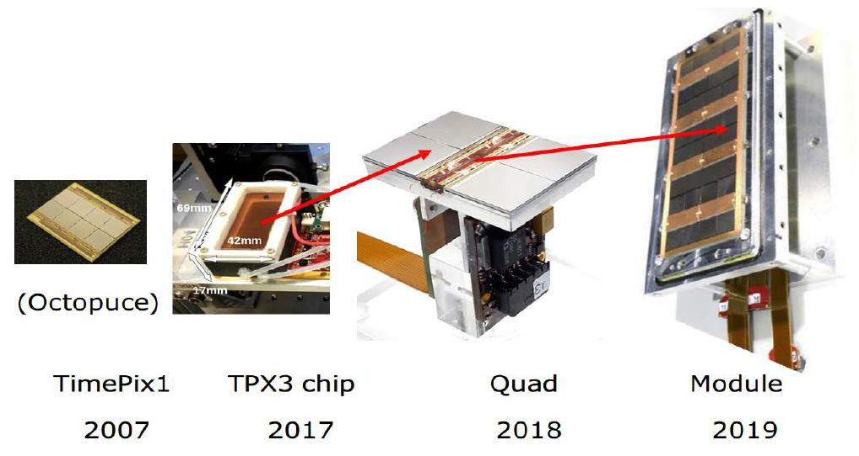
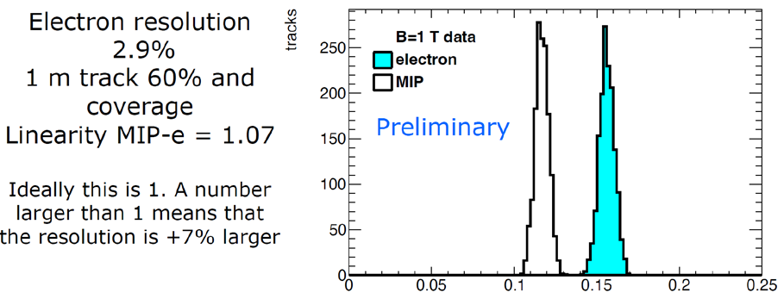
  Pixelated readout TPC beam test for PID
    Pixelated readout TPC is a good option at high luminosity Z on circular e+e- collider (2x36 cm⁻²s⁻¹)
      High spatial resolution under 2T or 3T magnetic field
      Better momentum resolution
      High-rate operation (MHz/cm²)
      dE/dx and Cluster counting (in space)
      Very low voxel occupancy
8

Slide 9
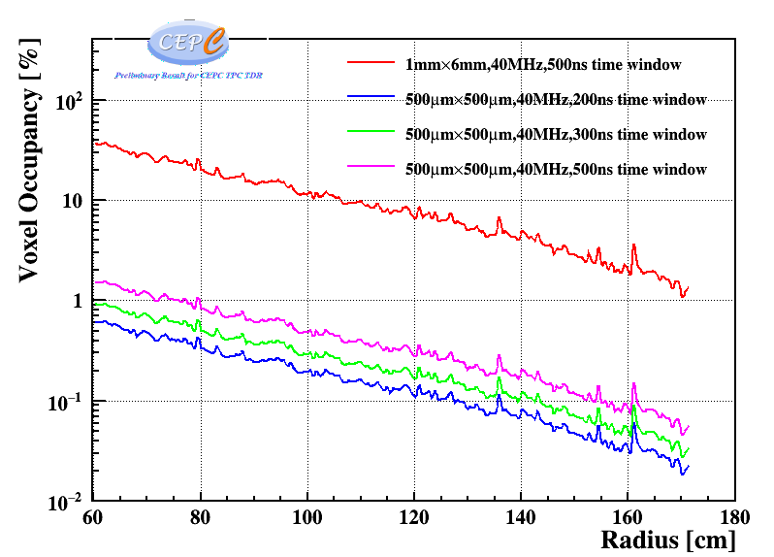
Voxel Occupancy
基于CEPC Soft实现对Z-pole模式下，分析完成了TPC探测器腔体内占空比研究和确认
  对于单个500μm×500μm 读出像素，40MHz采样率，单位时间总的Voxel数为4×10⁷/s
  z向Voxel大小为V_{d}×25ns~2mm，单个Voxel大小~0.5×0.5×2=0.5 mm³
  对于500ns时间窗，z向平均占用20个voxel
    实际将采用200ns左右时间窗
  最内层Voxel Occupancy=20×31.5k/4×10⁷ ~1.58%
  对于1mm×6mm Pad，最内层Voxel Occupancy~35%
结果表明：现有MDI设计下，TPC探测器占空比保持非常低，满足探测与物理需求
半径方向上不同大小读出像素单元，时间窗下Occupancy
Notes:
下面将从模拟和实验两个部分介绍该季度取得研究进展。
首先，完成了beam效应在TPC中产生原初离子密度的模拟。下面分别是采用的探测器几何模型以及z-pole模式下多次对撞后TPC中离子密度的分布，平均每次对撞，TPC中将产生约27.37k离子，任意时刻平均原初离子密度约2.43nC/m3

Slide 10
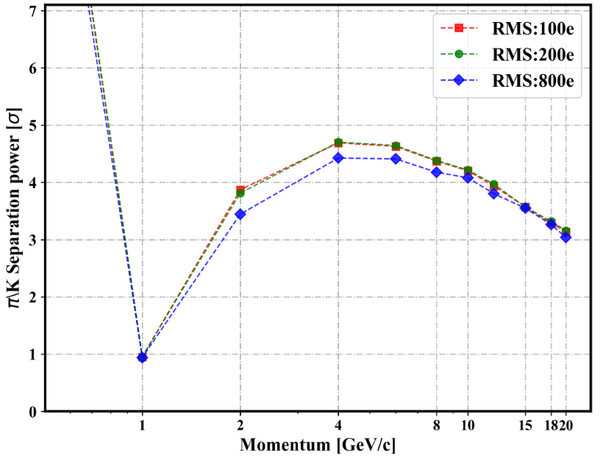
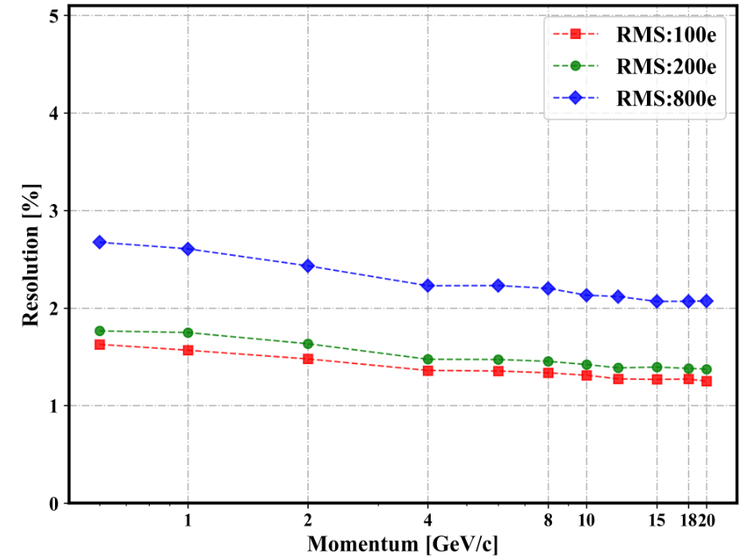

Slide 11
Drift Chamber

Slide 12
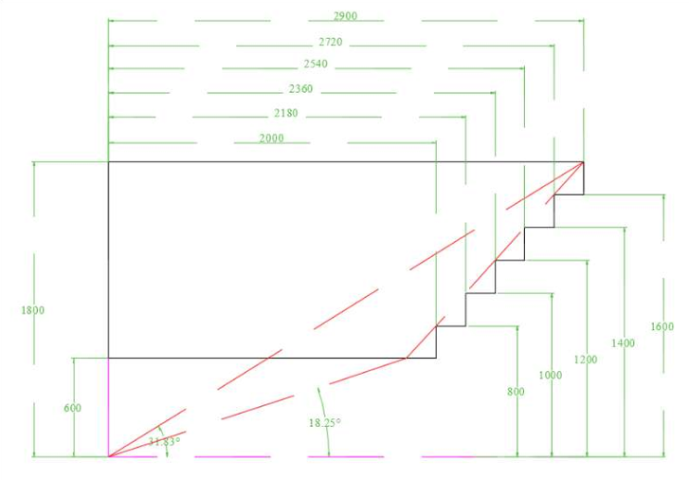
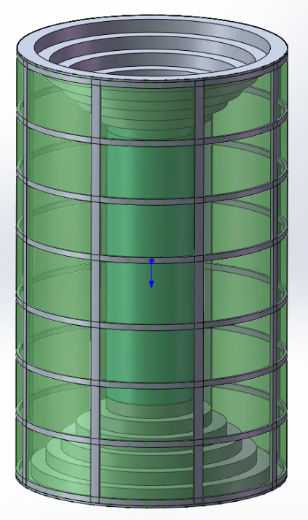
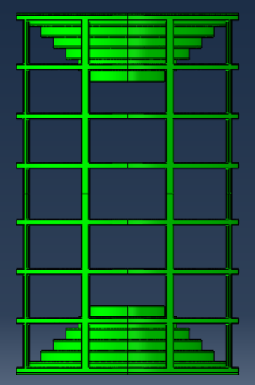
Overall Design (preliminary)
CF Frame structure：8 longitudinal hollow beams + 8 annular hollow beams + inner CF cylinder and outer CF cylinder
Length : 5800mm
Outer diameter: 3600mm，Inner Diameter: 1200mm；
Thickness of each end plate: 25mm/20mm，weight :1100kg /880kg

Slide 13
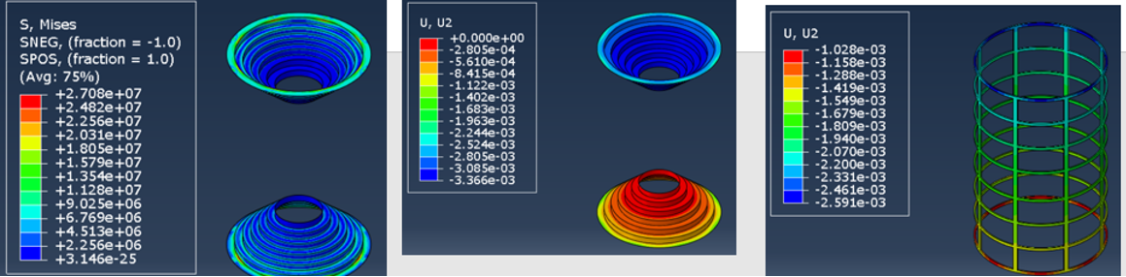
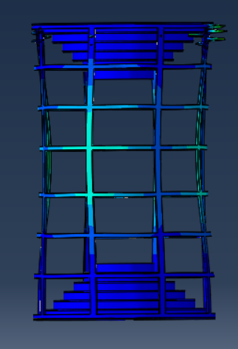
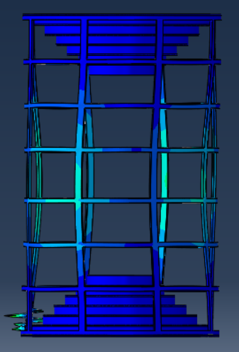
Results of FEA
Loads: Wire tension
+ Axial self weight
End plate thickness: 20mm
Stress 27.1MPa,
Endplate deformation 3.4mm,
CF frame deformation 1.6mm
The structure is stable
Vertical self weight
Buckling coefficient : ~12
Horizontal self weight
Buckling coefficient : ~14

Slide 14
Layout design of wiring

Slide 15
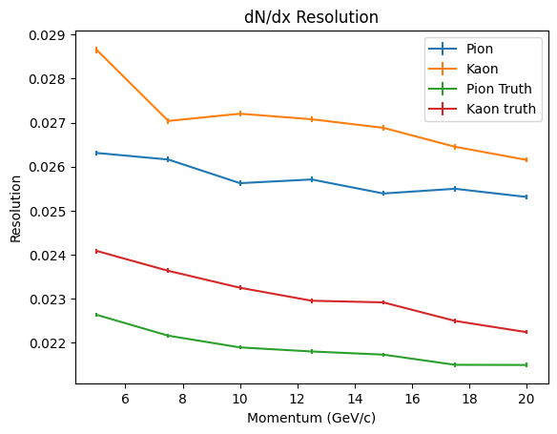
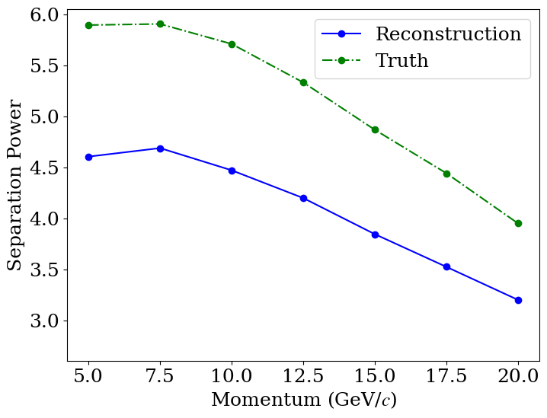
dN/dx Resolution and separation power
dN/dx resolution: 2.5%-2.6% for pion
2.6%-2.7% for Kaon
1.2 m track length
For 20 GeV/c K/π, Separation power: $3.2\text{σ}$

Slide 16
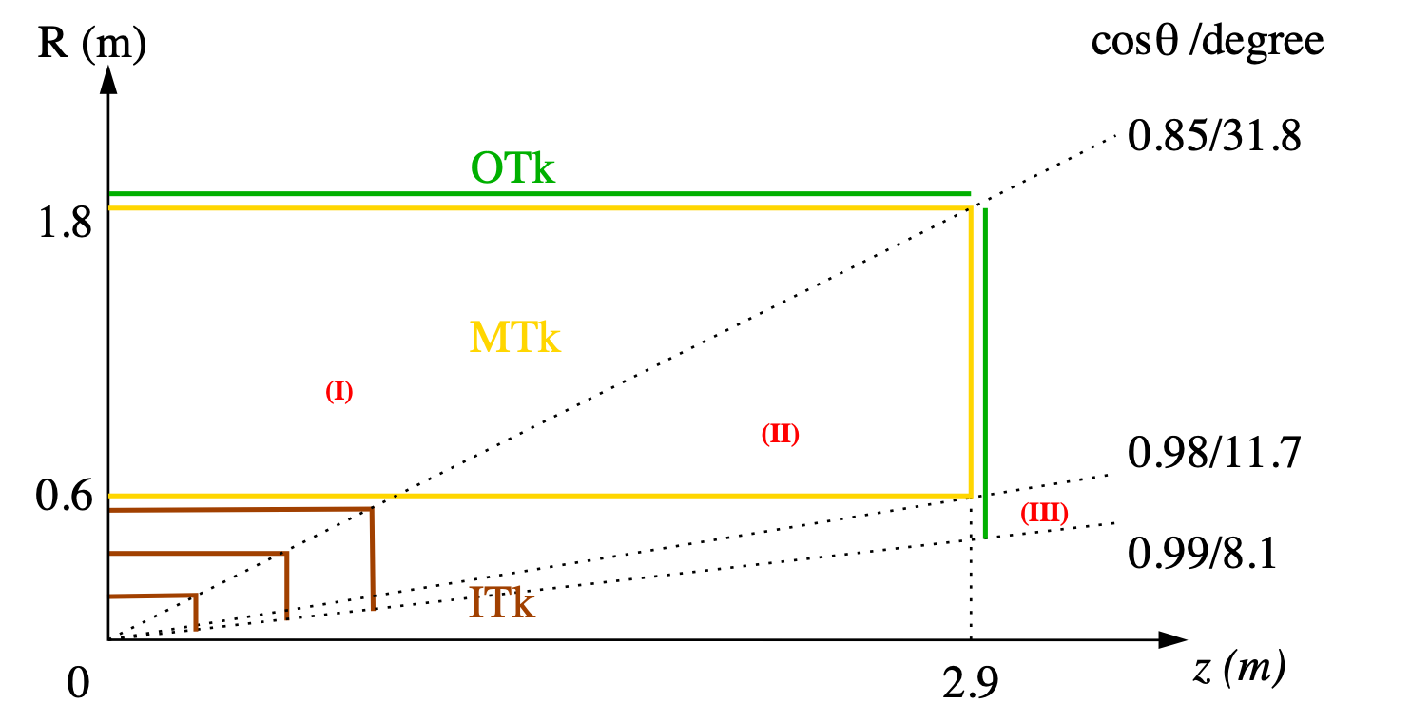
CEPC tracking system, draft
Three tracking regions
barrel: full Gas + Si trackers
endcap: partial Gas tracker
forward: Si tracker only

Slide 17
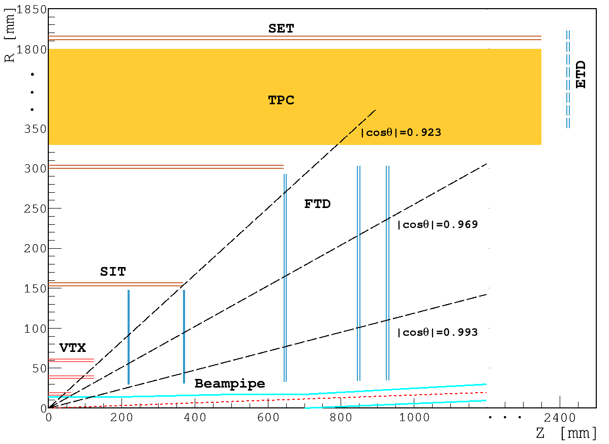
CDR layout for acronyms

