Slide 1
Electronic analysis of time measurement of Muon detector
Reporter：Jianjun Wang
2024/04/29

Slide 2
Muon detector back-end electronics
Evaluation of the number of extensible channels in electronics

Slide 3
Muon detector back-end electronics
Evaluation of the number of extensible channels in electronics
FPGA：XC7K325TFFG900-2
I/O
Logical Resource
Storage Resource

Slide 4
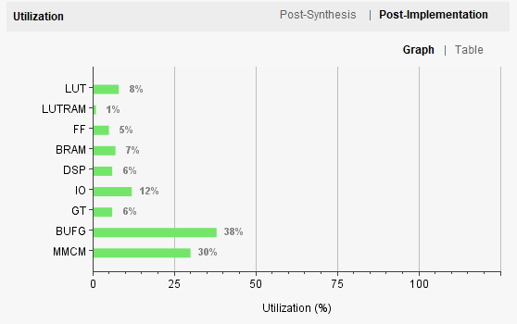
Muon detector back-end electronics
I/O：
I/O consumed by driving a single ADS5263 chip for time measurement ：64 pins.
Logical Resource ：
A single chip 4-channel ADC for time measurement requires less logic resources such as CLB, DSP, etc.
Storage Resource
Processing 4 channels of data (channel trigger and match, algorithm) requires 32 units of BRAM.

Slide 5
Muon detector back-end electronics
Evaluation of the number of extensible channels in electronics
Compared with logical resources and storage resources, I/O interface resources have more significant limitations
A single ADS5263 chip requires 26 IO pins
The FPGA chip can drive 64-channel ADS5263 at most
Number of channels = [（Max IO – Other related circuits require IO（PLL ,DAC，SFP）] / 26

Slide 6
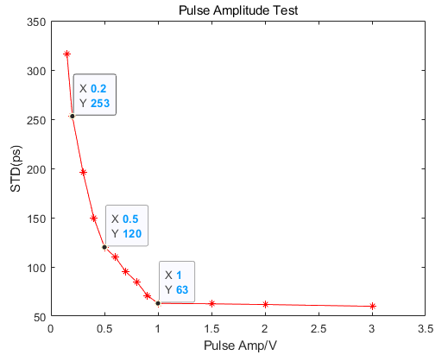
Muon detector back-end electronics
Different energy pulse time test ：To test the contribution of electronics to time accuracy under different energy pulses
Test pulse amplitude from 200mv to 1V +
Time resolution with signal amplitude curve

Slide 7
Thanks.

